Slide 1
Viruses
Good teaching is more a giving of right questions than a giving of right answers.
– Josef Albers
Chapter 19

Slide 2
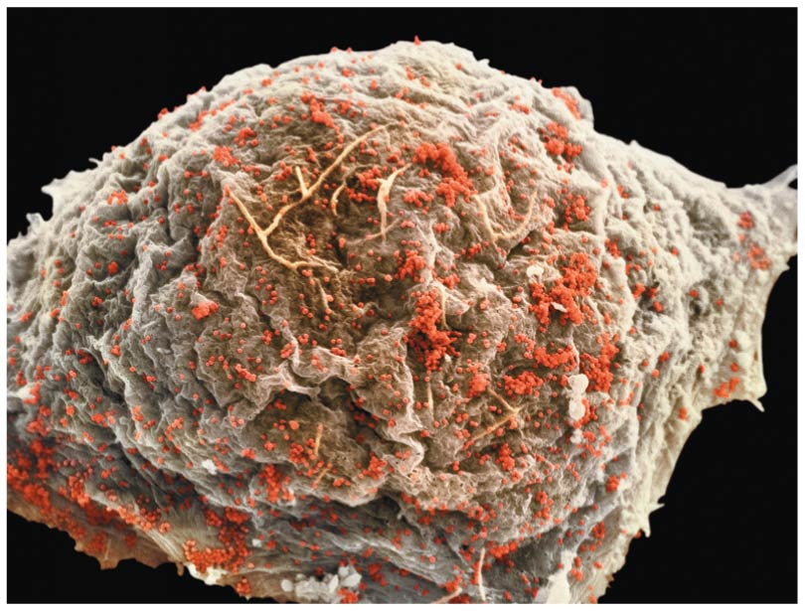
A Borrowed Life
Virus: an infections particle incapable of replicating outside of a cell, which consists of an RNA or DNA genome enclosed in a protein coat (capsid)
____________________ parasites
Arguments for describing viruses as non-living
Can not ____________ outside of host cell
Can not carry out ___________________ outside of outside of host cell
Lack ____________ and enzymes

Slide 3
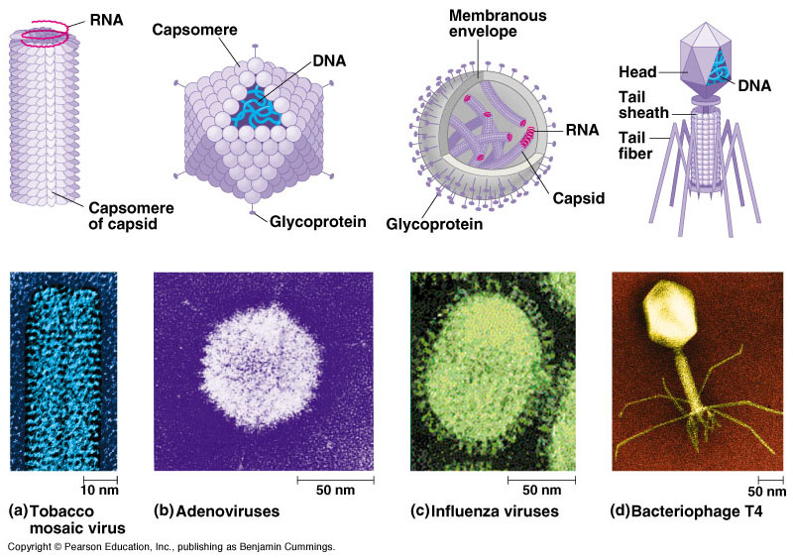
Structure of Viruses
Capsids are made up of protein subunits called _____________.
Viral envelopes: membranous envelope made up of phospholipids and membrane proteins that surrounds the capsids of some viruses

Slide 4
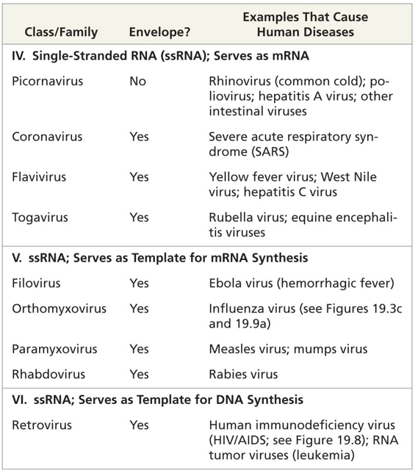
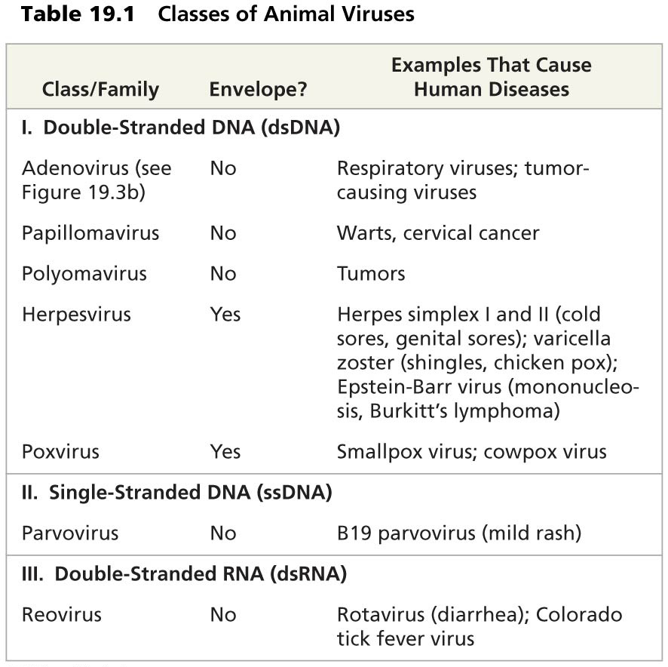
Virus Classification

Slide 5
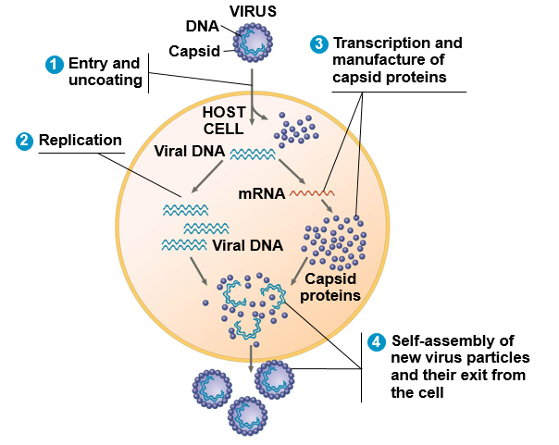
Virus Reproduction
Virus enters host cell after host cell recognition
Host enzymes replicate virus DNA
Host enzymes transcribe viral DNA into viral mRNA, which is used to make capsid proteins
New virus particles assemble and leave host cell

Slide 6
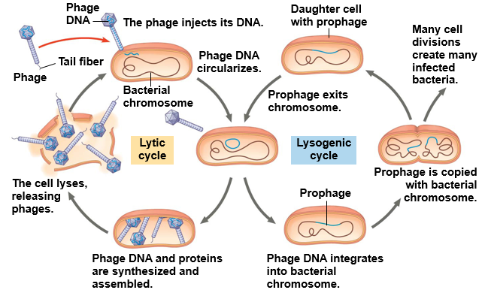
Replication of Phages
Lytic cycle: host cell _____ when releasing phages = cell death
Surface proteins
Restriction enzymes
CRISPR
Lysogenic cycle: __________ of phage genome ≠ cell death
Prophage

Slide 7
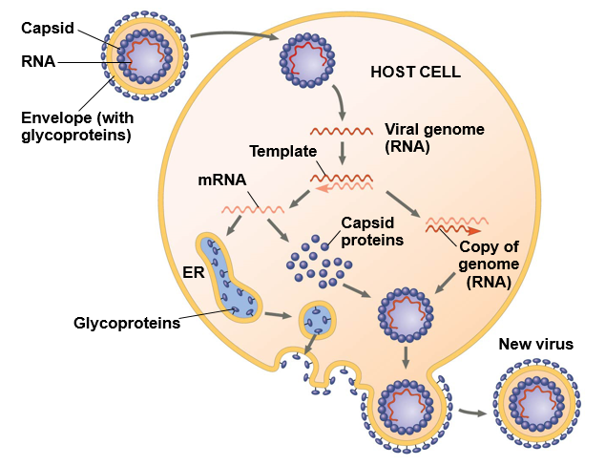
Replication of Animal Viruses (Class V)
Glycoproteins on viral envelope bind to receptors on host cell
Cellular enzymes digest capsid
Viral genome copied by viral RNA polymerase to make mRNA
Viral RNA functions as mRNA, which is translated to make capsid proteins and glycoproteins
Vesicles transport viral envelope to plasma membrane
Capsid assembles around viral genome
New virus buds from host cell
1
2
3
4
6
5
7

Slide 8
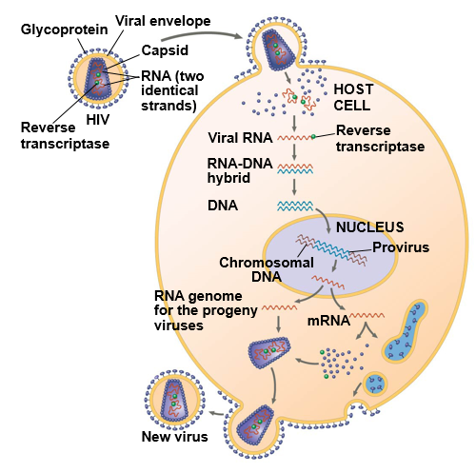
Replication of Retroviruses (Class VI)
Glycoproteins on viral envelope bind to ______ _________ on immune cell then fusing with plasma membrane and releasing capsid proteins and RNA into the host cell
___________________ synthesizes DNA from viral RNA then subsequent DNA strands complementary to the first
Double stranded viral DNA incorporated into host cells DNA (__________)
Proviral genes transcribed to make RNA genome for progeny viruses and mRNA for translation into viral proteins
Capsids assembled around viral genomes
New viruses with viral envelope glycoproteins bud from host cell
1
2
3
4
5
6

Slide 9
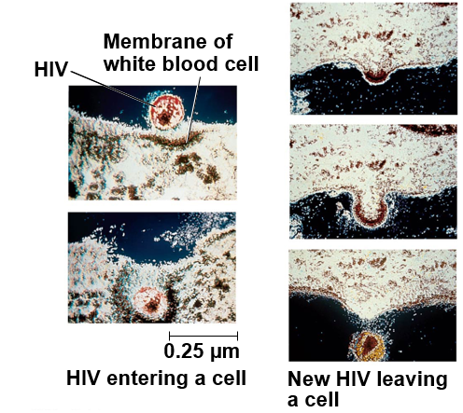
Human Immunodeficiency Virus (HIV)
Description:
Class VI: ssRNA that is template for DNA synthesis
____________
Infects vital human immune system cells
Helper T cells, macrophages
Treatment:
Azidothymidine (AZT)
Blocks reverse transcriptase
Protease inhibitors
Blocks building of capsid

Slide 10
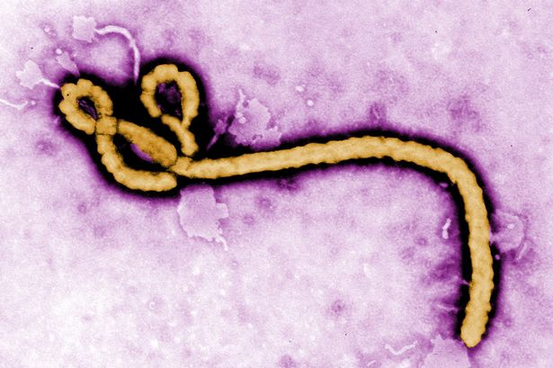
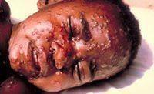
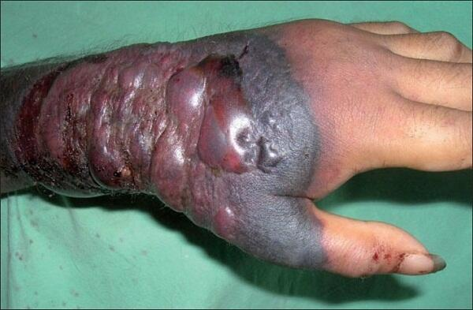
Ebola Virus
Description:
Class V: ssRNA that is template for mRNA synthesis
Infects human _______ system cells
Causes hemorrhagic fever
Small blood clots throughout body
Fever, vomiting, bleeding, organ failure
Treatment:
No known treatment
Vaccines currently being tested

Slide 11
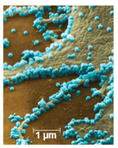
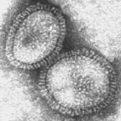
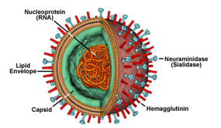
Influenza Virus
Description:
Class V: ssRNA that is template for mRNA synthesis
Infects epithelial cells of ___________ system
H1N1 refers to surface proteins of virus
Hemagglutinin (H) and Neuraminidase (N)
Treatment:
Rest and wait for immune response
Shortened and less severe when vaccinated
Antiviral drugs
Neuraminidase inhibitors block _______ from host cell
M2 proton inhibitors block virus from ________ host cell
H1N1 influenza A virus
Nucleoprotein
(RNA)
Neuraminidase
Lipid
envelope
Capsid
Hemagglutinin

Slide 12
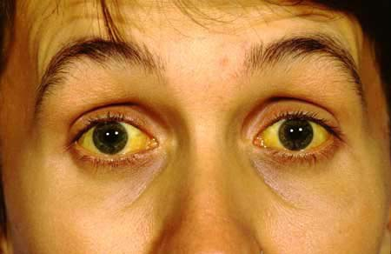
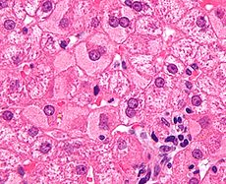
Hepatitis
Description:
At least five different unrelated viruses
Causes _______________
Hep A
ssRNA without envelope
Ingestion of contaminated food or water
Vaccination
Hep C
ssRNA with envelope
Transmitted through contact with blood
Antiviral drugs

Slide 13
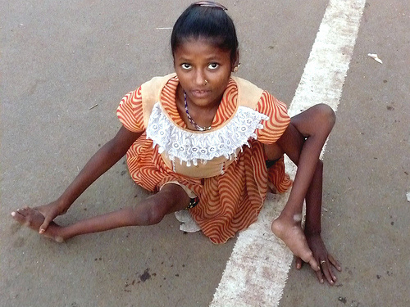
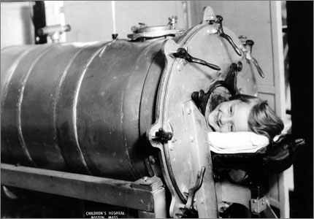
Poliomyelitis
Description:
Class IV: ssRNA that can serve as mRNA
__% of infections target human nerve cells
Do not divide and cannot be replaced
Infected feces entering the mouth
Treatment:
Few people show symptoms
Iron lung
___________ developed vaccine
No cure for polio

Slide 14
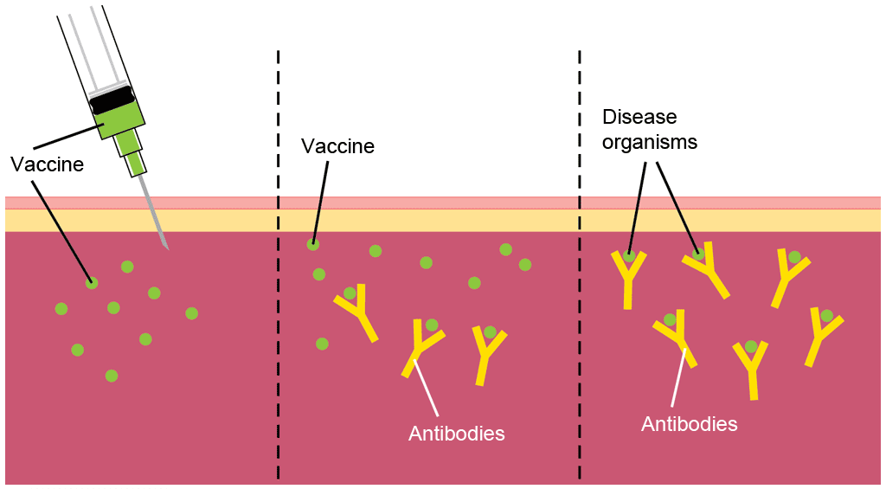
Vaccination
Vaccine: a ____________________ form of a pathogen that when administered to an organism, causes the organisms immune system to build up an immunity to the pathogen without the individual contracting the disease.
Pathogen: a bacteria, virus or other microorganism that causes a disease
Antibodies: specialized proteins produced by the immune cells to help destroy pathogens

Slide 15
Check Your Understanding
1. True or False: Virus replication occurs via the prophage in the lysogenic cycle
2. True or False: Some viruses can replicate outside of a host cell

Slide 16
Check Your Understanding
Which of the following viruses replicates by incorporating its DNA into the DNA of the host?
a. Ebola
b. Poliomyelitis
c. HIV
d. Influenza

Slide 17
Check Your Understanding
Draw and describe the replication of a Class V virus with your neighbor

