Slide 1
The Outcomes of Evolution
“When you realize how perfect everything is, you will tilt your head back and laugh at the sky”
-Budda
Chapter 18

Slide 2
What is a Species?
Biological species concept: species are groups of actually or potentially interbreeding natural populations which are ______________ ___________ from other such groups
Reproductive isolation: the inability of individuals from two populations to _________________ with each other, thereby making it impossible for gene exchange between the populations
Between 3 million and 15 million species exist on earth
Only 1.8 million species have been described
99% of all species that have existed are extinct!
Notes:
If two populations are separated but successful breed when brought together, they are considered the same species
Ex. Humans all over the world can still interbreed
Natural conditions means that they could interbreed in the wild, not in captivity

Slide 3
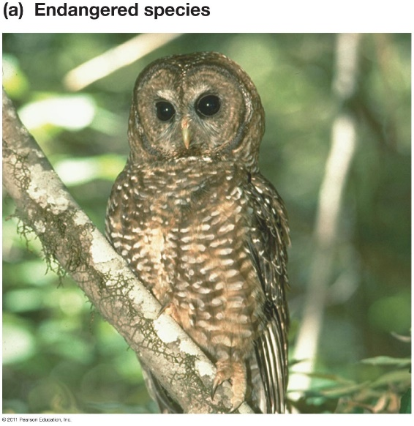
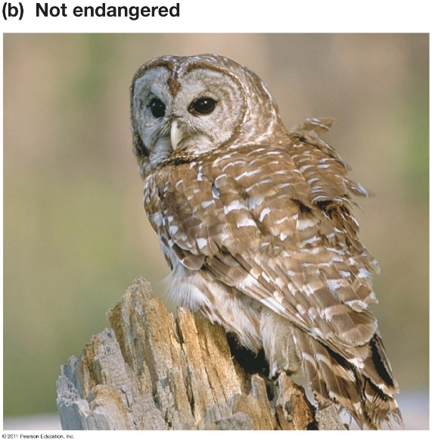
Describing Species
Ways species differ
Physical appearance
Adaptations
Behavior
Mating behavior
Vocalizations
Geographic range
Habitat type
Ecological niche
DNA
Molecular differences

Slide 4
Evolution of a New Species
Macroevolution: Large-scale evolution occurring over long periods of time (geologic time) that results in the formation of new species (speciation)
Microevolution: Small-scale evolutionary change resulting from a change of the _________________ of a population
Speciation: Development of a new species through evolutionary processes

Slide 5
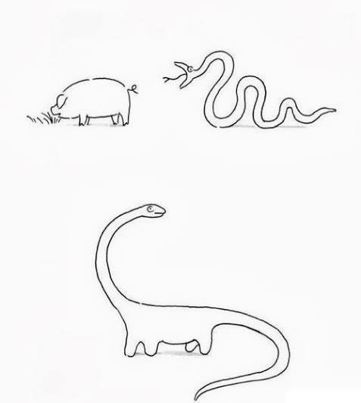
How Do New Species Arise?
___________ separation of population into two or more separate populations that no longer interbreed
Geological event
Migration into a new area
Shift in allele frequencies of separate populations
Genetic drift, natural selection, gene flow, sexual selection, mutation
Changes in allelic frequencies of populations results in differences that prevent individuals from each population from interbreeding with one another

Slide 6
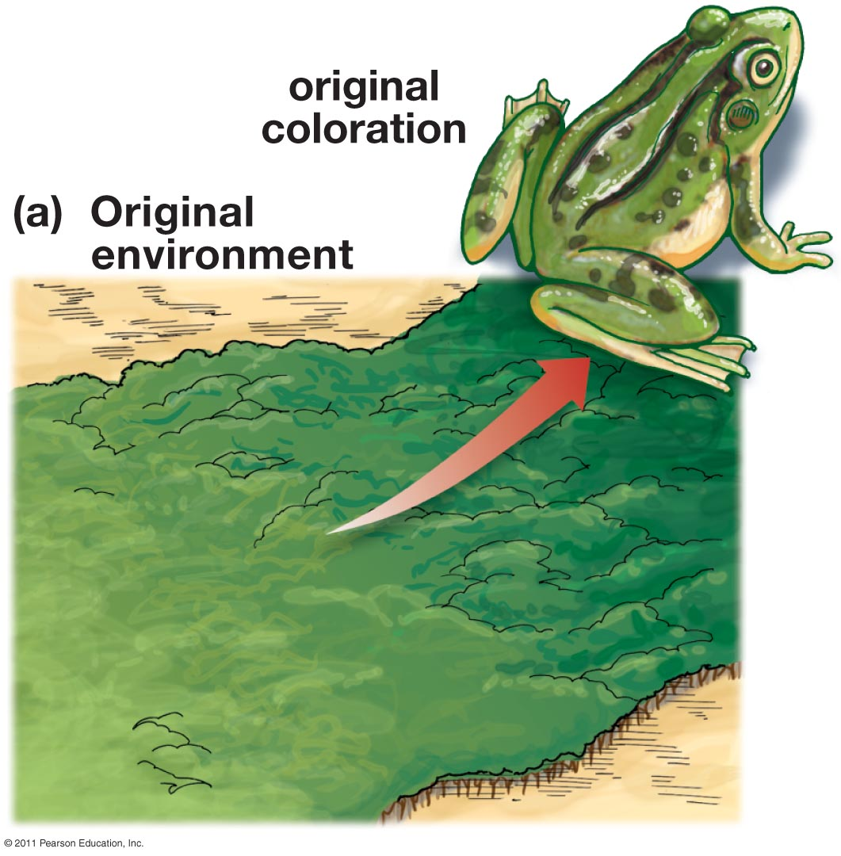
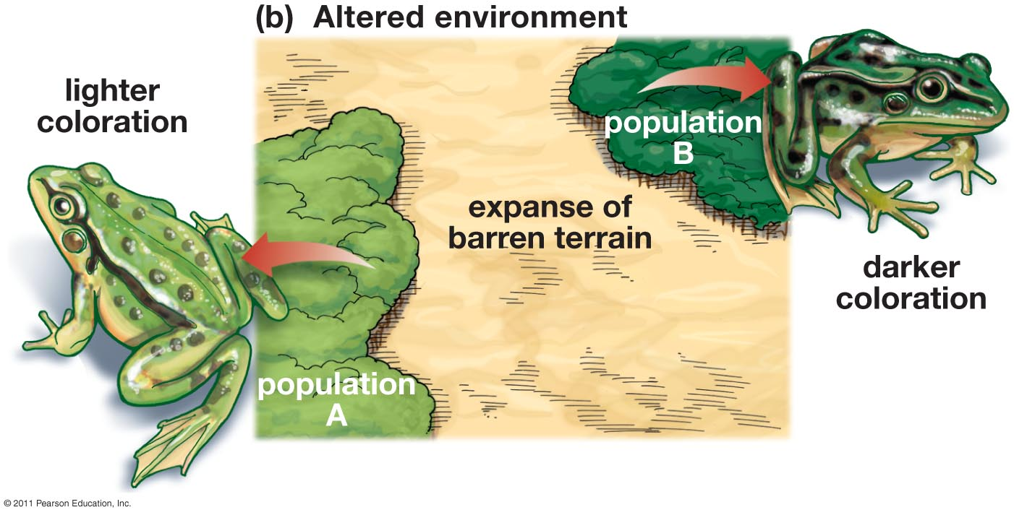
Evolution After Geographic Isolation
_________ speciation: speciation that results from the geographic isolation of populations by a barrier that prevents interbreeding between populations

Slide 7
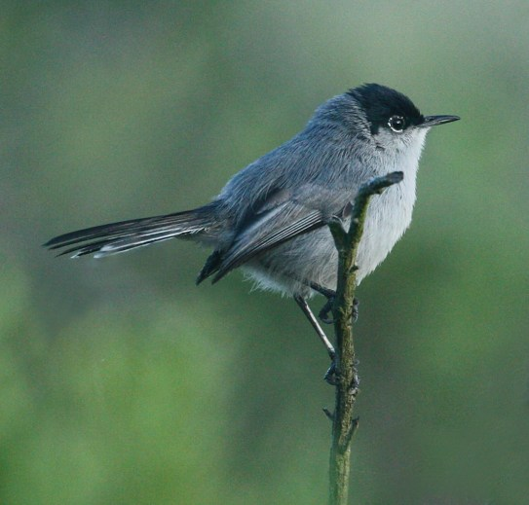
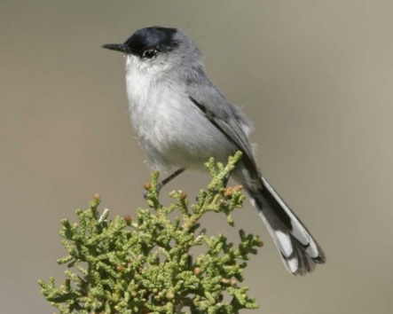
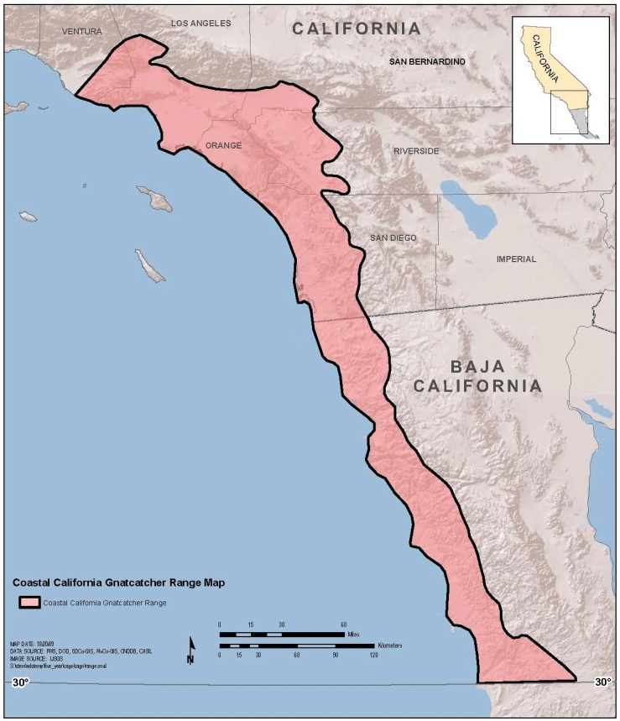
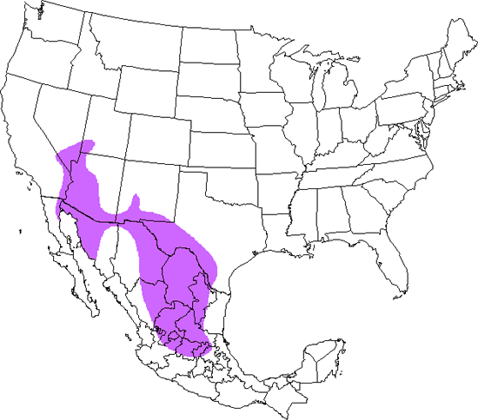
← California gnatcatcher
Black-tailed gnatcatcher →
Notes:
Coastal mountain range and Mojave desert separate sister species

Slide 8
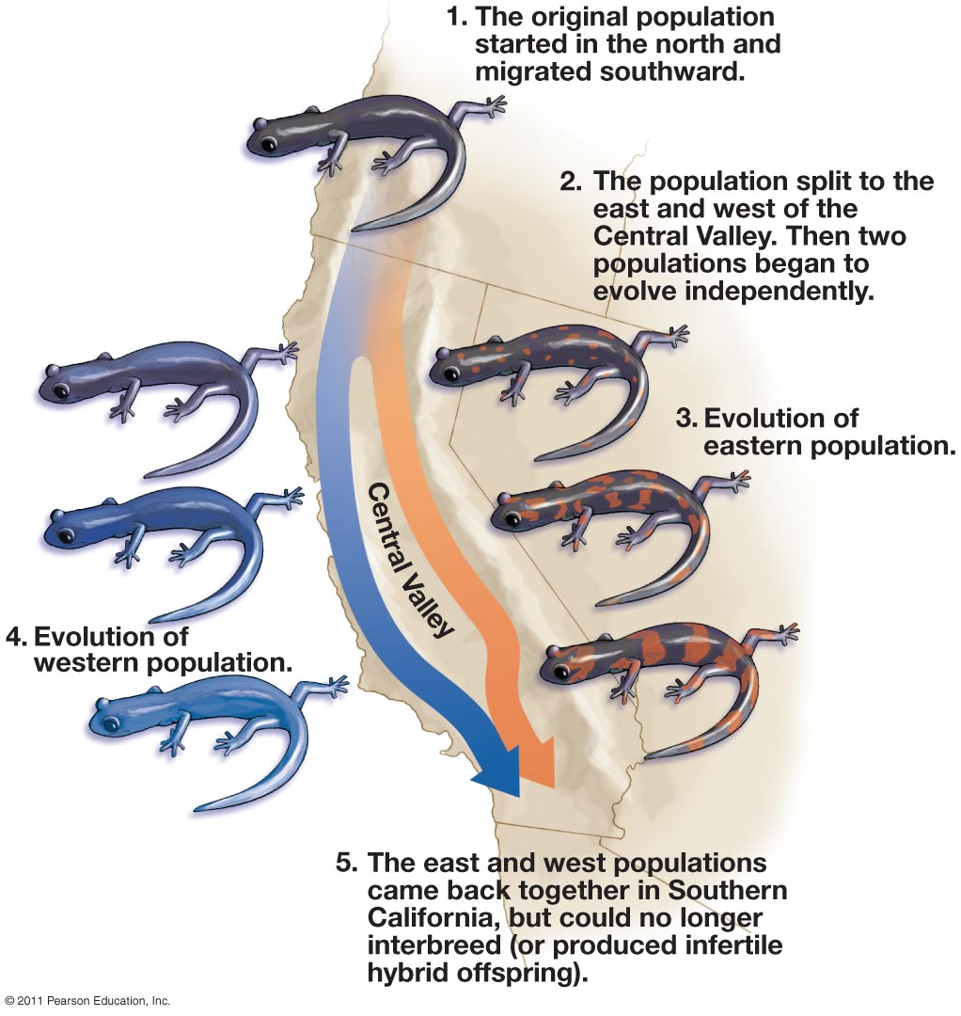
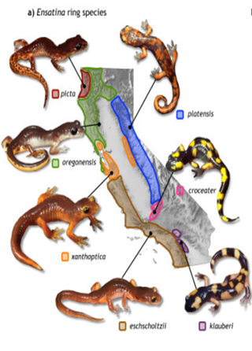
Notes:
Salamander Ensatina eschscholtzii began migrating southward millions of years ago. Populations were aplit by the California central valley.
Example of a ring species

Slide 9
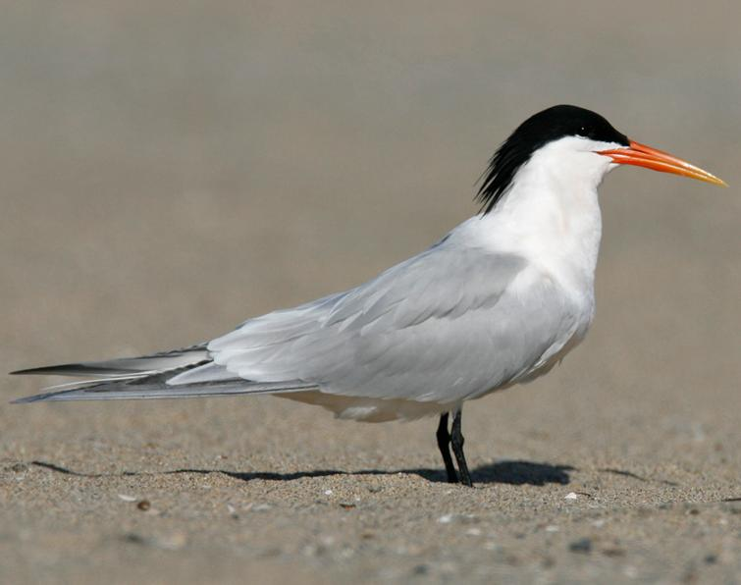
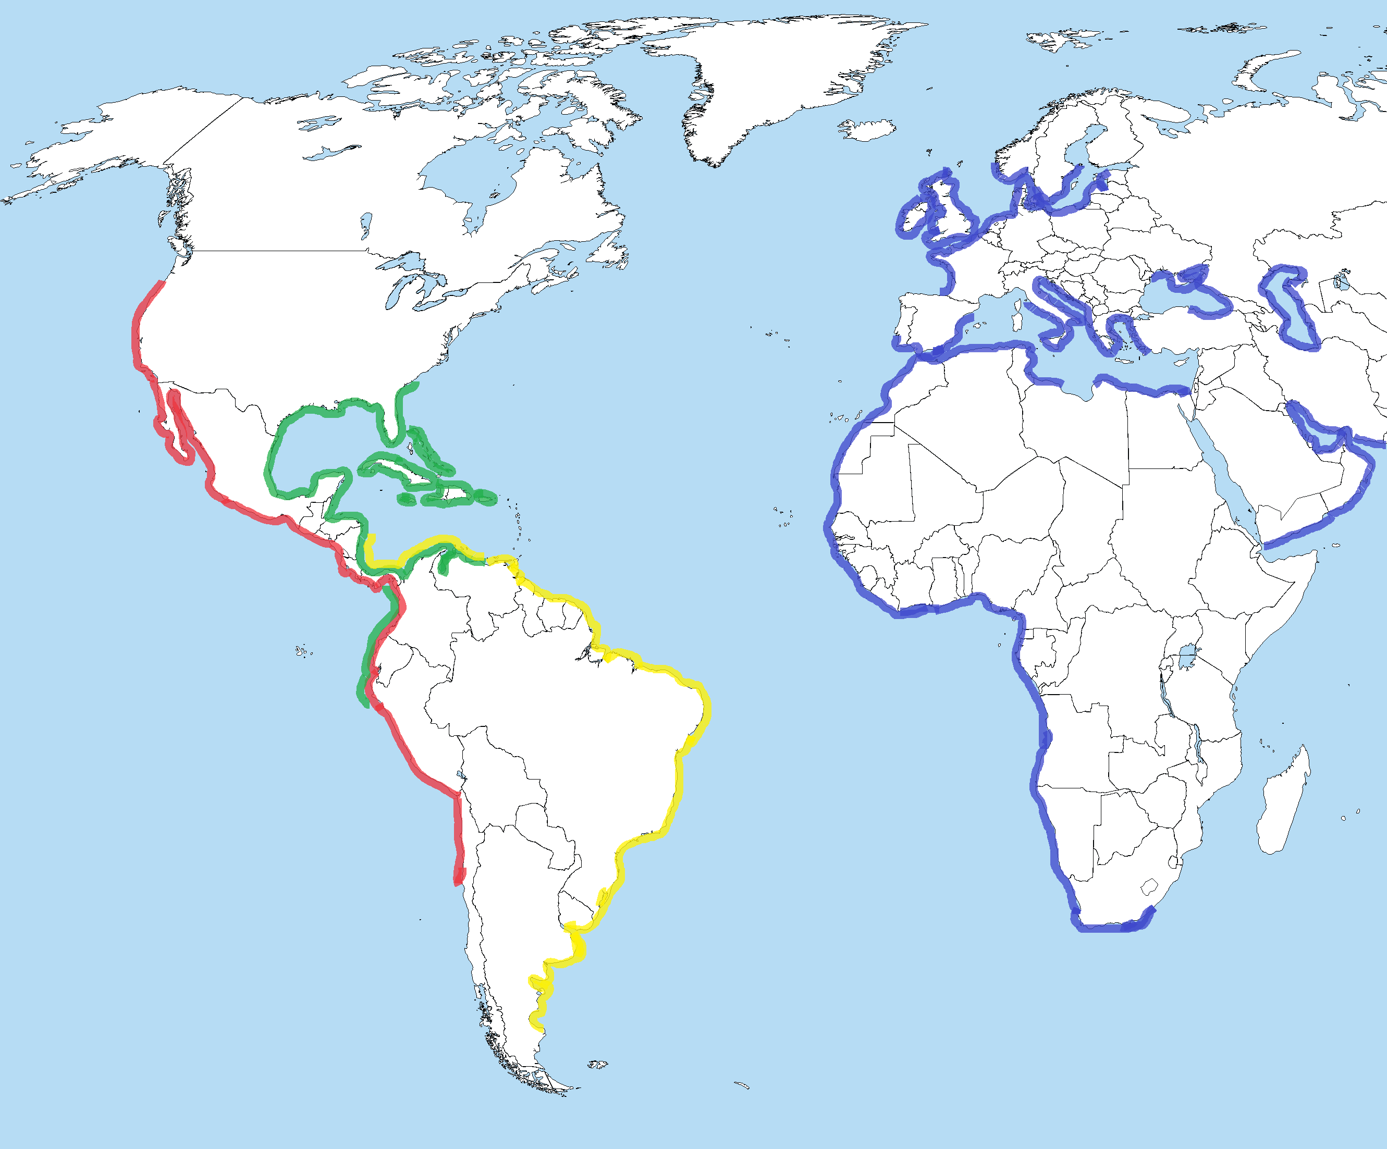
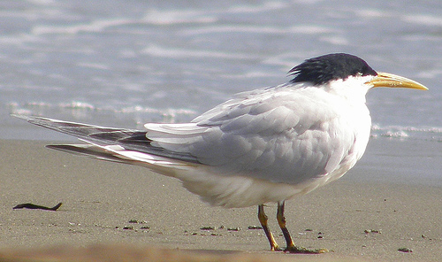
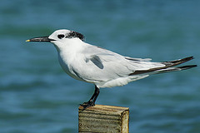
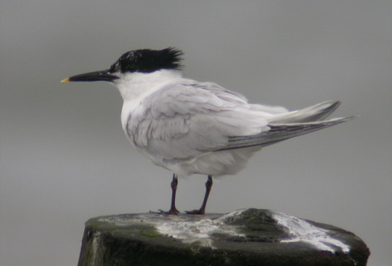
= Elegant tern
= Cabot’s tern
= Cayenne tern
= Sandwich tern

Slide 10
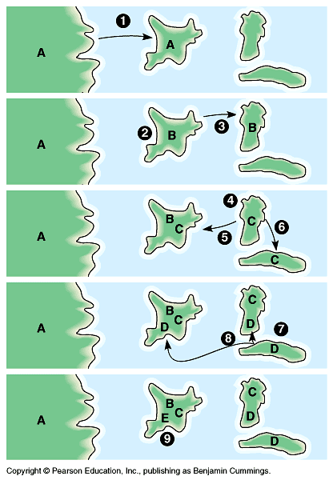
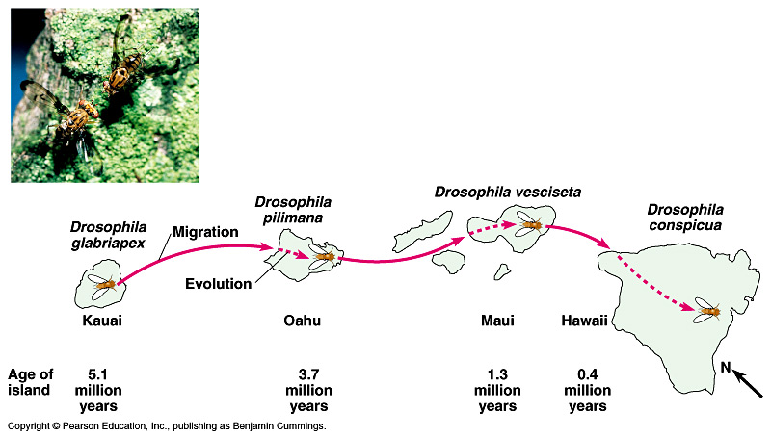
Allopatric Speciation
Common in island chains (archipelagos)
Ex. Drosophila on Hawaiian Islands

Slide 11
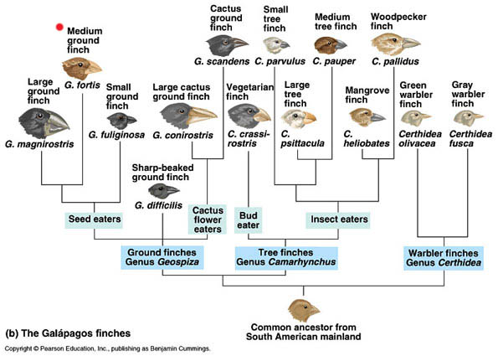
Adaptive Radiation
Adaptive radiation: process in which organisms ______________, especially when exposed to a new environment with different challenges, new resources, and available niches
After mass extinction events
Cambrian explosion
Archipelagos
Galapagos finches

Slide 12
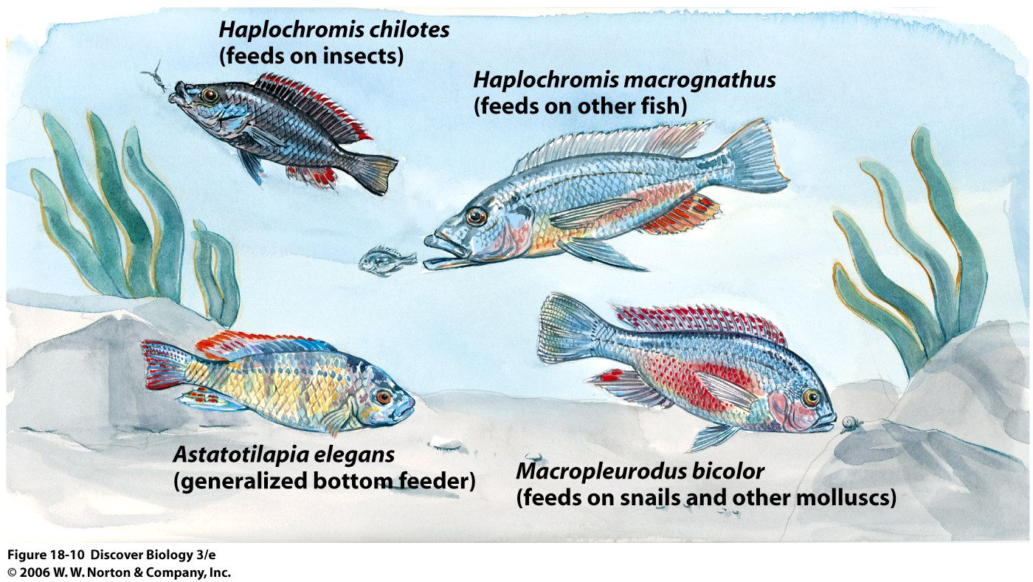
Speciation Without Isolation
Sympatric speciation: speciation without ____________ separation
Ecological niche: The role of a species within its ecosystem
Polyploidy: organisms containing more than two paired sets of chromosomes
Most common in plants
Notes:
Sympatric = of the same country
More than 500 species of cichlids in Lake Victoria and Lake Malawi
Cichlids of Lake Victoria

Slide 13
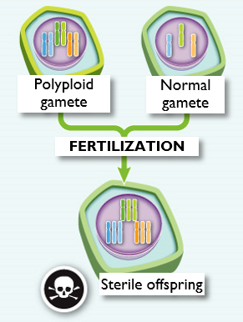
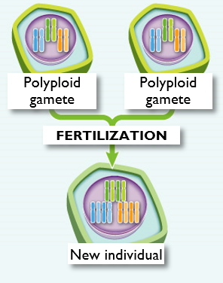
Sympatric Speciation
Polyploidy within a single species
A cell division error during meiosis can lead to polyploid gametes (e.g., 2n rather than n).
A gamete with twice as many sets of chromosomes can produce offspring by fertilizing another gamete with twice as many sets of chromosomes (or via self-fertilization).
The individual with polyploid gametes can no longer interbreed with individuals having normal gametes. Three sets of chromosomes cannot divide evenly during cell division.
New individual is reproductively isolated from the original population and, therefore, is considered a new species.
Images modified from What is Life? A Guide to Biology, Third Edition, © W.H. Freeman and Company

Slide 14
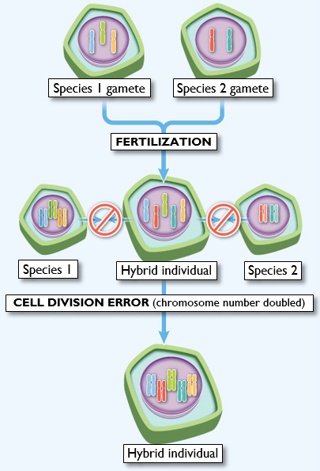
Sympatric Speciation
Polyploidy as a result of two separate species interbreeding
Two plants from different species interbreed, forming a hybrid.
The hybrid may propagate itself asexually—as many plants can. A future cell division error can result in doubling of chromosome number producing gametes that are fertile with each other.
The polyploid hybrid has achieved reproductive isolation from the parental populations and, therefore, is considered a new species
Image modified from What is Life? A Guide to Biology, Third Edition, © W.H. Freeman and Company

Slide 15
Reproductive Isolating Mechanisms
Reproductive isolating mechanisms: any factor in nature that prevents inbreeding between individuals of the same species or closely related species
Prezygotic barriers: physical or reproductive conditions that that make it impossible to individuals to ______ with one another
Postzygotic barrier: conditions that prevent the ________ of two different species from producing viable offspring

Slide 16
Prezygotic Isolation Mechanisms
Ecological Isolation
Species unique _________ prevent hybridization
Ex. Ladybug species
Feeding and mating on single plant species
Notes:
Organisms occupy the same general area but rarely meet due to differences in the ways they use the habitat

Slide 17
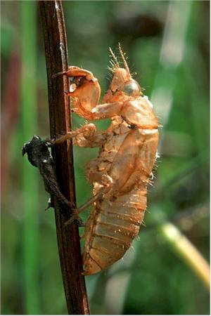
Prezygotic Isolation Mechanisms
Temporal Isolation
Mating/flowering of species occurs at _____________ of the year
Eastern and Western spotted skunks
Eastern = late winter, western = fall
Ex. 13 and 17 year cicadas
Can meet every 221 years
Notes:
Temporal isolation = isolated in time

Slide 18
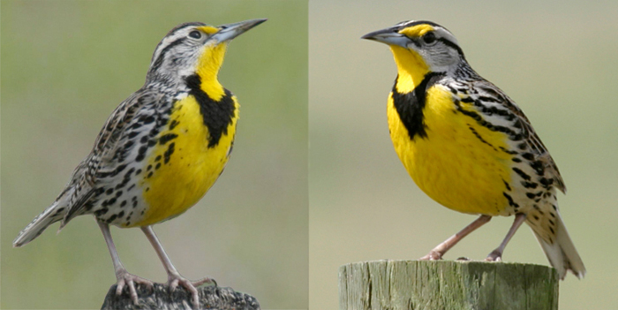
Prezygotic Isolation Mechanisms
Behavioral Isolation
Behaviors prevent two species from hybridizing
Ex. Western and Eastern Meadowlarks
Each has distinctive courtship songs that prevent hybridization
Western meadowlark
Eastern meadowlark

Slide 19
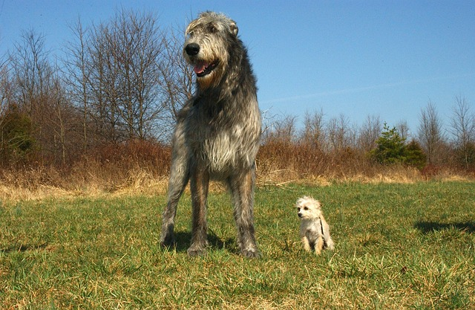
Prezygotic Isolation Mechanisms
Mechanical Isolation
Difference in size or shape of __________________ make two species physically incompatible
Insects have lock-and-key fit genitalia
Irish wolfhound and Chihuahua

Slide 20
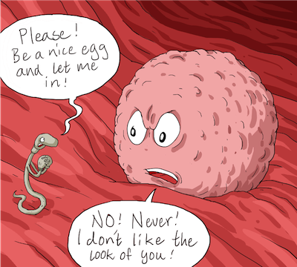
Prezygotic Isolation Mechanisms
Gametic Isolation
Sperm and egg of two species are ________________
Receptive membrane proteins cannot recognize each other
Notes:
Similar to wind pollination

Slide 21
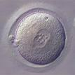
Postzygotic Isolation Mechanisms
Zygote Mortality
Gametes fuse to form zygote, but zygote fails to ________ properly or is spontaneously aborted

Slide 22
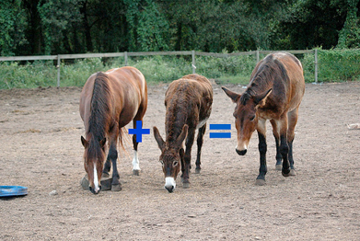
Postzygotic Isolation Mechanisms
Hybrid _____________
First generation hybrid forms but shows lower fitness
Hybrid _____________
Viable hybrid offspring are sterile
Mule (male donkey X female horse)
Liger
Notes:
Horses and donkeys have a different number of chromosomes
Horses have 64
Donkeys have 62
Mule has 63
Hybrids in plants can lead to development of new species

Slide 23
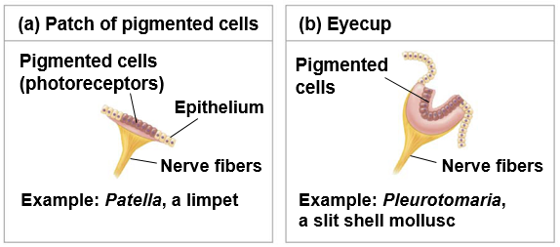
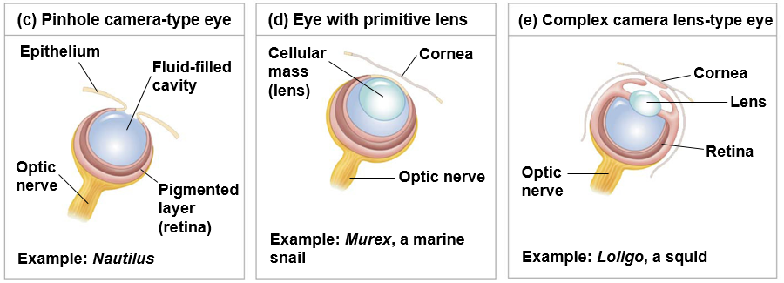
Evolutionary Novelties
Novel and complex structures arise from __________________ to existing structures

Slide 24
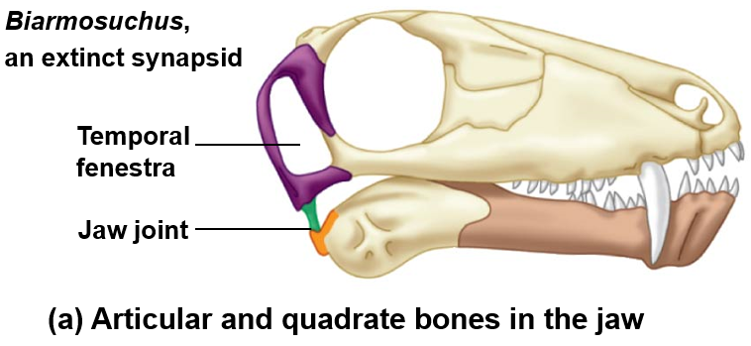
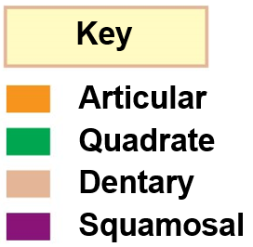
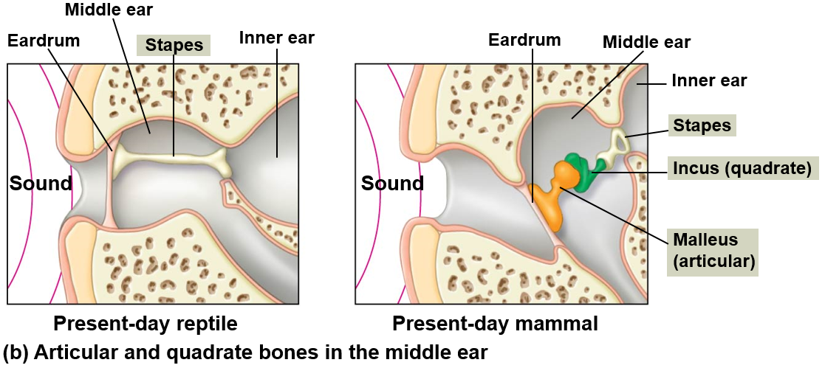
Exaptation
Structures that evolved for one function but become ___________ for another function.
Inner ear bones in mammals
Feathers in birds
Wings in insects

Slide 25
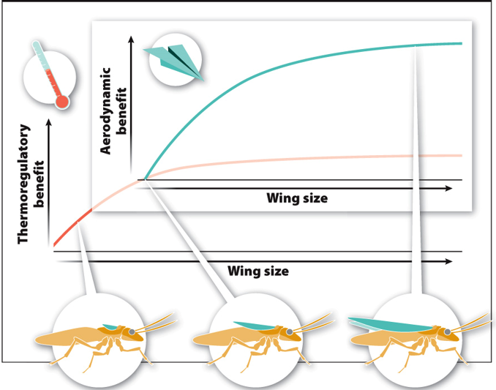
Exaptation
Tiny wing nubs provide a thermoregulatory benefit, which leads to the selection for greater nub size.
At an intermediate size wing nubs provide an aerodynamic benefit
Greater wing size is selected for due to aerodynamic benefit

Slide 26
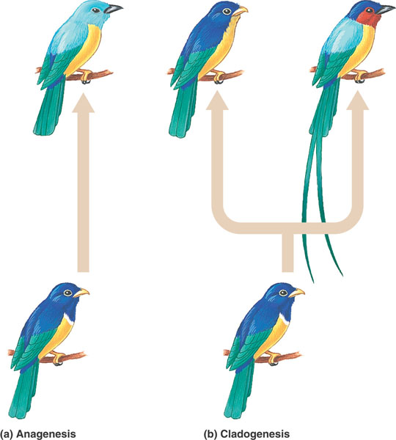
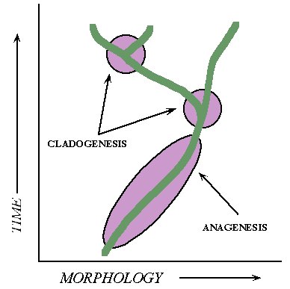
Evolution of Species
Anagenesis: evolutionary change that occurs _________ a lineage
Cladogenesis: evolutionary change that results in the formation of a new lineage
Anagenesis
Cladogenesis

Slide 27
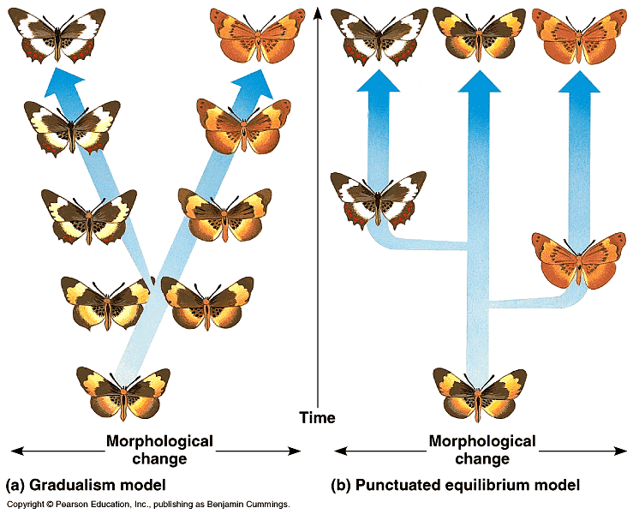
Theories of Evolutionary Change
Gradualism: Small changes over time
Punctuated Equilibrium: Speciation occurs in _______________ with long periods of time with little change and short periods of time with large change

Slide 28
Evolutionary Trends
Evolutionary trends are not ______________
Interaction between organisms and their current environment
Notes:
Browsers eat leaves and bark from trees while grazers eat mostly grasses that they clip off at ground level
Before the Pliocene, grazers were selected for while the browsers died off after diverging 35 million years before.
Equus is just a twig of a much larger bush.

Slide 29
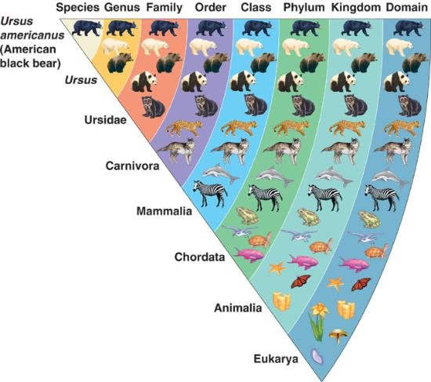
Classifying Organisms: Taxonomy
Domain
Kingdom
Phylum (plural, phyla)
Class
Order
Family
Genus (plural, genera)
Species (no specie!)
Notes:
Taxon = named taxonomic unit at any level of the taxonomy

Slide 30
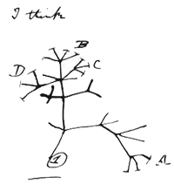
Phylogenetic Trees
Phylogeny: evolutionary history of a group of organisms
Ancestral trait: a characteristic that existed in an ancestor
Derived trait: a characteristic that is a modified form of an ancestral trait
_________________: a shared, derived characteristic
Used to support evolutionary relationships

Slide 31
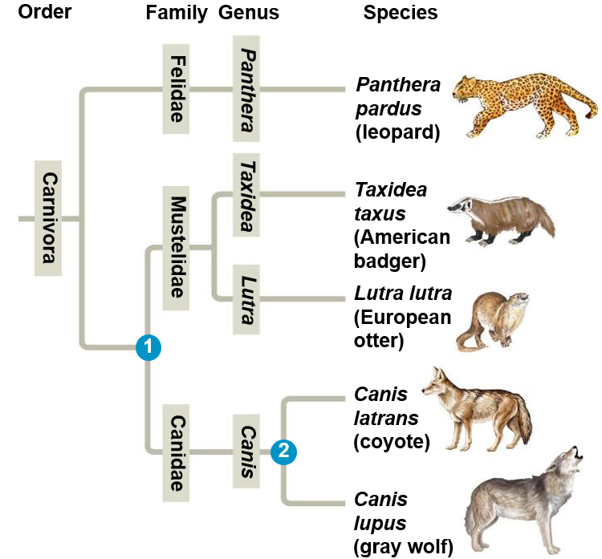
Phylogenetic trees can be used to depict taxonomic classification and evolutionary relationships
1
= Last common ancestor between Mustelidae and Canidae
= Last common ancestor between coyotes and gray wolves
2

Slide 32
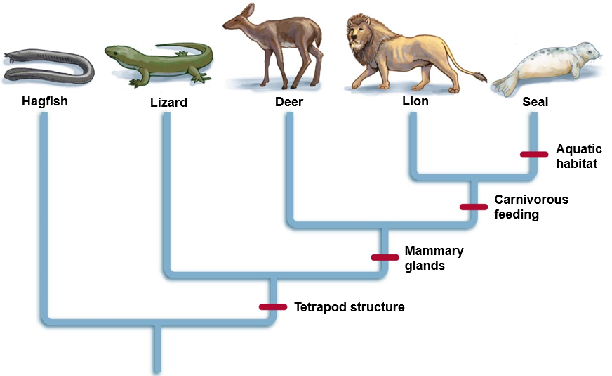
Interpreting Phylogenetic Trees
Synapomorphies are placed on the phylogeny to depict the groups with the derived traits

Slide 33
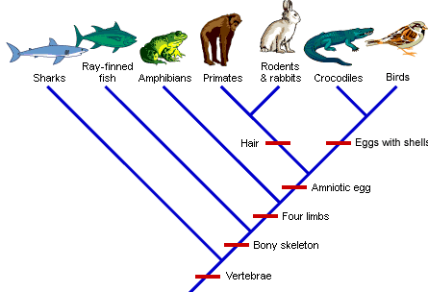
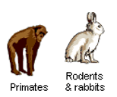
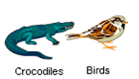
Interpreting Phylogenetic Trees
Eggs
Hair
Can be rotated on axes and still represent same evolutionary history
Notes:
Sister taxa = groups of organisms that share an immediate common ancestor
Basel taxon = lineage that diverged earliest in the displayed phylogeny

Slide 34
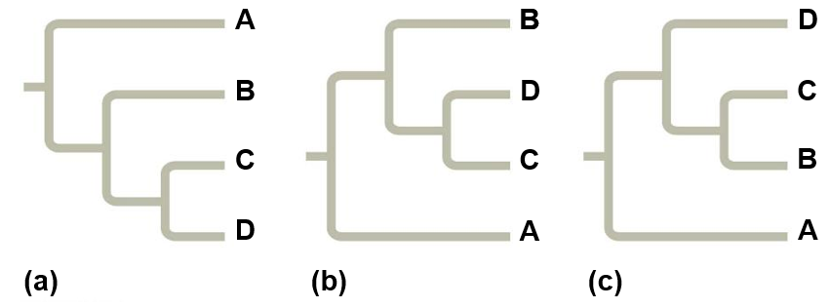
Interpreting Phylogenetic Trees

Slide 35
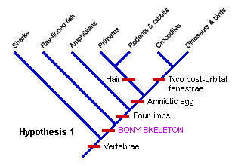
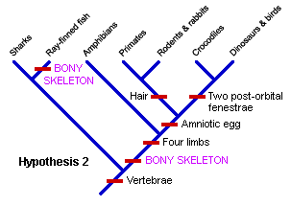
Constructing a Phylogeny
Maximum Parsimony: adopting the simplest explanation that is consistent with the facts.
Tree which requires the ________________________ or the number of times a derived trait appears within the phylogenetic tree

Slide 36
Check your Understanding
True or False: Given enough time microevolutionary changes can result in speciation
True or False: Populations of the individuals that can interbreed but are geographically separated are considered different species
True or False: Sympatric speciation occurs when two populations of the same species are geographically separated

Slide 37
Check Your Understanding
Which of the following is not a form of prezygotic isolation?
a. Behavior isolation
b. Mechanical isolation
c. Temporal isolation
d. Hybrid infertility
e. All of the above are a form of prezygotic isolation

Slide 38
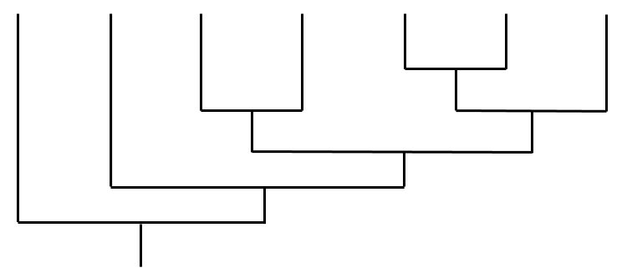
Check Your Understanding
Write the names of the listed organisms in the correct location in the phylogeny below. Place the synapomorphies in the correct location on the phylogeny.
Species list
Butterfly
Wolf
Coyote
Bear
Eagle
Rabbit
Mouse
Adaptations
Wings
Backbone
Mammary glands
Carnassial pair

Slide 39
Check Your Understanding
What are the two ways that speciation can occur? What are the names of the different processes? Provided an example of each type of speciation.

