Slide 1
Protists
“I strongly encourage you to never use the word “bore” or “boring”. It says a lot about a person. It’s hard for me to imagine being “bored”, ever. The world is so exciting and fascinating, yes?”
-Bill Nye
Chapter 28

Slide 2
“Protista” Characteristics
Eukaryotic organisms that are not plants, animals, or fungi
Most are unicellular
Without _________
First eukaryotes arose ~1.5 bya
Protists: similar appearing but diverse phyla that are not related through an exclusive common ancestor, which have different life cycles, trophic levels, modes of locomotion and cellular structures.
*Cluster______ that is under constant debate and revision

Slide 3
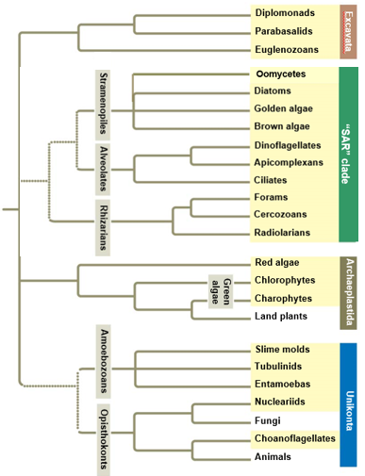
Four Supergroups:
Excavata
SAR (Stramenopiles, Alveolata, Rhizaria)
Archaeplastida
Includes land plants
Unikonta
Includes animals and fungi
*Need to know entire phylogeny for test and practicum

Slide 4
Eukaryotic Cells
Animal cell Plant cell

Slide 5
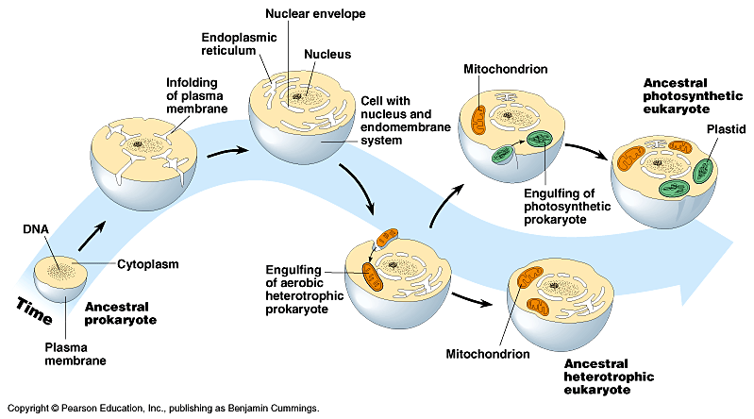
Evolution of Eukaryotes
Autogenesis: ________ of prokaryote plasma membranes lead to compartmentalization
Endoplasmic reticulum
Golgi
Nuclear membrane

Slide 6
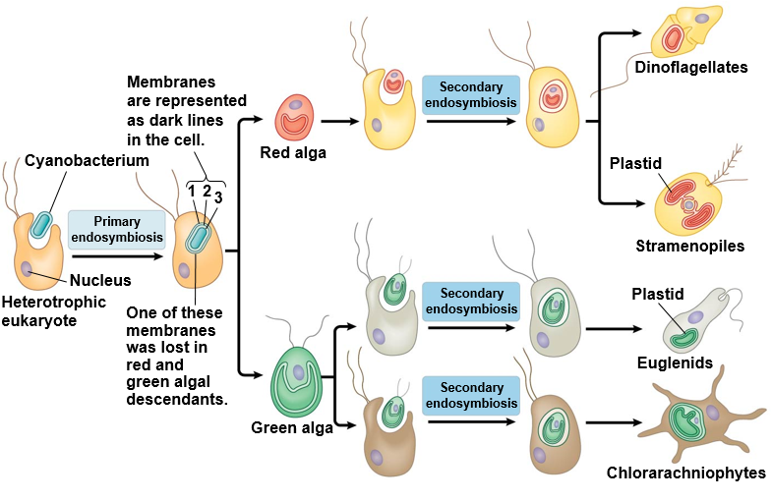
Evolution of Eukaryotes
______________: one organism lives inside the cell or cells of the other organism
Mitochondria
Chloroplast
Plastid: double membrane organelle
Ex: Chloroplast

Slide 7
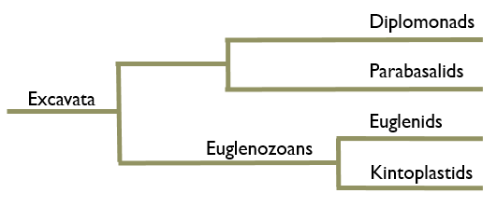
Supergroup: Excavata
Characteristics of Excavata:
“Excavated” groove on side of cell body (some)
Free living, symbiotic and parasitic forms
Reduced or modified ____________
Multiple flagella
Similar cytoskeleton elements (Simpson 2003)
Simpson, A.G.B. 2003. Cytoskeletal organization, phylogenetic affinities and systematics in the contentious taxon Excavata (Eukaryota). International Journal of Systematic and Evolutionary Microbiology. 53, 1759-1777

Slide 8
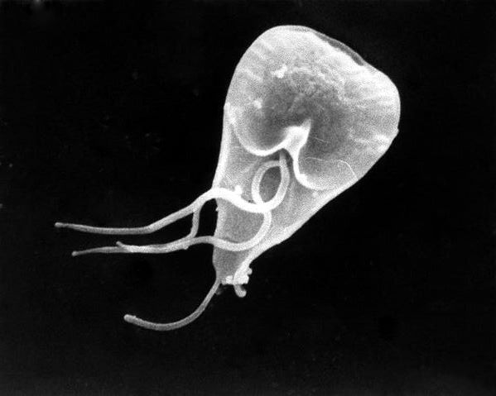
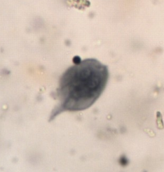
Supergroup: Excavata Clade: Diplomonads
Example: Giardia lamblia
Two equal sized, haploid nuclei
Four flagella
Reduced mitochondria
___________
Internal parasite to vertebrates
Giardiasis infection from drinking contaminated water
Lab photo

Slide 9
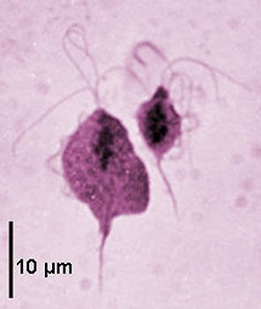
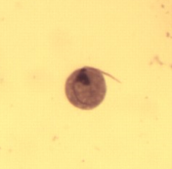
Supergroup: Excavata Clade: Parabasalids
Example: Trichomonas vaginalis
Multiple flagella
_________ membrane
Reduced mitochondria
________________
Sexually transmitted disease
Vaginitis infection from skin to skin contact with infected person
Lab photo

Slide 10
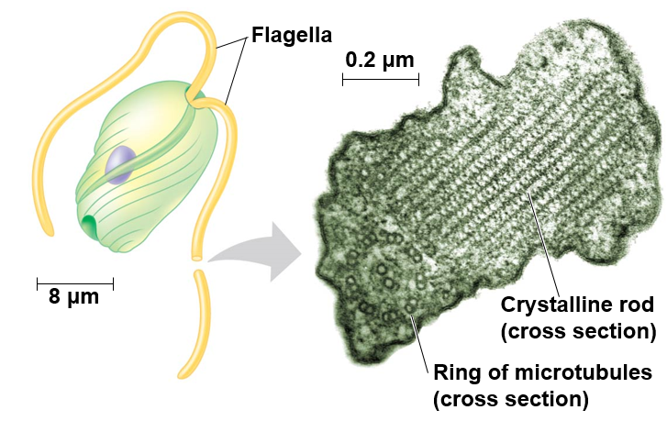
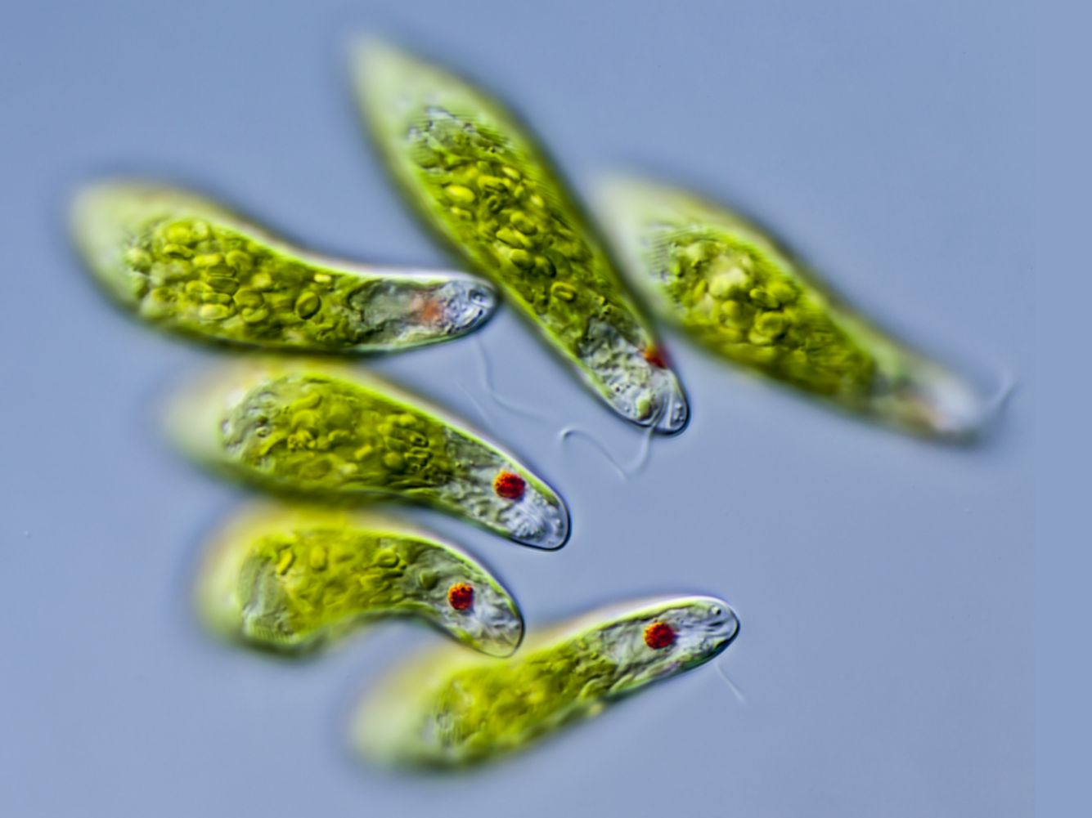
Supergroup: Excavata Clade₁: Euglenazoans; Clade₂: Euglenids
Example: Euglena sp.
Crystalline or spiral rod inside of flagella (all Euglenazoans)
__________: photosynthesize when light is present, heterotrophic when its not
Flagella emerge from _____________

Slide 11
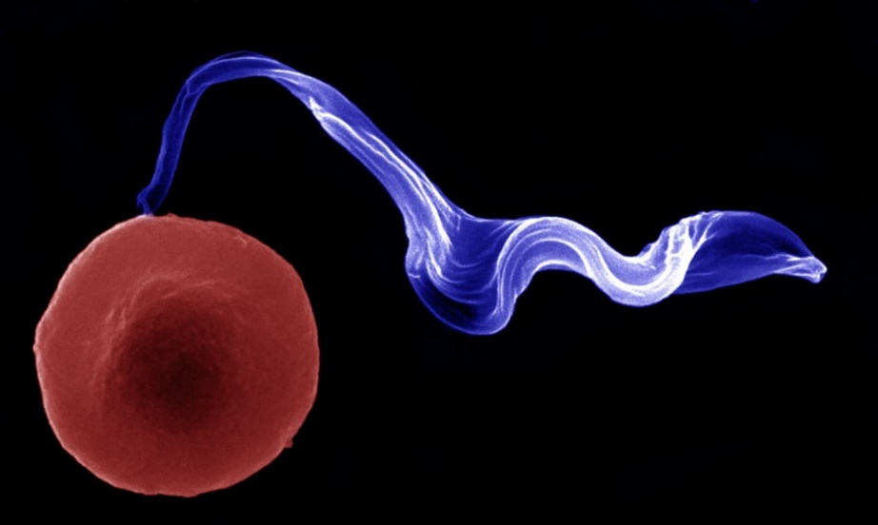
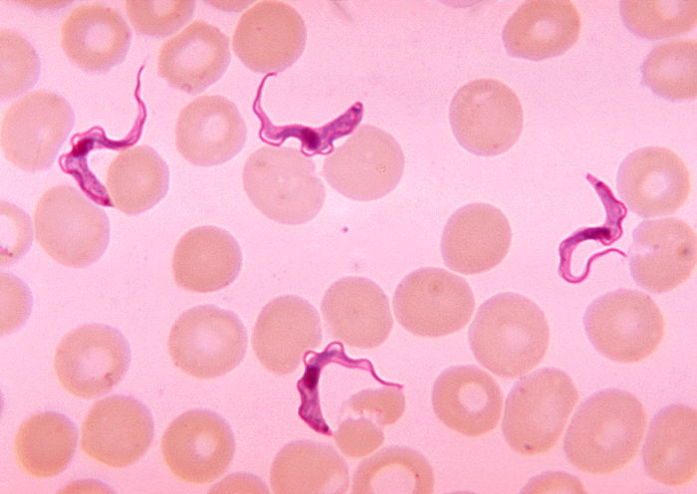
Supergroup: Excavata Clade₁: Euglenazoans; Clade₂: Kinetoplastids
Example: Trypanosoma sp.
Crystalline or spiral rod inside of flagella (all Euglenazoans)
_______________: Single, large mitochondrion
African sleeping sickness from tsetse fly
Chagas’ disease from kissing bugs
Notes:
Trypanosomes has ability to switch membrane proteins to avoid detection by immune system cells

Slide 12
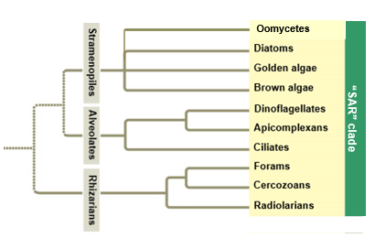
Supergroup: SAR
SAR
Starmenopila
Alveolata
Rizaria
Characteristics of SAR:
Secondary endosymbiosis of red algae
Similar DNA sequences

Slide 13
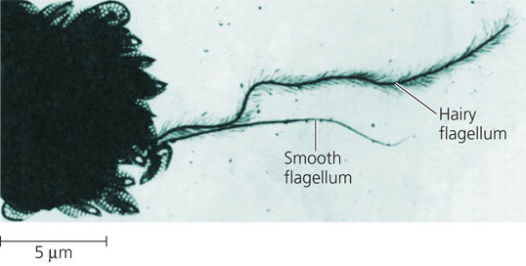
Supergroup: SAR Clade₁: Stramenopila
Characteristics of Stramenopila:
One hairy and one smooth ______ (most Stramenopiles)
Stramen = straw; pilos = hair
Includes:
Oomycetes (water molds)
Diatoms
Golden algae (Chyrsophyta)
Brown algae

Slide 14
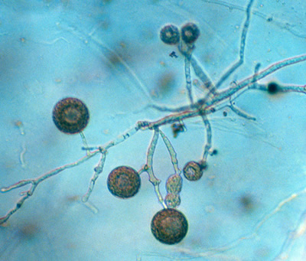
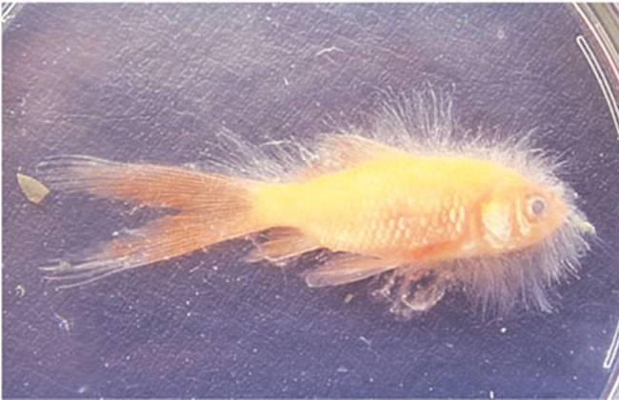
Supergroup: SAR Clade₁: Stramenopila; Clade₂: Oomycota
Example: water molds
Cellulose cell wall
__________ hyphae
Heterotrophic decomposers
Some parasitic
Caused __________and French Wine Crisis

Slide 15
Supergroup: SAR Clade₁: Stramenopila; Clade₂: Oomycota
Example: Water molds
Cellulose cell wall
_____________ hyphae
Heterotrophic decomposers
Some parasitic
Caused ____________, French wine crisis, and sudden oak death
Notes:
Coenocytic hyphae: lacks divisions between cells of branching, filamentous structures (hyphae)
Fungi have chitin cell wall
Can grow on eggs or scales of fish
Causing sudden oak death disease

Slide 16
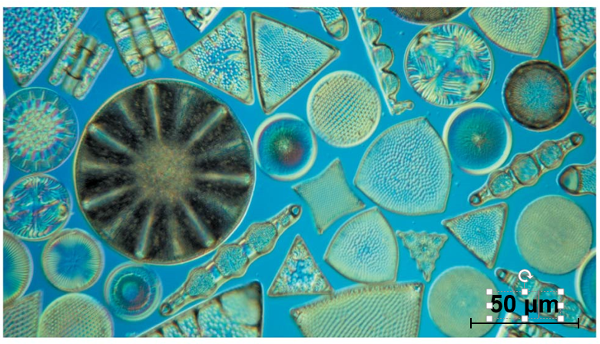
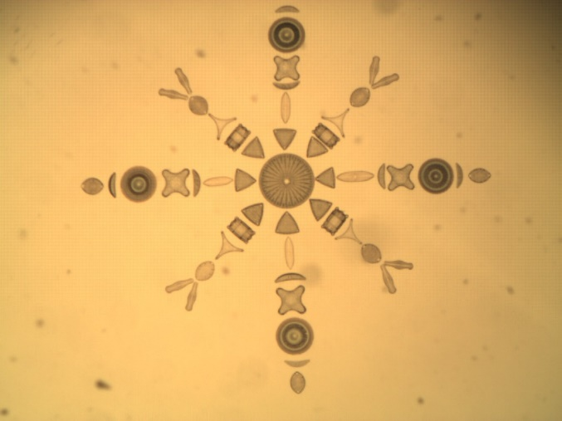
Supergroup: SAR Clade₁: Stramenopila; Clade₂: Diatoms
Example: Diatoms
Unicellular algae
_____ cell wall
Important photosynthetic organisms
Fossilized diatoms form diatomaceous earth
Lab photo

Slide 17
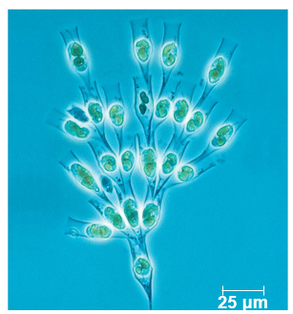
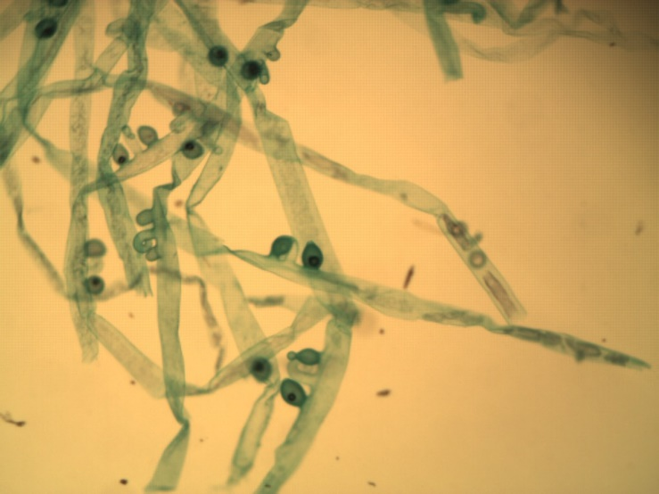
Supergroup: SAR Clade₁: Stramenopila; Clade₂: Chyrsophyta
Example: Golden Algae
Yellow and brown carotenoids
____________
Bi-flagellated cells
Many planktonic
Some are mixotrophic
Most unicellular, some colonial
Lab photo

Slide 18
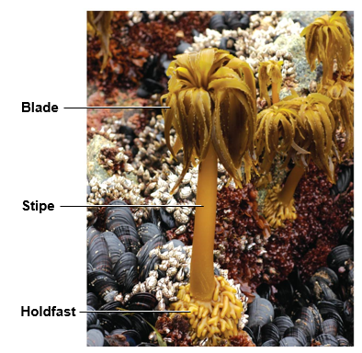
Supergroup: SAR Clade₁: Stramenopila; Clade₂: Brown Algae
Example: Brown algae
Multicellular
Most marine (temperate coasts)
Brown and yellow carotenoids
____________
Algin

Slide 19
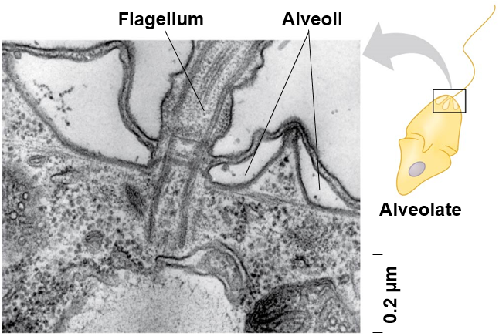
Supergroup: SAR Clade₁: Alveolata
Characteristics of Alveolata:
Membrane bound sacs (_______)
DNA similarities
Includes:
Dinoflagellates
Apicomplexans
Ciliates

Slide 20
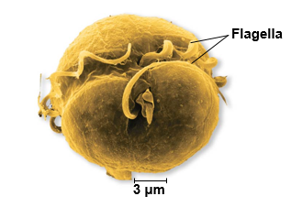
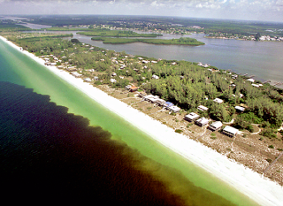
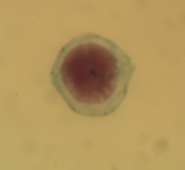
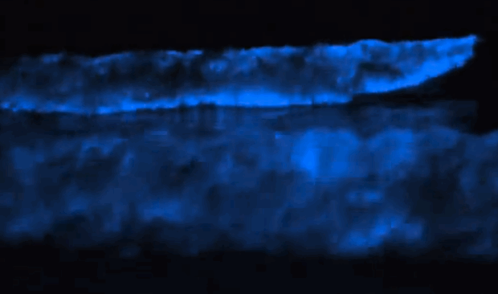
Supergroup: SAR Clade₁: Alveolata; Clade₂: Dinoflagellates
Example: Dinoflagellates
Reinforced cellular plates
Move via flagella
Flagella in grooves
Cause _________
Lab photo

Slide 21
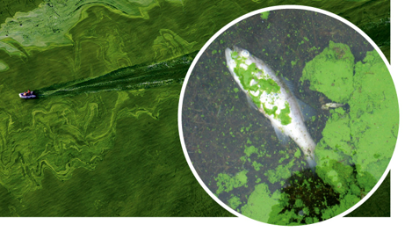
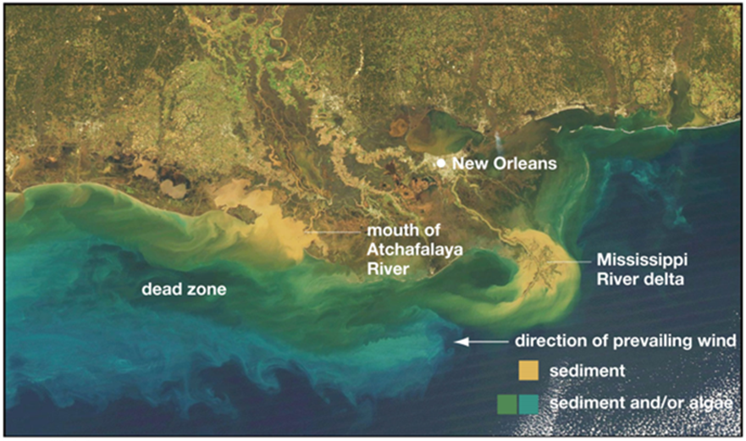
Algal Blooms
______________: excessive richness of nutrients in a body of water, frequently due to runoff from agricultural areas on land
Can cause algal blooms, which is the dense growth of algae and bacteria that can result in __________ where animals die from lack of oxygen (hypoxia).
Notes:
Nitrogen and phosphorus

Slide 22
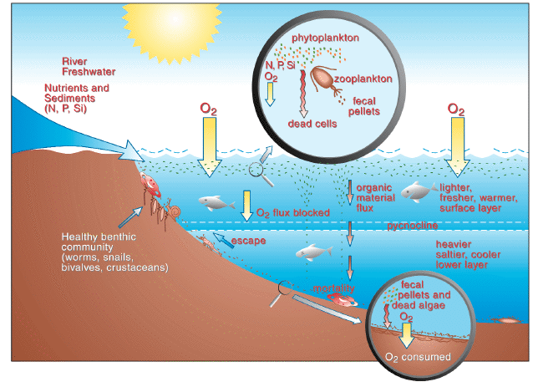
What Causes Dead Zones?
During the summer months nutrient rich runoff from land enters the oceans resulting in eutrophication
Eutrophication along with abundant solar energy leads to massive algal blooms
Dead algae sink to the bottom where bacteria aid in decomposition
Heterotrophic bacteria deplete oxygen available to other organisms forming a hypoxic environment

Slide 23
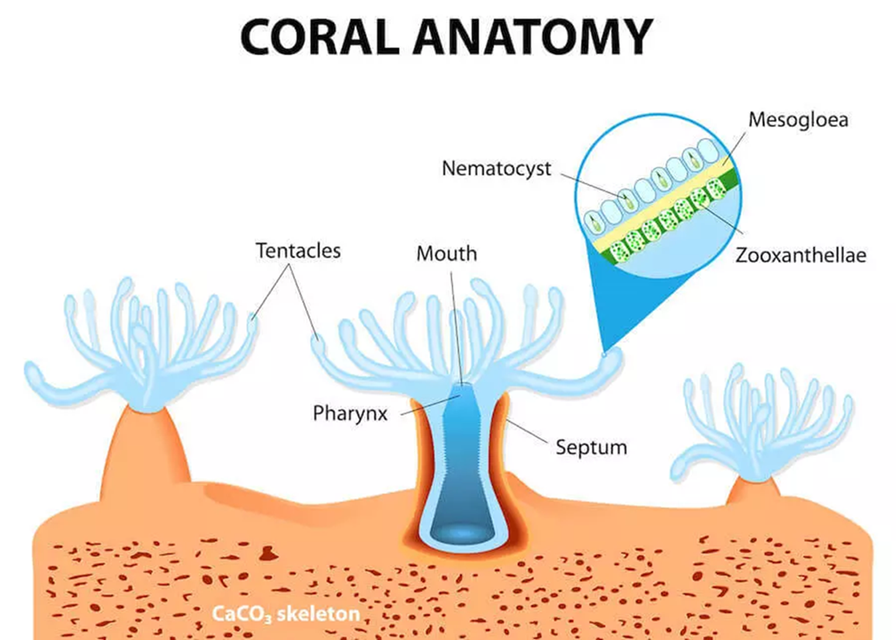
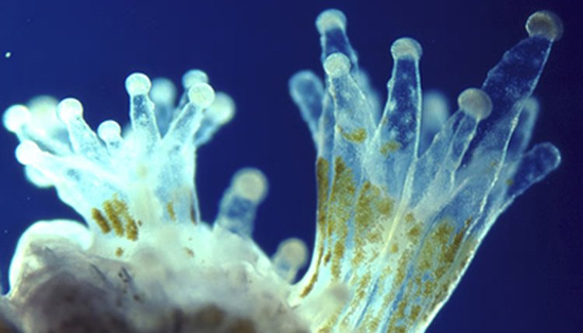
Supergroup: SAR Clade₁: Alveolata; Clade₂: Dinoflagellates
Zooxanthellae
Symbiotic dinoflagellate found in the tissue of many marine invertebrates
Photosynthetic zooxanthellae provide hosts with carbon products used for energy and growth
Zooxanthellae

Slide 24
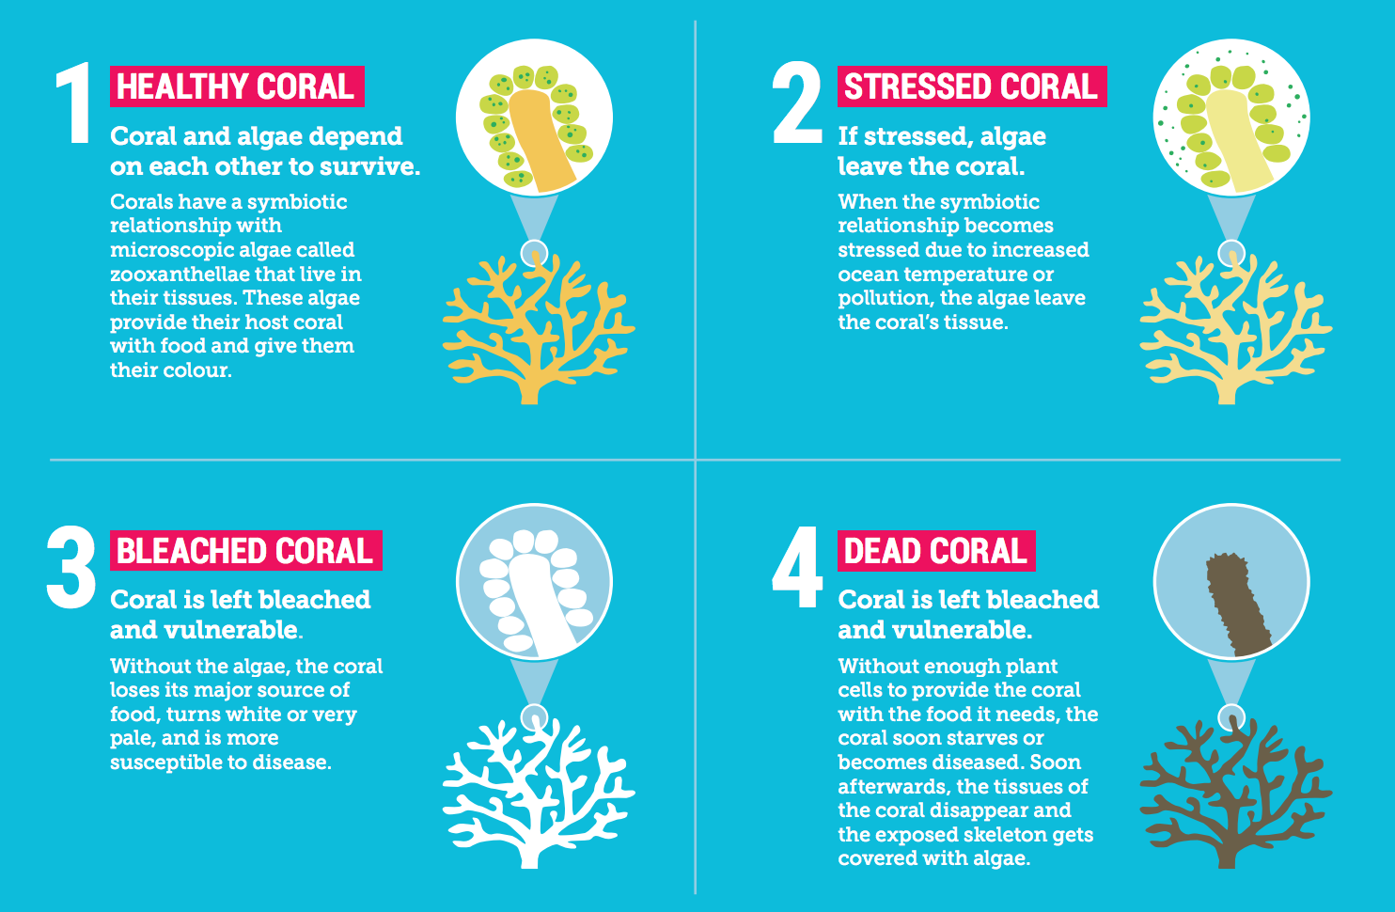
Zooxanthellae and Coral Bleaching

Slide 25
Algal Blooms and Bioluminescence
Bioluminescence in dinoflagellates is produced by a chemical reaction in the organism
Luciferin + O2 Oxyluciferin + Light
Luciferase

Slide 26
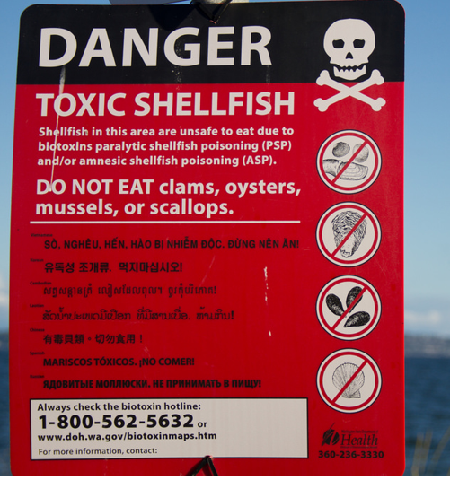
Algal Blooms and Toxins
Paralytic Shellfish Poisoning (PSP): caused by saxitonin produced by dinoflagellates
Neurotoxic Shellfish Poisoning (NSP): caused by brevitoxin produced by dinoflagellates
Amnesic Shellfish Poisoning (ASP): caused by domoic acid produced by diatoms

Slide 27
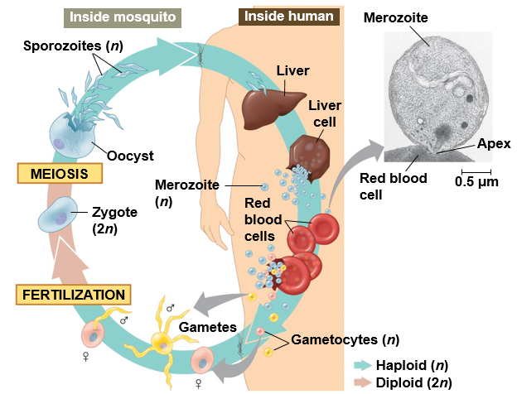
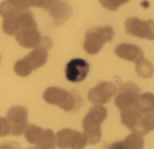
Supergroup: SAR Clade₁: Alveolata; Clade₂: Apicomplexans
Example: Plasmodium sp.
Animal parasites
Sporozoites: infectious cells
_______ structure
Cause malaria
Mosquito
Plasmodium
Lab photo
Mosquito

Slide 28
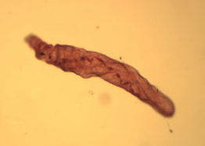
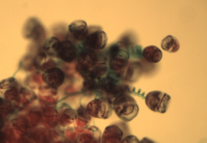
Supergroup: SAR Clade₁: Alveolata; Clade₂: Ciliates
Examples: Paramecium sp., Vorticella sp.
Most are predatory
Two types of nuclei
Micronuclei and Macronuclei
____________: exchange of micronuclei without reproduction
Binary fission: asexual reproduction
________
Spirostomum
Lab photo
Vorticella
Lab photo

Slide 29
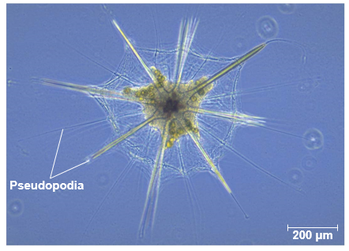
Supergroup: SAR Clade₁: Rhizaria
Characteristics of Rhizaria:
Amoebas
Thread-like __________
DNA similarities
Includes:
Foraminiferans
Cercozoans
Radiolarians

Slide 30
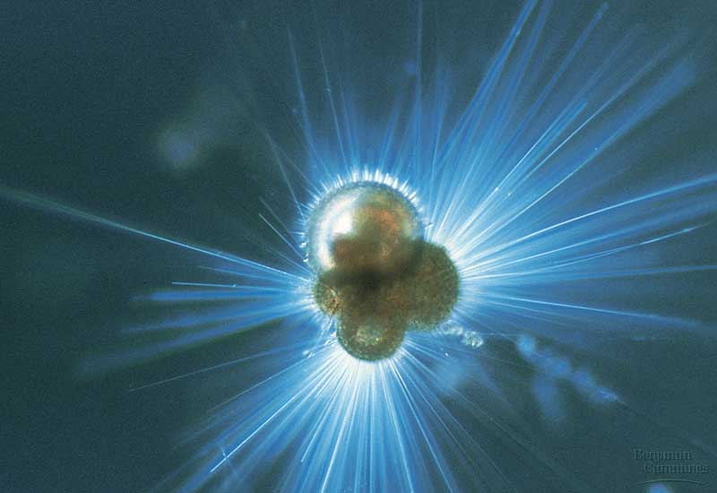
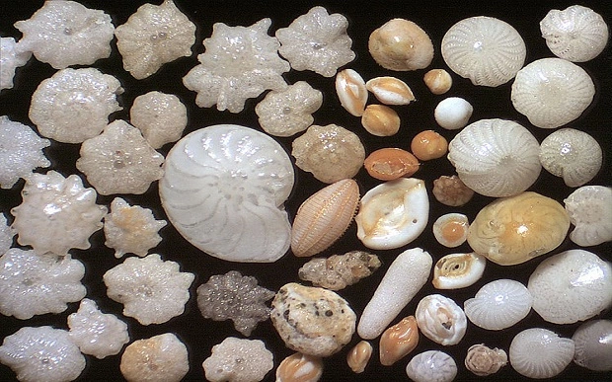
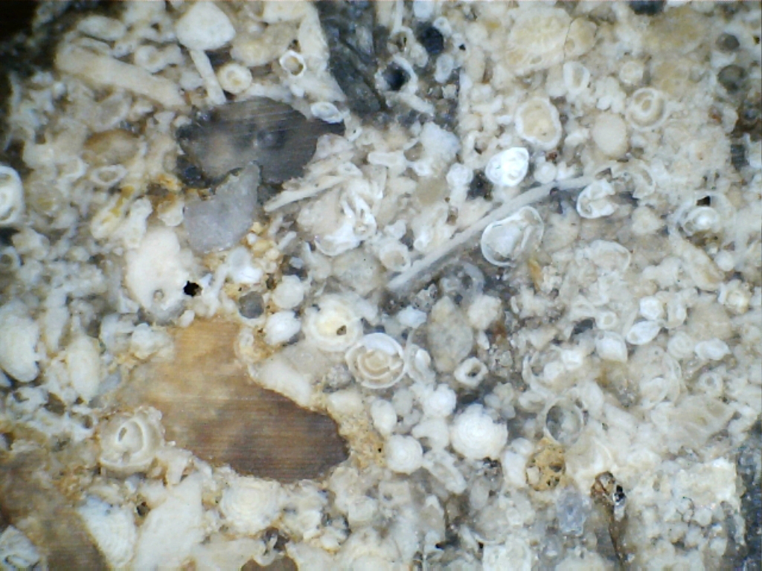
Supergroup: SAR Clade₁: Rhizaria; Clade₂: Foraminiferans
Examples: Foraminiferans
Porous, _______________ tests (shells)
Foramen (little hole), ferre (to bear)
Thin pseudopodia (false feet) capture food
Marine and freshwater
Most are _________ (live on the bottom)
Fossilized forams = limestone rock
Chemical markers in tests used to determine previous climates

Slide 31
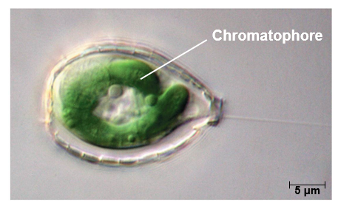
Supergroup: SAR Clade₁: Rhizaria; Clade₂: Cercozoans
Examples: Cercozoans
Thin pseudopodia
_____________: photosynthetic structure
Marine, freshwater and soil
Lab photo

Slide 32
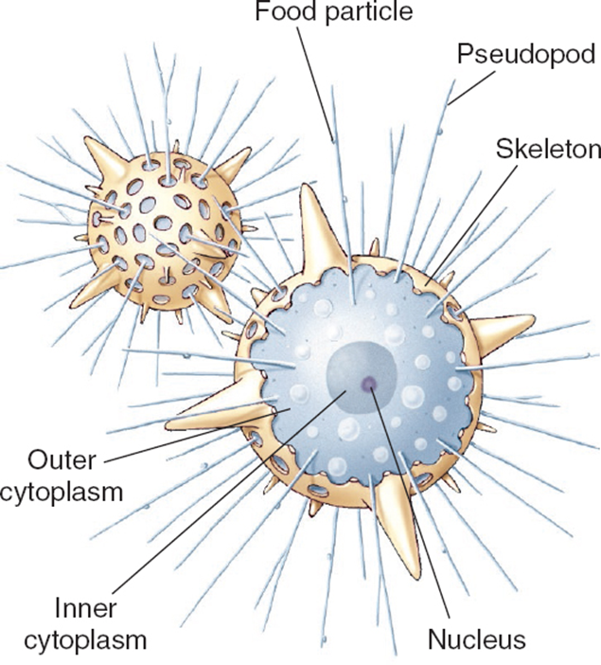
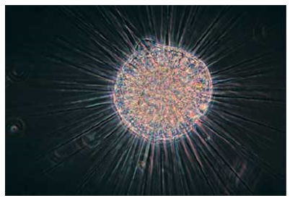
Supergroup: SAR Clade₁: Rhizaria; Clade₂: Radiolarians
Examples: Radiolarians
Silica tests
Pseudopodia reinforced with microtubules
Mostly marine
______________
Lab photo

Slide 33
Supergroup: Archaeplastida
Characteristics of Archaeplastida:
Similar DNA sequences
___________ of cyanobacterium
Includes:
Red algae
Chlorophytes
Charophytes
Land plants

Slide 34
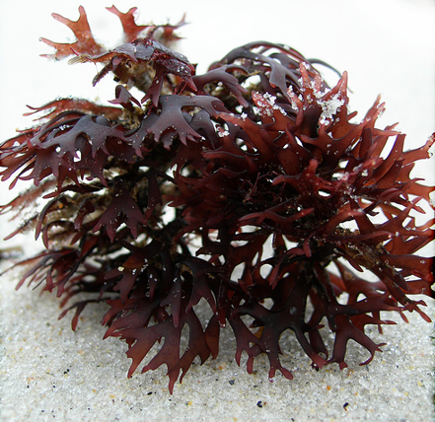
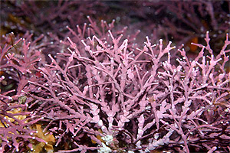
Supergroup: Archaeplastida Clade₁: Red algae
Examples: Chondrus, Coralline
Multicellular
Cellulose cell wall
_______________: photosynthetic pigment
Mostly marine (warm tropical)
Agar
Lack flagellated gametes
Chondrus
Coralline
Lab photo

Slide 35
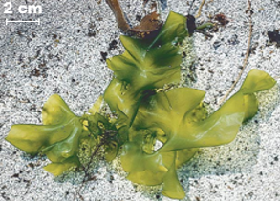
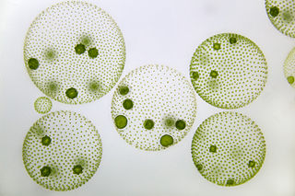
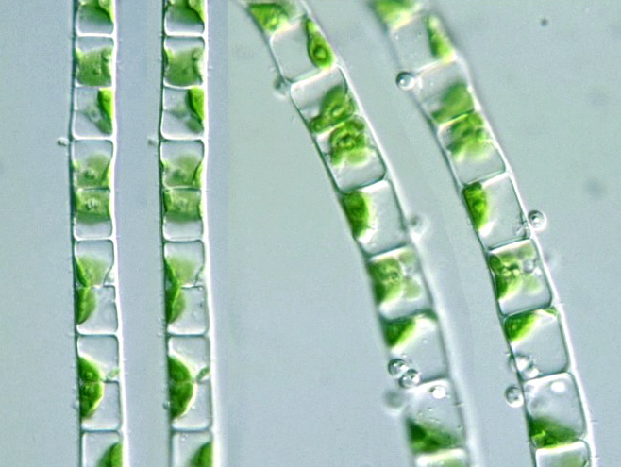
Supergroup: Archaeplastida Clade₁: Chlorophytes
Example: Ulva, Volvox, Ulothrix
Unicellular, Multicellular, and Colonial
Cellulose cell wall
Pigments
_________________
Carotenoids
Mostly freshwater
Ulva
Volvox
Lab photo
Ulothrix

Slide 36
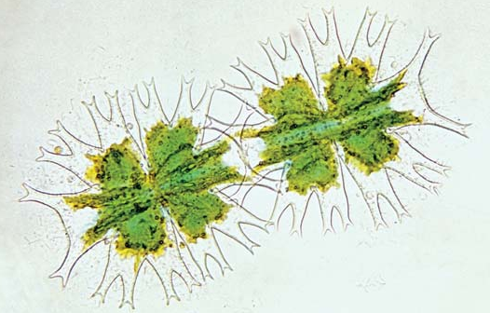
Supergroup: Archaeplastida Clade₁: Charophytes
Sister taxa of land plants
Rings of cellulose synthesizing proteins
Peroxisome enzymes
Structure of flagellated sperm
Formation of ______________
Cellulose cell wall
Pigments
Chlorophyll A, B
Carotenoids
Mostly freshwater
Desmid
Spirogyra
Lab photo
Notes:
Distinctive circular proteins in the plasma membrane, which synthesize the cellulose microfibrils in the cell wall.
Phragmoplast: group of microtubules that forms between the daughter nuclei of the dividing cell. Cell plate develops inside of phragmoplast.
Proxisome enzymes:

Slide 37
Supergroup: Unikonta
Characteristics of Unikonta:
Two major subgroups (Amoebazoans and Opisthokonts)
Within group relationships support with DNA sequencing
May have been first group to diverge from eukaryotes
Single _______
Lobe or tube shaped ___________
Fusion of three genes

Slide 38
Supergroup: Unikonta Clade₁: Amoebazoans
Characteristics of Amoebazoans:
_________________ pseudopod used for movement and feeding
Includes:
Slime molds
Plasmodial
Cellular
Gymnaoembas
Entamoebas

Slide 39
Supergroup: Unikonta Clade₁: Amoebazoans; Clade₂: Slime molds
Example: Plasmodial slime molds
Many are brightly colored
_____________: Single mass of cytoplasm
Supercell
Single celled with multiple nuclei
Coenocytic hyphae

Slide 40
Supergroup: Unikonta Clade₁: Amoebazoans; Clade₂: Slime molds
Example: Cellular slime molds
Solitary feeding stage
Form asexual fruiting bodies when food stressed
_________ hyphae

Slide 41
Supergroup: Unikonta Clade₁: Amoebazoans; Clade₂: Gymnamoebas
Example: Tubulinids (Gymnamoebas)
Lobe or tube-shaped pseudopodia
____________ streaming
Lack of test
Unicellular
Mostly heterotrophic
Marine, freshwater, and soil

Slide 42
Supergroup: Unikonta Clade₁: Amoebazoans; Clade₂: Entamoebas
Example: Entamoeba histolytica
_________
Amoebic dysentery
Contaminated drinking water or food
Lab photo

Slide 43
Supergroup: Unikonta Clade₁: Opisthokonts
Characteristics of Opisthokonts:
Unicellular or multicellular
________ location of flagellum
Includes:
Nucleariids
Fungi
Choanoflagellates
Animals

Slide 44
Supergroup: Unikonta Clade₁: Opisthokonts; Clade₂: Nucleariids
Example: Nucleariids
Lack distinctive characteristics
Unicellular
Posterior flagella
Temporary pseudopods
Feed on algae and bacteria
Closely related to fungi

Slide 45
Supergroup: Unikonta Clade₁: Opisthokonts; Clade₂: Choanoflagellates
Example: Choanoflagellates
Unicellular or colonial
___________ feeders
Closest relative to animals

Slide 47
Check Your Understanding
True or False: Organisms are classified as protists if they are multicellular organisms that are not plants, animals or fungi.
True or False: Chloroplast and mitochondria are theorized to have arisen through endosymbiosis

Slide 48
Check Your Understanding
Which of the following clades do not have a reduced or modified mitochondria?
a. Parabasalids
b. Kintoplastids
c. Cercozoans
d. Diplomonads
e. More than one of the above

Slide 49
Check Your Understanding
Which of the following are not one of the characteristics of organisms in the supergroup Unikonta?
a. Fusion of three genes
b. Secondary endosymbiosis of red algae
c. Single flagella
d. Excavated groove
e. More than one of the above

