Slide 1
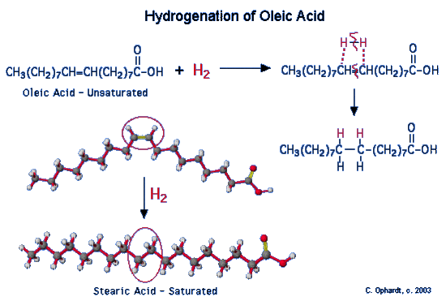
Biology Article #2: Margarine
Hydrogenation: a chemical reaction between hydrogen and another compound. A process that is commonly used to saturate fatty acids

Slide 2
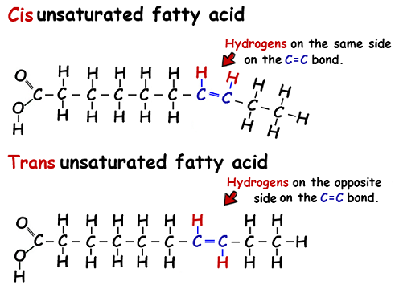
Biology Article #2: Margarine
Cis-unsaturated fatty acids have added hydrogens on the same side
Fatty acid is kinked making it difficult for lots of fatty acids to stack together
Trans unsaturated fatty acids have added hydrogens on opposite sides, making the fatty acids easier to stack

Slide 3
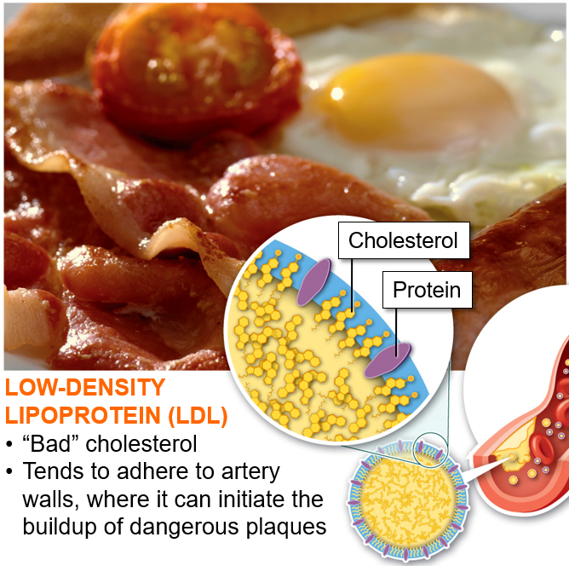
“Good” and “Bad” Cholesterol
Notes:
While trans-fats are harmful to the body, foods containing cis-fats are beneficial. Monounsaturated cis-fats decrease LDL cholesterol and triglycerides, and increase HDL. Foods containing a high percentage of monounsaturated fats include almonds, avocados, bacon, canola oil, cashews, eggs, grapeseed oil, ground beef, hazelnuts, high oleic safflower oil, high oleic sunflower oil, macadamia nuts, olives, olive oil, pecans, peanuts, peanut oil, pistachios, sunflower oil and tea seed oil.

Slide 4
Life’s Border: The Plasma Membrane
“The greatest enemy of knowledge is not ignorance, it is the illusion of knowledge”
-Stephen W. Hawking
“It is impossible for anyone to learn that which he thinks he already knows”
-Epictetus
Chapter 5

Slide 5
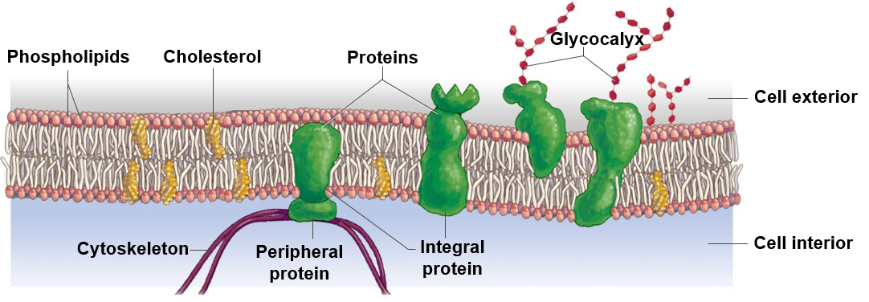
The Plasma Membrane
Plasma membrane: a __________ permeable barrier at the outer boundary of cells, composed of a phospholipid bilayer.

Slide 6
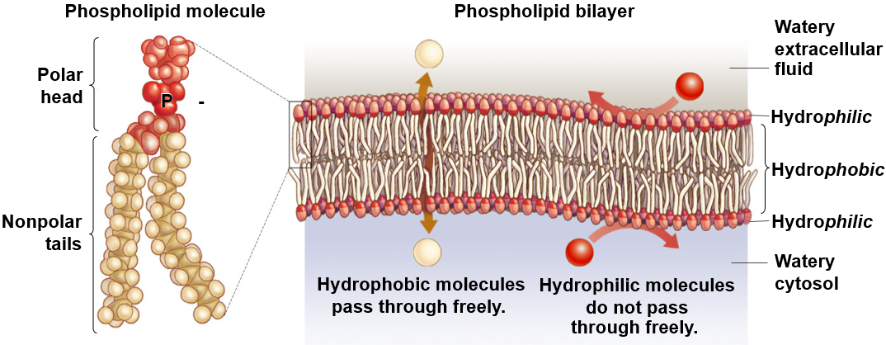
The Phospholipid Bilayer
__________ phosphate head and two _____________ fatty acid tails
Composed of two layers of phospholipids

Slide 7
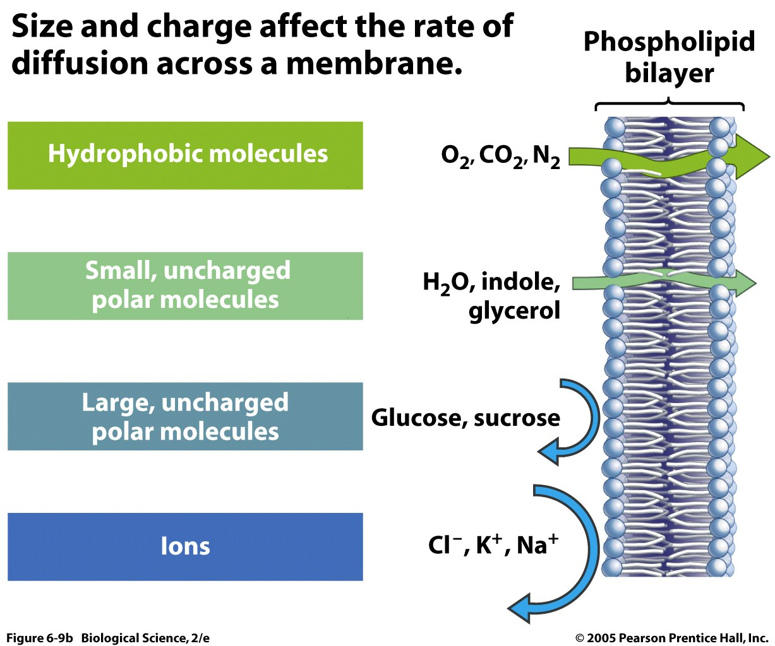
Membrane Permeability

Slide 8
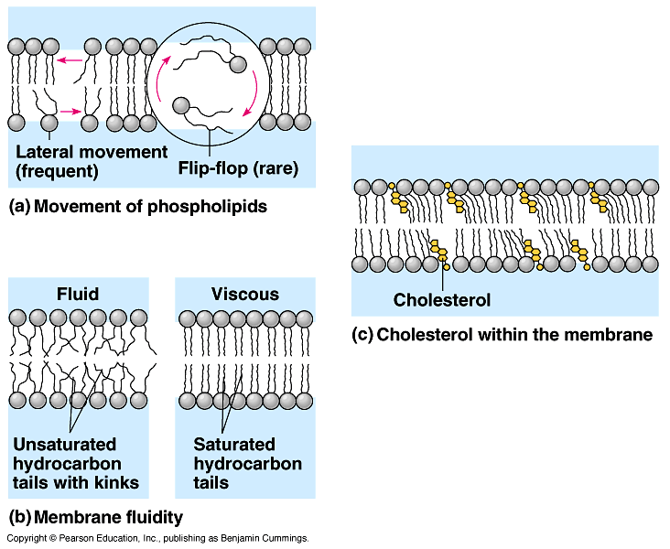
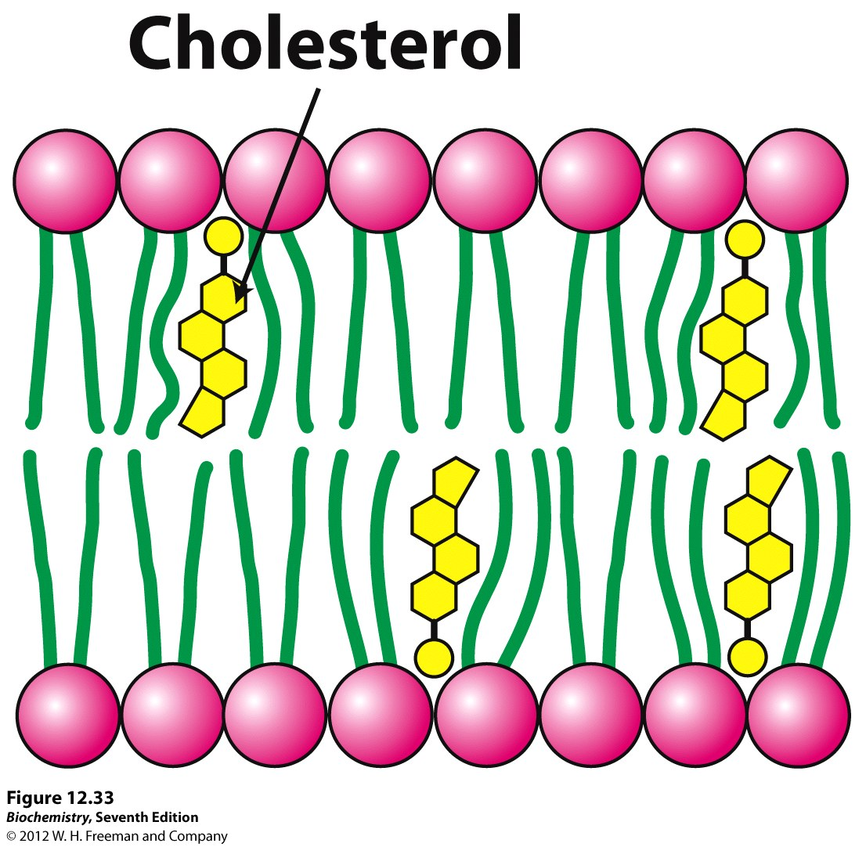
Cholesterol
Maintains membrane ________
Buffers against changes in temperature
Secures membrane proteins
Patching material in animal cells

Slide 9
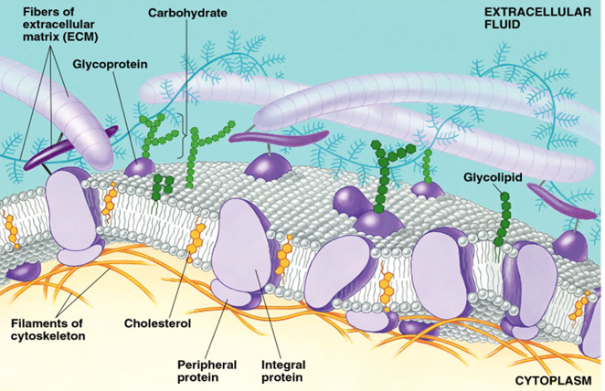
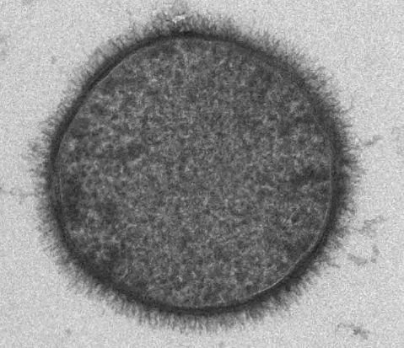
Glycocalyx
Glycocalyx: an outer layer of the plasma membrane composed of short ___________ chains attached to membrane proteins (glycoproteins) or membrane lipids (glycolipids)
Aid in cell signaling
Cell recognition by immune system cells
Cancer cells and foreign invaders
Cell adhesion
Fertilization (sperm recognize eggs)
Glycocalyx on a bacterial cell

Slide 10
Membrane Proteins
Integral proteins: membrane proteins bound to the hydrophobic interior of the membrane
Peripheral proteins: membrane proteins attached to the hydrophilic layer on either side of the plasma membrane

Slide 11
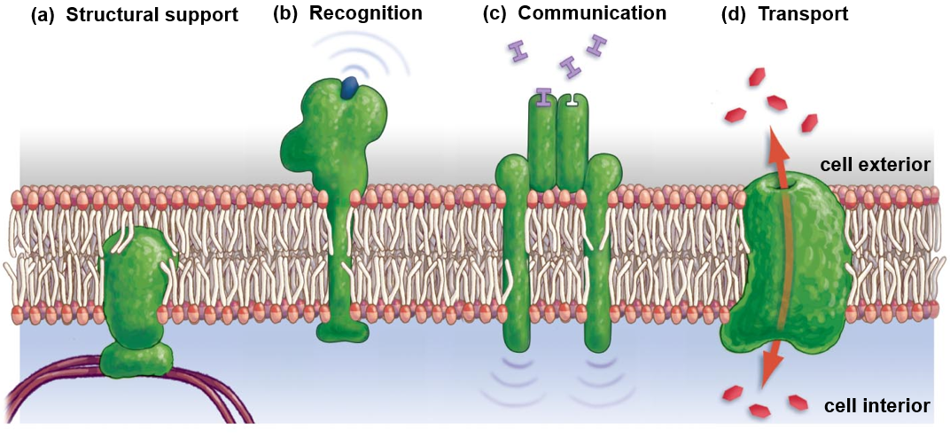
Functions of Membrane Proteins

Slide 12
Functions of Membrane Proteins
Structural support proteins: Peripheral proteins on the interior side on animal cells, bound to the interior cytoskeleton of the cell
Provide support and stabilization

Slide 13
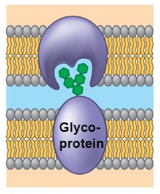
Functions of Membrane Proteins
Recognition proteins: Membrane proteins that present protein fragments or carbohydrates (glycoproteins) for other cells to bind with.
______________ cells bind to protein fragments to determine if cell is healthy or infected
Glycoproteins act as cells “fingerprint”

Slide 14
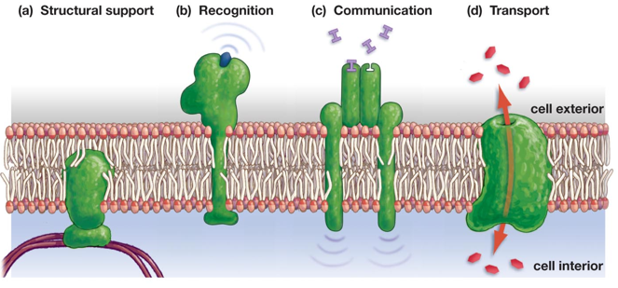
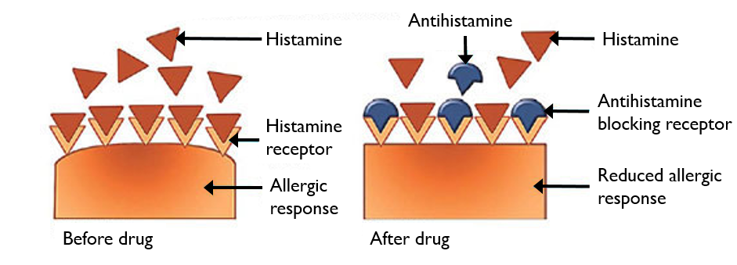
Functions of Membrane Proteins
Receptor proteins: Membrane proteins that bind with ______ _________ on exterior of cell and initiate a response in the cell interior
Binding sites specific to certain signaling molecules
Ex: Insulin and adrenaline
Beta-blockers or anti-histamines

Slide 15
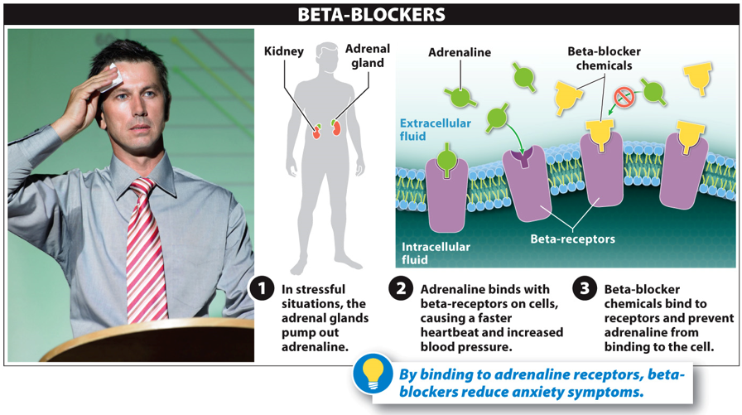
Drugs and Receptor Proteins

Slide 16
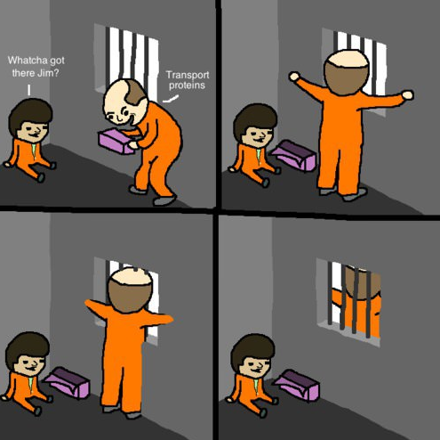
Functions of Membrane Proteins
Transport proteins: transmembrane proteins that help _______________ molecules through the plasma membrane.
Ex: Sodium potassium pumps

Slide 17
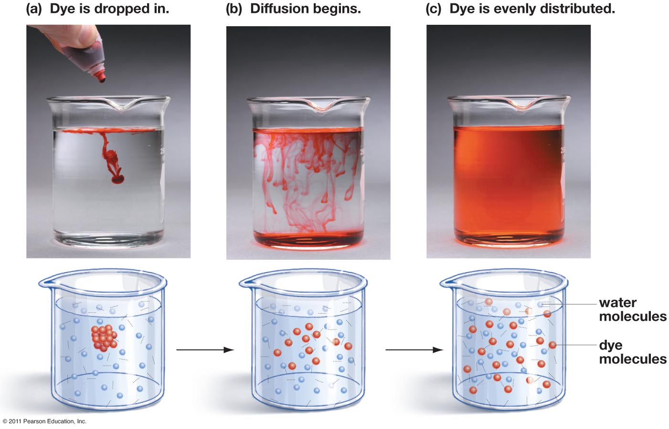
Movement of Molecules
___________: movement of molecules or ions from a region of greater concentration to an region of lower concentration

Slide 18
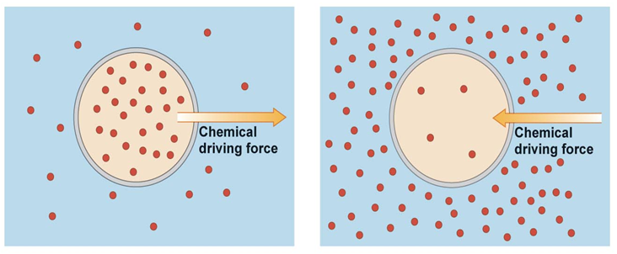
Movement of Molecules
Concentration gradient: difference between the highest and lowest concentration of a _______ in a given medium
Solutes are move from higher concentration to lower concentration
until _____________________ is reached

Slide 19
Movement of Molecules
Brownian movement: _______ movement of particles suspended in a fluid or gas
Movement related to temperature

Slide 20
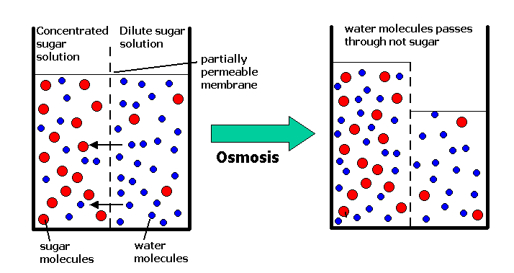
Movement of Molecules
Osmosis: movement of water across a ______________ membrane from a region Higher water concentration (lesser solute concentration) to a region of lower water concentration (greater solute concentration).
Notes:
Osmosis: Net movement of water across a semi-permeable membrane from an area of lower solute concentration to an area of greater solute concentration

Slide 21
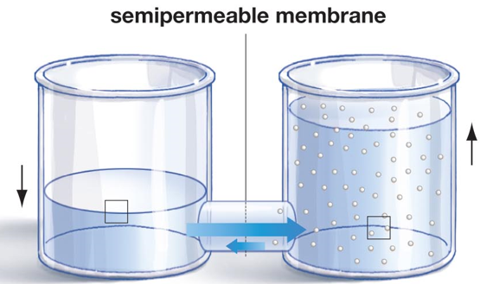
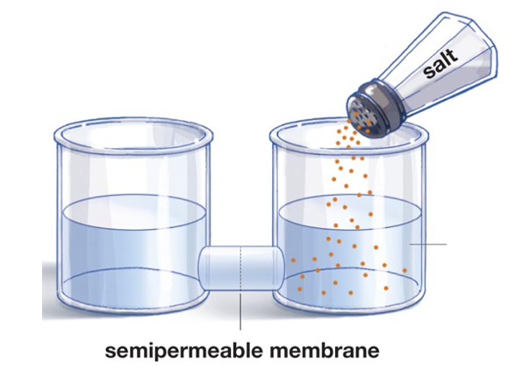
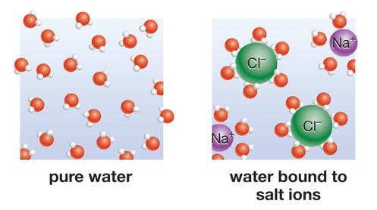
Osmosis
Step 1. Step 2.
Solute? Solvent?
Water

Slide 22
Osmosis in Cells
Tonicity: a measure of the osmotic pressure against a semi-permeable membrane
Hypertonic: a solution with a _____ solute concentration than another adjacent solution
Isotonic: two solutions with ______ concentrations of solutes
Hypotonic: a solution with a ______ solute concentration than another adjacent solution

Slide 23
Osmosis in Plant and Animal Cells

Slide 24
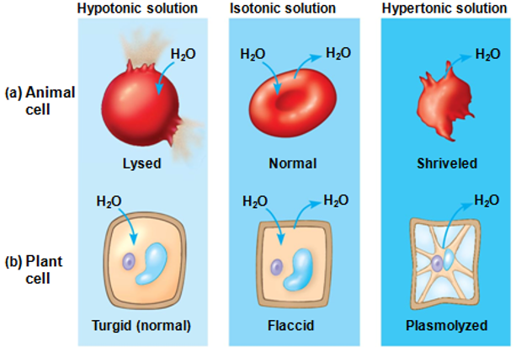
Osmosis in Plant and Animal Cells
Lysis: disintegration of a cell be rupture
Plasmolysis: shrinkage of plant cell _____________ away from the cell wall

Slide 25
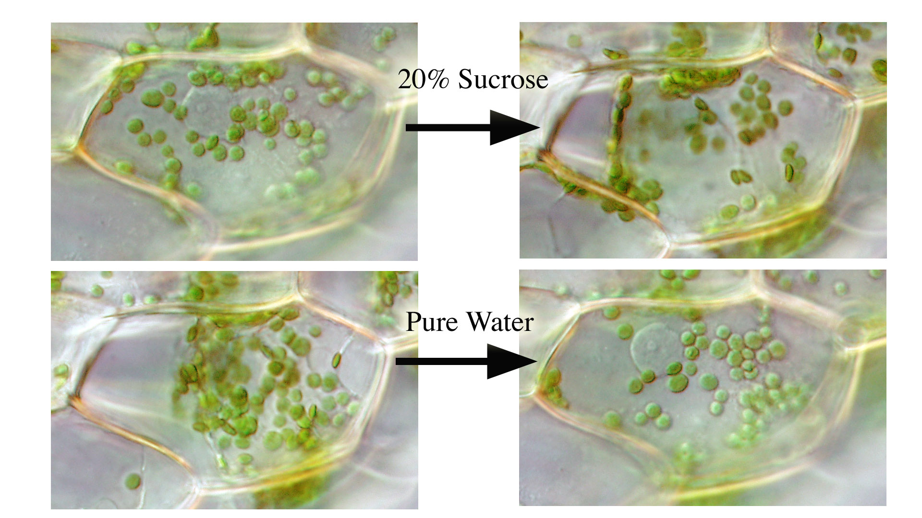
Plasmolysis

Slide 26
Which direction will H₂O move?
5% NaCl
0.1% NaCl
0.15% NaCl
2% NaCl
0.15% NaCl
0.5% NaCl

Slide 27
Movement Through the Plasma Membrane
Passive transport: movement of ions or molecules across the plasma membrane without the use of energy
Simple diffusion: movement of ions or molecules directly through the cell membrane without the use of a protein channel (transport protein)
__________ diffusion: movement of ions or molecules across the plasma membrane through a specialized protein channel.
Active transport: movement of ions or molecules across the plasma membrane _____ the concentration gradient with the use of energy (ATP)

Slide 28
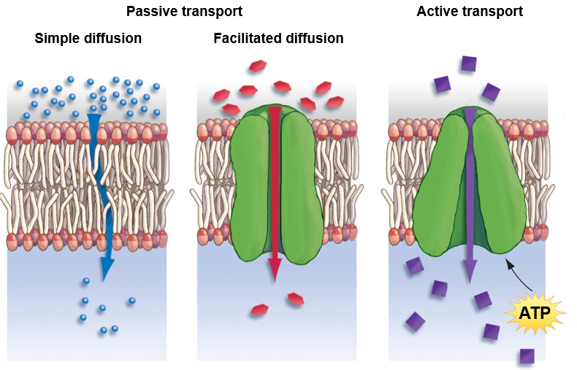
Movement Through the Plasma Membrane

Slide 29
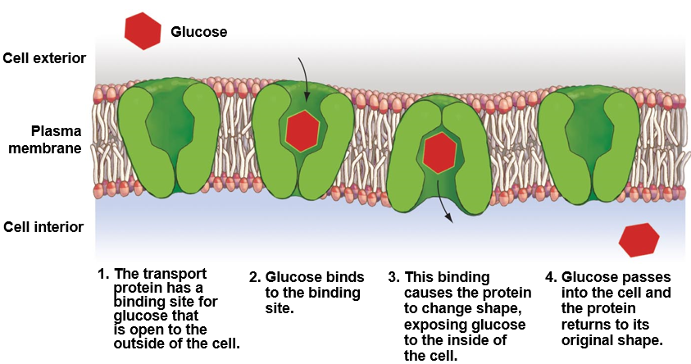
Facilitated Diffusion

Slide 30
Active Transport
Sodium-Potassium pump: maintains concentration gradient of sodium (Na⁺) and potassium (K⁺) inside and outside for the cell
Critical to nerve cell function

Slide 31
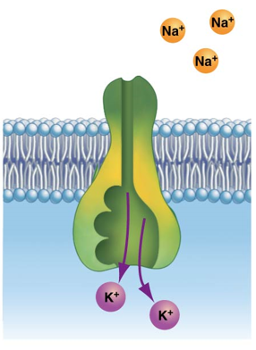
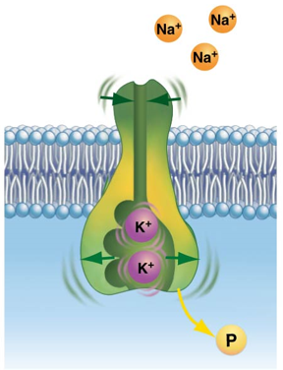
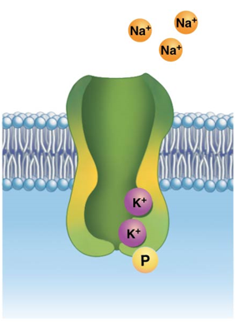
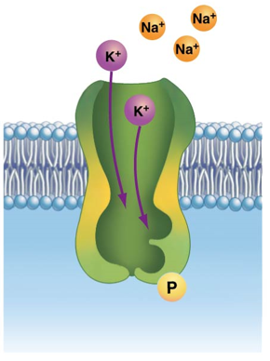
8. Potassium release
1.Unbound protein
2. Sodium binding. Phosphorylation of pump by ATP
Sodium Potassium Pump
7. Phosphate release. Shape change
3. Shape change
6. Potassium binding
5.Unbound protein
4. Sodium release

Slide 32
Movement of Large Molecules
Exocytosis: movement of materials out of cell through the fusion of the plasma membrane and a transport vesicle
Endosytosis: movement of large molecules into the cell by infolding of plasma membrane
Pinocytosis: peripheral proteins (receptors) bind to molecules before forming transport vesicle
Phagocytosis: pseudopodiums (false feet) surround large molecules and fuse together to form transport vesicle

Slide 33
Exocytosis

Slide 34
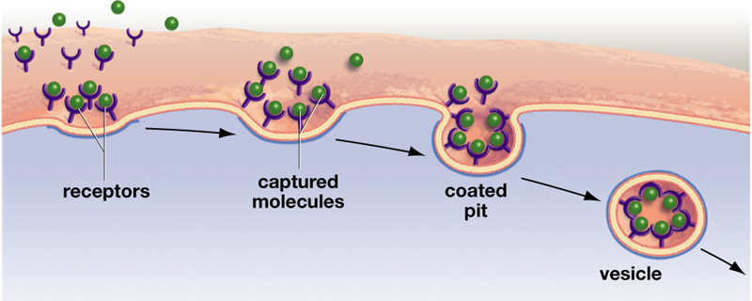
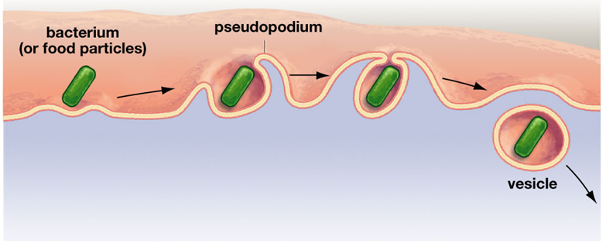
Endocytosis
Exterior of cell
Pinocytosis
Phagocytosis
Interior of cell

Slide 35
Check your Understanding
1. T or F – Phospholipids have a hydrophobic head and two hydrophilic tails
2. Which of the following solutions is hypotonic to the cell within the solution?
3. Draw the direction of water movement for each of the solutions above.
A
B
C
0.5% NaCl
10% NaCl
0.1% NaCl
0.5% NaCl
0.1% NaCl
0.9% NaCl

Slide 36
Check Your Understanding
4. Which of the following do not require energy to transport ions or molecules out of the cell?
a. Facilitated transport
b. Active transport
c. Passive transport
d. Sodium potassium pumps
e. More than one of the above

Slide 37
Check Your Understanding
5. When a plant cell is placed in a hypertonic solution it will become ________.
a. turgid
b. flaccid
c. plasmolyzed
d. lysed
e. hyper

Slide 38
Check Your Understanding
6. Describe dynamic equilibrium.

