Slide 1
Plant Structure and Growth
“You will never change your life until you change something you do daily."
- John C. Maxwell
Chapter 35

Slide 2
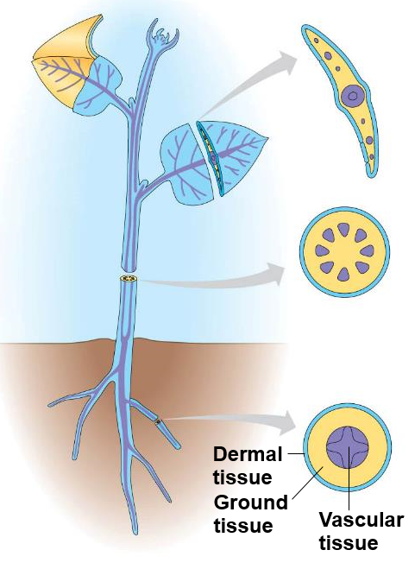
Plant Tissue Systems
Ground tissues
Storage
____________
Support
Vascular tissues
Transport of water and minerals
Support
Dermal tissues
Protective outer tissue layer

Slide 3
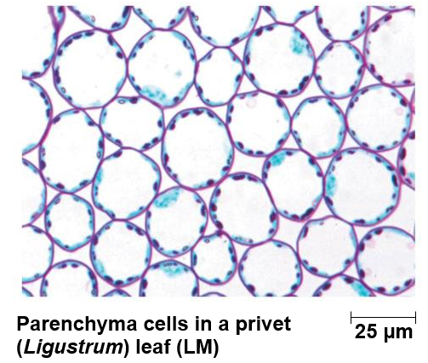
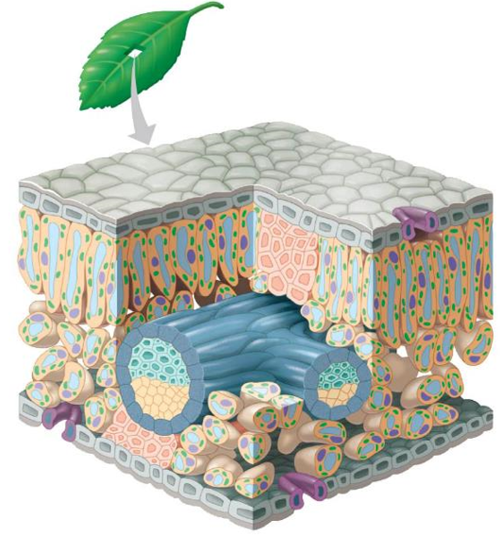
Ground Tissue System
____________ cells: living cells with thin, flexible primary walls, that make up the inside of most non-woody plant structures including the leaves, stems and roots
Metabolic functions
Photosynthesis
Starch storage
Palisade mesophyll
Spongy mesophyll

Slide 4
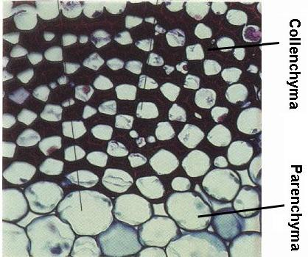
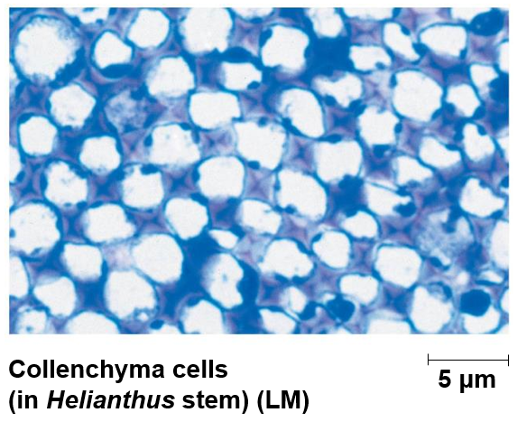
Ground Tissue System
Collenchyma cells: elongated cells with _______ _____________ that provide support to growing shoots and leaves
Living and flexible at maturity

Slide 5
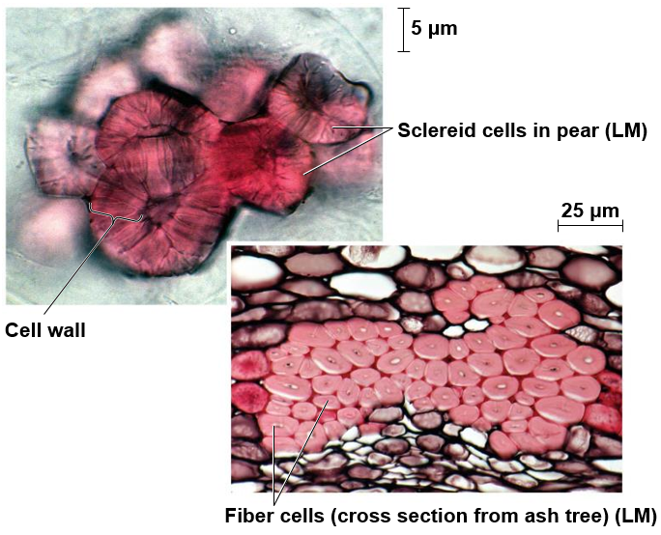
Ground Tissue System
Sclerenchyma cells: support cells with thick, __________________ that develop after cell elongation
Usually dead at maturity
Fibers: long, slender cells typically found in strands or bundles
__________: boxy, irregularly shaped cells with thick, lignified secondary walls
Lignin: a strong polymer that provides support to cell walls of vascular plants

Slide 6
Dermal Tissue System
Epidermis: a single layer of tightly packed cells comprising the outermost tissue layer in non-woody plants
Cuticle: a waxy coating on surface of stems and leaves
Prevents desiccation
__________: protective coat that replaces epidermis in woody plants
Cuticle
Stoma
Upper
epidermis
Lower
epidermis
Cuticle
Guard cells

Slide 7
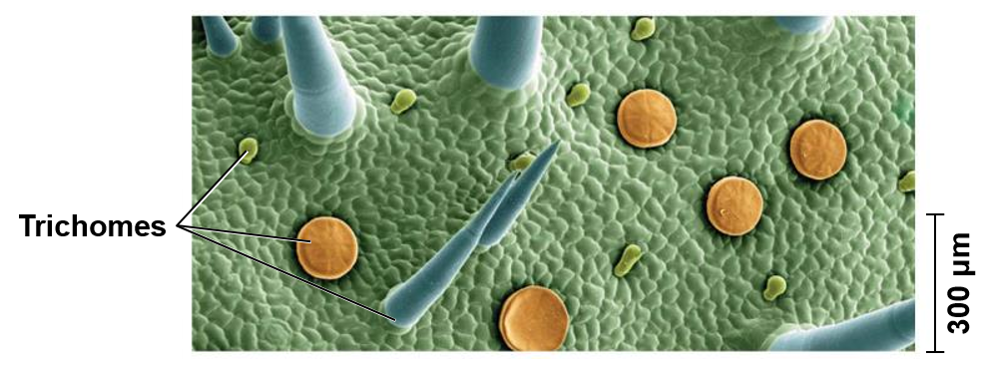
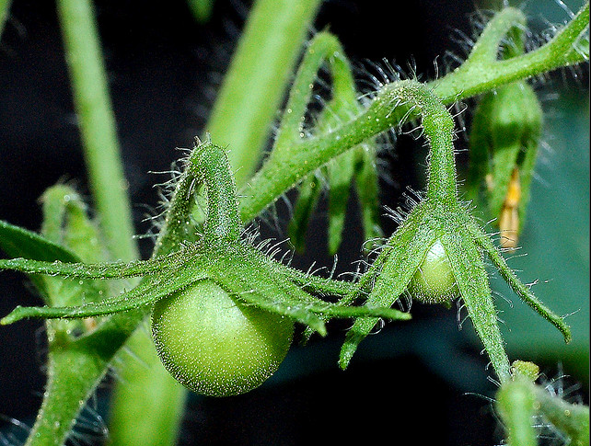
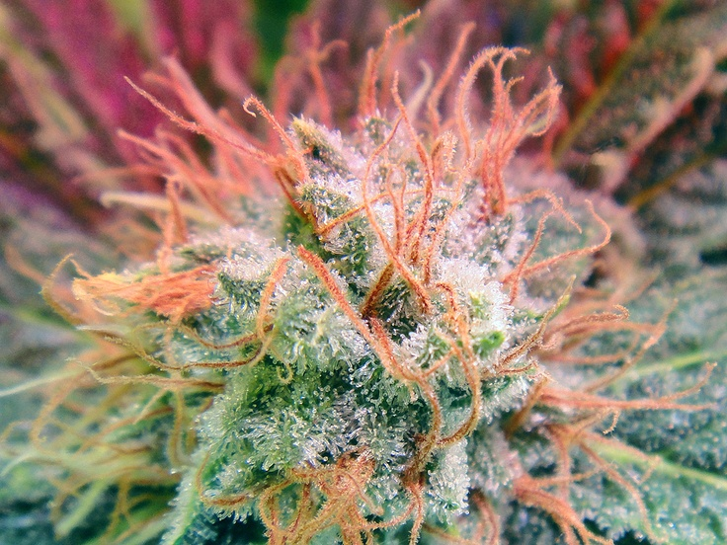
Dermal Tissue System
Trichomes: small ________ _________ of the epidermis
Protect against insects
Reflect UV light
Release oils or chemicals

Slide 8
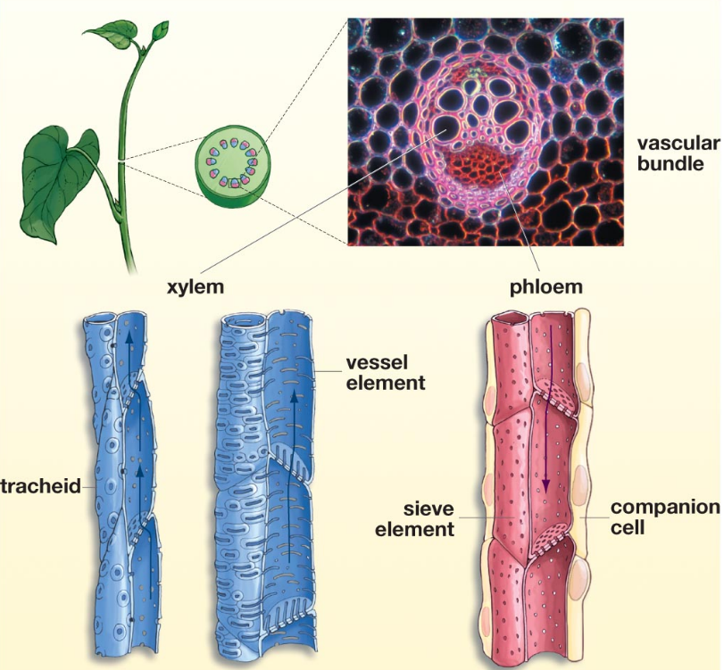
Vascular Tissue System
______: vascular tissue of root or stem
Xylem: conducts waters and dissolved minerals upwards from roots
Tracheids
Vessel elements
Phloem: transports sugars (from photosynthesis) to roots and other are as of growth
Sieve-tube elements
Companion cells

Slide 9
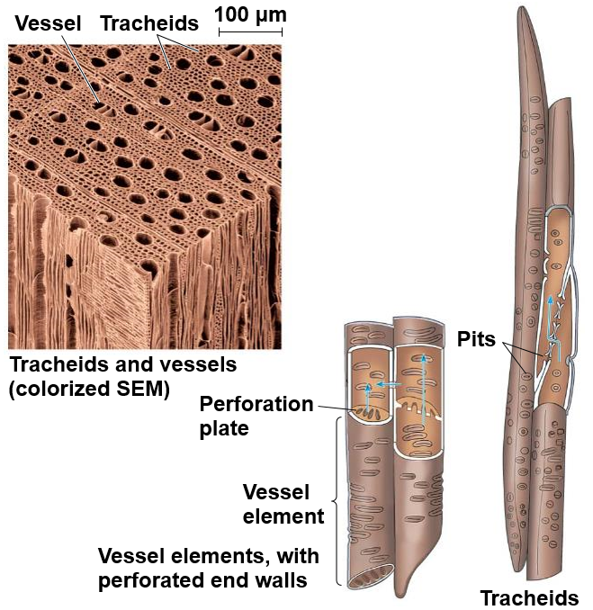
Xylem
Tracheids: long thin cells with tapered ends
Dead at maturity
Pits: lateral water movement
Vessel Elements: wide, short, thinly walled cells
Dead at maturity
_____________: water movement through the ends of vessel elements

Slide 10
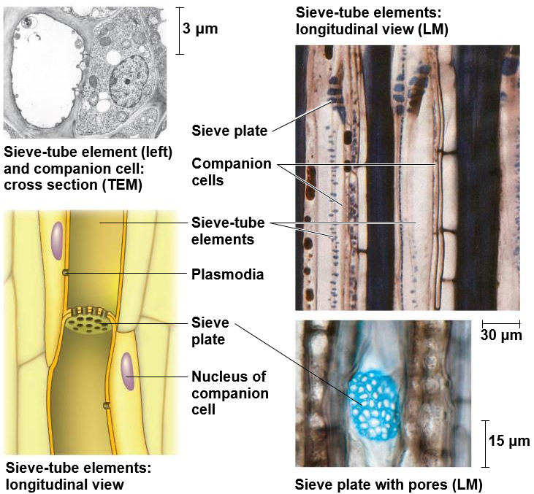
Phloem
Sieve-tube elements: chains of long, narrow cells that transport nutrients and sugars
Alive at maturity
Lack __________________
Sieve plates: porous plates that allow fluid to pass between cells
Companion cells: nonconducting cell adjacent to sieve-tube cells
Alive at maturity
Nucleus and ribosomes serve both companion cell and sieve-tube cell
Plasmodia: connect companion cells to sieve-tube cells

Slide 11
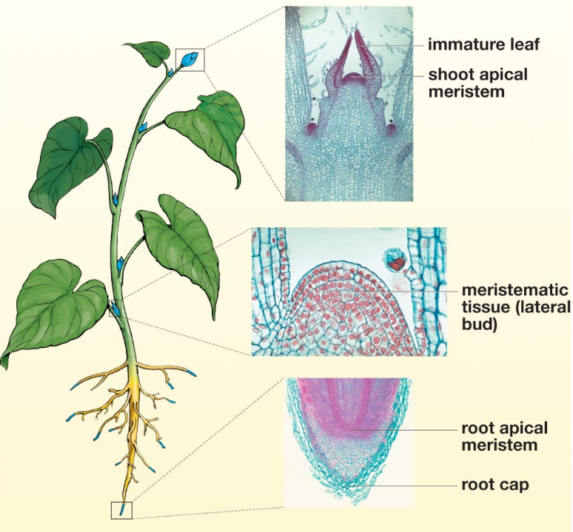
Plant Growth
Meristematic tissue: unspecialized tissue that continuously divides, creating _______ that elongate and become specialized
Apical meristems
Primary growth = increase in length
Lateral meristems
Secondary growth = increase in thickness

Slide 12
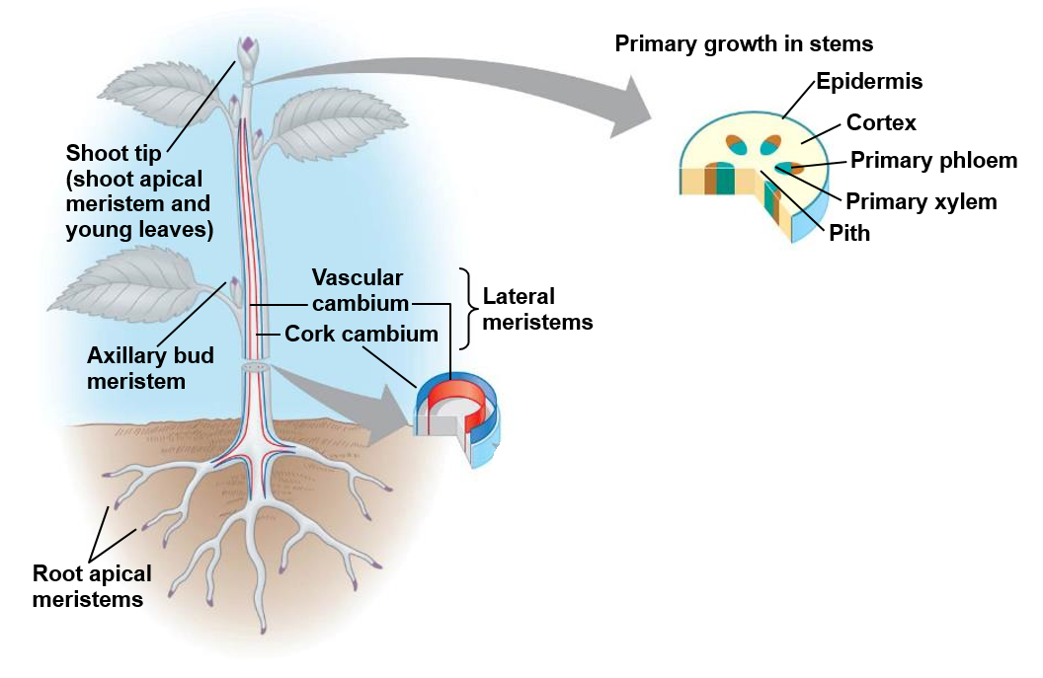
Apical Meristems
Apical meristems: meristematic tissue in root and shoot tips that ___________ of roots and shoots
Protoderm: gives rise to epidermis
Ground meristem: gives rise to ground tissue
Procambium: gives rise to _______ xylem and phloem

Slide 13
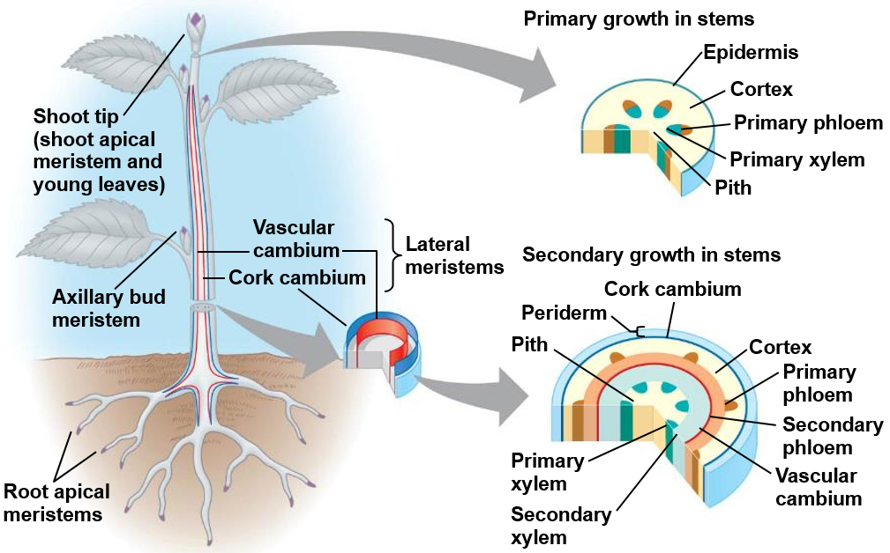
Lateral Meristems
Lateral meristems: meristematic tissue that thickens the roots and shoots in woody plants
Vascular cambium: produces ________ xylem and phloem
Cork cambium: replaces epidermis with tough ________

Slide 14
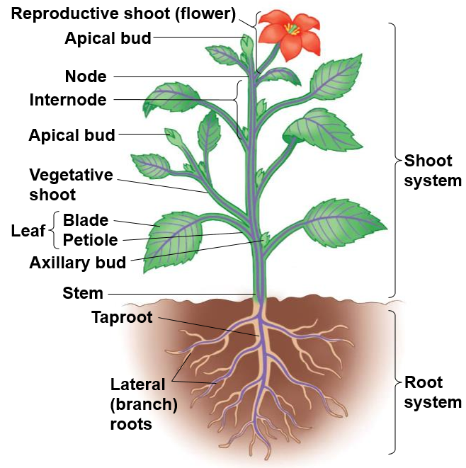
Plant Morphology
Shoot system: photosynthesis and reproduction
Stem
Nodes
Internodes
Leaves
Blade
Petiole
Buds
Apical bud
Axillary bud
Root System: anchors plant, absorbs minerals and water, and stores carbohydrates
Taproot
Fibrous root

Slide 15
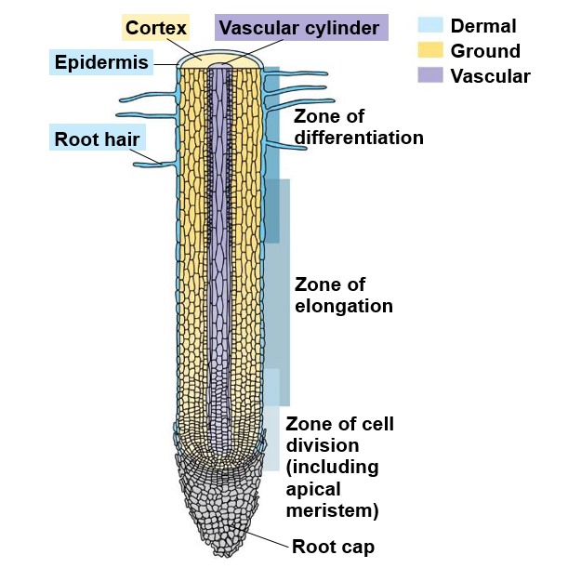
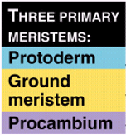
The Root System
Root cap: cells at the tip of the root that protect the apical meristem as root pushes through the soil
Root hair: thin extensions of _______ ____ that increase surface area
Root tissues:
Protoderm: gives rise to epidermis
Ground meristem: gives rise to cortex
Procambium: gives rise to stele
Xylem and phloem
Pith (Monocots)

Slide 16
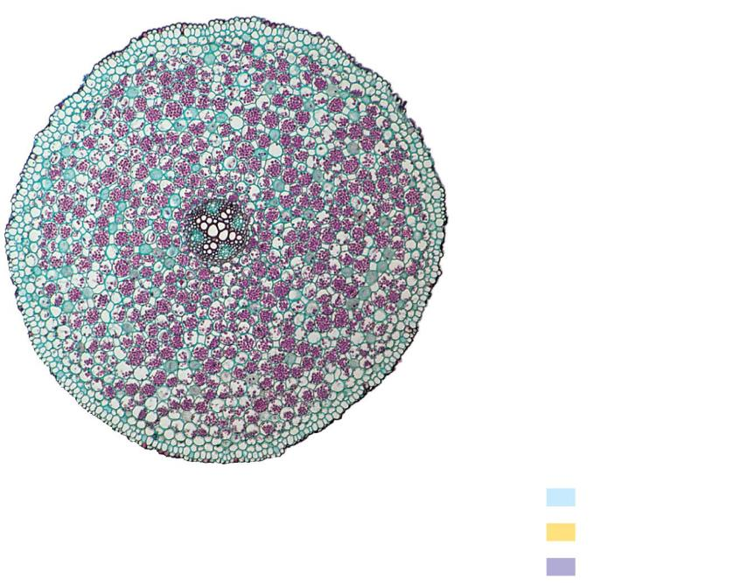
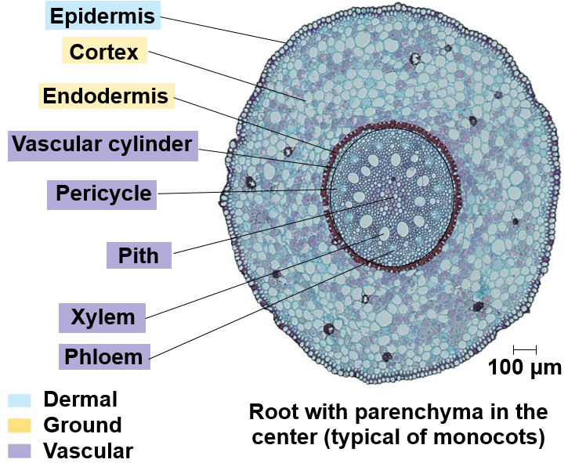
Monocot and Eudicot Root
Pericycle: Outermost cell layer of vascular cylinder
Pith: Core of parenchyma cells
Endodermis: cylinder one cell thick that forms boundary of vascular cylinder
________ Strip
Regulates water and minerals
Suberin
Passage Cells
Allow water to pass through
Dicot
Monocot

Slide 17
Monocot Roots (Inside to Outside)
Pith
Xylem
Transport water
Phloem
Transport food
Pericycle
Dividing cells
Endodermis
Casparian Strip
Passage Cells
Cortex
Storage
Epidermis
Protection

Slide 18
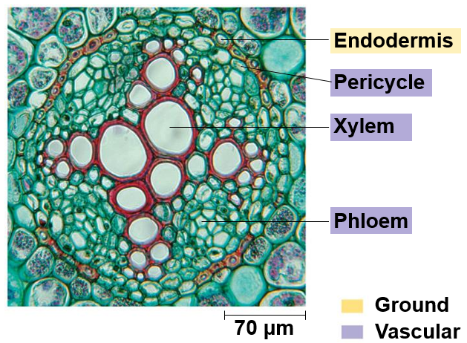
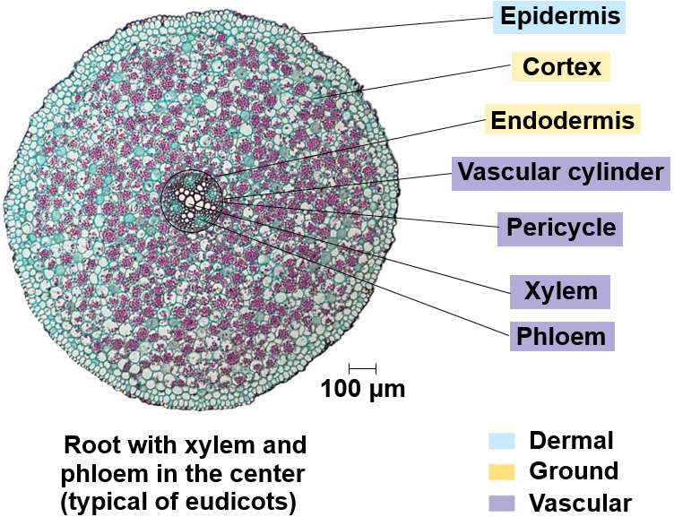
Eudicot Root (Inside to Outside)
Xylem
Transport water
Phloem
Transport food
Pericycle
Dividing cells
Endodermis
Casparian Strip
Passage Cells
Cortex
Storage
Epidermis
Protection

Slide 19
Formation of Lateral Roots
Lateral roots develop from meristematic cells of the _______

Slide 20
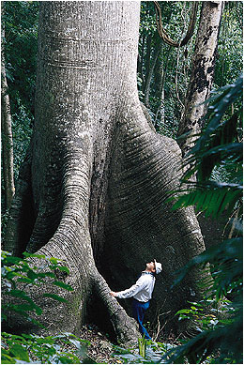
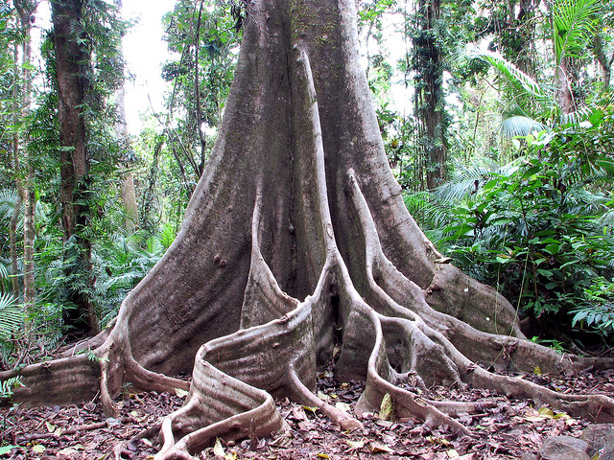
Modified Roots
________ roots: provide support to large trees with shallow root systems
Nutrient poor soil in tropics

Slide 21
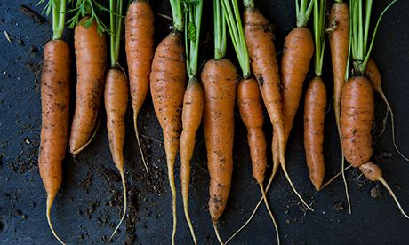
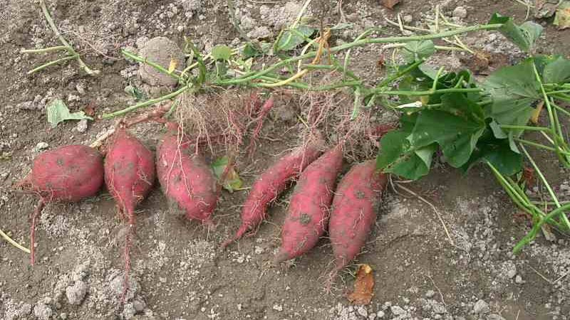
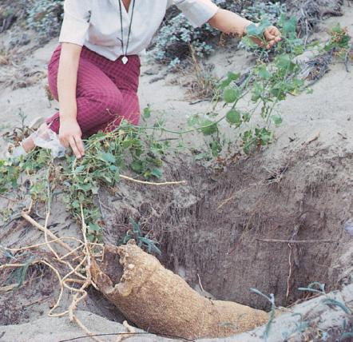
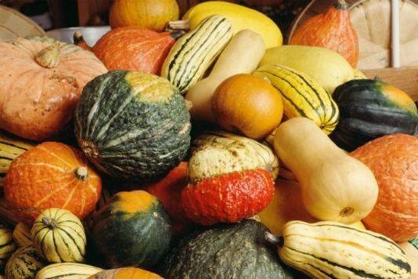
Modified Roots
Storage roots: store ______ and/or water
Food storage: sweet potatoes, radishes, beets, carrots
Water storage: pumpkin family

Slide 22
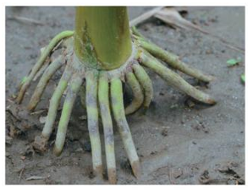
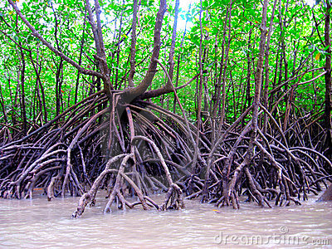
Modified Roots
Prop roots: adventitious roots (emerge from stem) and aid in supporting tall, heavy plants
Notes:
Adventitious: appearing in an abnormal or unusual position.

Slide 23
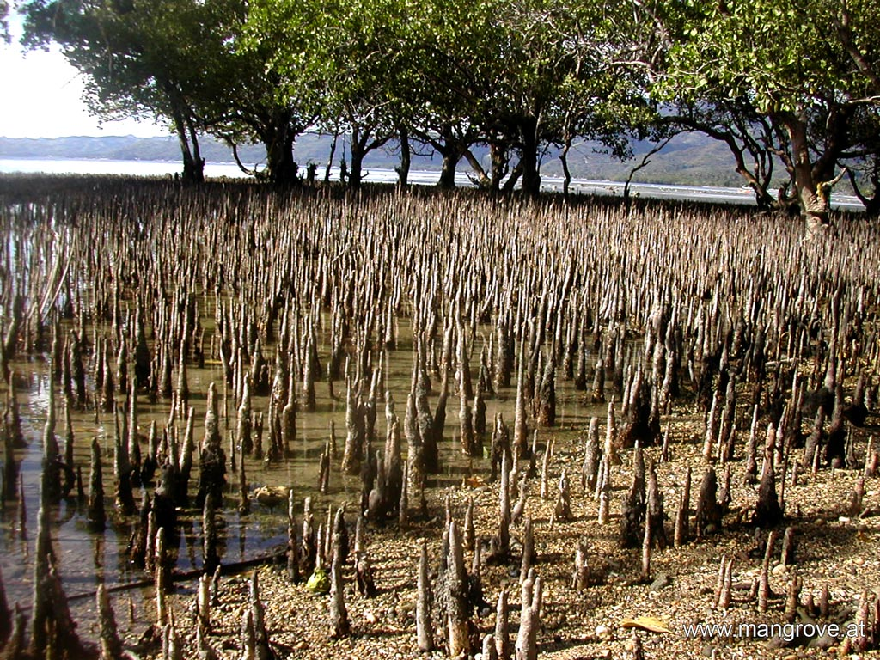
Modified Roots
Pneumatophores: roots that extend above the water allowing the roots to perform __________
Mangroves

Slide 24
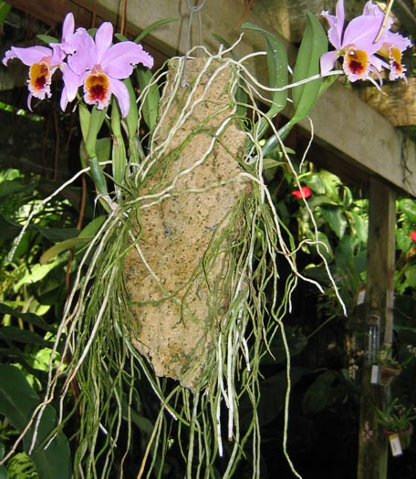
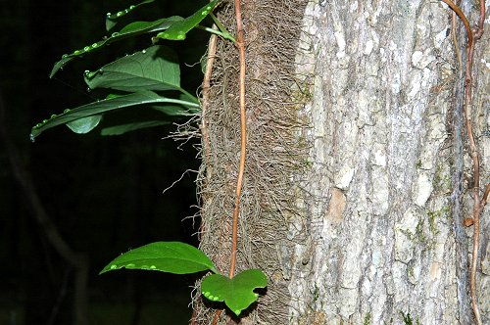
Modified Roots
Ariel roots: roots entirely above ground
Ivies and orchids

Slide 25
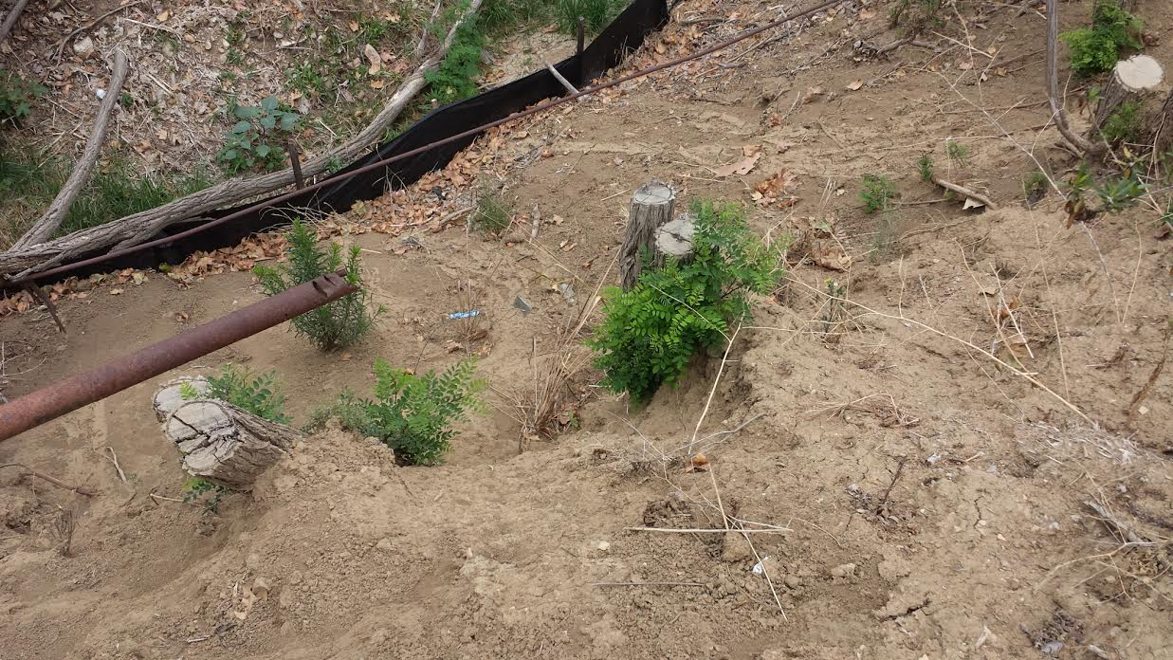
Modified Roots
____________ roots: roots that for adventitious buds that develop into above ground
Suckers

Slide 26
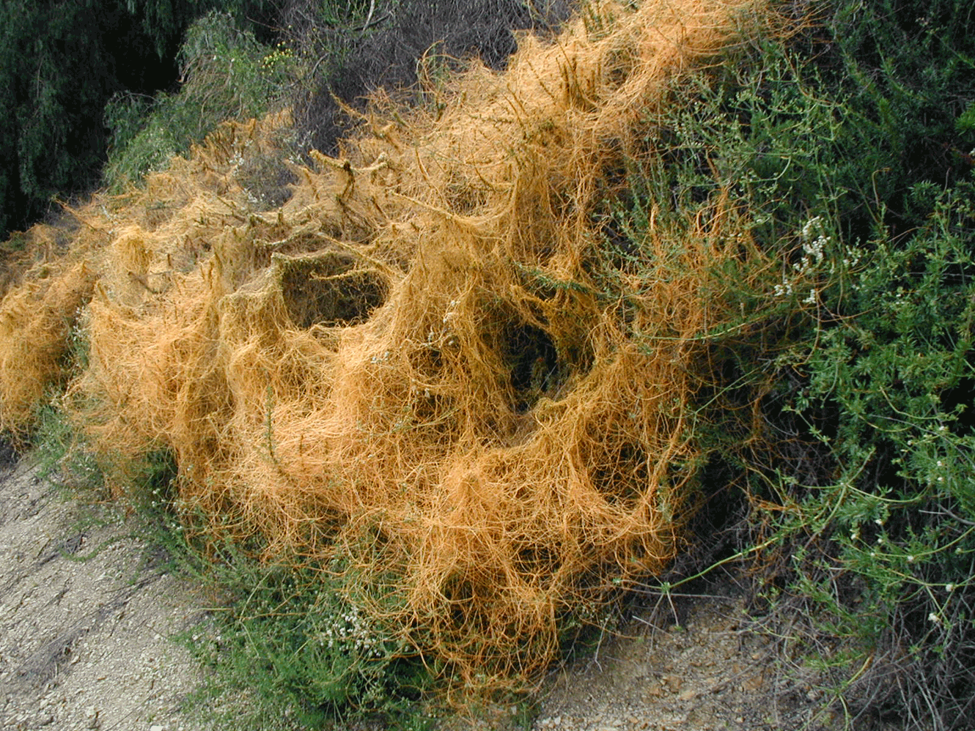
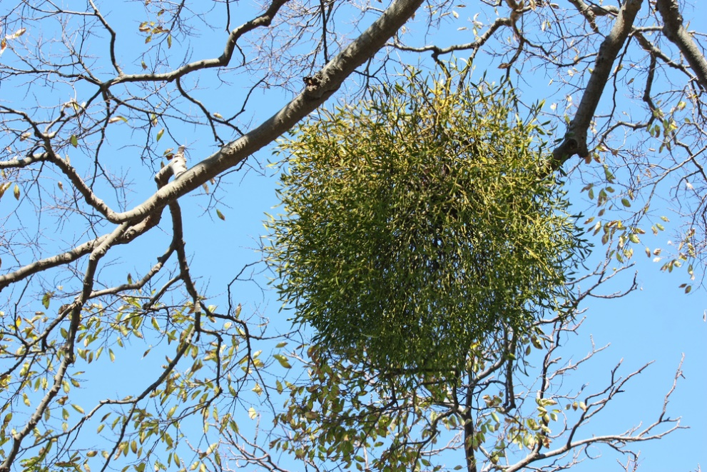
Modified Roots
Haustorial roots: roots of a ______ plant that absorb water and nutrients from host plant
Mistletoe
Dodder (Witches hair)

Slide 27
Check Your Understanding
True or False: Xylem cells are dead at maturity
True or False: Root hairs develop from the meristematic cells of the pericycle
True or False: The procambium is a meristematic tissue that produces secondary xylem and phloem, which adds girth to the plant.

Slide 28
Check Your Understanding
Which of the following cells have rigid secondary cell walls and act as support cells?
a. Collenchyma cells
b. Sclerenchyma cells
c. Parenchyma cells
d. Periderm cells

Slide 29
Check Your Understanding
Which of the following cells lack a nucleus and ribosomes?
a. Companion cells
b. Sieve-tube elements
c. Tracheids
d. Vessel elements

Slide 30
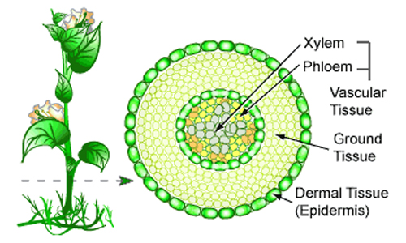
The Shoot System
Protoderm - gives rise to the epidermis
Procambium - gives rise to the stele
Vascular bundles of xylem and phloem
Eudicots - found in ring
Pith
Monocots - scattered throughout
Ground Meristem
Cortex

Slide 31
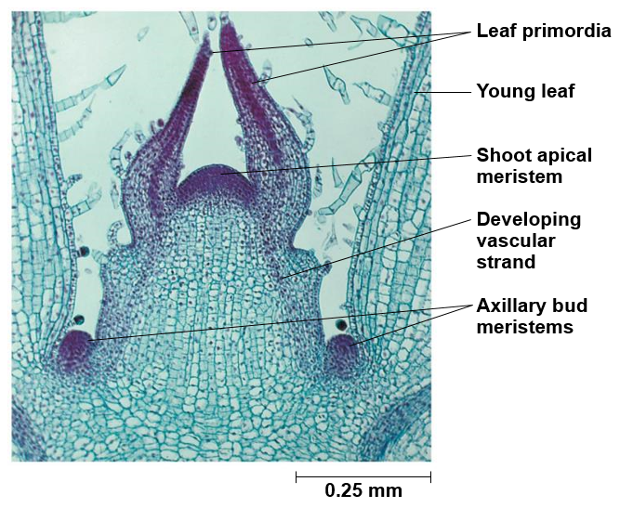
Shoot Growth
______ bud: growing shoot tip
Leaf primordia: developing leaves
________ bud: embryonic stem at base of petiole that contains meristematic cells
Develop into branches, thorns or flowers
Hormone controlled

Slide 32
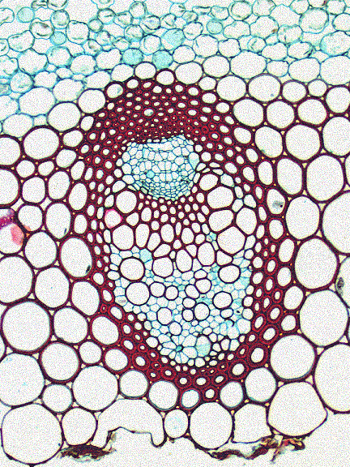
Vascular Bundles
Region of concentrated vascular tissue
Phloem (outside)
Sieve-tube members
Companion cells
Xylem (inside)
Vessel elements
Tracheids
Phloem
Companion cells
Sieve-tube elements
Vessel elements
Xylem
Tracheids

Slide 33
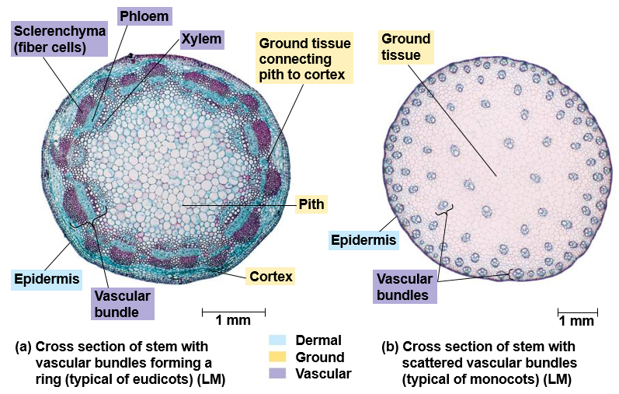
Monocot and Eudicot Stems

Slide 34
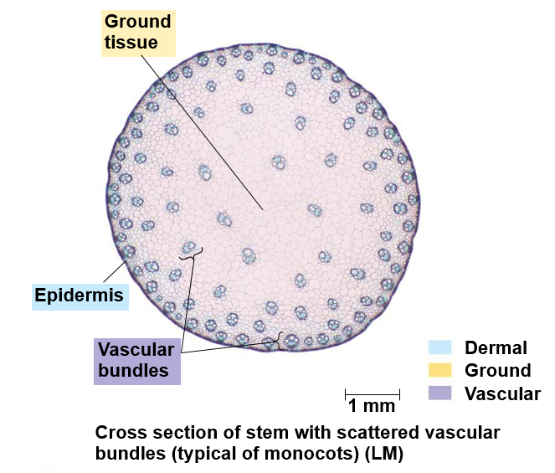
Monocot (Inside to Outside)
Ground Tissue
Vascular Bundles
Xylem
Phloem
Fibers
Cortex
Epidermis

Slide 35
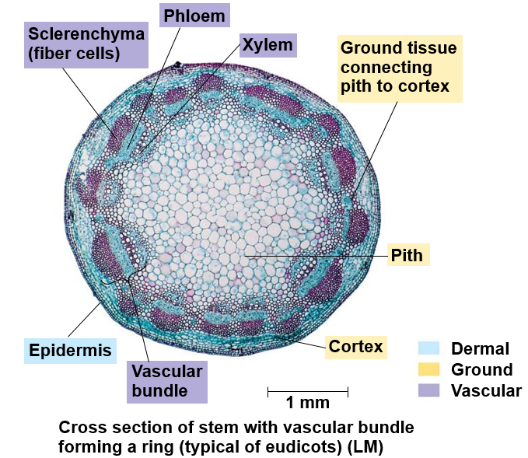
Eudicot (Inside to Outside)
Pith
Vascular Bundles
Xylem
Phloem
Fibers
Cortex
Epidermis

Slide 36
Secondary Growth in Stems
Increase in thickness by the lateral meristems.
Primarily Gymnosperms and Eudicots
Vascular cambium: produces secondary xylem and phloem
Cork cambium: replaces epidermis with tough periderm
Cork
Phelloderm

Slide 37
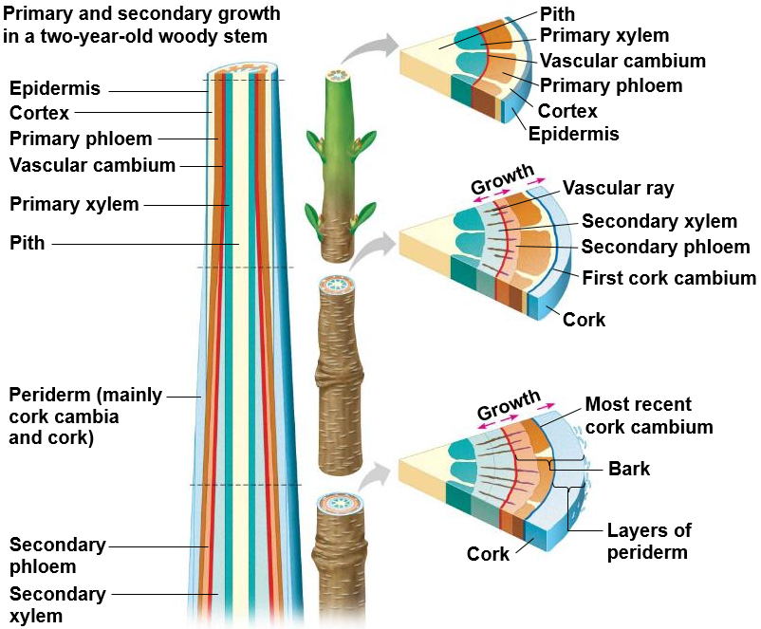
Secondary Growth in Stems
1.
Primary growth is completed and the vascular cambium has been formed
Vascular cambium forms secondary xylem (inside) and secondary phloem (outside). Cork cambium produces cork cells to replace ___________ _______________.
During second year of lateral growth cork cambium re-forms deeper in cortex. Cork cambium and cork form layer of _______.
2.
3.

Slide 38
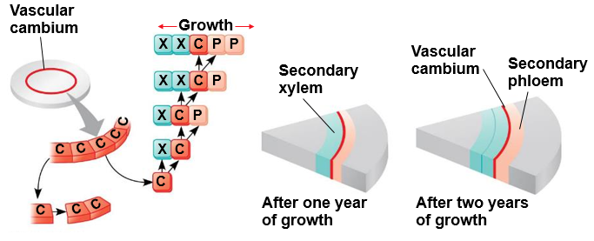
Sequence of Secondary Growth
Vascular cambium cells divide, increasing diameter of root or stem
Cambial initial cells [C] can divide to form another cambial cell and a xylem [X] or phloem cell [P]

Slide 39
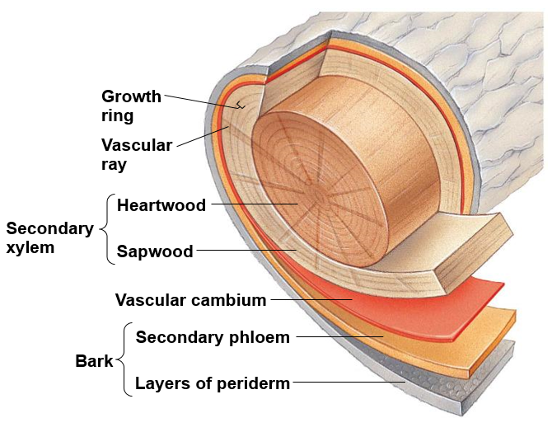
Modified Stems
Heartwood: older secondary xylem cells that no longer transport water of minerals
Sapwood: newer secondary xylem that transports water and minerals (sap)

Slide 40
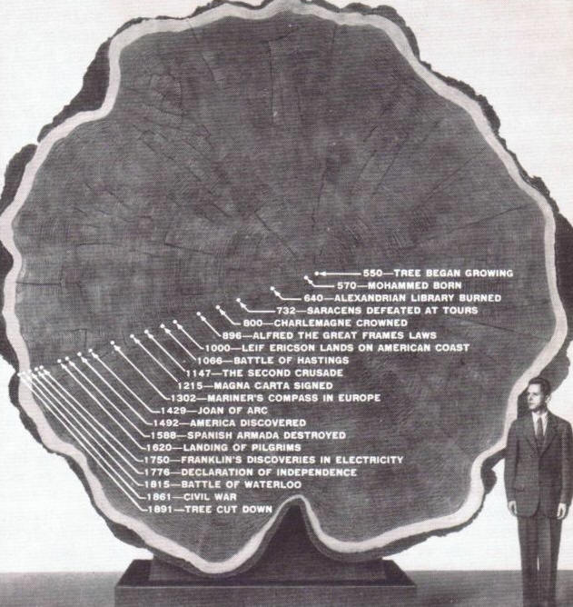
Dendrochronology
Notes:
Dendrochronology = tree ring dating using growth rings

Slide 41
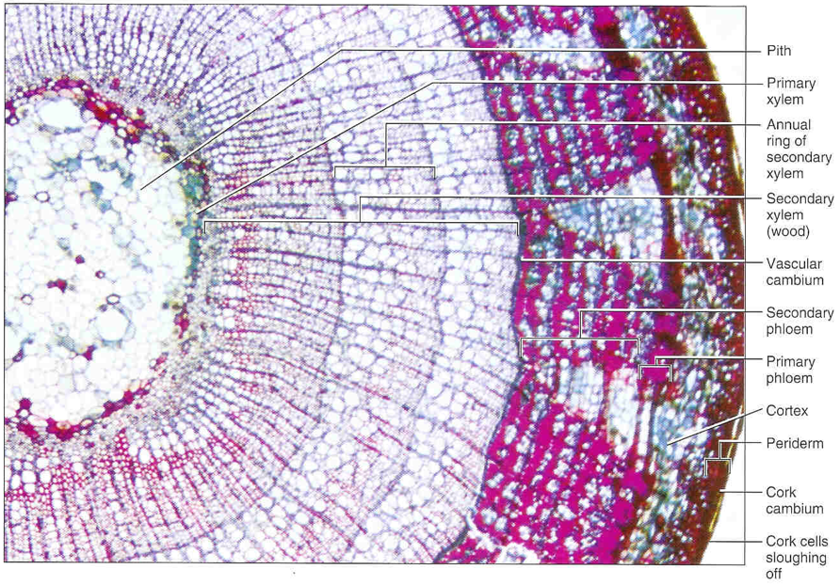
Secondary Growth of Stem (Inside to Outside)
Pith
Primary Xylem
Secondary Xylem (wood)
Vascular Cambium
Secondary Phloem
Primary Phloem
Cortex
Phelloderm
Cork Cambium
Cork

Slide 42
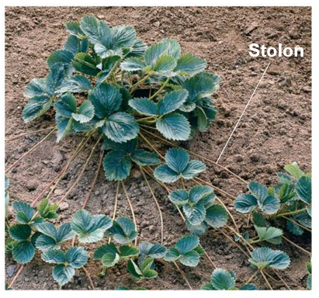
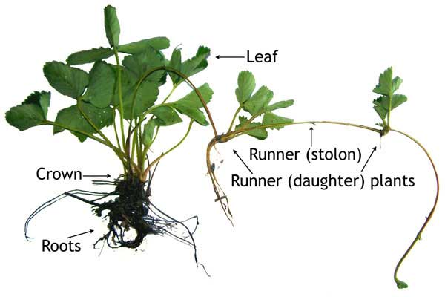
Modified Stems
Stolons: horizontal shoots that grow along the surface
______ reproduction trough plantlets

Slide 43
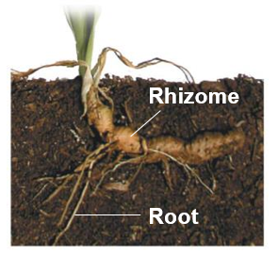
Modified Stems
_________: horizontal shoot that grows just below the surface
Vertical shoots arise from axillary buds

Slide 44
Modified Stems
Tubers: enlarged ends of rhizomes or stolons that are specialized in _________
Potatoes

Slide 45
Modified Stems
Cladophylls: flattened leaf-like stem
____________
Cactus

Slide 46
Types of Leaves
Palmate
Notes:
Axillary bud: can form a lateral branch, thorn or flower.

Slide 47
Tissue Systems in a Leaf

Slide 48
Leaf Structure
Epidermis
Stomata - openings on underside of leaf
Guard Cells - surround stomata
________ - waxy coating excreted by epidermis
Mesophyll - middle of leaf
Palisade layer - photosynthesis
Spongy layer - gas exchange
Notes:
Mesophyll: paraenchyma cells specialized for photosynthesis
Leaf veins bring vascular tissue into the leaf where photosynthesis takes place.
Bundle sheath cells regulate transport between mesophyll cells and vascular tissue

Slide 49
Modified Leaves
Needles: long thin leaves often in clusters
Reduced __________
Reduced water loss
_______ stomata

Slide 50
Modified Leaves
________: long, thin leaves that cling to other plants or structures

Slide 51
Modified Leaves
Spines: ______________ structures modified for protection against herbivory

Slide 52
Modified Leaves
Storage leaves: fleshy leaves atop a short stem that act as food storage
____
Onions
Garlic

Slide 53
Modified Leaves
Succulent leaves: thick leaves modified for ___________

Slide 54
Check Your Understanding
True or False: Heartwood is comprised of dead cells that no longer transport water or minerals.
True or False: The vascular bundles are arranged in a ring within a eudicot stem
True or False: Secondary xylem grow on the outside of the vascular cambium and secondary phloem grows on the inside of the vascular cambium

Slide 55
Check Your Understanding
Which of the following stem types are involved in the asexual reproduction of the plant?
a. Stolons
b. Cladophylls
c. Rhizomes
d. Tubers

Slide 56
Check Your Understanding
Describe the process of secondary growth in stems.

