Slide 1
Plant Diversity I
“Man is the most insane species. He worships an invisible God and destroys a visible Nature. Unaware that this Nature he’s destroying is this God he’s worshipping.”
— Hubert Reeves
Chapter 29

Slide 2
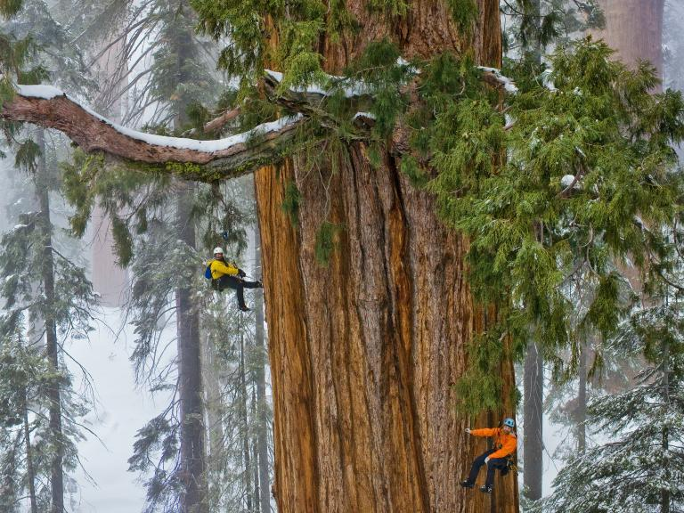
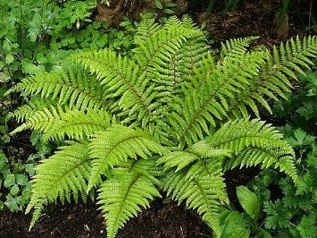
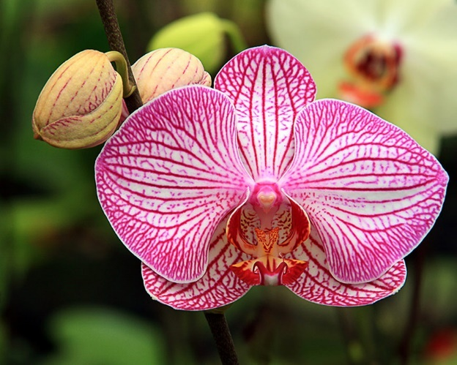
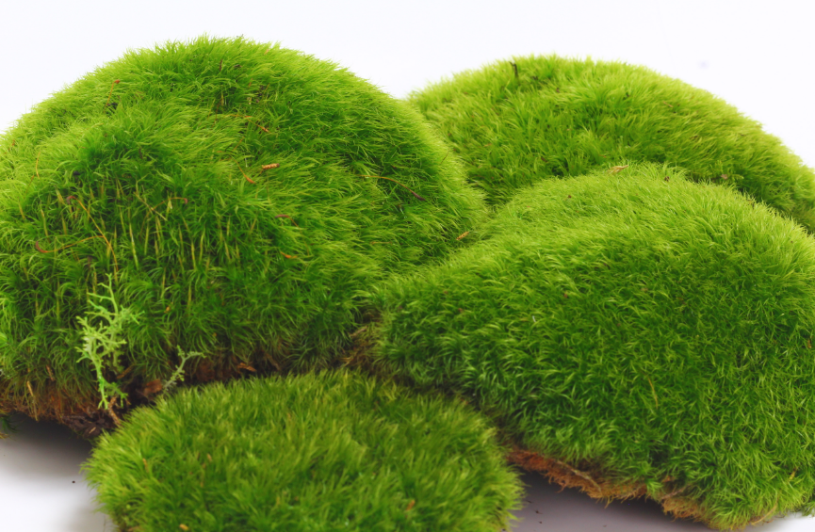
Introduction to Plants
Multicellular, eukaryotic, photosynthetic autotrophs
Cell walls made of cellulose
More than 290,000 species described
Plants colonized land ~ 475 mya during Ordovician
Evolved from green algae (Charophytes)
Notes:
The colonization of land by plants allowed other life-forms to exist on land. Some factors that may have movement of photosynthetic organisms (green algae) onto land include unfiltered light, greater CO2 concentration in the atmosphere, and nutrient rich soil.

Slide 3
Derived Traits of Land Plants
Alternation of generations
Multicellular, dependent embryos
Spores with protective walls
Multicellular gametangia (organs that produce gametes)
Apical meristem

Slide 4
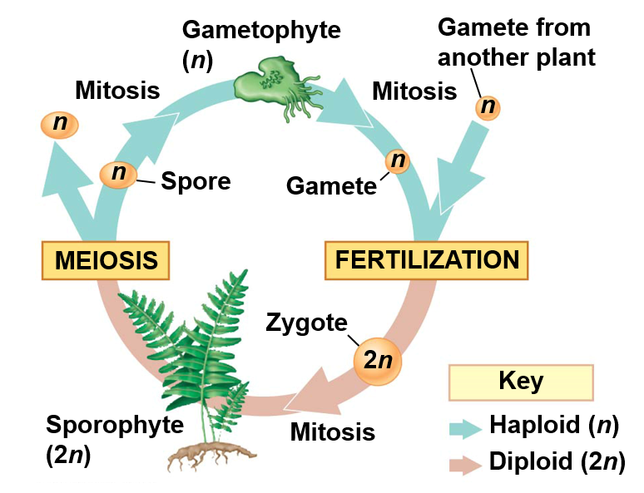

Alternation of Generation
Life cycle alternates between multicellular haploid gametophytes and multicellular diploid sporophytes
Gametophyte produces haploid gametes by mitosis
Two gametes unite to form diploid zygote
Zygote develops into multicellular Sporophyte
Sporophyte produces unicellular haploid spores by meiosis
Spores develop into multicellular haploid Gametophyte
1.
5.
2.
4.
3.
Notes:
Audio transcript: The process of alternation of generation is an odd concept to think about because it is very different from our own development. In plants, a multicellular structure called a gametophyte produces gametes, egg or sperm, through mitosis. In animals, gametes are produced through meiosis. Once the egg and sperm of the different gametophytes fuse together during fertilization, they form a zygote. The zygote then grows through mitosis to form a multicellular, diploid structure called a sporophyte. The mature sporophyte produces spores through meiosis. Spores are haploid cells that grow through mitosis to form the multicellular, haploid gametophyte, and the cycle continues.
Key points:
Both haploid and diploid generations are multicellular
Meiosis occurs during spore production not gamete production
Gametophyte produce gametes
Sporophytes produce spores

Slide 5
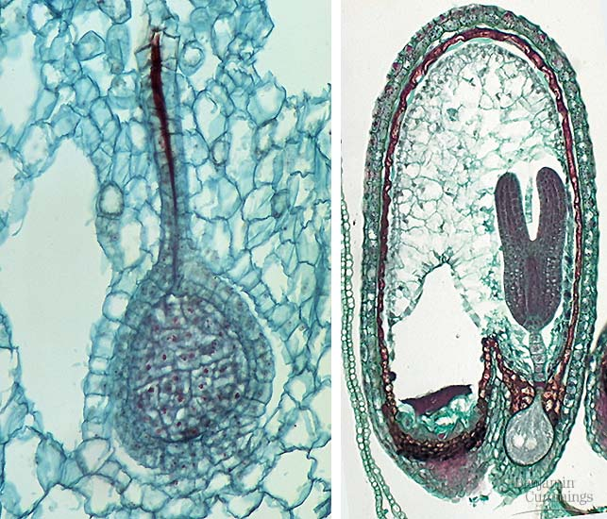
Multicellular, Dependent Embryos
Diploid embryo retained within tissue of female gametophyte
  Embryophytes
Nutrients are transferred from parental tissues to embryo through specialized placental transfer cells
Embryo
Maternal tissue
Notes:
When the zygote grows it is retained within the female gametophyte, and the gametophyte provides the developing zygote with nutrients though the placental transfer cells.

Slide 6
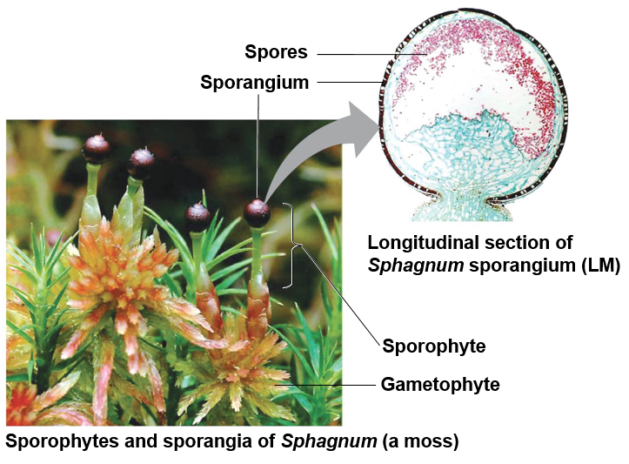
Spores with Protective Walls
Spore: a haploid cell that divides by mitosis to form a multicellular gametophyte
Sporangia: multicellular, spore producing organs on sporophyte
  Sporopollenin: polymer in walls of plant spores that makes them tough and resistant to harsh conditions
Notes:
Sporopollenin: tough outer walls of spores and pollen grains.
Well preserved in soils and sediments.
Often used in determine plant and fungal populations in the past

Slide 7
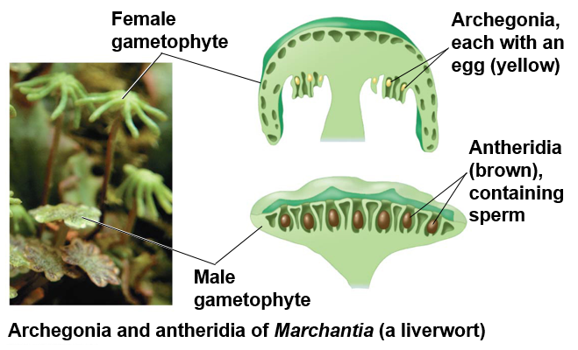
Multicellular Gametangia
Gametangia: multicellular organs that produce gametes
Archegonia = female
  Produces single egg retained within archegonia
Antheridia = male
  Produces many sperm that are released into the environment
Notes:
Audio transcript: Like the sporangia that produce spores in the sporophyte, the gametophytes have structures known and gametangia that produce the gametes. Archegonia produce eggs, which is usually retained within the gametophyte, and antheridia produce sperm, which leaves the gametophyte to fertilize the egg within the female gametophyte.

Slide 8
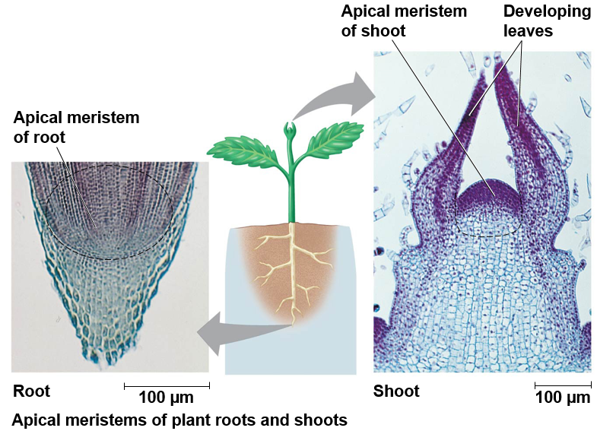
Apical Meristem
Apical meristem: localized regions of cell division at the tips of roots and shoots
Regions of plant growth
Notes:
Plants grow at the tips of their shoots and roots in areas known as the apical meristem. Cells go through mitosis in the apical meristem, then the cells elongate causing plant growth.

Slide 9
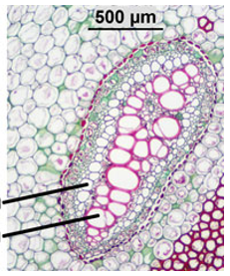
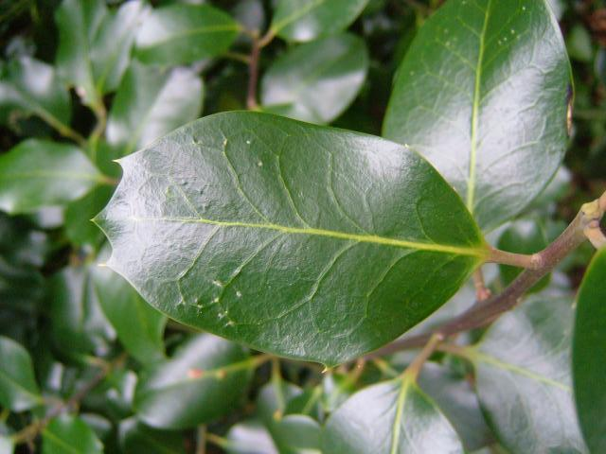
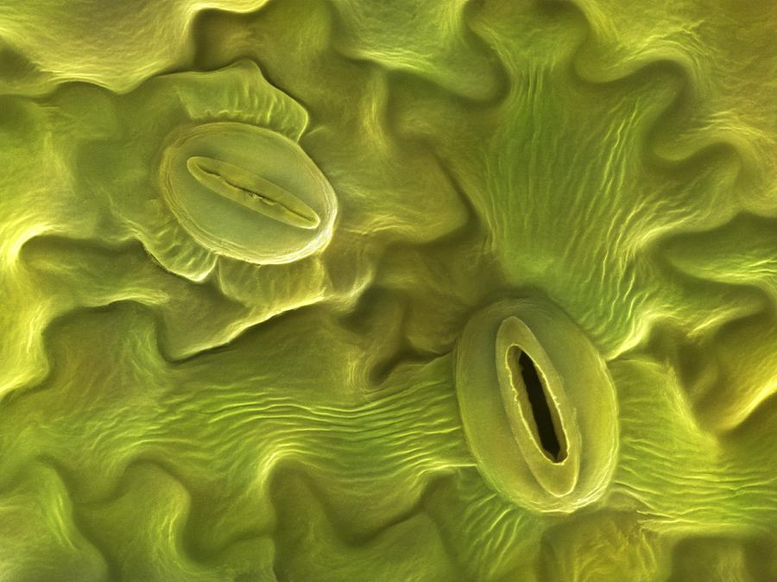
Adaptations for Terrestrial Life
Vascular tissue: tubes made of cells that transport water and nutrients throughout the plant
  Xylem: water transport
  Phloem: nutrient transport
Cuticle: waxy covering on the epidermis of many plant species
Stomata: specialized pores that allow the exchange gases and between the outside air and the plant
Phloem
Xylem
Notes:
These adaptations for life on land are found in most but not all terrestrial plants.

Slide 10
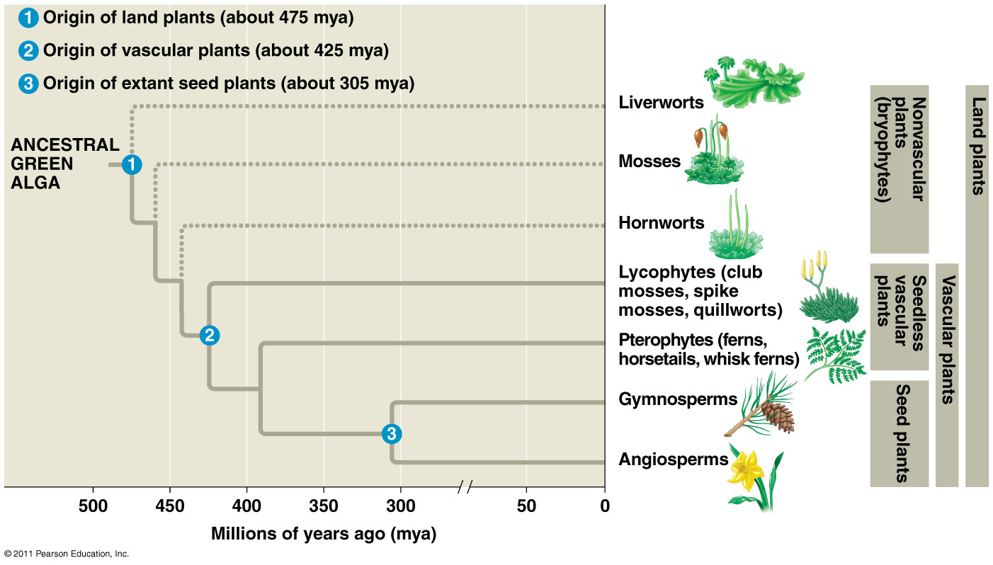
Plant Evolution
Vascular tissue
Flowers
Seeds
Notes:
We will learn the different plant divisions (phyla) in this lecture and the next. One of your possible essay questions is to draw the plant phylogeny and include the locations for the evolution of vascular tissue, seeds, and flowers.

Slide 11
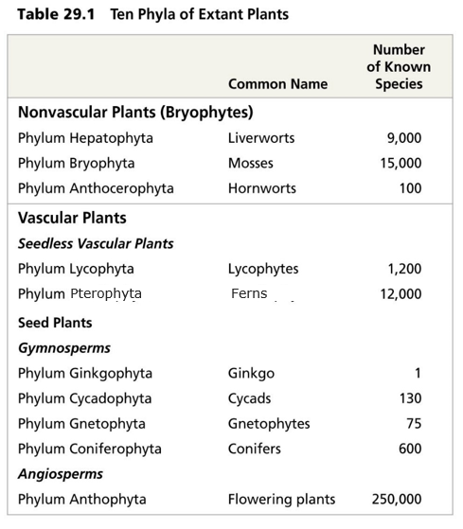
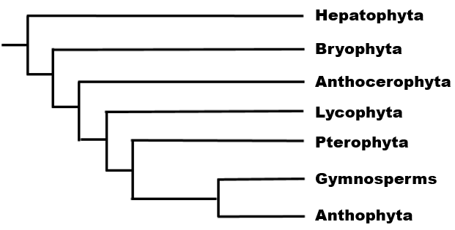
Plant Phyla (Divisions)
Notes:
Phylum (phyla) = Divisions
Nonvascular plants = bryophytes (not monophyletic group or clade)
Gymnosperms = naked seeds
Nearly 90% of all living plants are Angiosperms

Slide 12
Classification of Seedless Plants
Nonvascular, Seedless Plants
  Bryophyta
    Mosses
  Hepatophyta
    Liverworts
  Anthocerophyta
    Hornworts
Vascular, Seedless plants
  Lycophyta
    Club mosses
  Psilophyta
    Whiskferns
  Spenophyta
    Horsetails
  Pterophyta
    Ferns

Slide 13
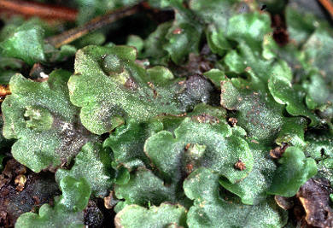
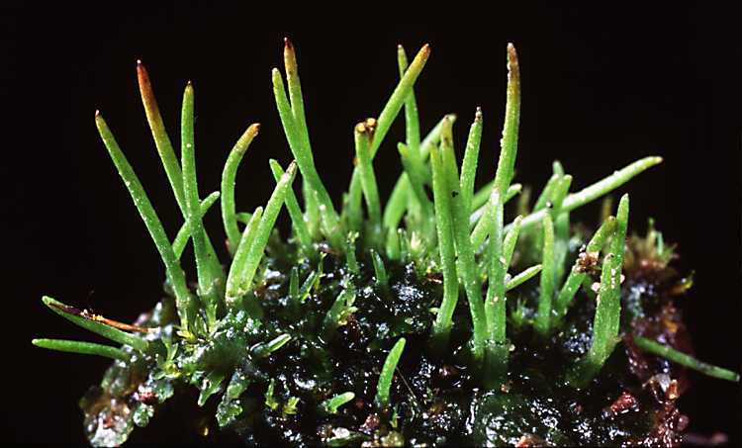
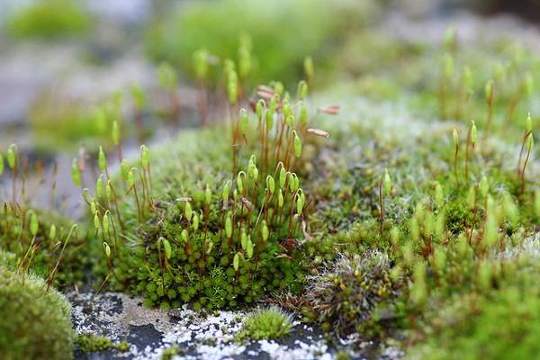
Characteristics of Seedless, Non-vascular Plants
Gametophyte generation dominant
No true leaves, stems or roots
  Rhizoids: tubular or filamentous cells that anchor the thallus
  Thallus: flat vegetative body lacking vascular tissue
Flagellated sperm
Notes:
Audio transcript: In non-vascular, seedless plant, the gametophyte generation is the structure that we see, and in known as the thallus. The sporophyte is much smaller and retained within the female gametophyte. The term true leaves, roots, and stems refers to the presence of vascular tissue. Vascular tissue, which includes xylem and phloem, evolved after these plants diverged from the lineage that became the vascular plants. Non-vascular seedless plants often have rhizoids, which are like roots in that the help anchor the plant, but unlike roots the rhizoids don’t transport water.
Flagellated sperm requires damp or wet environments for fertilization. Sperm need water to swim from antheridia to archegonia.

Slide 14
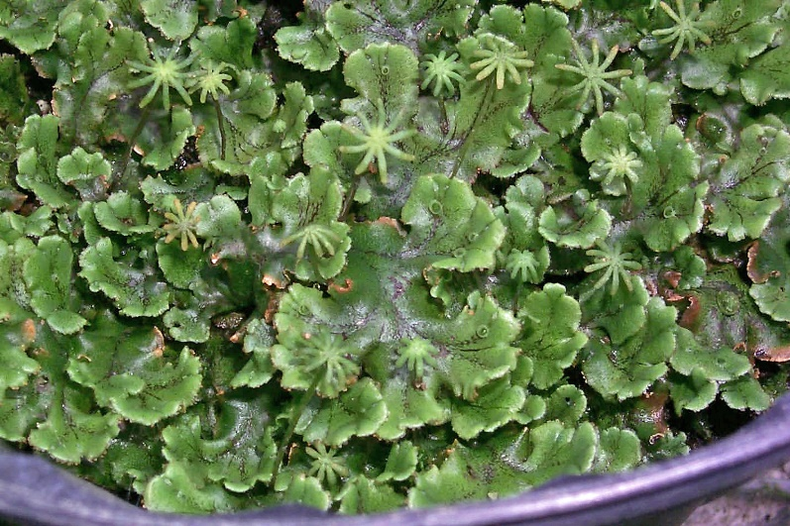
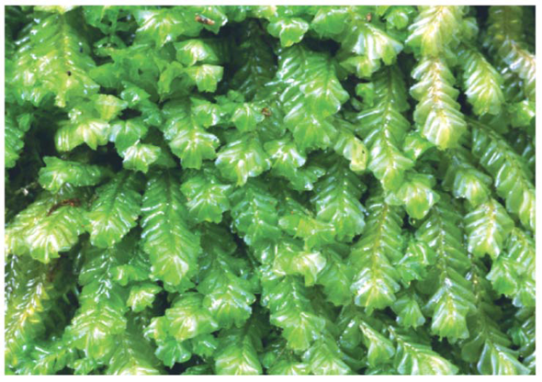
Phylum Hepatophyta
Liverworts
Name refers to the liver shaped gametophyte
  Hepaticus = liver
Gametophyte dominant
No true leaves, roots or stems
  Rhizoids
Two forms
  Leafy (80%)
  Thalloid (20%)

Slide 15
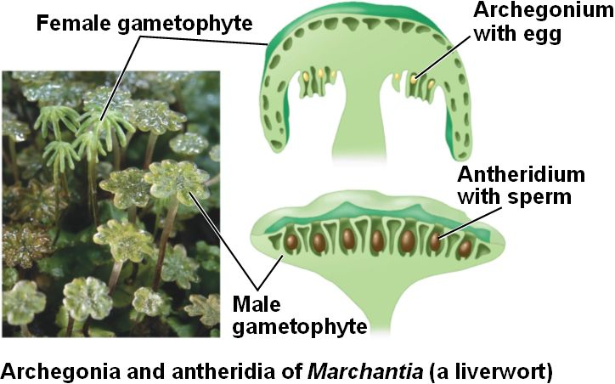
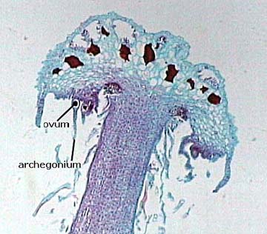
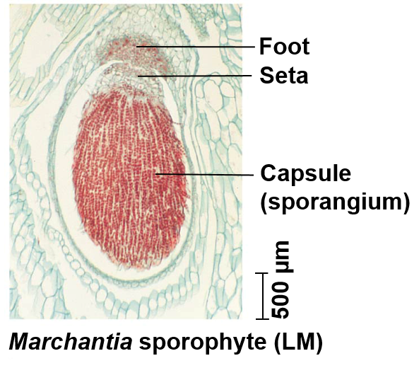
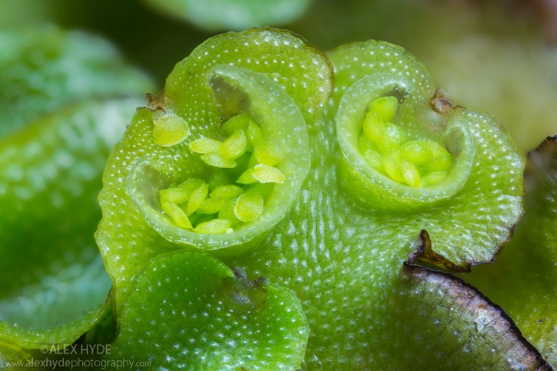
Hepatophyta Reproduction
Reproduction
Sexual
  Sporophyte develops on female gametophyte
Asexual
  Gemmae cups
Sporophyte
Notes:
Gemmae cups contain small gametophytes

Slide 16
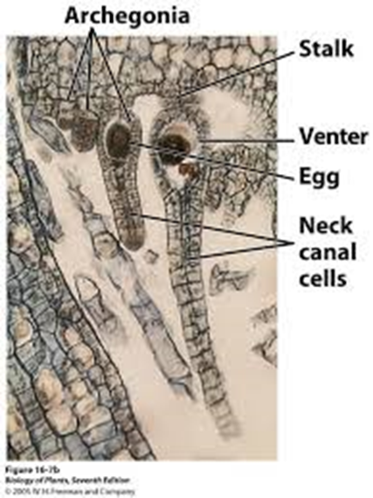
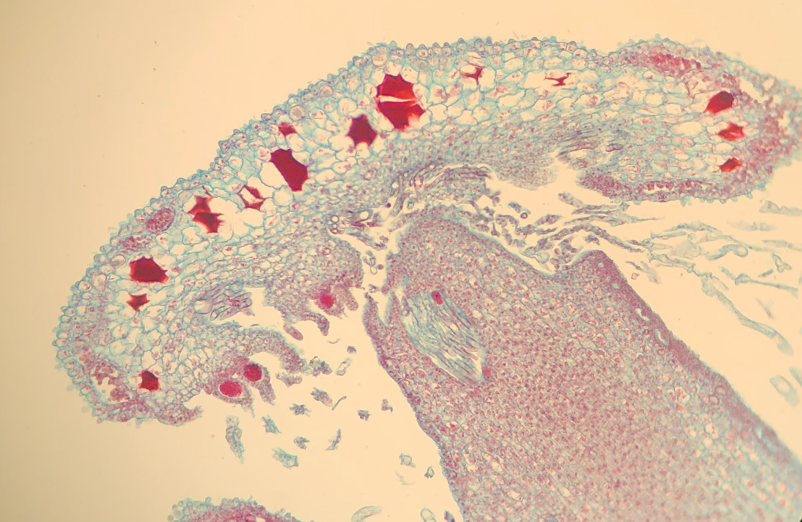
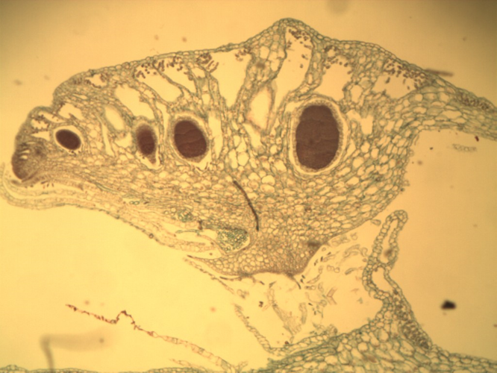

Sporophyte
Notes:
Audio transcript: One of the important connections to make when studying the plant structures in lab is where they belong in the different plant life cycles. I’ve tried to direct you through the images on some of slides in the plant lecture powerpoints to show you how the different structures fit into the different life cycles. In our non-vascular seedless plants like liverworts and mosses, the gametophyte is the structure we see. The image in the top left shows the actual male and female gametophyte then a drawing of a cross section of those structures. I’ve included the labs images of those cross sections so that you can see the antheridia and archegonia within the gametophytes. When the sperm is released from the antheridia in the male gametophyte is swims up the neck of the female archegonia to fertilize the egg. Once the egg is fertilized it develops into the diploid sporophyte which hangs down from the female gametophyte, which is shown in the image on the next slide. In nonvascular plants the sporophyte is dependent on the female gametophyte. We see this again in the moss life cycle.

Slide 17
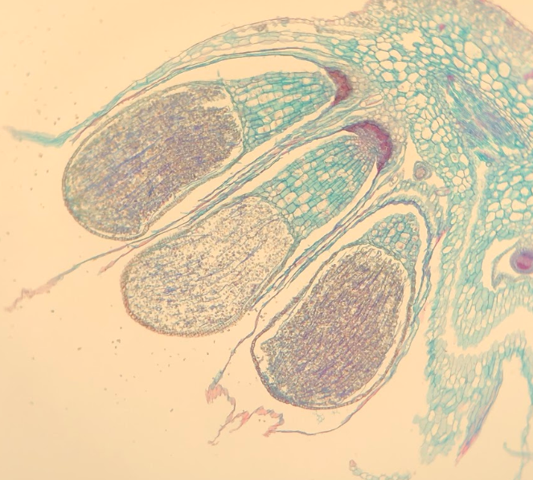
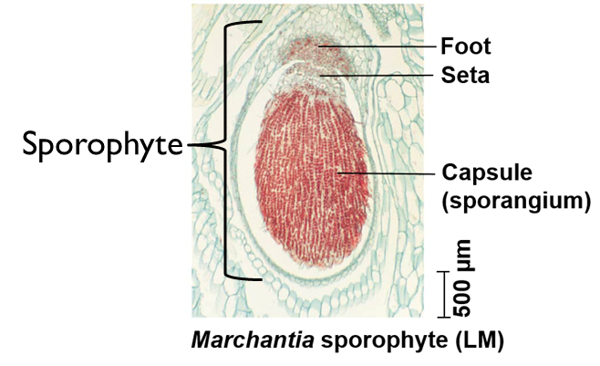
Parts of a Mature Liverwort Sporophyte
Foot: absorbs nutrients from gametophyte
Seta: stalk that conducts nutrients to capsule (sporangium)
Capsule: produces haploid spores via meiosis
  Up to 50 million spores/capsule
Notes:
Liverwort sporophyte

Slide 18
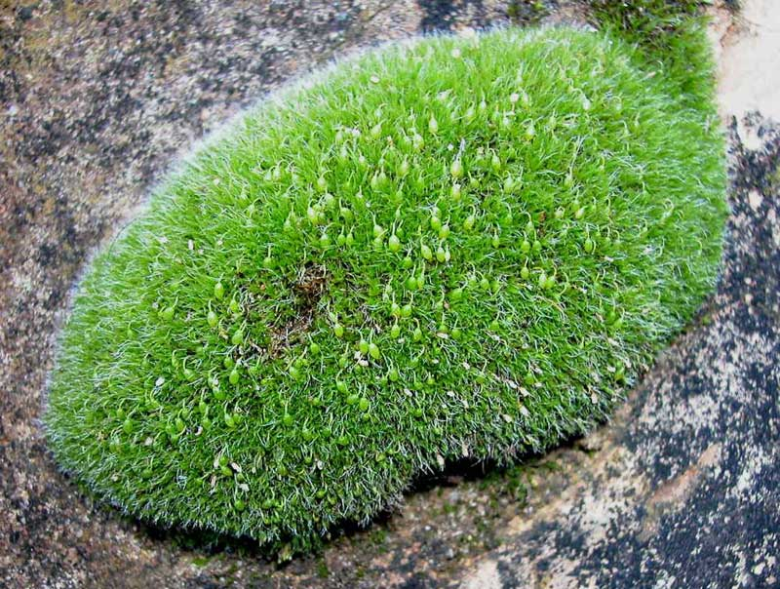
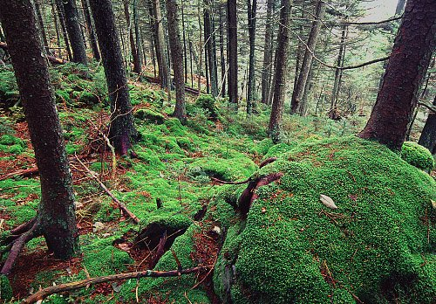
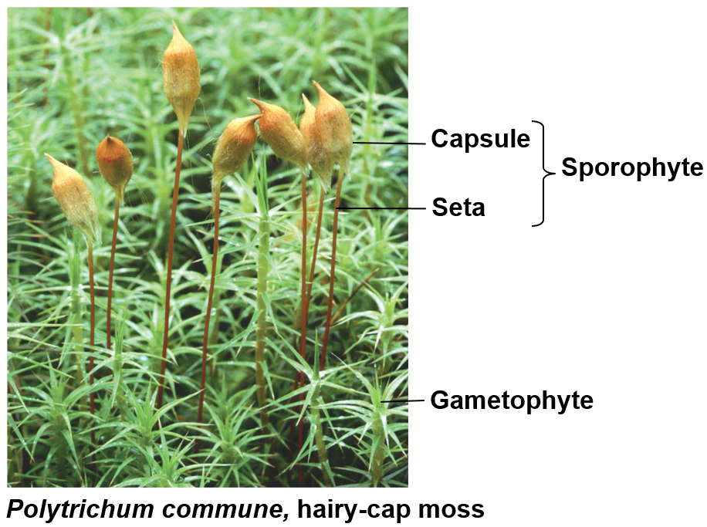
Phylum Bryophyta
Mosses
Gametophyte dominant
No true leave, roots, or stems
  Lack vascular tissue
Traits similar to more derived plants
  Stomata
  Cuticle

Slide 19
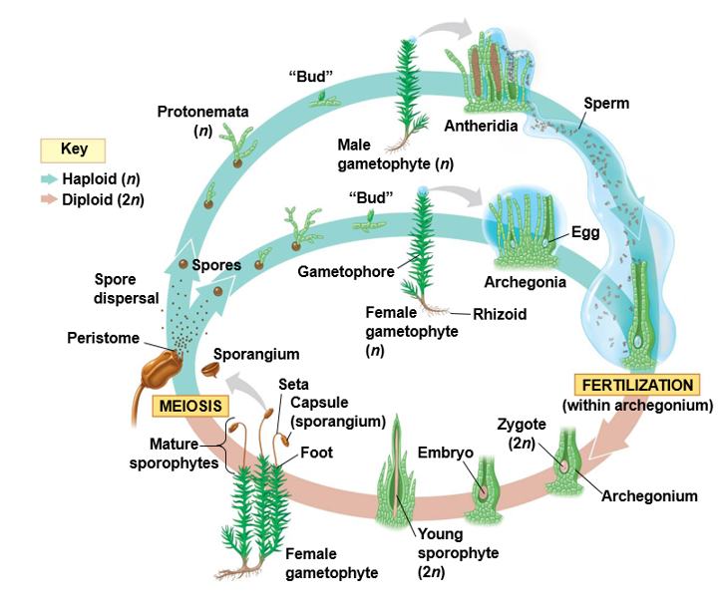
Bryophyte Life Cycle
Sexual Reproduction
Protonema: one-cell thick filaments grown from germinated moss spore
  Mature gametophyte grows from protonema
Sporophyte dependent on female gametophyte
  Foot
  Seta
  Capsule
  Peristome
Asexual Reproduction
  Brood bodies
Notes:
You need to know the plant life cycles for your second exam. Make sure you know which structures are haploid and which ones a diploid.
Bryophyte: general term for all non-vascular plants
Flagellated sperm swim to egg within female archegonia
Foot: absorbs nutrients from gametophyte
Seta: stalk that conducts nutrients to capsule (sporangium)
Capsule: produces haploid spores via meiosis (up to 50 million spores/capsule)
Peristome: interlocking, tooth-like structures on top of capsule that opens and closes in response to wet or dry conditions

Slide 20
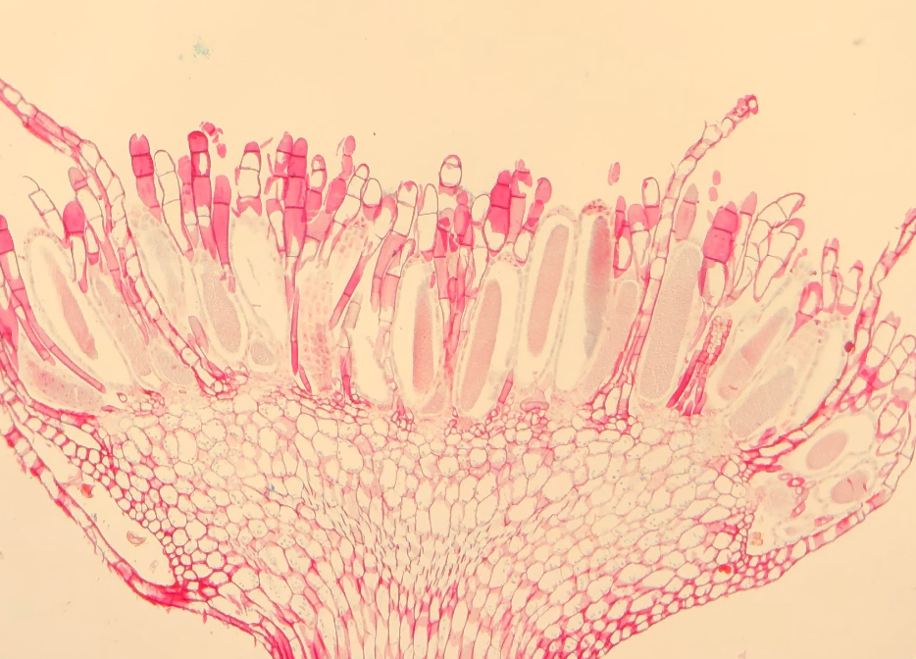
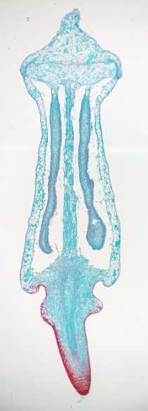
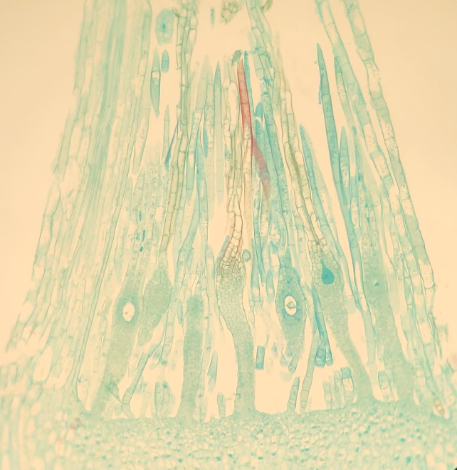
Paraphyses
Sterile jacket cells
Antheridia
Operculum (2n)
Paraphyses
Spores (n)
Neck
Columella (2n)
Archegonia
Egg
Venter
Notes:
Audio transcript: In mosses the antheridia and archegonia are located at the top of the male and female gametophytes. Sperm released from the antheridia swims down the neck of the archegonia to fertilize the egg. Once the egg is fertilized the sporophyte begins to grow out of the female gametophyte. The capsule of the sporophyte at the end of the stalk or seta is where the spores are produced through meiosis. The columella and operculum are part of the sporophyte, so they are diploid, whereas the spores are haploid. Once mature the operculum at the top of the capsule will open releasing the spores.

Slide 21
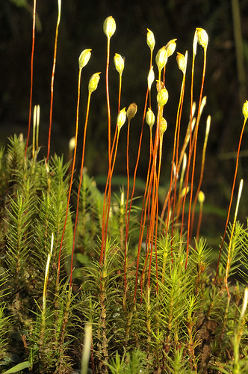
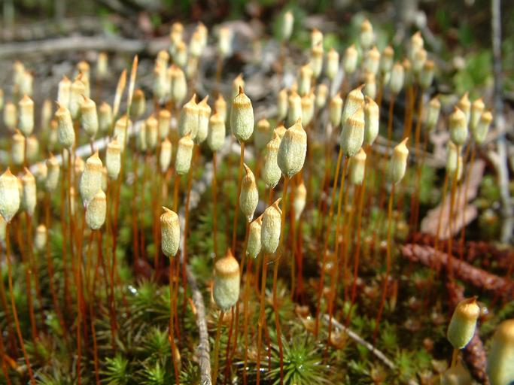
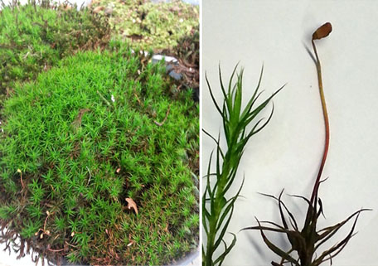
Male Gametophyte (n)
More sporophytes growing out of the female gametophytes
Capsule of sporophyte (2n)
Female Gametophyte (n) with sporophyte growing out of it.

Slide 22
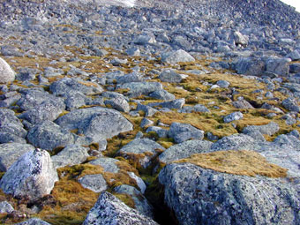
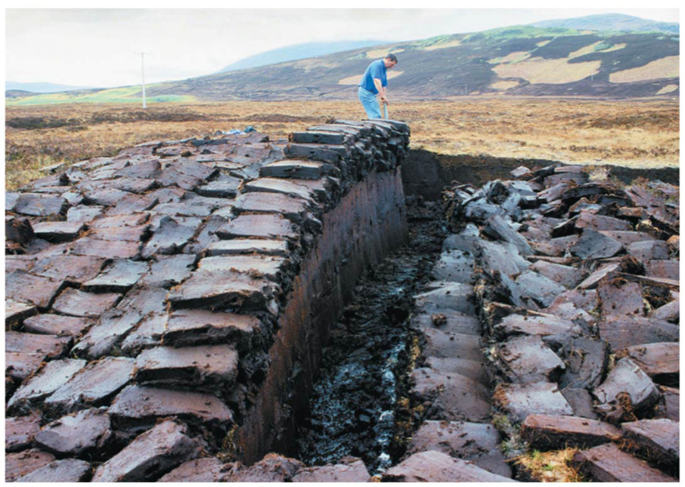
Ecological Importance of Bryophytes
Colonize harsh environments
  Adaptations for harsh conditions
    Desiccation
    UV exposure
  Symbiotic relationship with Cyanobacteria
    Nitrogen fixation
Peet moss used as fuel source
  Phenolic compounds
  Carbon sink
Notes:
Phenolic compounds aid in UV absorption and delay decay in peatlands

Slide 23
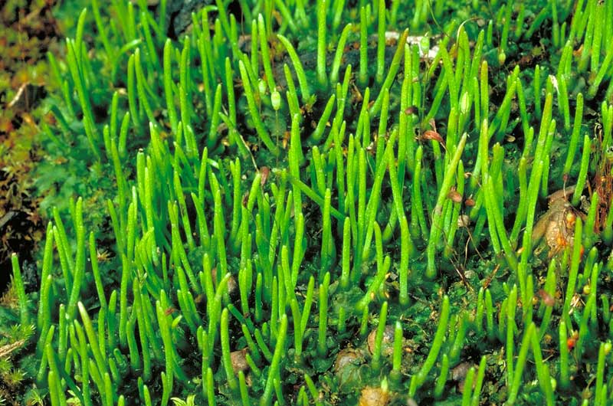
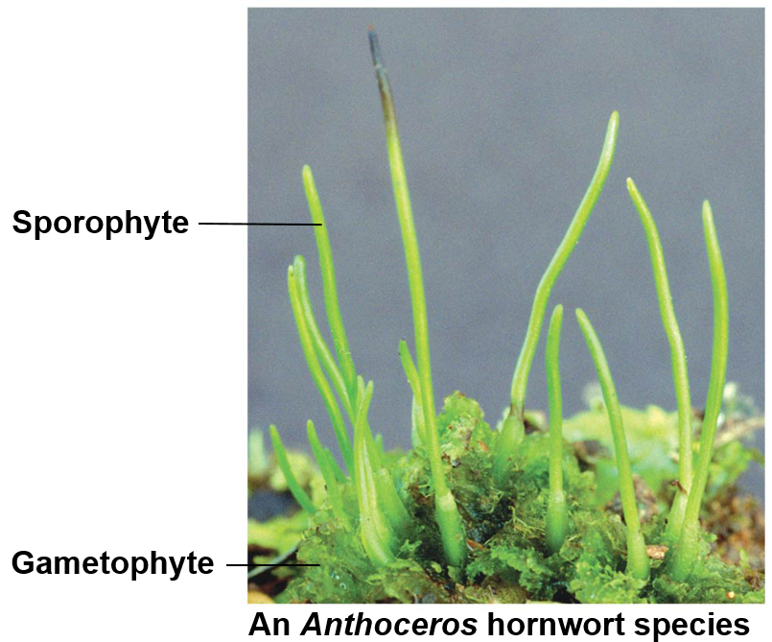
Phylum Anthecerophyta
Hornworts
Gametophyte dominant
No true leave, roots, or stems
  Lack vascular tissue
Traits similar to more derived plants
  Stomata
  Cuticle
Sporophyte lack seta
Symbiotic relationship with nitrogen-fixing cyanobacteria
Notes:
Symbiotic relationship with nitrogen fixing cyanobacteria allows them to colonize open areas with moist soils

Slide 24
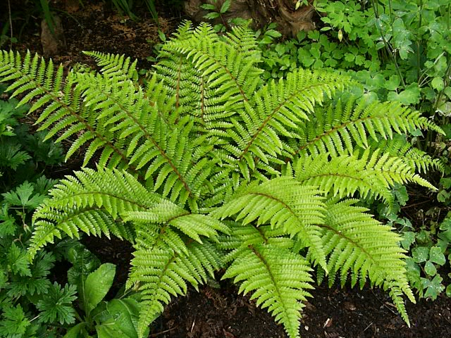
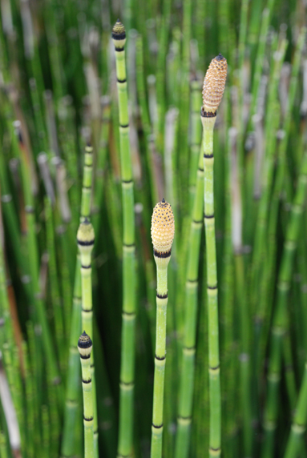
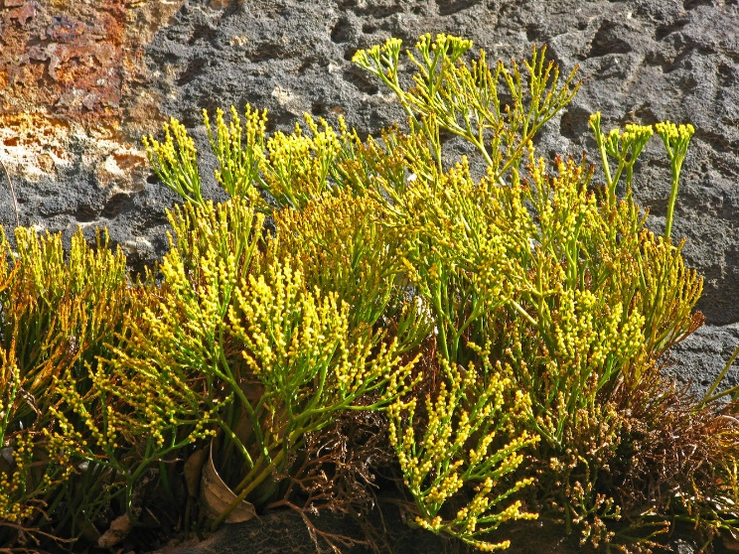
Characteristics of Seedless, Vascular Plants
Diverged ~ 450 mya (Ordovician)
Sporophyte generation dominant
Formation of vascular tissue
  Xylem (water)
  Phloem (nutrients)
Lignin: polymer that strengthens the cell walls of water-conducting cells
True leaves, roots and stems
  Have vascular tissue
Sperm with flagella
Notes:
Lignin: polymer that strengthens the cell walls of water-conducting cells. Allowed plants to grow vertically

Slide 25
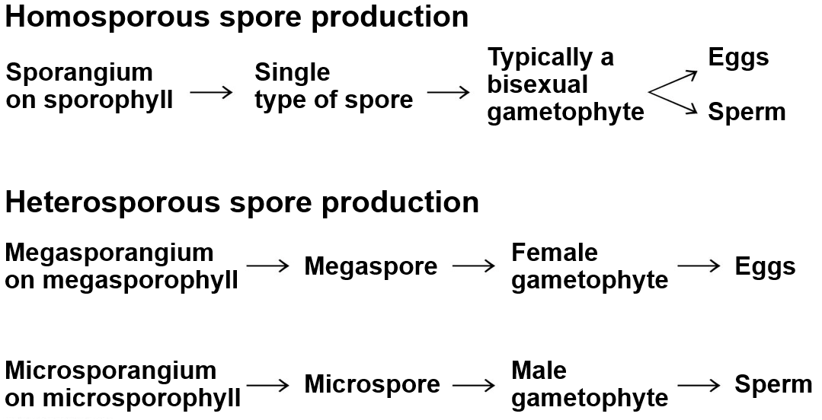
Types of Sporangia
Some seedless vascular plants
All seed plants and some seedless vascular plants
Notes:
Homo means same and Hetero means different. Ferns and some other seedless vascular plants have bisexual gametophytes that contain both the archegonia and antheridia in a single structure. All seed plants and some vascular seedless plants have heterosporous sporangia, which means the megasporangia (female) and microsporangia (male) are completely different structures.

Slide 26
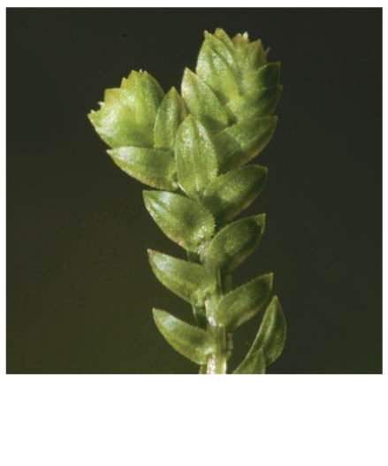
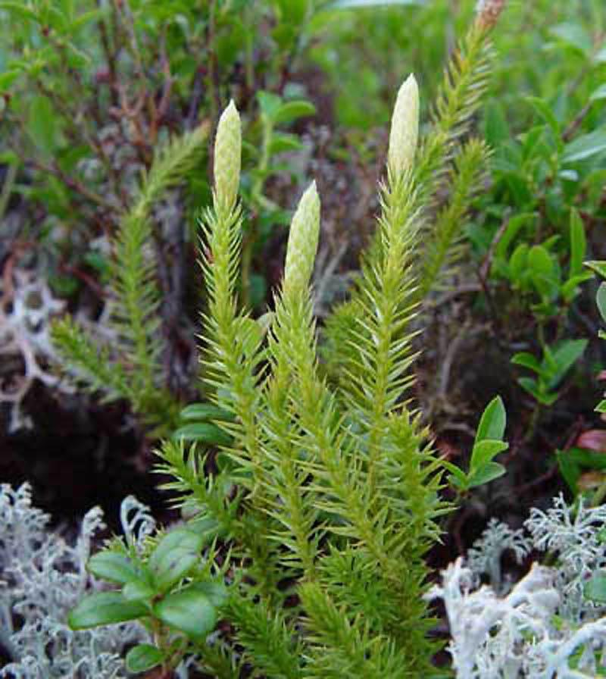
Phylum Lycophyta
Club mosses, Spike mosses, and Quillworts
Sporophyte generation dominant
True leaves
  Mircophylls: leaves with single strand of vascular tissue
  Sporophylls: leaves that bear sporangia
    Strobilus: cone-like structure formed by clusters of sporophylls
True stems and roots
Vascular tissue
Homosporous and Heterosporous
Microphyll
Stobili
Notes:
Not true mosses
Grew very large during Carboniferous period (2m diameter and 40m tall)
Extinct when earth’s climate became dryer
Many lycophytes are epiphytes (plants that use other plants as substrate but are not parasitic)

Slide 27
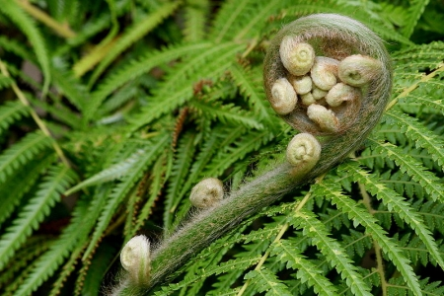



Phylum Pteropyta (Monilophyta)
Ferns
Sporophyte generation is dominant
Megaphylls: large leaves with branched vascular tissue
  Fronds
Homosporous
Sori: clusters of sporangia located on the underside of sporophylls
True leaves, roots, and stems
  Branching roots
Fiddleheads
Sori
Notes:
Audio transcript: The textbook groups the next three phyla under a single phyla called Monilophyta, but we are going to learn them as separate phyla. The ferns belong to the phylum Pteropyta, horse tails belong to Sphenophyta, and Whisk ferns belong to Psilophyta. Sporophylls are modified leaves that produce spores

Slide 28


Life Cycle of Pterophyta
Homosporous
Bisexual gametophyte
  Prothallus
Notes:
Audio transcript: Ferns are homosporous which means they have spores that develop into a single structure with both the antheridia and archegonia. The bisexual gametophyte in ferns is known as the prothallus. The sperm produced in the antheridia will fertilize the egg in the archegonia resulting in a zygote. The zygote will develop into the sporophyte which will grow out of the prothallus (gametophyte). Structures on the bottom of the fern fronds called sori contain sporangia which produce spores. The previous slide has images of sori and the sporangia contained within them. The covering over the sori is called the indusium.
You need to know the different life cycles for your second exam. Make sure you identify which structures are haploid and which ones are diploid.

Slide 29



Phylum Sphenophyta (Monilophyta)
Horsetails
Homosporous
True roots
True leaves
  Microphylls
True stems
  Silica
Strobili
Strobilus
Microphylls
Notes:
Microphylls are tiny leaves with a single, unbranched veins.

Slide 30


Phylum Psilophyta (Monilophyta)
Whisk ferns
Homosporous
Lack true roots and leaves
  Rhizoids
Sporangia
Spores

Slide 31
Check Your Understanding
True or False: Gametophytes are typically unicellular, and sporophytes are typically multicellular
True of False: Xylem transports water and the phloem transports nutrients
True or False: Some seed plants develop from a bisexual gametophyte

Slide 32
Check Your Understanding
Which of the following are not one of the derived characteristics of land plants?
a. Spores with protective walls
b. Apical meristem
c. Chlorophyll A and B
d. Multicellular, dependent embryos
e. Alternation of generation

Slide 33
Check Your Understanding
In which of the following plant phyla is the sporophyte generation the dominant generation?
a. Sphenophyta
b. Lycophyta
c. Pterophyta
d. Anthocerophyta
e. More than one of the above

