Slide 1
Mitosis and Cancer
“There are no traffic jams on the extra mile”
-Zig Ziglar
“Chop your own wood and it will warm you twice”
- Henry Ford
Chapter 9

Slide 2
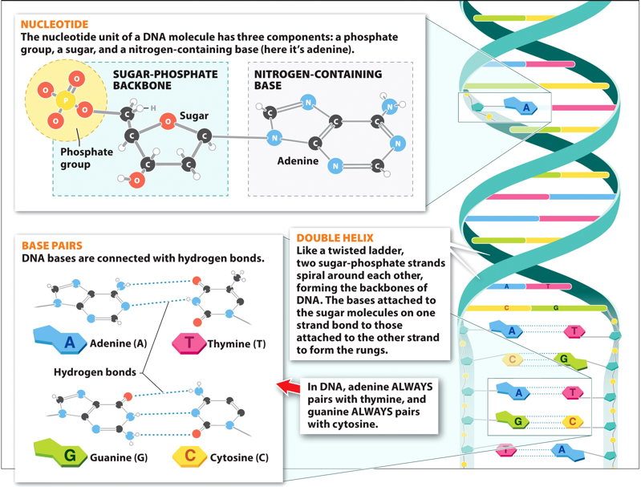
Introduction to Genetics
Deoxyribonucleic acid (DNA): primary information bearing molecule of life.
Two chains of nucleotides linked together to form a double helix
Nucleotide: nitrogenous base attached to a ___________ sugar (ribose) and a phosphate molecule
Complementary base pairs
_________ and Thymine
_________ and Cytosine

Slide 3
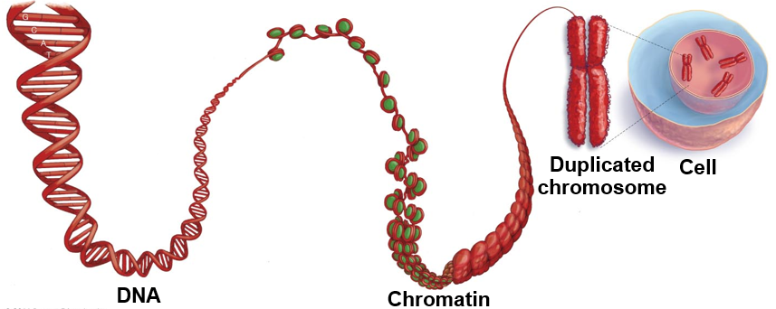
DNA and Chromosomes
________: a specific section of DNA that contains information necessary to produce a protein
Chromatin: linear strand of DNA wrapped around histones
Histones: proteins that keep DNA from getting tangled
________________: a compact strand of DNA
Histones
Genome
Gene

Slide 4
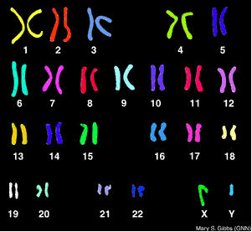
Chromosomes
Genome: complete collection of an organisms genetic information
Karyotype: pictorial arrangement of chromosomes

Slide 5
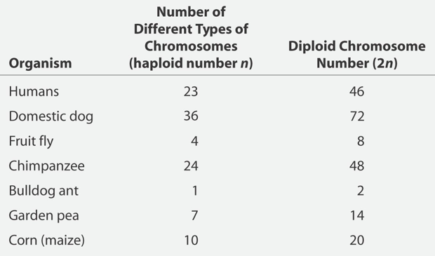
Comparison of Chromosome Number
Haploid: cells with a single copy of each chromosome
___________: sex cell
Egg and sperm
Diploid: cells with two copies of each chromosome, one maternal and one paternal
________ cells: cells forming the body of the organism

Slide 6
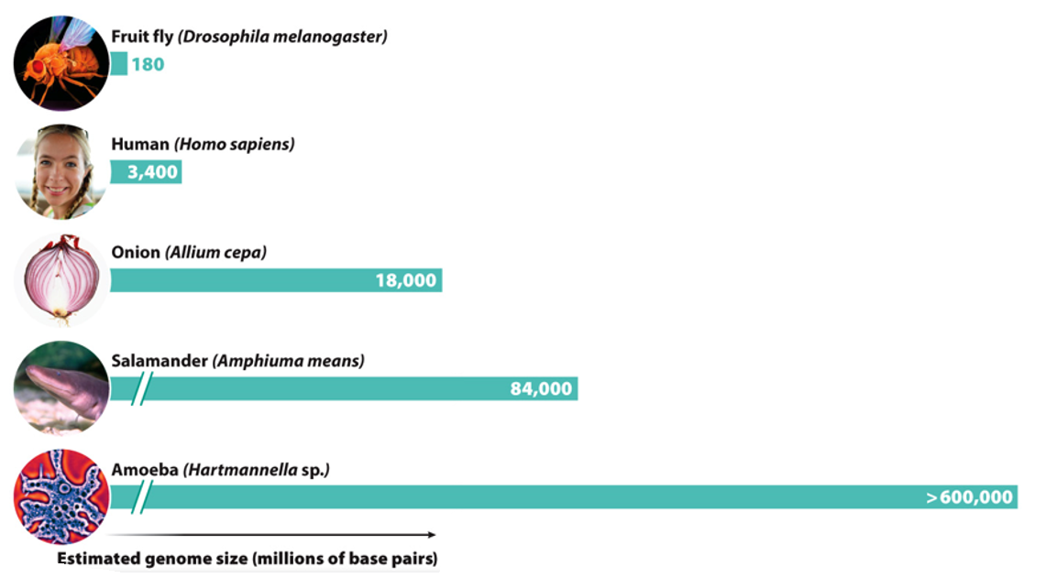
Variation in Genome Size
Size of an organism’s genome is not related to the complexity of the organism

Slide 7
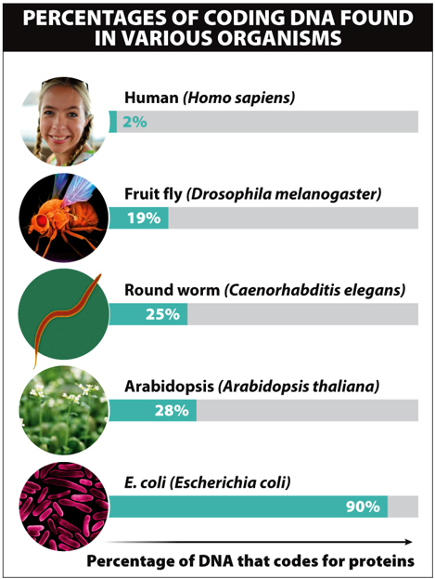
Percentage of Coding DNA
Many organisms have large portions of DNA that do not code for proteins and have no known purpose
Only __% of human DNA codes for proteins

Slide 8
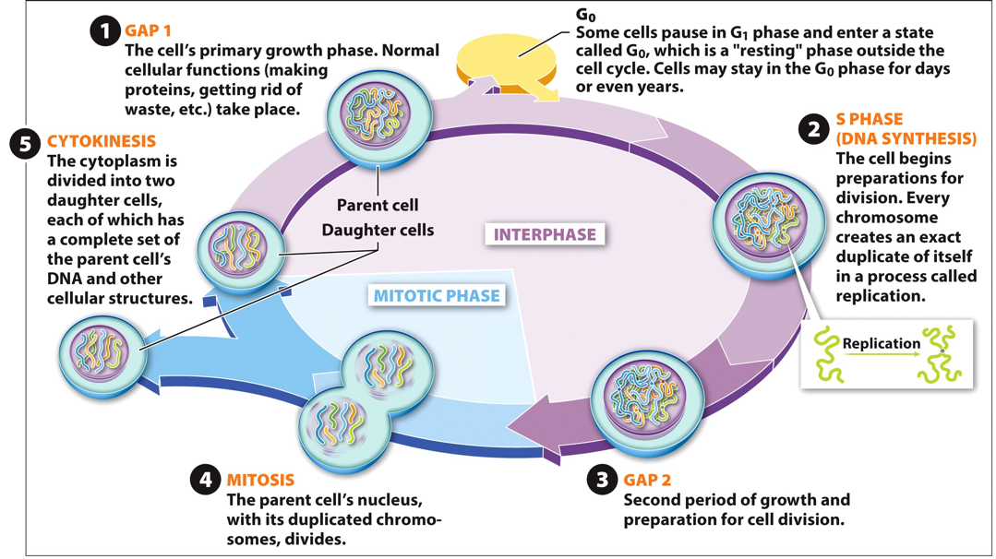
The Cell Cycle

Slide 9
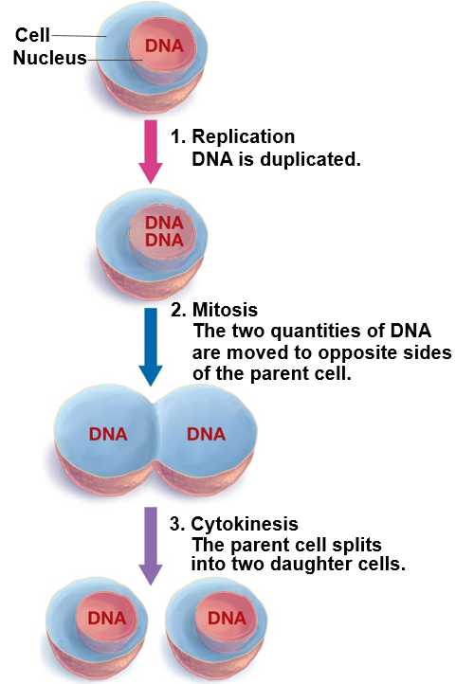
Introduction to Cell Division
Cells come from other cells
Growth
Replacement
Three main steps
DNA replication
Mitosis: division of parent cell’s nucleus and chromosomes
Cytokinesis: division of __________ into two daughter cells

Slide 10
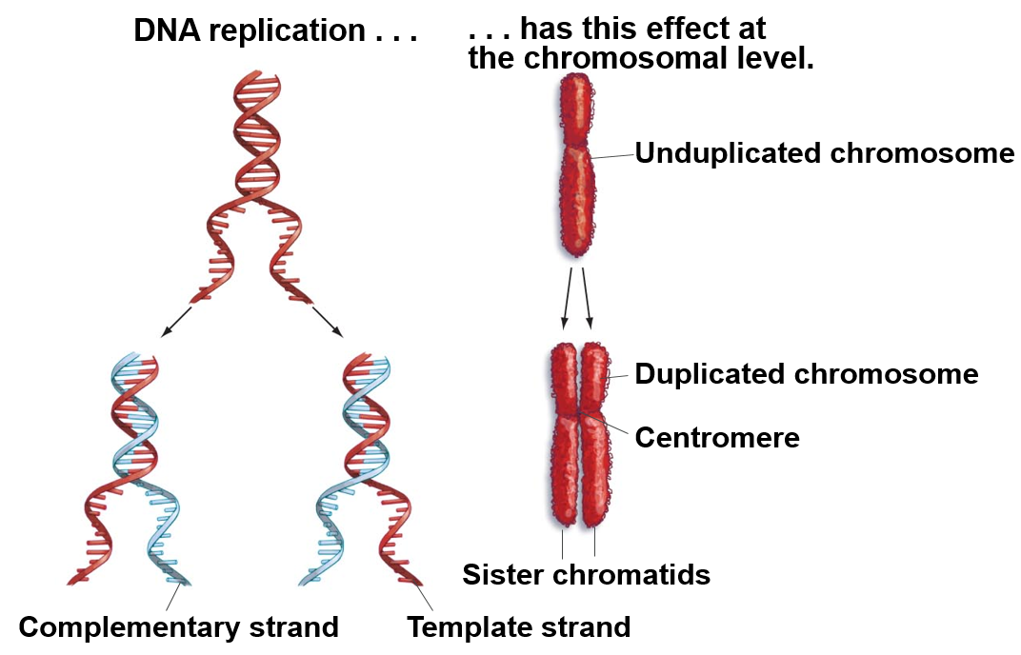
DNA Replication
DNA of unduplicated chromosome unwinds
New DNA nucleotides join with each individual DNA strand to form a new double helix
Duplicated DNA results in duplicated chromosome
Sister chromatids
Centromere

Slide 11
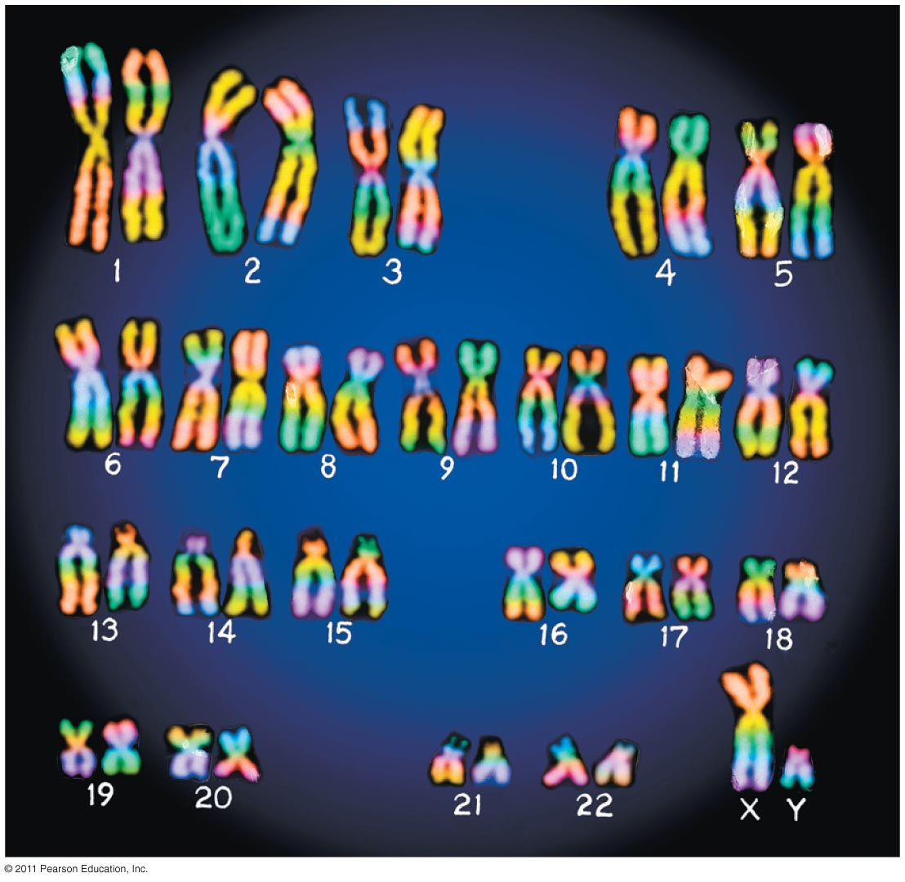
Chromosomes Before and After Replication

Slide 12
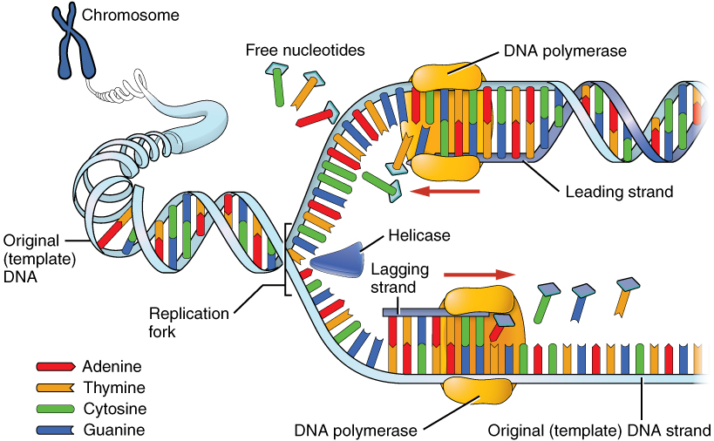
DNA Replication
Helicase: enzyme that unwinds DNA separating it into two complementary strands
____________: enzyme that creates the complementary strand by adding new DNA nucleotides to the template strand
Only moves from 5’ end to 3’ end

Slide 13
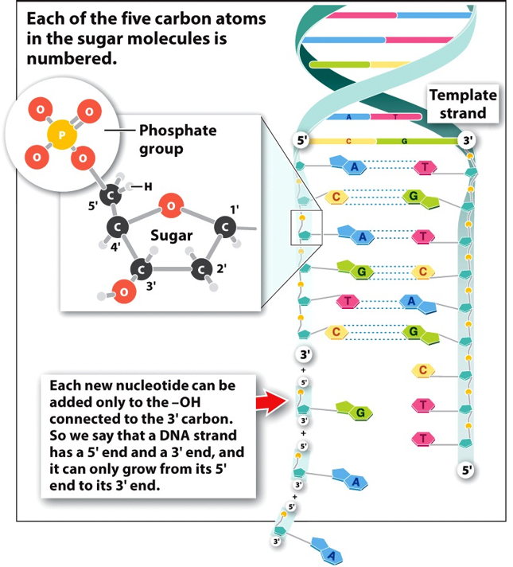
5’ and 3’ ends of DNA
DNA Polymerase attaches the 5’ end (phosphate) of the free nucleotides to the 3’ end (ribose) of the DNA strand
DNA Polymerase only moves from 5’ end of DNA strand to 3’ end of DNA strand
Leading and lagging strands

Slide 14
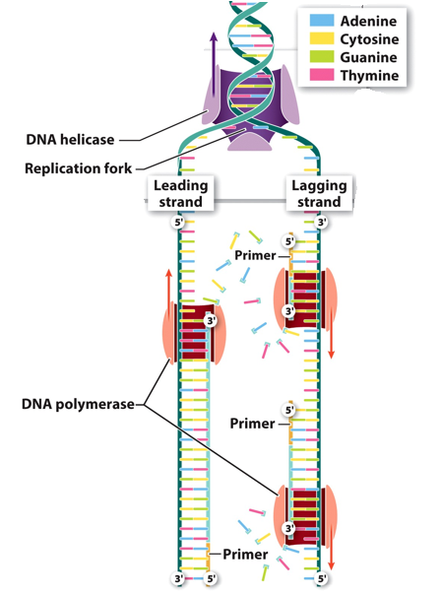
DNA Replication
Leading strand: template strand of DNA that is replicated by adding nucleotides to a continuously growing complementary strand moving in the 5’ to 3’ direction
Lagging strand: template strand of DNA that is replicated _____________ as a series of DNA fragments (Okazaki fragments)
DNA Helicase
Replication fork
Leading
strand
Lagging
strand
5’
5’
3’
Primer
3’
3’
DNA Polymerase
5’
Primer
Okazaki fragment
3’
Primer
3’
5’
5’

Slide 15
DNA Replication
Notes:
Helicase = Protein that unzips DNA double helix by breaking hydrogen bonds between nucleotides
DNA polymerase = connects free nucleotides with single strand
Single strand binding proteins = prevent single strands from binding with each o
Leading strand = continuous strand, 5’ to 3’ direction
Lagging strand = discontinuous strand, 3’ to 5’ direction

Slide 16
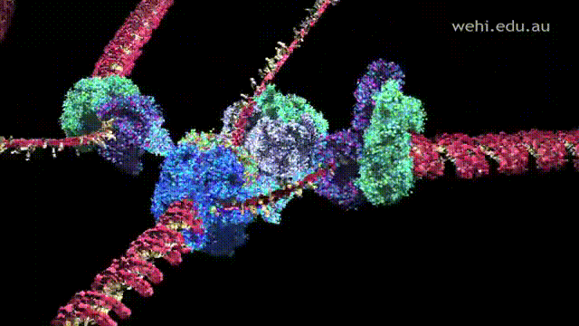
DNA Replication
Notes:
Helicase spins as fast as a jet engine

Slide 17
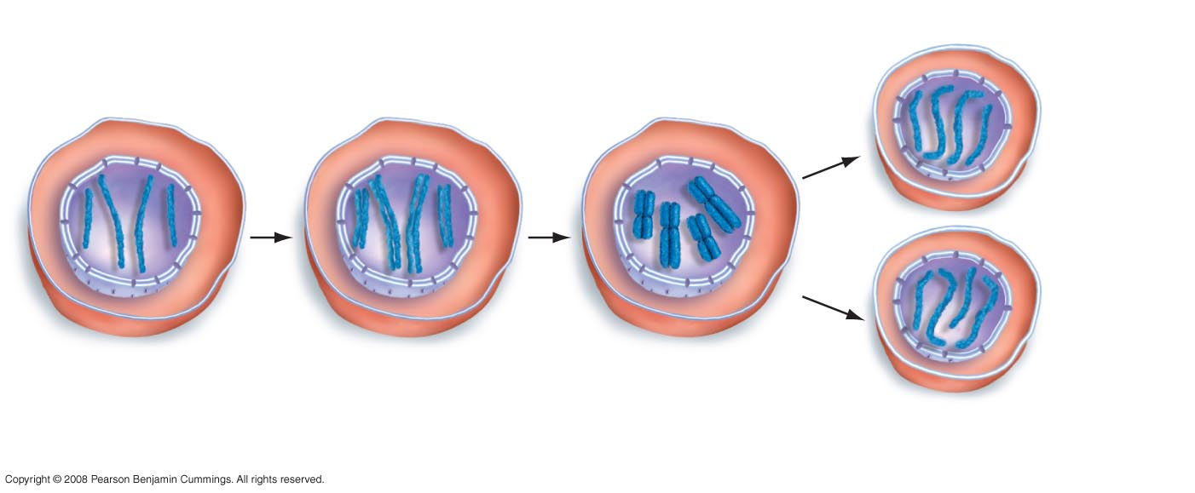
An Overview of Mitosis
Mitosis and Cytokinesis
__________
Daughter cells
contain the same
complement of
chromosomes as
the parent cell.
G₁
S PHASE AND G₂
Sister
chromatids
Parent cell:
4 unreplicated
chromosomes
Parent cell:
4 replicated
chromosomes
During mitosis, sister chromatids
separate. Two daughter cells are
formed by cytokinesis.

Slide 18
Mitosis and Cytokinesis
Prophase
Metaphase
Anaphase
Telophase
Cytokinesis
End of Interphase
Beginning of Interphase

Slide 19
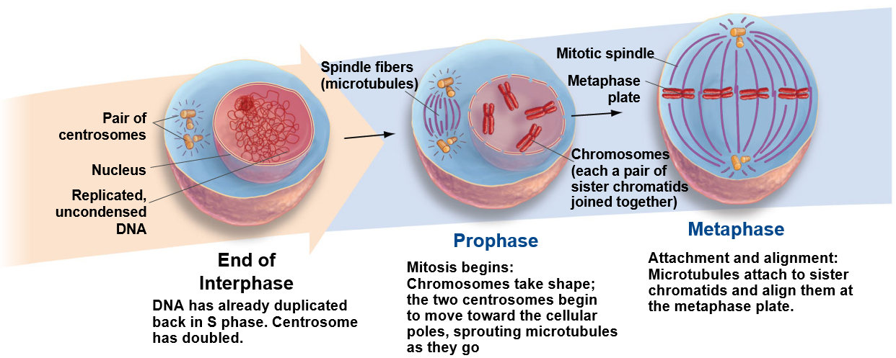
Mitosis

Slide 20
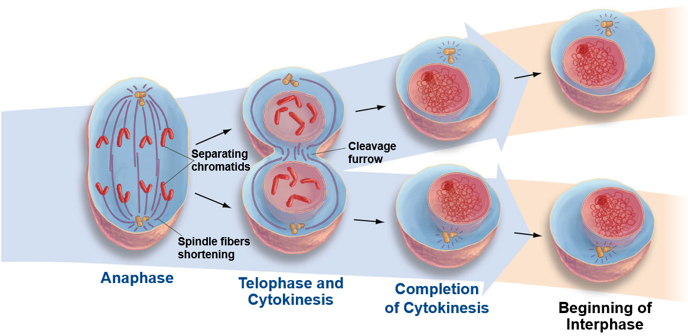
Mitosis and Cytokinesis
Separation:
Sister chromatids are moved to opposite poles in the cell, each chromatid now becoming a full-fledged chromosome.
Exit from mitosis:
Chromosomes unravel; nuclear envelopes form
Cleavage furrow
begins to form.
One cell becomes two:
The cell membrane pinches
together completely
These two cells now enter
the G1 phase of interphase.

Slide 21
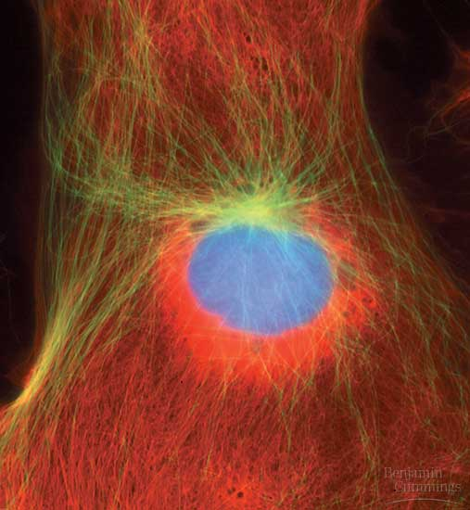
Interphase
Interphase (three parts)
G1 (gap 1 phase) = growth and normal functions
S (synthesis phase) = DNA (chromosome) replication
G2 (gap 2 phase) = growth and normal functions continue
Centrosomes develop

Slide 22
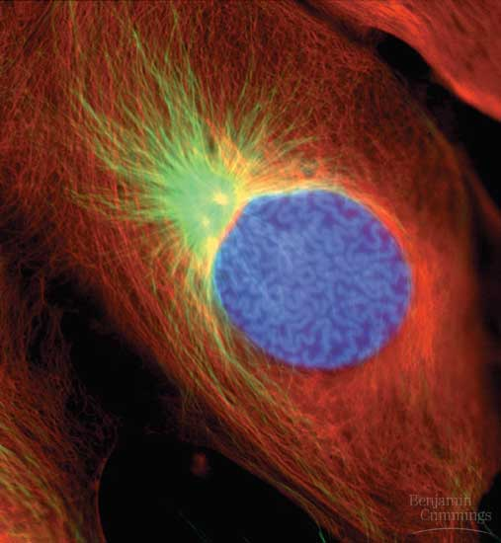
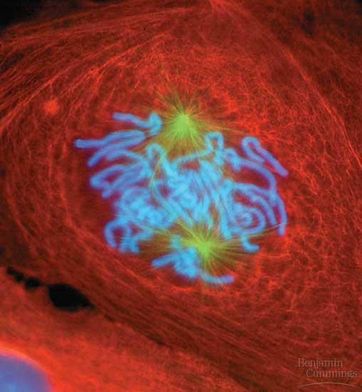
Mitosis: Prophase
Chromatin condenses to form ______________
Nuclear membrane and Nucleolus disappear
Chromosomes
Two chromatids with centromere
Mitotic spindles form
Microtubules

Slide 23
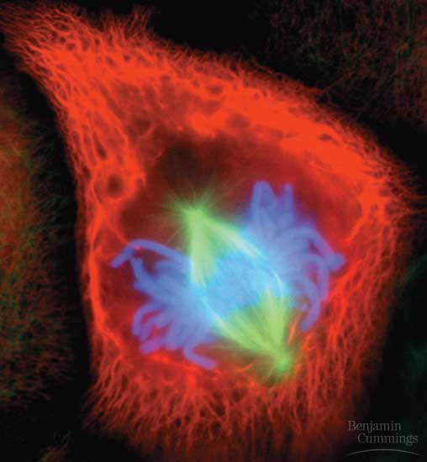
Mitosis: Metaphase
Centrosomes at opposite poles
Microtubules attach to sister chromatids
Chromosomes line up on ________ plate

Slide 24
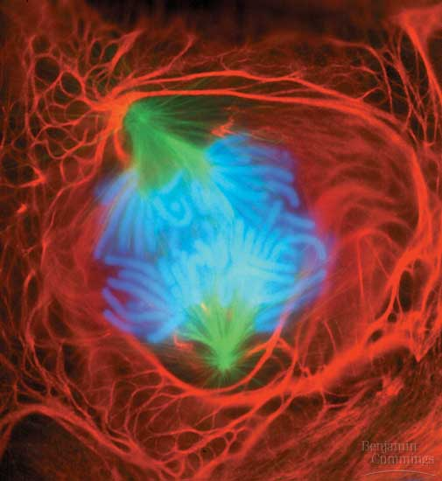
Mitosis: Anaphase
Duplicated chromosomes (sister chromatids) are pulled apart by spindle fibers
One full set of chromosomes goes to one end of the cell and one set goes to the other end

Slide 25
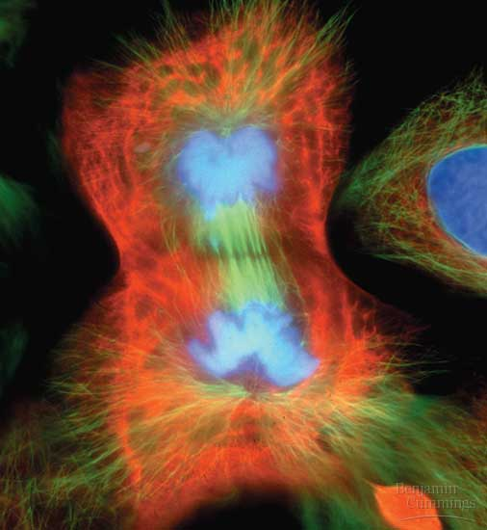
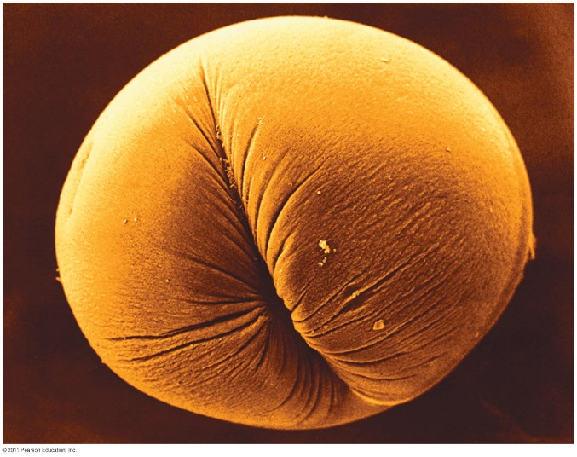
Mitosis: Telophase and Cytokinesis
Reverse of Prophase
Nuclear envelopes reform around chromosomes
Cytokinesis
Animal cells
_______ Furrow
Plant cells
Cell Plate

Slide 26
Interphase

Slide 27
Prophase

Slide 28
Metaphase

Slide 29
Anaphase

Slide 30
Telophase and Cytokinesis

Slide 31
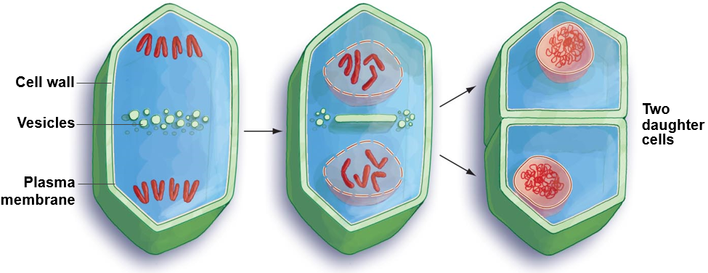
Cell Division in Plants
1. Membrane-lined vesicles accumulate near the metaphase plate. The vesicles contain precursors to the cell wall.
2. Vesicles fuse together, forming a cell plate that grows toward the parent cell wall.
3. The newly formed plasma membrane and cell wall fuse with the parent plasma membrane and cell wall, forming two distinct daughter cells.

Slide 32
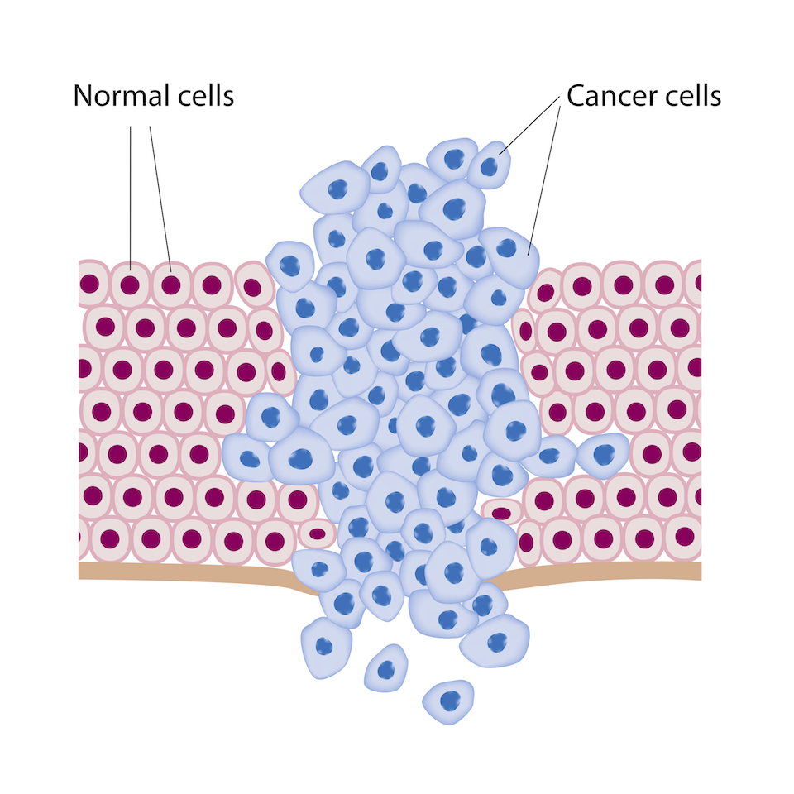
Cancer Cells
Cancer = ___________ cell multiplication, which invade nearby tissues or other parts of the body, destroying working tissues

Slide 33
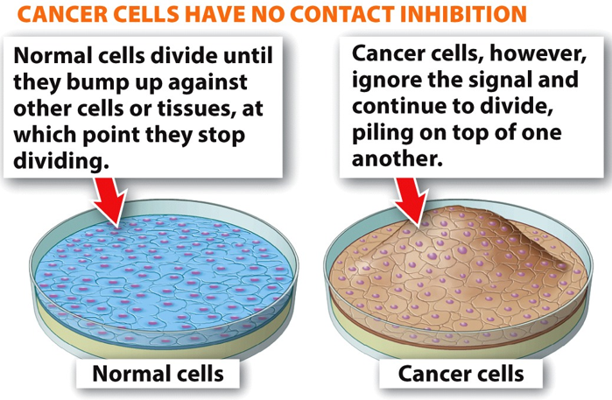
Characteristics of Cancer Cells
Non contact inhibition
____________ arrangement

Slide 34
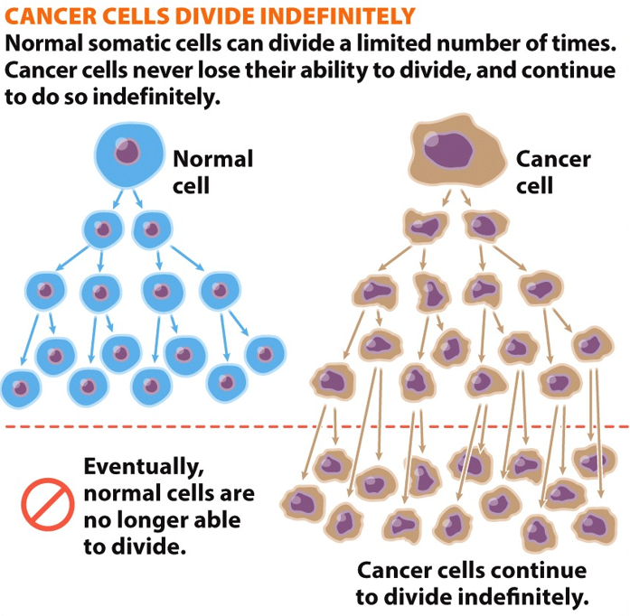
Characteristics of Cancer Cells
Indefinite cell division
Cancer cells can divide an ________ number of times

Slide 35
Characteristics of Cancer Cells
Membrane proteins have reduced adhesive properties
_________ tumors

Slide 36
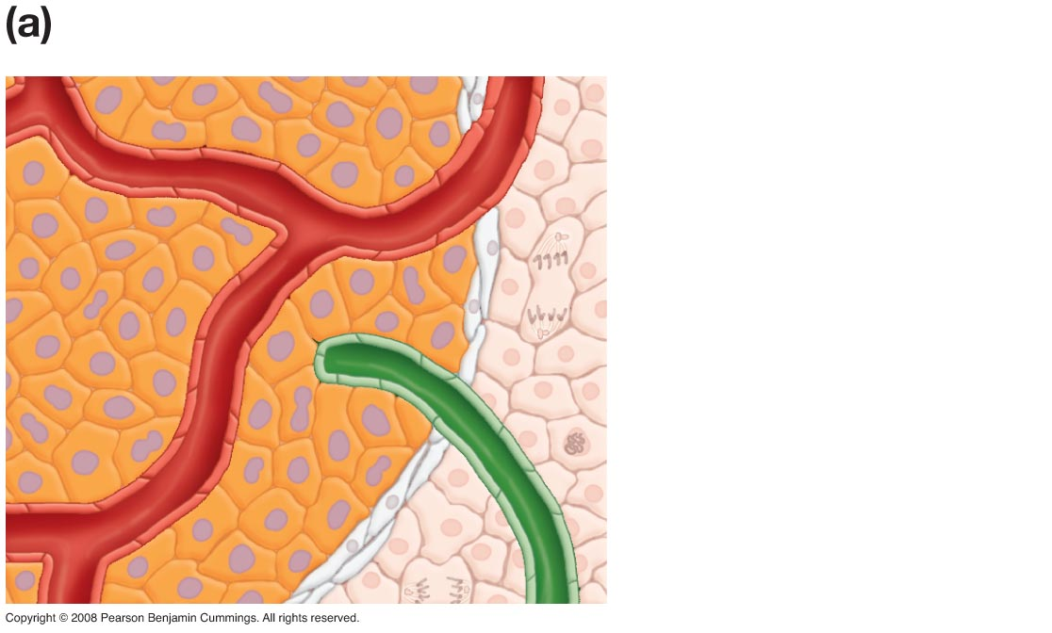
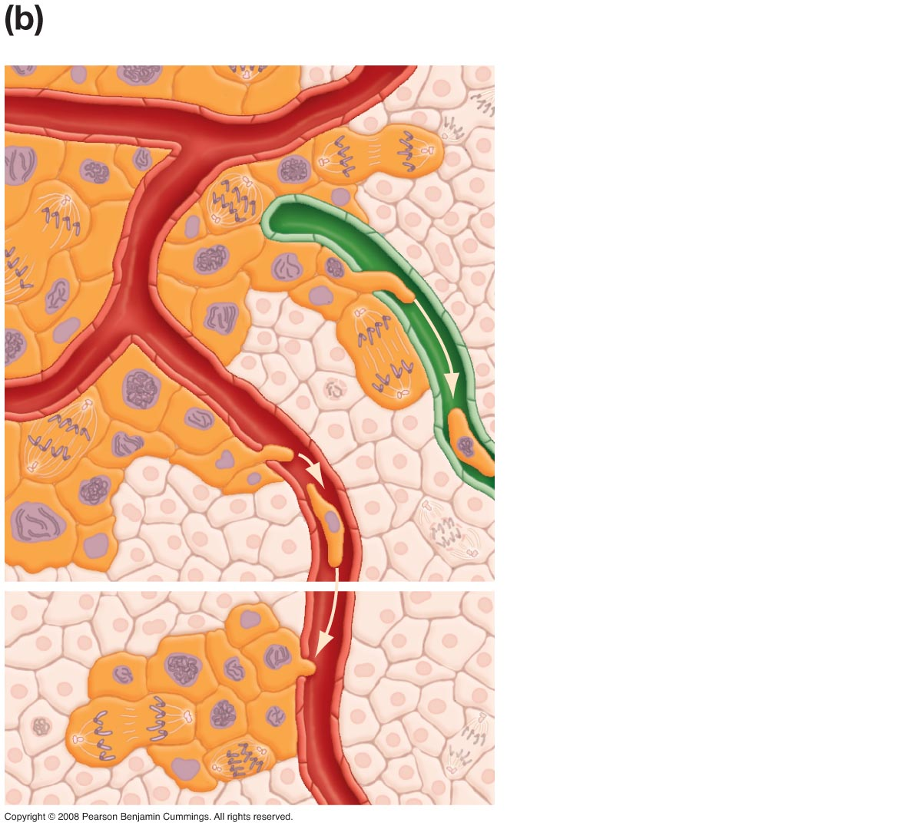
Cancerous Tumors
Benign
Malignant
Malignant tumor cells
divide and spread to
adjacent tissues and to
distant tissues through
lymphatic vessels and
blood vessels
Normal cells
Lymph vessel
Blood vessel
Benign tumor cells
may continue to
divide, but are not
invasive (they do not
spread from tumor)
New tumor that has
formed in distant
tissue by metastasis

