Slide 1
Mendelian Genetics
"There are no boring subjects, only disinterested minds.”
- G. K. Chesterton
Chapter 11

Slide 2
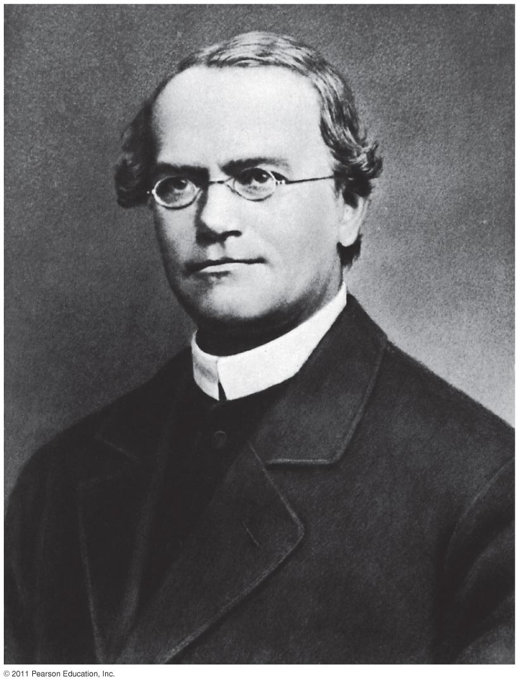
Father of Genetics
Gregor Mendel (1822 – 1884)
Austrian monk
Inheritance of traits in pea plants
Model organism
Tested leading hypothesis of blended inheritance
Credit for discovery came after his death

Slide 3
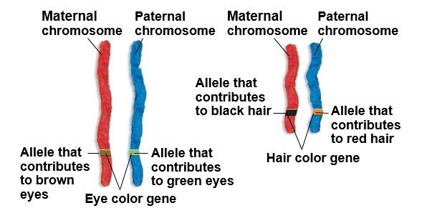
Genetics Terminology
Genetics: branch of biology that focuses on the inheritance of traits
Heredity: transmission of traits from parent to offspring; inheritance
Trait: characteristic of an individual
_____: a sequence of DNA that codes for a specific protein
Allele: different _________ of a gene

Slide 4
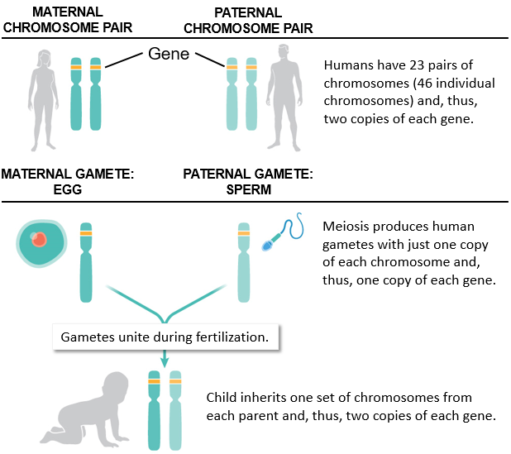
Genes and Inheritance

Slide 5
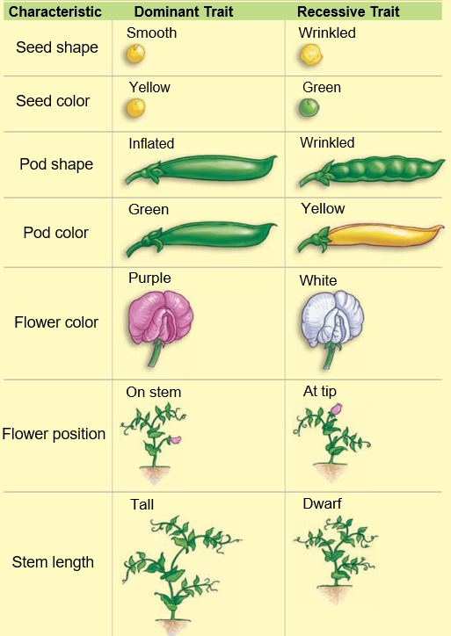
Why the pea?
Model organisms: organisms that are easy to care for and can be used to make inferences about many other similar species
Small
___________
Inexpensive to care for
Produce large numbers of offspring
Can be manipulated experimentally

Slide 6
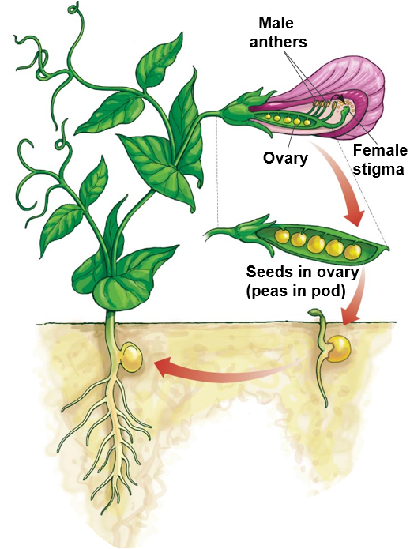
Life Cycle of the Pea Plant
1. Self-pollination. Pollen from the male anthers of a plant falls on the female stigma of that same plant.
2. Fertilization. Sperm from the pollen fertilize the plant's eggs, which lie inside the ovary. These eggs will develop into seeds in the ovary (peas in a pod), which represent a new plant generation. Each seed is fertilized separately.
3. Germination. Each seed can be planted and grown into a separate plant.
4. Development. Seedlings develop into mature seed plants, capable of producing their own offspring.

Slide 7
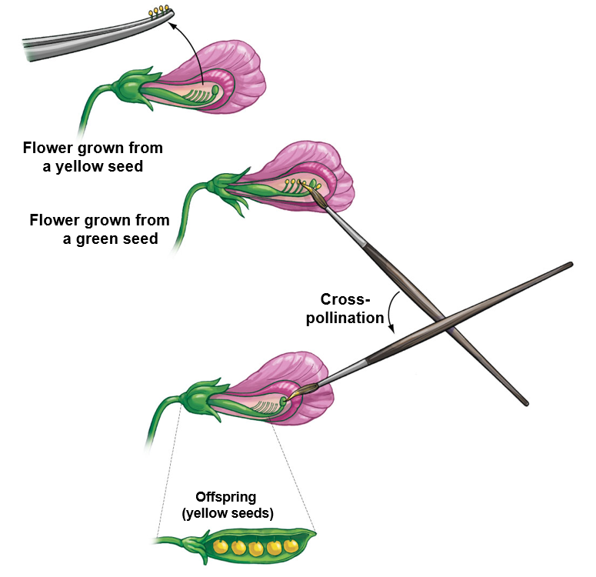
Mendel’s Procedure: Cross Pollination
1. Before fertilization occurs, peel back the closed petals of a pea plant (in this case, one that came from a line that yielded yellow peas). Then pull out the pollen-bearing stamens with tweezers so that self-fertilization is no longer possible.
2. Next, gather pollen from a green-seed plant by dabbing its anthers with a
paintbrush.
3. Finally, rub these pollen grains onto the stigma of
the first plant. The results of the cross-pollination
can be observed when the fertilized eggs mature
into seeds in the ovary, meaning peas in a pod.
Notes:
Cross-pollinate: one plant pollinating with another
Self-pollinate: a plant replicating with itself
Parent generation (P): initial group of organisms
First generation (F1): first offspring generation
Second generation (F2): second offspring generation with F1 as parent generation

Slide 8
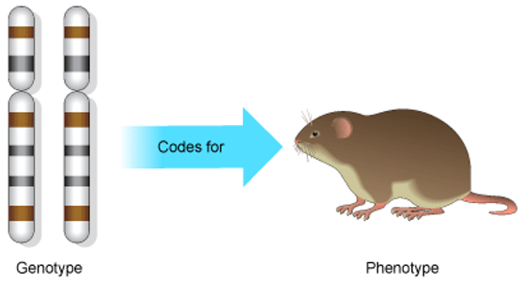
Genotype vs. Phenotype
____________: observable features of an individual
Ex. Yellow seeds, white flowers
Genotype: the ________ found within a particular individual
One allele from mother and one from father
Only one allele expressed as the phenotype
Denoted as letters
Ex: YY or Yy for yellow seeds
Codes for
Genotype
Phenotype

Slide 9
Characterizing the Genotype
Dominant allele: allele that determines the phenotype of a heterozygous individual
Denoted with a capital letter. Ex: Y or R
Recessive allele: allele whose phenotype is only expressed in __________ individuals
Denoted with a lowercase letter. Ex: y or r
Homozygous: having two __________ alleles of a certain gene
Ex:YY or yy
Heterozygous: having two ___________ alleles of a certain gene
Ex: Yy or Rr

Slide 10
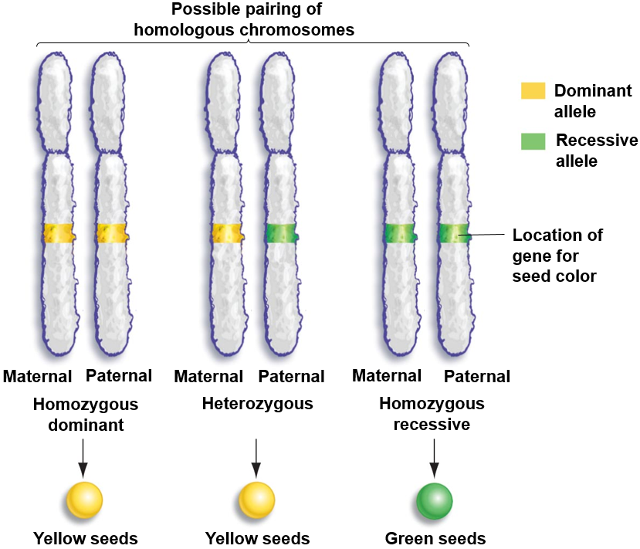
Homozygous and Heterozygous

Slide 11
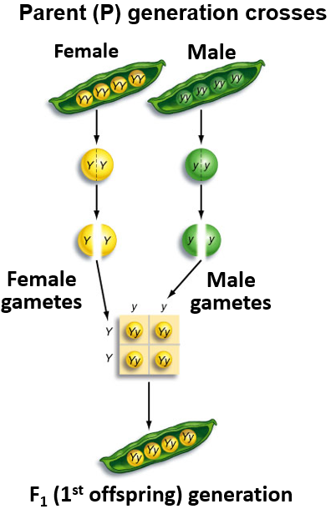
Mendel’s First Test
Letters represent alleles from parents
Paired chromosomes = two alleles
Dominant alleles = Capital letter
Y
Recessive alleles = lowercase letter
y
Green seeds absent in F₁ generation

Slide 12
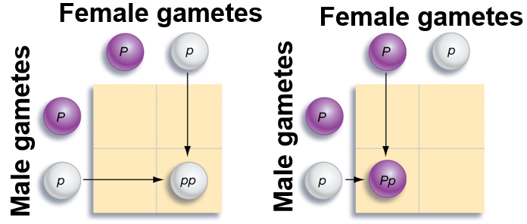
Using a Punnett square
Punnett squares are used to predict the outcome of a cross between two individuals

Slide 13
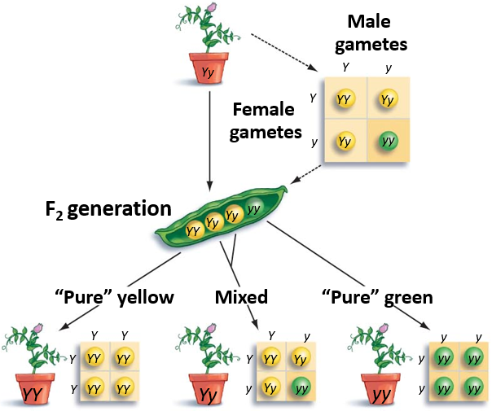
Mendel’s 2nd and 3rd Generations
F₁ generation self pollinated
F₂ generation
3:1 phenotypic ratio
1:2:1 genotypic ratio
Return of green phenotype!
Whaa?!
F₃ generation had mixed and pure lines
F₃ generation

Slide 14
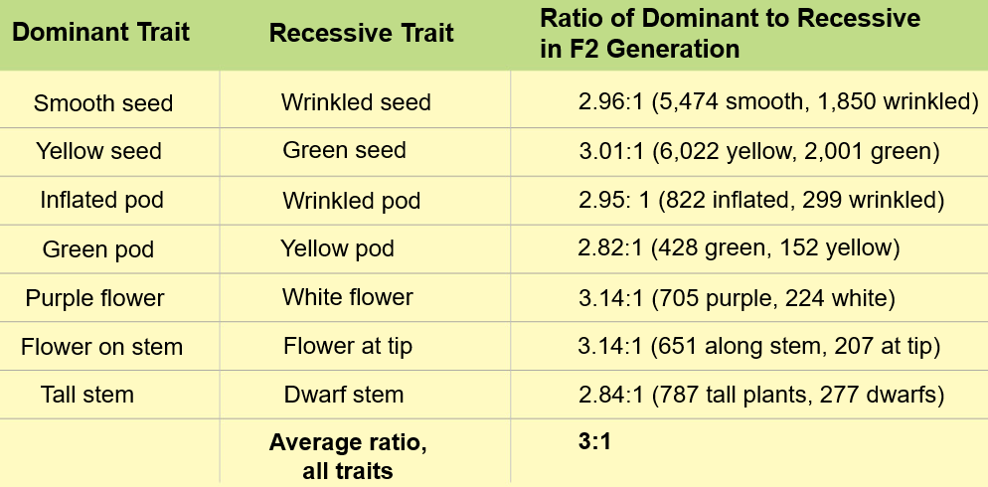
Mendel’s Results
Notes:
When Mendel crossbred two pure lines for each trait he got a 3:1 expression for each allele
Mendel differed from previous researchers in that he counted the seeds and then analyzed the proportion of each trait that was expressed in the offspring generation. Something that did not seem important turned out to be the key to understanding inheritance.
Key points
3:1 ratio instead of 1:1 or 50/50 ration means some are alleles are dominant over others
No blending occurred
Plants could retain recessive phenotypes
Because phenotypes were paired then perhaps the “elements” (allele) were also paired

Slide 15
Reviewing Mendel’s Results
 | y | y
Y | Yy | Yy
Y | Yy | Yy
P generation crosses
Phenotypic ratio = 4:0
4 Yellow: 0 Green
Genotypic ratio = 4:0
4 _______________ individuals
F1 generation self-fertilization
Phenotypic ratio = 3:1
3 Yellow: 1 green
Genotypic ratio 1:2:1
1 Homozygous dominant
2 Heterozygous
1 Homozygous recessive
Father’s genotype
Mother’s genotype
 | Y | y
Y | YY | Yy
y | Yy | yy
Father’s genotype
Mother’s genotype

Slide 16
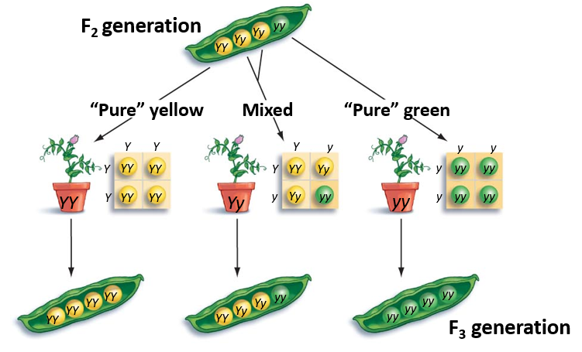
Reviewing Mendel’s Results
F2 generation self-fertilized
Rediscovery of pure lines

Slide 17
Mendel’s Findings
Peas have two versions, or alleles, of each gene
This is also true for many other organisms
Alleles do not blend together
The hereditary determinants maintain their integrity from generation to generation
Each gamete contains one allele of each gene
Law of segregation
Males and females contribute equally to the genotype of the offspring
When gametes fuse together the offspring has one allele from each parent per gene
Some alleles are dominant to other alleles
When dominant and recessive alleles are found together, the phenotype will be that of the dominant allele

Slide 18
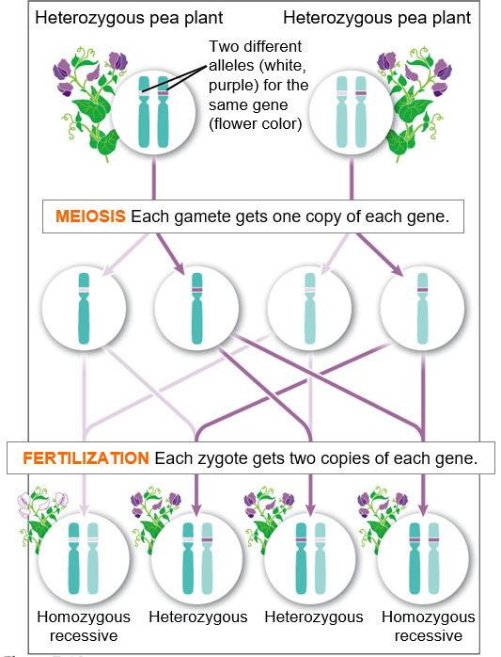
Mendel’s Law of Segregation
Law of segregation: alleles of each gene segregate during formation of gametes (meiosis)
Egg and sperm carry __________ copy of each gene

Slide 19
Check your Understanding
1. True or False: each sex cell (egg or sperm) contains two copies of a each gene
2. True or False: an individual with a dominant phenotype must be homozygous dominant for that particular trait
3. True or False: recessive alleles are only expressed when both parents contribute the recessive gene

Slide 20
Check your Understanding
Perform a cross between a man with brown eyes (BB) and a woman with blue eyes (bb). Brown eyes are a dominant trait and blue eyes are a recessive trait. How many of their children will have blue eyes?

Slide 21
Check your Understanding
Perform a cross between a man and a woman who are both heterozygous for eye color. Brown eyes are a dominant trait (B) and blue eyes are a recessive trait (b). How many of their children will have blue eyes?

Slide 22
Check your Understanding
Provide the genotypic ratio and phenotypic ratio for a cross between a man with blond hair, and a women with black hair who is a carrier of the blond allele. Blond hair is a recessive trait.
Genotypic ratio:
Phenotypic ratio:

Slide 23
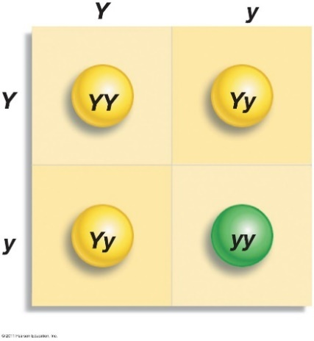
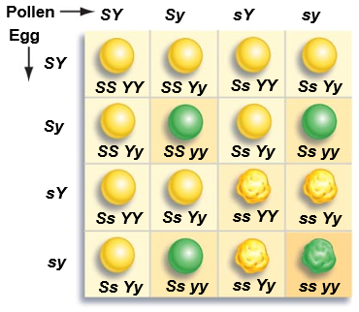
Monohybrid and Dihybrid Crosses
Male Genotype
Monohybrid cross: a cross between parents that are heterozygous for a single gene
Phenotypic ratio = ____
Genotypic ratio = _____
Dihybrid cross: a genetic cross between parents that are heterozygous for two genes
Phenotypic ratio = ________
Genotypic ration = 1:2:2:1:4:2:1:2:1
Gene for seed color
Female Genotype
Genes for seed color and texture

Slide 24
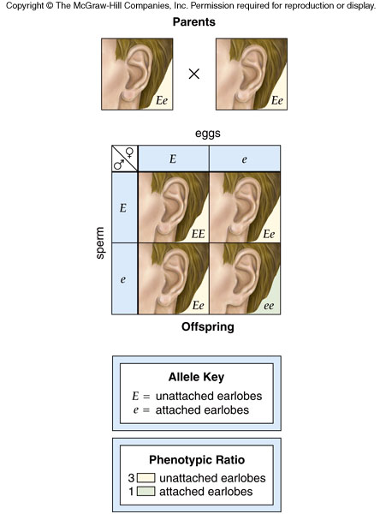
Monohybrid Cross in Humans

Slide 25
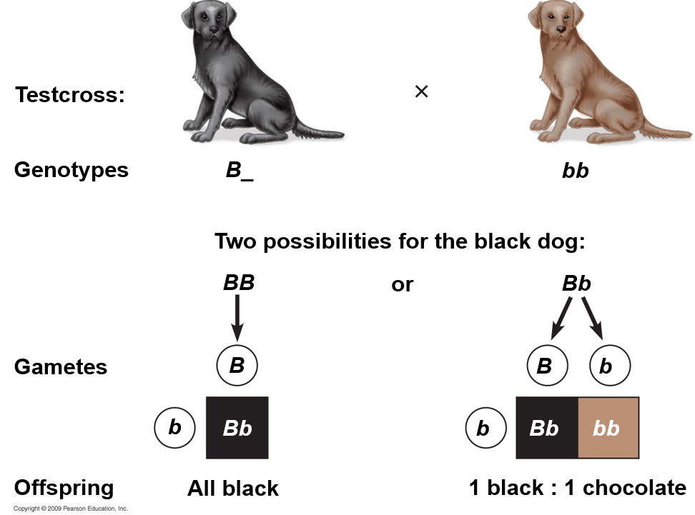
Test Cross
Test Cross: Cross _________ __________ with unknown genotype displaying dominant phenotype

Slide 26
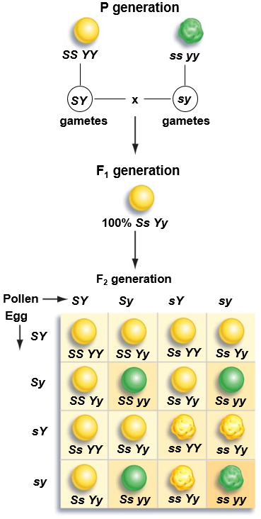
Dihybrid Cross
Yellow smooth
Green wrinkled
Parent generations are pure for two traits
Homozygous dominant
Yellow smooth
Homozygous recessive
Green wrinkled
F₁ generation is heterozygous for both traits
Phenotypic ratio = 9:3:3:1
9 Yellow smooth, 3 yellow wrinkled, 3 green smooth, 1 green wrinkled
Genotypic ration = 1:2:2:1:4:2:1:2:1

Slide 27
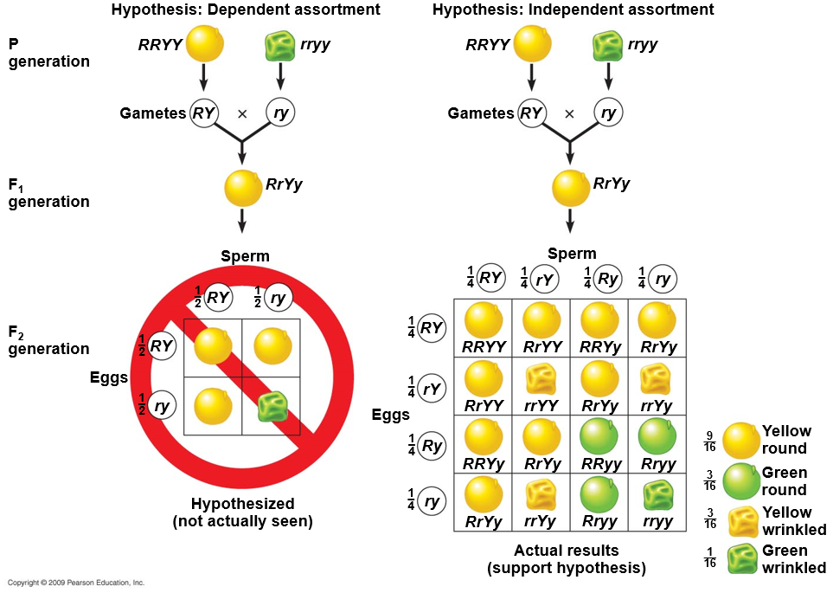
Mendel’s Law of Independent Assortment
Law of Independent Assortment: one trait does ___________ the inheritance of another trait
All traits are inherited independently of one another
Hypothesis: Dependent Assortment
Hypothesis: Independent Assortment
P Generation
F₁ Generation
F₂ Generation

Slide 28
Check your Understanding
Perform a Dihybrid cross between two individuals that are heterozygous for both hair color (Bb) and eye color (Ee). Black hair (B) is dominant to blond hair (b), and brown eyes (E) and dominant to blue eyes (e). Each individual’s genotype is BbEe
Genotypic ratio:
Phenotypic ratio:

Slide 29
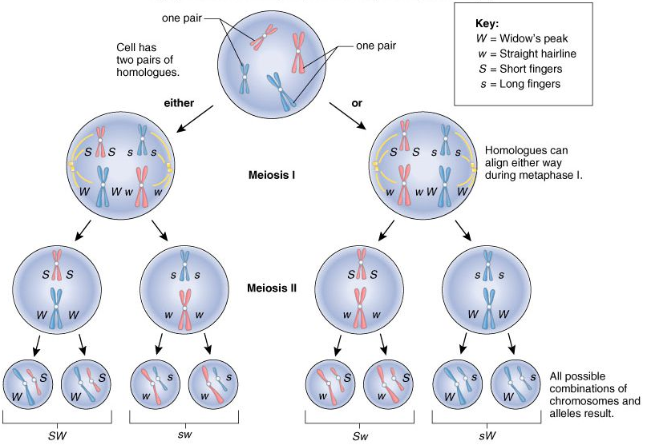
Independent Assortment

Slide 30
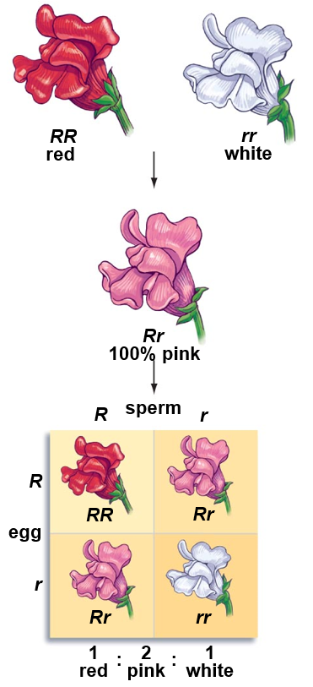
Incomplete Dominance
Incomplete dominance: heterozygous individual is an intermediate between either homozygous genotype
Not ________ of traits
Alleles separate again in F₂ generation
P generation
1. The starting plants are a snapdragon homozygous for red color (RR) and snapdragon homozygous for white color (rr).
F₁ generation
2. When these plants are crossed, the resulting Rr genotype yields only enough pigment to produce a flower that is pink—the only
phenotype in the F₁ generation.
F₂ generation
3. In the F₂ generation, alleles combine to produce red, pink, and white phenotypes.

Slide 31
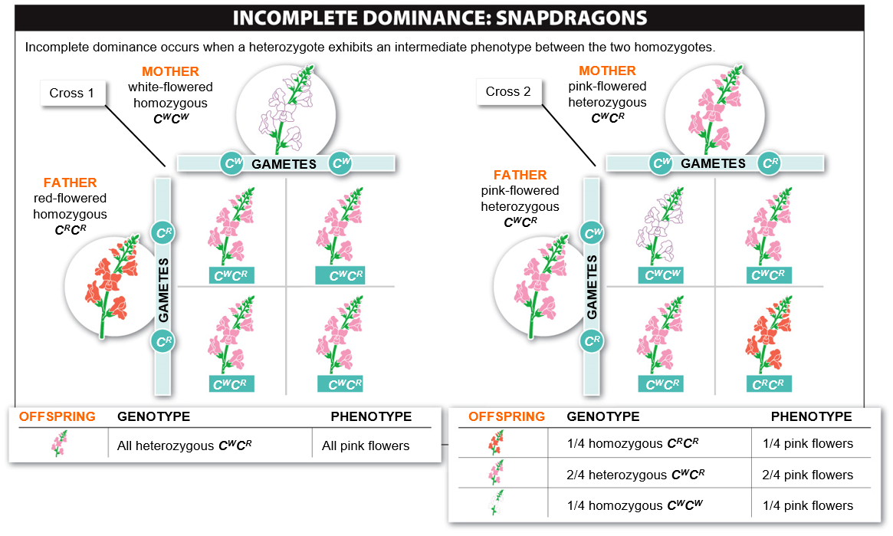

Slide 32
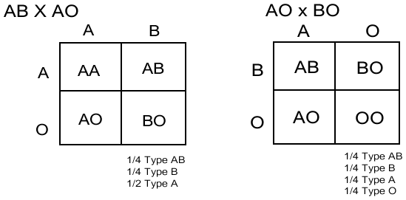
Codominance
________________: a condition in which two alleles of a given gene have different phenotypic effects, with both effects present in organisms heterozygous for the particular gene
Blood type

Slide 33
Multiple Alleles
Multiple alleles: when three or more alleles for the same gene exist within a ___________
Increased diversity of population
Ex: blood types
Polygenic inheritance: interaction of _____________ determine the phenotype or genetic character, each having a small additive effect on the outcome of the trait.
Results in continuous variation
Ex: human height, eye color, weight

Slide 34
Multiple Alleles: Blood Types

Slide 35
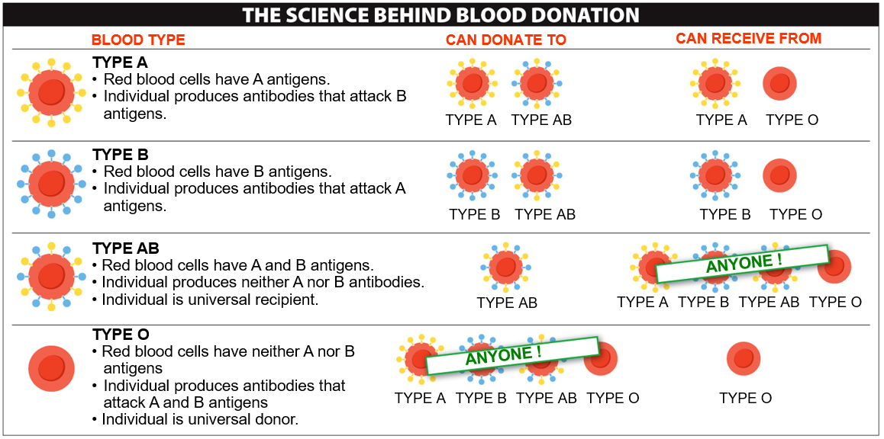
Blood Donation

Slide 36
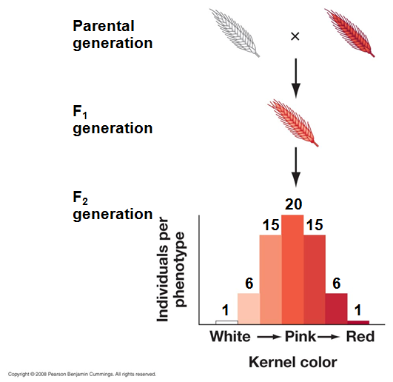
Polygenic Inheritance
Discrete traits: inherited traits that exhibit distinct phenotypic forms
Pea plant traits
_______________ traits: a heritable feature that exhibits phenotypic variation along a smooth, continuous scale of measurement
Human height

Slide 37
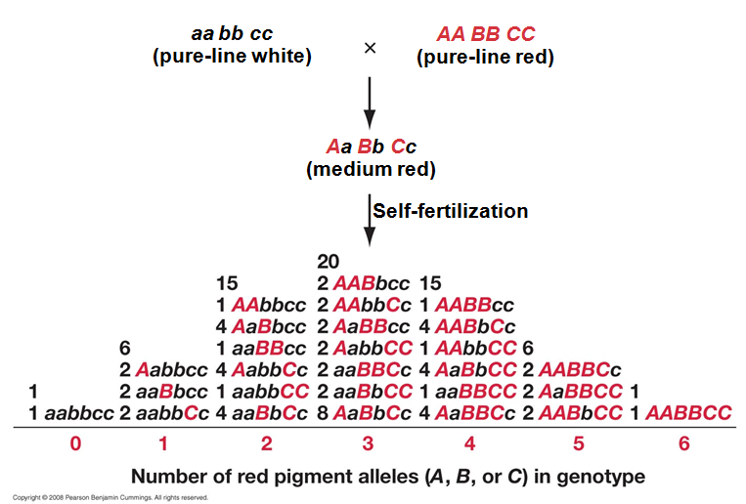
Quantitative Traits
Each gene has a small additive effect on the trait resulting in a normal distribution of the trait in the population.

Slide 38
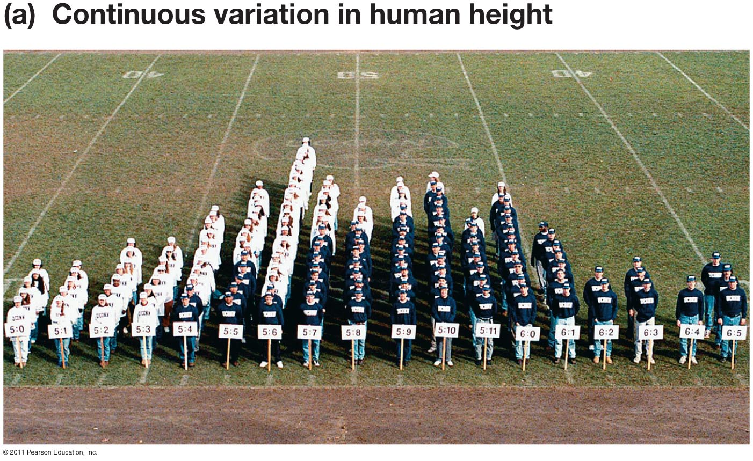
Genetic Diversity and Distribution

Slide 39
Quantitative Traits
Quantitative traits are __________ distributed
Bell curve: distribution of values is symmetrical around the average
Actual distribution
Normal distribution

Slide 40
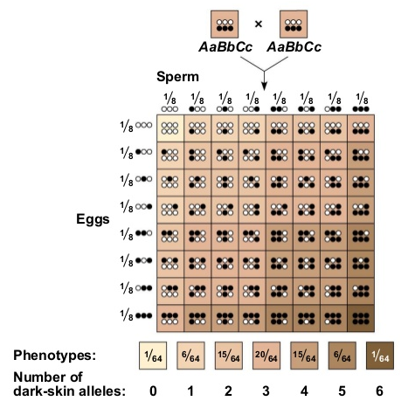
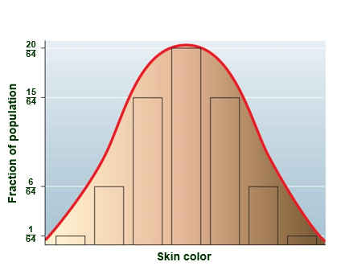
Polygenic Inheritance
Ex: Skin color

Slide 41
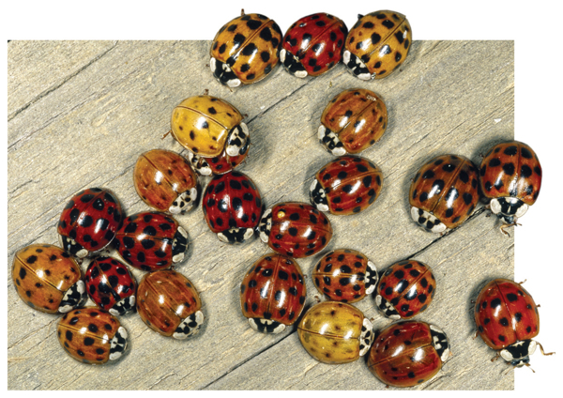
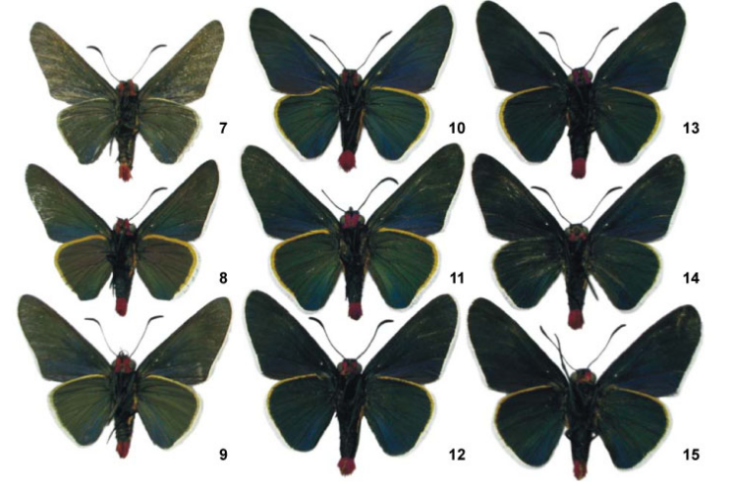
Within Species Variation
Within species variation is the basis for ____________ change

Slide 42
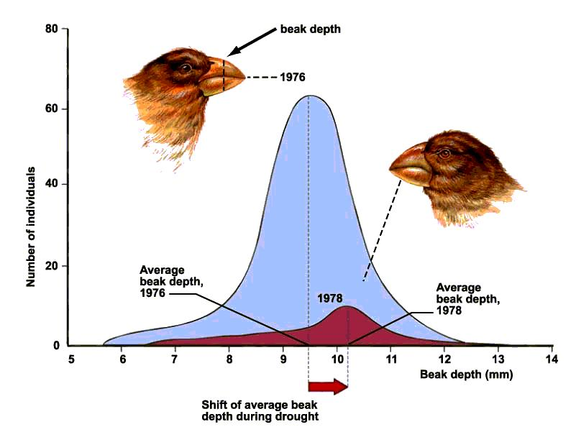
Genetic Variation and Evolution
Average beak depth in Galapagos finches shifted towards thicker beaks after a drought
Thicker billed individuals better at eating large seeds of drought tolerant plants.

