Slide 1
Meiosis
“Everybody is identical in their secret unspoken belief that way deep down they are different from everybody else”
– David Foster Wallace
Chapter 10

Slide 2
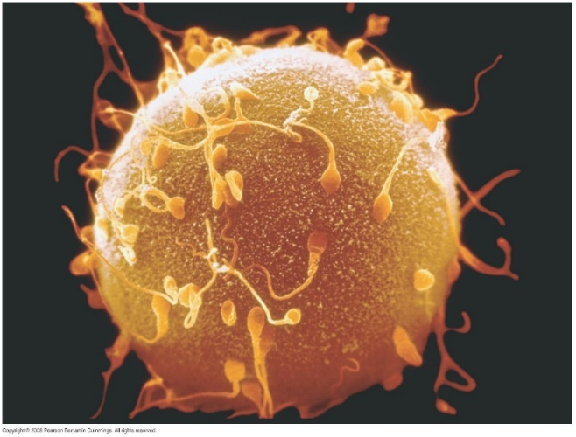
Sexual Reproduction
_______ cells = all cells other than sex cells
Mitosis: division of a cell into two genetically identical daughter cells
Diploid (2n): cells with two versions of each set of chromosomes
Sex cells = ________ = eggs and sperm
Meiosis: formation of reproductive cells with half the number of chromosomes
_______ (n): cells with a single set of each chromosome
Zygote (2n): sperm and egg fused together

Slide 3
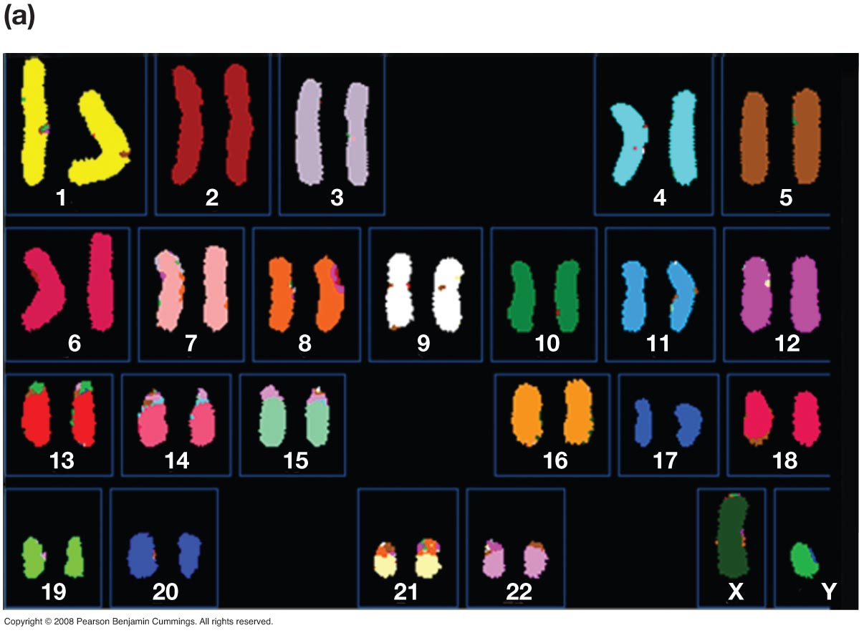
Chromosomes
Normal human karyotype
Human have ___ pairs of chromosomes
22 Autosomes
Non-sex chromosomes
1 pair sex chromosomes
XX = Female
XY = Male

Slide 4
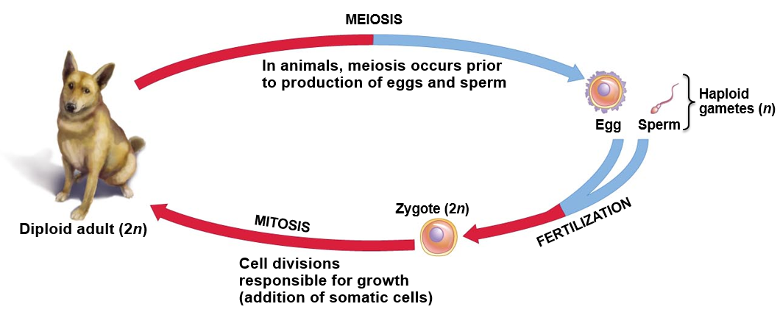
Haploid and Diploid

Slide 5
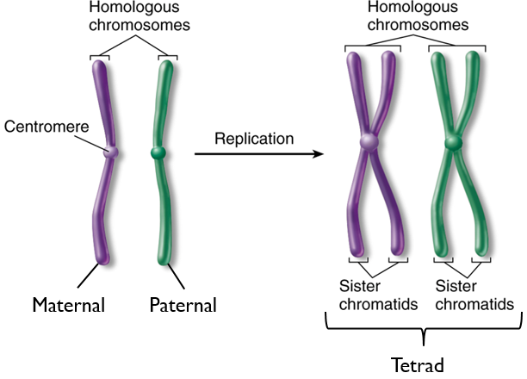
DNA Replication
____________ = chromosomes that are the same in function and size
Diploid organisms have a pair of homologous chromosomes
Tetrad = Pair of homologous chromosomes after replication
Occurs during metaphase I in Meiosis I
Sister chromatids = 1 chromosome

Slide 6
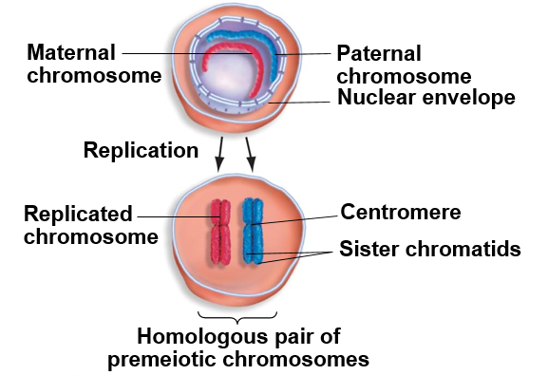
DNA Replication

Slide 7
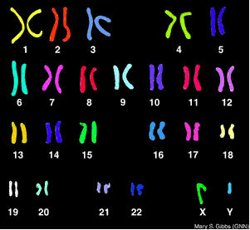
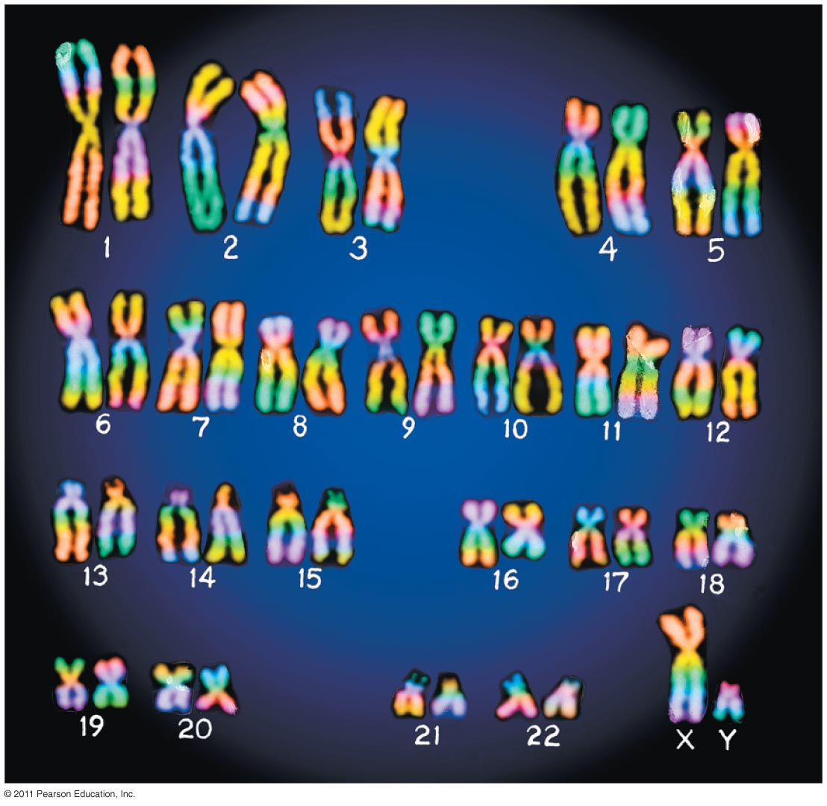
Chromosome Before and After Replication

Slide 8
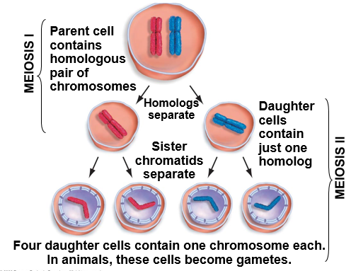
Summary of Meiosis
Two processes of cell division
Meiosis I: homologous chromosomes separate
Meiosis II: _____________ separate

Slide 9
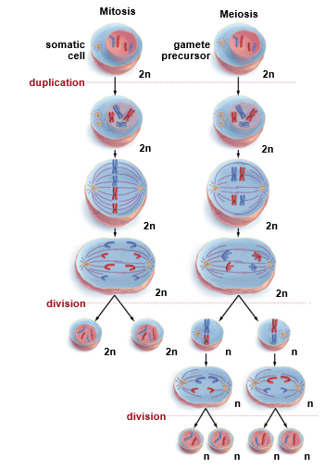
Mitosis
Meiosis I
1. Diploid cells with two pairs of homologous chromosomes (one pair from father and one pair from mother)
Somatic cell
Gamete precursor
2. Chromosomes duplicate to form two sister chromatids
3. Chromosomes line up on metaphase plate, one sister chromatid on each side of the plate
3. Homologous chromosomes line up on opposite sides of metaphase plate
4. Sister chromatids separate
4. Homologous pairs of chromosomes separate, sister chromatids still intact
Meiosis II
5. Chromosomes line up on metaphase plate, one sister chromatid on each side of the plate
6. Sister chromatids separate
7. Cells divide again, 4 haploid cells

Slide 10
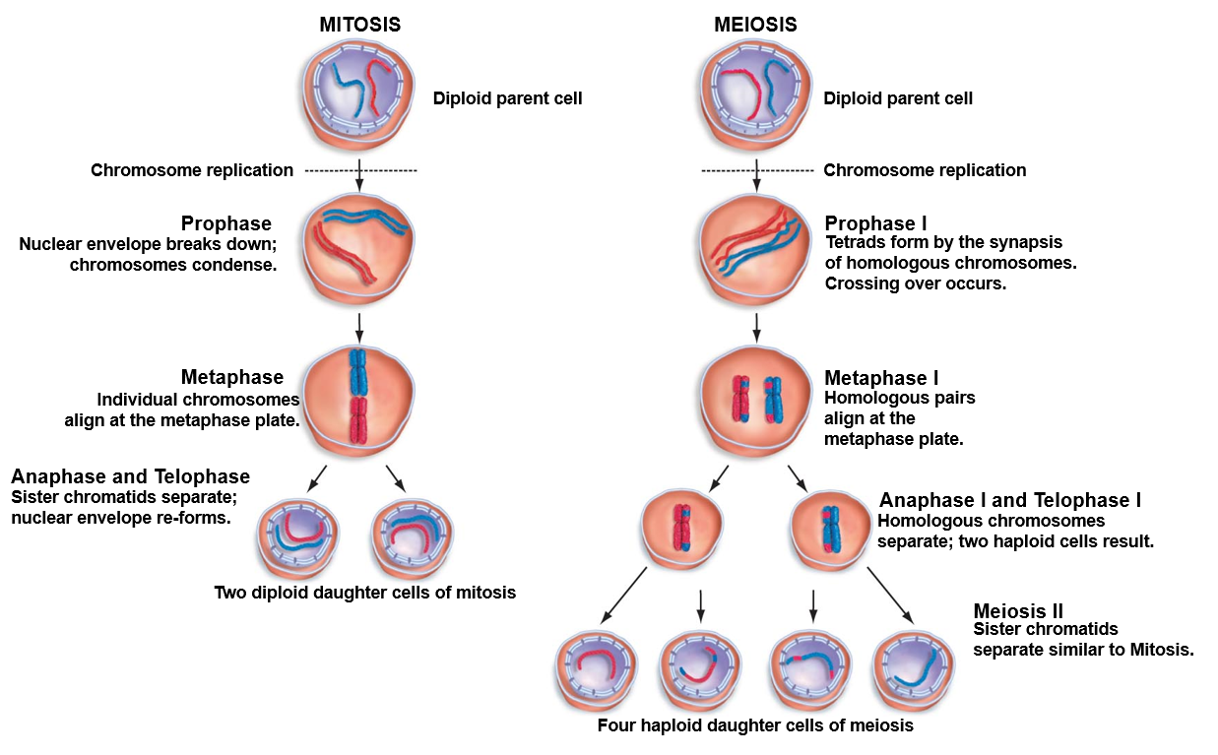

Slide 11
Meiosis vs. Mitosis
Mitosis
Meiosis
Produces 2 ________ daughter cells
Daughter cells 2n (diploid)
One cell division
Occurs in somatic cells for growth/development, and to replace damaged or dead cells
_________ increase genetic diversity
Produces 4 ___________ daughter cells
Daughter cells n (haploid)
Two cell divisions (Meiosis I and II)
Occurs in production of egg and sperm cells (gametes)
___________ genetic diversity

Slide 12
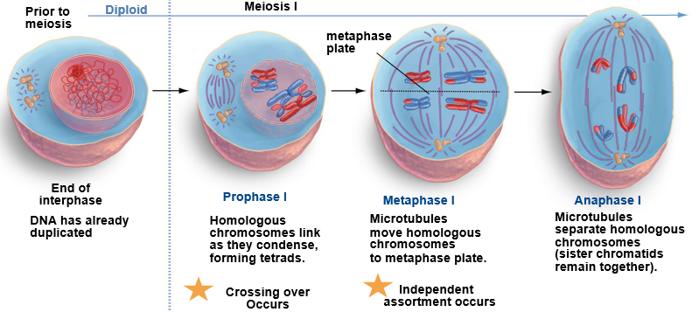
Steps of Meiosis

Slide 13
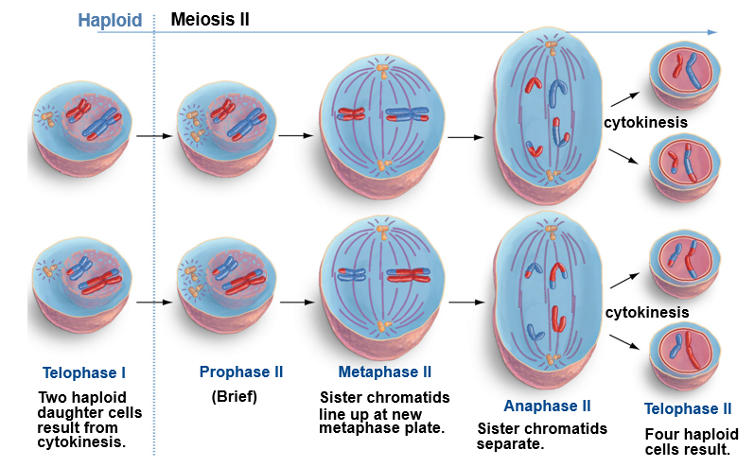

Slide 14
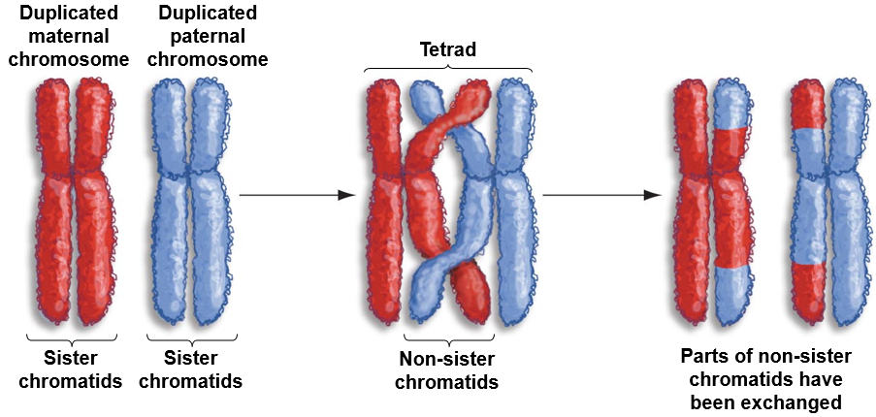
Sources of Genetic Variation
______________ = process in which homologous chromosomes exchange reciprocal portions of themselves during Prophase I

Slide 15
Sources of Genetic Variation

Slide 16
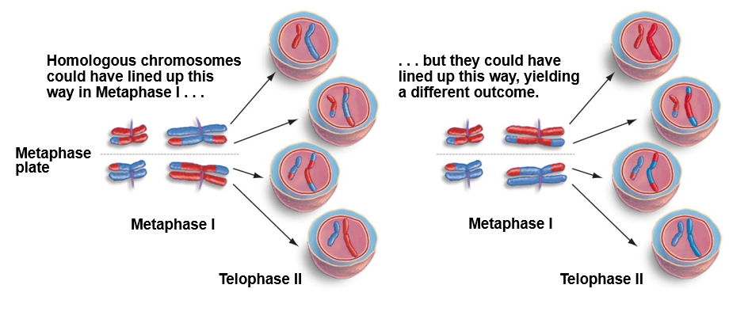
Sources of Genetic Variation
_____________ assortment = random distribution of homologous chromosome pairs during meiosis

Slide 17
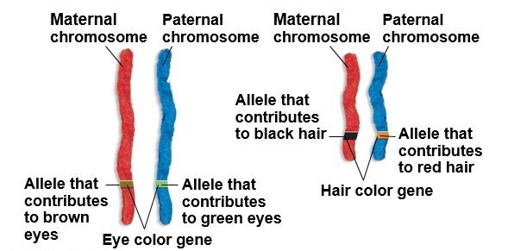
Location of Genes within Chromosomes
Gene = section of DNA that codes for a specific trait
Ex: Hair color
_______ = different versions of a gene
Ex. Black hair or red hair
Notes:
Gene = section of DNA that codes for a specific trait
Allele = different versions of a gene

Slide 18
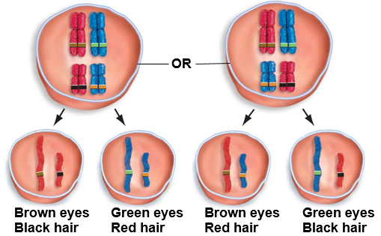
Independent Assortment
During meiosis I, tetrads can ________ two different ways before the chromosomes separate.

Slide 19
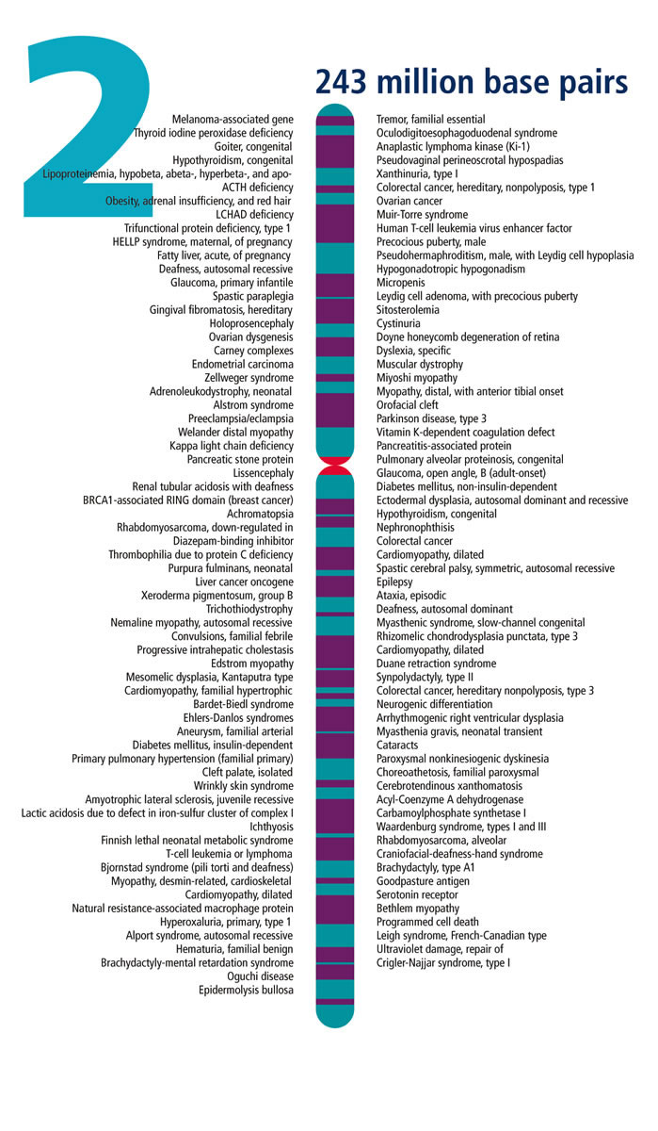
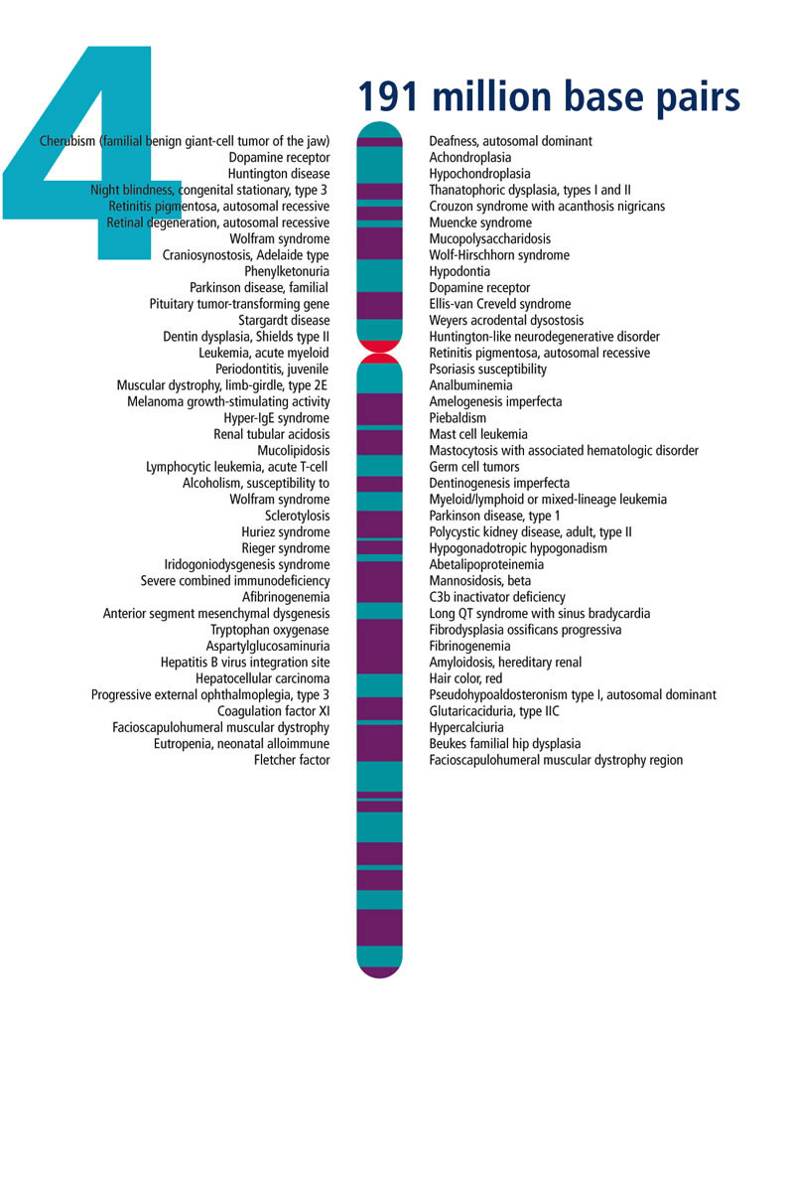

Slide 20
Check you Understanding
1. True or False: Sex cells are diploid
2. True or False: Humans have a total of 46 chromosomes
3. True or False: The purpose of meiosis is to create genetically identical daughter cells

Slide 21
Check you Understanding
4. Crossing over occurs during which of the following phases of meiosis?
a. Metaphase II
b. Prophase I
c. Anaphase I
d. Metaphase I
e. Prophase II

Slide 22
Check you Understanding
5. Sister chromatids pull apart during which of the following phases?
a. Anaphase of Mitosis
b. Metaphase of Meiosis I
c. Anaphase of Meiosis II
d. Metaphase of Mitosis I
e. More than one of the above

Slide 23
Genetic Diversity
Crossing over and independent assortment are the reason we look a little like each of our parents
Meiosis creates _____________, whereas Mitosis makes genetic copies retaining the quality of cells in subsequent generations
This variation in offspring is not limited to humans. Variation exists among all living things and is the basis for all evolution!!
Evolution starts with the variable survival and reproduction of individuals in a population with certain traits

Slide 24
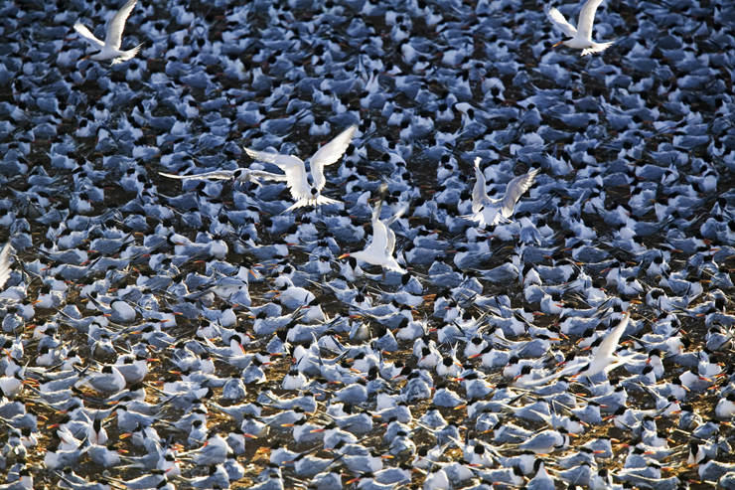
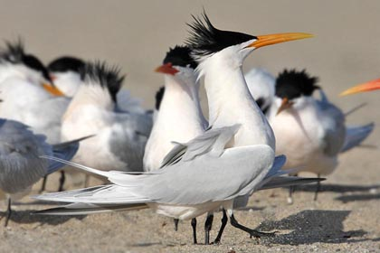
Genetic Diversity
“To them, we all look the same” – Dr. Horn

Slide 25
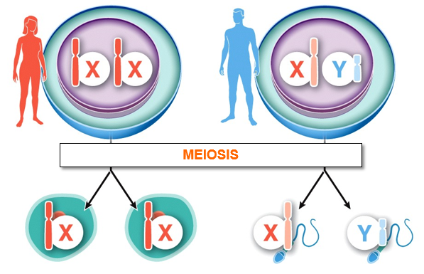
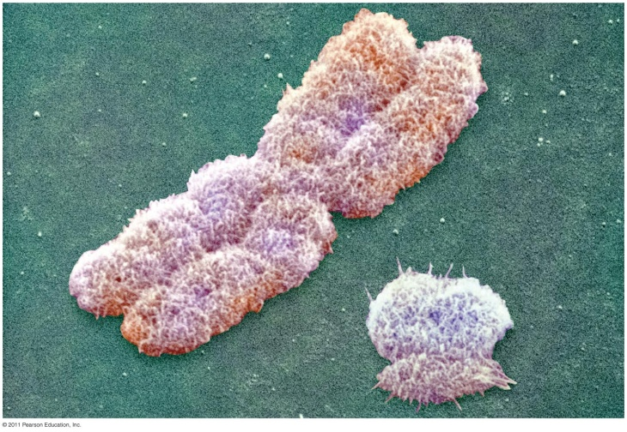
Boys and Girls
Individuals have two copies of sex chromosomes in every cell
Females = Two X chromosomes
Males = One X and one Y chromosome
Each egg gets one X chromosome
Half the sperm cells get an X chromosome, and half get a Y chromosome

Slide 26
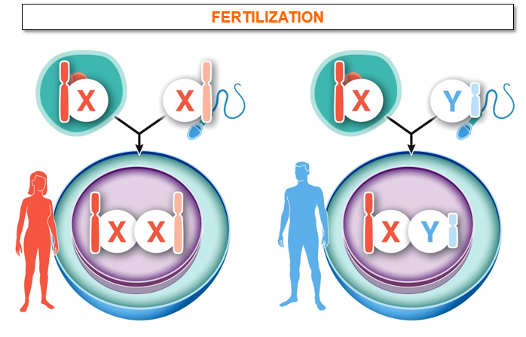
Boys and Girls
During fertilization, a sperm cell with an X chromosome will produce a female, while a sperm cell with a Y chromosome will produce a male offspring
______ determine the sex of the child
Notes:
Males decided the sex of the offspring

Slide 27
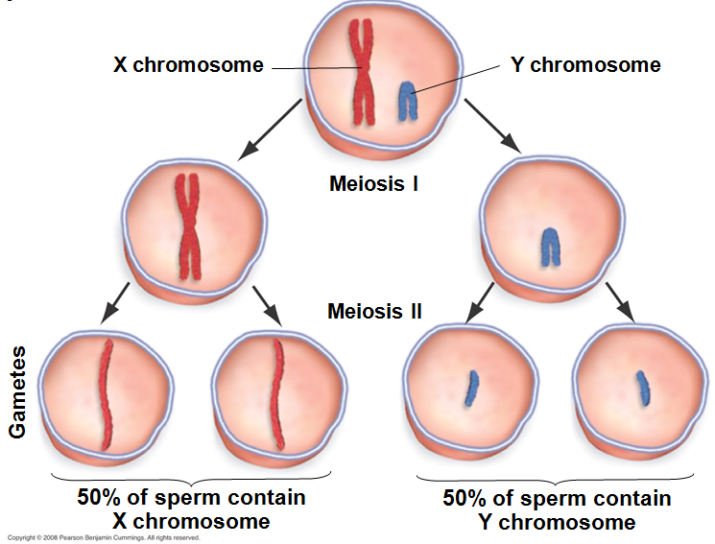
Sex of the Child
Half of the sperm produced have X chromosome and half have Y chromosome
__% chance of having either a boy or a girl

Slide 28
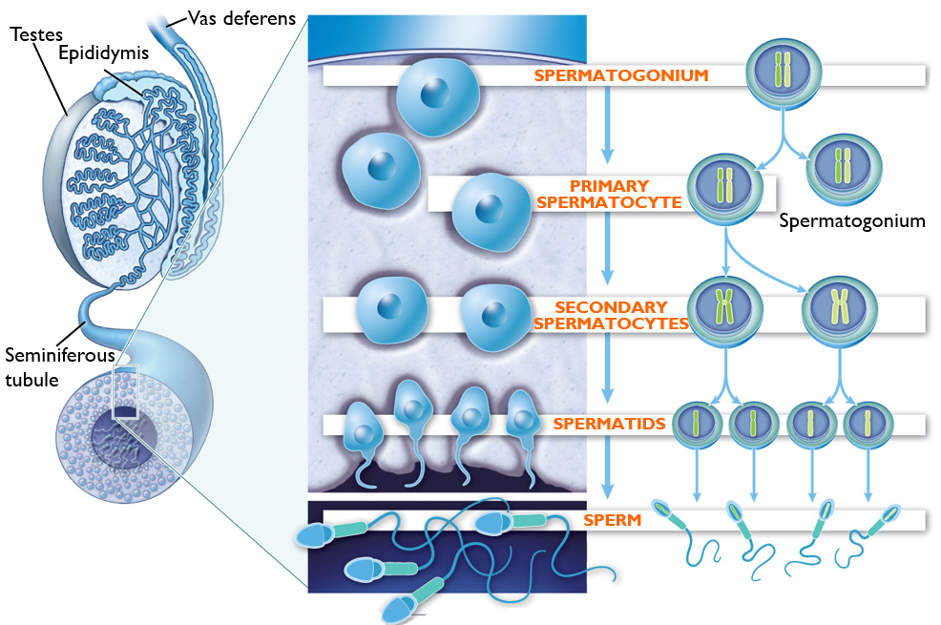
Spermatogenesis
Sperm cells develop in the seminiferous tubules in the testes then mature in the epididymis before being transported through the vas deferens during ejaculation.
Mitosis
Meiosis 1
Meiosis 11
Maturation
Image modified from What is Life? A Guide to Biology, Third Edition
© 2015 W. H. Freeman and Company

Slide 29
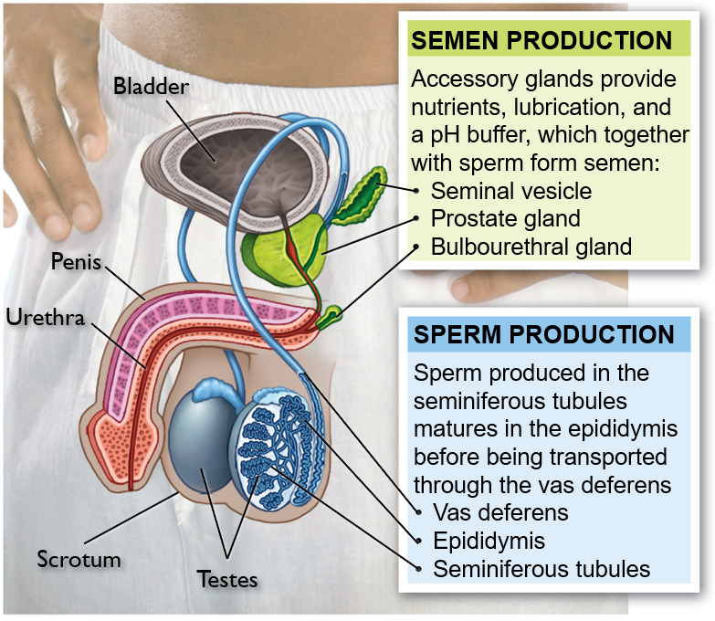
Male Reproductive Organs
Image modified from What is Life? A Guide to Biology, Third Edition
© 2015 W. H. Freeman and Company

Slide 30
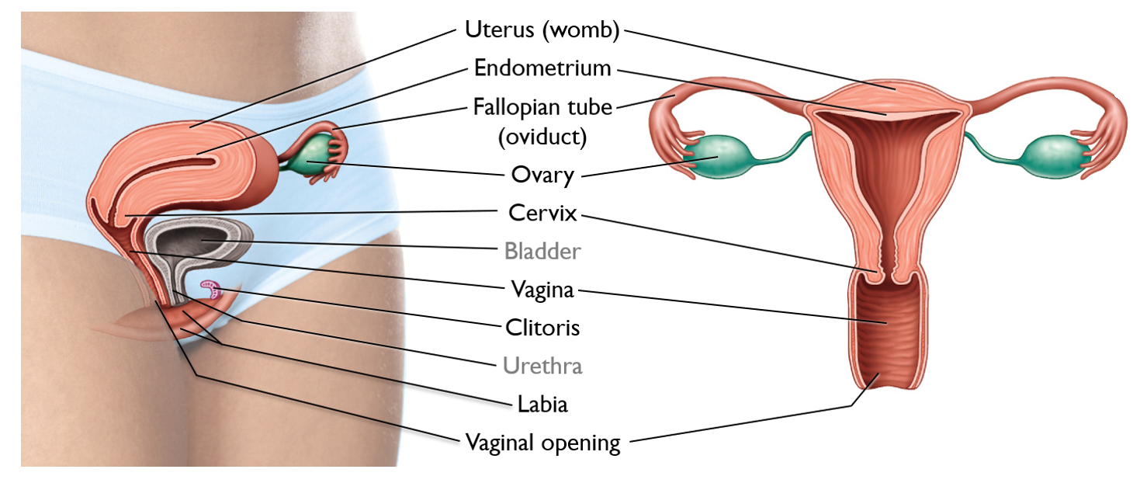
Female Reproductive Organs
Image modified from What is Life? A Guide to Biology, Third Edition
© 2015 W. H. Freeman and Company

Slide 31
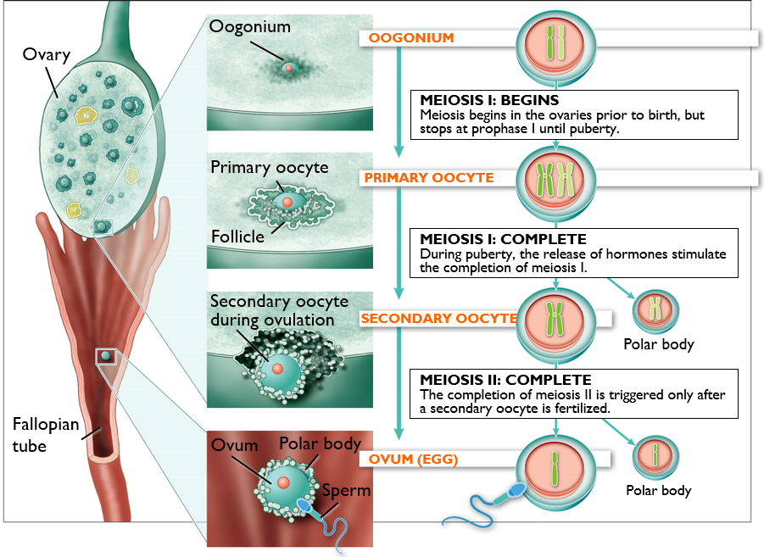
Oogenesis and the Release of an Egg
1. Oogonia (precursors to eggs) multiply by mitosis when the female fetus is developing.
2. Each oogonium begins meiosis but stops at Prophase 1, becoming a primary oocyte in a follicle (tissue where the egg will form)
3. After puberty follicle stimulating hormone (FHS) stimulates primary oocytes to complete meiosis 1. Two cells are formed, but almost all of the cytoplasm goes into the secondary oocyte with the polar body disintegrating later.
4. During ovulation, a follicle in the ovary ruptures and releases the secondary oocyte, which has yet to complete meiosis II. If fertilized by sperm, the secondary oocyte will complete meiosis II, resulting in another polar body and the ovum or egg with most of the cytoplasm
Image modified from What is Life? A Guide to Biology, Third Edition
© 2015 W. H. Freeman and Company

Slide 32
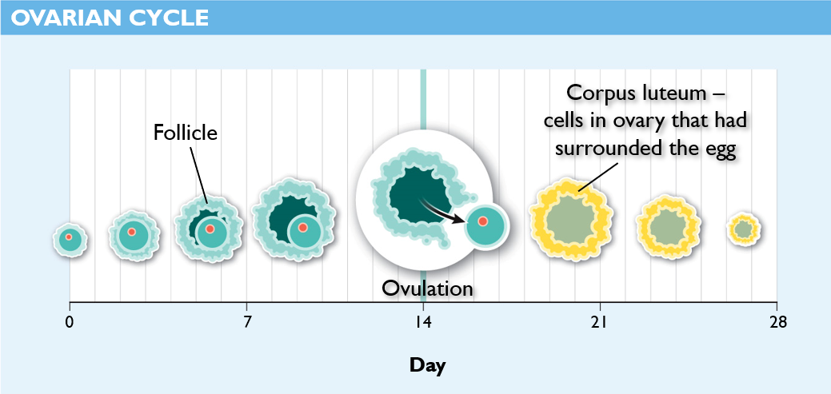
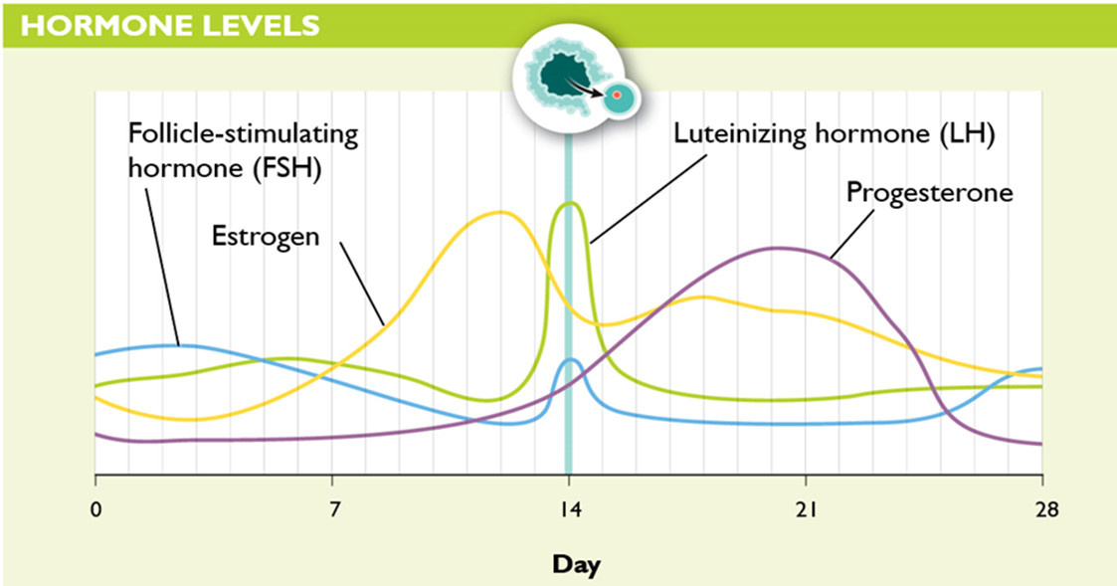
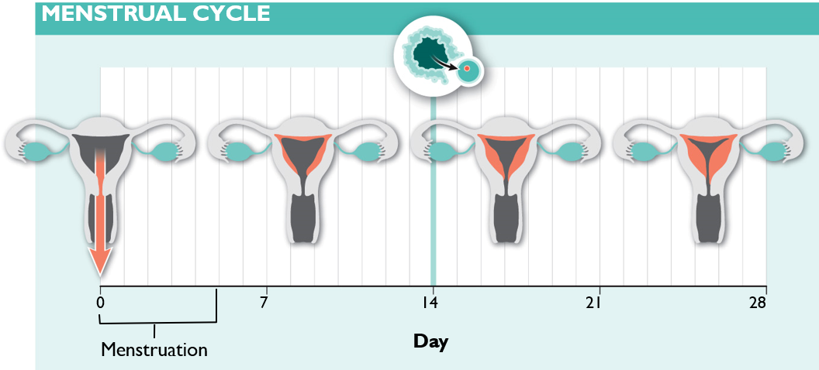
Female Reproductive Cycle
The ovarian cycle (egg development) and menstrual cycle (development and release of endometrium) are controlled by the female’s hormone levels.
Ovulation
Ovulation

Slide 33
Female Reproductive Cycle
Follicle-stimulating hormone (FHS): stimulates primary oocyte to complete meiosis
Progesterone: causes a thickening of the endometrium in preparation for implantation. Corpus luteum cells produce progesterone after the follicle releases the secondary oocyte
Estrogen: primary female sex hormone. Estrogen released from developing follicles cause a release of luteinizing hormones (LH)
Luteinizing hormone (LH): triggers ovulation, or the release of the secondary oocyte from the follicle.

Slide 34
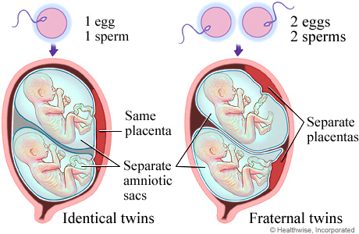
Making Twins
Identical twins
1 egg and 1 sperm
Egg divides after fertilization
Babies develop in same placenta
Fraternal twins
2 eggs and 2 sperm
Babies develop in separate placentas

Slide 35
Check Your Understanding
True or False: Sperm is produced in the prostate gland
True or False: Identical twins are the result of a single egg fertilized by two sperm cells
True or False: All of a females eggs are produced before she is born

Slide 36
Check Your Understanding
Which of the following are not involved in the production of semen?
a. Epididymis
b. Prostate gland
c. Seminal vesicle
d. Vas deferens
e. More than one of the above

Slide 37
Check Your Understanding
Which of the following best describes the function of luteinizing hormone (LH) during the female reproductive cycle?
a. Causes the thickening of the endometrium
b. Stimulates the primary oocyte to complete meiosis I
c. Stimulates the release of the secondary oocyte from the follicle.
d. Causes the endometrium to break down during menstruation
e. None of the above are correct concerning luteinizing hormone

