Slide 1
Marine Fishes
“Everyone is a genius. But if you judge a fish on its ability to climb a tree, it will live its whole life believing it is stupid”
–Albert Einstein
Chapter 8

Slide 2
Introduction to Fishes
“Fish”: poikilothermic, aquatic chordate with appendages developed as fins (when present), whose chief respiratory organ are gills and whose body is usually covered in scales
All fishes…
have distinct head region (eyes, mouth, etc.) and brain protected by braincase
Most fishes…
live in water
breathe with gills rather than lungs
are unable to regulate their body temperature
are covered in scales
have paired limbs in the form of fins
Notes:
Fish = plural for multiples of single species
Fishes = multiple fish from more than one species

Slide 3
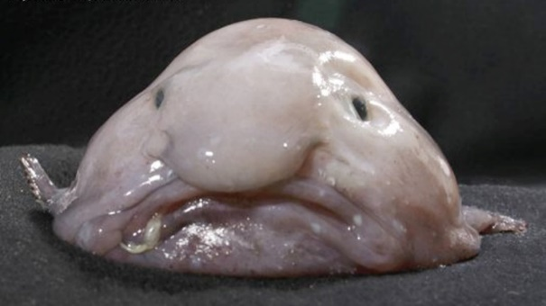
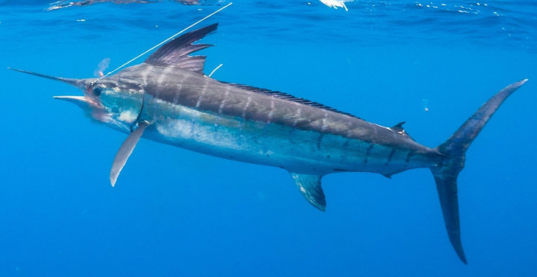
Diversity of Fishes
More fish species than birds, reptiles and mammals combined
27,900 species described
58% live in salt water, 41% in freshwater, and 1% move between salt and freshwater
Life span
Pygmy goby < 60 days Shape
Rockfish >200 years
Size
Minnow ≈ 0.3 in
Whale shark > 65ft
Notes:
Fish = plural for multiples of single species
Fishes = multiple fish from more than one species

Slide 4
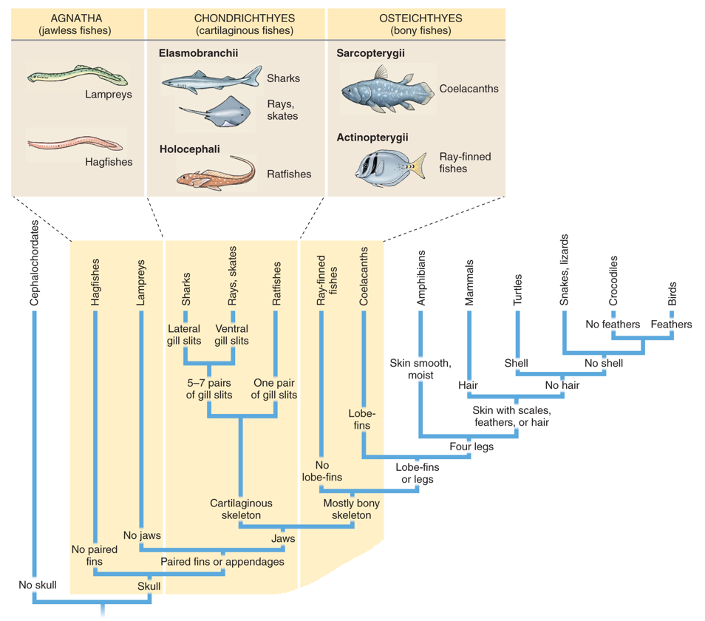
Major Groups of Fishes
Agnatha:
_________ fishes
Chondrichthyes: Cartilaginous fishes
Osteichthyes:
Bony fishes

Slide 5
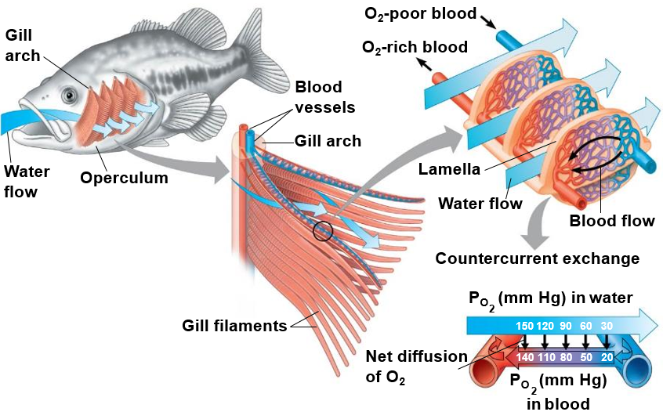
Respiration in Fishes
Countercurrent gas exchange: oxygen-poor blood runs ________________ to water high in oxygen content
Diffusion gradient for oxygen maintained along entire gill surface
Maximum efficiency in gas exchange

Slide 6
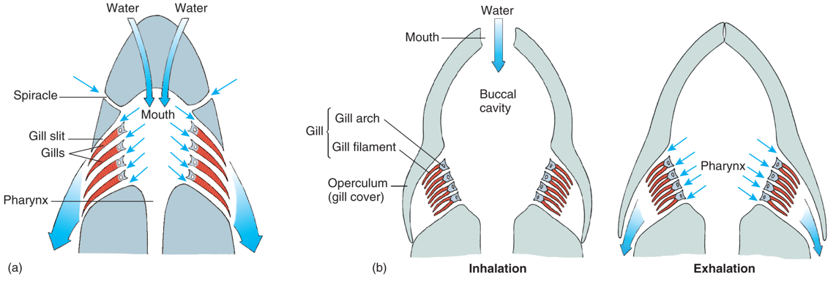
Respiration in Fishes
Most cartilaginous fish must swim ____________ to force water through their mouth and over their gills
Skates and rays that live on the bottom can take in water through the spiracle while buried in the sandy bottom
Most bony fish draw water into the buccal (mouth) cavity while the opercula are closed, then the fish close their mouth and contract their pharynx, forcing water across their gills
Most bony fish do not need to constantly swim to perform gas exchange

Slide 7
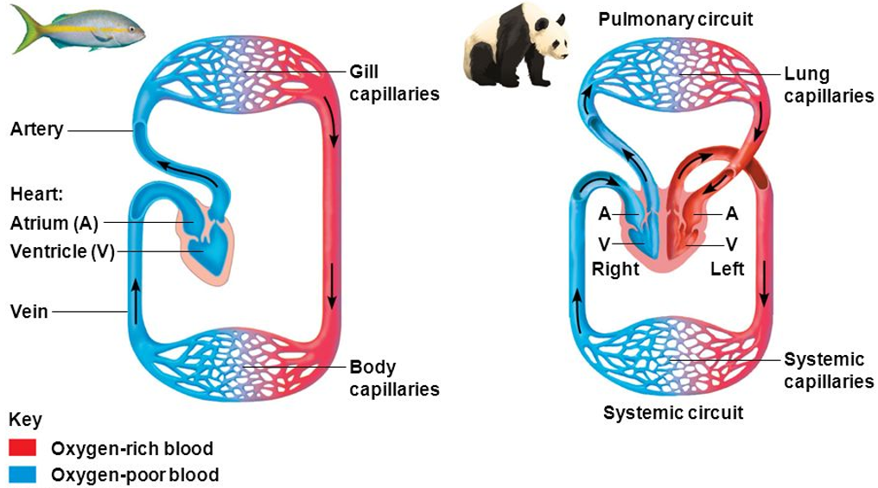
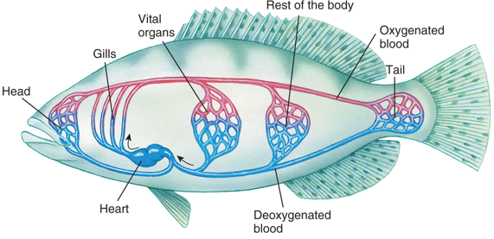
Fish Circulatory System
Fish have a _______________ heart (one atrium and one ventricle) and single circuit circulatory system.
Birds and mammals have a four chambered heart (two atria and two ventricles) and a double circuit circulatory system.
Increased _________________

Slide 8
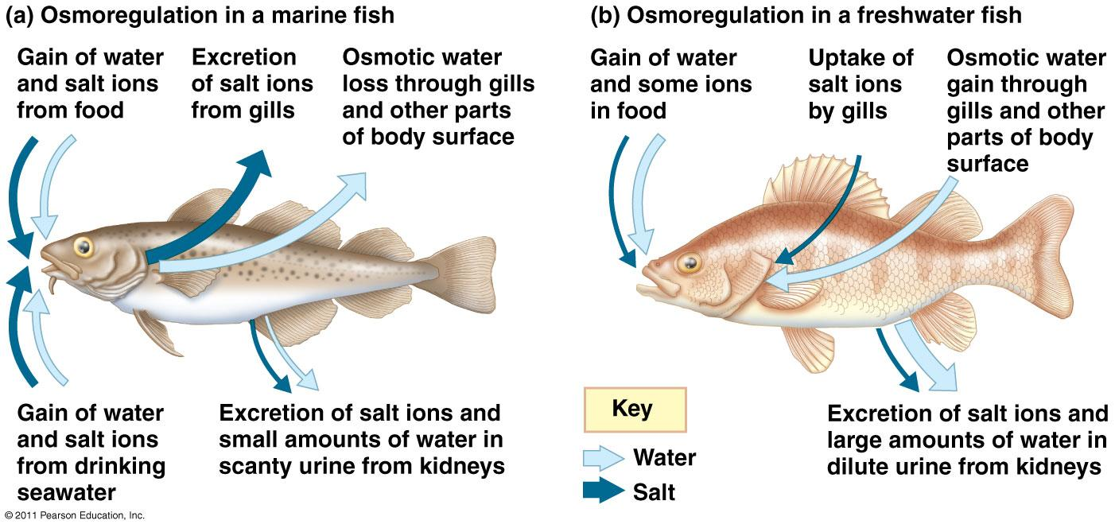
Osmoregulation in Fish
Osmoconformers: isotonic (same solute concentration) to surrounding water
Most marine invertebrates
___________________: actively regulate body osmolarity (solute concentration)
Most fish

Slide 9
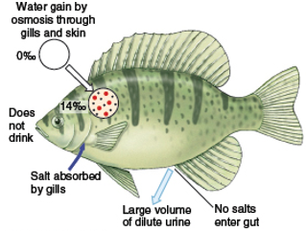
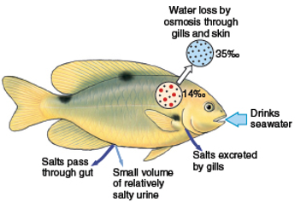
Osmoregulation in Fish
The cells of freshwater fish are _________ to the surrounding fresh water so freshwater fish are constantly gaining water and must excrete large volumes of water
The cells of marine fish are ________ to the surrounding salt water so marine fish are constantly losing water and must drink seawater to replace lost water
Freshwater fish
Marine fish

Slide 10
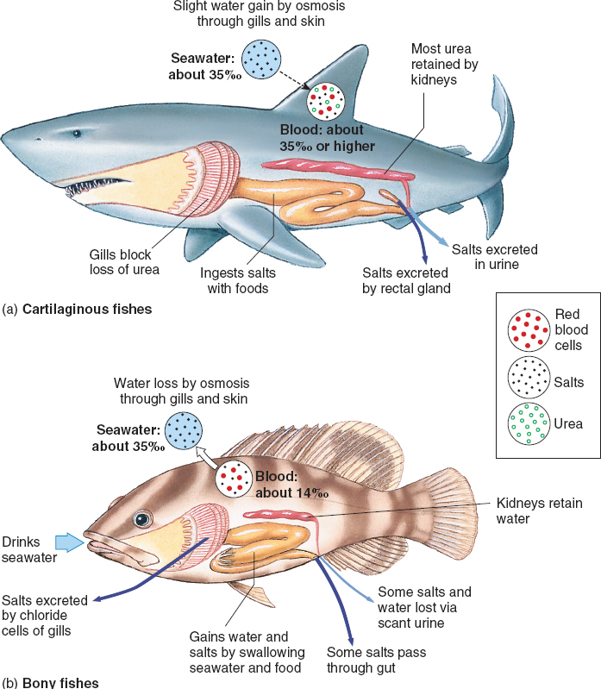
Osmoregulation in Fish
Sharks and other cartilaginous fishes concentrate urea in their blood which makes the solute concentration in their blood __________ to the surrounding seawater.
Excess salt secreted through specialized rectal gland
Marine bony fishes actively regulate their salt concentrations by excreting excess salts through their _____________

Slide 11
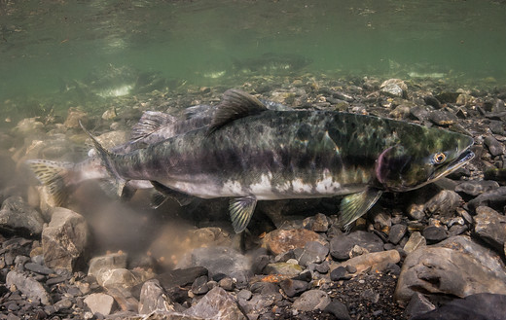
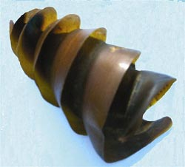
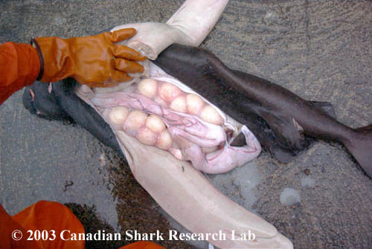
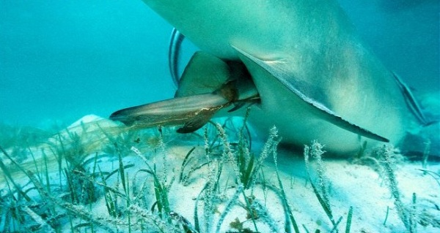
Modes of Reproduction
Ovuliparity: female lays unfertilized eggs, which are externally fertilized by the male
Most bony fish
__________: the mother deposits internally fertilized eggs that develop and hatch outside of mother’s body
Some bony fish and some sharks
Ovoviviparous: mother retains fertilized eggs within the oviduct, but __________ provide nourishment to the eggs
Few sharks
Viviparous: young develop within mother’s uterus and receive nourishment via the placenta, uterus or by eating other eggs, before being born (live birth)
Some sharks and fish

Slide 12
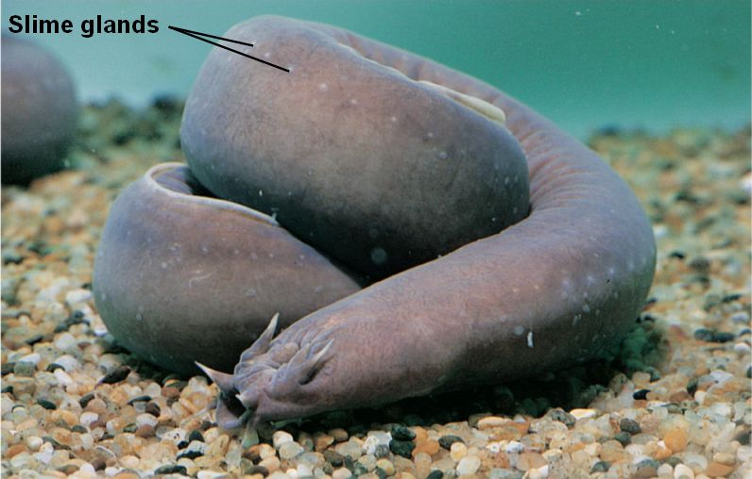
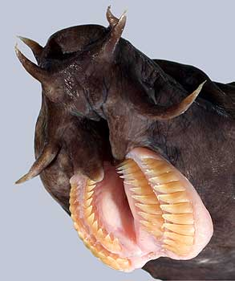
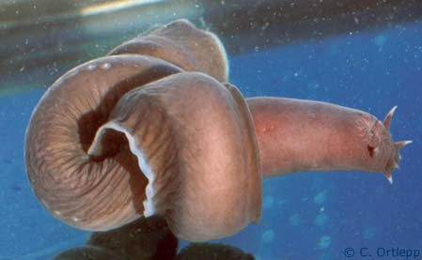
Agnatha
Hagfish
__________
Reduced vertebrae with cartilaginous braincase
Marine scavengers
Produce ________
Lack scales and paired appendages
Reduced brain, eyes, ears, and nasal opening
Tie themselves in a knot to release slime or provide leverage when feeding
Barbels

Slide 13
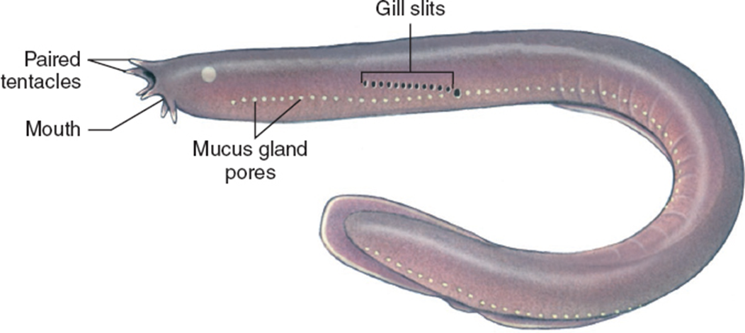
Hagfish Slime
https://youtu.be/Bta18FdkVcA

Slide 14
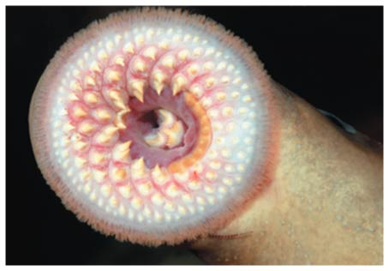
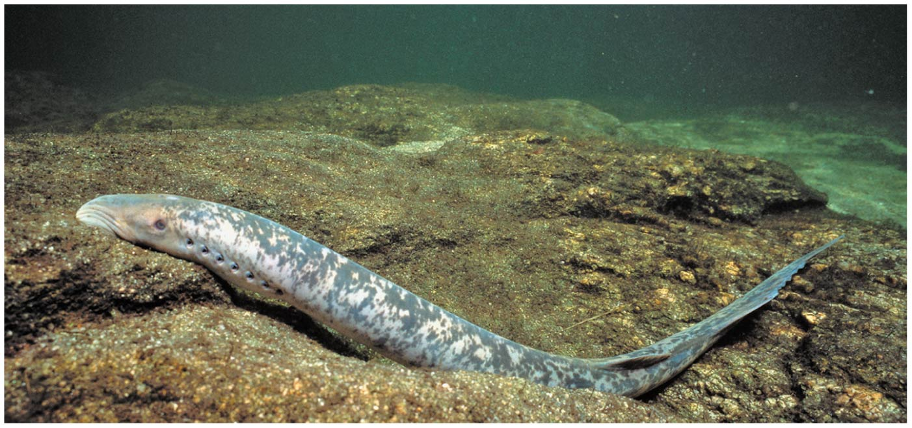
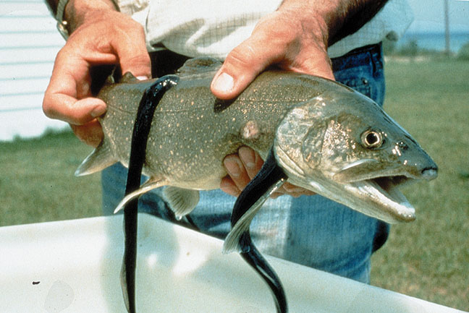
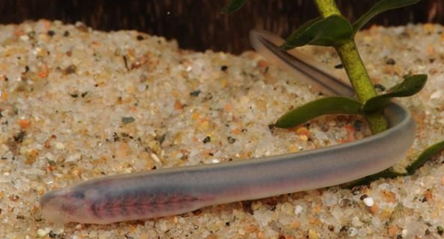
Agnatha
Lampreys
Jawless
Rudimentary vertebrae and cartilaginous skeleton
Marine and freshwater
____________: migrates to fresh water to spawn
Ammocoetes larvae: filter feeders, buried in sediment
Most are parasitic
Lack scales and paired appendages

Slide 15
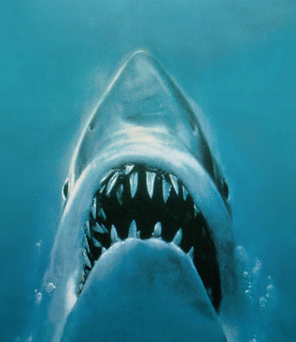
Evolution of Jaws
Jaws likely developed from gill arches used in filter feeding
Lead to the diversification of food types (carnivory and herbivory)
Allowed for active defense from ____________
De-emphasis on armored plates
Development of paired appendages
Notes:
“Perhaps the greatest of all advances in vertebrate history was the development of jaws and the consequent revolution in the mode of life of early fishes” –Romer 1962

Slide 16
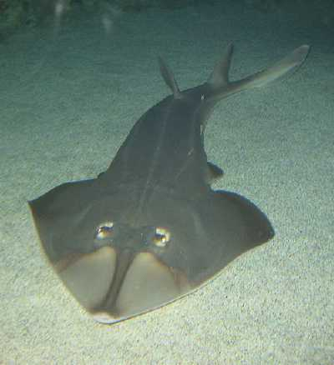
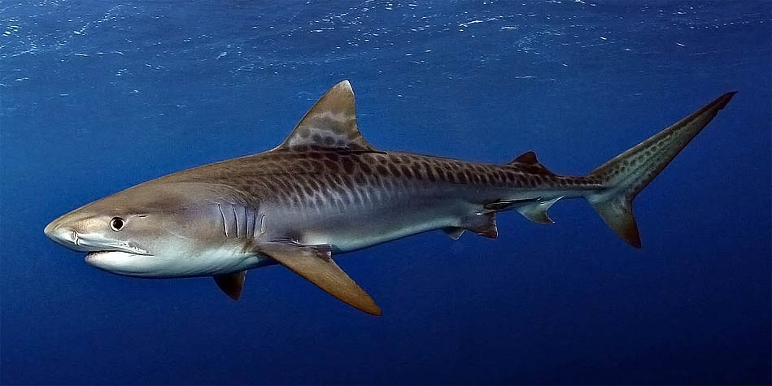
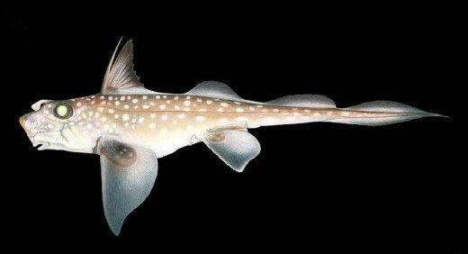
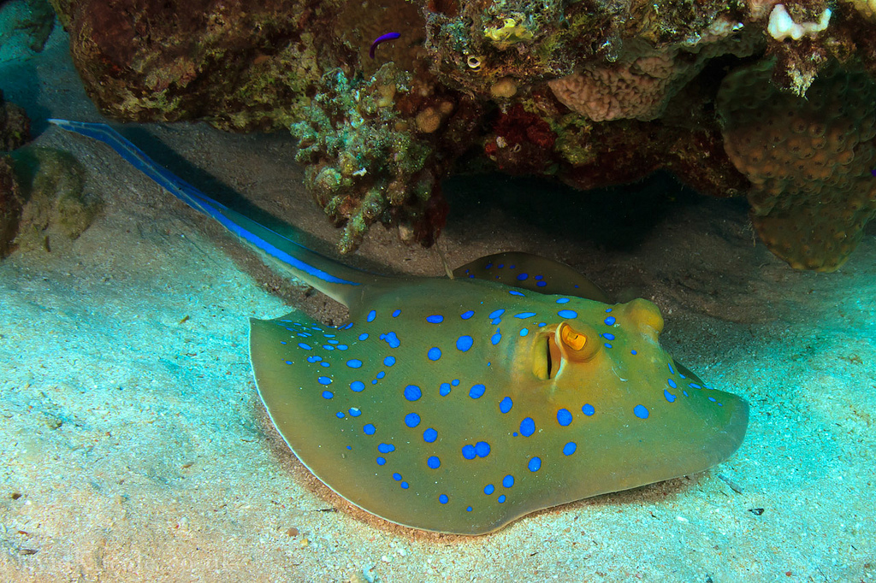
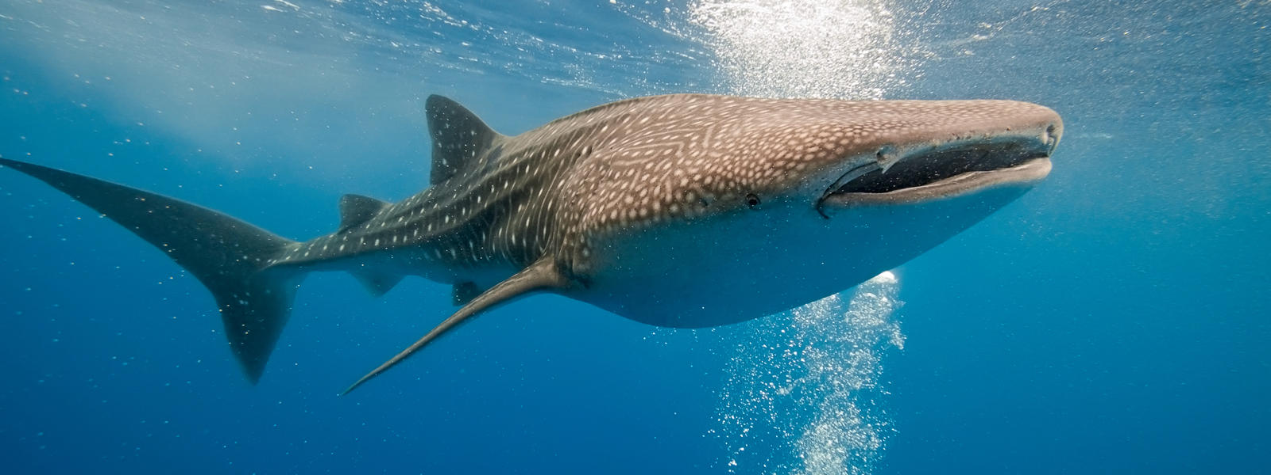
Class Chondrichthyes (kon-DRIK-thee-EEZ)
_____________ skeleton
Placoid scales
Teeth derived from placoid scales are not fused with jaw
Replaceable (every few days)
Large, buoyant livers
Lack gas bladder or lungs
____________ intestine
Highly developed sensory organs
Internal fertilization

Slide 17
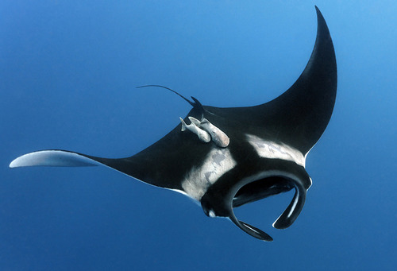
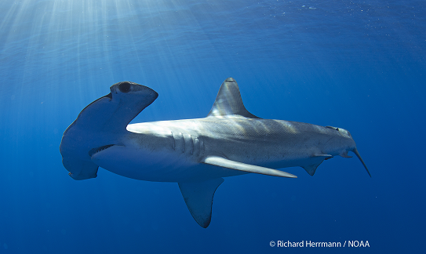
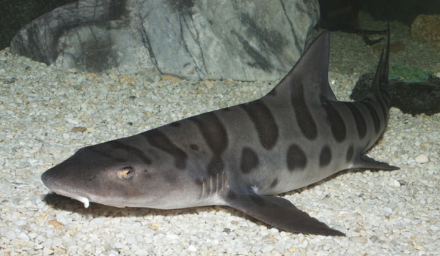
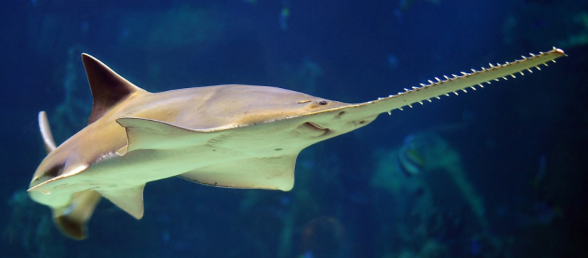
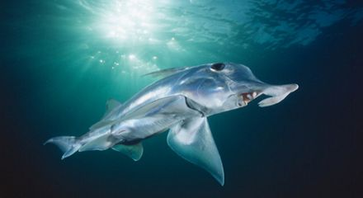
Class Chondrichthyes
Subclass Elasmobranchii
Sharks (8 orders, ~360 species)
Most are large (> 1m)
Most are active marine predators
Skates, Rays, Electric rays, Sawfish (4 orders, ~550 species)
Flattened bodies
Bottom dwelling predators
Subclass Holocephali
Chimaera (rat fish) (1 extant order, ~50 species)
Feed on benthic invertebrates in deep ocean

Slide 18
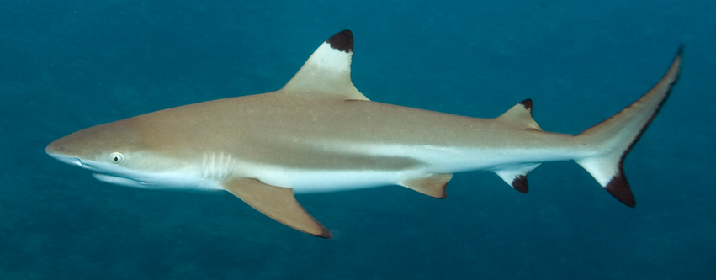
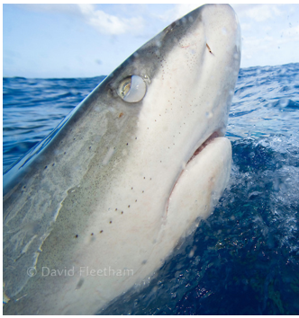
Class Chondrichthyes, Subclass Elasmobranchii
Sharks
Almost exclusively marine
Two dorsal fins, an anal fin, and 5 to 7 gill openings
______________ caudal fin
Nictitating membrane: translucent third eyelid that protects the eye when feeding
Elevated body temperature in some
Dorsal fins
Gill openings
Anal fin
Nictitating membrane

Slide 19
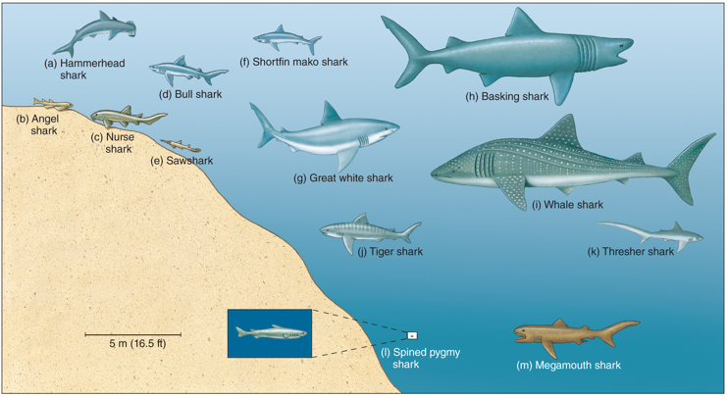
Distribution of Sharks in the Ocean
Sharks are found in nearly all habitats in the ocean and specialize in a variety of different prey types.

Slide 20
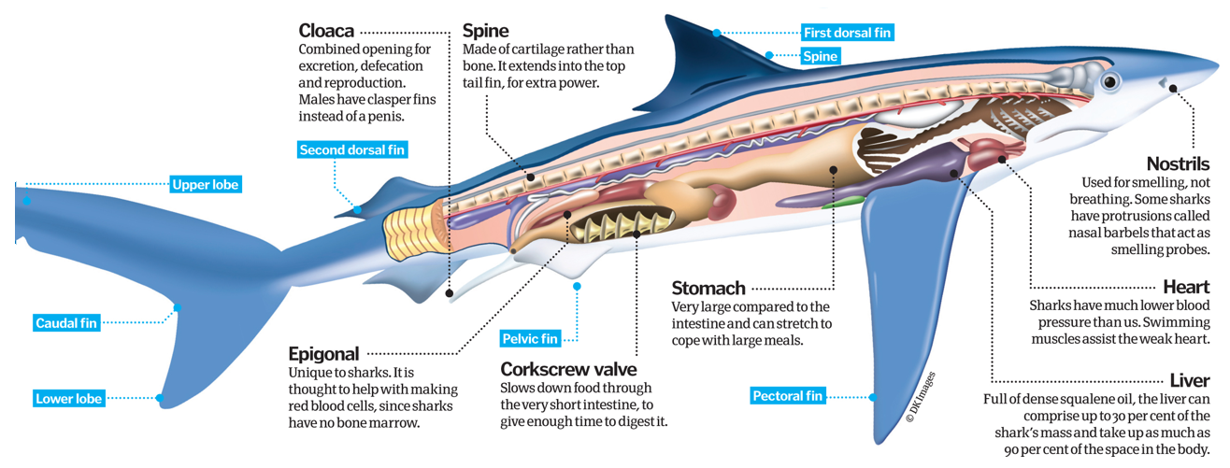
Anatomy of a Shark
Spiral valve

Slide 21
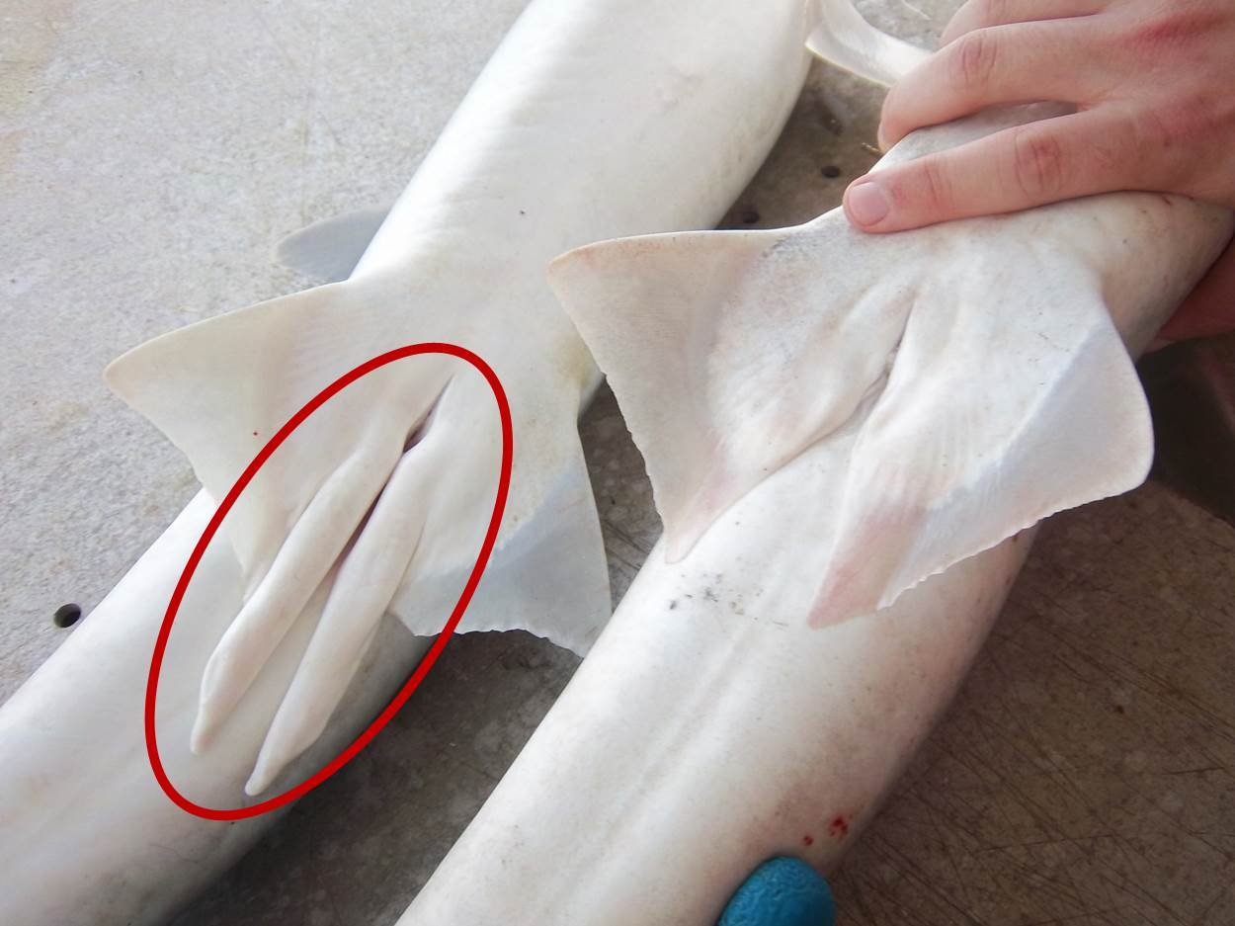
Chondrichthyes Reproduction
_______ of male shark
Cloaca of female shark

Slide 22
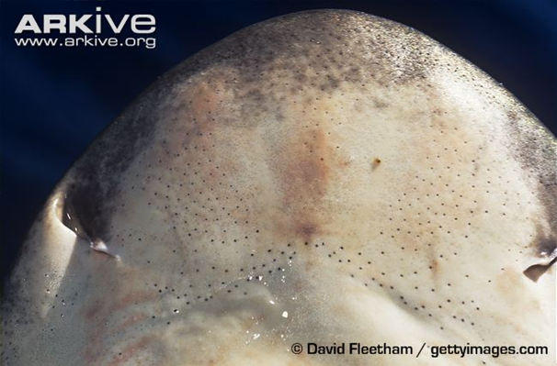
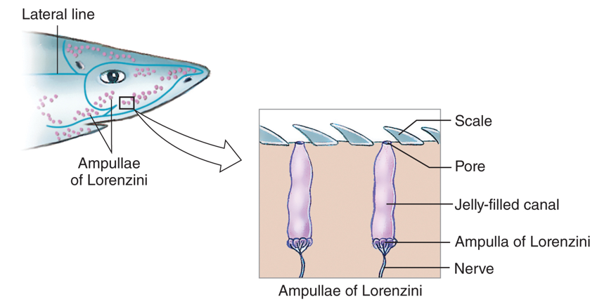
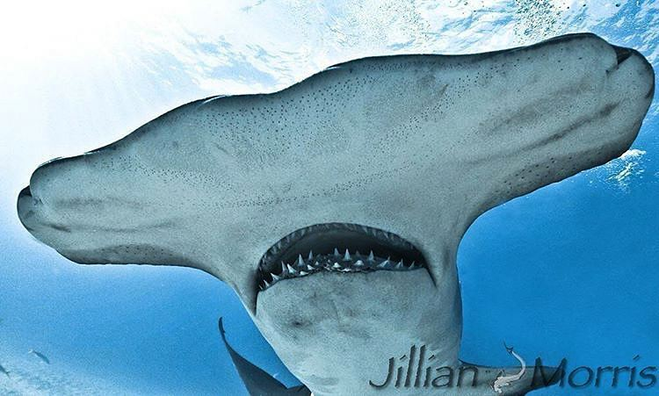
Ampullae of Lorenzini
Ampullae of Lorenzini: small, jelly filled pores that contain ______________, which can sense the electric fields produced by other fish
Ampullae of Lorenzini

Slide 23
Endothermy in Fish
_________________ heat exchange keeps swim muscles warmer in tuna, billfish, and some sharks
Warmer swim muscles allows predatory fish to swim faster and hunt in colder water

Slide 24
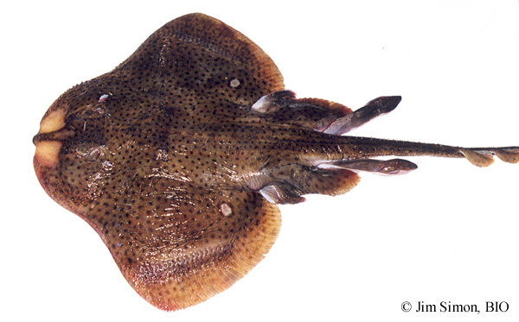
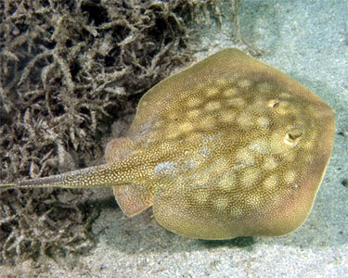
Class Chondrichthyes, Subclass Elasmobranchii
Most skates and rays are ________, which means they live on the bottom. When buried in the sandy bottom, water enters through the ________ and exits through the gills on their ventral side
Skates
Thorns on back
_________________
Two lobes on pelvic fin
Lay eggs (oviparous)
Rays
No thorns on back
Stinging spine
One lobe on pelvic fin
Live birth (viviparous)
Thorns
Stinging spine
Two lobes
Single lobe

Slide 25
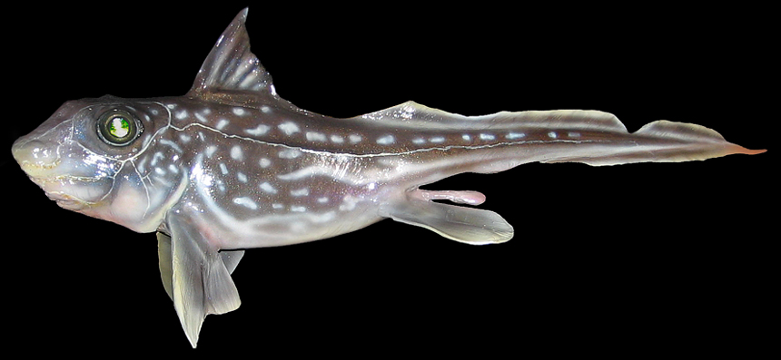
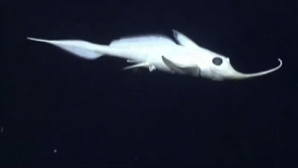
Class Chondrichthyes, Subclass Holocephali
Chimaera (ratfish)
Oviparous
One pair of gill slits
Upper jaw attached to braincase
Teeth modified as crushing plates
Diet of benthic invertebrates
Poisonous spine before first dorsal fin
Move by flapping pectoral fins
____________

Slide 26
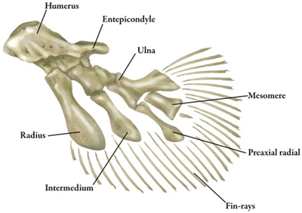
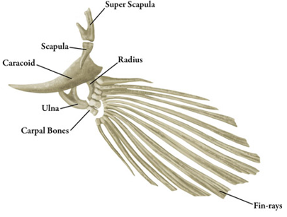
Osteichthyes (AH-stee-IK-thee-eez)
Bony fishes
Ossified (bony) endoskeleton
Pair of lungs or swim bladder
Bony fin rays
Ganoid, ctenoid, or cycloid scales (no placoid)
Divided into Two Classes
Class Sarcopterygii (sar-KOP-tuh-RIJ-ee-eye)
_____________ fishes
Pectoral and pelvic fins made of rod-shaped bones surrounded by muscle
Class Actinopterygii (ACK-tih-NOP-tuh-RIJ-ee-eye)
____________ fishes
Elongated, flexible fin rays
Lobed fin
Rayed fin

Slide 27
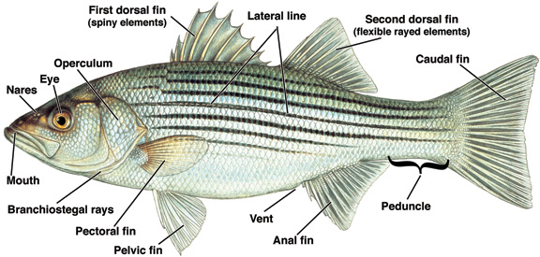
External Anatomy of a Bony Fish
Operculum: bony gill cover
Nares: nasal openings

Slide 28
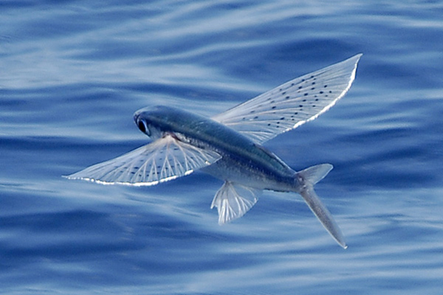
Modified Fins
The modified pectoral fins of the flying fish allow them to glide above the surface to evade predation
Tripod fish have modified pectoral fins and caudal fin that allow them to “walk” along the bottom
Clingfish have modified pelvic fins to form sucking disc that allows them to adhere to the substrate

Slide 29
Lateral Line
Lateral line: sensory organ along the side of the body used to detect vibrations and movements

Slide 30
Coloration in Fish
__________________: a type of camouflage where the dorsal side of the organism is darker than the ventral side of the organism.
Warning coloration: colors that warn potential predators that an organism may be dangerous or poisonous
Cryptic coloration: colors that allow fish to blend into their environment

Slide 31
Internal Anatomy of a Bony Fish
Swim bladder (gas bladder): internal air filled organ that aids in buoyancy

Slide 32
Differences Between Cartilaginous Fish and Bony Fish
Mouth ventrally located
5 to 7 gill slits
Placoid scales
Heterocercal caudal fin
Spiracle: respiratory opening
Large lipid-rich liver
Mouth at front of body (terminal)
Single gill cover (operculum)
Ctenoid or cycloid scales
Homocercal caudal fin
Swim bladder

Slide 33
Differences Between Cartilaginous Fish and Bony Fish
Cartilaginous fish have large, fleshy pectoral fins that provide lift, and a heterocercal tail that draws the head upward when swimming
Bony fish have a ____________ to maintain buoyancy, which allows them to use their thin, rayed fins for maneuverability
Greater diversity of swimming styles in bony fishes

Slide 34
Locomotion in Fish
Fish with elongated bodies, like eels, swim by undulating their entire bodies in waves from their head to their tail
Fast moving fish have more rigid bodies and move by flexing the caudal (tail) portion of their bodies
Some fishes swim by moving just their fins, especially the caudal and pectoral fins
Trunkfishes and porcupine fishes swim by just moving their caudal fin

Slide 35
Fish Body Shape
Streamlined body for fast swimming
Ex: tuna, most sharks, sardines
Dorsoventrally flatted bodies in demersal species
Ex: sea moth, flounder, skates, rays
Long, slender bodies in species that live among vegetation or in the rocks
Ex: gunnel, eels, pricklebacks
Slow swimming species have bulky, rigid bodies
Ex. seahorses, trunkfish, porcupine fish
Tuna
Sea moth
Flounder
Gunnel
Eel
Seahorse
Trunkfish
Porcupine fish

Slide 36
Fish Behavior
__________: a group of fish swimming in the same direction in a coordinated manner
Provides protection against predators
Confusion effect
Increase swimming efficiency
Reduced drag
Advantage in feeding and mating

Slide 37
Class Sarcopterygii – Lobed Finned Fishes
Coelocanths
Three lobed caudal fin
Fleshy operculum
Jointed skull
Viviparous
______________: electroreceptive organ located in the front of the braincase
Believed to have gone extinct 65mya
Re-discovered in 1938
Populations near Indonesia and South Africa

Slide 38
Class Sarcopterygii – Lobed Finned Fishes
Lungfish
All freshwater fish
Lungs
Breathe air
Slender fins
Single, long tapered caudal fin
Omnivorous diet
Can survive dry conditions by estivating in mucus-lined burrow for up to 4 years!
Largest genome among vertebrates
Notes:
Estivation: reduced activity during warm summer months

Slide 39
Class Actinopterygii – Ray Finned Fishes
Sturgeons and Paddlefishes
Primitive characteristics
Mostly cartilaginous skeleton
Heterocercal tail
Spiral valve intestine
Lack of vertebral centrum
Marine, freshwater and anadromous
_________
Barbels
4 in Sturgeons
2 in Paddlefish
Lack scales
Notes:
Secondary evolution of cartilaginous skeleton
Draw heterocercal and homocercal tail on board
Long lived species declining due to verexploitation, dams and habitat destruction

Slide 40
Class Actinopterygii – Teleost Fishes
Teleost fishes
____% of all living fishes (38 orders and 426 families)
Occupy nearly all freshwater and marine habitats
Most diverse group of all vertebrates
Significant variation in body plans, foraging and reproductive behaviors
Homocercal caudal fin
Mobile pre-maxilla bone
__________________
Notes:
“Perfect bone” refers to the reduction in bone mass but not strength

Slide 41
Jaw Protrusion in Teleost's
As the mandible moves downward the premaxilla shoots forward creating a suction that draws prey into the mouth.

Slide 42
Class Actinopterygii
True Eels
Elongated fish with dorsal and anal fins fused with caudal fin
Leptocephalus larvae: flat, ribbon-shaped, transparent larvae
______________: fish that breed in the sea then migrate to freshwater to grow and mature

Slide 43
Class Actinopterygii
Anchovies, Sardines, and Herring
Inner ear to gas bladder connection
Improves hearing of low frequency sounds
Most are marine, open water schooling species
Filter feeders
Important commercial fish
____________ for many predators including marine mammals, seabirds, and large predatory fish like tuna and marlin

Slide 44
Class Actinopterygii
Minnows, Catfish, Knifefish, Piranha
Dominant freshwater fish species
_________ apparatus: set of bones that connect the inner ear to the gas bladder
Improved hearing
Response to alarm signals of conspecifics
Brain
Semicircular canals
Weberian ossicles
Vertebrae
Ribs
Swim bladder

Slide 45
Class Actinopterygii
Cypriniformes: Minnows, Carp, Shiners
2nd largest order of fish
Early pharyngeal dentition
Invasive species in many freshwater habitats
Characiformes: Piranha, Tetras
Mostly tropical
Mouth teeth and replacement dentition
Adipose fin
Siluriformes: Catfish
Barbels
No scales

Slide 46
Class Actinopterygii
Salmon and Trout
____________: fish that breed in freshwater then migrate to the oceans to grow and mature
Ecologically and commercially important species
Reduced populations
Alteration to river systems (Dams)
Overfishing
Non-breeding male
Breeding male

Slide 47
Class Actinopterygii
Lanternfish
Deep sea fishes
Laterally compressed, with large eyes
Bioluminescence
Photophores
Majority of deep sea biomass (65%)
Diel _________________
From ~ 10,000ft deep to ~ 30ft deep
Important food source for marine predators
High lipid content
Photophores

Slide 48
Class Actinopterygii
Smelt
Small, silvery, elongate fishes
Single soft rayed dorsal fin
Freshwater, marine, diadromous
Delta smelt and Candlefish
Dragonfish, hatchetfish
Deep sea
__________________
Photophores: light producing organ

Slide 49
Class: Actinopterygii
Spiny-rayed fishes
Spiny rays on first dorsal fin, pelvic and anal fin
Two dorsal fins (1st spiny, 2nd soft)
Ascending process of premaxilla
Improved jaw protrusion
____________ dentition
Specialized depending on food type
Spiny fin rays
Soft fin rays
Ascending process

Slide 50
Spiny-rayed Fishes
Spiny-rayed fishes
Pelvic girdle attached to pectoral girdle
Increased maneuverability
Pelvic fin with anterior spine and 5 soft rays
Ctenoid scales
Pectoral girdle
Pelvic girdle
Spine

Slide 51
Spiny-rayed Fishes
Cod, Haddock, Pollock
Benthic marine
Nocturnally active
Barbels
Three dorsal fins, two anal fins
Commercially important
Fish and chips!
Populations declines due to ___________

Slide 52
Spiny-rayed Fishes
Pipefish, Seahorses, Sea dragons
Fused jaws form long snout
Pivot feeding (Super fast!)
Plates of body armor
Lack pelvic fins
Prehensile tail
_____ carry eggs in pouch or on tail

Slide 53
Spiny-rayed Fishes
Tuna, Mackerel, Bonito
Large, fast marine predators
Most are schooling
Open ocean (pelagic)
Two dorsal fins and strong caudal fin
Finlets behind dorsal and anal fins
Regional ______________
Non-protrusable jaw
Commercially important food
Populations declining
Overfishing
Finlets

Slide 54
Spiny-rayed Fishes
Wrasses, Bass, Cichlids, and Perch
Largest vertebrate order (Perciformes)
Contains ~ 40% of all fish species
Abdominal pelvic fins and lateral pectoral fins
Pelvic fins with one spine and five soft rays
Ctenoid scales
Lateral Pectoral fin
Abdominal pelvic fin

Slide 55
Spiny-rayed Fishes
Hermaphrodites: an organism that has __________________ reproductive organs
Simultaneous hermaphrodites: organisms that can produce both egg and sperm at the same time
Some deep water fishes
Sequential hermaphrodites: organisms that transition from one sex to another during their lifetime
Many wrasses (ex: sheephead)
Female sheephead
Female sheephead transitioning to male
Male sheephead

Slide 56
Spiny-rayed Fishes
Rockfish and Sculpin
Bony ridge/spines on _______
Most have spines on head
Round pectoral and caudal fins
Carnivorous
Live near bottom
Long lived
Spines on cheek

Slide 57
Spiny-rayed Fishes
Flatfishes (flounders, soles, halibut)
_____________ symmetric larvae metamorphose into flat formed adults
Left-eyed or right-eyed
Benthic carnivores
Camouflaged
Commercially important

Slide 58
Spiny-rayed Fishes
Triggerfish, Pufferfish, Mola Mola
Teeth in the outer jaws
Derived from jaw bone (not true teeth)
Four in some pufferfish
Mostly tropical reefs
Often eat animals inaccessible to other fishes
Sponges, sea jellies, sea urchins, corals
Mola mola’s can have >300,000,000 eggs!

Slide 59
Spiny-rayed Fishes
Silversides (Topsmelt, Grunion)
Two separate dorsal fins are common
Single spine on anal fin
Weak or absent lateral line
Surface-dwelling fish
______________ in grunion
Two dorsal fins

Slide 61
Check Your Understanding
True or False: Sharks are the only fish with a cartilaginous skeleton
True or False: Water moves across the gills moving in the opposite direction of the blood flow
True of False: All fish use gills to breath

Slide 62
Check Your Understanding
Which of the following reproductive strategies involve the mother depositing unfertilized eggs, which are then fertilized externally by the male?
a. Ovulparity
b. Oviparity
c. Ovoviviparous
d. Viviparious

Slide 63
Check Your Understanding
Which of the following fish are characterized by the presence of a Weberian apparatus?
a. Sharks and Rays
b. Tuna and Mackerel
c. Sardines and Anchovies
d. Dragonfish and Hatchet fish
e. Carp and Pirannha

Slide 64
Check Your Understanding
Which of the following are not one of the derived traits found in spiny-rayed fishes?
a. Ascending process
b. Spiny rays on dorsal fin
c. Ear to gas bladder connection
d. Pelvic girdle attached to pectoral girdle

