Slide 1
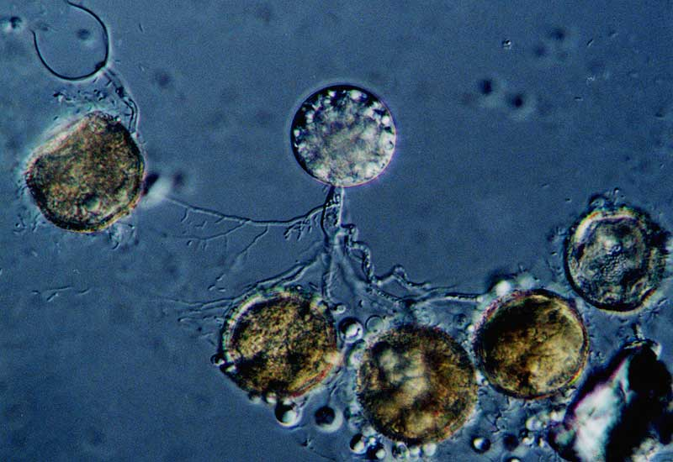
Notes:
Chtrid

Slide 2
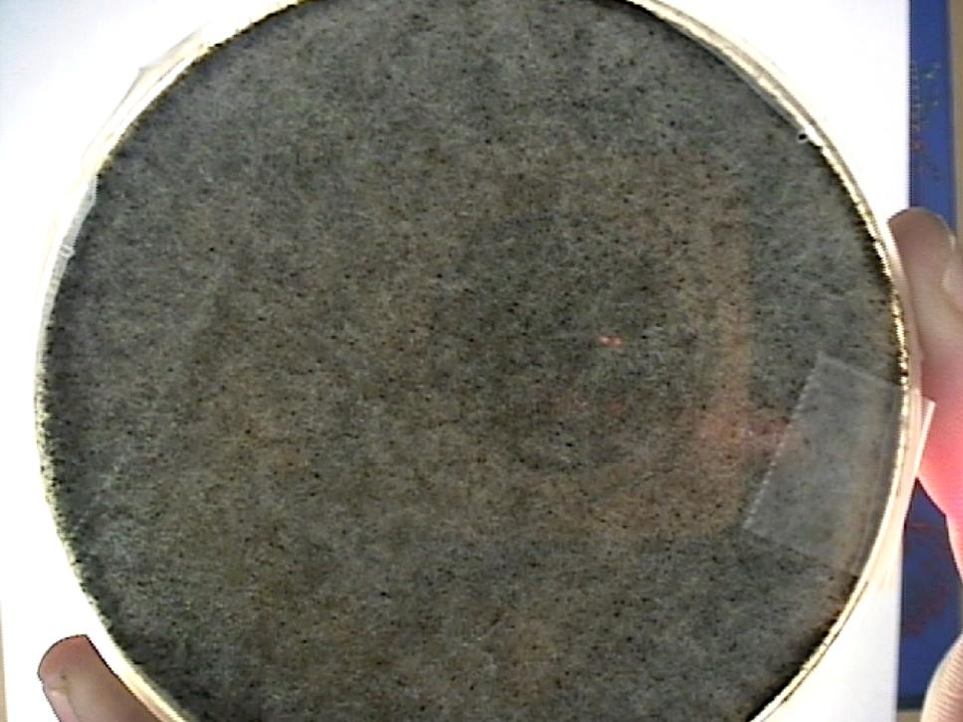
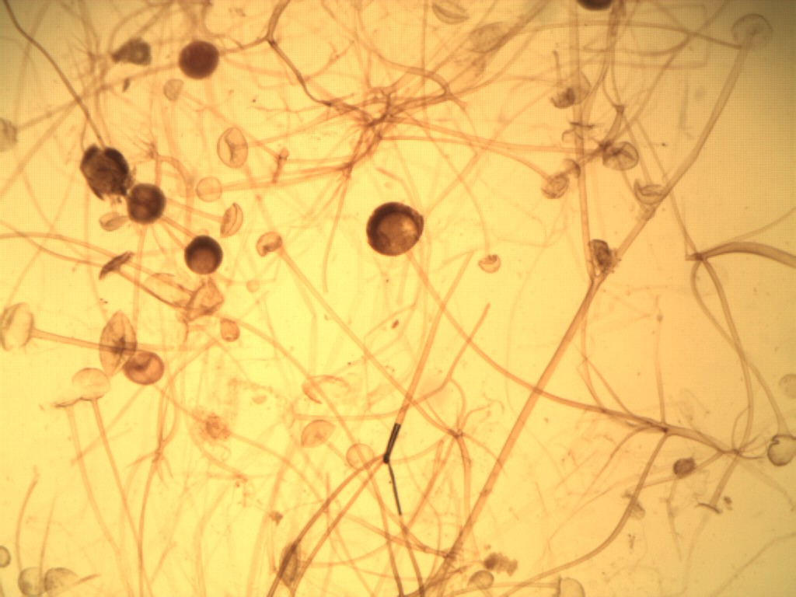
Hyphae
Mycelium
Sporangia
Sporangiophores
Notes:
Rhizopus plate and sporangia

Slide 3
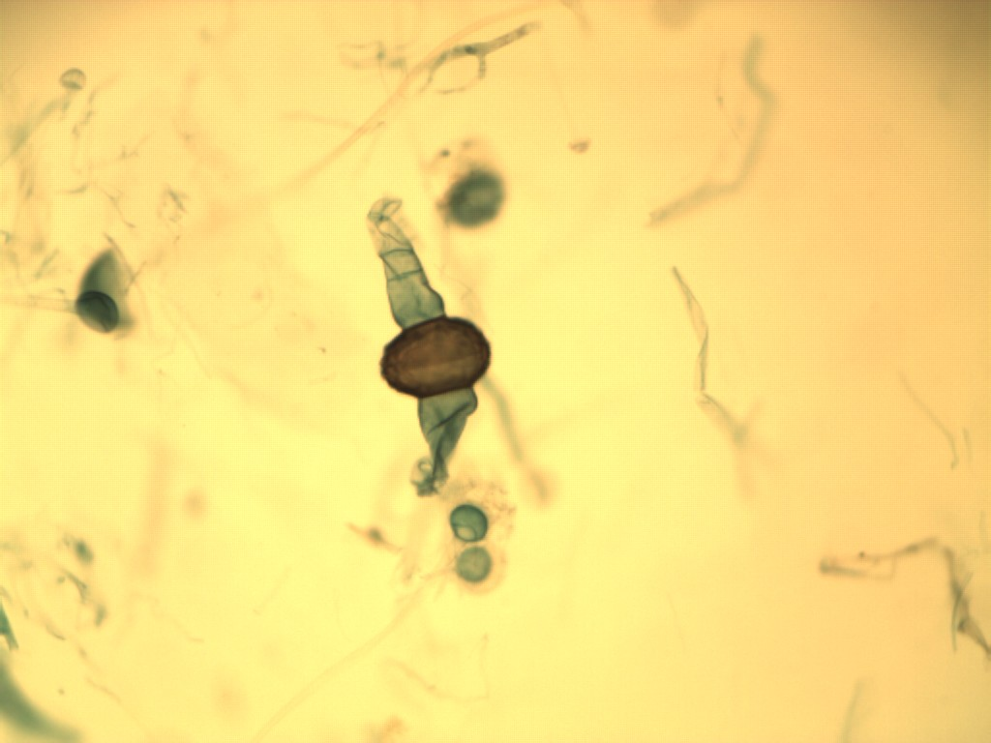
Progametes
Zygosporeangium
Conjugation = genetic recombination
Plasmogamy = fusion of cytoplasm
Dikaryotic = Cell with two nuclei
Karyogamy = fusion of nuclei
Notes:
Rhizopus zygospore and progametes

Slide 4
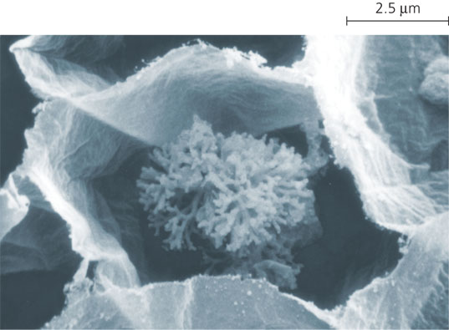
Notes:
Arbuscular Mycorrhiza

Slide 5
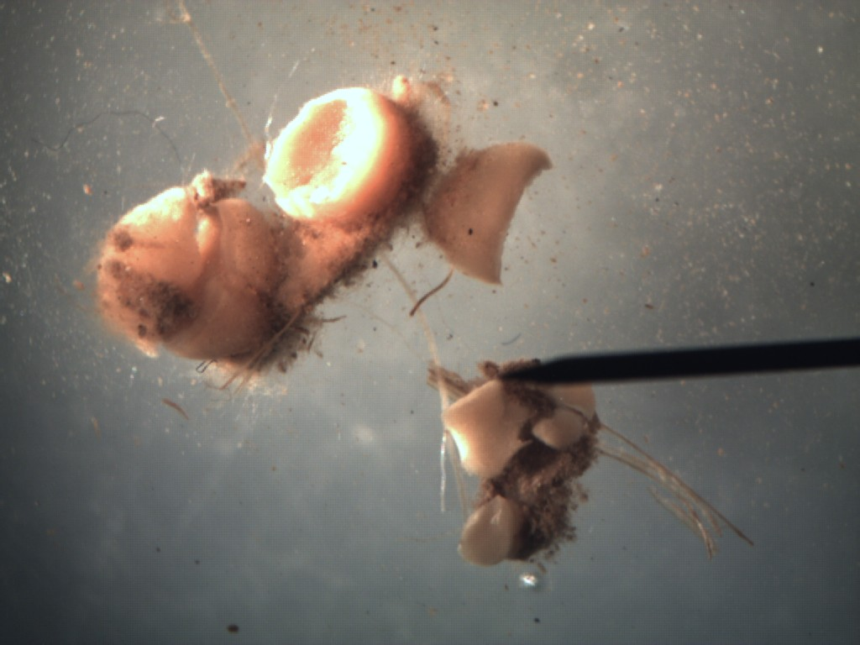
Ascocarp
Notes:
Ascomycetes

Slide 6
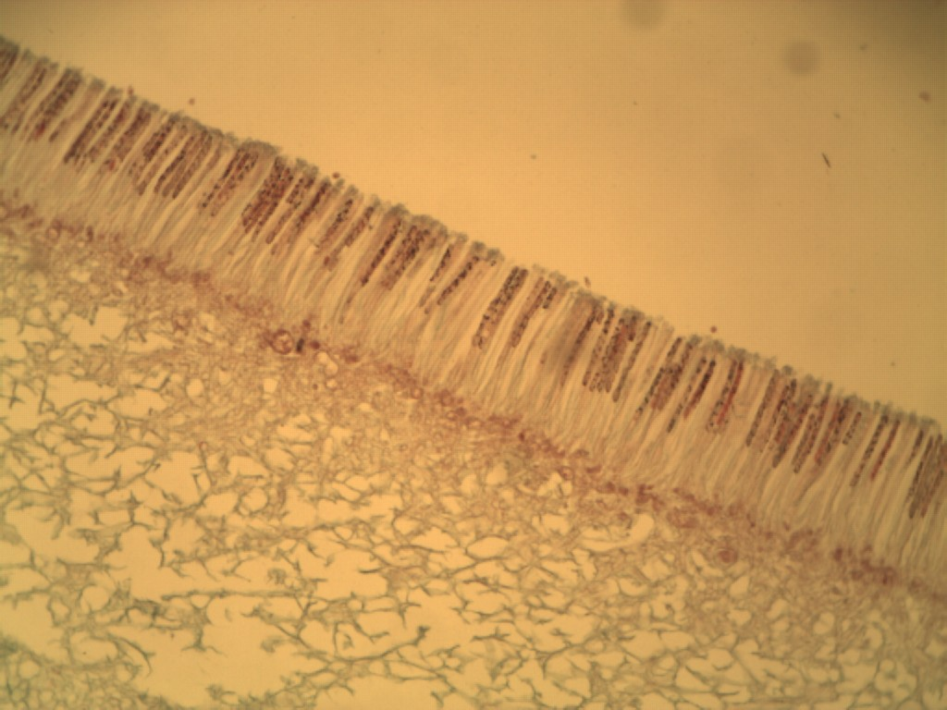
Asci
Ascospores
Hymenial layer
Mycelium
Notes:
Asci with ascospores

Slide 7
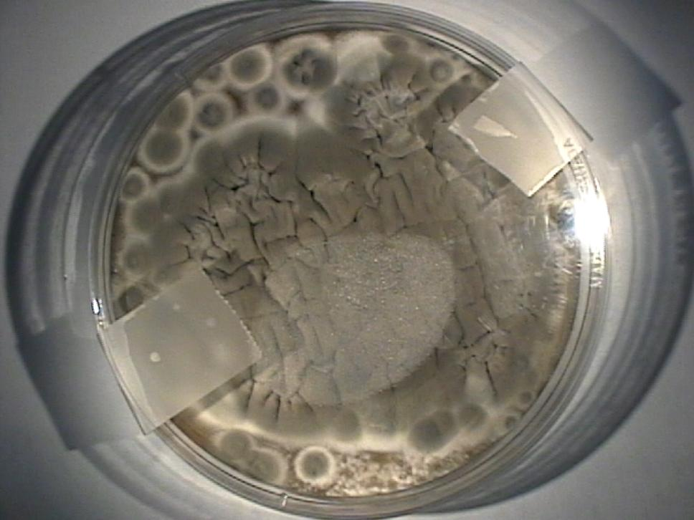
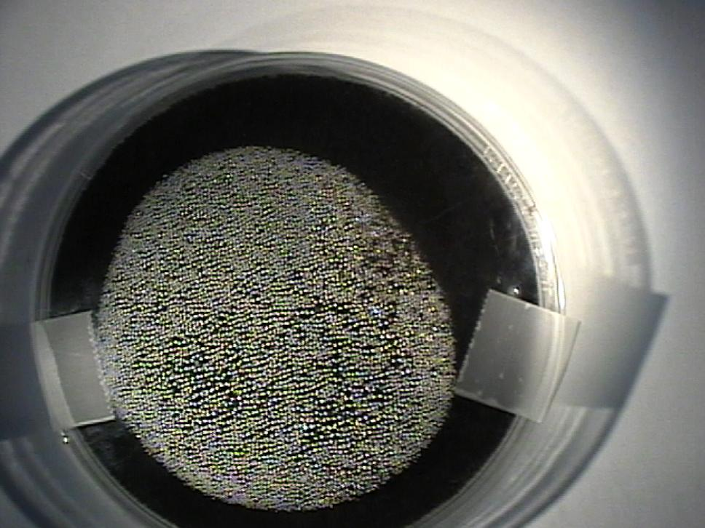
Notes:
Penicillum and Aspergillus plates

Slide 8
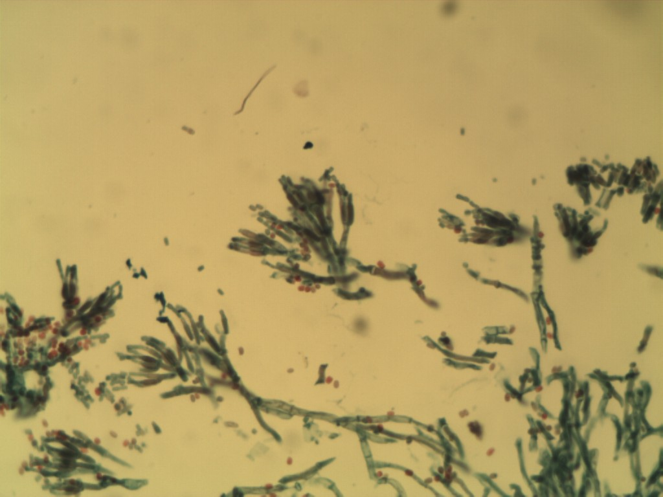
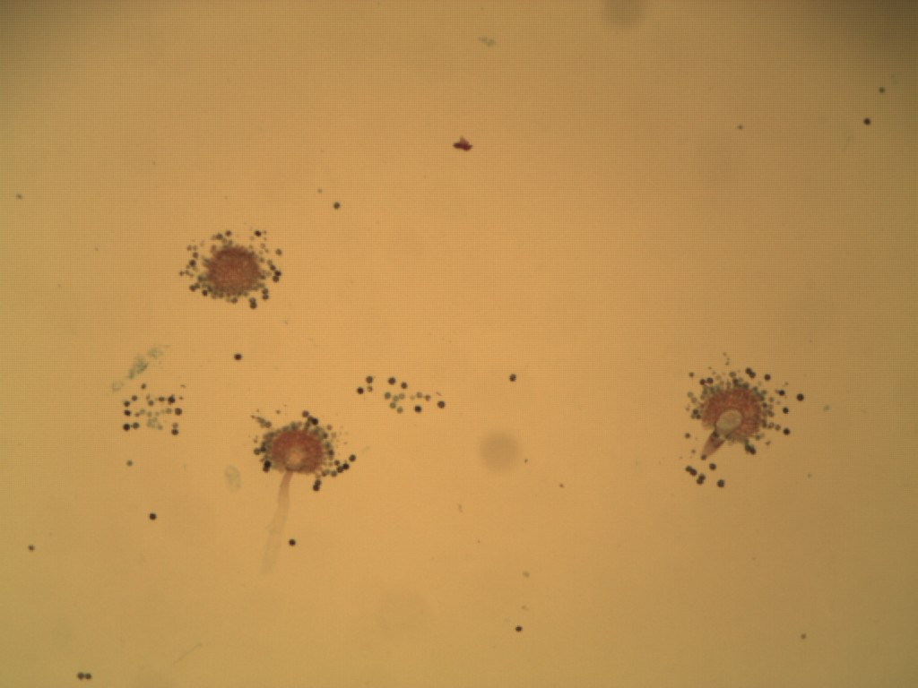
Conidiophores
Conidia
Notes:
Penicillum and Aspergillus Conidida

Slide 9
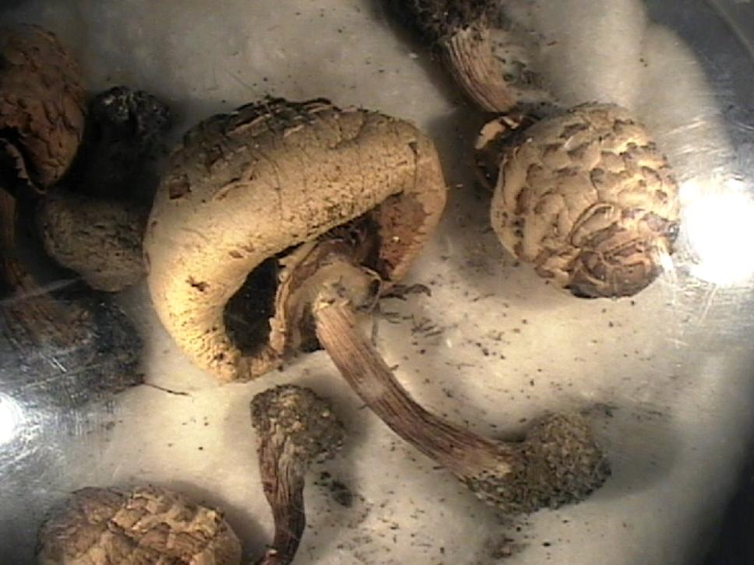
Cap
Gills
Annulus
Stipe
Notes:
Basidiomycetes

Slide 10
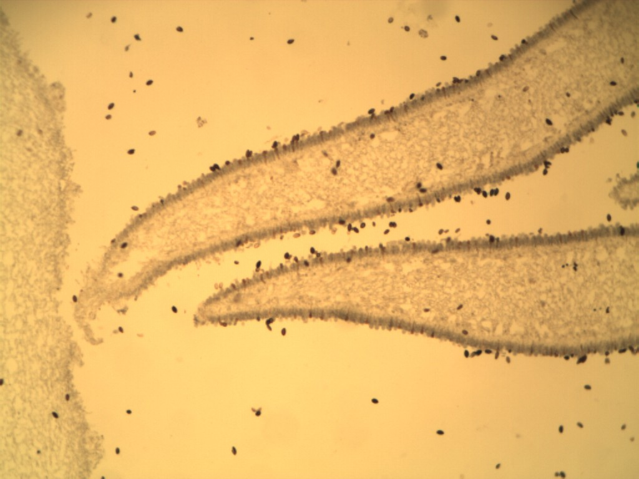
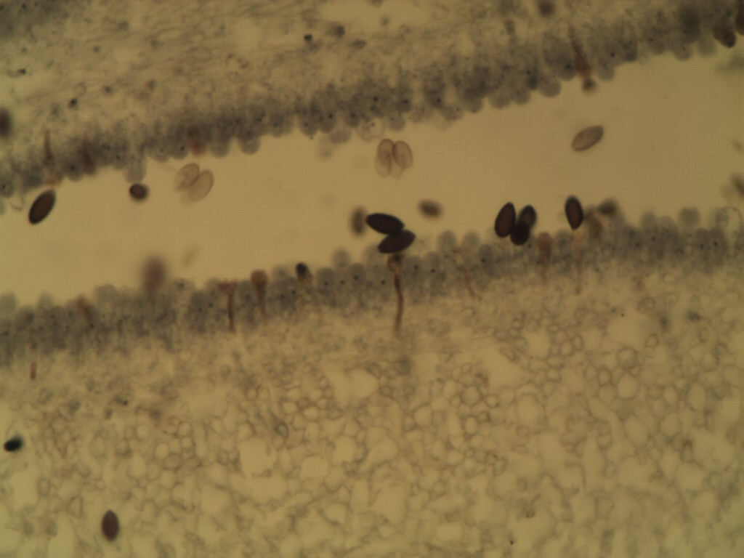
Gills
Basidiospores
Basidia
Hymenial layer
Notes:
Basidia with Basidiospores

