Slide 1
Biology 1 with Tyler Flisik
"The universe is full of magical things patiently waiting for our wits to grow sharper." - Eden Phillpotts
"All of science is nothing more than the refinement of everyday thinking."
- Einstein
Spring 2017

Slide 2
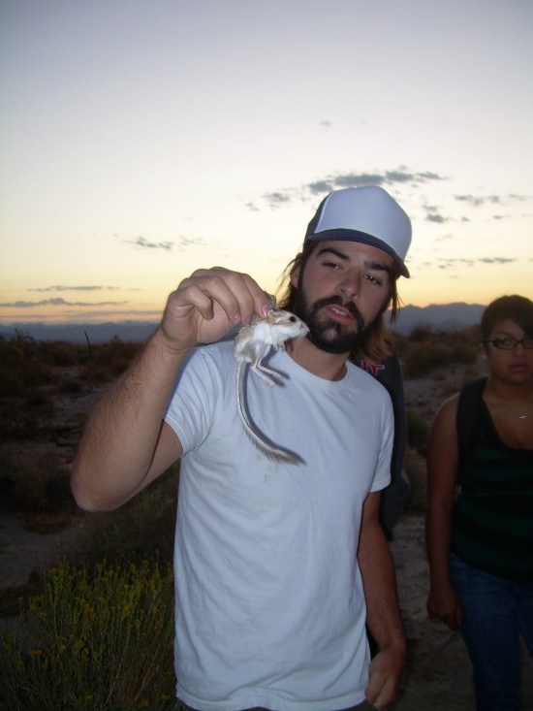
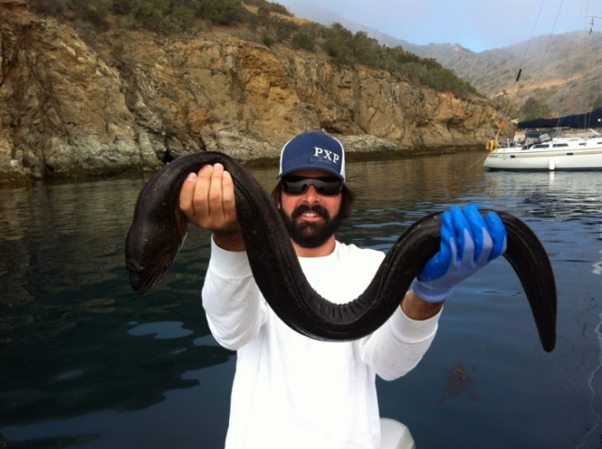
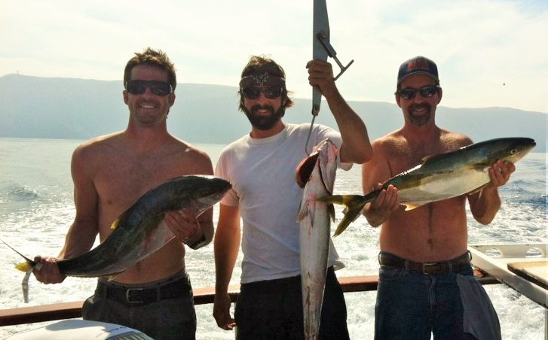
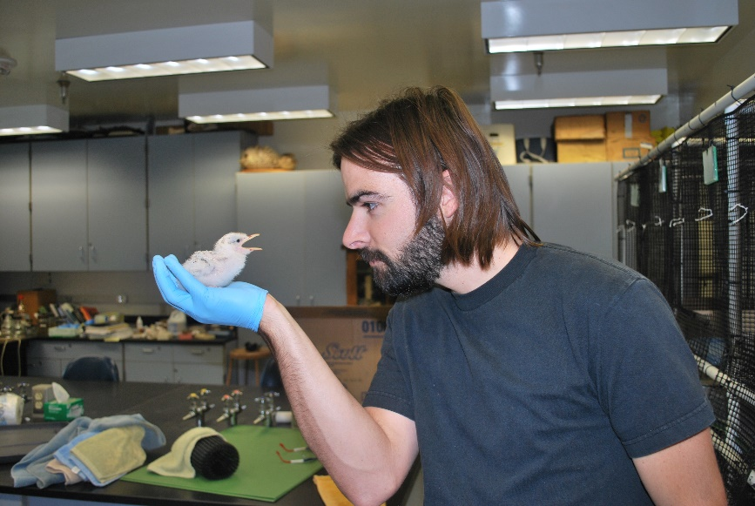
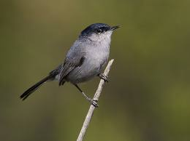
Who is Tyler Flisik?

Slide 3
Biology is the Study of Life
Greek and Latin root for Biology
Bi(ola) = life
log(y) = discourse, the study of
What defines something as alive?
The ability to assimilate and use ________
The ability to respond to their environment
The ability to maintain a relatively constant _________ environment
Have ________ from other living things
The ability to ___________
Composed of one or more ______ with information encoded by _____
Are highly organized when compared to inanimate objects
The ability to grow and develop
Non-living objects are not self-sustaining
Inanimate
Notes:
Assimilate = to take in and incorporate into one’s own body

Slide 4
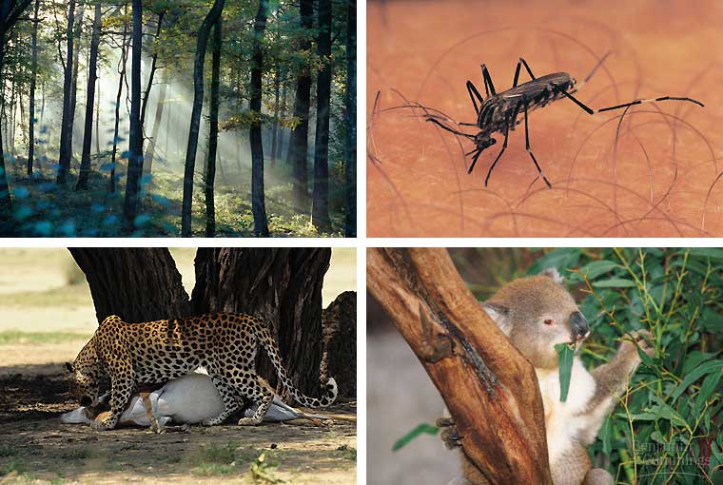
Characteristics of Living Things
Living organisms use energy
Notes:
Organisms can take in energy and transform it through a series of chemical reactions

Slide 5
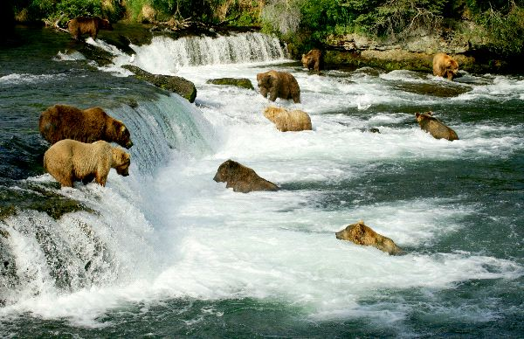
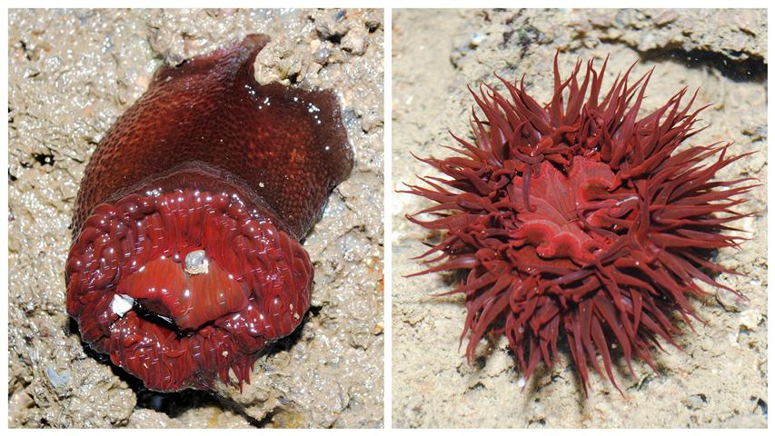
Characteristics of Living Things
Living organisms respond to their environment
Notes:
Respond to stimuli such as light, moisture or other organisms

Slide 6
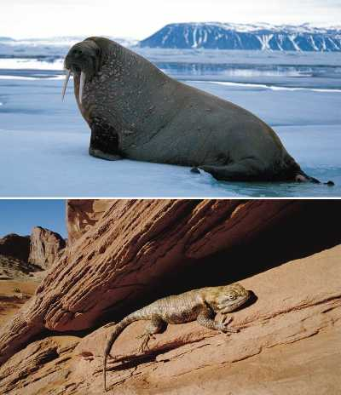
Characteristics of Living Things
Living organisms maintain ___________ or some relatively constant internal environment
Notes:
Internal environment differs from the external environment

Slide 7
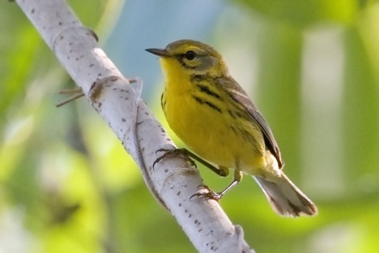
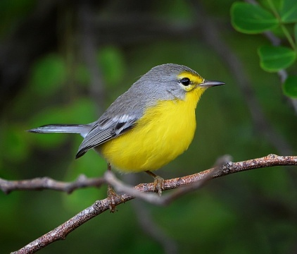
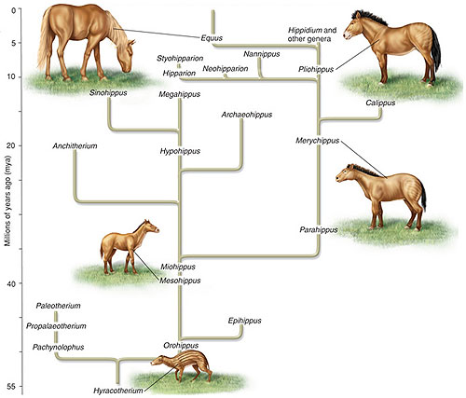
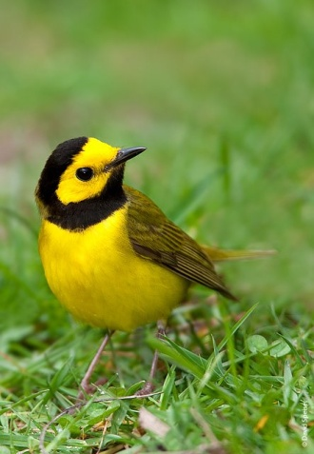
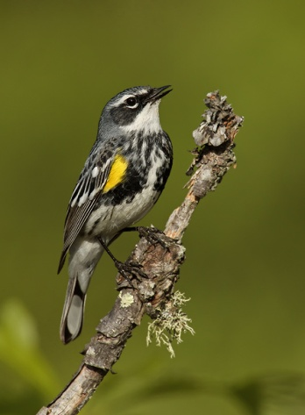
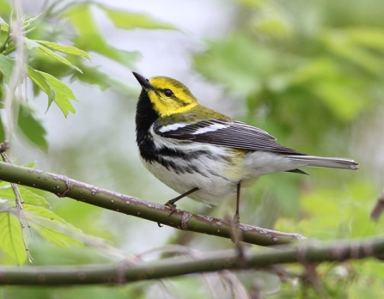
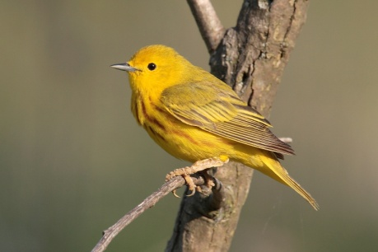
Characteristics of Living Things
Living things have evolved from other living things
Notes:
Diversity of organisms is the result of evolutionary changes and adaptations that have occurred with a population.

Slide 8
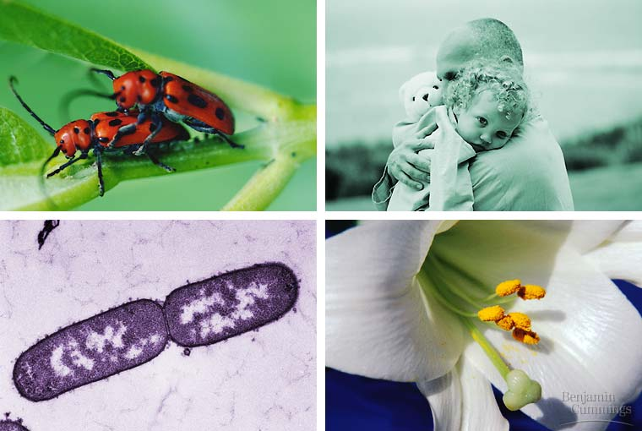
Characteristics of Living Things
Living organisms reproduce

Slide 9
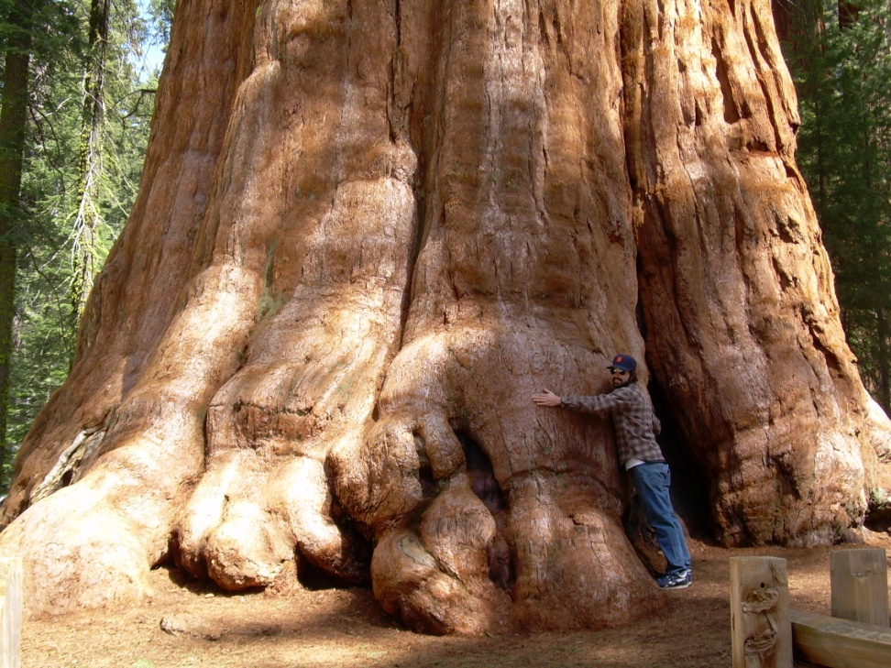
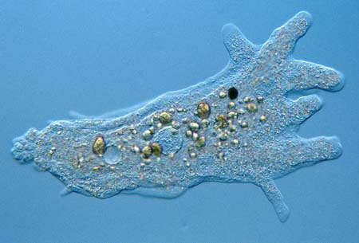
Characteristics of Living Things
Living things are composed of one or more cells
Notes:
Humans comprised of 10 trillion cells
Amoeba is a single celled organism

Slide 10
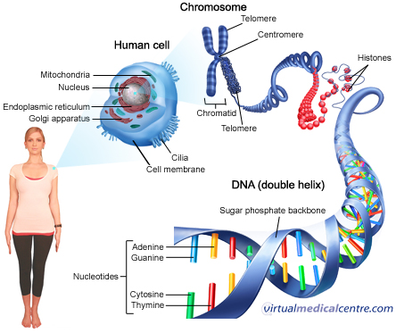
Characteristics of Living Things
Living organisms contain DNA
Inherited information base that codes for everything!

Slide 11
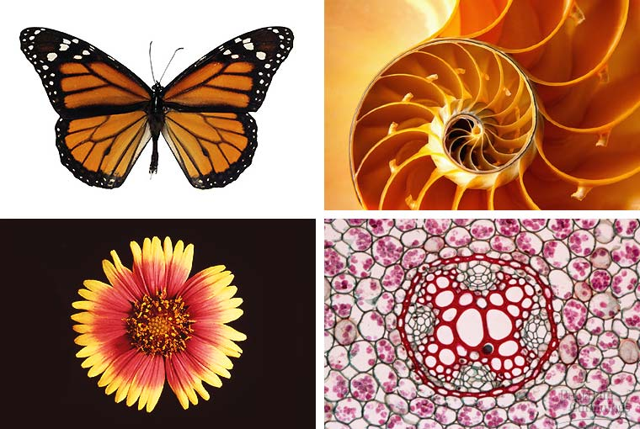
Characteristics of Living Things
Living organisms are highly organized compared to inanimate objects

Slide 12
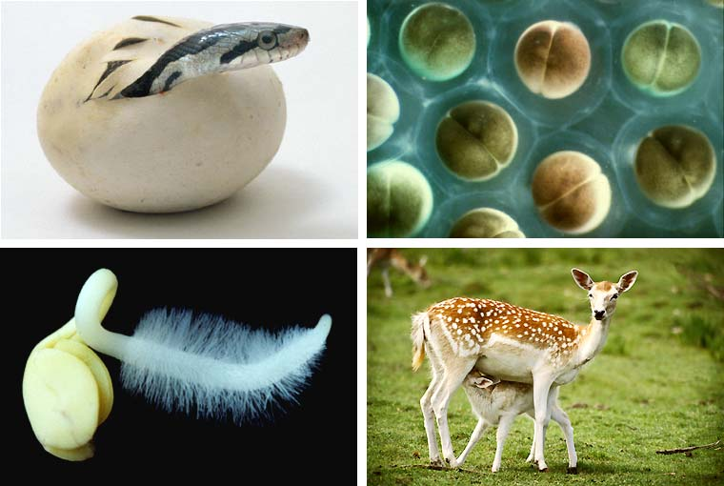
Characteristics of Living Things
Living organisms grow and develop

Slide 13
Hierarchy of life
Life is organized and studied at many different levels
Marine biology
Molecular biology
Epidemiology
Neurobiology
Conservation biology
Organismal biology
Population and community biology
Genetics
Immunology
Biochemistry
Microbiology
Cellular biology
Anatomy
Botany
Zoology
Biogeography
Ecology
Developmental biology

Slide 14
How does one do the science?
Scientists from a variety of disciplines are unified by their approach to understanding the unknown.
Scientific method
_____________ = What’s happening?
Questions = What do we want to know?
Formulate ___________ = Our proposed explanation for the unknown phenomena. Must be testable!
Methods/ Experimentation = Testing our hypothesis
Results and Conclusions = What did we discover? Does it support or refute our hypothesis?
Notes:
Nonlinear, observations often spark numerous questions and multiple hypotheses. Also, the method allows for constant revision based on new observations or results.

Slide 15
Famous example of Scientific Method
Louis Pasteur 1860’s
Can life be created spontaneously?

Slide 16
Make a Prediction
Formulate a __________ hypothesis

Slide 17
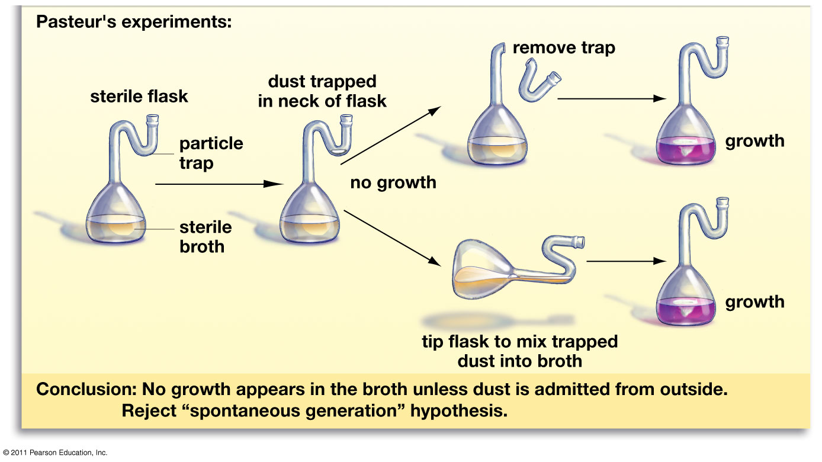
Experimentation
Design an experiment that tests your hypothesis while minimizing other variables.

Slide 18
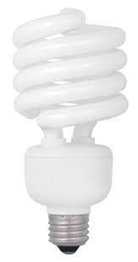
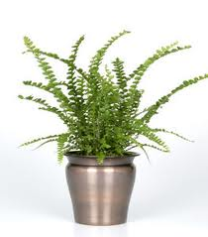
“Without speculation, there is no good and original observation” – Charles Darwin
Observation
Carefully review the unknown
Understand the variables influencing the unknown
__________: an adjustable condition in an experiment
Variables can be biotic or abiotic
Abiotic variables: temperature, lighting, precipitation, timing
Biotic variables: interaction with other organisms, chemical processes
Example experiment: Observation
Indoor plants = florescent lighting
Outdoor plants = sunlight
Spectrum of light
Notes:
One of the variables are that which is being tested in an experiment

Slide 19
Scientific Method
Questions
What do you want to understand about the unknown?
Can you test for the unknown?
What are the variables?
What do we already know about the unknown?
Literature search
Example experiment: Question
Do plants grow better under florescent lighting or natural lighting (sunlight)?

Slide 20
“No great discovery was made without a bold guess”
-Marie Curie
Formulate a hypothesis
Be specific. Fully address the question.
Is the hypothesis testable?
Is the hypothesis falsifiable?
____________: the potential to be proven false.
Example experiment: Hypothesis
Hypo1: The plant will grow better under sunlight.
Hypo 2: On average, the lemon button fern (Nephrolepis cordifolia) will grow more new leaves under natural light, than under florescent light, when all other variables are held constant.
Notes:
Falsifiability
Marie Curie: Mother or Radioactivity. First woman to win an Nobel Prize. Won Two
On average? Can conclusions be drawn by testing one plant under sunlight and one under florescent light? Large sample size is needed.
Null hypothesis: A hypothesis that states a lack of relationship between two factors.
Ex. There is no difference in the coarseness of hair that grows after shaving.

Slide 21
Scientific Method
Experimental design
Experiments should be designed to test one question at a time.
Design experiments to reduce the number of variables
Excess variables compound the results
Experimental ________
Used for comparison
Sample size!!
Take an average of multiple trials ( “on average”)
Repeatability!
Experiments should be able to be replicated by other scientists
Notes:
Excess variables: Different colored florescent bulbs, different temperature inside and outside,
Blind study: experimental subjects are unaware which treatment they are receiving
Double-blind study: subjects and researchers are unaware which treatment the subjects are receiving.

Slide 22
Scientific Method
Example experiment: Experimental Design
How are we going to test for growth?
Plant height, number of new leaves or flowers
What are our variables?
Abiotic: ___________________________
Biotic: ____________________________
Sample size?
Final design:
10 lemon button fern plants under each type of light
Same amount water
Same temperature
Light 12 hrs, Dark 12 hrs
# of leaves counted once a week for six months
Notes:
Ask class to think up some variables

Slide 23
Scientific Method
Conclusion and Discussion
Graph results
Do the findings support or refute hypothesis?
Reconsider and refine hypothesis and experiment
Nothing is proven!!
 | # of new leaves
Plant # | Florescent | Sunlight
1 | 15 | 13
2 | 11 | 18
3 | 13 | 16
4 | 18 | 18
5 | 9 | 22
6 | 7 | 14
7 | 14 | 23
8 | 17 | 15
9 | 15 | 21
10 | 11 | 20
Notes:
Proof is something that is now and forever the truth of a theory. Often times in science and biology,

Slide 24
Scientific Method
Conclusion and Discussion
Graph results
 | # of new leaves
Plant # | Florescent | Sunlight
1 | 15 | 13
2 | 11 | 18
3 | 13 | 16
4 | 18 | 19
5 | 9 | 22
6 | 7 | 14
7 | 14 | 23
8 | 17 | 15
9 | 15 | 21
10 | 11 | 20
Avg. | 13 | 18

Slide 25
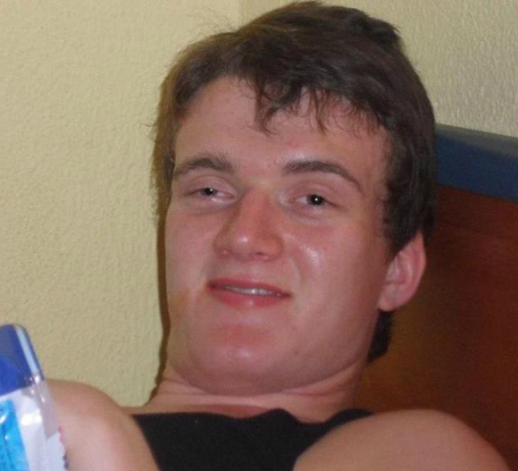
I have a theory!
?
Scientific theories vs. non-science theories
Non-science “theories” are typically ideas or hypotheses
Scientific theory: a general set of principles, supported by _________, that explains some aspect of nature
Scientific theories are supported or refuted, ___________.
Ex. Theory of evolution by natural selection
After many, many experiments in support a particular theory, the theory can be elevated to scientific law
Ex. Law of gravity
Notes:
Scientific theories are seen as facts by scientific community.

Slide 26
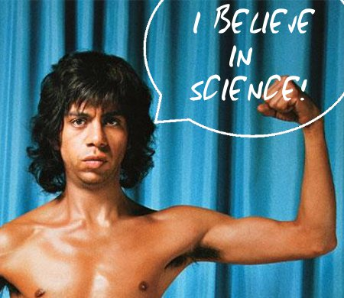
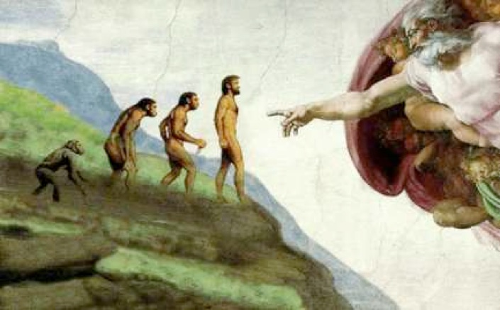
Intelligent Design and Creationism
Science _____ be falsifiable
Can not test the existence of God
Probably shouldn’t try it
Science strives to explain the physical world
Philosophy strives to explain the metaphysical
Notes:
Empirical: knowledge based on experience and observations.

Slide 27
Evolution not Evilution
“Seen in the light of evolution, biology is, perhaps, intellectually the most satisfying and inspiring science. Without that light it becomes a pile of sundry facts―some of them interesting or curious but making no meaningful picture as a whole”
– Theodosius Dobzhansky (1973)
___________: the gradual modification of populations of living things over time
*Chief Unifying Principle in Biology
The appearance, behavior, and physiology of living things, have been and are being shaped by the influence of other living and non-living factors

Slide 28
The Study of Evolution
Evolutionary biology
Marine biology
Molecular biology
Epidemiology
Neurobiology
Conservation biology
Organismal biology
Population and community biology
Genetics
Immunology
Biochemistry
Microbiology
Cellular biology
Anatomy
Botany
Zoology
Biogeography
Ecology
Developmental biology

Slide 29
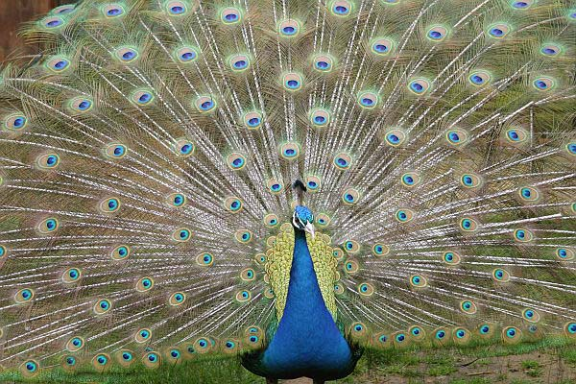
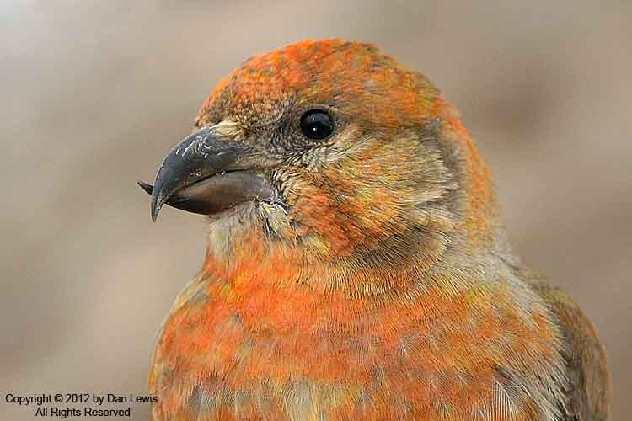
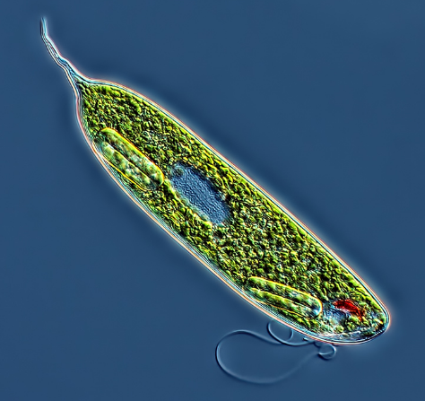
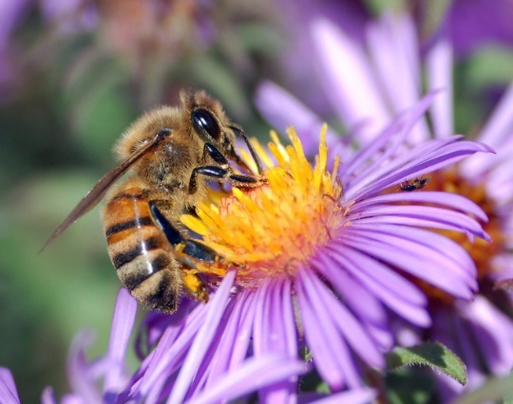
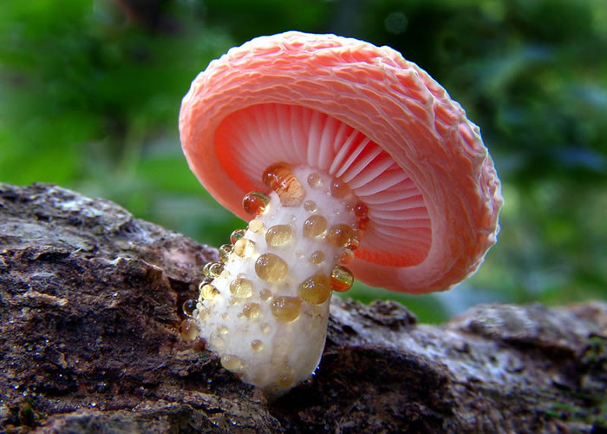
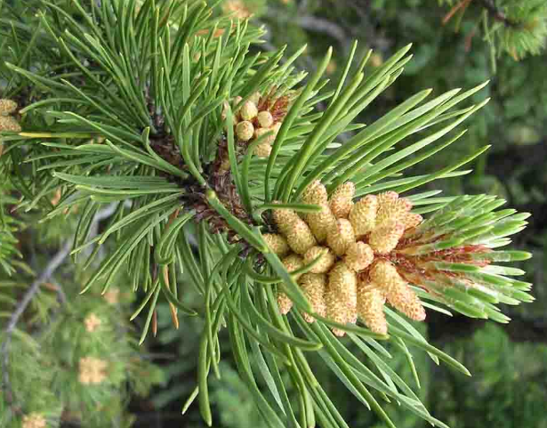
Evolution is Awesome!
Ask questions!
Why do living things look the way that they do?
How do living things acquire energy?
How do females choose a mate?
How do living things cope with the challenges of their habitat?
How do we know how species are related?

