Slide 1
Intertidal and Estuary Environments

Slide 2
Estuaries
Estuary: a partially enclosed area where a freshwater river or stream meets the ocean resulting in brackish waters.
Habitat types:
Open water: area covered with water during low tide
Mudflats: areas covered during high tide but exposed during low tide
Saltmarsh: area covered during high tide
Freshwater marshes and ponds: stagnant freshwater habitats
Riparian: terrestrial areas along freshwater habitats
Upland: terrestrial habitats not adjacent to fresh or salt water habitats

Slide 3
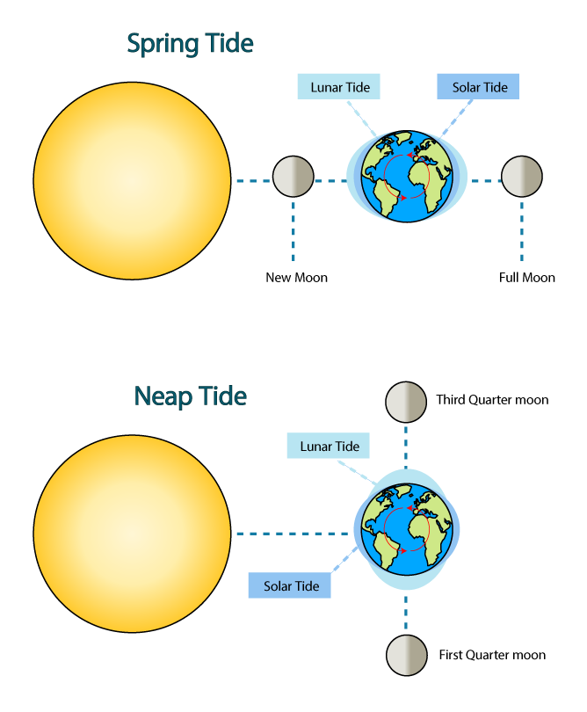
Tides
Created by the gravitational pull
Moon: large effect
Sun: small effect
Spring Tides
Direct alignment of sun, earth, and moon
Extreme tides (3x greater than neap tides)
Neap Tides
90 angle between sun, earth, and moon
Lower variation than spring tides
Spring Tide
Lunar Tide
Solar Tide
New Moon
Full Moon
Neap Tide
Third Quarter Moon
Lunar Tide
Solar Tide
First Quarter Moon

Slide 4
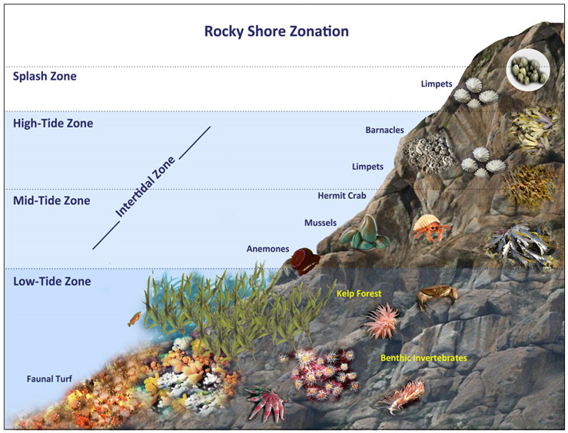
Intertidal Zonation
Splash zone: ~5ft above see level. Only inundated during highest high tides.
Small acorn barnacles, periwinkle snails
High-tide zone: ~2 to 5ft above sea level. Inundated during high tide and exposed to air during low tide.
Large acorn barnacle, chitons, limpets, Striped shore crab
Mid-tide zone: 0 – 2ft above sea level. Exposed to air only during low tide.
Seastar, California mussel, gooseneck barnacle, blueband hermit crabs, turban snails, sea anemones
Low-tide zone: Below sea level. Only exposed to air during lowest low tides.
Brown algae, opaleye, sand-castle worms, California sea hare, two spotted octopus, sea urchins

Slide 5
Challenges of the Intertidal Zone
Desiccation: drying out during low tide.
Bivalves close shells, snails secrete slime, anemones close tentacles, limpets and chitons trap moisture under shell
Wave shock: impacts from waves and other objects. Wear from sandy water
Hard external skeleton (shells or exoskeleton), attachment to rocks (byssal threads in mussels, tube feet in echinoderms, muscular foot in molluscs)
Exposure: exposure to heat and UV from sun.
Barnacles and muscles cluster together to reduce individual exposure, north side of rocks, move out of most exposed area
Temperature changes: drastic shifts in air and water temperature
Breathe atmospheric air in oxygen poor water, ridges in shell aid in evaporative cooling, ectothermic
Salinity changes: evaporation from pools changes salinity
Alter solute concentration in cells, salt excretion
Predation: intertidal predators including octopus, seastars and fish
Hide in rock crevices, firmly attach to rocks, ink (sea hare)

