Slide 1
Immune System
Chapter 43

Slide 2
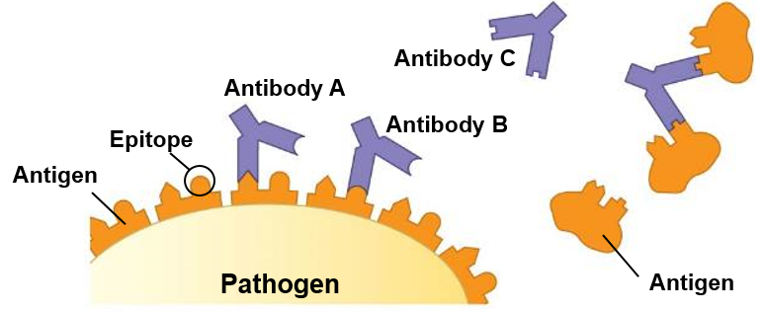
Types of Invaders
_________: a bacterium, fungus, virus, or other disease causing agent
Antigen: any foreign molecule or protein that elicits an immune system attack. Often attached to pathogen membranes
_______: region of the antigen where the antigen receptor or antibody bind
Antibody: a protein of the immune system that binds to a ____________, tagging it for attack by the immune system

Slide 3
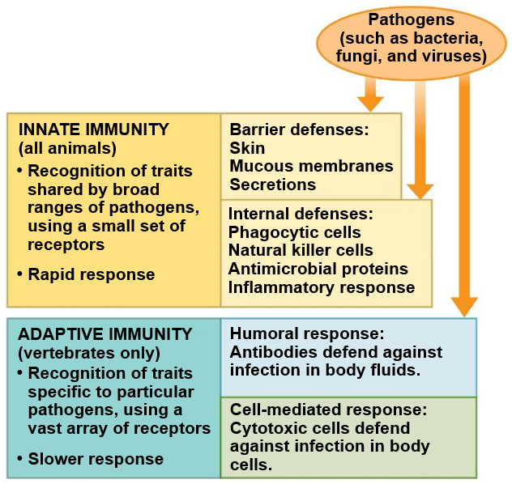
Types of Immune Response
Innate Immunity: cells that are always ready to respond to invaders and do ________ specific invaders
Found in all animals and most plants
Adaptive immunity: cells that are ________________ to eliminate a specific pathogen
Found in vertebrates only

Slide 4
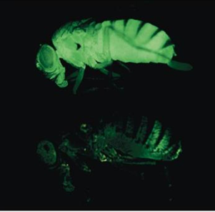
Innate Immunity in Invertebrates
Exoskeleton and lining of intestine made of _____ create a physical barrier
Lysozyme: enzyme that breaks down _______________
Hymocytes: immune cells in hemolymph
Phagocytosis
Antimicrobial peptides

Slide 5
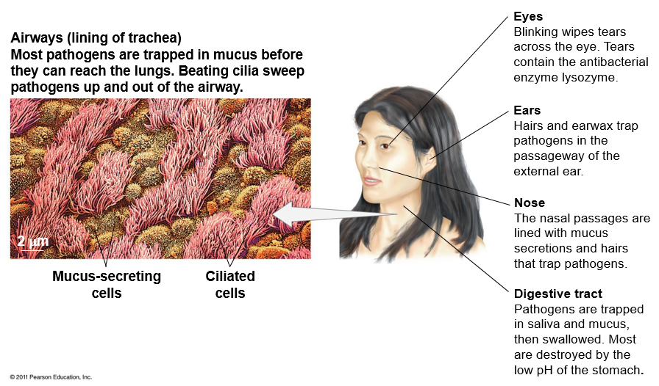
Barriers to Infection in Vertebrates
Skin
Layer of dead cells on the surface protect from invaders. Pores are flushed with sweat regularly with a low pH that prevents bacterial growth.

Slide 6
Cells Involved in Innate Immune Response
Phagocytes: cells capable of _________ other cells
Neutrophils: leukocytes that kill invading cells via phagocytosis
____________: leukocytes that secrete chemokines and cytokines (signaling molecules that recruit other cells to site). Kill invading cells via phagocytosis
Dendritic cells: located in tissues exposed to the environment. Engulf pathogens and initiate adaptive response
Eosinophils: defend against large, multicellular organisms
Mast cells: release signals that increase blood flow to wound site
_________: dilates and increase permeability of blood vessels during an innate response
Natural killer cells: recognize damaged or diseased cells very early and release signals that lead to cell death

Slide 7
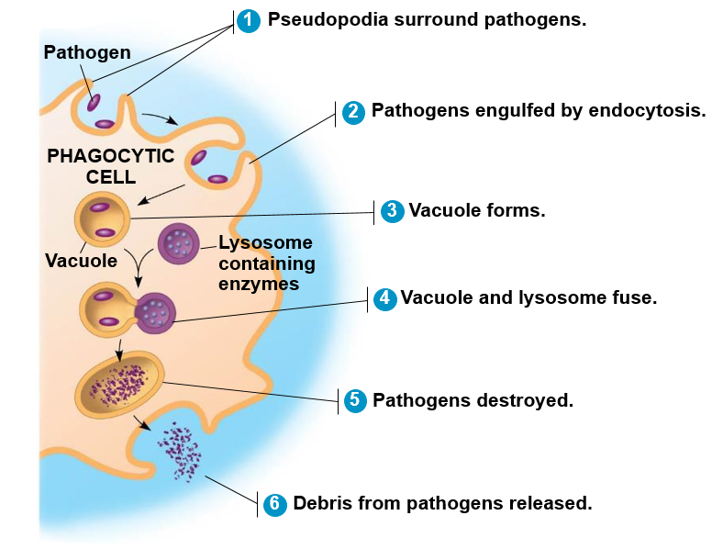
Phagocytosis

Slide 8
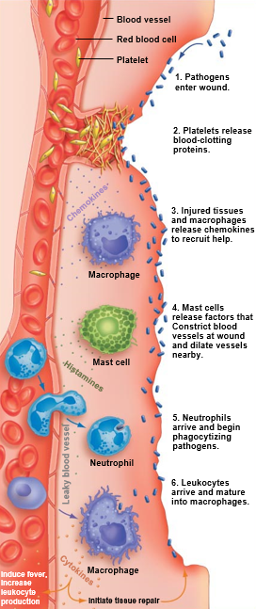
Inflammatory Response
Inflammation: a localized immune response to tissue injury

Slide 9
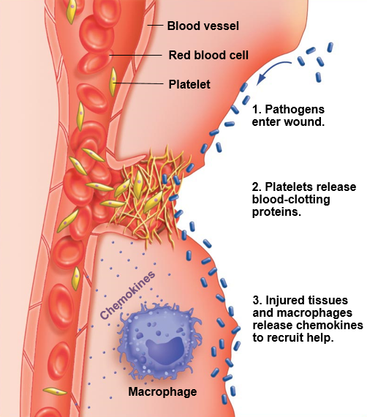
Inflammatory Response
Steps of innate immune response at a wound
A break in the skin allows bacteria to enter the body. Bleeding occurs if blood vessels or capillaries are broken.
Platelets release _____ and other proteins that form clots and reduce bleeding
Leukocytes called macrophages secrete __________ that mark the path to the wound site

Slide 10
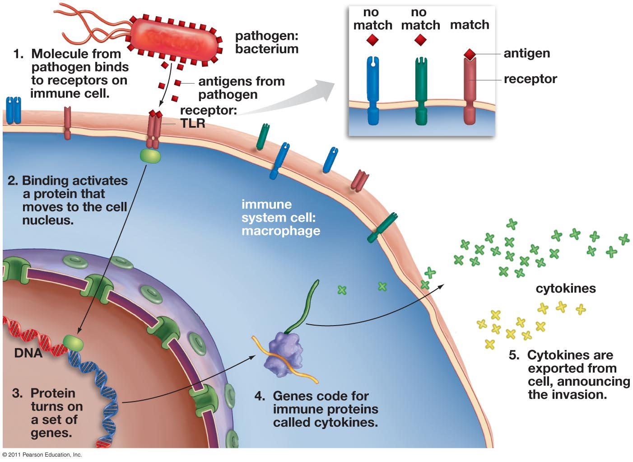
Innate Immune Response
________ receptors (TLRs): primary sensors of microbial infection in the human body
Receptors are specific to each class of invader and initiate the appropriate response
_________: signaling proteins that regulate immune response
Macrophage

Slide 11
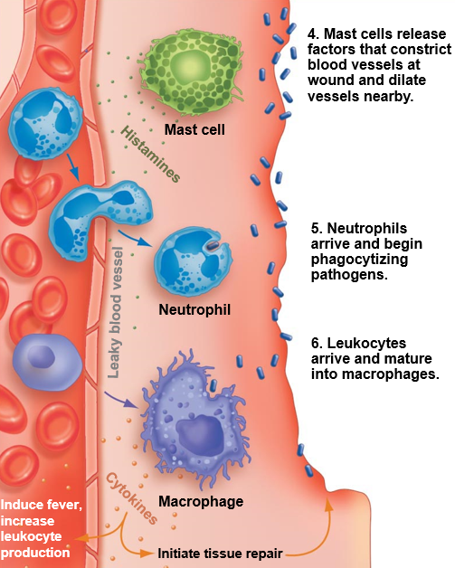
Inflammatory Response
Steps of innate immune response at a wound
Mast cells also release ________ that induces blood vessels to dilate, increasing blood flow to the wounded area.
Neutrophils move in an engulf (phagocytize) the invading pathogens
Macrophages release _________ that attract other immune cells to the site, stimulate bone marrow to release more neutrophils and macrophages, induce fever, and activate tissue repair

Slide 12
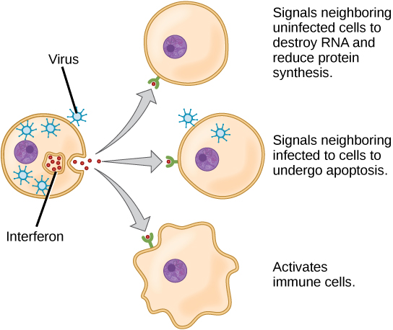
Antimicrobial Proteins
Interferons: proteins released by virus infected cells that signal near-by cells to inhibit viral replication
Apoptosis: programed _________
Compliment System
~30 proteins
Activated by substances on the surface of microbes
Initiate biochemical reactions that can ____ viruses or pathogens
Release histamine to attract phagocytes during inflammatory response

Slide 13
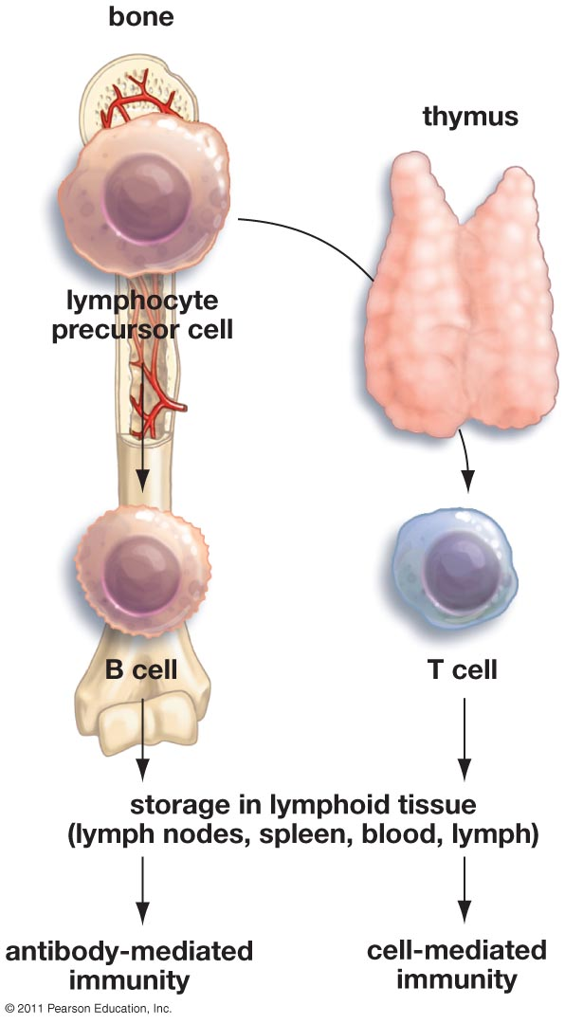
Adaptive Immune Response
Cell-mediated immunity: the production of cells that ______ infected cells in the body
T-lymphocytes or T-cells: cells involved in the activation of B-cells (helper T-cells) and the destruction of infected cells (killer T-cells)
Mature in the Thymus
Humoral (Antibody-mediated) immunity: an attack on pathogens in the blood and lymph through the production of proteins called __________
B-lymphocytes or B-cells: cells that produce antibodies and function in antigen prevention
Develop in the bone marrow

Slide 14
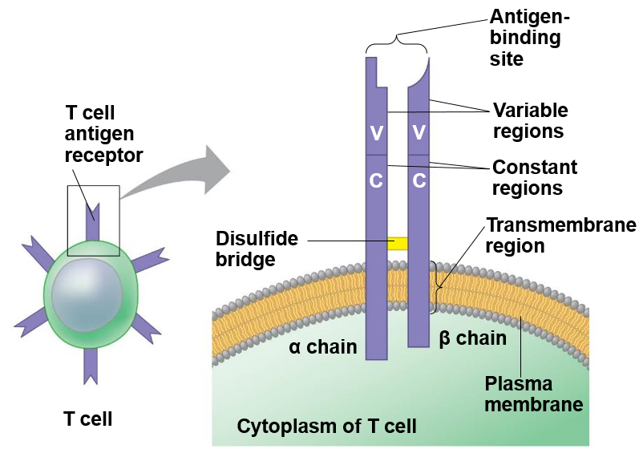
T-cell Antigen Receptors
T-cell antigen receptors
________ receptors
Alpha ($α)$and beta$(β)$ chains
Constant region
Variable region differs among T-cells and is specific to certain epitope of the antigens
Recognize ________ of antigens
~ 10 million different t-cell antigen receptors

Slide 15
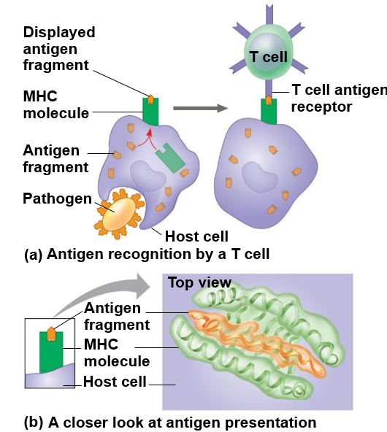
Antigen Recognition by T-cells
Major histocompatibility complex (MHC):
protein on host cell that _______________ of antigen for T-cell recognition.
Class I MHC
Most body cells
Class II MHC
Antigen presenting cells only

Slide 16
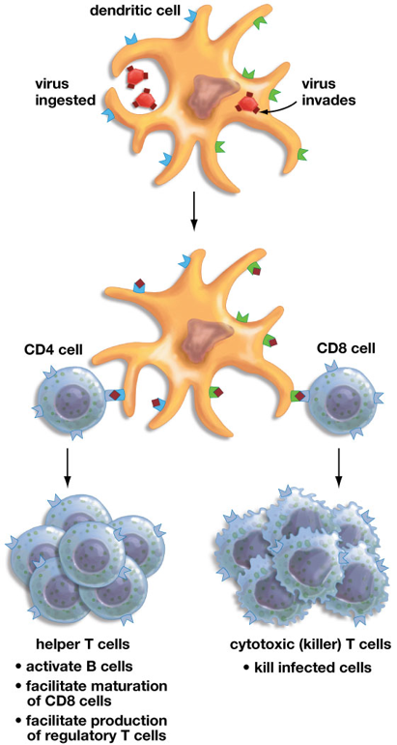
Cell-Mediated Pathway
Dendritic cell ingests pathogen or is invaded by it
Antigen-presenting cells: immune system cells that help initiate an immune response by ________ microbial antigens on their surface
Dendritic cells, macrophages, B-cells
Dendritic cell: migrate to the ______ ______ after capturing pathogen, where they connect with helper T-cells and/or killer T-cells.
T-cells become modified to recognize specific virus then multiply rapidly
Dendritic cell migrates to lymph node where it presents antigen fragments to CD4 and CD8 cells
CD4 cells becomes helper T cells and CD8 cells become Cytotoxic T cells, which continue to multiply

Slide 17
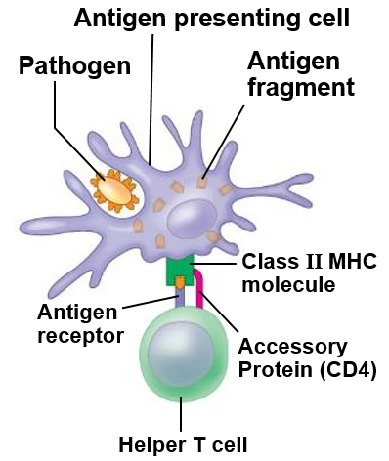
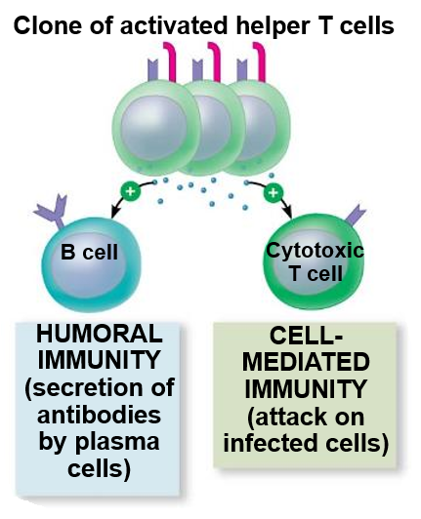
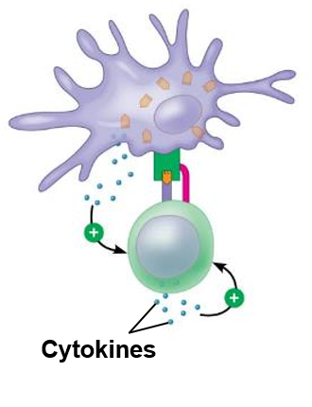
Helper T-cells
1. Antigen presenting cell presents antigen fragments with class II MHC molecules. Helper T cells bind to MHC molecule with antigen receptor and ___________
2. Cytokines released by antigen presenting cell and helper T cell stimulate T cell proliferation
3. T cell clones release cytokines that help activate B cell and cytotoxic T cells

Slide 18
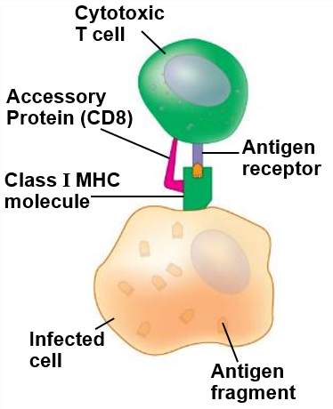
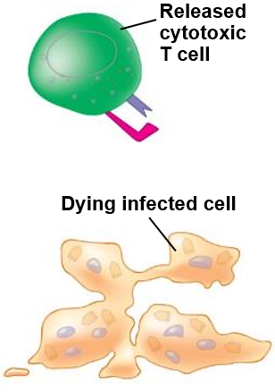
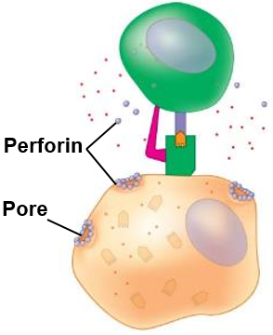
Cytotoxic (Killer) T Cells
Granzymes
1. Activated cytotoxic T cell binds with class I receptor of infected cell with antigen receptor and __________
2. Cytotoxic T cell releases perforin molecules, which create pores in infected cell, and granzymes, which break down proteins
3. Granzymes initiate apoptosis. Cytotoxic T cell releases to attack another infected cell

Slide 19
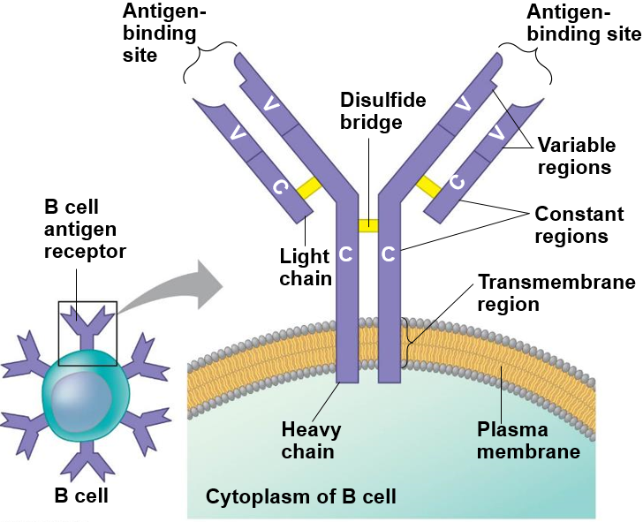
B-cell Antigen Receptors
B-cell antigen receptors
________ receptors
Two heavy chains and two light chains
Constant region
Variable region differs among B-cells and is specific to certain epitope of the antigens
Recognize ______ antigens
~ 1 million different B-cell antigen receptors

Slide 20
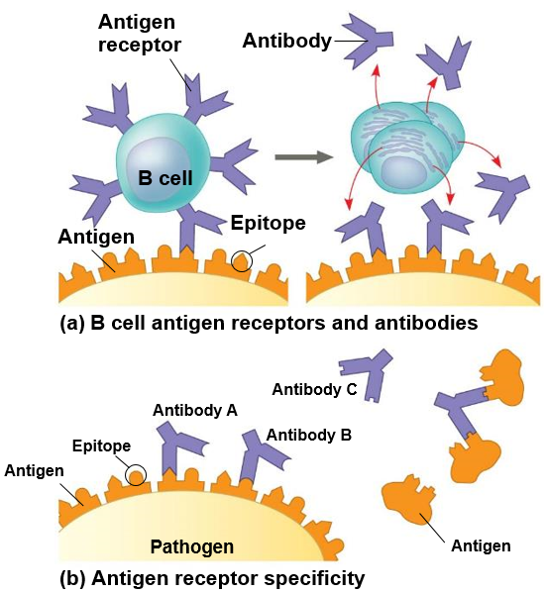
Antigen Recognition by B-cells
After antigen receptors bind to the epitope of an antigen, B-cells divide and also release antibodies
Every B-cell produced in the bone marrow has a different type of antibody
Estimates of 10 billion to 100 billion different antibodies produced in humans

Slide 21
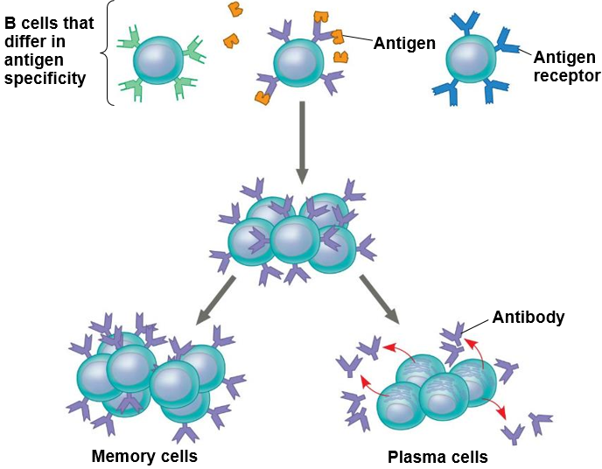
Antibody-mediated Immunity
Plasma cell: short-lived B cell specialized in producing antibodies
Memory B-cells: long-lived B-cells with antibodies for a specific antigen that remain in the body for a response to a _________ _________ by the same antigen
Clones with receptors for antigen
Notes:
Effector cells

Slide 22
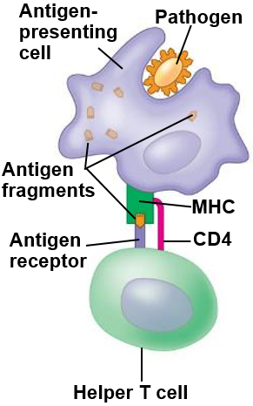
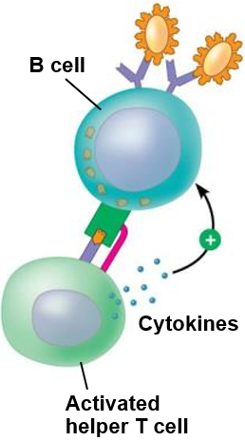
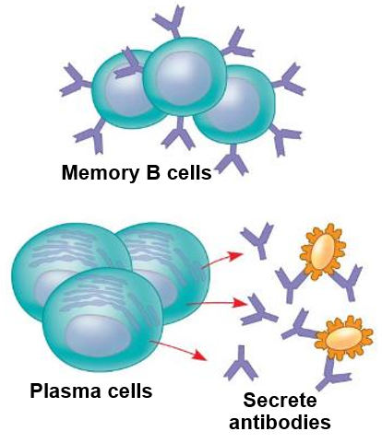
Activation of B Cells
1. Antigen-presenting cell displays antigen fragment with Class II MHC molecule. Helper T cell binds with antigen receptor and ___________
2. Activated helper T cell binds to Class II MHC molecule on B cell with the same antigen fragment, and activate the B cell
3. Activated B cell proliferates and differentiates into memory B cells and plasma cells that release antibodies specific to the initial antigen

Slide 23
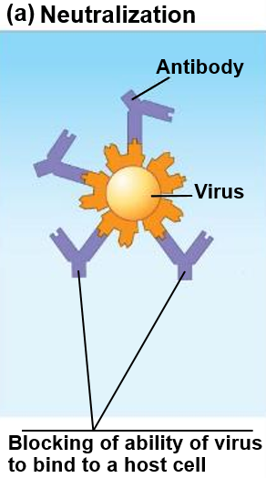
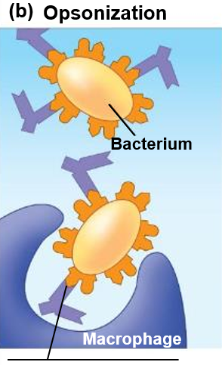
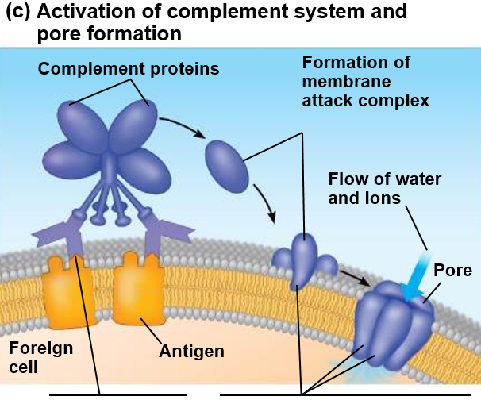
Function of Antibodies
Promotion of _____________ of bacteria by macrophages and neutrophils
Activation of the
Complement system
Pore formation allows water and ions to rush inside the foreign cell, which swells and lyses.
Blocking of ability of virus
to _____ to a host cell

Slide 24
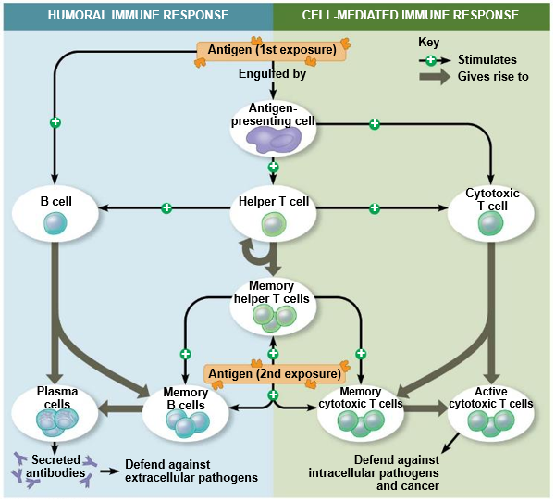

Slide 25
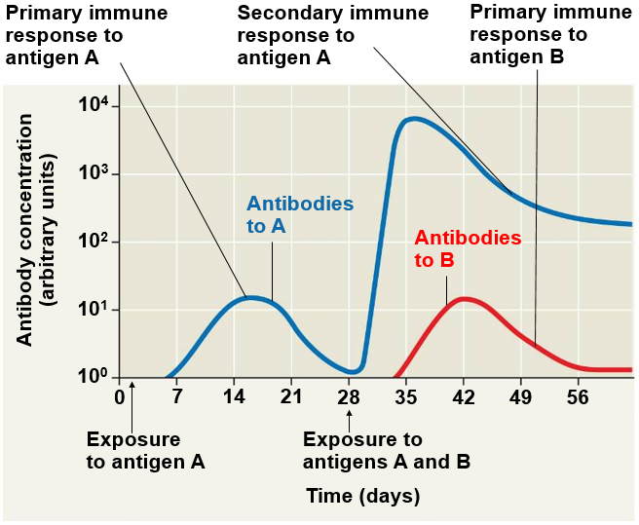
Immunological Memory
Primary immune response:
Peaks 10-17 days after exposure
Delay due to ________ immune response
Plasma B-cells
Helper T-cells
Secondary immune response:
Peaks 2-7 days after exposure
Faster response due to memory B and T cells

Slide 26
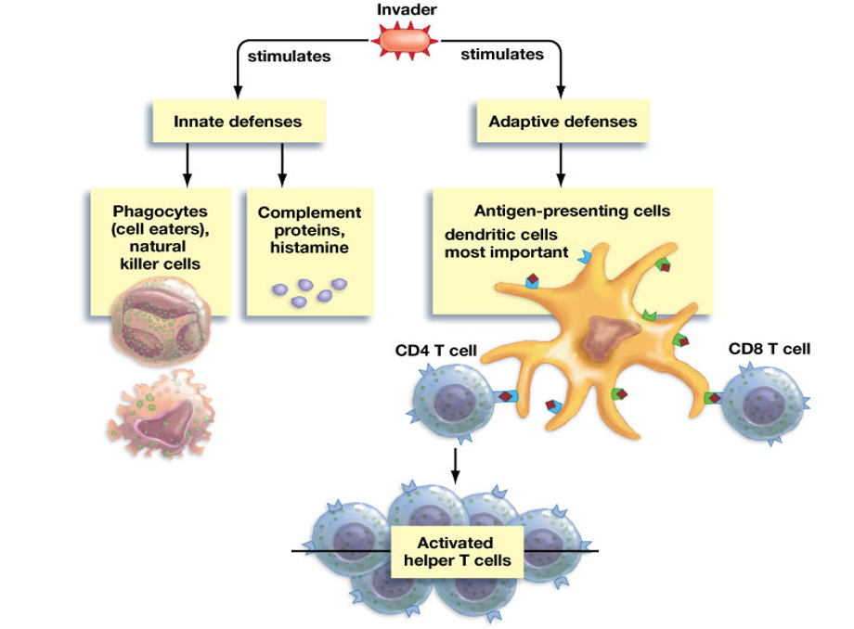
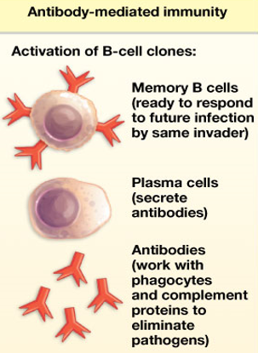
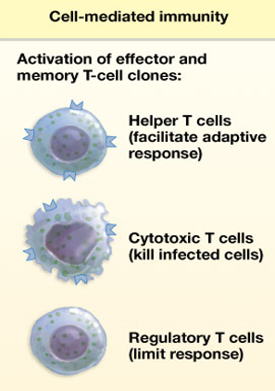

Slide 27
Immunity in Health and Disease
Active Immunity
Getting the disease
Immunizations (Vaccinations)
Passive Immunity
Antibodies transferred from one individual to another
Pregnancy and breast feeding
Injection of antibodies

Slide 28
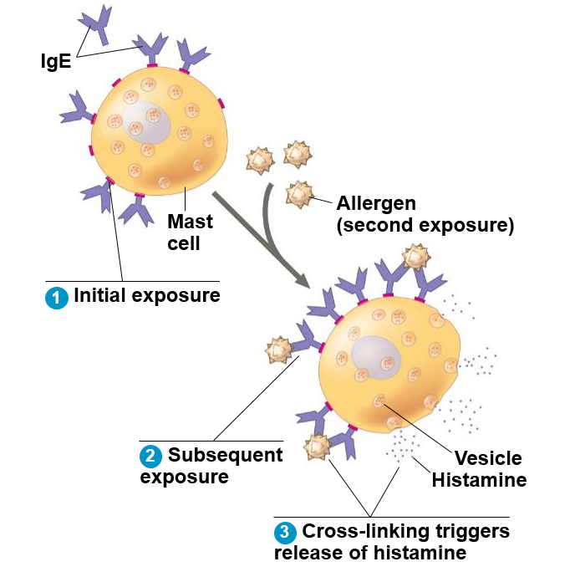
Disruptions in Immune System Function
Allergies
______________ responses to antigens
Anaphylactic shock
Autoimmune Diseases
Immune system attacks ________
Lupus, MS, ALS, Rheumatoid Arthritis
Immunodeficiency Diseases
Lowered immune system
SCIDS, AIDS
Allergic response

