Slide 1
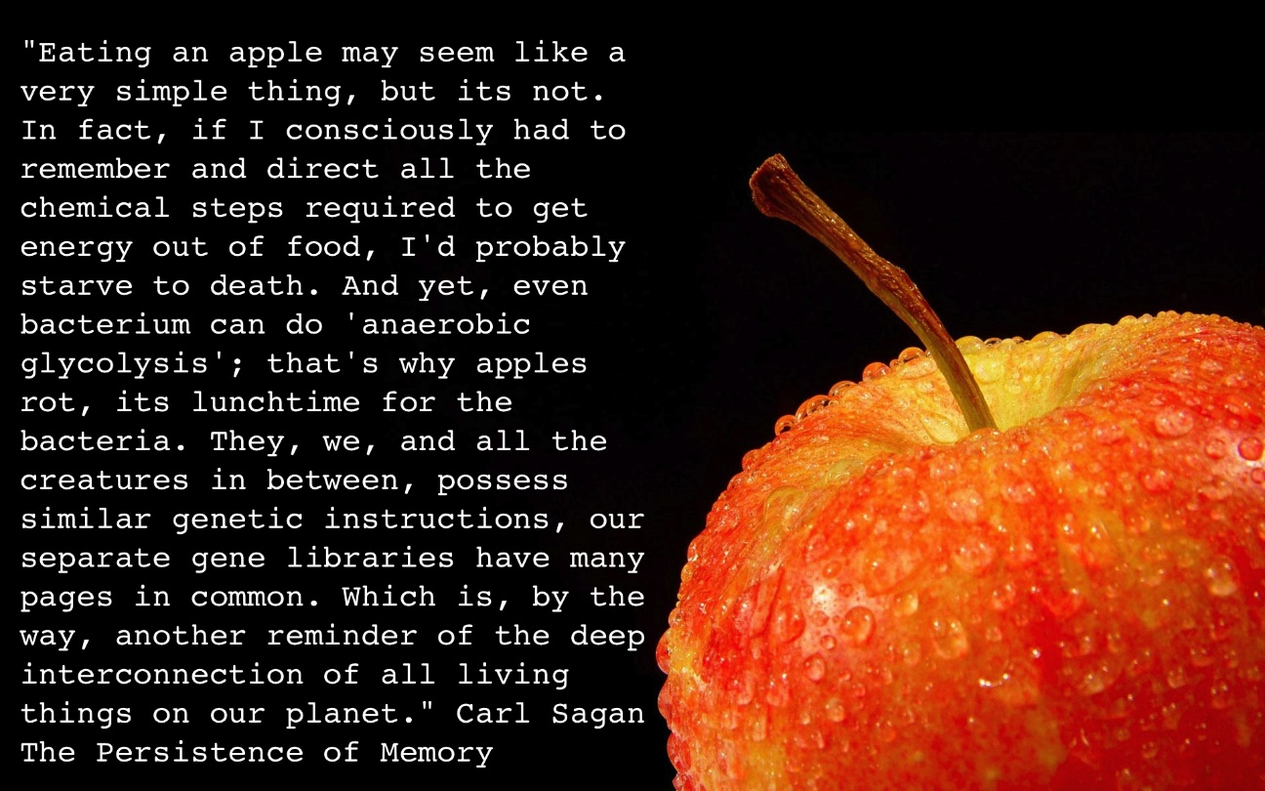
Vital Harvest: Deriving Energy from Food
Chapters 6 and 7
Notes:
Why do we need to breathe? What do we need the oxygen for, and where does the carbon dioxide come from that we exhale?

Slide 2
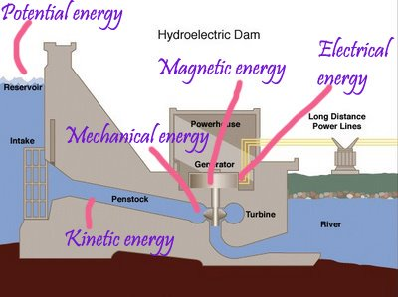
What is energy?
Energy: the capacity to bring about movement against an ______________; ability to do work
Forms of Energy
Potential energy: stored energy
Chemical energy
Ex. Hydroelectric dam, food
Kinetic energy: energy in motion
Running, biking, flying, etc.…

Slide 3
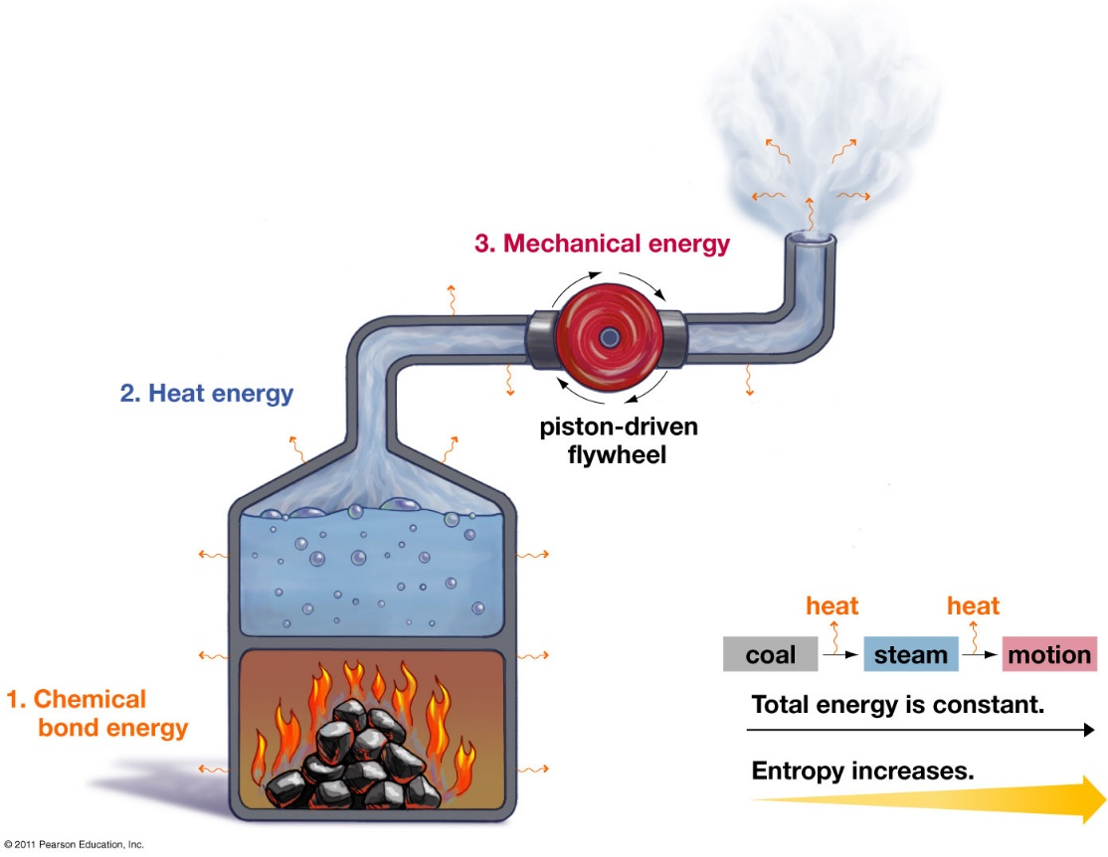
Thermodynamics
First Law of Thermodynamics: energy can not be created or destroyed, only transformed
Excess energy released as heat
Second Law of Thermodynamics: energy moves from _____________
Entropy: the amount of disorder

Slide 4
Exergonic and Endergonic Reactions
Exergonic reactions: reactants contain more energy than the products
Energy _________
Ex: Cellular respiration
Endergonic reactions: products contain more energy than reactants
Energy _________
Ex: Photosynthesis

Slide 5
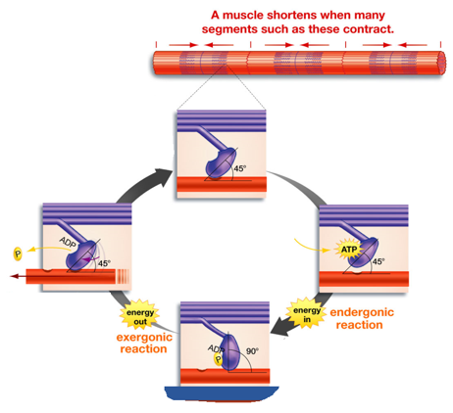
Coupled Reactions
Coupled reaction: a chemical reaction in which an exergonic reaction powers and endergonic reaction

Slide 6
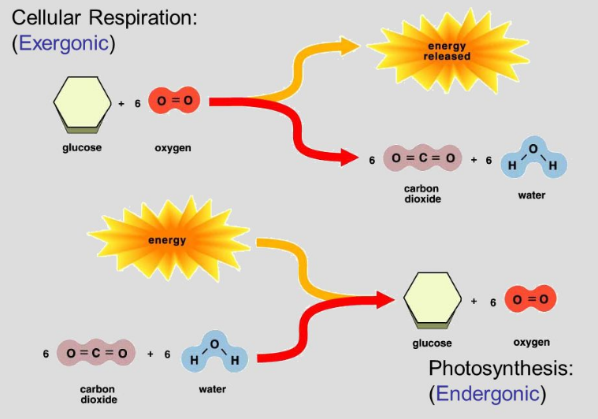
Exergonic and Endergonic Reactions
Cellular respiration: process by which all living things extract energy stored in the ______________ of molecules and use it to fuel cellular processes.
Photosynthesis: conversion of solar energy to chemical energy

Slide 7
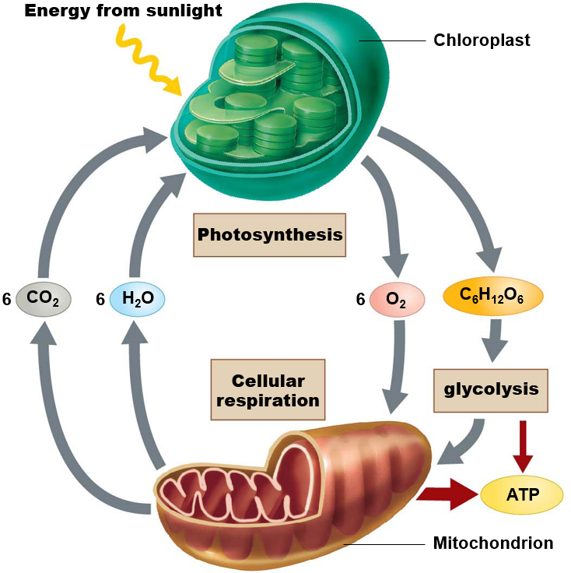
Cellular Respiration and Photosynthesis
Photosynthesis
6H₂O + 6CO₂ C₆H₁₂O₆ + 6O₂
Cellular Respiration
C₆H₁₂O₆ + 6O₂ 6CO₂ + 6H₂O + 36ATP
Light energy

Slide 8
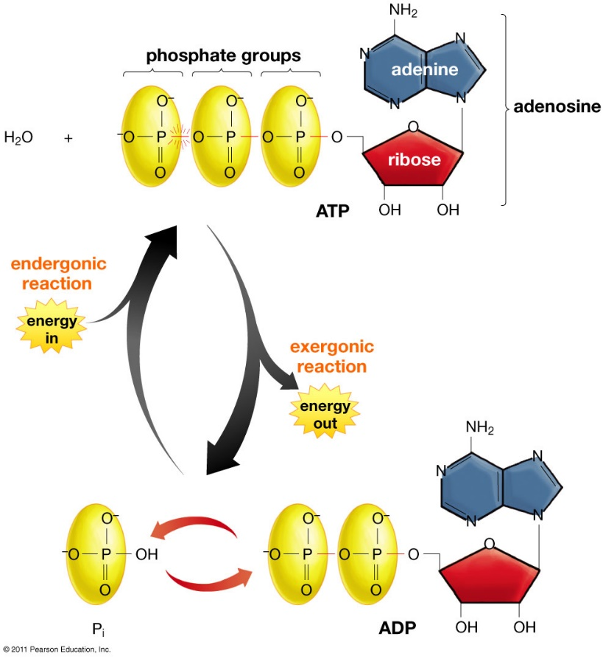
The Molecular Unit of Currency
Adenosine triphosphate (ATP)
Energy transfer molecule
Adenosine diphosphate (ADP)
Phosphorylation: addition of a ________________ to a molecule
Most important energy transfer molecule in living things!

Slide 9
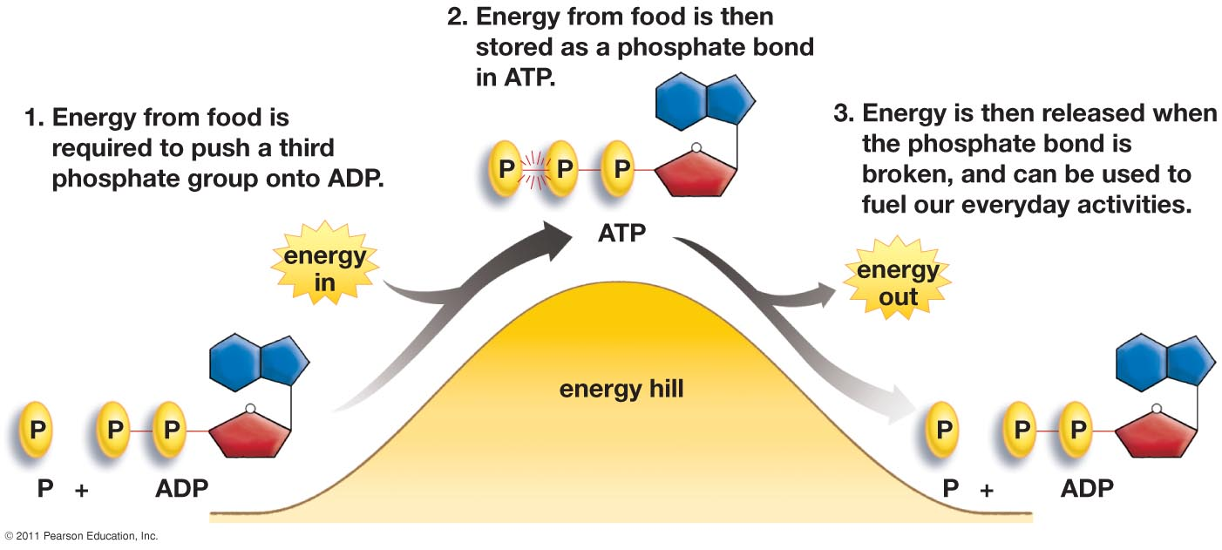
Energizing ATP
Adenosine triphosphate (ATP) and Adenosine diphosphate (ADP)

Slide 10
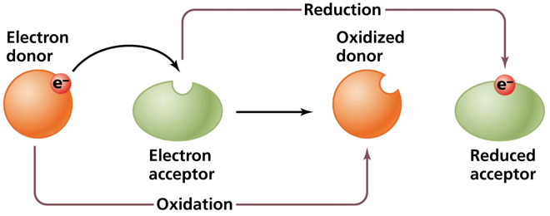
Oxidation Reduction Reactions
Oxidation: the process of _______ electrons
Reduction: the process of _______ electrons
Reduction in charge
Oxidation and Reduction reactions are always linked
Redox reaction: the transfer of electrons from one molecule to another

Slide 11
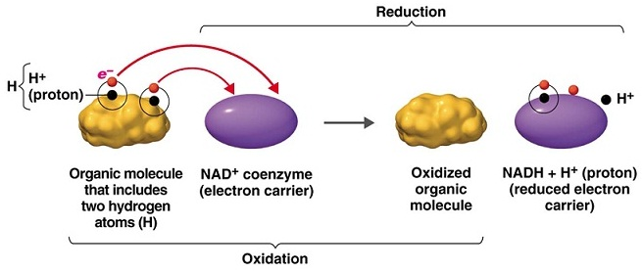
Oxidation and Reduction of NAD⁺
Nicotinamide adenine dinucleotide (NAD+): transfers electrons from hydrogen atoms

Slide 12
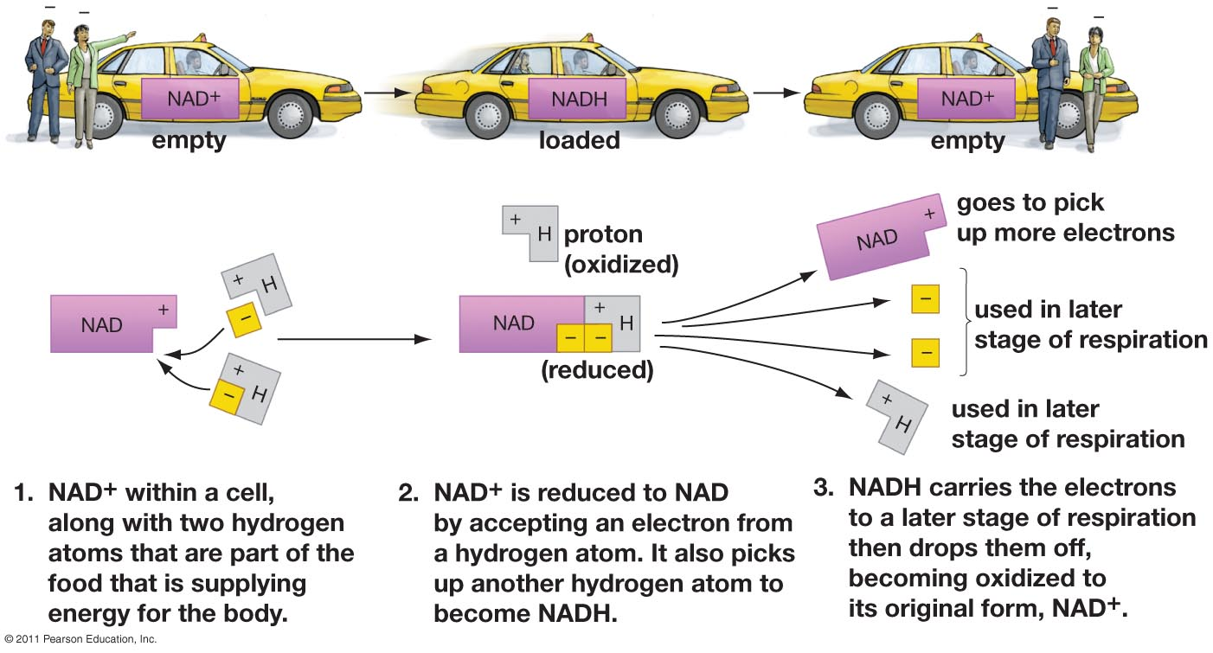
Energy’s Taxi Service: NAD⁺

Slide 13
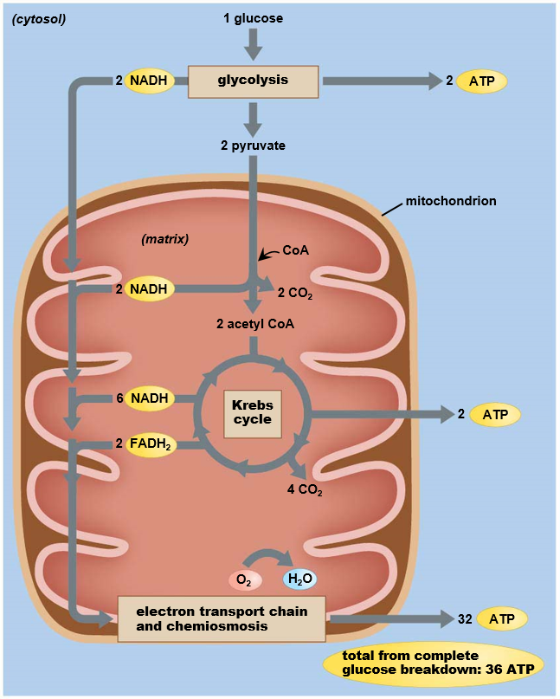
Cellular Respiration
Three part process that converts a single glucose molecule to ______
1. Glycolysis
2 ATP
2. Krebs cycle
2 ATP
3. Electron transport chain
32 ATP

Slide 14
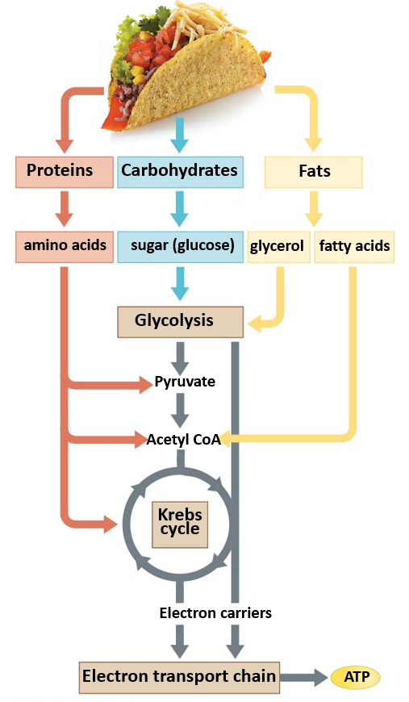
Macromolecules and Energy
Stored energy in chemical bonds of sugar and other macromolecules is captured and converted into the bonds of ATP.
Used in the production of tissue or excreted as waste

Slide 15
Glycolosis
Breakdown of 1 glucose molecule into 2 pyruvate molecules
Present in ____________
Two stages
Energy investment stage: requires 2 ATP
Energy harvesting stage: produced 4 ATP and 2 NADH

Slide 16
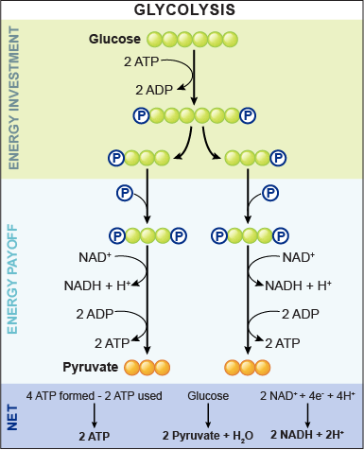
Glycolosis
1. 2 ATP are used to attach two phosphate groups to the 6-carbon glucose molecule
2. 6-carbon glucose split into two 3-carbon molecules
3. Phosphate added with energy from NAD+ oxidation
Two NADH molecules produced
4. Phosphate groups lost to ADP
Four ATP produced
5. Pyruvate end product
1
2
3
4
5
Notes:
Electrons derived from glucose (high in energy) will be running downhill. The downhill drop will power uphill push needed to attach phosphate to ADP
2 ATP produce
2 NADH produced
2 molecules of pyruvic acid produced

Slide 17
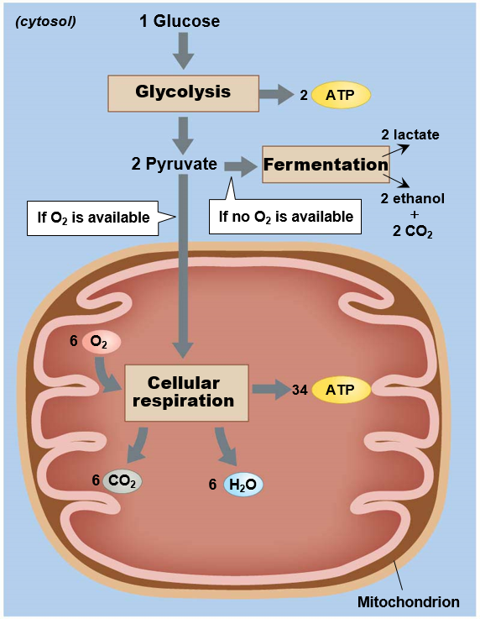
Aerobic and Anaerobic Pathways
Anaerobic: without the use of _______
Glycolysis
Fermentation
Aerobic: with the use of oxygen
Cellular respiration

Slide 18
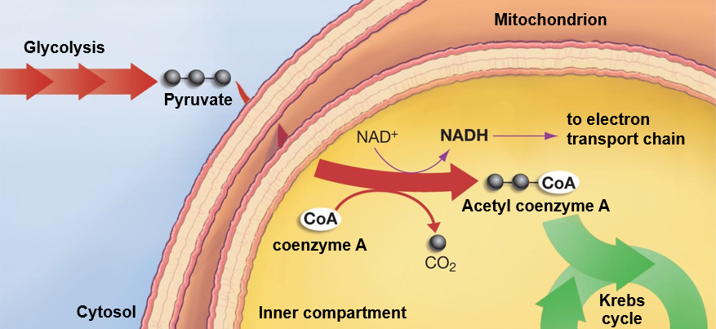
Transition Phase
Coenzyme A (acetyl CoA) added to pyruvate, Acetyl Coenzyme A produced
____________ byproduct
One NADH molecule produced from each pyruvate molecule

Slide 19
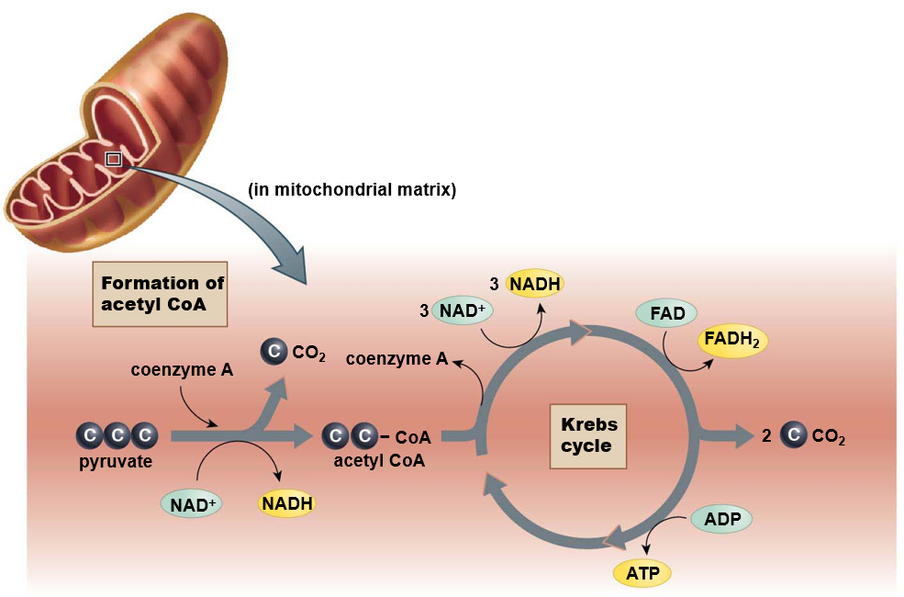
Krebs Cycle
Inner compartment of mitochondria
One glucose molecule
= 2 pyruvate
= _____ cycles
4 CO₂
6 NADH
2 ATP
2 FADH₂

Slide 20
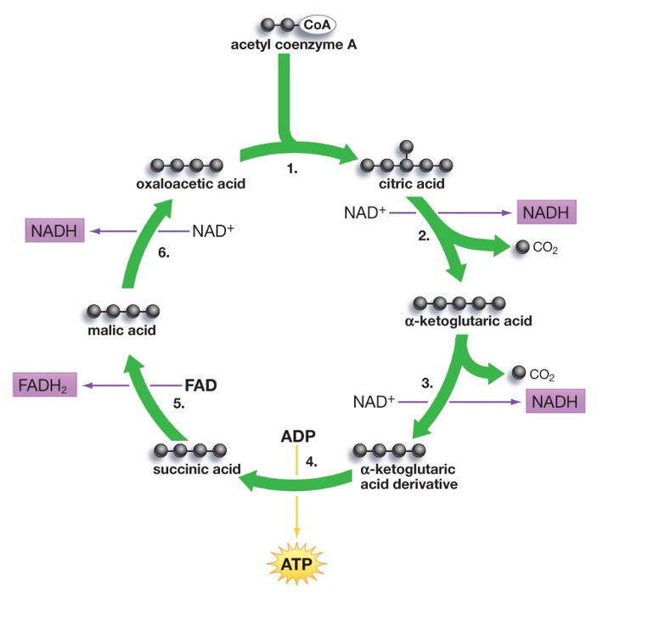
Krebs Cycle
6) 4C malic acid oxidized by NAD⁺ to form oxaloacetic acid
1 NADH
1) Acetyl CoA combines with 4C oxaloacetic acid to form 6C citric acid
5) 4C succinic acid oxidized by FAD to form malic acid
1 FADH₂
2) 6C Citric acid oxidized to form 5C α-ketoglutaric acid
1 NADH
1 CO₂
3) 5C α-ketoglutaric acid loses carbon, becomes 4C α-ketoglutaric acid derivative
1 NADH
1 CO₂
4) 4C α-ketoglutaric acid
derivative spilt to make
4C succinic acid
1 ATP

Slide 21
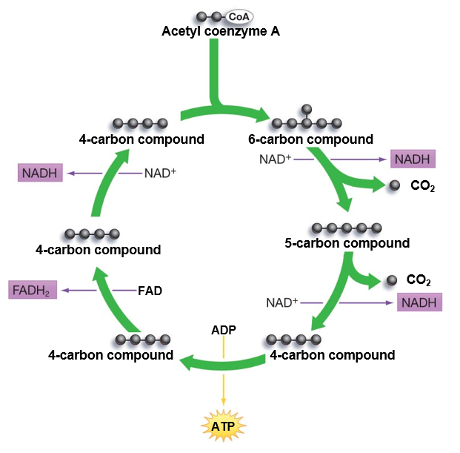
Krebs Cycle
1. Acetyl coenzyme-A combines with 4-carbon compound forming 6-carbon compound
2. 6-carbon compound loses electrons (oxidation) to NAD⁺ forming NADH, and two carbon dioxide molecules are released
3. 4-carbon compound rearranges and releases energy used to create ATP molecule
4. Newly arranged 4-carbon compound is oxidized by FAD forming FADH₂
5. 4-carbon compound is oxidized by NAD⁺ forming NADH. 4-carbon compound is transformed into original 4-carbon compound and the cycle continues
1
5
2
4
3

Slide 22
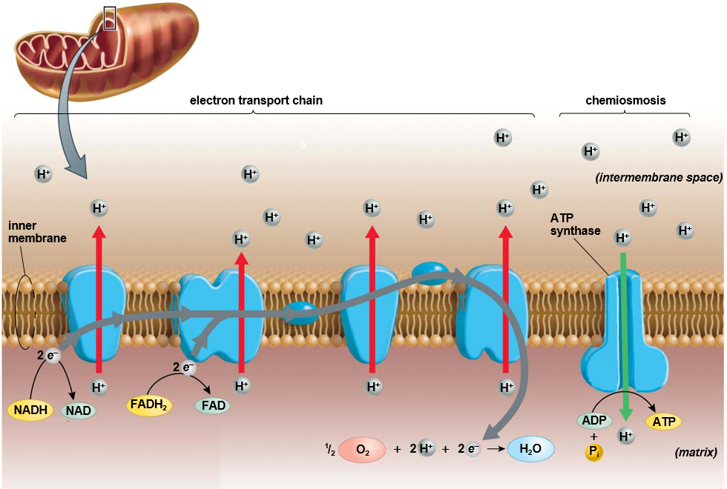
Electron Transport Chain
Electron Transport Chain: energy from e⁻ used to push H⁺ ions from inner compartment to outer compartment against concentration and electrical gradient
Inner membrane of mitochondria
Oxygen is the final electron acceptor
Chemiosmosis: movement of ions across semi-permeable membrane, down their electrochemical gradient
ATP synthase: enzyme uses energy from H+ ions to spin, which add phosphate to ADP making ATP
Notes:
Concentration gradient is a form of potential energy.
Electron carriers (NADH, and FADH₂) donate electrons
Electrons move downhill providing energy to hydrogen pumps
Oxygen = final electron acceptor
Energy from e⁻ used to push H⁺ ions from inner compartment to outer compartment against concentration and electrical gradient
ATP synthase: enzyme uses energy from H+ ions to spin, which add phosphate to ADP making ATP 100 revolutions/sec!
Hydrogen ions moving down concentration gradient from inner membrane to inner compartment

Slide 23
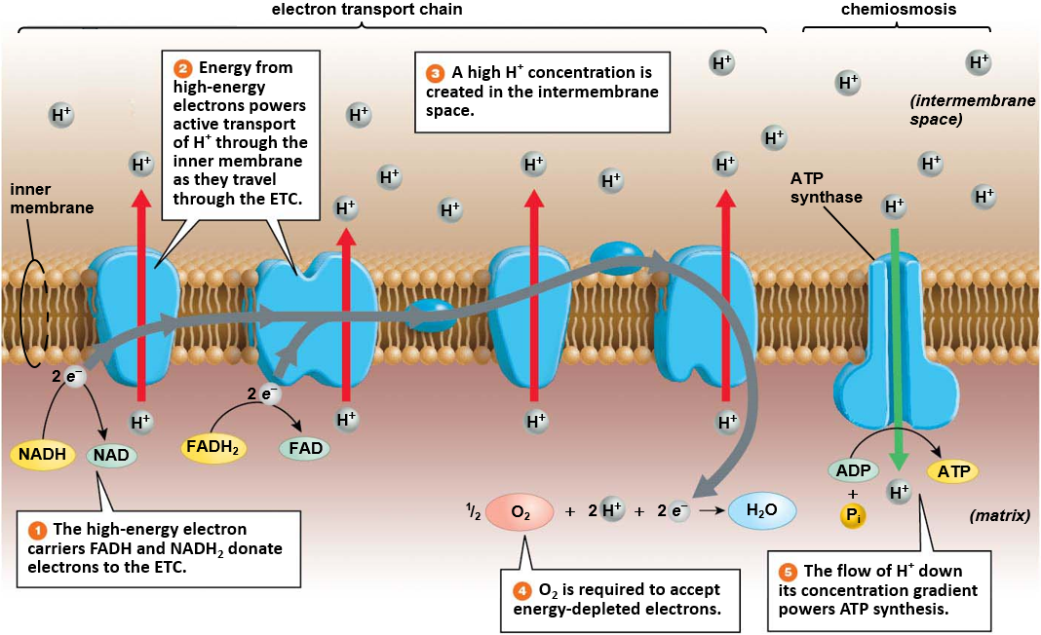

Slide 24
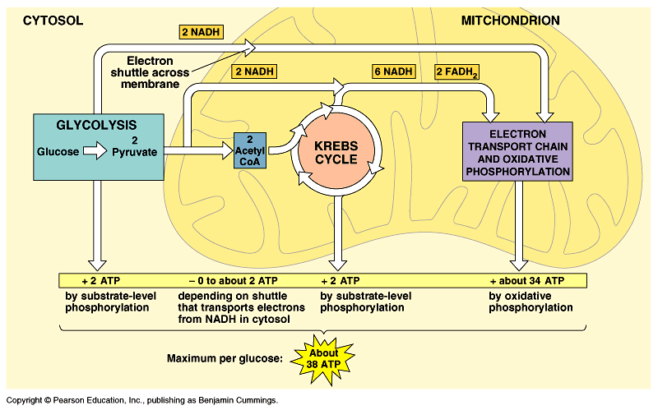
Cellular Respiration Review
C₆H₁₂O₆ + 6O₂ 6CO₂ + 6H₂O + 36ATP

Slide 25
Cellular Respiration Review
Step | Location | Input | Output | Electron Carriers | ATP
Glycolysis | Cytosol | Glucose | Pyruvate | Energy captured in 2 NADH | 2 ATP
Transition Phase | Inner compartment of mitochondrion | Pyruvate, Coenzyme-A, | Acetyl-Coenzyme-A, CO₂ | Energy captured in 2 NADH | -
Krebs Cycle | Inner compartment of mitochondrion | Acetyl Coenzyme-A, H₂O | CO₂ | Energy captured in 6 NADH, 2 FADH₂ | 2 ATP
Electron Transport Chain | Inner membrane of mitochondrion | Oxygen (O₂) | H₂O | Energy released from 10 NADH, 2 FADH₂ | 32 ATP

Slide 26
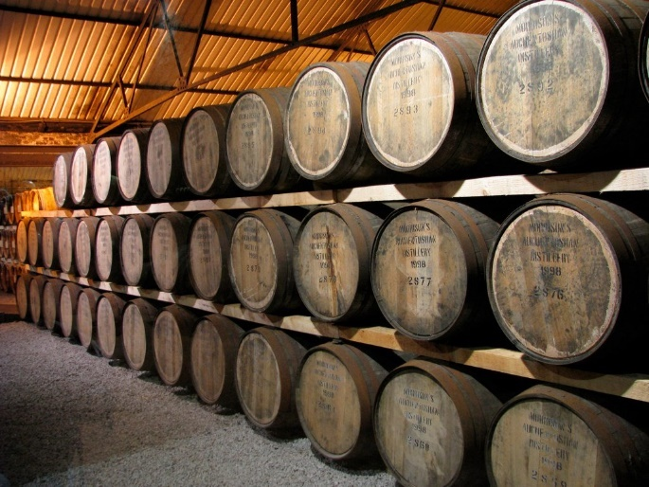
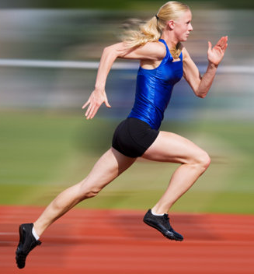
Anaerobic Pathway
_____________: metabolic pathway that regenerates NAD+ from NADH and allows for glycolysis to continue making ATP in the absence of oxygen
Alcohol fermentation
Yeast in anaerobic environment
Lactic acid fermentation
Occurs in _________ when ATP use exceeds oxygen uptake

Slide 27
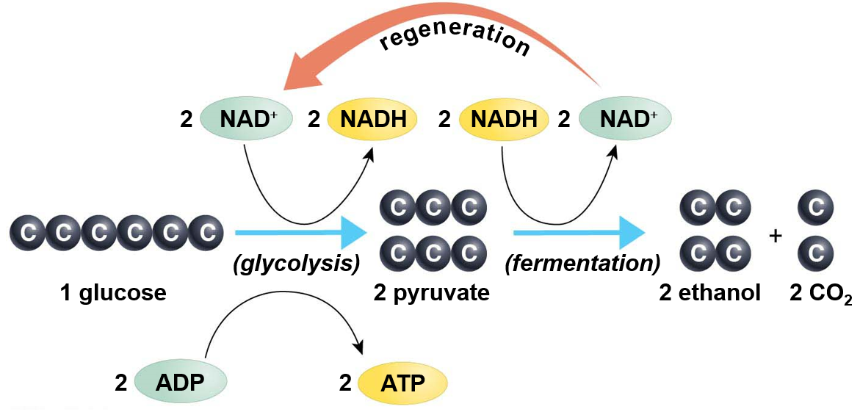
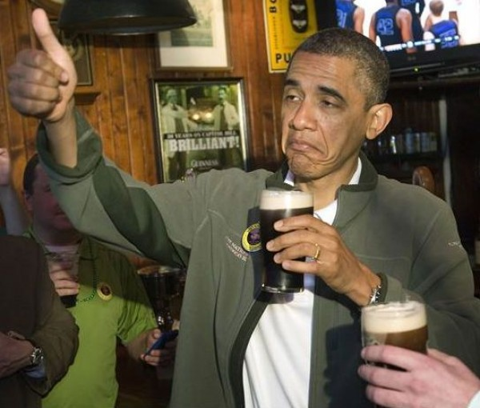
Alcohol Fermentation
Ethanol (drinking alcohol) is produced when acetaldehyde (pyruvate derivative) accepts electrons from NADH

Slide 28
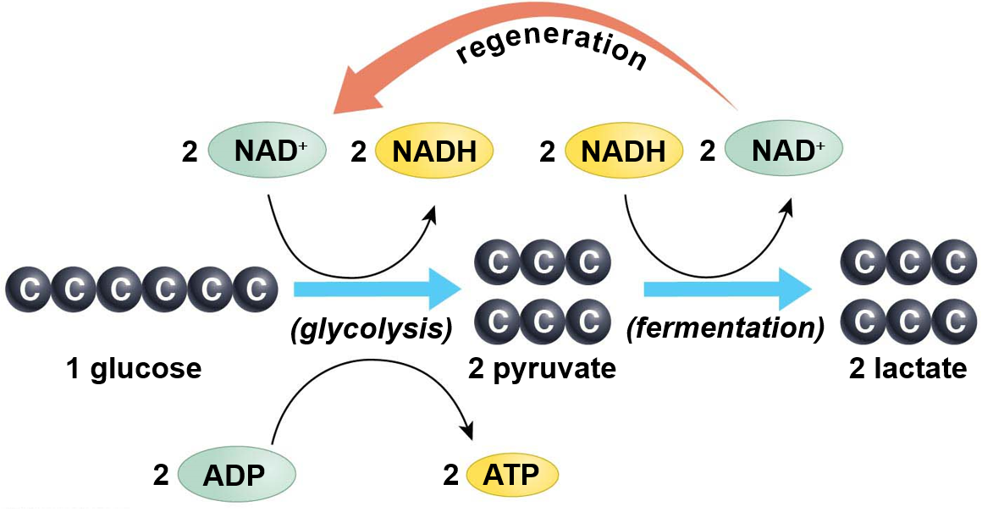
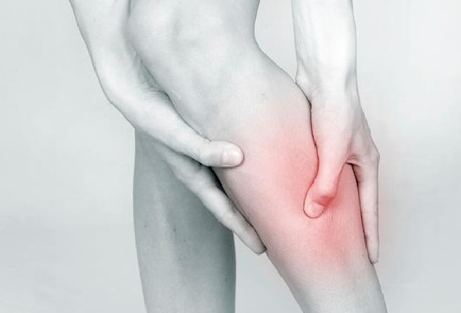
Lactic Acid Fermentation
Lactic acid is produced when pyruvate accepts electrons from NADH
Occurs when oxygen delivery to cells is lagging
Causes burning in muscles

Slide 29
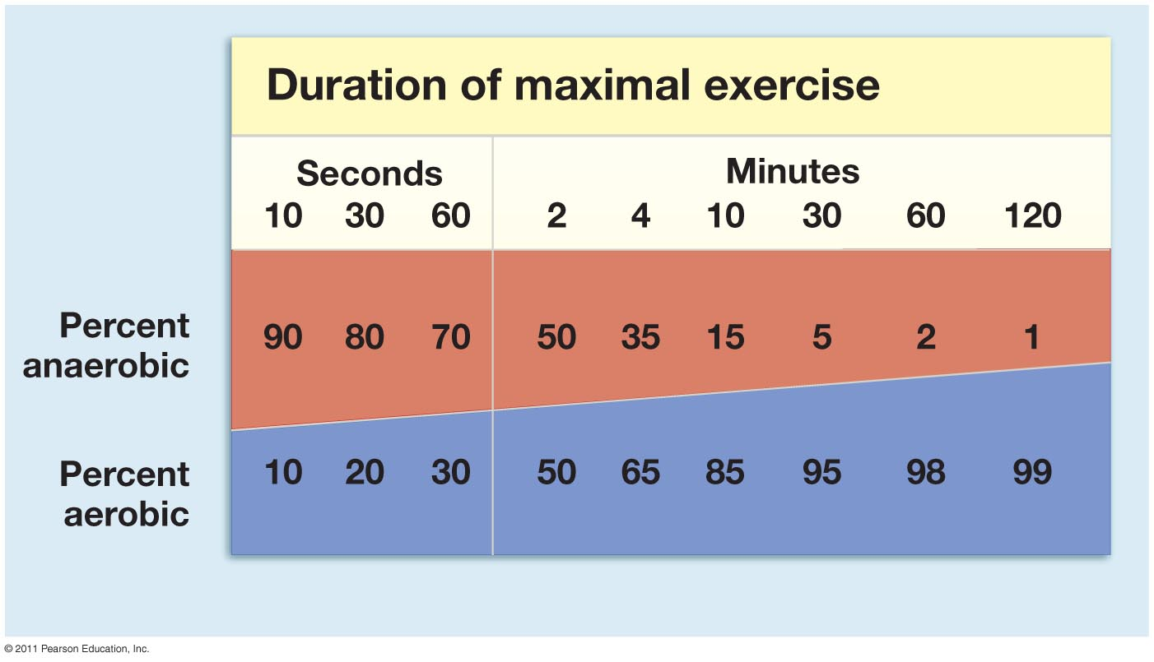
Anaerobic and Aerobic Contributions
Energy from anaerobic respiration is used for short bursts of activity

Slide 30
Check your Understanding
1. True or False: When NAD+ accepts and electron from a hydrogen it has been reduced
2. True or False: Oxygen is required to make ATP

Slide 31
Check your Understanding
3. Which of the following steps produce the most electron carriers?
a. Glycolysis
b. Transition phase
c. Krebs cycle
d. Electron transport chain

Slide 32
Check your Understanding
4. How much ATP is produced as one glucose molecule moves through the Krebs cycle?
a. 1 ATP
b. 2 ATP
c. 4 ATP
d. 32 ATP

Slide 33
Check your Understanding
5. Which of the following best describes the function of the electron transport chain?
a. Transfer electrons on to NAD⁺ to make NADH
b. Breakdown glucose into pyruvate
c. Use energy from electrons to pump hydrogen ions against their concentration gradient
d. Use the energy from electrons to attach phosphate groups to ADP

Slide 34
Check your Understanding
Which of the following best describes oxygens role in the cellular respiration?
a. Byproduct of the Krebs cycle and transition phase
b. Used to break down the glucose molecule
c. Accepts the electron at the end of the electron transport chain
d. Donates a phosphate group to ATP

Slide 35
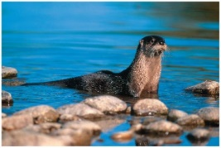
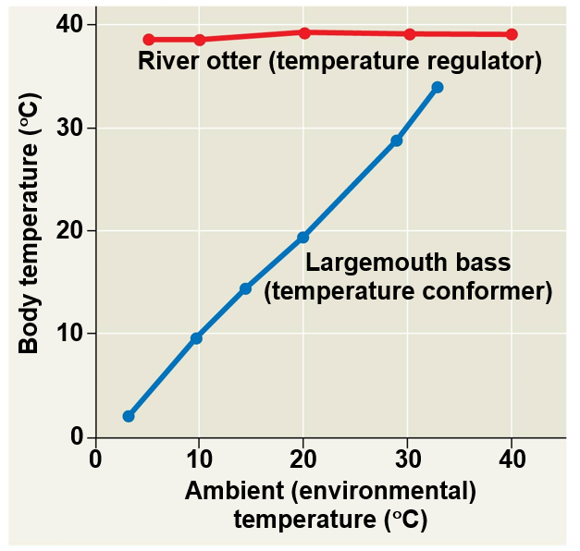
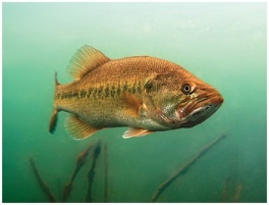
Homeostasis
Homeostasis: a physiological state where internal conditions are ______________
Regulators: use internal mechanisms to ________ external fluctuations
Conformers: allow internal conditions to ______________ to external fluctuations

Slide 36
Thermoregulation
Thermoregulation: Process by which animals maintain their body temperature within a normal range
Endothermic: body temperature maintained by _____________
Birds, mammals, and some insects
Ectothermic: body temperature controlled by _____________
Most reptile, fish, and invertebrates
Poikilotherm: animals whose body temperature fluctuates with the environment.
Homeotherm: animals with a relatively constant body temperature

Slide 37
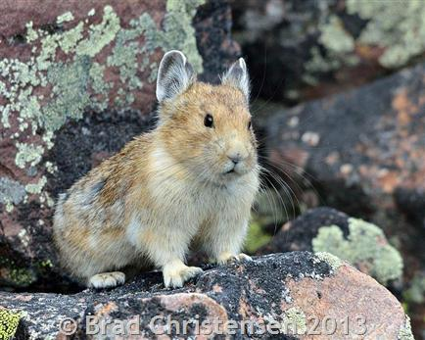
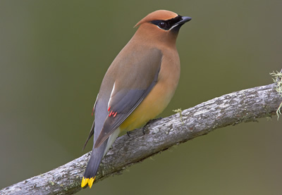
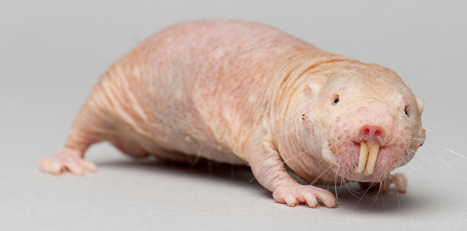
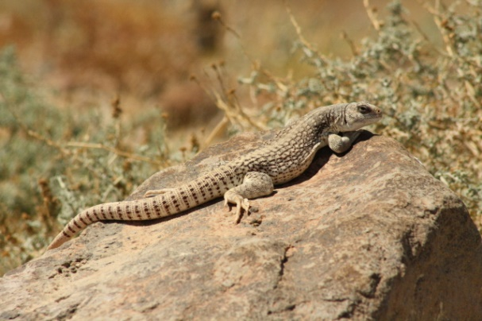
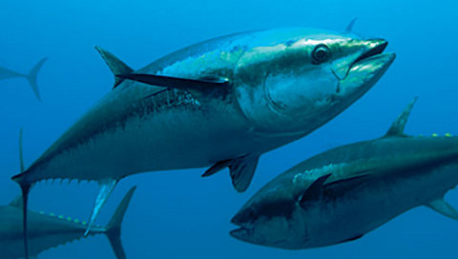
Variation in Thermoregulatory Strategies
Poikilotherms

Slide 38
Heat Exchange with Environment
Conduction - __________ of heat
Convection - transfer of heat by the movement of ________ across a surface
Radiation - emission of electromagnetic waves
Evaporation - loss of heat from changing a liquid into a gas

Slide 39
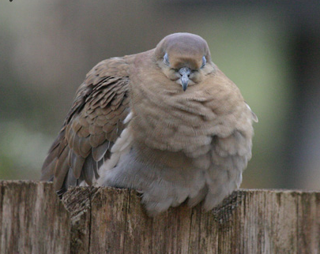
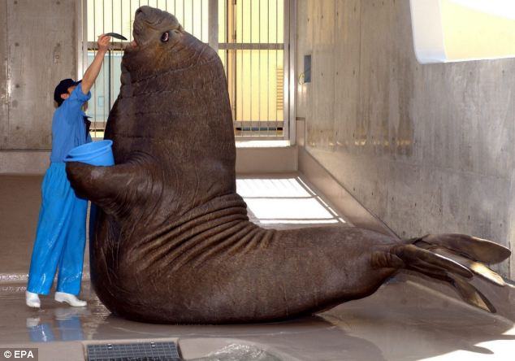
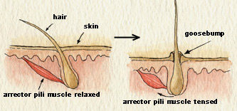
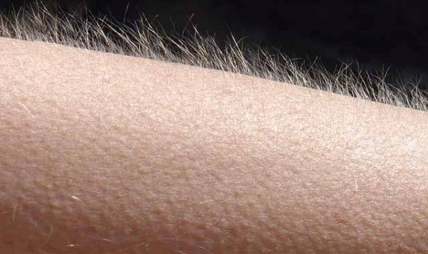
Adaptations for Thermoregulation
Insulation
Hair
Feathers
Fat (blubber)

Slide 40
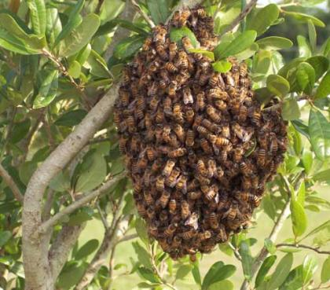
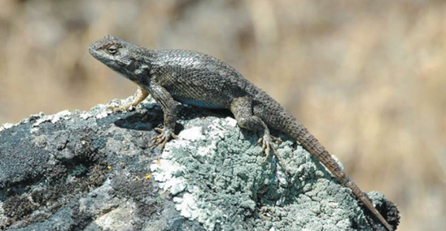
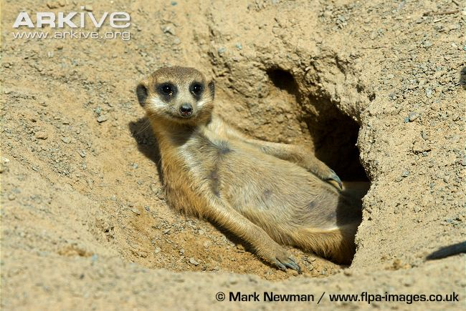
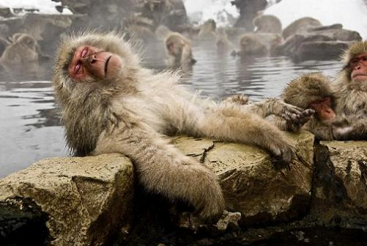
Adaptations for Thermoregulation
Behavior Responses
_______
Huddling
Burrowing
Hot tubbin’

Slide 41
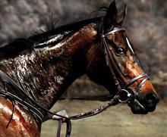
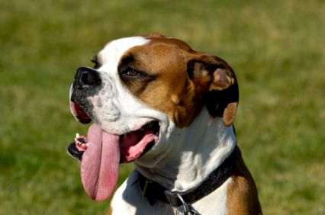
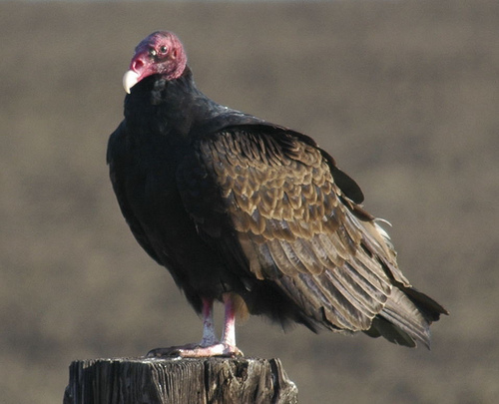
Adaptations for Thermoregulation
Evaporative heat loss
Sweating
Panting
Defecating

Slide 42
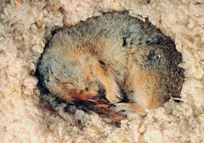
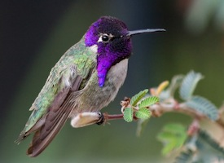
Energy Conservation
_________: physiological state of decreased activity and metabolism
Hibernation: long term torpor and a decreased body temperature in response to winter cold and food scarcity
___________: decreased metabolic rate and activity during hot summer months

Slide 43
Adaptations for Thermoregulation
Vasodilation: the widening of superficial blood vessels
Increases heat transfer
Vasoconstriction: _________ the diameter of superficial blood vessels

Slide 44
Adaptations for Thermoregulation
________________ heat exchange
Warm blood in arteries from animals core comes in close contact with veins returning from extremities
Blood in arteries remains slightly warmer than blood in veins resulting in heat transfer
Returning blood almost as warm as arterial blood

Slide 45
Negative Feedback Loops

Slide 46
Animal Diets
All animals are heterotrophic:
Herbivores
Carnivores
Omnivores
Insectivores
Three nutritional needs:
_______________ for cellular processes
Organic building blocks for macromolecules
Acquisition of _______________

Slide 47
Trade-offs of Thermoregulatory Strategy
=
=

Slide 48
Trade-offs of Thermoregulatory Strategy

Slide 49
Trade-offs of Thermoregulatory Strategy
Smaller endotherms have a greater surface area to volume ratio
Lose heat to the environment
Must consume more energy to maintain a constant body temperature

