Slide 1
Cellular Respiration, Thermoregulation, Comparative Anatomy, and Circulation
"There are no boring subjects, only disinterested minds.”
- G. K. Chesterton
Notes:
Why do we need to breathe? What do we need the oxygen for, and where does the carbon dioxide come from that we exhale?

Slide 2
Exergonic and Endergonic Reactions
Exergonic reactions: reactants contain more energy than the products
Energy ___________
Ex: Cellular respiration
Endergonic reactions: products contain more energy than reactants
Energy ___________
Ex: Photosynthesis

Slide 3
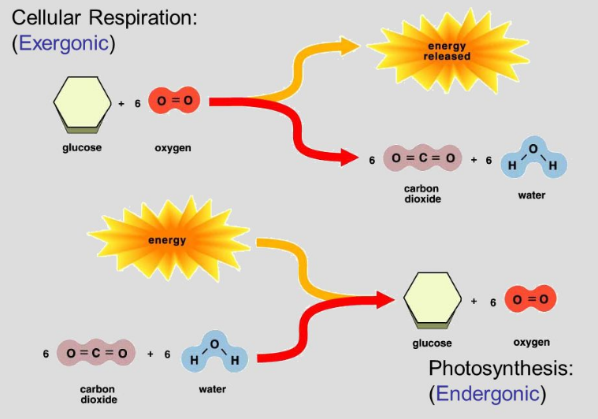
Exergonic and Endergonic Reactions
Cellular respiration: process by which all living things extract energy stored in the _____________ of molecules and use it to fuel cellular processes.
Photosynthesis: conversion of solar energy to chemical energy

Slide 4
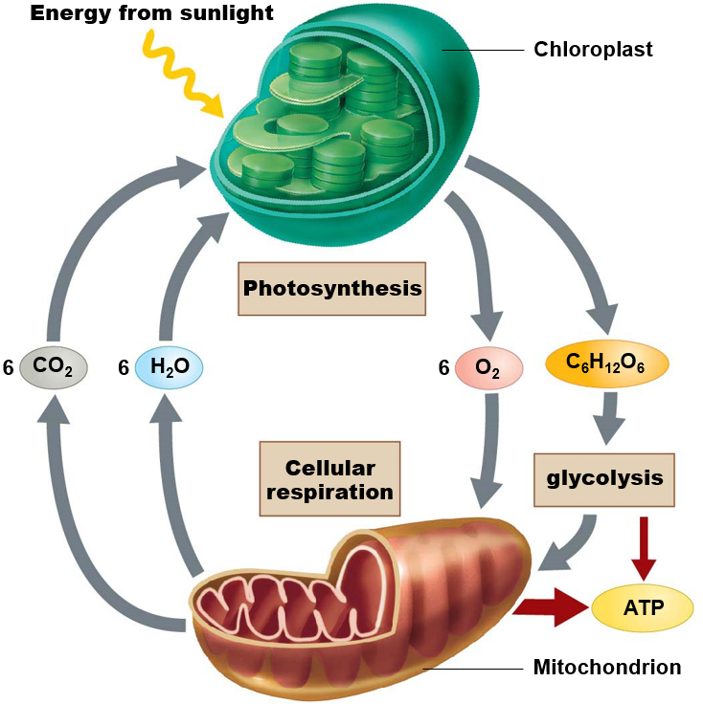
Cellular Respiration and Photosynthesis
Photosynthesis
6H₂O + 6CO₂ C₆H₁₂O₆ + 6O₂
Water + Carbon dioxide Glucose + Oxygen
Cellular Respiration
C₆H₁₂O₆ + 6O₂ 6CO₂ + 6H₂O + 36ATP + Heat
Glucose + Oxygen Carbon dioxide + Water + 36ATP + Heat
Light energy
Notes:
CO2 from atmosphere used to make glucose during photosynthesis, glucose broken down during cellular respiration is released back into the atmosphere.
Cellular Respiration
Aerobic = with oxygen
More efficient than power plant or auto engine
Photosynthesis
Chemical energy initially stored as carbohydrate

Slide 5
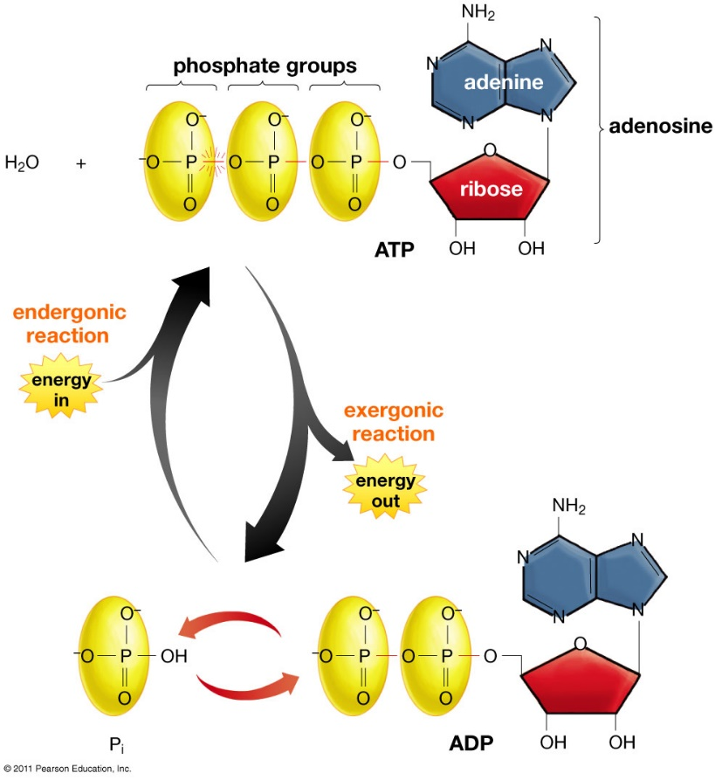
The Molecular Unit of Currency
Adenosine triphosphate (ATP)
Energy transfer molecule
Adenosine diphosphate (ADP)
Phosphorylation: addition of a _______________ to a molecule
Most important energy transfer molecule in living things!
Notes:
Like a rechargeable battery!
-Recycled tens of thousands of times a day
-Middle man used to transfer energy from food to
Adenosine triphosphate (ATP)
Energy transfer molecule
Sugar (ribose)
Nitrogen-containing base (adenine)
Three phosphate groups
Negatively charged
Adenosine diphosphate (ADP)
Two phosphate groups
Most important energy transfer molecule in living things!!
All life uses ATP, from bacteria to humans
Whip of flagella to muscle contraction

Slide 6
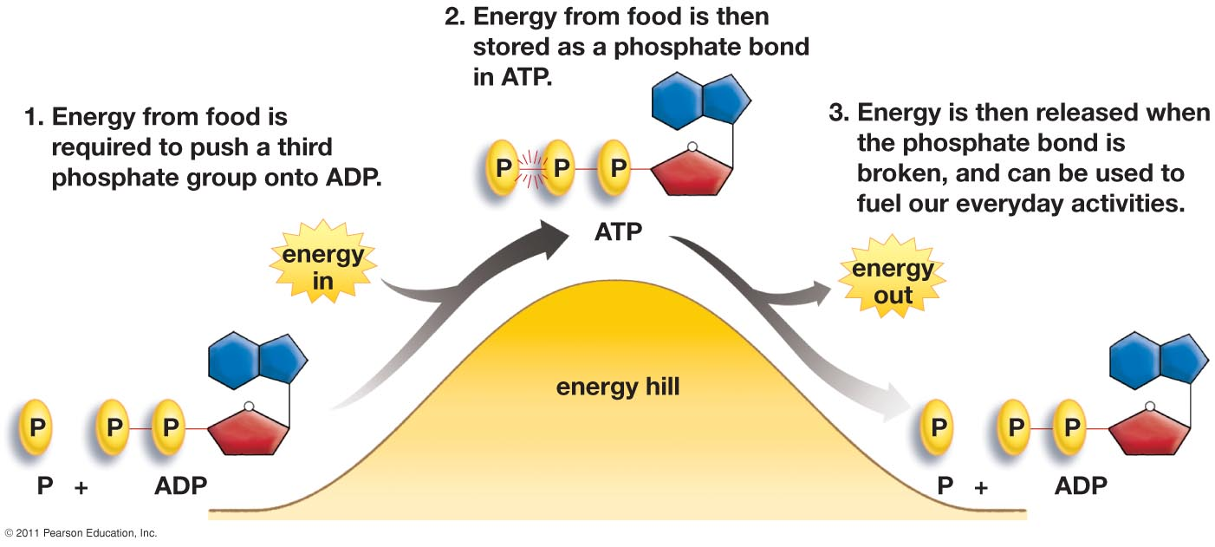
Energizing ATP
Adenosine triphosphate (ATP) and Adenosine diphosphate (ADP)
Notes:
The energy in to attach the third phosphate group comes from food. More specifically the electrons from glucose that are falling downhill.

Slide 7
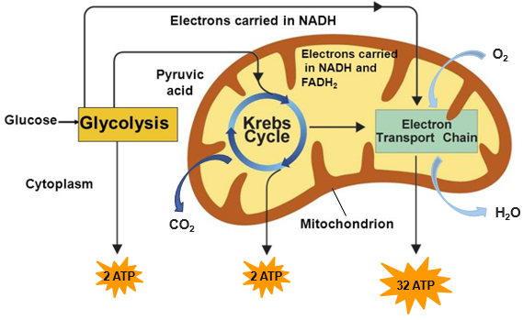
Cellular Respiration
Cellular respiration: a process where energy in the chemical bonds of glucose are converted into cellular energy in the form of ATP.
______________ and glucose are required
Carbon dioxide (CO₂) and water (H₂O) are by products of cellular respiration
Occurs in the _____________ of eukaryotic cells

Slide 8
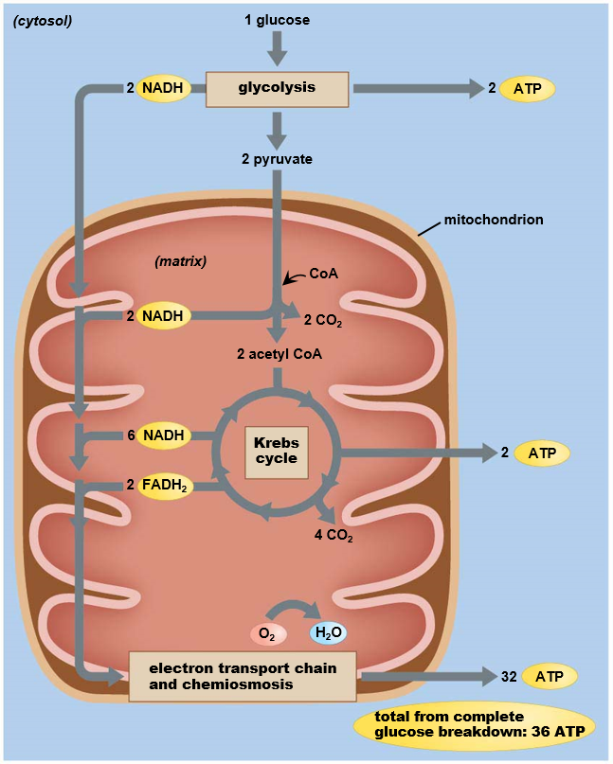
Cellular Respiration
Four part process that converts a single glucose molecule to ______
1. Glycolysis
2 ATP
2. Transition Phase
No ATP produced
3. Krebs cycle
2 ATP
4. Electron transport chain
32 ATP
Notes:
Electrons derived from glucose (high in energy) will be running downhill. The downhill drop will power uphill push needed to attach phosphate to ADP
-spinning a wheel as electrons flow downhill
One glucose molecule yields 36 molecules of ATP

Slide 9
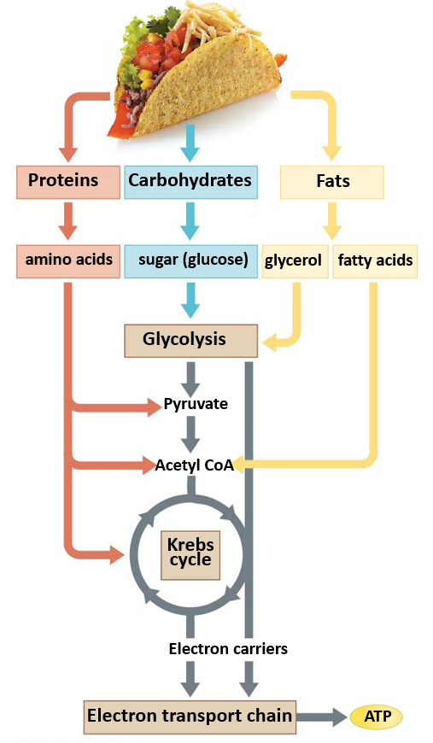
Food and Energy
Why do we have to eat food?
Through the cellular respiration process, stored energy in ____________ of sugar and other macromolecules is captured and converted into the bonds of ______.
Used in the production of tissue or excreted as waste
Notes:
Energy and molecules for cellular respiration come from food.

Slide 10
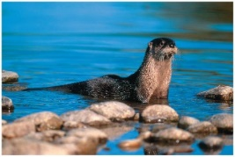
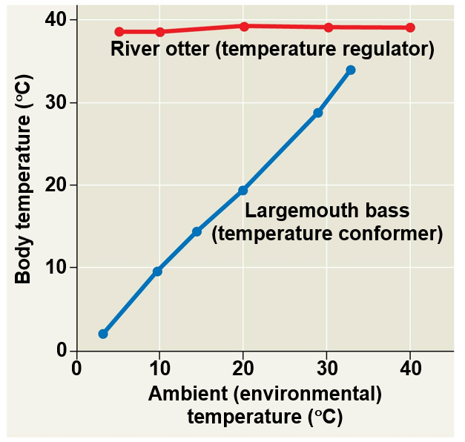
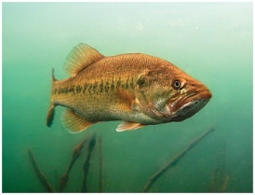
Homeostasis
Homeostasis: a physiological state where internal conditions are _________________
Regulators: use internal mechanisms to __________ external fluctuations
Conformers: allow internal conditions to _______________ to external fluctuations

Slide 11
Thermoregulation
Thermoregulation: Process by which animals maintain their body temperature within a normal range
Endothermic: body temperature maintained by _______________
Birds, mammals, and some insects
Ectothermic: body temperature controlled by ______________
Most reptile, fish, and invertebrates
Poikilotherm: animals whose body temperature fluctuates with the environment.
Homeotherm: animals with a relatively constant body temperature
Notes:
Endothermy and ectothermy are not mutually exclusive (Ex. Bird warming itself in the sun)
Endotherms have much greater food requirements

Slide 12
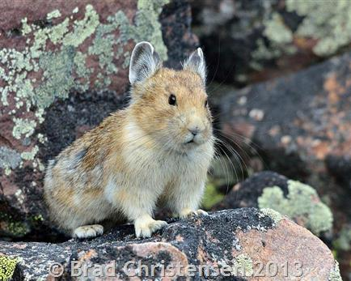
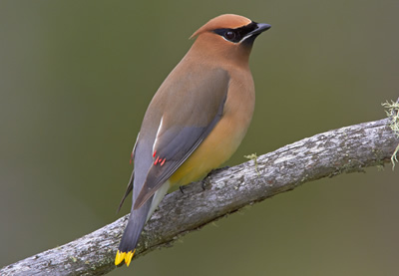
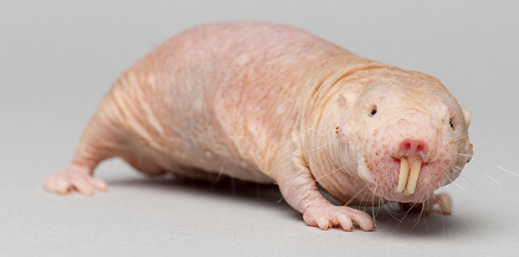
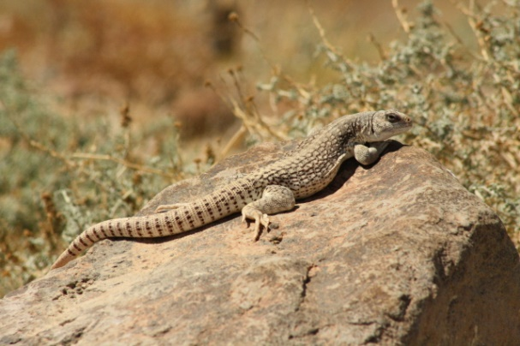
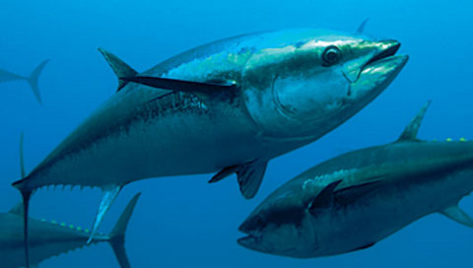
Variation in Thermoregulatory Strategies
Poikilotherms

Slide 13
Heat Exchange with Environment
Conduction - _____________ of heat
Convection - transfer of heat by the movement of ___________ across a surface
Radiation - emission of electromagnetic waves
Evaporation - loss of heat from changing a liquid into a gas

Slide 14
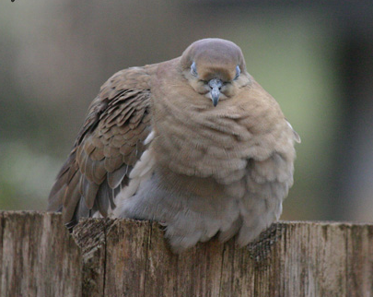
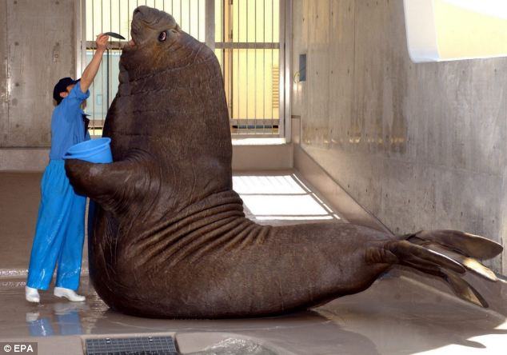
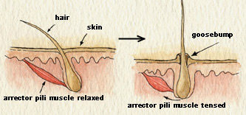
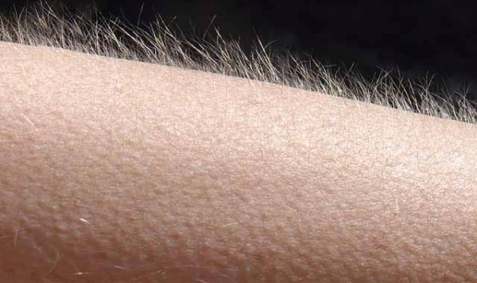
Adaptations for Thermoregulation
Insulation
Hair
Feathers
Fat (blubber)

Slide 15
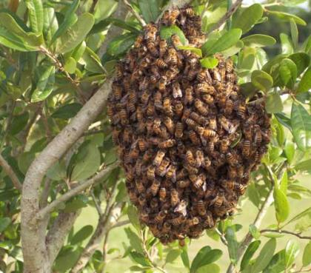
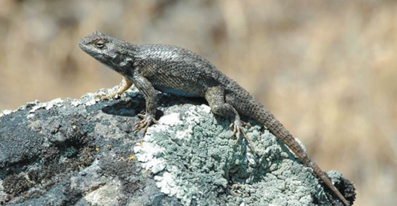
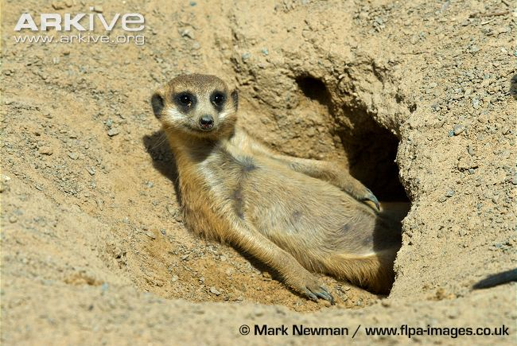
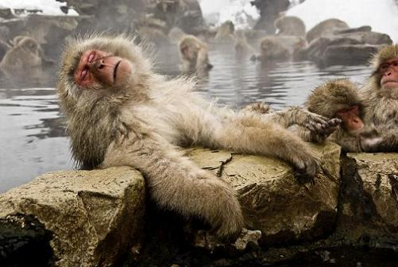
Adaptations for Thermoregulation
Behavior Responses
________
Huddling
Burrowing
Hot tubbin’

Slide 16
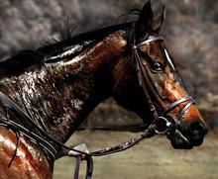
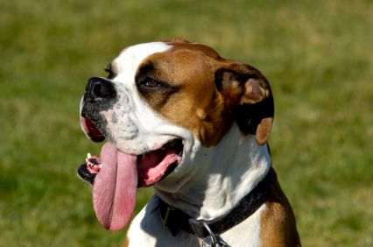
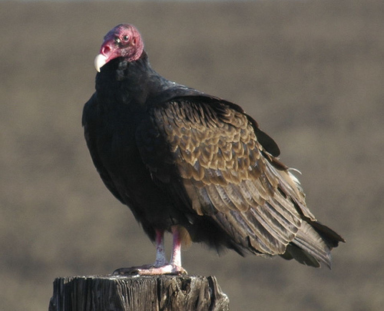
Adaptations for Thermoregulation
Evaporative heat loss
Sweating
Panting
Defecating

Slide 17
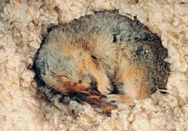
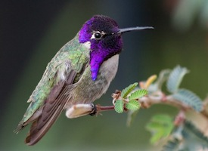
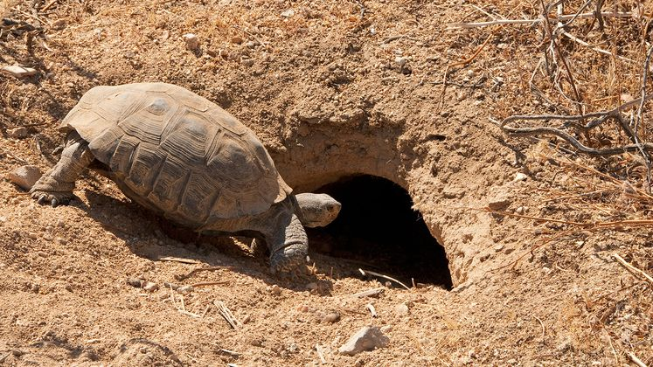
Energy Conservation
_________: physiological state of decreased activity and metabolism
Hibernation: long term torpor and a decreased body temperature in response to winter cold and food scarcity
__________: decreased metabolic rate and activity during hot summer months
Notes:
Metabolic rates can be 20 times lower during hibernation

Slide 18
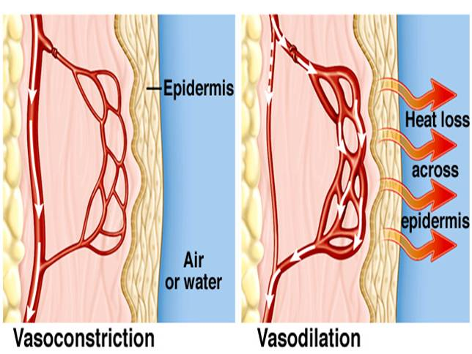
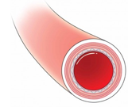
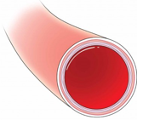
Adaptations for Thermoregulation
Vasodilation: the widening of superficial blood vessels
Increases heat transfer
Vasoconstriction: __________ the diameter of superficial blood vessels

Slide 19
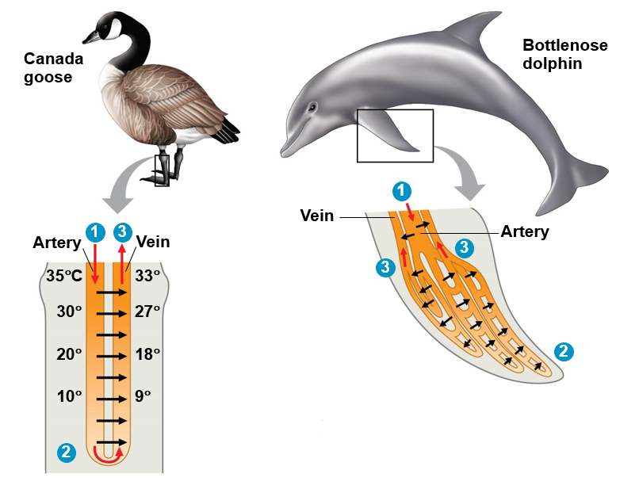
Adaptations for Thermoregulation
_________________ heat exchange
Warm blood in arteries from animals core comes in close contact with veins returning from extremities
Blood in arteries remains slightly warmer than blood in veins resulting in heat transfer
Returning blood almost as warm as arterial blood
Notes:
Counter-current heat exchange = transfer of heat between fluids flowing in opposite directions

Slide 20
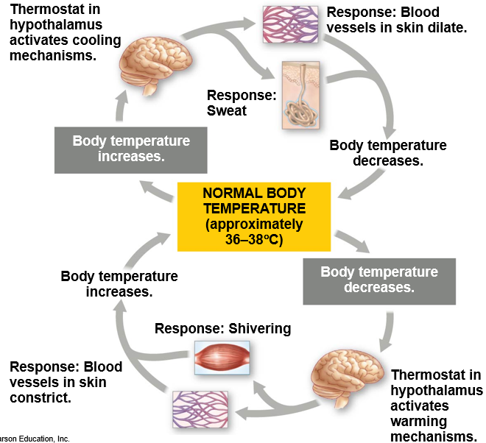
Negative Feedback Loops
Notes:
Negative feedback: when a change in a variable triggers a response that counteracts the initial change

Slide 21
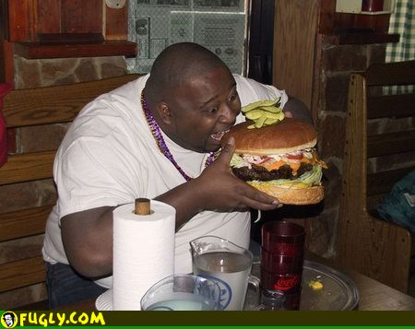
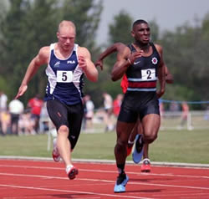
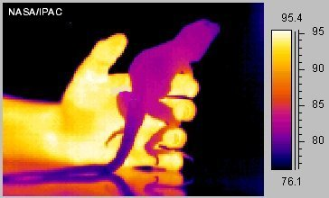
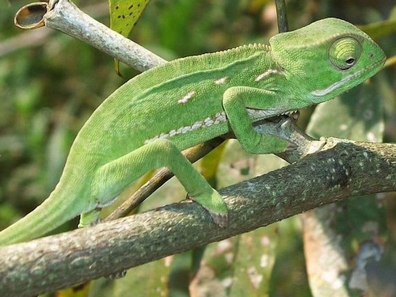
Trade-offs of Thermoregulatory Strategy
=
=

Slide 22
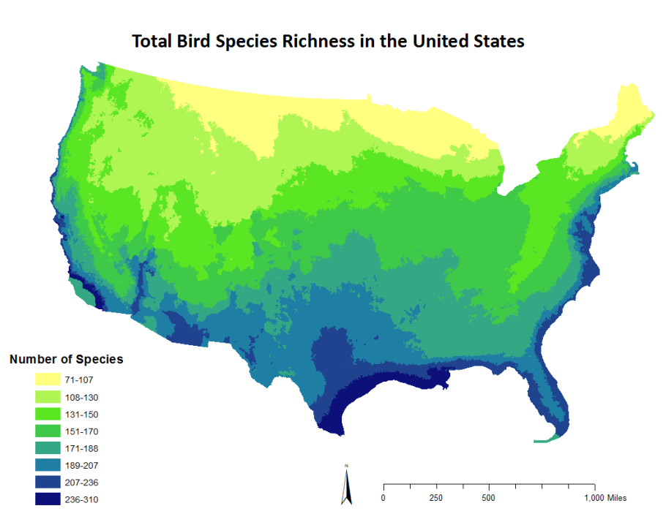
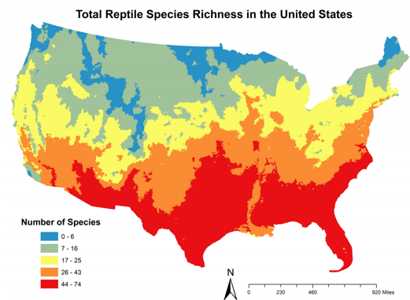
Trade-offs of Thermoregulatory Strategy

Slide 23
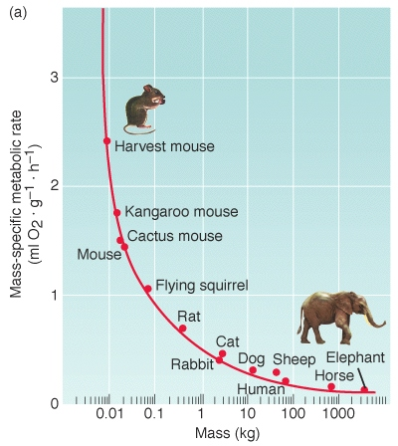
Trade-offs of Thermoregulatory Strategy
Smaller endotherms have a greater surface area to volume ratio
Lose heat to the environment
Must consume more energy to maintain a constant body temperature

Slide 24
Animal Diets
All animals are heterotrophic:
Herbivores
Carnivores
Omnivores
Insectivores
Three nutritional needs:
_______________ for cellular processes
Organic building blocks for macromolecules
Acquisition of _________________
Notes:
Chemical energy is used to produce ATP includes carbohydrates, lipids, and proteins
Organic carbon (sugar) and organic nitrogen (proteins) required to build new complex molecules
Essential nutrients often serve as substrates for enzymes, as coenzymes and as cofactors in biosynthetic reactions

Slide 25
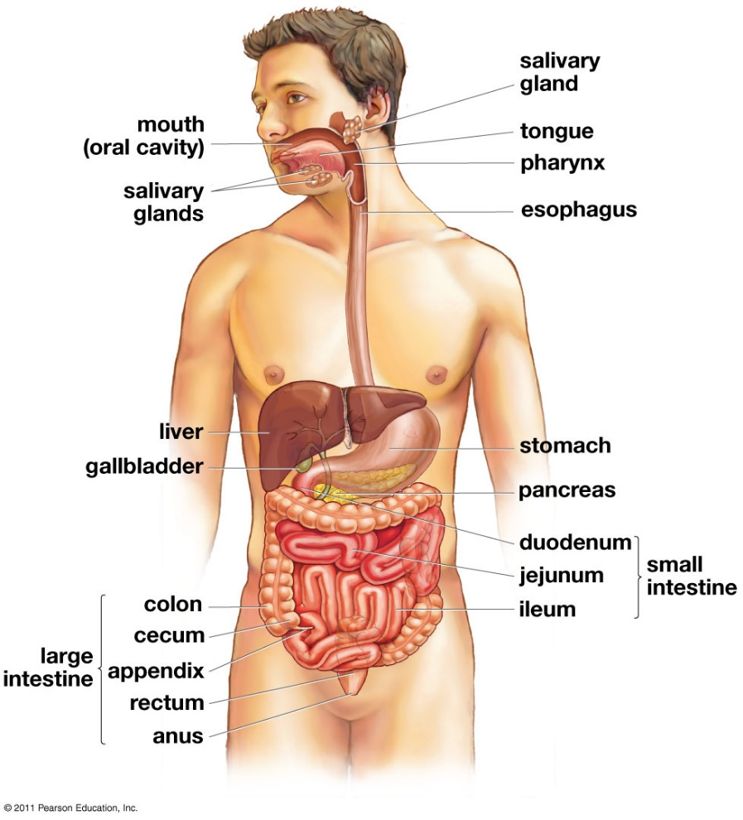
Digestive System
Digestive tract
Breakdown food and absorb macro and micronutrients
Mouth
Pharynx
Esophagus
Stomach
Small Intestine
Large Intestine
Rectum
Notes:
Nutrients to liver before heart and body

Slide 26
Digestive System
Site of Macromolecule Digestion
 | Carbs | Protein | Nucleic acids | Fats
Mouth | Initial |  |  | Initial
Stomach |  | Initial
Small intestine | Main | Main | Initial Main | Main

Slide 27
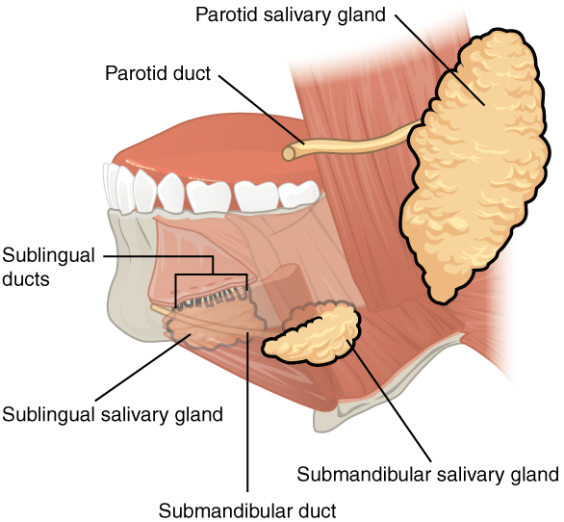
The Mouth
Mechanical breakdown of food
Release digestive enzymes
Salivary _________
Sugar breakdown
Lingual lipase
Lipid breakdown
Notes:
Starch and lipid breakdown begins in mouth
Amylase – enzyme for carbohydrates
Lipase – lingual lipase begins breakdown of triglycerides → fatty acids and monoglycerides
Salivary glands water and glycoproteins (mucins) called mucus
Water + mucus makes food slippery enough to be swallowed
Passes down esophagus to stomach through peristalsis

Slide 28
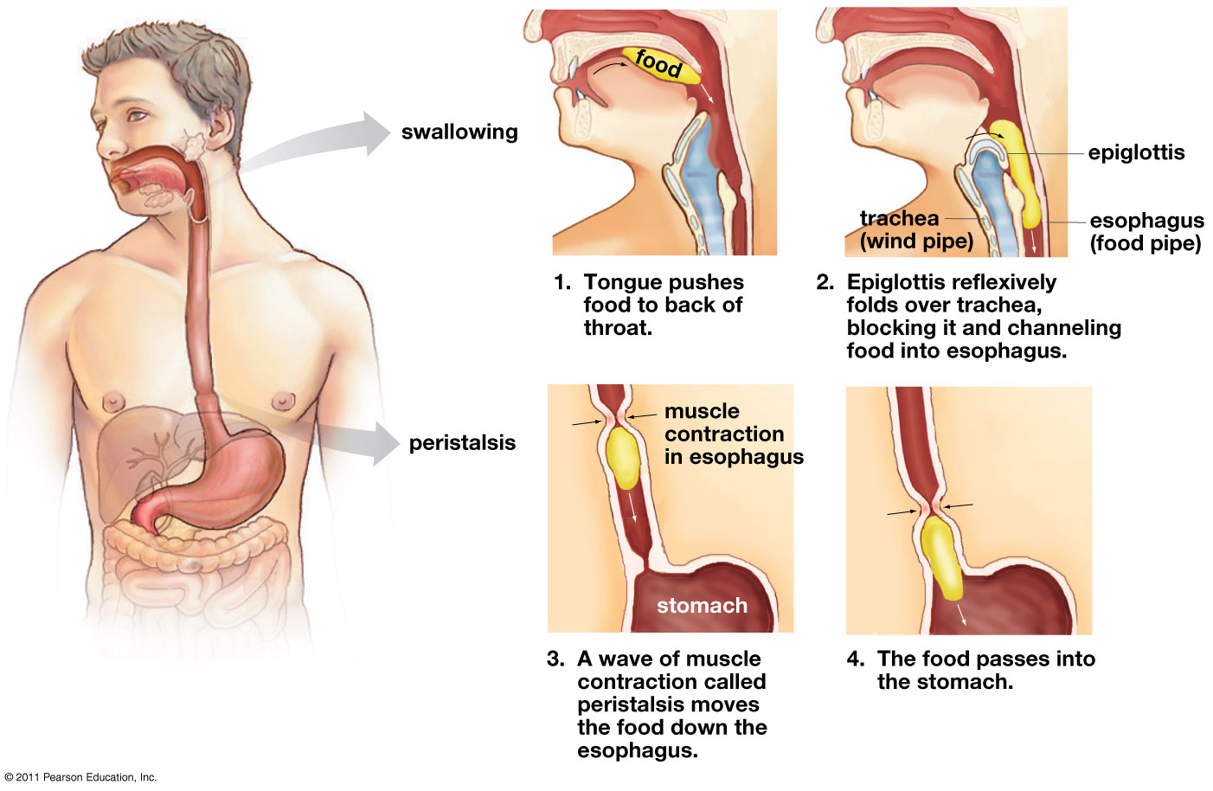
Move It Along
_____________: waves of muscle contractions that pushes food through digestive tract
Epiglottis: flap of cartilage that covers the trachea when swallowing
Notes:
Peristalsis = alternating contractions of circular and longitudinal muscles in esophagus

Slide 29
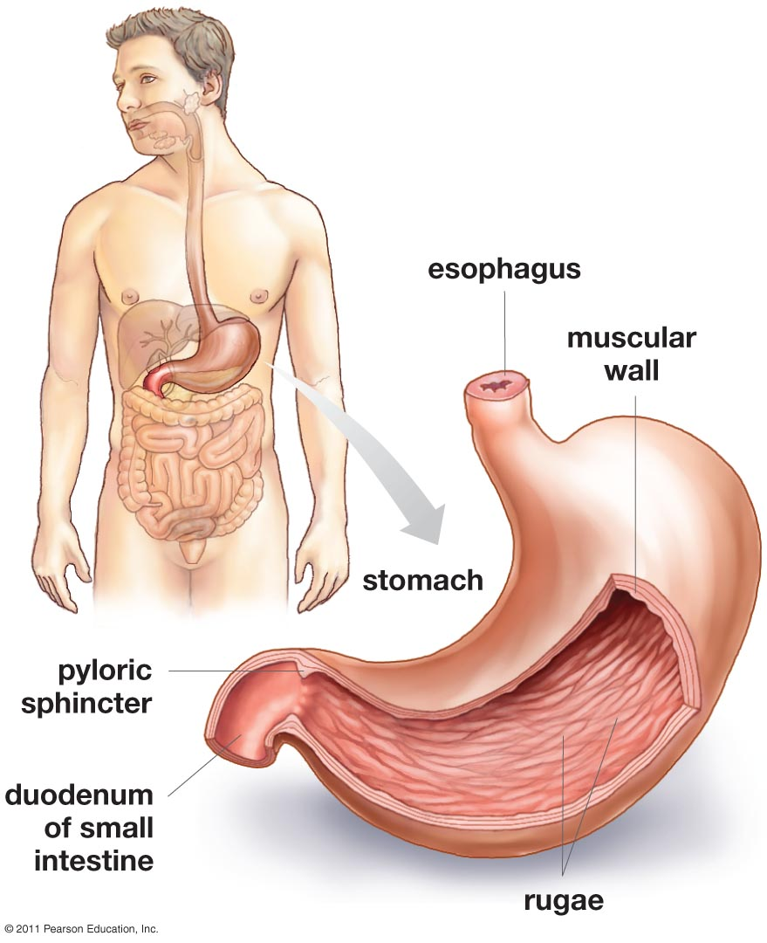
The Stomach
Continues mechanical breakdown
Gastric juice
HCl + pepsin
Pepsin: enzyme that breaks down _________
Acidity (pH=2) helps break down proteins and also kills bacteria
_________: mixture of food and gastric juices
Food storage
Expanding folds known as rugae
Notes:
Sphincter = a muscular valve that can close off a tube (blood vessel, digestive tract)
Muscular contractions churn and mix food to uniform consistency
Highly acidic (pH<2)
Necessary for breakdown of proteins destroying secondary and tertiary structure
Early experiments in digestion by William Beaumont, that stemmed from a shot gun blast to the gut, discovered that acids in the stomach are especially good at digesting meats
Pepsin = protein enzyme
Stored as inactive pepsinogen in chief cells (otherwise it would break down the cell it was made in)
Breaks peptide bonds between amino acids, breaking down polypeptides
Specialized secretory cells secrete HCL and mucus, which lines the stomach and protects in from the acid.

Slide 30
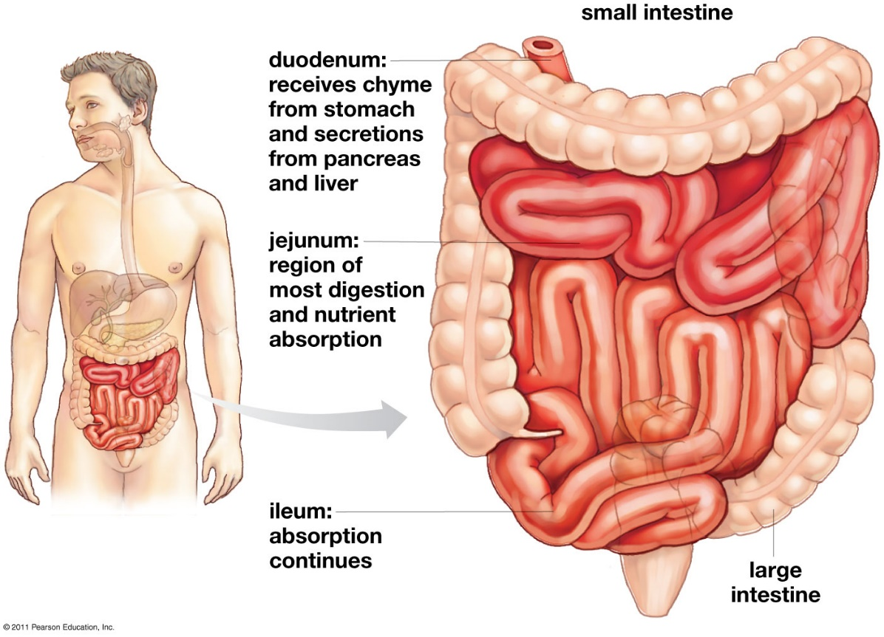
The Small Intestine
6m long!
Smaller diameter than large intestine
80% of nutrients absorbed
____________
Receives secretions from digestive glands
Liver
Pancreas
Gallbladder
Jejunum
Absorption
lleum

Slide 31
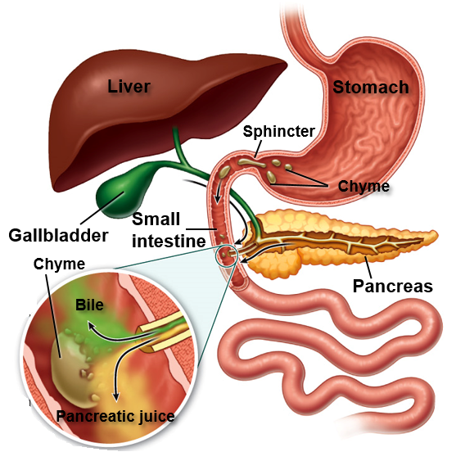
Digestive Glands
Pancreas
Produces insulin
Secretes enzymes and buffers
Increase pH
Liver
________________
Fat digestion
Regulates nutrients
Receives toxins
Gallbladder
Stores bile
Notes:
Pancreas secretes lipase, protease, nuclease and carbohydrases
pH of small intestine = 6-7.5
Proteases = protein digestive enzyme synthesized in pancreas (inactive)
Pancreatic lipase = lipid digestive enzyme
Bile salts = break up lipids = emulsification
Nucleases = digest RNA and DNA
Hormone secretin = signals release of bicarbonate, which neutralizes stomach acids
First hormone discovered

Slide 32
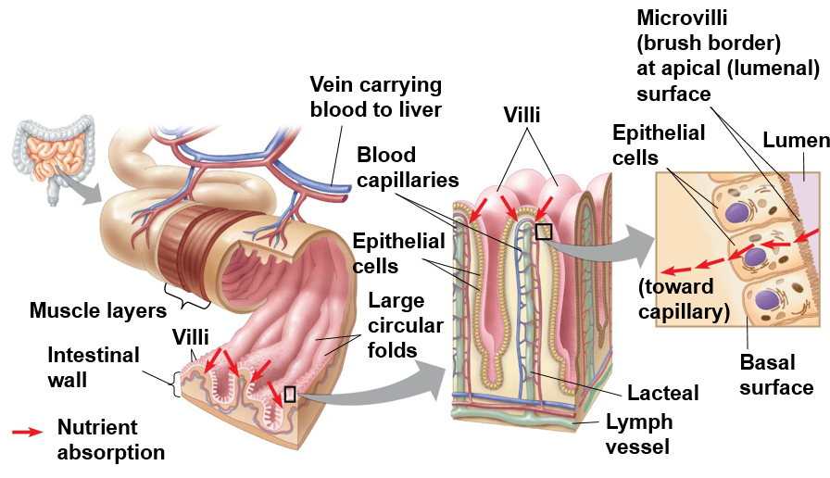
Absorption in the Small Intestine
Intestinal folds, villi and microvilli increase surface area
200-300m²
Monosaccharides, amino acids and monoglycerides absorbed through epithelial cells villi
________________ carries blood with nutrients to liver
Lipids transported through lymphatic system bypassing the liver
Notes:
Small intestine (20ft) longer than large intestine. Size refers to diameter
Blood and nutrients travel to liver for detoxification and distribution
Lipids bypass liver because liver uses lipids as fuel and by bypassing the liver the lipids can be used or stored elsewhere

Slide 33
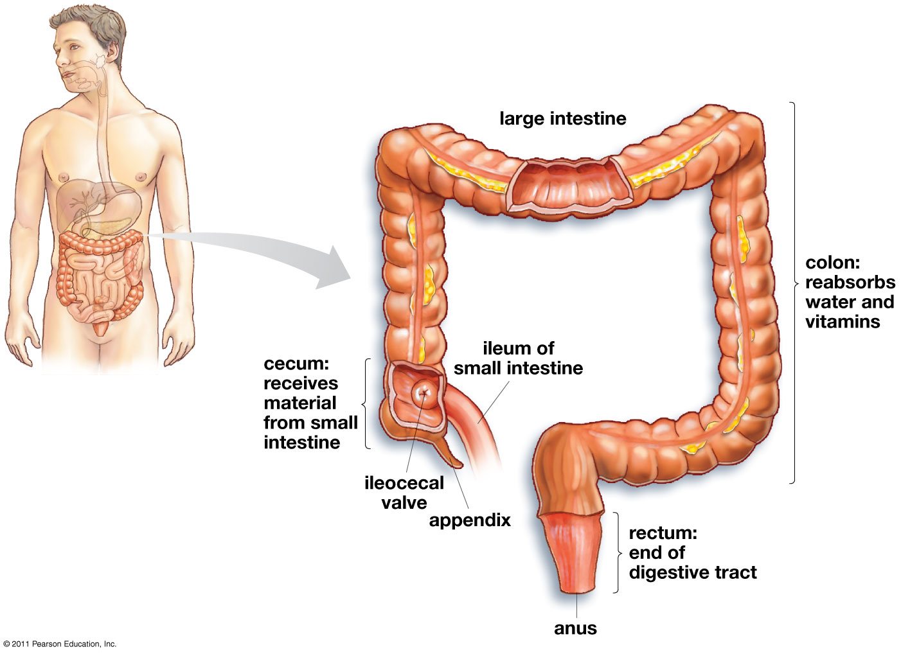
Absorption in the Large Intestine
Large intestine includes colon, cecum and rectum.
Absorbs water
Forms feces
Cecum: _________ of plant material
Function insignificant in humans
____________: minor role in immunity, may store “good” bacteria

Slide 34
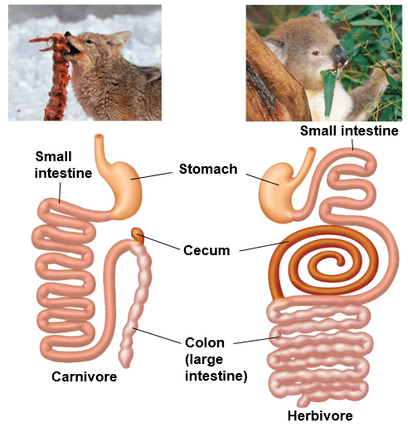
Digestive Tracts of Carnivores and Herbivores
Carnivores
Herbivores
Large, expandable ___________
_____ digestive tract
Large _______ with symbiotic bacteria break down plant material
_____ digestive tract

Slide 35
Digestion in Ungulates
Ruminants
Hindgut Fermenters
Deer, antelope, bovine, camel, kangaroos
Food chewed several times
Complex, multi-chambered __________
Rate of passage ~ 80 hours
Cellulose utilization ~ ____%
Horses, lagomorphs, rodents
Food chewed once
Simple stomach, large ________
Rate of passage ~ 48 hours
Cellulose utilization ~ ____%
Reticulum
Simple stomach
Omasum
Cecum
Rumen
Abomasum
Large intestine
Food chewed, regurgitated, then chewed again
Cecum
Food chewed once
Small intestine
Small intestine
Large intestine
Notes:
Ruminants (foregut fermenters) symbiotic microorganisms breakdown food in rumen and are digested with food in small intestine
Hid-gut fermenters has symbiotic bacteria in cecum but do

Slide 36
Bird Digestion
Crop: food storage
Proventriculus: glandular stomach, secretes mucus, HCl, and pepsinogen
___________: mechanical breakdown of food
Small intestine: three sections (duodenum, jejunum and ileum). Nutrient absorption
Large intestine: short, water absorption
Caeca: site of fermentation in some birds
________: common opening for digestive, urinary and reproductive systems
Esophagus
Crop
Liver
Proventriculus
Pancreas
Gizzard
Small
Intestine
Large
Intestine
Caeca
Cloaca
Notes:
Food may move back and forth between proventriculus and stomach as it is broken down enzymatically and mechanically

Slide 37
Check Your Understanding
1. True or False: Water is required for cellular respiration
2. True or False: Cellular respiration is considered an endergonic reaction because it releases energy
3. True or False: Small mammals have higher metabolic rate than larger mammals

Slide 38
Check Your Understanding
4. An organism that maintains a constant body temperature, and whose body temperature is controlled by the environment is a:
a. ectothermic poikilotherm
b. endothermic homeotherm
c. endothermic poikilotherm
d. ectothermic homeotherm
e. warm blooded animal

Slide 39
Check Your Understanding
5. The initial breakdown of proteins occurs in the ________.
a. mouth
b. stomach
c. small intestine
d. large intestine

Slide 40
Check Your Understanding
6. In your own words, describe counter current heat exchange.

Slide 41
Respiratory System
Uptake O₂ from environment and discharge CO₂ into the environment
Diffusion through skin
Many invertebrates, amphibians
Gills (internal of external)
Some arthropods, fish
__________ system
Insects
Lungs
Amphibians, reptiles, birds and mammals

Slide 42
The Respiratory System
Nasal Cavity
Pharynx
Larynx
Trachea
Bronchi
Bronchioles
_____________: sheet of skeletal muscle that extends along the bottom of the rib cage
Expands and contracts to force air into and out of lungs

Slide 43
Structure of the Alveoli
Carbon dioxide diffuses from the blood into the alveoli and out of the body as exhalation occurs.
Inhaled oxygen diffuses from the alveoli into the blood.

Slide 44
Respiratory and Circulatory Systems
Notes:
We don’t realize it but every bodily movement and function is taking place at a cellular level. Those cells combine to form tissues and tissues form organs and organ systems. The air we breathe and the food we eat is necessary for our bodies to function but more importantly for or cells to function.
Respiratory system acts to bring oxygen into the body and to expel carbon dioxide.
Circulatory or cardiovascular system transports oxygen to the cells for cellular respiration, transports wastes to the kidneys for processing and removal and transports carbon dioxide to the lungs to be exhaled from the body.

Slide 45
Functions of the Circulatory System
Transport: transports oxygen, nutrients, waste products, immune system cells, and hormones throughout the body.
Temperature regulation: helps maintain a body temperature that is optimum for metabolic function
Vasoconstriction and vasodilation
Protection: immune system cells transported throughout the body aid in fighting foreign invaders
Platelets and white blood cells

Slide 46
What’s in the Blood?
Red blood cells (erythrocytes): oxygen transport
Contain hemoglobin
Lack ________________________
95% of all blood cells in the body
White blood cells (leukocytes): immune response to disease and foreign invaders (pathogens)
Platelets: cell fragments that aid in _______________
Leukocytes
Platelets
Pathogens
Fibrin threads
Notes:
RBC’s facts
Approx. 2.4 million produced every sec.
5 to 6 million per microliter of blood, 25 trillion in human body, only 5,000-10,000 leukocytes
Each RBC contains around 250 million hemoglobin, which each bind to 4 oxygen molecules = 1 billion O2 molecules per RBC!
Develop in bone marrow
Circulate for 100-120 days
Circulation through the body takes about 20 seconds
About 1/3 of all cells in human body
WBC’s facts:
Produced in bone marrow
Live three to four days
Number of WBC’s in the blood is used as an indicator of disease
Most found in body tissue and lymphatic system rather than blood stream
Platelet info:
Found only in mammals
May have evolved in mammals to prevent death from hemorrhages during childbirth

Slide 47
Hemoglobin
Hemoglobin: an oxygen-carrying protein made up of four polypeptide chains.
Each hemoglobin can transport four oxygen molecules bound to seats of iron molecules
Approximately 250 million hemoglobin per red blood cell

Slide 48
Blood Vessels
Blood vessel tissues: endothelium, smooth muscle, connective tissue
Arteries (arterioles): vessels with ___________ that carry blood away from the heart
Capillaries: thinly walled vessels where gas, nutrient and waste _____________. Lack smooth muscle
Veins (venules): vessels carrying blood back to the heart
Valves
Notes:
Endothelium: single layer of flattened epithelial cells
Arteries have thicker, more muscular walls because they are under greater pressure.
Muscles allow for the arteries to constrict or expand, which can control blood flow
Arterial walls are about 3 times thinker than a similar sized vein
Capillaries are made up of a single layer of cells
RBC’s pass through them single file

Slide 49
Circulatory System

Slide 50
Open and Closed Circulatory Systems
Open Circulatory System
Closed Circulatory System
Arthropods and Mollusks
Less efficient
Lack of capillaries
__________ transports nutrients and wastes
Tissues and cells bathed in hemolymph
Slow, uncontrolled blood flow
Vertebrates and Annelids
More efficient
Capillaries present
__________ transports gases, nutrients and wastes
Fast, controlled blood flow

Slide 51
Vertebrate Circulatory System
Cardiovascular system: organ system that circulates blood through a network of vessels, transporting nutrients, gases and hormones to cells throughout the body
Heart: hollow muscular organ that pumps blood through circulatory system by rhythmic contraction
________: chambers that receive blood entering heart
____________: chambers that pump blood out of the heart
Pulmonary circuit: circuit of blood flow between the ___________________
Systemic circuit: circuit of blood flow between the _____________________
Notes:
Blood vessels are defined by direction, not the O2 content of the blood they carry

Slide 52
Vertebrate Circulatory Systems
Notes:
Single circulation: pass through heart once in complete circuit through body
Pressure drop after gills
Double circulation: two circuits through the heart, which the heart acts for a pump for both circuits simplifying coordination of p[umping cycles.
Higher pressure throughout body

Slide 53
Comparative Anatomy of Vertebrate Hearts

Slide 54
Circulation of Blood Through the Heart
Notes:
Four muscular chambers.
Two chambers for pulmonary circuit
Right atrium and right ventricle
Two chambers for systemic circuit
Left atrium and left ventricle
Left ventricle pumps blood to the whole body so it is the most muscular

Slide 55
Path of Blood Through The Heart
Anterior and Posterior Vena Cava
Right Atria
Atrioventricular (AV) Valve
Right Ventricle
Semilunar Valve
Pulmonary Arteries
Lungs (CO₂ out, O₂ in)
Pulmonary Veins
Left Atria
Atrioventricular (AV) Valve Left Ventricle
Semilunar Valve
Aorta
Body (O₂ out, CO₂ in)

Slide 56
Heart Valves
Semilunar valve: valve between ventricles and aorta or pulmonary artery
Atrioventricular valve: valve between atria and ventricles
Notes:
Valves allow for pressure to build up in the heart and ensures one-way flow of blood through the heart.
Heat beat caused by recoil of blood against AV valves then vibrations caused by closing of semilunar valves

Slide 57
Cardiovascular System in Humans
Right ventricle pumps blood through semi-lunar valve
Pulmonary arteries carry oxygen-poor blood to lungs
Oxygen is uploaded and carbon dioxide is unloaded in the capillary beds within the lungs
Pulmonary veins carry oxygen-rich blood into the left atria
Blood moves through the atrioventricular valve into the left ventricle
Oxygen rich blood is pumped through the semi-lunar valve into the aorta, where it is carried through arteries and arterioles to the capillary beds in the body
Oxygen is unloaded and carbon dioxide is loaded in the capillary beds in the body
Oxygen-poor blood is carried through the venules and veins into the right atrium through the inferior and superior vena cava
Oxygen-poor blood moves to the right ventricle through the atrioventricular valve

Slide 58
Cardiac Cycle
Diastole: period of heart _____________ when the heart fills with blood
Systole: period of heart ____________ when blood is forced out of the heart

Slide 59
Blood Pressure
First lets interpret the figure to the right
Interpretation:
Blood pressure and velocity decreases in the arterioles and capillaries
Blood flow is slowest in capillaries where exchange of gases, nutrients and waste occurs
Blood flow (velocity) increases in venules and veins
Notes:
Pressure during systolic phase stretches arteries which can be felt.

Slide 60
Human Excretory System
Notes:
Urine exits kidney through ureter and drain into urinary bladder. Urine leave body through urethra
Blood supplied by renal artery and removed via renal vein
Cortical nephrons (85%) reach short distance into medulla
Juxtamedullary reach further into medulla. Produce urine that is hyperosmotic to body fluids (water conservation in mammals)
Approx. 1 million nephrons per human kidney
Desert mammals have long loop of henle and more juxtamedullary nephrons

Slide 61
Excretory System
Disposal of ___________-containing metabolites and other waste products (nitrogenous wastes)
Ammonia
Toxic, but low energetic costs to produce
Urea
Less toxic, with some energetic costs
Uric acid
Low toxicity, but energetically costly to produce
Excretory System:
Filtration
Reabsorption
Secretion
Excretion
Notes:
Ammonia = highly toxic. Animal must live in aquatic environment to dilute concentration
Urea = combination of ammonia and carbon dioxide = lox toxicity = greater energy costs
Uric acid = nontoxic = greatest energy cost to produce

Slide 62
Lymphatic System
Lymphatic system: system of vessels and nodes that returns fluid, proteins, and cells back to the blood.
Separate from circulatory system
_______: fluid of lymphatic system
Lymph nodes: lymphatic organs that filter lymph and contain _________ cells that fight disease

Slide 63
Divisions of the Immune System
Physical barriers: skin, mucus-membranes, sweat glands, hair, and associated secretions that prevent pathogens from entering the body
Lysozyme: enzyme in sweat, saliva, and tears that destroys cell wall of bacteria
Non-specific (innate) immunity: immune system cells that quickly recognize and destroy all pathogens that enter the body
Responds to all pathogens the same
Found in plants, fungi, insects, and other non-vertebrate animals
Specific (adaptive) immunity: immune system cells that recognize and destroy specific pathogens, and can also remember previous pathogens
B-cells and T-cells target specific pathogens
Found only in _____________

Slide 64
Types of Reproduction
Asexual reproduction: reproduction without recombining DNA with another individual of the same species
Offspring are genetically identical to the parent
Common in single-celled organisms
Sexual reproduction: the formation of offspring as a result of the fusion of ________ (egg and sperm), which develop into an embryo
Offspring are genetically _______ from the parent
Common multicellular organisms

Slide 65
Types of Reproduction
Examples of asexual reproduction

Slide 66
Types of Sexual Reproduction
External fertilization (spawning): release of gametes (egg and sperm) into the water where fertilization occurs
Occurs in ____________ organisms
Parents have no further interaction with offspring

Slide 67
Types of Sexual Reproduction
Internal fertilization: sperm is directly transferred from male to female and fertilization occurs in the female.
Females can either lay eggs (internally or externally) or give live birth
Some parents provide parental care for young

Slide 68
Modes of Sexual Reproduction
Ovuliparity: female lays unfertilized eggs, which are externally fertilized by the male
Most bony fish and some amphibians
_____________: the mother deposits internally fertilized eggs that develop and hatch outside of mother’s body
Some bony fish and sharks, most reptiles and all birds
Viviparous: young develop within mother’s uterus and receive nourishment via the placenta, uterus or by eating other eggs, before being born (live birth)
Some sharks and fish, some reptiles, most mammals

Slide 69
Check Your Understanding
True or False: All organisms that reproduce through internal fertilization also give live birth.
True or False: Vertebrates are the only group of organisms with an innate immune response
True or False: Asexual reproduction results in offspring that are genetically different from the parents.

Slide 70
Check Your Understanding
4. Gas exchange occurs at which of the following sites?
a. Capillaries
b. Aorta
c. Alveoli
d. Veins
e. Gas exchange occurs at more than one of the above locations.

Slide 71
Check Your Understanding
5. Blood returning from the lungs enters which of the following?
a. Left ventricle
b. Right atrium
c. Left atrium
d. Right ventricle
e. Aorta

Slide 72
Check Your Understanding
6. Birds and Reptiles produce which of the following nitrogenous wastes?
a. Pee pee
b. Urea
c. Ammonia
d. Uric acid

