Slide 1
Biogeography and the History of Life
Chapters 24, 25 and 26

Slide 2
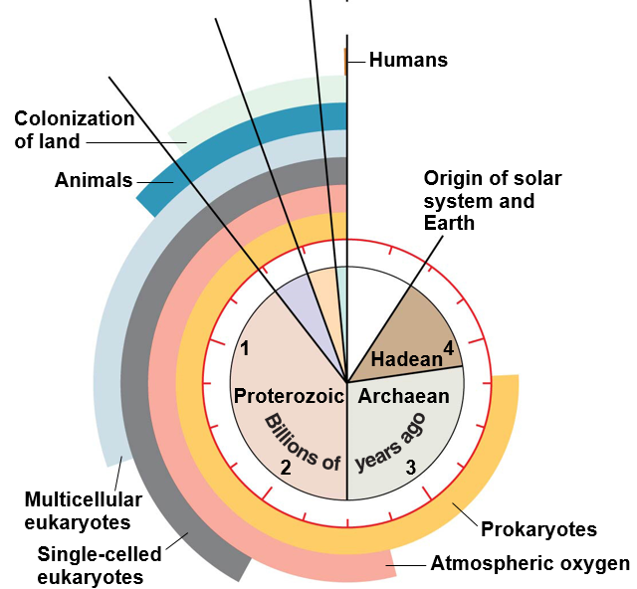
History of Life on Earth
Prokaryotes ~3.5 bya
Stromatalites for 1.5 billion years
Atmospheric Oxygen ~2.7 bya
Photosynthetic bacteria
Multicellular eukaryotes ~1.2 bya
Endosymbiosis of prokaryotes
__________ animals
Animals ~535 mya
Cambrian explosion
First _________
Colonization of land ~500 mya
Plants with mycorrhizae
Arthropods ~450 mya
Humans ~6-7 mya
Mesozoic
Cenozoic
Paleozoic

Slide 3
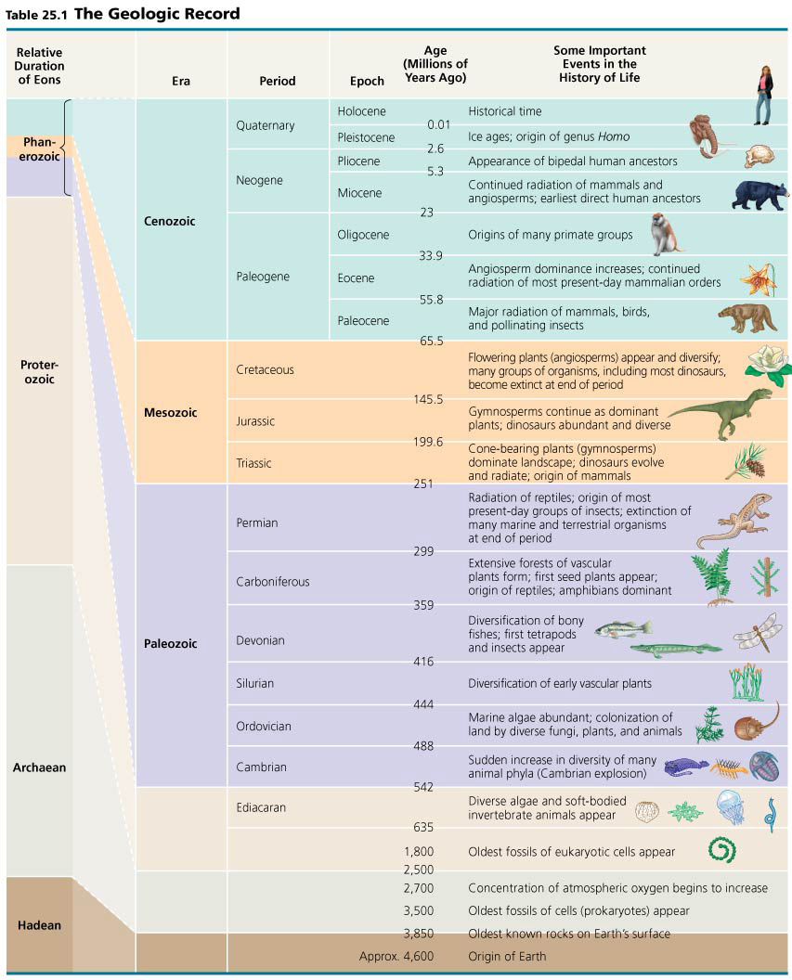
Geologic Timescale
Geologic record divided into Eons, Eras, Periods, and Epochs
Divisions between eras correspond to ________________ events

Slide 4
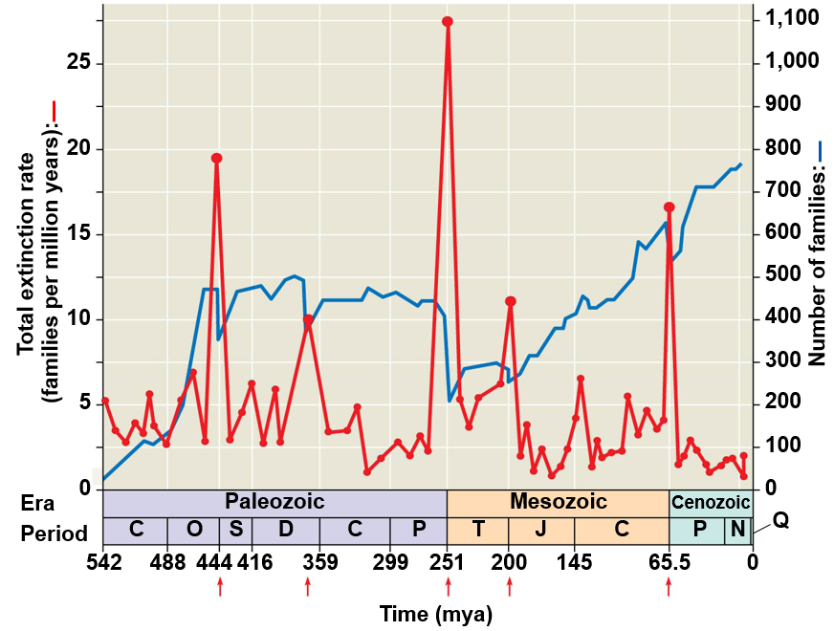
Mass Extinctions and the Diversity of Life
Ordovician (~440 mya)
50% animal families
Many trilobites
Devonian (~365 mya)
30% animal families
Many fish and trilobites
Permian (~245 mya)
___% animal families
Many marine species, insects, amphibians, and remaining trilobites
Triassic (~210 mya)
35% of animal families
Many reptiles
Cretaceous (~65 mya)
50% animal families
Remaining _________ and marine species

Slide 5
K-T Boundary (Cretaceous-Tertiary)
Chicxulub Crater - Caribbean Sea near the Yucatan Peninsula of Mexico

Slide 6
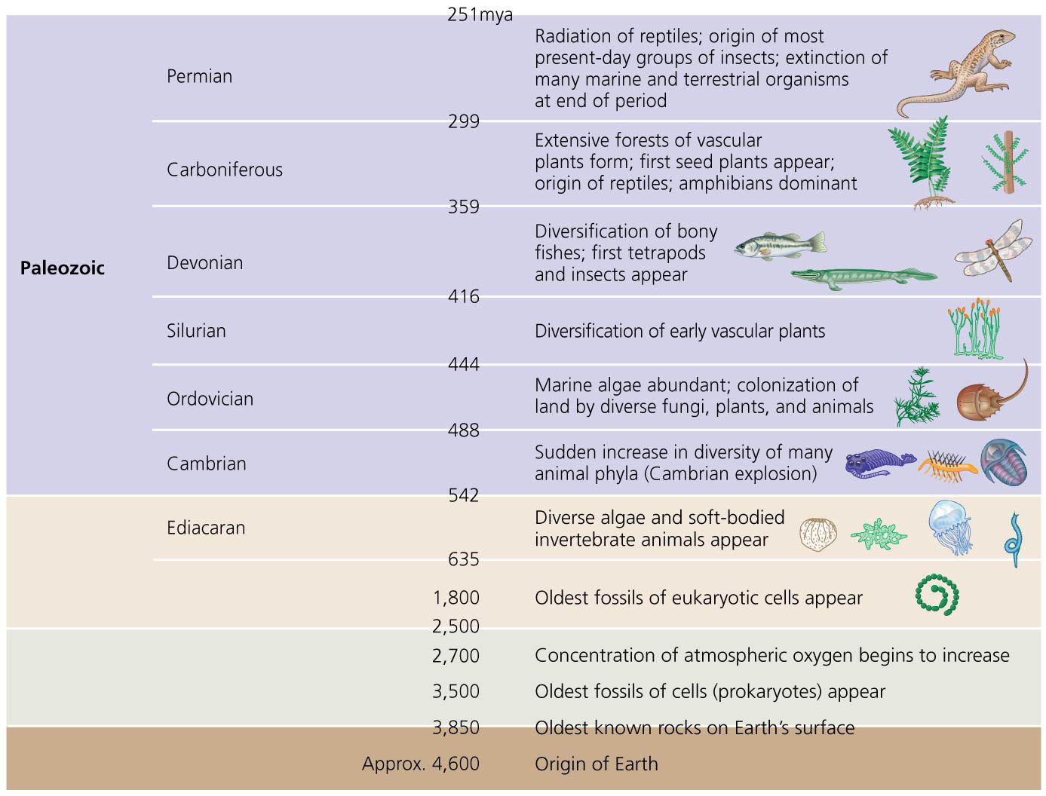
Geologic Timescale
Precambrian Era (4.6 bya – 542 mya)
___% of all time on Earth
First prokaryotes, eukaryotes
Soft bodies animals and algae at end of era
Paleozoic Era (251 mya – 542 mya)
Most animal phyla during Cambrian Period
Cambrian explosion ~500mya
Vascular plants dominant terrestrial environments
______________ and first tetrapods in Devonian Period
Amphibians and reptiles dominate

Slide 7
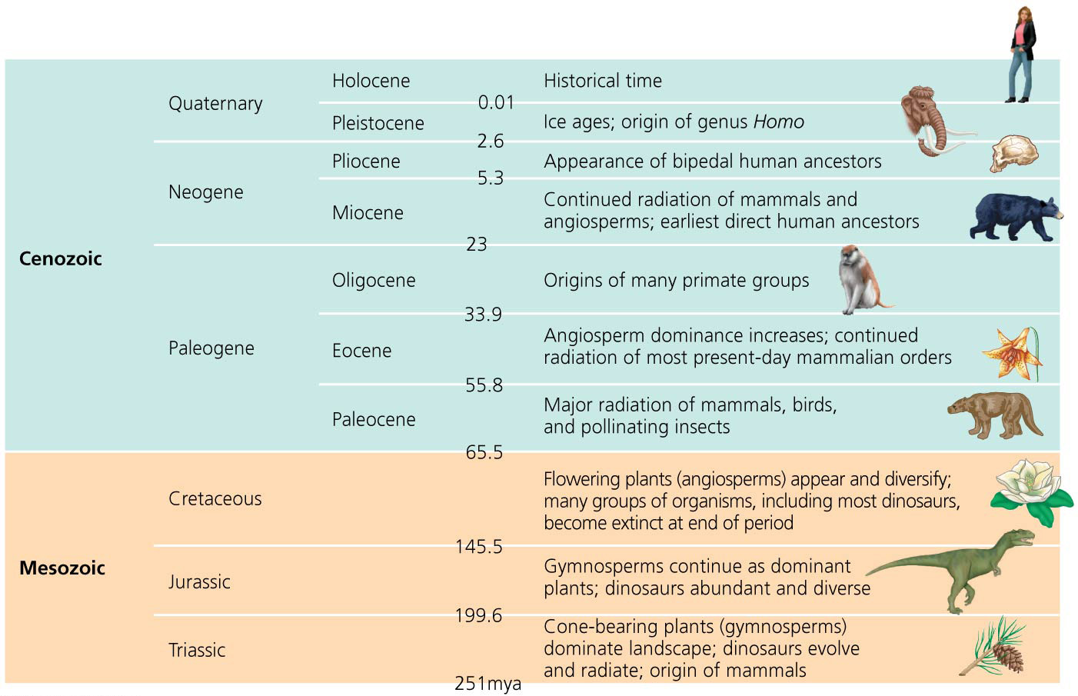
Geologic Timescale
Mesozoic Era (251 mya – 65 mya)
_______________ dominate early
Dinosaurs dominant
Angiosperms diversify late
Cenozoic Era (65 mya – Present)
Mammal radiate with loss of dinosaurs
____________ dominate
Human ancestors diverge

Slide 8
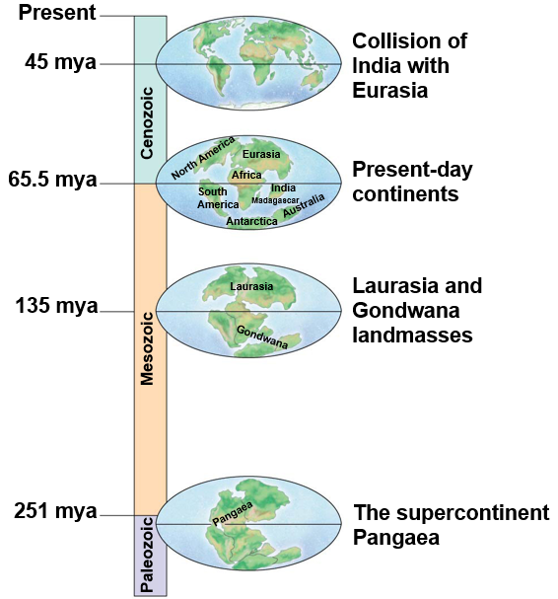
Earth’s History
Changes in climate and habitats on Earth
Pangaea (245 mya)- supercontinent
Deep oceans drained shallow seas
Pangaea began to break up (180 mya)
Laurasia
Europe, Asia and North America
Gondwana
Africa, Madagascar, South America, India, Australia, Antarctica

Slide 9
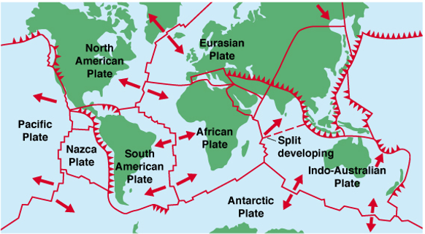
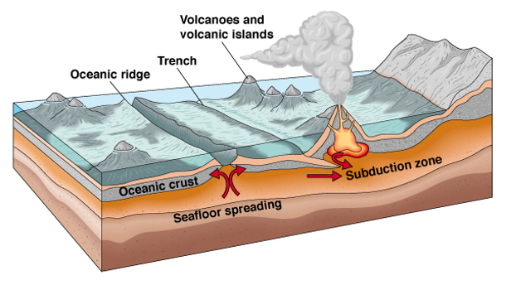
Plate Tectonics and Continental Drift
Linear mountain formation
Himalayan mountains
Rocky mountains
Andes
Appalachian mountains and Scottish highlands
Island arc formation
Aleutian Archipelago
Philippian Islands
Japanese Archipelago

Slide 10
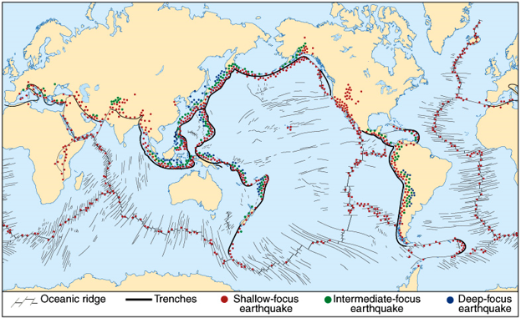
Plate Tectonics and Earthquakes

Slide 11
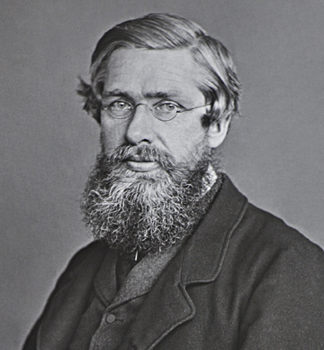
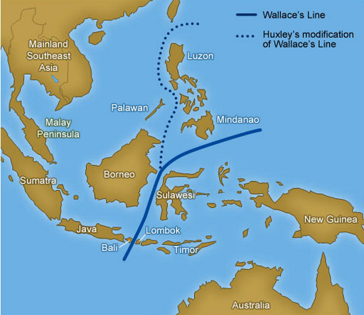
Biogeography
Biogeography: study of past and present geographic distributions of species through geologic time
Alfred Russel Wallace
Wallace’s line: separation of biogeographic regions in Malayan Archipelago
Dispersal: movement of organisms to locations outside of their native range
___________: splitting of an organisms native range through the formation of a _______ to gene flow

Slide 12
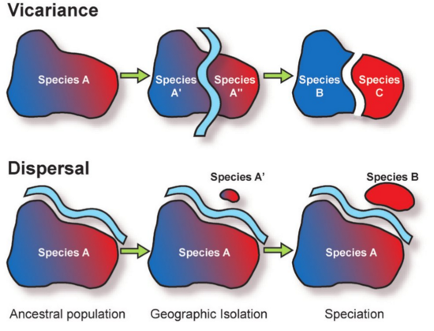
Vicariance vs. Dispersal
Vicariance
Dispersal
Ancestral population
Geographic isolation
Speciation

Slide 13
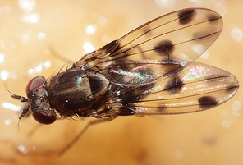
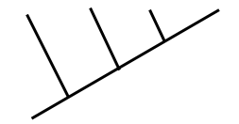
Biogeography: Dispersal
Drosophila dispersed as islands formed in the Hawaiian Archipelago
Older Island
Younger Island
More ancient lineage
More recent lineage
D. glabriapex
D. pilimana
D. vesciseta
D. conspicua

Slide 14
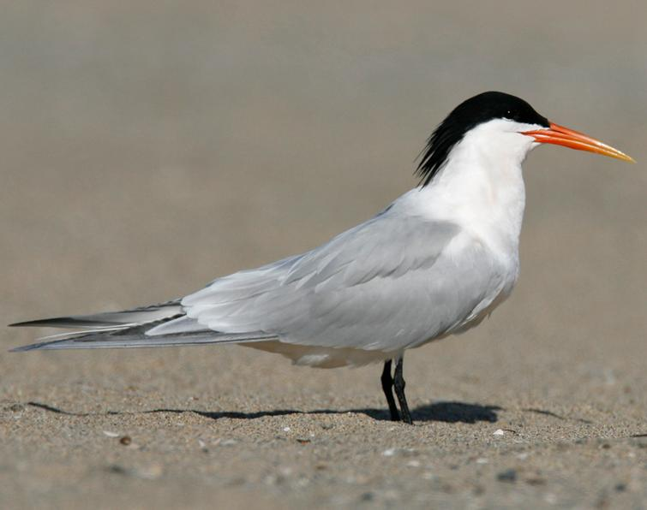
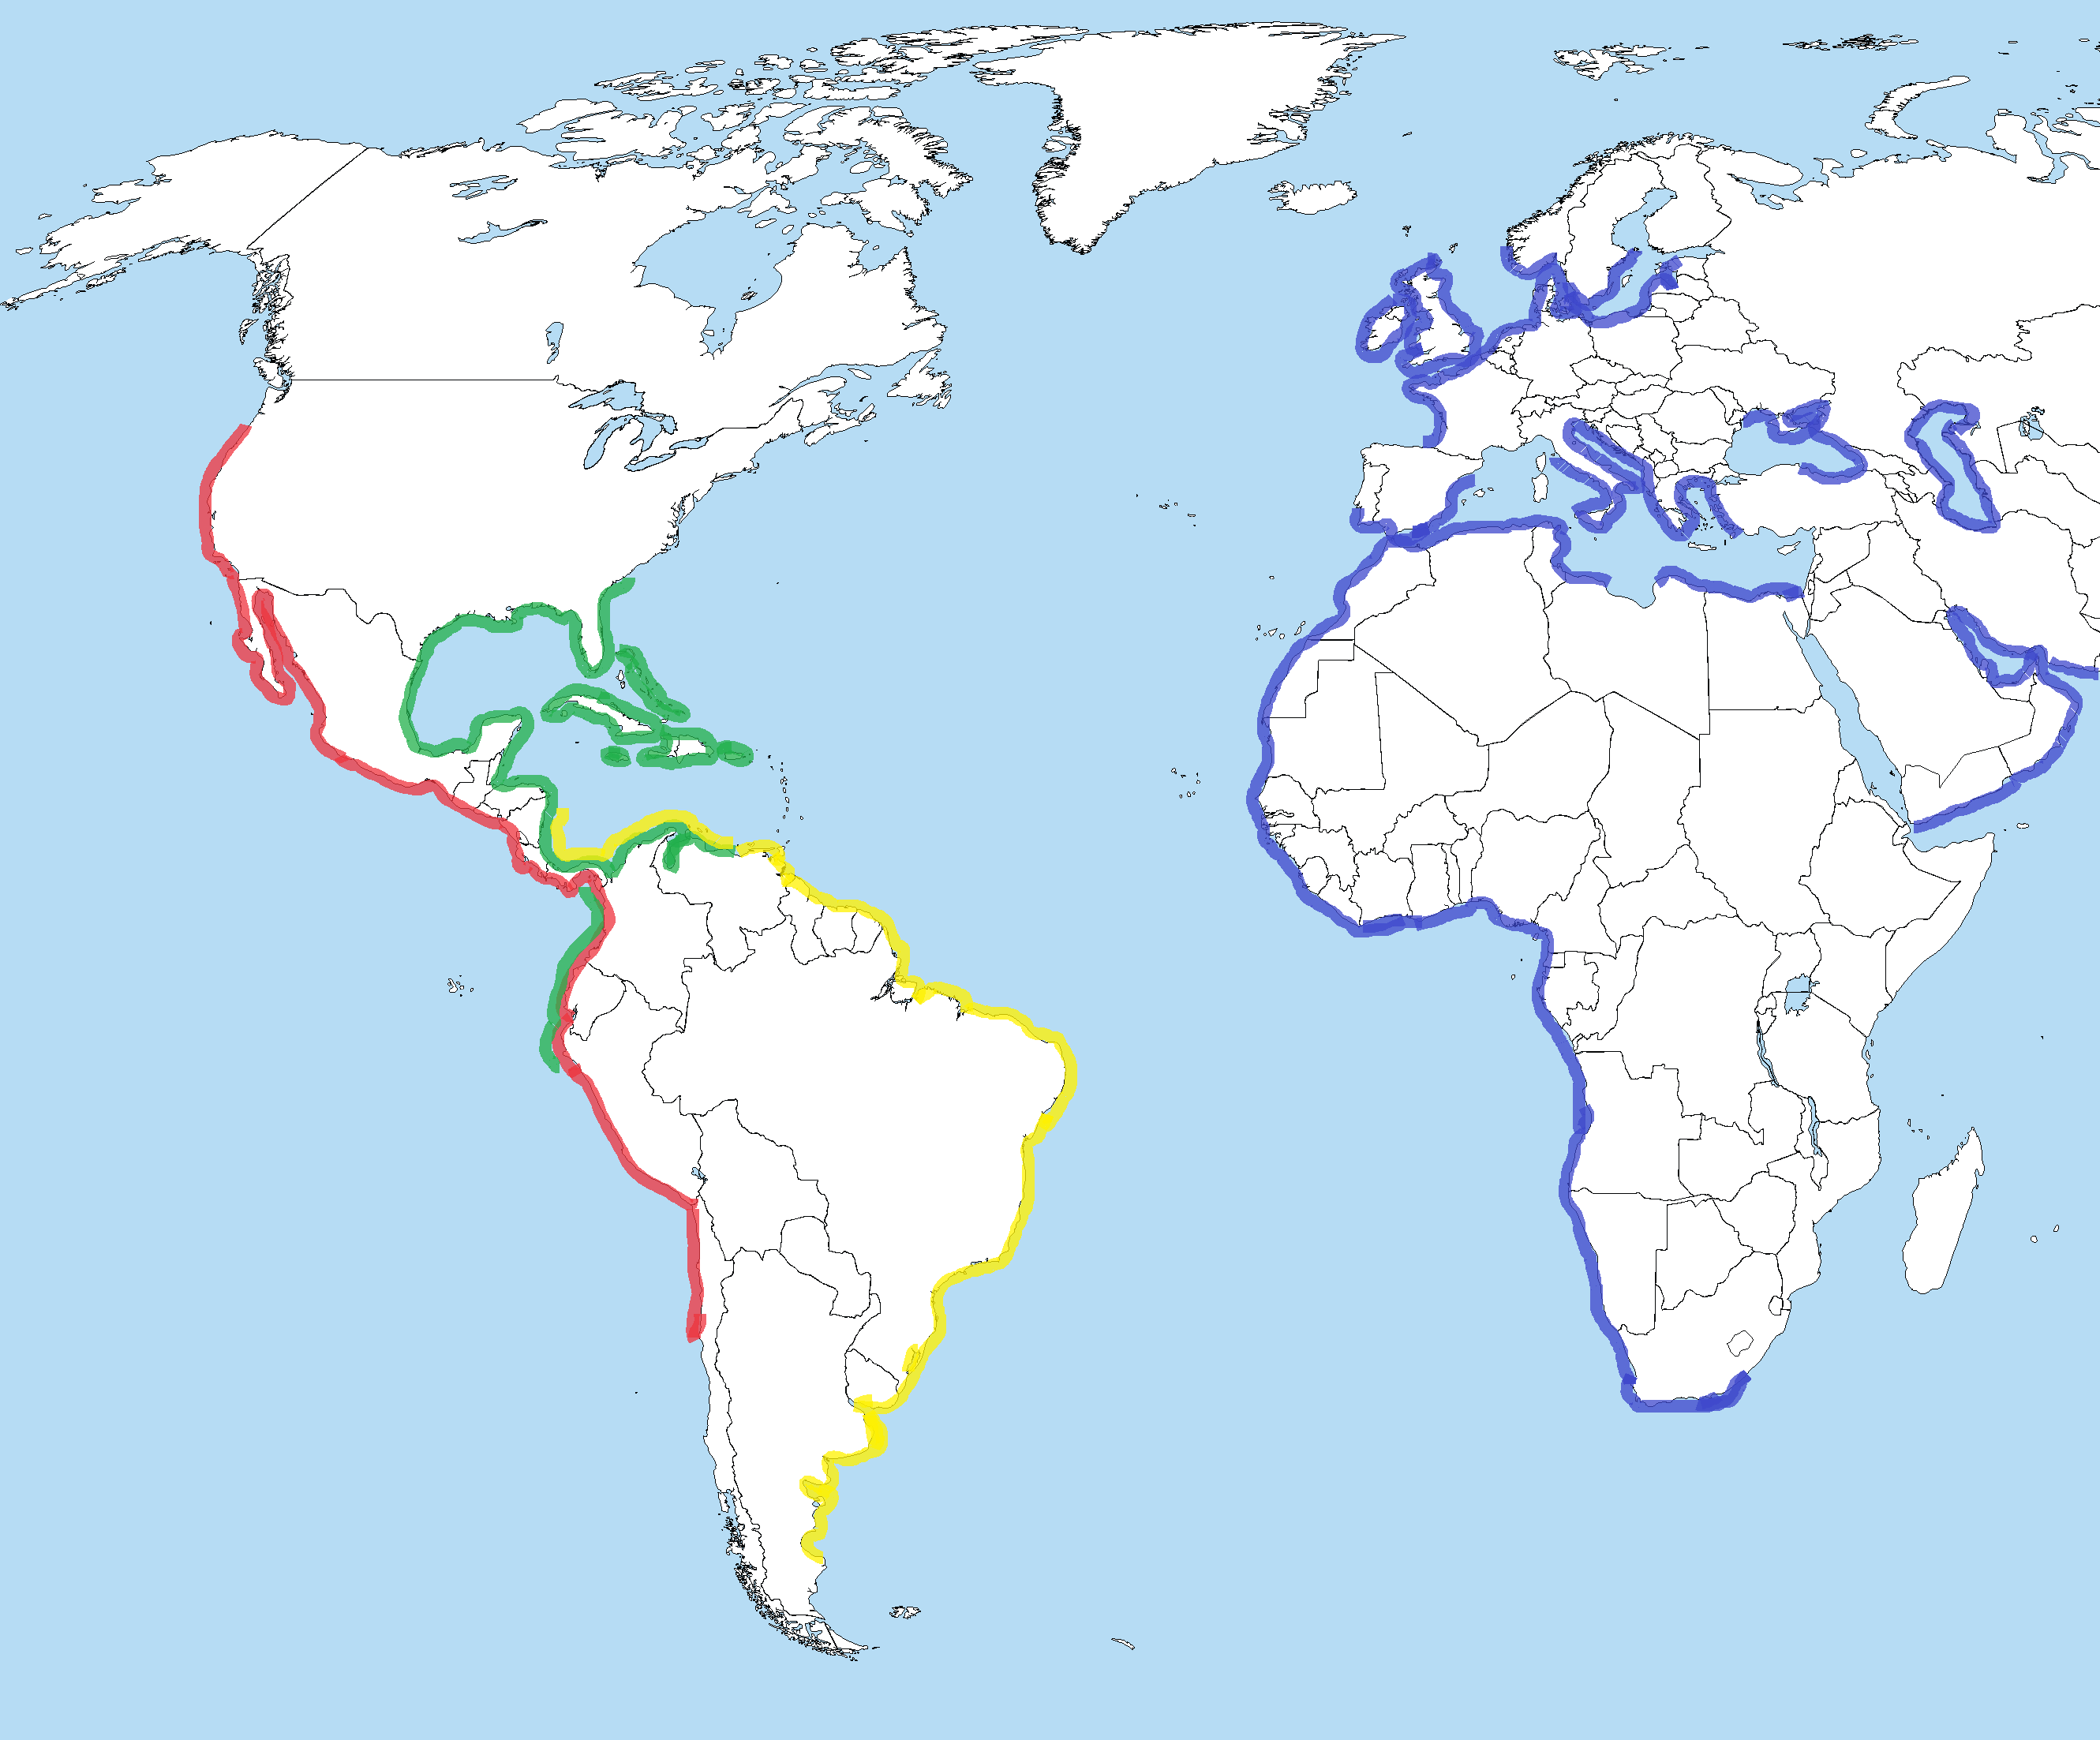
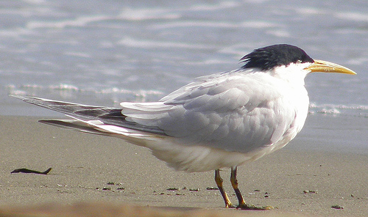
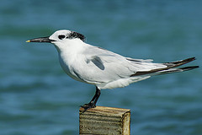
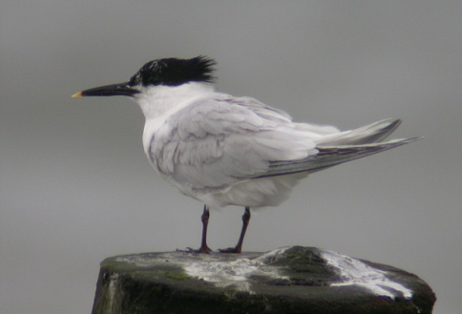
= Elegant tern
= Cabot’s tern
= Cayenne tern
= Sandwich tern

Slide 15
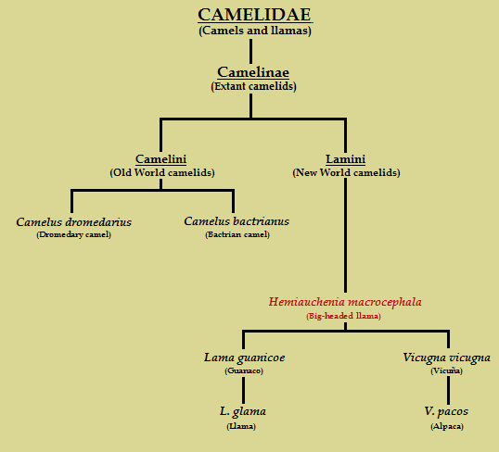
Biogeography of Camelidae: Dispersal

Slide 16
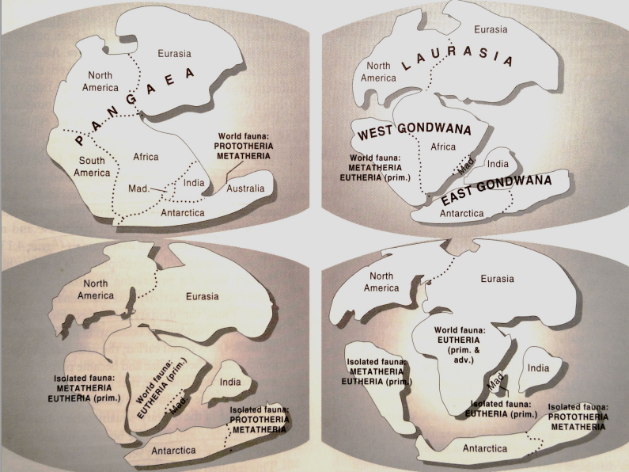
Biogeography of Mammals: Vicariance
Early Jurassic
(~ 200 mya)
Monotremes and marsupials in southern Pangaea
Late Jurassic (~ 180 mya)
Eutheria diverge from Marsupials in “South America”
Early Paleocene (~ 65 mya)
Dinosaurs extinct
Mammal radiation
Eutheria northern distribution (Laurasia)
Early Cretaceous (~ 135 mya)
Marsupials and monotremes isolated in “Australia”
Marsupials isolated on “South America”

Slide 17
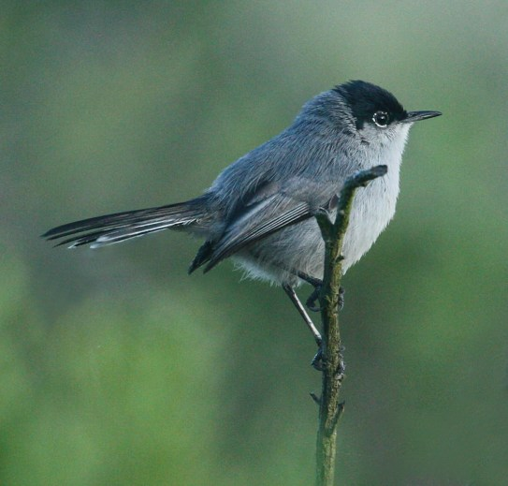
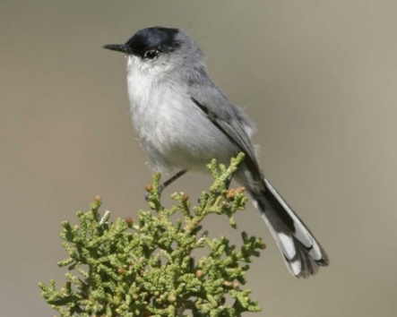
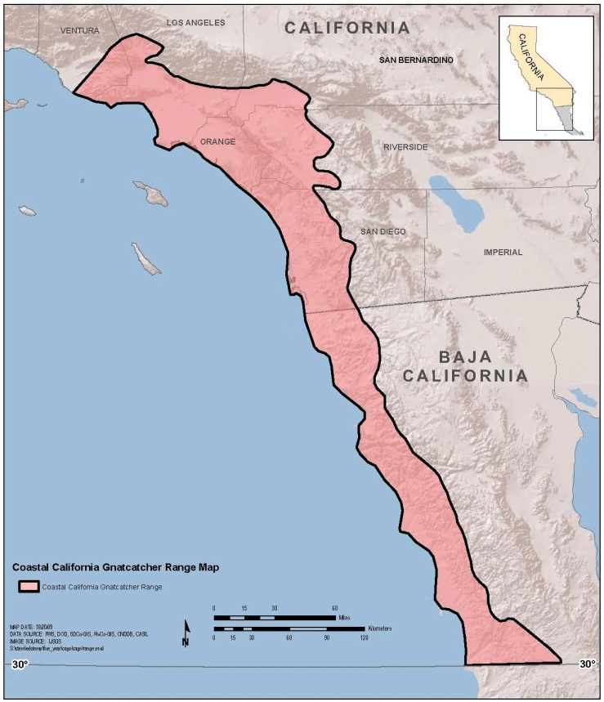
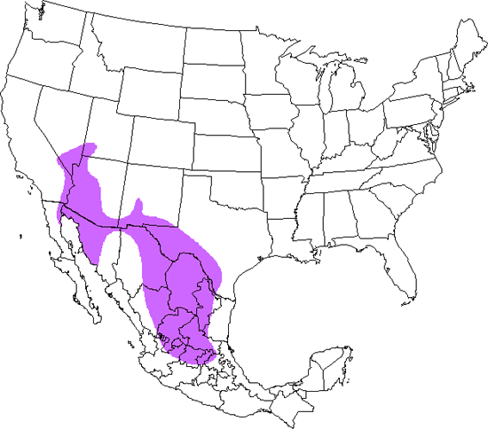
Biogeography or Gnatcatchers: Dispersal or Vicariance?
← California gnatcatcher
Black-tailed gnatcatcher →

Slide 18
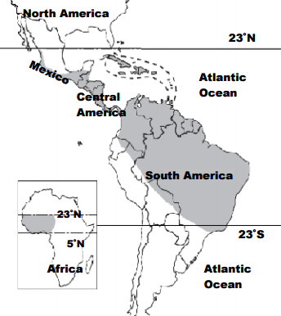
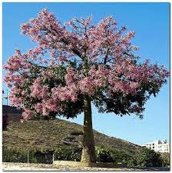
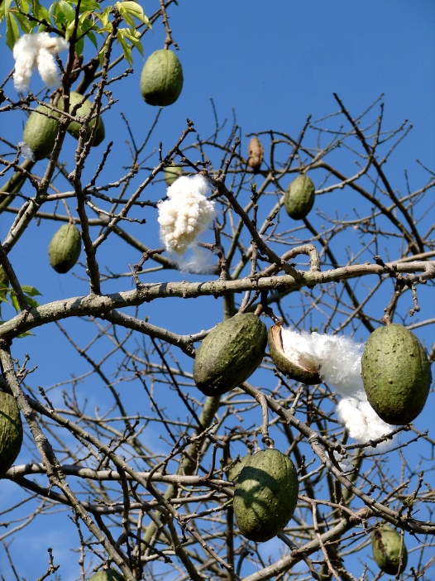
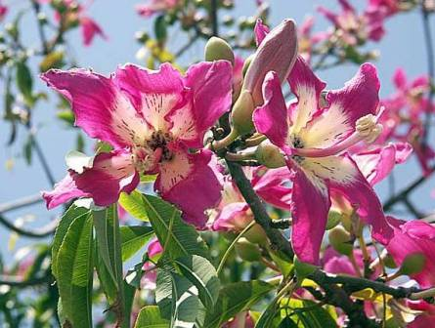
Biogeography of Kapok Tree: Dispersal or Vicariance?
African and Neotropic distribution
Low level of _________________ between populations
Long distance dispersal supported

Slide 19
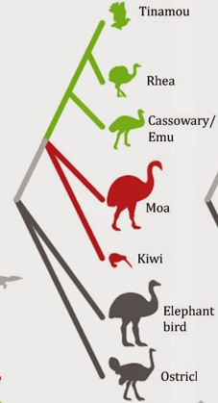
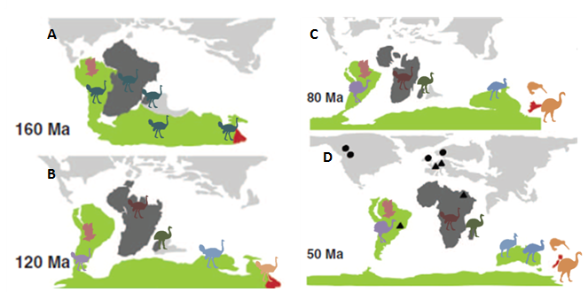
Biogeography of Paleognathae: Vicariance or Dispersal?
South America
Traditional Vicariance Model
South America
Australia
New Zealand
New Zealand
Madagascar
Africa

Slide 20
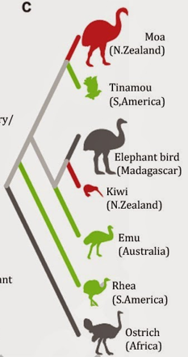
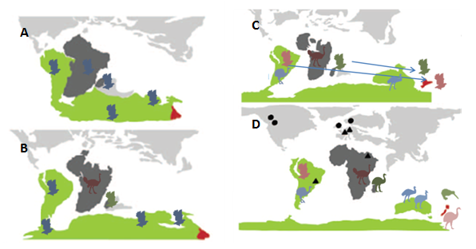
Biogeography of Paleognathae: Vicariance or Dispersal?
Modern Dispersal Model

Slide 21
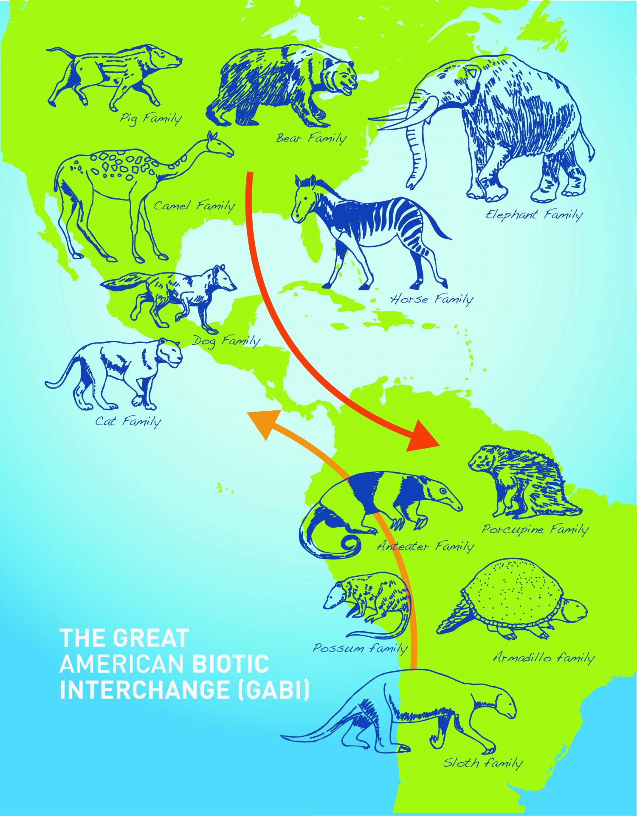
Biotic Interchange
Biotic interchange: when a _________ between previously separated biotas breaks down, resulting in drastic changes to ____________
Great American Biotic Interchange
Isthmus of Panama connected North and South America
Heading south: Bear, Cat, Camel, Horse, Elephant, Dog and Pig families
Heading north: Anteater, Porcupine, Armadillo, Sloth, and Possum families
Invasive Species = ___

Slide 22
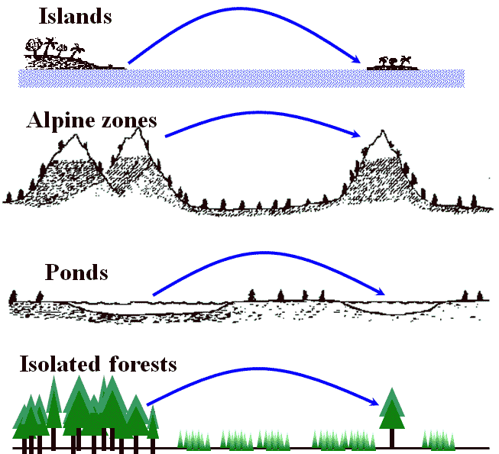
Theory of Island Biogeography
Island: area of land isolated from mainland by a body of water
_____________: area of suitable habitat some distance from source population

Slide 23
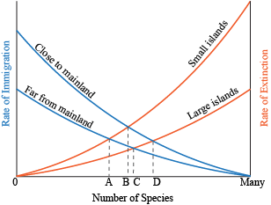
Equilibrium Theory of Island Biogeography
Greatest number of species based on rates of immigration and extinction
Large islands ______ to mainland/source
Large islands ___ from mainland/source
Small islands ______ to mainland/source
Small islands ___ from mainland/source

