Slide 1
Fundamental Building Blocks: Chemistry, Water and pH
“You are not separate from the whole. You are one with the sun, the earth, the air. You don’t have a life. You are life.”
- Eckhart Tolle
Chapter 2

Slide 2
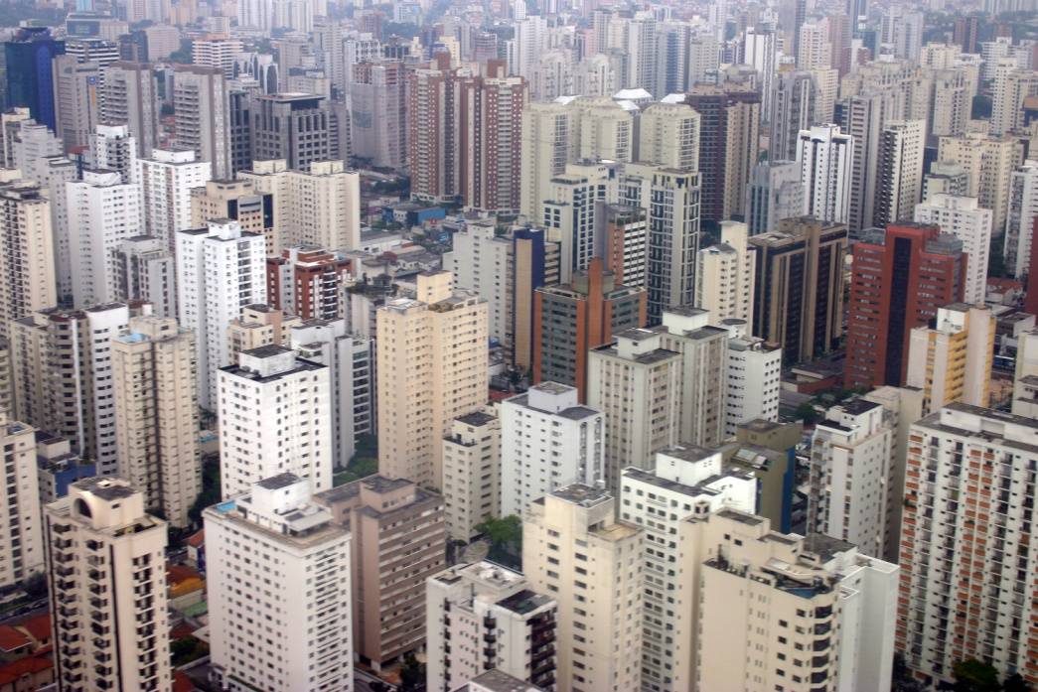
From dust were ye made!
“Everything is made from dirt” – Uncle Barry
Concrete: limestone
calcium sulfate (CaSO₄)
aggregate or rock (granite)
ash
Glass: silica (quartz) SiO₂
sodium carbonate(Na₂CO₃)
lime (calcium oxide CaO)
calcium magnesium
carbonate CaMg(CO₃)₂
aluminum oxide (Al₂O₃)
Metal (steel): iron (Fe)
carbon (C)
manganese (Mg)
phosphorus (P)
sulfur (S)

Slide 3
Matter, Mass, and the Atom
Matter: anything that takes up space and has mass
Mass: measure of the quantity of matter in a given object
Volume and density
Democritus (400 BCE): atoms are indivisible
Indivisible: cannot be ___________ further
Atoms are the fundamental unit of matter

Slide 4
The Atom
Atoms are made up of three subatomic particles:
________: component of the atom’s nucleus with a positive electrical charge.
Elements are defined by number of protons.
Neutrons: component of the atom’s nucleus with ______________.
Isotopes are defined by number of neutrons.
Electrons: located some distance from atom nucleus and has a negative electrical charge.

Slide 5
Structure of the Atom
electron
(negative charge)
electron
shell
proton
(positive charge)
nucleus
neutron
(no charge)
Hydrogen (H)
Helium (He)

Slide 6
Elements
Element: a substance that can not be reduced to a more simple set of components through chemical processes.
Elements are pure forms of chemicals consisting of a single type of atom
Currently 118 elements have been discovered/created
*Carbon, Oxygen, Nitrogen and Hydrogen make up 96% of human body mass
__________: two or more atoms together
Ex. O₂
Compound: two or more elements together
Ex. H₂O

Slide 7
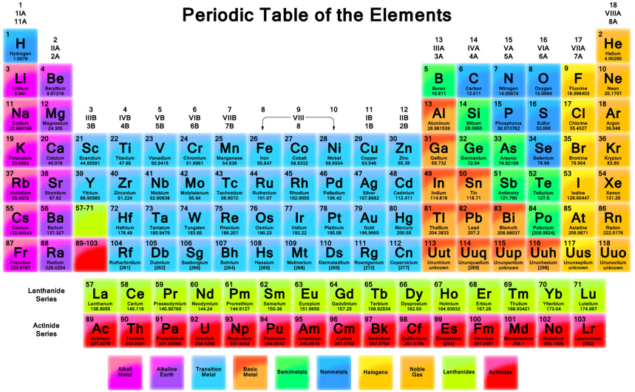

Slide 8
Understanding the Elements
Atomic number: number of protons in the atom’s nucleus
Elements differ in the ______________ in their nucleus
Element symbol: abbreviation of element’s name
Atomic mass: combined mass of atom’s protons and neutrons
Neutron = 1
Proton = 0.99862349, 99.86% mass of neutrons
Electron = 0.00054386734, 0.054% mass of neutrons
Atomic number
Element symbol
Element name
Atomic mass
3
Li
Lithium
6.941

Slide 9
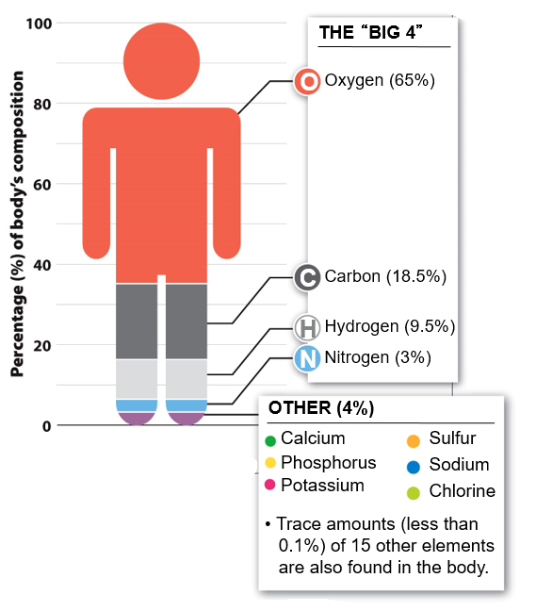
Elements in the Human Body
Only 10 elements make up 99% of the human body. Four of these ten elements (oxygen, ______, hydrogen and nitrogen) making up around 96% of your body

Slide 10
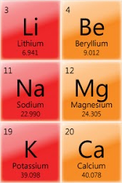
Check Your Understanding
What is the elemental symbol for potassium?
How many protons are found in the nucleus of calcium?
What is the average combined mass of the protons and neutrons in Beryllium?

Slide 11
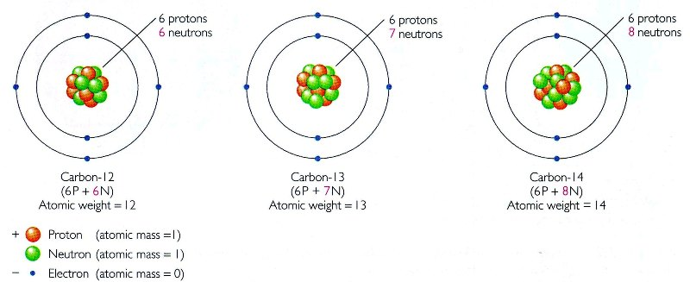
Isotopes
Isotopes: a form of an element as defined by the number of _________ contained in the nucleus

Slide 12
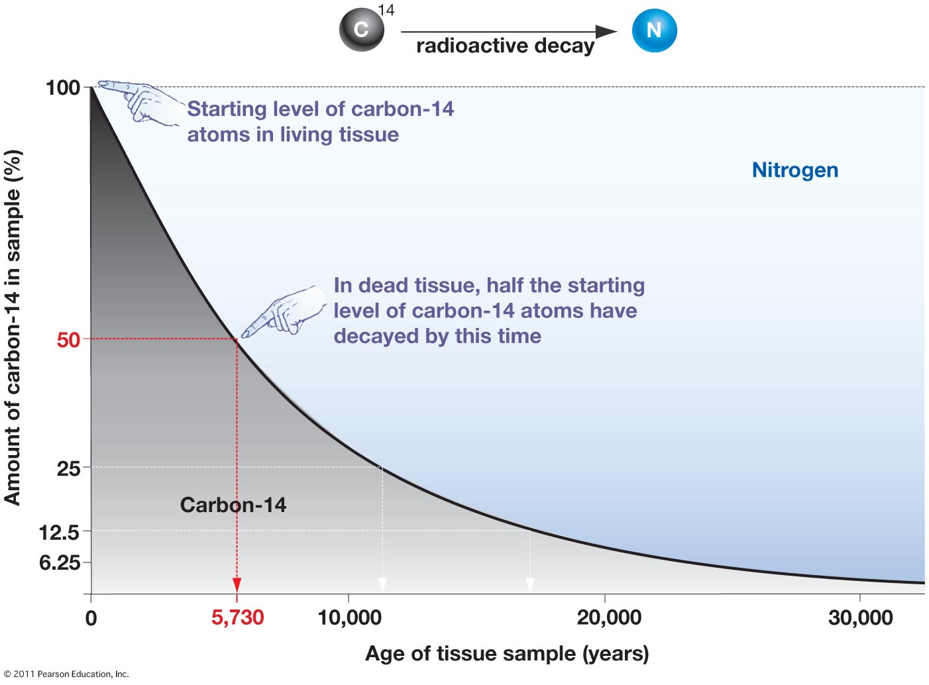
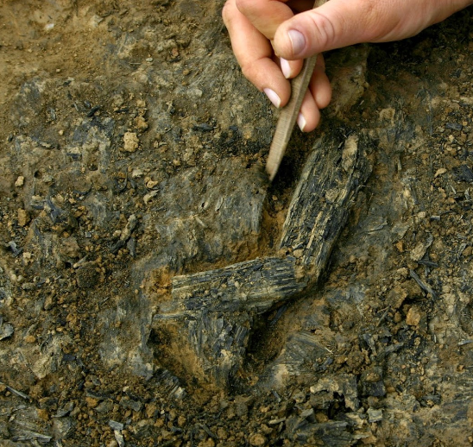
Radiometric Dating
Isotopes such as Carbon-14 are unstable and decay over time
Rate of _____ can be measured
Half-life: time is takes for 50% of isotope to decay
Half-life of Carbon-14 = 5730 years

Slide 13
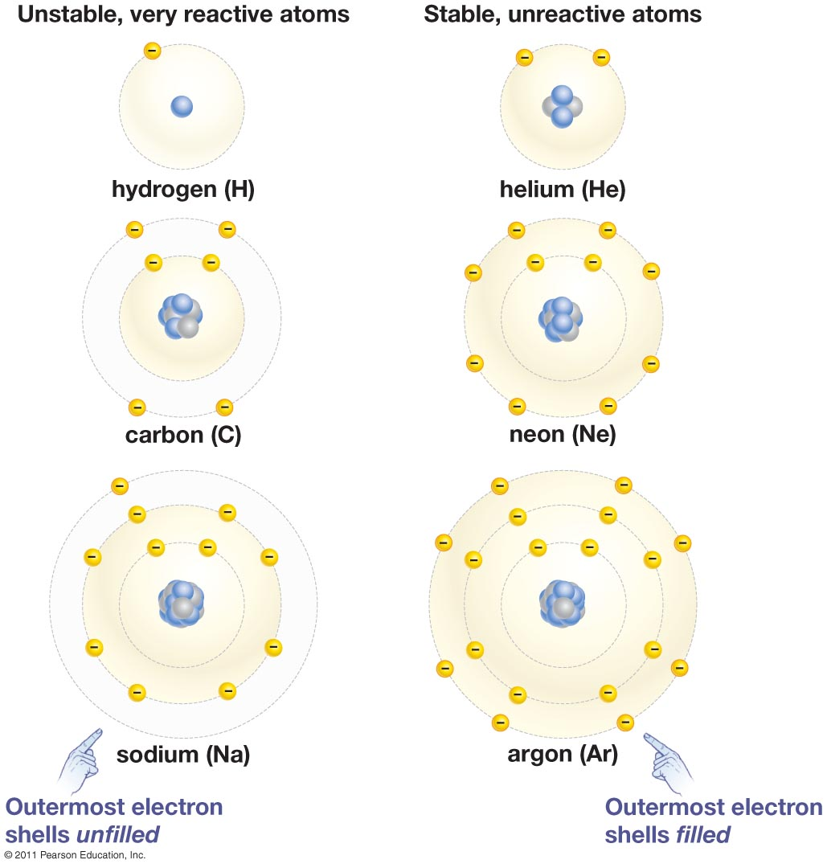
Electron Energy Levels
Electrons (e⁻) orbit atom nucleus at different energy levels (shells)
1st shell = 2 e⁻
2nd shell = 8 e⁻
3rd shell = 8 e⁻
^{And so on…}
Atoms with vacancies in their outermost electron shell are ______, whereas atoms with full shells are ________

Slide 14
Electron Energy Levels
Inner shell
Electron
Electron shell
Nucleus
Outer
(valence)
shell
Hydrogen
1
H
1
Carbon
6
C
12
Nitrogen
7
N
14
Oxygen
8
O
16

Slide 15
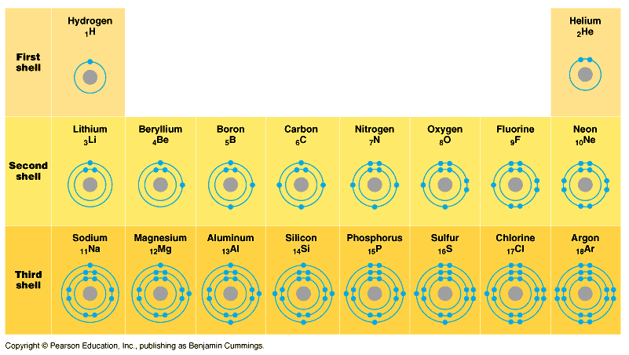
Another look at the Periodic Table

Slide 16
Check Your Understanding
1. Draw the structures for a calcium and chloride atom. Be sure to include the correct number of electrons in the outer most shell.
Calcium has an atomic number of 20 and chloride has an atomic number of 17

Slide 17
Check Your Understanding
2. How many electrons are found in a sodium atom? Hint: The atomic number for sodium is 11.
3. How many neutrons are found in the nucleus of the isotope Oxygen-18? Hint: The atomic number for oxygen is 8.

Slide 18
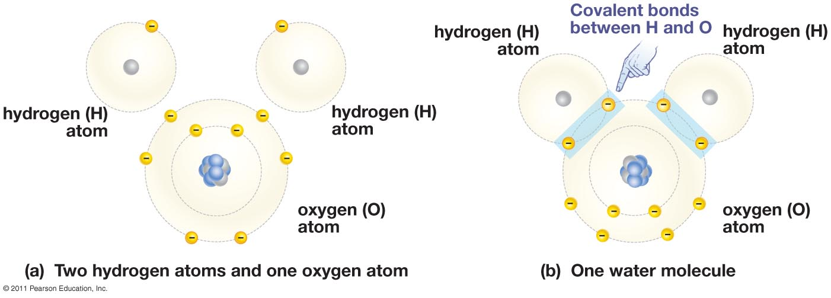
Making Stable Compounds
Atoms bond together to _______ outer shell electrons

Slide 19
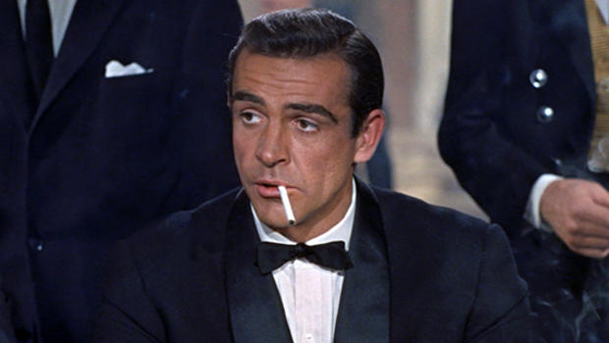
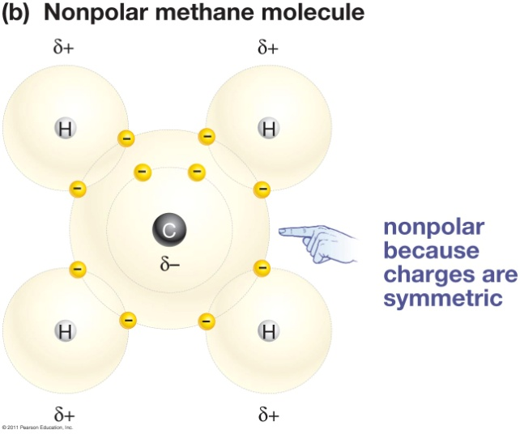
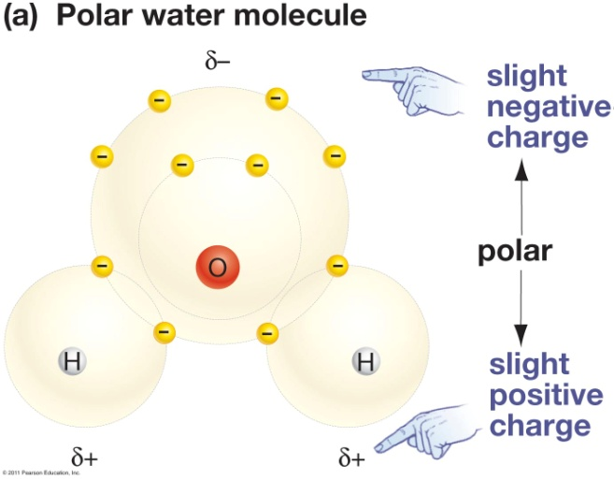
Types of Chemical Bonding
Covalent bonding: when two atoms ______ pairs of electrons
Non-polar covalent bond: when a covalent bond results in a ______ molecule
Ex: Carbon dioxide = CO₂
Polar covalent bond: when a covalent bond results in a polar molecule
Ex: Water molecule = H₂O
_________: a difference in electrical charge on opposing ends of molecule

Slide 20
Types of Chemical Bonding
Ionic bonding: when one atom _______ an electron to another atom, with resulting ions become linked by attraction of opposing charges
After gaining or losing an electron, atoms become charged
Cation: a positively charged ion
Ex: Na⁺
Anion: a negatively charged ion
Ex: Cl⁻
Ion: a charged atom; number of _________ does not equal number of _________

Slide 21
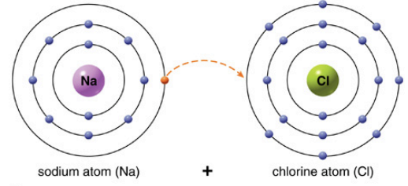
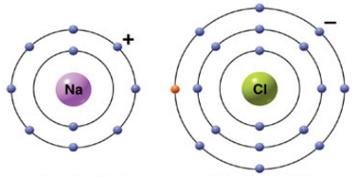
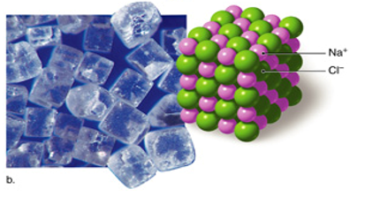
Ionic Bond
Sodium (Na) and Chlorine (Cl)
NaCl
Sodium atom (Na)
+
Chlorine atom (Cl)
Na⁺
Cl⁻
Sodium ion (Na⁺)
Chloride ion (Cl⁻)
Outer shells of both atoms are now complete

Slide 22
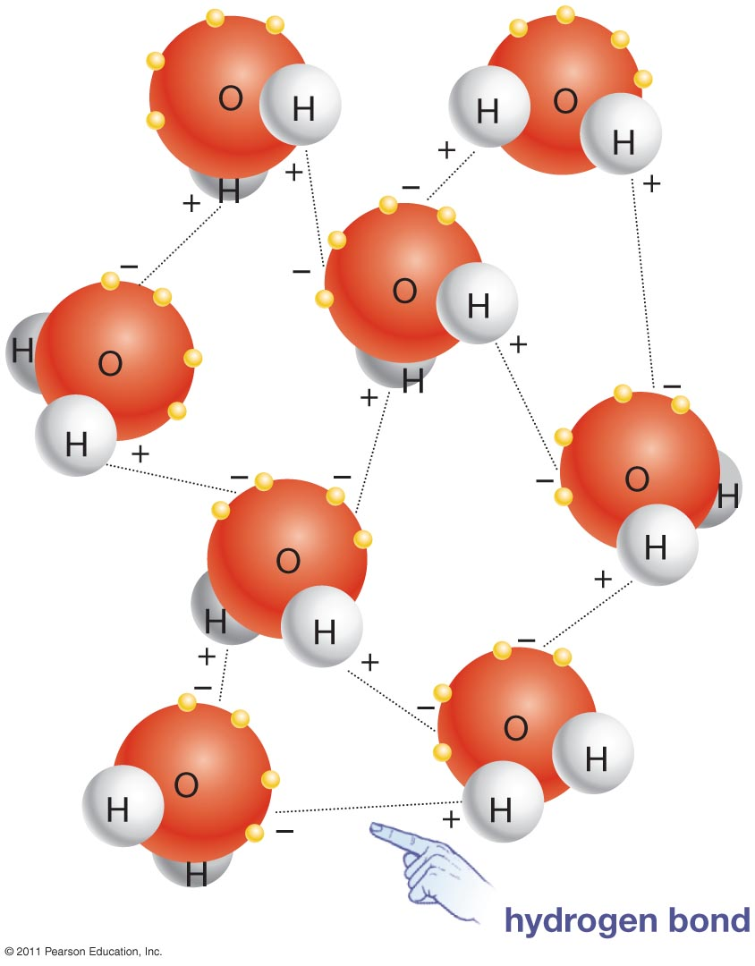
Types of Chemical Bonding
Hydrogen bonding: covalent bond between hydrogen atoms and an electronegative atom
Bound by attraction of electrical charge
Relatively _____ bonds

Slide 23
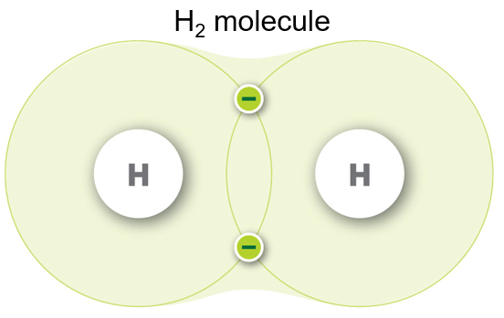
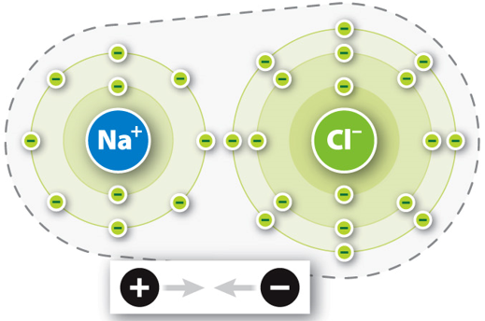
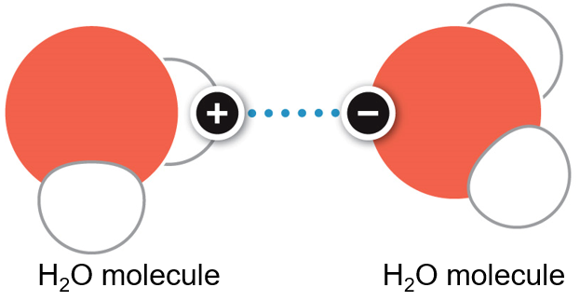
Summary of Molecule Bonding
Covalent bonding: a bond formed between two atoms that share electrons
Bond strength : ________
Ionic bonding: a compound that is formed by the attraction of two oppositely charged ions
Bond strength: ________
Hydrogen bonding: a bond formed between the slightly positively charged hydrogen atom and the slightly negatively charged region of another atom
Bond strength: ________

Slide 24
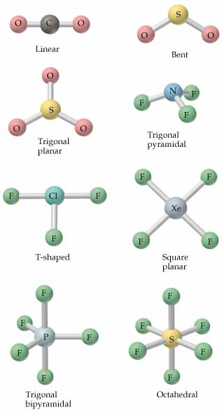
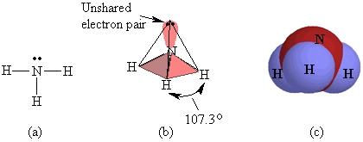
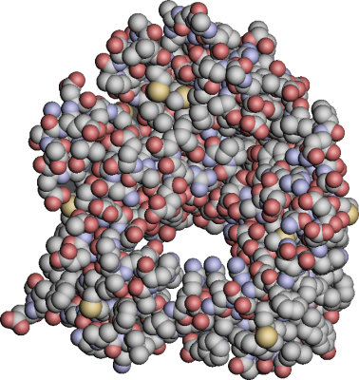
The Importance of Molecule Shape
When atoms bind together the resulting molecule takes on a specific shape

Slide 25
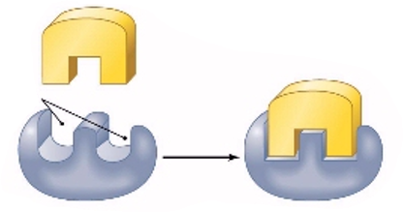
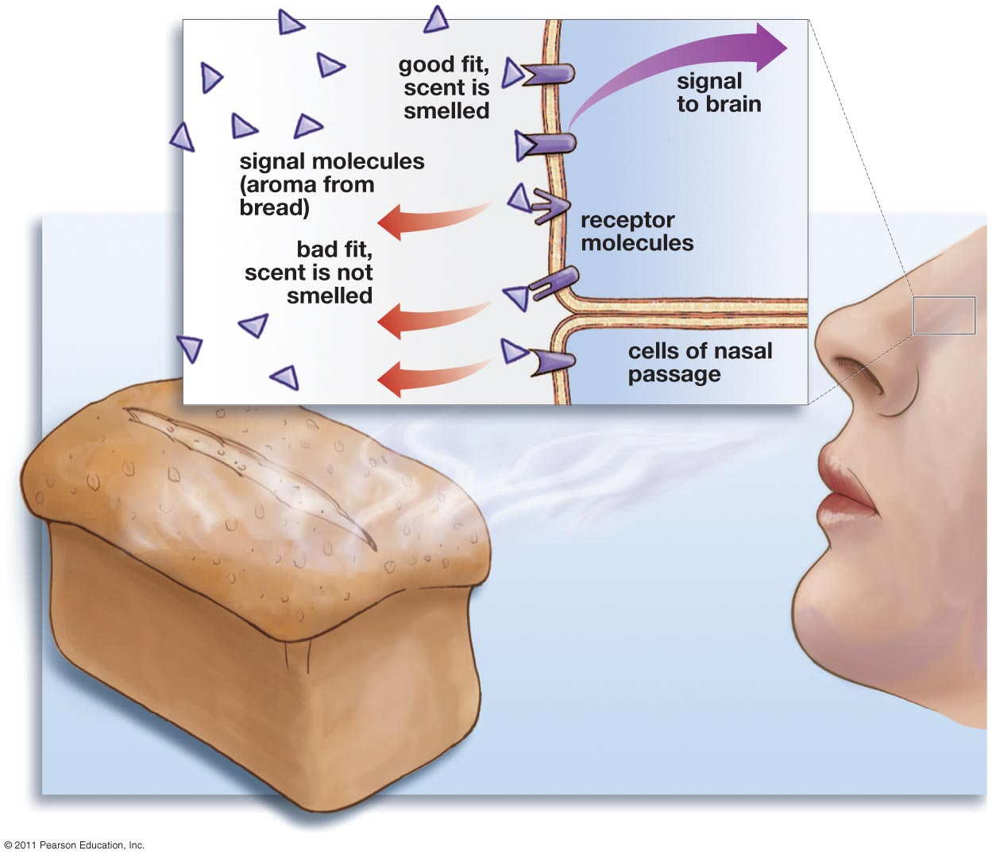
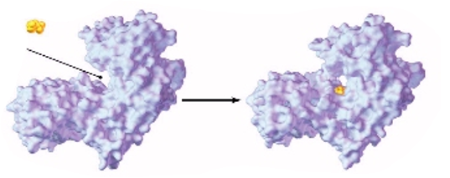
The Importance of Molecule Shape
Molecular shape works like a lock and key with enzymes
Substrate
Active sites
Enzyme
Enzyme-substrate complex
Substrate
Active site
Enzyme
Enzyme-substrate complex

Slide 26
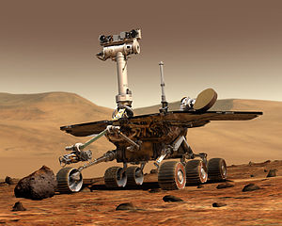
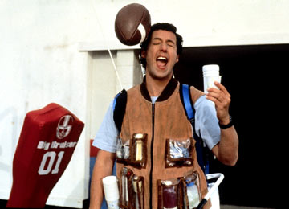
The Amazing H₂O
Water is essential to life
Life started in water
Terrestrial life depends of water
Cells immersed in water
66% of our body weight
Water has unique properties that allow life to exist on earth

Slide 27
Properties of Water
The Universal Solvent
Water can dissolve more substances than any other liquid
Solute: substance being ________ to form a solution
Solvent: substance that a solute is dissolved in to form a solution
Aqueous solution = water is the solvent
Solution: a ___________ mixture of two or more substances
Hydrogen bonds of water molecule pull other compounds apart

Slide 28
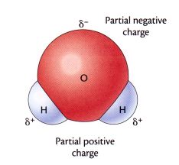
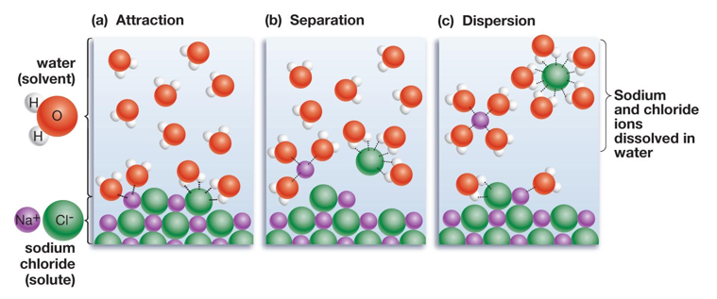
Properties of Water
Water is a polar molecule
_______ works to pull apart ions
Partial negative charge
Partial positive charge

Slide 29
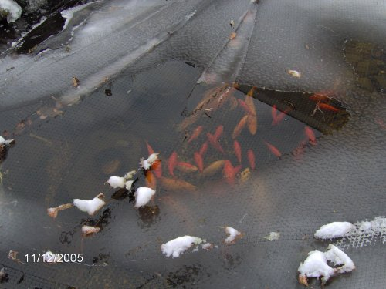
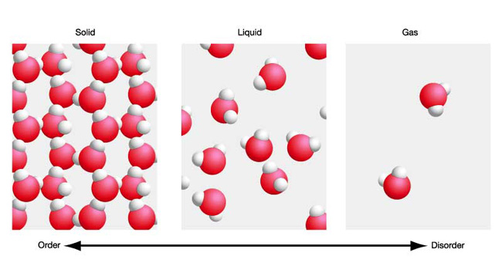
Properties of Water
Liquid form is ______ than solid form
Ice floats on water!

Slide 30
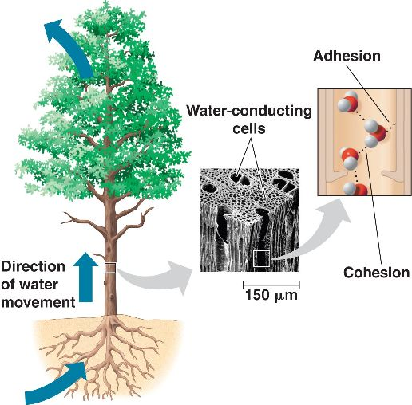
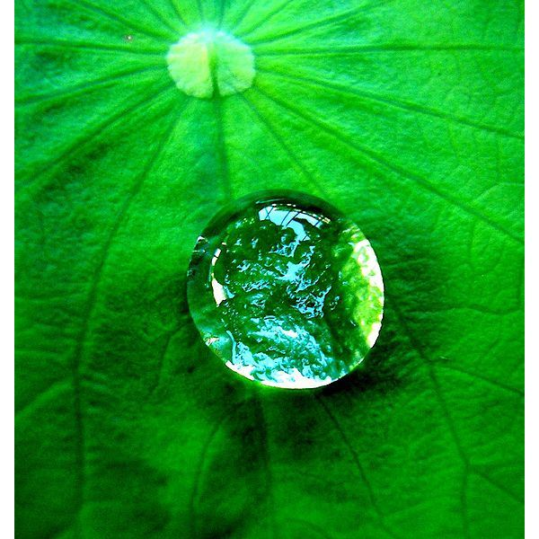
Properties of Water
__________: the tendency for like molecules to cling together due to attractive forces

Slide 31
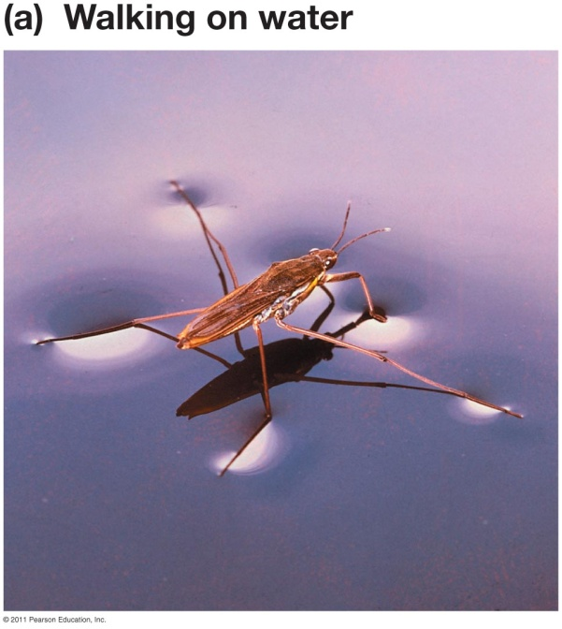
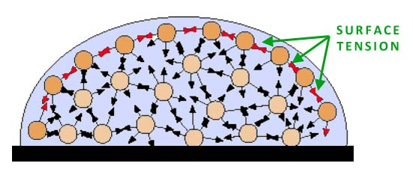
Properties of Water
Surface tension: water molecules are ____________ to air and pack more tightly at interface

Slide 32
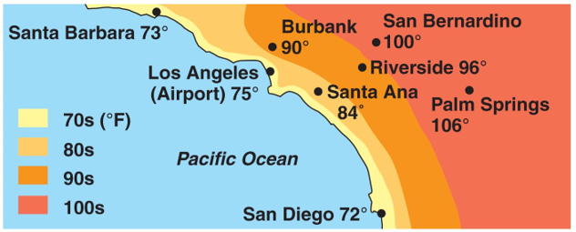
Properties of Water
Specific heat: amount of energy required to raise temp 1˚C
Water has a high specific heat compared to other molecules
Water acts as _____ to temperature changes

Slide 33
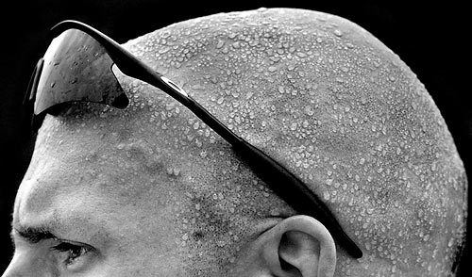
Properties of Water
High heat of vaporization
Vaporization: transformation from ___________
Fastest moving water molecules transform to a gaseous state.
Sweat helps release internal body heat
Evaporative cooling: cooling of surface when liquid evaporates

Slide 34
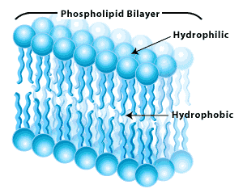
Molecular Attraction to Water
Hydrophilic (“water loving”): compounds that will interact with water
Ex. Sodium Chloride (NaCl)
____________ (“water fearing”): compounds that do not interact with water
Ex: Hydrocarbons (petroleum, oil) and lipids (fats)
Hydrophobic molecules help contain water
Cell membrane

Slide 35
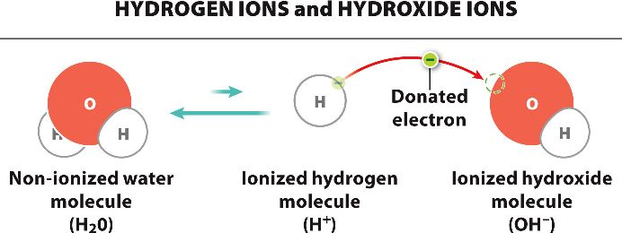
Acids and Bases
Acid: substance that _______ hydrogen ions in an aqueous (water-based) solution
Hydrogen ion = lone proton H⁺
Base: substance that _______ hydrogen ions in an aqueous solution
Hydroxide ion = Oxygen and Hydrogen OH⁻
Alkaline = basic solution

Slide 36
Acids and Bases
pH Scale : measures (p)ower of (H)ydrogen
pH = more acidic (6-0) pH of 7 = neutral pH = more basic (8-14)
household ammonia (11.9)
chlorine bleach (12.6)
vinegar, cola (3.0)
oven cleaner (13.0)
drain cleaner (14.0)
stomach acid (2)
lemon juice (2.3)
orange juice (3.5)
black coffee (5.0)
blood, sweat (7.4)
seawater (7.8–8.3)
tomatoes (4.5)
pure water (7.0)
baking soda (8.4)
beer (4.1)
antacid (10)
rain (5.6)
milk (6.4)

