Slide 1
Bacteria and Archaea
“We learn . . . 10% of what we read, 20% of what we hear, 30% of what we see, 50% of what we see and hear, 70% of what we discuss, 80% of what we experience, 95% of what we teach others.”
~ William Glasser
Chapter 27

Slide 2
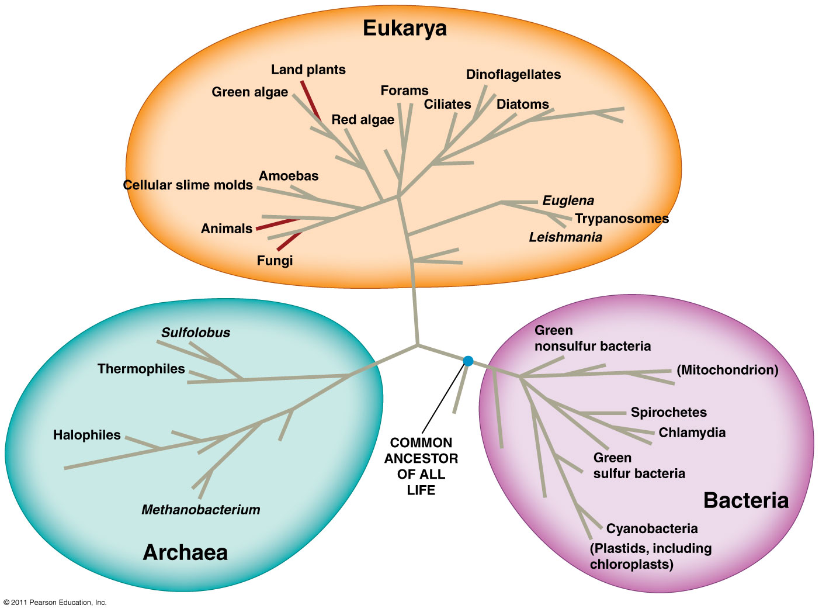
Domains of Life
Bacteria
Unicellular prokaryotes
Archaea
Unicellular prokaryotes
Extremeophiles
Eukarya
Unicellular and multicellular eukaryotes
Protists
Fungi
Plants
Animals

Slide 3
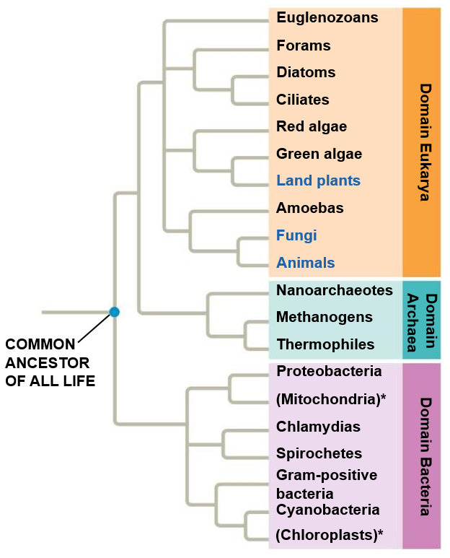

Slide 4
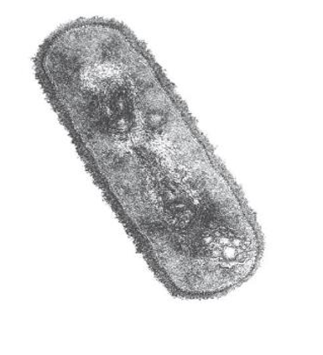
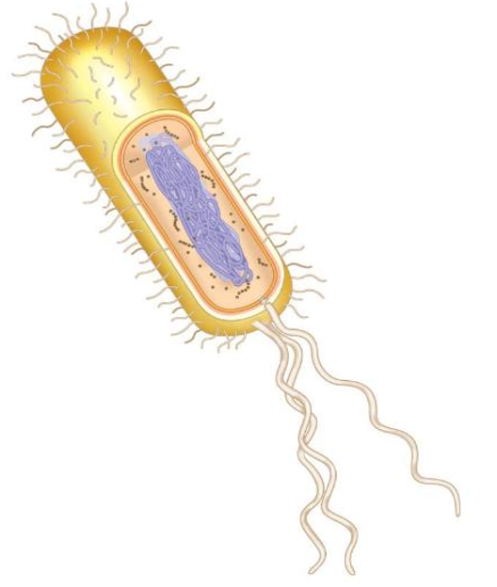
Prokaryotic Cells
Fimbriae: attachment structures on the surface of some prokaryotes
_________: location of cell’s DNA (not enclosed in a membrane)
Ribosomes: site of protein synthesis
Cell wall: rigid structure outside of cell membrane
________: sticky outer coating on many prokaryotes
Bacterial
chromosome
A typical
rod-shaped
bacterium
Flagella: locomotion organelles in some bacteria
A thin section through the
bacterium Bacillus coagulans
Notes:
Capsule layer allows bacteria to adhere to other substrates or other individuals in the colony

Slide 5
Prokaryotic and Eukaryotic Cells
Characteristics | Prokaryotic Cells | Eukaryotic Cells
Cell Size | Small (0.2 – 2.0 µm in diameter) | Large (10 – 100 µm in diameter)
Nucleus | __________________ or nucleoli, Nucleoid | Nuclear membrane and nucleoli
Membrane-enclosed organelles | ___________ | Present (e.g. lysosomes, Golgi complex, mitochondria)
Flagella | Consists of two protein building blocks | Consists of multiple microtubules
Glycocalyx | Present as a capsule of slime layer | Present in some cells that lack a cell wall
Cell wall | Usually present, ____________ (bacteria) | Chemically simple when present (cellulose and chitin)
Plasma membrane | No carbohydrates, typically lack sterols | Sterols and Carbohydrates serve as receptors
Cytoplasm | No cytoskeleton or cytoplasmic streaming | Cytoskeleton, cytoplasmic streaming
Ribosomes | Smaller size (___) | Larger size (___), smaller size (70S) in organelles
Chromosomes (DNA) | Usually ____________ chromosome | ____________ chromosomes
Cell division | ________________ | Involves mitosis
Sexual Recombination | None, transfer of DNA only | Involves meiosis

Slide 6
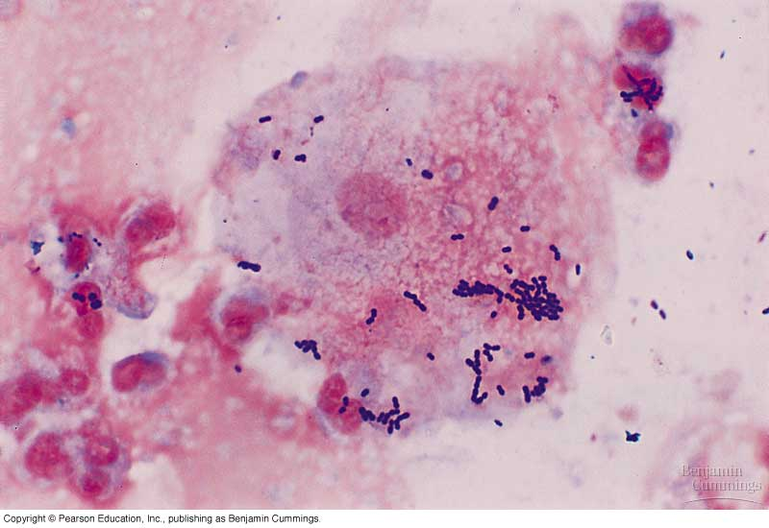
Prokaryotic and Eukaryotic Cells

Slide 7
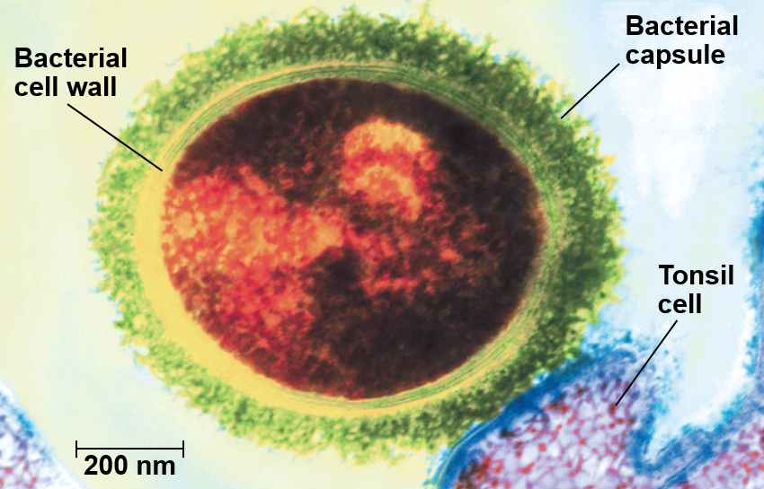
Bacteria Capsule
Capsule: sticky outer layer of _____________________ that enables bacteria to adhere to substrates or other individuals in the colony

Slide 8
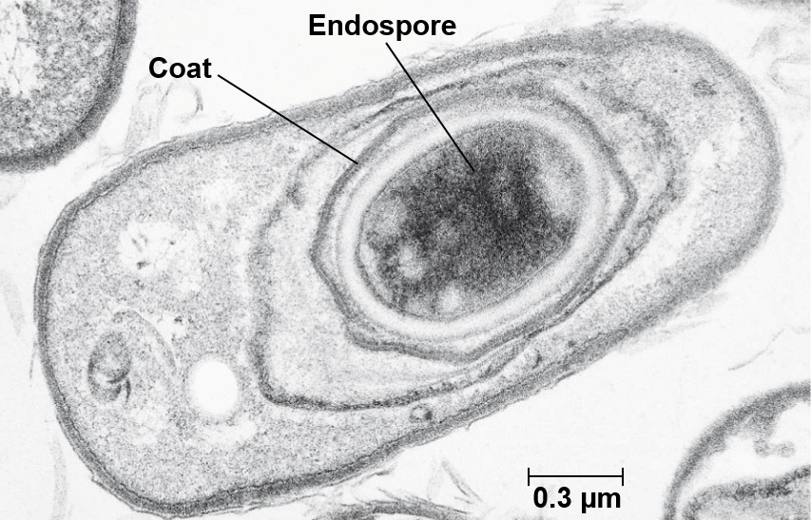
Bacterial Endospore
Endospore: structure consisting of a copy of the bacterium's chromosome protected by a _______________
Resistance to ______ conditions

Slide 9
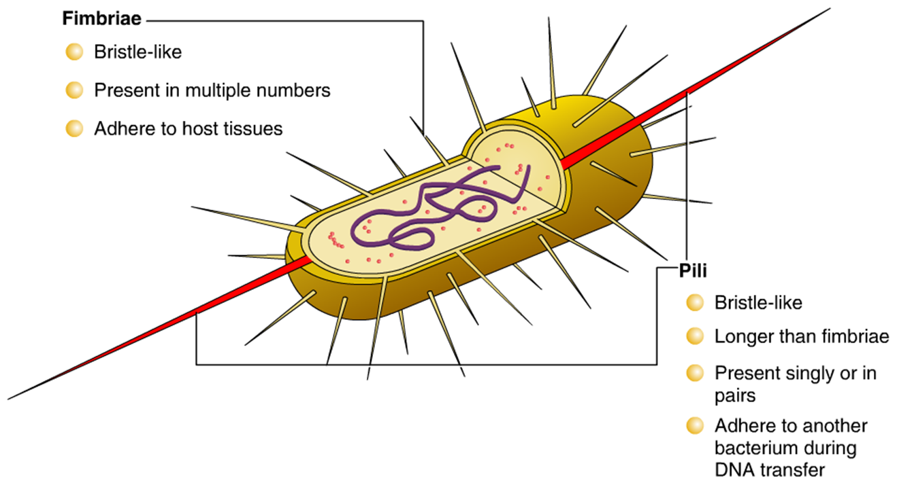
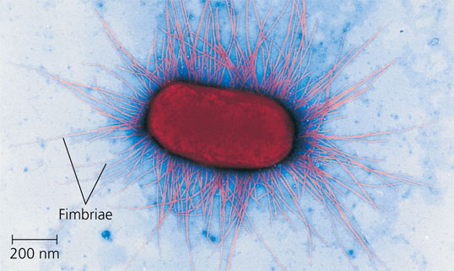
Prokaryotic Fimbriae and Pili

Slide 10
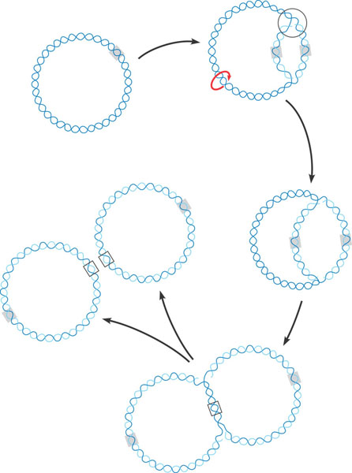
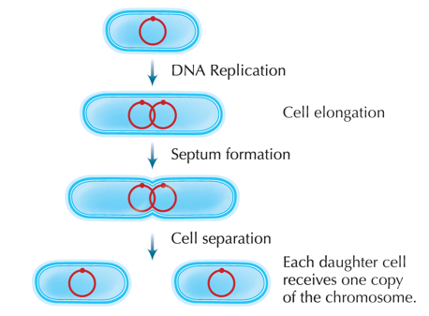
Prokaryotic Reproduction
Asexual Reproduction
______________: DNA replicates and then the cell divides into two separate cells

Slide 11
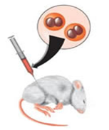
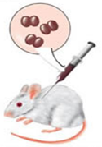
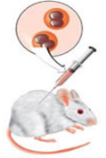
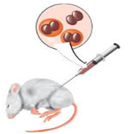
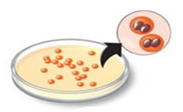
Genetic Recombination
______________ : DNA of prokaryotic cells are altered by the uptake of foreign DNA from its surroundings.
1. Living encapsulated bacteria injected into mouse
1. Living nonencapsulated bacteria injected into mouse
1. Heat-killed encapsulated bacteria injected into mouse
1. Living nonencapsulated and heat-killed bacteria injected into mouse
2. Mouse died
2. Mouse remained healthy
2. Mouse remained healthy
2. Mouse died
3. Colonies of encapsulated bacteria isolated from dead mouse
3. Few colonies of nonencapsulated bacteria isolated from mouse, phagocytes destroyed nonencapsulated bacteria
3. No colonies isolated from mouse
3. Colonies of encapsulated bacteria isolated from dead mouse

Slide 12
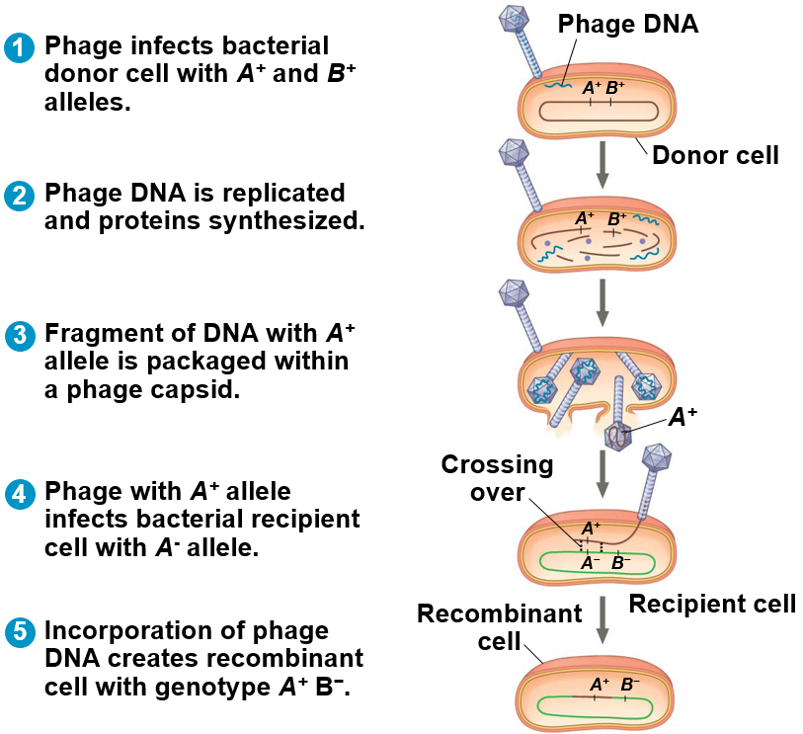
Genetic Recombination
___________: bacteriophages (viruses) transfer DNA from one host cell to another.
Crossing over incorporates new genetic material into recipient cell DNA creating recombinant cell

Slide 13
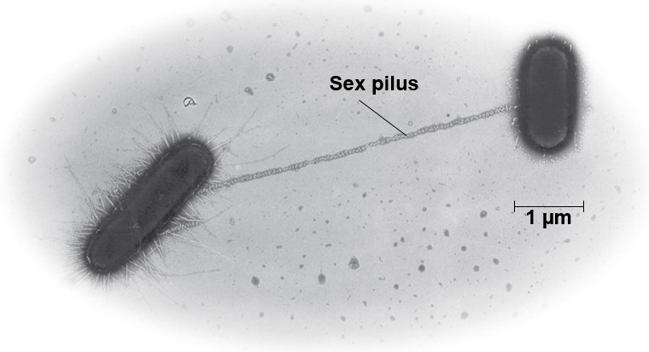
Genetic Recombination
_____________: DNA transferred between two prokaryotic cells that are temporarily joined together.
________ transfer
Pili

Slide 14
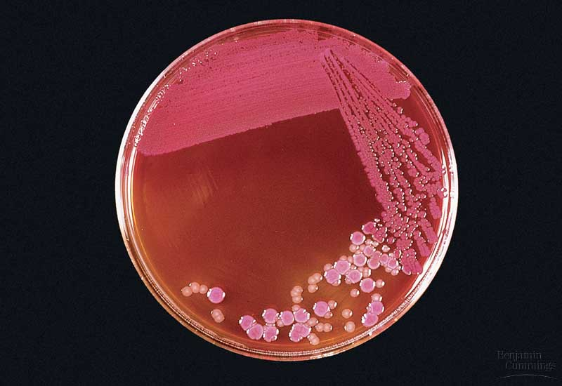
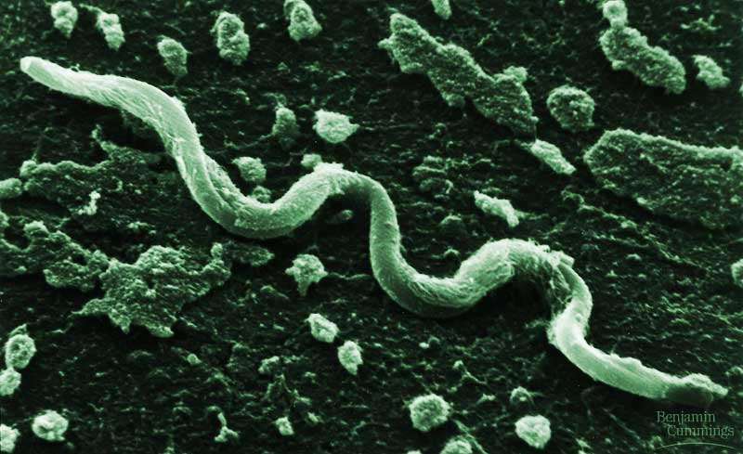
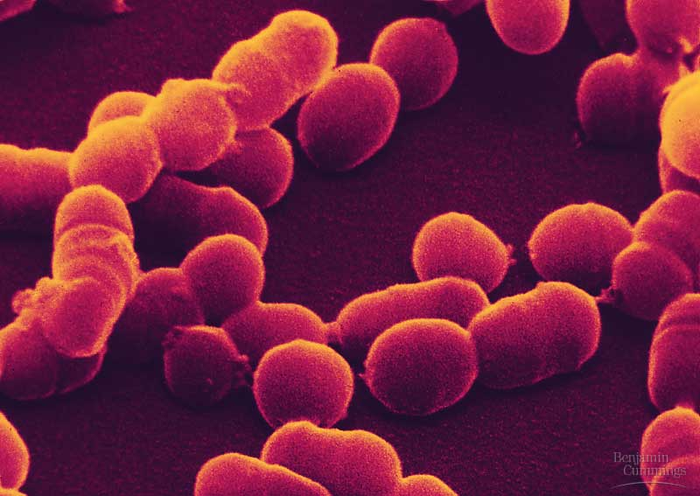
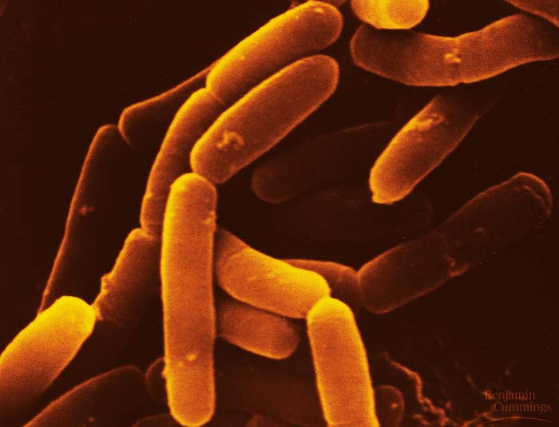
Domain: Bacteria
No membrane bound nucleus or organelles
Single-celled organisms
Asexual reproduction
____________ in cell wall separates bacteria from archaea

Slide 15
Classifying Bacteria
Shape
Gram-stain
Oxygen requirements
Nutritional requirements

Slide 16
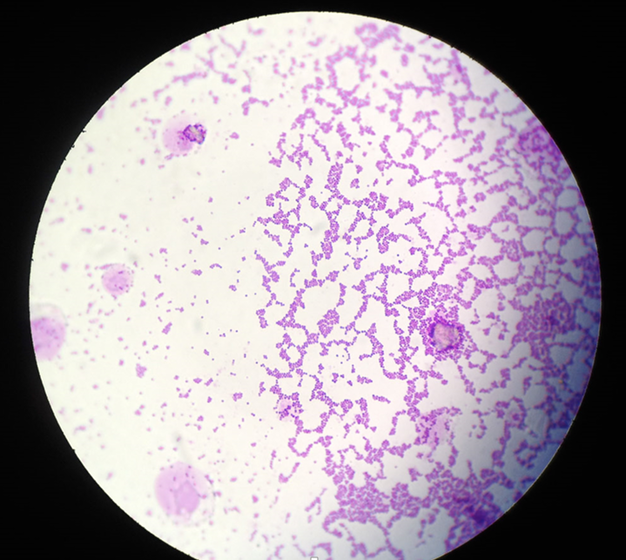
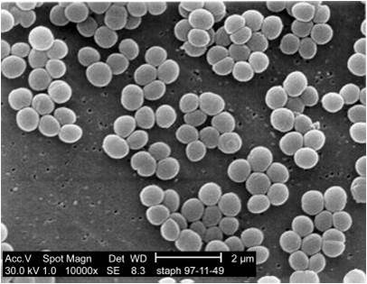
Bacterial Shapes
Coccus or cocci
Round or spherical shaped
Photo of Gram + bacteria from lab

Slide 17
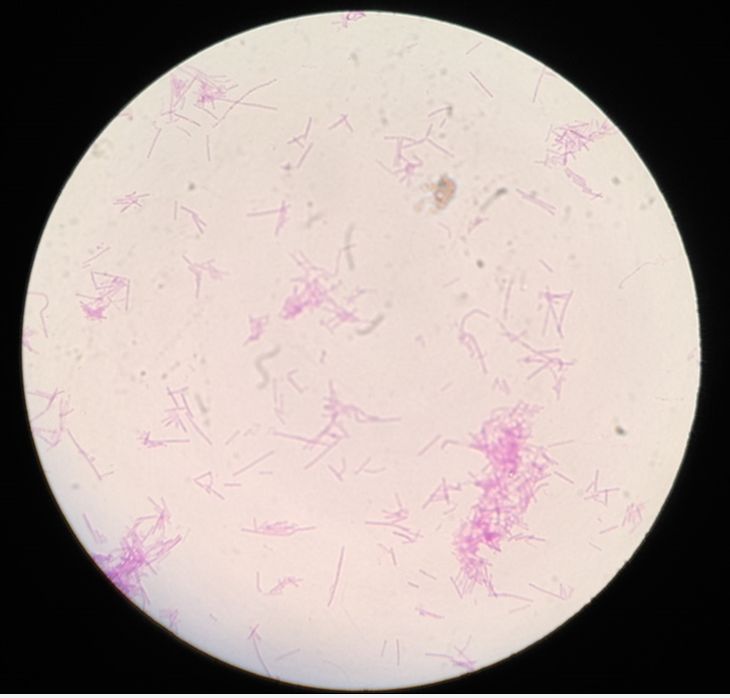
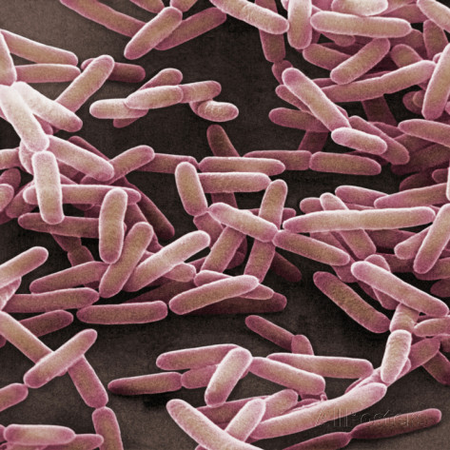
Bacterial Shapes
Bacillus or Bacilli
Rod or pill shaped
Clostridium tetani from lab photo

Slide 18
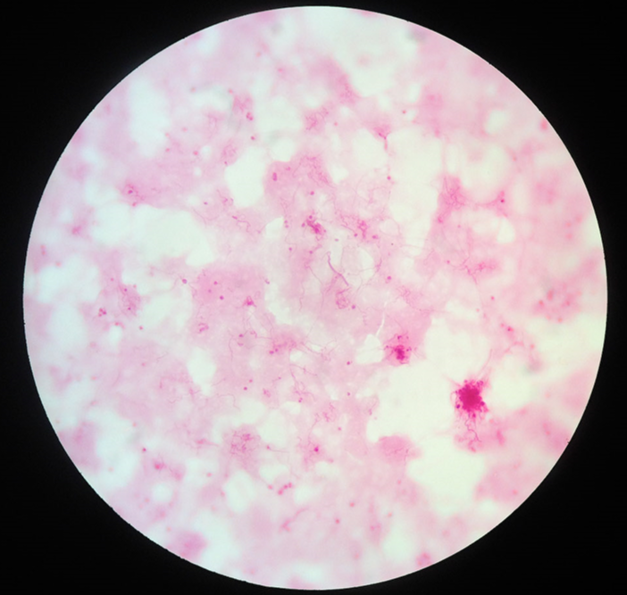
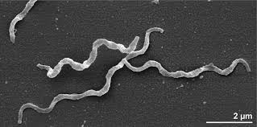
Bacterial Shapes
Helical
Spiral shaped
Treponema pallidum from lab photo

Slide 19
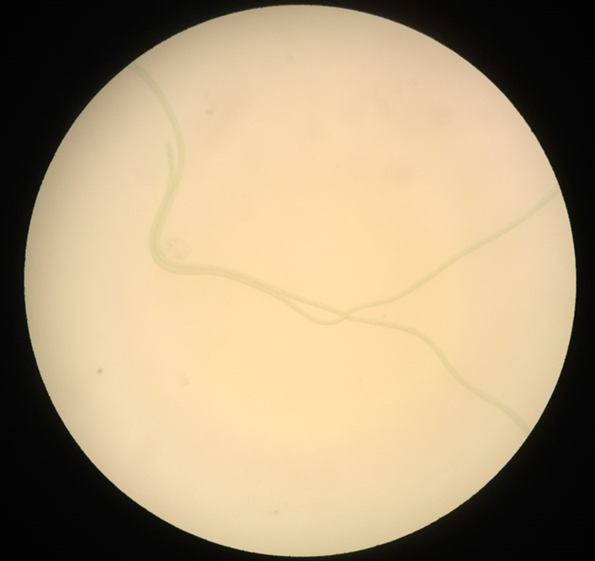
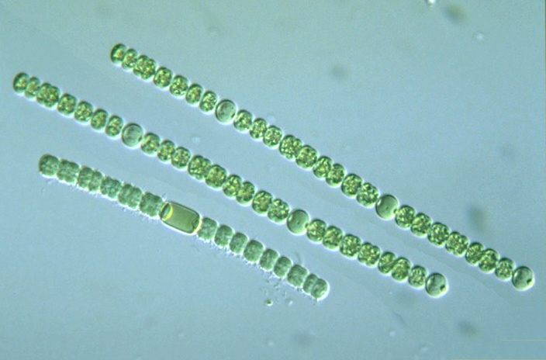
Bacterial Shapes
Filamentous
Elongated “chain” of cells
Cyanobacteria from lab photo

Slide 20
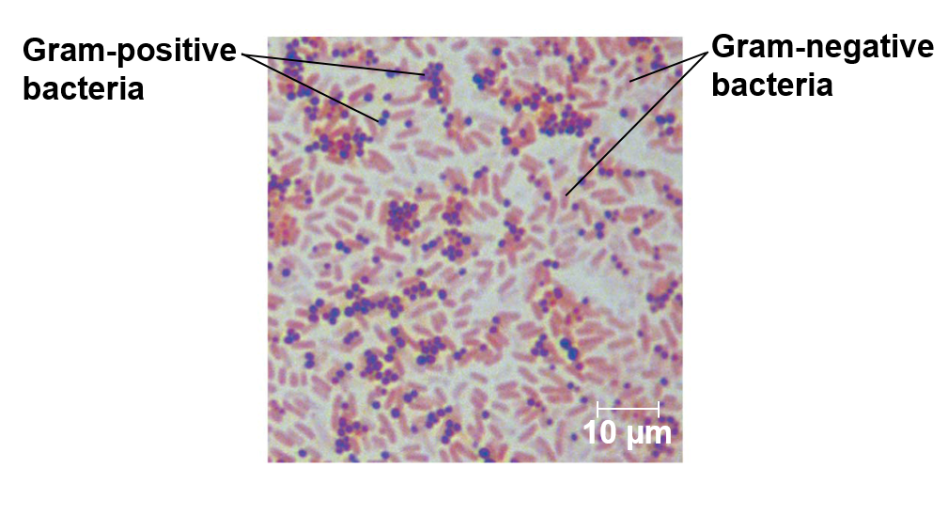
Cell Walls and Gram Staining
Gram staining identifies differences in bacterial cell wall structures
Most bacterial cell walls contain peptidoglycan
_______________: a polymer composed of modified sugars cross-linked by short polypeptides
Antibiotics inhibit polypeptide formation
The staining procedure is as follows:
1. Application of crystal violet
2. Application of iodine
3. Alcohol wash
4. Application of safranin
Gram-positive – Violet in Color
Gram-negative – Red in Color

Slide 21
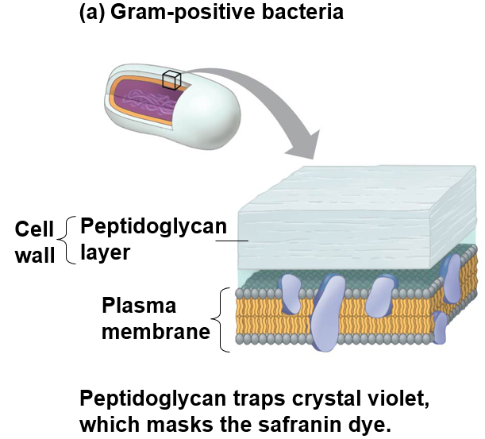
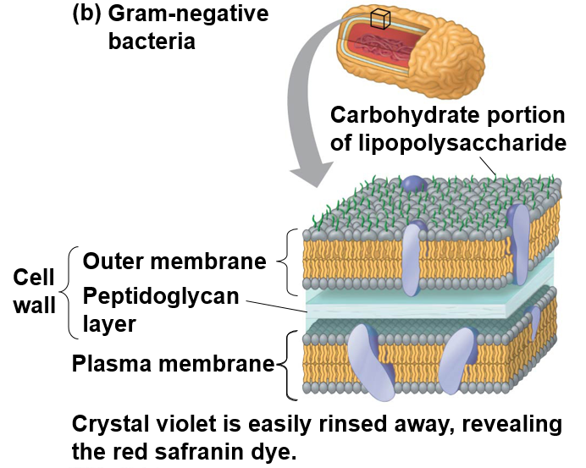
Gram+ and Gram- Bacteria

Slide 22
Check Your Understanding
True or False: Eu karyotic and prokaryotic cells both have a
membrane-bound nucleus
True or False: Spherical shaped bacteria are known as bacillus

Slide 23
Check Your Understanding
The sticky outer coating that enables many prokaryotic cells to stick to each other or their host is known as the ___________.
a. capsule
b. endospore
c. cell wall
d. flagella

Slide 24
Check Your Understanding
The recombination of bacterial DNA as a result of introductions by bacteriophages is known as _______________.
a. conjugation
b. transformation
c. transduction
d. binary fission

Slide 25
Oxygen Requirements
Obligate aerobes: must use oxygen (O₂) for cellular respiration
Obligate anaerobes: ________ by oxygen and live by fermentation or anaerobic respiration (ions other than O₂ act as electron acceptors)
___________ anaerobes: use O₂ if present, but can survive by fermentation or anaerobic respiration in anaerobic environments

Slide 26
Nutritional Requirements
Energy source: how they obtain energy
Phototrophs: obtain energy from light
Chemotrophs: obtain energy from __________
Carbon source: source of carbon used in organic molecules that make up cells
Autotrophs: need only CO₂ or related compounds for carbon source
Heterotrophs: require at least one ______________ (ex. glucose) to make organic molecules

Slide 27
Nutritional Requirements
 | Mode | Energy Source | Carbon Source | Organisms
Autotrophs | Photoautotroph | Light | CO₂, HCO₃⁻ | Photosynthetic prokaryotes (cyanobacteria), plants, some protists
 | Chemoautotroph | Inorganic chemicals (H₂S, NH₃, or Fe₂⁻) | CO₂, HCO₃⁻ | Unique to some prokaryotes
Heterotrophs | Photoheterotroph | Light | Organic compounds | Unique to some aquatic and salt-loving prokaryotes
 | Chemoheterotroph | Organic compounds | Organic compounds | Many prokaryotes, protists, fungi, animals, and some plants

Slide 28
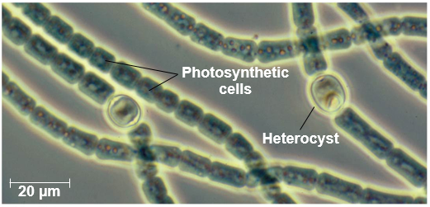
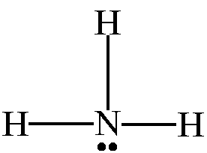
Nitrogen Metabolism
Nitrogen fixation: conversion of _____________(N₂) to ammonia (NH₃)
___________ carry out nitrogen fixation
Nitrogen used in formation of proteins and organic compounds
N₂
NH₃

Slide 29
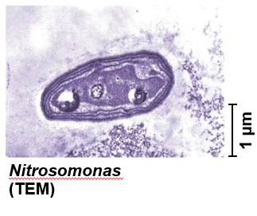
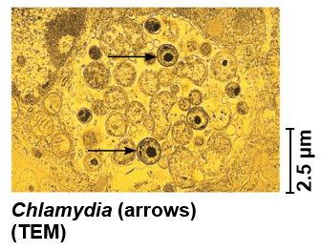
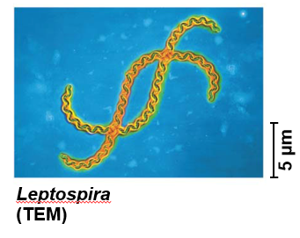
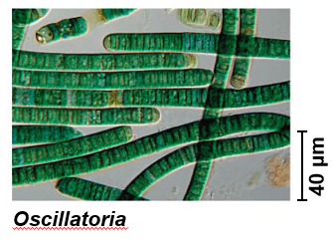
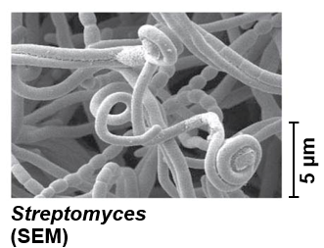
Five Major Clades of Bacteria
Proteobacteria
Chlamydia
Bacteria
Spirochetes
Cyanobacteria
Gram + Bacteria

Slide 30
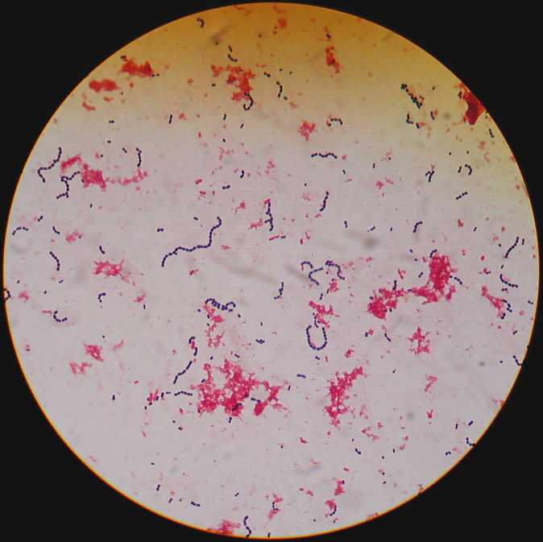
Bacteria: Proteobacteria
Large, diverse group of gram-negative bacteria made up of five subgroups
Group includes pathogens E. coli, Vibrio cholerea, and Salmonella, and Rhizobium
_________: finger-like projections for attachment
Example: Escherichia coli (E. coli)
Shape: bacillus
Gram stain: negative
Nutritional requirements: chemoheterotrophs
Oxygen requirements: facultative anaerobic

Slide 31
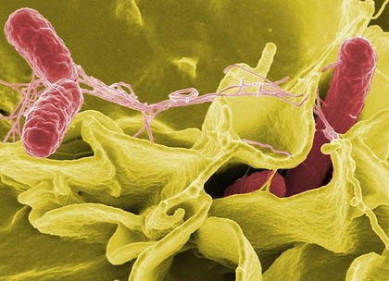
Bacteria: Proteobacteria
Large, diverse group of gram-negative bacteria made up of five subgroups
Group includes pathogens E. coli, Vibrio cholerea, and Salmonella, and Rhizobium
Fimbrae: finger-like projections for attachment
Example: Salmonella
Shape: bacillus
Gram stain: negative
Nutritional requirements: chemoheterotrophs
Oxygen requirements: __________________
Causes: Food poisoning

Slide 32
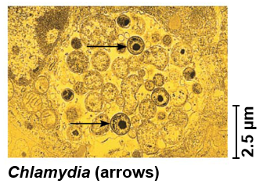
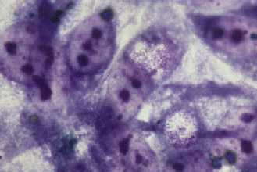
Bacteria: Chlamydias
Parasites that can only survive within animal cells
Intercellular parasite
Example: Chlamydias trachomatis
Shape: _______
Gram stain: negative
Nutritional requirements: parasitic (heterotrophs)
Oxygen requirements: uncertain
Causes: Blindness, Most common STD in U.S.
Lab photo

Slide 33
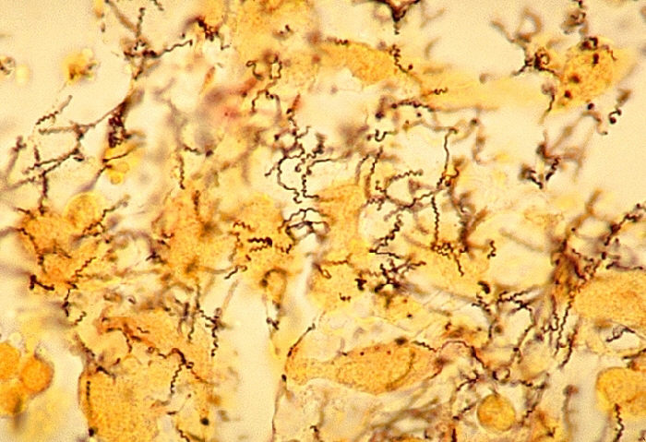
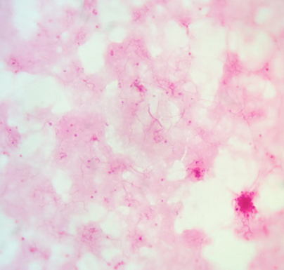
Bacteria: Spirochetes
Some free living, others parasitic
Fibrils: flagella like filaments used for movement
Example: Treponema pallidum
Shape: ________
Gram stain: negative
Nutritional requirements: chemoheterotrophs
Oxygen requirements: anaerobic, but oxygen tolerant
Causes: Syphilis
Lab photo

Slide 34
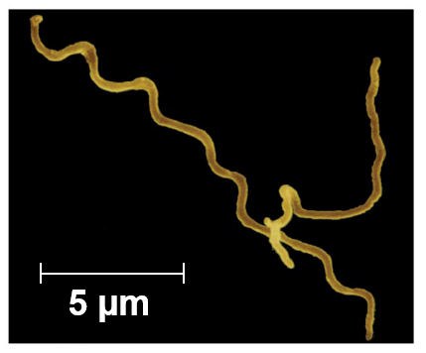
Bacteria: Spirochetes
Some free living, others parasitic
Fibrils: flagella like filaments used for movement
Example: Borrelia burgdorferi
Shape: helical
Gram stain: negative
Nutritional requirements: chemoheterotrophs
Oxygen requirements: _______, but low oxygen requirement
Causes: Lyme disease

Slide 35
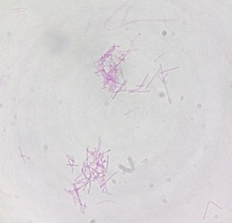
Bacteria: Gram Positive Bacteria
Large, diverse group of mostly chemoheterotrophic bacteria
Endospore
Example: Clostridium tetani
Shape: bacillus
Gram stain: positive
Nutritional requirements: chemoheterotrophs
Oxygen requirements: ________________
Causes: lockjaw, tetanus
Exotoxin
Endospore
Lab photo

Slide 36
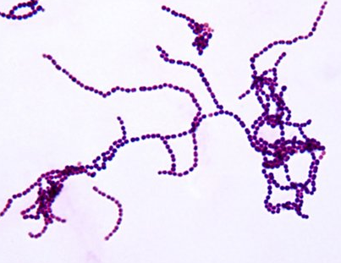
Bacteria: Gram Positive Bacteria
Large, diverse group of mostly chemoheterotrophic bacteria
Endospore
Example: Streptococcus
Shape: coccus
Gram stain: positive
Nutritional requirements: chemoheterotrophs
Oxygen requirements: __________, but oxygen tolerant
Causes: Strep throat

Slide 37
Bacteria: Gram Positive Bacteria
Large, diverse group of mostly chemoheterotrophic bacteria
Endospore
Example: Staphylococcus
Shape: coccus
Gram stain: positive
Nutritional requirements: chemoheterotrophs
Oxygen requirements: facultative anaerobic
Causes: Food poisoning, toxic shock syndrome

Slide 38
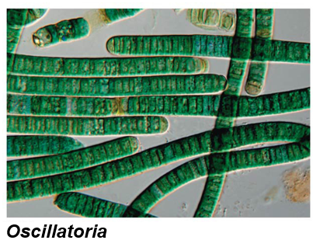
Bacteria: Cyanobacteria
Contains Chlorophyll A and phycocyanin
Only organism that can _______________ ___________(product of photosynthesis)
Example: Oscillatoria
Shape: filamentous
Gram stain: no stain
Nutritional requirements: photoautotrophs
Oxygen requirements: facultative anaerobes
Causes: nitrogen fixation and photosynthesis
Lab photo

Slide 39
Bacteria: Cyanobacteria
_____________: layered bio-chemical structures formed through the cementation of bio-films produced by cyanobacteria
Oldest known fossils
3.5 billion years old
Only organisms for 1.5 billion years
Found in shallow seas

Slide 40
Domain: Archaea
Carl Woese – Prokaryotic cell but similar to Eukaryotes in DNA replication and Protein synthesis
____________: organisms that live grow best in one or more conditions that would kill most organisms
Thermophiles: live in extremely ___ environments
Halophiles: live in extremely _____ environments
Methanogens: Methane releasing archaea that are poisoned by _______

Slide 41
Comparison of Three Domains of Life
Characteristics | Bacteria | Archaea | Eukarya
Nuclear envelope | Absent | ________ | Present
Membrane-bound organelles | Absent | ________ | Present
Peptidoglycan in cell wall | Present | Absent | Absent
Membrane lipids | Unbranched hydrocarbons | Some branched hydrocarbons | Unbranched hydrocarbons
RNA polymerase | One kind | Several kinds | Several kinds
Initiator amino acid for protein synthesis | Formylmethionine | ____________ | Methionine
Response to antibiotics | Growth inhibited | Growth not inhibited | Growth not inhibited
Histones associated with DNA | Absent | Present in some species | Present
Introns in genes | Very rare | Present in some genes | Present in many genes
Circular chromosome | Present | _________ | Absent
Growth at temps above 100°C | No | Some species | No

Slide 42
Comparison of Three Domains of Life

Slide 43
Prokaryotes Role on Earth
Decomposers
__________________ bacteria breakdown organic matter
Symbiosis with other organisms
Mutualism (+ host, + symbiont)
Intestinal bacteria
Sulfate consuming bacteria and methane consuming archaea
Commensalism (N/A host, + symbiont)
Bacteria on skin
Parasitism (- host, + symbiont)
Pathogens
Endotoxins: only release when bacteria die or cell walls break down
Exotoxins: released by bacteria
______________: use of organisms to remove pollutants from soil, air, or water

Slide 44
Check Your Understanding
True or False: Gram-negative bacteria have a thin plasma membrane sandwiched between two layers of peptidoglycan
True or False: Cyanobacteria are the only organism that can perform nitrogen fixation and photosynthesis
True or False: Bacteria and Archaea are both made up of prokaryotic cells

Slide 45
Check Your Understanding
Which of the following modes of nutrient acquisition use inorganic compounds as an energy source and organic compounds as a carbon source?
a. photoautotrophs
b. chemoheterotrophs
c. photoheterotrophs
d. chemoautotrophs

Slide 46
Check Your Understanding
A bacteria that is poisoned by oxygen and must synthesize energy through fermentation is known as a(n)______________.
a. obligate anaerobe
b. obligate aerobe
c. facultative anaerobe
d. facultative aerobe

