Slide 1
Animal Diversity and Physiology
"The surest way to corrupt a youth is to instruct him to hold in higher esteem those who think alike than those who think differently."
-Friedrich Nietzsche
Chapter 32

Slide 2
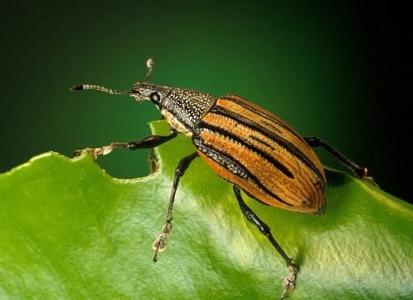
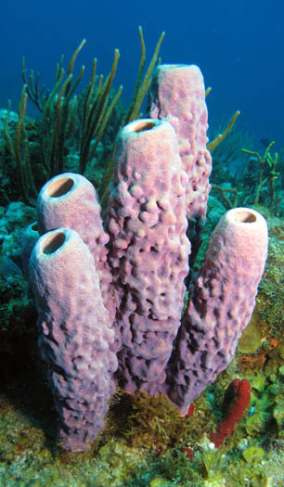
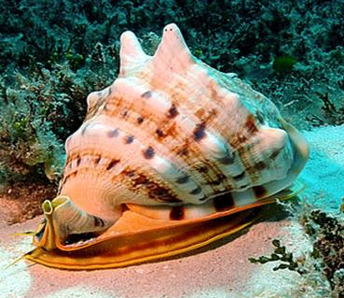
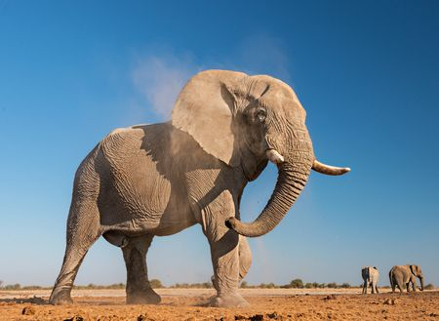
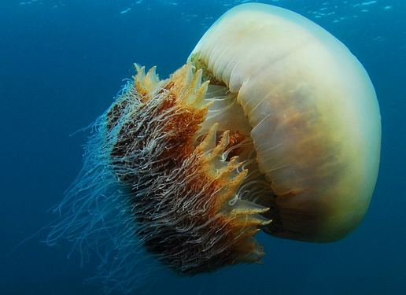
What is an Animal?
Multicellular, heterotrophic, eukaryotes
Lack cell walls
______________
Contain muscle and nervous tissue
Allow for movement and nerve impulses
Most reproduce sexually
Diploid stage dominate the life cycle

Slide 3
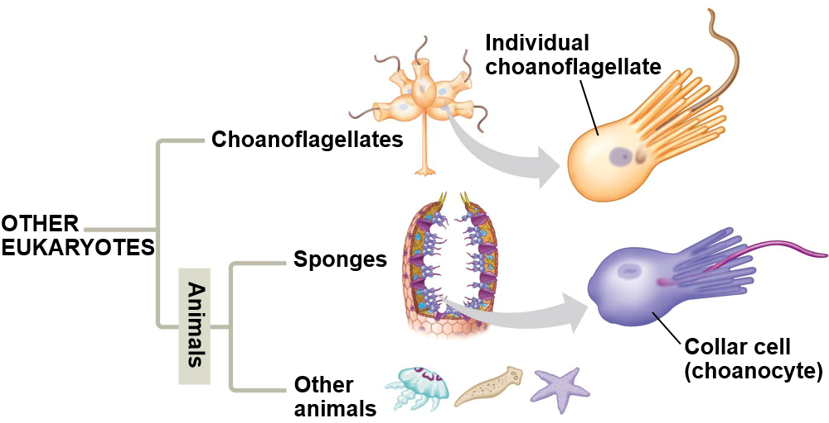
Origin of Animals
DNA sequence data supports Choanoflagellates as sister group
Choanoflagellate cells and collar cells of sponges are nearly identical
Similar collar cells have been observed in other animals

Slide 4
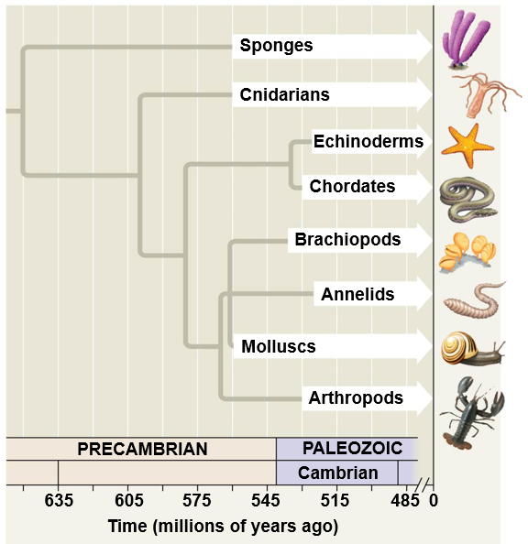
Origin of Animals
Earliest animals appeared ~ 700mya
First fossils ~ 560 mya
Most animal phyla appear suddenly around 535 mya
___________________
Large predators (> 1m)
Hard bodied
Bilateral symmetry
DNA analysis suggests earlier divergence

Slide 5
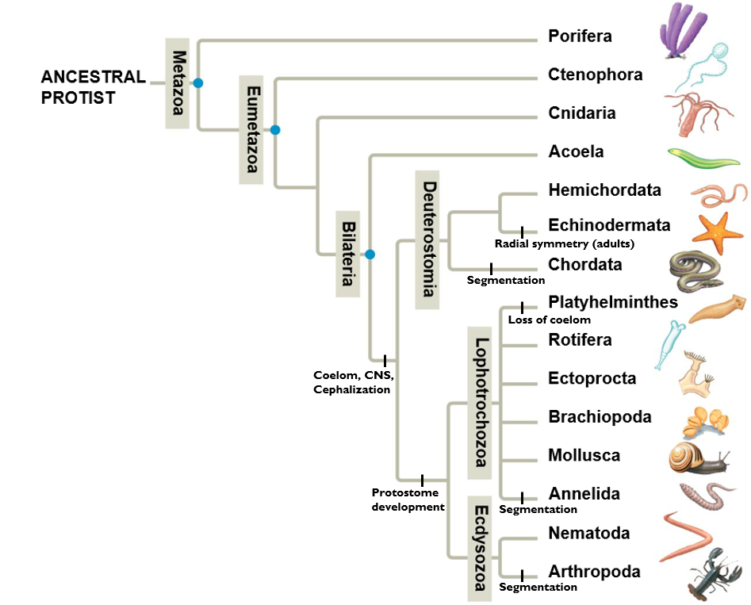
Animal Phylogeny
Animals Classified by:
Development
Symmetry
Organization level
Germ layers
Body cavities
Skeletal Systems
Segmentation
Molecular data

Slide 6
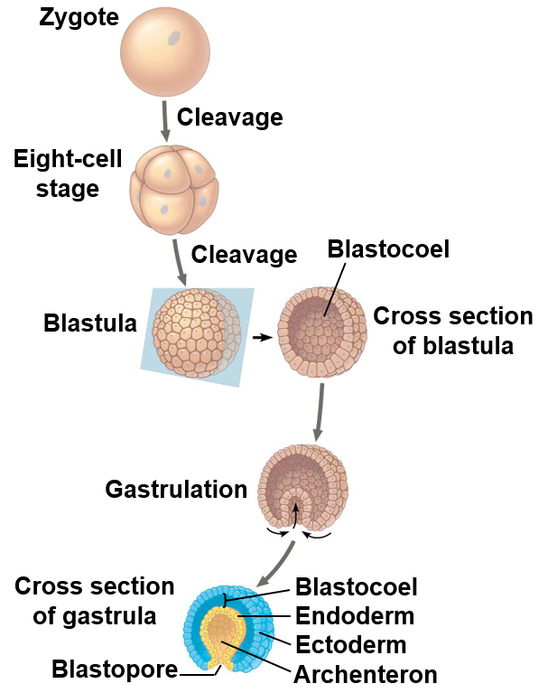
Early Development
Division of zygote (cleavage)
Formation of blastula = hollow ball of cells with blastocoel
Gastrulation: invagination of blastula wall to form embryo with three tissue layers (__________)
Blastopore
Archenteron
Endoderm: develops into digestive tract tissue
Ectoderm: develops into nervous system and skin

Slide 7
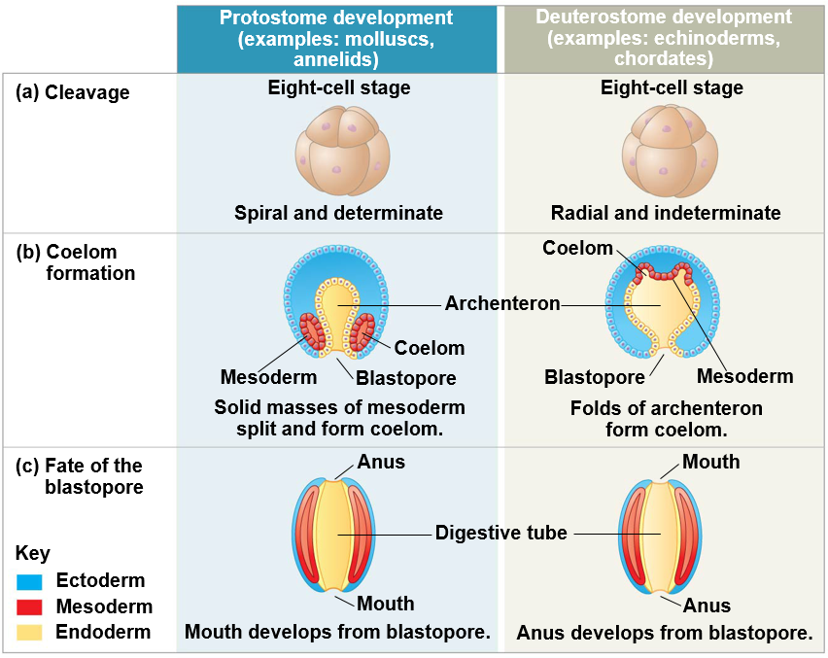
Protostome and Deuterostome Development

Slide 8
Protostome and Deuterostome Development
Protostome
Deuterostome
Cleavage
Spiral
Determinate
Coelom Formation
Mass of mesoderm splits
Fate of Blastopore
Becomes _______
Cleavage
Radial
Indeterminate
Coelom Formation
Mesoderm buds from archenteron
Fate of Blastopore
Becomes ______

Slide 9
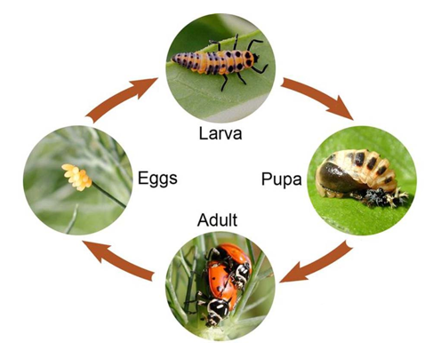
Late Development
Larva: sexually immature life stage that is __________________ from adult form
Different food, habitat
__________________: developmental transformation from larval to adult form

Slide 10
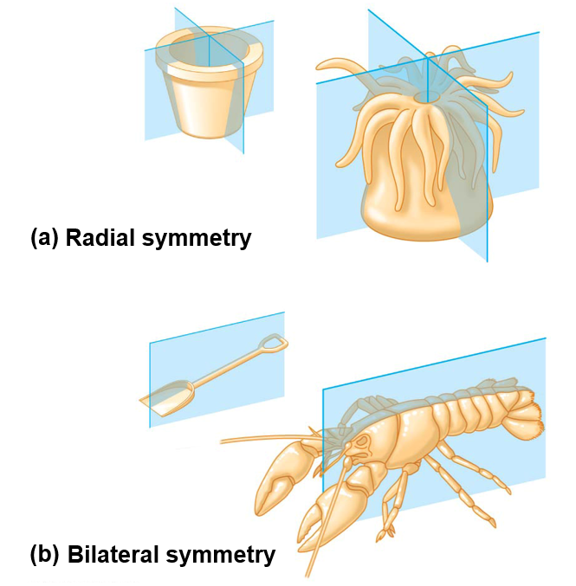
Symmetry
Asymmetry: no symmetry
Some sponges
Radial symmetry: Identical morphology along _____________ trough the center
Echinoderms (adult), sea jellies, and some sponges
Bilateral symmetry: Identical morphology along a _________________, yielding a left and right side
Dorsal (top), ventral (bottom), anterior (front), posterior (back)
Most animals

Slide 11
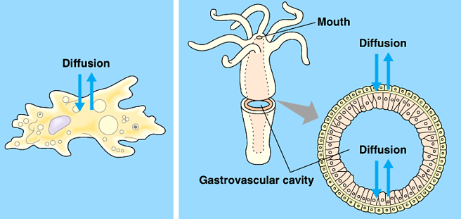
Organization Level
Tissue: collection of specialized cells that act as functional unit
All animals except sponges (Porifera)
Cellular-level organization: _____________ between cells and environment
Tissue-level organization: diffusion between cells, and cells and the environment
Cellular level Tissue level

Slide 12
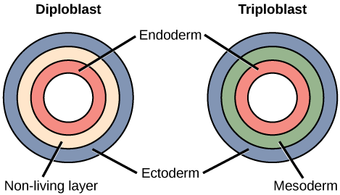
Germ Layers
Endoderm: gives rise to lining of digestive tract and some organs
Mesoderm: lines the coelom and gives rise to muscle, bone, blood
Ectoderm: gives rise to outer covering and nervous system
________________: Two germ layers (endoderm and ectoderm)
________________: Three germ layers (endoderm, mesoderm, and ectoderm)

Slide 13
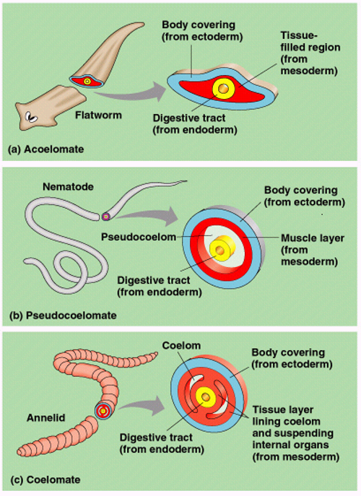
Body Cavities
Body cavity: fluid or air-filled space between the digestive tract and outer body wall
____________
Acoelomates: animals that lack body cavity
Platyhelminthes
Pseudocoelomates: animals with a “false” coelom, derived from ____________________
Nematodes, Rotifers
Coelomates: animals with a “true” coelom, derived from _____________
All other animals

Slide 14
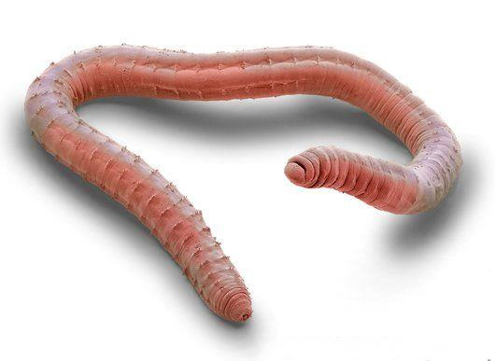
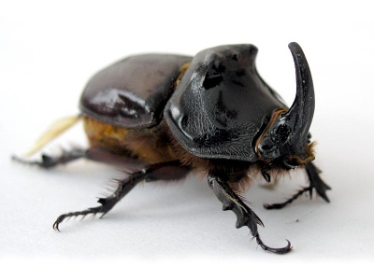
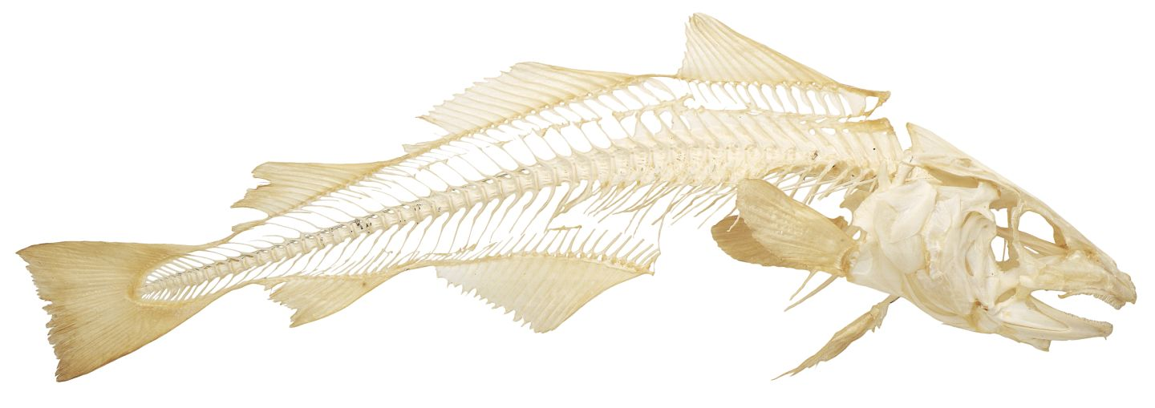
Skeletal Systems
Hydrostatic skeleton: _______ held under pressure within a closed body compartment
Cnidarians, Platyhelminthes, Nematodes, Annelids
Exoskeleton: hard covering deposited on the animals surface that provides protection and points for muscle attachment
Arthropods, Molluscs
Endoskeleton: hard _______ skeleton buried within soft tissue
Porifera, Echinodermata, Chordata

Slide 15
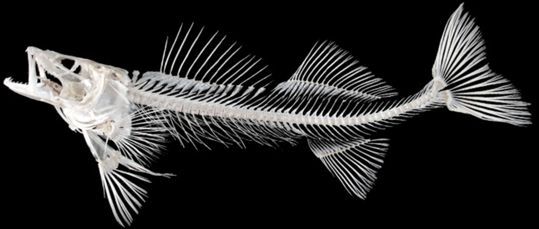
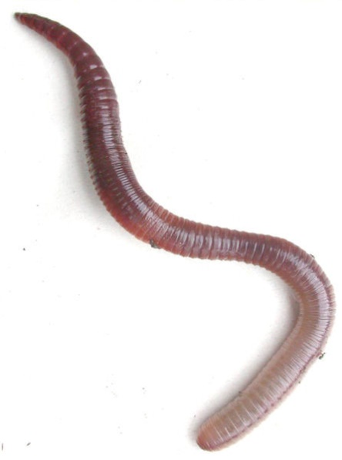
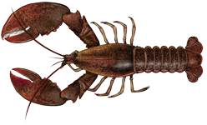
Segmentation
Series of _________ parts or body segments
Efficient movement
Specialization of parts
Evolved (independently?) in four phyla
Annelida
Onychophora
Arthropoda
Chordata

Slide 16
Animal Phylogeny
Animals Classified by:
Development
Symmetry
Organization level
Germ layers
Body cavities
Skeletal Systems
Segmentation
Molecular data
Notes:
Coeloms and segmentation arose independently many times

Slide 17
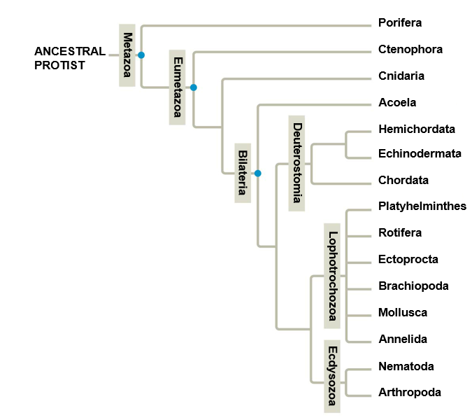
Which Phylogeny is Correct?
2008
2014

Slide 18
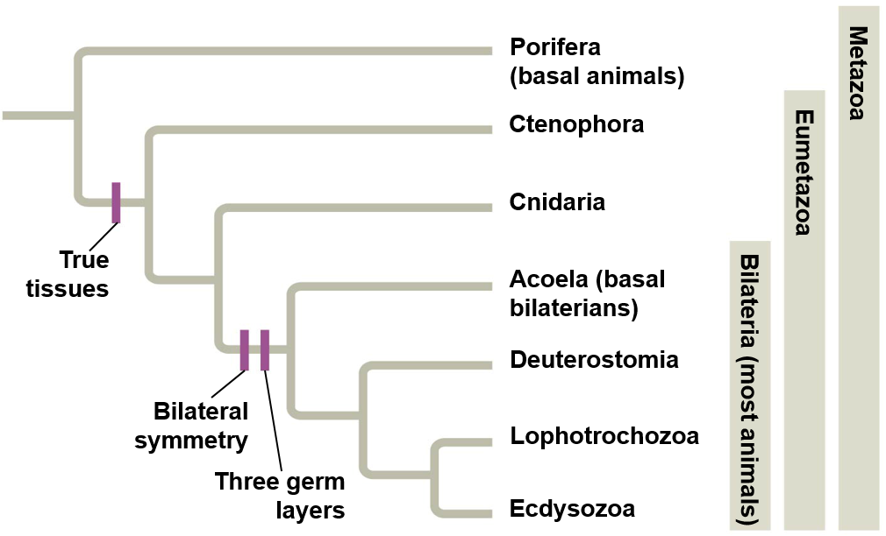
Animal Classification: What we agree on
1. All animals share a common ancestor
______________ clade
2. Sponges are the ___________ of animals
3. All animals except sponges have ________
Cnidarians and Ctenophores are diploblastic
4. Most animals have bilateral symmetry
Bilatarians are triploblastic
5. Three major clades of bilaterian animals
Deuterostomia, Lophotrochozoa, and Ecdysozoa
Notes:
Under debate

Slide 19
Animal Classification: Under debate
1. Are sponges (“Porifera”) a monophyletic group?
2. Are sponges (Porifera) or comb jellies (Ctenophora) the basal group of animals?
3. Are acoelomate flatworms (Acoela) basal bilaterians?

Slide 20
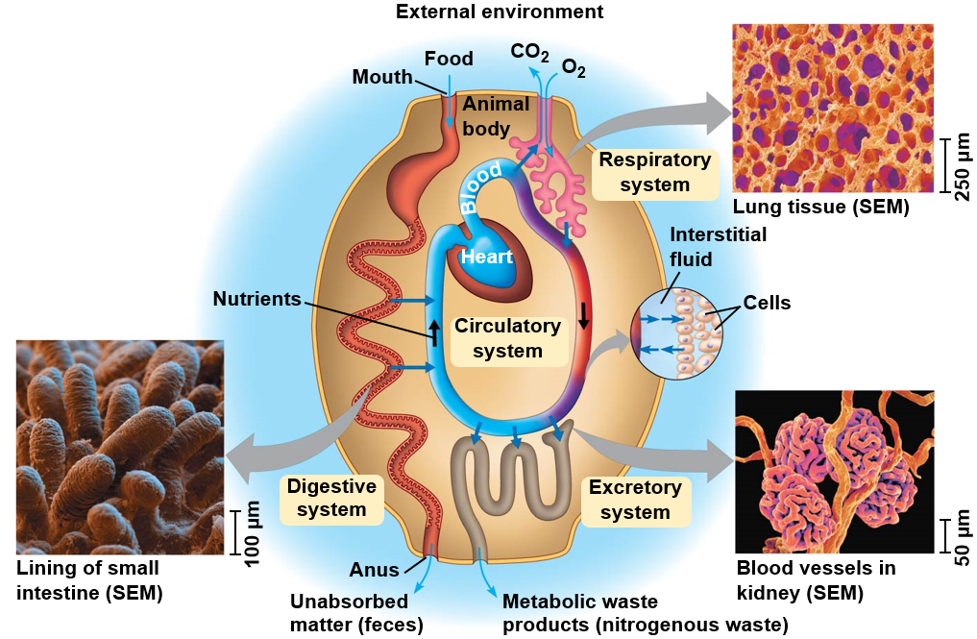
Exchange with the Environment
Exchange nutrients, gases and waste products with the environment
__________ = exchange
Every cells needs aqueous environment to work
___________ fluid: fluid surrounding cells that function in exchange of nutrients and waste products

Slide 21
Overview of Animal Organ Systems
Organ system: a group of organs that work together to perform one or more functions
Digestive system
Nervous system
Excretory system
Circulatory system
Immune system
Respiratory system

Slide 22
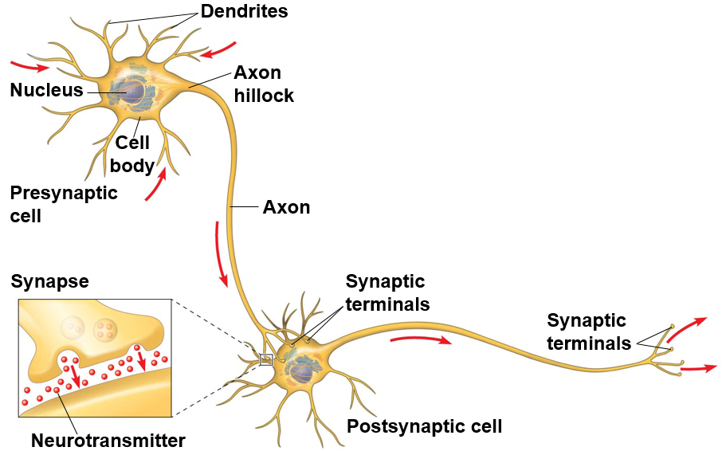
Nervous System
Network of sensory receptors, nerve cells (neurons) connected to muscles and glands, which respond to external stimuli, control movement and regulate internal homeostasis through _________________

Slide 23
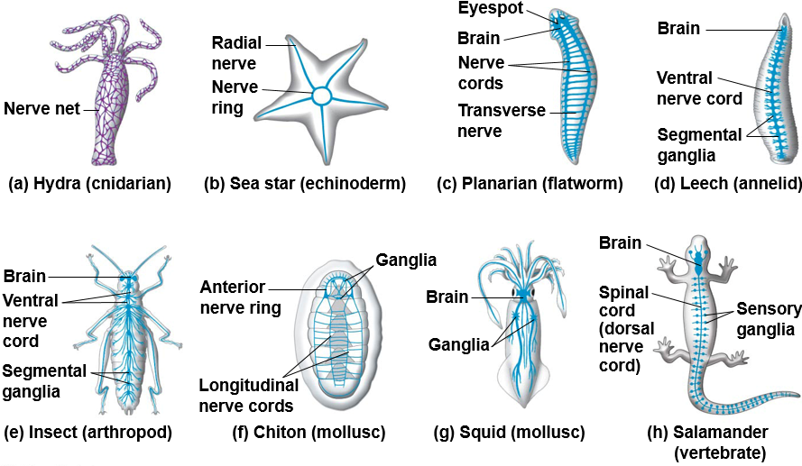
Nervous Systems in Animals

Slide 24
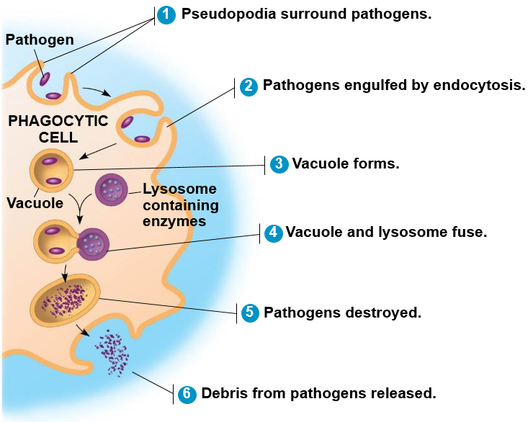
Immune System
System of defense against agents (pathogens) that cause disease
Innate immunity (all animals)
Rapid, ___________ response to antigens
Phagocytosis
Inflammatory response
Adaptive immunity (vertebrates)
Recognition and response to ________________
B-cells and T-cells

Slide 25
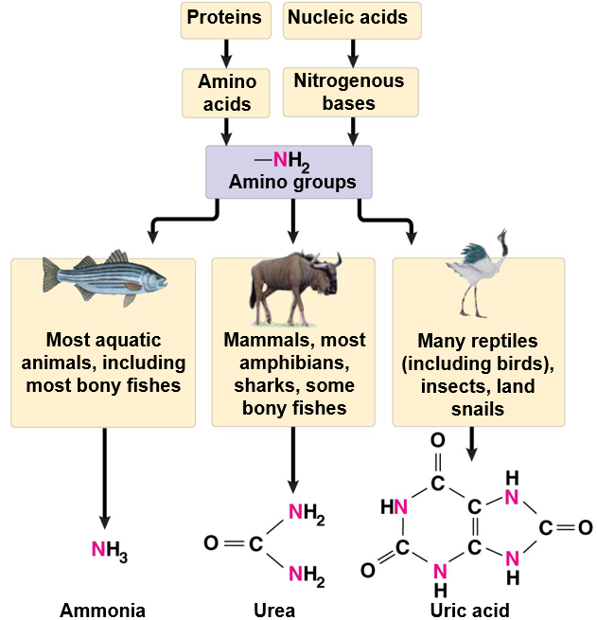
Excretory System
Disposal of ________-containing metabolites and other waste products (nitrogenous wastes)
Ammonia
Urea
Uric acid
Excretory System:
Filtration
Reabsorption
Secretion
Excretion

Slide 26
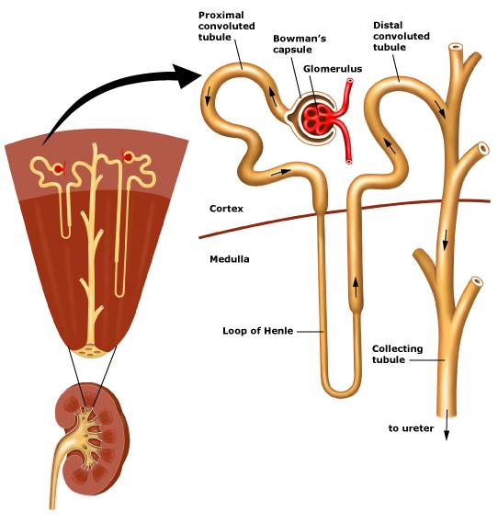
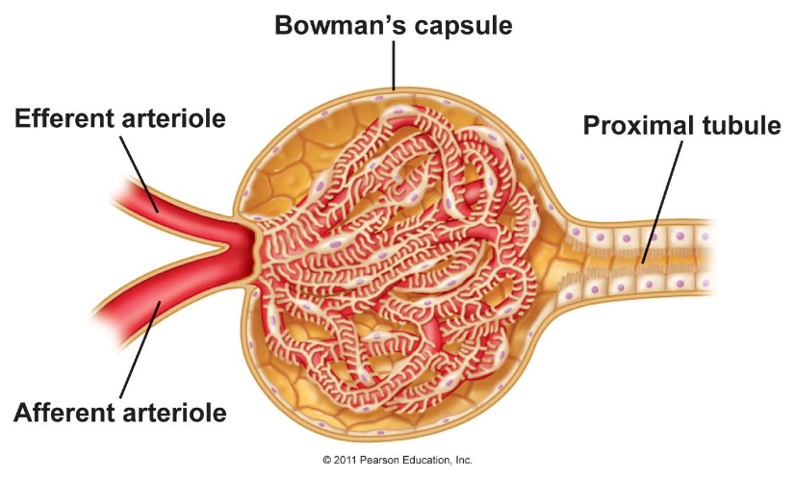
Evolution of the Excretory System
__________: multicellular unit of the kidney, comprised of a tubule and the surrounding vasculature
Glomerulus: cluster of blood vessels
Bowman’s capsule: membranous structure surrounding glomerulus at the start of the nephron in vertebrates

Slide 27
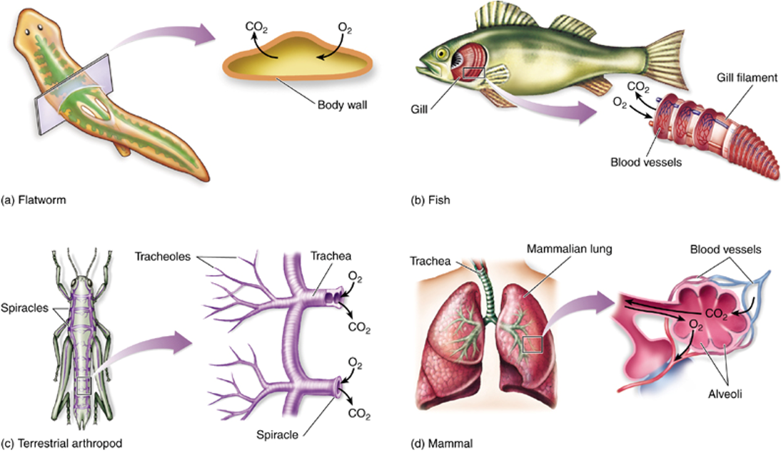
Respiratory System
Uptake O₂ from environment and discharge CO₂ into the environment
Diffusion through skin
Many invertebrates, amphibians
Gills (internal of external)
Some arthropods, fish
__________ system
Insects
Lungs
Amphibians, reptiles, birds and mammals

Slide 28
Circulatory System
Circulatory system: transport of gases, nutrients, and waste throughout the body
Circulatory fluid
Interconnecting vessels
Muscular pump (heart)
Gastrovascular cavity: central cavity with single opening that functions in both digestion and distribution of nutrients
Cnidarians, Platyhelminthes
Open circulatory system: hemolymph baths body cells directly
Arthropods and some molluscs
Closed circulatory system: blood confined within vessels
Annelids and chordates

Slide 29
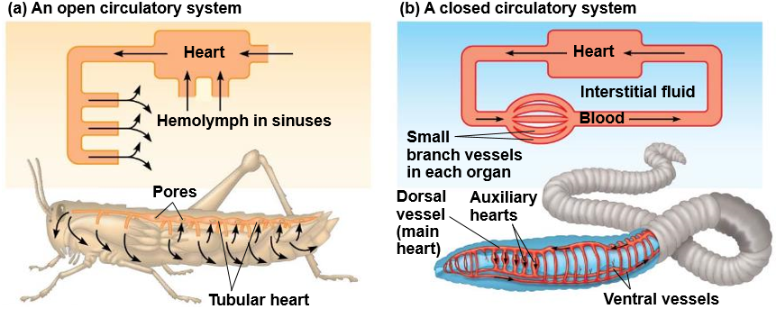
Circulatory System

Slide 30
Open and Closed Circulatory Systems
Open Circulatory System
Closed Circulatory System
Arthropods and mollusks
Less efficient
Lack of capillaries
_________ transports nutrients and wastes
Tissues and cells bathed in hemolymph
Slow, uncontrolled blood flow
Vertebrates and annelids
More efficient
Capillaries present
________ transports gases, nutrients and wastes
Fast, controlled blood flow

Slide 31
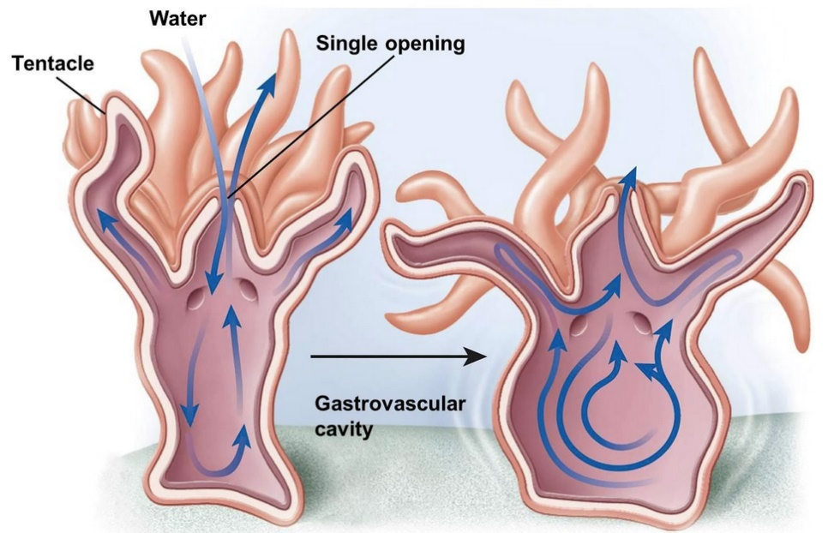
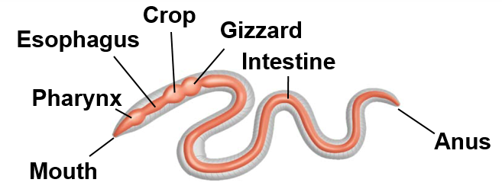
Digestive System
Animals have diverse nutritional requirements and feeding strategies
Digestive System
Ingestion
Digestion
Absorption
Elimination
Intercellular digestion: digestion inside cells
________________ cavity: central cavity with single opening that functions in both digestion and distribution of nutrients
Alimentary canal: digestive tract with ____________ (mouth and anus)
Alimentary canal

Slide 32
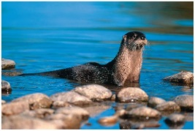
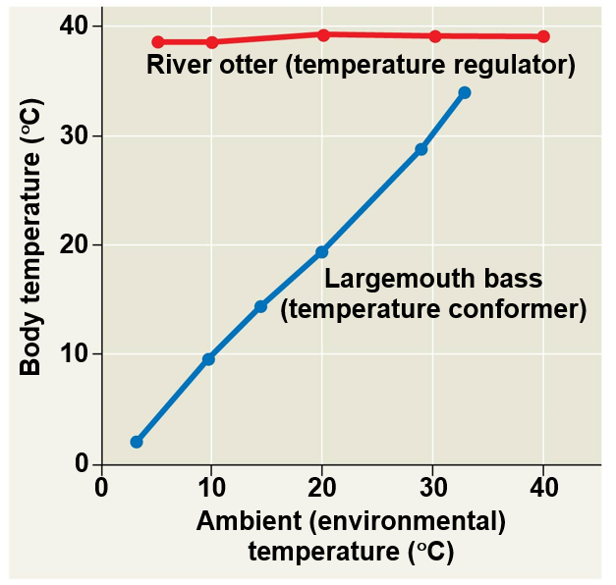
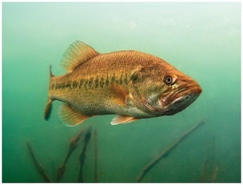
Homeostasis
Homeostasis: a physiological state where internal conditions are _______________
Regulators: use internal mechanisms to _________ external fluctuations
Conformers: allow internal conditions to ______________ to external fluctuations

Slide 33
Thermoregulation
Thermoregulation: Process by which animals maintain their body temperature within a normal range
Endothermic: body temperature maintained by ________________
Birds, mammals, and some insects
Ectothermic: body temperature controlled by _____________
Most reptile, fish, and invertebrates
Poikilotherm: animals whose body temperature fluctuates with the environment.
Homeotherm: animals with a relatively constant body temperature
Notes:
Endothermy and ectothermy are not mutually exclusive (Ex. Bird warming itself in the sun)
Endotherms have much greater food requirements

Slide 34
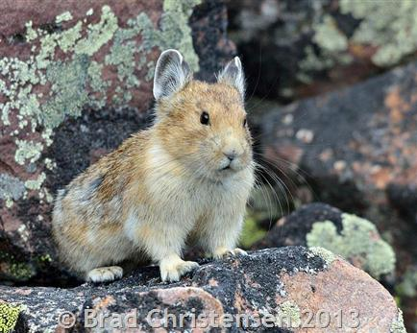
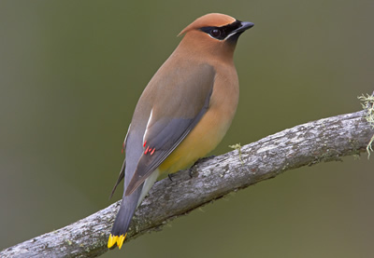
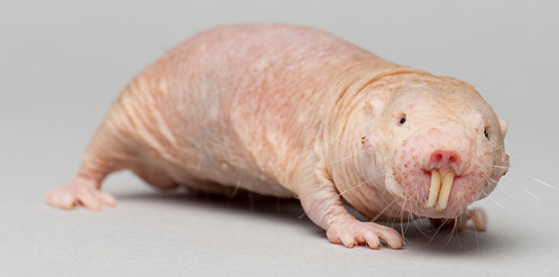
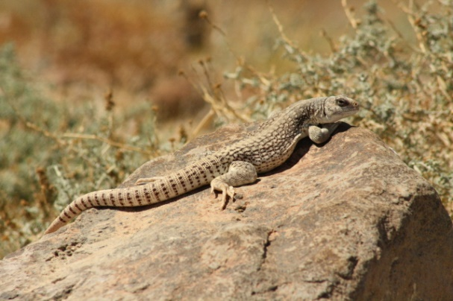
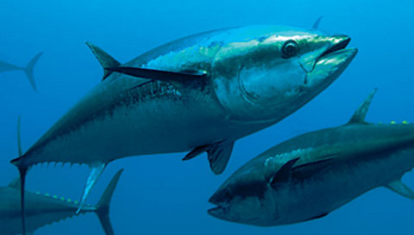
Variation in Thermoregulatory Strategies
Poikilotherms

Slide 35
Heat Exchange with Environment
Conduction - ____________ of heat
Convection - transfer of heat by the movement of ___________ across a surface
Radiation - emission of electromagnetic waves
Evaporation - loss of heat from changing a liquid into a gas

Slide 36
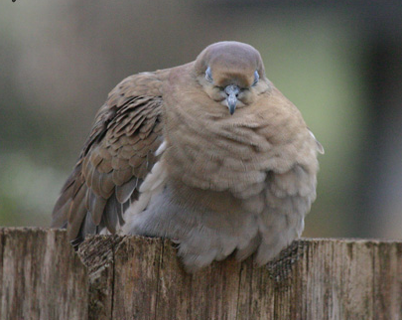
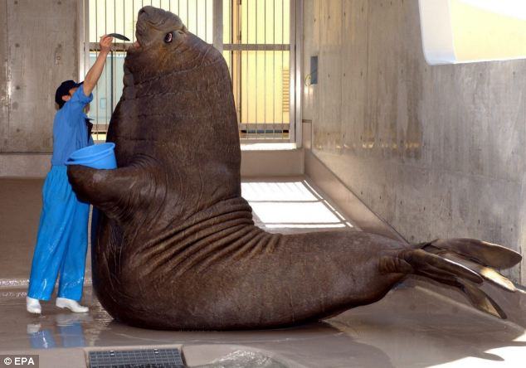
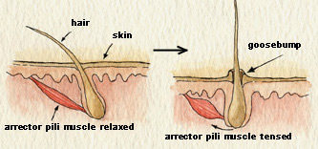
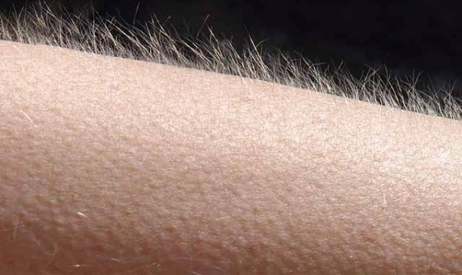
Adaptations for Thermoregulation
Insulation
Hair
Feathers
Fat (blubber)

Slide 37
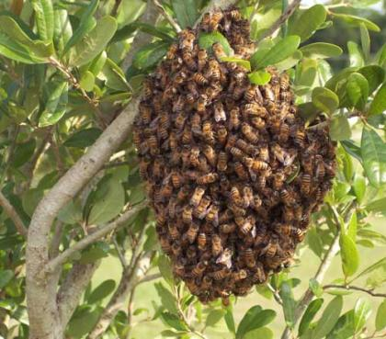
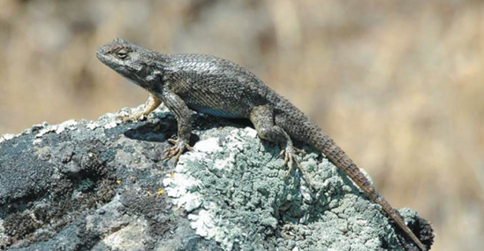
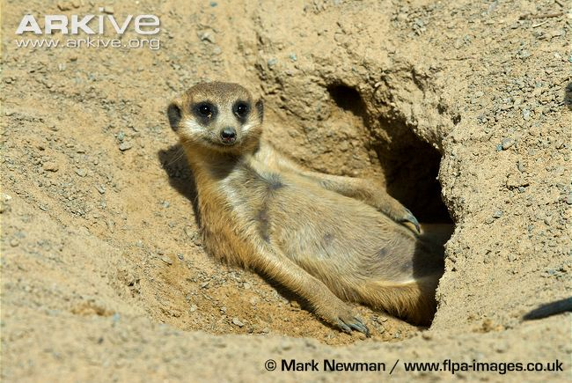
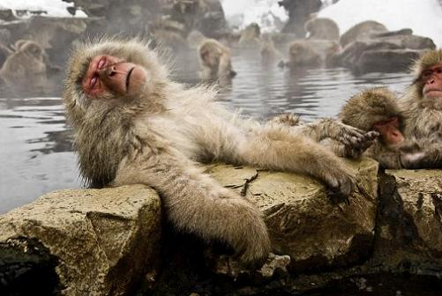
Adaptations for Thermoregulation
Behavior Responses
________
Huddling
Burrowing
Hot tubbin’

Slide 38
Adaptations for Thermoregulation
Evaporative heat loss
Sweating
Panting
Defecating

Slide 39
Energy Conservation
_________: physiological state of decreased activity and metabolism
Hibernation: long term torpor and a decreased body temperature in response to winter cold and food scarcity
_________: decreased metabolic rate and activity during hot summer months

Slide 40
Adaptations for Thermoregulation
Adjusting metabolic heat production
_______________
Moving or shivering
Nonshivering thermogenesis
Hormones increase metabolic activity
Brown fat
Notes:
Brown fat has a high mitochondrial density
Non-shivering thermogenesis: increase in metabolic activity of mitochondria to produce heat instead of ATP
Hawkmoth shivers to warm up before flight

Slide 41
Adaptations for Thermoregulation
Vasodilation: the widening of superficial blood vessels
Increases heat transfer
Vasoconstriction: ________ the diameter of superficial blood vessels

Slide 42
Adaptations for Thermoregulation
_________________ heat exchange
Warm blood in arteries from animals core comes in close contact with veins returning from extremities
Blood in arteries remains slightly warmer than blood in veins resulting in heat transfer
Returning blood almost as warm as arterial blood
Notes:
Counter-current heat exchange = transfer of heat between fluids flowing in opposite directions

Slide 43
Negative Feedback Loops
Notes:
Negative feedback: when a change in a variable triggers a response that counteracts the initial change

Slide 44
Trade-offs of Thermoregulatory Strategy
=
=

Slide 45
Trade-offs of Thermoregulatory Strategy

Slide 46
Animal Diets
All animals are heterotrophic:
Herbivores
Carnivores
Omnivores
Insectivores
Three nutritional needs:
______________ for cellular processes
Organic building blocks for macromolecules
Acquisition of ________________

Slide 47
Feeding Behavior
Filter feeders: obtain nutrients from particles _________ in the water
Baleen whales
Many aquatic invertebrates

Slide 48
Feeding Behavior
Substrate feeders: ________ _____ their food source and eat their way through it
Caterpillar
Earthworm

Slide 49
Feeding Behavior
Fluid Feeders: obtain nutrients by consuming another organisms _____
Mosquitos
Hummingbirds

Slide 50
Feeding Behavior
Bulk Feeders: ingest fairly large pieces of food
Most vertebrates

Slide 51
Nutritional Requirements
Essential nutrients: a substance that an animal ______________ from any other material and therefore must be obtained by the diet
Essential macronutrients
Amino acids
Fatty acids
Essential micronutrients
Vitamins
Minerals
Notes:
.

Slide 52
Nutritional Requirements
Lipids, carbohydrates and proteins provide energy!
1 Calorie (Cal) = 1kcal = 4.184 joules
Energy required to heat 1 kg of H₂O 1°C
Energy producing nutrients
__ Cal/g protein
__ Cal/g carbohydrate
__ Cal/g fat
4
4
9

Slide 53
Nutritional Requirements
Undernourished
Not enough calories
Overnourished
Too many calories
____________
Missing one or more essential nutrients

Slide 54
Essential Amino Acids
Make up proteins
20 in humans
Nine essential to humans
Essential Amino Acid | Non-essential Amino Acids
Histidine | Alanine
Isoleucine | Arginine
Leucine | Asparagine
Lysine | Aspartic Acid
Methionine | Cysteine
Phenylalanine | Glutamic Acid
Theronine | Glutamine
Tryptophan | Glycine
Valine | Proline
 | Serine
 | Tyrosine

Slide 55
Essential Fatty Acids
Low-density lipoproteins (LDLs): cholesterol that travels from liver to body and can clog arteries of the heart
“Bad cholesterol”
Saturated fats and trans fats
High-density Lipoproteins (HDLs): cholesterol that travels from body to liver, clearing cholesterol from the system
“Good cholesterol”
Omega-3 fatty acids
Two fatty acids are essential to humans
Alpha-linolenic acid (omega-3 fatty acid)
Linoleic acid (omega-6 fatty acid)

Slide 56
Essential Vitamins
Vitamins: Organic compounds that aid in chemical reactions within the body
13 Essential Vitamins
Fat soluble:
A, D, E, K
Water soluble: co-enzymes
B vitamins (thiamin, riboflavin, niacin, vitamin B6, folate (folic acid), vitamin B12, biotin and pantothenic acid), vitamin C

Slide 57
Essential Vitamins

Slide 58
Essential Minerals
Minerals: chemical _________ needed by the body to form bodily structure or facilitate chemical reactions
Major Minerals (more than 100mg/day for normal body function)
Mineral | Sources | Function
Calcium (Ca) | Dairy products, leafy green vegetables | Maintenance of bones, muscle contraction, nerve signaling
Chloride (Cl) | Table salt | Water balance, digestion
Phosphorus (P) | Dairy products, meat, whole grains | Component of bone, nucleic acids, ATP
Potassium (K) | Fruits and vegetables, dairy products | Nerve signaling, fluid balance
Sodium (Na) | Table salt | Nerve signaling, fluid balance

Slide 59
Essential Minerals

Slide 60
Check Your Understanding
True or False: In deuterostomes the blastopore becomes the anus
True or False: All animals have true tissue
Ture or False: Open circulatory systems are more efficient than closed circulatory systems
True or False: An essential nutrient is a substance that provides animals with a lot of energy

Slide 61
Check Your Understanding
Which of the following nitrogenous wastes are the most toxic?
a. Ammonia
b. Urea
c. Uric acid
d. pee-pee

Slide 62
Check Your Understanding
An animal whose body temperature is relatively constant and whose body temperature is controlled by the environment is known as a ______________.
a. Endothermic poikilotherm
b. Ectothermic homeotherm
c. Ectothermic poikilotherm
d. Endothermic homeotherm

Slide 63
Check Your Understanding
Animals with a coelom lined with mesoderm on the outside and endoderm on the inside are known as _______________.
a. acoelomates
b. pseudocoelomates
c. coelomates
d. chordates

