Slide 1
Soil and Plant Nutrition
Chapter 37

Slide 2
Respect the Soil
Soils anchor plant and provide water and dissolved minerals
______________________ that may have taken centuries to develop
One teaspoon of soil can contain ~5 billion bacteria
Soil texture depends on the ____ of the particles in the soil, which are the result of erosion of rock
Water, and acids in soil and roots facilitate break down
Topsoil: mixture of mineral particles and ________ (organic material)
Loams = equal parts clay, silt and sand = most fertile soil
Notes:
Variation in soils result in different morphologies or growth forms of a single species of plant
Loams have high surface area for adhesion of minerals and water, but spaces that allow for gas exchange with roots

Slide 3
Soil Composition
Inorganic Compounds
Cations: _______ charged ions (K⁺, Ca²⁺, Mg²⁺)
Require cation exchange
Anions: negatively charged ions (NO₃⁻, H₂PO₄⁻, SO₄²⁻)
Do not bind to soil negatively charged soil particles
Leaching
Organic Compounds
Humus: organic material produced by the decomposition of leaf litter, dead organisms, feces, bacteria and fungi

Slide 4
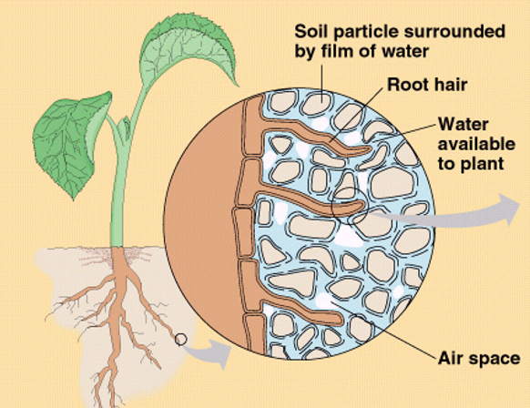
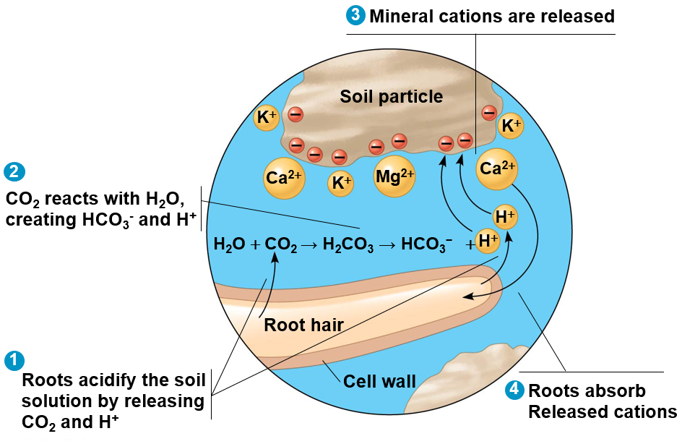
Cation Exchange in the Soil

Slide 5
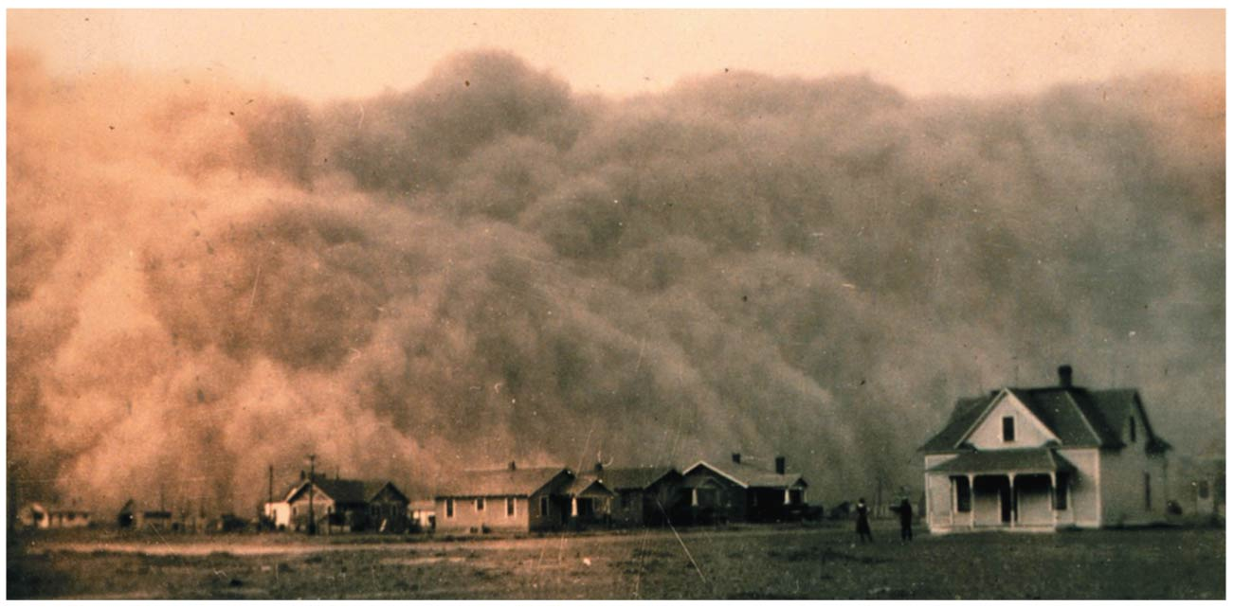
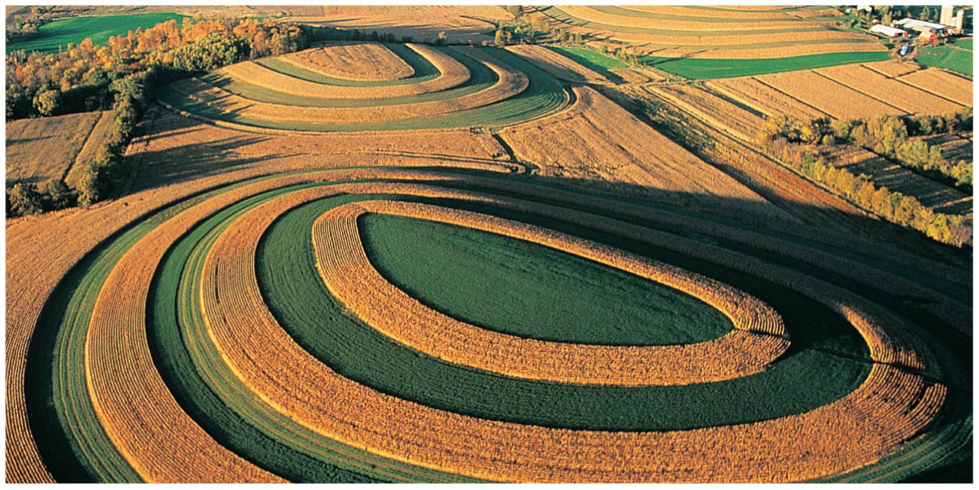
Soil Conservation
Irrigation
Land subsidence
Soil salinization
Drip irrigation
Fertilization
Off-set nutrient depletion
Nitrogen (N), Phosphorus (P), and Potassium (K)
Runoff
Erosion control
Wind breaks, terraces and contour planting

Slide 6
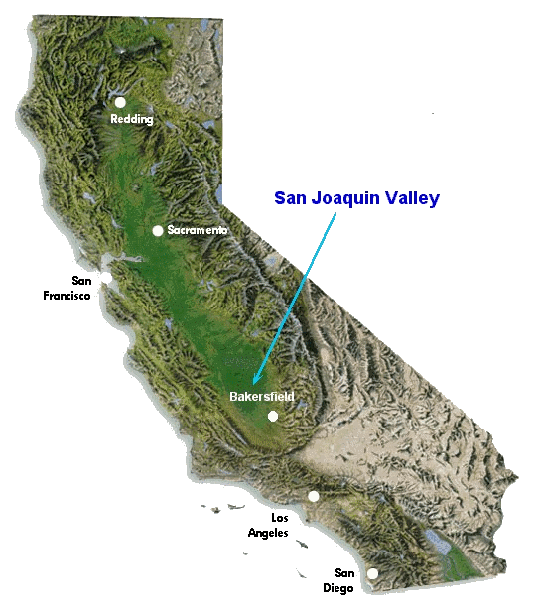
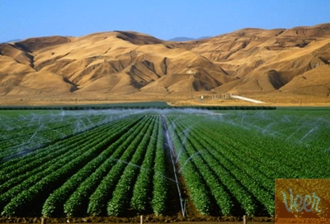
Curbing the California Drought

Slide 7
Essential Elements for Plants
Essential element: an element that is ______ for the plant to complete its _______
17 essential elements needed by all plants
Macronutrients: nutrients needed in large quantities
9 macronutrients in plants
Critical to plant structure
Micronutrients: nutrients needed in low quantities
8 micronutrients in plants
________
Notes:
Cofactors: non-protein helpers in enzymatic reactions

Slide 8
Macronutrients in Plants
Carbon - organic compounds
Oxygen - organic compounds
Hydrogen - organic compounds
Nitrogen - nucleic acids, proteins, chlorophyll
Sulfur - proteins
Phosphorus- nucleic acids, lipids
Potassium - Protein synthesis, water balance
Calcium - cell walls, membranes, permeability
Magnesium - chlorophyll, enzymes

Slide 9
Micronutrients in Plants
Chlorine - water balance, photosynthesis
Iron - cytochromes
Boron - chlorophyll synthesis
Manganese - amino acids, photosynthesis
Zinc - chlorophyll synthesis
Copper - enzymes for redox reactions
Molybdenum - nitrogen fixation
Nickel - cofactor in nitrogen metabolism

Slide 10
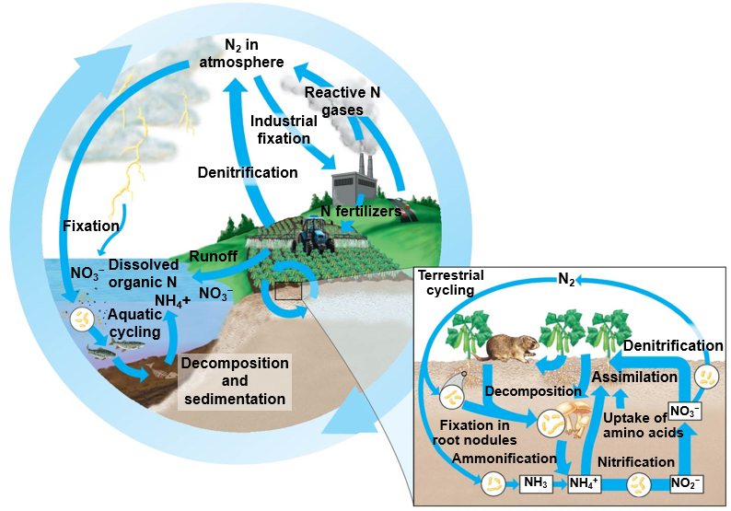
Nitrogen Fixation
Nitrogen is _________ essential nutrient in plants
_______ nitrogen (NH₄⁺ and NO₃⁻) is not naturally available
N₂ must be “fixed” by bacteria
Ammonification: converting organic nitrogen back to NH₄⁺
Nitrification: oxidation of ammonia (NH₃) then nitrate (NO₂⁻) to form nitrate ion (NO₃⁻)
Notes:
Atmosphere = 79% nitrogen
Triple bond of N2 makes it unusable
Nitrogen fixation: conversion of N2 to useable NH3 by nitrogen fixing bacteria

Slide 11
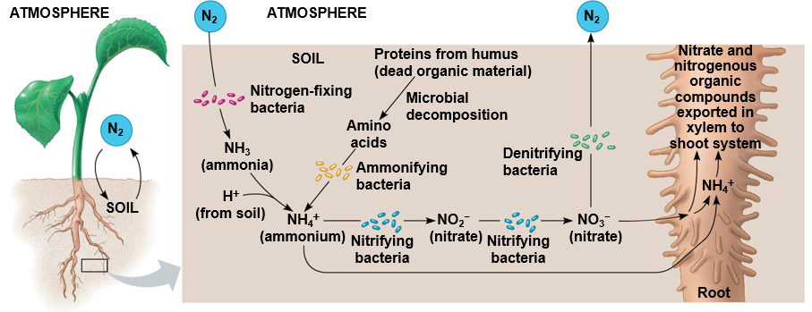
Roles of Soil Bacteria in Nitrogen Cycling
Notes:
Ammonification = converting organic nitrogen back to NH4+

Slide 12
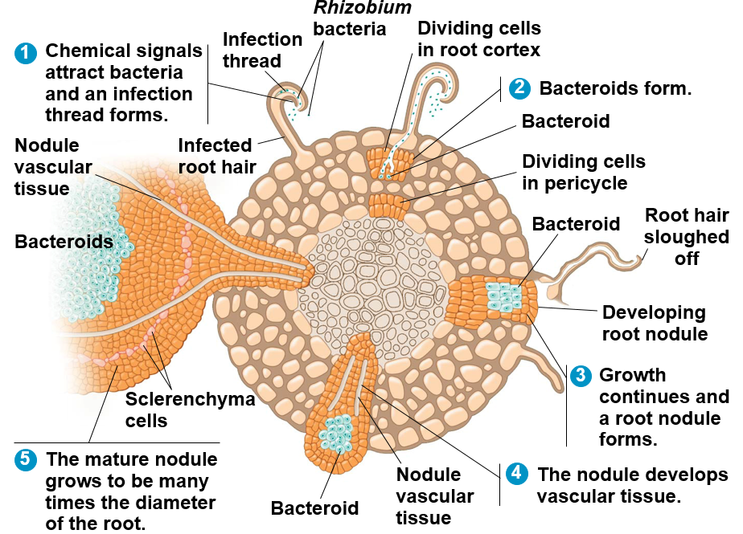
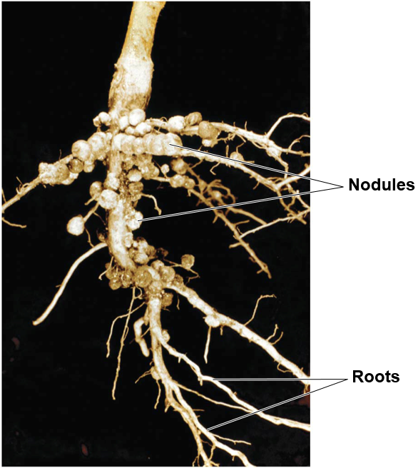
Mutualism between Rhizobium and Legumes
Roots develop nodules containing Rhizobium bacteria (bacteriods)
Notes:
Roots emit chemical that attract bacteria that stimulates root hair growth and formation of an infection thread
Bacteria penetrates the root cortex through infection thread and enter vesicles which become bacteriods
Growth continues and includes pericycle which forms a nodule
Growth continues to include vascular tissue which transfer nitrogenous compounds and nutrients between the plant and nodule
The mature nodule develops slerenchyma cells which aid in creating an anerobic environment for the bacteriod

Slide 13
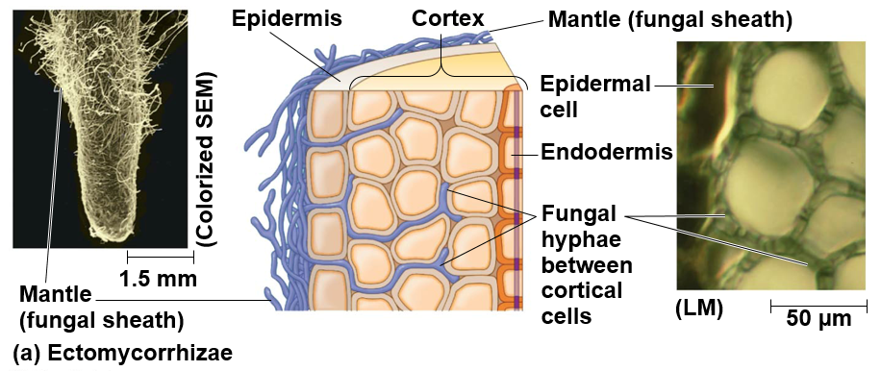
Mycorrhizae
________________: sheath of fungal mycelia (mass of hyphae) cover the surface of the root and also extend into the extracellular spaces of the root cortex.
Notes:
Mycorrhizae in root cortex increases surface area for nutrient exchange
About 10% of plant species form relationships with ectomycorrhizae (pines, oaks, birch and eucalyptus)

Slide 14
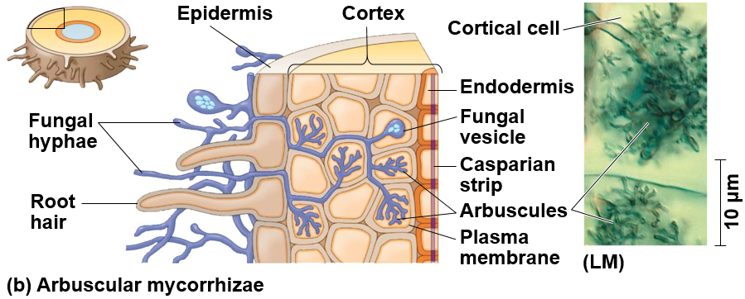
Mycorrhizae
Arbuscular mycorrhizae: small, branching structures called ______ (little trees) develop inside the cell walls of cortical cells where nutrient exchange occurs
Notes:
Arbuscular mycorrhizae are found in 85% of all plant species

Slide 15
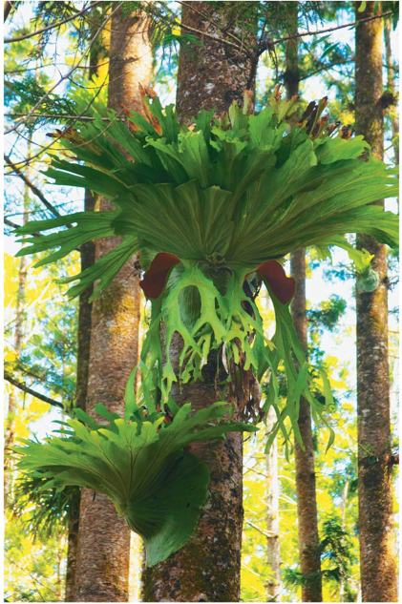
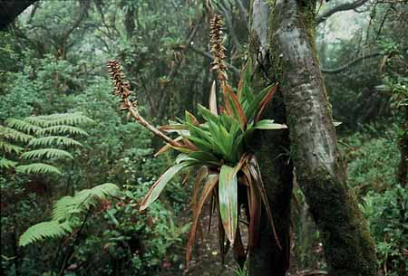
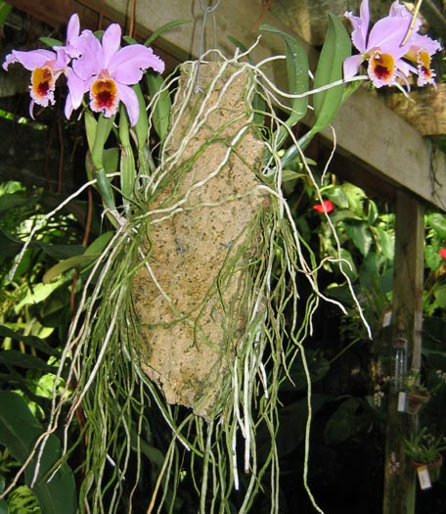
Unique Adaptations in Plants
_________: plants that grow on other plants
Not parasitic
Notes:
Epi = upon, phyton = plant Greek

Slide 16
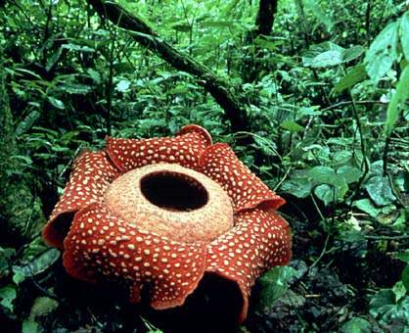
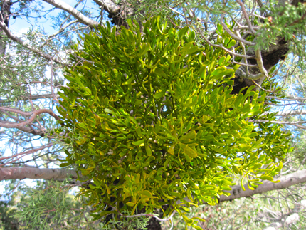
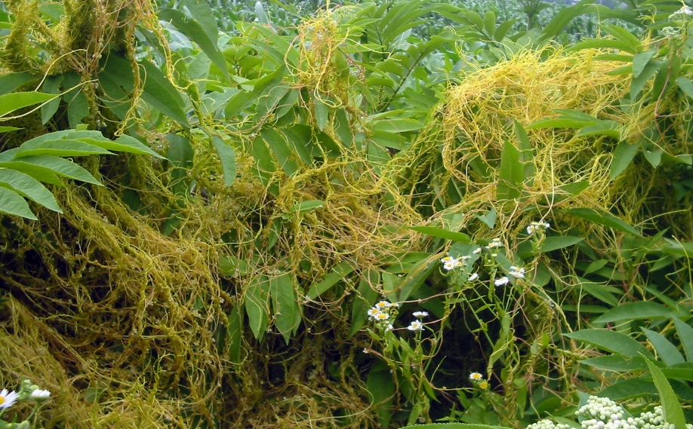
Unique Adaptations in Plants
Parasitic plants: plants that absorb water, nutrients and/or photosynthetic products from their plant hosts
Haustoria

Slide 17
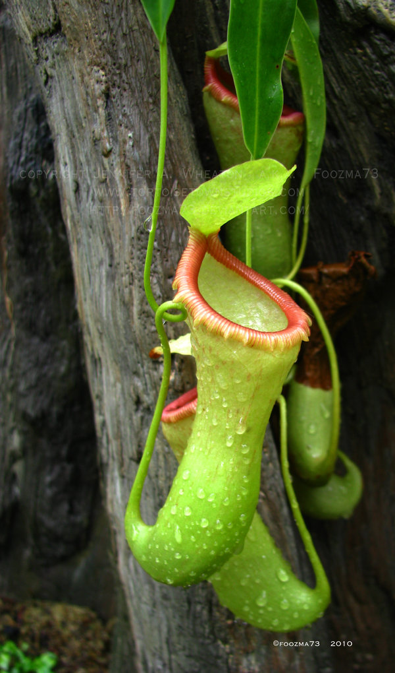
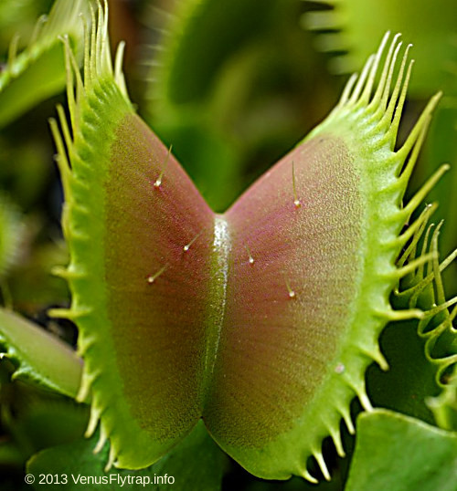
Unique Adaptations in Plants
Carnivorous plants: photosynthetic plants that supplement _______________ by consuming small insects or other animals
Nitrogen poor soils

