Slide 1
Protists
“I strongly encourage you to never use the word “bore” or “boring”. It says a lot about a person. It’s hard for me to imagine being “bored”, ever. The world is so exciting and fascinating, yes?”
-Bill Nye
Chapter 28

Slide 2
“Protista” Characteristics
Eukaryotic organisms that are not plants, animals, or fungi
Most are unicellular
Without true tissue
First eukaryotes arose ~1.5 bya
Protists: similar appearing but diverse phyla that are not related through an exclusive common ancestor, which have different life cycles, trophic levels, modes of locomotion and cellular structures.
*Cluster______ that is under constant debate and revision
ed mess
Notes:
“Protista” Kingdom is now broken up into multiple lineages recognized as their own kingdoms
Protists are hard to classify because they are so diverse
Always exceptions to generalizations
Many single celled protists are also the most complex cells

Slide 3
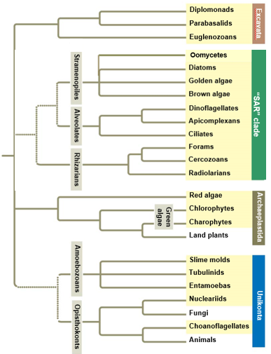
Four Supergroups:
Excavata
SAR (Stramenopiles, Alveolata, Rhizaria)
Archaeplastida
Includes land plants
Unikonta
Includes animals and fungi
*Need to know entire phylogeny for test and practicum
Notes:
The protist phylogeny is every changing with new research in DNA and morphological data
First protest group to diverge from common ancestor remains uncertain
Protist phylogeny provided is most well supported
*Clades used instead of taxonomy because the current taxonomy is too complicated
Paraphyletic

Slide 4
Eukaryotic Cells
Animal cell Plant cell
Notes:
Eukaryotes have a well developed cytoskeleton which allows for eukaryotic cells to have irregular forms and change shape to feed, move, and grow.
Prokaryotic cells lack a cytoskeleton

Slide 5
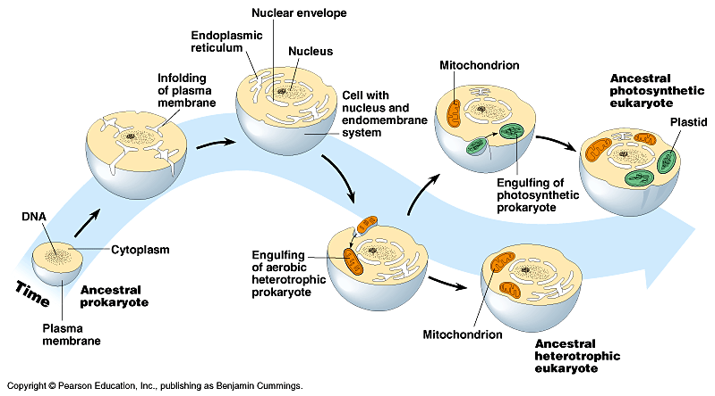
Evolution of Eukaryotes
Autogenesis: infoldings of prokaryote plasma membranes lead to compartmentalization
Endoplasmic reticulum
Golgi
Nuclear membrane
Notes:
Auto= self, genesis=beginning, orgin

Slide 6
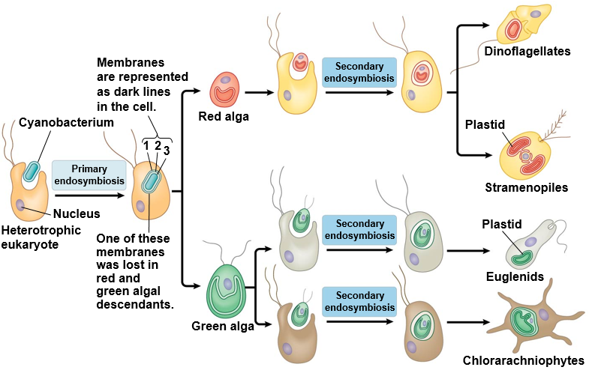
Evolution of Eukaryotes
Endosymbiosis: one organism lives inside the cell or cells of the other organism
Mitochondria
Chloroplast
Plastid: double membrane organelle in plants and algae
Ex: Chloroplast
Notes:
Eukaryotic mitochondria is the result of the endosymbiosis of a bacterium by a eukaryotic cell
Secondary endosymbiosis = engulfed again
Evidence for endosymbiotic origin of mitochondria and plastids
Formed through binary fission like process
Transport proteins (porins)
Circular chromosome
Smaller ribosomes (70S)

Slide 7
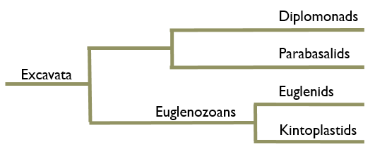
Supergroup: Excavata
Characteristics of Excavata:
“Excavated” groove on side of cell body (some)
Free living, symbiotic and parasitic forms
Reduced or modified mitochondria
Multiple flagella
Similar cytoskeleton elements (Simpson 2003)
Simpson, A.G.B. 2003. Cytoskeletal organization, phylogenetic affinities and systematics in the contentious taxon Excavata (Eukaryota). International Journal of Systematic and Evolutionary Microbiology. 53, 1759-1777

Slide 8
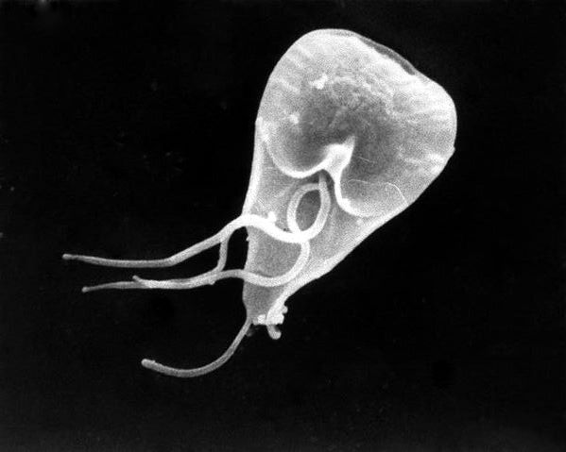
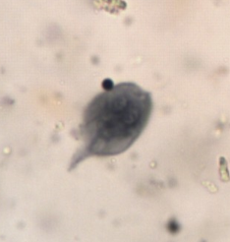
Supergroup: Excavata Clade: Diplomonads
Example: Giardia lamblia
Two equal sized, haploid nuclei
Four flagella
Reduced mitochondria
Mitosomes
Internal parasite to vertebrates
Giardiasis infection from drinking contaminated water
Lab photo
Notes:
Mitosomes: mitochondrial relics
Gain energy through anaerobic biochemical pathways

Slide 9
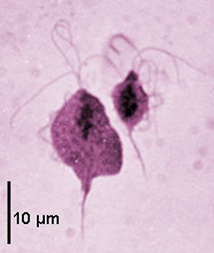
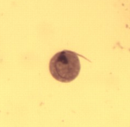
Supergroup: Excavata Clade: Parabasalids
Example: Trichomonas vaginalis
Multiple flagella
Undulating membrane
Reduced mitochondria
Hydrogenosomes
Sexually transmitted disease
Vaginitis infection from skin to skin contact with infected person
Lab photo
Notes:
Mitochondria produce energy anaerobically while releasing hydrogen gas as a byproduct
Vaginitis is a sexually transmitted parasite that effects 5 million people annually

Slide 10
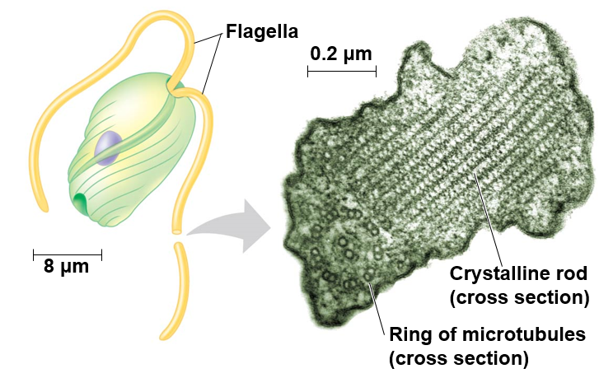
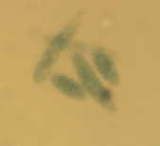
Supergroup: Excavata Clade₁: Euglenazoans; Clade₂: Euglenids
Example: Euglena sp.
Crystalline or spiral rod inside of flagella (all Euglenazoans)
Mixotrophs: photosynthesize when light is present, heterotrophic when its not
Flagella emerge from anterior pocket
Lab photo

Slide 11
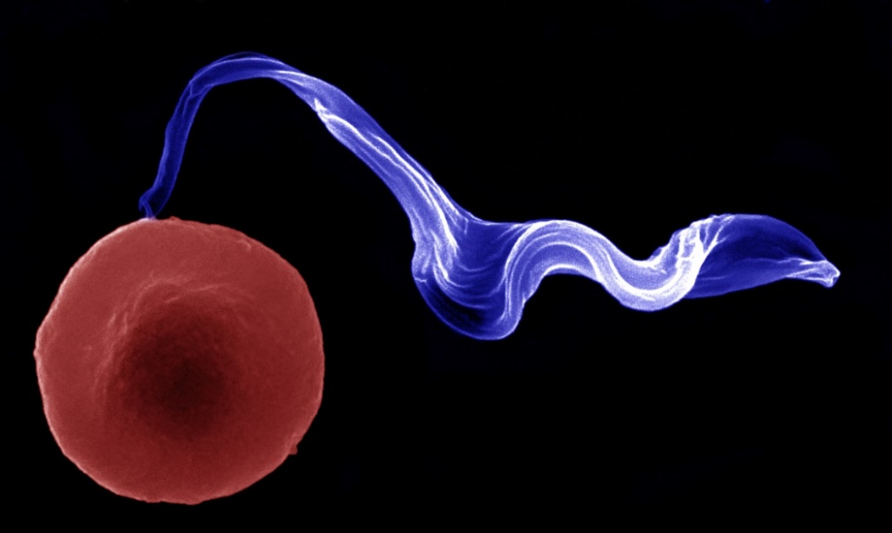
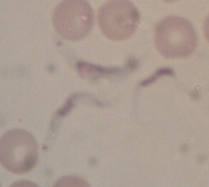
Supergroup: Excavata Clade₁: Euglenazoans; Clade₂: Kinetoplastids
Example: Trypanosoma sp.
Crystalline or spiral rod inside of flagella (all Euglenazoans)
Kinetoplast: Single, large mitochondrion
African sleeping sickness from tsetse fly
Chagas’ disease from mosquitos
Lab photo
Notes:
Trypanosomes has ability to switch membrane proteins to avoid detection by immune system cells

Slide 12
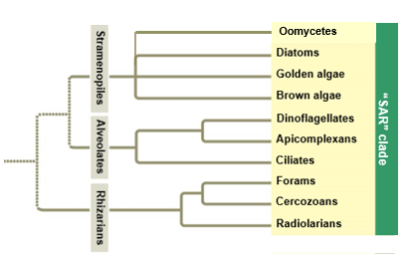
Supergroup: SAR
SAR
Starmenopila
Alveolata
Rhizaria
Characteristics of SAR:
Secondary endosymbiosis of red algae
Similar DNA sequences

Slide 13
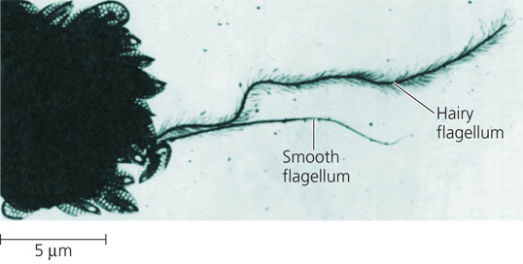
Supergroup: SAR Clade₁: Stramenopila
Characteristics of Stramenopila:
One hairy and one smooth flagella (most Stramenopiles)
Stramen = straw; pilos = hair
Includes:
Oomycetes (water molds)
Diatoms
Golden algae (Chyrsophyta)
Brown algae
Notes:
Includes some of the most important photosynthetic organisms on earth

Slide 14
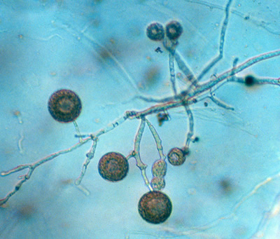
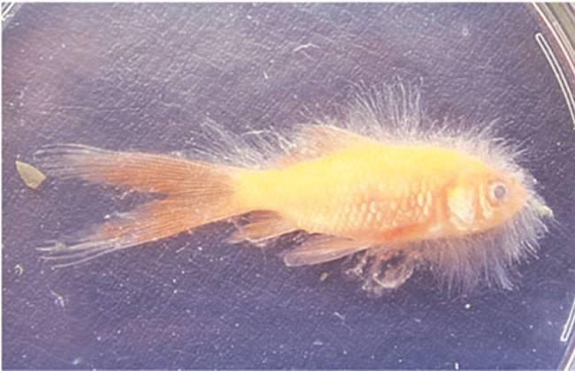
Supergroup: SAR Clade₁: Stramenopila; Clade₂: Oomycota
Example: Water molds
Cellulose cell wall
Coenocytic hyphae
Heterotrophic decomposers
Some parasitic
Caused Potato Famine and French Wine Crisis
Notes:
Coenocytic hyphae: lacks divisions between cells of branching, filamentous structures (hyphae)
Fungi have chitin cell wall
Can grow on eggs or scales of fish

Slide 15
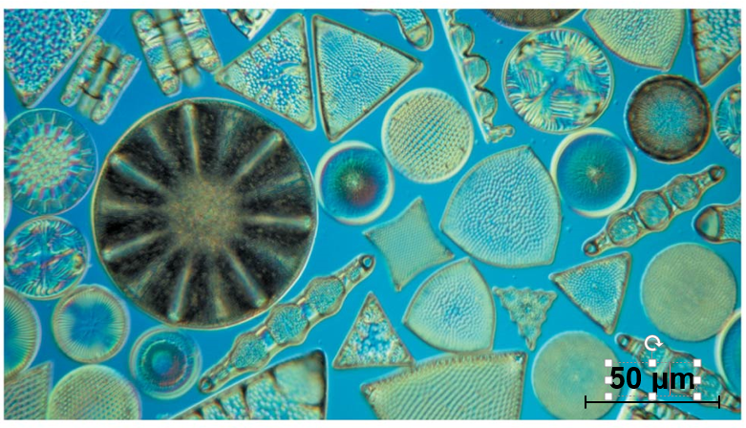
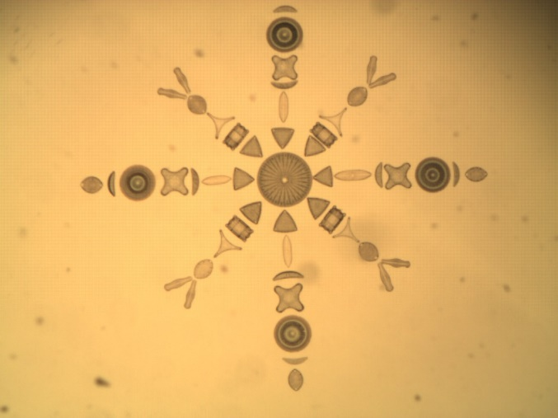
Supergroup: SAR Clade₁: Stramenopila; Clade₂: Diatoms
Example: Diatoms
Unicellular algae
Silica cell wall
Important photosynthetic organisms
Fossilized diatoms form diatomaceous earth
Lab photo
Notes:
Invasive quagga mussels eating lipid rich diatoms affecting the entire food chain in great lakes
Some of the most abundant photosynthetic organisms in the ocean and in lakes
Fertilizing ocean with Iron to stimulate diatom growth is a proposed solution to global waring.
Diatomaceous earth used as filter aid, abrasive in metal polish and toothpaste, absorbant

Slide 16
Diatoms in the Food Web

Slide 17
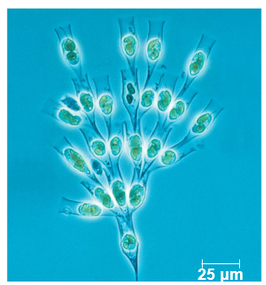
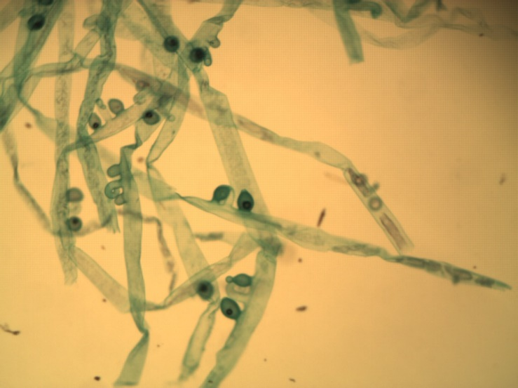
Supergroup: SAR Clade₁: Stramenopila; Clade₂: Chyrsophyta
Example: Golden Algae
Yellow and brown carotenoids
Xanthophyll
Bi-flagellated cells
Many planktonic
Some are mixotrophic
Most unicellular, some colonial
Lab photo

Slide 18
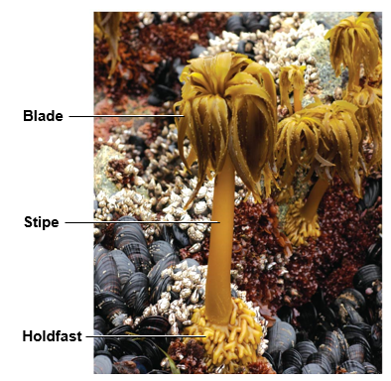
Supergroup: SAR Clade₁: Stramenopila; Clade₂: Brown Algae
Example: Brown algae
Multicellular
Most marine (temperate coasts)
Brown and yellow carotenoids
Fucoxanthin
Algin
Notes:
Largest and most complex algae
Seaweeds and kelps
Algin: gel-forming substance used to thicken foods (pudding and salad dressing)
One of the fastest growing organisms can grow 2ft/day and 48ft per season

Slide 19
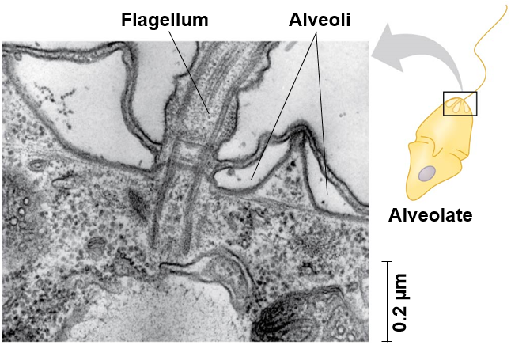
Supergroup: SAR Clade₁: Alveolata
Characteristics of Alveolata:
Membrane bound sacs (alveoli)
DNA similarities
Includes:
Dinoflagellates
Apicomplexans
Ciliates

Slide 20
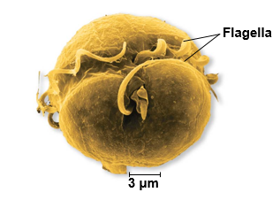
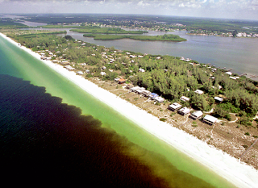
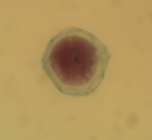
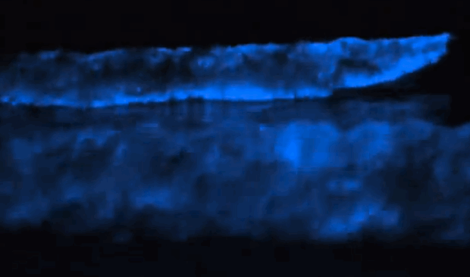
Supergroup: SAR Clade₁: Alveolata; Clade₂: Dinoflagellates
Example: Dinoflagellates
Reinforced cellular plates
Move via flagella
Flagella in grooves
Cause red tides
Lab photo
Notes:
Bioluminescent on contact

Slide 21
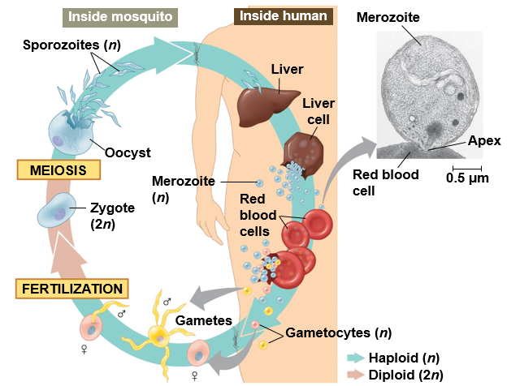
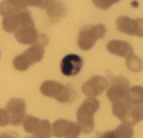
Supergroup: SAR Clade₁: Alveolata; Clade₂: Apicomplexans
Example: Plasmodium sp.
Animal parasities
Sporozoites: infectious cells
Apical structure
Cause malaria
Mosquito
Plasmodium
Lab photo
Mosquito
Notes:
Apical structure of sporozoite specialized for penetrating host cells and tissue
Complex life cycles with asexual and sexual stages and often requiring multiple host species

Slide 22
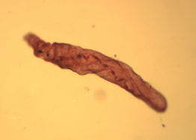
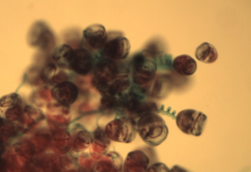
Supergroup: SAR Clade₁: Alveolata; Clade₂: Ciliates
Examples: Paramecium sp., Vorticella sp.
Most are predatory
Two types of nuclei
Micronuclei and Macronuclei
Conjugation: exchange of micronuclei without reproduction
Binary fission: asexual reproduction
Cilia
Spirostomum
Lab photo
Vorticella
Lab photo

Slide 23
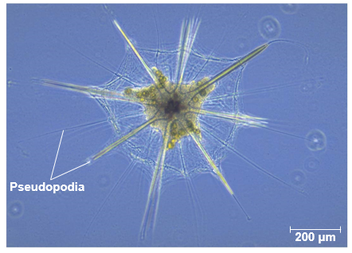
Supergroup: SAR Clade₁: Rhizaria
Characteristics of Rhizaria:
Amoebas
Thread-like pseudopodia
DNA similarities
Includes:
Foraminiferans
Cercozoans
Radiolarians

Slide 24
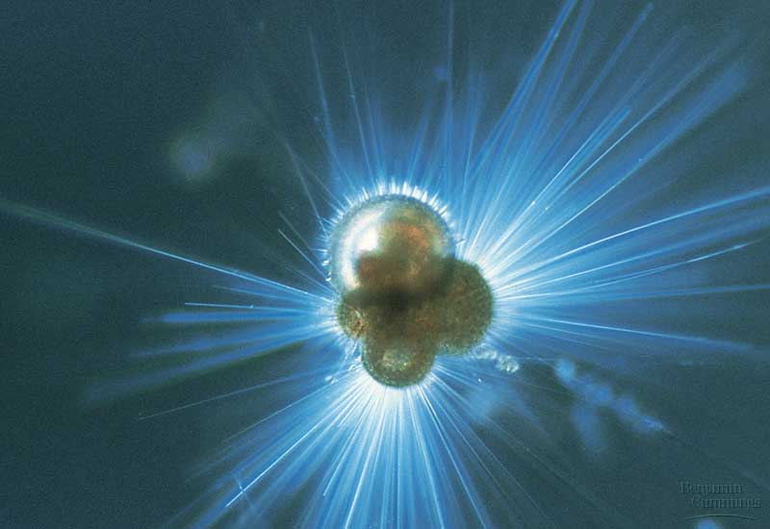
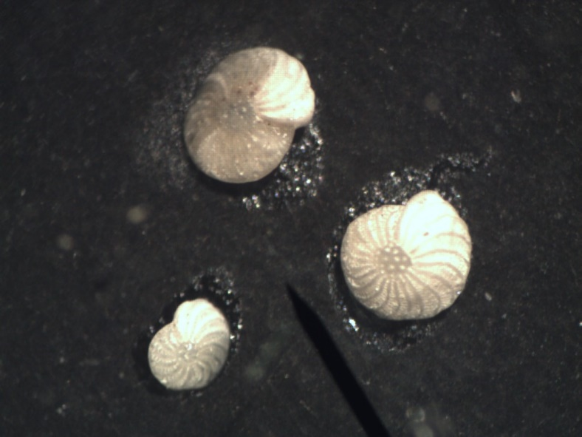
Supergroup: SAR Clade₁: Rhizaria; Clade₂: Foraminiferans
Examples: Foraminiferans
Porous, calcium carbonate tests
Foramen (little hole), ferre (to bear)
Marine and freshwater
Fossilized forams = sedimentary rock
Lab photo

Slide 25
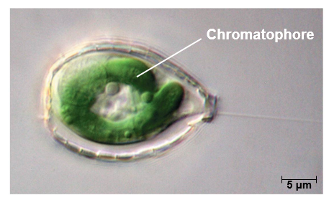
Supergroup: SAR Clade₁: Rhizaria; Clade₂: Cercozoans
Examples: Cercozoans
Thin pseudopodia
Chromatophore: photosynthetic structure
Marine, freshwater and soil
Lab photo
Notes:
Chromatophores are enclosed in a membrane with a peptidoglycan layer different from other plastids, suggesting that it was derived from the endosymbiosis of a different cyanobacteria.

Slide 26
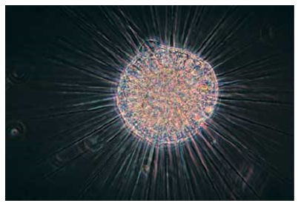
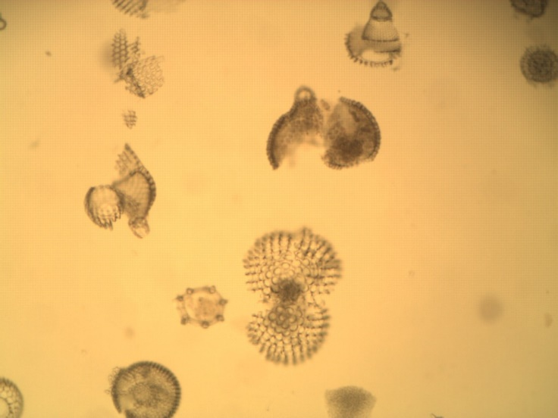
Supergroup: SAR Clade₁: Rhizaria; Clade₂: Radiolarians
Examples: Radiolarians
Silica tests
Pseudopodia reinforced with microtubules
Mostly marine
Radiolarian ooze
Lab photo
Lab photo

Slide 27
Supergroup: Archaeplastida
Characteristics of Archaeplastida:
Similar DNA sequences
Endosymbiosis of cyanobacterium
Includes:
Red algae
Chlorophytes
Charophytes
Land plants

Slide 28
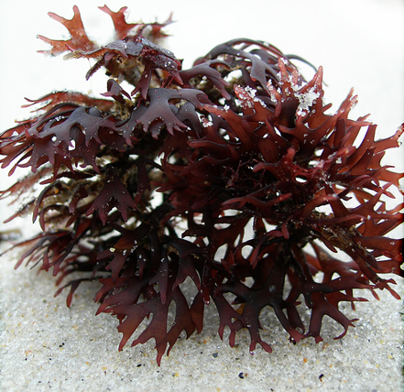
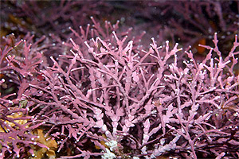
Supergroup: Archaeplastida Clade₁: Red algae
Examples: Chondrus, Coralline
Multicellular
Cellulose cell wall
Phycoerythrin: photosynthetic pigment
Mostly marine (warm tropical)
Agar
Lack flagellated gametes
Chondrus
Coralline
Lab photo
Notes:
Japanese nori used in making sushi

Slide 29
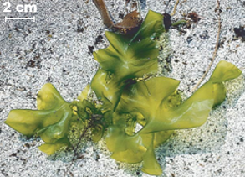
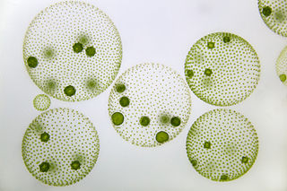
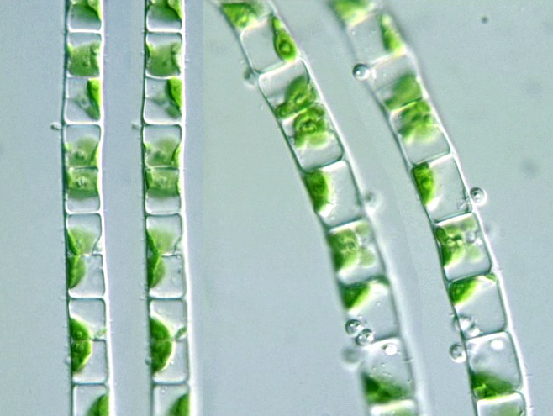
Supergroup: Archaeplastida Clade₁: Chlorophytes
Example: Ulva, Volvox, Ulothrix
Unicellular, Multicellular, and Colonial
Cellulose cell wall
Pigments
Chlorophyll A, B
Carotenoids
Mostly freshwater
Ulva
Volvox
Lab photo
Ulothrix

Slide 30
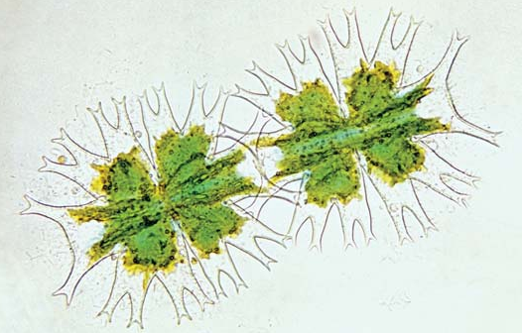
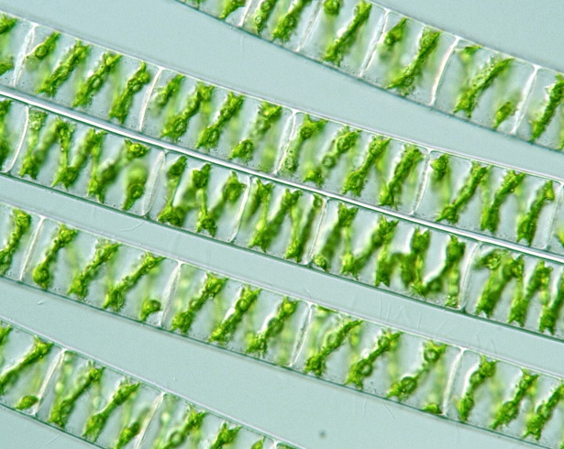
Supergroup: Archaeplastida Clade₁: Charophytes
Sister taxa of land plants
Rings of cellulose synthesizing proteins
Peroxisome enzymes
Structure of flagellated sperm
Formation of phragmoplast
Cellulose cell wall
Pigments
Chlorophyll A, B
Carotenoids
Mostly freshwater
Desmid
Spirogyra
Lab photo
Notes:
Distinctive circular proteins in the plasma membrane, which synthesize the cellulose microfibrils in the cell wall.
Phragmoplast: group of microtubules that forms between the daughter nuclei of the dividing cell. Cell plate develops inside of phragmoplast.
Proxisome enzymes:

Slide 31
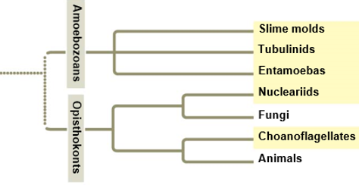
Supergroup: Unikonta
Characteristics of Unikonta:
Two major subgroups (Amoebazoans and Opisthokonts)
Within group relationships support with DNA sequencing
May have been first group to diverge from eukaryotes
Single flagella
Lobe or tube shaped pseudopodia
Fusion of three genes
Notes:
The unikonts have a triple-gene fusion that is lacking in the bikonts. The three genes that are fused together in the unikonts, but not bacteria or bikonts, encode enzymes for synthesis of the pyrimidinenucleotides: carbamoyl phosphate synthase, dihydroorotase, aspartate carbamoyltransferase. This must have involved a double fusion, a rare pair of events, supporting the shared ancestry of Opisthokonta and Amoebozoa

Slide 32
Supergroup: Unikonta Clade₁: Amoebazoans
Characteristics of Amoebazoans:
Lobe or tube-shaped pseudopod used for movement and feeding
Includes:
Slime molds
Plasmodial
Cellular
Gymnaoembas
Entamoebas

Slide 33
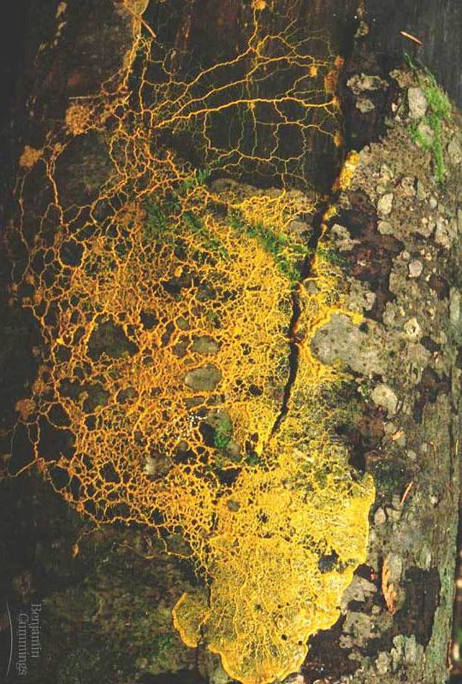
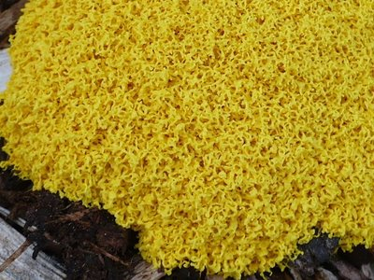
Supergroup: Unikonta Clade₁: Amoebazoans; Clade₂: Slime molds
Example: Plasmodial slime molds
Many are brightly colored
Plasmodium: Single mass of cytoplasm
Supercell
Single celled with multiple nuclei
Coenocytic hyphae

Slide 34
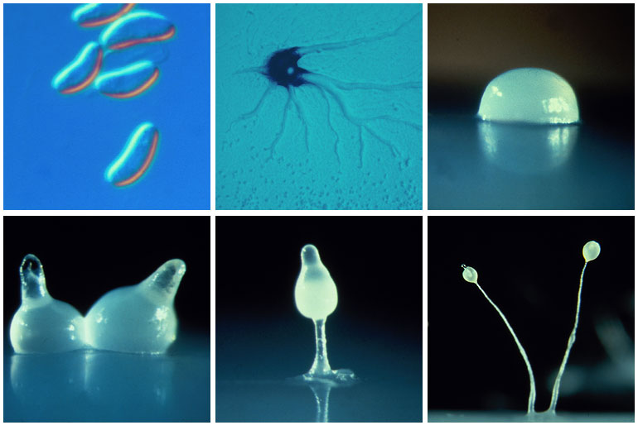
Supergroup: Unikonta Clade₁: Amoebazoans; Clade₂: Slime molds
Example: Cellular slime molds
Solitary feeding stage
Form asexual fruiting bodies when food stressed
________ hyphae

Slide 35
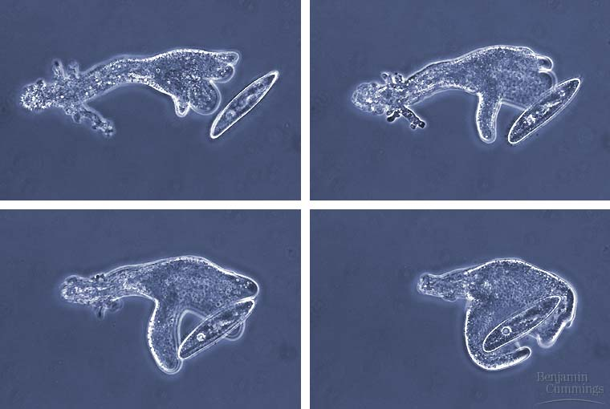
Supergroup: Unikonta Clade₁: Amoebazoans; Clade₂: Gymnamoebas
Example: Tubulinids (Gymnamoebas)
Lobe or tube-shaped pseudopodia
Cytoplasmic streaming
Lack of test
Unicellular
Mostly heterotrophic
Marine, freshwater, and soil

Slide 36
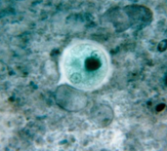
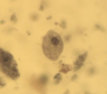
Supergroup: Unikonta Clade₁: Amoebazoans; Clade₂: Entamoebas
Example: Entamoeba histolytica
Parasitic
Amoebic dysentery
Contaminated drinking water or food
Lab photo
Notes:
Entamoebas are parasitic to all vertebrate classes
Dysentery: infection of the intestines resulting diharhea in bloody shit

Slide 37
Supergroup: Unikonta Clade₁: Opisthokonts
Characteristics of Opisthokonts:
Unicellular or multicellular
Posterior location of flagellum
Includes:
Nucleariids
Fungi
Choanoflagellates
Animals

Slide 38
Supergroup: Unikonta Clade₁: Opisthokonts; Clade₂: Nucleariids
Example: Nucleariids
Lack distinctive characteristics
Unicellular
Posterior flagella
Temporary pseudopods
Feed on algae and bacteria
Closely related to fungi

Slide 39
Supergroup: Unikonta Clade₁: Opisthokonts; Clade₂: Choanoflagellates
Example: Choanoflagellates
Unicellular or colonial
Suspension feeders
Closest relative to animals
Notes:
Funnel shaped collar with microvillia. Flagella used to create water currents to drive food into body.

Slide 42
Check Your Understanding
True or False: Organisms are classified as protists if they are multicellular organisms that are not plants, animals or fungi.
True or False: Chloroplast and mitochondria are theorized to have arisen through endosymbiosis

Slide 43
Check Your Understanding
Which of the following clades do not have a reduced or modified mitochondria?
a. Parabasalids
b. Kintoplastids
c. Cercozoans
d. Diplomonads
e. More than one of the above

Slide 44
Check Your Understanding
Which of the following are not one of the characteristics of organisms in the supergroup Unikonta?
a. Fusion of three genes
b. Secondary endosymbiosis of red algae
c. Single flagella
d. Excavated groove
e. More than one of the above

Slide 46
Diplomonads
Parabasalids
Euglenozoans
Oomycetes
Diatoms
Golden algae
Brown algae
Dinoflagellates
Apicomplexans
Ciliates
Forams
Cercozoans
Radiolarians
Red algae
Chlorophytes
Charophytes
Land plants
Slim mold
Gymnamoebas
Entamoebas
Nuclearids
Fungi
Choanoflagellates
Animals
Excavata
Stramenopiles
Alveolates
SAR
Rhizarians
Archiaeplastidia
Green
algae
Amoebazoans
Unikonta
Opisthokonts
Notes:
The protist phylogeny is every changing with new research in DNA and morphological data
First protest group to diverge from common ancestor remains uncertain
Protist phylogeny provided is most well supported

Slide 48
Oomycetes
“SAR” clade

