Slide 1
Population and Community Ecology
"The more I read, the more I acquire, the more certain I am that I know nothing." – Voltaire
“Suburbia is where the developer bulldozes out the trees, then names the streets after them.”
- Bill Vaughan
Chapters 34 and 35

Slide 2
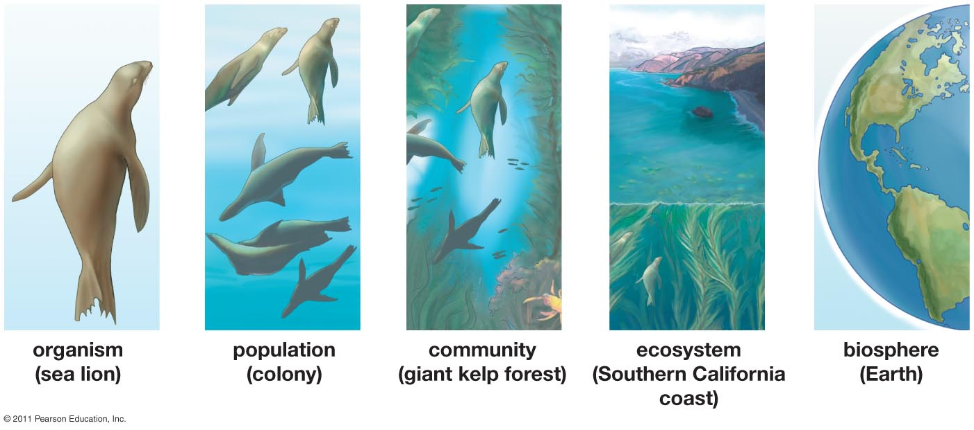
Studying Ecosystems
Ecology: Study of ___________ that living things have with each other and with their environment

Slide 3
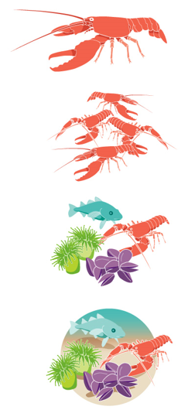
Different Levels of Study
Individuals: study of individual organisms within an environment
Population: all the members of a single species living in the same geographic area at the same time
___________: populations of all species that interact with one another in the same geographic area
Ecosystem: community of organisms and the _________ environment with which they interact
Biotic and abiotic factors

Slide 4
Factors that Influence Population Growth
Demography: the study of factors that determine the size and structure of populations through time
Four factors that determine the actual size of a population
Natality: birth rate
Mortality: death rate
Immigration: migrate into a population
Emigration: migrate out of an area
Fecundity: the number of _______________ produced by each female in the population
Actual reproductive rate of the population

Slide 5
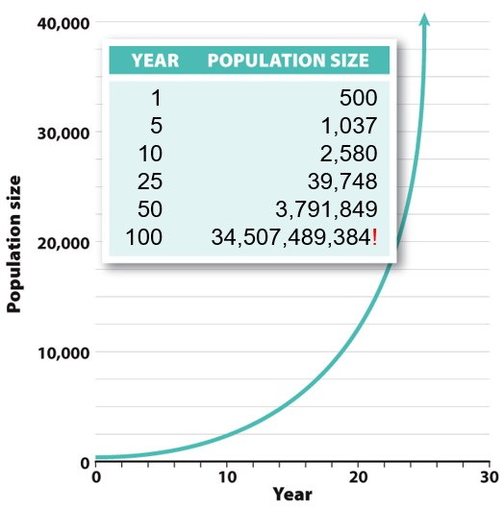
Population Growth
______________(r): the change in the number of individuals in the population over some unit of time (year)
Growth rate = natality – mortality
Population growth = r x N
where N equals the current number of individuals in the population
Notes:
Population growth only occurs when individuals produce more than one offspring (direct replacement)
Populations can not grow unchecked forever, so exponential growth never lest long in nature.
Example has growth rate of 0.2 births per individual per year

Slide 6
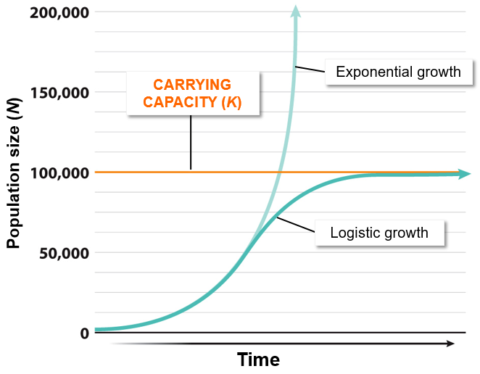
Types of Population Growth
Exponential growth: when the population’s size increases at a rate proportional to its current size
J-shaped curve
Logistic growth: the density-_________ decrease in growth rate as population size reaches the carrying capacity
S-shaped curve

Slide 7
Types of Population Growth
Carry capacity (K): the maximum population size of a certain species that a given habitat can support
Environmental resistance: forces of the environment that act to ______________________
Competition for resources, predation, disease

Slide 8
Human Population Growth

Slide 9
Types of Disease
Genetic = caused by a defective gene or abnormal chromosome number.
Non-contagious, but few if any treatments. Down-syndrome, cystic fibrosis
Deficiency = individuals are lacking certain necessary vitamins or minerals.
Non contagious but usually treatable. Scurvy, rickets
Degenerative = manifest with aging process.
Non contagious with minimal treatment. Alzheimers, osteoarthritis
Communicable = caused by the transfer of a pathogen.
Contagious, treatment varies. Influenza, chicken pox, STD’s

Slide 10
Communicable Diseases
_____________ = the infectious agent, what you catch. Viruses, bacteria
Transmission = the transfer of a pathogen from one individual to another
Viral – few treatment options, impossible to cure. Include: HIV, herpes, hepatitis B, ebola
Bacterial – most treatable with anti-biotics, some have developed genetic resistance. Includes: chlamidia, gonorrhea, syphilis
Other – yeasts, mites (scabies), insects (pubic lice). Treatments very

Slide 11
Different Life History Strategies
Density dependent: when the density of the population becomes limited by factors that limit population growth
Food supply, space
K-selected species: one whose population sizes tend to be limited by _____________________
Density dependent
r-selected species: one whose population size is limited by _________________
Density independent

Slide 12
r-Selected and K-selected Species
r-selected
K-selected
__________ environment
Small organism size
Little energy used to produce each offspring
______ offspring produced
Early maturity
Short life expectancy
Single reproduction in lifetime
________ environment
Large organism size
Large amount of energy used to produce each offspring
_____ offspring produced
Late maturity (long parental care)
Long life expectancy
Multiple reproductions in lifetime

Slide 13
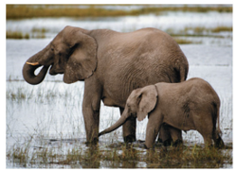
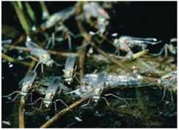
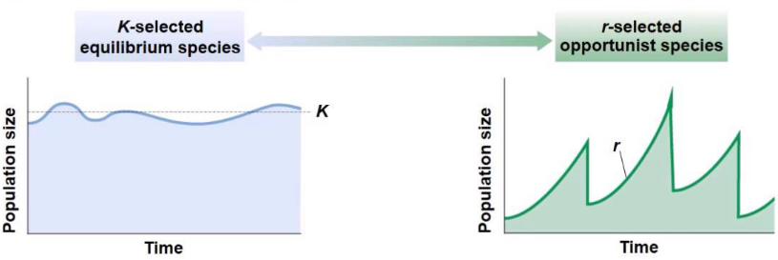
Population Dynamics
Population size:
limited by carrying capacity
density dependent
relatively stable
Population size:
limited by reproductive rate
density independent
relatively unstable

Slide 14
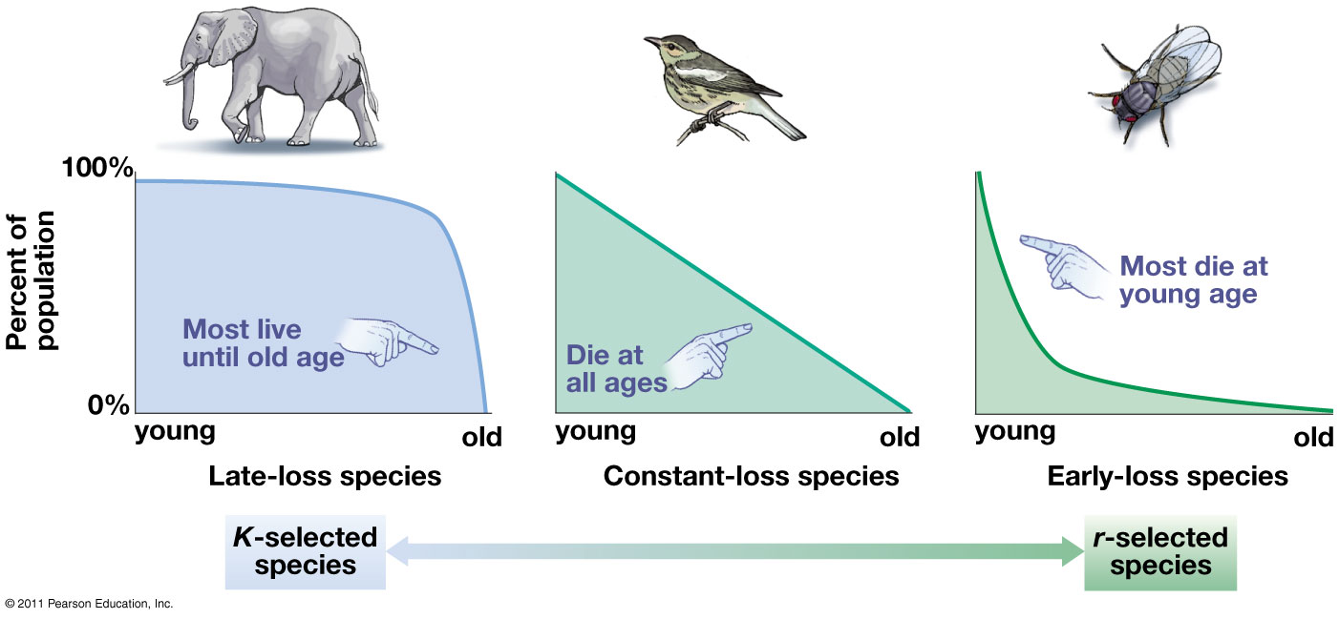
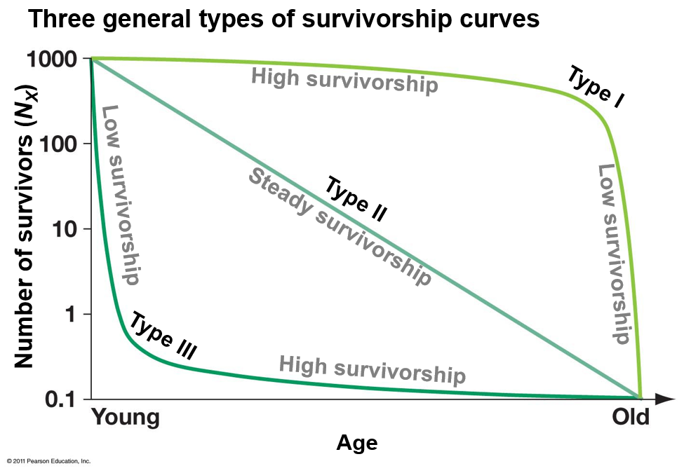
Survivorship Curves
Type I and Type II = K-selected species
Type III = r-selected species

Slide 15
Community Ecology
Interactions among different species | Affect on fitness for species 1 | Affect on fitness for species 2
Competition: occurs when individuals use the same resources | __________ | Negative
Predation and parasitism: occurs when one organism eats or absorbs nutrients from another | Positive | Negative
___________: occurs when two species interact in a way that confers fitness benefits to both | Positive | Positive
Commensalism: occurs when one species benefits but the other species is unaffected | Positive | Unaffected

Slide 16
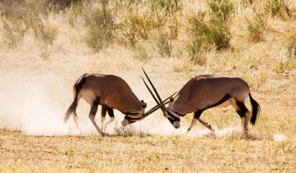
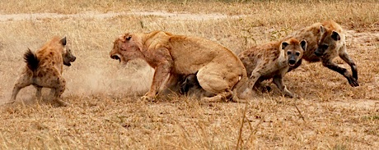
Community Ecology
Intraspecific competition: completion among members of the ___________
Resources, space, sunlight, food, mates
Increases as pop. density increases
Interspecific competition: competition among individuals of _____________ for the same limited resources

Slide 17
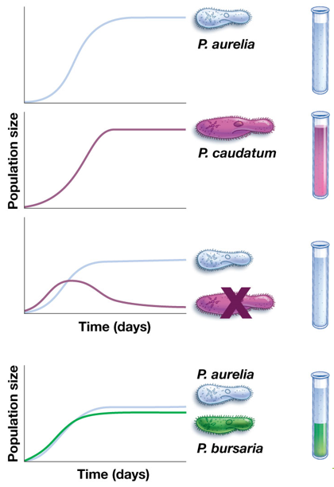
Interaction Through Competition
_________________: an organism’s place or role within a community
Space it requires, food it consumes, reproductive requirements
Competitive exclusion principle: two species cannot occupy the same ecological niche in the same area, because one species will always out compete the other
G.F. Gause – It is not possible for two species to occupy the same ecological niche in the same area

Slide 18
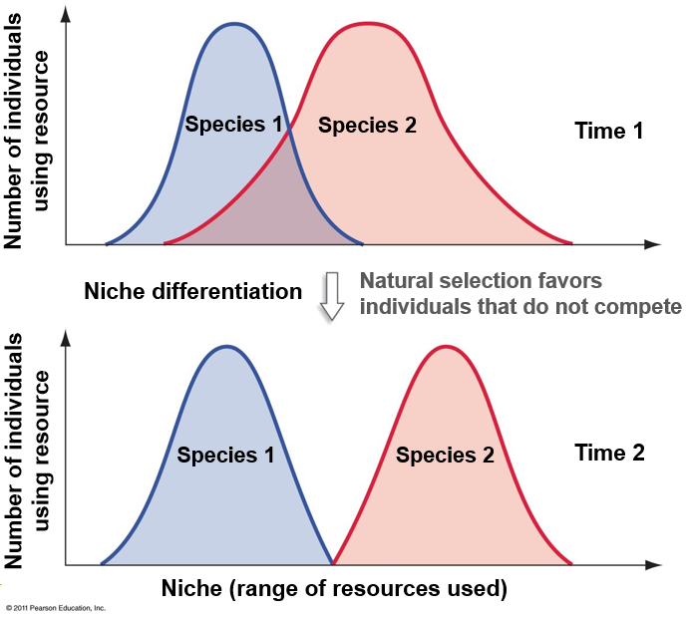
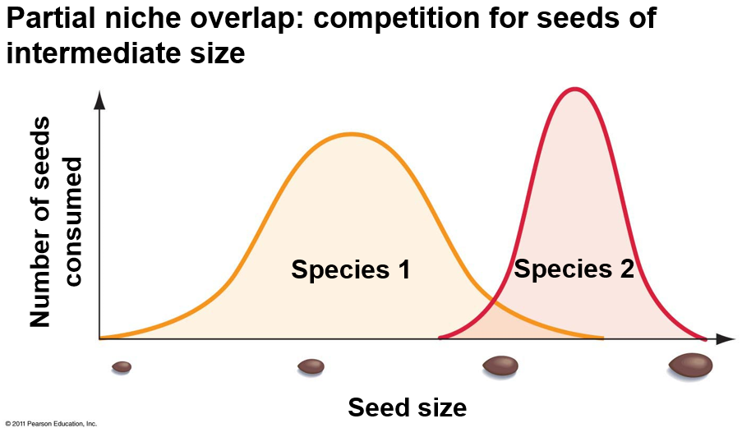
Resource Partitioning
Resource partitioning: dividing up of scarce resources among species with similar requirements
______________

Slide 19
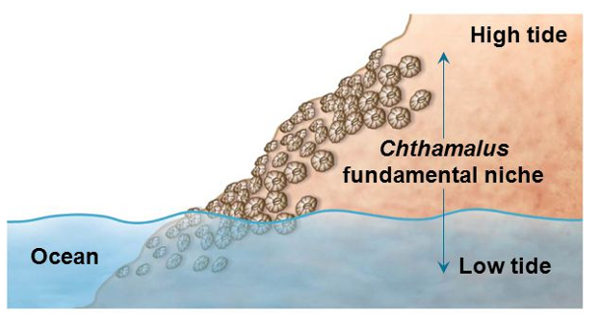
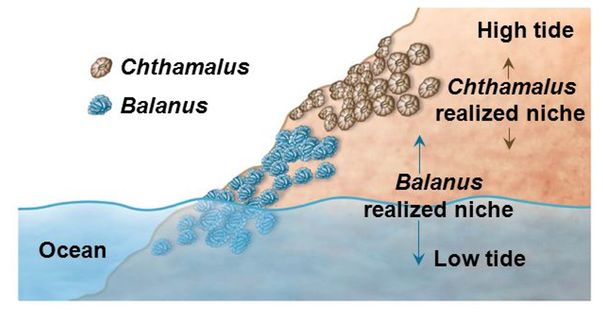
Fundamental vs. Realized Niche
Fundamental niche: the full range of environmental conditions and resources an organism can possible occupy and use in the absence of competitors
___________ niche: the part of the fundamental niche that an organism occupies as a result of competitors in the habitat

Slide 20
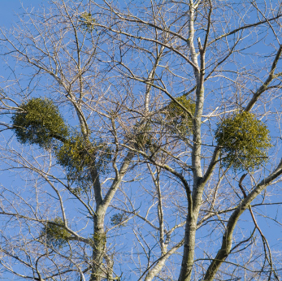
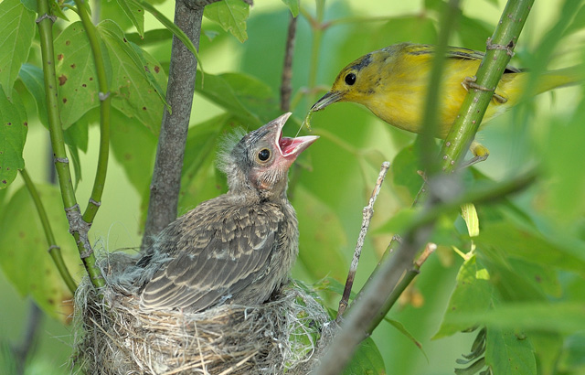
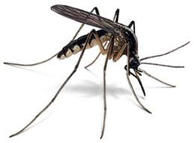
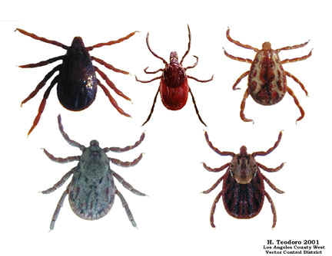
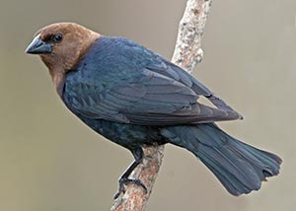
Parasitism
Parasitism: a non-mutual symbiotic relationship, where one species (the parasite) benefits at the expense of the other (the host)

Slide 21
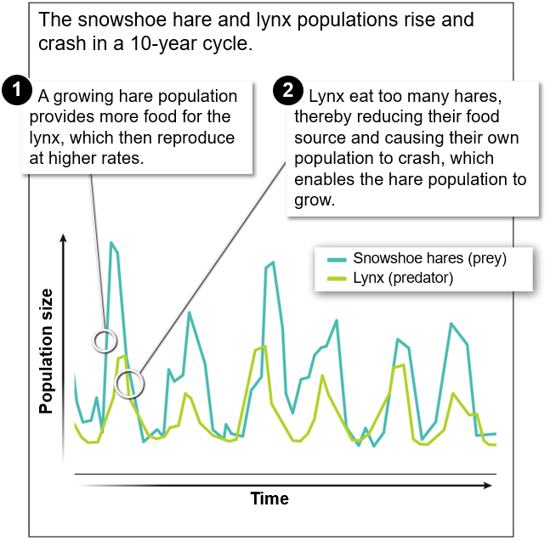
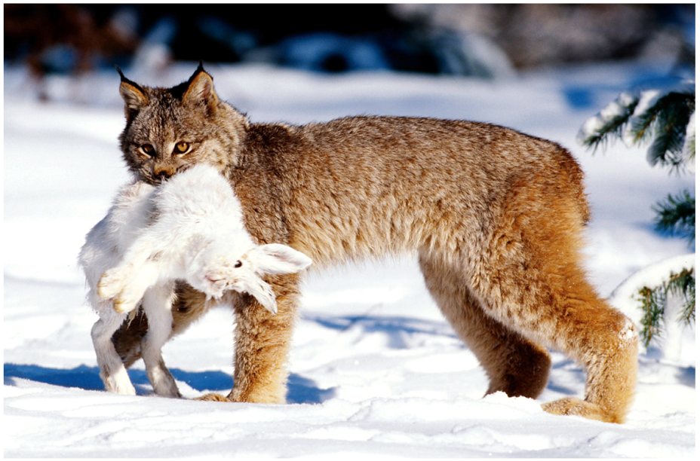
Predator and Prey Relationships
Predator and prey populations are often linked in a dynamic relationship of population increases and decreases

Slide 22
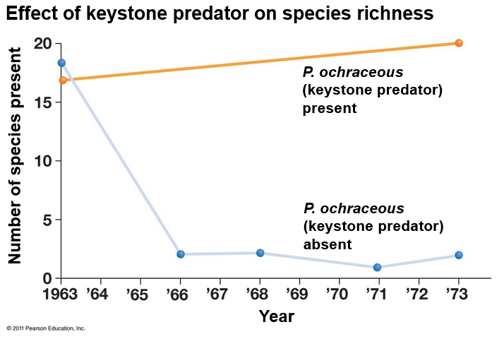
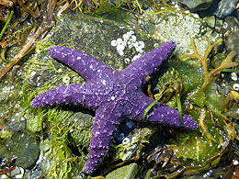
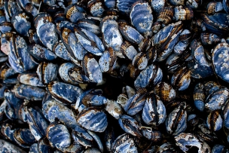
Predator and Prey Relationships
Predators act to control prey populations
_________________: a species whose absence in the community would bring about significant change in that community
Predator:
Pisaster ochraceous
Prey:
Mytilus californianus

Slide 23
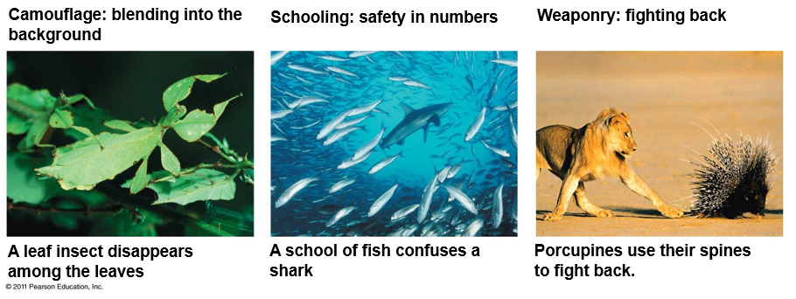
Predatory Defenses
Coevolutionary ____________: a repeating cycle of reciprocal adaptation

Slide 24
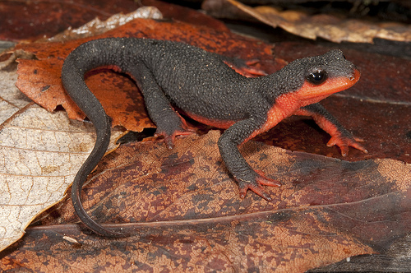
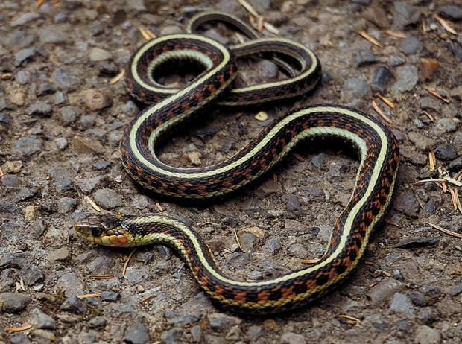
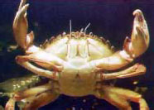
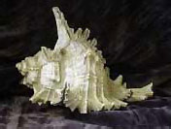
Evolutionary Arms Race
"Arms races . . . it is a colorful way of talking about coevolution, particularly when it is coevolution between enemies: between predator and prey, between parasite and host. Adaptations on one side call forth counter adaptations on the other side, and the counter adaptations call forth more and so on, escalating all the time.
The consequence is that the apparatus that we see gets better but the efficacy of it does not necessarily get better because the other side is getting better at the same time."
-Richard Dawkins

Slide 25
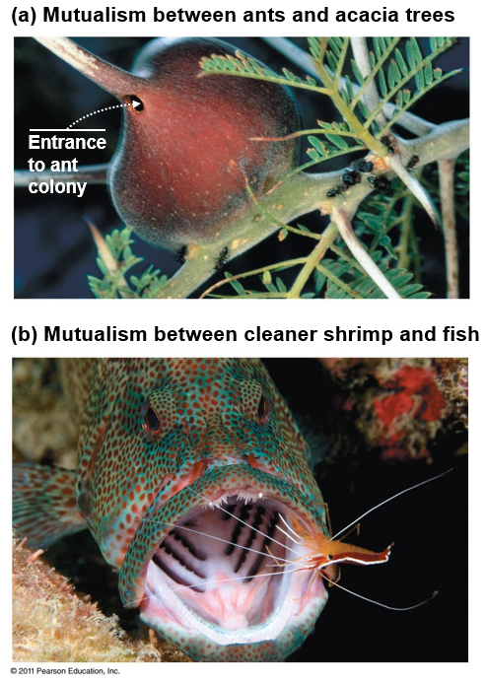
Mutualism
Mutualism: An interaction between individuals of two species that is _________ to both individuals
Examples of mutualistic relationships
Flowers and pollinators
Mycorrhizal fungi and plants root systems
Ants and acacia trees
Cleaner shrimp or fish and larger fish
E.coli and humans
Termites and trichonympha

Slide 26
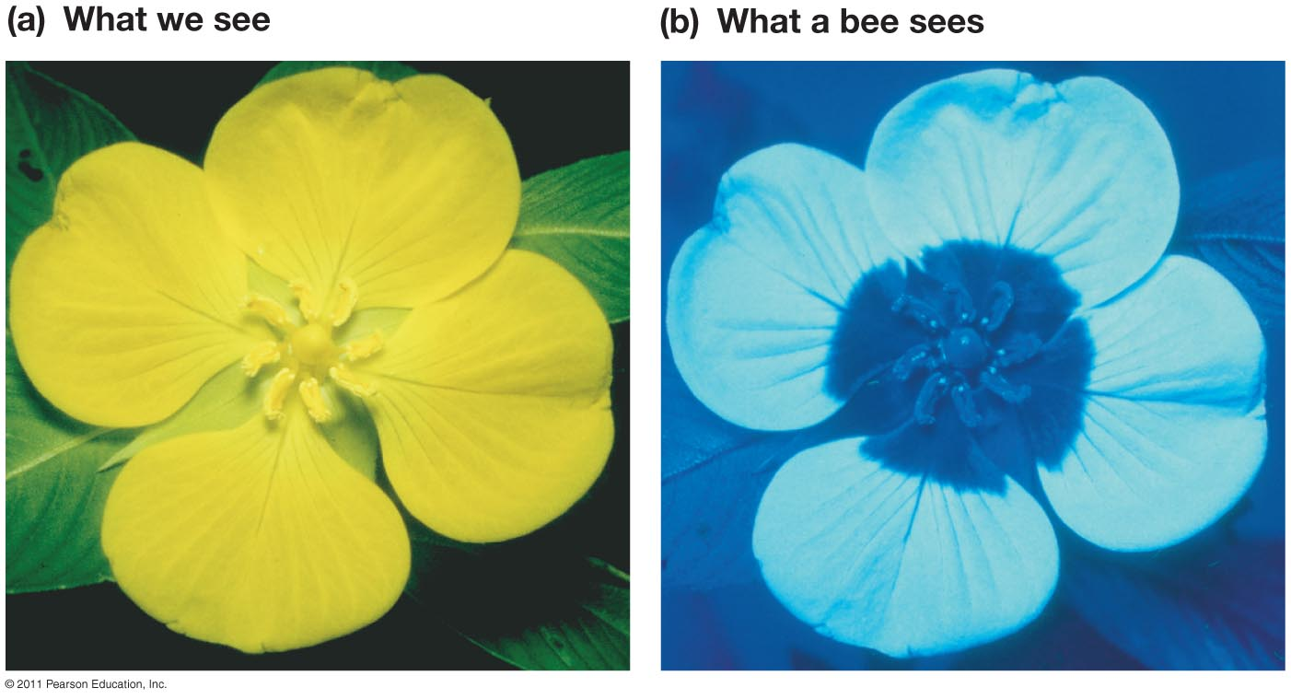
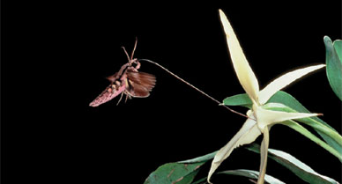
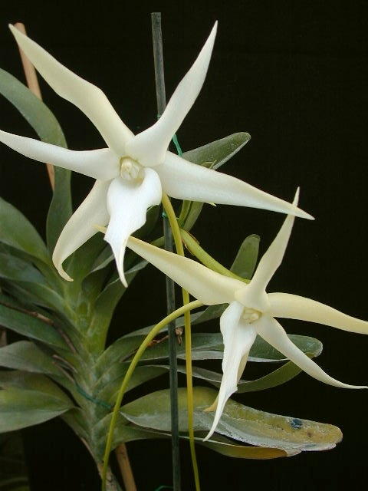
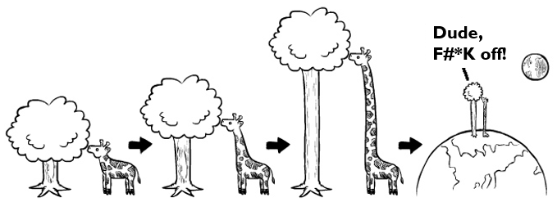
Coevolution
Coevolution: interdependent evolution of two or more species

Slide 27
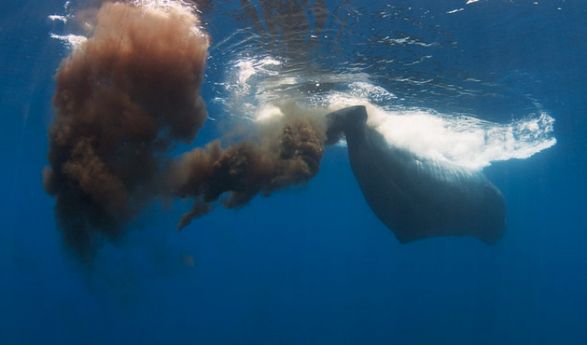
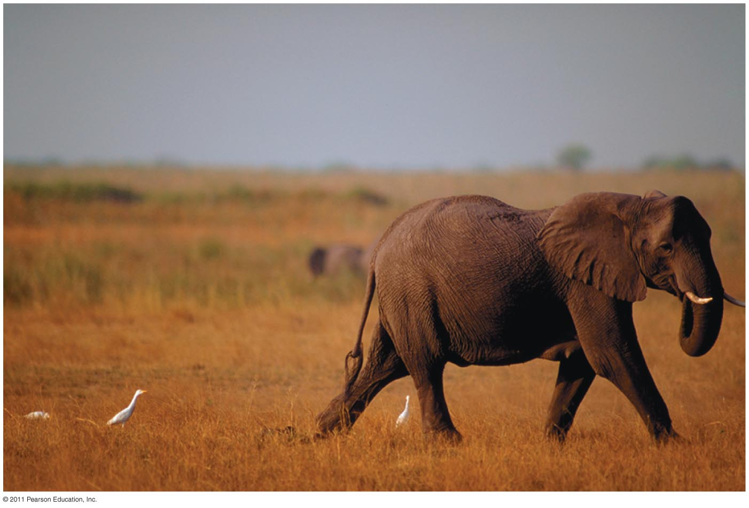
Commensalism
Commensalism: an interaction between individuals of two species in which one benefits while the other is neither harmed nor helped
Whale poo stimulates phytoplankton growth
Elephants kicking up insects for cattle egrets

Slide 28
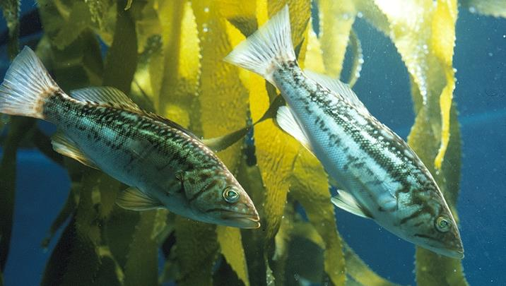
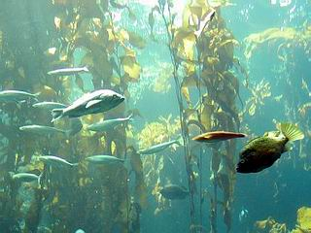
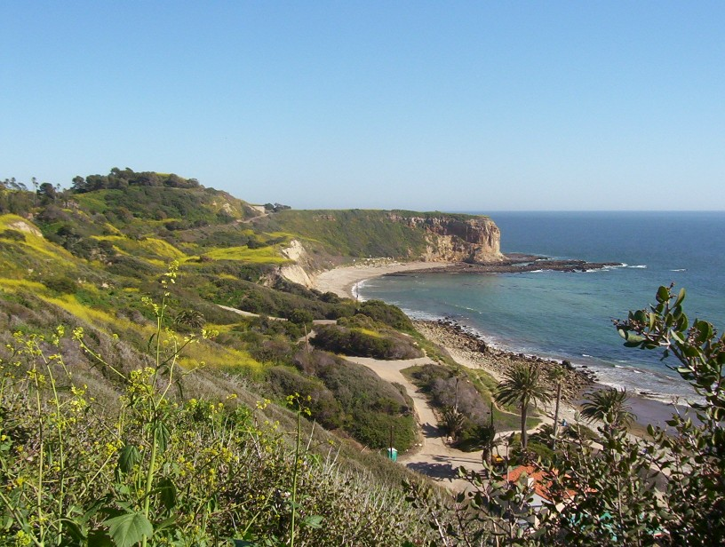
Biodiversity
Biological diversity or biodiversity: the ______ of plants and animals, or other living things, in a particular area or region
Three levels of Biodiversity
Genetic diversity Species diversity Ecosystem diversity

Slide 29
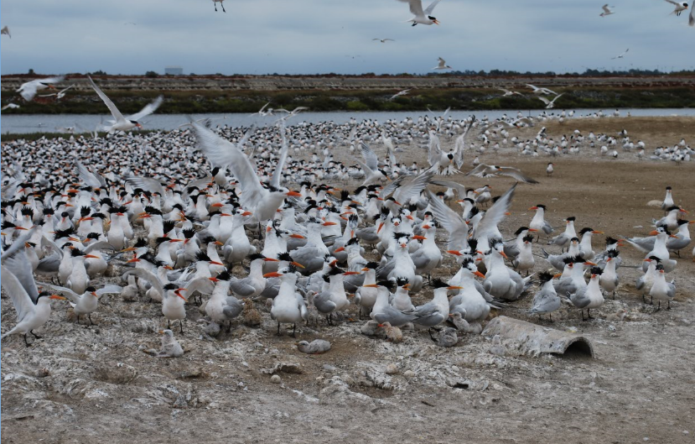
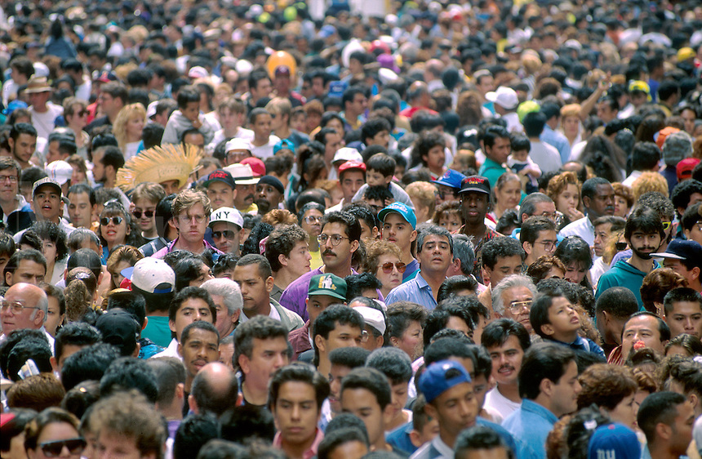
Genetic Diversity
Genetic diversity: genetic variation among individuals of the ___________
__________ potential
Disease resistance
Antibiotic resistance

Slide 30
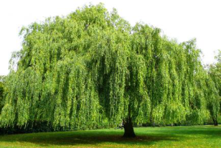
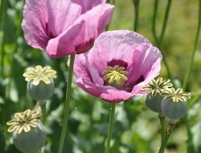
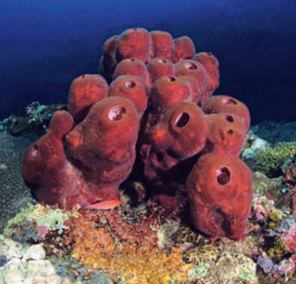
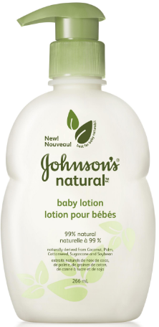
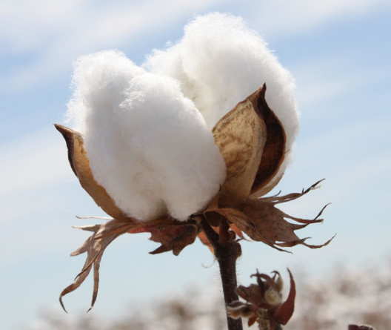
Species Diversity
Species diversity: the variety of species within an ecosystem
Health of an ecosystem
Diverse ecosystems are have a greater adaptive potential
Potential benefits to humans
Medications
Approximately _____% of all prescriptions originated from plants and animals
Food
____________ species of edible plants on Earth
Products
Wood, fibers for clothing and other uses, lotions, oils, etc..

Slide 31
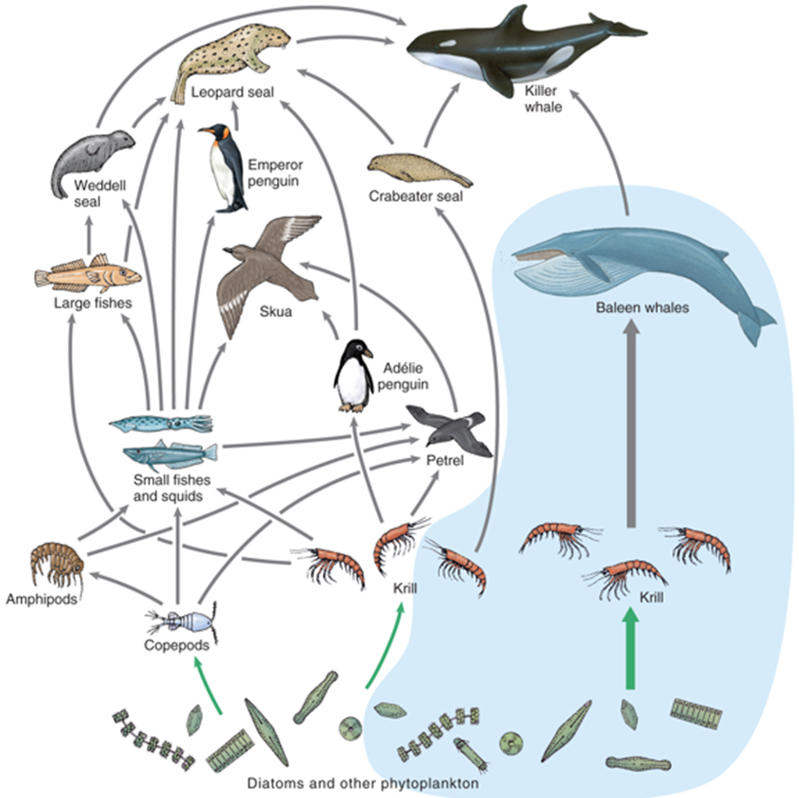
Food Webs
Food chain: the linear transfer of energy between organisms in an ecosystem from producers to consumers
Phytoplankton → Krill → Whale
Food web: the interconnection of all the food chains within a particular ecosystem

Slide 32
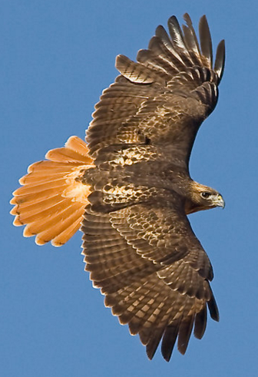
Species Diversity
Red-tailed hawk
Oak woodland food web
Cooper’s Hawk
Coyote
Acorn woodpecker
Warbler
Gray squirrel
Gall wasp
Spotted orbweaver
Scrub jay
Brush rabbit
Mule deer
Purple awn grass
Coast live oak
Western fence lizard
Notes:
.

Slide 33
Species Diversity
Red-tailed hawk
Oak woodland food web
Cooper’s Hawk
Coyote
Warbler
Spotted orbweaver
Scrub jay
Brush rabbit
Mule deer
Purple awn grass
Western fence lizard

Slide 34
Trophic Levels
Primary producers: autotrophs (plants) that convert solar energy to chemical energy
Primary consumers: herbivores are animals that eat plants
Secondary consumers: carnivores are animals that eat herbivores
Tertiary consumers: carnivores that eat other carnivores
Only about 10% of the biomass from one trophic level is converted to biomass in the next trophic level
TERTIARY CONSUMERS
SECONDARY CONSUMERS
PRIMARY CONSUMERS
PRIMARY PRODUCERS

Slide 35
Energy Transfer Between Trophic Levels
Most energy consumed is lost as waste or is used in cellular respiration and is lost as heat.
Only about 10% of consumed energy goes toward growth (stored energy), which can then be passed on to the next trophic level
__________ available at higher trophic levels

Slide 36
Trophic Levels
Only about 10% of the biomass from one trophic level is converted to biomass in the next trophic level, which results in fewer top predators

Slide 37
Trophic Levels
Eating meat is an inefficient way of using the available energy from primary production
It takes 10 pounds of feed corn to produce 1 pound of bacon or beef steak

Slide 38
Trophic Levels

Slide 39
Biomagnification
Biomagnification: toxic substances become increasingly ____________ within living things as they move up each trophic level
Common with DDT, Mercury, and PCB’s

Slide 40
Ecosystem Diversity
Ecosystem diversity: variation of types of ecosystems in a given area
Many ecosystems under threat in developing areas
>50% of __________________ on earth have been lost
>85% of coastal sage scrub habitat lost in southern California
>____% of estuaries and other riparian habitats lost in California

Slide 41
Ecosystem Diversity
Ecosystem services: all the processes through which natural ecosystems benefit _____________.
Provide water, food and building materials
__________ production and nutrient cycling
Medicinal benefits derived from plants
Pollinators
__________ control
Water filtration
______________ of organic material
Recreation and cultural services

Slide 42
Check Your Understanding
True or False: population growth in r-selected species tends to be limited by carrying capacity
True or False: humans are currently experiencing exponential growth
True or False: Two species with the same ecological niche can coexist within the same area

Slide 43
Check Your Understanding
A(n) _________________ consists of all the different species that interact and live within a given area.
a. population
b. community
c. ecosystem
d. demography

Slide 44
Check Your Understanding
Which of the following characterizes the relationship between two species where one species benefits at a cost to the other species?
a. Commensalism
b. Mutualism
c. Predation
d. Competition

Slide 45
Check Your Understanding
Describe the differences between the fundamental niche and realized niche of an organism.

