Slide 1
Plant Form and Function
“Consider the lilies how they grow, they neither toil nor spin, yet I assure you, even Solomon in all his glory was not arrayed like one of these”
-Luke 12:27
Chapters 24 and 25

Slide 2
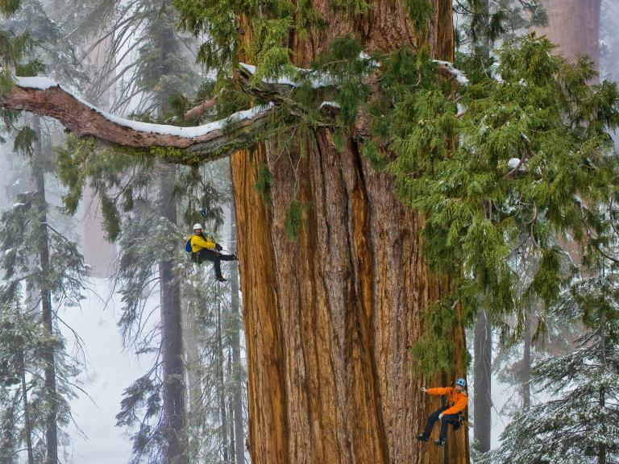
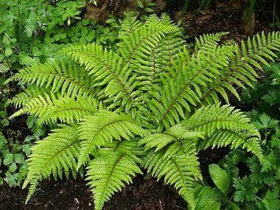
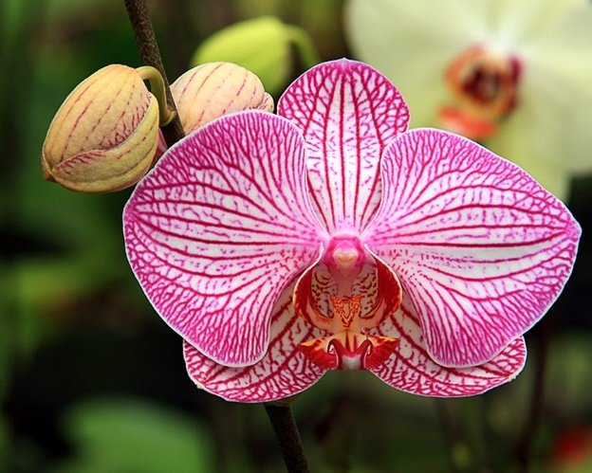
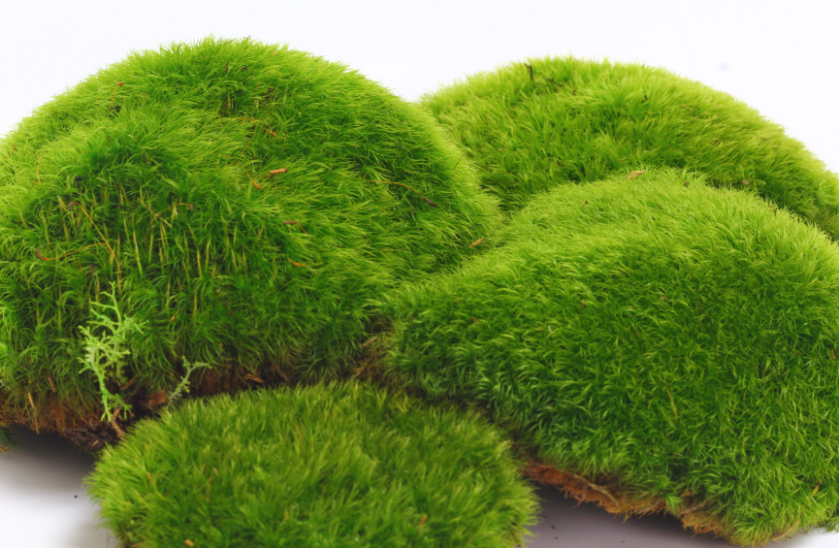
What is a plant?
Multicellular eukaryote that produces its own food through photosynthesis
Mostly terrestrial (land dwelling)
Sessile (stay in one place)
Range from 1 millimeter to 380ft tall!

Slide 3
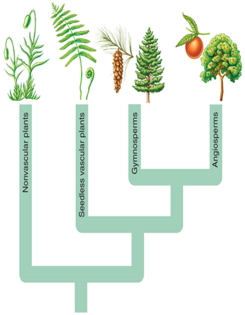
Evolutionary History of Plants
Phylogenetic tree: diagram showing evolutionary relationships among organisms
Groups organized by their shared characteristics
Common ancestor
Flowers
Seeds
Vascular tissue
Notes:
Vascular tissue (xylem and phloem) → seeds → flowers
Vascular tissue = specialized groups of cells that transport water and dissolved nutrients throughout the plant

Slide 4
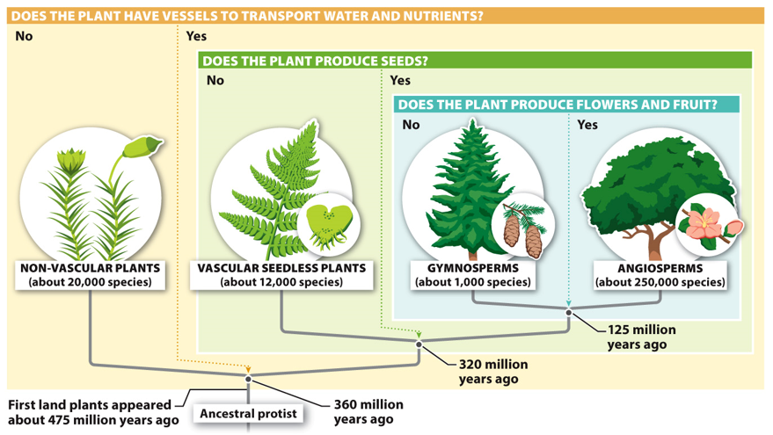
Evolutionary History of Plants
Notes:
Evolution of land plants 475 mya was significant because it provided a food source on land and thus paved the way for the evolution and diversification of animals on land.

Slide 5
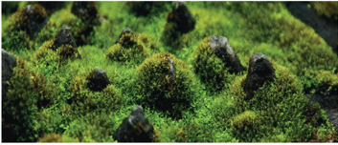
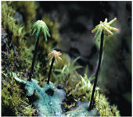
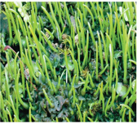
Nonvascular Seedless Plants
Mosses, Liverworts, Hornworts
Lack vascular tissue
Limited vertical growth
Water and nutrients enter plant though diffusion
Lack seeds
_______: asexual reproduction
Haploid generation dominant
Flagellated sperm
Wet environments
Mosses
Liverworts
Hornworts

Slide 6
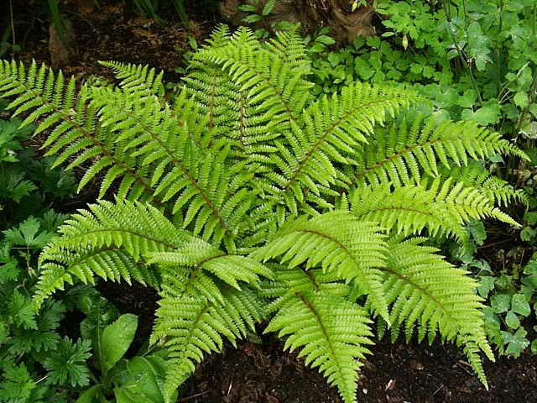
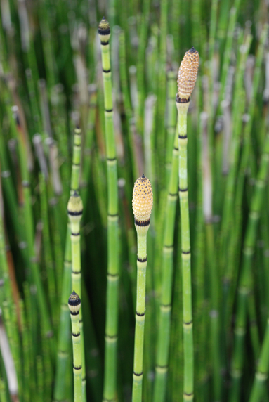
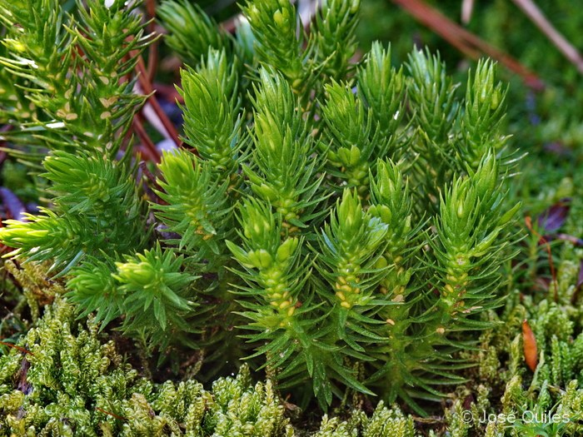
Vascular Seedless Plants
Ferns, Clubmosses and Horsetails
Vascular tissue present
________ growth
Lack seeds
Spores: asexual reproduction
Diploid generation dominant
Flagellated sperm
Wet environments
Ferns
Horsetails
Clubmosses
Notes:
Presence of vascular tissue allows for vertical growth
Spores located under fronds

Slide 7
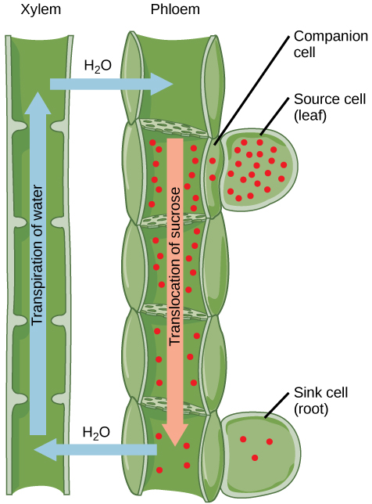
Evolution of Vascular Tissue
Vascular tissue: tube-like vessels that transport water and nutrients
_______ – Moves water up a plant
_______ – Moves food up or down a plant
Allowed for vertical growth in plants
Vascular bundles: bundles of xylem and phloem within plant roots, shoots and leaves
Xylem
Phloem
Notes:
Vascular bundles =

Slide 8
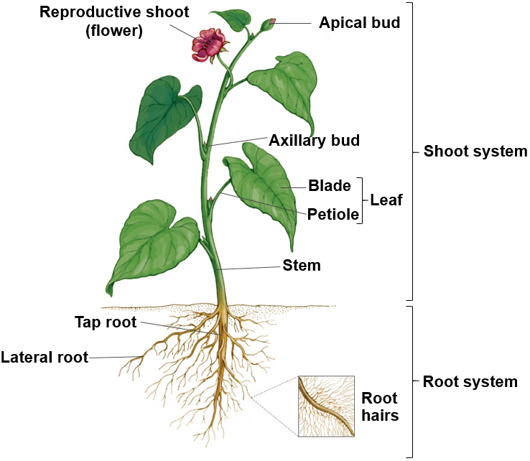
Plant Morphology
Shoot system: photosynthesis and ______________
Stem: produce leaves, branches and flowers, transports nutrients and water from roots to leaves
Leaves: primary location of photosynthesis
Buds: undeveloped shoot
Root System: anchors plant, absorbs minerals and water, and stores carbohydrates
Notes:
Three basic organs in plants (roots, stems and leaves)
Nodes: point where leaves attach to stem
Internodes: Space between nodes
Apical bud: growing shoot tip
Axillary bud: embryonic stem at base of petiole that contains meristematic cells, can develop into branch, thorn or flower.
Taproot: main vertical root in eudicots. Allows for plants (trees) to grow taller
Lateral roots: roots that branch off of taproot
Root hairs: increase surface area

Slide 9
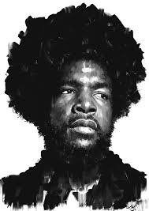
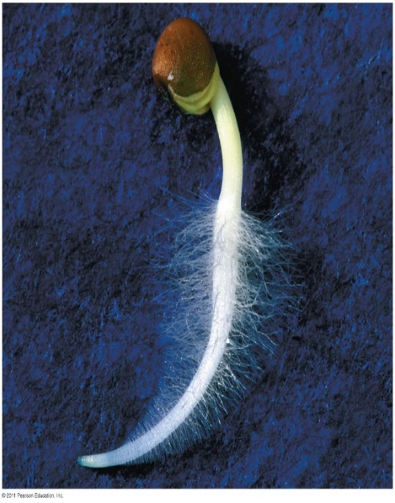
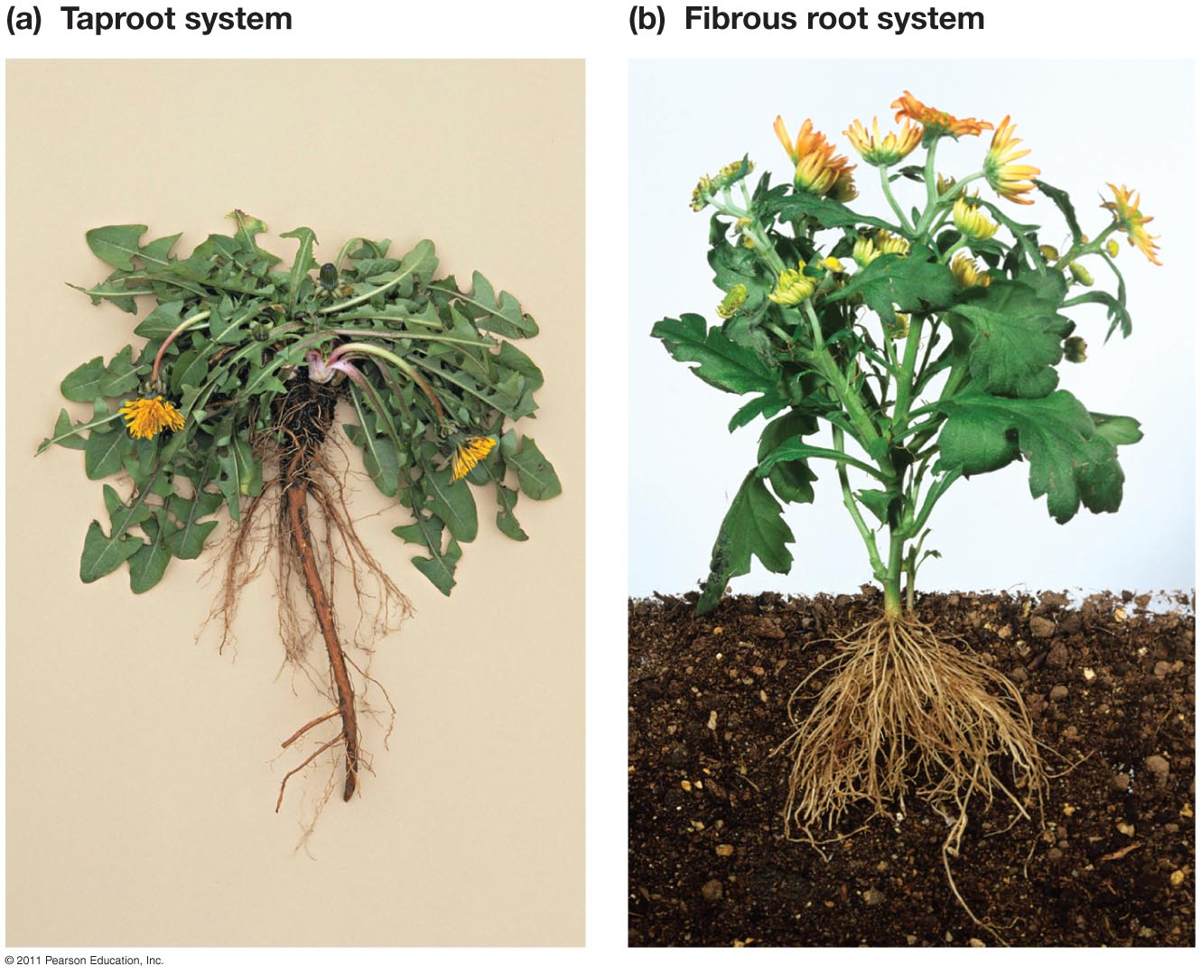
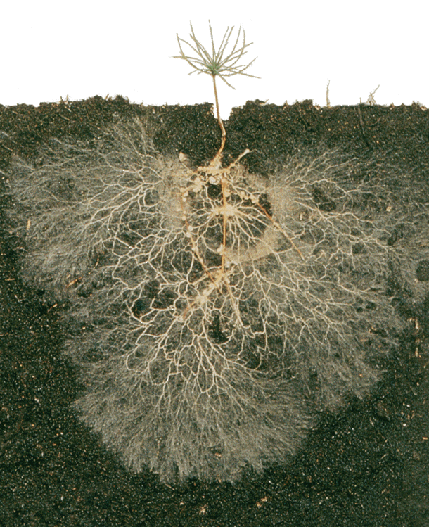
Roots
Taproot or fibrous root
Absorb water, minerals, nutrients
Root hairs
Increase surface area
Mycorrhizae: symbiotic relationship between a fungus and plant roots
Fungus get carbohydrates
Plant gets more water and nutrients
Taproot system
Fibrous root system
Root hairs
Mycorrhizae
Notes:
Taproot = large central root
Fibrous root = many smaller roots
Surface area!! Roots can have the same coverage as the crown of the tree
Mycorrhizae = fungus with symbiotic relationship with plant roots
Fungus gets carbohydrates, plant gets more water and minerals from higher absorptive capacity of fungus

Slide 10
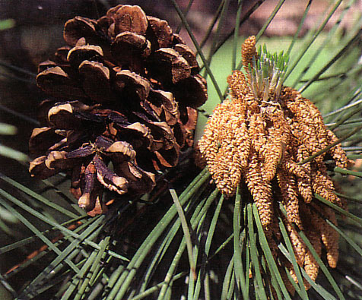
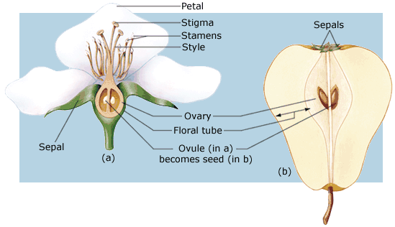
Vascular Seed Plants
Gymnosperms: seed bearing vascular plants in which the seed is not enclosed in an ovary
“naked seed”
Cone bearing
Angiosperms: seed bearing vascular plant in which the seed is enclosed in an ovary
“enclosed seed”
Flowering plants
Fruits
Female cone
Male cone
Notes:
Seed = baby plant package = plant embryo and stored carbohydrates (starch) in a tough protective covering
Pollen = air borne sperm dispersal = 1 pollen grain = 2 sperm
Long distance dispersal
Gymnosperms = “naked seed”
mostly wind pollinated
Angiosperms = “enclosed seeds” in fruit
wind and animal pollinated

Slide 11
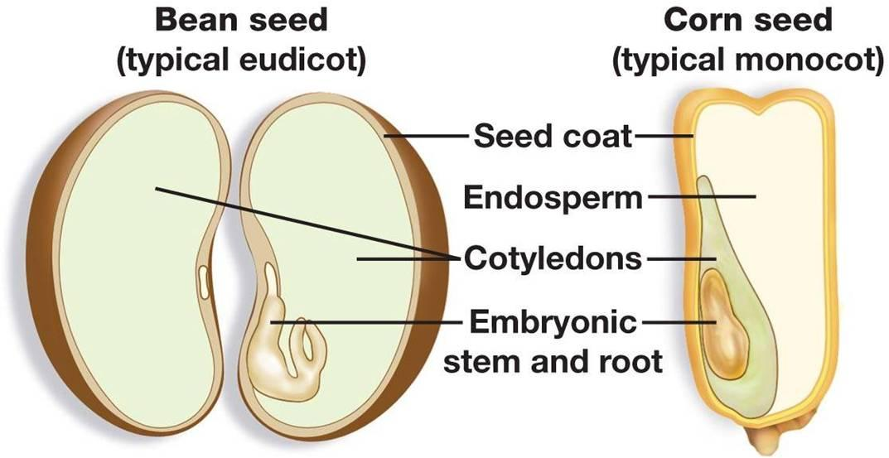
Evolution of Seeds
Seed: embryonic plant and food supply
Protective layer (seed coat)
Longer lifespan
Cotyledons: seed leaves
Endosperm: energy rich tissue that nourishes developing embryo
Notes:
Some seeds over 2000 years old have been successfully germinated.

Slide 12
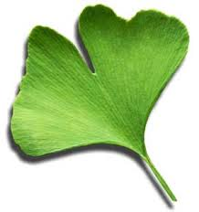
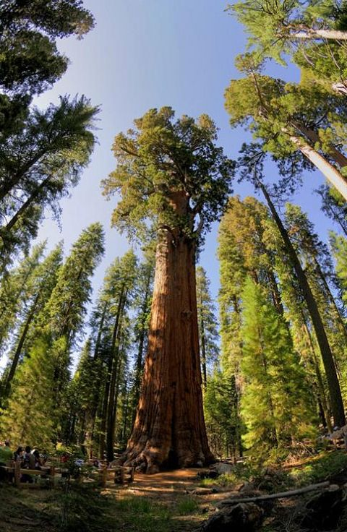
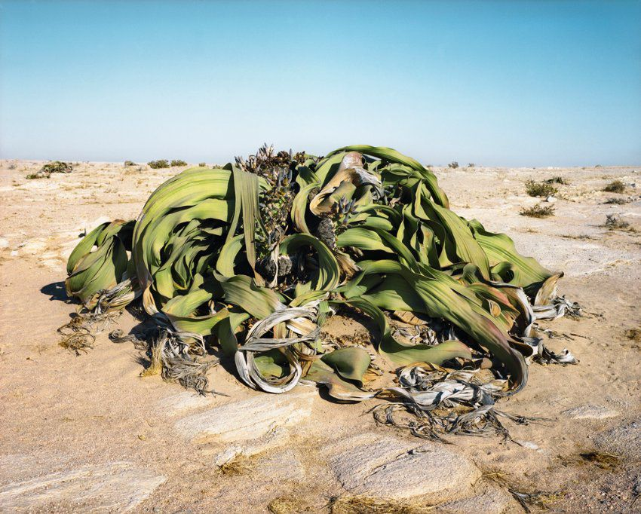
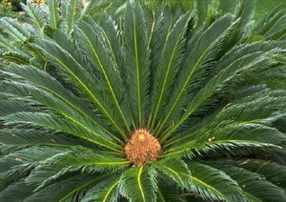
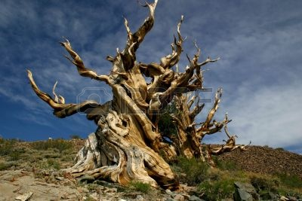
Gymnosperms
Conifers, Ginkgos, and Cycads
Approximately 1000 species
680 are conifers
Major ___________ importance
Ginkgo biloba
Gnetophytes
Cycads
Conifers
Conifers
Notes:
Conifers = pines, fir, spruce
Bristlecone pine (4,900 yo)
Ginkgo = one species Ginkgo biloba. Deciduous = loses leaves during dormant months
male or female trees
Cycads = sago palms (not real palms)

Slide 13
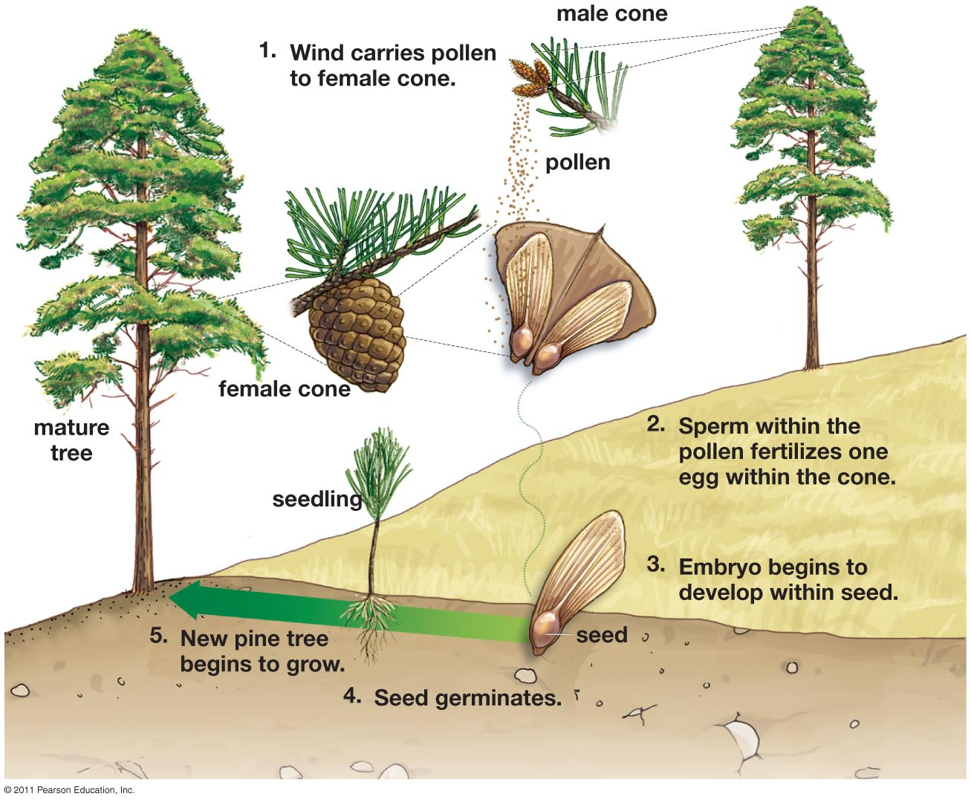
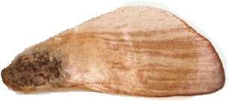
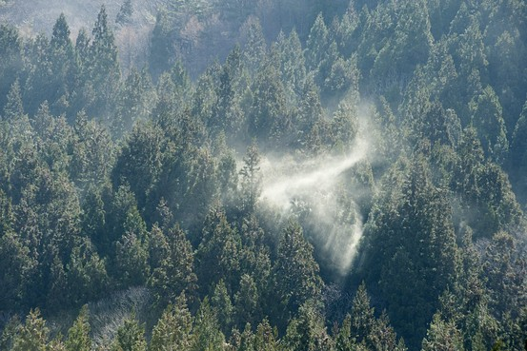
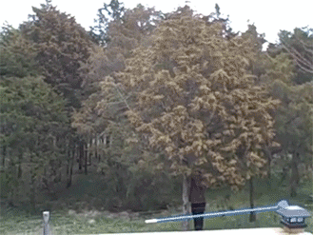
Gymnosperm Dispersal
Wind dispersal of pollen and seeds

Slide 14
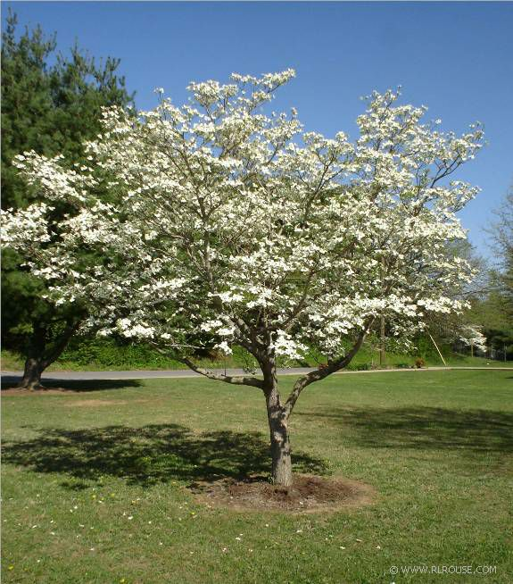
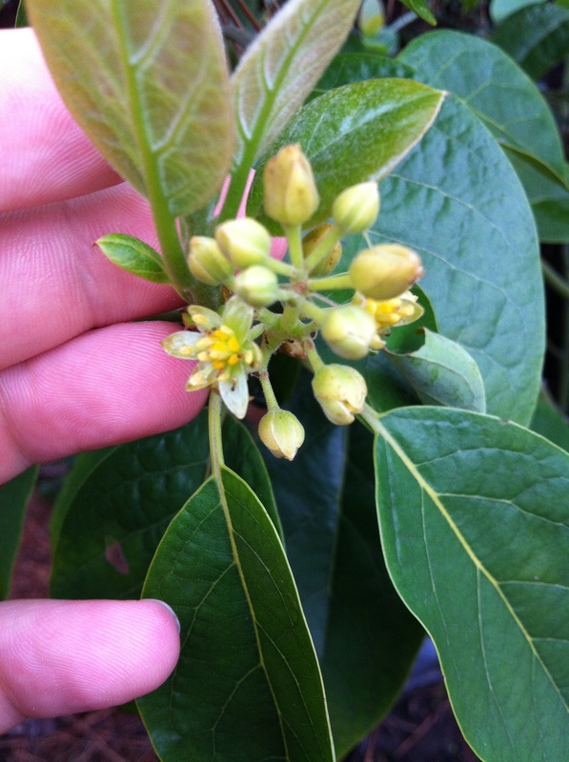
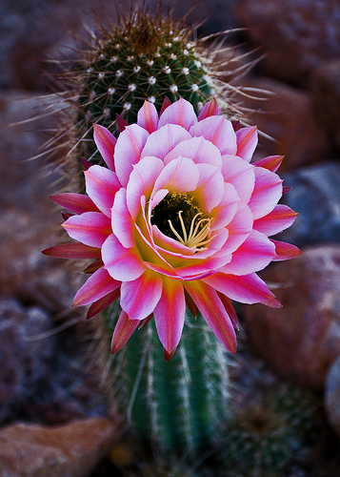
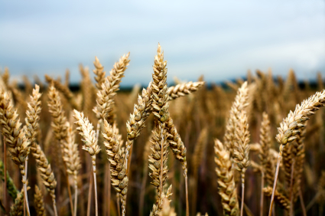
Angiosperms
300,000 species of flowering plants
Food crops (fruits, corn, vegetables, wheat)
Most all trees other than conifers
Grasses

Slide 15
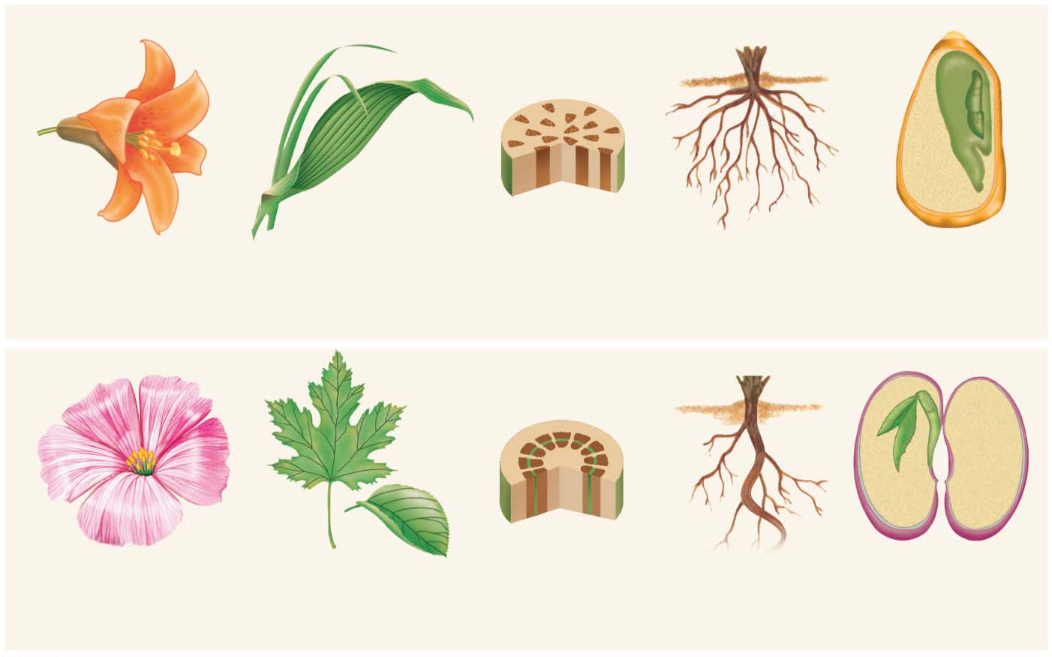
Flowers
Leaves
Stems
Roots
Seeds
Monocots
embryo
cotyledon
Flower parts usually in multiples of three.
Leaves have smooth edges, often narrow, with parallel veins.
Vascular tissue
are scattered
throughout the stem.
Monocots have a fibrous root system.
The seed has one
cotyledon (seed leaf).
Dicots
embryo
cotyledons
Flower parts usually in
multiples of four or five.
Leaves are palmate or oval with netlike veins.
Vascular bundles
are arranged in a
ring around the stem.
Dicots have a
taproot system.
The seed has
two cotyledons
(seed leaves).
Notes:
Figure 44-2 Characteristics of monocots and dicots

Slide 16
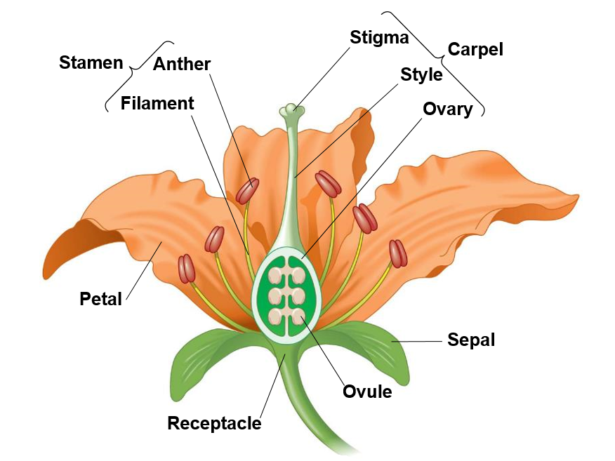
Flower Anatomy
Sepal: protects developing flower
Petals: attract pollinators
Carpel: Female reproductive parts
Stigma
Style
Ovary
Stamen: Male reproductive parts
Filament: stalk
Anther: pollen production

Slide 17
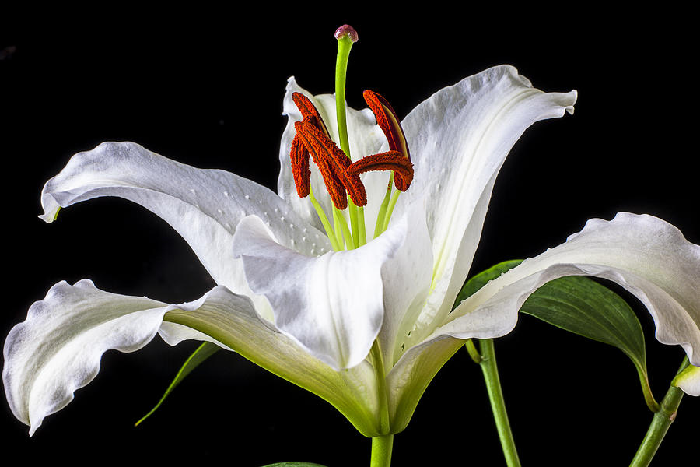
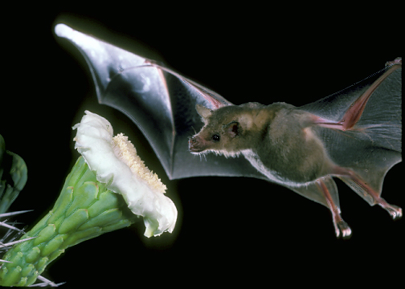
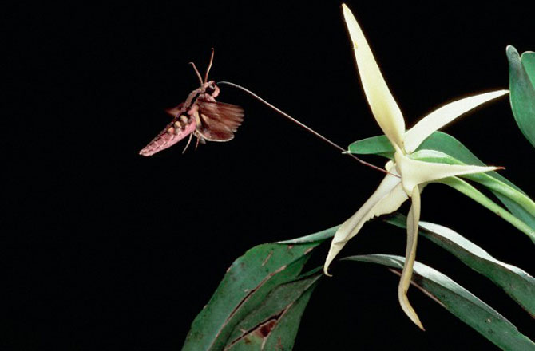
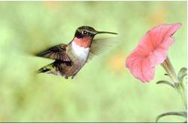
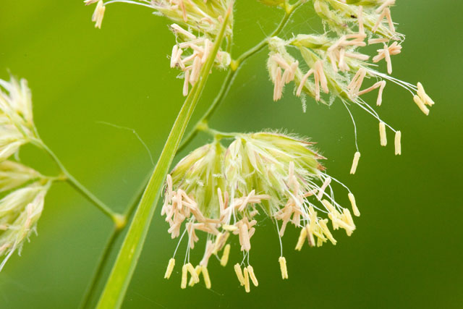
Variation in Flowers
Notes:
Carpel and stamen may develop at different times
Stamen and carpel may be arranged to avoid contact
Flowers are often pollinator specific
Flowers have nectar and sweet fragrance to attract pollinators
Color of flower of attracts certain kinds of pollinators
Bees – bright white, yellow, blue, shallow flower
Bats – white, green, purple, musty odor, lots of nectar, bowl shaped flower closed during day
Birds – scarlet, orange red, large, funnel shaped flower
Moth – pale red, purple white, lots of nectar, strong scent
Beetle – white, green
Wind – pale green, brown, no scent or nectar, lots of pollen

Slide 18
Pollination in Angiosperms
Each pollen grain contains two sperm cells and one tube cell
Tube cell forms pollen tube
Pollination: the transfer of pollen from the male anther to the female stigma
Double fertilization: one sperm cell fuses with egg forming the zygote, while the other sperm cell fuses with nuclei within the ovule to form endosperm
Notes:
Double fertilization: one sperm fertilizes the egg while the other fertilizes two nuclei, which go on to

Slide 19
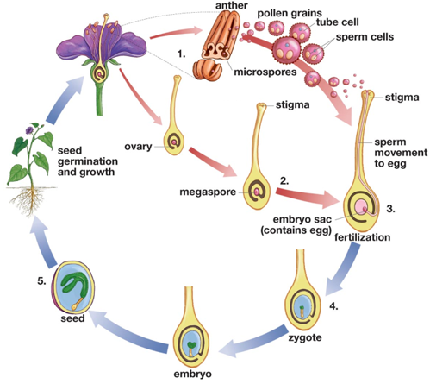
Angiosperm Life Cycle
Microspores in anther develop into pollen grains, with one tube cell and two sperm cells
Megaspore in ovary develops into embryo sac with egg.
Pollen grain contacts stigma (pollination) and pollen tube forms
One sperm fertilizes egg forming zygote, one sperm fertilizes nuclei forming endosperm
Embryo and endosperm develop into a seed
Seed grows into a mature plant
1.
6.
2.
3.
5.
4.

Slide 20
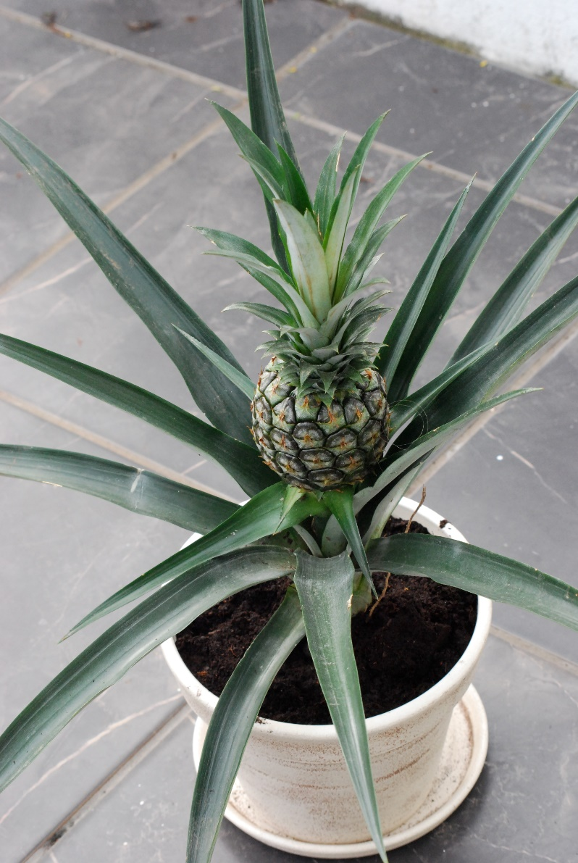
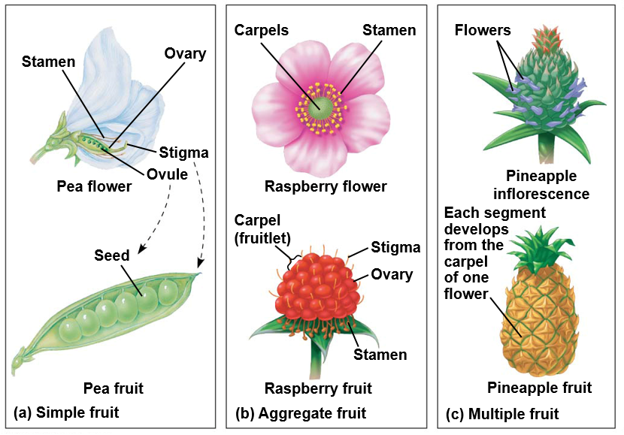
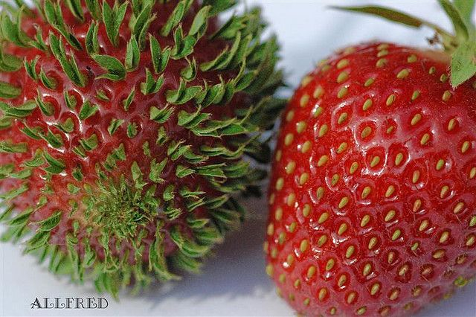
Fruit Development
Simple fruit: develops from single ovary
Aggregate fruit: develops from several ovaries (carpels) in the same flower
Multiple fruit: develops from fusion of multiple flowers

Slide 21
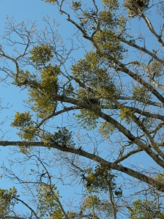
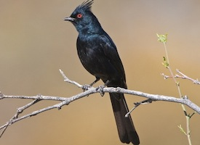
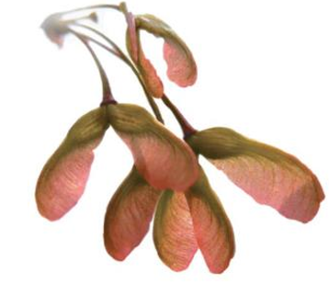
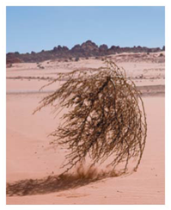
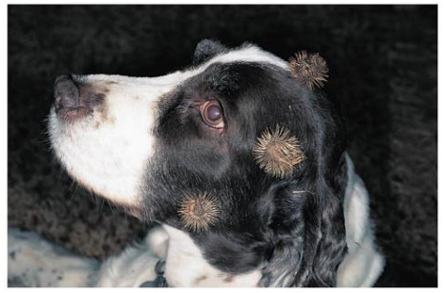
Angiosperm Seed Dispersal

Slide 22
Plant Defenses
Anatomical structures
Thornes and thick bark
Sticky traps
Plant sap traps insect invaders
________ compounds
Reduce herbivory

Slide 23
Resource Acquisition and Transport in Vascular Plants
Photosynthesis uses light energy and CO2 to make sugar and oxygen (byproduct)
Transpiration
Water moves upward
Phloem sap flows both to the roots and the shoots
Water and minerals are absorbed by the roots
Roots exchange gases with air spaces in soil
Notes:
Transpiration creates force within leaves to pull xylem sap upward.
Sugars produced through photosynthesis are transported both ways via phloem

Slide 24
Stomata
Stomata open
Stomata closed

Slide 25
Water Transport in Plants
Transpiration: water loss from above ground plant parts by diffusion and/or evaporation
Cohesion-tension hypothesis: transpiration provides negative pressure that pulls water molecules bound by cohesion, from the roots to the leaves
H₂0
H₂0
Notes:
Single corn plant transpires 60L of water (170 water bottle) in a single growing season.

Slide 26
Trade-off between Leaf Size and Transpiration
Larger leaf size = more light capture, but more water loss
Tropical environments
Small leaf size = less light capture, but less water loss
Dry, exposed environments
Deserts
Temperate forests
Notes:
Large leaves in warm, in warm hot environments with low light conditions.
Small leaves in sunny, dry environments and cold environments

Slide 27
Adaptations to Reduce Transpiration
Small, thick leaves
Reduce surface area
Thick cuticle
Recessed stomata
Lose their leaves
Drought deciduous
C₄ and CAM plants
Grasses, cacti
Notes:
Xerophytes: plants adapted for desert conditions
Plants need free water to open stomata and photosynthesize
Crassulacean acid metabolism CAM plants open stomata at night

Slide 28
Nutrient Transport in Plants
Sugar-rich xylem sap rises up the trunk in late winter to fuel leaf and flower production
“Real” maple syrup
Notes:
Sugar rich food is stored in xylem cells of maple trees not phloem

Slide 29
Plant Growth
Apical meristem: group of cells located in the root and shoot tips, that give rise to all plant tissues
Regions of cell division and differentiation
Notes:
90% of plants are dead cells

Slide 30
Primary and Secondary Growth
Vascular cambium: gives rise to secondary xylem and phloem
Secondary xylem = tree rings

Slide 31
Human uses of Seed Plants
Six crops = 80% of all calories consumed by humans
Maize, rice, wheat, potatoes, cassava, sweet potatoes
Medications
25% of medications come from plants
Oxygen!
Wood
Paper

Slide 32
Treats to Plant Diversity: Habitat Destruction
Deforestation
14 million acres of tropical rain forest cleared every year!
Causes:
48% due to subsistence farming
32% due to commercial agriculture
14% due to logging
5% used as wood for fuel
Habitat loss in Borneo

Slide 33
Threats to Plant Diversity: Invasive Bark Beetle
Notes:
46 million acres of forest lost to bark beetle

Slide 34
Bark Beetle Impacts

Slide 35
Check Your Understanding
Which of the following are not one of the characteristics of monocots?
a. Flower parts in multiples of threes
b. Single cotyledon
c. Taproot
d. Parallel veins in the leaves
e. Vascular bundles scattered in stem

Slide 36
Check Your Understanding
Which of the following parts of the flower are responsible for the production of pollen?
a. Stigma
b. Anther
c. Style
d. Ovary
e. Filament

Slide 37
Check Your Understanding
Draw the phylogenetic tree for the evolutionary history of plants. Be sure to include the three major adaptations that occurred in plants

Slide 38
Check Your Understanding
Explain the cohesion-tension hypothesis.

