Slide 1
Nervous System
Chapter 48,49, and 50

Slide 2
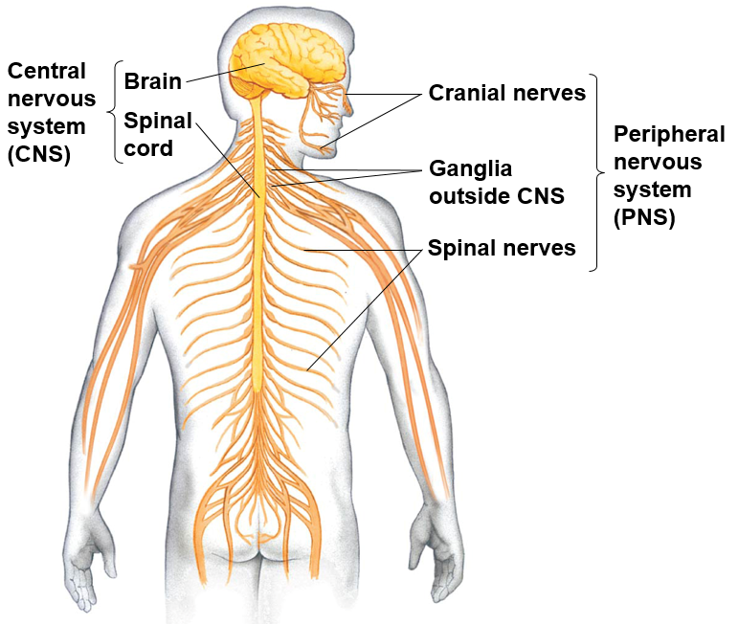
The Nervous System
Central nervous system (CNS): portion of nervous system consisting of brain and spinal cord
Integration of signals
Peripheral nervous system (PNS): the nervous system outside of the brain and spinal cord, which includes the sensory organs
Eyes
Skin
Ears
Mouth

Slide 3
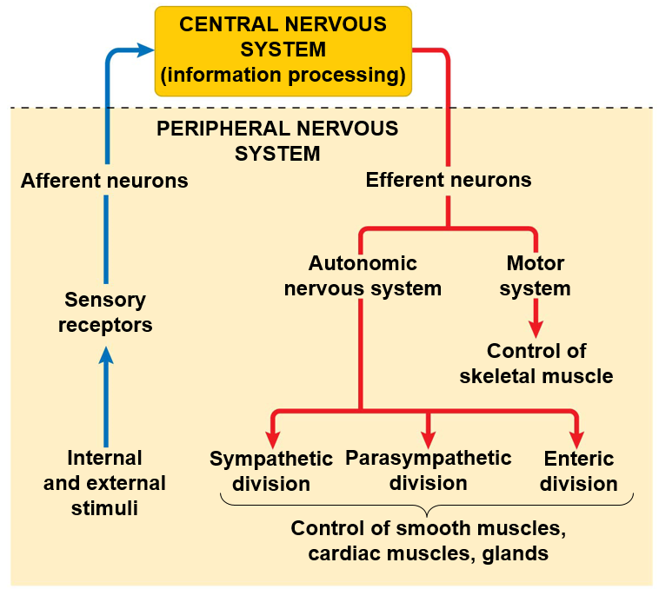
The Nervous System
Afferent division: collection of nerves that ______________ the brain or spinal cord
Efferent division: collection of nerves that _______________ the brain or spinal cord to other parts of the PNS.

Slide 4
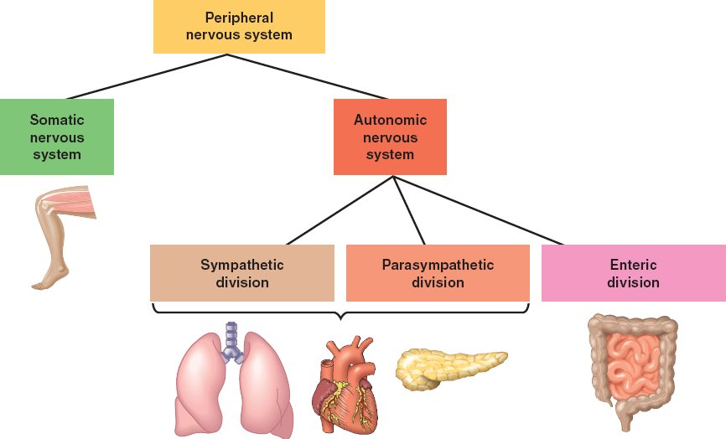
The Nervous System
Somatic nervous system: portion of PNS’s efferent division that provides _________ control of skeletal muscles.
Autonomic nervous system: part of the PNS’s efferent division that provided _________________ of smooth muscle, cardiac muscle, and glands

Slide 5
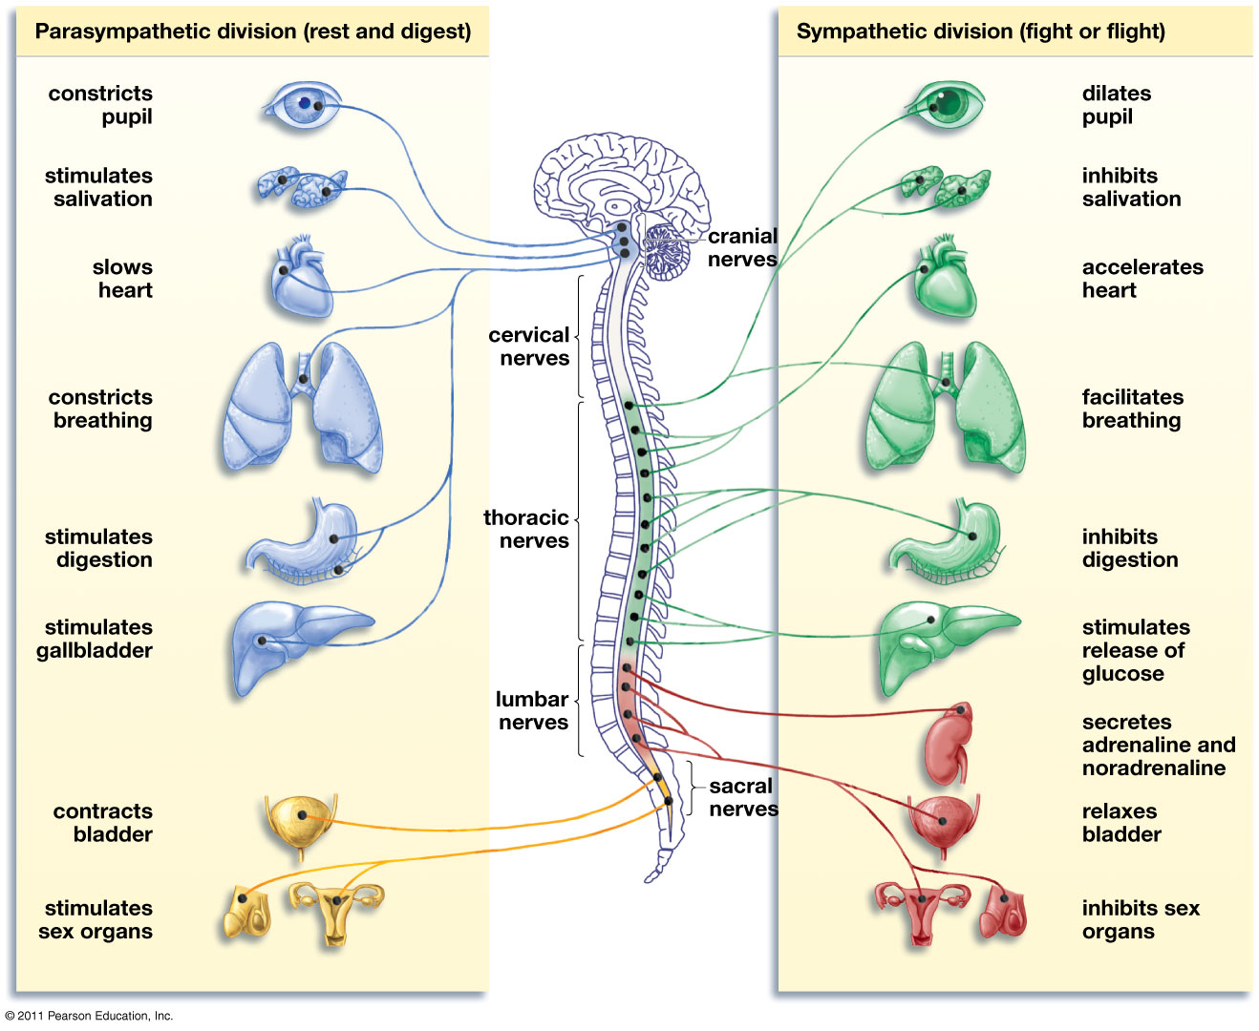
Autonomic Nervous System
Parasympathetic division: controls internal organs during ____________ conditions
“rest and digest”
Sympathetic division: controls internal organs during periods of _______
“flight or fight”

Slide 6
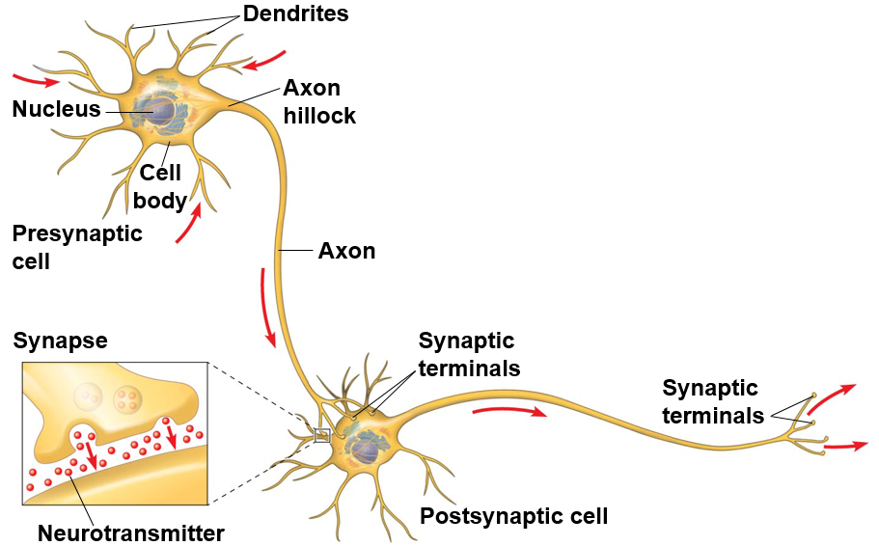
The Neuron
Dendrites: extensions of neuron that receive signal and relay signal towards nerve cell body
Axon: extension of the neuron that _____________ to other neurons
Cell body: area of the neuron containing organelles and nucleus
Synaptic terminals: transmit signal to adjacent nerve cells across the synapse

Slide 7
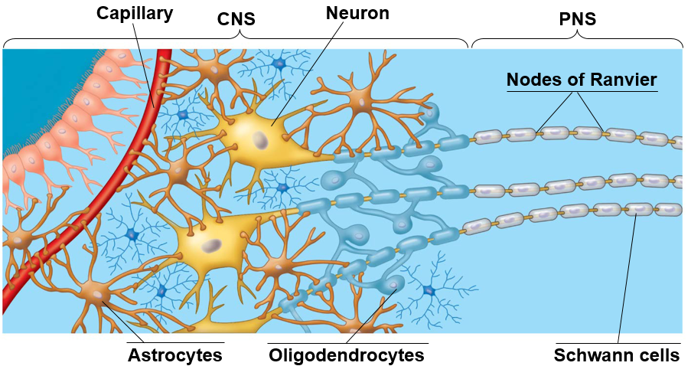
Glial Cells
___________: membrane covering over axon that speeds up signal transmission
Schwann cells in PNS
Oligodendrocytes in CNS
Nodes of Ranvier: spaces between myelin sheath
Astrocytes: restrict substances in blood from entering CNS

Slide 8
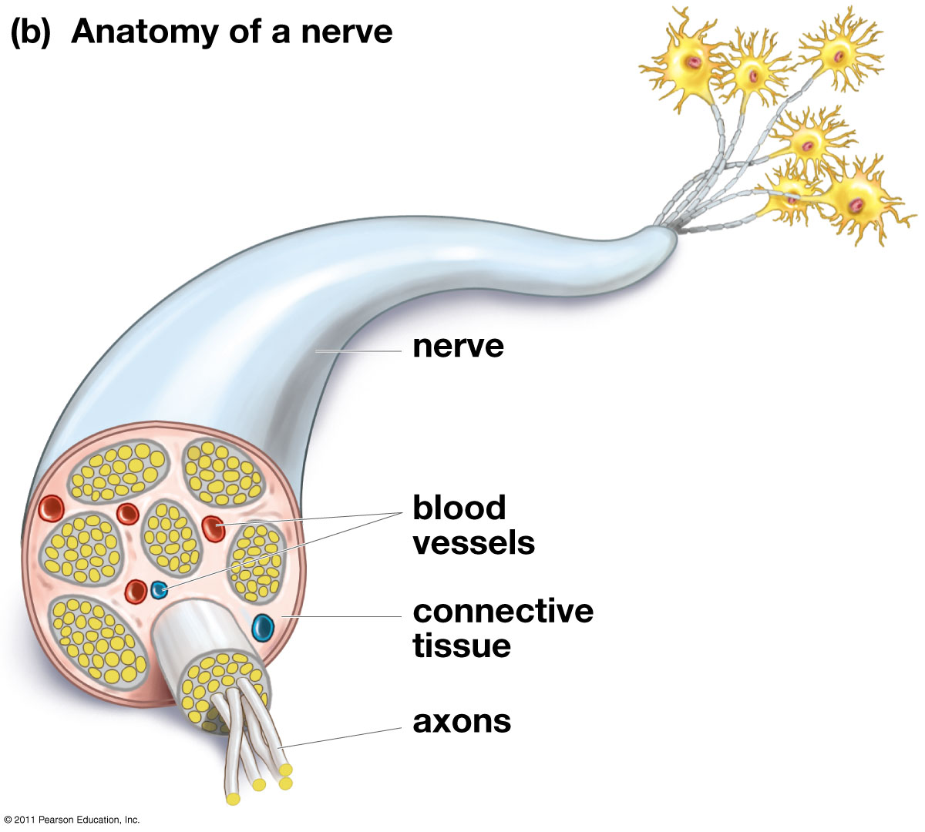
Clusters of Nerves
Nerve: one or more bundles of nerve cell axons in the PNS
Ganglion: Cluster of nerve cell bodies in the PNS
Nuclei: Cluster of cell bodies in the CNS

Slide 9
Types of Neurons
Sensory or afferent neuron: nerve cell that receives signals from _______________ inside and outside of the body then sends information to CNS
Interneuron: nerve cells that interconnect other neurons
Motor or efferent neuron: nerve cells that transmit signals from the CNS to _______ ___________

Slide 10
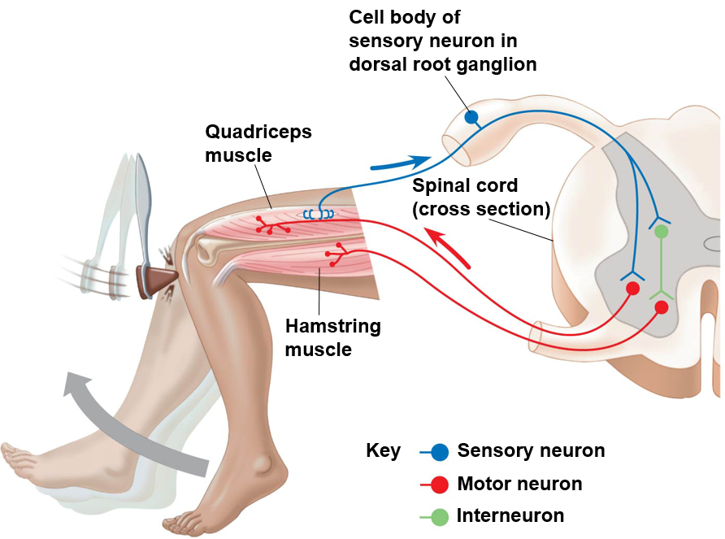
Reflexes
Automatic responses independent of integration from _________
Sensory neuron → Spinal cord interneuron or motor neuron → Automatic muscle movement

Slide 11
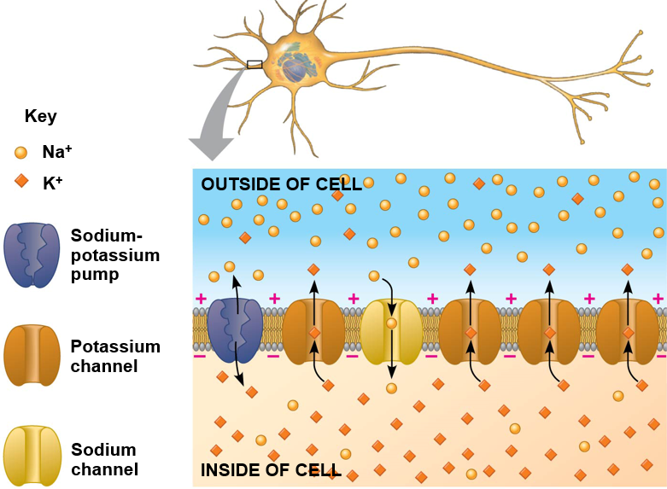
Membrane Potential
Membrane potential: _____ difference between the inside and outside of the plasma membrane of a neuron
Acts as stored energy
Resting potential: membrane potential when not sending a signal
-60mV to -80mV
Different concentration gradients for Na⁺ and K⁺ inside and outside of cell
Controlled by ion channels and sodium-potassium pumps
Net _______________ inside neuron

Slide 12
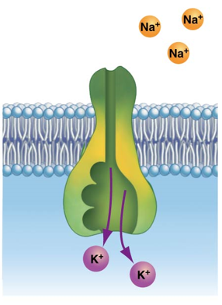
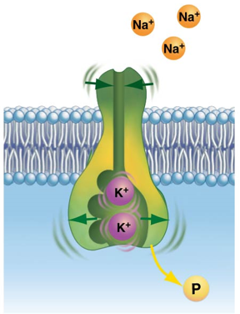
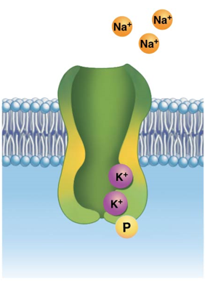
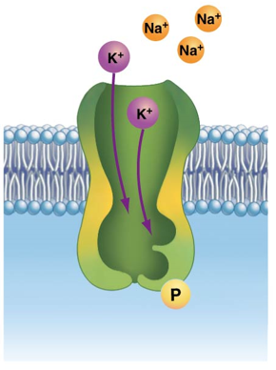
8. Potassium release
1.Unbound protein
2. Sodium binding. Phosphorylation of pump by ATP
Sodium Potassium Pump
7. Phosphate release. Shape change
3. Shape change
6. Potassium binding
5.Unbound protein
4. Sodium release

Slide 13
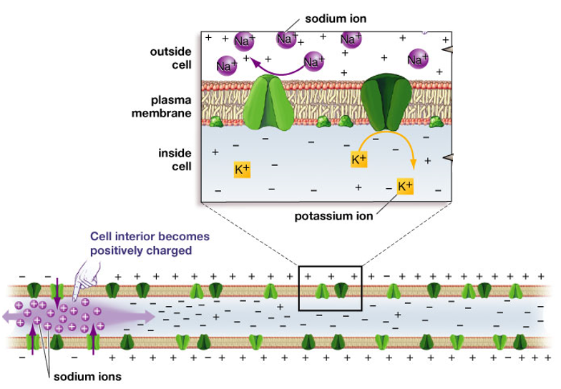
Transmitting a Signal
Gated ion channels: ion channels that open or close in response to stimuli
Voltage-gated ion channels
_____________: reduction in the magnitude of the membrane potential (negative charge) within the neuron
Opening of Na⁺ channels
Action potential: a temporary reversal of cell membrane potential that results in a conducted nerve impulse down the axon.
_________ must be reached

Slide 14
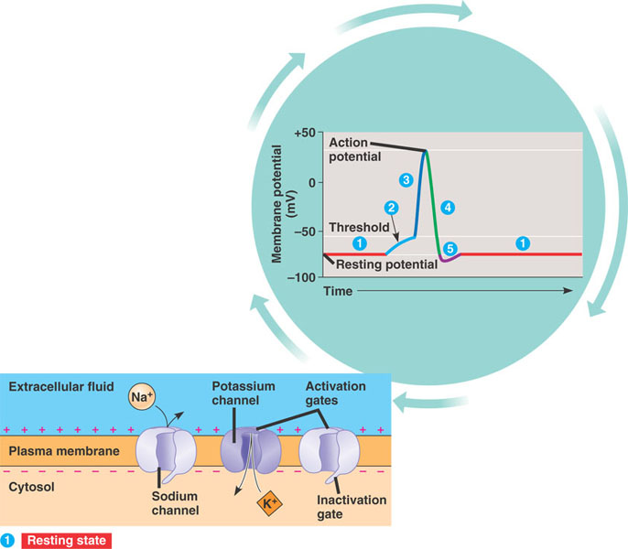
Sodium (Na⁺) and Potassium (K⁺) Channels
Resting state: gated Na⁺ and K⁺ channels are closed.
Membrane potential maintained by sodium-potassium pump and ungated channels

Slide 15
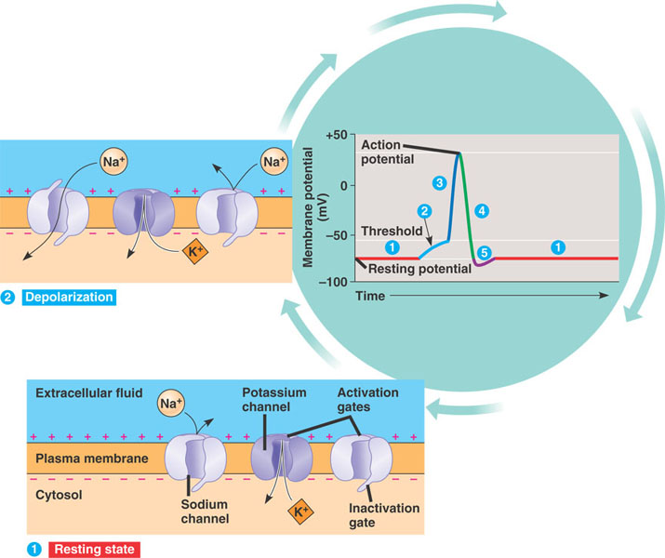
Sodium (Na⁺) and Potassium (K⁺) Channels
Depolarization: stimulus opens some of the sodium channels causing Na⁺ to enter the neuron
Graded potential
Action potential

Slide 16
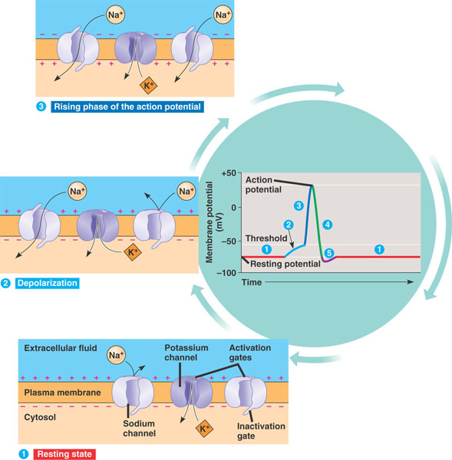
Sodium (Na⁺) and Potassium (K⁺) Channels
Rising phase of action potential: more sodium channels ____ causing further depolarization. Potassium channels remain ______.

Slide 17
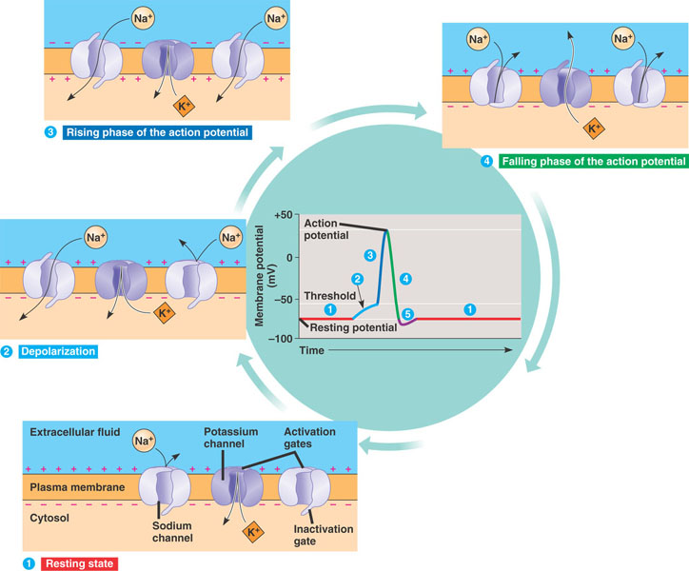
Sodium (Na⁺) and Potassium (K⁺) Channels
Falling phase of action potential: gates close in Na⁺ channels and potassium channels ____, decreasing the charge within the neuron

Slide 18
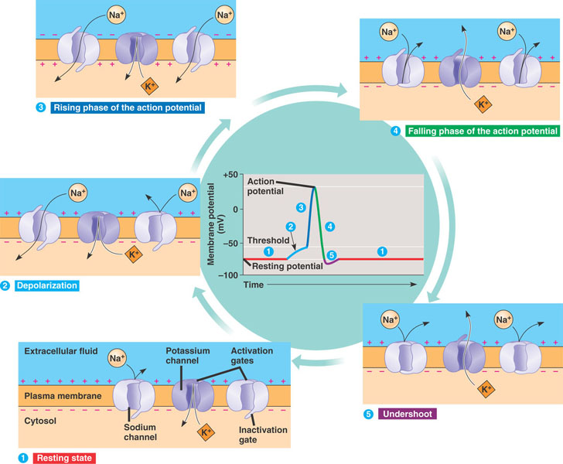
Sodium (Na⁺) and Potassium (K⁺) Channels
Undershoot: sodium channels closed and potassium channels are closing, causing negative charge within neuron to dip below resting potential before returning to resting state.
_________ period: period that a second action potential can not be initiated

Slide 19
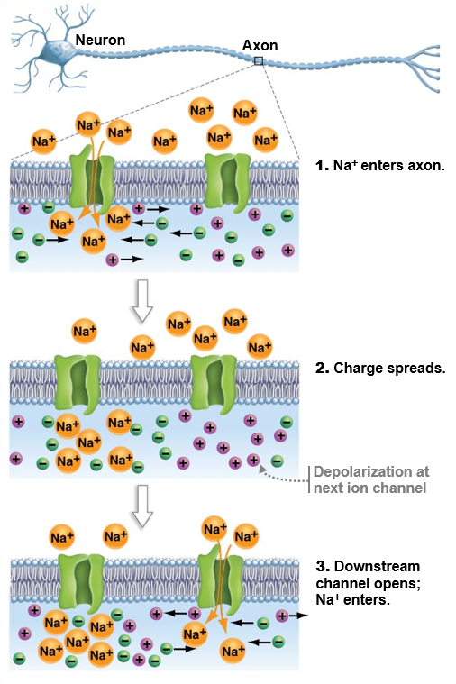
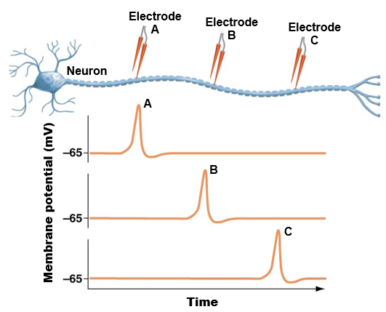
Propagation of the Action Potential
Initial action potential is a localized event
Axon hillcock
First action potential’s depolarization sets off second action potential
Travels ___________ due to refractory period
Sodium channels remain inactive

Slide 20
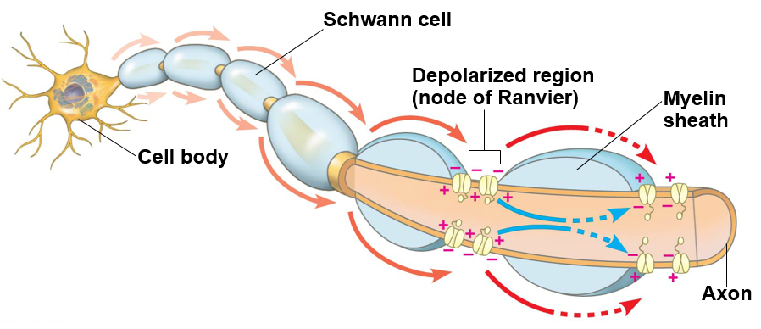
Adaptations for Signal Transmission
____________ insulate the axon of the neuron.
Vertebrates
Voltage-gated sodium channels are only located in the _______ _______ (gaps in myelin sheath)
Fewer ion channels opening and closing means faster signal

Slide 21
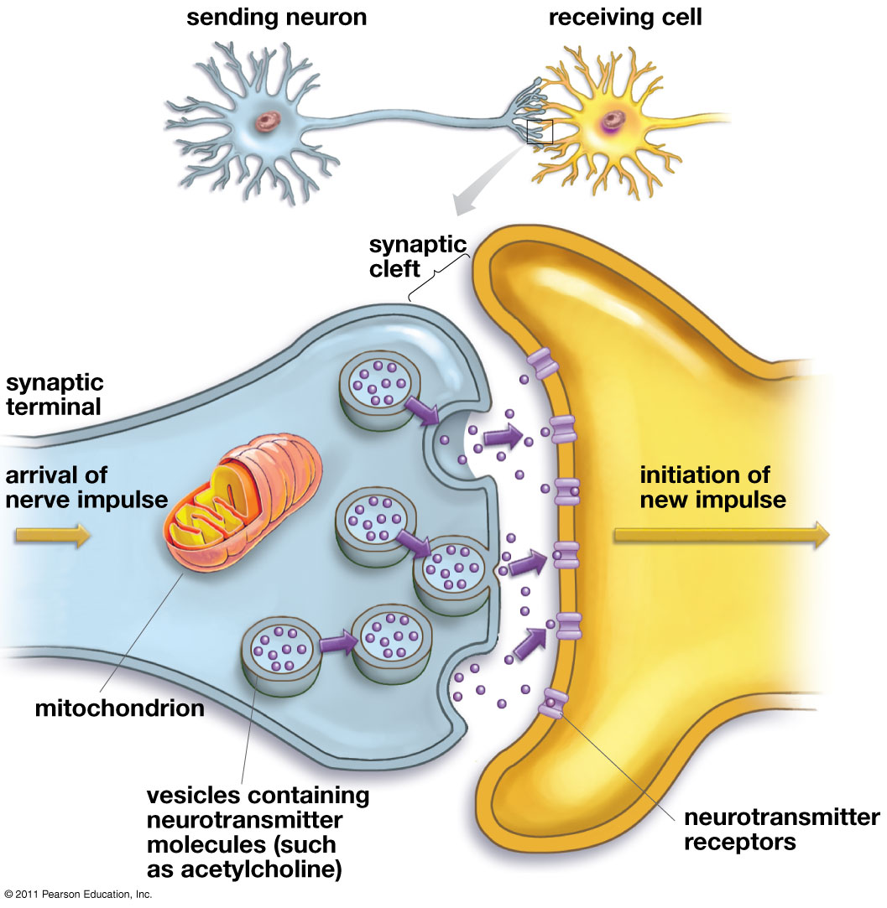
Passing the Signal Along
_________: area where sending neuron, receiving nerve cell and space between the two all come together
Synaptic cleft: the gap between adjacent nerve cells within the synapse
_______________: A chemical, secreted into the synaptic cleft, that affects another neuron or effector by binding with receptors on it.

Slide 22
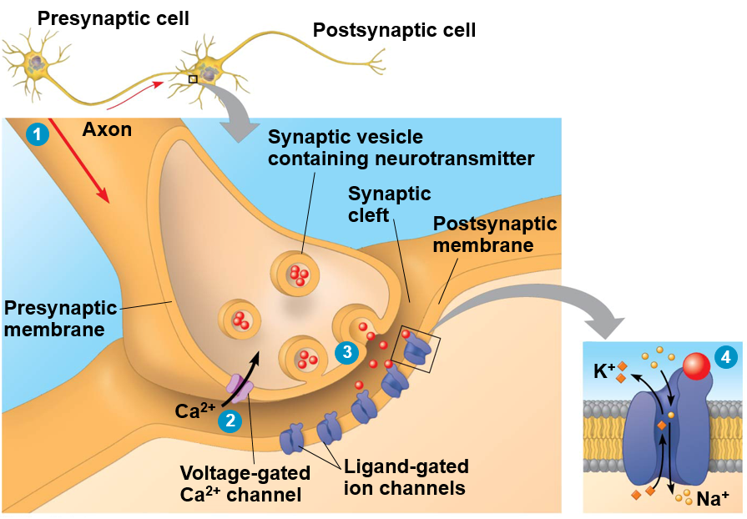
Passing the Signal Along
Action potential depolarizes presynaptic membrane
Depolarization triggers voltage-gated Ca²+ channels to open
Ca²+ channels cause synaptic vesicles o fuse with presynaptic membrane, releasing neurotransmitter into synaptic cleft
Neurotransmitters bind __________ ion channels on postsynaptic membrane which sets off new action potential
Neurotransmitter

Slide 23
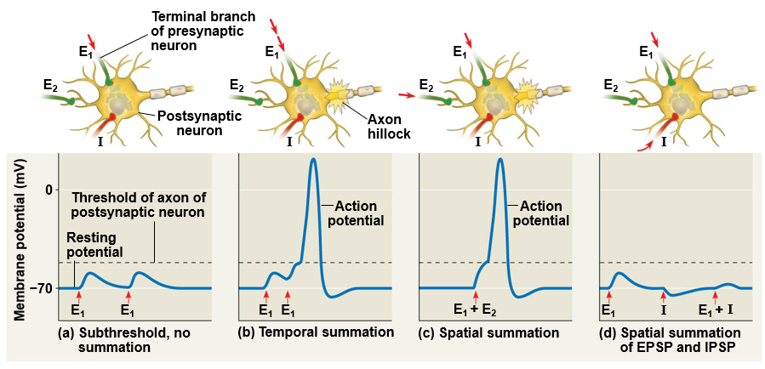
Summation of Postsynaptic Potentials

Slide 24
Types of Neurotransmitters
Neurotransmitters can be inhibitory or excitatory
Inhibitory: moves membrane potential ______ from threshold
Botox
Valium
GABA
Seratonin
Excitatory: depolarization that brings membrane potential ______ to threshold.
Acetylcholine
Norepinephrine
Dopamine
Glutamate

Slide 25
Major Neurotransmitters
Neurotransmitter | Function | Problems Caused by Imbalance
Serotonin | Affects mood, hunger, sleep, arousal | Oversupply linked to depression
_________ | Influences movement, learning, attention, and emotion | Oversupply linked to schizophrenia Undersupply linked to tremors and decreased mobility (Parkinson’s and ADHD)
Acetylcholine (Ach) | Enables muscle action, learning, and memory | Degeneration of Ach-producing neurons cause progression of Alzheimer’s disease
Norepinephrine | Helps control alertness and arousal | Undersupply can depress mood and cause attention problems
GABA (gamma-aminobutyric acid) | Inhibitor neurotransmitter | Undersupply linked to seizures, tremors, and insomnia
___________ | Excitatory neurotransmitter, memory | Oversupply can overstimulate the brain producing migraines or seizures

Slide 26
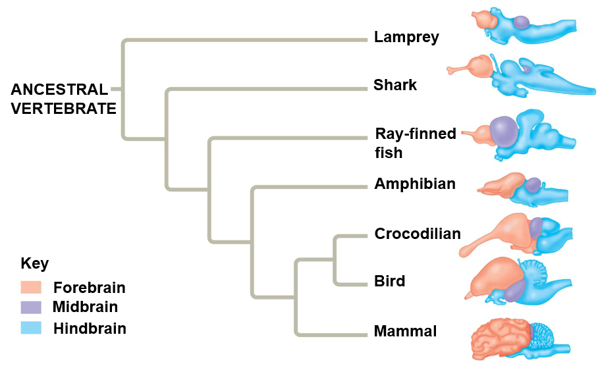
Evolution of the Vertebrate Brain
Forebrain: olfactory bulb and cerebrum
Sleep, learning, complex processing, smells
Midbrain: coordinates sensory input
Hindbrain: contains cerebellum
Coordinates _________ activities

Slide 27
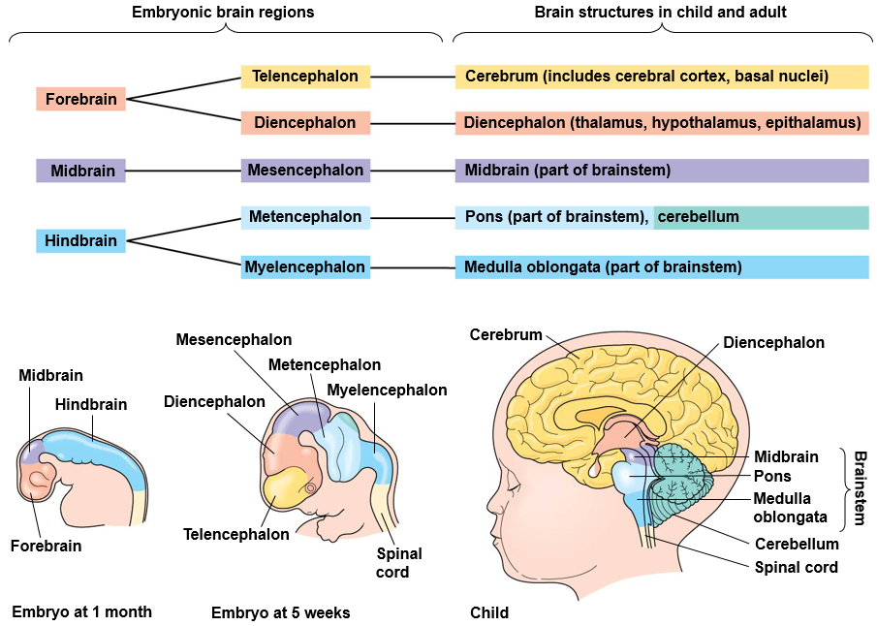
Development of Different Regions of the Brain

Slide 28
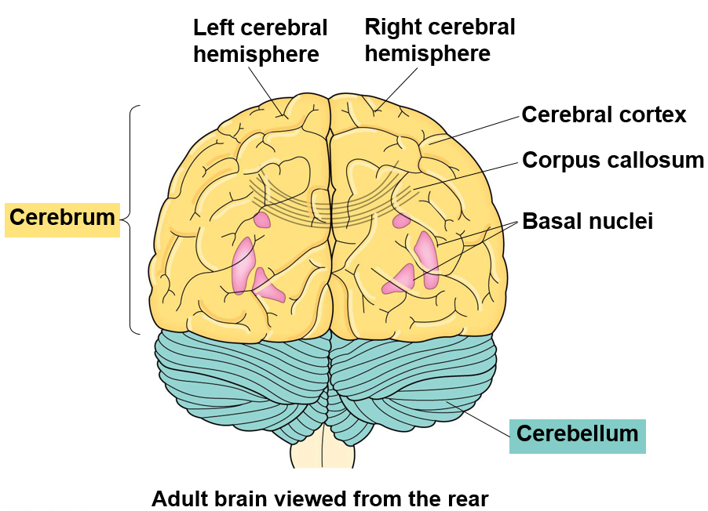
Regions of the Brain
Cerebrum: controls skeletal muscles, learning, emotion, memory and perception
_______________: connection between left and right hemispheres
Cerebellum: Coordinates movement and balance

Slide 29
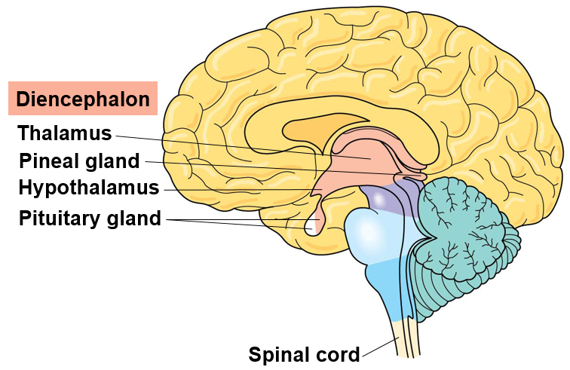
Regions of the Brain
Diencephalon
Thalamus: Input center for sensory information
_____________: Controls thermostat and biological clock; homeostasis
Pituitary gland: secretes hormones that control hunger, thirst, growth, and sex organs

Slide 30
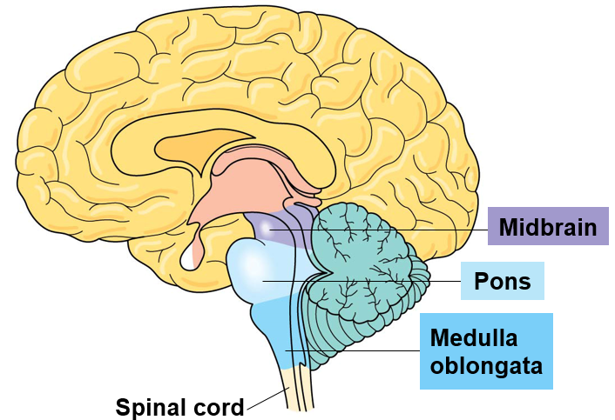
Regions of the Brain
Brainstem
Midbrain: integrates ________ information
Hearing and peripheral vision reflex
Pons and medulla oblongata: transmit information between PNS and the midbrain and forebrain.
Controls breathing, swallowing, digestion, heart and blood vessel activity
Coordinates movements like running or climbing

Slide 31
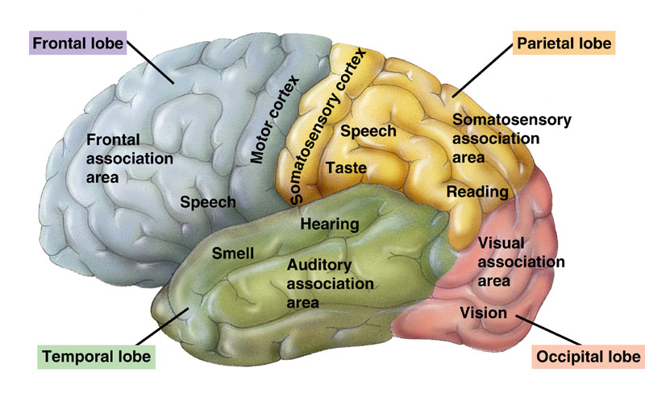
Cerebrum
Thalamus relays sensory information to primary sensory areas in cerebrum
___________ = region where motor commands originate

Slide 32
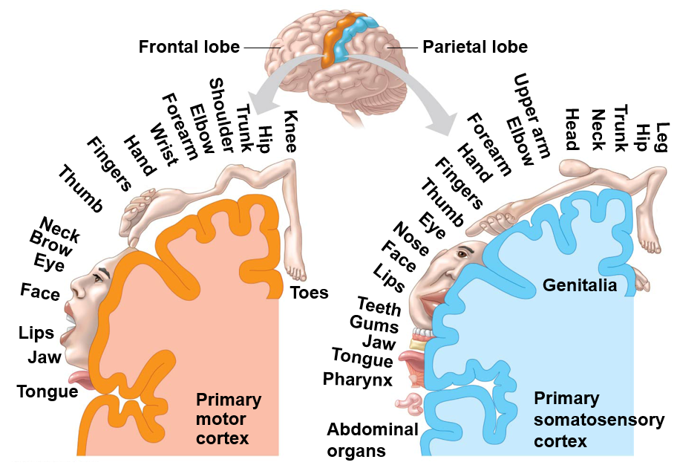
Information Processing
Surface area correlates with amount of neural control needed (motor cortex) or the number of sensory neurons from a particular part (somatosensory cortex)

Slide 33
Sensory Receptors
__________________: receptors that responds to pressure or distortion
Touch, hearing
Thermoreceptors: receptors that respond to changes in temperature
Touch, pit vipers, spicy food (capsaicin receptor), menthol
Chemoreceptors: receptors that respond to different chemical stimuli in the environment
Taste, smell, solute concentration (osmoreceptors), glucose, oxygen, carbon dioxide
Photoreceptors: receptors that respond to different wavelengths of light
_______________
Electromagnetic Receptors: receptors that respond to electric or magnetic signals
Ampullae of Lorenzini, platypus bill, elephant fish, magnetite

Slide 34
Sending a Signal
Tonic receptors: as long as the stimulus is present they activate
Ex. Photoreceptors, ear mechanoreceptors
_______ receptors: begin to ignore stimulus after a period of continued activation. Sensory adaptation.
Ex. Olfactory sense, touch

Slide 35
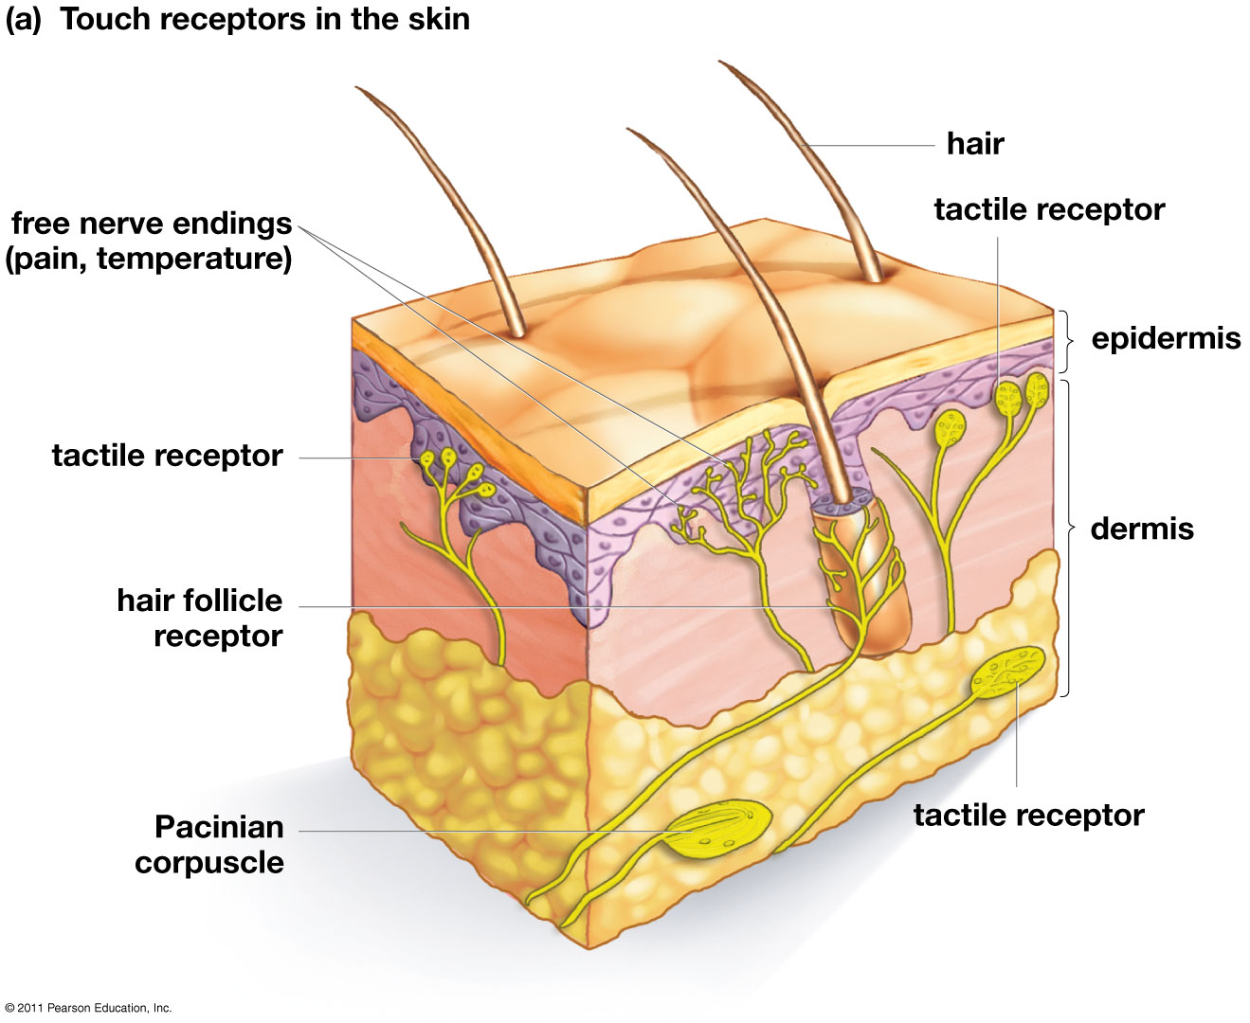
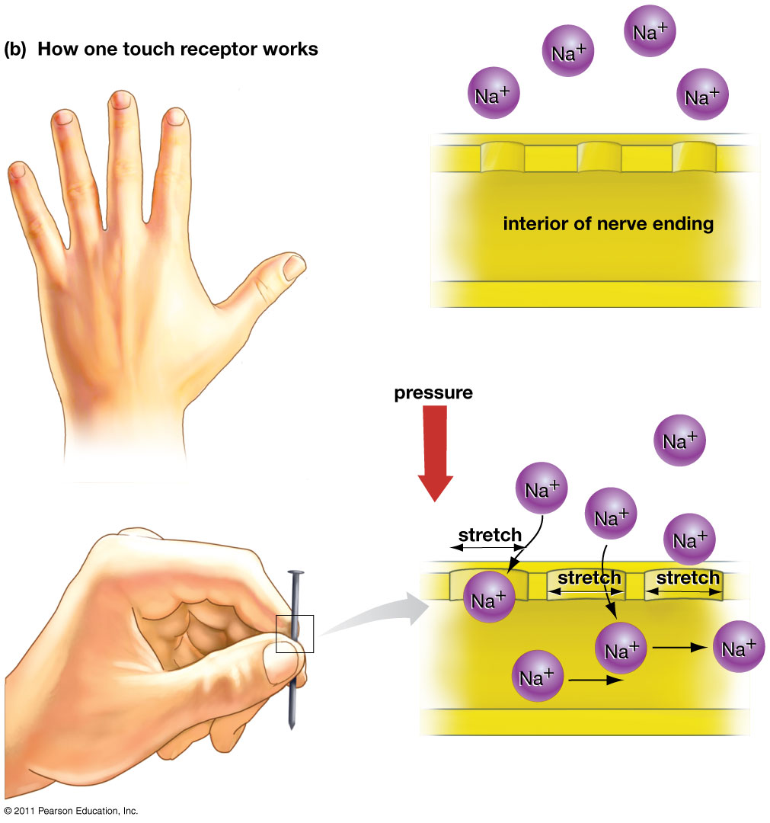
Mechanoreceptors: Touch
Touch receptors in the skin
Ex: Pacinian corpuscle receptor

Slide 36
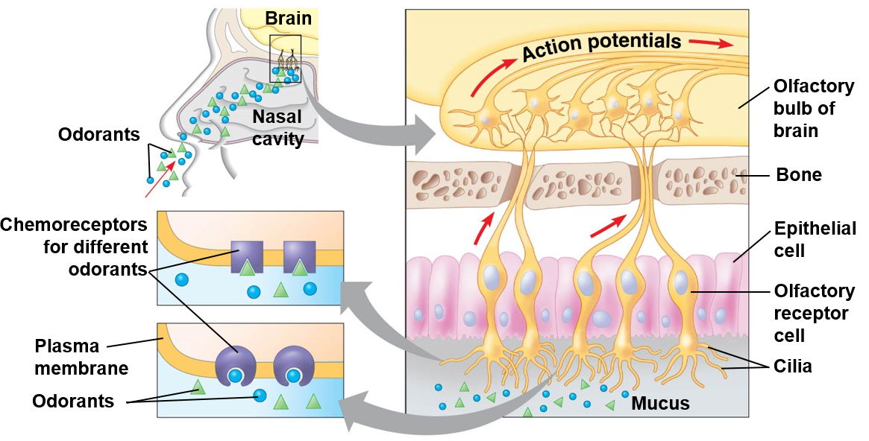
Chemoreceptors: Olfaction (Smell)

Slide 37
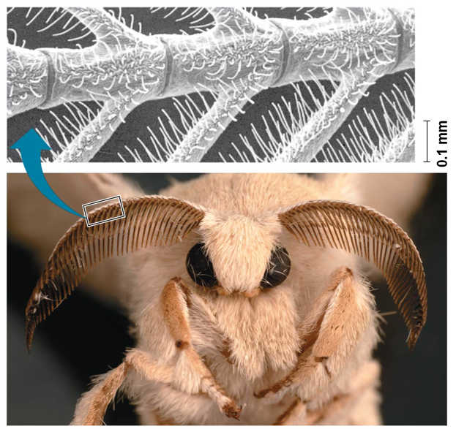
Chemoreceptors: Smell
Silkworm moth senses female pheromones
______ blocks the olfactory receptors in mosquitos that detect human scent

Slide 38
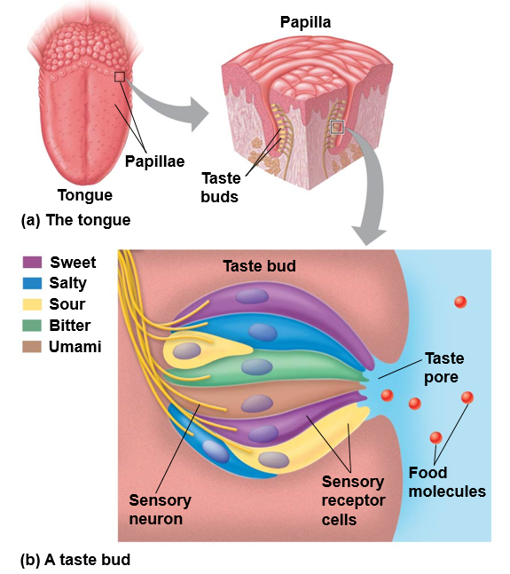
Chemoreceptors: Taste

Slide 39
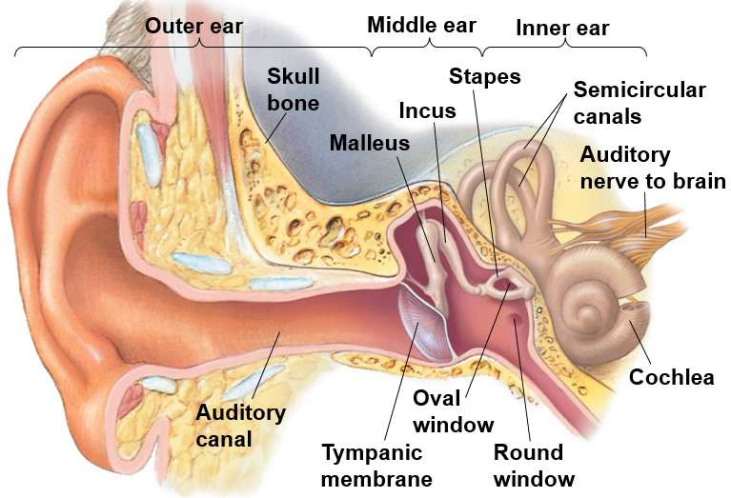
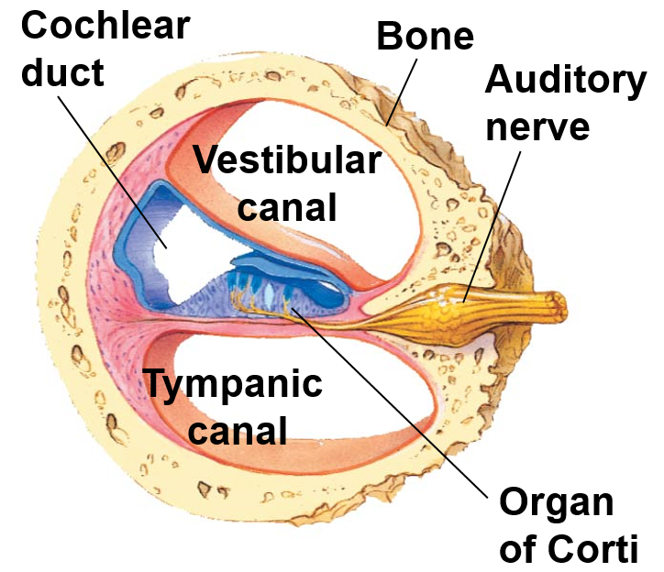
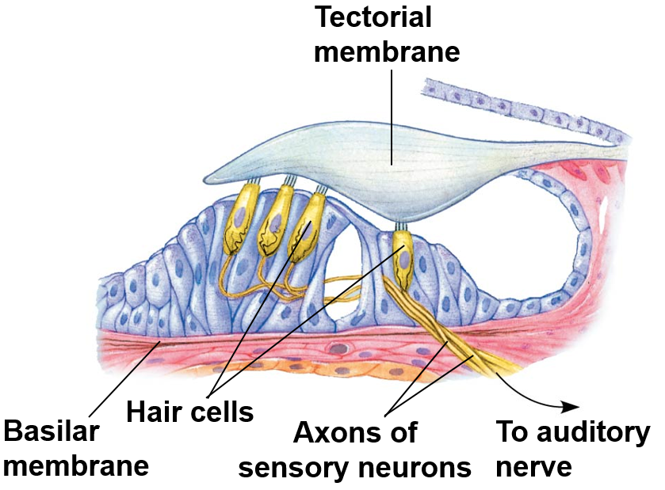
Mechanoreceptors: Hearing
Sound wave

Slide 40
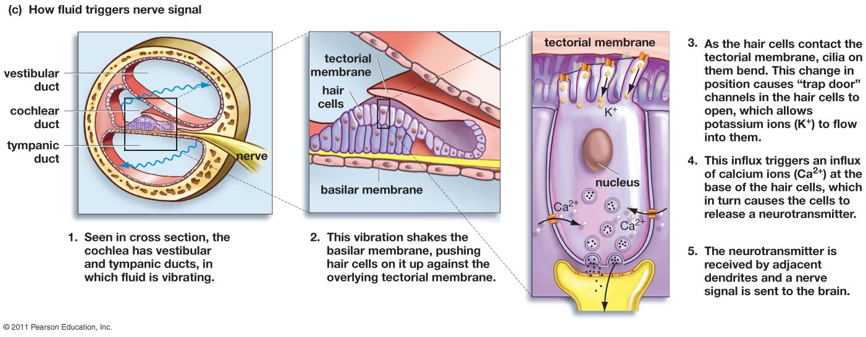
Mechanoreceptors: Hearing

Slide 41
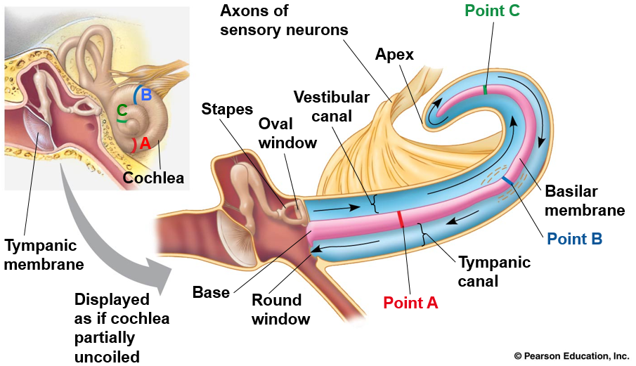
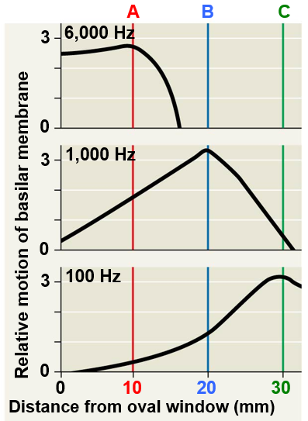
Mechanoreceptors: Hearing
High frequency waves are detected at ________ of cochlea
Low frequency waves towards the end of cochlea

Slide 42
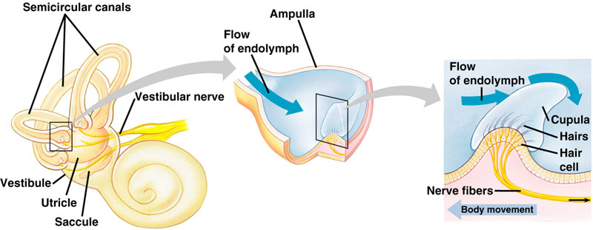
Mechanoreceptors: Balance

Slide 43
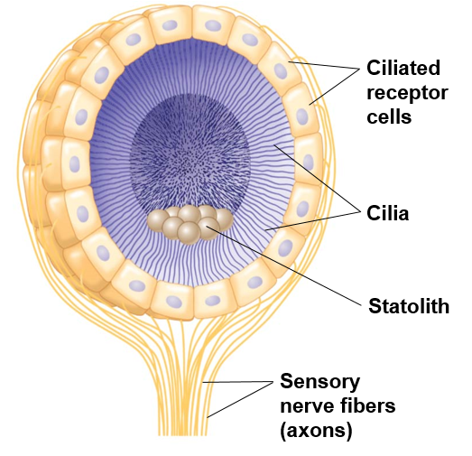
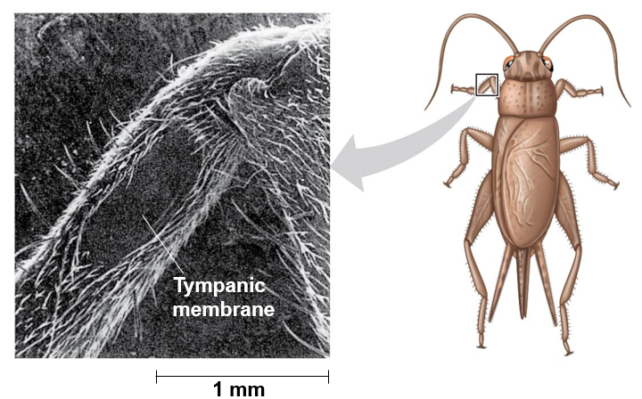
Sensing Gravity and Sound in Invertebrates
____________
Tympanic membrane

Slide 44
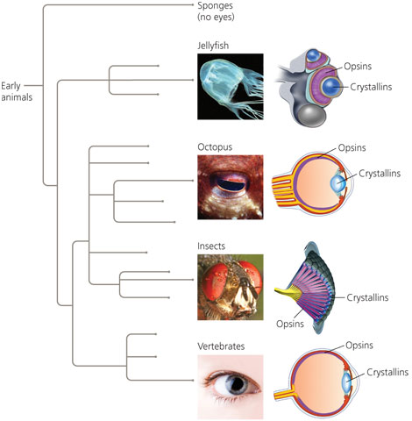
Evolution of the Eye
All light-sensitive organs rely on specialized photo-receptive proteins called _______
Crystallins: transparent structural proteins that make up the lens of the eye in many different eyes
Eyes evolved many times during evolution of animals
Simple eye: single lens
Ocelli: eyespots with concentration of photoreceptor cells
Planarians
__________: eye with lens that can adjust amount of light directed onto photoreceptors
Vertebrate, spiders, many molluscs, polycheate worms
Compound eye: multiple lenses
Insects, crustaceans

Slide 45
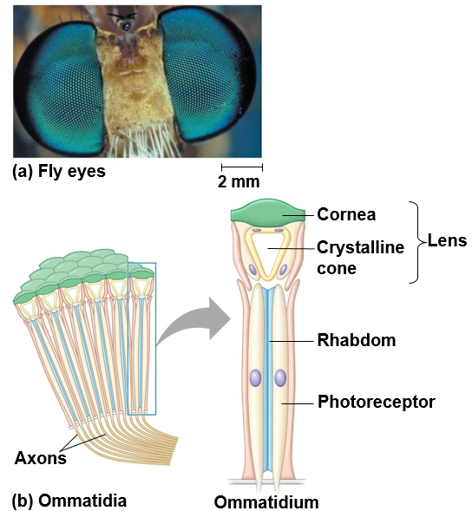
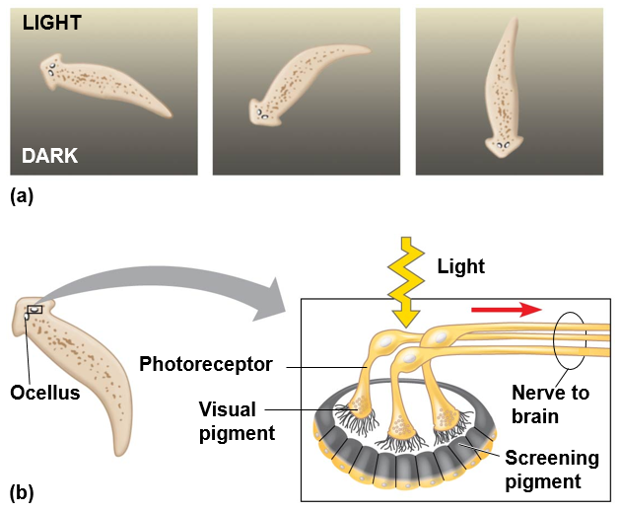
Types of Invertebrate Eyes
Ocelli or eyespots
Compound eye

Slide 46
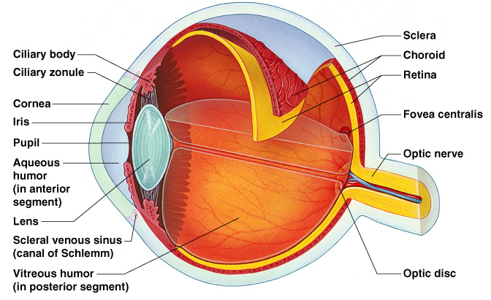
Anatomy of the Human Eye
_______: allows light to enter
eye, changes diameter based on light conditions
Lens: biconvex structure that refracts light passing into the eye
Iris: pigmented smooth
muscle controls pupil diameter
Ciliary body: controls lens shape
With near objects lens bulges, far objects it is thin
Retina: inner layer of eye tissue containing _____________

Slide 47
Photoreceptors: Vision
Rods: photoreceptors that function in _______________ (night vision)
Provide only black-and-white vision
Cones: photoreceptors responsible for ___________
Three types of cones with different color sensitivities

Slide 48
Focusing
Normal vision: light rays converge on retina
Farsighted vision: light rays converge ______ retina
Nearsighted vision: light rays converge _______ of the retina

