Slide 1
Mitosis and Cancer
“There are no traffic jams on the extra mile”
-Zig Ziglar
“Chop your own wood and it will warm you twice”
- Henry Ford
Chapter 9

Slide 2
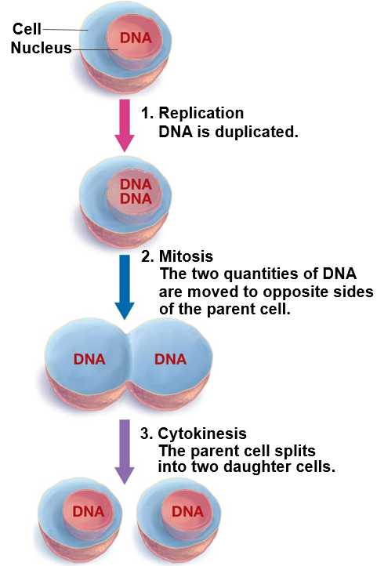
Introduction to Cell Division
Cells come from other cells
Growth
Replacement
Three main steps
DNA replication
Mitosis: division of parent cell’s nucleus and chromosomes
Cytokinesis: division of __________ into two daughter cells
Notes:
Cell division is the basis for human growth, plant development, healing
25 million cell divisions take place in you body every second
Dust is primarily dead skin cells, which are sloughed off every day
Cells die and need to be replaced. Also, cells only grow so large before it need to start over
Not all cells divide (most brain cells form in the first three months of the embryonic phase then live for decades)
Leaf cells grow to a point then function at a mature size

Slide 3
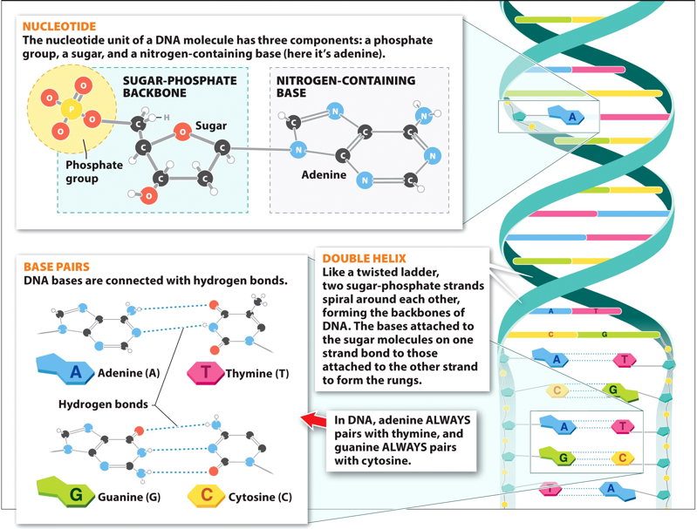
Introduction to Genetics
Deoxyribonucleic acid (DNA): primary information bearing molecule of life.
Two chains of nucleotides linked together to form a double helix
Nucleotide: nitrogenous base attached to a ___________ sugar (ribose) and a phosphate molecule
Complementary base pairs
_________ and Thymine
_________ and Cytosine

Slide 4
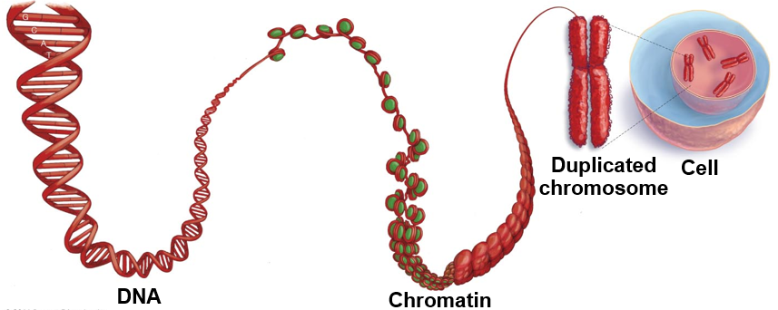
DNA and Chromosomes
________: a specific section of DNA that contains information necessary to produce a protein
Chromatin: linear strand of DNA wrapped around histones
Histones: proteins that keep DNA from getting tangled
________________: a compact strand of DNA
Histones
Genome
Gene

Slide 5
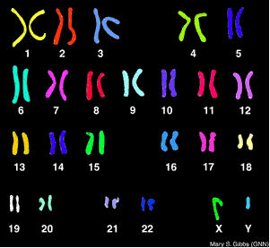
Chromosomes
Genome: complete collection of an organisms genetic information
Karyotype: pictorial arrangement of chromosomes

Slide 6
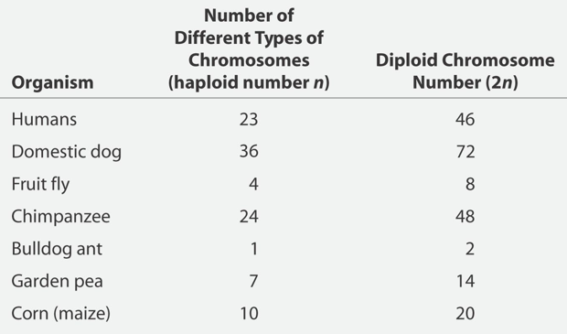
Comparison of Chromosome Number
Haploid: cells with a single copy of each chromosome
___________: sex cell
Egg and sperm
Diploid: cells with two copies of each chromosome, one maternal and one paternal
________ cells: cells forming the body of the organism

Slide 7
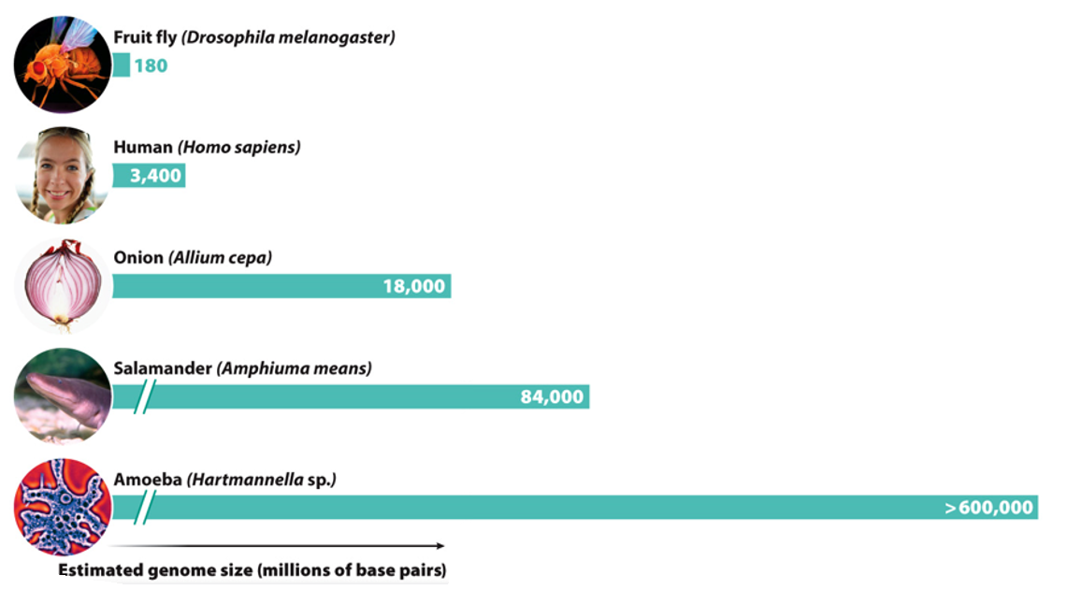
Variation in Genome Size
Size of an organism’s genome is not related to the complexity of the organism

Slide 8
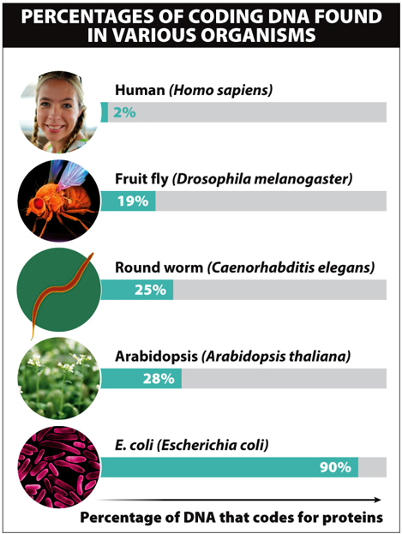
Percentage of Coding DNA
Many organisms have large portions of DNA that do not code for proteins and have no known purpose
Only __% of human DNA codes for proteins

Slide 9
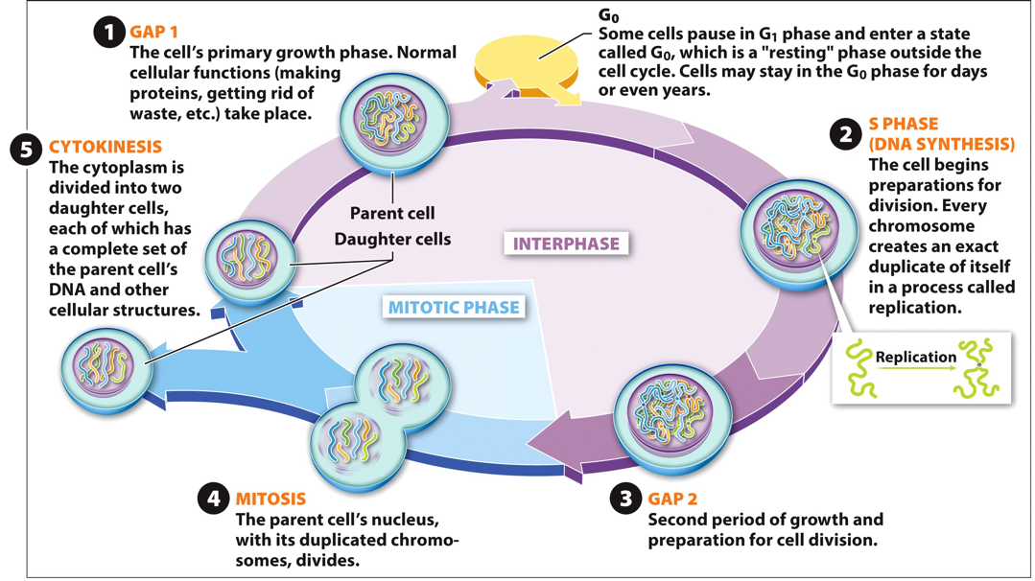
The Cell Cycle

Slide 10
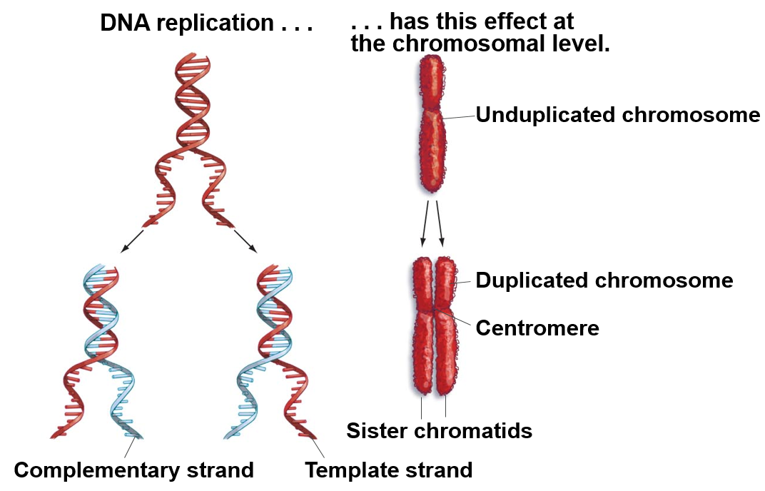
DNA Replication
DNA of unduplicated chromosome unwinds
New DNA nucleotides join with each individual DNA strand to form a new double helix
Duplicated DNA results in duplicated chromosome
Sister chromatids
Centromere

Slide 11
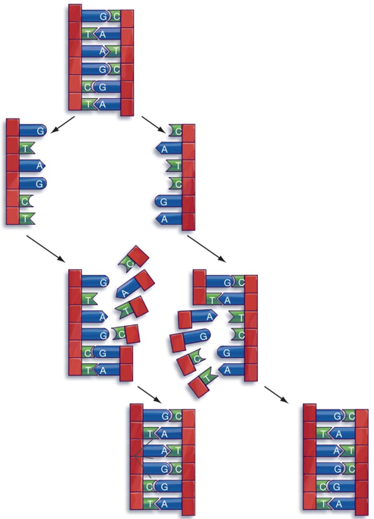
DNA Replication
1. DNA to be replicated
2. Strands separate
3. Each strand now serves as a template
for the synthesis of a separate DNA
molecule as free nucleotides base-pair
with complementary nucleotides on
the existing strands.
Order of bases encodes
Information for protein
production.
4. This results in two
identical strands of DNA.

Slide 12
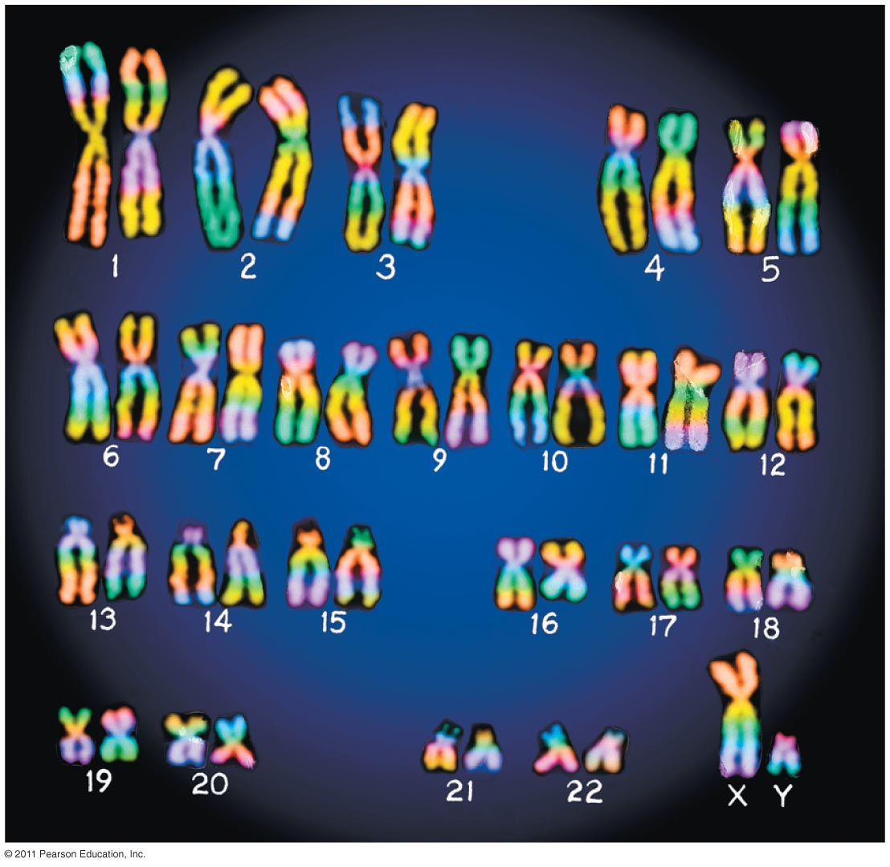
Chromosomes Before and After Replication

Slide 13
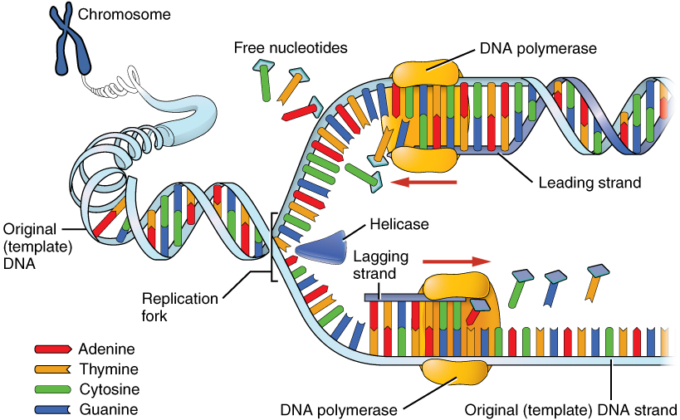
DNA Replication
Helicase: enzyme that unwinds DNA separating it into two complementary strands
__________________: enzyme that creates the complementary strand by adding new DNA nucleotides to the template strand
Notes:
Helicase = Protein that unzips DNA double helix by breaking hydrogen bonds between nucleotides
DNA polymerase = connects free nucleotides with single strand
Single strand binding proteins = prevent single strands from binding with each o
Leading strand = continuous strand, 5’ to 3’ direction
Lagging strand = discontinuous strand, 3’ to 5’ direction

Slide 14
Check Your Understanding
True or False: Gametes are the only cells within the human body that have two sets of chromosomes
True or False: Most of the DNA found in humans codes for proteins
True or False: Adenine always binds with Thymine

Slide 15
Check Your Understanding
A section of DNA that codes for a specific protein is known as ___________.
a. chromatin
b. a genome
c. a chromosome
d. a gene
e. a nucleotide

Slide 16
Check Your Understanding
Which of the following are responsible for unwinding the DNA to form two complementary strands?
a. Histones
b. Helicase
c. DNA polymerase
d. Chromatin
e. Okazaki fragments

Slide 17
The Cell Cycle
Notes:
Cell cycle = pattern of growth, genetic duplication, and division
In animals
Mitotic Phase = mitosis and cytokinesis

Slide 18
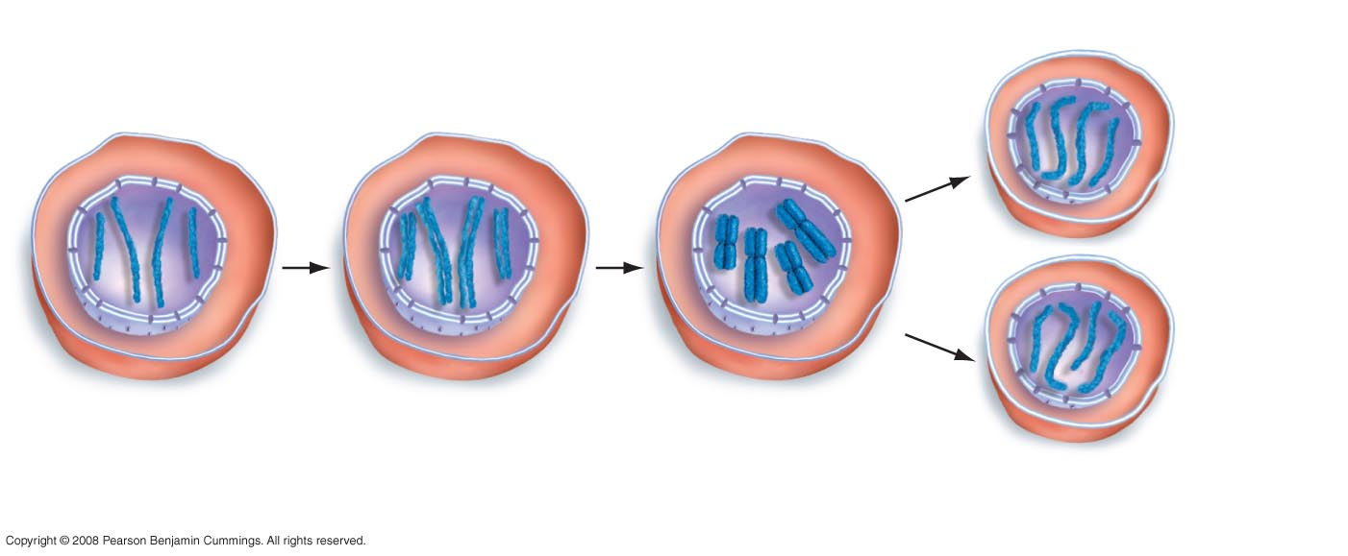
An Overview of Mitosis
Mitosis and Cytokinesis
__________
Daughter cells
contain the same
complement of
chromosomes as
the parent cell.
G₁
S PHASE AND G₂
Sister
chromatids
Parent cell:
4 unreplicated
chromosomes
Parent cell:
4 replicated
chromosomes
During mitosis, sister chromatids
separate. Two daughter cells are
formed by cytokinesis.

Slide 19
Mitosis and Cytokinesis
Prophase
Metaphase
Anaphase
Telophase
Cytokinesis
End of Interphase
Beginning of Interphase

Slide 20
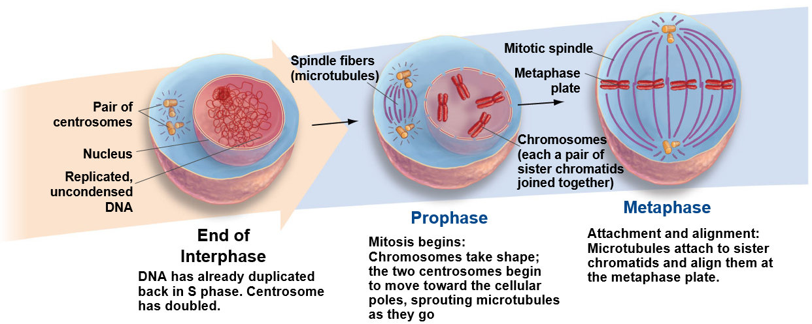
Mitosis

Slide 21
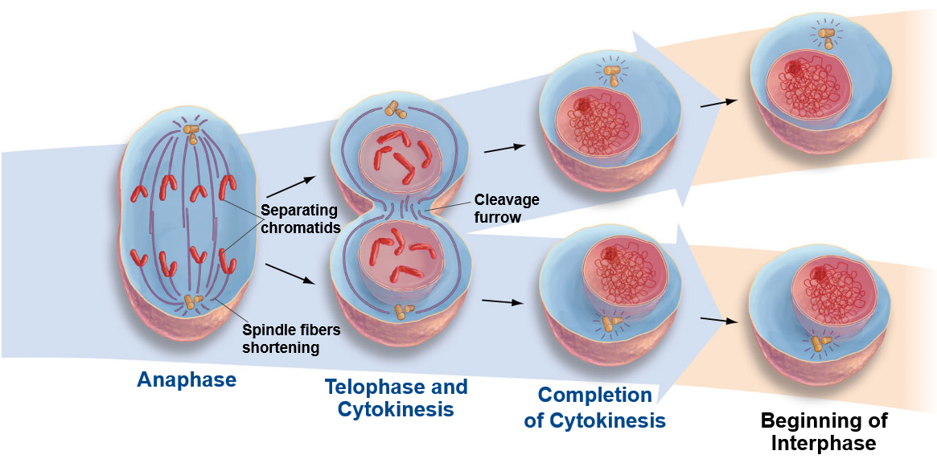
Mitosis and Cytokinesis
Separation:
Sister chromatids are moved to opposite poles in the cell, each chromatid now becoming a full-fledged chromosome.
Exit from mitosis:
Chromosomes unravel; nuclear envelopes form
Cleavage furrow
begins to form.
One cell becomes two:
The cell membrane pinches
together completely
These two cells now enter
the G1 phase of interphase.

Slide 22
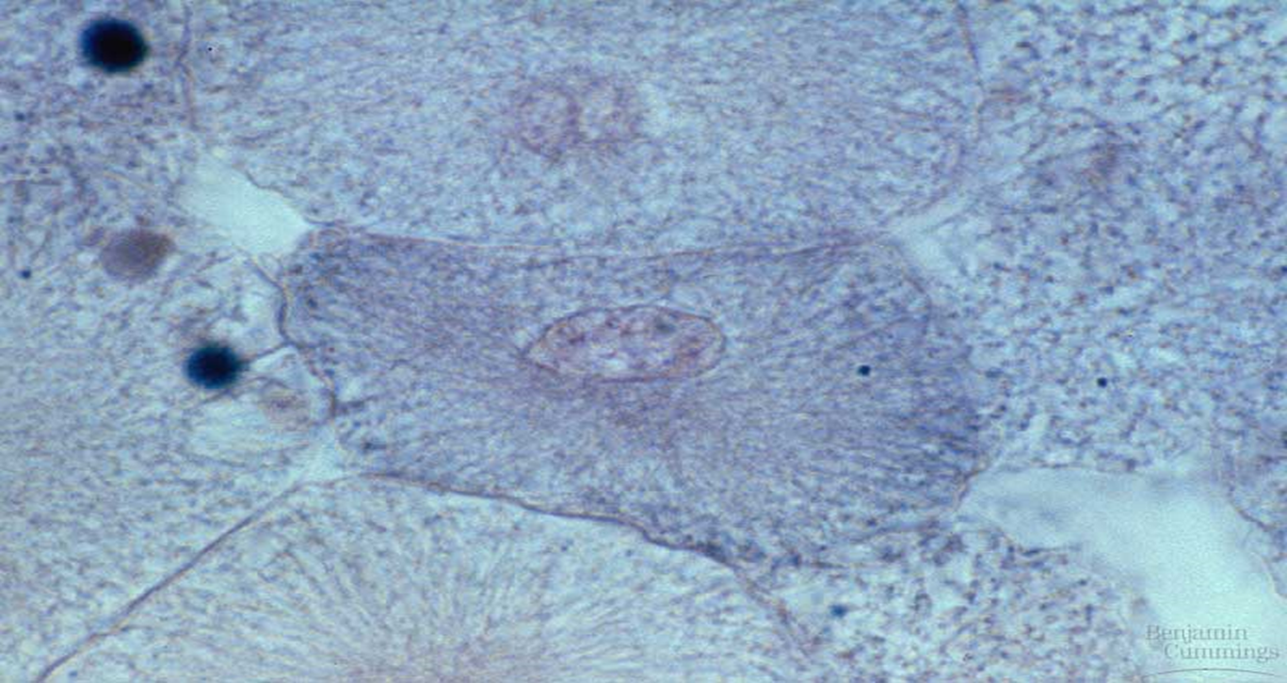
Interphase
Interphase (three parts)
G1 (gap 1 phase) = growth and normal functions
S (synthesis phase) = DNA (chromosome) replication
G2 (gap 2 phase) = growth and normal functions continue
Centrosomes develop
Notes:
Centrosome = structure that acts as an organizing center for assembly of microtubules

Slide 23
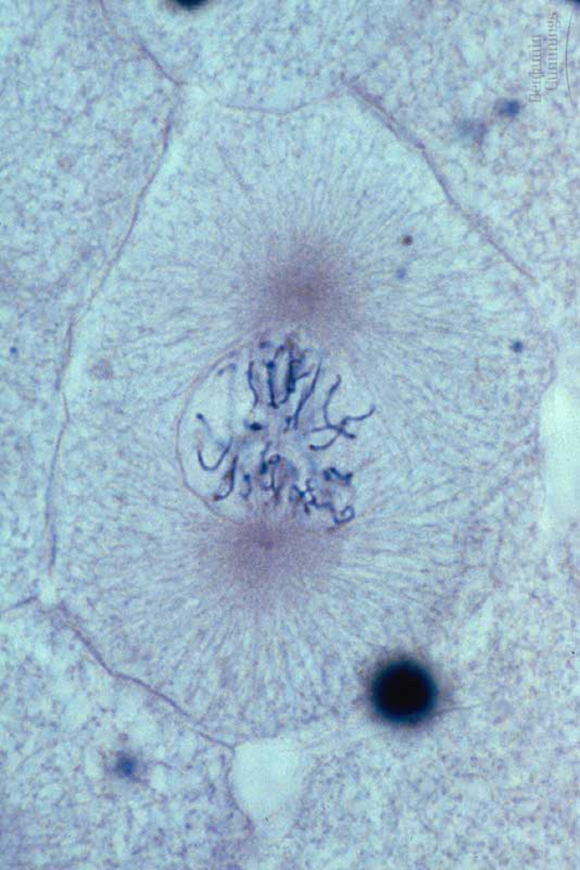
Mitosis: Prophase
Chromatin condenses to form _______________
Nuclear membrane and Nucleolus disappear
Chromosomes
Two chromatids with centromere
Mitotic spindles form
Microtubules
Notes:
Prophase (“before-phase”)
Chromatin condenses to form compact chromosomes
Mitotic spindles = microtubules active in cell division
Spindle fibers = groups of microtubules that attach to chromosomes

Slide 24
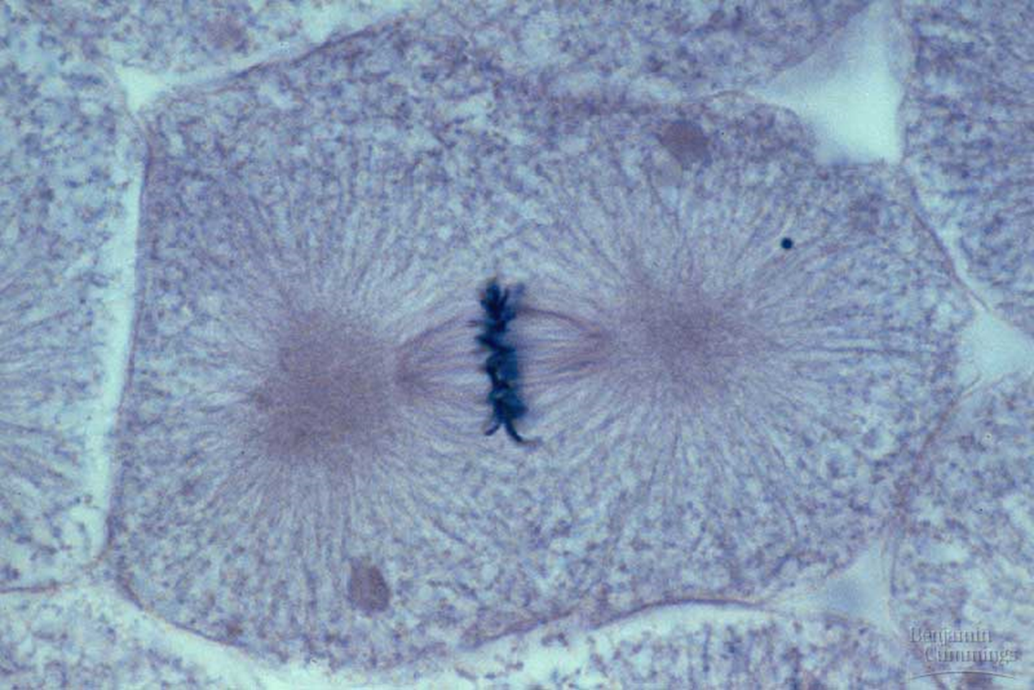
Mitosis: Metaphase
Centrosomes at opposite poles
Microtubules attach to sister chromatids
Chromosomes line up on _________ plate
Notes:
Metaphase plate = imaginary plant where sister chromatids line up

Slide 25
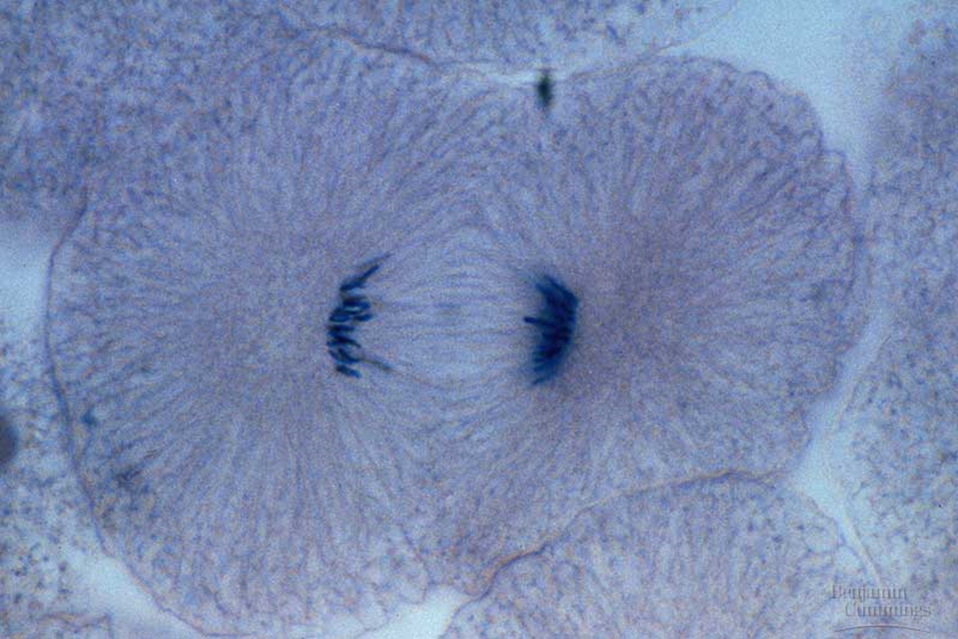
Mitosis: Anaphase
Duplicated chromosomes (sister chromatids) are pulled apart by spindle fibers
One full set of chromosomes goes to one end of the cell and one set goes to the other end
Notes:
Spindle fibers shorten pulling chromosomes apart
Replicated chromosomes split into two sets of unreplicated chromosomes

Slide 26
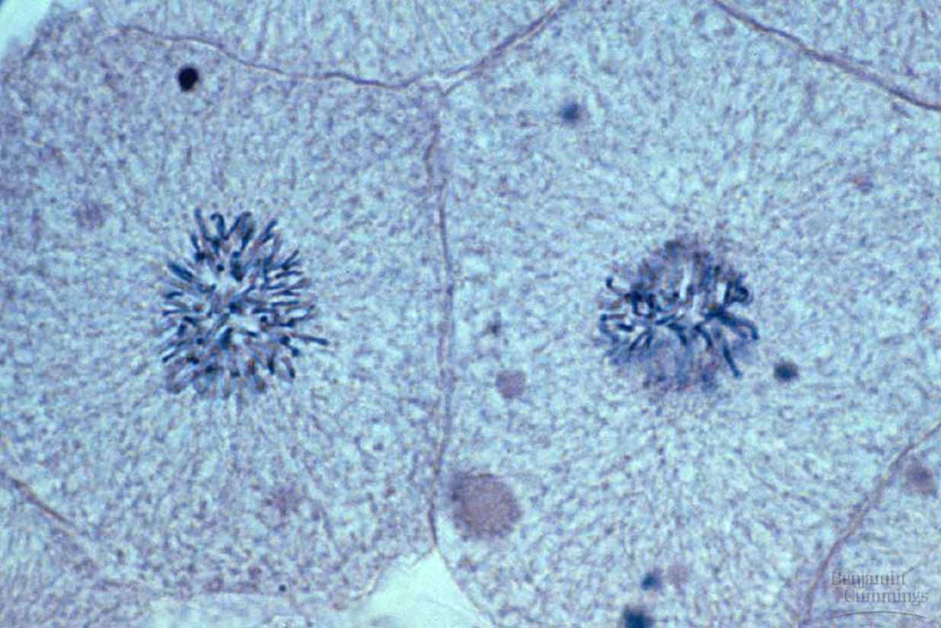
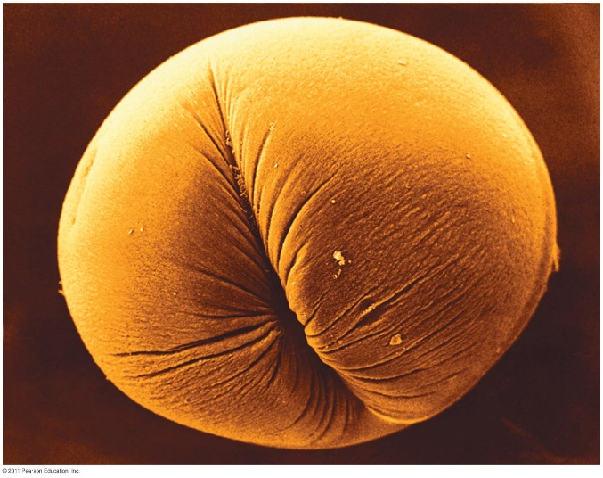
Mitosis: Telophase and Cytokinesis
Reverse of Prophase
Nuclear envelopes reform around chromosomes
Cytokinesis
Animal cells
_______ furrow
Plant cells
Cell Plate

Slide 27
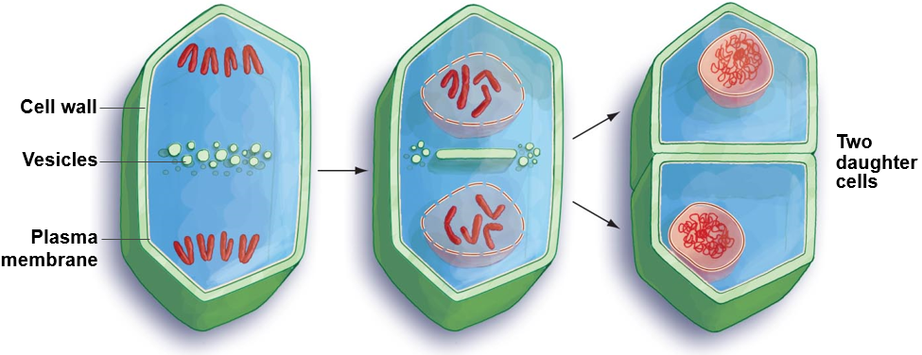
Cell Division in Plants
1. Membrane-lined vesicles accumulate near the metaphase plate. The vesicles contain precursors to the cell wall.
2. Vesicles fuse together, forming a cell plate that grows toward the parent cell wall.
3. The newly formed plasma membrane and cell wall fuse with the parent plasma membrane and cell wall, forming two distinct daughter cells.

Slide 28
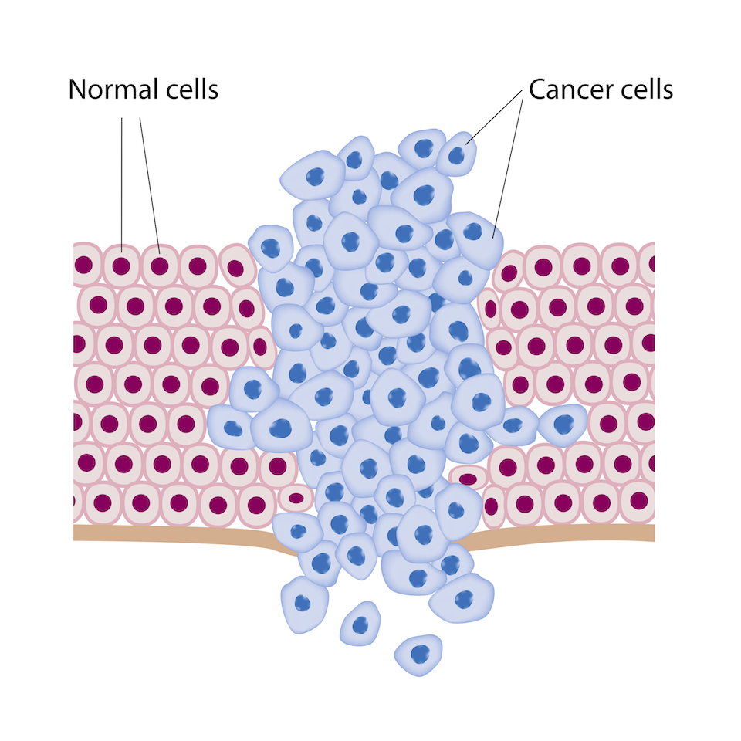
Cancer Cells
Cancer = ___________ cell multiplication, which invade nearby tissues or other parts of the body, destroying working tissues

Slide 29
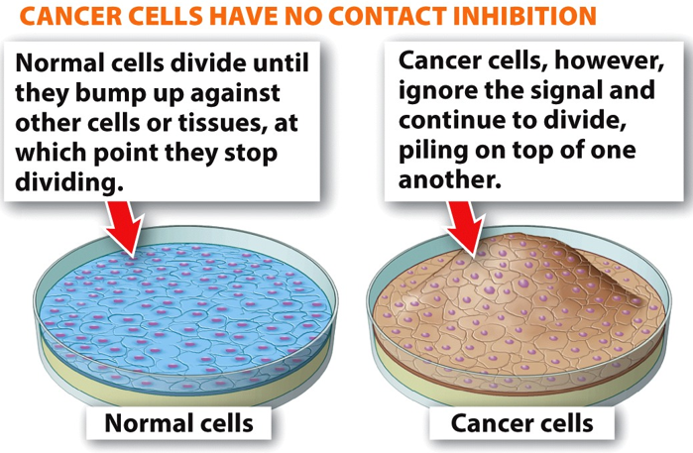
Characteristics of Cancer Cells
Non contact inhibition
____________ arrangement

Slide 30
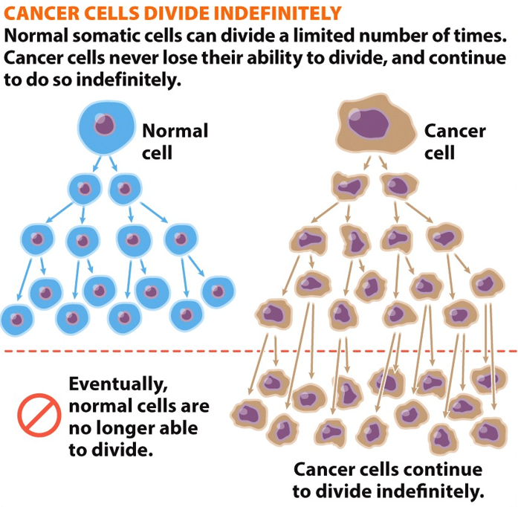
Characteristics of Cancer Cells
Indefinite cell division
Cancer cells can divide an ________ number of times

Slide 31
Characteristics of Cancer Cells
Membrane proteins have reduced adhesive properties
_________ tumors

Slide 32
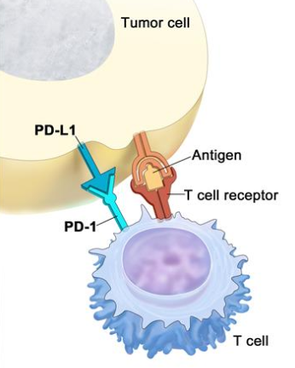
Characteristics of Cancer Cells
T-cell deactivation
Cancer cells have membrane proteins that turn off some immune system cells called T-cells, which prevents the T-cells from finding and killing the cancer cells
Cancer cell
Antigen
Cancer membrane protein
T-cell receptor
T-cell receptor
T-cell

Slide 33
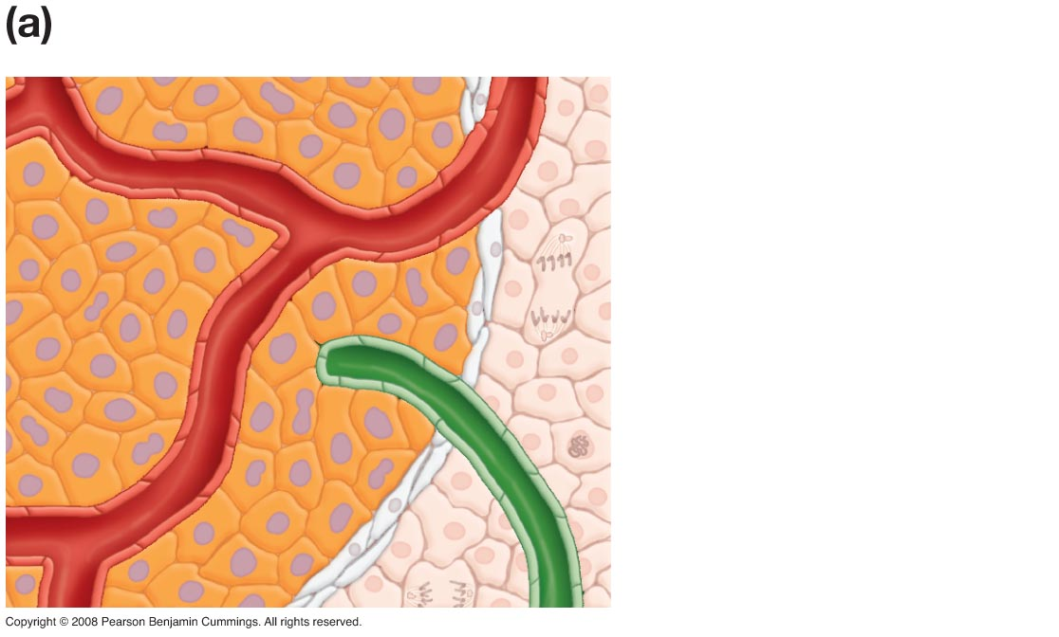
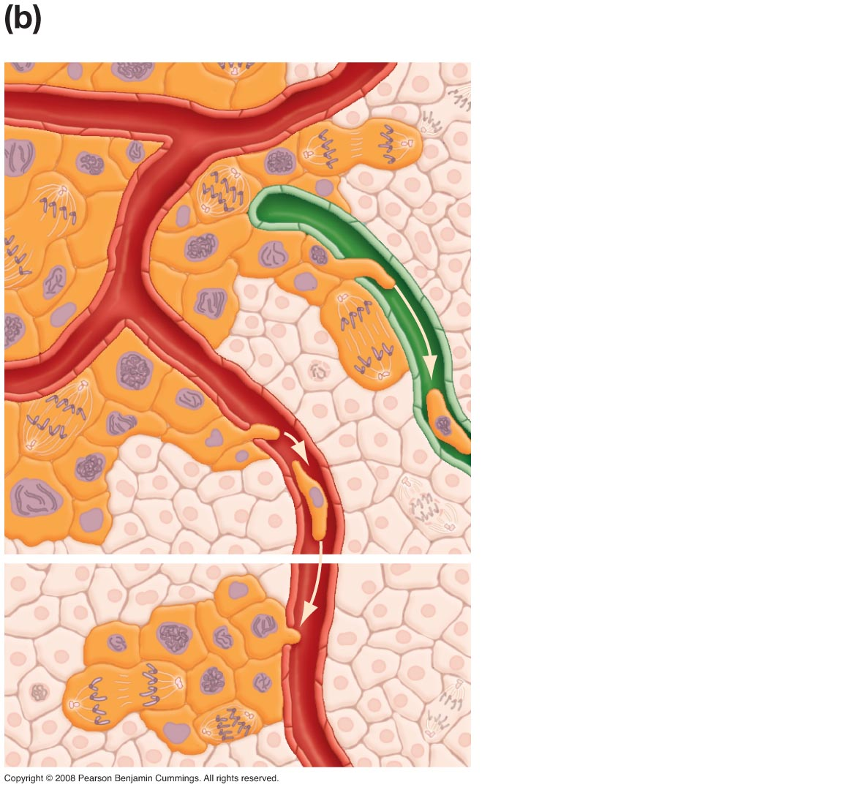
Cancerous Tumors
Benign
Malignant
Malignant tumor cells
divide and spread to
adjacent tissues and to
distant tissues through
lymphatic vessels and
blood vessels
Normal cells
Lymph vessel
Blood vessel
Benign tumor cells
may continue to
divide, but are not
invasive (they do not
spread from tumor)
New tumor that has
formed in distant
tissue by metastasis

Slide 34
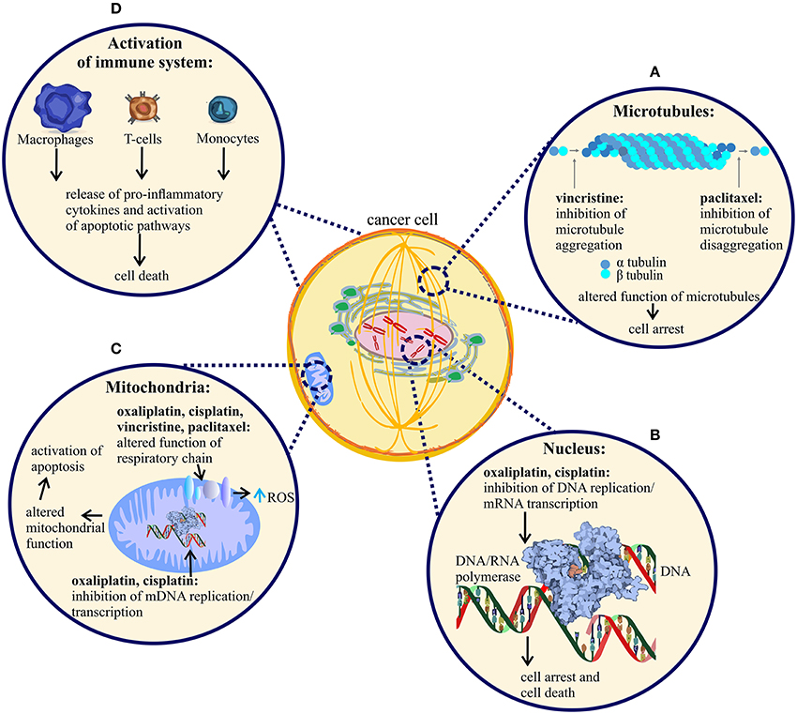
Cancer Treatments
Chemotherapy: treatment using drugs that either kill cancer cells or keep cancer cells from dividing
Drugs designed to attack fast dividing cell
Prevent DNA replication
Prevent transcription
Inhibit microtubule formation
Alter mitochondrial DNA replication and transcription
Notes:
Chemotherapy also attacks fast growing cells in the bone marrow where immune system cells are formed., and in the hair follicles (hair loss) and digestive system (nausea)
Scientists are now able to extract cancer cells and test their response to various cancer drugs to determine which chemotherapies will work best for the patient

Slide 35
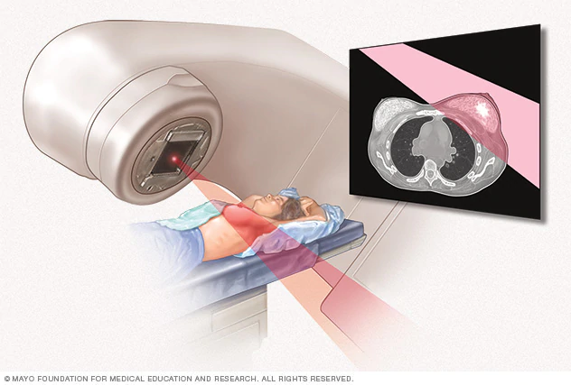
Cancer Treatments
Radiation therapy: ionizing radiation used to damaged the DNA of cancer cells which prevents them from replicating.
Ionizing radiation is radiation caused by high energy particles that cause electrons to detach from atoms or molecules.
Radiation can be administer externally or internally

Slide 36
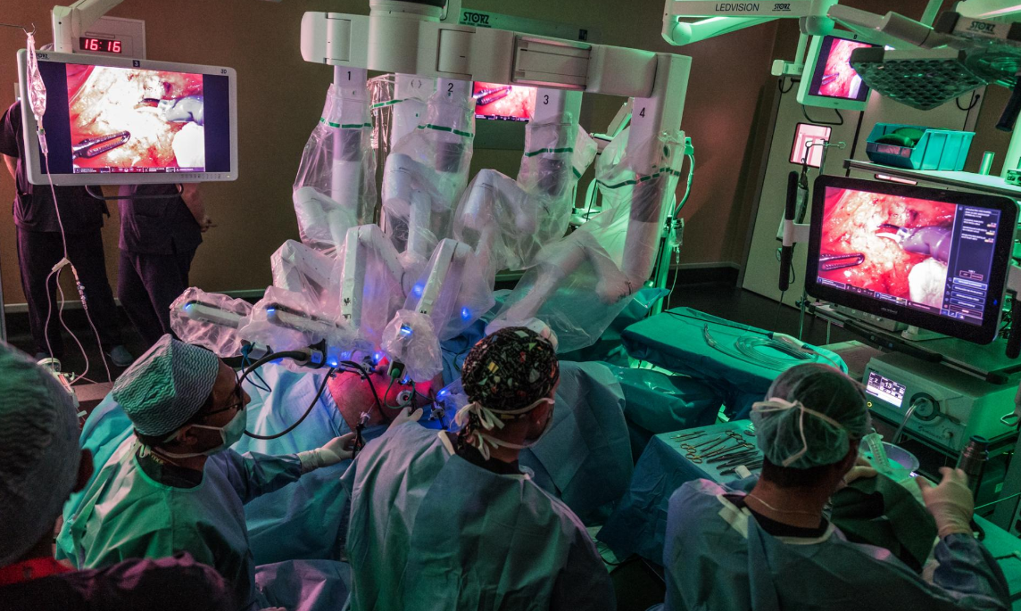
Cancer Treatments
Surgery: surgeons remove cancerous cells or tumors from the body.
Cryosurgery: extreme cold used to destroy cancerous tissue
Hyperthermia: extreme heat used to damage and kill cancerous cells
Lasers: precision lasers used to cut through cancerous tissue
Photo from National Geographic

Slide 37
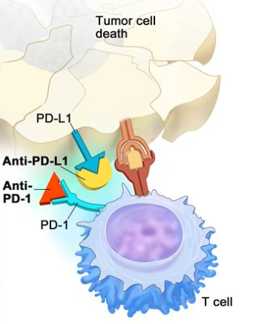
Cancer Treatments
Immunotherapy: drugs that contain protein inhibitors that prevent the cancer proteins from binding with the t-cell receptors, which allows t-cells to destroy cancer cells
Protein inhibitors
T-cell receptor
T-cell

