Slide 1
The Means of Evolution
“Seen in the light of evolution, biology is, perhaps, intellectually the most satisfying and inspiring science. Without that light it becomes a pile of sundry facts―some of them interesting or curious but making no meaningful picture as a whole”
– Theodosius Dobzhansky (1973)
Chapter 7

Slide 2
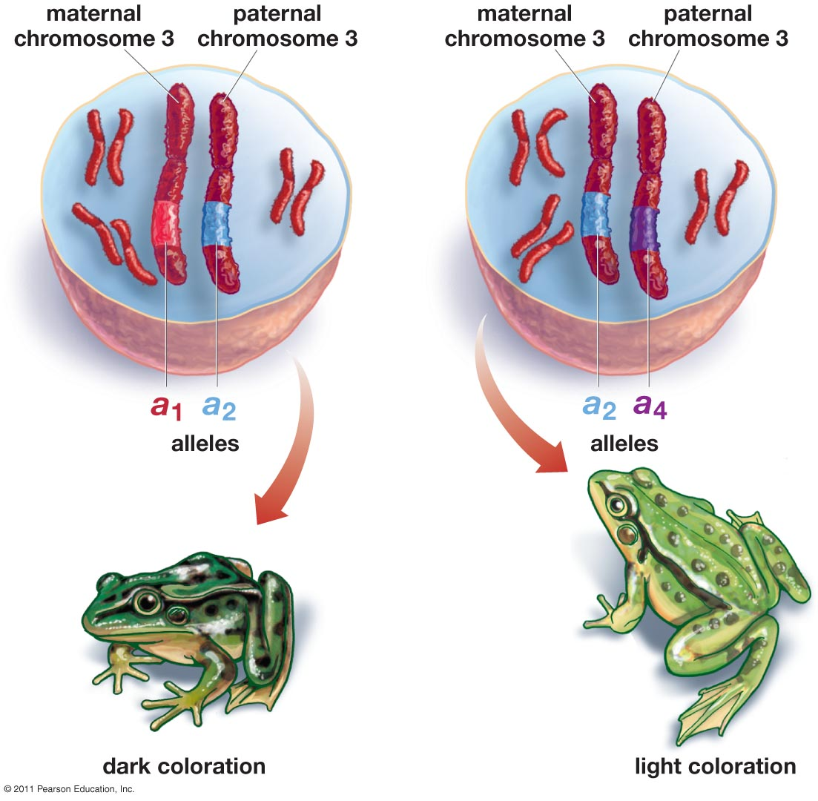
What we know about genetics
Each individual has a genetic blueprint (genotype) that determines their physical and physiological characteristics (phenotype)
Variation of genotype exists among individuals of the same species
Individuals pass on heritable traits to offspring
Sexual reproduction and meiosis
Gene pool: all the alleles that exist within a population

Slide 3
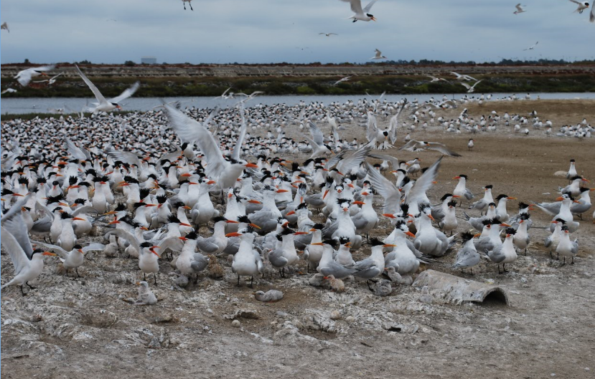
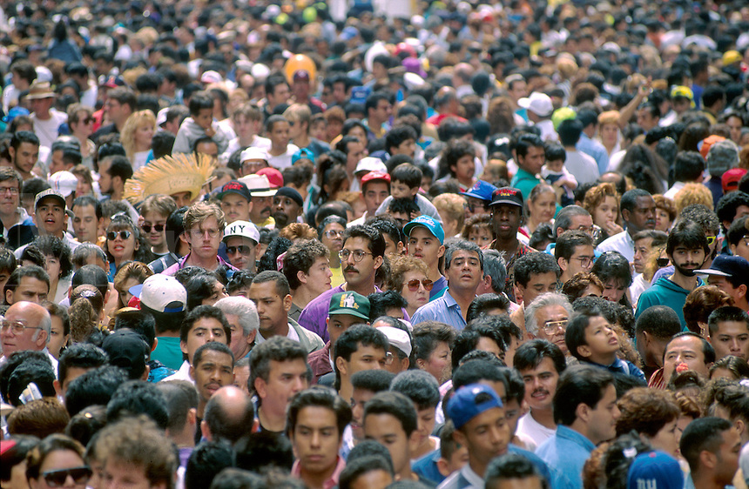
Genetic Diversity
Genetic diversity: genetic variation among individuals of the same species
Adaptive potential
Disease resistance
Antibiotic resistance
Notes:
Humans have relatively low genetic diversity compared to other animals
Adaptive potential: capacity for an organism or ecosystem to adapt to a changing environment.

Slide 4
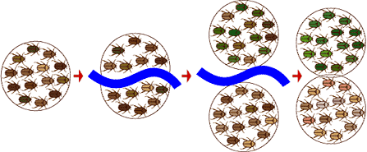
Types of Evolutionary Change
Microevolution: evolutionary change resulting from a change of the allele frequencies of a population
Macroevolution: Large-scale change occurring over long periods of time that results in the formation of new species (speciation)
2 species
1 species
Time

Slide 5
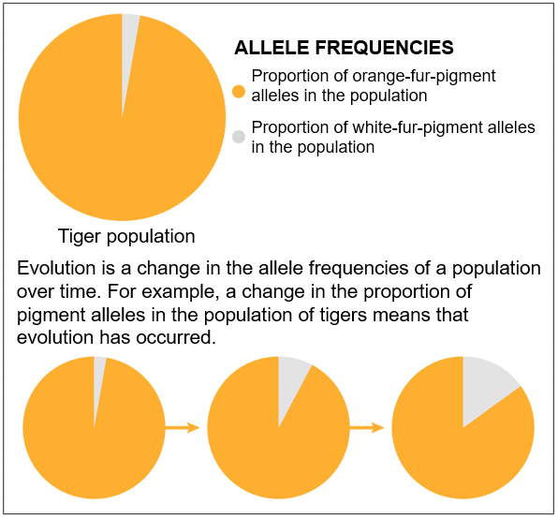
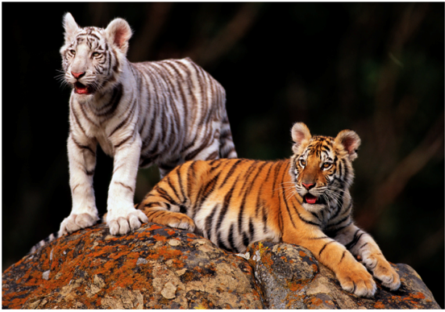
Microevolution in Captive Tigers

Slide 6
How does microevolution occur?
Population: Individuals of the same species that live in the same area at the same time and have the potential to interbreed
Five mechanisms of evolutionary change within a population
1) Mutation
2) Gene flow
3) Genetic drift
4) Natural selection
5) Sexual selection

Slide 7
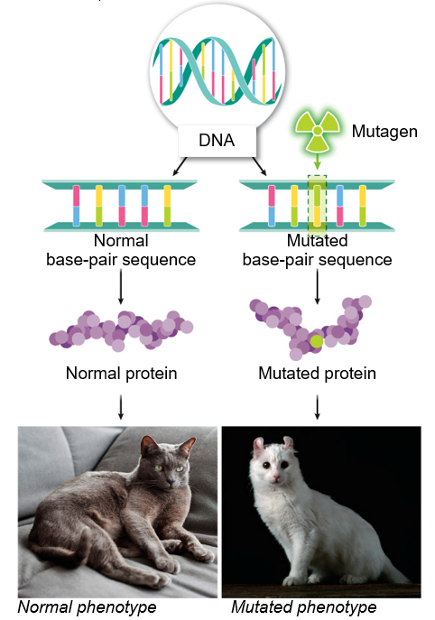
Mutation
Mutation: a permanent change in an organism’s DNA
Are random
*Organisms can not will a change
Primary way new alleles are created
Only mutations that affect reproductive cells can be inherited
Can be positive (beneficial) or negative (deleterious) towards fitness
Deleterious mutations eliminated through purifying selection
Notes:
Occur at a very low rate
Once per 30 million DNA base pair duplications
Mutagens can increase the rate of mutations but not the genes that are mutated
Mutations may create new alleles in the population which may confer a higher fitness in the future

Slide 8
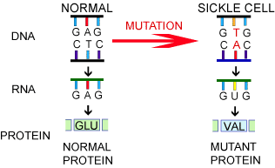
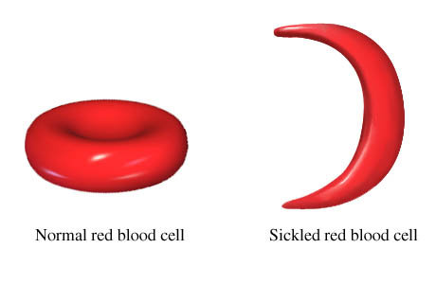
Mutation: Sickle Cell Anemia
A single mutation alters the shape of the hemoglobin
Sickle shaped red blood cells can clog blood vessels causing pain and death
Images from evolution.berkeley.edu and web.md.com

Slide 9
Beetle Case Study: Mutation
1) Mutation occurs in the DNA of a beetle resulting in a new brown phenotype
2) Brown beetle survives and produces offspring, increasing frequency of allele for brown phenotype in the population
Mutated gene results in brown coloration
Image from evolution.berkeley.edu

Slide 10
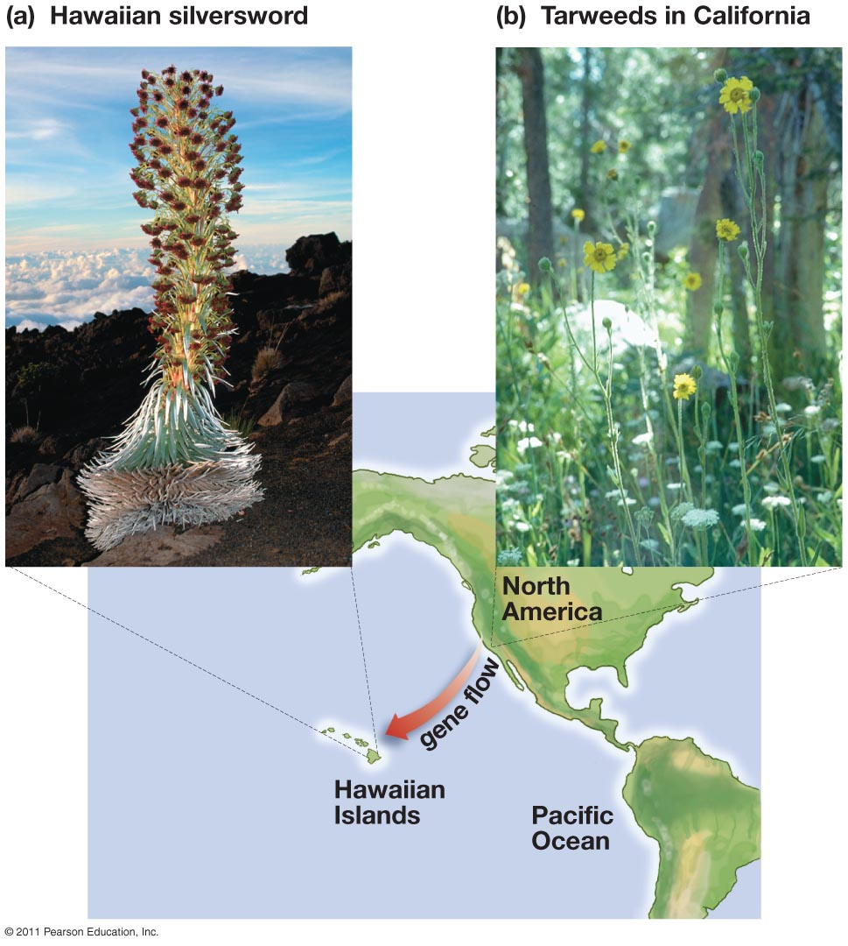
Gene Flow
Gene flow: the movement of alleles from one population to another
Random with respect to fitness
Occurs through migration of individuals
Can reduce genetic differences between populations

Slide 11
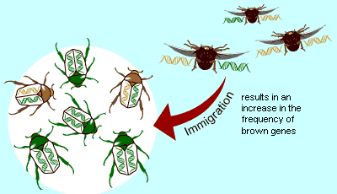
Beetle Case Study: Gene Flow
Individuals with brown allele in genotype migrate to a different population and increase genetic variability of new population

Slide 12
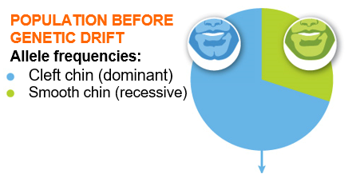
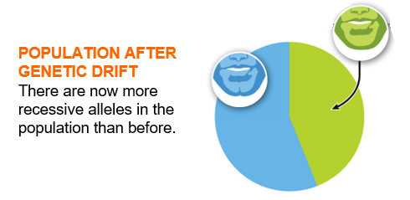
Genetic drift
Genetic drift: a random shift in change in the allele frequencies of a population
Random with respect to fitness
Most pronounced in small populations
Can lead to the loss or fixation of alleles
Fixation: when genetic drift leads to fixation when an allele’s frequency becomes 100% in a population.
Loss of genetic variation of the gene
Reproduction results in increase in homozygous recessive individuals

Slide 13
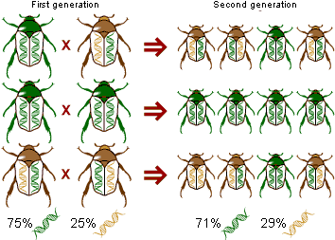
Beetle Case Study: Genetic Drift
By random occurrence the brown alleles increased in the second generation

Slide 14
Genetic Drift
Genetic drift is most pronounced in smaller populations

Slide 15
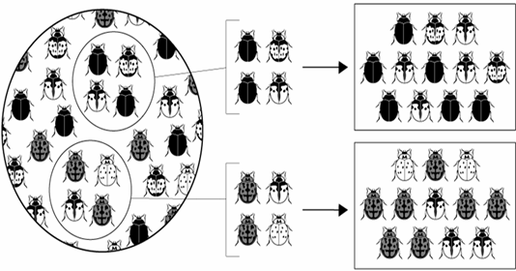
Genetic Drift in Small Populations
Founder effect: a change in allele frequencies that occurs when a new population is established
Alleles of founders are random with respect to fitness
Alleles of founders shape the alleles of the new populations

Slide 16
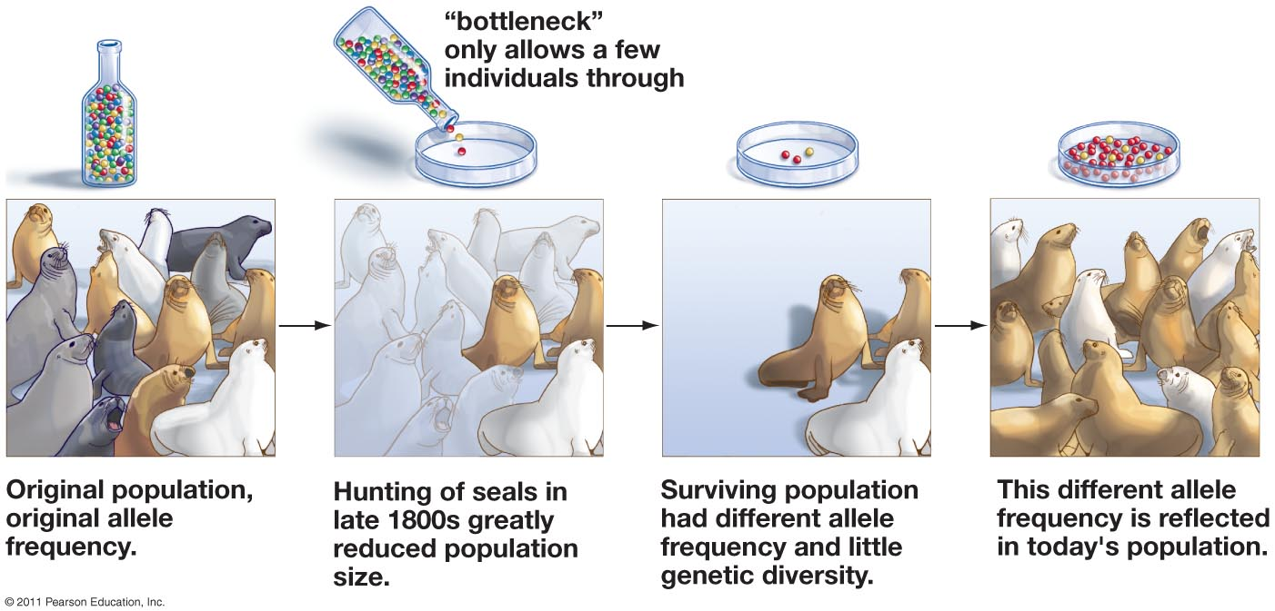
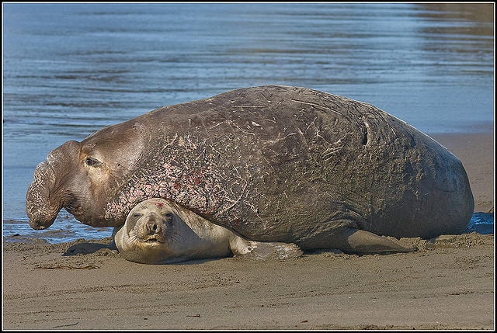
Genetic Drift in Small Populations
Genetic bottleneck: a sudden reduction in the alleles of a population
Ex. Elephant seals
Notes:
Most northern elephant seals were killed by whalers and sealers in the late 1800’s, but an estimated 20 to 100 individuals survived on Guadalupe Island in Baja California

Slide 17
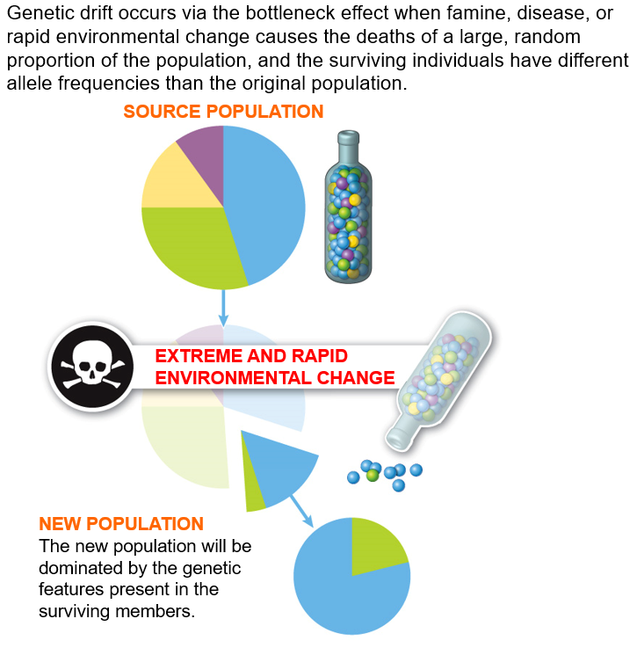
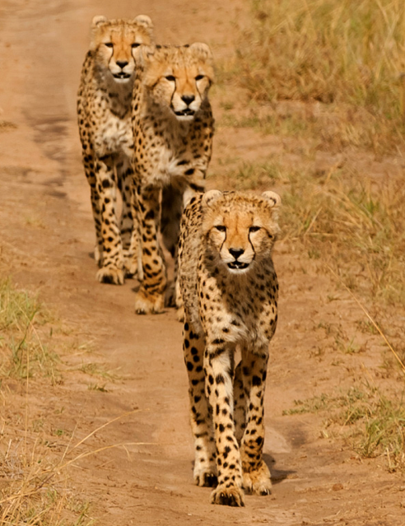
Genetic Bottleneck
Notes:
Cheetahs underwent a genetic bottle neck around 12,000 years ago at the end of the last ice age.
Related animals in most species share 80% gene similarity, whereas cheetahs have a 99% similarity among almost all cheetahs
Researchers working to increase genetic diversity

Slide 18
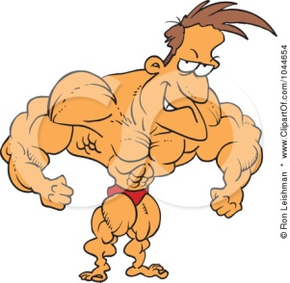
Natural Selection
Biological fitness: ability of an individual to produce viable offspring, relative to other individuals of the same species
“Survival of the fittest”
Adaptation: heritable trait that increases the fitness of an individual relative to individuals lacking that trait in the same environment
Adaptations do not occur because of want or need

Slide 19
Natural Selection
Natural selection: The process by which individuals with certain heritable traits tend to produce more surviving offspring than do individuals without those traits
Natural “selection” is a non-random process
Only process to consistently influencing adaption of within a populations

Slide 20
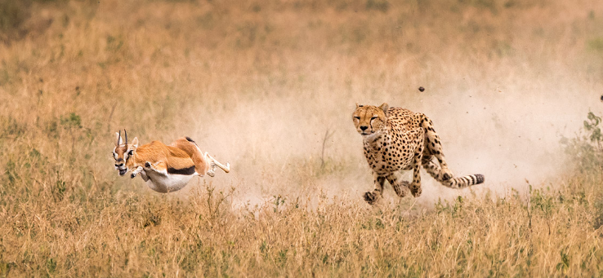
Natural Selection
Selective pressure: Any factor that reduces the survival and/or reproductive success of a portion of the population
Environmental conditions
Temperature, rainfall
Predation/prey
Evolutionary arms race

Slide 21
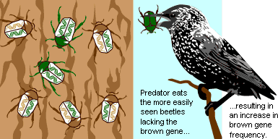
Beetle Case Study: Natural Selection
Green beetle phenotype is easier for predator to find against brown bark. Green genotype is reduced and brown phenotype is increased in population

Slide 22
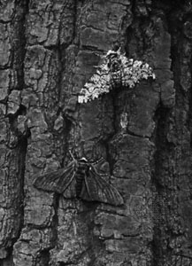
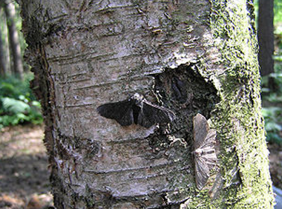
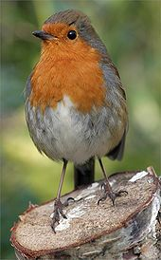
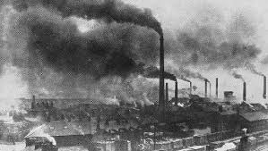
Natural Selection: Peppered Moth
Peppered moth
Two morphs
Gray with black spots
Black
In 1848 gray morph ≈ 98% of population, by 1900 black morph ≈ 95% of population
Industrial revolution
Coal factories covered forests in soot
Increased environmental standards has led to an increase in gray morph
Notes:
Take Away: genetic diversity in peppered moths allowed for the population to adapt to a changing environment
Dark morph peppered moths were extremely rare in mid 1800s but by the turn on the century the dark morph made up as much as 95% of the population round English cities.
Dark and light morph are examples of different alleles (versions of a gene)
Shift in allele frequency of a population is known as __________________________. Not the evolution of microscopic organisms.
Moths active at night and hide on trees during the day
European robin and other birds act as selector

Slide 23
Natural Selection: Bacteria
Antibiotic resistance: rapid evolution in bacteria that is the result of selection by antibiotics and the rapid reproduction and variation in bacteria
Mutated bacteria with antibiotic resistant gene
Population of bacteria
Bacteria divide and one bacteria contains a mutation
Antibiotic resistant bacteria survives
New population of antibiotic resistant bacteria grows
Notes:
Mutation is the primary way new alleles are created
Antibiotic resistance
Many bacterial reproduce every 1 to 3 hours, while some can replicate every 20 minutes.
Penicillin and tetracycline
Stain of super gonorrhea in Europe

Slide 24
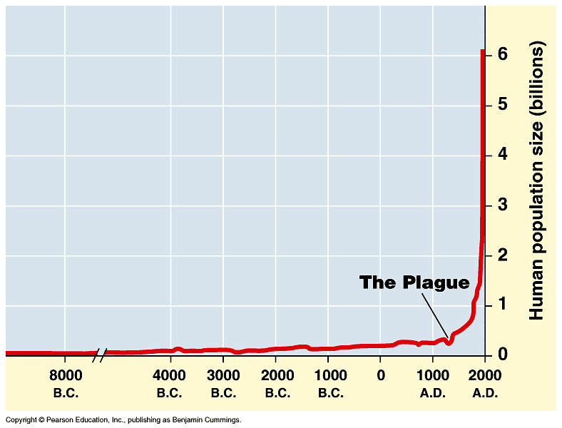
Natural Selection: Human Disease
Disease resistance: some individuals within the population have genes that make them resistant to certain diseases
Bubonic plague
Ebola and HIV

Slide 25
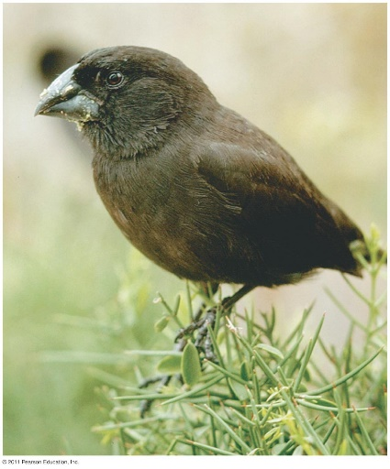
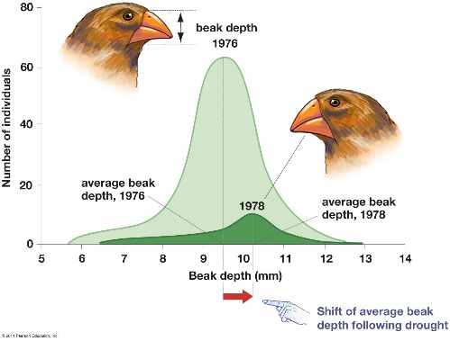
Natural Selection: Galapagos Finches
Peter and Rosemary Grant
Severe drought of Daphne Major in 1977
85% of ground finch population died off
Individuals with larger beaks were able to eat more seeds
Geospiza fortis
Notes:
In 1984 and 85 there was an abundance of small seeds which caused a shift towards smaller beaks

Slide 26
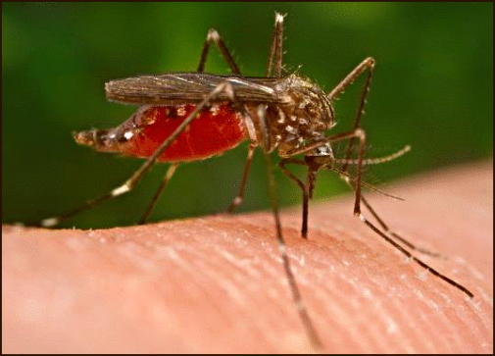
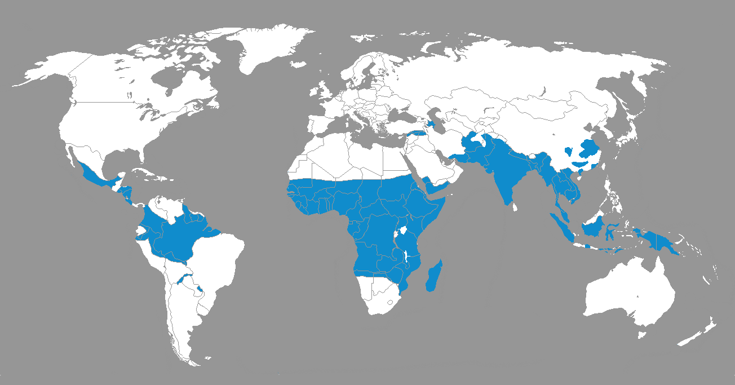
Natural Selection: Sickle Cell Anemia
Sickle cell anemia is a recessive trait
Carriers have strong resistance to malaria
Carriers of sickle cell trait selected for in malaria stricken regions

Slide 27
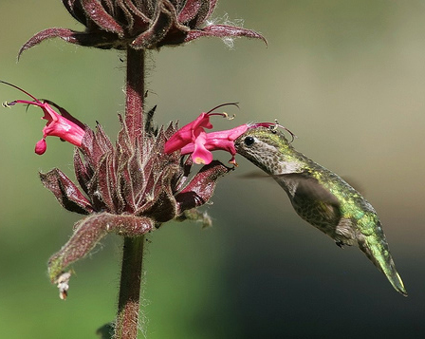
Coevolution
Coevolution: the process where two species reciprocally influence the other’s evolution
Predator and prey interactions
Competitive species
Mutualistic relationships
Pollinators and plants

Slide 28
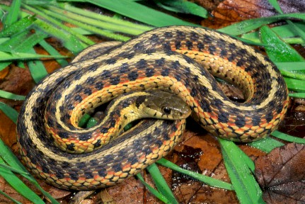
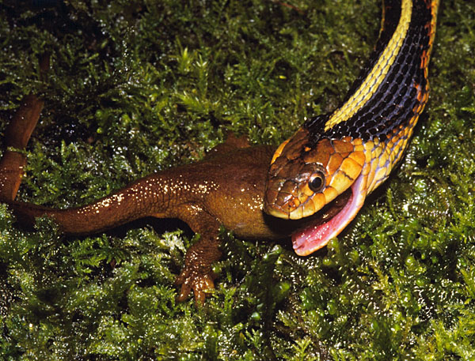
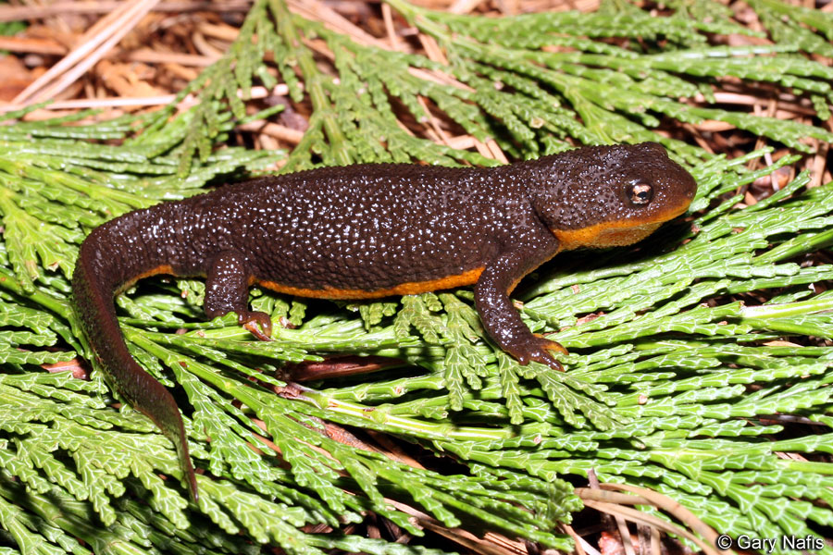
Evolutionary Arms Race
Evolutionary arms race: Coevolution between predator and prey species where adaptations in one species influence the evolution of counter adaptations in the other species
Garter snake and rough skinned newt

Slide 29
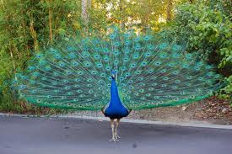
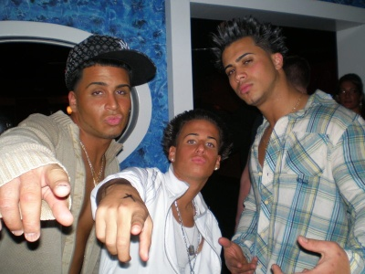
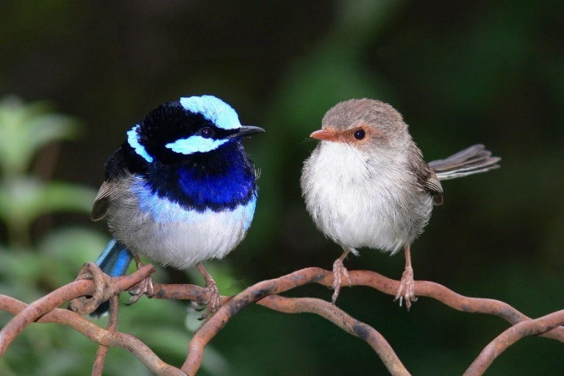
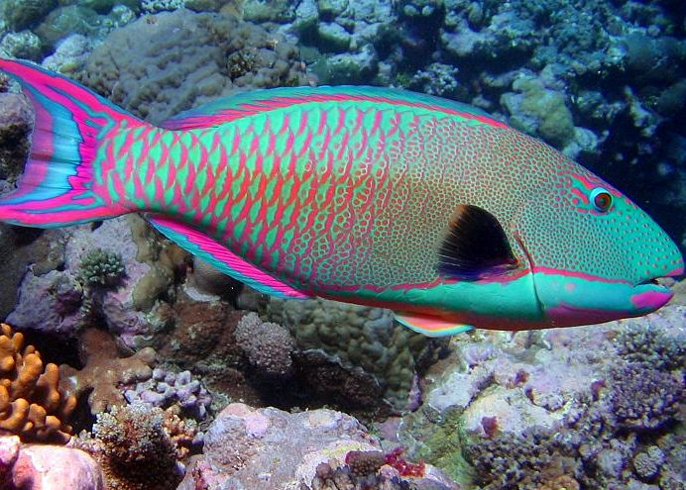
Sexual Selection
Sexual selection: selection based on an organisms ability to obtain a mate
Typically female choice
Can have fitness trade-offs
Sexual dimorphism: phenotypic differences in the males and females of the same species

Slide 31
Check Your Understanding
True or False: Evolution occurs when some individuals in a population survive longer than other individuals in the population
True or False: Mutations in somatic cells can result in evolutionary change
True or False: Genetic drift is more pronounced in small populations

Slide 32
Check Your Understanding
Which of the following mechanisms of evolutionary change are non random with respect to fitness?
a. Gene flow
b. Mutation
c. Natural selection
d. Genetic drift

Slide 33
Check Your Understanding
Which of the following is not an example of natural selection?
a. The evolution of antibiotic resistant bacteria
b. A sudden reduction in alleles due to a genetic bottleneck
c. The addition of new alleles to a population
d. The coevolution of predator and prey species
e. More than one of the above is not an example of natural selection

Slide 34
Summary of Evolutionary Mechanisms
Mutations are they only mechanism to produce new alleles
Genetic drift and gene flow are greatest in small populations
Natural selection can produce adaptations
Mutations, genetic drift and gene flow are random while natural selection is non-random
Mechanisms of microevolution are precursors to large scale change (Macroevolution)

