Slide 1
Biological Molecules
"Knowledge is knowing that a tomato is a fruit. Wisdom is knowing that a tomato doesn't belong in a fruit salad."
- Miles Kingston
“I learned very early the difference between knowing the name of something and knowing something.”
- Richard P. Feynman
Chapters 2 and 22
Notes:
Bid question of the day:

Slide 2
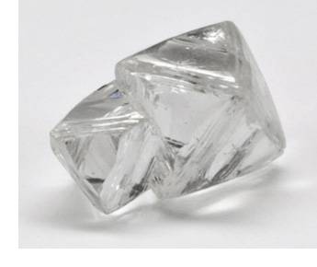
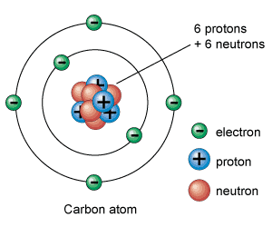
Organic Chemistry
Carbon is the backbone of life
Earth’s crust = 0.05% carbon
Earth’s atmosphere = 0.01% carbon
Organisms = 18% carbon w/ water and 50% w/out water
Carbon forms ___________ bonds
with many different elements
High bonding capacity
Four electrons in outer shell
Forms long, stable chains

Slide 3
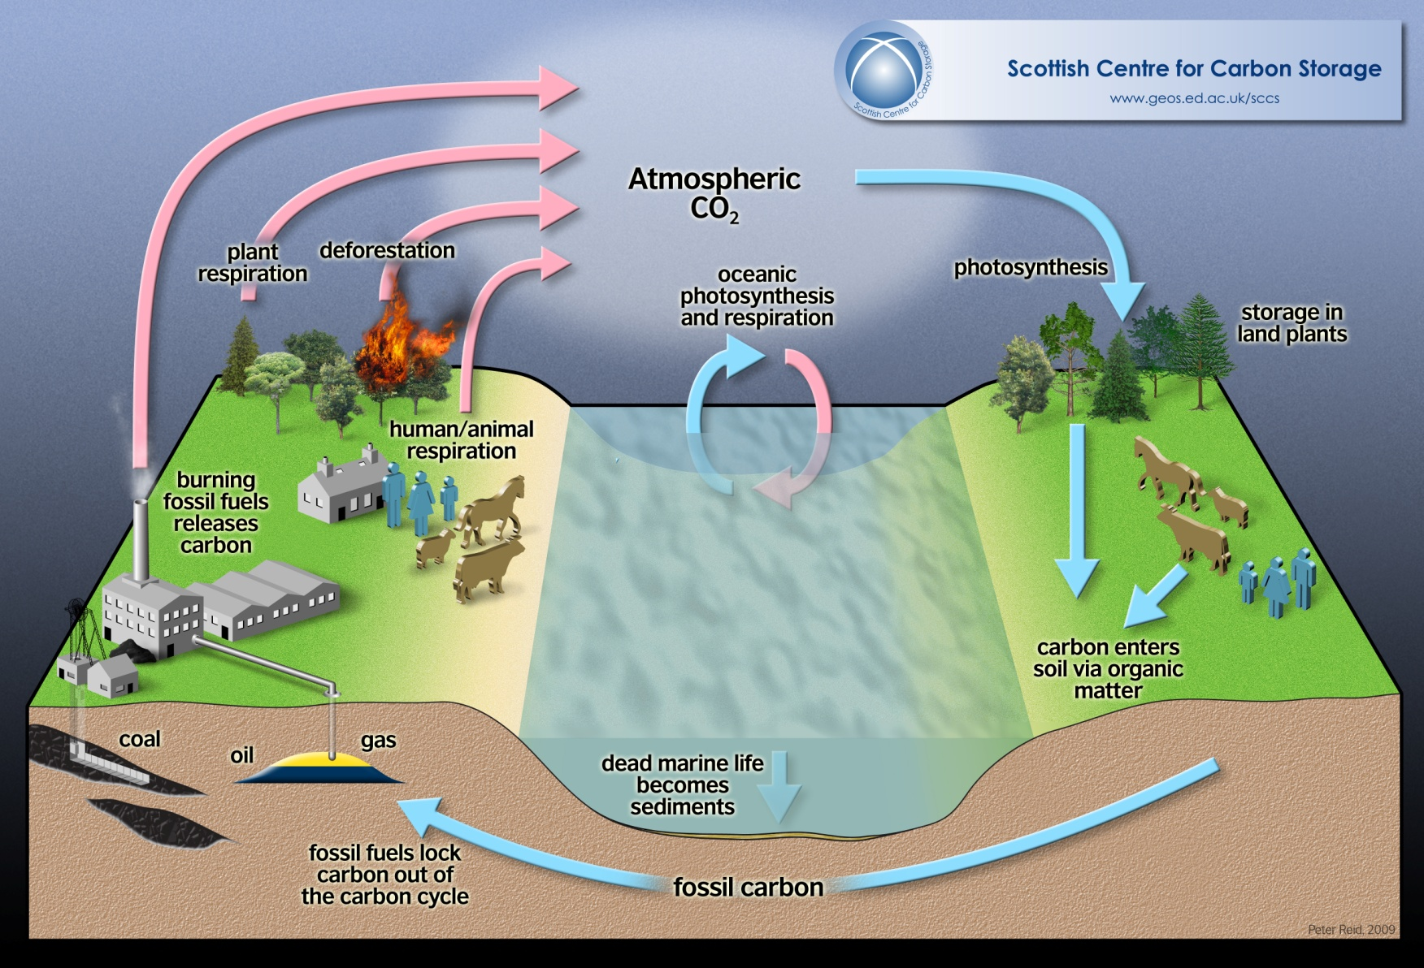
Carbon Cycle
Notes:
Carbon enters atmosphere by either respiration or combustion
Carbon dioxide is absorbed by primary producers and used to make carbohydrates
Animals eat plants passing carbon through food chain. When animals die their stored carbon is released by decomposers or stored as fossil carbon (dinosaur juice)

Slide 4
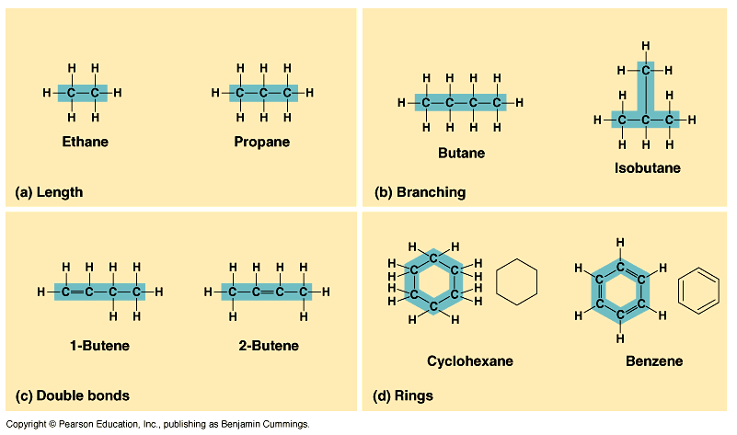
Organic Chemistry
Carbon molecules: hydrocarbons

Slide 5
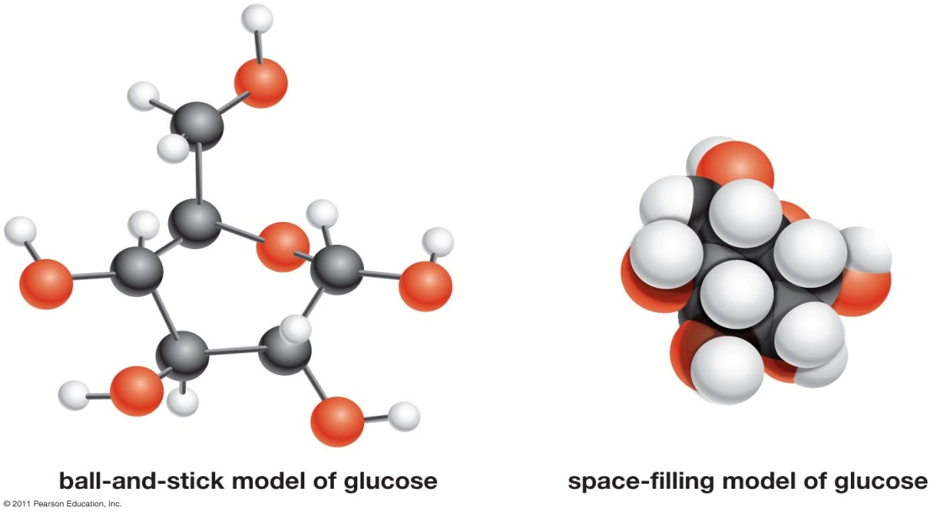
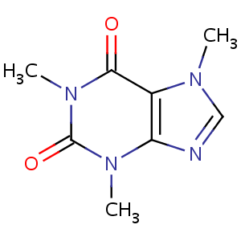
Organic Chemistry
Molecular models
Carbon atom (unless labeled)
Double bond = 2 shared e⁻
Caffeine (C₈H₁₀N₄O₂)

Slide 6
Macromolecules
Macromolecules: large organic molecule, usually comprising smaller molecules (monomers) joined together to form a polymer
Monomers: a smaller molecule that can be combined with other similar or identical molecules to create a polymer
____________: a larger molecule made up of many similar or identical subunits
Four major macromolecules
Carbohydrates
Lipids
Proteins
Nucleic Acids

Slide 7
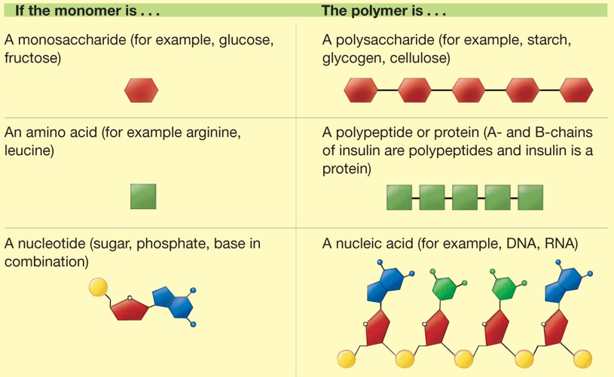
Monomers and Polymers
Examples from common macromolecules

Slide 8
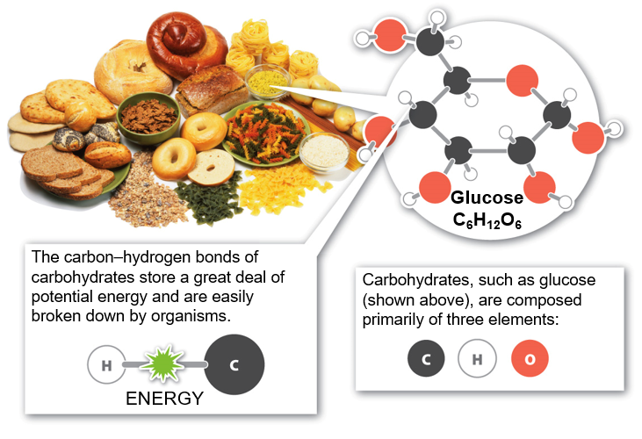
Carbohydrates
Essential to energy production
1:2:1 ratio
Carbon:Hydrogen:Oxygen
Notes:
Simple sugars provide empty calories = calories from food that do not contain any nutrients
Nearly all the energy powering your brain everyday comes from glucose

Slide 9
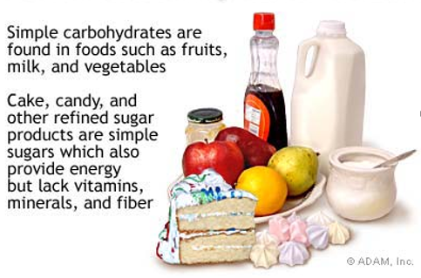
Simple Carbohydrates
Simple carbohydrates (monomers)
Monosaccharides and Disaccharides
Glucose
Fructose
Galactose
Notes:
Sucrose=table sugar (glucose+fructose)
Lactose=milk sugar (glucose+galactose)
Maltose=malt sugar (glucose+glucose)
Fast energy release=easy to break down

Slide 10
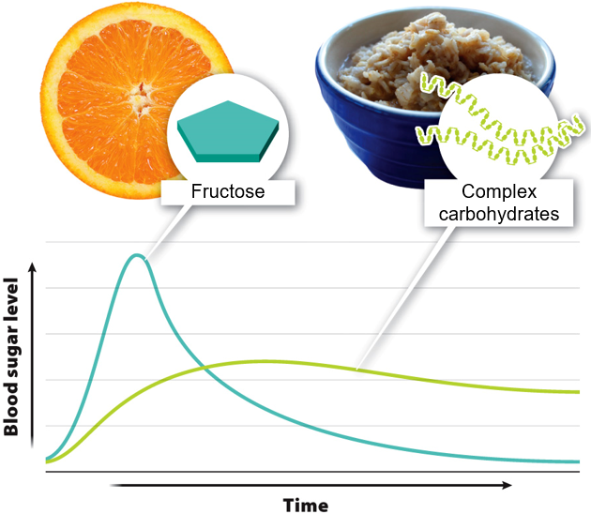
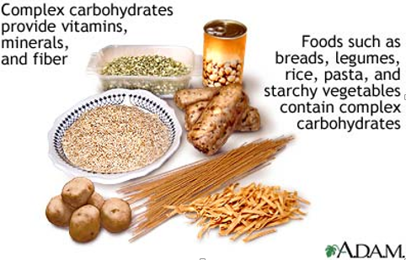
Carbohydrates: Complex Sugars
Complex Carbohydrates (Polymers)
Polysaccharides
Starch
Glycogen
Cellulose
Chitin
Notes:
Slow energy release: harder to break down

Slide 11
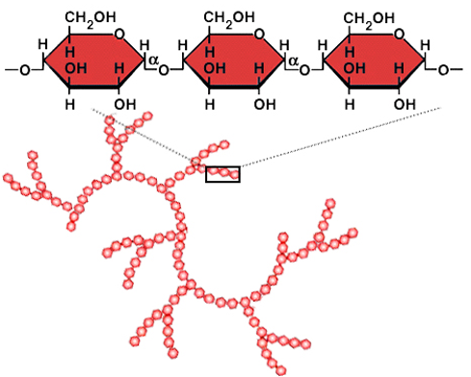
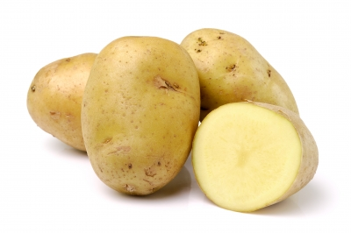
Complex Carbohydrates
Starch: carbohydrate _________ in plants
Potatoes, carrots, rice, corn
Glucose molecules
Starch
Notes:
Starch = hundreds of glucose molecules strung together
Starch doesn’t taste sweet because the molecular shape does not activate the sweet receptors

Slide 12
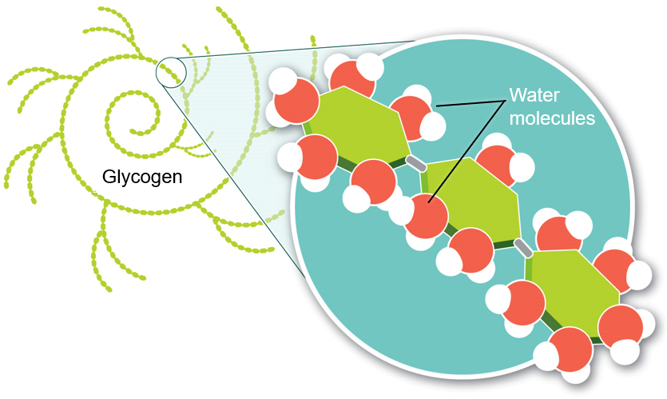
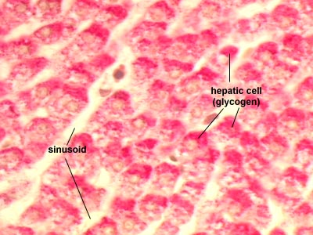
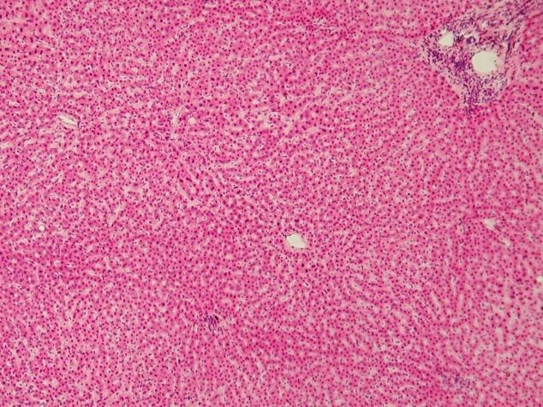
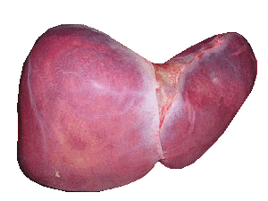
Complex Carbohydrates
Glycogen: carbohydrate storage in ___________
Stored in liver and muscles

Slide 13
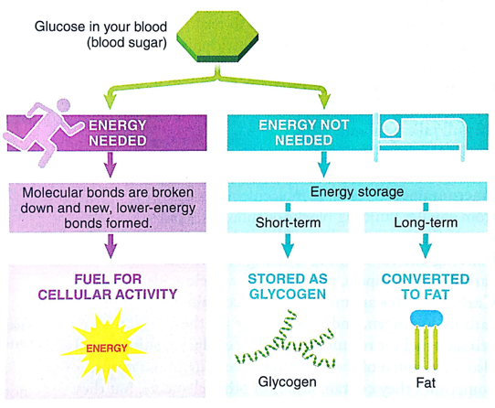
Carbohydrates
Glucose provides molecular energy for body
Excess glucose stored as __________ in the short term or fat in the long term
Notes:
Carb-loading: athletes double or triple amount of glycogen stored in muscles and liver to increase amount of fuel available for extended exertion.
Loss of glycogen (and associated water molecules) are usually the initial weight loss seen starting a new diet. 1 lb glycogen has about 4 lbs water bound to it.

Slide 14
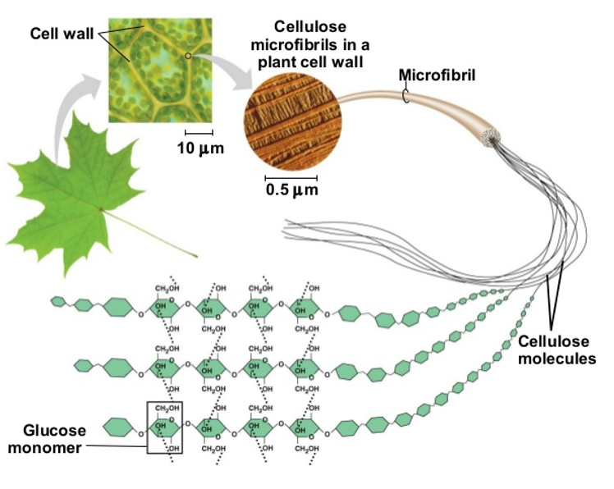
Complex Carbohydrates
Cellulose: structural carbohydrate produced in ________
Most abundant carbohydrate on earth
Forms cell wall
Notes:
If you remove all the water from a tree or plant, cellulose alone accounts for about a quarter of the plants dry mass
Indigestible to humans, acts a fiber in our diet
Cellulose and lignin create the wood we use to build and the strength of cotton in our clothes.

Slide 15
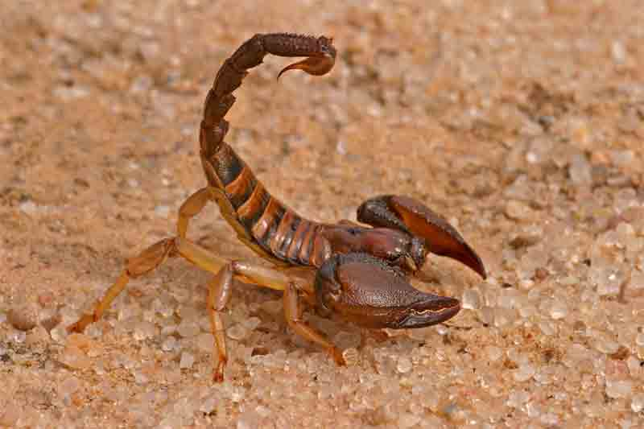
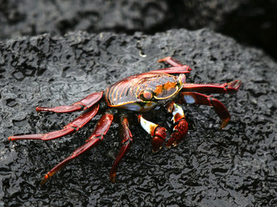
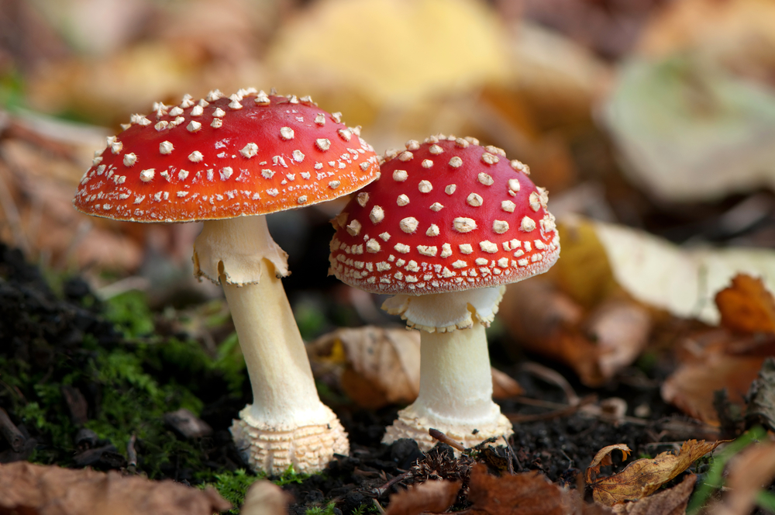
Complex Carbohydrates
Chitin: part of the external skeleton arthropods and cell walls of fungi
Arthropods are animals that include spiders, crustaceans and insects
Notes:
phylum of animals having an exoskeleton, jointed appendages, and segmented bodies

Slide 16
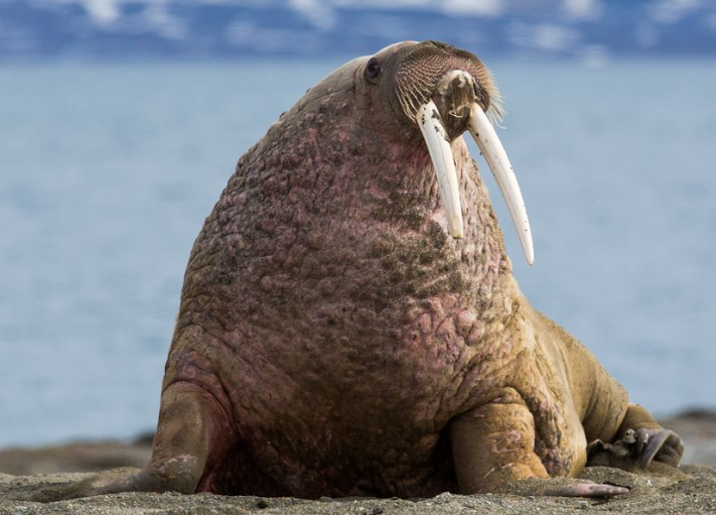
Lipids
Lipids: _________ molecules insoluble in water
Fats, oils, waxes, cholesterols and hormones
Lipid function
Energy storage
Cushions internal organs
Insulation
Membrane Structure
Water storage
Toxic storage
Chemical Messengers
Notes:
Lipids are hard to define because they do not have any unifying characteristics

Slide 17
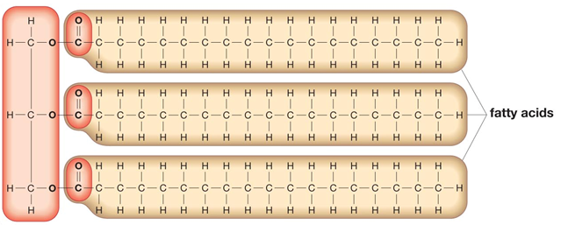
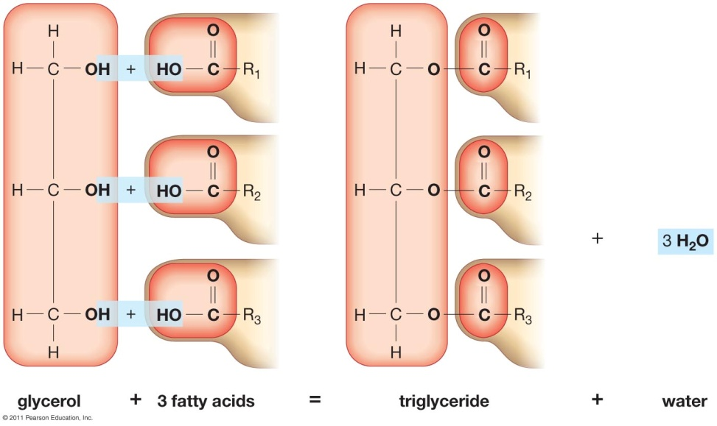
Lipids
____________: long hydrocarbon found in many lipids
Triglyceride: lipid molecule formed by three fatty acids bonded to a glycerol
Most common lipid molecule found in foods
+ 3H₂O
Glycerol + 3 fatty acids = triglyceride + water
Notes:
What kind of reaction creates polymers with a water byproduct?

Slide 18
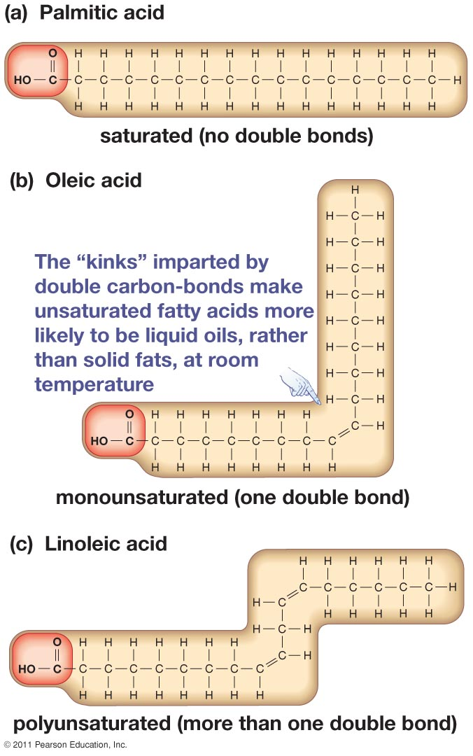
Saturated vs. Unsaturated Fatty Acids
Saturated fatty acid: no ______________
Saturated with H atoms
Unsaturated fatty acid: one or more double bonds between carbon atoms
Notes:
The “kinks” imparted by double carbon-bonds make unsaturated fatty acids more likely to become liquid oils, rather than solid fats, at room temp
Hydrogenation: process of adding hydrogen to break down double or triple bonds
Trans fats in hydrogenated oils

Slide 19
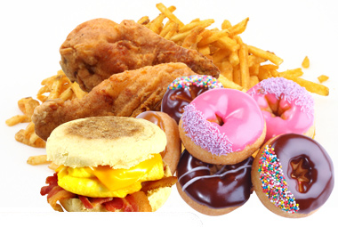
Lipids
Partially _____________ fats (trans)

Slide 20
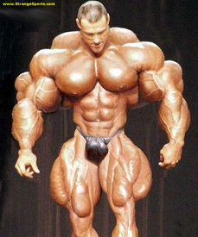
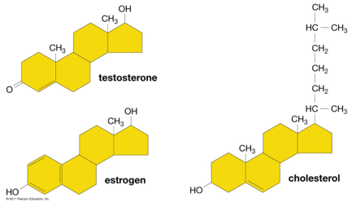
Lipids
__________: lipid with four interlocking carbon rings
Cholesterol: important in animal cell membranes
Testosterone and Estrogen: hormones important to the development of different sexes in humans
Notes:
Anabolic steroids are the synthetic version of the male sex hormone testosterone

Slide 21
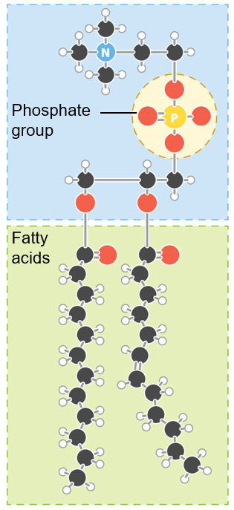
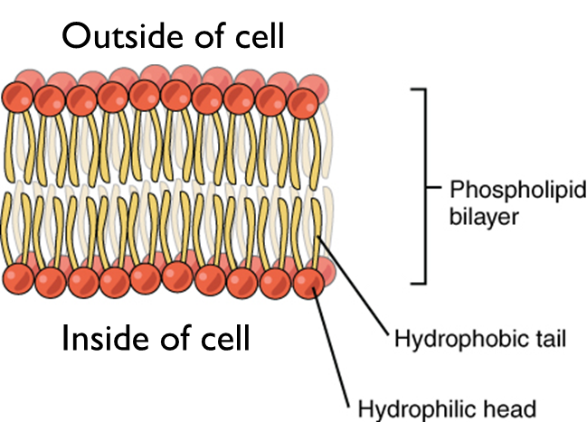
Lipids
Phospholipids: a charged lipid composed of a glycerol, a phosphate group, and two fatty acids
─
Hydrophilic head
(attracted to water)
Hydrophobic tails
(not attracted to water)

Slide 22
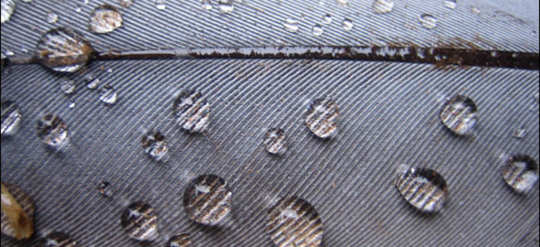
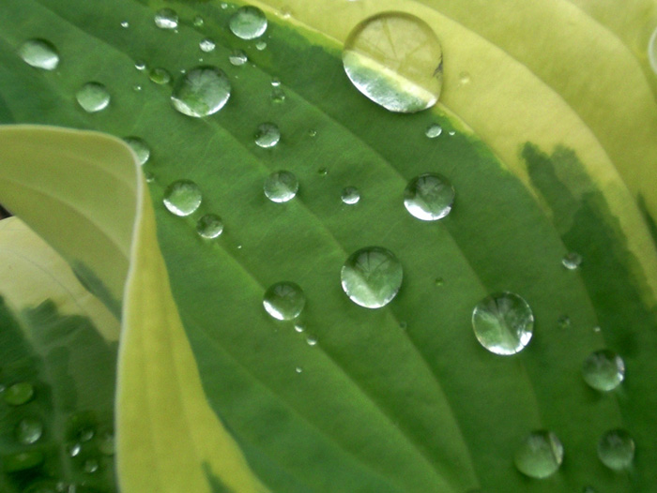
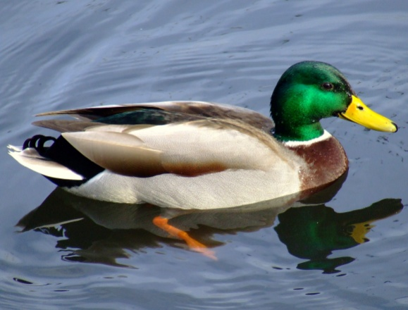
Lipids
Waxes: a single long chain fatty acid linked to a glycerol head
Water repellant coating used by plants and animals
Notes:
Long fatty acid is nonpolar which makes waxes strongly hydrophobic

Slide 23
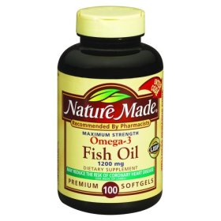
Essential Fatty Acids
Low-density lipoproteins (LDLs): cholesterol that travels from liver to body and can clog arteries of the heart
“Bad cholesterol”
Saturated fats and trans fats
High-density Lipoproteins (HDLs): cholesterol that travels from body to liver, clearing cholesterol from the system
“Good cholesterol”
Omega-3 fatty acids
Two fatty acids are __________ to humans
Alpha-linolenic acid (omega-3 fatty acid)
Linoleic acid (omega-6 fatty acid)
Notes:
Omega-3
Reduces fat deposits in blood which clog vessels
Essential fatty acids synthesize prostragladins
cause constriction or dilation in vascular smooth muscle cells
induce labor
regulate calcium movement
control hormone regulation
control cell growth

Slide 24
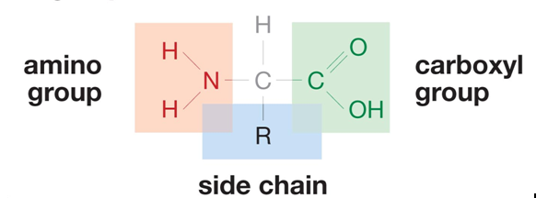
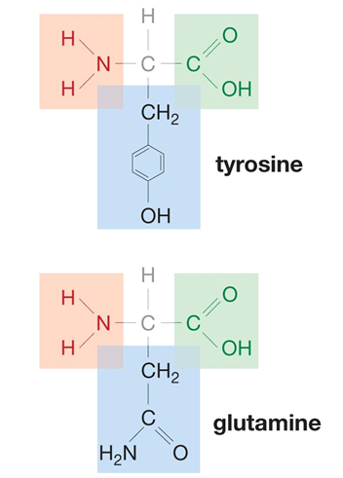
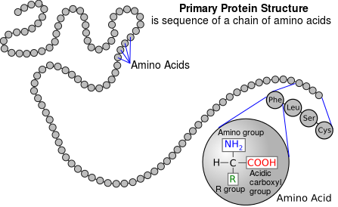
Proteins
Proteins: a long, folded polypeptide
Polypeptide = a chain of amino acids
Amino acid = compounds consisting of an amino and carboxyl functional group, which act as the building block (monomers) of proteins.
20 different amino acids
Nine essential to humans
Notes:
The nine essential amino acids are: histidine, isoleucine, leucine, lysine, methionine, phenylalanine, threonine, tryptophan, and valine.
All found in animal proteins
Vegetarians need to eat beans and grains for amino acids

Slide 25
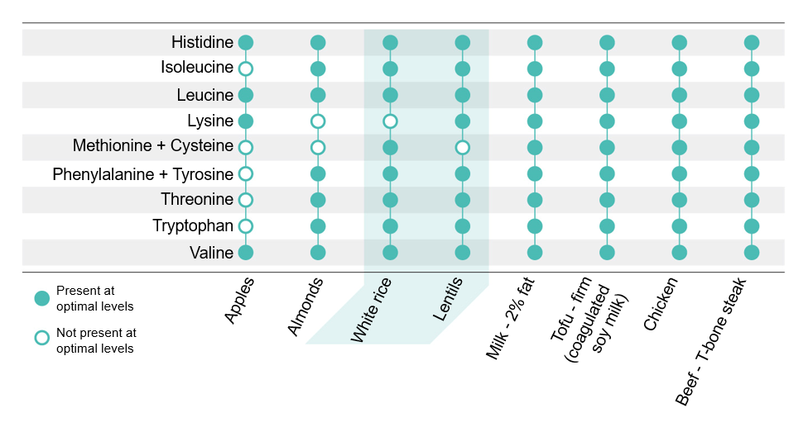
Essential Amino Acids
Essential amino acids: amino acids ___________ by the body, which must be obtained through the diet
Nine in humans
All found in animal protein
Essential Amino Acid | Non-essential Amino Acids
Histidine | Alanine
Isoleucine | Arginine
Leucine | Asparagine
Lysine | Aspartic Acid
Methionine | Cysteine
Phenylalanine | Glutamic Acid
Theronine | Glutamine
Tryptophan | Glycine
Valine | Proline
 | Serine
 | Tyrosine
Notes:
Like our 26 letter alphabet which has been used to write a variety of different works, the 20 amino acids are the alphabet for all proteins.
The nine essential amino acids are: histidine, isoleucine, leucine, lysine, methionine, phenylalanine, threonine, tryptophan, and valine.
All found in animal proteins
Vegetarians need to eat beans and grains for amino acids
Soy and quinoa have all eight

Slide 26
Protein Structure
PRIMARY STRUCTURE
The sequence of amino acids in a polypeptide chain, similar to the sequence of letters that spell out a specific word
SECONDARY STRUCTURE
The corkscrew-like twists or pleated folds formed by hydrogen bonds between amino acids in the polypeptide chain
TERTIARY STRUCTURE
The complex three-dimensional shape formed by multiple twists and bends in the polypeptide chain
QUATERNARY STRUCTURE
Two or more polypeptide chains bonded together

Slide 27
Protein Function
Type of Protein | Role | Example
Enzymes | Quicken chemical reactions | Sucrase: Positions sucrose in a way that it can be broken down into glucose and fructose
Hormones | Chemical messengers | Growth hormone: Stimulates growth of bones
Transport | Move other molecules | Hemoglobin: Transports oxygen throughout blood
Contractile | Movement | Myosin and actin: Proteins in muscle fibers that allow muscles to contract
Protective | Healing; defense against invaders | Fibrinogen: Stops bleeding Antibodies: Combat microbial invaders
Structural | Mechanical support | Keratin: Hair, collagen, and cartilage
Storage | Stores nutrients | Ovalbumin: Egg white, stores nutrients for embryos
Toxins | Defense, predation | Bacterial diphtheria toxin
Communication | Cell signaling | Glycoprotein: Receptor on cell surface
Notes:
Proteins are the chief building block of all organisms
Diverse Functions
Antibodies
Enzymes
Hormones
Signaling
Transport
Hemoglobin
Structural proteins
Muscle fibers, Connective tissue, Hair, skin, and organs

Slide 28
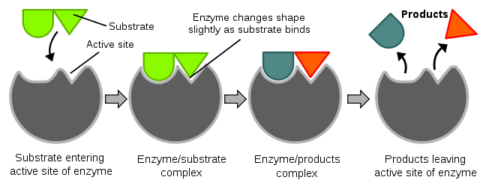
Enzymes
Proteins that accelerate chemical reactions
Catalysts: chemical agent that increases the rate of a reaction without being ___________ by the reaction
Notes:
Rate of enzymatic reactions vary but some enzymes can catalyze over 1 million reactions per second.

Slide 29
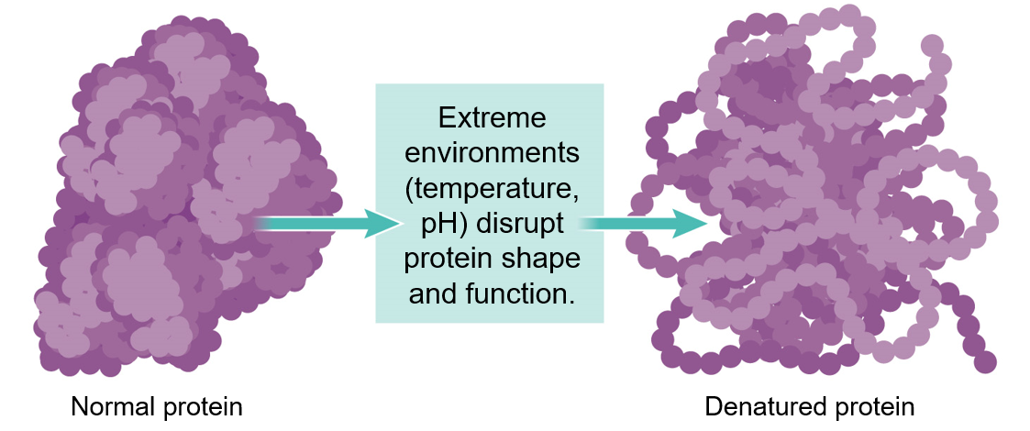
Denatured Proteins
Protein shape can be altered, disrupting function of protein
___________: loss of protein shape due to external stress or interaction with hazardous compounds
Temperature, pH
Notes:
Alcohol works as a disinfectant because it denatures shape of bacterial proteins on skin

Slide 30
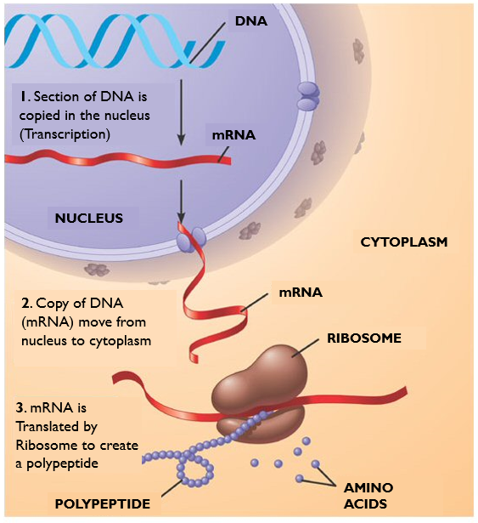
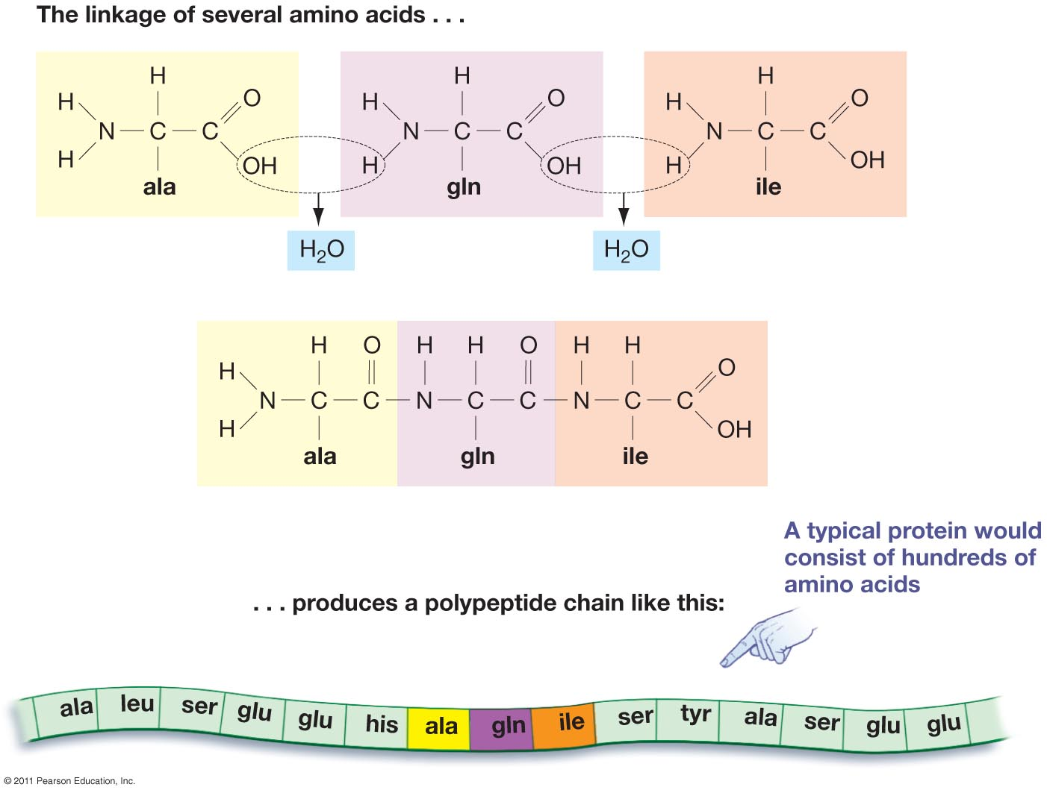
Protein Synthesis
DNA is copied (transcription) and translated to make proteins

Slide 31
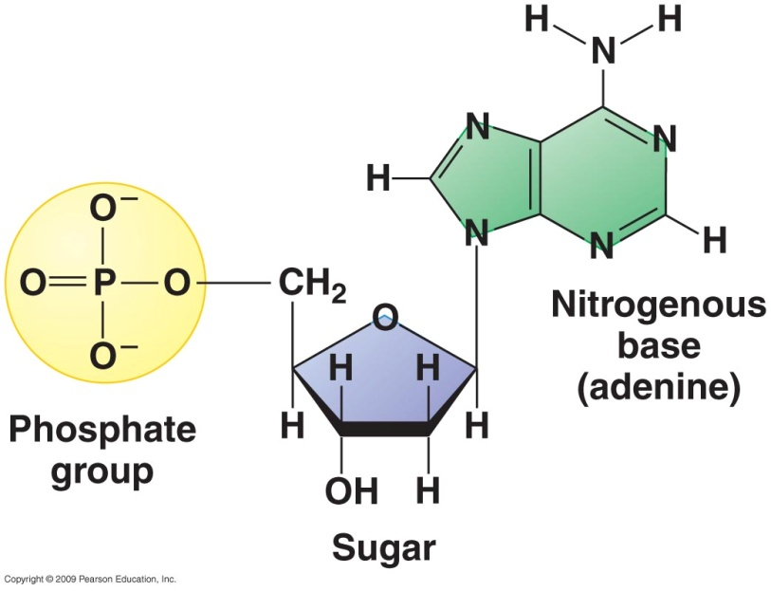
Nucleic Acids
Nucleic acids are large molecules made up of nucleotides
Nucleotides: Organic molecules that serve as the building blocks (monomers) of nucleic acids, and are made up of a phosphate group, a sugar and a nitrogenous base
DNA and RNA
Instructions for making proteins
ATP
Energy transfer

Slide 32
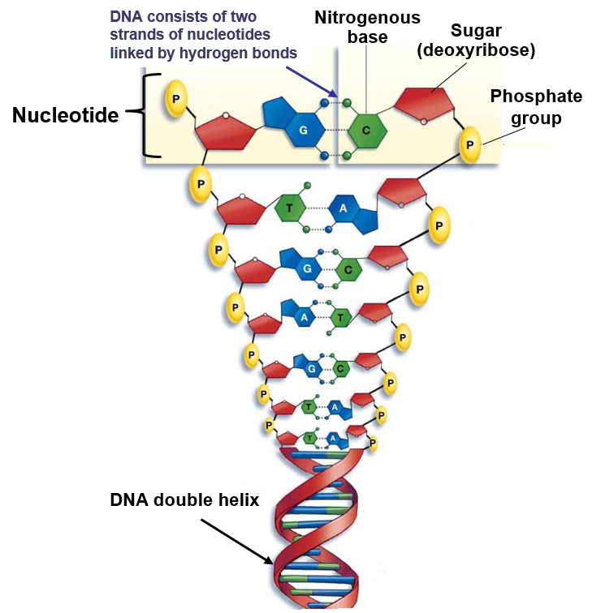
Nucleic Acids
Deoxyribonucleic acid (DNA): primary information bearing molecule of life, composed of two linked chains of nucleotides (double helix)
Nitrogenous bases:
Adenine
Thymine
Cytosine
Guanine
Uracil (RNA)
Notes:
Human DNA contains about 3 billion nucleotides!
Just like the meaning of a sentence is determined by the sequence of letters that are strung together, the information in a segment of DNA is determined by the sequence of the nucleotides

Slide 33
Nucleic Acids
Ribonucleic acid (RNA): active in protein synthesis and also forms part of ribosomes
Uracil nucleotide instead of Thymine

Slide 34
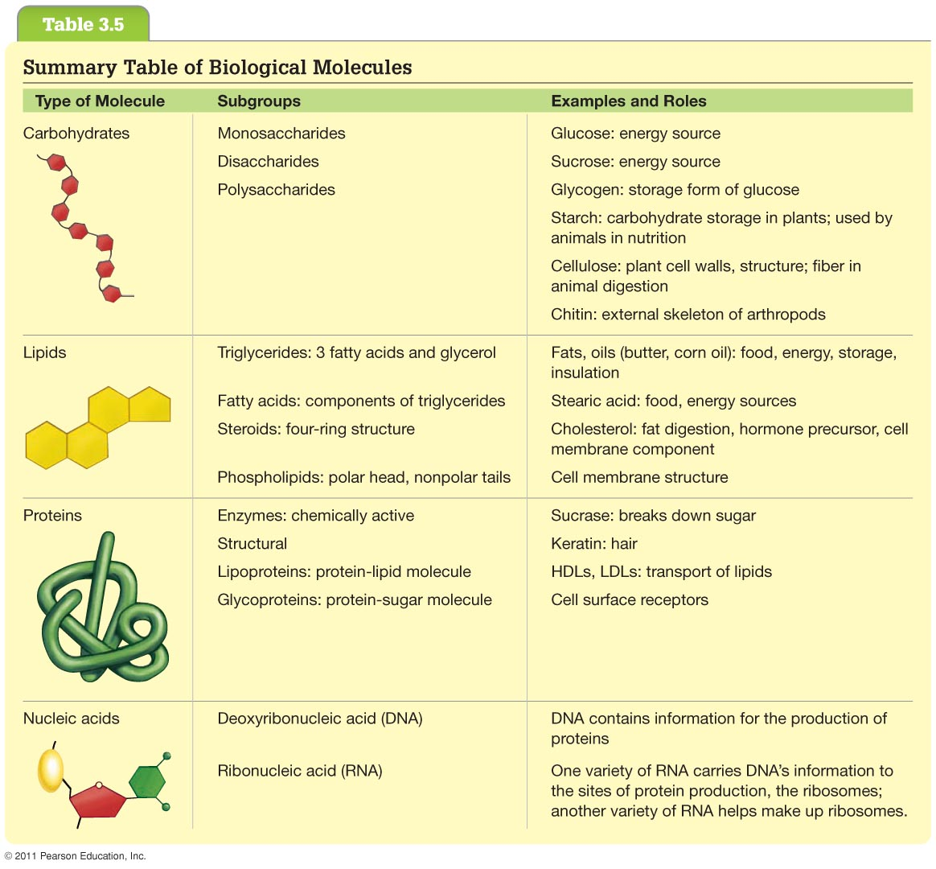

Slide 35
Check Your Understanding
1. T or F – Excess carbohydrates can be converted to fat
2. Which of the following is a form of carbohydrate storage in plants?
a. Glycogen
b. Cellulose
c. Chitin
d. Starch
e. More than one of the above

Slide 36
Check Your Understanding
3. Which of the following is an example of a polymer?
a. Glucose
b. Polypeptide
c. Nucleotides
d. Amino acids
e. More than one of the above

Slide 37
Check Your Understanding
Provide an example of a monomer and a polymer for each of the four major macromolecules.
Monomer | Polymer

Slide 38
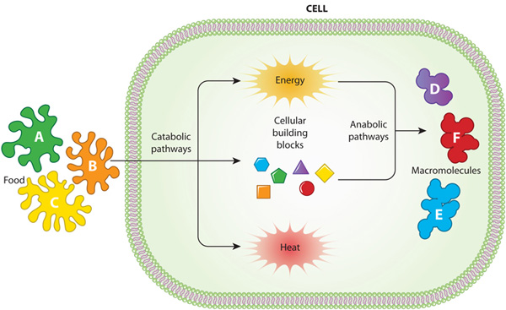
Metabolic Pathways
Metabolism: the sum of all chemical reactions within a living organism
Catabolic pathway: breakdown larger molecules into smaller molecules
Usually ________ energy and heat
Anabolic pathway: builds new molecules out of products of catabolic pathway
Usually _________ energy
Notes:
Metabolism: the sum of all chemical reactions within a living organism
Catabolic pathway: breakdown larger molecules into smaller molecules
Usually release energy
Anabolic pathway: build new molecules and/or stores energy
Requires energy form catabolic reactions

Slide 39
Nutritional Requirements
Nutrient: a substance that either provides energy, helps regulate the body’s physical processes, or provides the body with structural building blocks.
Six Classes of Nutrients
Carbohydrates
Amino acids
Fatty acids
Vitamins
Minerals
Water
Notes:
Can not be synthesized and must be supplied by diet
Do not yield energy
Help carry out necessary physiological processes

Slide 40
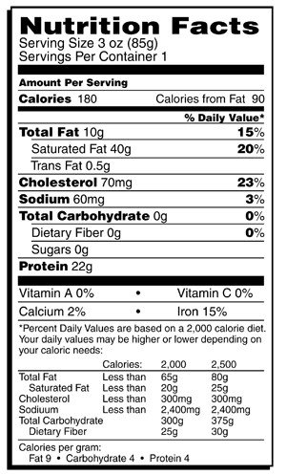
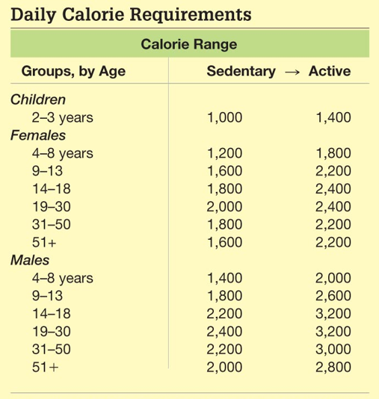
Nutritional Requirements
Lipids, carbohydrates and proteins provide energy!
1 Calorie (Cal) = 1kcal = 4.184 joules
Energy required to heat 1 kg of H₂O 1°C
Energy producing nutrients
__ Cal/g protein
__ Cal/g carbohydrate
__ Cal/g fat
4
4
9
Notes:
Fats supply more energy than proteins and sugars, that’s why we need to eat them sparingly. Too much energy and the body stores it.
Active lifestyle = walking briskly 3-4 miles a day.
Proteins are actually not a great source of energy because the body does not store excess protein

Slide 41
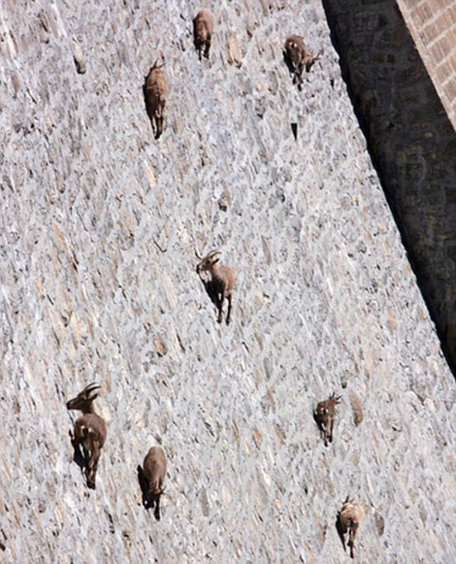
Nutritional Requirements
Undernourished
Not enough calories
Overnourished
Too many calories
Malnourished
Missing one or more essential nutrients

Slide 42
Essential Vitamins
Vitamins: Organic compounds that aid in chemical reactions within the body
13 Essential Vitamins
Fat soluble:
A, D, E, K
Water soluble: co-enzymes
B vitamins (thiamin, riboflavin, niacin, vitamin B6, folate (folic acid), vitamin B12, biotin and pantothenic acid), vitamin C
Notes:
Water-soluble (water is required for absorption and are excreted in urine)
Excreted in urine
B-complex vitamins and Vitamin C act as co-enzymes
Fat-soluble (requires fat for absorption and are stored in fat tissue).
Stored in liver and fatty tissue
Absorbed slowly
Vitamin A = eyes adjust to light, bone growth
Vitamin D = obtained from sunlight, aids in calcium absorption
Vitamin E = antioxidant=prevents destruction of other vitamins
Vitamin K = produced by bacteria in intestine, blood clotting and protein production

Slide 44
Essential Minerals
Minerals: chemical _________ needed by the body to form bodily structure or facilitate chemical reactions
Major Minerals (more than 100mg/day for normal body function)
Mineral | Sources | Function
Calcium (Ca) | Dairy products, leafy green vegetables | Maintenance of bones, muscle contraction, nerve signaling
Chloride (Cl) | Table salt | Water balance, digestion
Phosphorus (P) | Dairy products, meat, whole grains | Component of bone, nucleic acids, ATP
Potassium (K) | Fruits and vegetables, dairy products | Nerve signaling, fluid balance
Sodium (Na) | Table salt | Nerve signaling, fluid balance
Notes:
Minerals are single elements, cannot be broken down further, whereas, vitamins are compounds
Vitamins serve no structural roles in body, but minerals act as components of bones

Slide 46
Digestive System
Digestive tract
Breakdown food and absorb macro and micronutrients
Mouth
Pharynx
Esophagus
Stomach
Small Intestine
Large Intestine
Rectum
Notes:
Nutrients to liver before heart and body

Slide 47
Digestive System
Site of Macromolecule Digestion
 | Carbs | Protein | Nucleic acids | Fats
Mouth
Stomach
Small intestine

Slide 48
Digestive System
Site of Macromolecule Digestion
 | Carbs | Protein | Nucleic acids | Fats
Mouth | Initial
Stomach
Small intestine | Main

Slide 49
Digestive System
Site of Macromolecule Digestion
 | Carbs | Protein | Nucleic acids | Fats
Mouth | Initial
Stomach |  | Initial
Small intestine | Main | Main

Slide 50
Digestive System
Site of Macromolecule Digestion
 | Carbs | Protein | Nucleic acids | Fats
Mouth | Initial
Stomach |  | Initial
Small intestine | Main | Main | Initial Main

Slide 51
Digestive System
Site of Macromolecule Digestion
 | Carbs | Protein | Nucleic acids | Fats
Mouth | Initial |  |  | Initial
Stomach |  | Initial
Small intestine | Main | Main | Initial Main | Main

Slide 52
The Mouth
Mechanical breakdown of food
Release digestive enzymes
Salivary _________
Sugar breakdown
Lingual lipase
Lipid breakdown
Notes:
Starch and lipid breakdown begins in mouth
Amylase – enzyme for carbohydrates
Lipase – lingual lipase begins breakdown of triglycerides → fatty acids and monoglycerides
Salivary glands water and glycoproteins (mucins) called mucus
Water + mucus makes food slippery enough to be swallowed
Passes down esophagus to stomach through peristalsis

Slide 53
Move It Along
_____________: waves of muscle contractions that pushes food through digestive tract
Epiglottis: flap of cartilage that covers the trachea when swallowing
Notes:
Peristalsis = alternating contractions of circular and longitudinal muscles in esophagus

Slide 54
The Stomach
Continues mechanical breakdown
Gastric juice
HCl + pepsin
Pepsin: enzyme that breaks down __________
Acidity (pH=2) helps break down proteins and also kills bacteria
_______: mixture of food and gastric juices
Food storage
Expanding folds known as rugae
Notes:
Sphincter = a muscular valve that can close off a tube (blood vessel, digestive tract)
Muscular contractions churn and mix food to uniform consistency
Highly acidic (pH<2)
Necessary for breakdown of proteins destroying secondary and tertiary structure
Early experiments in digestion by William Beaumont, that stemmed from a shot gun blast to the gut, discovered that acids in the stomach are especially good at digesting meats
Pepsin = protein enzyme
Stored as inactive pepsinogen in chief cells (otherwise it would break down the cell it was made in)
Breaks peptide bonds between amino acids, breaking down polypeptides
Specialized secretory cells secrete HCL and mucus, which lines the stomach and protects in from the acid.

Slide 55
The Small Intestine
6m long!
Smaller diameter than large intestine
80% of nutrients absorbed
_______________
Receives secretions from digestive glands
Liver
Pancreas
Gallbladder
Jejunum
Absorption
lleum

Slide 56
Digestive Glands
Pancreas
Produces insulin
Secretes enzymes and buffers
Increase pH
Liver
_____________
Fat digestion
Regulates nutrients
Receives toxins
Gallbladder
Stores bile
Notes:
Pancreas secretes lipase, protease, nuclease and carbohydrases
pH of small intestine = 6-7.5
Proteases = protein digestive enzyme synthesized in pancreas (inactive)
Pancreatic lipase = lipid digestive enzyme
Bile salts = break up lipids = emulsification
Nucleases = digest RNA and DNA
Hormone secretin = signals release of bicarbonate, which neutralizes stomach acids
First hormone discovered

Slide 57
Absorption in the Small Intestine
Intestinal folds, villi and microvilli increase surface area
200-300m²
Monosaccharides, amino acids and monoglycerides absorbed through epithelial cells villi
_________________ carries blood with nutrients to liver
Lipids transported through _________ system bypassing the liver
Notes:
Small intestine (20ft) longer than large intestine. Size refers to diameter
Blood and nutrients travel to liver for detoxification and distribution
Lipids bypass liver because liver uses lipids as fuel and by bypassing the liver the lipids can be used or stored elsewhere

Slide 58
Negative Feedback Loop
Homeostasis of blood glucose levels are maintained by the Pancreas.
High blood glucose levels
Pancreas secretes insulin
Insulin facilitates conversion of glucose to glycogen for storage
Glucose level in blood decreases
Low blood glucose levels
Pancreas secretes ___________
Glucagon facilitates breakdown of glycogen into glucose
Blood glucose levels increase
Notes:
Insulin = hormone produced in pancreas when blood-glucose is high
Binds to cells signaling the need for more glucose uptake
Liver makes more glycogen
More lipids are synthesized from glucose
Glucagon = hormone stimulating glycogen breakdown to glucose
Type 1 diabetes = do not synthesize insulin
Type 2 diabetes = defective insulin receptors

Slide 59
Absorption in the Large Intestine
Large intestine includes colon, cecum and rectum.
Absorbs water
Forms feces
Cecum: _________ of plant material
Function insignificant in humans
____________: minor role in immunity, may store “good” bacteria

Slide 60
Summary of Macronutrient Digestion

Slide 61
Summary of Digestive System

Slide 62
Check Your Understanding
1. The initial site of protein breakdown is in the _________.
a. mouth b. muscles c. stomach
d. small intestine e. liver
2. Which of the following contains the greatest amount of Calories per gram?
a. Fat b. Protein c. Carbohydrates d. Potato chips

Slide 63
Check Your Understanding
3. Describe the process of a negative feedback loop using blood glucose as an example.

