Slide 1
Marine Reptiles and Birds
“If you can’t fly then run, if you can’t run then walk, if you can’t walk then crawl, but whatever you do you have to keep moving forward”
– Martin Luther King Jr.
Chapter 9

Slide 2
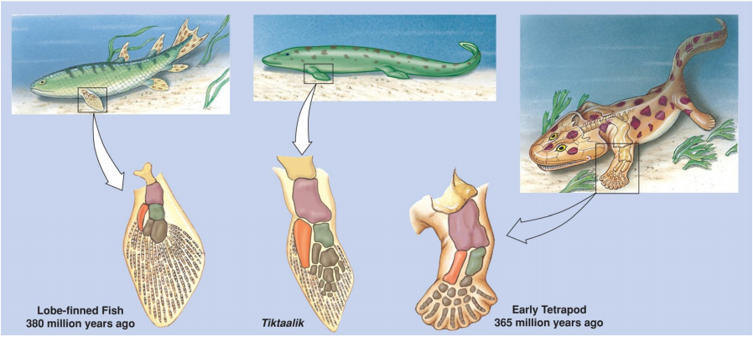
Origin of Limbs
Tetrapod limbs were modification of preexisting body plan
Humerus and femur became larger and stronger
Able to support weight on land
_______________ separate tetrapods from fins of lobe-finned fish

Slide 3
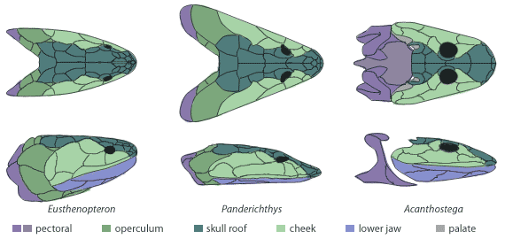
Evolution of Tetrapods
Increased air breathing capabilities
More efficient lung
Limbs with digits support tetrapod’s weight on land
Evolution of a ______________ separated head from body
Allowed for head movement
Pectoral and pelvic girdle fuse with spine better support weight on land

Slide 4
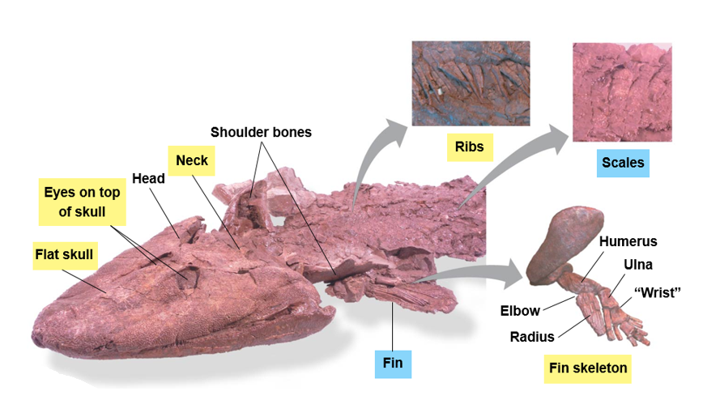
Evolution of Tetrapods: Tiktaalik
Tetrapod characteristics
Independent neck and shoulders
Ribs to support weight
Front fin bone structure similar to all tetrapods
Limbs bent at elbow and knee
Flat skull with eye on top of head
Fish characteristics
Gills
Scales
Fins
Notes:
Fish = plural for multiples of single species
Fishes = multiple fish from more than one species

Slide 5
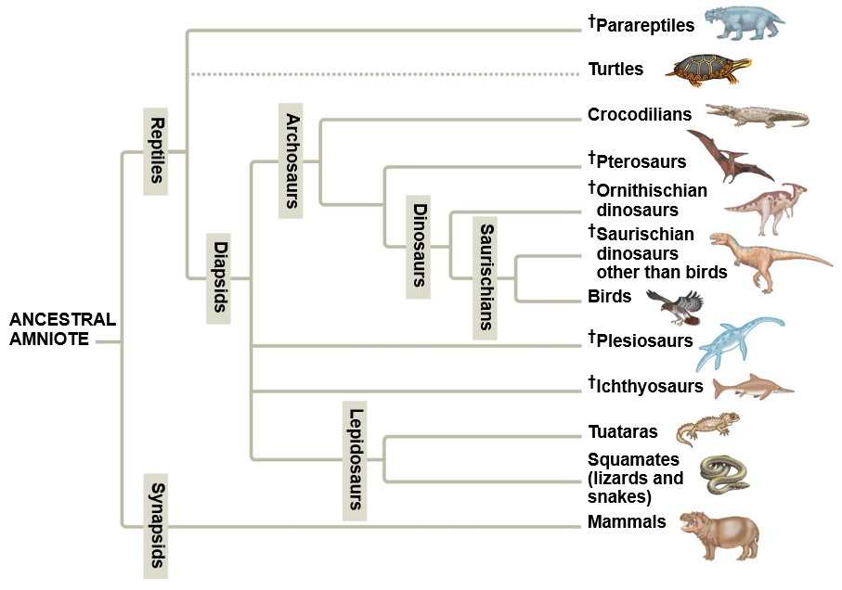
Amniotes
Amniotic egg: allowed for embryos to develop in terrestrial environment without ______________ _________.
Two major lineages:
Reptiles, including birds
_________

Slide 6
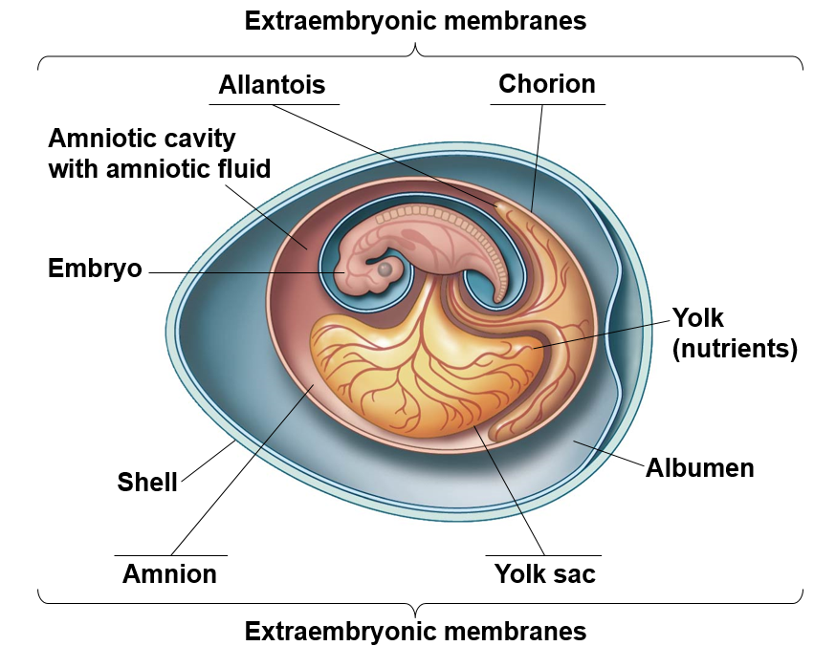
Amniotic Egg
Amnion: inner membrane filled amniotic fluid, which cushions the embryo
Yolk sac: sac containing nutrients (yolk) for the developing embryo
________: membrane that facilitates gas exchange between the embryo and the air
Allantois: sac that collects ________ ________ produced by the embryo
Notes:
Extraembryonic membranes develop from tissues that grow out from the embryo, but are not part of the embryo itself.

Slide 7
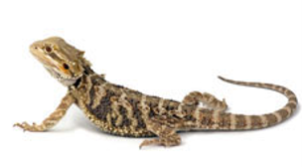
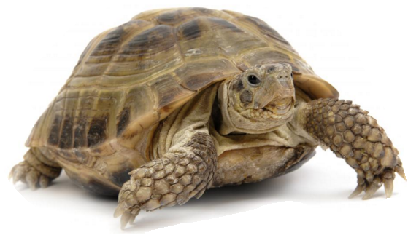
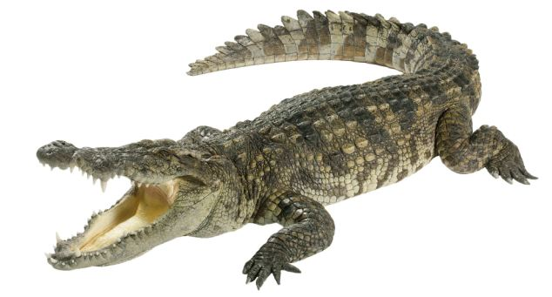
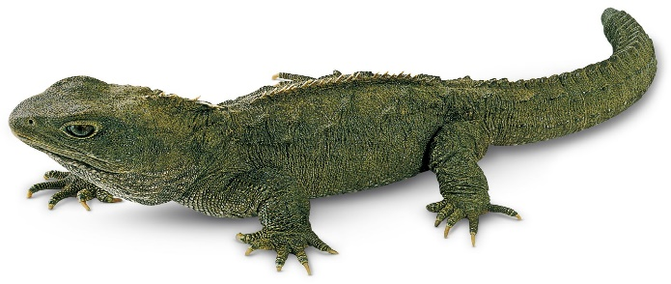
Class Reptilia
Scales made of keratin
Internal fertilization
Most oviparous
Lay eggs on land
Ectothermic, poikilotherms
Four orders
Turtles
Snakes and lizards
Crocodiles and allies
Tuataras

Slide 8
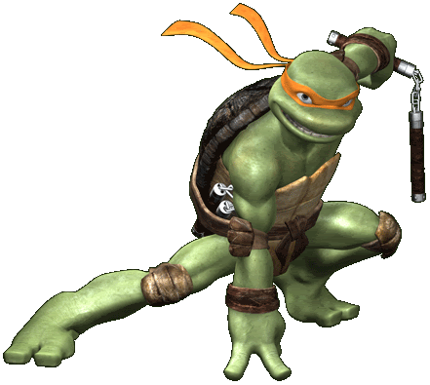
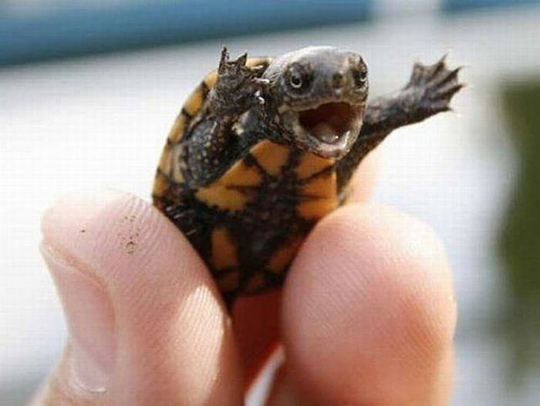
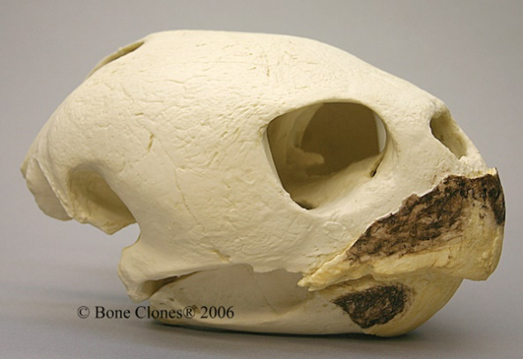
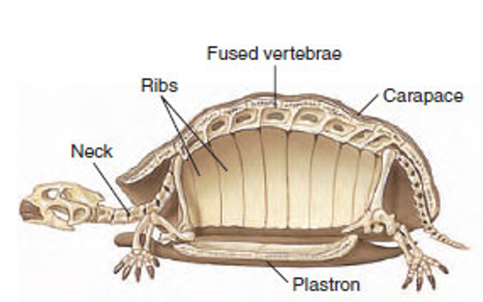
Class: Reptilia
Turtles and Tortoises
Bony or cartilaginous shell from fusion of vertebrae and ribs
Scutes: bony plates that make up the shell
__________: scutes on top of shell
Plastron: scutes on bottom of shell
Tortoise = terrestrial
Turtles = live in or near water
Herbivorous and carnivorous
Beaks (no teeth)
Fused vertebrae
Scutes
Ribs
Carapace
Neck
Plastron

Slide 9
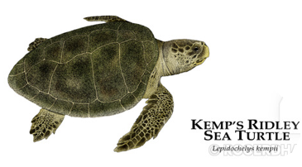
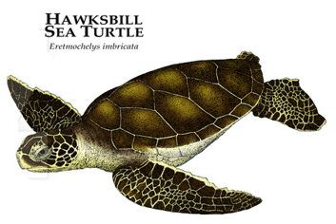
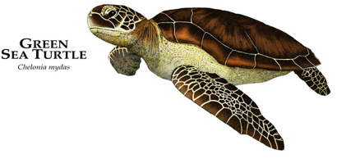
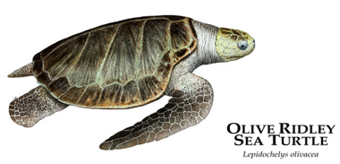
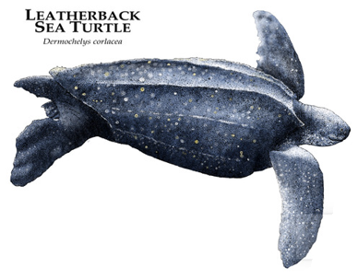
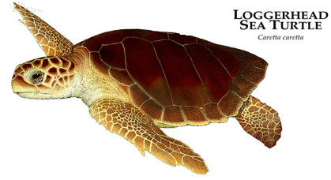
Class: Reptilia
Sea Turtles
Seven species
Legs modified to ________
Can not retract their heads into their shells
Most sea turtles are omnivorous
Green sea turtle is herbivorous as an adult
Leatherback almost exclusively eat sea jellies
Hawksbill eat primarily sponges

Slide 10
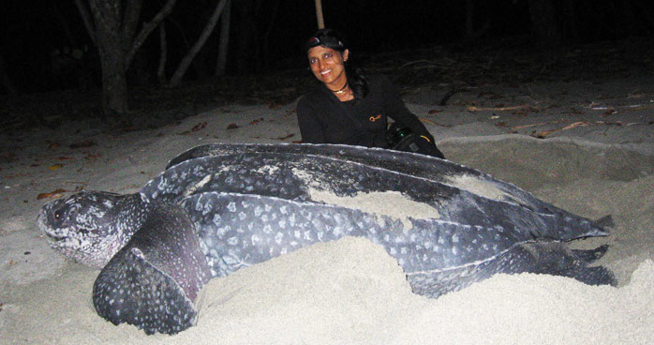
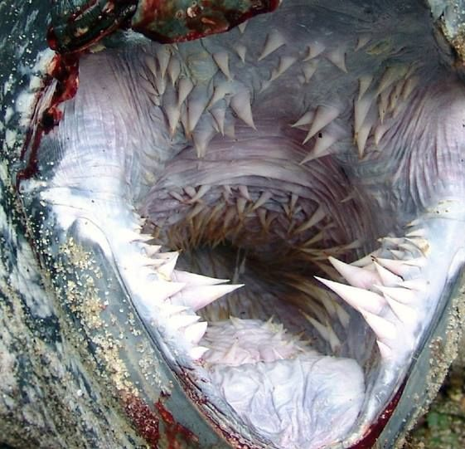
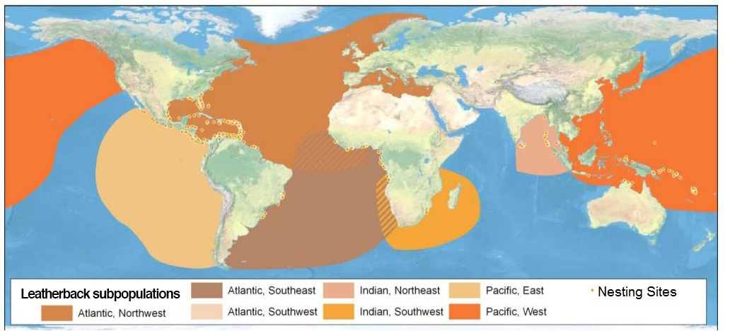
Class: Reptilia
Leatherback Sea Turtle
Largest sea turtle
7ft long and over 1,500 lbs
Lack a hard bony carapace
Thick, leathery skin covers bony plates
Diet of mostly _________
Can dive to 4,000ft deep
Notes:
Upper respiratory disease and habitat destruction are reasons for decline in desert tortoise and western pond turtle. Overexploitation of leatherbacks eggs and meat.

Slide 11
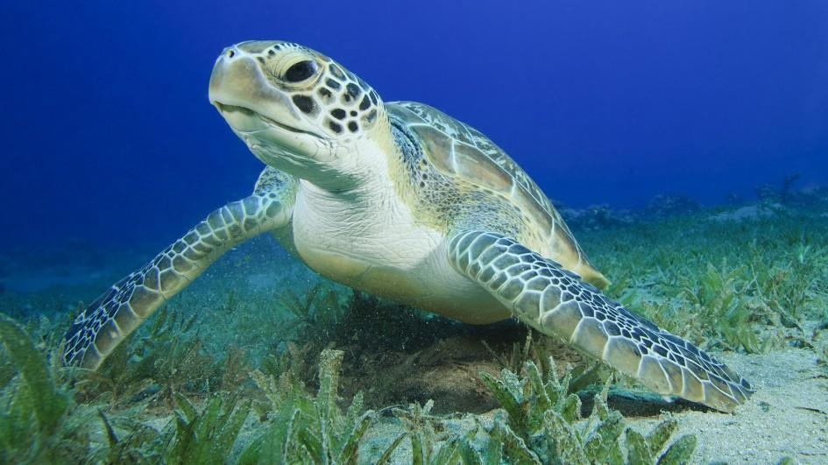
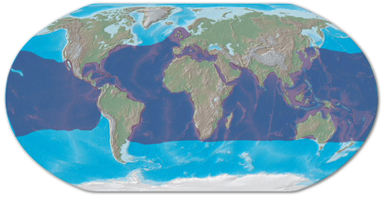
Class: Reptilia
Green Sea Turtles
Found in tropical and subtropical waters around the world
Omnivorous as a juvenile and herbivorous as an adult
Adults feed on seagrasses
Sex of hatchlings determined by nest _____________
> 30 °C = Females
< 30 °C = Males

Slide 12
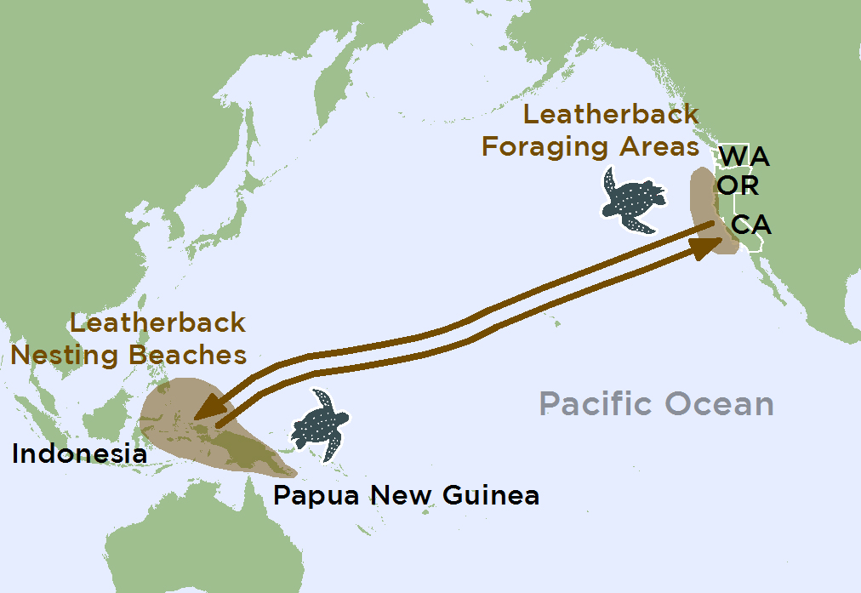
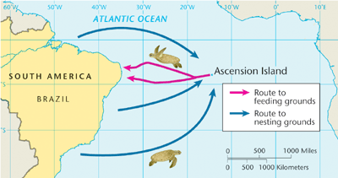
Sea Turtle Migration
Sea turtles often migrate between feeding areas and nesting beaches
Turtles believed to use light cues and earth’s magnetic field to navigate between areas
Leatherbacks sea turtles migrate between feeding areas in North America to nesting sites in Indonesia
Travels >10,000 miles a year
Green sea turtles migrate between the coastal waters of Brazil and the remote island of Ascension where they lay their eggs

Slide 13
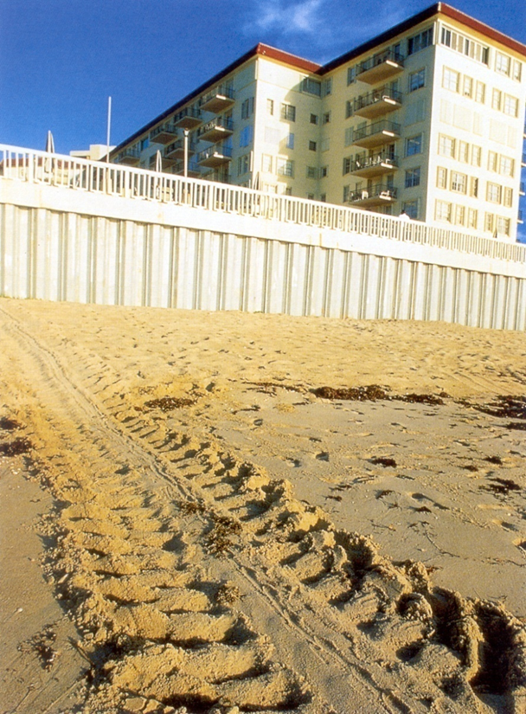
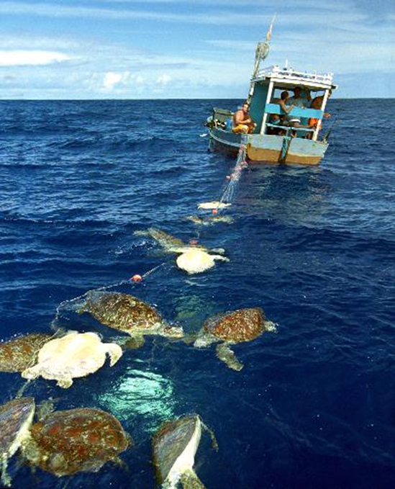
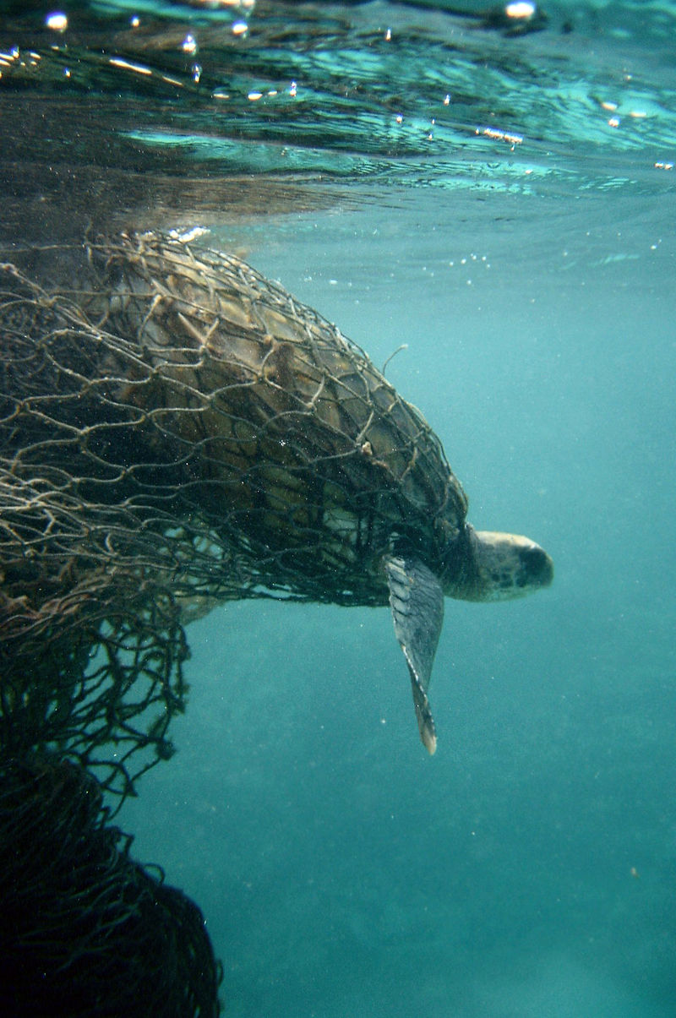
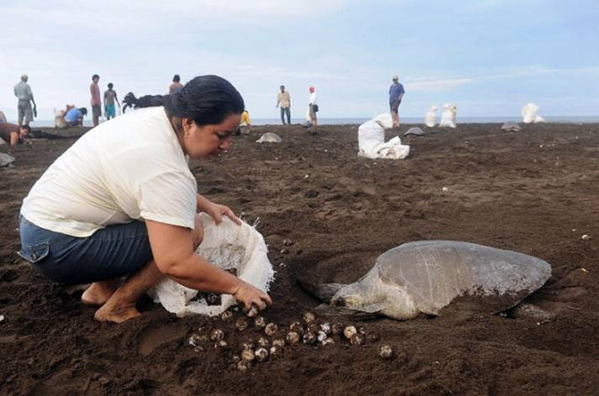
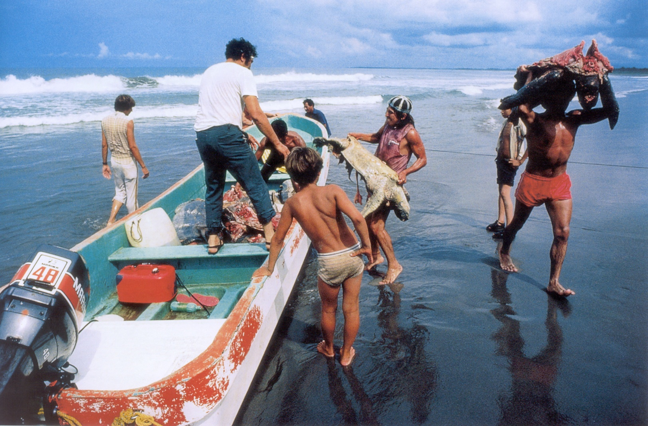
Threats to Sea Turtles
Most sea turtles are endangered due to human activities
Human impacts include:
Poaching and egg harvesting
Fishing nests
Loss of nesting habitat
Toxic accumulation
________

Slide 14
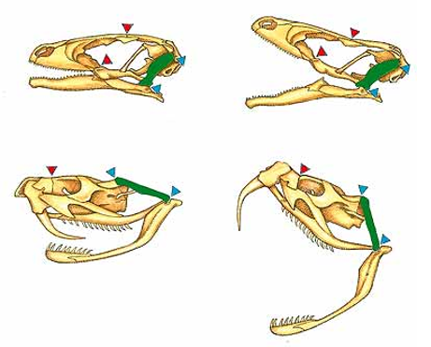
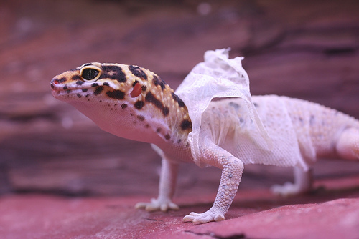
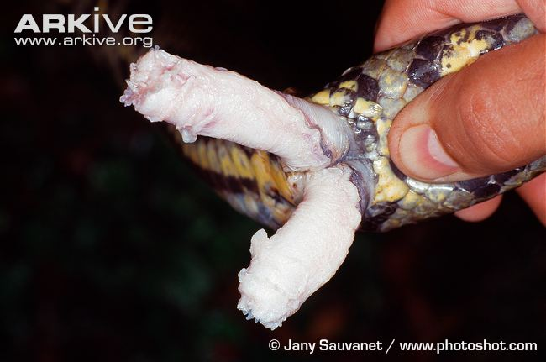
Class Reptilia
Lizards and Snakes
Largest order of reptiles, second largest order of vertebrates
~ 9,000
Snakes evolved from ________
Snakes lack legs and movable eyelids
All snakes are carnivorous
_______ their skin/scales
Flexible upper jaw with movable quadrate bone
Hemipenies: paired copulatory organ
Quadrate bone

Slide 15
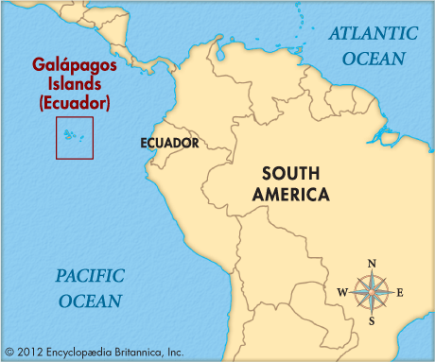
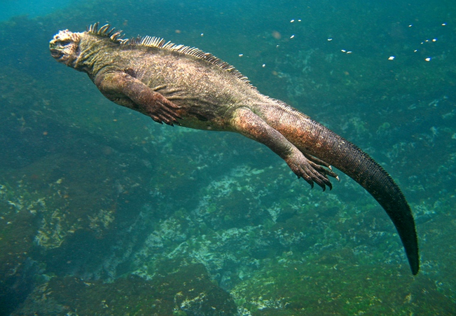
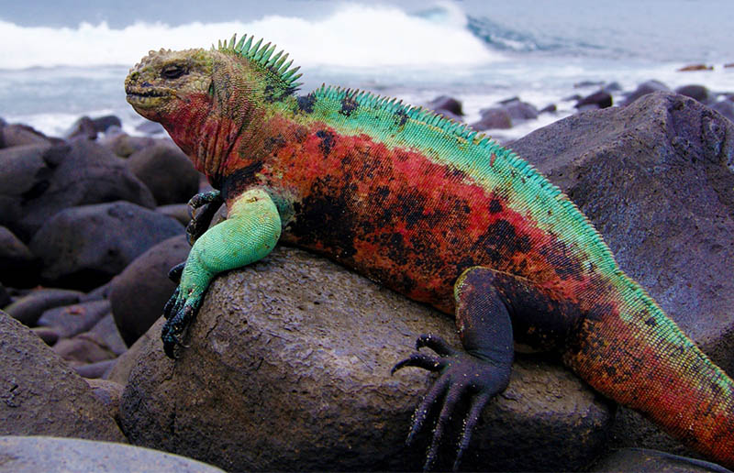
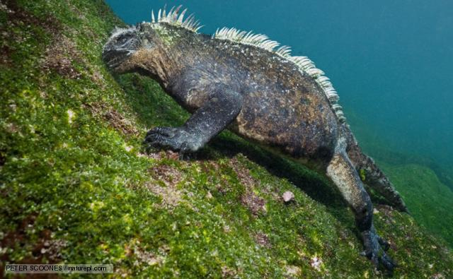
Class Reptilia
Marine Iguanas
Found only in the Galapagos Islands
Different subspecies found of different islands
Herbivorous
Eat primarily marine algae
Males larger than females
Dark colors allow them to gain heat quickly after leaving the water
Can dive to 66 ft and stay underwater for an hour
Notes:
Parthogenesis: female produces clones without fertilization

Slide 16
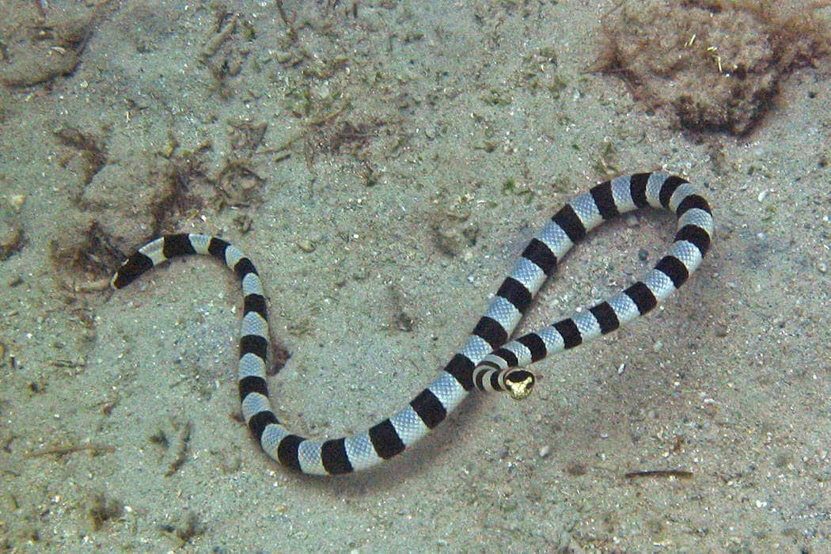
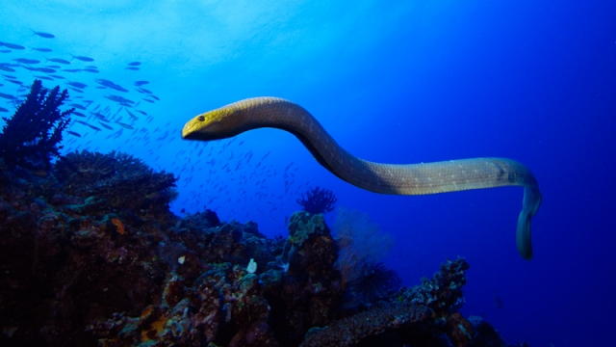
Class Reptilia
Sea Snakes
About 70 different species
Found in tropical Indian and Pacific Oceans
Laterally flattened tails for swimming
Feed on eels and fish
Almost all are ovoviviparous giving birth to young in the water, but five are oviparous laying eggs on land
Highly _____________
Related to cobras and mambas

Slide 17
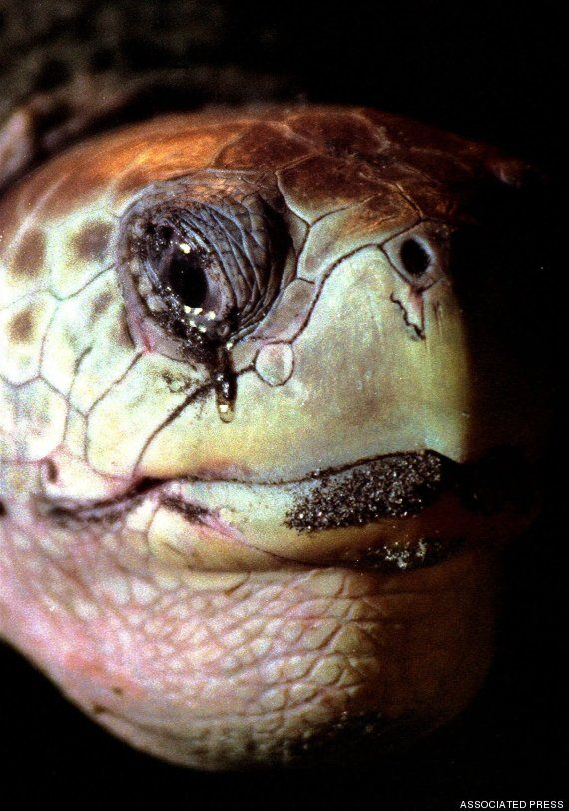
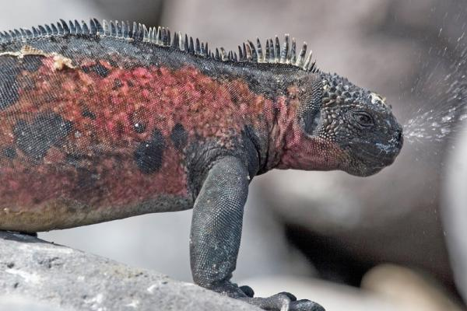
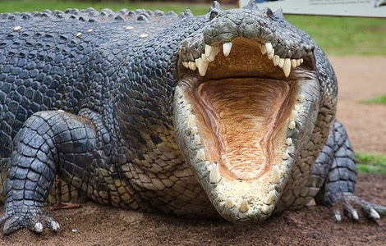
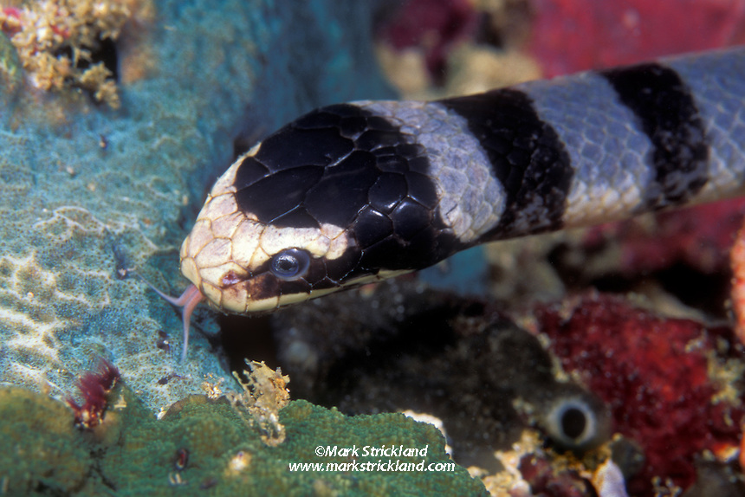
Salt Glands in Marine Reptiles
Salt glands are used to excrete excess salt acquired from the environment
Lacrimal glands (tear glands) in sea turtles
____________ in marine iguanas
Salivary glands in sea snakes and saltwater crocodiles
Salt excreted by the tongue

Slide 18
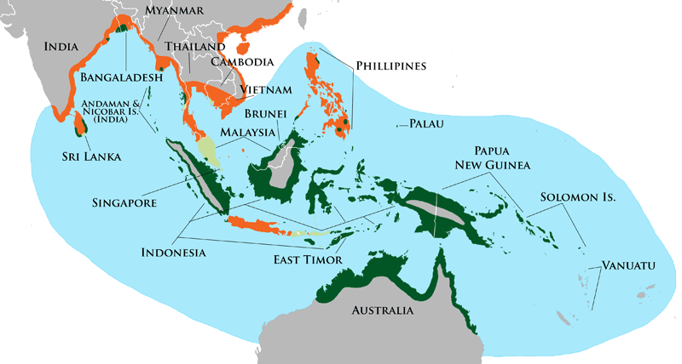
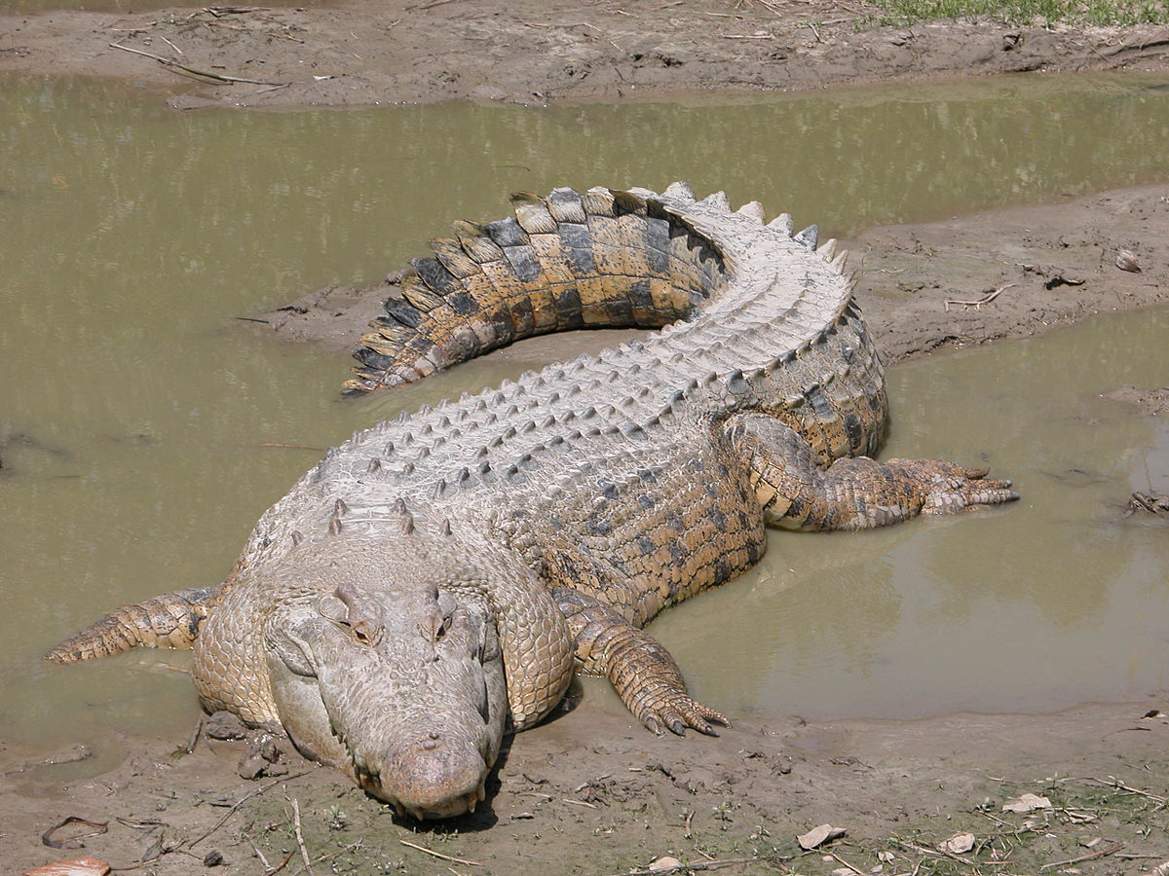
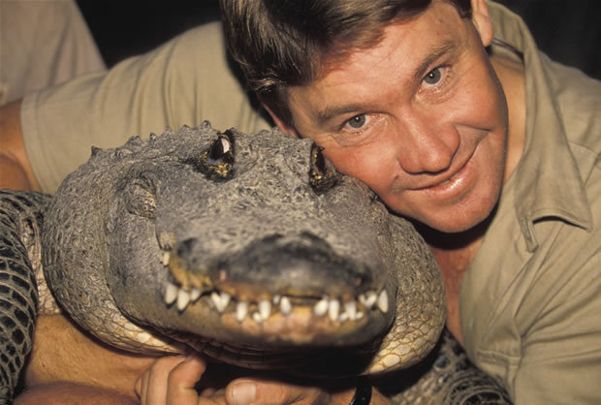
Class Reptilia
Saltwater Crocodiles
Found in Australia and southeast Asia
Largest living reptile
Can reach 20ft and weigh over 2,500lbs
Closely related to birds and dinosaurs
5 unwebbed digits front, 4 webbed back
______________________
Foramen of Panizza
Diverse diet including fish, birds, and mammals
Nest temperature influences sex

Slide 19
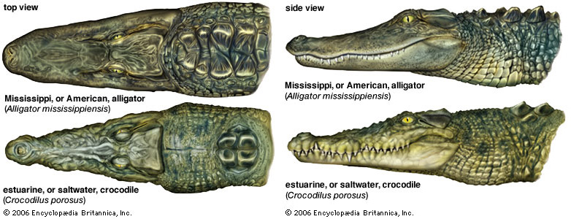
Alligators vs. Crocodiles
Crocodile
Lower teeth ______
Narrow, pointed snout
Alligator
Lower teeth not visible
Blunt, ________ snout

Slide 20
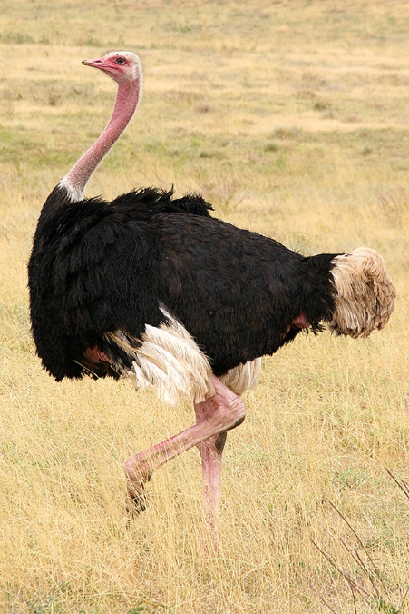
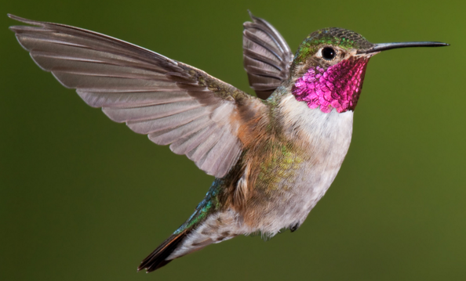
What is a bird?
Endothermic, vertebrate
High metabolic rate
Four chambered heart
Beak with ________
Bipedal
Arms modified as wings
Lays egg with hard outer shell
Strong, light weight skeleton
Closely related to ____________
Notes:
Range from 5cm hummingbee to 5.2m ostrich

Slide 21
Evolution of Birds
Evolved from theropod dinosaurs
Early feathers used for insulation, camouflage, attraction
Arms too short
Bodies too heavy
Key adaptations for flight
Reduction an fusion of digits
Hollow bones
Fusion of clavicles (furcula)
Feather development
Asymmetrical feathers (flight)
Loss of teeth
Reduction of bony tail (pygostyle)

Slide 22
Archaeopteryx lithographica
Modern Bird Features
Reptile Features
Three claws on wing
Flat __________
Ribs
Jaw bones with teeth
Long, bony tail
Flight feathers
Asymmetrical
Wings
Furcula
Fusion of metacarpals and phalanges
Larger braincase
Notes:
“Ancient wing”
First discovered in Bavaria in 1861
At least 10 fossils of Archaeopteryx have been discovered
Gliding but not long flights

Slide 23
Bird Anatomy: Adaptations for Flight
_________: fused clavicles that compress and rebound down stroke
________: projection of sternum used in flight muscle attachment
Pygostyle: fused tail vertebrae that supports and controls tail feathers
Carpometacarpus: fusion of hand and wrist bones for strength
“Hollow” bones: long bones have air pockets and are reinforced with struts
Notes:
Fixed tail is easier to control than

Slide 24
Bird Anatomy: Muscles and Flight
Both flight muscles attached to ______
Downstroke
Pectoralis muscle contracts
Attached to ventral side of humerus
Upstroke
Supercoracoideus muscle contracts
Attached to dorsal side of humerus by tendon

Slide 25
Feather Function
Flight
Insulation
Downy feathers
Nesting material
Heat absorption
Mate attraction
Camouflage
Protection from elements

Slide 26
Thermoregulation in Birds
Response to heat stress
Hyperthermia (elevated body temp)
Panting
Terns and gulls
Reduced activity during day
Response to cold stress
Fluff feathers for added insulation
Shivering
Increase metabolic rate
___________
Penguins
Manipulate blood circulation to fee
Notes:
Huddling in penguins, nuthatches
Hummingbirds save as much as 27% of their daily energy expenditure by allowing their body temp to drop at night.
Requires an hour to wake up out of torpor

Slide 27
Salt Glands in Marine Birds
Excess salt is from the blood of marine birds by passing the blood through salt glands in the head
____________ flow drives the diffusion of salt from blood into salt gland
NaCl is excreted from the nostrils (nares)

Slide 28
Respiration in Birds
One-way breathing
Two respiratory cycles
No residual air left in lungs
Lungs constantly receiving fresh air with high O₂ content
Sequence of respiration in birds
Inhaled air passes through primary bronchi to posterior air sac
Exhalation moves inhaled air from posterior air sacs to lungs
Air is inhaled again. Oxygen depleted air moves from lungs to anterior air sacs
Second exhalation moves air from anterior air sacs, bronchi and trachea into the atmosphere
Notes:
Birds have higher body temps than mammals and thus require more energy and oxygen

Slide 29
Comparison of Birds, Mammals and Reptiles
Characteristic | Reptiles | Birds | Mammals
Lower jaw bones | Several | Several | One (mandible)
Inner ear bones | One (stapes) | One (stapes) | Three (malleus, stapes, incus)
Red blood cells | Nucleated | Nucleated | ______________
Heart | Three-chambered (except crocodilians) | Four-chambered | Four-chambered
Thermoregulation | Ectothermic | ______________ | Endothermic
Reproduction | Oviparity (most) | Oviparity | Viviparous (most)
Egg shell | Leathery | Hard | Leathery (monotremes)
Notes:
Monotremes have a yolked, polar egg, similar to birds and reptiles, with an embryo that develops from divisions of the cytoplasm on the surface of the egg.

Slide 30
Bird Behavior: Flocking
Flock: congregation of birds usually in flight or foraging
Advantages
__________ – finding food
Protection – predator detection, mobbing
Mating – increased selection of mates
Chick rearing – protection from predators
Aerodynamics – less air resistance
Warmth – share body heat
Disadvantages
Visibility – attract predators
Competition – competition for food and mates
_______ – higher densities = greater disease transmission

Slide 31
Different Feeding Strategies in Seabirds
_____________: birds dive into the water from flight to feed on prey near the surface
Surface feeding: birds snatch prey off the ocean surface
Pursuit diving: birds pursue prey underwater by swimming with either their wings or feet
Kleptoparasitism: birds that steal food from other seabirds
Notes:
Pursuit divers often consume more energy rich prey, however many have given up flight ability for underwater swimming ability

Slide 32
Different Bill Shapes and Feeding Strategies
The strong, hooked bill of tubenoses are ideal for tearing prey to large to swallow whole
Heavy, streamlined bills in razorbills and penguins are ideal for deep diving pursuit foragers that eat crustaceans like krill
Straight, narrow beaks of terns and other plunge divers are adapted for swallowing prey whole
Skimmers have a longer lower bill that is perfect for skimming prey off of the surface while flying

Slide 33
Bird Behavior: Courtship
Most seabirds are ___________ and mate for life
Many have elaborate courtship behaviors to attract a mate
One of few birds that perform ritualized dances as part of the courtship

Slide 34
Seabird Reproduction
Most seabirds are long lived birds that produce few chicks each season
Provide long term parental care
Parents can spend up to 9-months raising their chick
Most form nesting colonies
Islands and cliffs to avoid predation from terrestrial animals
Introduction of ___________ to islands has devastated many seabird populations

Slide 35
Types of Marine Birds
Seabirds: birds that spend a significant amount of time at sea and are adapted for life in the marine environment.
Albatross, gulls, terns, penguins, puffin
Most feed on small fish, squid, or krill
Shorebirds (waders): birds that live in the wetland or coastal environments
Sandpipers, avocet, plovers, oystercatcher
Most feed on invertebrates picked out of the mud

Slide 36
Penguins
18 different species
Range from 3.7ft tall (emperor) to 16in tall (fairy penguin)
Flightless
Found in southern hemisphere
Except Galapagos penguin
All penguins exhibit ______________
Feed primarily of krill, fish, and squid
Pursuit diving
Larger penguins found in colder habitats
Usually feed near the surface, but emperor penguins can dive to 1,800ft

Slide 37
Penguins
Adaptations for swimming
Flat, solid bones instead of hollow bones increase the density and strength of the bones
Well developed muscles help power the flapping “flying” under water where there is greater resistance
Rather than large flight feathers the wing is covered with skin with short, waterproof feathers
Relatively inflexible elbow and wrist joints create stiffer wings that improve movement when swimming
Webbed feet provide better thrust when swimming
Flat, solid bones
“Elbow”
Short feathers
“Wrist”

Slide 38
Emperor Penguin Breeding Cycle
Jan-Mar: Feeding
April: March 60-100 miles to breeding grounds (rookery)
May: Mating
Jun-Jul: Males incubate a single egg
August: Eggs hatch and females return
Sept-Oct: Males feed and return to feed chicks
Oct-Nov: Chicks form creche
Dec: Parents leave and chicks fledge
https://youtu.be/6AiCIZ9wM1o
https://youtu.be/MfstYSUscBc

Slide 39
Tubenoses
Albatross, petrels and shearwater
Nostrils fused into single tube on top of the bill
Many can spends months or years out in open ocean
Most catch their prey on the sea surface
Strong sense of _____ allows them to find patchily distributed prey at sea
Notes:
Albatross can lock their wings in place to reduce energy expenditure

Slide 40
Dynamic Soaring
Albatross and other seabirds can spend days on the wing without flapping their wings
Wind speed is greater higher above the surface and is slowed by friction at the surface
Seabirds will fly toward the wind, gaining height, then glide back down with the wind to gain speed
Air moving over the top of the wing faster than under the wing generate lift

Slide 41
Pelicans and Related Seabirds
Pelicans, Frigate birds, Gannets, Cormorants, Ibis, and Boobies
Most have all four toes webbed
Nostrils evolved into dysfunctional slits
Breath through mouth
Most feed on fish or squid
Plunge diving and pursuit diving
Brown pelicans were endangered due to the biomagnification of DDT

Slide 42
Brown Pelicans and DDT
25.0 ppm birds
2.0 ppm needlefish
.5 ppm minnows
.04 ppm zooplankton
.000003 ppm runoff
Note
1 ppm = 1 inch in 16 miles
1 ppm = 1 minute in 1.9 years
1 ppm = 1 pound in 500 tons
1 ppm =1 cent in $10,000.00

Slide 43
Pelicans and Related Seabirds
Cormorants
Cormorants are used as a traditional fishing method in some Asian countries
Ring around the neck prevents bird from swallowing fish
Flightless cormorants in Galapagos evolved to lose wing function
Lack of ___________ on islands
Food obtained through diving
Non-migratory bird

Slide 44
Gulls and Terns
Gulls, Terns and Skimmers
Diverse group of seabirds with worldwide distribution
Marine, wetland and freshwater habitats
Most are species are grey above and white below
Most are migratory
Most nest in large colonies
Terns = plunge divers
Gulls = surface feeding, scavenging
Skimmers = surface feeding

Slide 45
Migration
Arctic Tern
Longest migration of any animal
Travel 44,000 miles a year
Over 1.5 million miles in a lifetime
Two summers a year!
Migrate along with _________________
Nest along North Atlantic coast
“Winter” in the ice off Antarctica during the summer months of the southern hemisphere
Abundance of energy-rich prey during summer months

Slide 46
Migration
Red Knot
Migrate over 9,000 miles from tip of South America to high Arctic
Threats to Red Knots include:
Loss of coastal habitats in North and South America
Decline of ______________ and bivalves that provide energy for their journey
Hunting in Caribbean and South America
Predation by foxes and jaegers in the Arctic

Slide 47
Shorebirds
Sandpipers, Avocet, Plovers, Stilts Oystercatcher, and Curlews
Live in the wetland or coastal environments
Most feed on ____________ picked out of the mud
Many exhibit sexual dimorphism
Sexual dimorphism: males and females differ in their appearance differ

Slide 48
Resource Partitioning
Resource partitioning: when species evolve to occupy different ecological niches to reduce the amount of ___________ between species
Different bill lengths in shorebirds allow different species to specialize in different prey types

Slide 49
Resource Partitioning

Slide 50
Sea Eagles
Bald eagle, Steller's Sea Eagle
Eagles that specialize in capturing and eating fish
Typically catch fish at the surface
Large eagles
Sea eagles weigh up to 20lbs with wingspan up to 8ft

Slide 51
Osprey
Osprey
Large raptor that is not an eagle
Specializes in capturing fish
Plunge diver
Dense, oily feathers repel water
Closable nostrils
__________ outer toes for grasping prey
Worldwide distribution
Estuaries and freshwater lakes
Artificial nest platforms
Monogamous, mate for life

Slide 53
Check Your Understanding
True or False: All snakes and lizards are carnivorous
True or False: Crocodiles are similar to birds because they both have a four-chambered heart
True or False: The temperature of the nest can determine the sex of the offspring in some reptiles

Slide 54
Check Your Understanding
Which of the following are not one of the advances that led to the evolution of tetrapods?
a. Increased air breathing capabilities
b. Fusion of head and body
c. Limbs with digits
d. Fusion of pectoral and pelvic girdles with the spine

Slide 55
Check Your Understanding
Which of the following parts of the amniotic egg are involved in gas exchange?
a. Amnion
b. Chorion
c. Allantois
d. Yolk sac
e. Shell

Slide 56
Check Your Understanding
Describe the removal of salt through the salt glands in marine birds

