Slide 1
Intro to Life, Protists and Fungi
“The man who asks a question is a fool for a minute, the man who does not ask is a fool for life.”
― Confucius

Slide 2
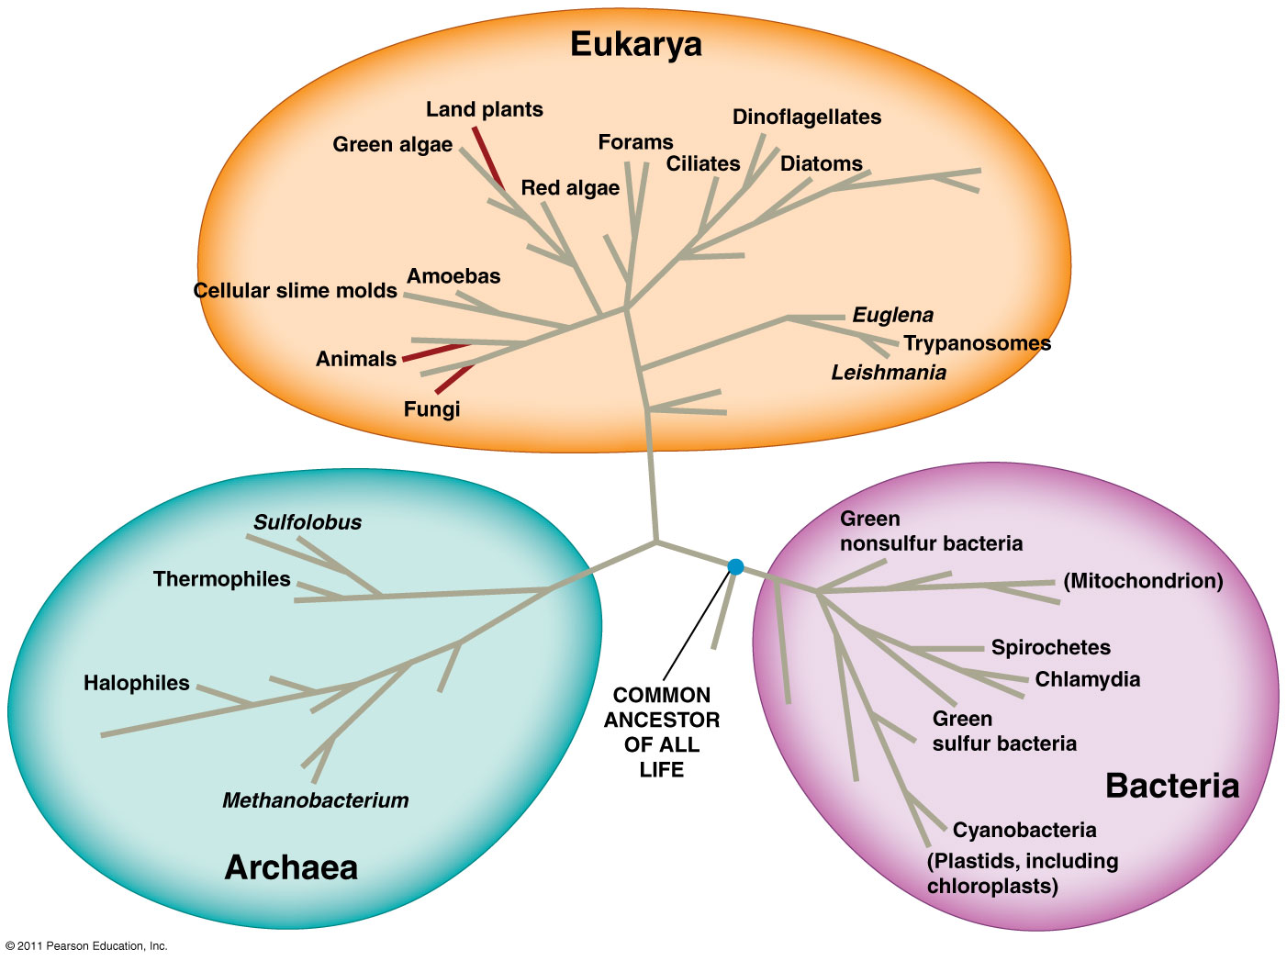
Domains of Life
Bacteria
Unicellular prokaryotes
Archaea
Unicellular prokaryotes
Extremophiles
Eukarya
Unicellular and multicellular eukaryotes
Protists
Fungi
Plants
Animals
You are here

Slide 3
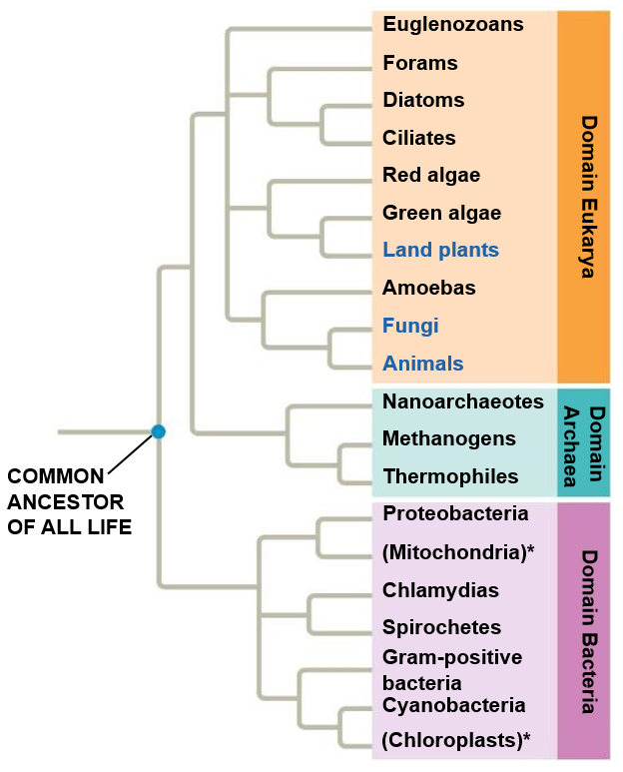

Slide 4
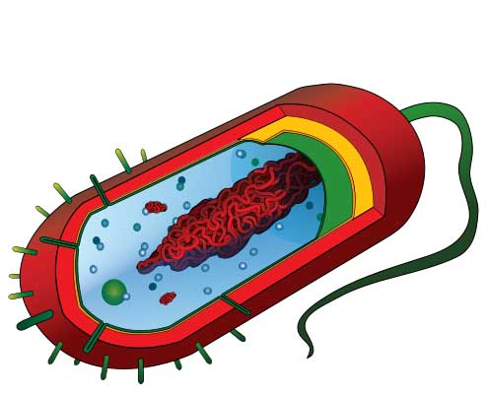
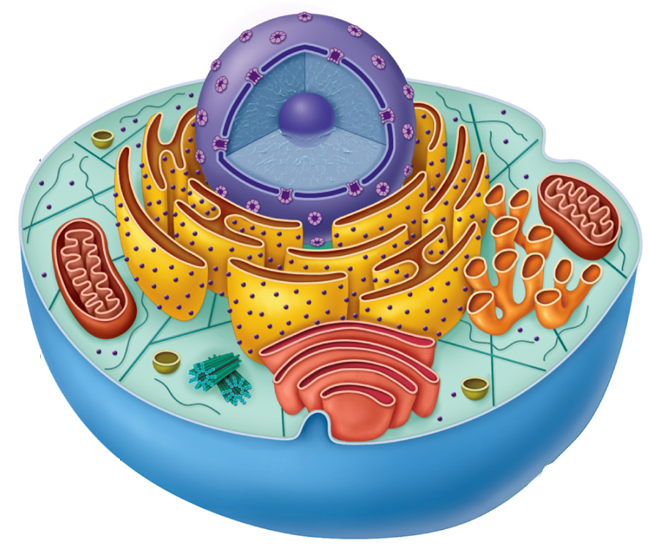
Two Main Groups of Cells
Prokaryotic
(Bacteria and Archaea)
Eukaryotic
(Protists, Plants, Animals and Fungi)
*Not to scale

Slide 5
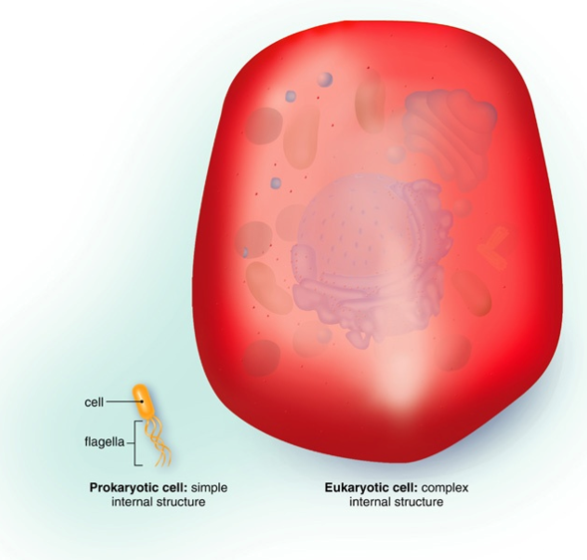
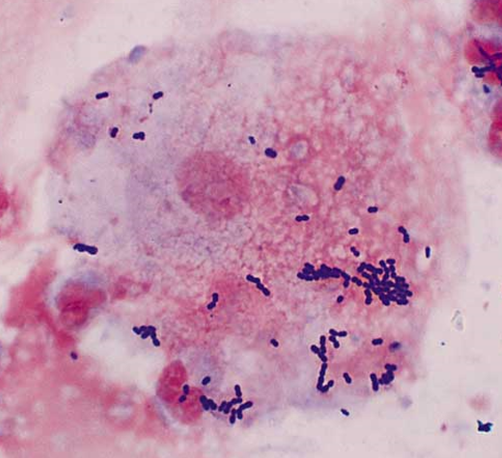
Prokaryotic and Eukaryotic Cells
Eukaryotic cell
Prokaryotic cell
Eukaryotic cell
Prokaryotic cell

Slide 6
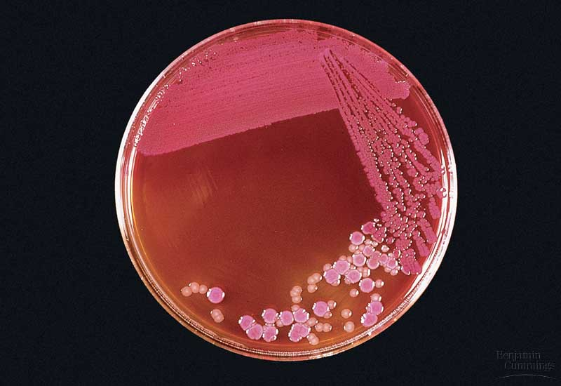
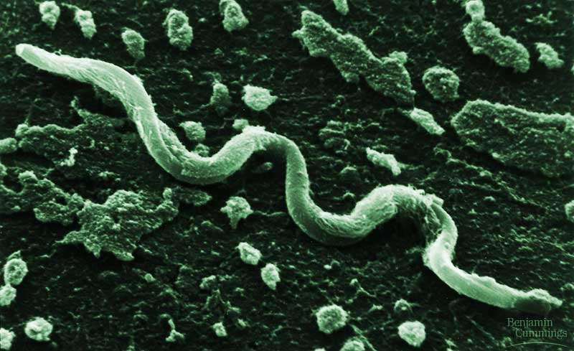
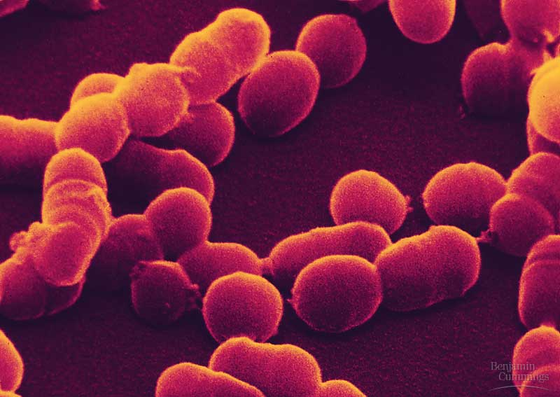
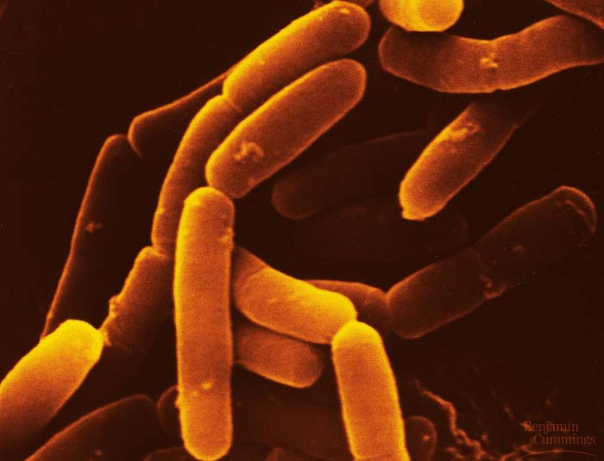
Domain: Bacteria
Prokaryotic cells
No membrane bound nucleus or organelles
Single-celled organisms
Asexual reproduction
_____________ in cell wall separates bacteria from archaea

Slide 7
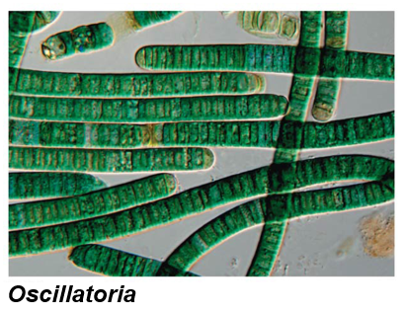
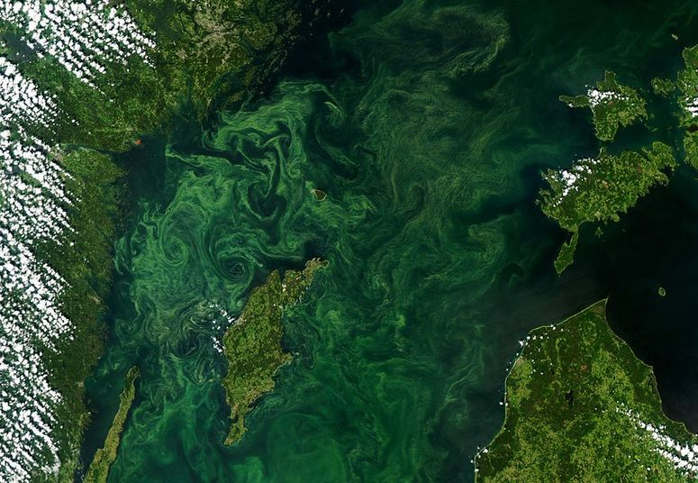
Bacteria: Cyanobacteria
Autotrophic bacteria: obtain food energy through photosynthesis.
1st photosynthetic organisms on Earth
Increased oxygen in atmosphere
Accounts for most primary production in open oceans
Likely evolved into chloroplast in eukaryotic cells
Only organism that can ______________ ____________(product of photosynthesis)

Slide 8
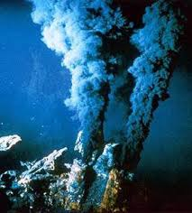
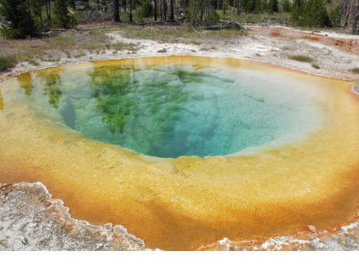
Domain: Archaea
Prokaryotic cell but similar to Eukaryotes in DNA replication and protein synthesis
More closely related to ___________
_______________: organisms that live grow best in one or more conditions that would kill most organisms
Thermophiles: live in extremely hot environments
Halophiles: live in extremely salty environments
Methanogens: Methane releasing archaea that are poisoned by oxygen

Slide 9
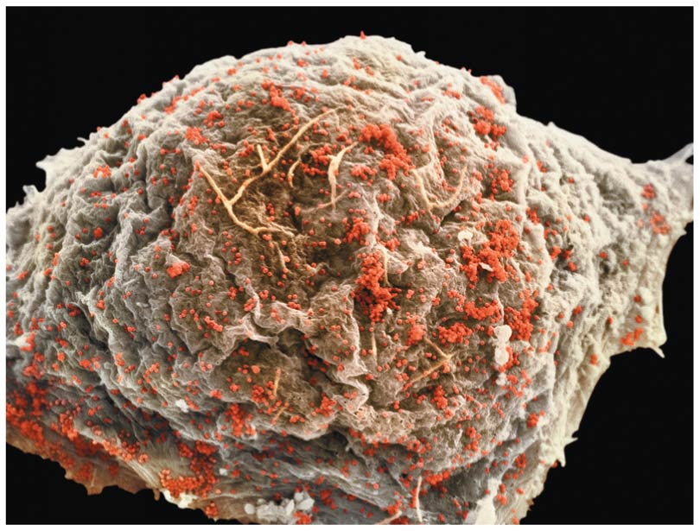
A Borrowed Life
Virus: an infections particle incapable of replicating outside of a cell, which consists of an RNA or DNA genome enclosed in a protein coat (capsid)
____________________ parasites
Arguments for describing viruses as non-living
Can not ___________ outside of host cell
Can not carry out metabolic processes outside of outside of host cell
HIV attacking a white blood cell

Slide 10
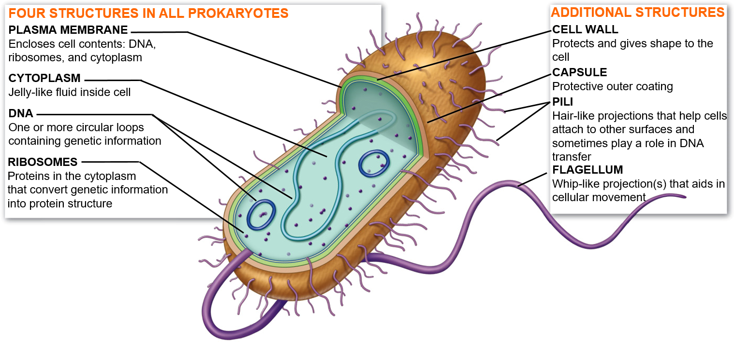
Prokaryotic Cell Structure

Slide 11
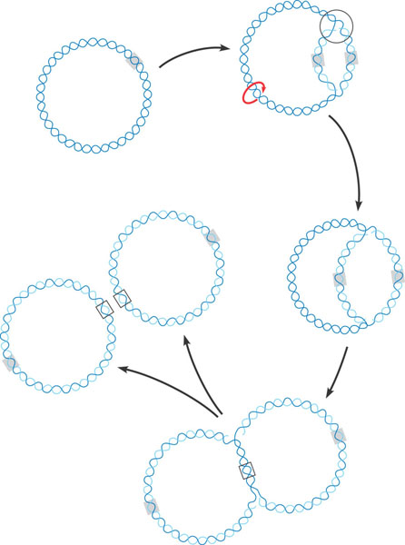
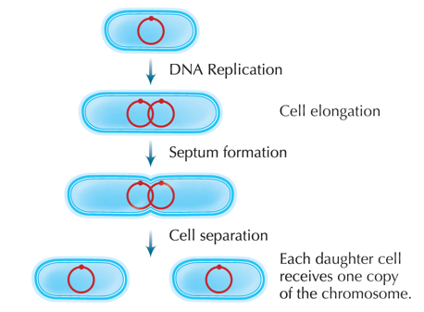
Prokaryotic Reproduction
________________: DNA replicates and then the cell divides into two separate cells

Slide 12
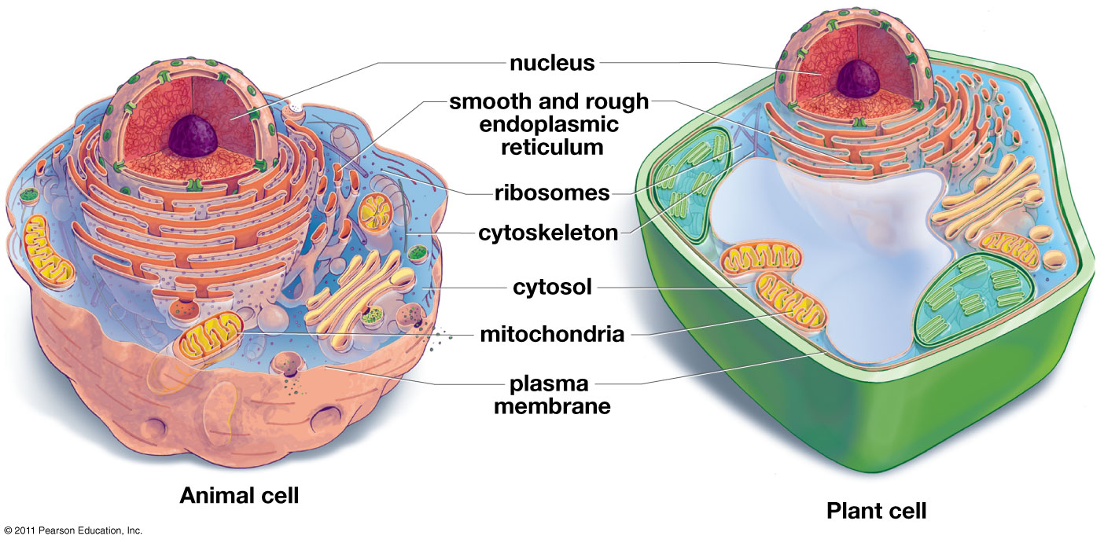
Eukaryotic Cell Structure

Slide 13
Prokaryotic and Eukaryotic Cells
Characteristics | Prokaryotic Cells | Eukaryotic Cells
Cell Size | Small (0.2 – 2.0 µm in diameter) | Large (10 – 100 µm in diameter)
Organization | Always single celled | Often __________________
Nucleus | __________________ | Membrane bound nucleus
Membrane-enclosed organelles | Absent | Present (e.g. lysosomes, Golgi complex, mitochondria)
Chromosomes (DNA) | Usually ______________ chromosome | __________________ chromosomes
Cell division | Binary fission | Involves mitosis
Sexual Recombination | None, transfer of DNA only | Involves meiosis

Slide 14
Check Your Understanding
Which of the following are not one of the characteristics of bacteria?
a. Cell wall containing peptidoglycan
b. Contain a membrane bound nucleus
c. Asexual reproduction
d. Single-cell organisms
e. More than one of the above

Slide 15
Check Your Understanding
Archaea that thrive in extremely hot environments are known as ___________.
a. Halophiles
b. Heatophiles
c. Methanogens
d. Feugophiles
e. Thermophiles

Slide 16
Domain: Eukarya, Kingdom: “Protista”
Protists: similar appearing but diverse phyla that are not related through an exclusive common ancestor, which have different life cycles, trophic levels, modes of locomotion and cellular structures.
Under constant debate and revision
Eukaryotic organisms that are not plants, animals, or fungi
Most are unicellular
Without ____________
First eukaryotes arose ~1.5 bya
Photosynthetic plant-like protists (algae) and heterotrophic animal-like protists

Slide 17
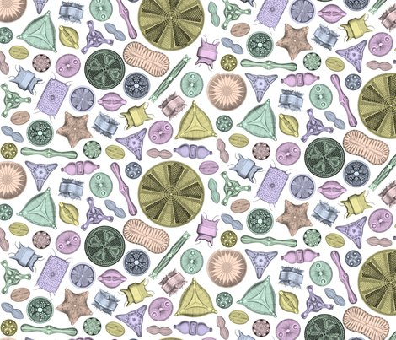
Kingdom: Protista
Diatoms
Planktonic
Unicellular, but often form chains
Cell walls made of silica (glass-like material) called frustule
Diatomaceous earth
Carotenoids (yellow and brown pigments)
Important primary producers

Slide 18
Diatoms in the Food Web

Slide 19
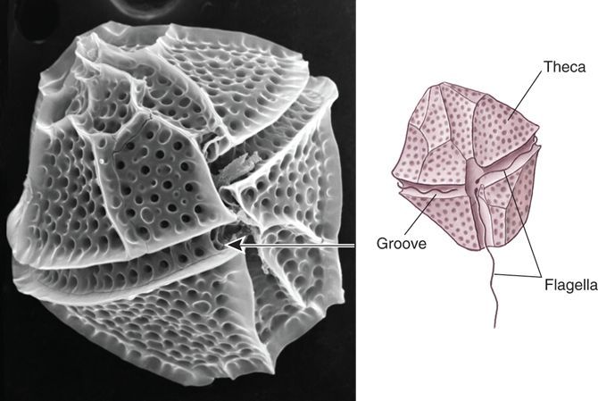
Kingdom: Protista
Dinoflagellates
Planktonic
Unicellular
Many are mixotrophic
Mixotroph: organisms that perform photosynthesis but are also heterotrophic
Cell wall made of cellulose plates
Two flagella
Some are bioluminescent
Algal blooms (red tides)
Demonic acid

Slide 20
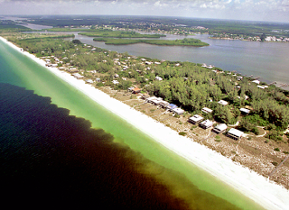
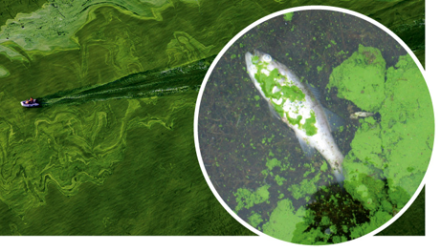
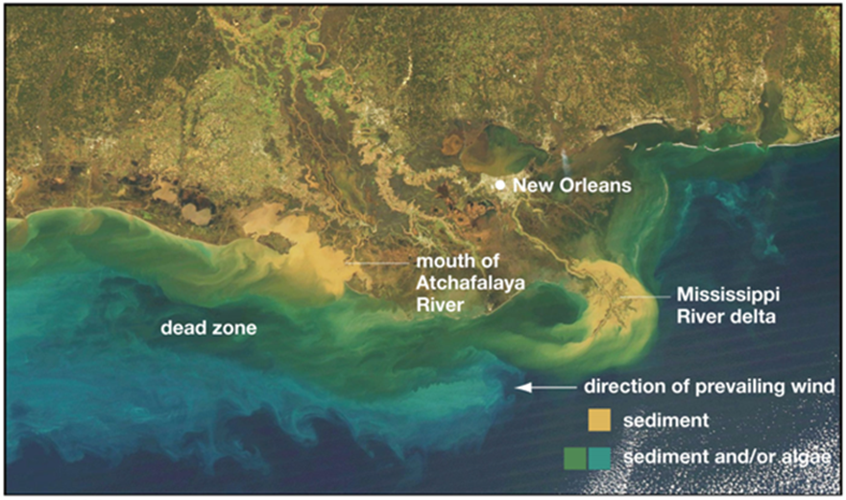
Algal Blooms
______________: excessive richness of nutrients in a body of water, frequently due to runoff from agricultural areas on land
Can cause algal blooms, which is the dense growth of algae and bacteria that can result in __________ where animals die from lack of oxygen (hypoxia).
Notes:
Nitrogen and phosphorus

Slide 21
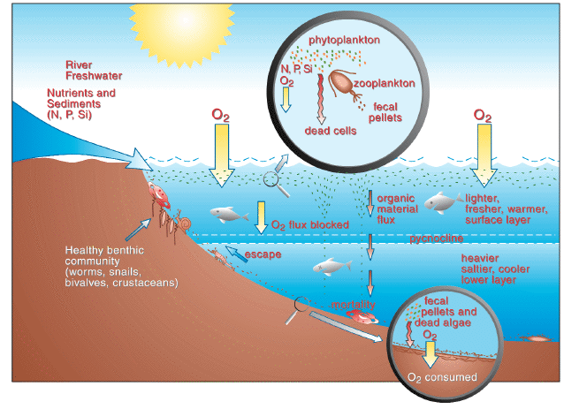
What Causes Dead Zones?
During the summer months nutrient rich runoff from land enters the oceans resulting in eutrophication
Eutrophication along with abundant solar energy leads to massive algal blooms
Dead algae sink to the bottom where bacteria aid in decomposition
Heterotrophic bacteria deplete oxygen available to other organisms forming a hypoxic environment

Slide 22
Algal Blooms and Toxins

Slide 23
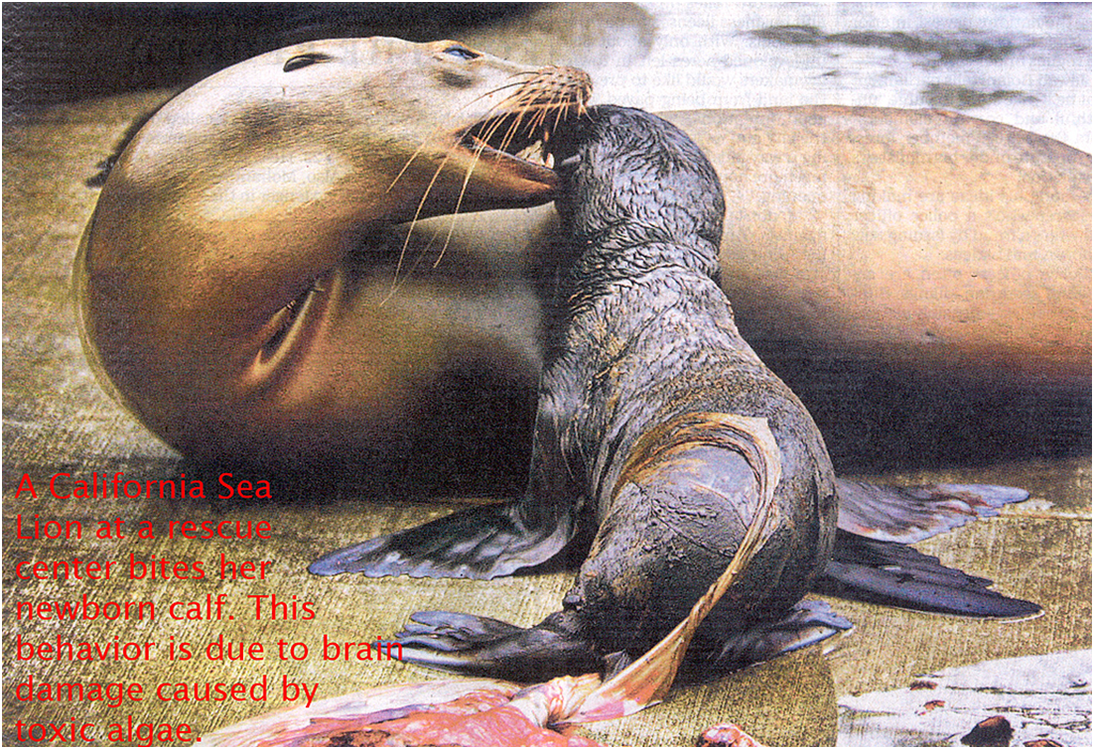
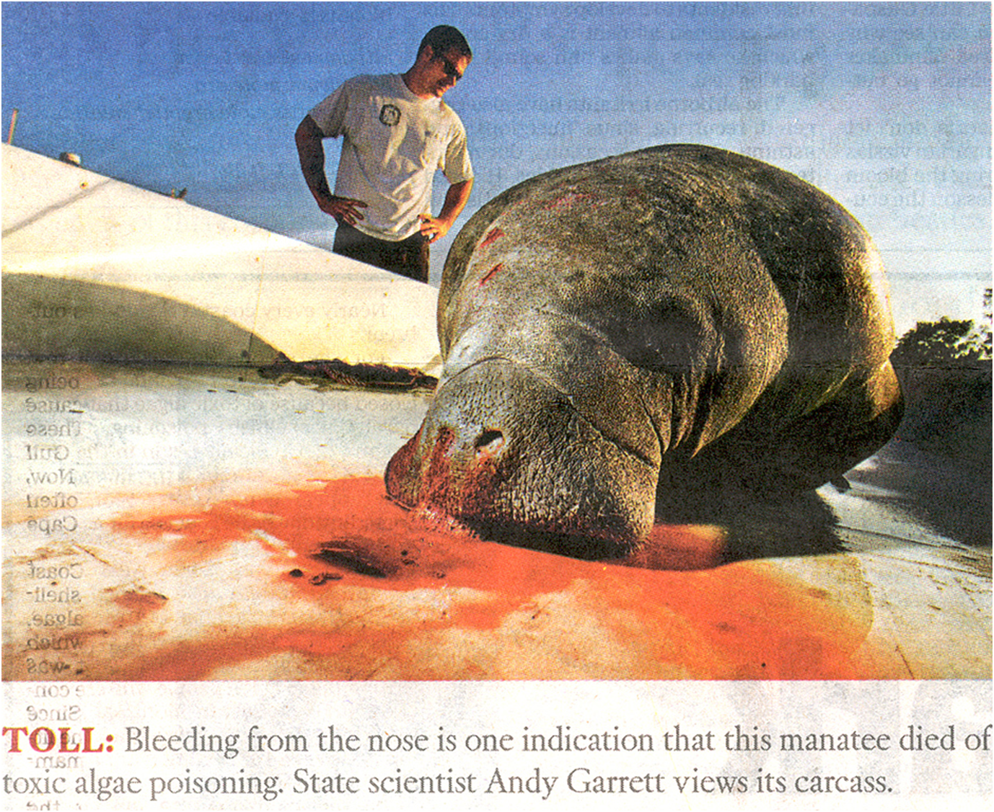
Algal Blooms and Toxins

Slide 24
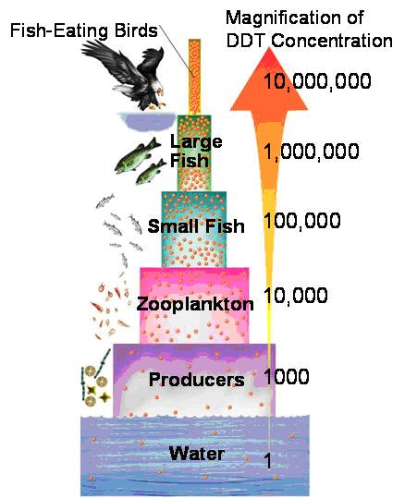
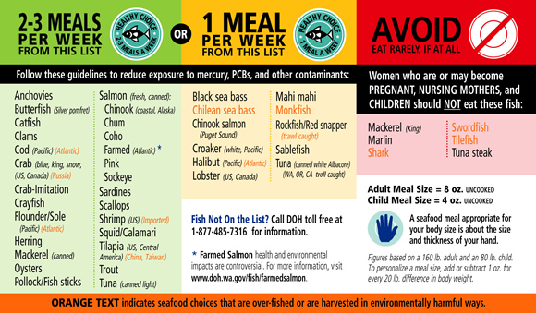
Biomagnification
Biomagnification: toxic substances become increasingly ___________ within living things as they move up each trophic level
Common with algal toxins, DDT, Mercury, and PCB’s

Slide 25
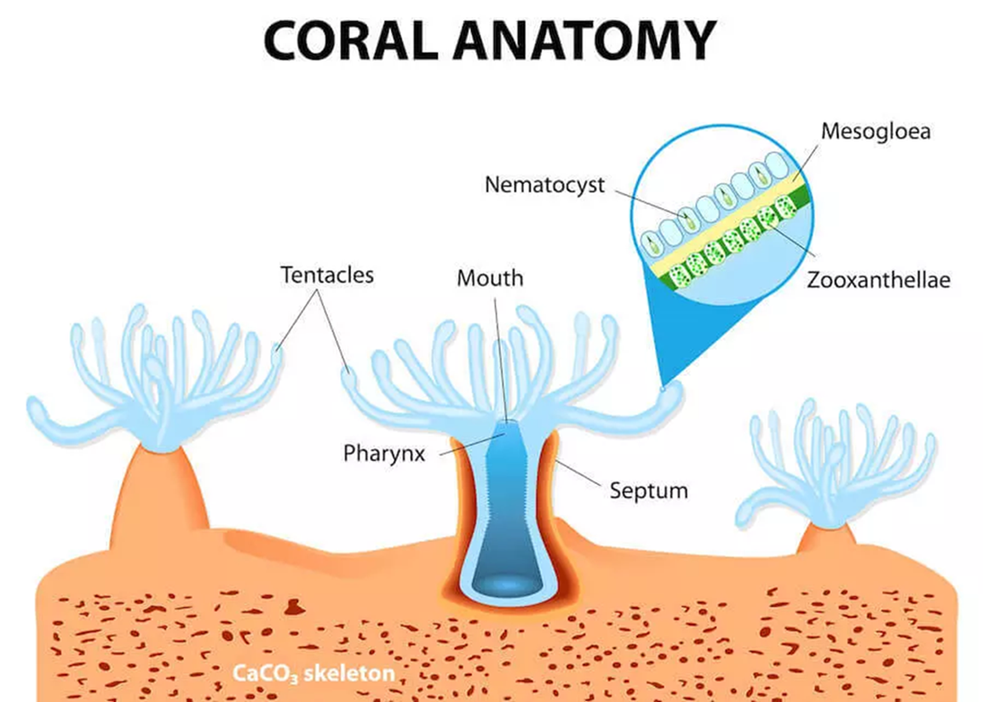
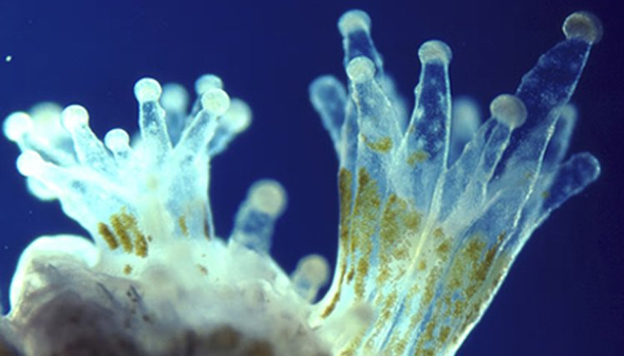
Kingdom: Protista
Zooxanthellae
Symbiotic dinoflagellate found in the tissue of many marine invertebrates
Photosynthetic zooxanthellae provide hosts with carbon products used for energy and growth
Zooxanthellae

Slide 26
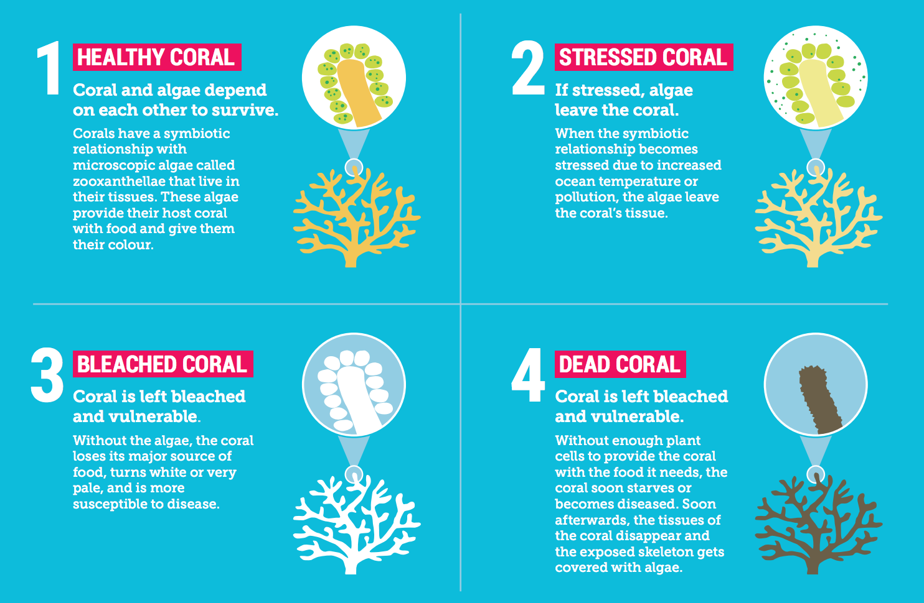
Zooxanthellae and Coral Bleaching

Slide 27
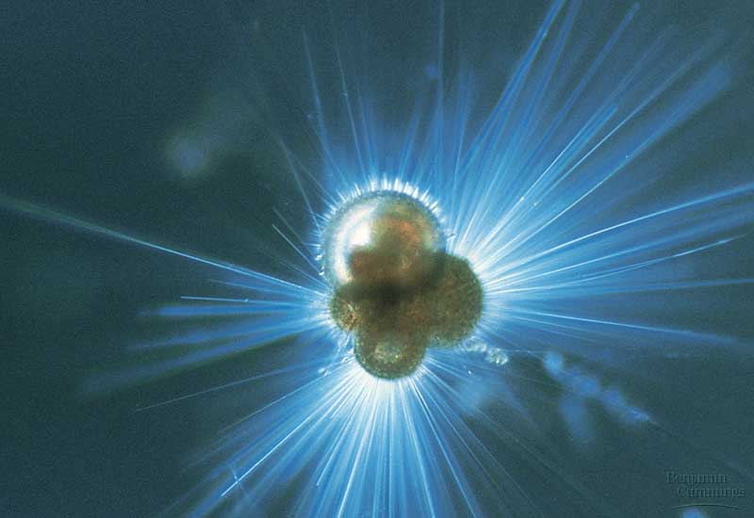
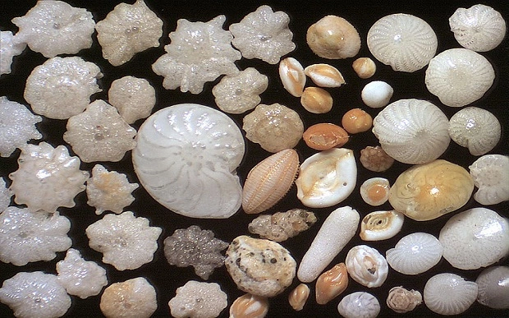
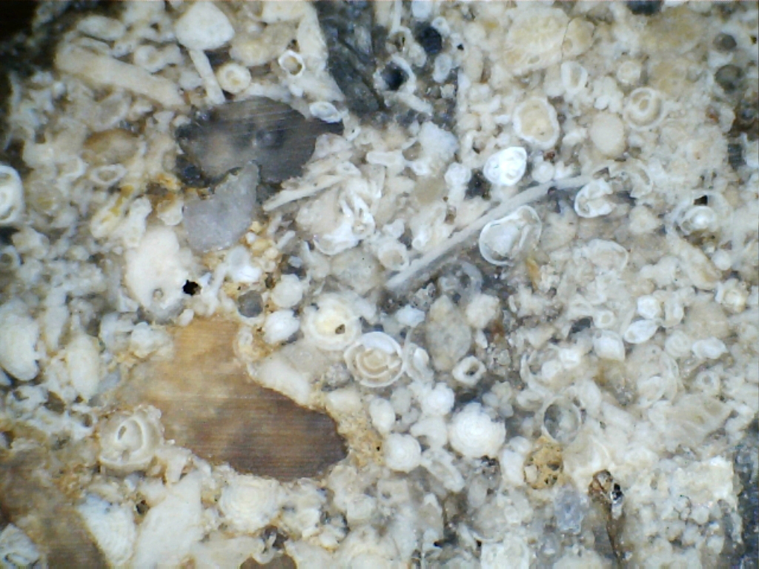
Kingdom: Protista
Foraminiferans
Porous, _______________ tests (shells)
Foramen (little hole), ferre (to bear)
Thin pseudopodia (false feet) capture food
Marine and freshwater
Most are benthic (live on the bottom)
Fossilized forams = limestone rock
Chemical markers in tests used to determine previous climates

Slide 28
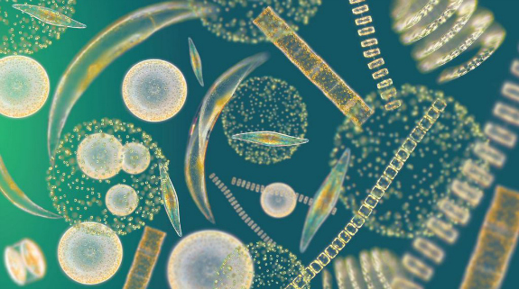
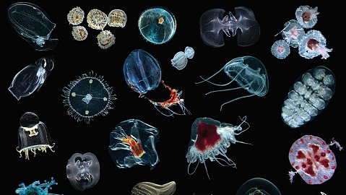
Plankton
Plankton: aquatic organisms that are unable to swim against the current
Phytoplankton: photosynthetic planktonic organisms
Zooplankton: heterotrophic planktonic organisms

Slide 29
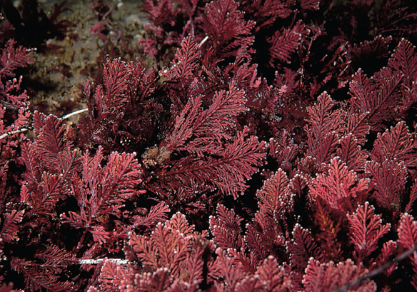
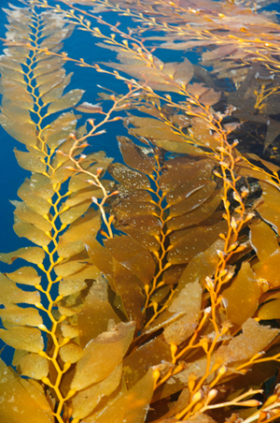
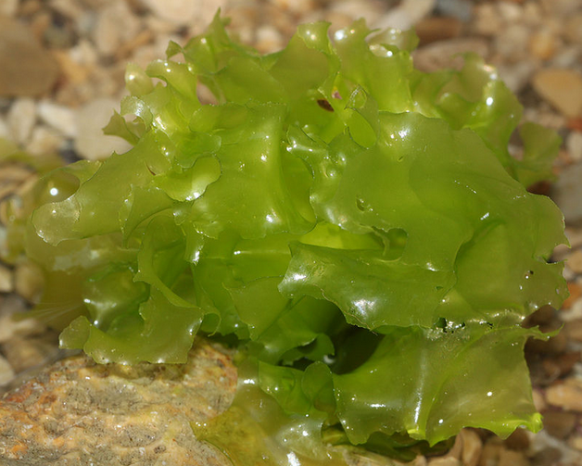
Multicellular Primary Producers
Macroalgae (seaweeds): multicellular, photosynthetic organisms that lack true tissue, leaves, stems, and roots.
Classification depends on photosynthetic pigments
Green, red, and brown seaweeds
Wide range of growth forms

Slide 30
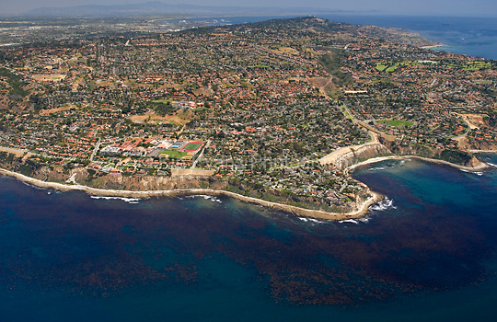
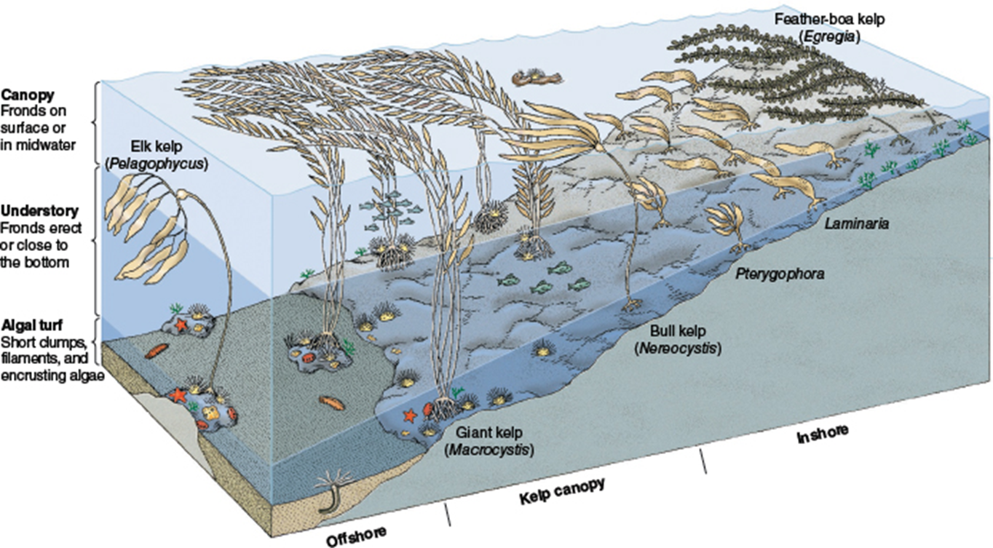
Kelp Forest Communities
Kelp Forests
Dense forests of fast-growing brown algae
Different species of brown algae grow best at different depths
Found in temperate and subpolar regions
Important food source and shelter for many organisms

Slide 32
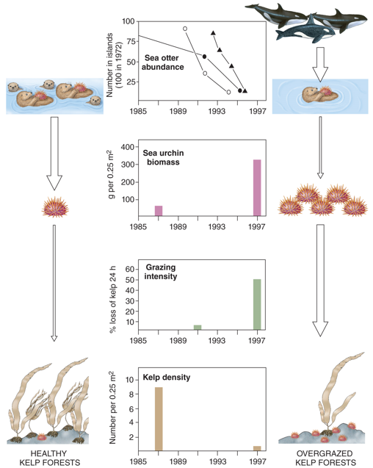
Kelp Forest Ecology
A decline in seal and sea lion populations has led to more sea otters being eaten by killer whales
A decline in sea otters has led to an increase in se urchins
An increase in sea urchins has led to an increase in sea urchin grazing intensity on the kelp
Increased grazing by sea urchins has led to a decline in healthy kelp forests

Slide 33
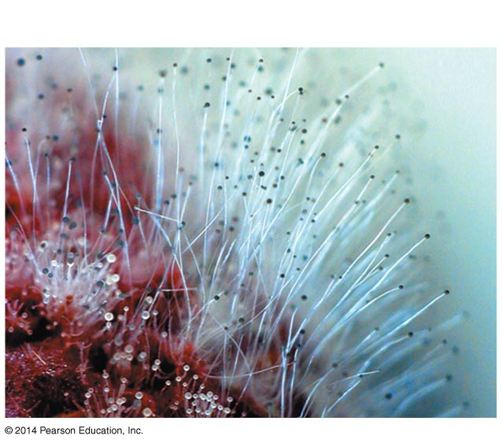
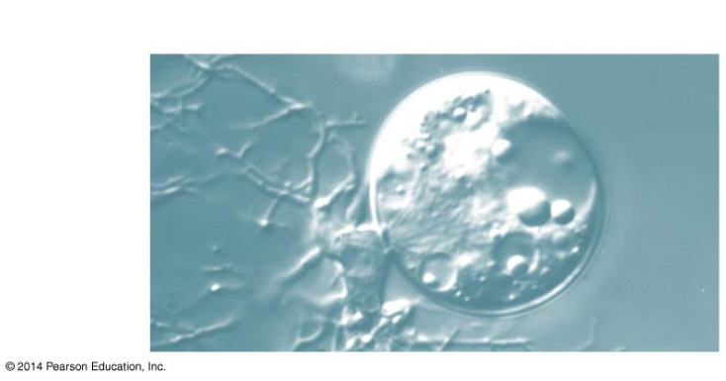
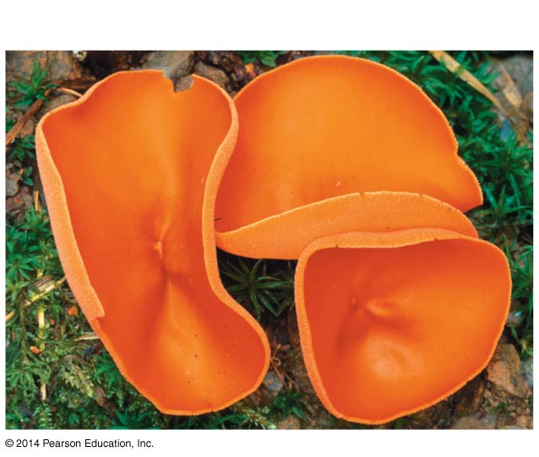
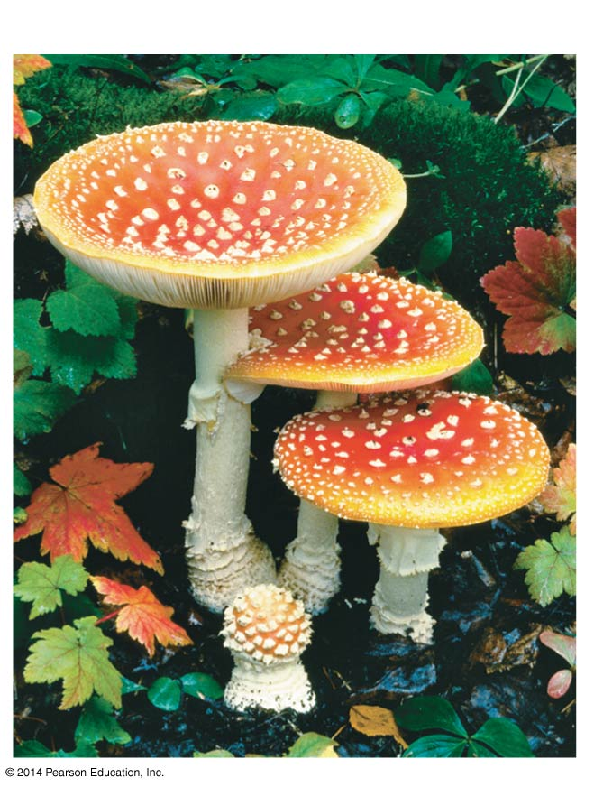
Kingdom Fungi
____________ eukaryotes that ______ nutrients from environment
Mostly multicellular
Yeast = unicellular
Decomposers, parasites or mutualists
Excess sugar stored as ___________
Similar to animals
Primarily terrestrial

Slide 34
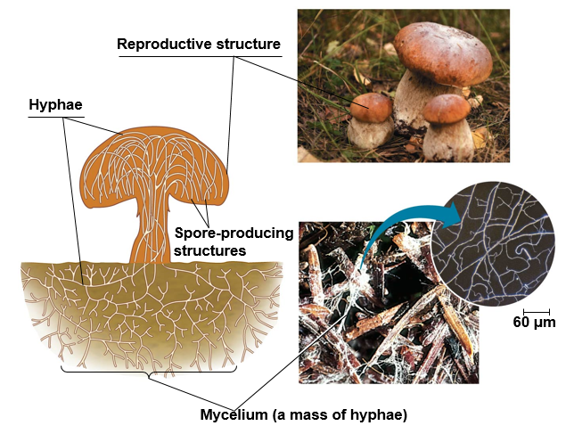
Fungi Anatomy
Multicellular or single celled (yeasts)
________: long, thread-like filamentous structure that forms the main vegetative growth of fungi
Tubular cell walls strengthened by chitin
Fast growing
___________: the interwoven mass of hyphae
Above ground parts produce spores

Slide 35
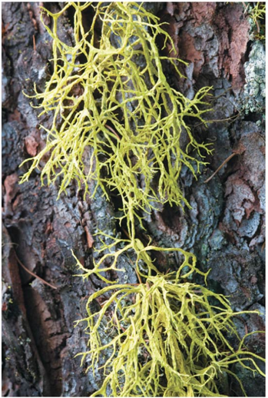
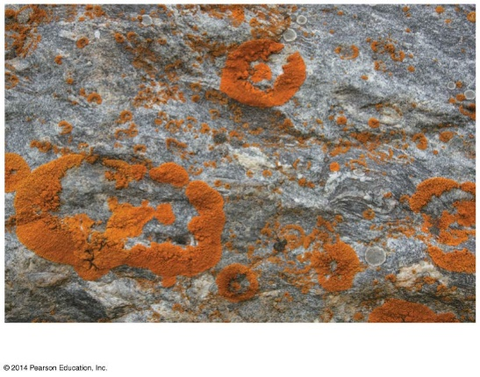
Lichen
Symbiotic association between a ____________ microorganism and a fungus
Photosynthetic organism (cyanobacteria or green algae) provides carbon compounds
Fungi provided environment suitable for growth

Slide 36
Importance of Fungi
Fungi are important decomposers in terrestrial ecosystems.
Break down organic material and return nutrients to the soil, which are then taken up by plants
Nutrient cycling

Slide 37
Ecological Impacts and Uses of Fungi
Important decomposers
Nutrient recycling
Mutualistic relationships
Lichen
Mycorrhizae
Parasitic pests (30% of all fungi)
Chestnut blight
__________: fungal infection in animals
Chytridiomycosis caused by B. dendrobatidis
Athletes foot and ring worm
Yeasts = booze and bread. Yay!
Antibiotics
Penicillin

