Slide 1
Marine Invertebrates II
“A human being should be able to change a diaper, plan an invasion, butcher a hog, conn a ship, design a building, write a sonnet, balance accounts, build a wall, set a bone, comfort the dying, take orders, give orders, cooperate, act alone, solve equations, analyze a new problem, pitch manure, program a computer, cook a tasty meal, fight efficiently, die gallantly. Specialization is for insects.”
-Robert A. Heinlein
Chapter 7

Slide 2
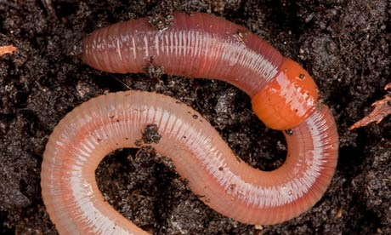
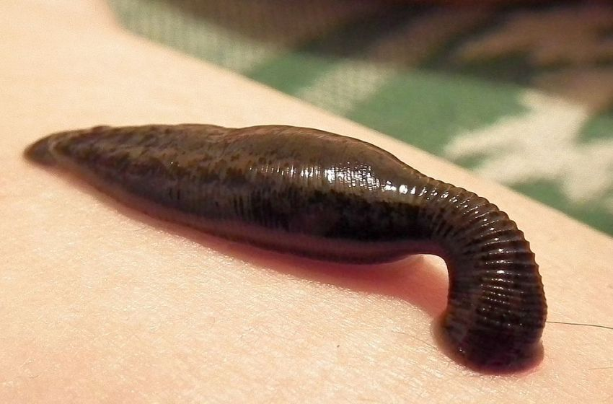
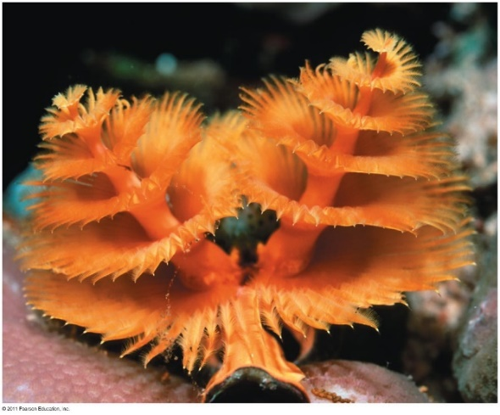
Phylum Annelida
Earthworms, leaches and polycheate worms
Characteristics:
Protostome development
Hydrostatic skeleton
Bilateral symmetry
Segmented bodies
________________
Coelomates

Slide 3
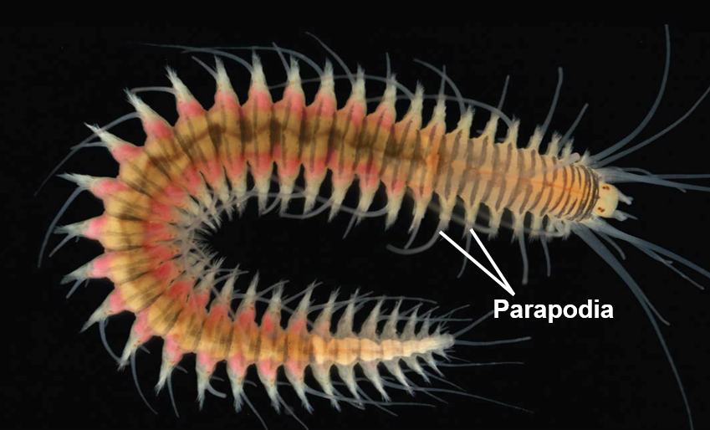
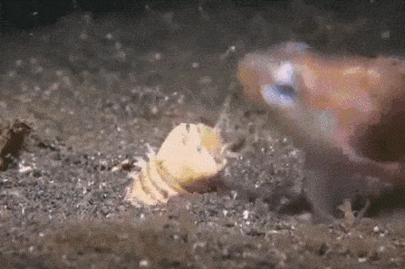
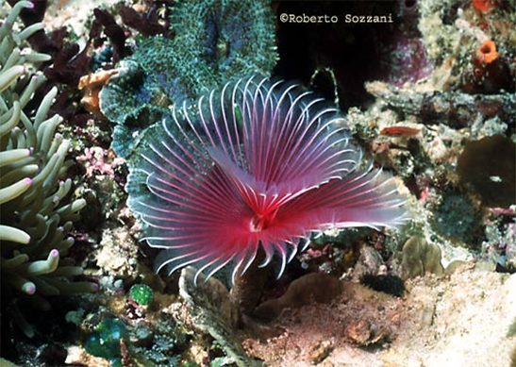
Phylum Annelida
Polycheates
Mostly marine
Well developed ____________
Sensory organs
Predators, filter feeders and grazers
___________: paired, unjointed outgrowths that bear chaetae, often used in locomotion
__________: stiff bristles on the body
Chaetae
Notes:
Cheatae also setae

Slide 4
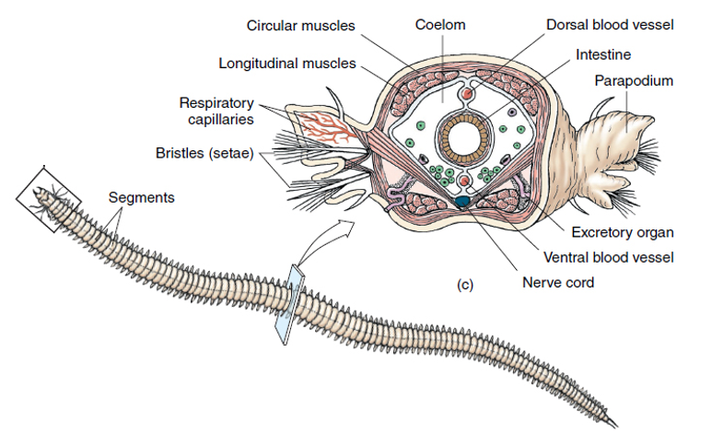
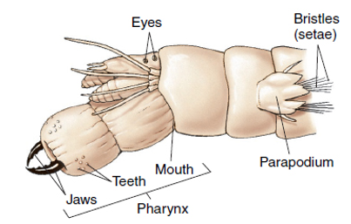
Phylum Annelida, Class Polychaete

Slide 5
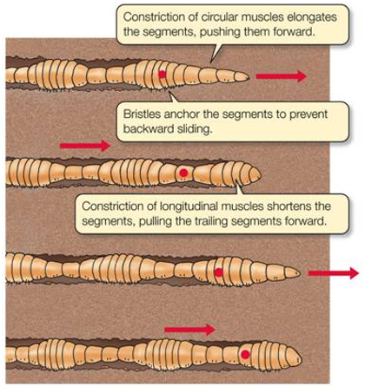
Annelid Movement
____________: movement produced by rhythmic waves of muscle contractions
Circular muscles contract pushing worm forward
Longitudinal muscles contract pulls trailing end forward
_________ prevent backsliding

Slide 6
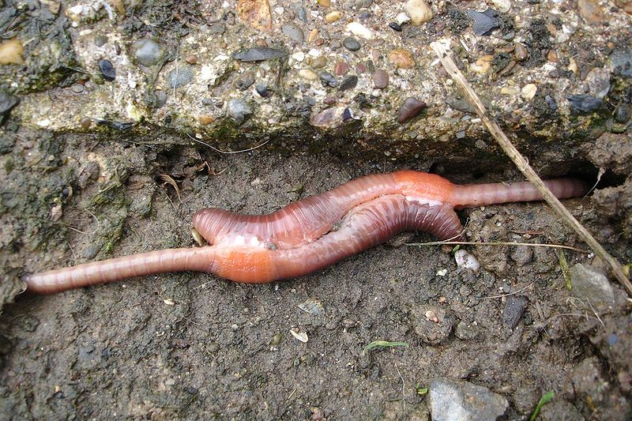
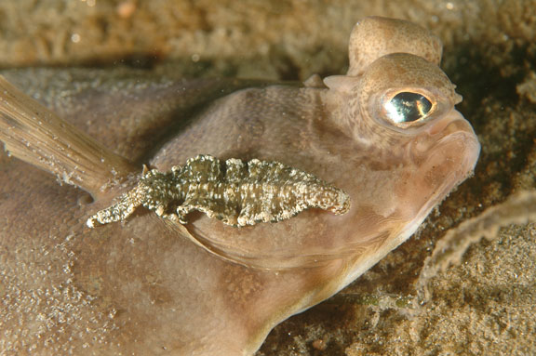
Phylum Annelida
Earthworms and Leeches
Filter feeders, detritivores, predators and parasites
__________: Unsegmented section of the body used in reproduction
Few chaetae
Hirudin: anticoagulant released by parasitic leeches
Notes:
Leeches used to drain blood from patients after surgery.
Hirudin used to prevent blood clotting
Earthworms eat through soil
Most earthworms introduced from Europe
Farmers like them
May e bad for certain habitats (northern forests that require decaying organic material for nutrition)
Leeches have 32 brains

Slide 7
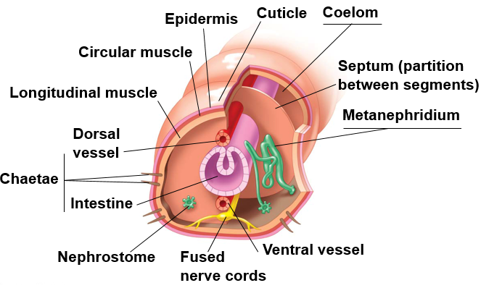
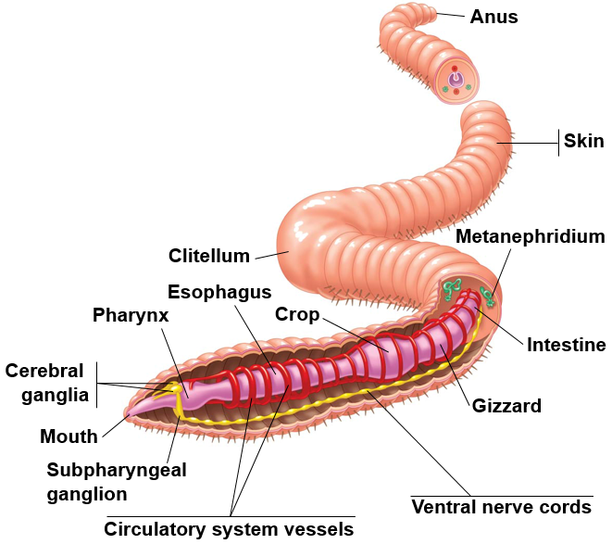
Annelid Anatomy
Notes:
Nervous system: Pair of cerebral ganglia (brain) connected to subphrayngeal ganglions, which connect to ventral nerve cords (fused)
Closed circulatory system: dorsal and ventral vessels
Alimentary canal: Mouth – Esophagus – Crop (storage) – Gizzard (breakdown) – Intestine – Anus
Pair or metanephridia in each segment
Septa separate segments
Respiration through skin

Slide 8
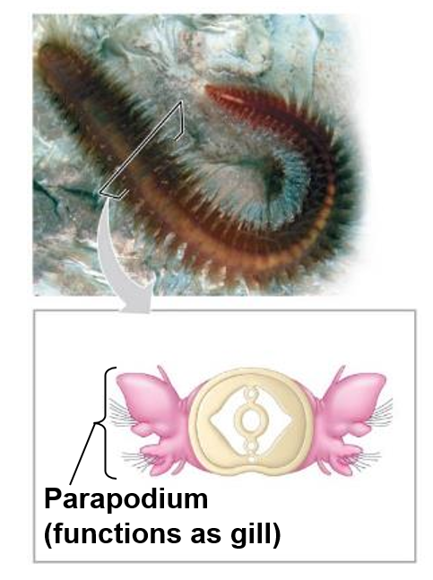
Respiration in Annelids
Marine Annelids
Parapodia on each body segment serve as gills, as well as a means of locomotion
Terrestrial Annelids and Leeches
_______________ across moist skin surface

Slide 9
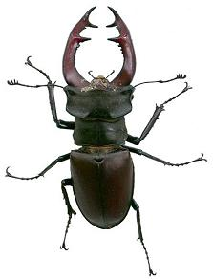
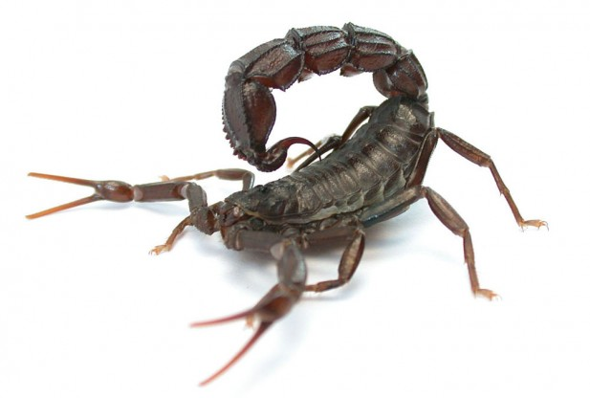
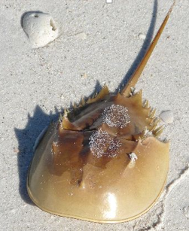
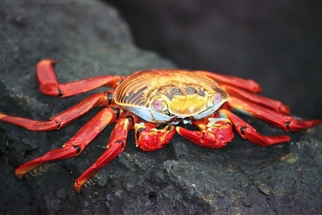
Phylum Arthropoda
Spiders, crustaceans, and insects
2/3 of all known species
More than 1 million described
Found in all habitats on earth
________________, segmented body, _________________
Must molt to grow
Segments carry paired appendages
Complex behavior patterns
Notes:
Nervous system similar to annelids
Estimates of about a billion billion arthropods on earth
Evolved from unspecialized lobopods
Specialization of segments key to evolutionary success.
Must shed exoskeleton to grow
Chitin: polysaccarhide
Protection
Muscle attachment

Slide 10
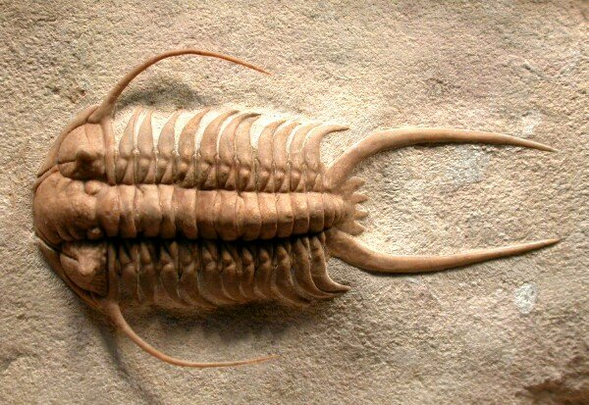
Phylum Arthropoda
Trilobites
All extinct (Permian era - 250 mya)
Segmented bodies without specialized appendages
Paired appendages

Slide 11
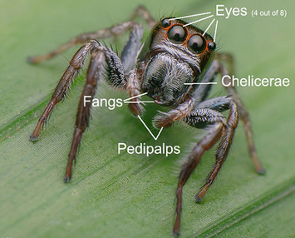
Phylum Arthropoda
Subphylum Chelicerata
Sea spider, horseshoe crabs
Cephalothorax and Abdomen
Fusion of head and thorax
Six pairs of appendages
One pair of _______________: specialized feeding appendages
Fangs or pinchers
One pair of _____________: sensory organ, feeding, defense, reproduction
Four pairs of walking legs
No antennae
Most with simple eye (single lens)

Slide 12
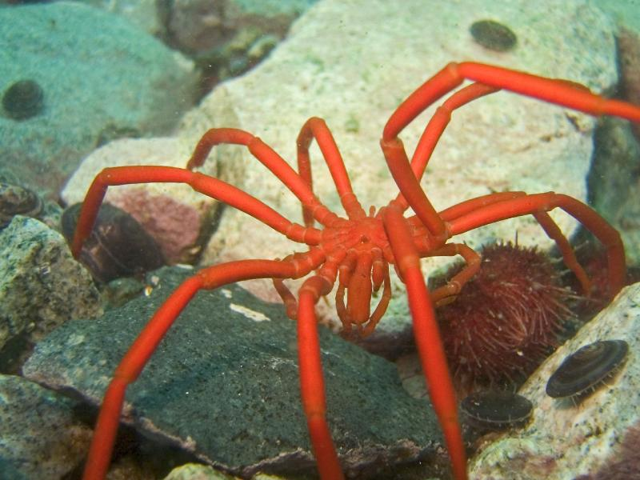
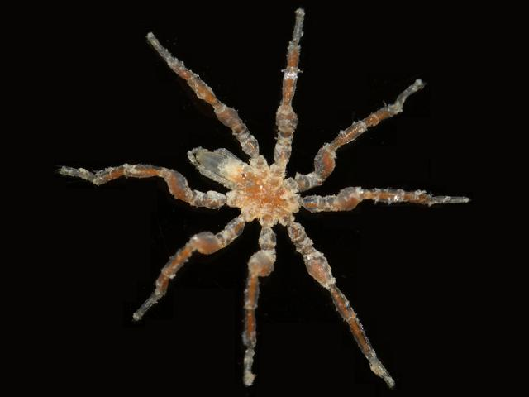
Phylum Arthropoda
Sea spiders
Approx: 1300 species
Not true spiders
Reduced body
No circulatory system
Predators or scavengers
____________: elongated sucking mouthpart
Typically 8 walking legs
May have extra legs
Widespread marine distribution
Notes:
Not true spiders or arachnids

Slide 13
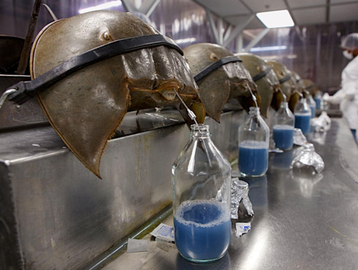
Phylum Arthropoda
Horseshoe carbs
Six pairs of appendages
One pair of chelicerae
Five pair of walking legs
Unchanged since the Triassic period
Shallow coastal waters
Blue hemolymph used to test for bacterial endotoxins
Hemocyanin
Notes:
Hemocyanin: oxygen transport protein with copper (blue color)
Amebocytes: mobile cells in the body of invertebrates move via pseudopodia. Active in defense against pathogens.
Blue blood cost $15,000 qt.

Slide 14
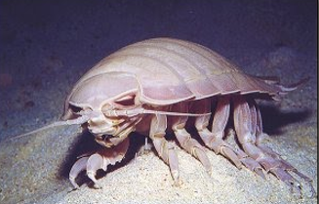
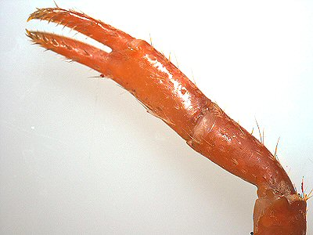
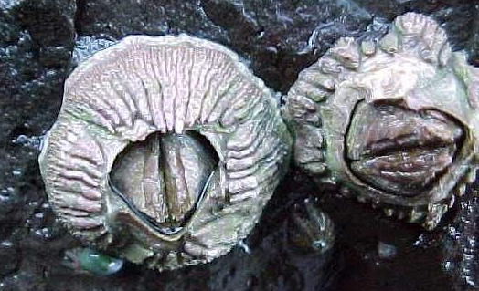
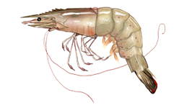
Phylum Arthropoda
Subphylum Crustacea
Copepods, lobster, barnacles, pill bugs, amphipods, isopods, copepods, krill
Contain __________ of antennae
_______ appendages (two main branches)
Three mouth parts
1 pair of mandibles
2 pairs of maxillae
Body of two or three parts
Appendages on thorax and abdomen
Mostly marine

Slide 15
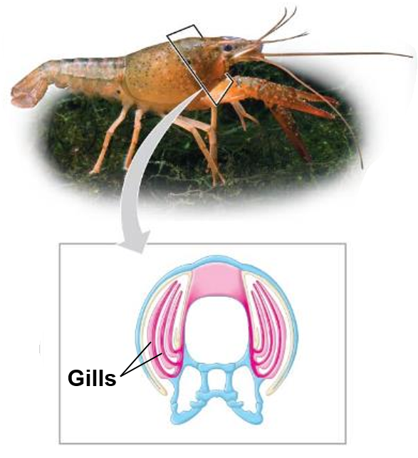
Respiration in Crustaceans
Gas exchange occurs across long, feather gills within the body cavity
Specialized appendages draw water across the gills

Slide 16
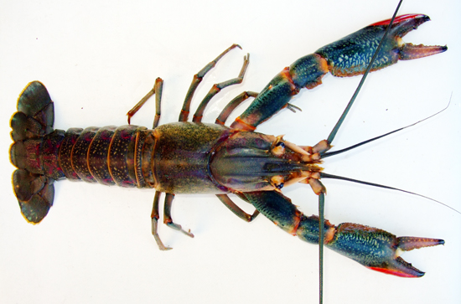
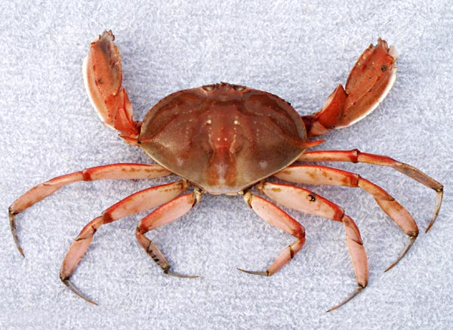
Phylum Arthropoda
Crabs, lobster, and shrimp
_____ legs (Decapods)
Mostly marine
Calcium carbonate and chitin cuticle
Carapace
________ (pinchers)

Slide 17
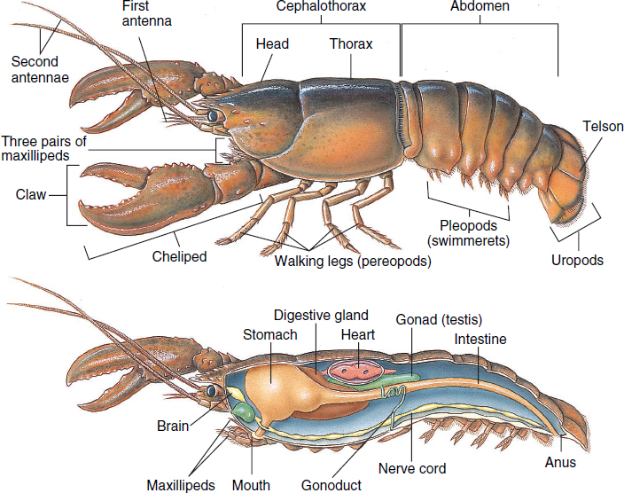
Decapod Anatomy
Notes:
A lobsters brain is in it throat, nervous system in its abdomen, teeth in it stomach, kidneys in its head. It hears with its legs, tastes with its feet and tend to favor either the left or right claw.

Slide 18
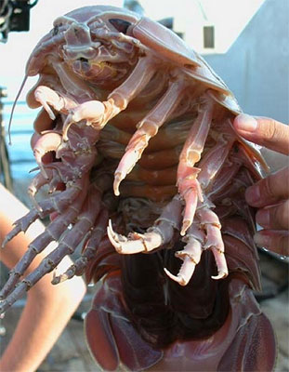
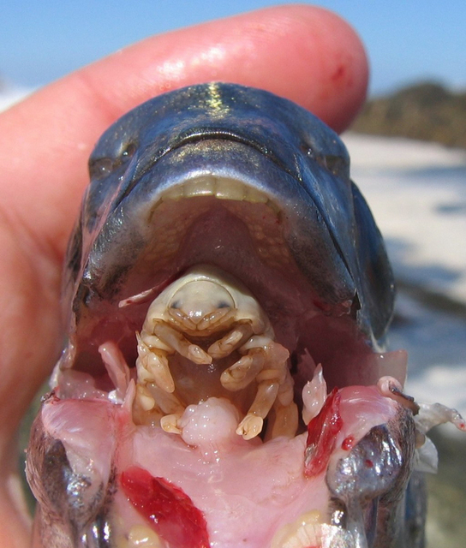
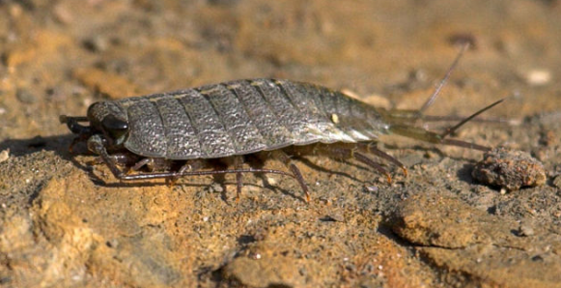
Phylum Arthropoda
Isopods
Approx.11,000 species
Dorsal/ventrally flattened
Marine, freshwater and terrestrial
Detritivores, herbivores, predators and parasites

Slide 19
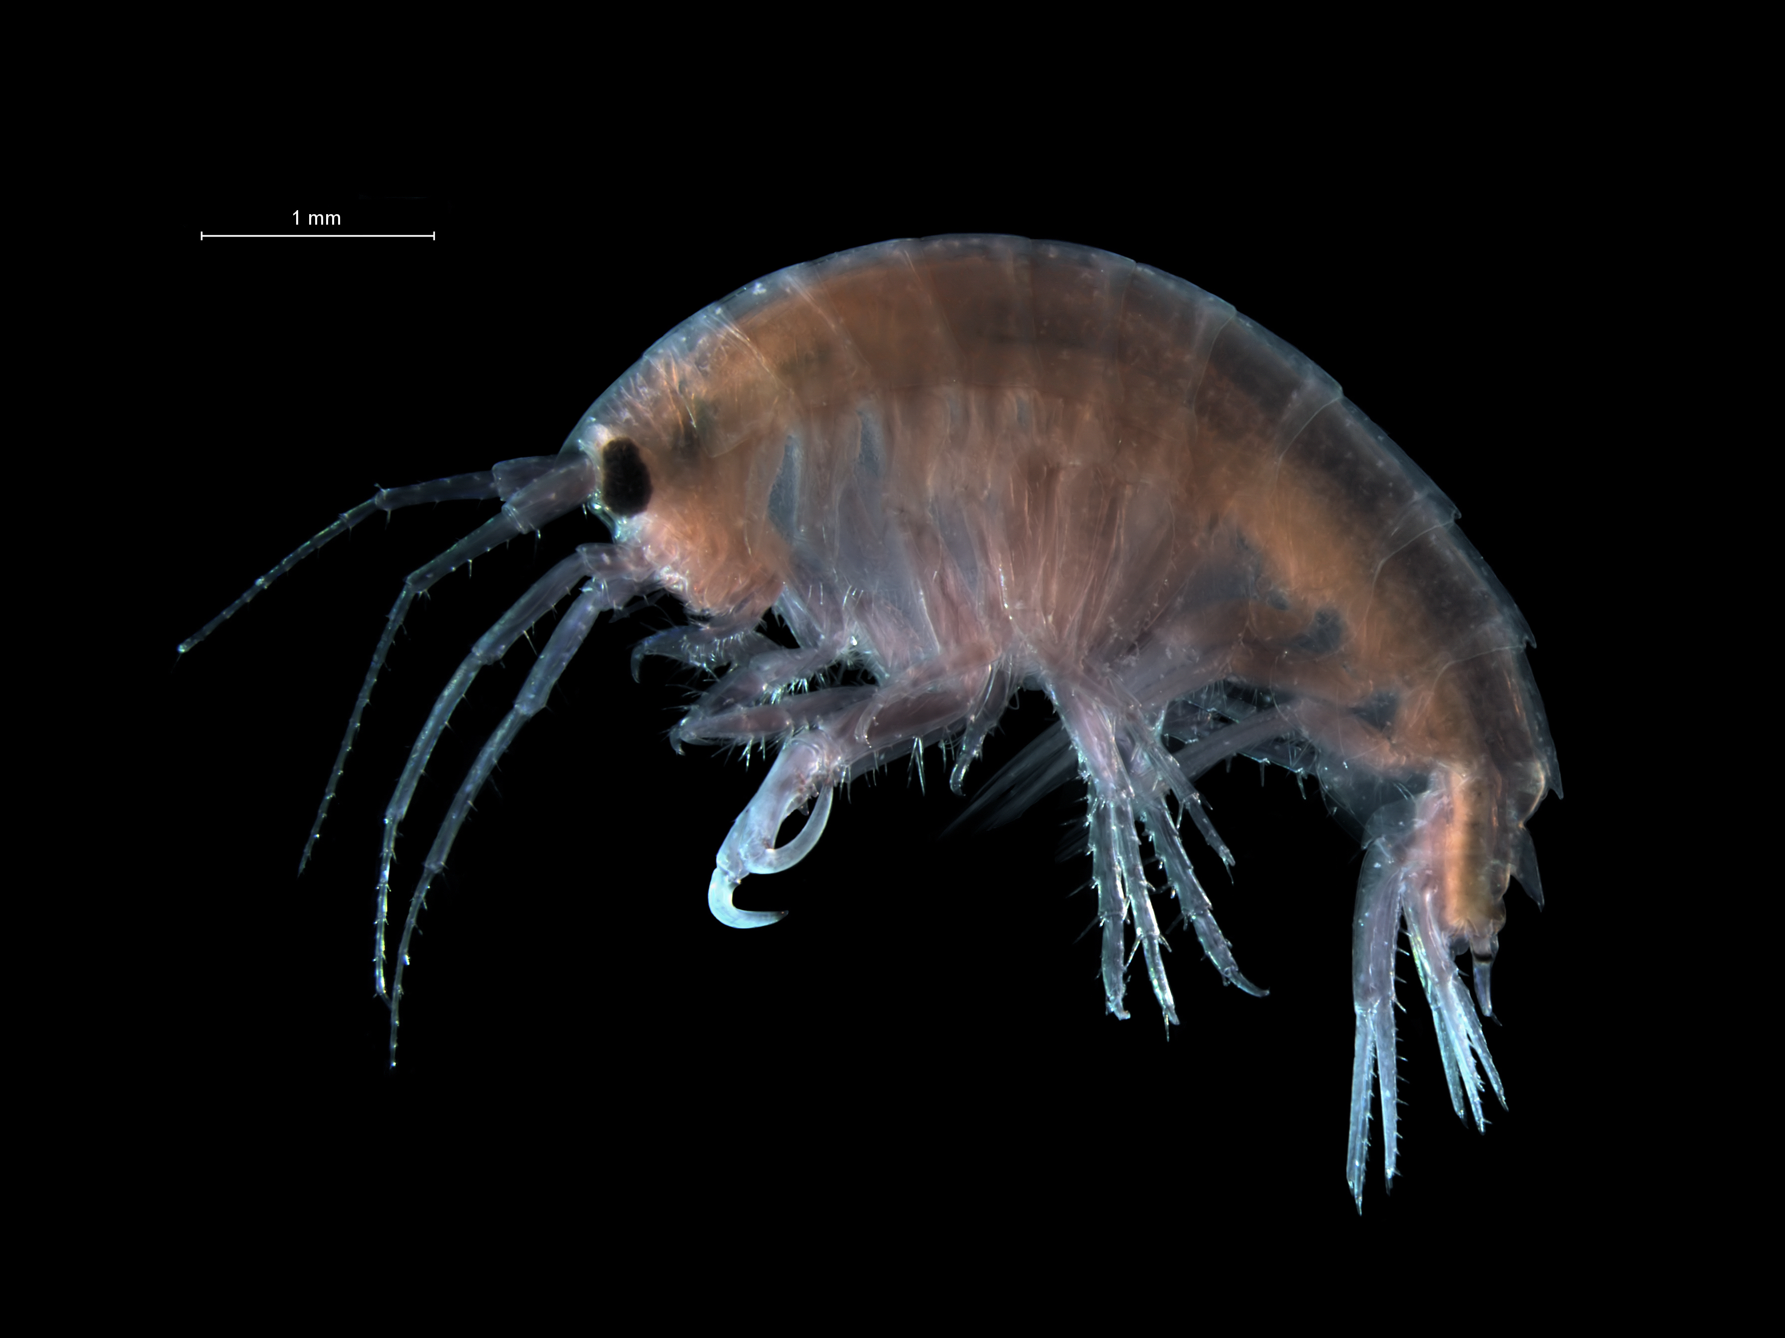
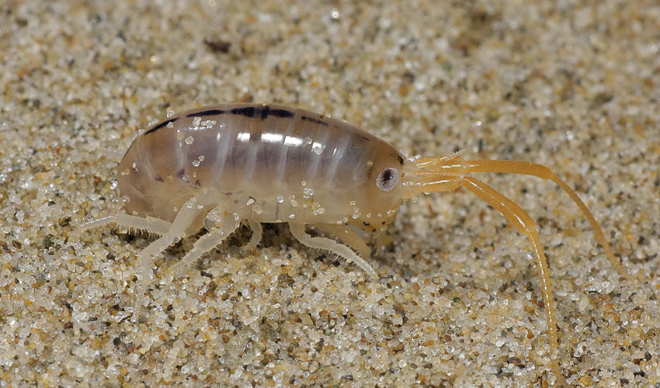
Phylum Arthropoda
Amphipods
Approx. 9,900 species
Marine, freshwater and terrestrial
Curved bodies that are laterally compressed
Detritivores or scavengers

Slide 20
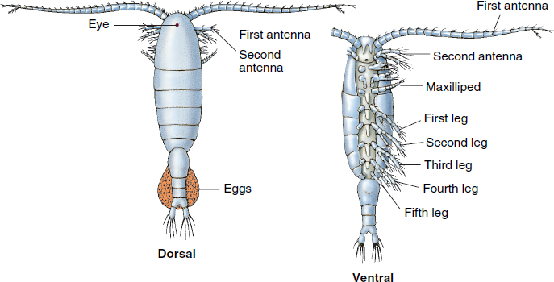
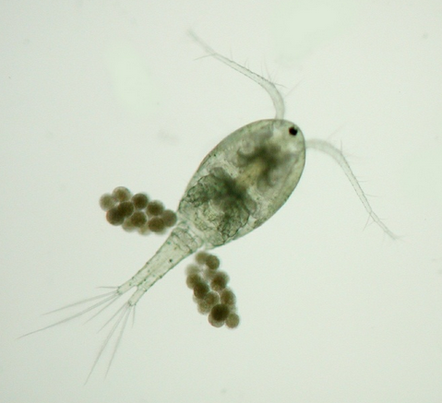
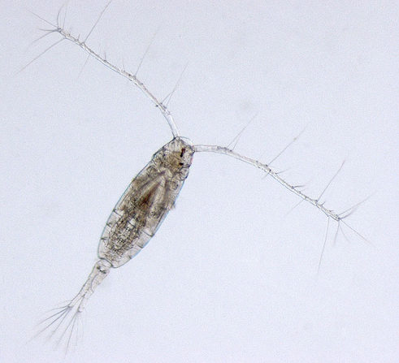
Phylum Arthropoda
Copepods
Most ____________
Marine, freshwater and wet terrestrial habitats
Small size
Tear-drop shaped body with large antennae
Food source for many fish species
Notes:
Planktonic: organisms that drift with current

Slide 21
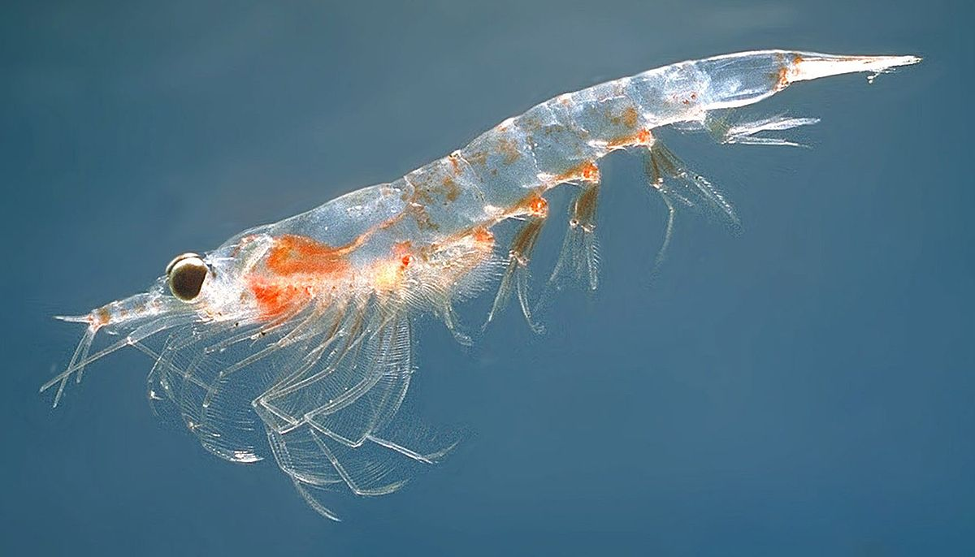
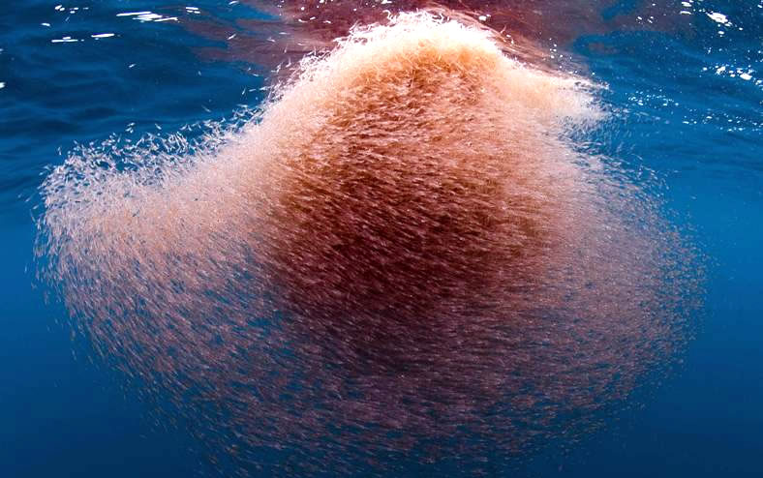
Phylum Arthropoda
Krill
Approx. 85 species
Marine
Found in all the world’s oceans
Daily vertical migration
Surface at night and deeper depths during the day
Important food source for many marine species including whales, penguins, seals, squid, and fish

Slide 22
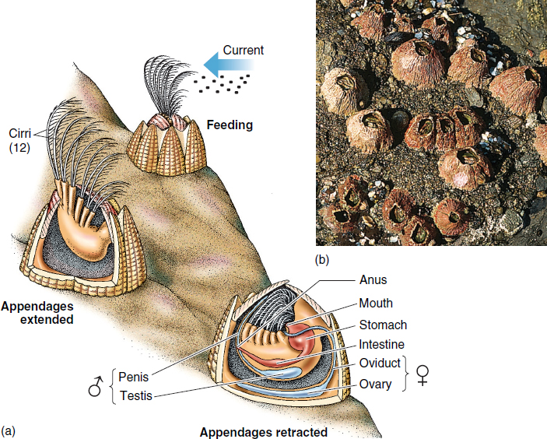
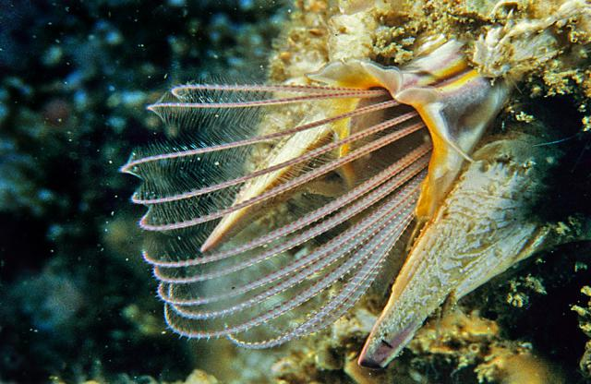
Phylum Arthropoda
Barnacles
Marine only
Filter feeders
________ modified feeding legs
Calcium carbonate cuticle

Slide 23
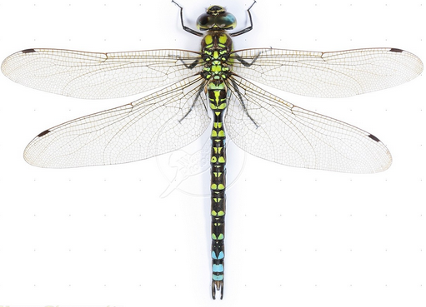
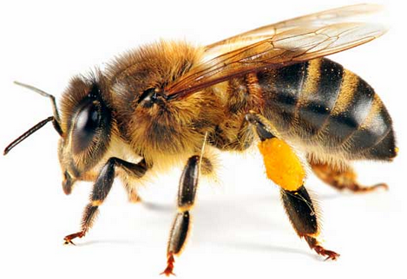
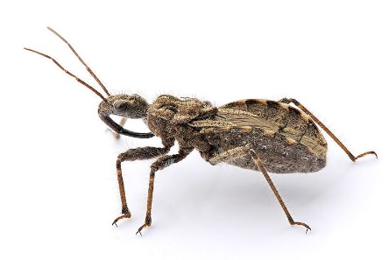
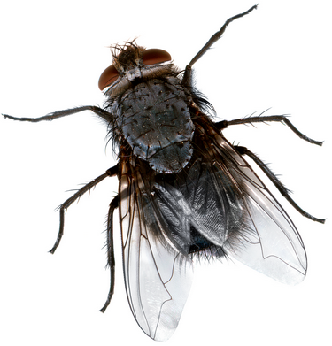
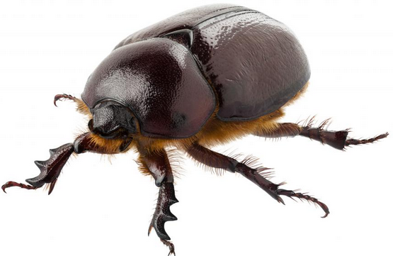
Phylum Arthropoda
Subphylum Hexapoda
Insects
Most diverse group of arthropods
Mostly terrestrial and freshwater
___________ of legs on thorax
Three body sections
Head, thorax, abdomen
Compound eye
One pair of antennae
One or two pairs of wings
Notes:
May have been the cause of angiosperm diversity (approx. 90 mya), new food sources mean new species
Wings are an extension of the cuticle so no walking legs were effected. (Contrary to birds and bats which are clumsy on the ground)
Internal or external fertilization (sperm packet or spermatophore)

Slide 24
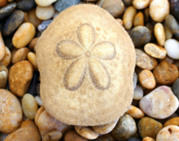
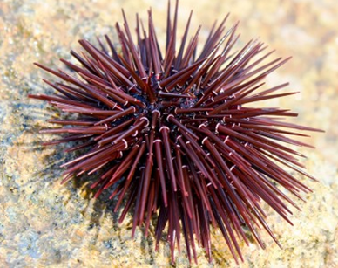
Phylum Echinodermata
Sea stars, sea urchins, sand dollars, and sea cucumbers
Characteristics:
_______________ development
Closest relative of chordates
Secondary radial symmetry
Evolved from bilateral symmetry
Water vascular system: network of hydraulic canals branching into extensions called __________ that function in locomotion and feeding
Notes:
Spiny skin

Slide 25
General Echinoderm Anatomy
_____________: Sieve-like plate which filters water entering the water vascular system
___________: tiny claw or clamp structures on the external surface of some echinoderms
Pedicellaria
(Papulae)
Ambulacral groove
Notes:
Dermal branchiae = projections of the coelom from outer skin

Slide 26
Water Vascular System
1.
2.
3.
4.
5.
6.
7.

Slide 27
Respiratory System in Echinoderms
Dermal branchiae or papulae: hollow projections within the skin that extend to the coelom.
______________________
Diffusion across gill surface
Notes:
Fluid from coelom circulates through hollow chambers within each gill facilitating gas exchange.
Tube feet also aid in respiration

Slide 28
Classification
Class: Asteroidea (Sea stars)
Class: Ophiuroidea (Brittle stars)
Class: Echinoidea (Sea Urchins, Sand Dollars)
Class: Holothuroidea (Sea Cucumbers)
Class: Crinoidea (Sea Lilies)
Deep ambulacral groove
Asteroidea
Central disk
Ophiuroidea
Madreporite
Aristotle’s lantern
Echinoidea
Radial symmetry
Soft bodied
Holothuroidea
Crinodea

Slide 29
Phylum Echinodermata
Class Crinoidea
Sea lilies and feather stars
Attached to substrate with many branched arms
Suspension feeder
Open ambulacral grooves
No _______________
No pedicellariae or papulae

Slide 30
Phylum Echinodermata
Class Echinoidea
Sea urchins
No arms but have five rows of tube feet
_________
Closed ambulacral grooves
Madreporite on the aboral side
Contain pedicellariae or papulae
Aristotle’s lantern
Notes:
Aristole’s (greek philosopher) was first to describe urchin mouth parts, which he described a lantern without panes

Slide 31
Anatomy of Sea Urchins
_________________: calcareous plates and muscles supporting teeth of a sea urchin
Notes:
Aristole’s (greek philosopher) was first to describe urchin mouth parts, which he described a lantern without panes

Slide 32
Phylum Echinodermata
Class Holothuroidea
Sea cucumbers
____________
Lack spines
Five rows of tube feet
Closed ambulacral grove
Internal madreporite
No pedicellariae or papulae

Slide 33
Phylum Echinodermata
Class Ophiuroidea
Brittle stars
Five thin arms radiating from a ____________
No organs in arms
Closed ambulacral grooves
Madreporite on the oral side
No suckers on tube feet, pedicellariae or papulae
Notes:
No organs for reproduction or digestion in arms like asteriodea

Slide 34
Phylum Echinodermata
Class Asteroidea
Sea stars (not fish!!)
Five arms radiating from a central disc
Open ambulacral groove
Madreporite on the aboral side
Contain pedicellariae or papulae
Intertidal predators
Bivalves
Keystone species

Slide 35
Phylum Chordata
Deuterostome development
Bilateral Symmetry
_____________
Coelomates
_________________________
Four distinct anatomical features
Notochord
Dorsal, hollow nerve cord
Pharyngeal gill slits
Muscular, post-anal tail
ANCESTRAL
DEUTEROSTOME

Slide 36
Chordata Characteristics
Notochord: longitudinal, flexible rod that provides structural support, becomes disks between vertebrae in humans and other vertebrates
Dorsal, Hollow Nerve Cord: develops into central nervous system
Pharyngeal Slits: develop into _____ in some vertebrates and part of the ear and neck in tetrapods
Muscular, Post-anal Tail: used for locomotion in aquatic chordates, ________ during development in many species
Notes:
Notocord is between digestive tube and nerve cord

Slide 37
Phylum Chordata
Subphylum Cephalochordata
Lancelets
Contains _______ chordate characters as an adult
Metamorphosis

Slide 38
Phylum Chordata
Subphylum Tunicata
Tunicates or sea squirts
_______
Closest relative to vertebrates
Metamorphosis
Retains only pharynx with slits as an adult
Reabsorbed tail and notochord
Notes:
Some species shoot water through the excurrent siphon when attacked “sea squirt”

Slide 39
Phylum Chordata
Pyrosomes
Free-floating colonial tunicates
Planktonic
Bioluminescent
“Fire-body”

Slide 40
Phylum Chordata
Subphylum Vertebrata
Vertebrate column (backbone): flexible column stretching from the neck to the tail, made up of series of bones (vertebrae)
_______ circulatory system
_______ skeleton
Cartilage and/or bone
Bilateral symmetry
Well developed sensory organs and nervous system
Highly develop ______________________
Notes:
Approximately 57,000 species of vertebrates
Tetrapods diverged 365 mya
Range from 8.4mm fish 100 billion times smaller than blue whale

Slide 41
Check Your Understanding
True or False: The paired, unjointed outgrowths of some annelids are known as chelicerae
True or False: Echinoderms move using peristalsis
True or False: Barnacles are more closely related to spiders than to clams

Slide 42
Check Your Understanding
All of the following are characteristics of arthropods except:
a. Jointed appendages
b. Tube feet
c. Segmented bodies
d. Exoskeleton
e. All of the above are characteristics of arthropods

Slide 43
Check Your Understanding
Brittle stars belong to which of the classes of echinoderms?
a. Asteroidea
b. Ophiuroidea
c. Echinoidea
d. Holothuroidea
e. Crinoidea

Slide 44
Check Your Understanding
All of the following are characteristics of chordates except:
a. Notochord
b. Pharyngeal slits
c. Dorsal, hollow nerve cord
d. Endoskeleton
e. All of the above are characteristics of chordates

