Slide 1
Marine Invertebrates I
Chapter 7

Slide 2
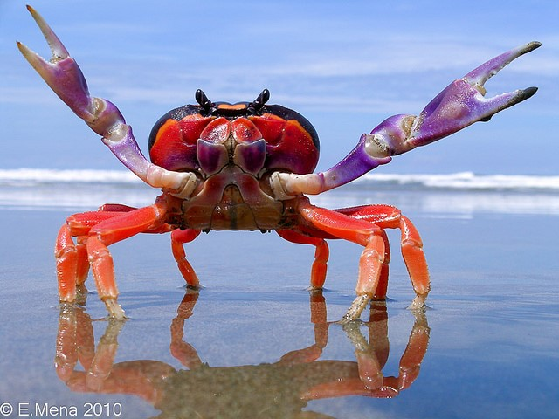
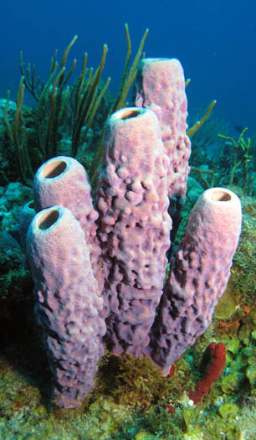
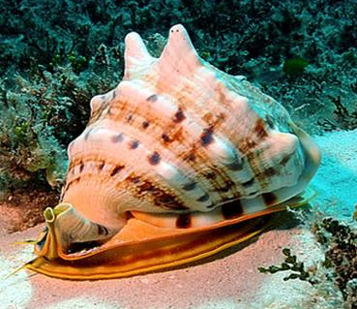
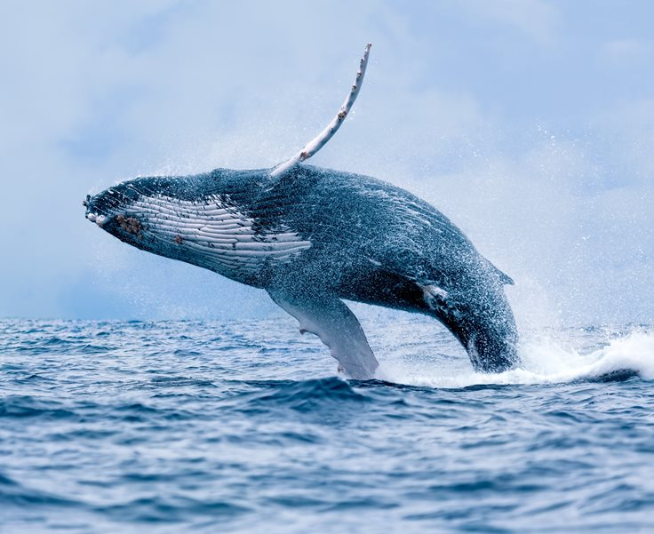
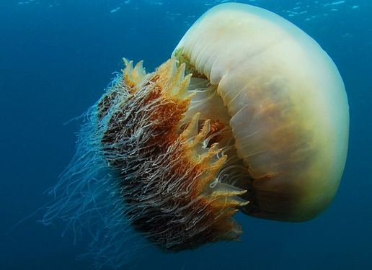
What is an Animal?
Multicellular, heterotrophic, eukaryotes
Lack cell walls
_________: structural protein in connective tissue
Contain muscle and nervous tissue
Allow for movement and nerve impulses
Most reproduce sexually
First animals appeared ~ 700mya
Notes:
Collagen: structural protein in the extracellular space in the connective tissue of most animals. Provides elasticity. Most abundant protein in animals

Slide 3
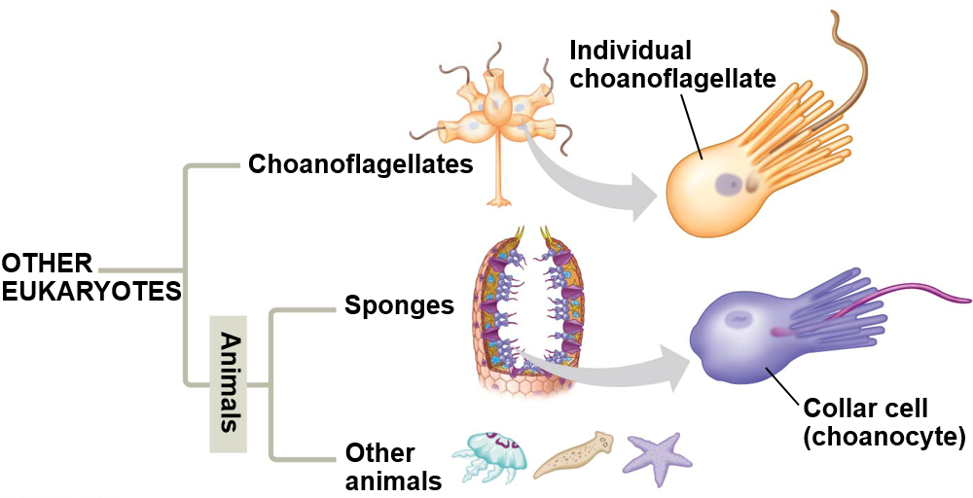
Origin of Animals
DNA sequence data supports Choanoflagellates as sister group
Choanoflagellate cells and collar cells of sponges are nearly identical
Similar collar cells have been observed in other animals

Slide 4
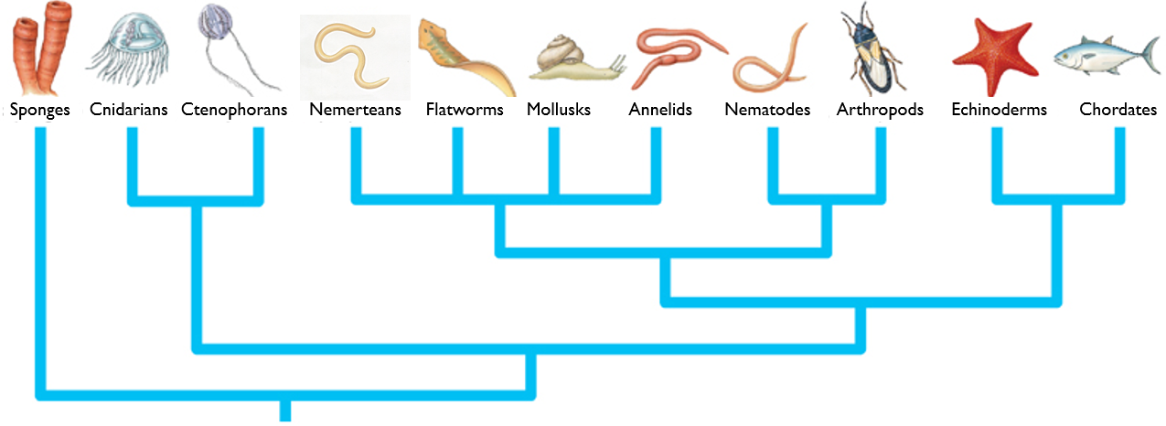
Invertebrates and Vertebrates
Invertebrates: animals without a backbone
___% of all animals
Vertebrates: animals with a backbone
Invertebrates

Slide 5
Animal Classification
Animals Classified by:
Development
Symmetry
Organization level
Germ layers
Body cavities
Skeletal Systems
Circulatory systems
Segmentation
Molecular data
Notes:
Coeloms and segmentation arose independently many times

Slide 6
Animal Phylogeny
Segmentation
Segmentation
Segmentation
Protostome development
Deuterostome
development
Asymmetry
Radial symmetry,
tissue level organization
Bilateral symmetry,
organ system organization
True tissue

Slide 7
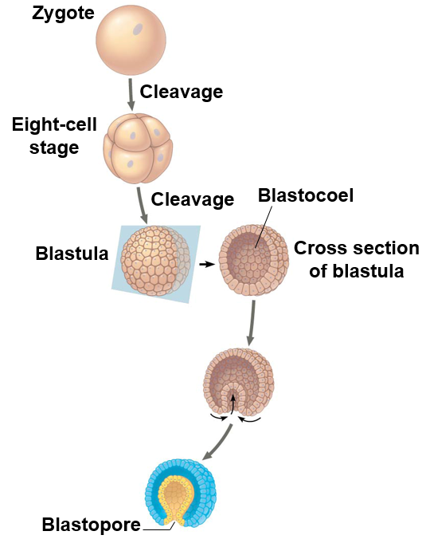
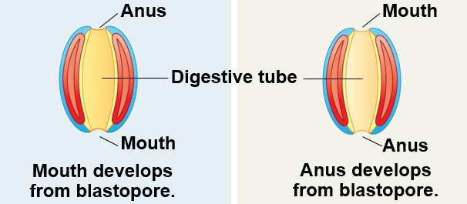
Animal Development
_____________
Deuterostome
Mouth develops first
Anus develops first
Notes:
Protostome = protos – first, stoma – mouth (Greek)
Deuterostome = deuteros – second, stoma - mouth

Slide 8
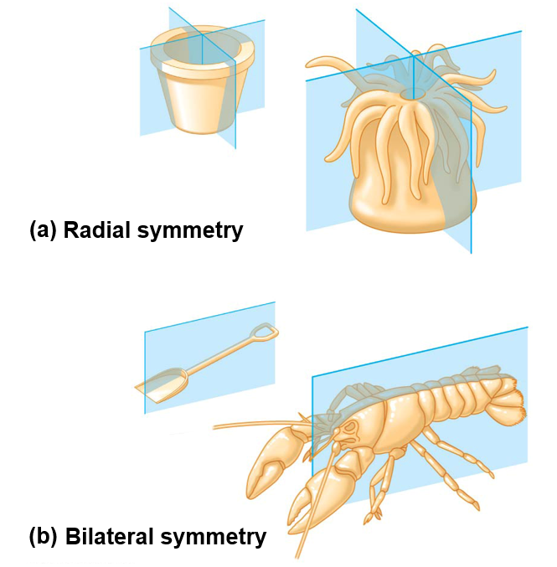
Symmetry
Asymmetry: no symmetry
Some sponges
Radial symmetry: Identical morphology along ______________ trough the center
Echinoderms (adult), sea jellies, and some sponges
Bilateral symmetry: Identical morphology along a ______________, yielding a left and right side
Dorsal (top), ventral (bottom), anterior (front), posterior (back)
Most animals
Notes:
Animals with radial symmetry are typically sessile or planktonic and encounter environment on all sides
Bilateral animals actively move from place to place, thus requiring a central nervous system

Slide 9
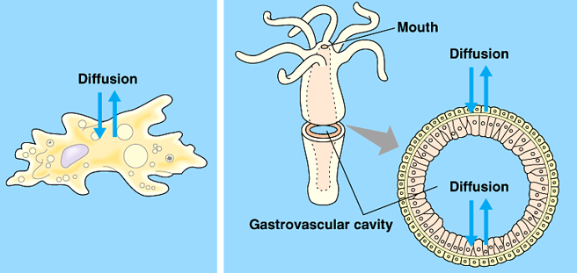
Level of Cellular Organization
Tissue: collection of specialized cells that act as functional unit
All animals except sponges (Porifera)
Cellular-level organization: _________ _________ between cells and environment
Porifera
Tissue-level organization: cells organized into tissues that perform specific functions
Cnidaria and Ctenophora
Organ-system organization: tissues organized into organs that perform specific functions
Platyhelminthes, Nemertea, Mollusca, Arthropoda, Chordata, Nematoda, Echinodermata
Cellular level Tissue level
Notes:
True tissue: tissues isolated from other layers by membranous layers

Slide 10
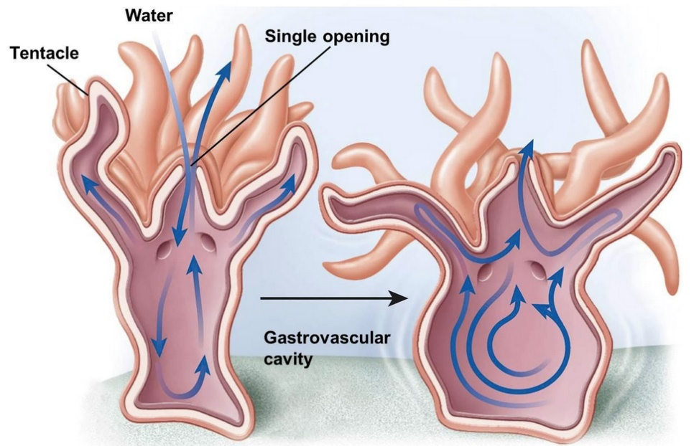
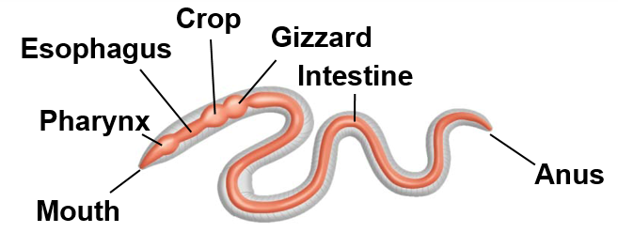
Digestive System
Animals have diverse nutritional requirements and feeding strategies
Intracellular digestion: digestion inside cells
________________ cavity: central cavity with single opening that functions in both digestion and distribution of nutrients
Alimentary canal: digestive tract with two separate openings (mouth and anus)
Gastrovascular cavity
Alimentary canal

Slide 11
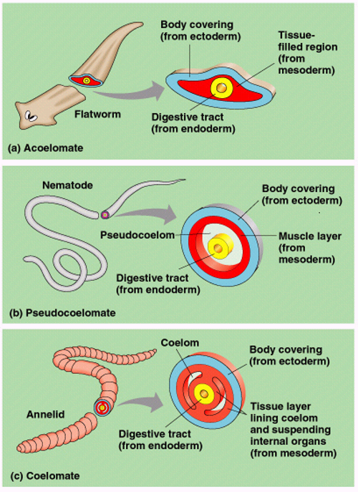
Body Cavities
Body cavity: fluid or air-filled space between the digestive tract and outer body wall
Coelom
Acoelomates: animals that lack body cavity
Platyhelminthes
Pseudocoelomates: animals with a “false” coelom, derived from endoderm and mesoderm
Nematodes, Rotifers
_______________: animals with a “true” coelom, derived from mesoderm
All other animals
Notes:
Coelom completely enclosed by mesoderm = true coelom

Slide 12
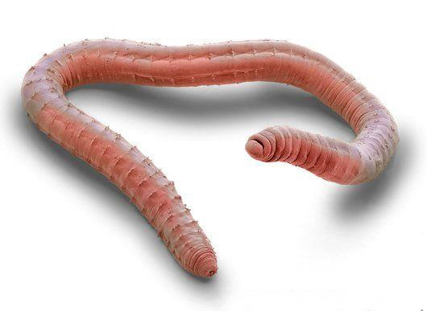
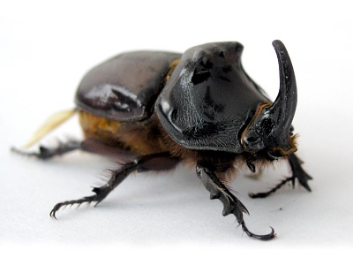
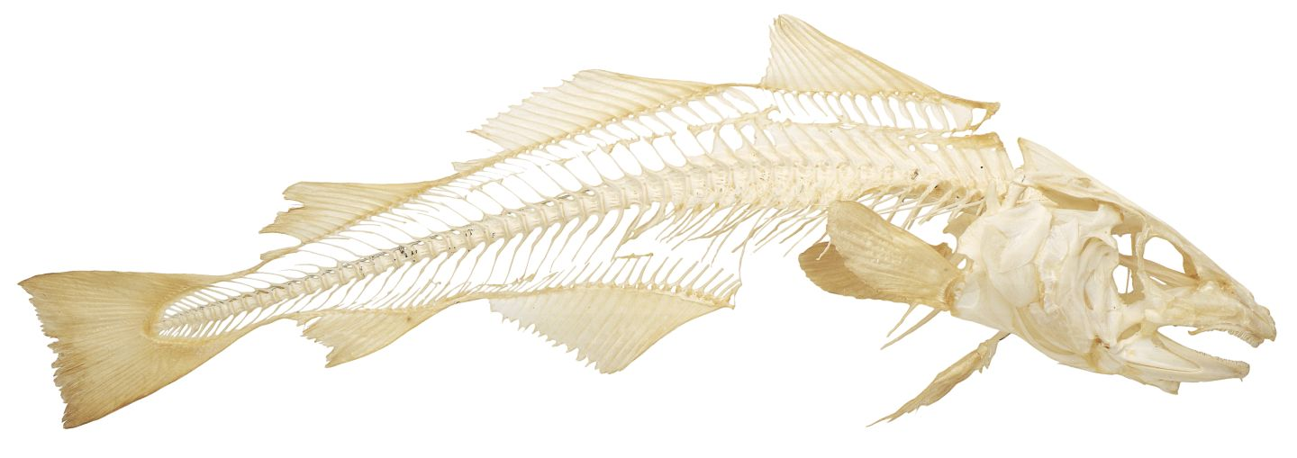
Skeletal Systems
Hydrostatic skeleton: ________ held under pressure within a closed body compartment
Cnidarians, Platyhelminthes, Nematodes, Annelids
Exoskeleton: hard covering deposited on the animals surface that provides protection and points for muscle attachment
Arthropods, Molluscs
Endoskeleton: hard _________ skeleton buried within soft tissue
Porifera, Echinodermata, Chordata

Slide 13
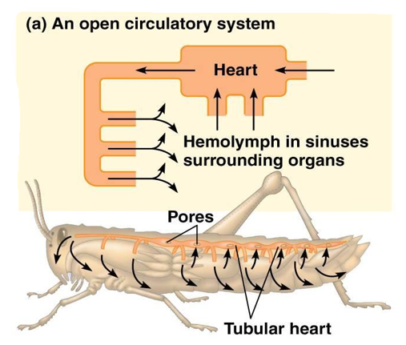
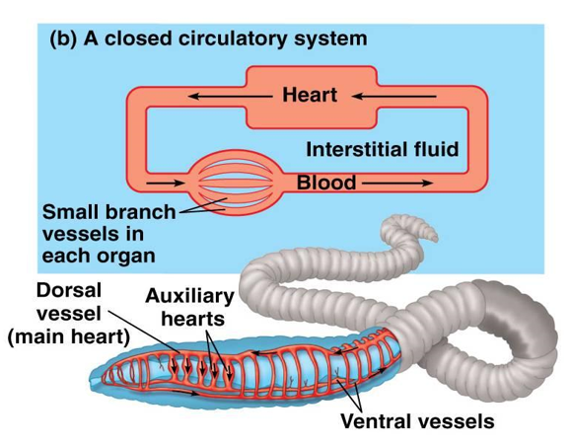
Different Circulatory Systems
Open circulatory system: __________ bathes organs directly then diffuse back into heart through sinuses
Closed circulatory system: _____ transported through vessels into capillaries where diffusion of gases and nutrients occurs
Notes:
As organisms evolved and became more complex, their cells required more efficient transport and exchange

Slide 14
Different Circulatory Systems
Open Circulatory System
Closed Circulatory System
Arthropods and mollusks
Less efficient
Lack of capillaries
Hemolymph transports nutrients and wastes
Tissues and cells _________ in hemolymph
Slow, uncontrolled blood flow
Vertebrates and annelids
More efficient
___________ present
Blood transports gases, nutrients and wastes
Blood delivered directly to cells
Fast, ___________ blood flow

Slide 15
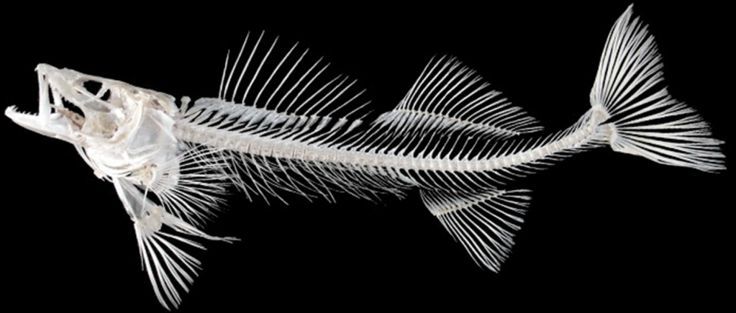
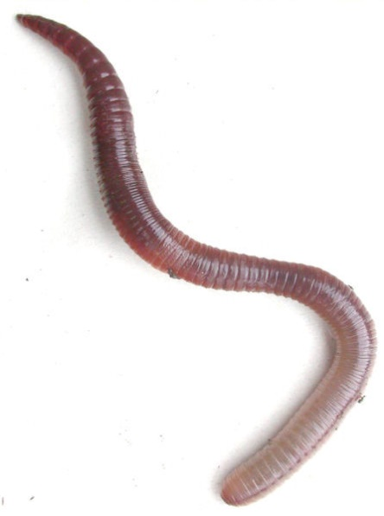
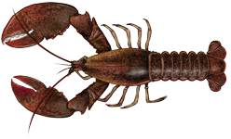
Segmentation
Series of __________ parts or body segments
Efficient movement
Specialization of parts
Evolved in three phyla:
Annelida
Arthropoda
Chordata

Slide 16
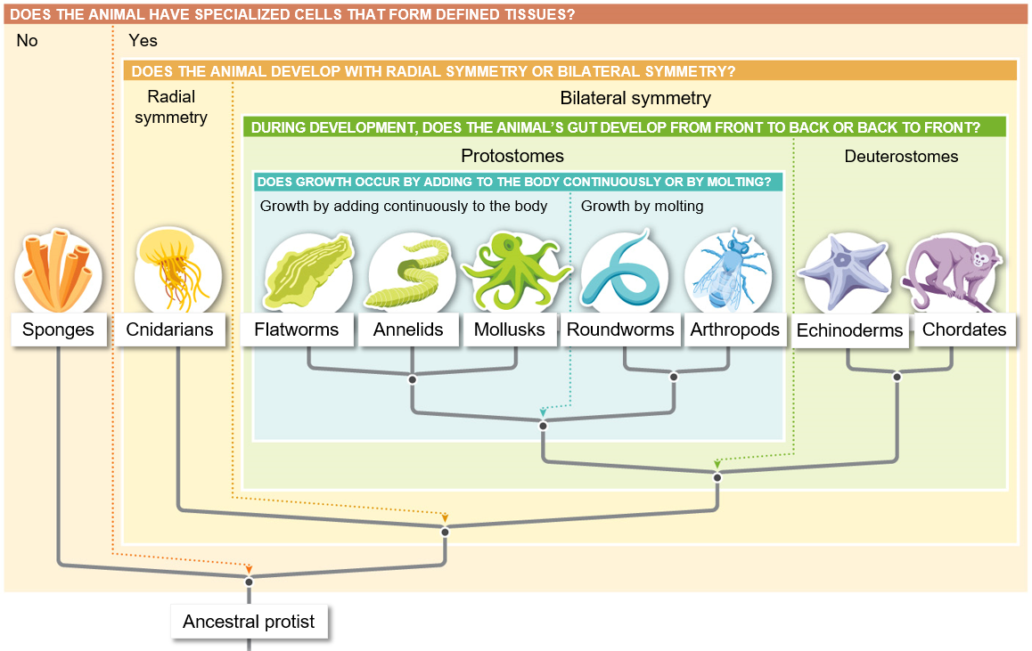
Notes:
From an evolutionary prospective every living species is successful. Everything can find food, escape predators and reproduce.
More complex does not mean less evolved
Some adaptations have lead to rapid and extensive diversification
“Never the use of higher or lower”- Chuck Darwin
Of the 36 animal phyla, 9 account for 99% of all animal species

Slide 17
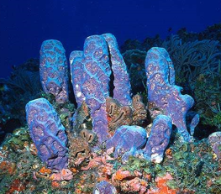
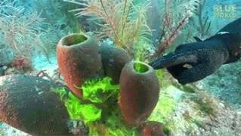
Phylum Porifera
Sponges “Pore bearers”
Characteristics:
No tissues or organs
Cellular-level organization
Intracellular digestion
________________
Free-swimming larvae
Sessile as adults
Image modified from What is Life? A Guide to Biology, Third Edition ©2015 W.H. Freeman and Company

Slide 18
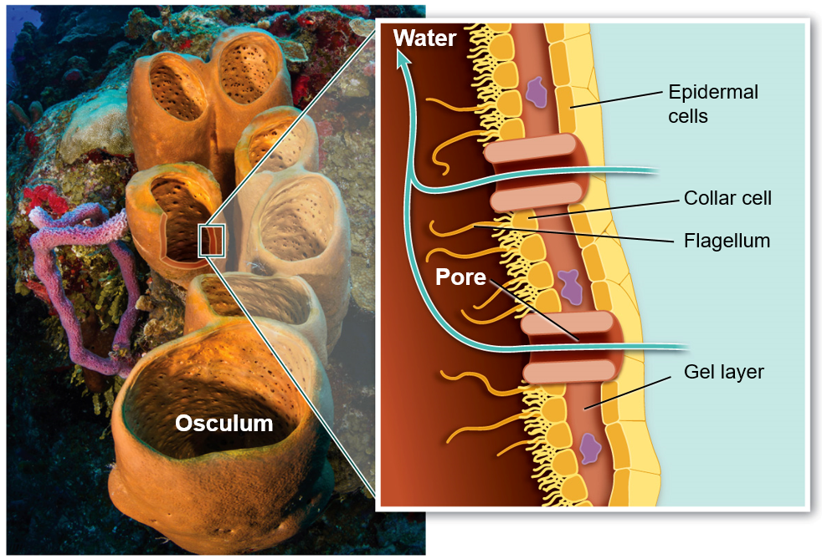
Phylum Porifera
____________ (choanocytes): specialized cells with flagella that create water current up through osculum
Spongocoel: central cavity
Osculum: opening at the top of the sponge
Spongin
Spongocoel
Spicule
Spongocoel
Image modified from What is Life? A Guide to Biology, Third Edition ©2015 W.H. Freeman and Company

Slide 19
Feeding Strategies of some Marine Organisms
Suspension feeders: organisms that feed on particulate organic matter suspended in the water
Deposit feeders: organisms that feed on particulate organic matter that settles on the bottom (detritus)
SUSPENSION FEEDING
DEPOSIT FEEDING

Slide 20
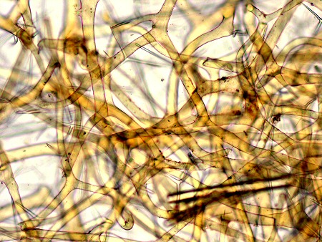
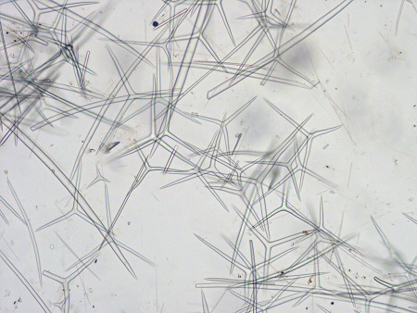
Phylum Porifera
Skeleton
Spicules (calcium carbonate or silica): support and protection
________ (protein): support and flexibility
Spongin
Spicules
Notes:
Created by amoebocytes

Slide 21
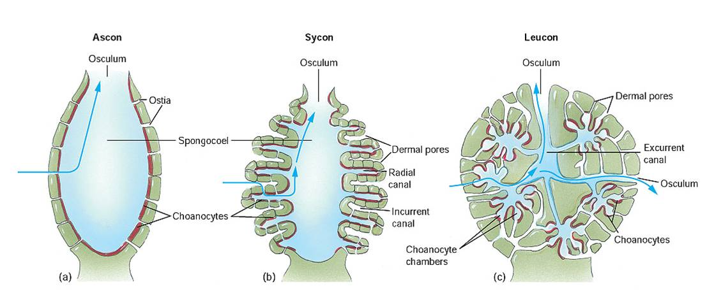
Porifera Body Forms
Asconoid
Syconoid
Leuconoid

Slide 22
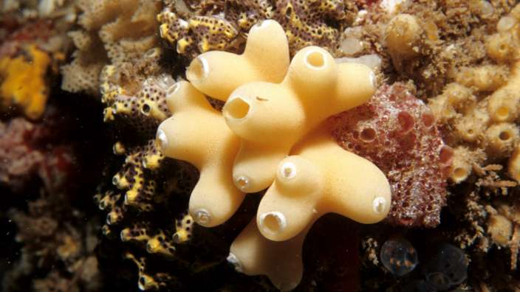
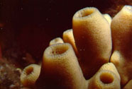
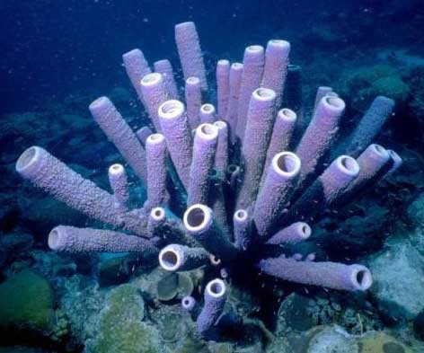
Phylum Porifera
Class Calcarea
Calcium carbonate spicules
Body forms:
Asconoid
Syconoid
Leuconoid

Slide 23
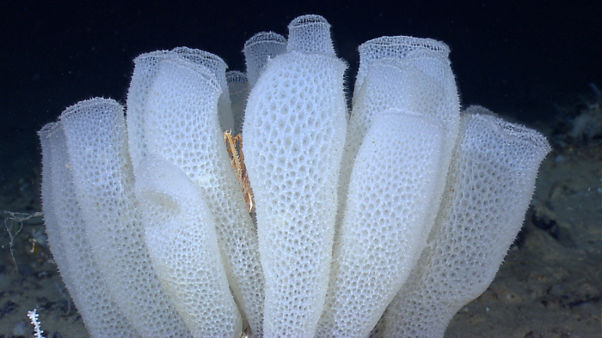
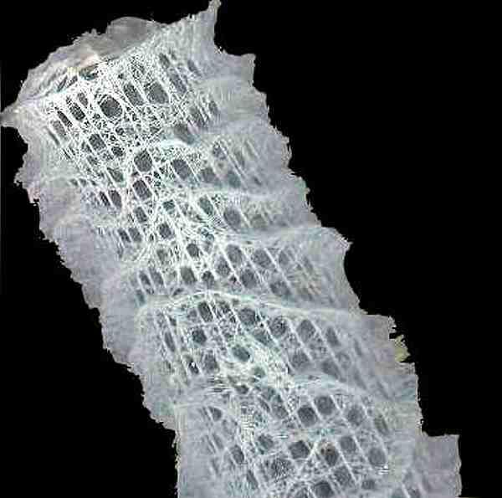
Phylum Porifera
Class Hexactinellida
Silica spicules
Body forms:
Syconoid
Leuconoid

Slide 24
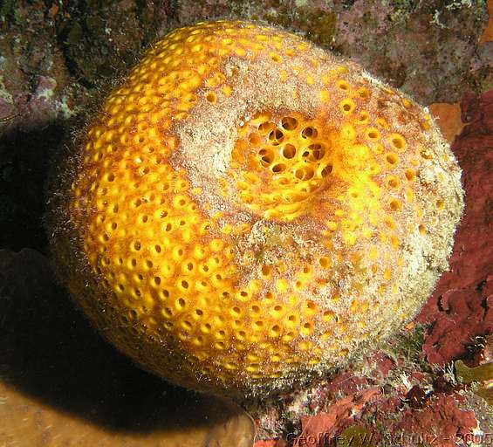
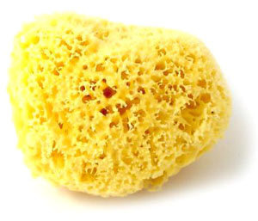
Phylum Porifera
Class Demospongia
Silica spicules and/or spongin
90% of all sponges
Body forms:
Leuconoid

Slide 25
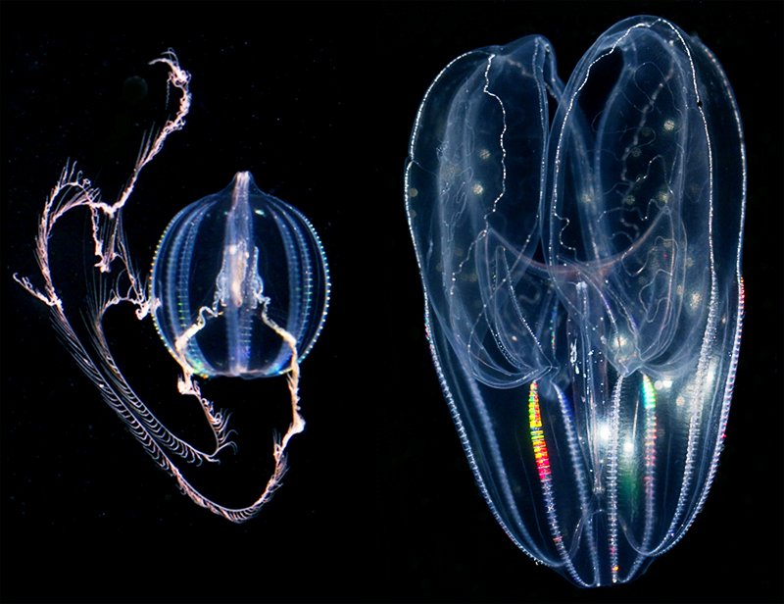
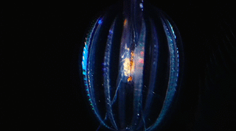
Phylum Ctenophora
Comb jellies
Characteristics:
Approx: 180 species
All marine
Radial symmetry
Eight “combs” of ______
Gastrovascular cavity
Tissue-level organization
Notes:
Largest animals to move via cilia

Slide 26
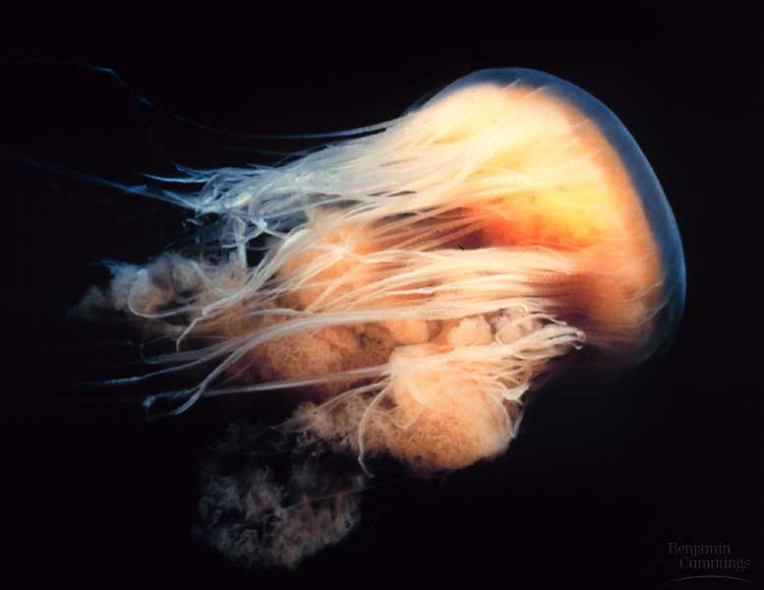
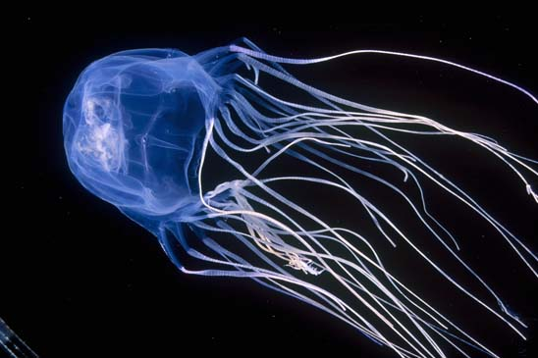
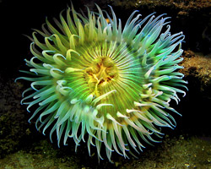
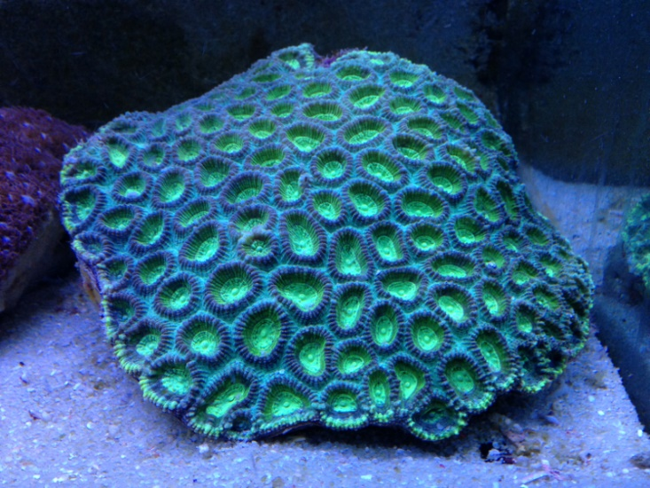
Phylum Cnidaria
Sea jellies, sea anemones, coral
Characteristics:
Approx: 10,000 species
Radial symmetry
Two life forms (some)
Polyp and Medusa
Gastrovascular cavity
Tissue-level organization

Slide 27
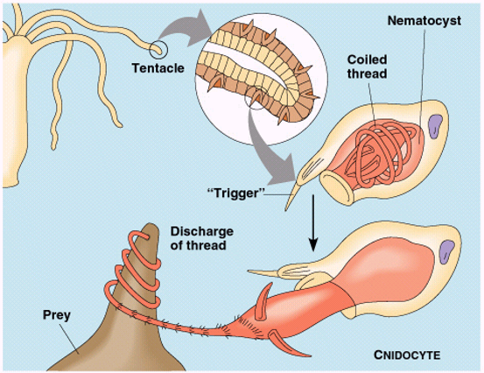
Cnidocytes and Nematocysts
______________: specialized cells used in feeding and defense
Nematocysts (stinging organelle)

Slide 28
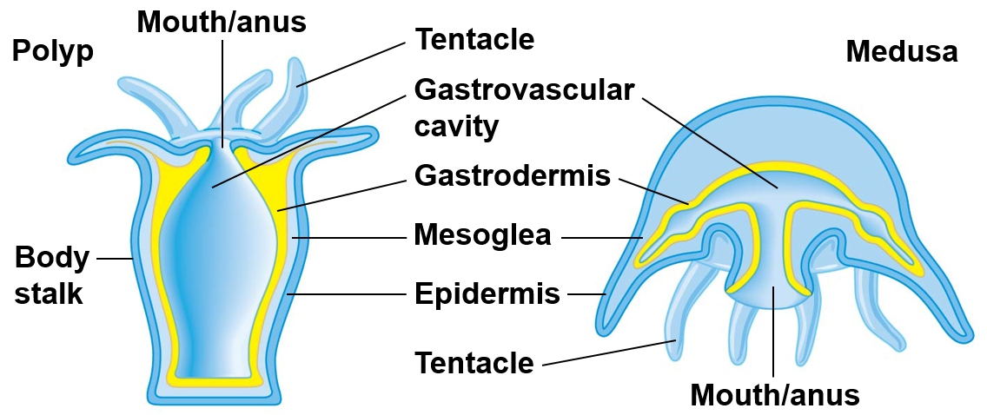
Cnidaria Body Forms
Polyp
Medusa
Notes:
Sessile: stationary
Motile: free swimming or moving

Slide 29
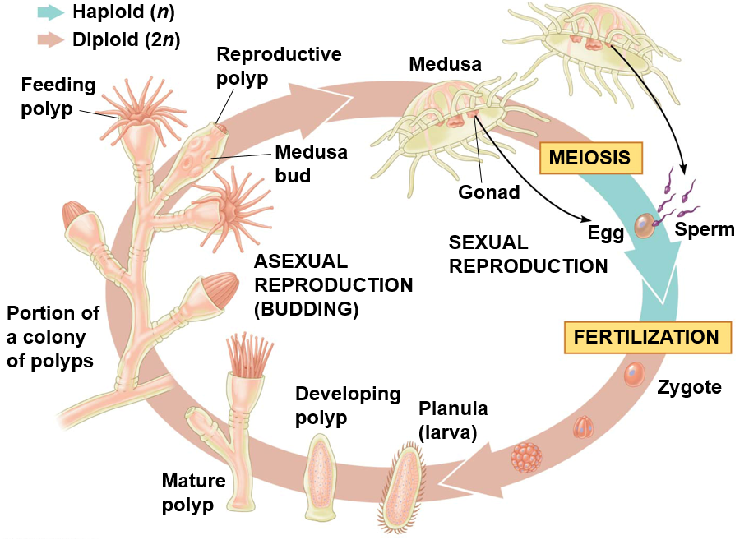
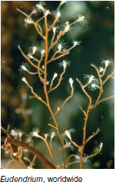
Cnidarian Life Cycle

Slide 30
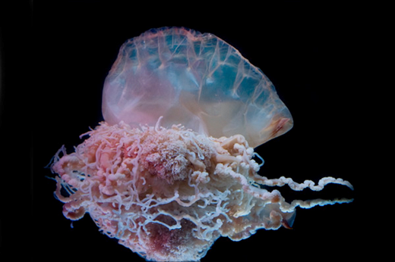
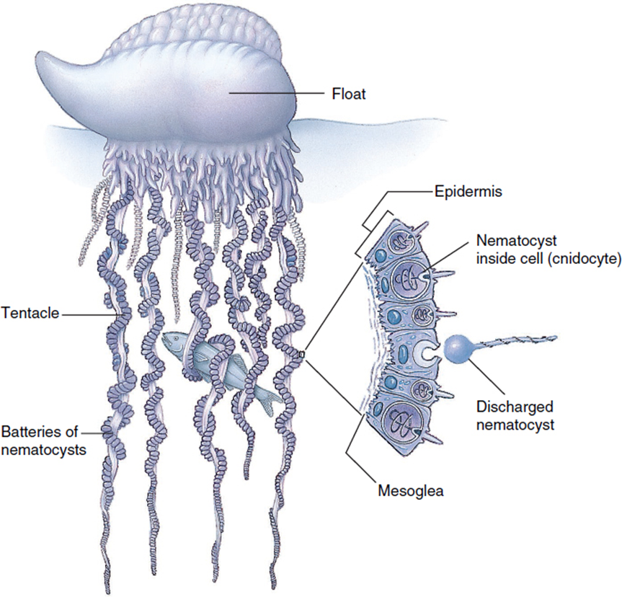
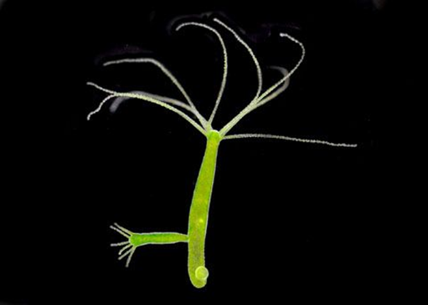
Phylum Cnidaria
Class Hydrozoa
Most are marine
Most species contain both a polyp and medusa stage
Polyp stage often colonial
Reproduction
Asexual: _______
Sexual: zygotes and larvae (planula)

Slide 31
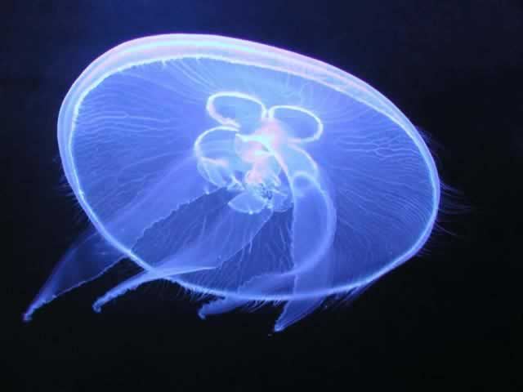
Phylum Cnidaria
Class Scyphozoa
Sea jellies or “true” jellies
All are marine
Polyp stage reduced or absent
Medusa stage is free living

Slide 32
Phylum Cnidaria
Class Cubozoa
Box jellies
All are marine
Polyp and medusa stage
At least four tentacles
Extremely potent venom

Slide 33
Phylum Cnidaria
Acetic acid in ______ can prevent the nematocytes from discharging

Slide 34
Phylum Cnidaria
Class Anthozoa
Corals and anemones
All marine
Many are colonial
No _____________
Calcium carbonate external skeleton

Slide 35
Phylum Platyhelminthes
Tape worms, Turbellarians and Flukes
Characteristics:
Protostome development
Bilateral symmetry
_______________________
Hydrostatic skeleton
Acoelomates: no body cavity
Well-defined head and tail regions
Hermaphroditic
Can engage in both sexual and asexual reproduction

Slide 36
Phylum Platyhelminthes
Turbellarians: free living carnivores
Flukes: parasites
Adult flukes live in vertebrates, larval flukes live in invertebrates
Tapeworms: parasites
Live in the intestine of many vertebrates
Flukes

Slide 38
Phylum Nemertea
Ribbon worms or proboscis worms
Characteristics:
Mostly marine
Carnivorous
Alimentary canal: complete digestive tract
Respiration through body surface
Proboscis: extendable sucking organ

Slide 39
Coelomates
Body cavity completely lined with __________
Divided into protostomes and deuterostomes
Protostome phyla include:
Mollusca: soft and unsegmented
Annelida: soft and segmented
Arthropoda: hard and segmented
Deuterostomes phyla include:
Echinodermata: secondary radial symmetry
Chordata: bilateral symmetry, segmented
Notes:
Rotifera, and lophophorates also coelomates

Slide 40
Molluscs
Clams, Snails, and Octopuses
Characteristics:
Protostome development
Bilateral symmetry
Exoskeleton (shell), Hydrostatic in some
Alimentary canal
___________
Muscular foot
Visceral mass
Mantle

Slide 41
Mollusc Body Plan
Visceral mass: contains internal organs
Muscular foot: used for locomotion
Mantle: layer of tissue that covers the body and secretes _______________ ________ in some molluscs
Radula: scraping mouth parts used for feeding
Notes:
Radula made up of hardest naturally produced material known to man! Look it up.

Slide 42
Phylum Mollusca
Class Polyplacophora
Chitons
Shell with _____ overlapping plates
Unsegmented body
Marine
Foot used for locomotion
Head reduced
Radula used to scrap algae off rocks
Intertidal zone

Slide 43
Phylum Mollusca
Class Bivalvia
Clams, Oysters, Mussels and Scallops
Marine and Freshwater
Flattened shell with two valves
Head reduced
Filter feeders (siphons)
____________
Byssal threads: strong fibers that mussels use to attach to rocks

Slide 44
Bivalve Anatomy
Gas exchange and feeding occur across the gill surface
Water movement
Incurrent siphon → Gill surface → Excurrent siphon
Food particles move from the gills to the mouth
Umbo
Gills
Notes:
Food particles enter

Slide 45
Phylum Mollusca
Class Gastropoda
Snails, slugs, limpets, nudibranchs
Marine, Freshwater, and Terrestrial
~ ¾ of all molluscs
Shell coiled (reduced or absent in some)
Foot for locomotion
Radula present
Most herbivores (some carnivores)
Notes:
Gills absent in terrestrial species. Lining of mantle functions as a lung
Dextral= right
Sinistral = left

Slide 46
Phylum Mollusca
Class Cephalopoda
Octopuses, squid, nautilus
All Marine predators
Shell external, internal or absent
Mouth with radula and beak
Locomotion by _______________
Chromatophores
Most developed invertebrate nervous system
Complex brain
Camera eye

Slide 47
Phylum Mollusca
Mantle forms mantle cavity which is used for respiration and locomotion (siphon)
Muscular foot modified into arms and tentacles
Radula modified into rows of teeth inside beak
Visceral mass is the area behind the head containing the organs
Radula
Beak

Slide 48
Check Your Understanding
True or False: Cnidarians have specialized stinging cells called choanocytes
True or False: Suspension feeders feed on particulate organic matter that settles on the bottom
True or False: Molluscs are true coelomates with and alimentary canal

Slide 49
Check Your Understanding
What type of cellular organization is found in cnidarians?
a. Cellular-level
b. Tissue-level
c. Organ-level
d. Organism-level

Slide 50
Check Your Understanding
Which of the following classes of molluscs lack a radula?
a. Polyplacophora
b. Cephalopoda
c. Bivalvia
d. Gastropoda

Slide 51
Check Your Understanding
Provide the name for the two major groups of animals and describe how each group develops.

Slide 52
Sponges
Cnidarians
Ctenophorans
Nemerteans
Flatworms
Mollusks
Annelids
Nematodes
Arthropods
Echinoderms
Chordates

