Slide 1
Chemical and Physical Properties of Ecosystems
“No man steps in the same river twice, for its not the same river and he’s not the same man”
- Heraclitus
Chapters 3, 4, 22, 24, 25

Slide 2
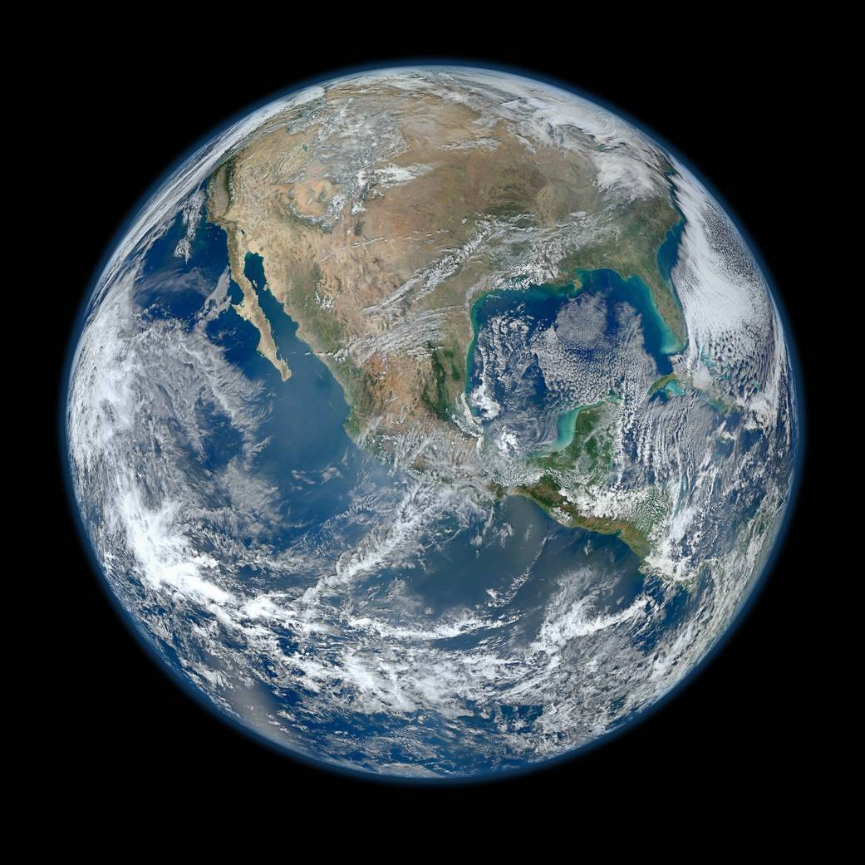
The Water Planet
What percentage of the Earth is covered in water?
50%
70%
80%
90%

Slide 3
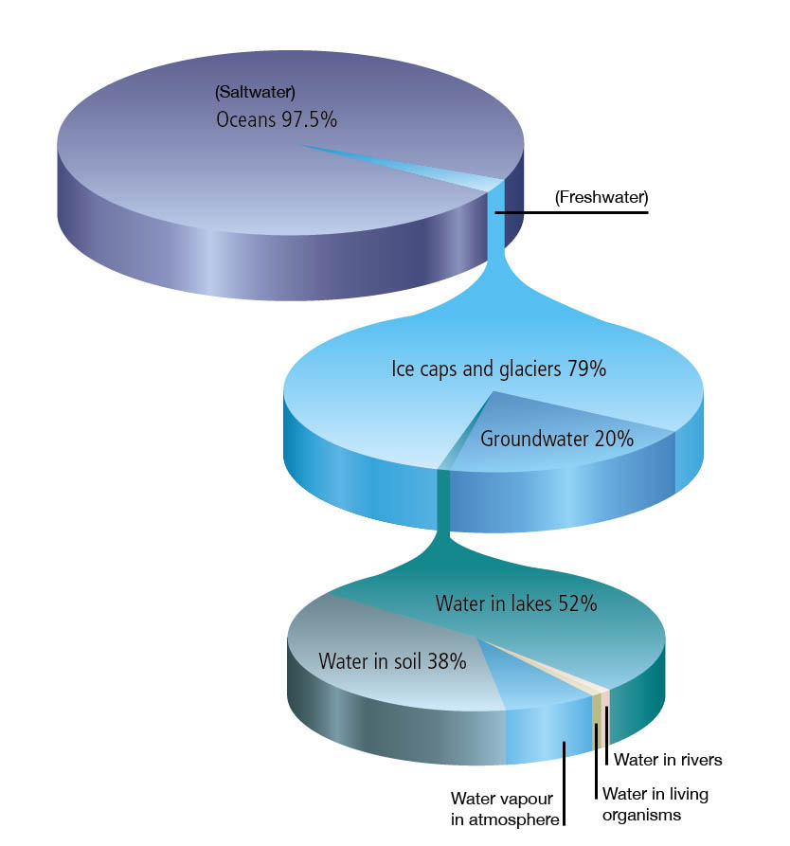
The Water Planet
What percentage of the water on Earth is seawater?
75%
80%
85%
90%
97%

Slide 4
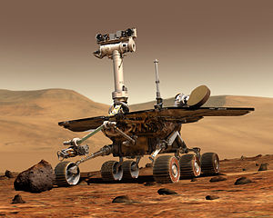
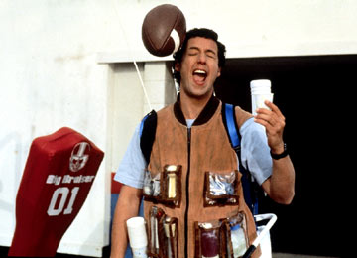
The Amazing H₂O
Water is essential to life
Life started in water
Terrestrial life depends of water
Cells immersed in water
___% of our body weight
80% or more in most marine organisms
Water has unique properties that allow life to exist on earth

Slide 5
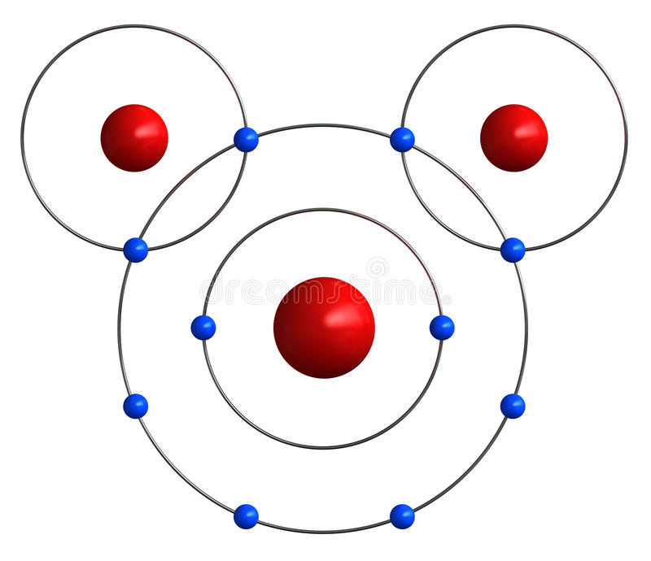
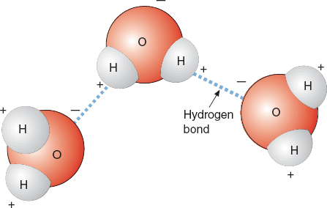
Properties of Water
Water is a ______ molecule
Protons in oxygen atom pull electrons toward nucleus causing one side of water molecule to become slightly positively charged and the opposite side to become slightly negatively charged.
Partial negative charge
Hydrogen
Hydrogen
1P⁺
1P⁺
Hydrogen bond
8 P⁺
Oxygen
Partial positive charge

Slide 6
Structure of the Atom
electron
shell
electron
(negative charge)
proton
(positive charge)
nucleus
neutron
(no charge)
Hydrogen (H)
Helium (He)
Notes:
If the nucleus were the size of a golf ball the electrons would be anywhere from half a mile to six miles away.

Slide 7
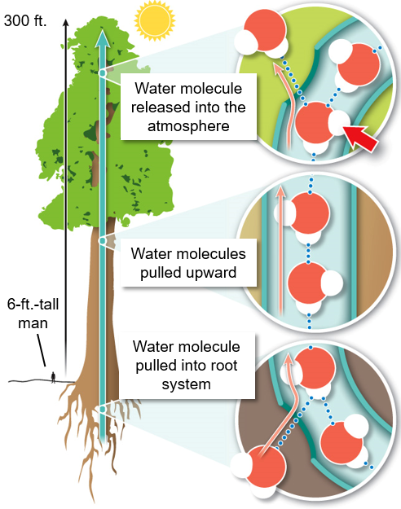
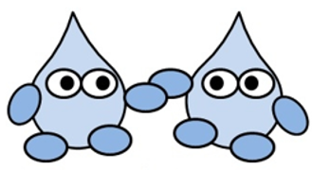
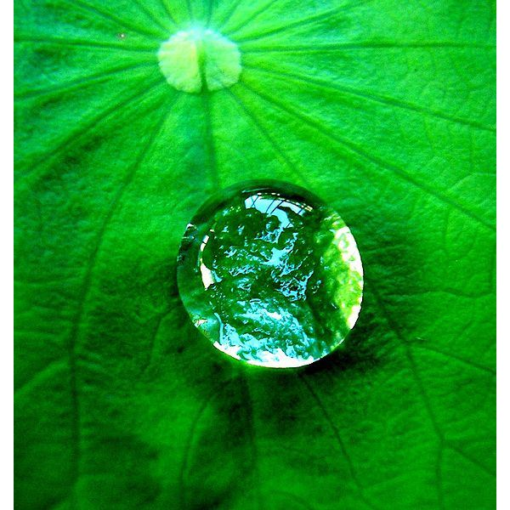
Properties of Water
____________: the tendency for like molecules to cling together due to attractive forces

Slide 8
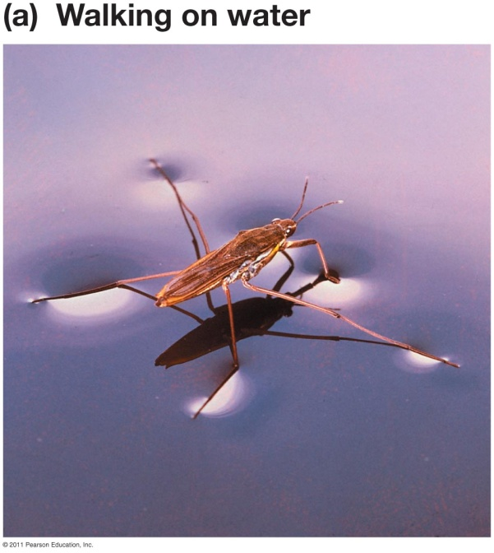
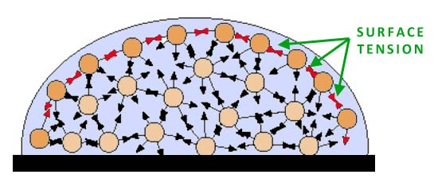
Properties of Water
Surface tension: water molecules are ____________ to air and pack more tightly at interface

Slide 9
Properties of Water
The Universal Solvent
Water can dissolve more substances than any other liquid
Solute: substance being __________ to form a solution
Solvent: substance that a solute is dissolved in to form a solution
Aqueous solution = water is the solvent
Solution: a homogeneous mixture of two or more substances
Hydrogen bonds of water molecule pull other compounds apart
Notes:
Homogenous: all the same kind, like

Slide 10
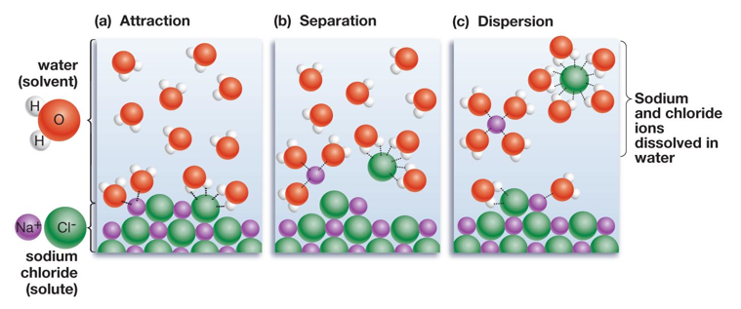
Properties of Water
Water as a solvent
________ works to pull apart ions

Slide 11
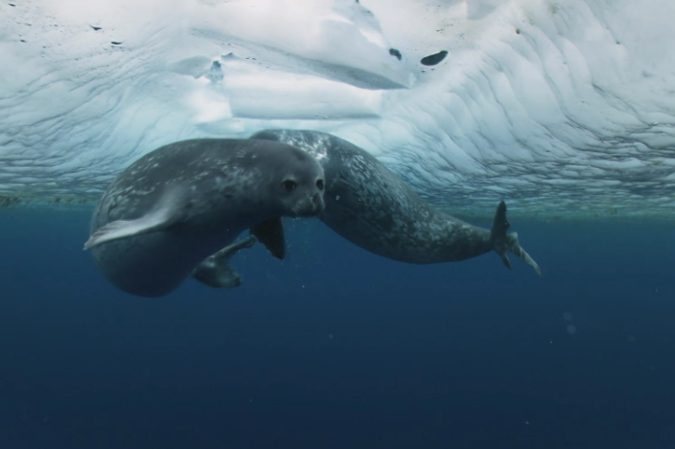
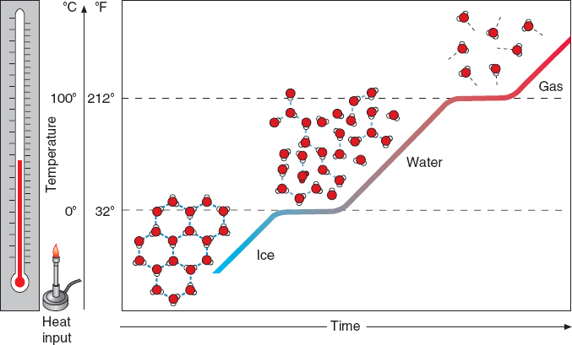
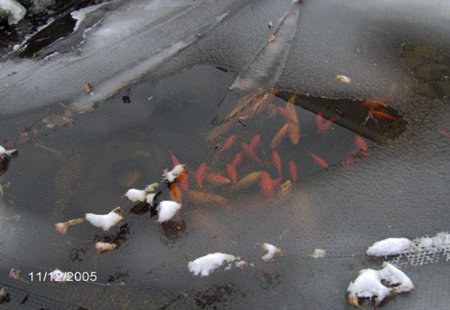
Properties of Water
Liquid form is ________ than solid form
Ice floats on water!
Notes:
Brownian movement and temperature

Slide 12
Properties of Water
When heat is applied, how does it affect the hydrogen bonds between water molecules and the molecular speed (temp.) of the water molecules?

Slide 13
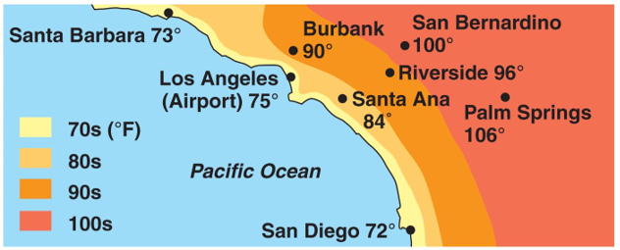
Properties of Water
Specific heat: amount of energy required to raise temp 1˚C
Water has a high specific heat compared to other molecules
Water can absorb a lot of heat energy before changing temperature
Notes:
Reason why desert experiences such extreme temperature changes. Little water vapor fails to capture heat from day so desert nights are very cold.
Water absorbs heat because solar energy causes hydrogen bonds to break but the quickly reform, which prevents an increase in the movement of the molecules and thus the temperature of water.

Slide 14
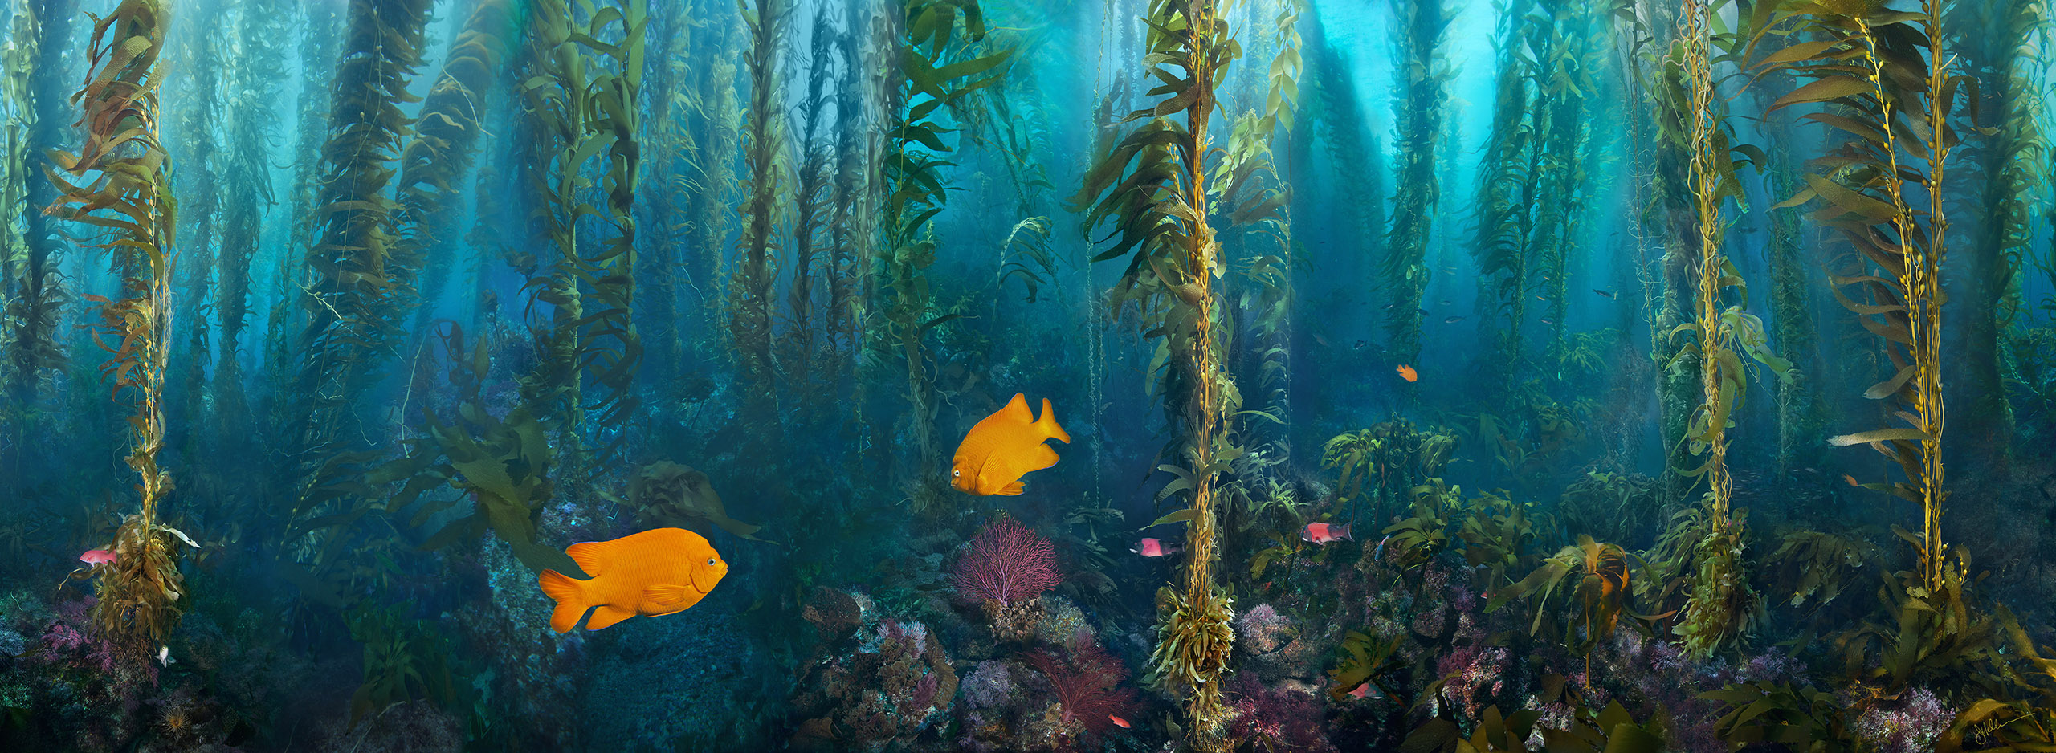
Properties of Water
How does the high specific heat of water affect marine organisms?

Slide 15
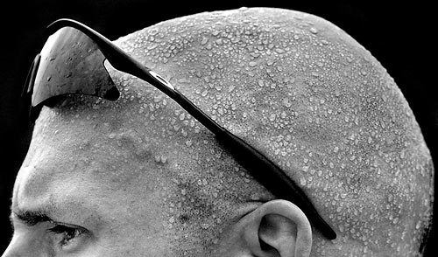
Properties of Water
High heat of vaporization
Vaporization: transformation from ______________
Fastest moving water molecules transform to a gaseous state.
Sweat helps release internal body heat
Evaporative cooling: cooling of surface when liquid evaporates
Notes:
High heat of vaporization means that a lot of energy I required to transform water from a liquid to a gas due to the strength of the hydrogen bonds. Boiling point of water 100C or 212F

Slide 16
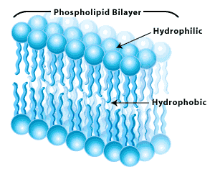
Molecular Attraction to Water
Hydrophilic (“water loving”): compounds that will interact with water
Ex. Sodium Chloride (NaCl)
____________ (“water fearing”): compounds that do not interact with water
Ex: Hydrocarbons (petroleum, oil) and lipids (fats)
Hydrophobic molecules in the membranes around our cells help contain water
Cell membrane

Slide 17
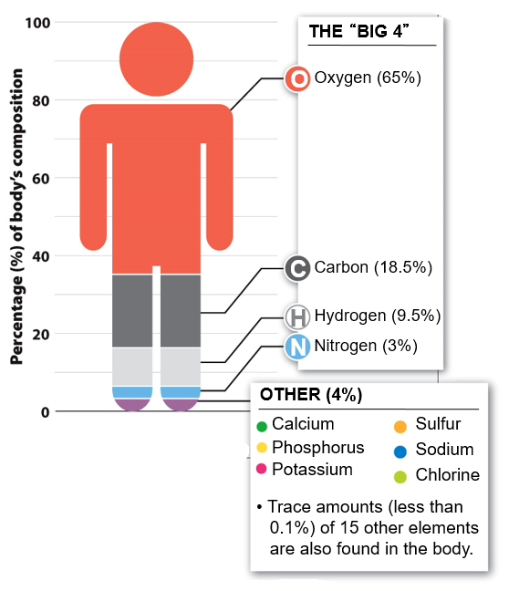
Elements in the Human Body
Cells immersed in water
66% of our body weight
80% or more in most marine organisms
Only 10 elements make up 99% of the human body. Four of these ten elements (oxygen, ______, hydrogen and nitrogen) making up around 96% of your body

Slide 18
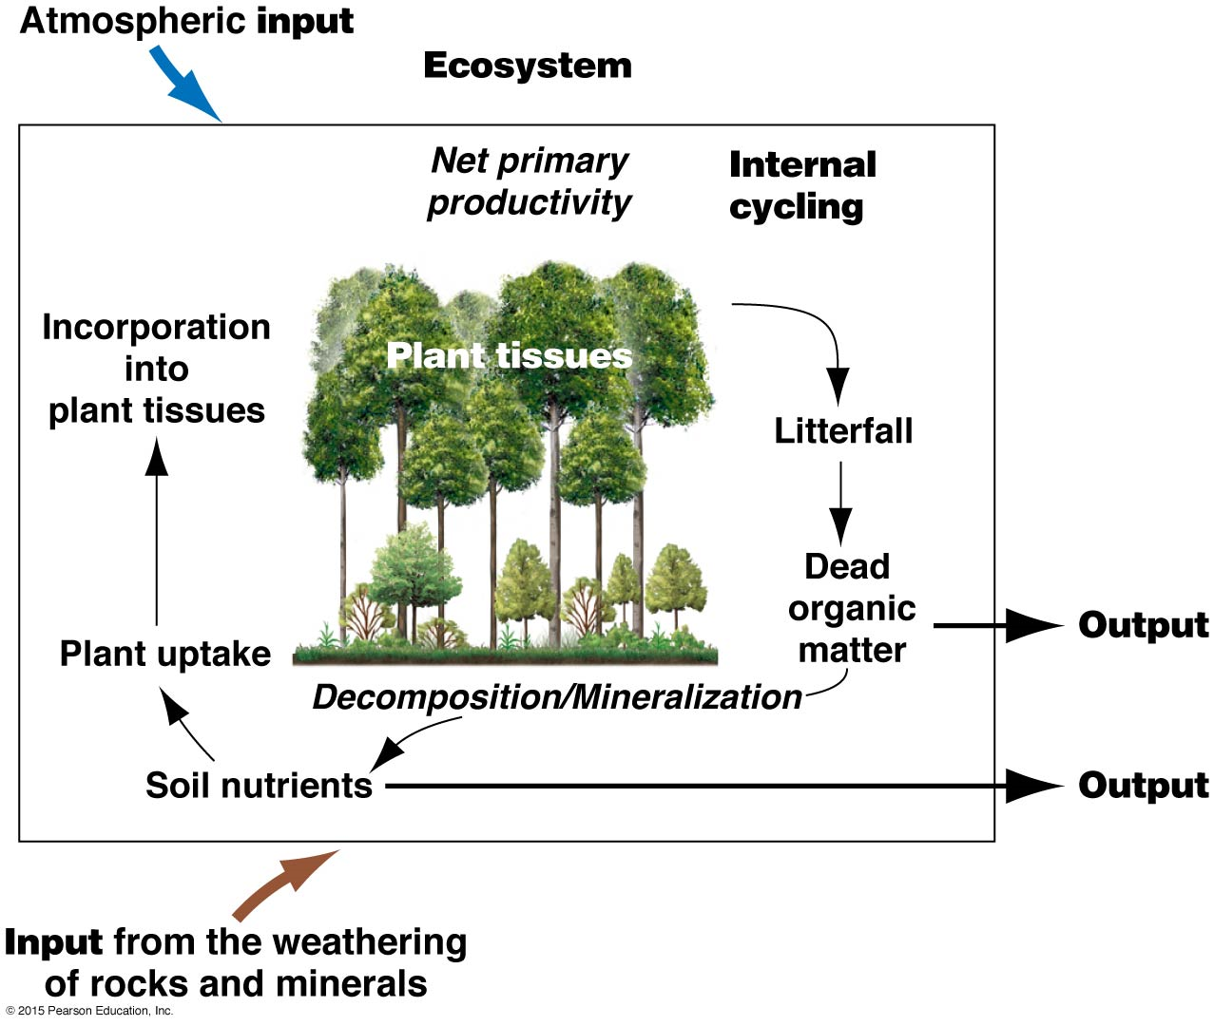
Biogeochemical Cycles
Biogeochemical cycle: transfer of nutrients from the nonliving (abiotic) to the living (biotic) and back to the nonliving components of an ecosystem.
Important Biogeochemical Cycles:
Water
Carbon
Nitrogen
Oxygen
Phosphorous

Slide 19
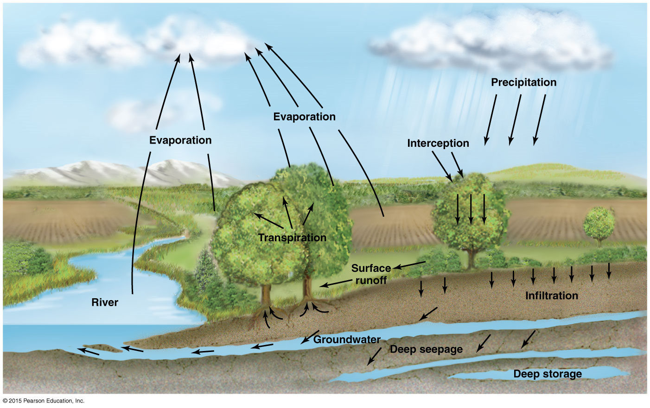
Water Cycle
Solar energy causes evaporation which drives the water cycle
Precipitation that reaches the soil will either be infiltrated into the soil or become surface runoff when the soil is saturated
Precipitation can be intercepted by vegetation or urban structure and evaporate before reaching the soil
Water evaporates from plants in a process called transpiration
Notes:
All marine and freshwater environments are directly or indirectly linked by the global water cycle

Slide 20
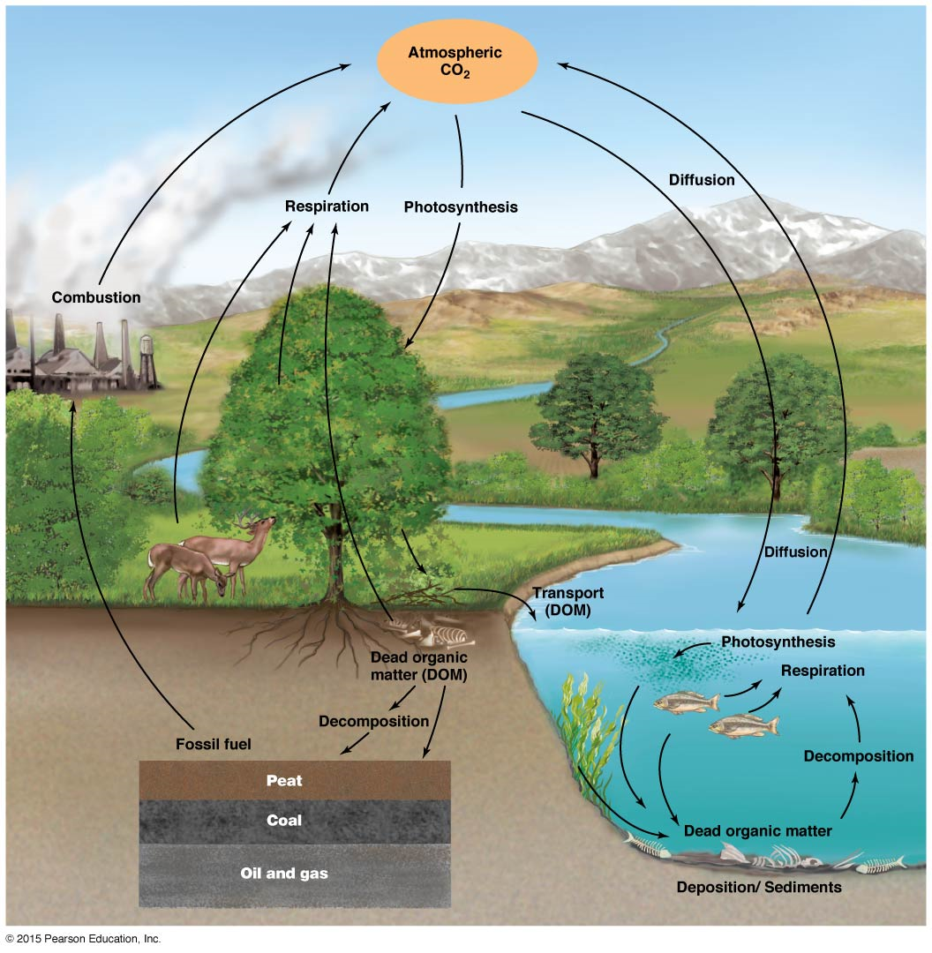
Nutrient Cycling: Carbon Cycle
Atmospheric CO₂ becomes a living component of an ecosystem through the process of _______________
Living organisms release CO₂ back into the atmosphere through respiration
Carbon in the tissue of living organisms becomes dead organic matter (DOM) which eventually decomposes to become fossil fuels
Burning of fossil fuels or living organisms releases carbon into the atmosphere as CO₂
Notes:
Storage and transfer
Carbon enters into the world through plants with create carbon based material from CO2

Slide 21
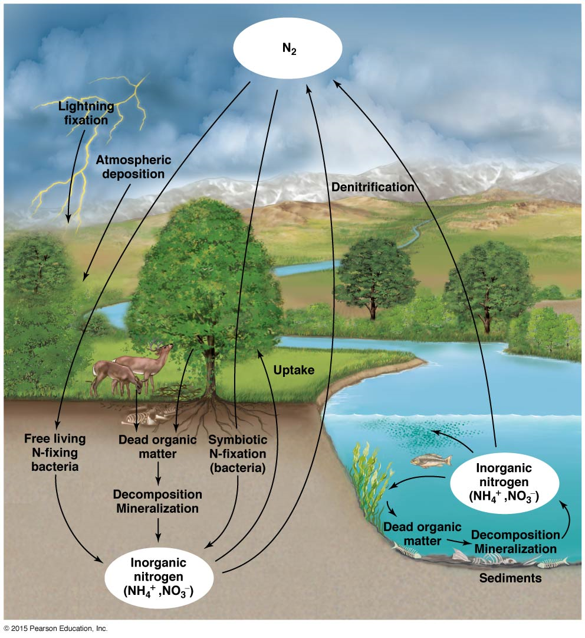
Nutrient Cycling: Nitrogen Cycle
Nitrogen gas (N≡N) makes up nearly 80% of the atmosphere but is unavailable for uptake by plants.
Bacteria in the soil or in the roots of some plants (legumes) covert unusable N₂ to ammonia (NH₃) then usable ammonium (NH₄⁺) or nitrate (NO₃⁻) in a process called _______________
Nitrogen taken up and assimilated into the cells of plants is then transferred through the food web
Decomposition of dead organic matter by soil bacteria and fungi coverts nitrogen in the organic matter back to ammonium (NH₄⁺)
Notes:
Nitrogen makes up about 78% of the Earth’s atmosphere
Nitrogen makes a small portion of living things but it if necessary for life
Nitrogen makes up part of our DNA, RNA and all our proteins
A small amount of nitrogen is fixed through high energy fixation caused by cosmic radiation, meteorite trails, and lightning

Slide 22
Importance of Soil
Soils anchor plant and provide water and dissolved minerals
Ecosystem of _____________ that may have taken centuries to develop
One teaspoon of soil can contain ~5 billion bacteria
Soil texture depends on the size of the particles in the soil, which are the result of erosion of rock
Water, and acids in soil and roots facilitate break down
Climate influences the rate at which parent material (material that forms the soil) is weathered.
Notes:
Variation in soils result in different morphologies or growth forms of a single species of plant
Loams have high surface area for adhesion of minerals and water, but spaces that allow for gas exchange with roots

Slide 23
Soil Composition
Soils are classified based on the texture of the soil which varies depending on the proportion of sand, silt and clay
Loams = equal parts clay, silt and sand
Most fertile soil

Slide 24
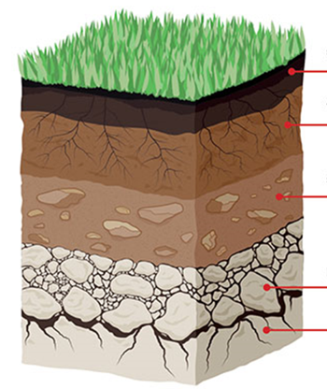
Soil Horizons
O Horizon: Organic layer consisting of partially decomposed plant material, dead organisms, feces, bacteria and fungi (_______)
A Horizon: Topsoil; a mixture of mineral particles and humus leached from the organic layer
B Horizon: Subsoil; accumulation of minerals leaching from the topsoil, such as clay and salts
C Horizon: Parent material comprising partially weathered rock
R Horizon: Bedrock; solid rock. Also acts a parent material

Slide 25
Water Movement in Aquatic Ecosystems
The movement of water determines the nature of many aquatic environments
Changing tides influence many coastal areas
Velocity of flow in streams and rivers alters the sediment on the streambed and the erosion of the riverbank
The movement of water in aquatic environments is important to the cycling of nutrients.
Wind generated waves on large lakes and oceans transport nutrients
Changes in water temperature and density cycle nutrients between the surface and deeper water

Slide 26
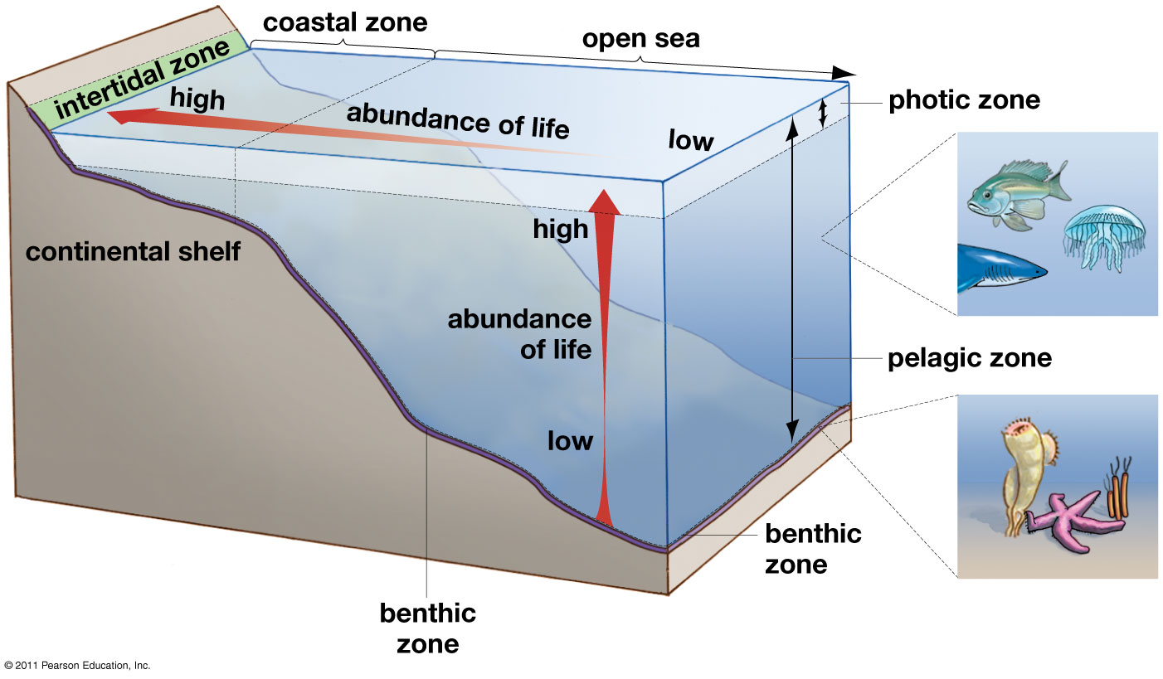
Marine Ecosystems
Intertidal zone: beach that is submerged at high tide but exposed to air at low tide
Coastal zone: from intertidal zone to end of continental shelf (≈200m deep)
____________: from surface to depth that sunlight no longer penetrates strongly enough to drive photosynthesis
Pelagic zone: from ocean surface to ocean floor
Benthic zone: bottom of the ocean
Notes:
Plankton: microorganisms that live in the water column, which can not swim against the current
Nekton: active swimming organisms able to swim against the water current

Slide 27
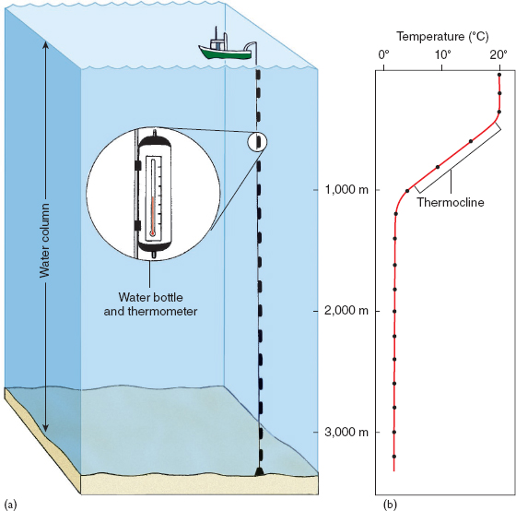
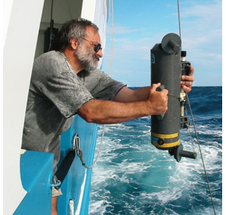
Temperature and Density of Water
_________ of seawater depends on temperature and salinity of the water
Temperature varies by region, but also by depth in the water column
Thermocline: zone of drastic temperature change over relatively small depth intervals
Notes:
What varies more in the oceans? Temperature or salinity?
Temperature ranges from -2ºC to 30ºC (28ºF to 86ºF)

Slide 28
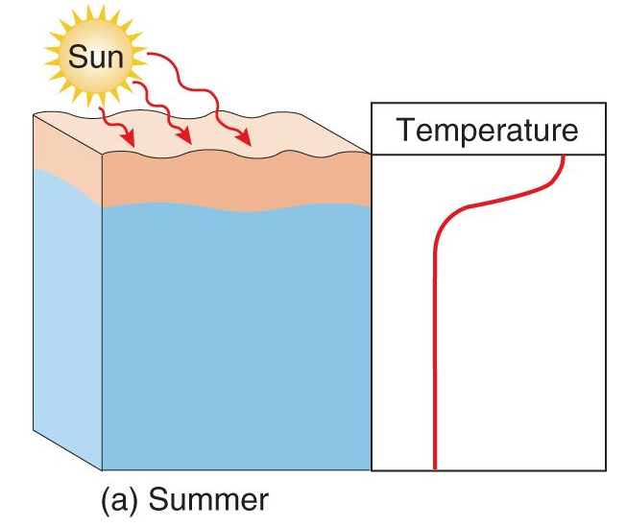
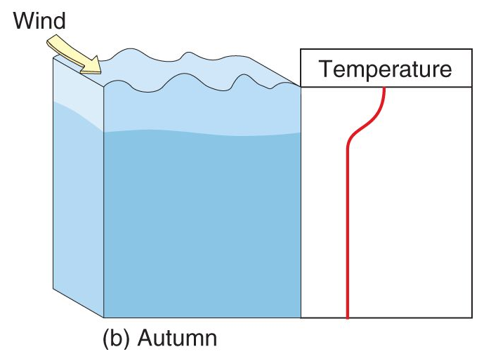
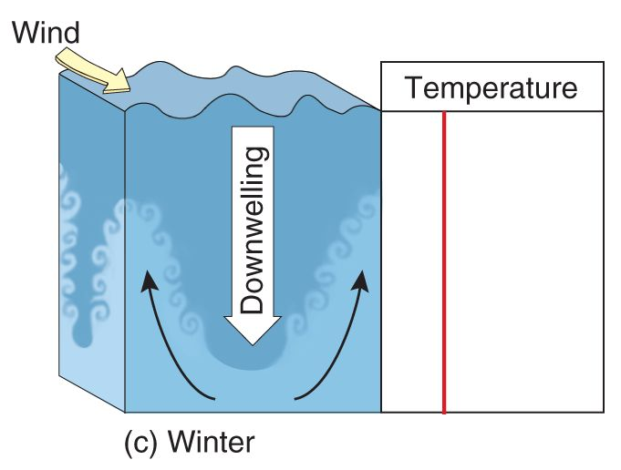
Changes in Water Density
During the summer months in temperate and polar regions the surface waters are less dense than the water layers below
In autumn, the surface waters cool and winds mix surface waters with colder, deeper water
During winter, the surface waters become _______________ than deeper waters causing them to sink (downwelling)

Slide 29
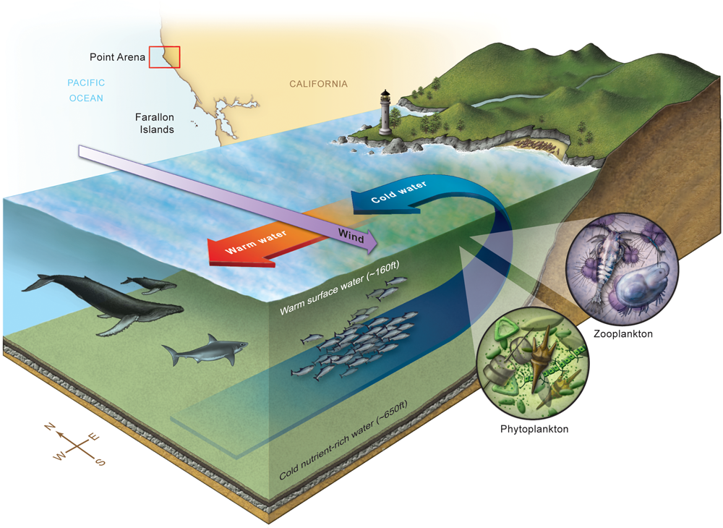
Nutrient Cycling in Aquatic Ecosystems
Coastal Upwelling
Winds running parallel to shore cause warm near shore surface waters to move out to sea.
Cold, nutrient rich waters from the depths rise to the surface to replace the warm surface waters
Coastal upwelling “fertilizes” coastal waters leading to areas of high biological diversity

Slide 30
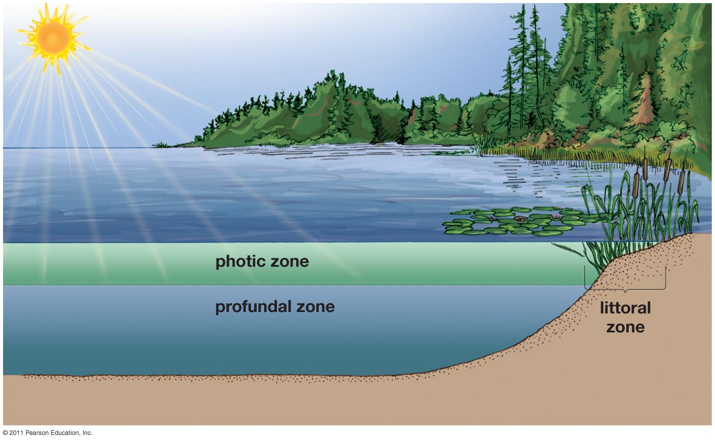
Freshwater Ecosystems
Photic zone: from surface to depth that sunlight no longer penetrates strongly enough to drive photosynthesis
Profundal zone: area below photic some where photosynthesis cannot be performed
Littoral zone: shallow water from edge of water to depth the rooted plants can grow
Most productive zone

Slide 31
Nutrient Upwelling in Lakes
Seasonal change of water temperature drives mixing between photic and profundal zones
Reversal of cold and warm surface waters during the spring and fall cause water at the surface to sink and mix with the nutrient rich deeper waters.

Slide 32
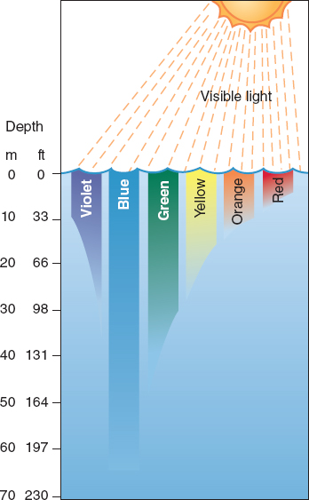
Transparency of Seawater
The transparency of seawater important to the organisms that live in the ocean, especially the photosynthetic organisms
Different wavelengths (colors) of light penetrate the ocean to different depths
______ penetrates the deepest in clear water
Green typically penetrates the deepest in coastal waters where blue wavelengths are absorbed

Slide 33
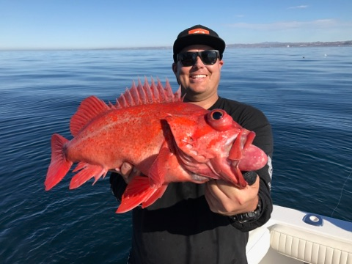
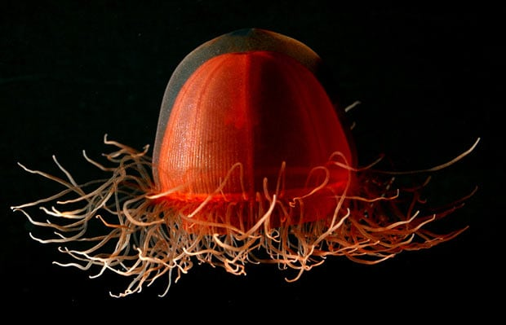
Transparency of Seawater
How does the transparency of water affect the color of different marine organisms?

Slide 34
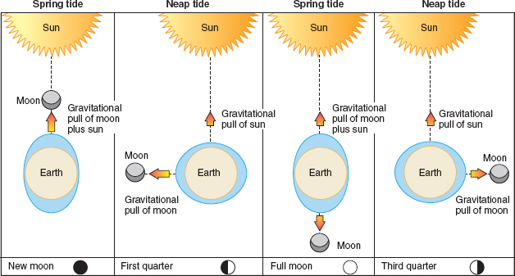
Waves and Tides
Spring tides: when the moon and sun are in alignment causing the combined gravitational pull of the moon and the sun
Neap tides: when the moon is at a __________ to the sun causing their gravitational pulls to partially cancel each other out.
Sun is 400 times further away than moon so it has less effect on the tides

Slide 35
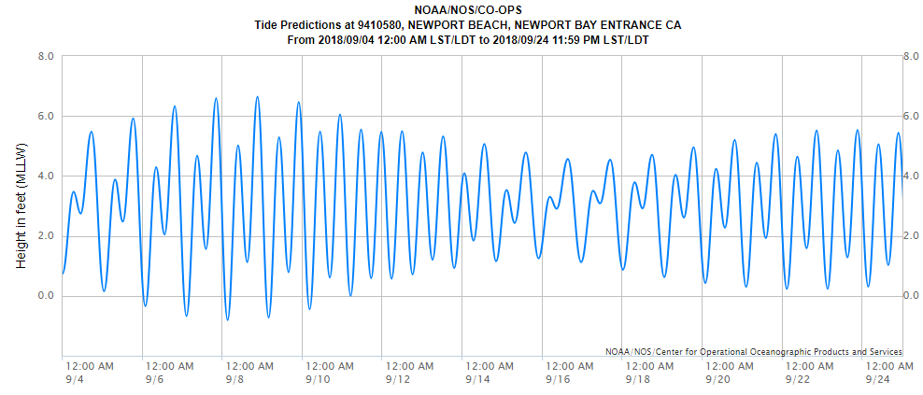
Waves and Tides
Predict when you think there is a full or new moon based on the tide chart above.
When will there be a quarter moon?
Notes:
Scientists can predict tidal conditions based on the position of the Earth, sun and moon.

Slide 36
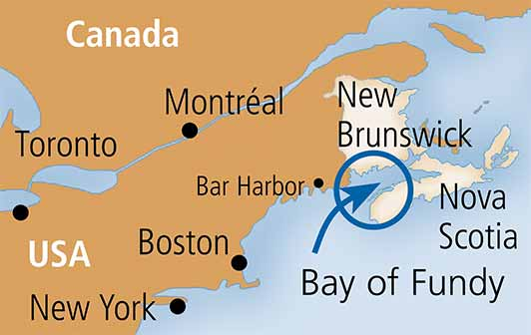
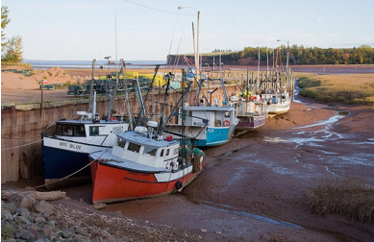
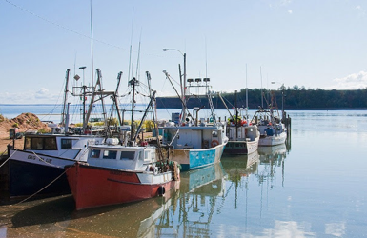
Waves and Tides
Bay of Fundy: Largest high tides on Earth
Sea level can rise by almost 50 feet during spring tides
160 billion tones of seas water flows in and out of the bay twice a day
Low Tide
High Tide
https://youtu.be/qfhNjpu_IU4

Slide 37
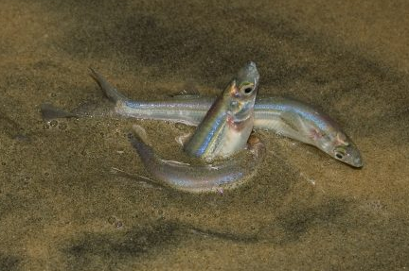
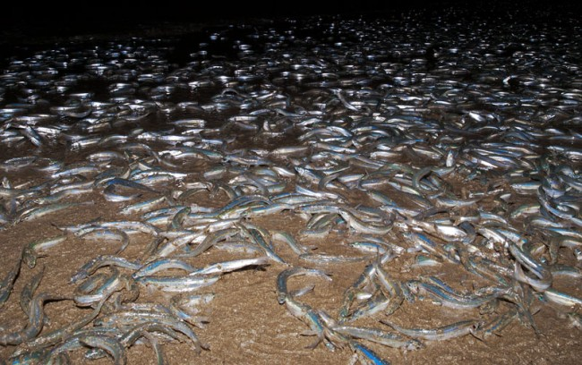
Marine Organisms and Tides
California grunion (Leuresthes tenuis) are a species of fish that spawn on the sandy beaches in southern California between March and August
Spawn during ___________ and eggs incubate in the sand for two weeks

Slide 38
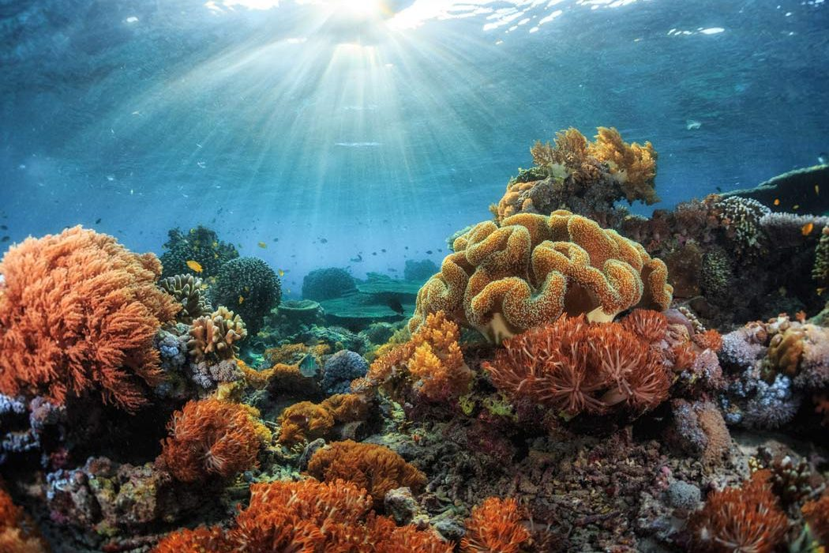
Marine Organisms and Tides
Many corals spawn during _________ when there is less water in the water column, thus increasing the likelihood that the egg and sperm will meet.

Slide 39
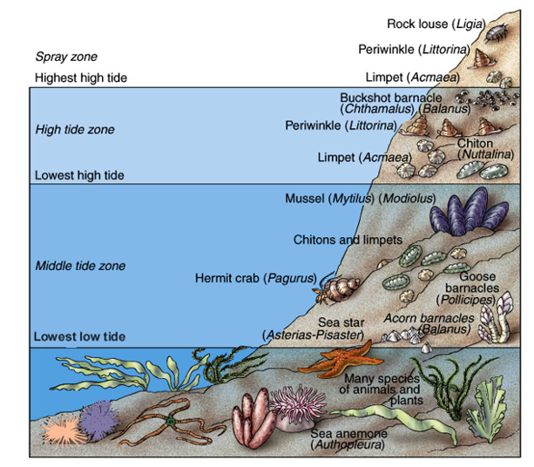
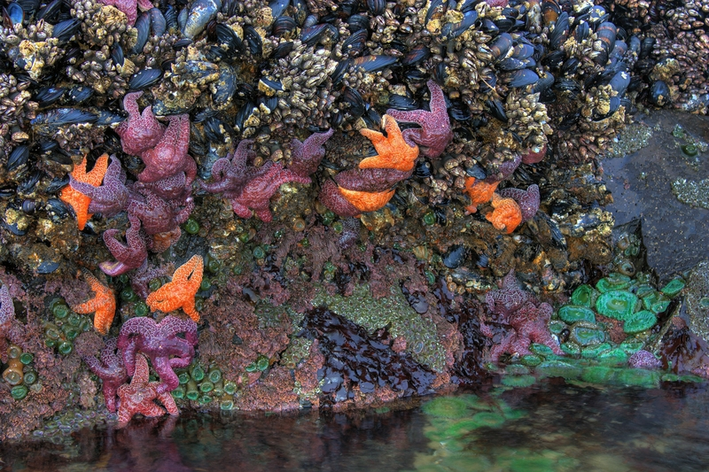
Marine Organisms and Tides
Intertidal organisms deal with periods of exposure during low tide, wave action, and changes in salinity and temperature.
Mostly shelled organisms
Many
soft-bodied organisms and algae

Slide 40
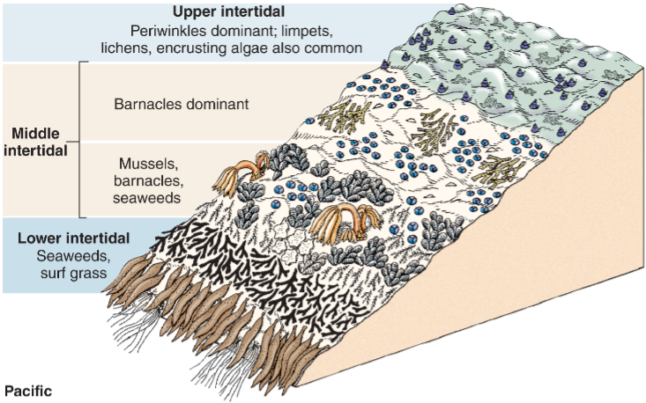
Zonation in the Intertidal
Intertidal organisms typically occupy distinct bands or vertical zones within the intertidal ecosystem
Zonation is due to varying degrees of __________
Upper intertidal (most exposed)
Middle and lower intertidal (least exposed)

Slide 41
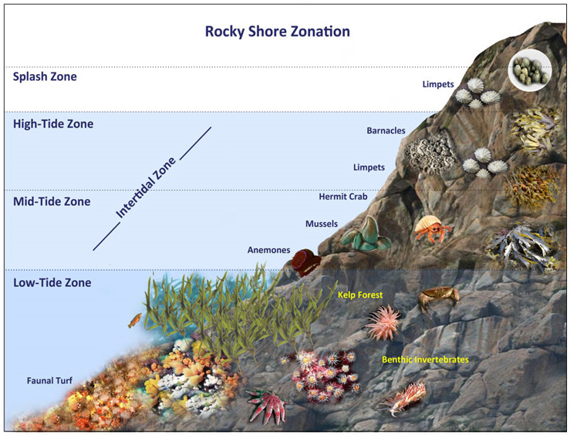
Intertidal Zonation
Splash zone: ~5ft above see level. Only inundated during highest high tides.
High-tide zone: ~2 to 5ft above sea level. Inundated during high tide and exposed to air during low tide.
Mid-tide zone: 0 – 2ft above sea level. Exposed to air only during low tide.
Low-tide zone: Below sea level. Only exposed to air during lowest low tides.

Slide 42
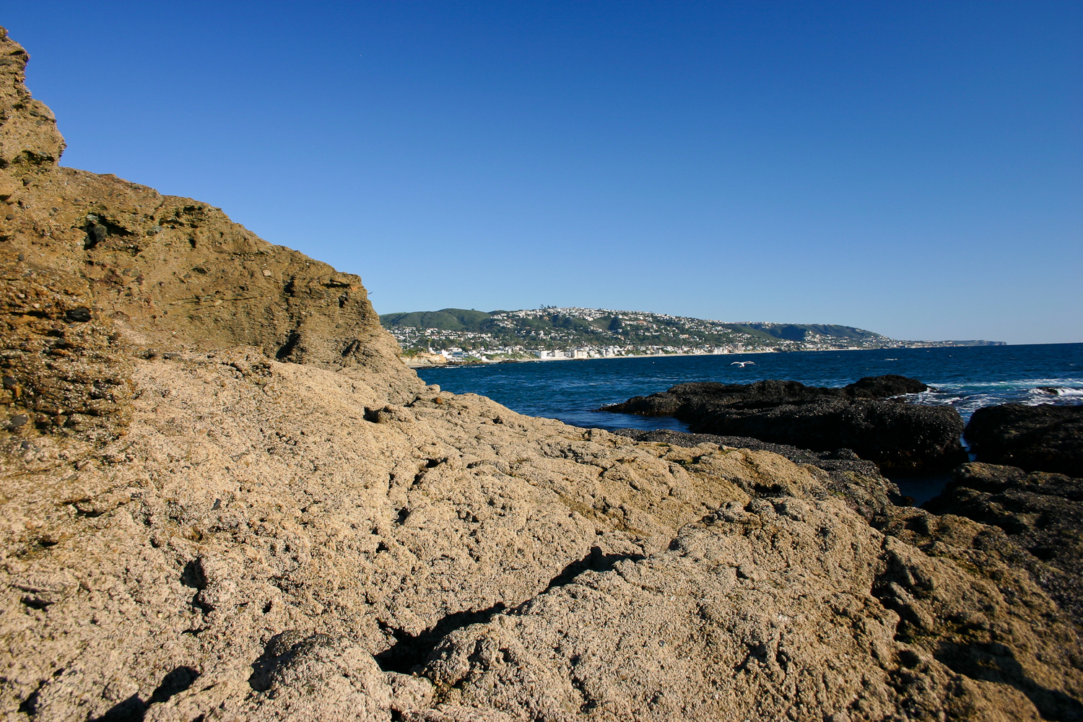
Splash Zone and Upper Intertidal
The Splash Zone, Upper Intertidal, and Middle Intertidal

Slide 43
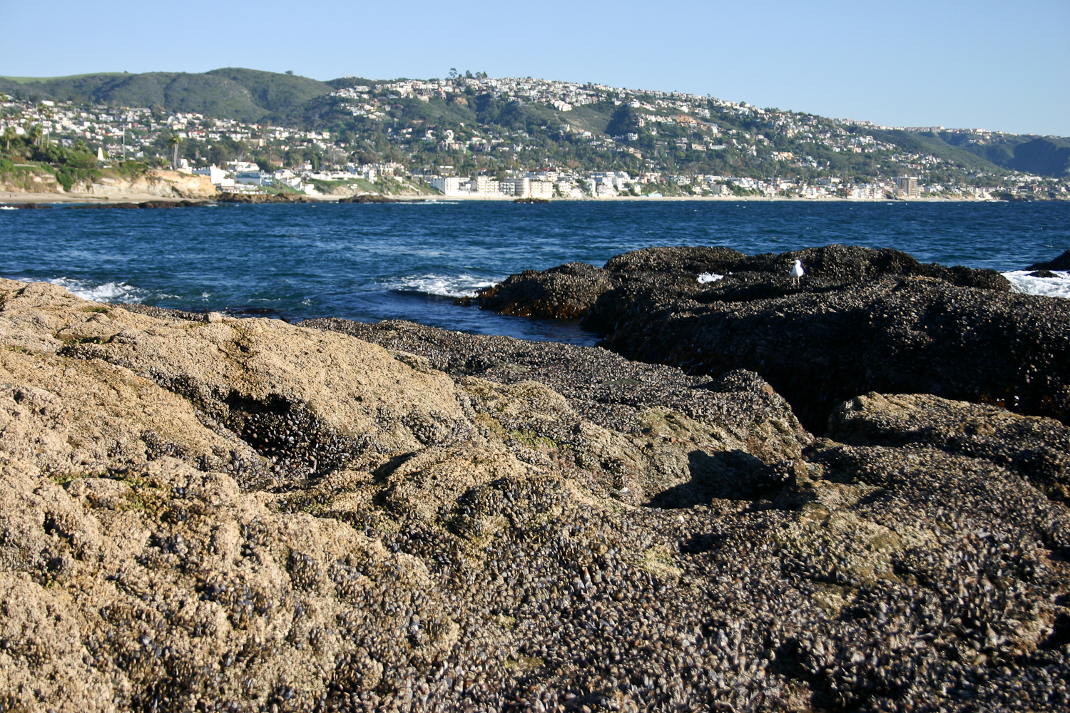
Upper and Middle Intertidal
The Upper and Middle Intertidal

Slide 44
Middle and Lower Intertidal
Middle and Lower Intertidal

Slide 45
Intertidal Zonation
Splash zone: ~5ft above see level.
Only inundated during highest high tides.
Organisms sprayed with water during high tide but are rarely submerged
Organisms found in splash zone
Periwinkle snails
Small acorn barnacles
Periwinkle snails
Small acorn barnacles

Slide 46
Intertidal Zonation
High-tide zone: ~2 to 5ft above sea level.
Inundated during high tide and exposed to air during low tide.
Organisms found in high-tide zone
Large acorn barnacle
Chiton
Limpets
Shore crabs
Rough chiton
Shore crab

Slide 47
Intertidal Zonation
Mid-tide zone: 0 – 2ft above sea level.
Exposed to air only during low tide.
Organisms found in mid-tide zone
Sea star
California mussel
Gooseneck barnacles
Hermit crabs
Sea anemones
Sea stars and sea anemones
California mussels and gooseneck barnacles

Slide 48
Intertidal Zonation
Low-tide zone: Below sea level.
Only exposed to air during lowest low tides.
Organisms found in low-tide zone
Brown algae
Opaleyes
California sea hare
Two spotted octopus
Sea urchins

Slide 49
Zonation in the Intertidal
Competition is greatest in the lower intertidal because it is exposed to a lesser degree than the upper intertidal.
The lower intertidal has the _________________ of species because it is the least extreme of the zones

Slide 50
Challenges of the Intertidal Zone
_______________: drying out during low tide.
Wave action and tides: impacts from waves and other objects. Wear from sandy water
Exposure: exposure to heat and UV from sun.
Temperature changes: drastic shifts in air and water temperature
Salinity changes: evaporation from pools changes salinity
Predation: intertidal predators including octopus, sea stars and fish
Limited space: intertidal organisms compete for space on the substrate
Oxygen availability: lack of oxygen in the water when exposed

Slide 51
Rocky Intertidal Food Web
Secondary consumers
Primary consumers
Primary Producers

Slide 52
Rocky Intertidal Food Web
Predators act to control prey populations
________________: a species whose absence in the community would bring about significant change in that community
Predator:
Pisaster ochraceous
Prey:
Mytilus californianus

Slide 53
Rocky Intertidal Food Web
Sea stars are especially important in controlling California mussel populations in the lower intertidal zone. The absence of sea stars can lead to the expansion of the mussel beds into the lower intertidal.

Slide 54
Sea Star Wasting Disease
Sea Star Wasting Syndrome (SSWD) is a disease that affects various echinoderm species causing them to decay and die
Some areas in southern California experienced a ____% decline in sea star populations
Sea water temperature may be correlated with the spread of the disease
Cause of the disease has yet to identified

Slide 55
Estuaries
__________: a partially enclosed area where a freshwater river or stream meets the ocean resulting in brackish waters.
Newport Back Bay
Bolsa Chica Ecological Reserve
Newport Harbor
Pacific Ocean
Pacific Ocean

Slide 56
Estuaries
Estuary habitat types:
Open water: area covered with water during low tide
Mudflats: areas covered during high tide but exposed during low tide
Saltmarsh: area covered during high tide
Freshwater marshes and ponds: stagnant freshwater habitats
Riparian: terrestrial areas along freshwater habitats
Upland: terrestrial habitats not adjacent to fresh or salt water habitats
Habitats of Upper Newport Bay

Slide 57
Estuaries and Tides
Mudflats are fully submerged and the salt marsh partially submerged during high tide. The mudflats are exposed during low tide allowing shorebirds to feed on the invertebrate infauna buried in the mud.

Slide 58
Estuary Habitats – Open Water
Tidal cycle brings in plankton and other marine organisms
Freshwater input and tides affect salinity levels of brackish water
Nutrients from freshwater input stimulates growth of photosynthetic algae

Slide 59
Estuary Habitats – Mudflats
Area exposed during low tide.
Mud formed by fine particles consisting of silt, clay and detritus deposited by freshwater and marine inputs.
_________________ of living organisms of all estuary habitats
Invertebrate infauna are dominant in mudflat habitat
Important food source for shorebirds during low tide and fishes during high tide
Notes:
One cubic foot can have as many as 40,000 inhabitants

Slide 60
Estuary Habitats – Mudflats
Various bill lengths and shapes of shorebird species are an example of ___________________

Slide 61
Resource Partitioning
Resource partitioning: when species evolve to occupy different ecological niches to reduce the amount of ____________ between species
Different bill lengths in shorebirds allow different species to specialize in different prey types

Slide 62
Resource Partitioning

Slide 63
Estuary Habitats – Salt Marsh
Areas partially flooded during high tide
Saltmarsh plants bordering mudflats mark height of average high tide.
Temperate and subarctic regions worldwide
Dominated by __________ (salt-tolerant plants)
Salt grass, cord grass and pickleweed
Salt marsh plants help stabilize soils by decreasing erosion caused by wave action

Slide 64
Estuary Habitats – Salt Marsh
Salt Grass
Typically found in middle zone of salt marsh
Halophytes: salt tolerant plant species
Excretes salt from pores crystallizes on the blade forming characteristic square salt shape.
Asexual reproduction through rhizomes (horizontal stems)
Used by nesting birds and as a food source for ducks and geese

Slide 65
Estuary Habitats – Salt Marsh
Pickleweed
Typically found in low to middle zones of salt marsh
Succulent
Excess salt is transported to the tips of the plant where the salt containing cells break down and die, turning red in the process
Important habitat for protected species
Belding’s savanna sparrow and saltmarsh harvest mouse

Slide 66
Importance of Estuaries
Estuaries act as __________ for numerous marine organisms
Fewer predators and rich food sources
Approximately 90% of the marine commercial catch in northern Gulf of Mexico rely on estuaries for part of their life cycle

Slide 67
Importance of Estuaries
Estuaries act as critical stopovers for many migratory bird species
Many migratory birds breed in estuaries

Slide 68
Importance of Estuaries
Estuaries help buffer against _________________ by absorbing excess runoff and slowly releasing it into the ocean.

Slide 69
Importance of Estuaries
Estuary plants filter silt and nutrients from the water, but also trap trash and other pollutants
Estuary soils help neutralize toxic pollutants that are on their way out to sea

Slide 70
Check Your Understanding
True or False: The sun has a greater effect on the tides than the moon
True or False: The liquid state of water is denser than the solid state of water
True or False: California mussels are considered a keystone species in the rocky intertidal zones in southern California
True or False: The greatest number of species are found in the middle tide zone where there is a mix of high tide and low tide conditions

Slide 71
Check Your Understanding
Which of the following habitats are covered with water during high tide but exposed during low tide?
a. Open water
b. Mud flats
c. Salt Marsh
d. Sea grasses
e. More than one of the above habitats

Slide 72
Check Your Understanding
Which wavelength of light penetrates the deepest into the ocean in coastal areas?
a. Blue
b. Red
c. Green
d. Orange
e. Violet

Slide 73
Check Your Understanding
Describe how the number of hydrogen bonds in water molecules are affected by temperature?

