Slide 1
Chemical and Physical Properties of Seawater
“Everybody complains about the weather, but nobody does anything about it”
– Charles Dudley Warner
Chapter 3

Slide 2
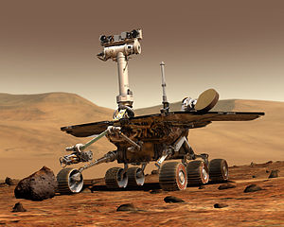
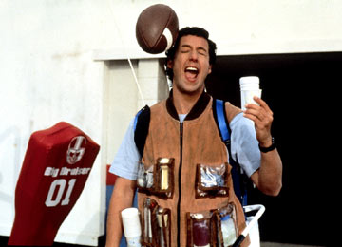
The Amazing H₂O
Water is essential to life
Life started in water
Terrestrial life depends of water
Cells immersed in water
____% of our body weight
80% or more in most marine organisms
Water has unique properties that allow life to exist on earth

Slide 3
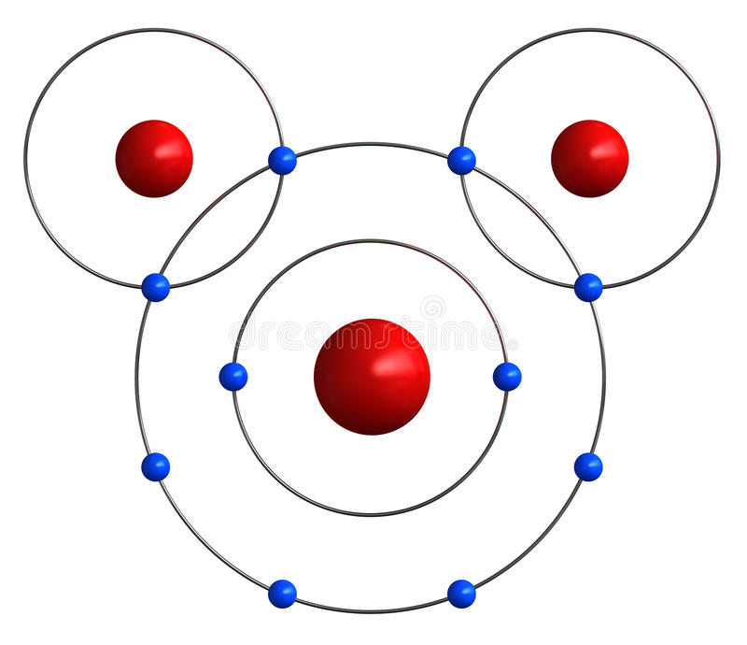
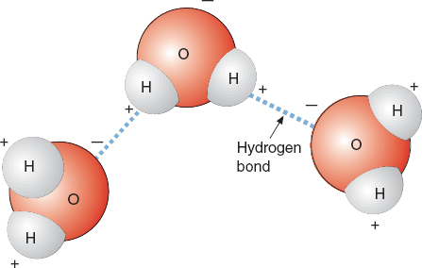
Properties of Water
Water is a ________ molecule
Protons in oxygen atom pull electrons toward nucleus causing one side of water molecule to become slightly positively charged and the opposite side to become slightly negatively charged.
Partial negative charge
1P⁺
1P⁺
Hydrogen bond
8 P⁺
Partial positive charge

Slide 4
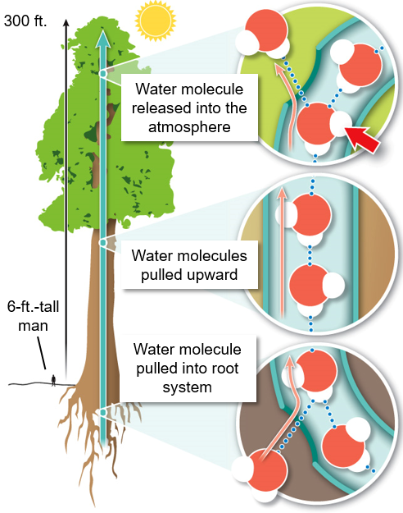
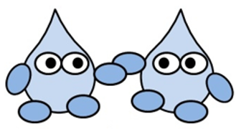
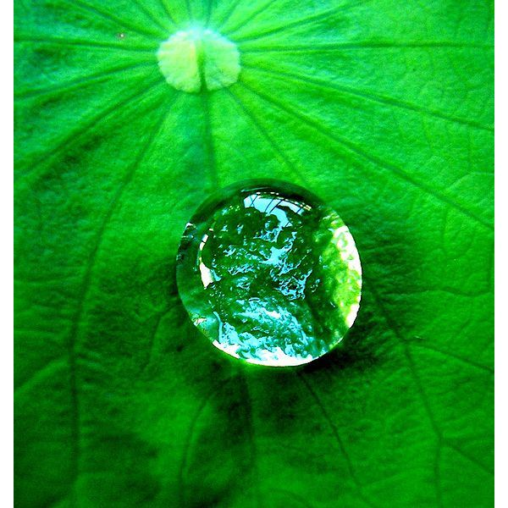
Properties of Water
_____________: the tendency for like molecules to cling together due to attractive forces

Slide 5
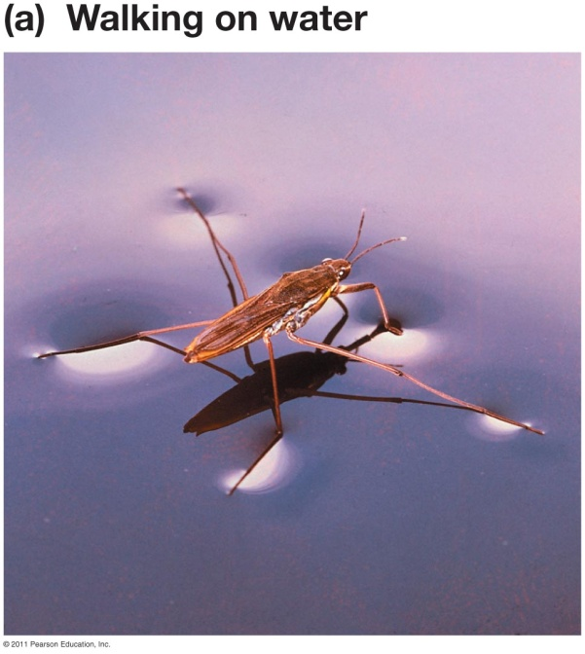
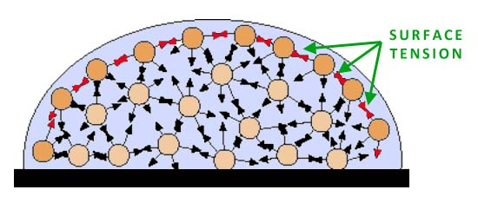
Properties of Water
Surface tension: water molecules are ___________ to air and pack more tightly at interface

Slide 6
Properties of Water
The Universal Solvent
Water can dissolve more substances than any other liquid
Solute: substance being ___________ to form a solution
Solvent: substance that a solute is dissolved in to form a solution
Aqueous solution = water is the solvent
Solution: a homogeneous mixture of two or more substances
Hydrogen bonds of water molecule pull other compounds apart
Notes:
Homogenous: all the same kind, like

Slide 7
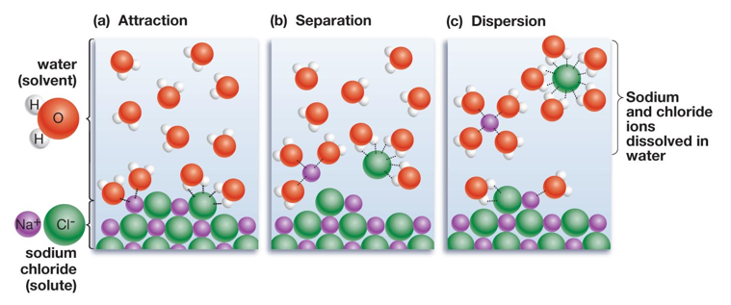
Properties of Water
Water as a solvent
_________ works to pull apart ions

Slide 8
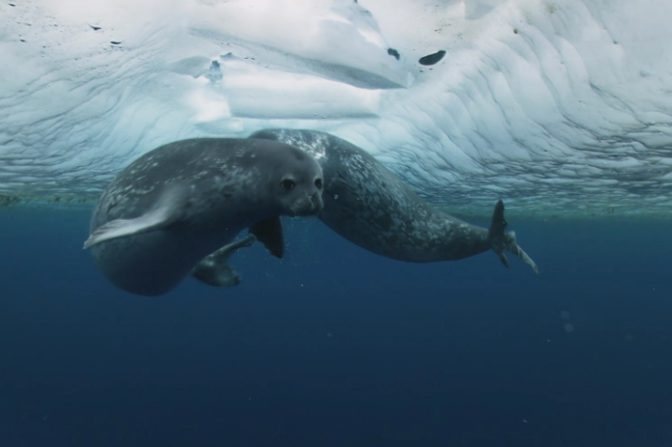
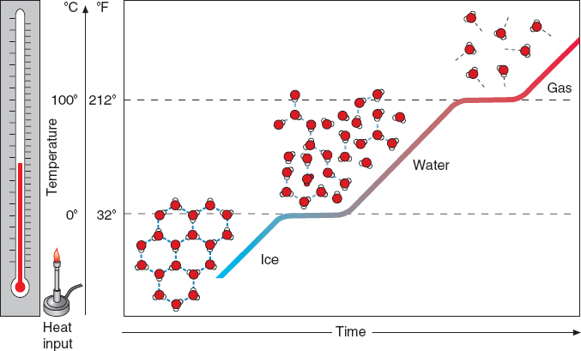
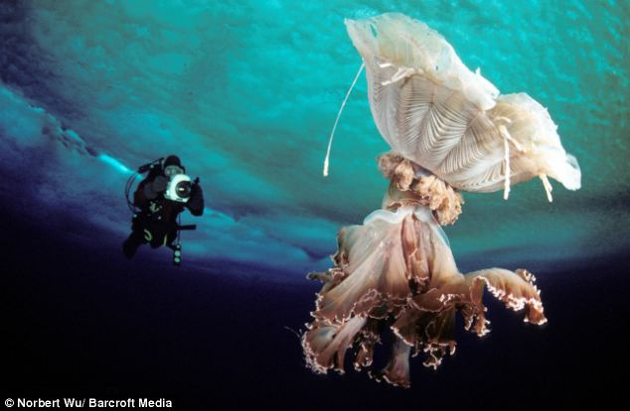
Properties of Water
Liquid form is _______ than solid form
Ice floats on water!
Notes:
Brownian movement and temperature

Slide 9
Properties of Water
When heat is applied, how does it affect the hydrogen bonds between water molecules and the molecular speed (temp.) of the water molecules?

Slide 10
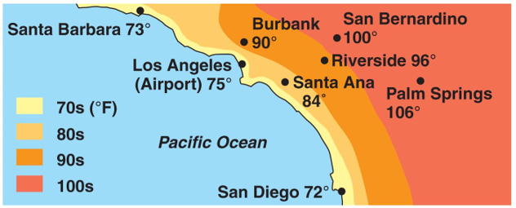
Properties of Water
Specific heat: amount of energy required to raise temp 1˚C
Water has a high specific heat compared to other molecules
Water can absorb a lot of heat energy before changing temperature
Notes:
Reason why desert experiences such extreme temperature changes. Little water vapor fails to capture heat from day so desert nights are very cold.
Water absorbs heat because solar energy causes hydrogen bonds to break but the quickly reform, which prevents an increase in the movement of the molecules and thus the temperature of water.

Slide 11
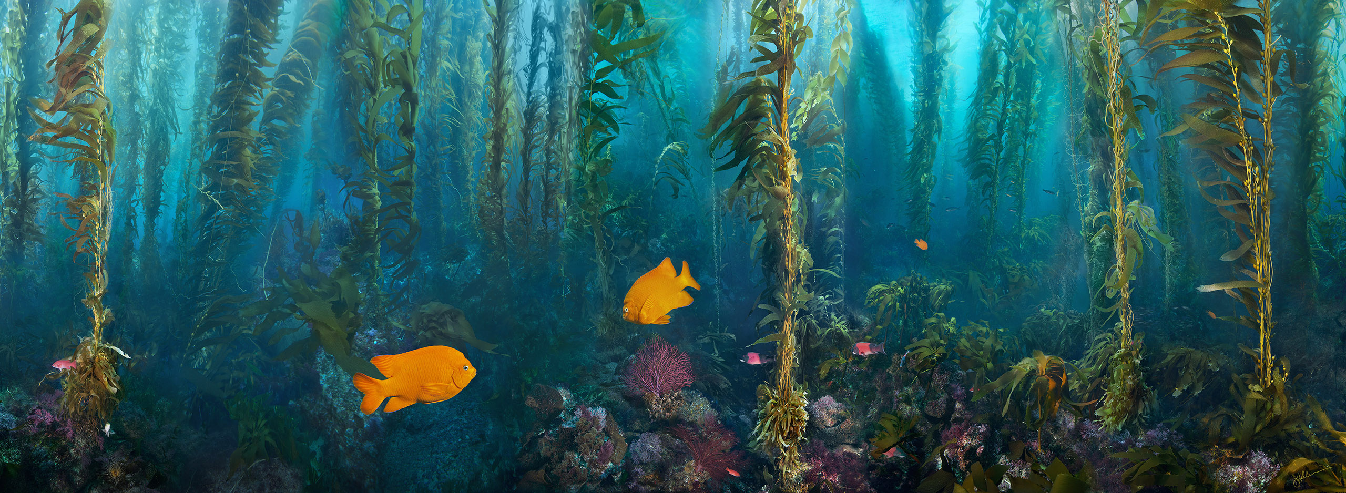
Properties of Water
How does the high specific heat of water affect marine organisms?

Slide 12
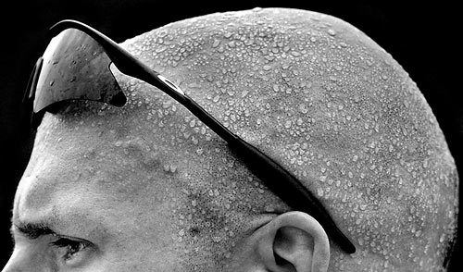
Properties of Water
High heat of vaporization
Vaporization: transformation from ______________
Fastest moving water molecules transform to a gaseous state.
Sweat helps release internal body heat
Evaporative cooling: cooling of surface when liquid evaporates
Notes:
High heat of vaporization means that a lot of energy I required to transform water from a liquid to a gas due to the strength of the hydrogen bonds. Boiling point of water 100C or 212F

Slide 13
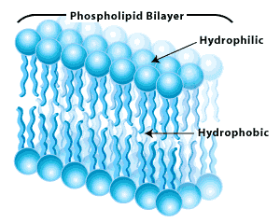
Molecular Attraction to Water
Hydrophilic (“water loving”): compounds that will interact with water
Ex. Sodium Chloride (NaCl)
___________ (“water fearing”): compounds that do not interact with water
Ex: Hydrocarbons (petroleum, oil) and lipids (fats)
Hydrophobic molecules help contain water
Cell membrane

Slide 14
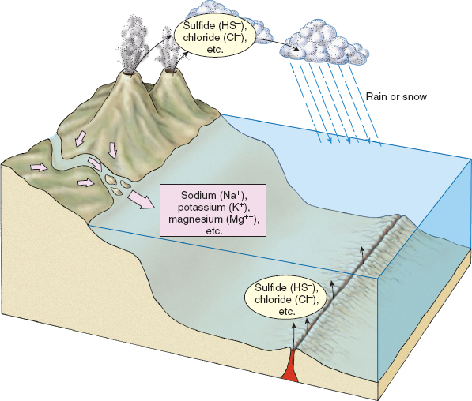
Composition of Seawater
Chemical ions introduced to seawater through weathering of rocks, hydrothermal vents, and volcanos

Slide 15
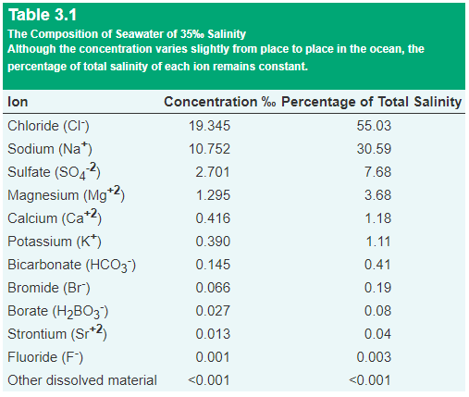
Composition of Seawater
___________: total amount of salt dissolved in seawater
Expressed as parts per thousand
35 grams salt per 1000 grams of water = 35 ppt or 35 ⁰/00
Practical Salinity Units (psu)
Rule of Constant Proportions: the proportions of different ions in seawater are relatively constant in all seawater.
Notes:
Salinity greatly affects the organisms living in it.
Organisms living in estuaries where fresh water and salt water mix, must be adapted to a range of salinities.

Slide 16
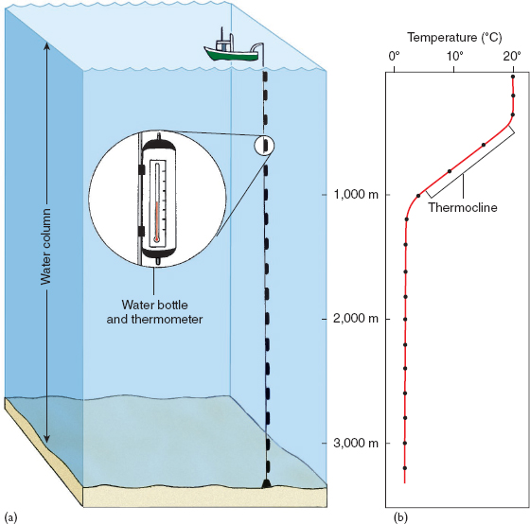
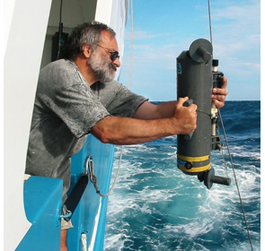
Salinity, Temperature, and Density
_________ of seawater depends on temperature and salinity of the water
Temperature varies by region, but also by depth in the water column
Notes:
What varies more in the oceans? Temperature or salinity?
Temperature ranges from -2ºC to 30ºC (28ºF to 86ºF)

Slide 17
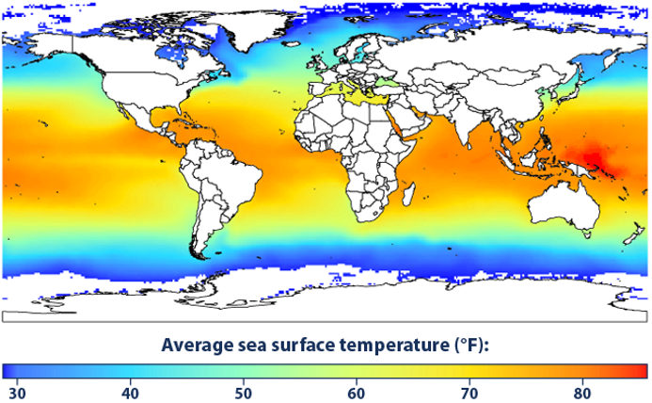
Salinity, Temperature, and Density
Pacific Warm Pool off northeast New Guinea strongly influenced the climate of the entire planet.

Slide 19
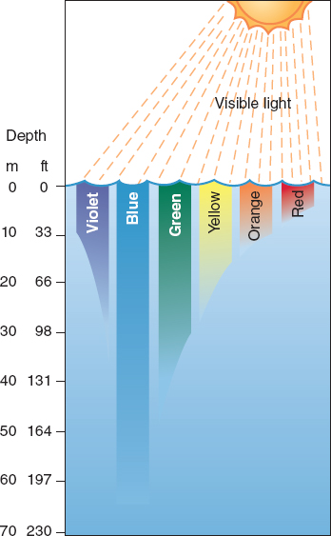
Transparency of Seawater
The transparency of seawater important to the organisms that live in the ocean, especially the photosynthetic organisms
Different wavelengths (colors) of light penetrate the ocean to different depths
______ penetrates the deepest in clear water
Green typically penetrates the deepest in coastal waters where blue wavelengths are absorbed

Slide 20
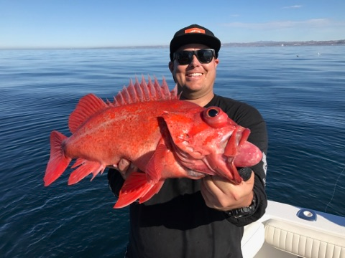
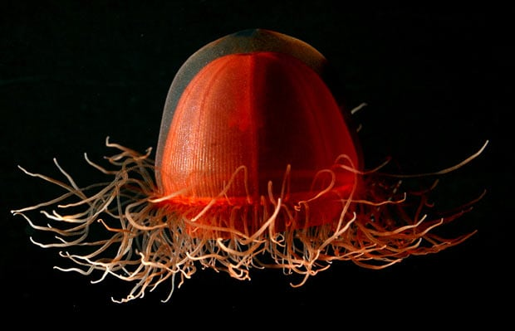
Transparency of Seawater
How does the transparency of water affect the color of different marine organisms?

Slide 21
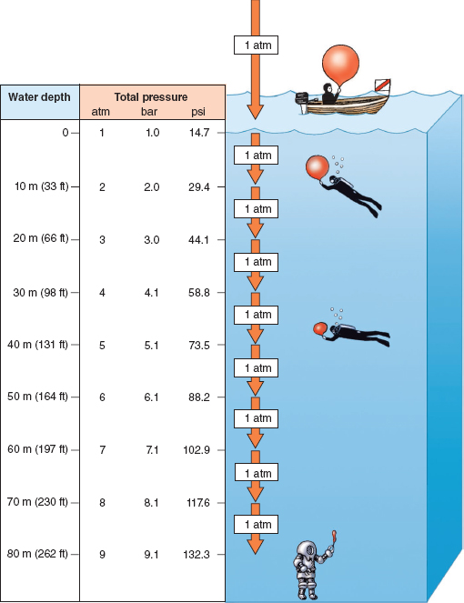
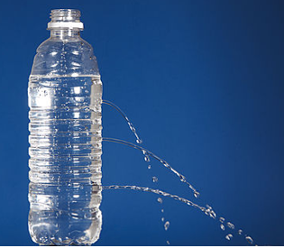
Depth and Pressure
Pressure increases with depth
1 Atmosphere (14.7 pounds per square inch, or psi) at sea level = weight of all air above you at sea level
1 atm added for every __________ of depth

Slide 22
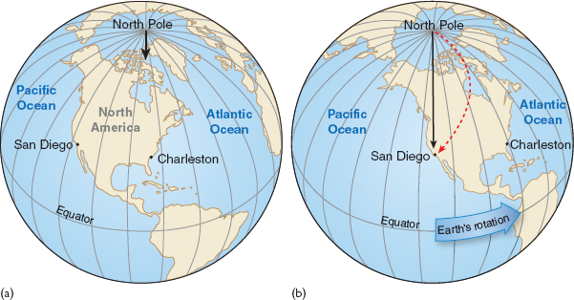
Ocean Circulation
Coriolis effect: the deflection of air and water currents on the surface of the Earth caused by the eastward rotation of the Earth.
Deflects to the _____ in northern hemisphere and _____ in southern hemisphere

Slide 23
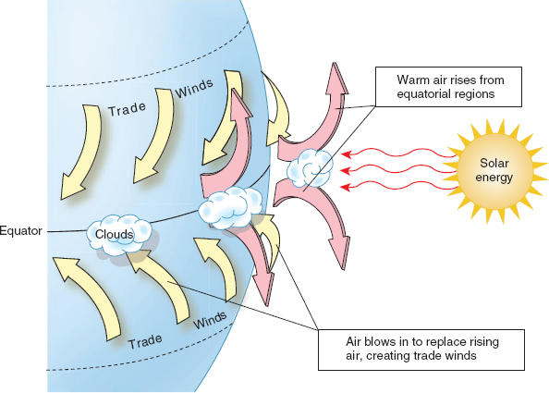
Ocean Circulation
Global Wind Patterns
Solar energy is greatest at the equator causing the warm air near the equator to rise
Air from adjacent areas moves into equatorial areas to replace rising warm air
Coriolis effect causes winds to approach equator at 45° angle
__________

Slide 24
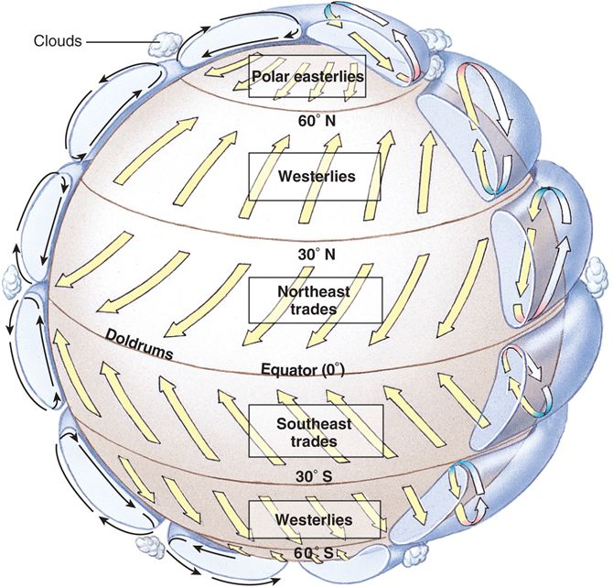
Ocean Circulation
Trade winds: prevailing winds that originate in the east and blow toward the equator
___________: prevailing winds in the middle latitudes (30° to 60° N and S) that originate in the west and blow pole ward
Polar easterlies: weak and irregular winds that blow from the poles eastward toward the equator

Slide 25
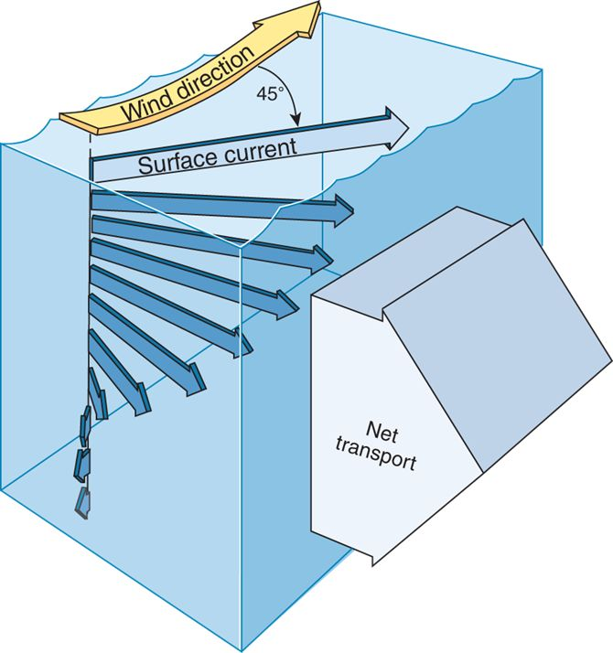
Ocean Circulation
Surface currents move at a 45° angle to the surface winds due to the Coriolis effect.
Deeper layers of water are pushed by the layer above it, but at a slower rate and at slightly more angle (Ekman spiral)
To the right in northern hemisphere, to the left in southern hemisphere
_______________: the net movement of water currents are 90° from the wind direction

Slide 26
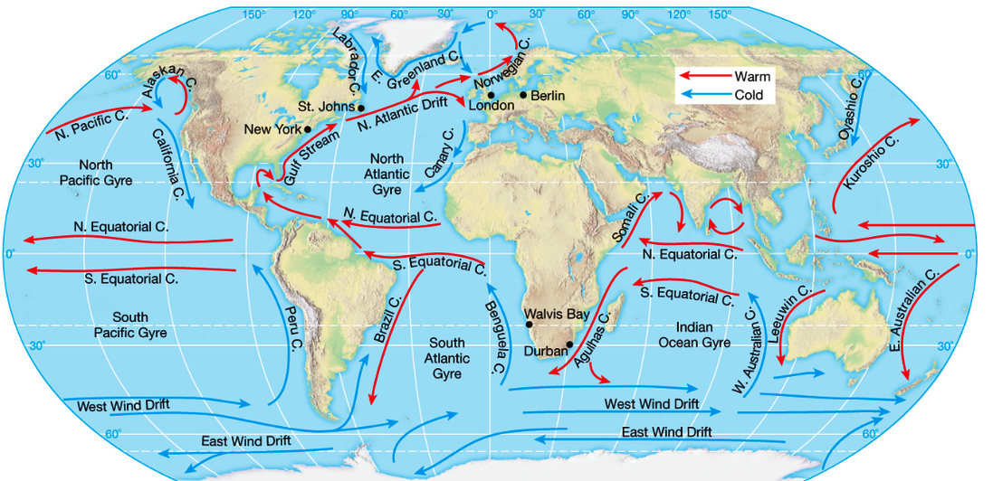
Ocean Circulation
_______: a large, nearly circular system of wind drive surface currents that center around 30° N and S latitude

Slide 27
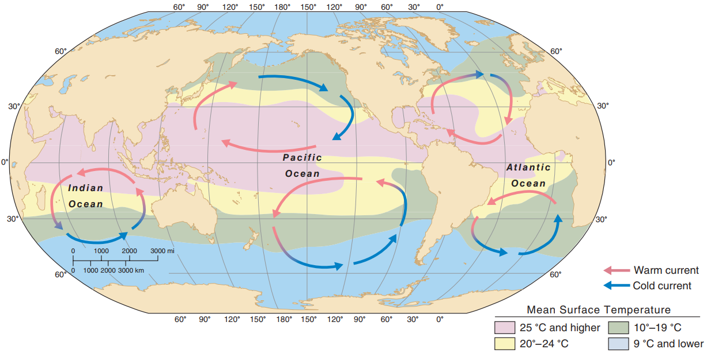
Ocean Circulation
Sea-surface temperature in different oceans is strongly affected by ocean gyres

Slide 28
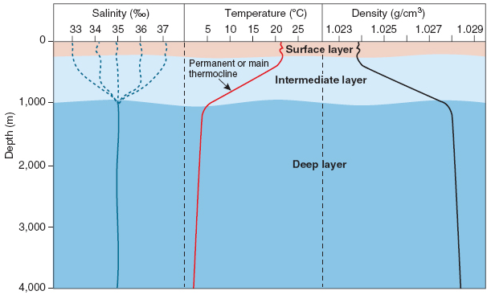
Ocean Layers
Surface layer: area from surface to100m to 200m deep that is mixed by wind, waves, and currents
Intermediate layer: from surface layer to 1000m deep where temperature transitions from warm surface waters to cold water below
______________: zone of drastic temperature change over relatively small depth intervals
Deep layer: from 1000m of depth to ocean floor, where water salinity, temperature, and density are relatively constant
Notes:
There is no thermocline on the continental shelf, where the surface waters extend all the way to the bottom.

Slide 29
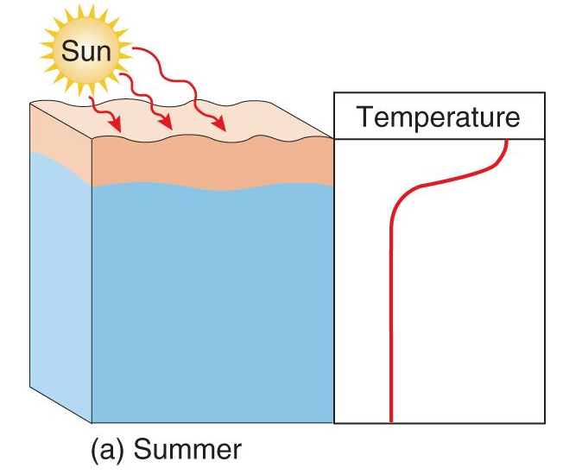
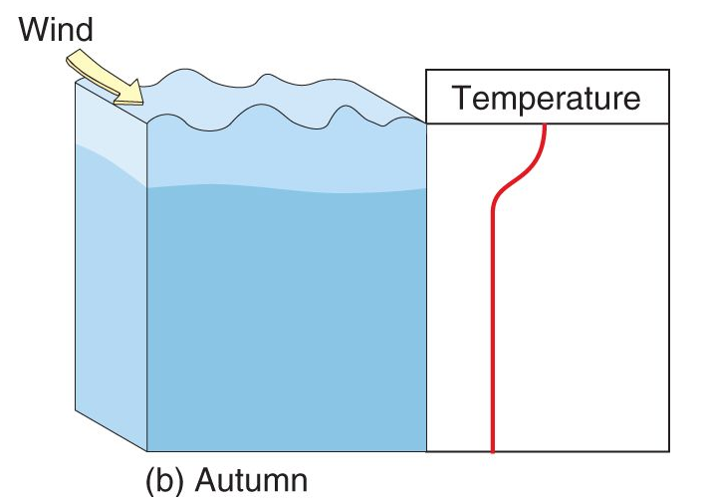
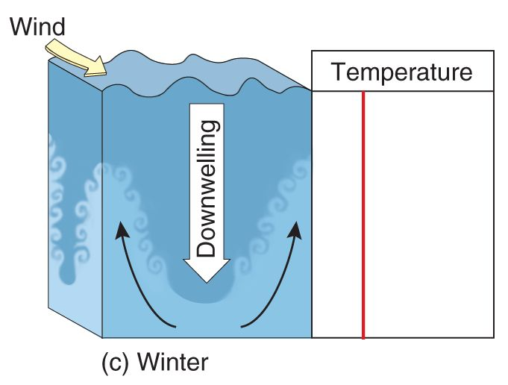
Changes in Water Density
During the summer months in temperate and polar regions the surface waters are less dense than the water layers below
In autumn, the surface waters cool and winds mix surface waters with colder, deeper water
During winter, the surface waters become _____________ than deeper waters causing them to sink (downwelling)

Slide 30
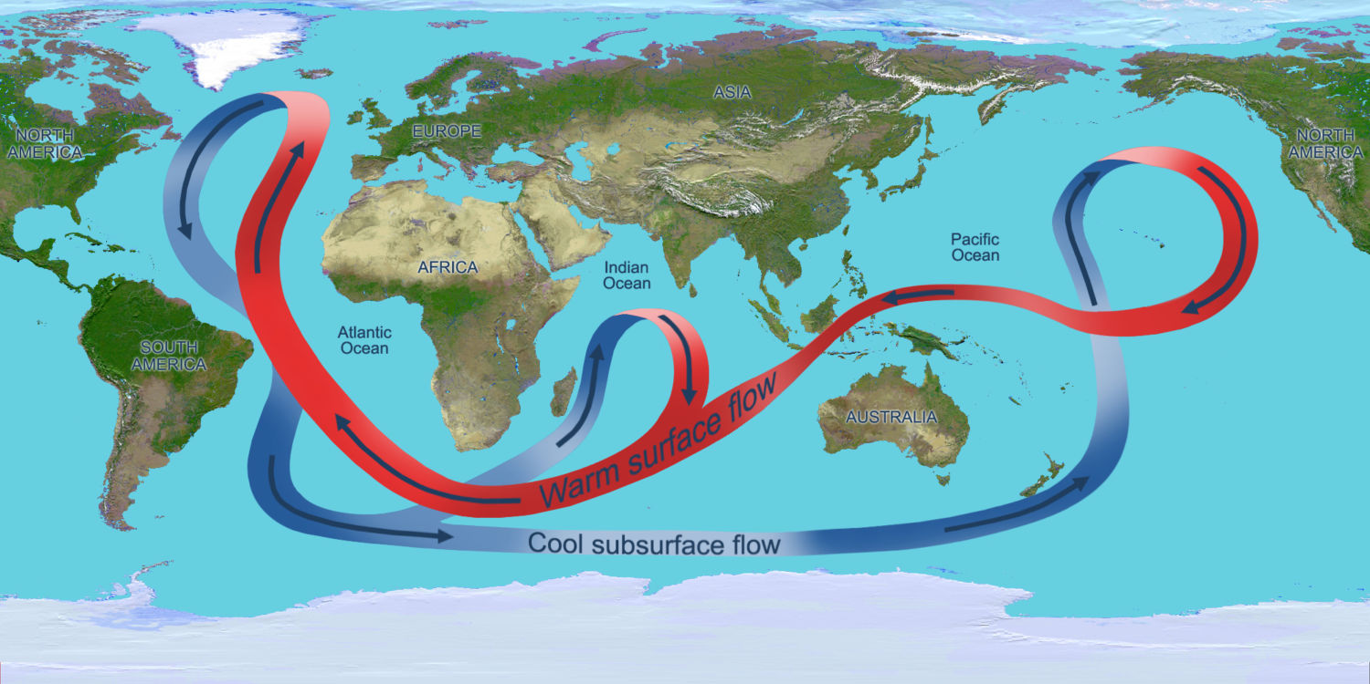
Ocean Circulation
The Great Ocean Conveyor Belt: a constantly moving system of deep ocean circulation driven by changes in water density, which is determined by temperature and salinity (thermohaline circulation)

Slide 31
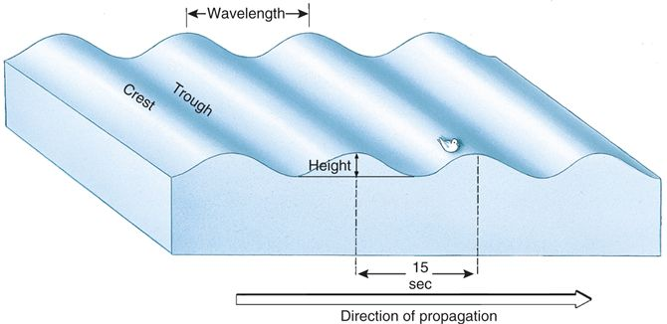
Waves and Tides
_______: highest point of the wave
Trough: lowest point of the wave
Wavelength: distance between wave crests or troughs
Wave period: the time it takes for a wave to pass by a given point

Slide 32
Waves and Tides
______: wind blown waves with sharp peaks and flat troughs
Swell: smooth crests and troughs that form when not blown by winds
Surf: waves that become high and steep when the water becomes shallow, often falling forward and breaking
Wind
Seas
Swell
Surf
Motion
of water particles

Slide 33
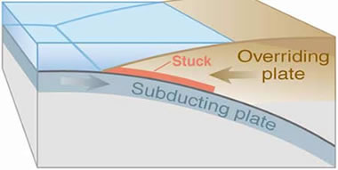
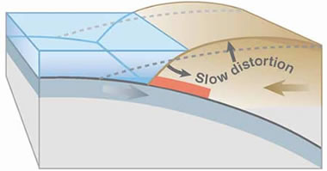
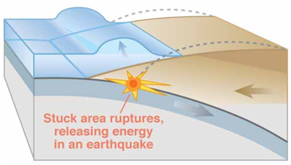
Tsunamis
Oceanic plates subducting under continental plate create tension in the trench between plates
Tension builds between plates as the subducting oceanic plate causes distortion in the continental plate
Distortion in continental plate is released during an earthquake which displaces large amounts of water causing a tsunami

Slide 34
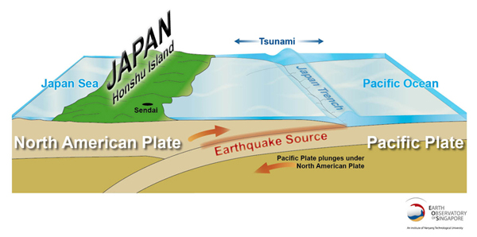
Tsunamis
The March 11th, 2011 tsunami that struck Japan was caused by a 9.0 earthquake that lifted the seafloor 10ft across a distance the size of Connecticut

Slide 35
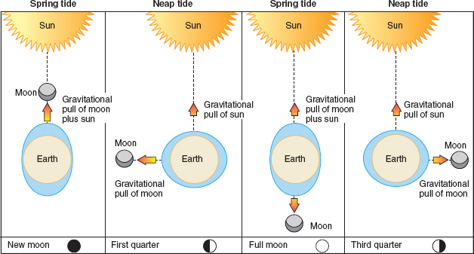
Waves and Tides
Spring tides: when the moon and sun are in alignment causing the combined gravitational pull of the moon and the sun
Neap tides: when the moon is at a ___________ to the sun causing their gravitational pulls to partially cancel each other out.
Sun is 400 times further away than moon so it has less effect on the tides

Slide 36
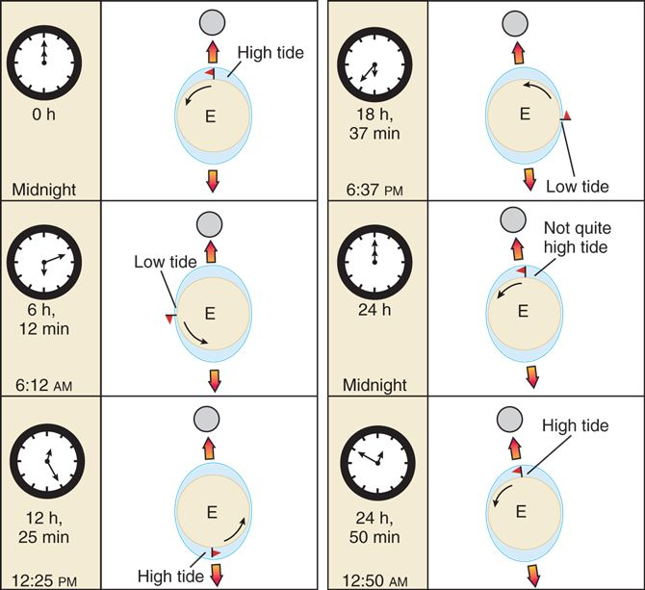
Waves and Tides
The full tidal cycle takes 24 hours and 50 minutes because the moons orbit around the Earth has advanced over the 24 hours.

Slide 37
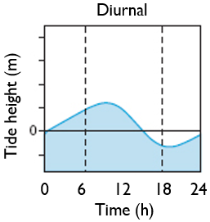
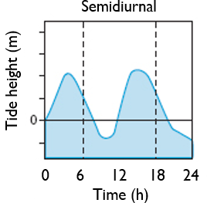
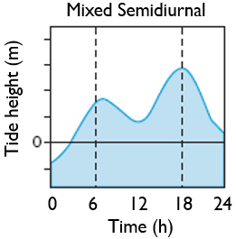
Waves and Tides
Diurnal: One high tide and one low tide every day
Semidiurnal: two high tides and two low tides a day
Mixed Semidiurnal: successive high tides of ______________ each day

Slide 38
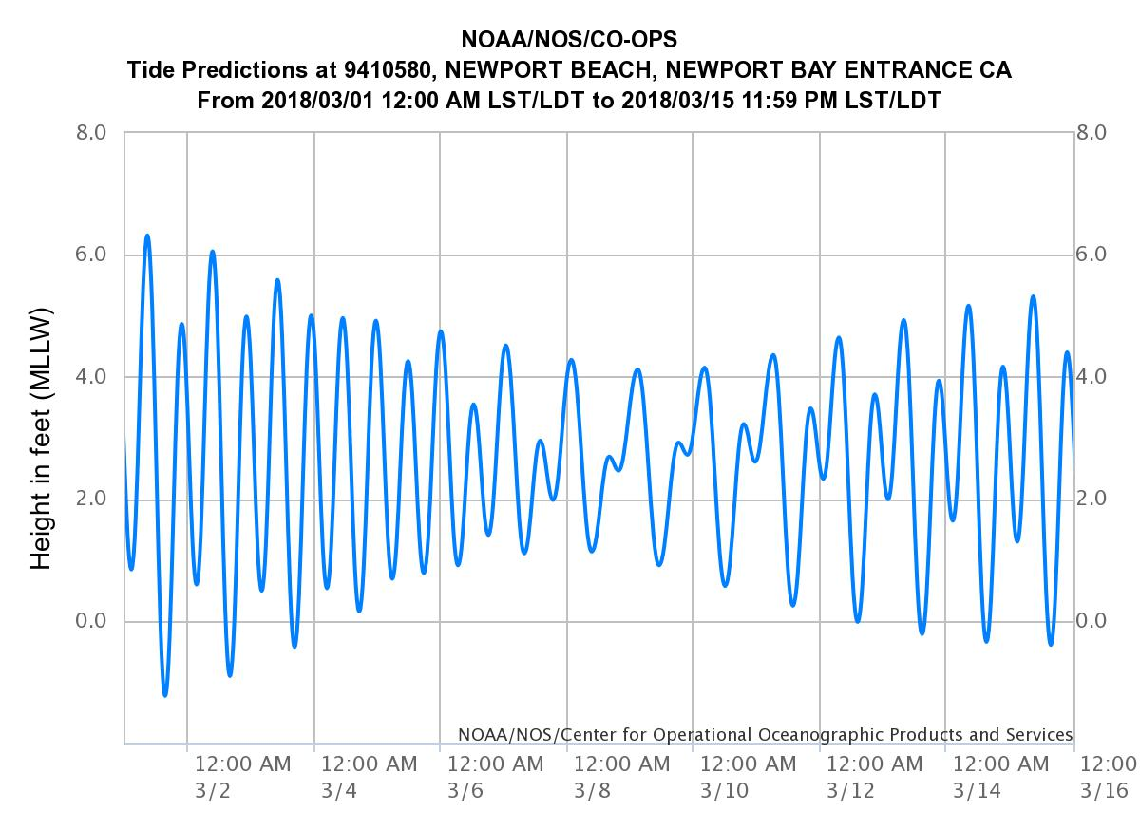
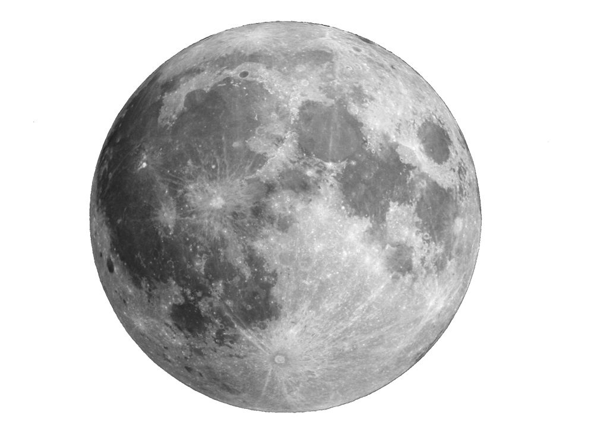
Waves and Tides
Scientists can predict tidal conditions based on the position of the Earth, sun and moon.
Based on the tide chart to the right, what type of tides do we have in southern California?
Predict when you think there is a full moon based on the tide chart. When will there be a quarter moon?

Slide 39
Waves and Tides

Slide 40
Waves and Tides
Bay of Fundy: Largest high tides on Earth
Sea level can rise by almost 50 feet during spring tides
160 billion tones of seas water flows in and out of the bay twice a day
Low Tide
High Tide
https://youtu.be/qfhNjpu_IU4

Slide 41
Marine Organisms and Tides
California grunion (Leuresthes tenuis) are a species of fish that spawn on the sandy beaches in southern California between March and August
Spawn during ____________ and eggs incubate in the sand for two weeks

Slide 42
Marine Organisms and Tides
Many corals spawn during _________ when there is less water in the water column, thus increasing the likelihood that the egg and sperm will meet.

Slide 43
Marine Organisms and Tides
Intertidal organisms deal with periods of exposure during low tide, wave action, and changes in salinity and temperature
Mostly shelled organisms
Many
soft-bodied organisms and algae

Slide 44
Check Your Understanding
True or False: The sun has a greater effect on the tides than the moon
True or False: The liquid state of water is denser than the solid state of water

Slide 45
Check Your Understanding
Which wavelength of light penetrates the deepest into the ocean in coastal areas?
a. Blue
b. Red
c. Green
d. Orange
e. Violet

Slide 46
Check Your Understanding
Describe how the number of hydrogen bonds in water molecules are affected by temperature?

Slide 47
Check Your Understanding
Explain why the average sea-surface temperature during summer in southern California is approximately 10 degrees colder than the average sea-surface temperature of Charleston South Carolina even though the two locations are at about the same northern latitude?

