Slide 1
The Science of Marine Biology
Chapter 1

Slide 2
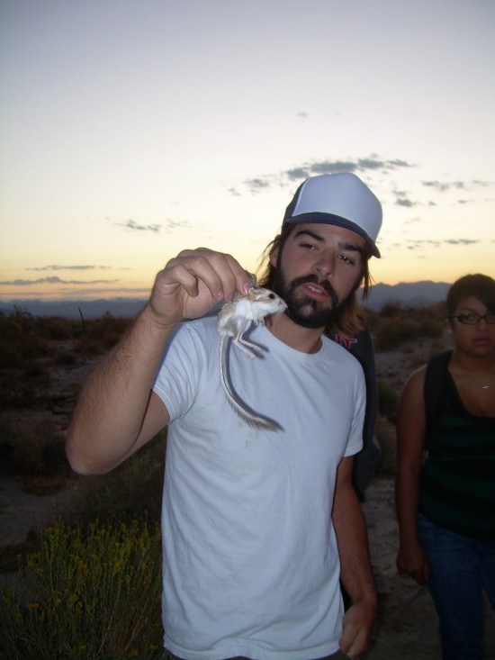
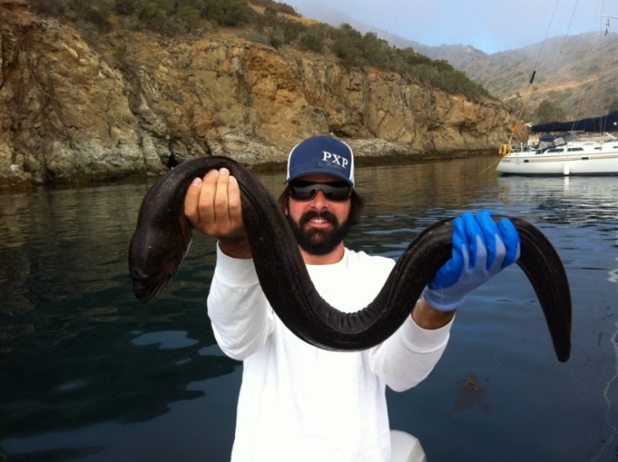
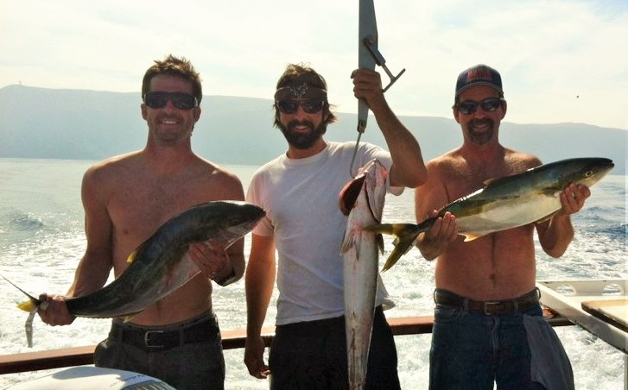
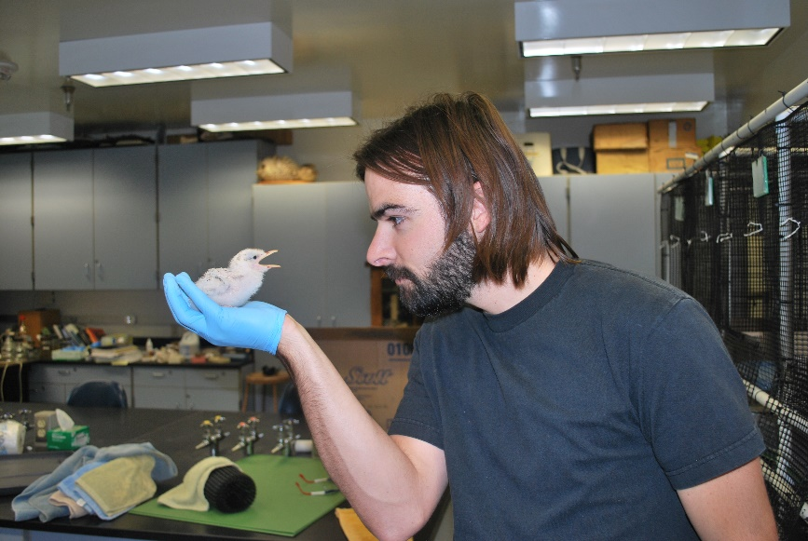
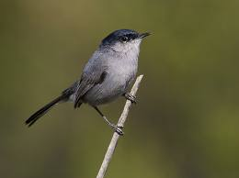
Who is Tyler Flisik?

Slide 3
What is Marine Biology?
Marine Biology is a study of marine organisms, their behaviors, and the environment in which they live.
Marine biologists study marine ecosystems from the basic chemistry of marine environments, to the adaptations and behaviors of marine organisms, to the interactions between organisms and their environment.

Slide 4
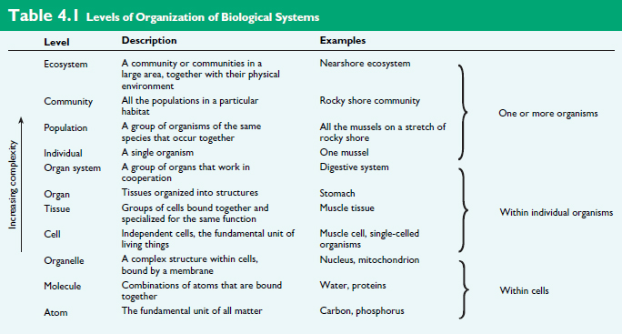
Levels of Organization in Biological Systems

Slide 5
Levels of Organization in Biological Systems
Life is organized and studied at many different levels
Marine biology
Molecular biology
Epidemiology
Neurobiology
Conservation biology
Organismal biology
Population and community biology
Genetics
Immunology
Biochemistry
Microbiology
Cellular biology
Anatomy
Botany
Zoology
Biogeography
Ecology
Developmental biology

Slide 6
Marine Biology vs. Oceanography
Marine Biology studies living things that live in the sea
Greek and Latin root for Biology
Marine = sea
Bi(ola) = life
log(y) = discourse, the study of
Oceanography studies non-living characteristics of oceans
Abiotic = non-living
Temperature, precipitation, geology, chemical composition

Slide 7
Marine Biology vs. Oceanography
What defines something as alive?
The ability to assimilate and use _______
The ability to respond to their environment
The ability to maintain a relatively constant _________ environment
Have ________ from other living things
The ability to ___________
Composed of one or more _____ with information encoded by _______
Are highly organized when compared to inanimate objects
The ability to grow and develop
Non-living objects are not self-sustaining
Inanimate

Slide 8
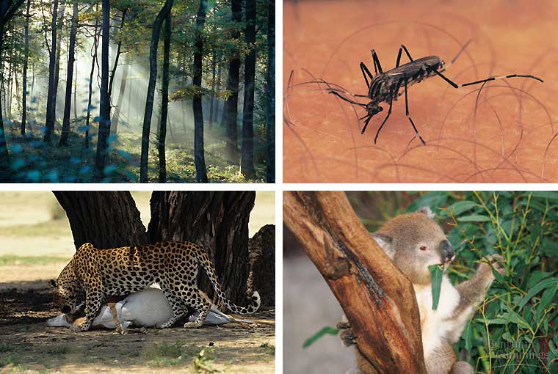
Characteristics of Living Things
Living organisms use energy

Slide 9
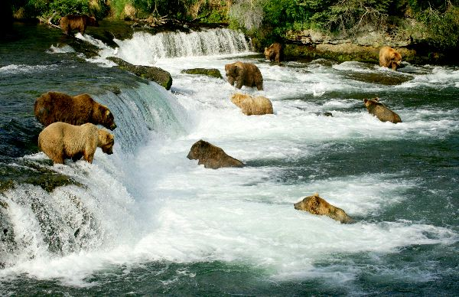
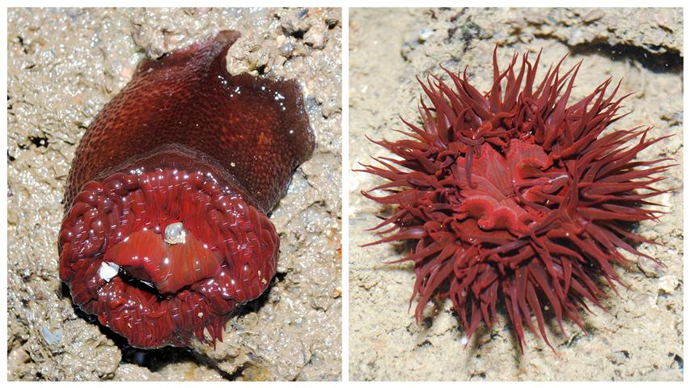
Characteristics of Living Things
Living organisms respond to their environment

Slide 10
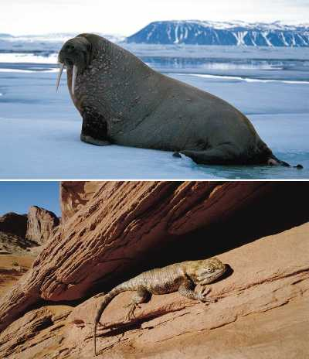
Characteristics of Living Things
Living organisms maintain ___________ or some relatively constant internal environment

Slide 11
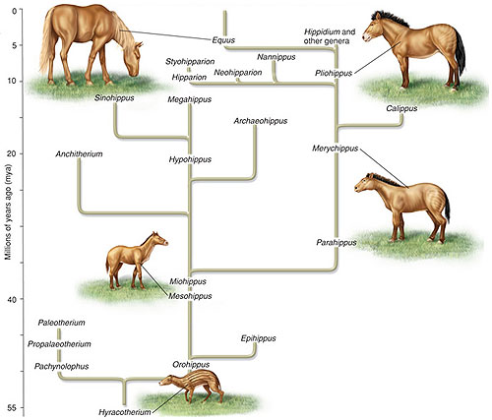
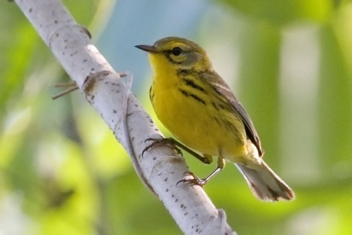
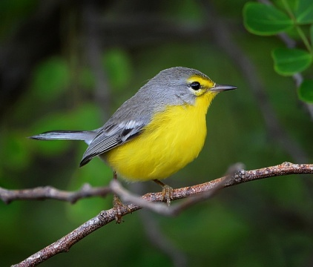
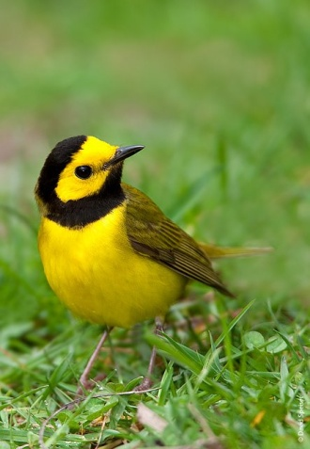
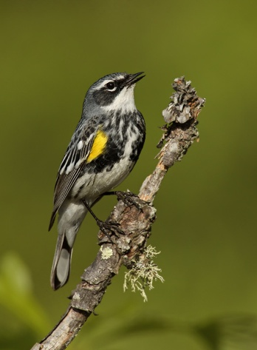
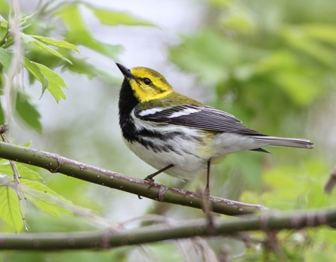
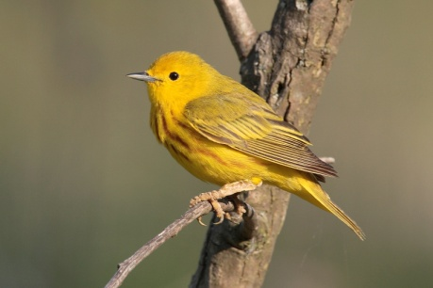
Characteristics of Living Things
Living things have evolved from other living things

Slide 12
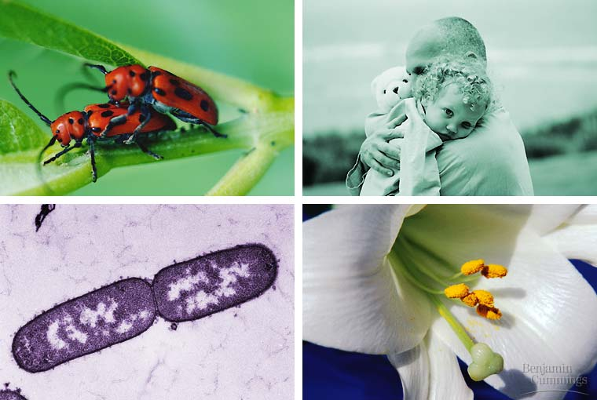
Characteristics of Living Things
Living organisms reproduce

Slide 13
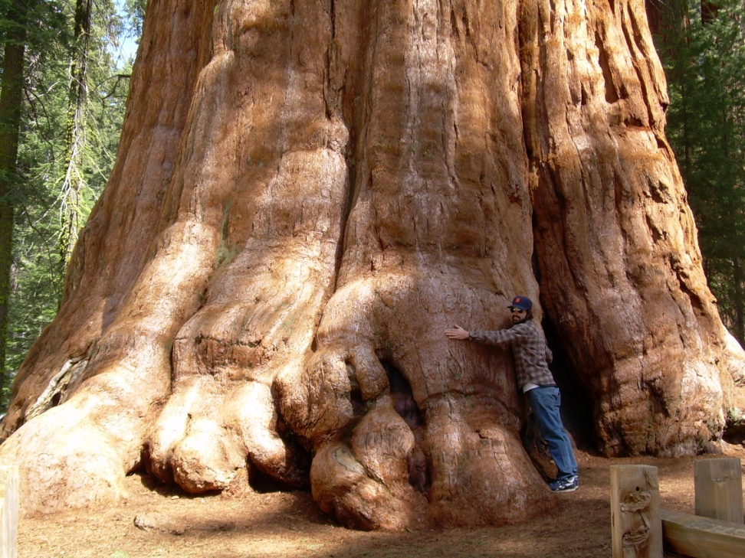
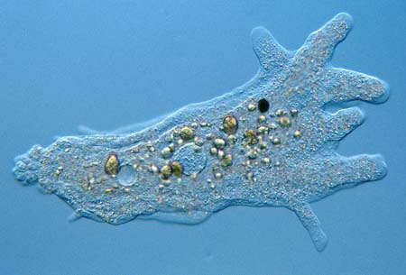
Characteristics of Living Things
Living things are composed of one or more cells

Slide 14
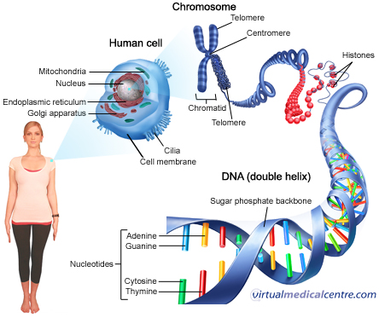
Characteristics of Living Things
Living organisms contain DNA
Inherited information base that codes for everything!

Slide 15
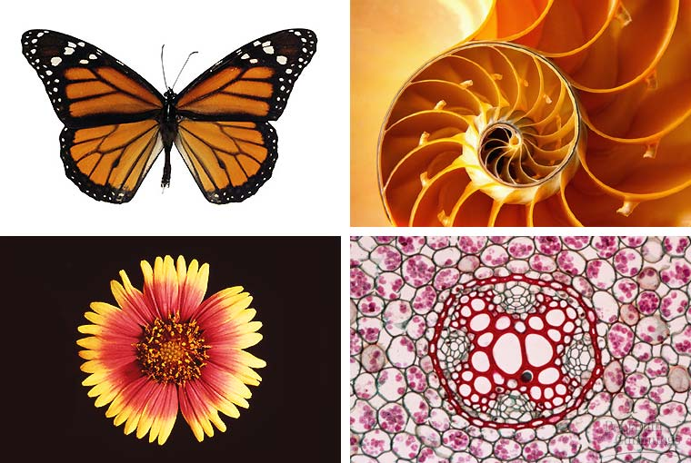
Characteristics of Living Things
Living organisms are highly organized compared to inanimate objects

Slide 16
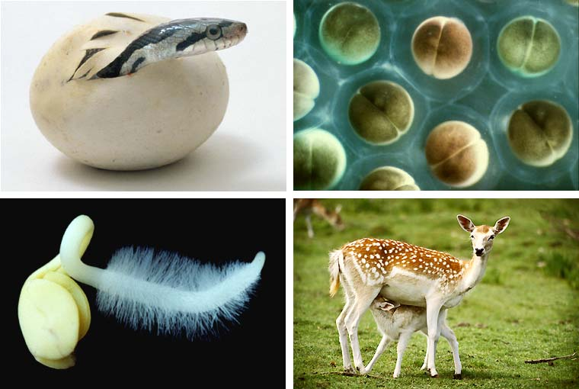
Characteristics of Living Things
Living organisms grow and develop

Slide 17
Why should we care about marine biology?
Extrinsic value: The value to humans, ecosystem services
Provisioning services: we need it for food, medicine or industrial uses
Cultural services: we like the way it looks, spiritual value
Regulating services: decomposition and pest control
Habitat services: produces oxygen (photosynthesis), nutrient cycling
______________: The worth of an entity independent from external circumstances or its value to human
Value to biodiversity

Slide 18
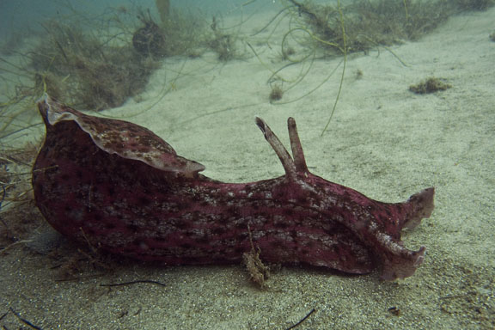
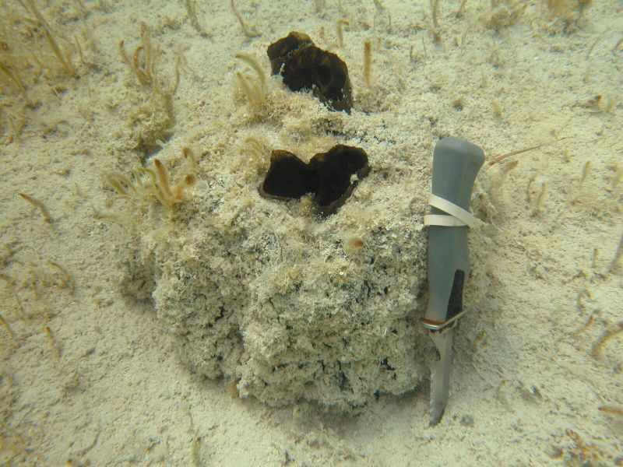
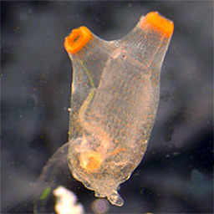
Why should we care about marine biology?
Medicinal uses
Research of marine organisms have provided numerous medical advances for humans.
Anti-viral drug AZT derived from marine sponge (Tectitethya crypta)
Nerve signaling research in gastropods (sea snails and octopi)
Cancer medicines derived from tunicates and sponges

Slide 19
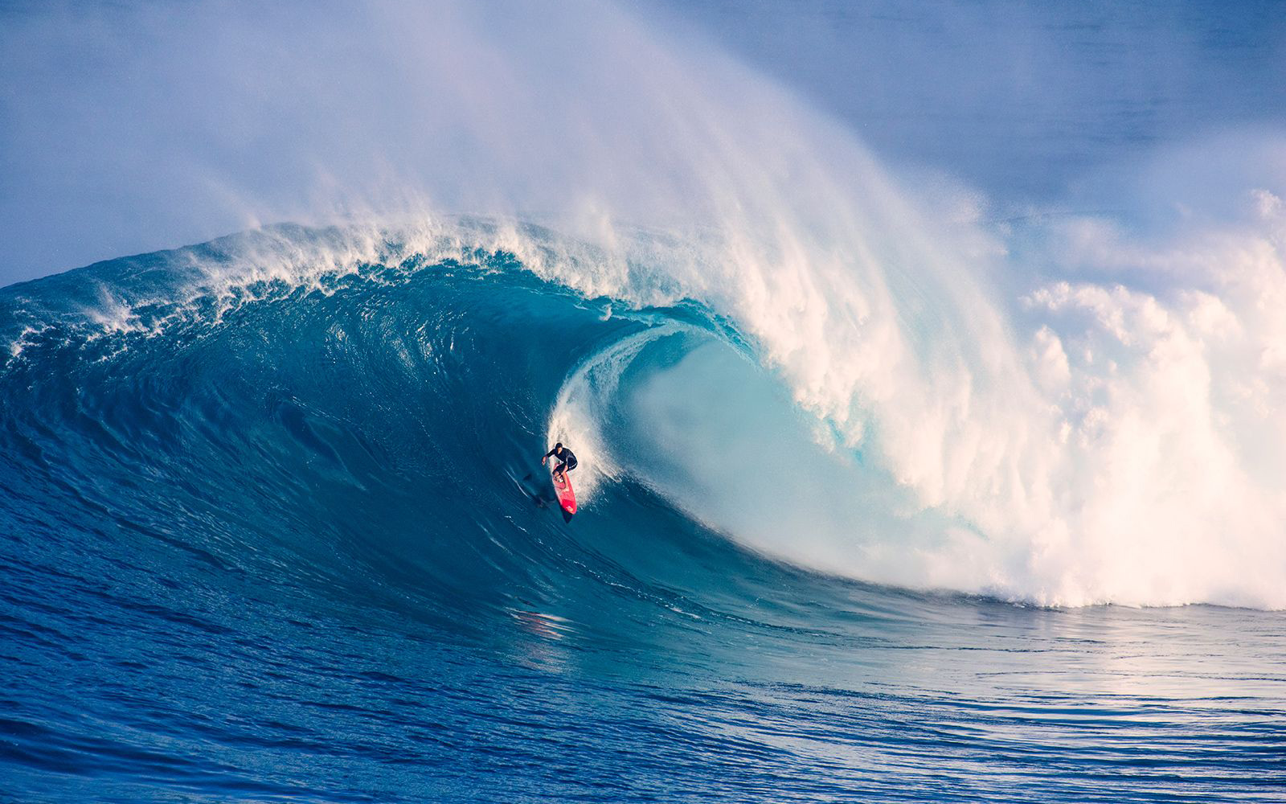
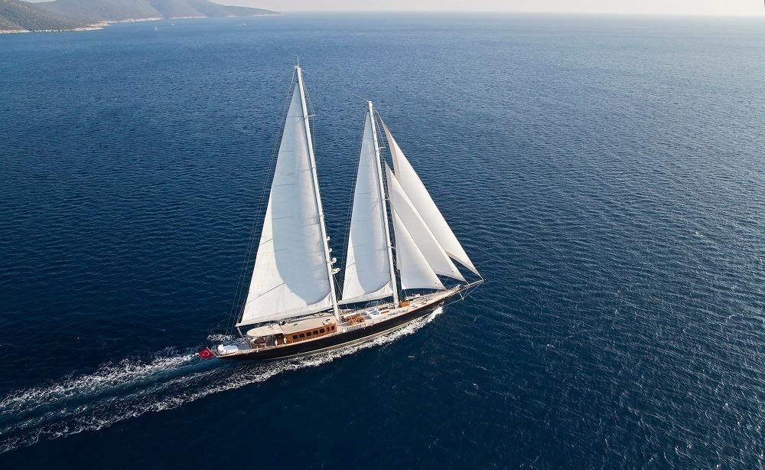
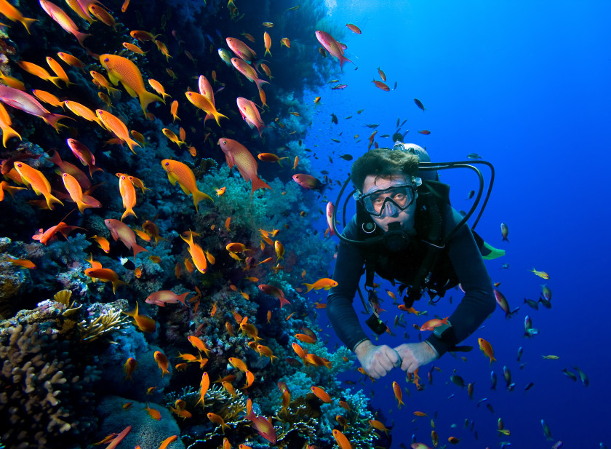
Why should we care about marine biology?
Recreational value
Diving, surfing, fishing, sailing

Slide 20
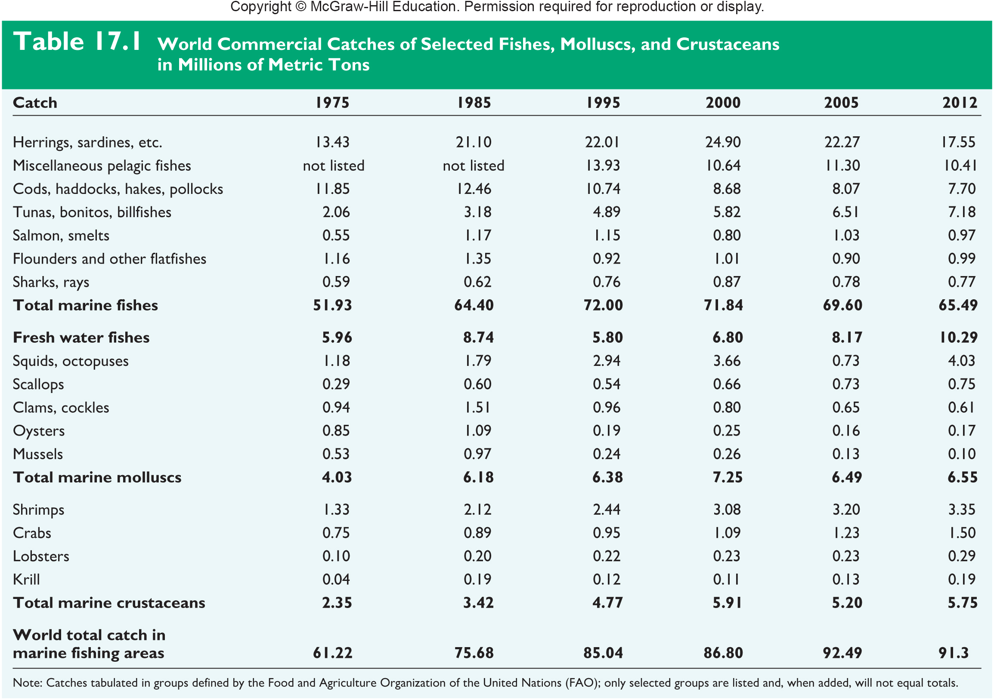
Why should we care about marine biology?
Source of Food
Other than cereals, fish and other seafood may be humans most important source of food.
Seafood provides approximately ___% of the worlds protein intake
Ocean’s living systems are worth more than 20 trillion a year

Slide 21
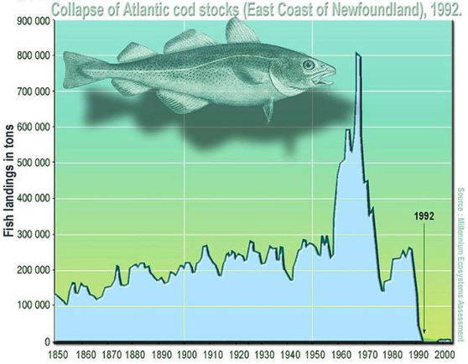
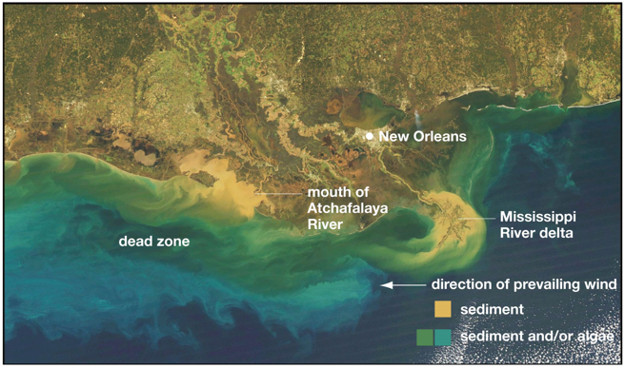
Why should we care about marine biology?
Study factors that impact human lives
Algal blooms
____________
Overfishing

Slide 22
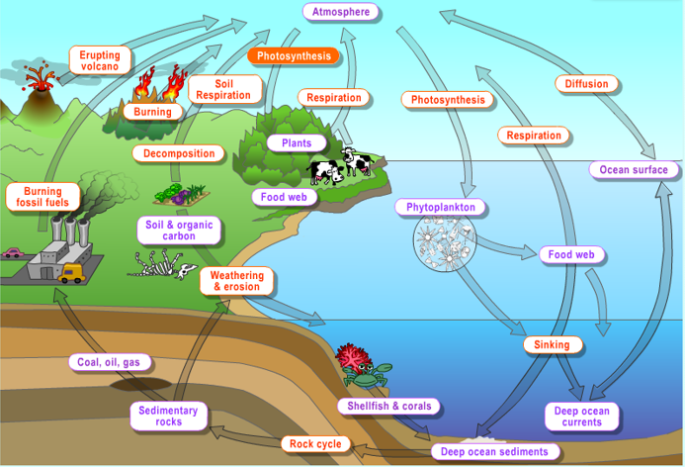
Why should we care about marine biology?
The Carbon Cycle
Climate Change
Photosynthetic marine organisms (phytoplankton and algae) use atmospheric carbon during photosynthesis. Oceans act as _________ that absorb carbon dioxide reducing the effects of climate change.

Slide 23
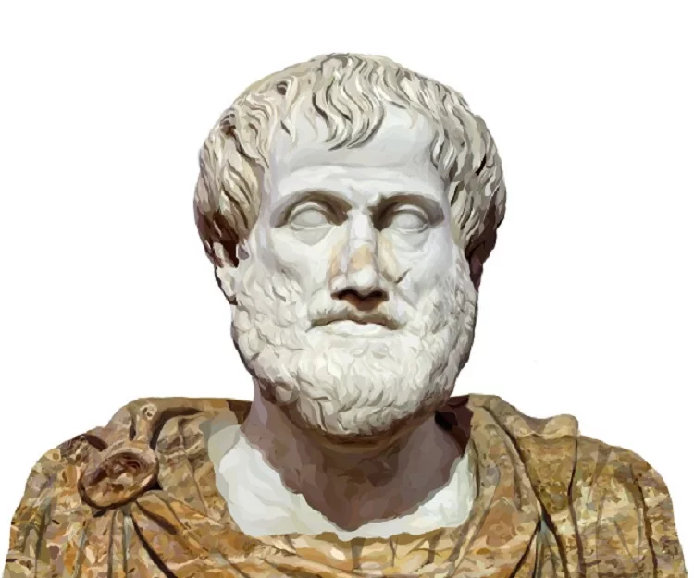
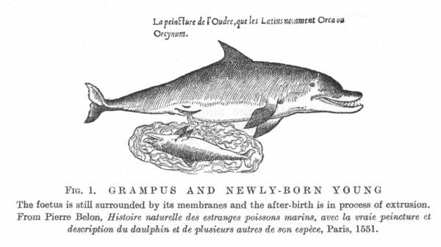
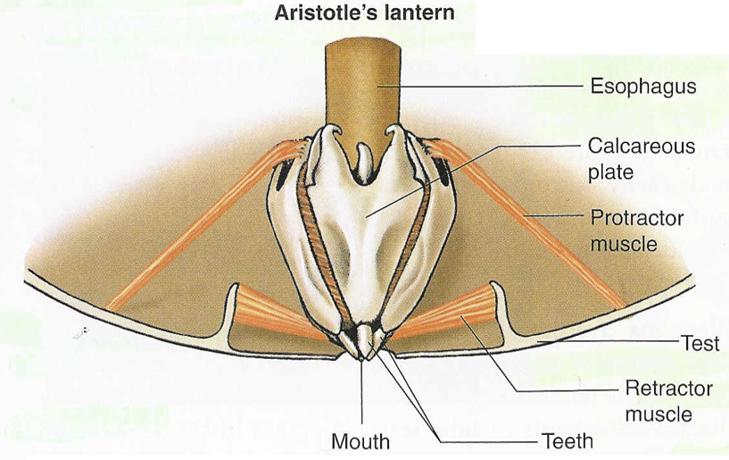
History of Marine Biology
Aristotle (384-322 BCE)
Documented distribution and behaviors of marine life
Described hundred of marine species
Described cetaceans as mammals
Developed early _________________

Slide 24
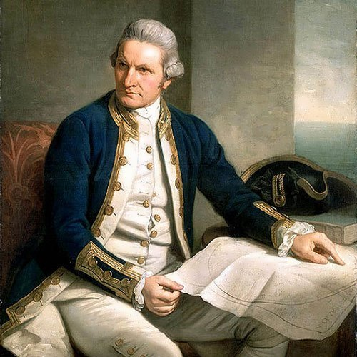
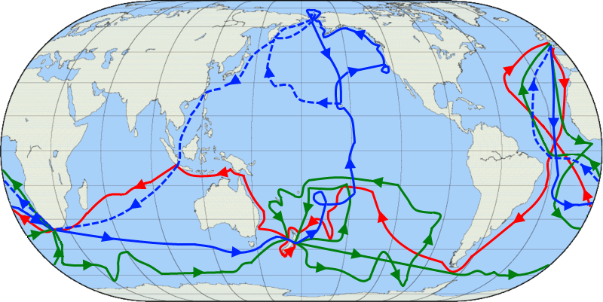
History of Marine Biology
Captain James Cook (1728-1729) – early explorer and first European to discover Hawaii, Tahiti, New Zealand, and many other Pacific Islands
Accurately determined longitude
Included naturalists on his expeditions that collected plants and animals from newly discovered islands
Killed by natives in Hawaii
First voyage
Second voyage
Third voyage

Slide 25
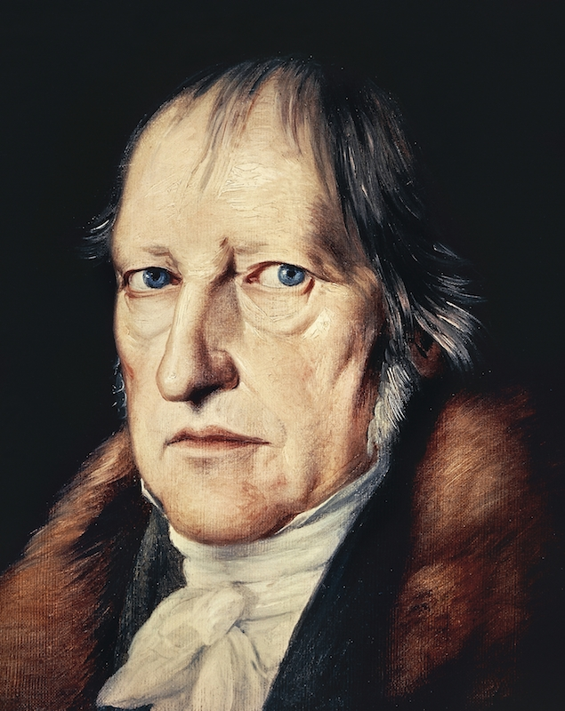
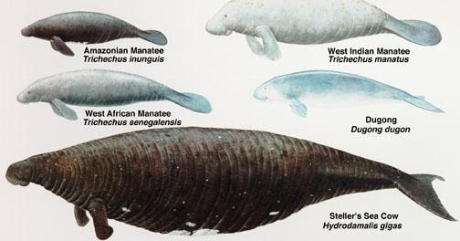
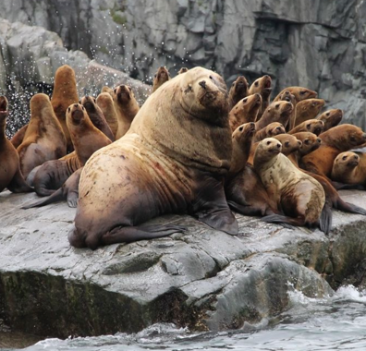
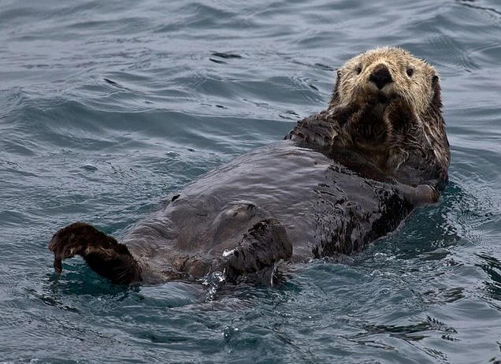
History of Marine Biology
Georg Wilhelm Steller (1709-1746) – German zoologist and explorer that discovered many north Pacific marine animals
Most of the animals he discovered are either extinct or endangered

Slide 26
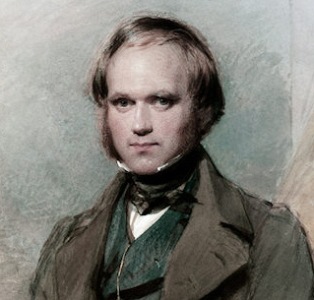
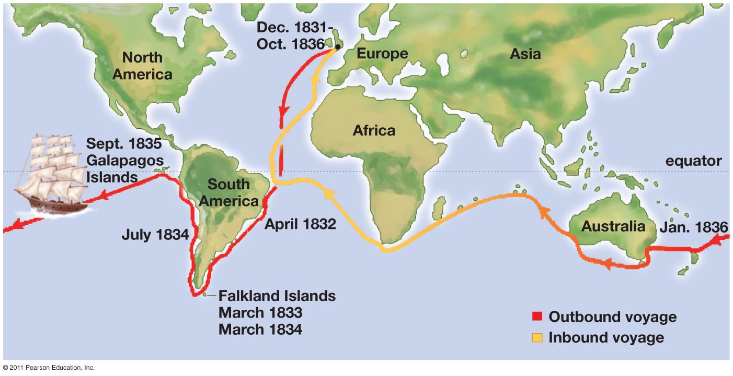
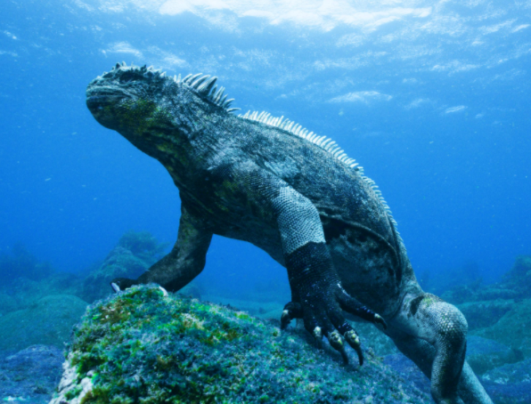
History of Marine Biology
Charles Darwin (1809-1882) – Study behaviors of marine species and island species on his voyage around the world aboard the HMS Beagle
Studied adaptations and similarities in __________
Discovered many marine and island species

Slide 27
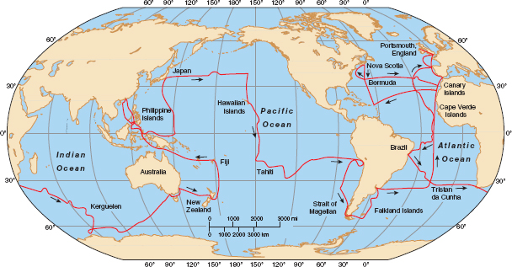
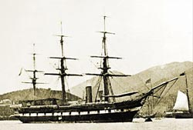
History of Marine Biology
Challenger Expedition (1872-1876): first science-based voyage around the world
Led by Chief Scientist Charles Wyville Thompson
Discovered thousands of marine species

Slide 28
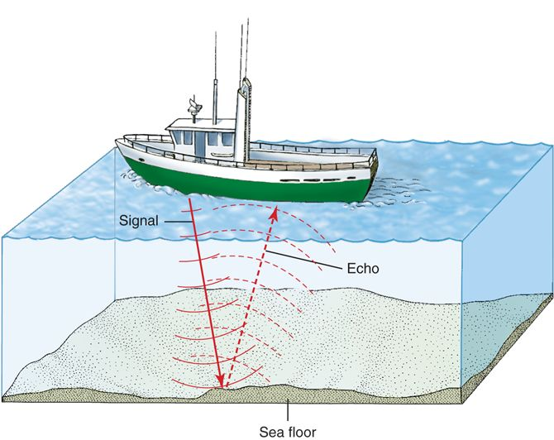
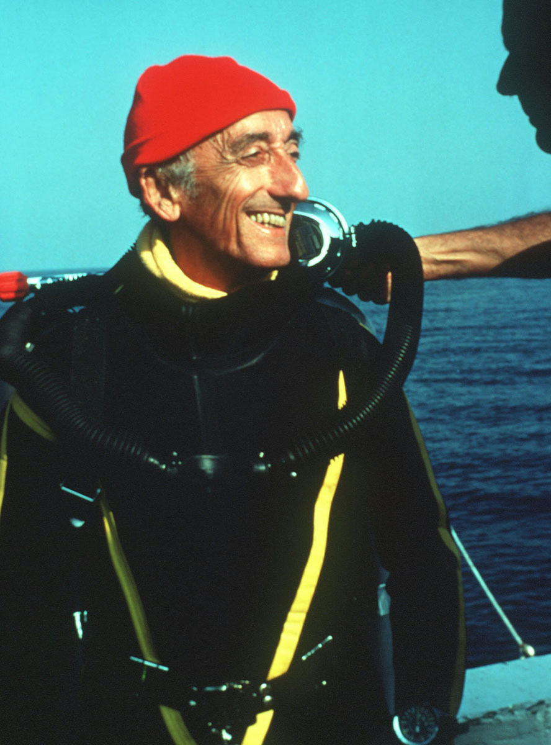
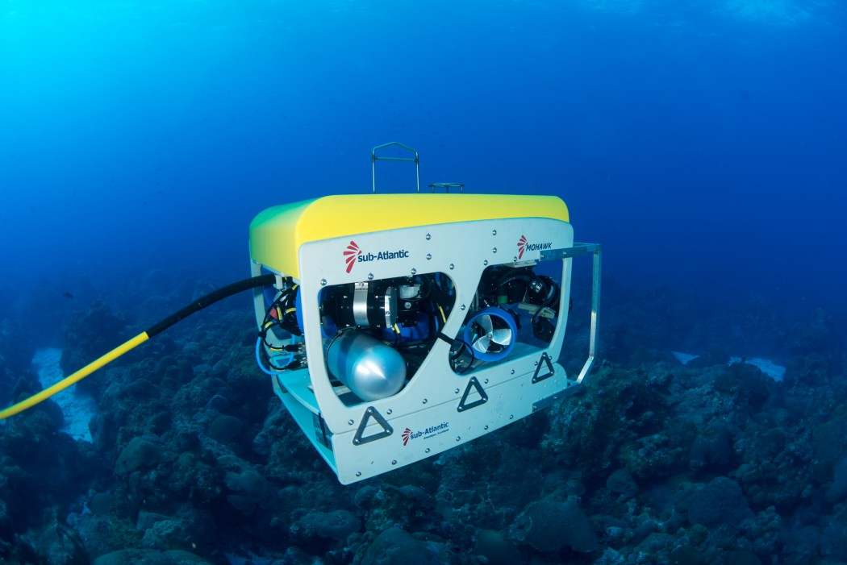
Studying Marine Biology
Development of Sonar (sound navigation and ranging) before World War II allowed researchers to measure depth and also hear marine organisms
Self Contained Underwater Breathing Apparatus or SCUBA allowed researchers to study organisms underwater for longer period of time
Jacques Cousteau helped develop first scuba gear
Remotely operated vehicles (ROVs) – Allows for direct exploration of the marine environment when scuba is not an option.

Slide 29
Studying Marine Biology
Many marine biology research stations exist in locations around the world.
Several facilities in the United States are considered among the most famous:
Friday Harbor Laboratories, Washington state
Woods Hole Oceanographic Institution and Marine Biological Laboratory, Massachusetts
Scripps Institution
La Jolla, California

Slide 31
Studying Marine Biology
DSV Alvin is one of the first deep-sea submersibles. Scientists aboard the Alvin have made numerous deep sea discoveries.
The Aquarius is a underwater marine science laboratory in the Florida Keys Marine Sanctuary that is stationed at 20m (60ft) below the surface.
The R/V FLIP is a floating instrument platform that becomes vertical when the lower tube is filled with water.

Slide 32
Studying Marine Biology
Scientific method
_____________ = Carefully observe the some phenomena and consider what we already know and what we don’t know about the unknown phenomena.
Perform background research
Question = Narrow focus to a specific question. What do we want to know?
Formulate ____________ = Our proposed explanation for the unknown phenomena. What we think is happening.
Must be testable and falsifiable
Experimentation = Design an experiment to test your hypothesis and collect data.
Quantitative data: Deals with numbers. Things that can be measured.
Ex: Height, weight, length, time
Qualitative data: Deals with descriptions. Things that cannot be measured.
Ex: Color, texture
Results and Conclusions = Analyze data and display results in figures or tables. Do our results support or refute our hypothesis? How do our findings relate to the big picture?
Notes:
Nonlinear, observations often spark numerous questions and multiple hypotheses. Also, the method allows for constant revision based on new observations or results.

Slide 33
Famous example of Scientific Method
Louis Pasteur 1860’s
Can life be created spontaneously?

Slide 34
Make a Prediction
Formulate a __________ hypothesis

Slide 35
Experimentation
Design an experiment that tests your hypothesis while minimizing other variables.

Slide 36
“Without speculation, there is no good and original observation” – Charles Darwin
Conduct detailed observations
Careful review of the unknown
Understand the variables influencing the unknown
_________: an adjustable condition in an experiment
Variables can be biotic or abiotic
Abiotic variables: temperature, lighting, precipitation, timing
Biotic variables: interaction with other organisms, chemical processes
Example experiment: Observation
California sea hare (Aplysia californica) can eat both red algae and brown algae growing in the tide pools
Notes:
One of the variables are that which is being tested in an experiment
Scientific conclusions are based on observations because they are repeatable

Slide 37
Scientific Method
Formulate a specific question
What do you want to understand about the unknown?
Can you test for the unknown?
What are the variables?
What do we already know about the unknown?
Literature search
Example experiment: Question
Do Aplysia californica grow larger when they eat red algae or brown algae?

Slide 38
“No great discovery was made without a bold guess”
-Marie Curie
Formulate a hypothesis
Be specific. Fully address the question.
Is the hypothesis testable?
Is the hypothesis falsifiable?
______________: the potential to be proven false.
Good example: All marine animals have gills
Bad example: There are mermaids in the ocean
Example experiment: Hypothesis
Hypo1: The sea slug will grow better when it eats red algae.
Hypo 2: On average, the California sea hare (Aplysia californica) will gain more mass when fed red algae (Laurencia pacifica), than when fed invasive brown algae (Sargassum muticum), when all other variables are held constant.
Notes:
Falsifiability
Marie Curie: Mother or Radioactivity. First woman to win an Nobel Prize. Won Two
On average? Can conclusions be drawn by testing one plant under sunlight and one under florescent light? Large sample size is needed.
Null hypothesis: A hypothesis that states a lack of relationship between two factors.
Ex. There is no difference in the coarseness of hair that grows after shaving.

Slide 39
Scientific Method
Design an experiment to test your hypothesis
Experiments should be designed to test one question at a time.
Design experiments to reduce the number of variables
Excess variables compound the results
Experimental __________
Used for comparison
Sample size!!
Take an average of multiple trials ( “on average”)
Repeatability!
Experiments should be able to be replicated by other scientists
Notes:
Excess variables: Different colored florescent bulbs, different temperature inside and outside,
Blind study: experimental subjects are unaware which treatment they are receiving
Double-blind study: subjects and researchers are unaware which treatment the subjects are receiving.

Slide 40
Scientific Method
Example experiment: Experimental Design
How are we going to test for growth?
Length, weight, width
What are our variables?
Abiotic: ___________________________
Biotic: ____________________________
Sample size?
Final design:
9 California sea hares fed each type of seaweed
Same amount of each food
Same temperature and salinity
Light 12 hrs, Dark 12 hrs
Weight of sea hare measured at the end of six weeks
Notes:
Ask class to think up some variables

Slide 41
Scientific Method
Results and Conclusions
Graph results
Do the findings support or refute hypothesis?
Reconsider and refine hypothesis and experiment
Nothing is proven!!
 | Weight Gain
Sea Hare # | Brown Algae | Red Algae
1 | 150 | 130
2 | 110 | 180
3 | 130 | 160
4 | 180 | 180
5 | 90 | 220
6 | 70 | 140
7 | 140 | 230
8 | 170 | 150
9 | 150 | 210
10 | 110 | 200
Notes:
Proof is something that is now and forever the truth of a theory. Often times in science and biology,

Slide 42
Scientific Method
Results and Conclusions
Graph results
 | Weight Gained (g)
Sea Hare # | Brown Algae | Red Algae
1 | 150 | 130
2 | 110 | 170
3 | 130 | 160
4 | 180 | 190
5 | 90 | 220
6 | 70 | 140
7 | 140 | 230
8 | 170 | 150
9 | 150 | 210
10 | 110 | 200
Avg. | 130 | 180

Slide 43
I have a theory!
?
Scientific theories vs. non-science theories
Non-science “theories” are typically ideas or hypotheses
Scientific theory: a general set of principles, supported by _________, that explains some aspect of nature
Scientific theories are supported or refuted, not proven.
Ex. Theory of evolution by natural selection
After many, many experiments in support a particular theory, the theory can be elevated to scientific law
Ex. Law of gravity
Notes:
Scientific theories are seen as facts by scientific community.

Slide 44
Intelligent Design and Creationism
Science must be falsifiable
Can not test the existence of God
Probably shouldn’t try it
Science strives to explain the physical world
Philosophy strives to explain the metaphysical
Notes:
Empirical: knowledge based on experience and observations.

Slide 45
Evolution not Evilution
“Seen in the light of evolution, biology is, perhaps, intellectually the most satisfying and inspiring science. Without that light it becomes a pile of sundry facts―some of them interesting or curious but making no meaningful picture as a whole”
– Theodosius Dobzhansky (1973)
____________: the gradual modification of populations of living things over time
*Chief Unifying Principle in Biology
The appearance, behavior, and physiology of living things, have been and are being shaped by the influence of other living and non-living factors

Slide 46
The Study of Evolution
Evolutionary biology
Marine biology
Molecular biology
Epidemiology
Neurobiology
Conservation biology
Organismal biology
Population and community biology
Genetics
Immunology
Biochemistry
Microbiology
Cellular biology
Anatomy
Botany
Zoology
Biogeography
Ecology
Developmental biology

Slide 47
Evolution is Awesome!
Ask questions!
Why do living things look the way that they do?
How do living things acquire energy?
How do females choose a mate?
How do living things cope with the challenges of their habitat?
How do we know how species are related?

Slide 48
Check Your Understanding
All of the following are true concerning living things except:
a. All living things evolved from other living things
b. All living things can make their own food
c. All living things are made up of cells
d. Living things are organized
e. All of the above are true concerning living things

Slide 49
Check Your Understanding
List each step of the scientific method and describe the purpose of each step.

