Slide 1
Human Impacts on Marine Ecosystems
Chapters 17 and 18

Slide 2
Biodiversity
Biological diversity or biodiversity: the variety of plants and animals, or other living things, in a particular area or region
Why is it important?
Extrinsic value: The value to humans, ecosystem services
Provisioning services: we need it for food, medicine or industrial uses
Cultural services: we like the way it looks, spiritual value
Regulating services: decomposition and pest control
Habitat services: produces oxygen (photosynthesis), nutrient cycling
________________: The worth of an entity independent from external circumstances or its value to human
Value to biodiversity
Notes:
40% of all prescriptions are for medicines that originated from plants and animals.
80,000 species of edible plants known on Earth, but 90% of the world’s food comes from a mere 20 of these species.
Since 2000, 53 new species of primates have been described (IUCN 2008) including a new species of Brazilian monkey, Mura’s saddleback tamarin.

Slide 3
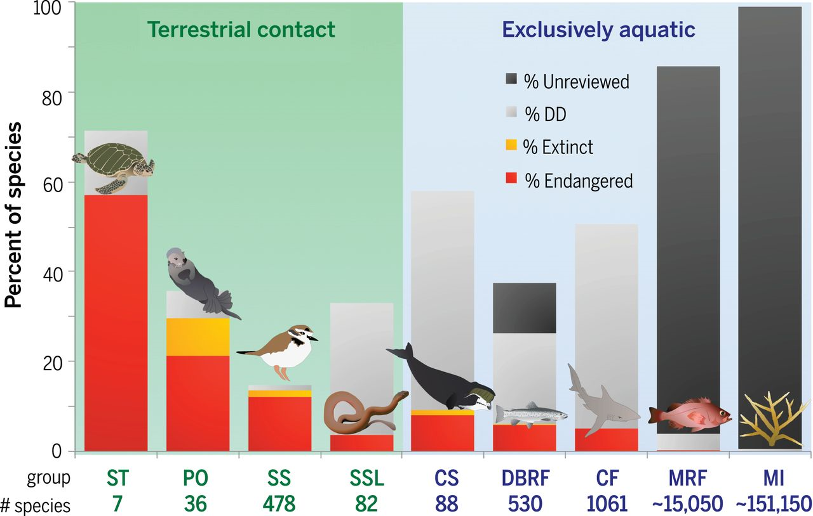
Loss of Marine Biodiversity
50% decline in marine life populations between 1970 and 2012
Most ______________ are threatened or endangered
Marine animals that have some terrestrial contact are at greater risk
Advancement in fishing practices threatens exclusively aquatic species
Population data on most marine species is nonexistent or data deficient
Image from McCauley et al. 2015
Notes:
Threat from defaunation is portrayed for different groups of marine fauna as chronicled by the IUCN Red List (113). Threat categories include “extinct” (orange), “endangered” (red; IUCN categories “critically endangered” + “endangered”), “data deficient” (light gray), and “unreviewed” (dark gray). Groups that contact land during some portion of their life history (green) are distinguished from species that do not (light blue). The total number of species estimated in each group is listed below the graph. Species groupings are coded as follows: ST, sea turtles; PO, pinnipeds and marine mustelids; SS, seabirds and shorebirds; SSL, sea snakes and marine lizard; CS, cetaceans and sirenians; DBRF, diadromous/brackish ray-finned fishes; CF, cartilaginous fishes; MRF, exclusively marine ray-finned fishes; MI, marine invertebrates. See further details in (8).

Slide 4
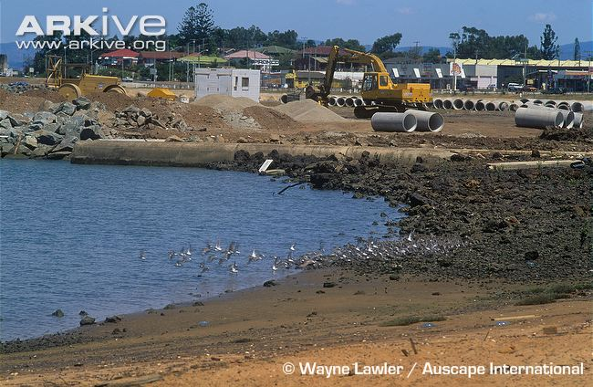
Habitat Loss
Habitat loss: the conversion or transformation of a natural area into wholly human occupied area of little or no use to wild species
__________ threat to biodiversity
>75% of coral reefs are threatened by human activity
>___% of estuaries and other riparian habitats lost in California
Seagrass meadows, coral reefs and mangroves are disappearing at rates comparable to the loss of tropical rainforests
Notes:
Many of the mangroves and sea grasses have been lost. In fact, mangroves are being lost two to five times faster than forests. Also, the oceans' tropical reefs have decreased by half and could all be lost by the year 2050

Slide 5
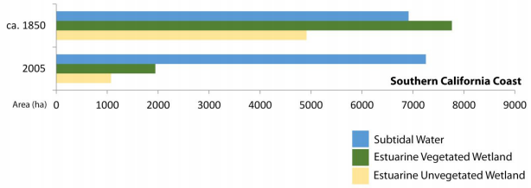
Habitat Loss
The Southern California Coastal Water Research Project (SCCWRP) estimates a 75% loss in estuarine vegetated wetlands and a 78% loss in estuarine unvegetated wetlands in southern California since 1850.

Slide 6
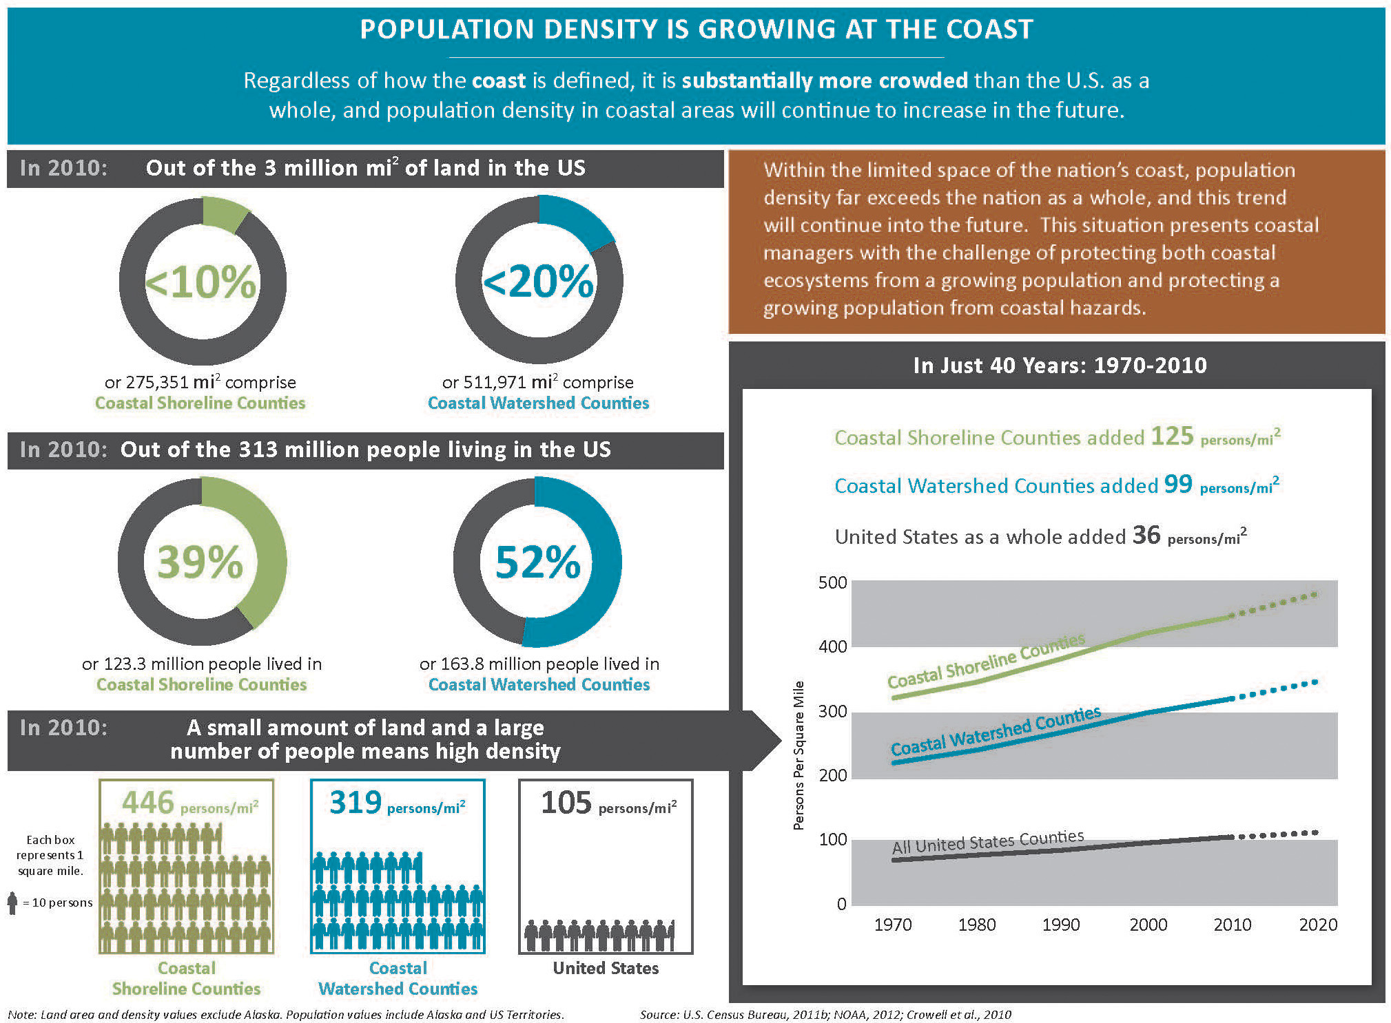

Slide 7
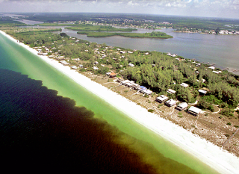
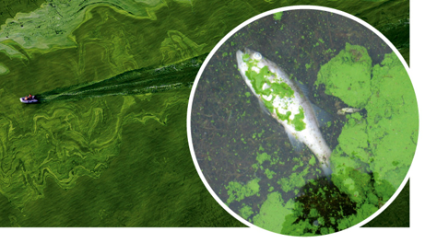
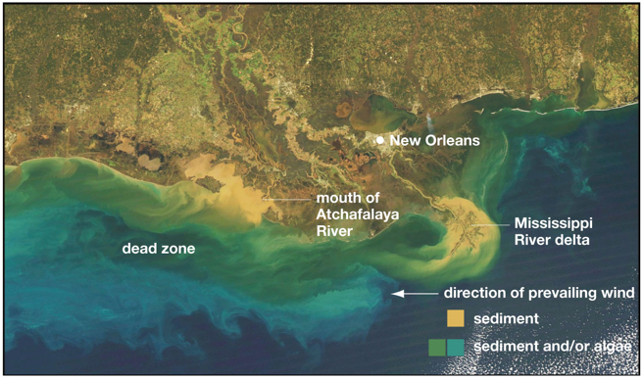
Eutrophication and Dead Zones
_______________: excessive richness of nutrients in a lake or other body of water, frequently due to runoff from the land, which causes a dense growth of algae and bacteria resulting in the death of animal life from lack of oxygen.
Hypoxia: the depletion of oxygen in the water often resulting in dead zones
Notes:
Nitrogen and phosphorus

Slide 8
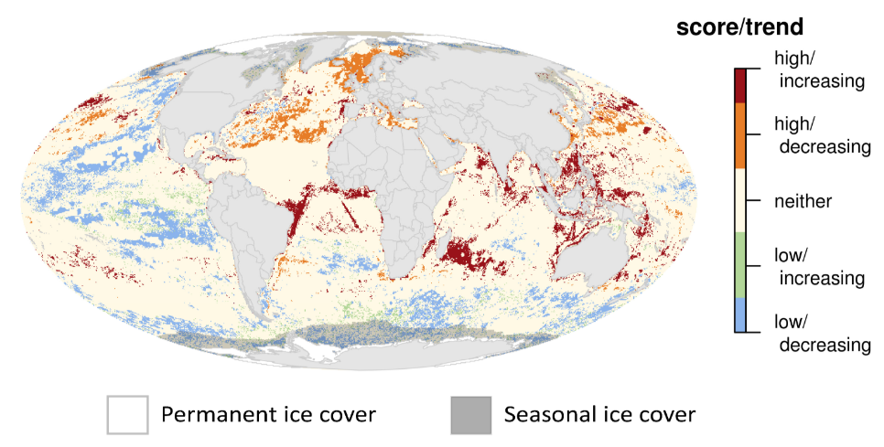
Assessing Human Impacts
The National Center for Ecological Analysis and Synthesis (NCEAS) determined the areas where human impacts are having the greatest impacts on marine ecosystems

Slide 9
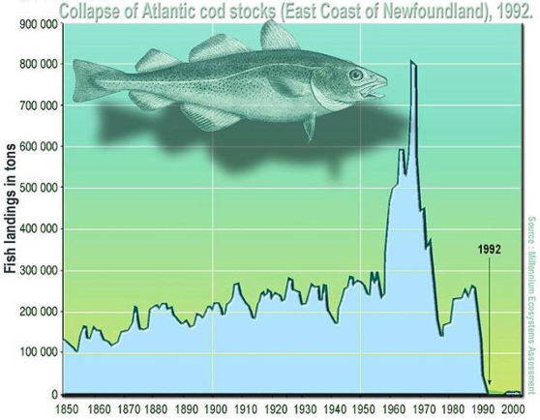
Overfishing
Overfishing: overexploitation of fish stocks in an ______________ manner
30% of all commercial fish stocks are overfished
Factors that lead to overfishing:
International waters (>200 mi from shore) are unregulated resulting in open access fisheries
Poor fisheries management
Fish are caught by multiple countries making data collection difficult to impossible
Illegal fishing
Many catches are unreported
Subsidized fishing fleets result in 2 times more fleets than necessary
Notes:
Many of the Chinese boat owners rely on government money to build vessels and fuel their journeys to Senegal, a monthlong trip from crowded ports in China. Over all, government subsidies to the fishing industry reached nearly $22 billion between 2011 and 2015, nearly triple the amount spent during the previous four years, according to Zhang Hongzhou, a research fellow at Nanyang Technological University in Singapore.

Slide 10
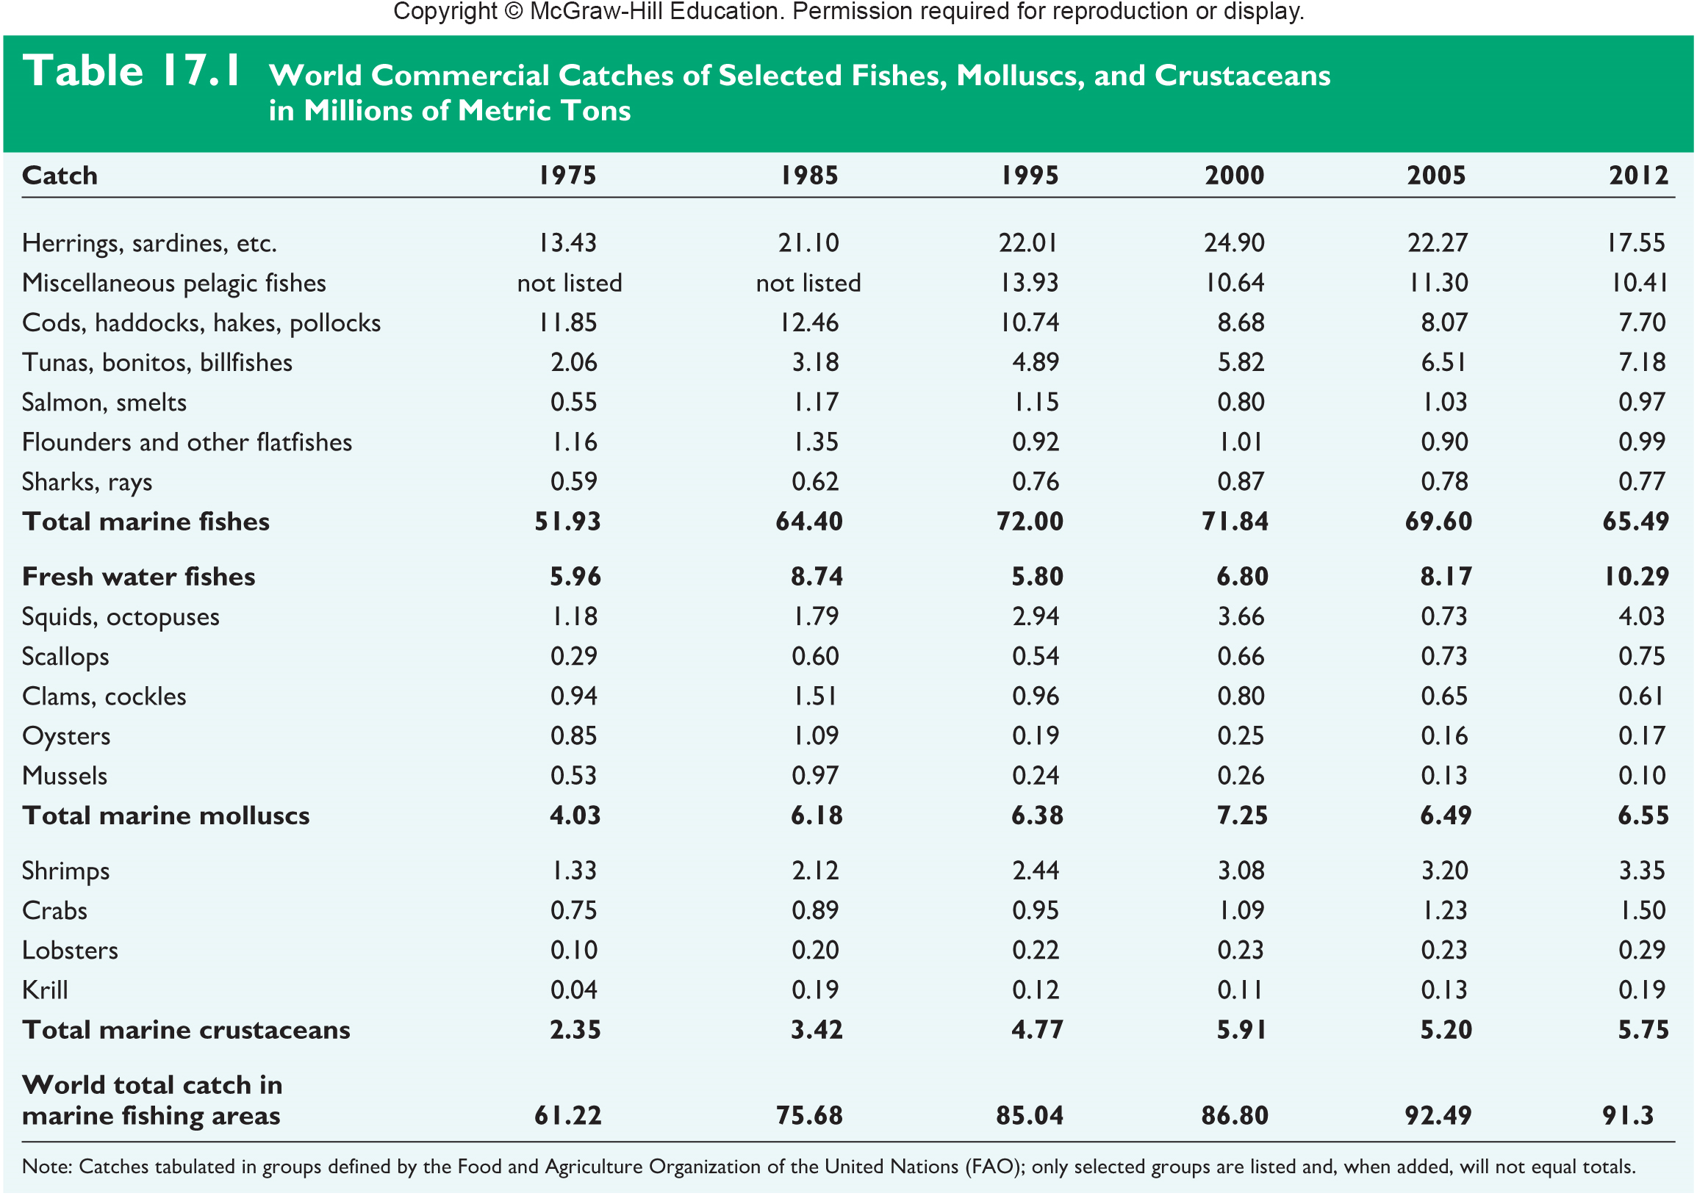
World Commercial Catch of Marine Species
The total catch of marine species has been increasing since 1975
Estimated at 109 million metric tons in 2016
Approximately 30% of marine catch is ____________
Amount of large predatory fish (tuna, billfish) has increased by 250% since 1975
Notes:
1 metric ton = 2,200 lbs
1 million metric tons = 2,200,000,000 lbs

Slide 11
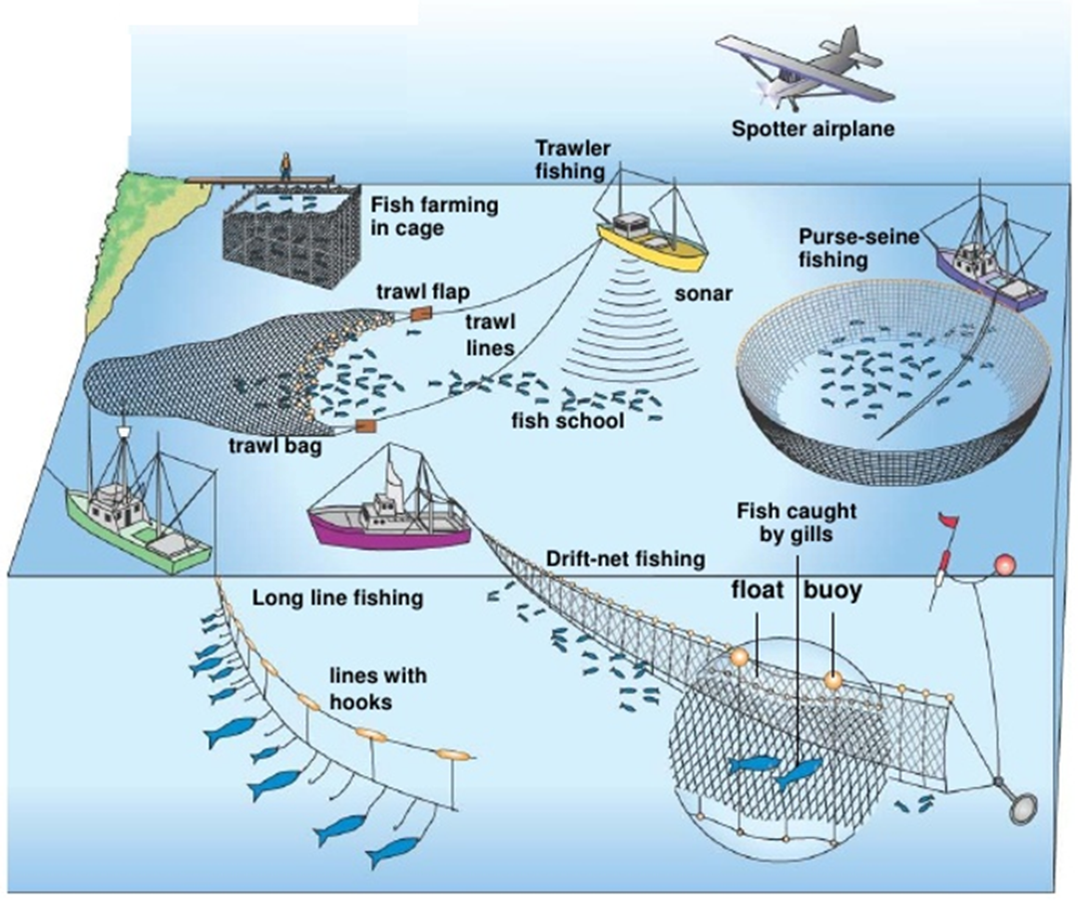
Commercial Fishing Methods
Purse-seining: a large net encircles a school of fish then the bottom of the net is closed to create a bag-like net full of fish
Trawling: large cone-shaped nets are dragged behind boats at different depths. Bottom trawls can destroy benthic habitats
Gillnets: a long net hangs suspended in the water with holes that allow fish heads to pass through catching fish by their gills
____________: a single fishing line stretching for up to 50 miles with thousands of baited hooks
Notes:
Chile has completely banned the practice of bottom trawling and other countries are placing restrictions on it.

Slide 12
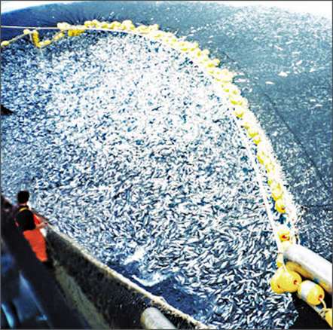
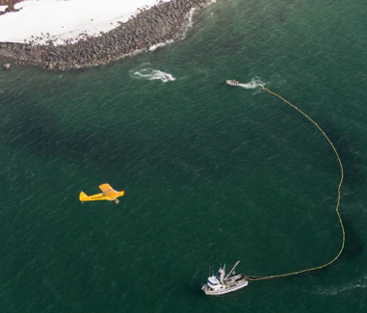
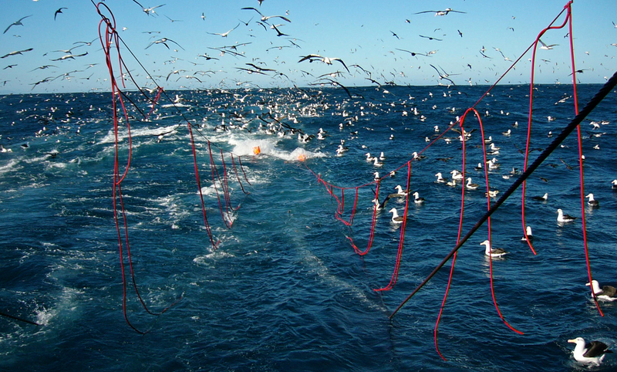
Overfishing
Tori lines
Purse-seining can capture entire schools of fish. The use of spotter planes to catch tuna has been outlawed in the Mediterranean in an effort to increase tuna stocks.
Long-lining kills and estimated 160,000 seabirds every year. Fisherman are now required to use of tori lines to scare off birds while the long lines are being set.

Slide 13
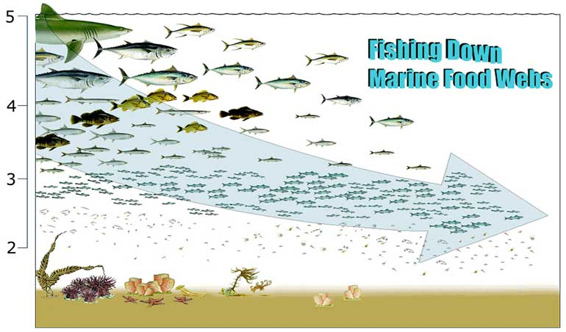
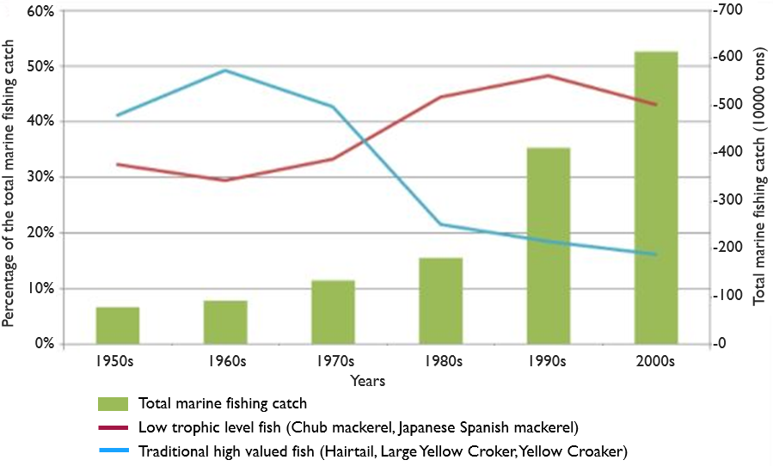
Overfishing
Fishing down the food web: process by which fisheries deplete large predatory fish then begin to catch smaller and smaller species
Trophic Level

Slide 14
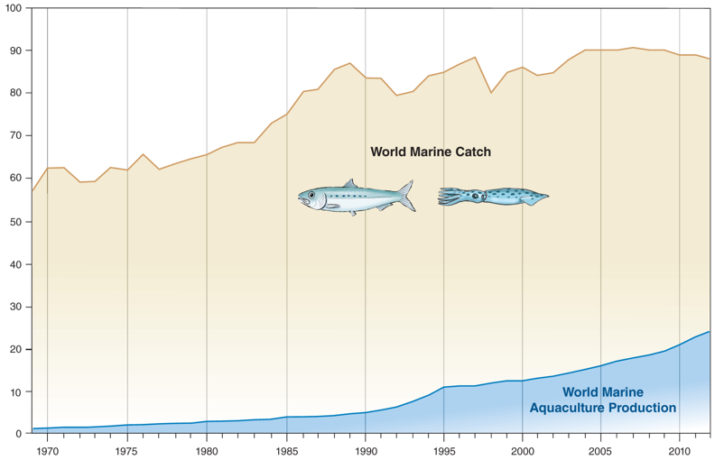
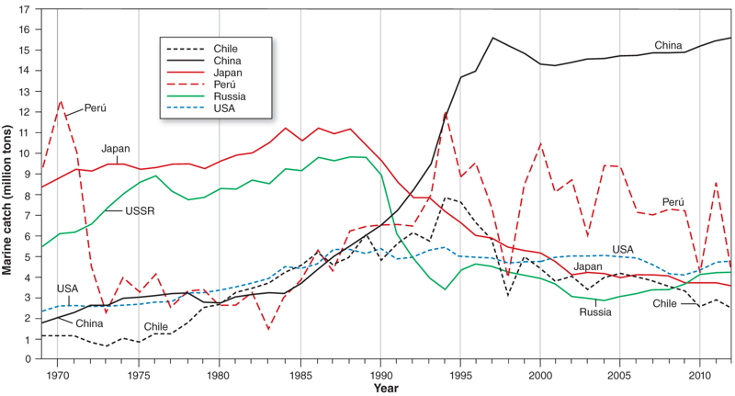
Overfishing
World marine catch has been increasing since 1970, with recent decline in catch possibly attributed to declining fish stocks. China catches almost four times as much as other major nations and accounts for more than a third of all fish consumed every year.

Slide 15
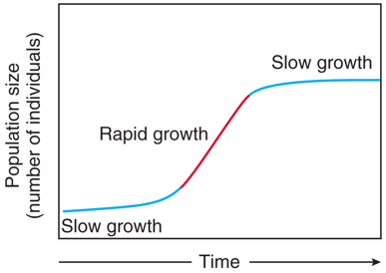
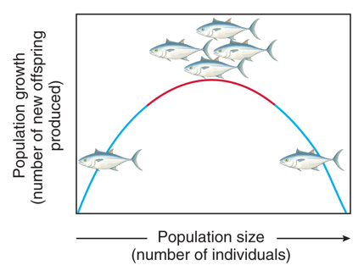
Sustainable Fishing
Sustainable fishing: when the number of fish caught does not exceed the number of new fish added through reproduction.
Maximum sustainable yield: the _____________ that can be continued year after year without threatening the fish population
Intermediate population size where the maximum growth rate can occur
60% of all fish stocks are at or near their max sustainable yield
Maximum sustainable yield

Slide 16
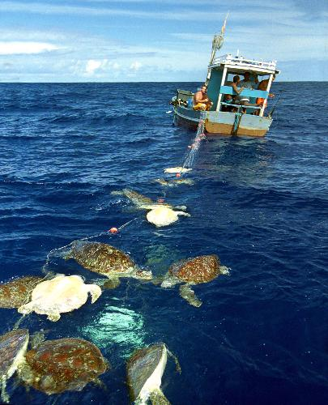
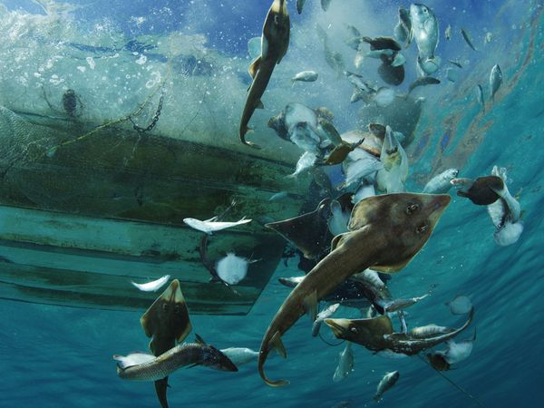
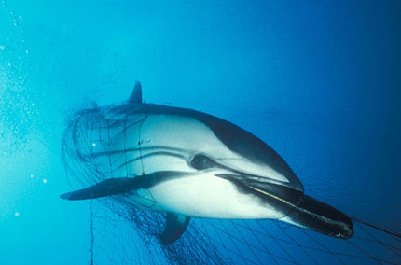
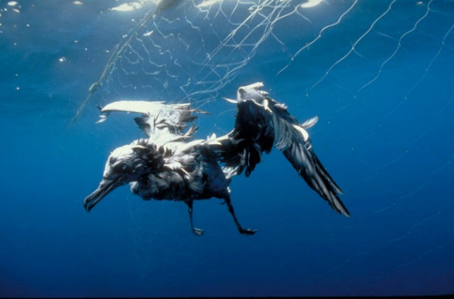
Bycatch
__________: a fish or other species that is caught unintentionally
38.5 million tones of bycatch caught world-wide
Estimated to be nearly 40% of total catch every year
Most bycatch goes unreported
Injured or killed organisms often thrown back
Notes:
650,000 whales, dolphins, and seals were killed throughout the 1990s as a result of bycatch

Slide 17
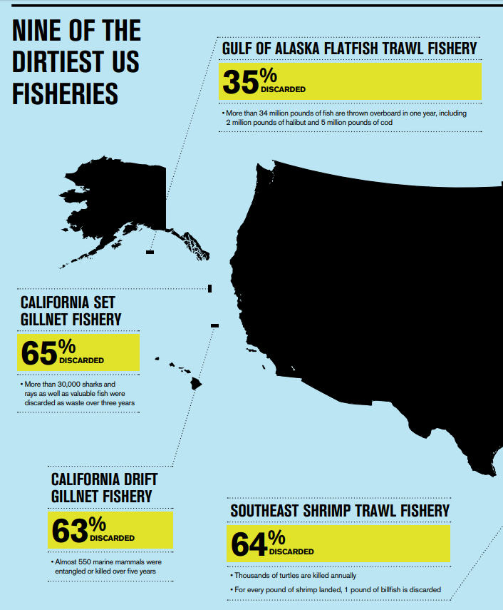
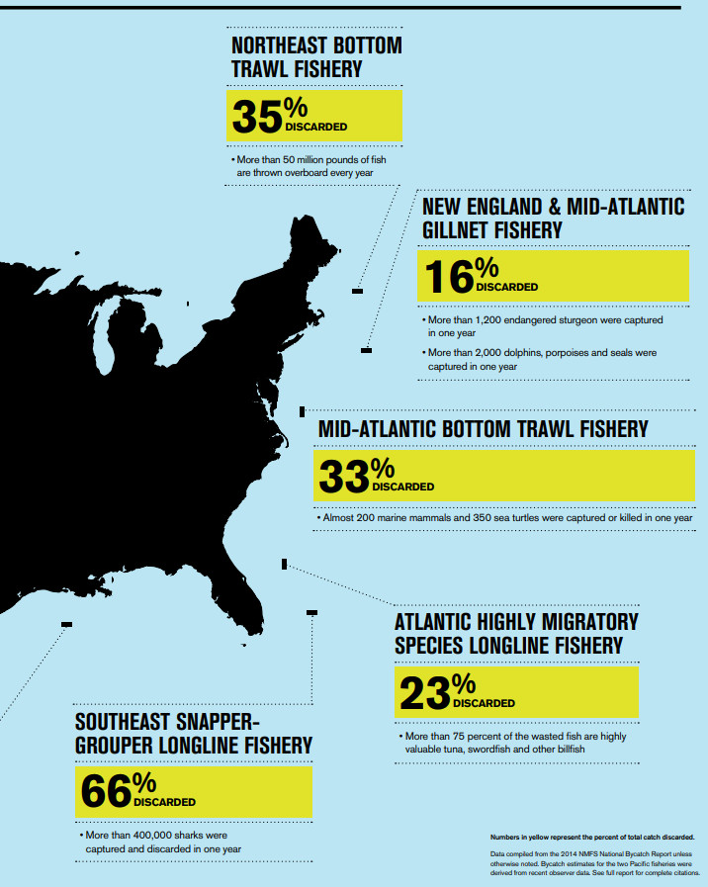

Slide 18
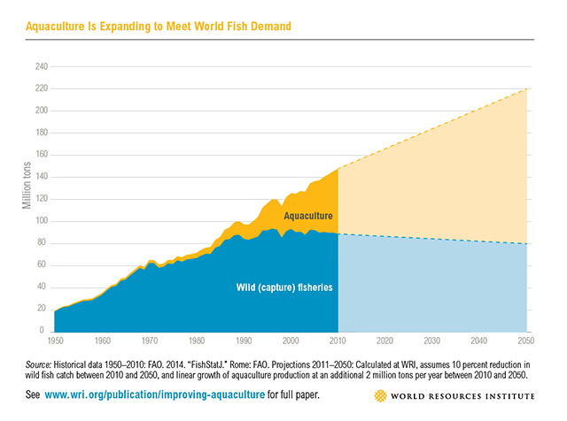
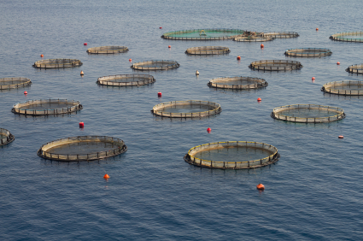
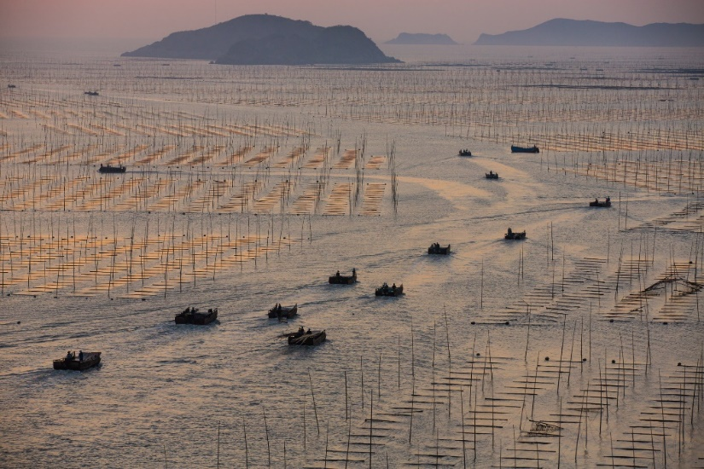
Aquaculture
Aquaculture: _______ of aquatic organisms including fish, molluscs, crabs and algae
Accounts for more than half of all seafood consumed annually
Expected to exceed wild capture fisheries by 2050

Slide 19
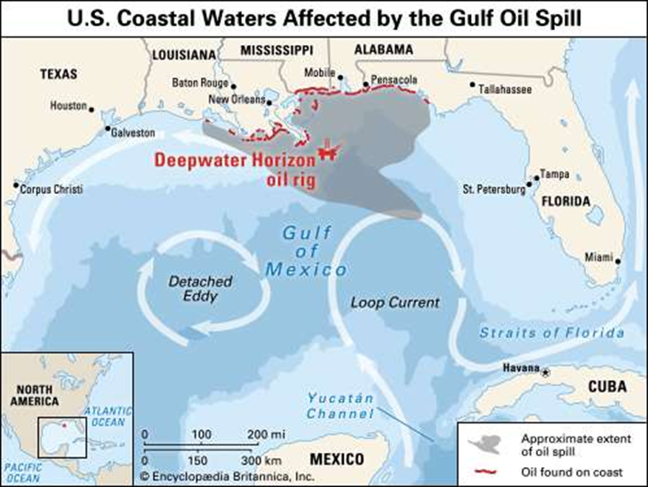
Oil Spills
BP Deepwater Horizon Oil Spill: Explosion on an oil platform in the Gulf of Mexico on April 10th, 2010 led to the release of an estimated 4,900,000 barrels of oil.
1 barrel = 42 gallons
Worst oil spill in U. S history
Notes:
Over 2 billion gallons of oil leaked into the gulf

Slide 20
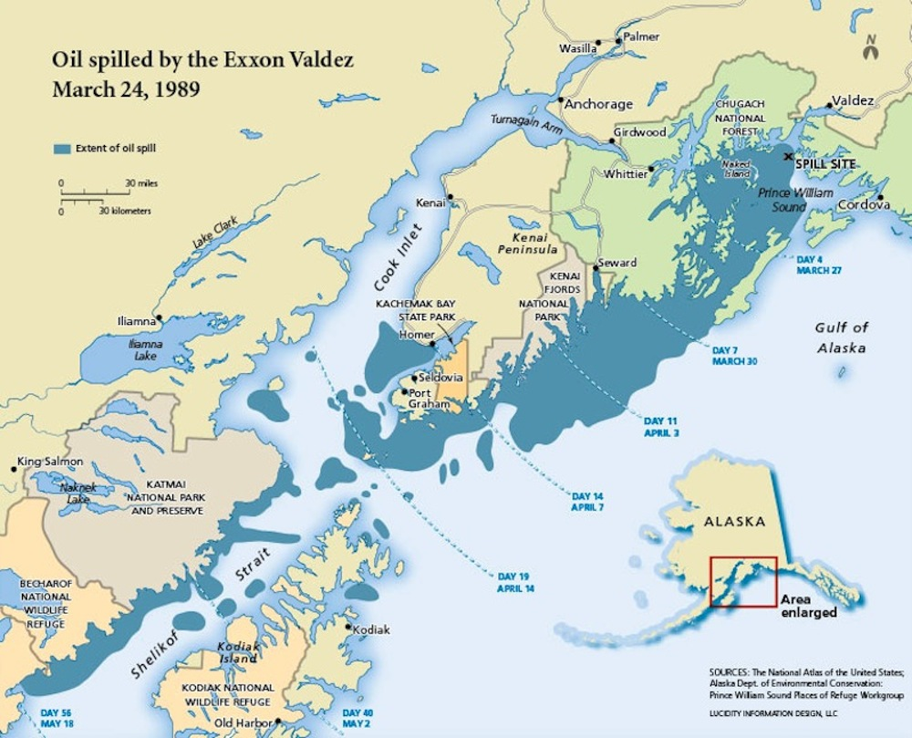
Oil Spills
Exxon Valdez Oil Spill: Exxon Valdez oil tanker struck the reef on March 24, 1989 releasing almost 11,000,000 barrels of oil in Prince William Sound, Alaska
Second worst oil spill in U.S History

Slide 21
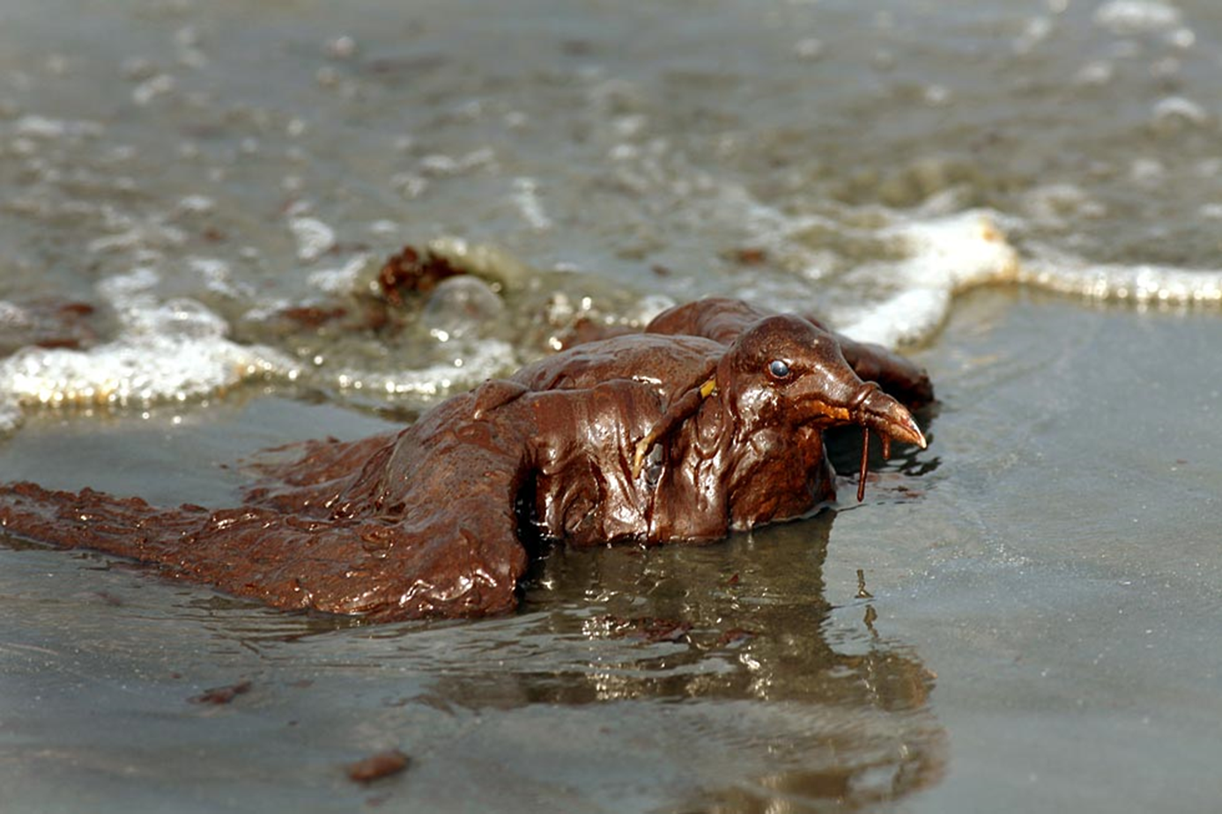
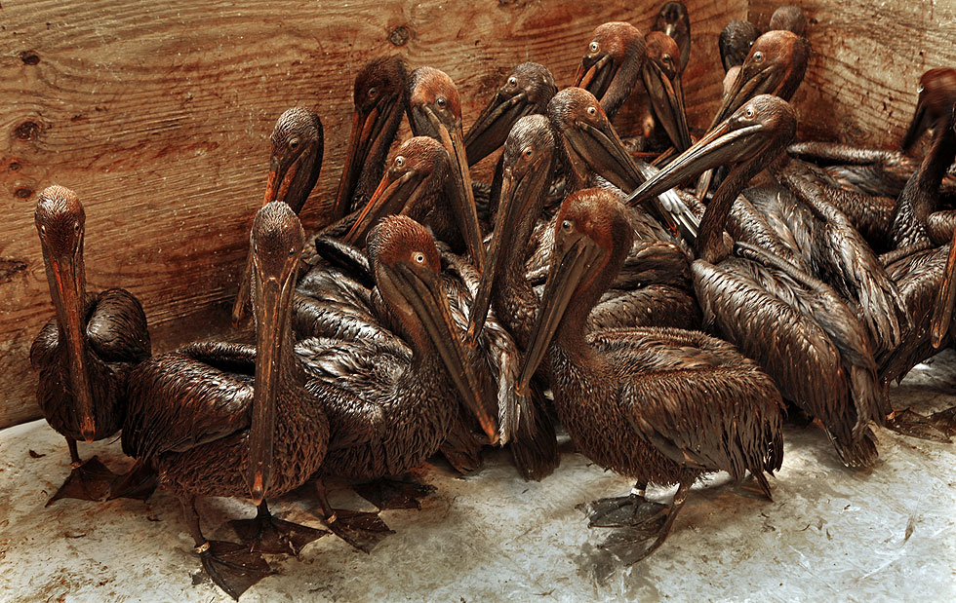
Impacts from Oil Spills
Still alive but almost unrecognizable, a sea gull is paralyzed by oil on the beach at East Grand Terre Island in Barataria Bay, La. (Carolyn Cole / Los Angeles Times / June 4, 2010)
At the Bird Rehabilitation Center in Fort Jackson, La., a group of oiled brown pelicans huddles together as they wait for a bath. More than 40 birds were brought to the center after a wave of oil hit Barataria Bay over the weekend. (Carolyn Cole / Los Angeles Times / June 8, 2010)

Slide 22
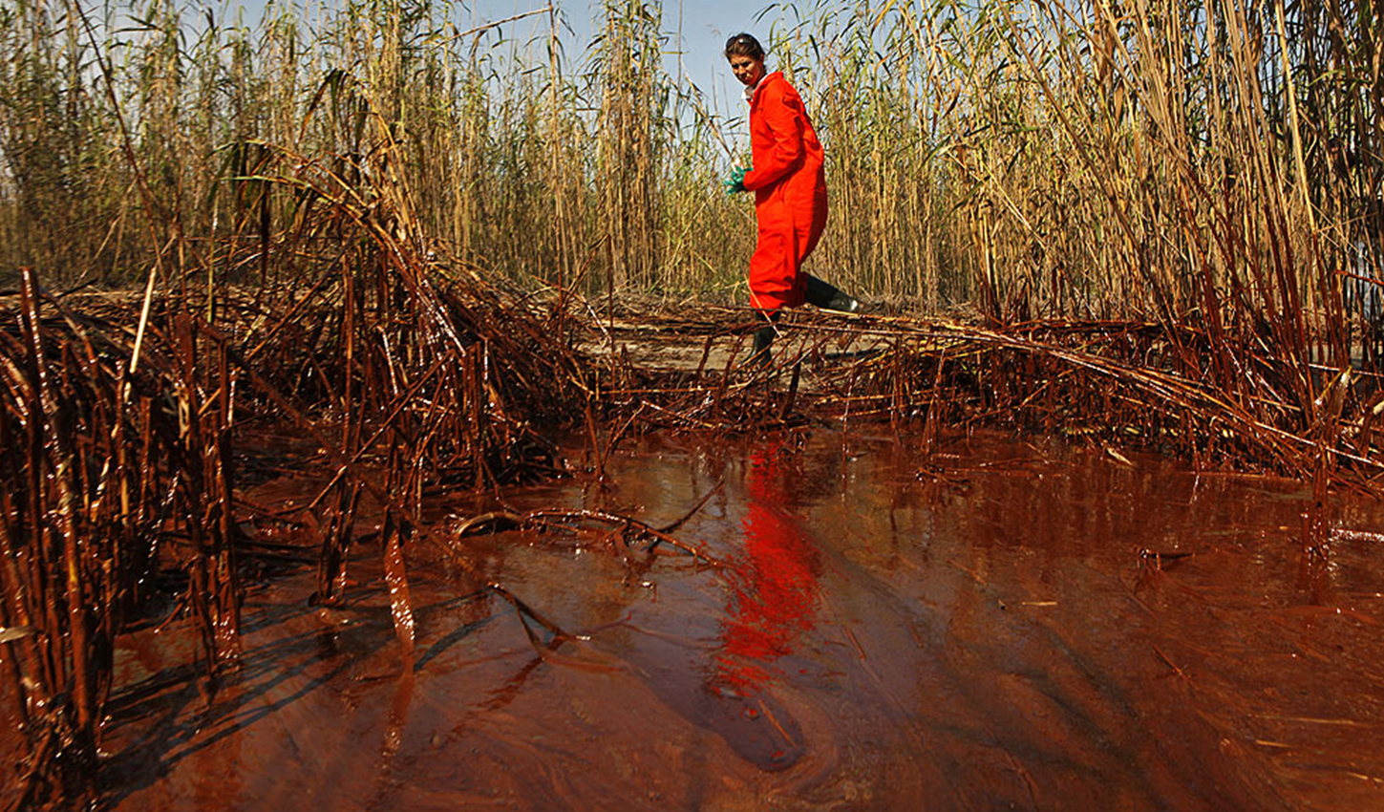
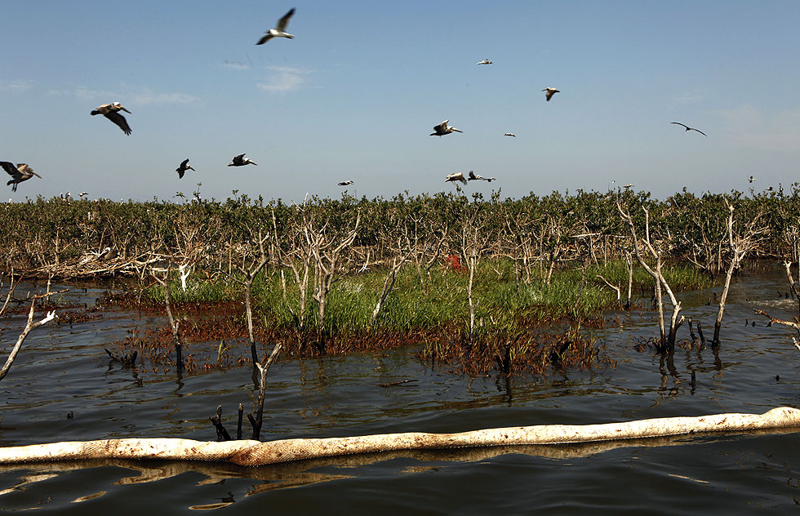
Impacts from Oil Spills
Greenpeace senior campaigner Lindsey Allen takes water samples along a 20-yard area of marsh where oil is thick in concentration near the south pass of the Mississippi River. (Carolyn Cole / Los Angeles Times / May 18, 2010)
Oil has reached islands close to Grand Isle, La. (Carolyn Cole / Los Angeles Times / May 24, 2010)

Slide 23
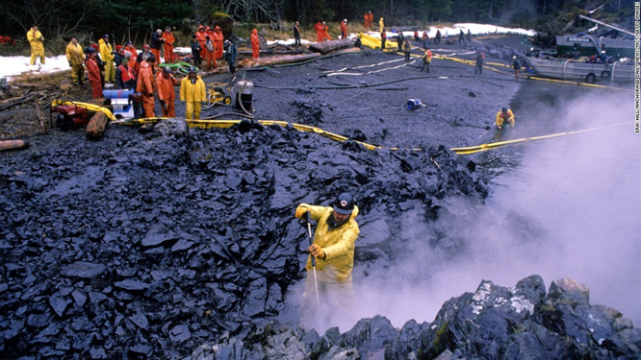
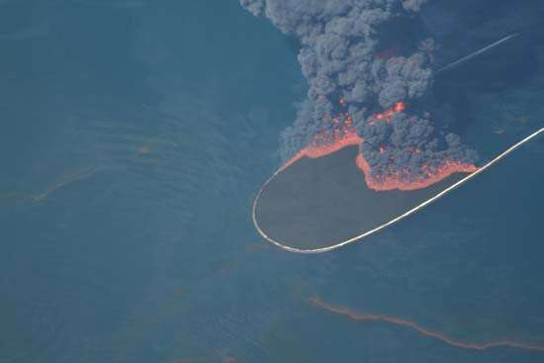
Impacts from Oil Spills
Dispersants and steam are used to clean oiled surfaces on land. Use of detergents and dispersants were found to have a significantly more negative impact on coral reefs than the oil itself.
Booms are often used to contain the oil on the surface. On method of reducing the oil on the surface is to burn it.

Slide 24
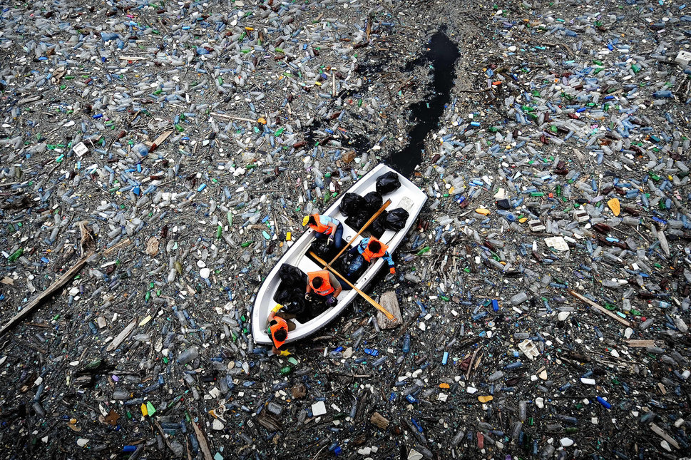
Marine Plastics
Estimated that _________ metric tons of plastic are dumped into the ocean annually.
Most of the plastic in the ocean consists to microplastics (< 5mm)
Plastics are consumed by a variety of marine species
Plastics coated in algae mimic food items
Plastic chemicals can be transferred up the food chain
Fishing nets and other plastics entangle marine life
Over 300 marine species have been recorded
https://youtu.be/AWgfOND2y68
Notes:
Dead sperm whale recently discovered with 64 lbs of plastic in its stomach

Slide 25
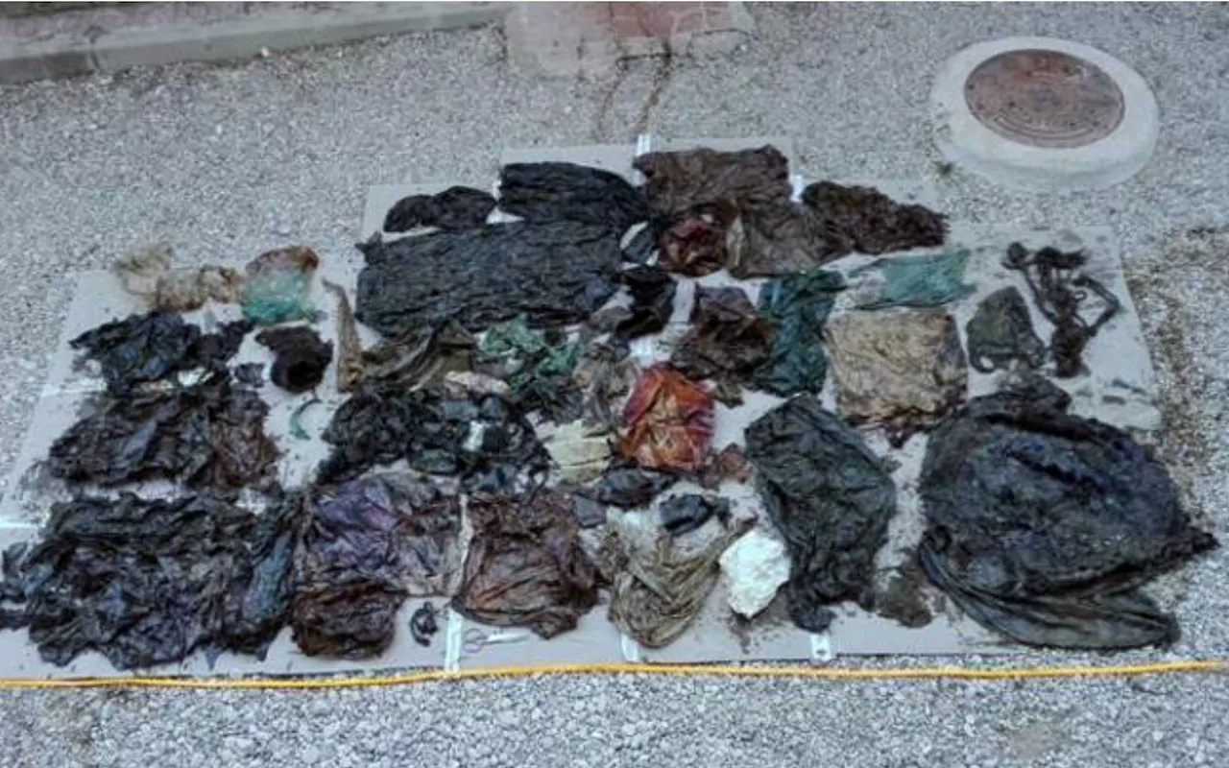
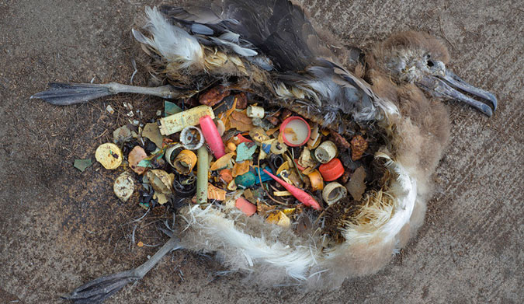
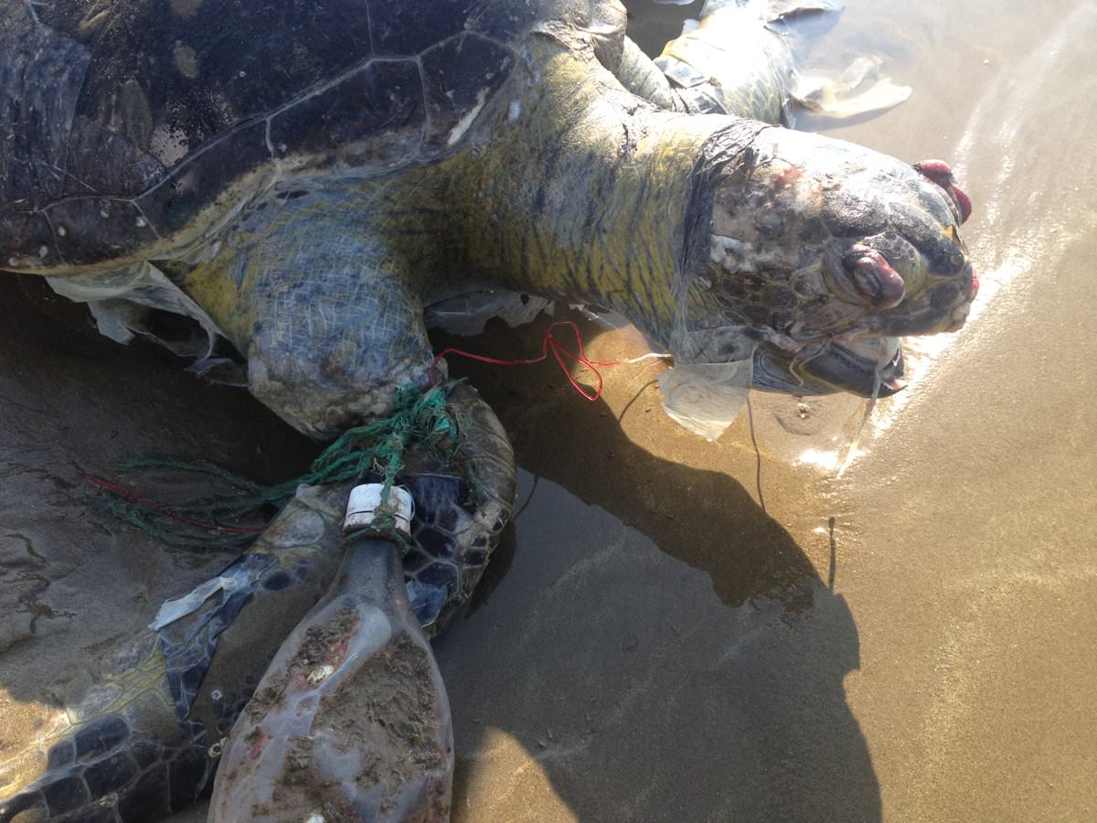
Marine Plastics
Some of the 65 pounds of plastic found in the gut of a deceased sperm whale that washed on shore in Spain
It is estimated that 90% of seabirds are ingesting some plastic. Plastics covered in algae take on the smell of seabird prey items. Many seabirds mistakenly feed plastic to their chicks
It is estimated that hundreds of sea turtles die every year from becoming entangled in plastics. More than half of all sea turtles are reported to have ingested some plastic

Slide 26
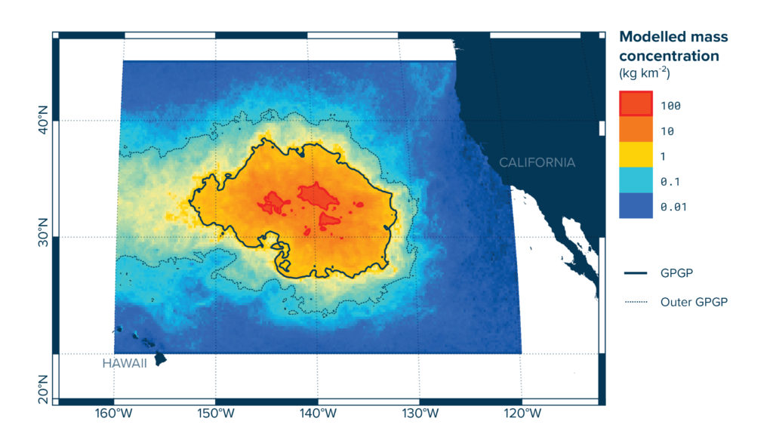
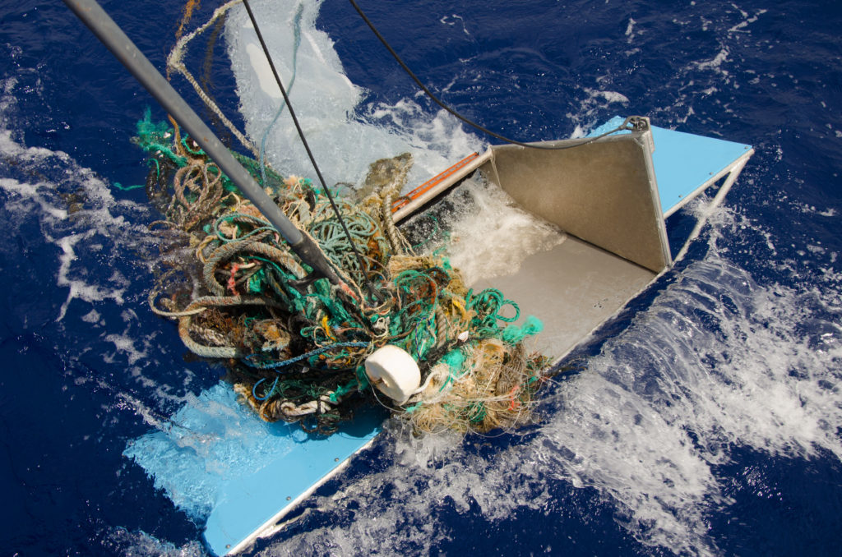
Marine Plastics
Giant Pacific Garbage Patch
Covers 617,000 square miles of the northern Pacific Ocean
Plastics make up 99.9 percent of the trash in the patch
Discarded _________ made up almost 50% of all plastic discovered

Slide 27
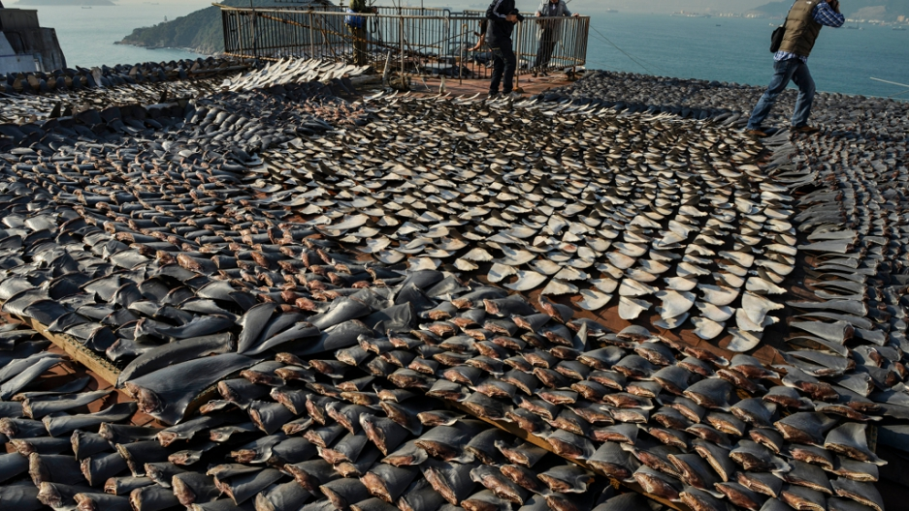
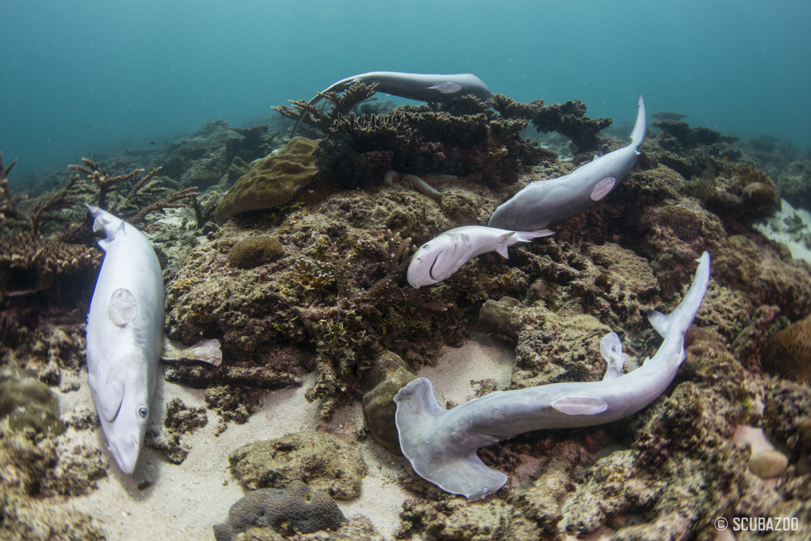
Shark Finning
Shark finning: the removal of shark fins often while the shark is still alive
Driven primarily for demand of shark fin soup
Estimates of __________ sharks killed every year
Late maturity and k-selected life history strategy of sharks leads to drastic population declines
Populations increasing in United States due to protections

Slide 28
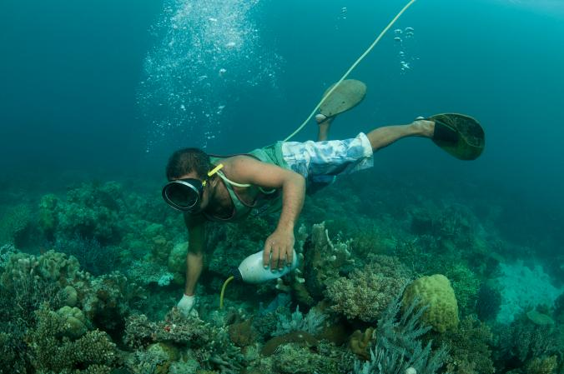
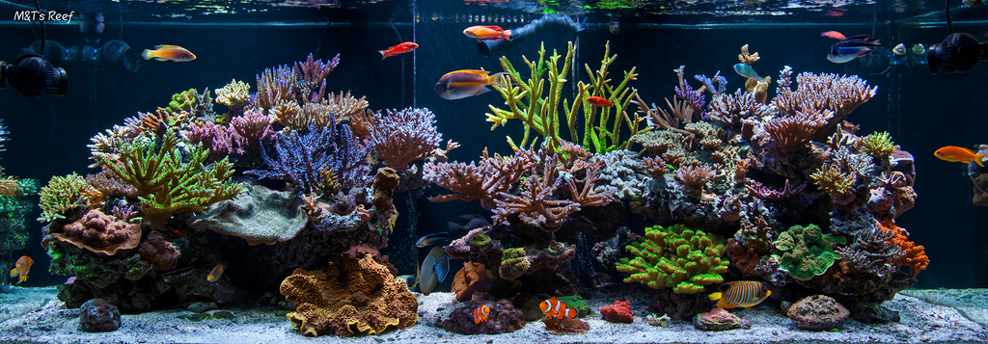
Aquarium Trade
Most marine aquarium fish can not breed in captivity and must be collected from the wild
___% of aquarium fish species are collected from coral reefs
Estimated that more than 90% are caught using cyanide
Cyanide kills coral while disabling the target fish
Many fish die in transit

Slide 29
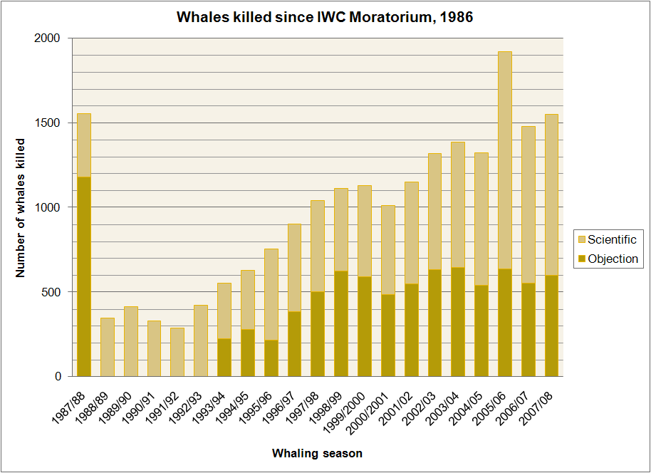
Whaling
By 1930’s more than 50,000 whales were killed annually.
International Whaling Commission (IWC): an international body that was established to monitor commercial whaling and conserve whale stocks
In 1982 the IWC placed a moratorium on all commercial whaling
Norway, Denmark, and Iceland still hunt whales commercially, while Japan kills around 300 whales a year for “scientific” research

Slide 30
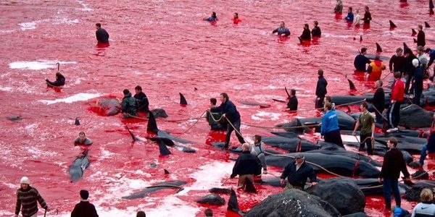
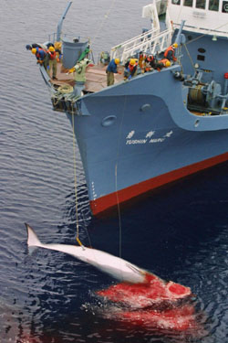
Whaling
Whales killed by Japanese whaling boats for “research”
White-sided dolphins killed in an annual hunt in the Faroe Islands

Slide 31
Climate Change
Climate change
___% of climate scientists agree that climate trends over the last century are extremely likely to be due to human activity (NASA, 2016)
Sea Surface Temperature (SST) has been rising at a greater rate than any other time in the last millennium.
Oceans have warmed by 0.3°F since 1969
Many marine species unlikely to adapt to rapid increase in sea temperature

Slide 32
Effects of Climate Change on Oceans
Warm water carries less ________ than cooler water
Melting ice sheets alter the salinity of seawater
Rising sea level could alter intertidal environments through more frequent flooding
Coral bleaching resulting from higher sea surface temperatures
Increase in ocean acidity with more carbon dioxide dissolved in the water
1909
2005

Slide 33
Coral Bleaching
Coral reefs cover less than 1% of the ocean floor
Home to ___% of all marine species
Sea surface temperatures already exceeding upper tolerances for most of the world’s corals

Slide 34
Dams
Hydroelectric dams alter natural water ways
Reduce natural nutrient-rich runoff
Impede fish _______________
Fish ladders

Slide 35
Invasive Species
_________ species: a species that is non-native to and ecosystem and has caused or is likely to cause economic or environmental harm
Characteristics of Successful Invasive Species
Fast growth
Rapid _____________
Tolerance to wide range of environmental conditions
High ______________
Lack of natural predators
Rapid evolution
Notes:
Second greatest threat to biodiversity after habitat destruction
Linked to the decline of greater than 42% of the threatened and endangered species in the United States
Cost U.S. an estimated 120 billion dollars a year
Approximately 100 million acres (size of California) suffering from invasive plant infestations

Slide 36
Invasive Species Introductions
Ballast water: water carried in the ballast tanks of cargo ships to level the load and provide stability during transit
Many small marine organisms are transported in ballast water
American comb jelly in European Seas
Zebra mussel in North America
Ballast exchange at sea to reduce introductions

Slide 37
Negative Impacts of Invasive species
Zebra Mussel
Can produce 5 million eggs in 5 years
Dense growth blocks pipes and damage boats and other structures
Consume majority of plankton leading to a collapse of the food web

Slide 38
Invasive Species Introductions
Unintentional introductions
Rats have been introduced to most islands where they have caused the extinction of countless species including many seabirds
Eradication of rats from islands is on-going challenge
The brown tree snake hitchhiked to Guam in military cargo and has led to the extinction of at least 12 bird species on Guam

Slide 39
Invasive Species Introductions
Pet trade and aquarium release
Lionfish were released into the waters off Florida and are now found throughout the east coast of U.S, the Caribbean, and Gulf of Mexico
Large venomous spines and appearance likely deters predators
They breed year round and can produce young every 4 days
Reduce populations of juvenile and small fish on coral reefs by as much as 90%
Caulerpa taxifoila is a popular aquarium algae that became established off southern California coast
Caulerpa taxifolia is now illegal in California
Notes:
Caulerpa was introduced into the Mediterranean in 1984 and now covers thousands of acres of coastline

Slide 40
Preservation of Species
Endangered Species Act of 1973: a U.S. environmental law designed to protect and recover imperiled species and the ecosystems upon which they depend
Governed by U.S. Fish and Wildlife Service (FWS) and the Commerce Department’s National Marine Fisheries Service (NMFS)
Species designated as either __________________________
Designates critical habitat
Develops a recovery plan

Slide 41
Preservation of Species
Protected Areas
Exclusive economic zones
Sea zone 200 miles from shore that the country claims exclusive rights for fishing, drilling, and other economic activities
Marine protected areas
Only 1.6% of the oceans have been designated as marine protected areas
90% of MPAs are open to fishing

Slide 42
Check Your Understanding
True or False: An organism value to humans is known as its intrinsic value
True or False: Most aquarium fish are captured from the wild
True of False: Bycatch are the smaller fish species that are caught after all the big fish have been caught

Slide 43
Check Your Understanding
Which of the following pose the greatest threat to biodiversity?
a. Overfishing
b. Habitat loss
c. Shark finning
d. Invasive species
e. Whaling

Slide 44
Check Your Understanding
All of the following are characteristics of invasive species except:
a. Slow growth
b. High dispersal ability
c. Rapid reproduction
d. Tolerance to a wide range of conditions
e. Lack of natural predators

