Slide 1
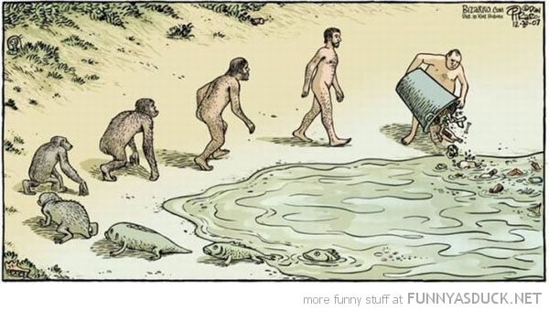
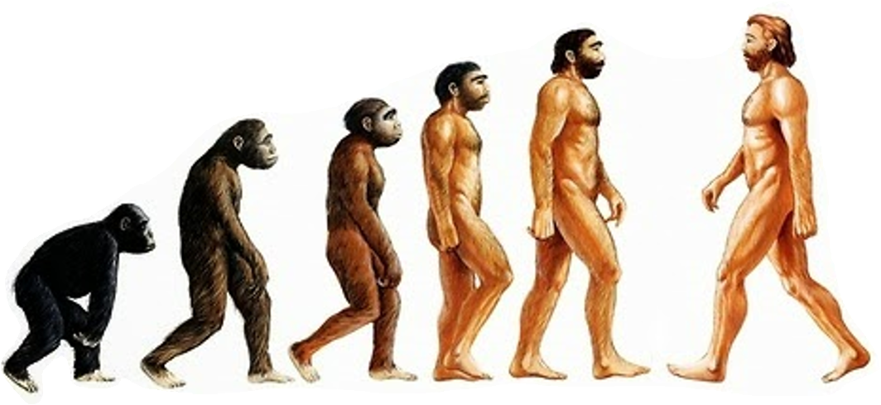
The Diversity of Life
Go back! We f*#ked everything up
“We exist in a bizarre combination of Stone Age emotions, medieval beliefs, and god-like technology”
-E. O. Wilson
Chapters 21-24

Slide 2
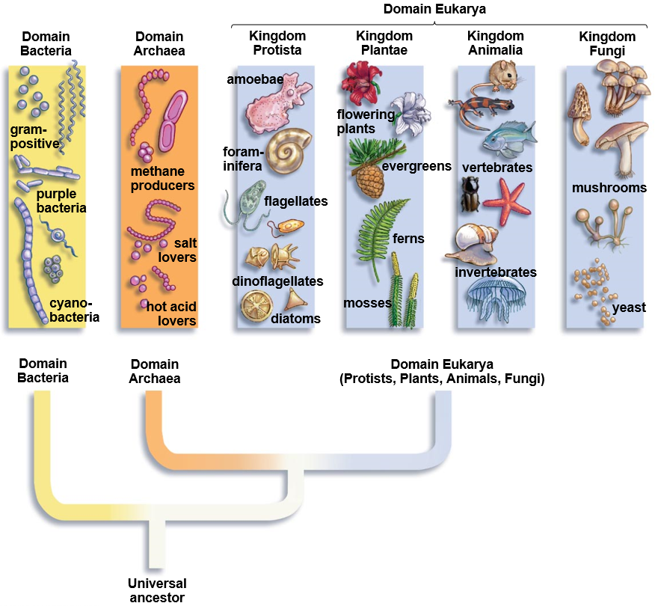
Domains and Kingdoms of Life
Earth – ___ BYA
Prokaryotes – 3.8 BYA
Eukaryotes – 2.0 BYA
First Animals – 635 MYA

Slide 3
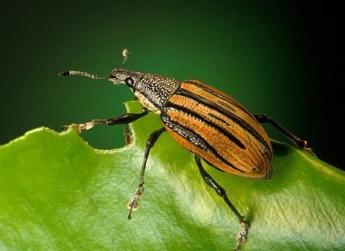
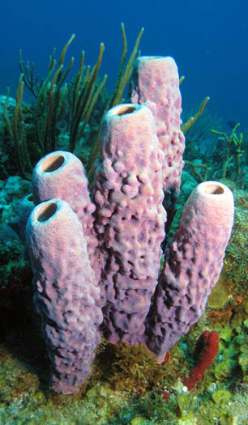
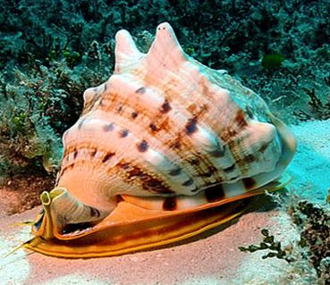
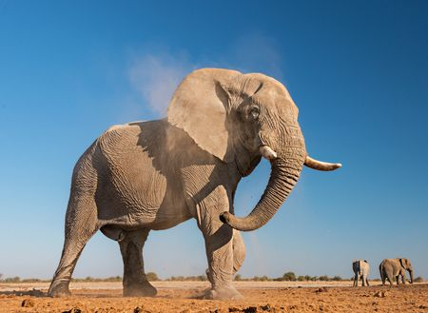
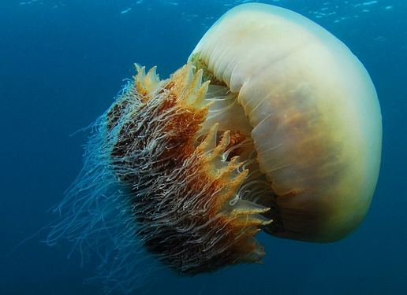
What is an Animal?
Multicellular, heterotrophic, eukaryotes
Lack cell walls
________________
Contain muscle and nervous tissue
Allow for movement and nerve impulses
Most reproduce sexually

Slide 4
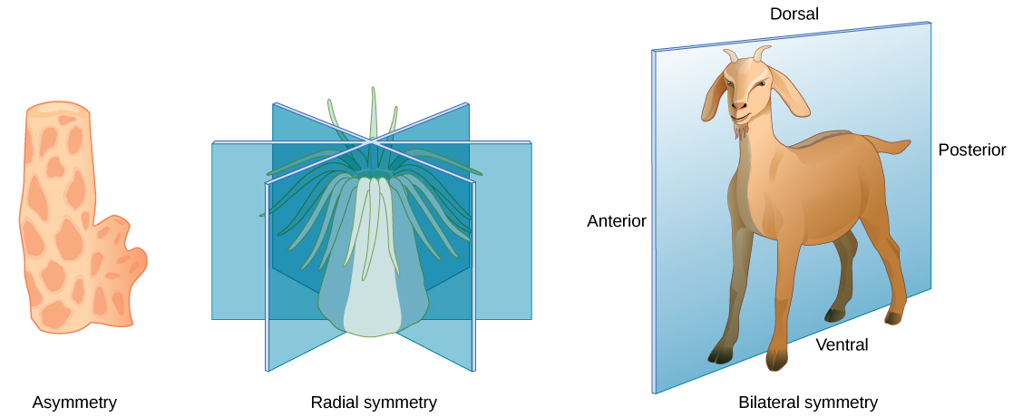
Animal Symmetry
Asymmetrical: no symmetry
Radial symmetry: body parts distributed evenly around a central point
_________ symmetry: opposite sides of sagittal plane are mirror images of one another
Asymmetry
Radial symmetry
Bilateral symmetry

Slide 5
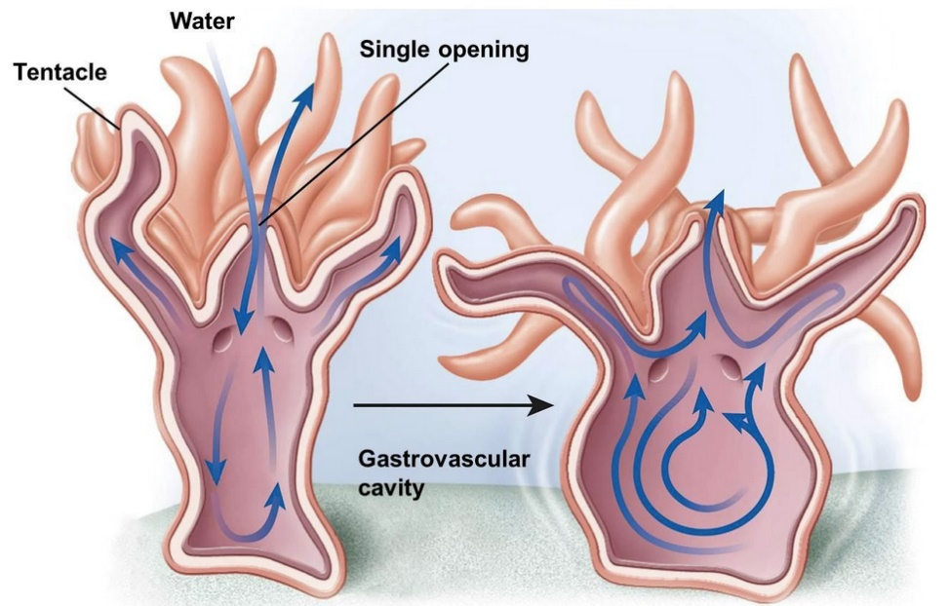
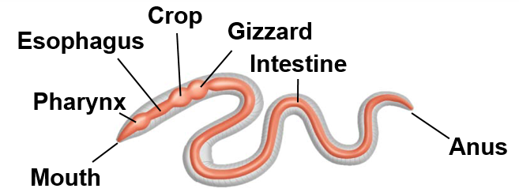
Digestive System
Animals have diverse nutritional requirements and feeding strategies
Intracellular digestion: digestion inside cells
________________ cavity: central cavity with single opening that functions in both digestion and distribution of nutrients
Alimentary canal: digestive tract with two separate openings(mouth and anus)
Gastrovascular cavity
Alimentary canal

Slide 6
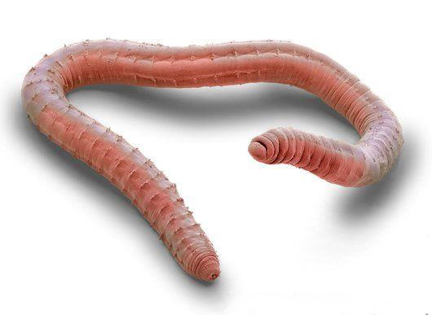
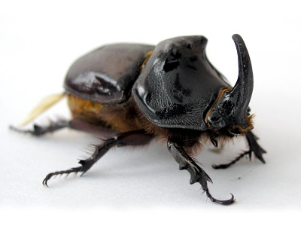
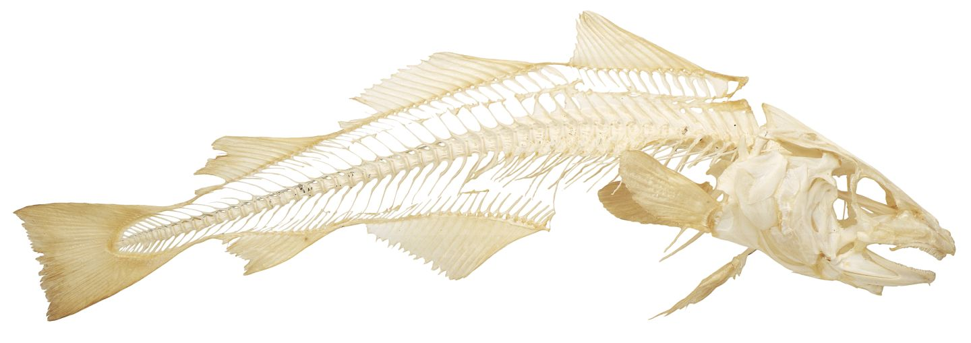
Skeletal Systems
Hydrostatic skeleton: ______ held under pressure within a closed body compartment
Cnidarians, Flatworms, Annelids, Roundworms
Exoskeleton: hard covering deposited on the animals surface that provides protection and points for muscle attachment
Arthropods, Molluscs
Endoskeleton: hard ______ skeleton buried within soft tissue
Sponges, Echinodermata, Chordata

Slide 7
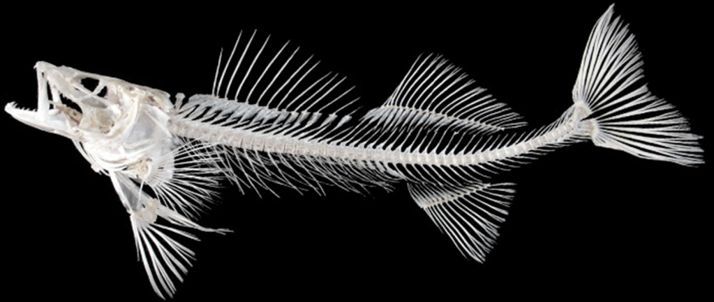
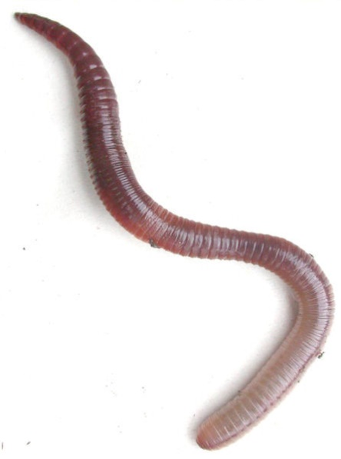
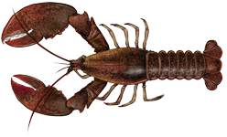
Segmentation
Series of repeating parts or body segments
Efficient movement
______________ of parts
Evolved independently in three phyla
Annelida
Arthropoda
Chordata

Slide 8
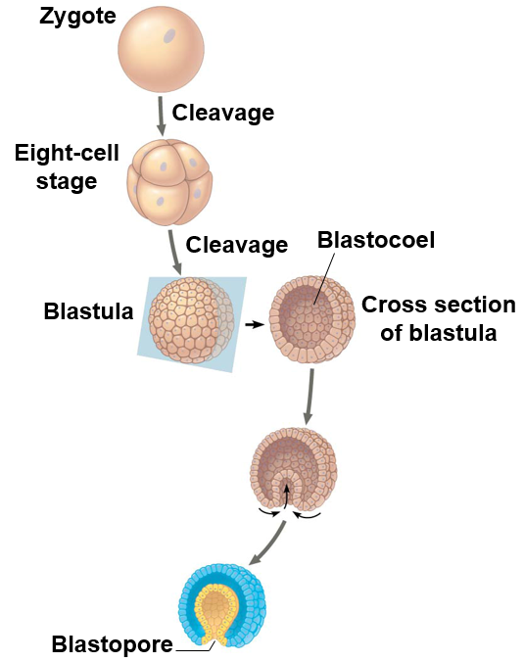
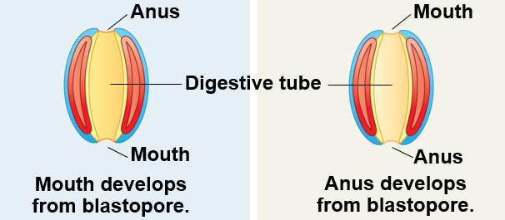
Animal Development
_____________
Deuterostome
Mouth develops first
Anus develops first

Slide 9
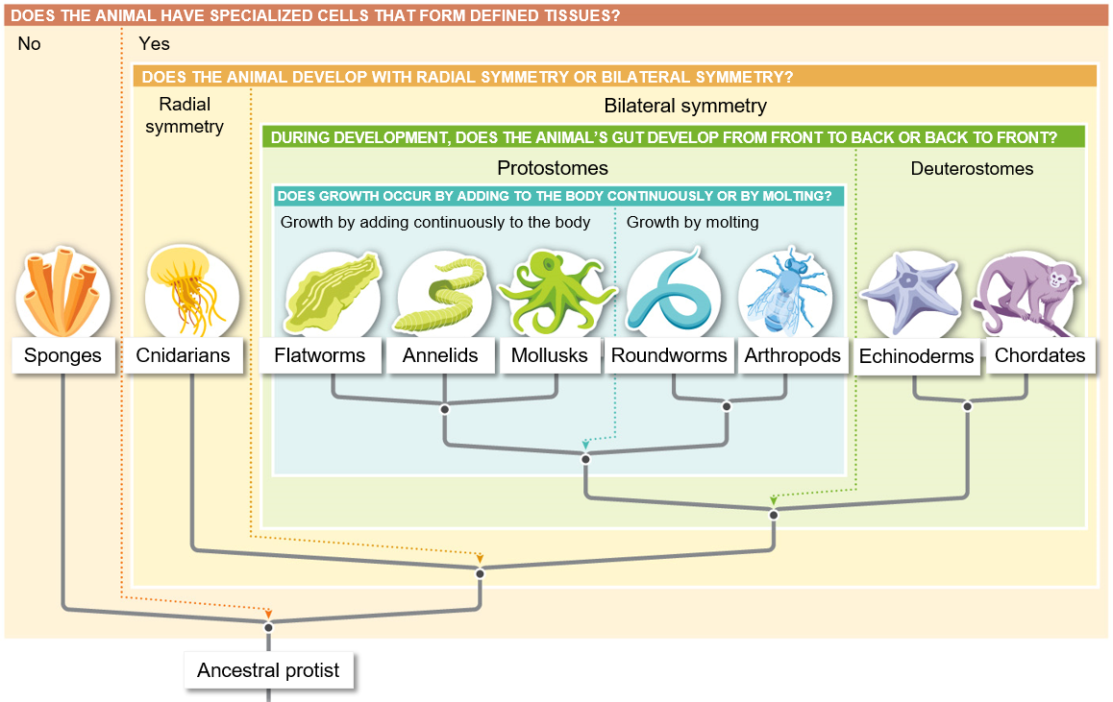

Slide 10
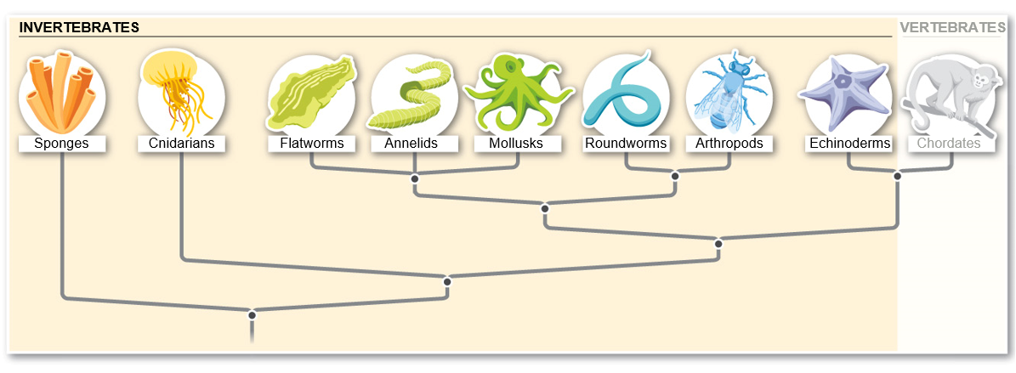
Invertebrates
Invertebrates: animals without a backbone
___% of all animals
Image modified from What is Life? A Guide to Biology, Third Edition ©2015 W.H. Freeman and Company

Slide 11
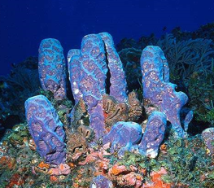
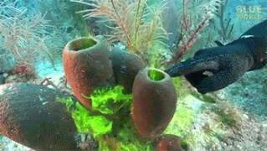
Porifera
Sponges
CHARACTERISTICS
No tissues or organs
Intercellular digestion
_______________
Free-swimming larvae
Sessile as adults
Image modified from What is Life? A Guide to Biology, Third Edition ©2015 W.H. Freeman and Company

Slide 12
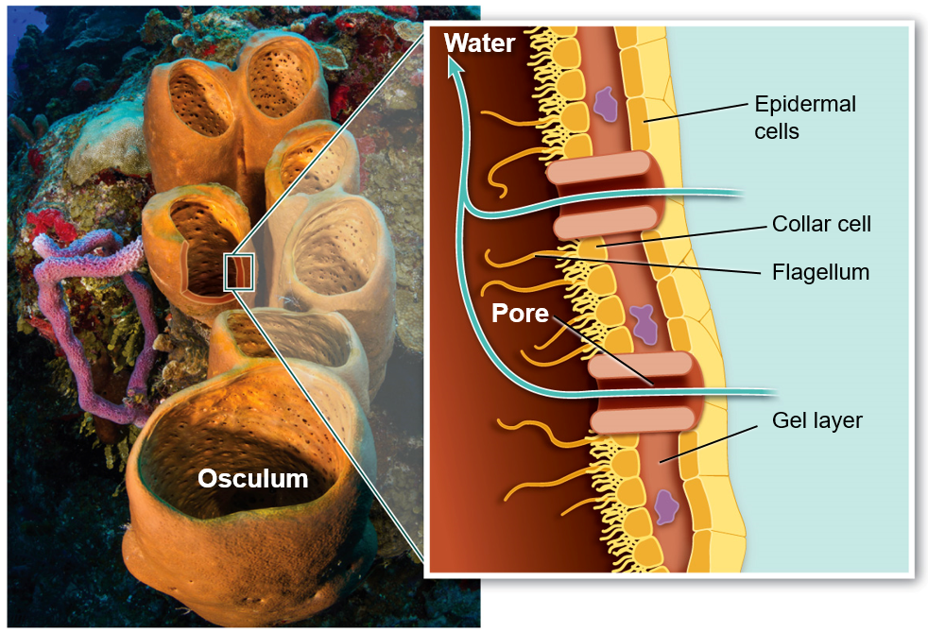
Sponges
____________: specialized cells with flagella that create water current up through osculum
Osculum: opening at the top of the sponge
Image modified from What is Life? A Guide to Biology, Third Edition ©2015 W.H. Freeman and Company

Slide 13
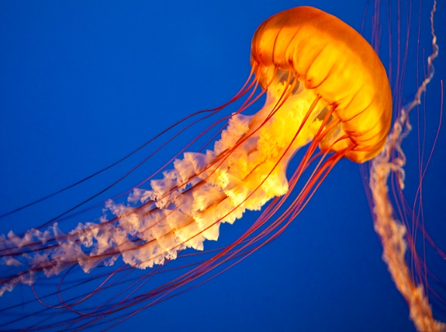
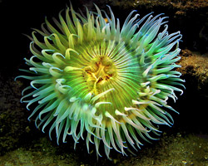
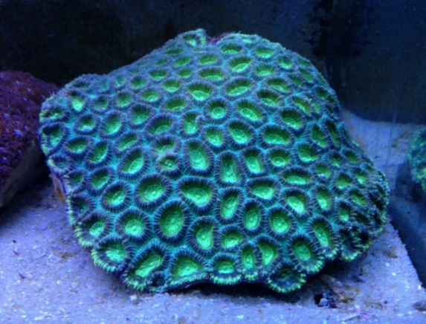
Cnidarians
Sea jellies, Corals and Sea anemones
CHARACTERISTICS
_________ symmetry
Gastrovascular cavity
Cnidocytes: stinging cells
Two life stages
Medusa
Polyp
Image modified from What is Life? A Guide to Biology, Third Edition ©2015 W.H. Freeman and Company

Slide 14
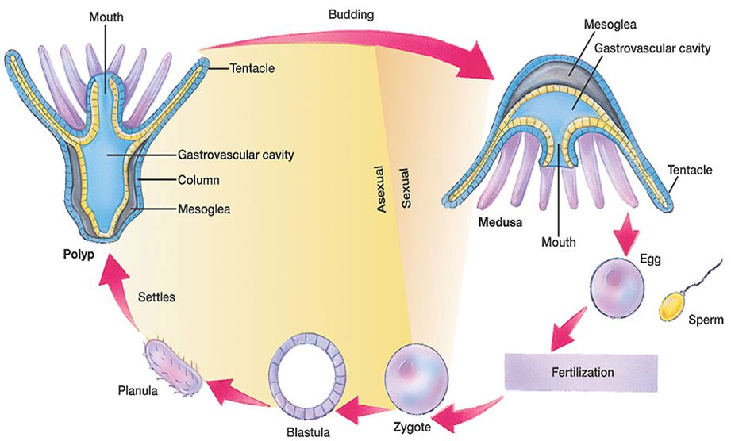
Cnidarians
Medusa
Polyp

Slide 15
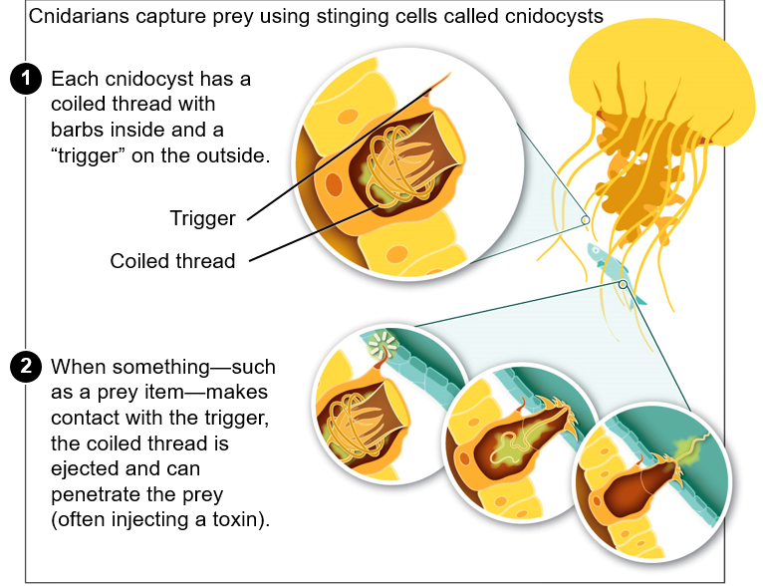
Cnidarians
Image modified from What is Life? A Guide to Biology, Third Edition ©2015 W.H. Freeman and Company

Slide 16
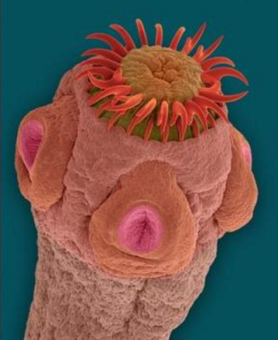
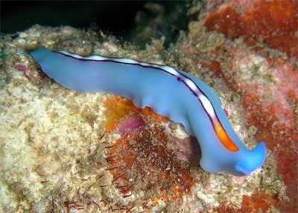
Platyhelminthes
Flatworms, including tape worms and flukes
CHARACTERISTICS
Protostome development
Bilateral symmetry
___________________
Hydrostatic skeleton
Well-defined head and tail regions
Hermaphroditic
Can engage in both sexual and asexual reproduction

Slide 18
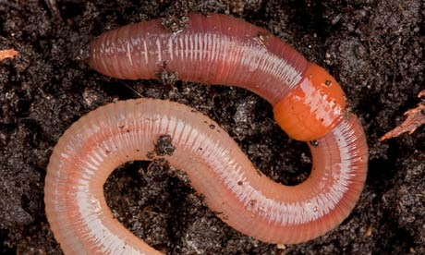
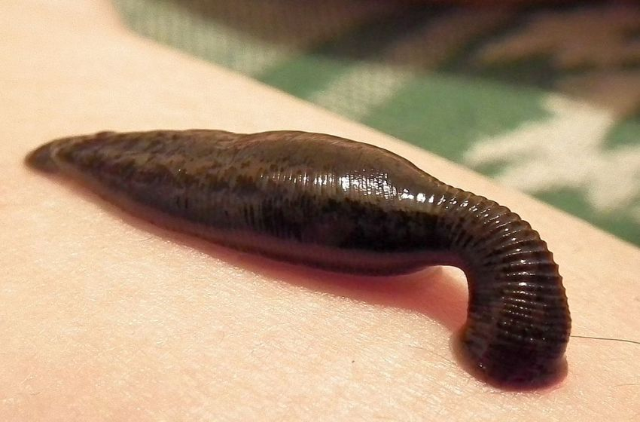
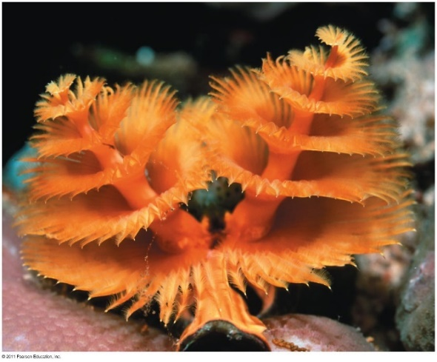
Annelida
Earthworms, leaches and polycheate worms
CHARACTERISTICS
Protostome development
Hydrostatic skeleton
Bilateral symmetry
Segmented bodies
_________________

Slide 19
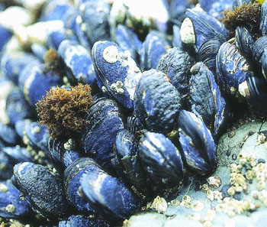
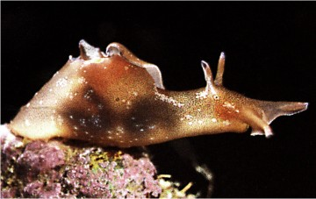
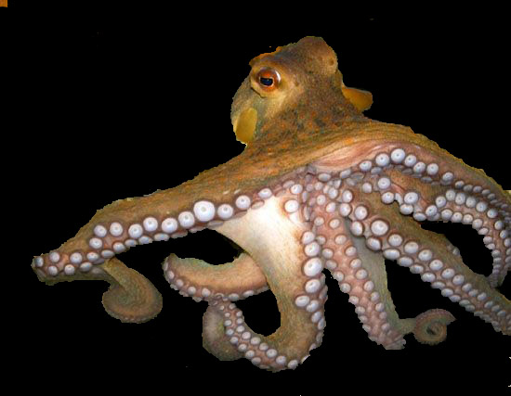
Molluscs
Includes clams, snails, and octopus
CHARACTERISTICS
Protostome development
Bilateral symmetry
Exoskeleton (shell), Hydrostatic in some
Alimentary canal
_______: grading mouth parts
Muscular foot
Mantle
Forms shell

Slide 20
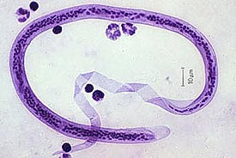
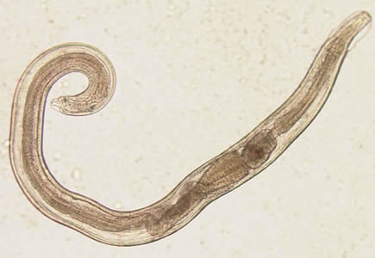
Nematoda
Round Worms
CHARACTERISTICS
Protostome development
Exoskeleton
Molt exoskeleton to grow
Bilateral symmetry
Alimentary canal
Many are ___________

Slide 21
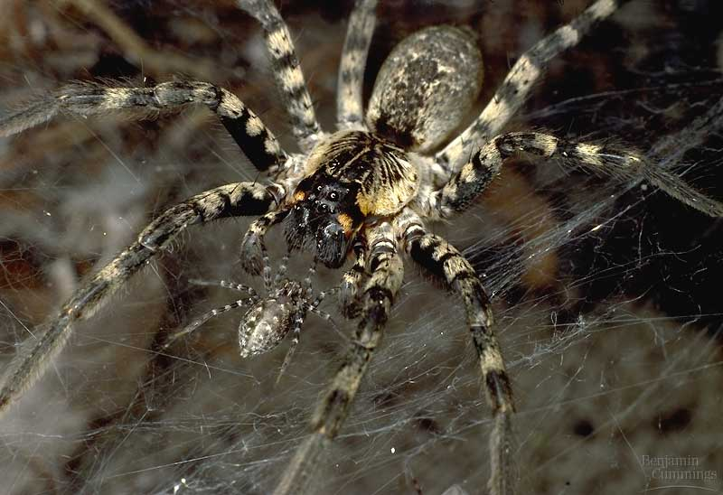
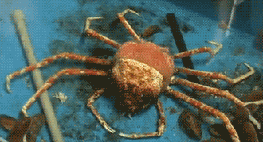
Arthropods
Includes barnacles, spiders, insects, millipedes and crustaceans
CHARACTERISTICS
Protostome development
Bilateral symmetry
Alimentary canal
______________
Molt exoskeleton to grow
___________ appendages
Segmented bodies
Head, thorax, abdomen

Slide 22
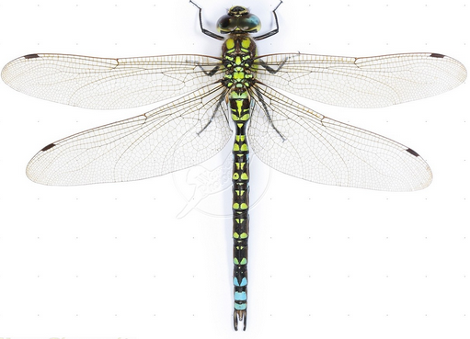
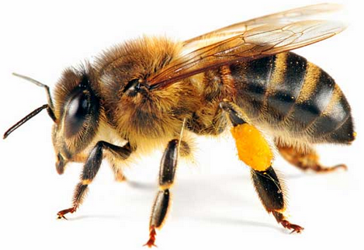
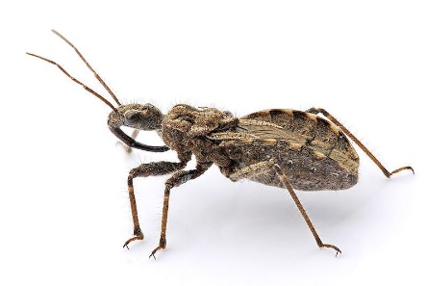
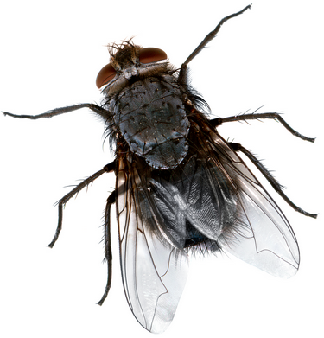
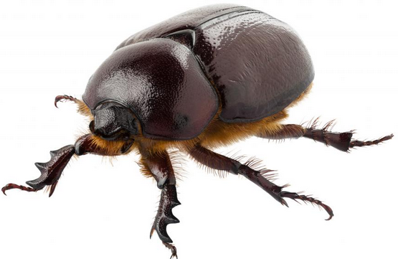
Phylum: Arthropoda, Subphylum: Hexapoda
Class: Insecta
Most diverse group of arthropods
Diverged approx. 415 mya
Mostly terrestrial and freshwater
___________ of legs on thorax
_____________________
Head, thorax, abdomen
Compound eye
_________ of antennae
One or two pairs of wings
Thorax
Extensions of the cuticle

Slide 23
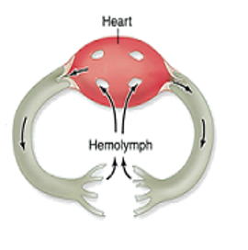
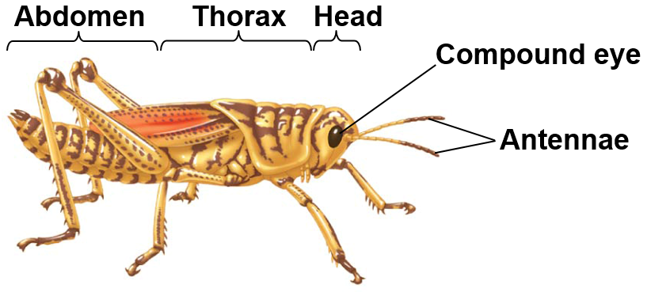
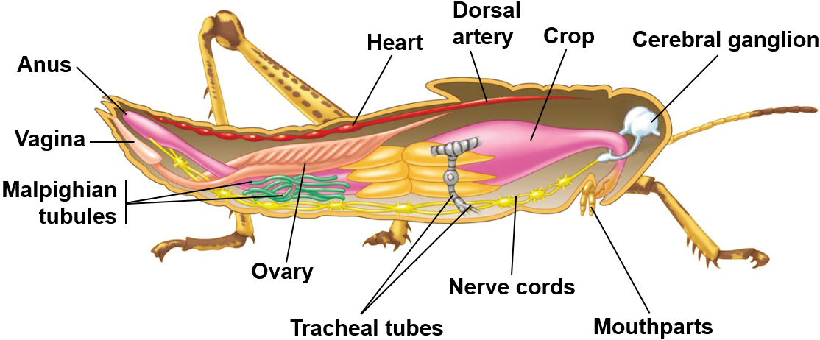
General Anatomy of Arthropods
Open circulatory system
______________: circulatory fluid
Highly developed sense organs
_____________ eye
Antennae
Touch and smell
Olfactory receptors
Specialized mouthparts for various feeding behaviors
Heart
Hemocoel
Sinuses

Slide 24
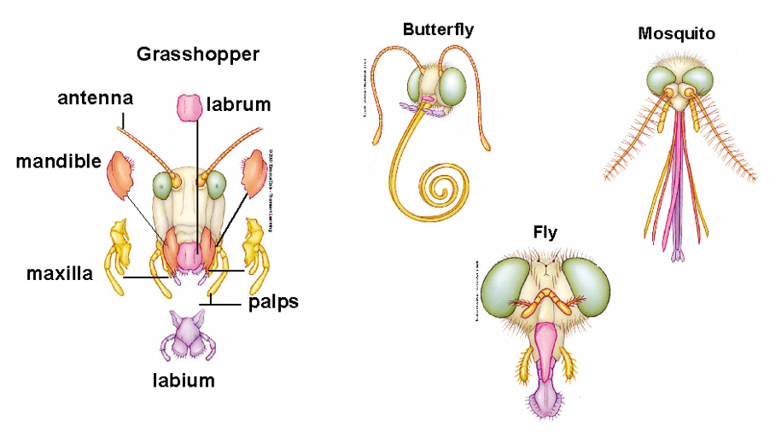
Insect Mouthparts
Sucking
Piercing
Chewing
Lapping

Slide 25
Metamorphosis
_________ metamorphosis: four distinct life stages
Egg, larvae, pupa, adult
Beetles, bees, butterflies, mosquitos
Incomplete metamorphosis: three distinct life stages
Egg, nymph, adult
________ = smaller version of adult
Grasshoppers, true bugs, termites
Notes:
Metamorphosis: process of transformation from immature form to adult form
Nymph lack wings
Incomplete metamorphosis = series of molts, acquiring wings after final molt and becoming sexually mature.
“There is nothing in a caterpillar that tells you its going to be a butterfly” – Buckminster Fuller

Slide 26
Class: Insecta, Order: Coleoptera
Beetles
Approx. 350,000 species
Largest order of insects
Two pairs of wings
One pair of __________ wings
Elytra
One pair of ___________ wings
_________ mouth parts
One pair of antennae
Used for smell
Complete metamorphosis

Slide 27
Class: Insecta, Order: Diptera
Flies and mosquitos
Approx. 150,000 species
Scavengers, predators, parasites
One pair of membranous wings
__________ mouth parts
__________ metamorphosis
Maggots used by forensic entomologists

Slide 28
Class: Insecta, Order: Lepidoptera
Butterflies and Moths
Approx 120,000 species
Two pairs of wings with ______
Long proboscis
Complete metamorphosis
Caterpillars – chewing mouthparts
Butterflies – proboscis, sucking mouthparts
Notes:
Communicate through pheromones
Monarch butterflies migrate 2,500 to 3000 miles from Mexico to Canada.
Chrysalis about 2 weeks
Multiple generations to complete on migration
Milkweed needed

Slide 29
Class: Insecta, Order: Hemiptera
True bugs
Approx 85,000 species
Two pairs of wings
One half wing
Thick in front, membranous in back
One membranous wing
Piercing or sucking mouthparts
Most feed on plants
_________ metamorphosis
Notes:
Half wing

Slide 30
Class: Insecta, Order: Homoptera
Cidadas, Aphids
_____________
Wings held roof-like over body
Some wingless as adults
Piercing – sucking mouth parts
___________ metamorphosis
Notes:
Now classified as suborder of hemiptera
Some cicadas have life cycles that last either 17 or 13 years to avoid predation

Slide 31
Class: Insecta, Order: Hymenoptera
Ants, Bees, Wasps
_____________
Two pairs of membranous wings
___________ and thin waist
Chewing or sucking mouthparts
Complete metamorphosis

Slide 32
Class: Insecta, Order: Odonata
Dragonflies and damselflies
Long, narrow membranous wings
Transparent
Long, slender body
Large head with highly developed __________________
____________
Chewing mouthparts
Incomplete metamorphosis
Aquatic or semi-aquatic as juveniles
Notes:
Catch by throwing sand

Slide 33
Class: Insecta, Order: Orthoptera
Grasshoppers and crickets
Large hind legs for _________
Two pairs of wings
One leathery
One membranous
____________ mouthparts
Incomplete metamorphosis
Produce sound by rubbing wings or legs together
Notes:
Grasshoppers can fold their wings

Slide 34
Echinoderms
Sea stars, sea urchins, sand dollars, and sea cucumbers
CHARACTERISTICS
_______________ development
Closest relative of chordates
Radial symmetry evolved from bilateral symmetry
Alimentary canal
Endoskeleton
Tube feet
Locomotion and sensory system

Slide 35
Chordates
Includes fish, reptile, birds, and mammals
CHARACTERISTICS
Deuterostome development
Bilateral symmetry
Alimentary canal
Endoskeleton
Dorsal hollow nerve cord
_____________
Pharyngeal gill slits
Post anal tail

Slide 36
Chordates
Includes fish, amphibians, reptiles, birds, and mammals
Notochord: develops into vertebrate column in vertebrate
Dorsal nerve cord: develops into ______ and spinal cord in vertebrates
Pharyngeal slits: gills in fish, present in embryos of terrestrial vertebrates but disappears during development
Post-anal tail: present in embryo of humans, becomes tail bone

Slide 37
Vertebrate Phylogeny

Slide 38
Fishes
More fish species than all other vertebrate groups combined
_________ fish
Hagfish
Cartilaginous fish
Sharks, skates and rays
Bony fishes
Ray finned fish
Teleosts
Lobe finned fish
Lungfish

Slide 39
Adaptations to Terrestrial Environments
Jaws: Allowed organism to grasp food
Diversification of _______
Lungs: Allowed organisms to breath air outside of water
Limbs: Allowed organisms to move around and search for food on land
____________ egg: Allowed for organisms to reproduce away from water

Slide 40
Vertebrates Move onto Land
Early Tetrapods Amphibians Reptiles Dinosaurs Birds
Mammals

Slide 41
Amphibians
Frogs and Salamanders
Approximately 6,150 species
Most go through metamorphosis (“two lives”)
Aquatic, gill breathing larvae
Terrestrial, lung breathing adults
Thin, highly vascularized skin
_________________ heart
Ectothermic

Slide 42
Amphibian Metamorphosis
Egg development:
6-21 days
Metamorphosis:
0-7 days: tadpole feeds on yolk then attaches to substrate, breathes through external gills
7–28 days: tadpole swims freely feeding on aquatic vegetation, breathes through internal gills
4-6 weeks: lungs develop, skin grows over operculum
6-9 weeks: legs develop from buds
10-12 weeks: froglet with small tail
12-16 weeks: adult frog

Slide 43
Amphibians as Ecological Indicators
Indicator species: a species whose presence, absence of abundance can be used to assess the biological ____________________ of a particular ecosystem
1/3 of amphibian species are at risk of extinction
Characteristics that make amphibians good indicators
Aquatic and terrestrial habitats
Metamorphosis
Breathe with gills and lungs
Thin skin
Cutaneous respiration
Susceptible to environmental contaminants (chemicals)
Jelly-like eggs lack shell
Integral part of the food chain
Herbivorous tadpoles and carnivorous frogs and toads

Slide 44
Amniotic Egg
Amniotic egg: Egg with hard outer casing (shell) and inner supportive membranes that provide padding to the developing embryo
Reptiles and a couple mammals have leathery eggs
Birds have hard shells
“Egg” evolved to for placenta in mammals

Slide 45
Phylogeny of Amniotic Vertebrates

Slide 46
Reptiles
Snakes, lizards, tortoises, crocodiles and birds
Ectothermic
Except birds (endothermic)
Three-chambered hearts
Except crocodiles and birds (4 chambers)
_________ and scutes
Lungs
No embryonic stage with gills

Slide 47
Birds
Ostrich, penguins, kiwi, sparrows, eagles, and albatross
______________
Four-chambered heart
Feathers
Wings
Bill with no teeth
Strong, lightweight skeleton

Slide 48
Bird Bill Types
Bills size and shape evolved to exploit different resources (diets)
Upper and lower mandible covered in keratinized layer of epidermis
All-purpose
Seed eating
Nectar
Crossbill (conifer seeds)
Insect eating
Fruit eating
Dip netting
Chiseling
Hooked (raptorial)
Scavenging
Filter feeding
Sieve feeding
Notes:
Higher metabolic rate in birds means

Slide 49
Nesting Cycle
Establish a territory
Find a mate
Hatching
Feeding young
~ 2-3 weeks
Chicks fledge
Build a nest
~ Several days
Copulation and egg formation
Egg laying
~1 per day
Incubation
~12-14 days
Parental care
~ 2-3 weeks
Egg tooth
Brood patch

Slide 50
Bird Development
Altricial: young are immobile, lack down and have closed eyes after hatching
Essential parental care
Fast growth
__________: young are mobile, have downy feathers, and open eyes after hatching
Minimal parental care (self-feeding)
Notes:
Precocial tends to have longer incubation periods and smaller clutch sizes

Slide 51
Types of Nests
Scrapes: small depression in the ground
Shorebirds, gulls, terns, vultures
Burrow nests: burrows or holes dug into the ground
Burrowing owls, kingfishers, bank swallows
Cavity nest: nest constructed in a chamber, typically in a tree trunk
Woodpeckers, bluebirds, parrots, some ducks
Cup nest: cup-shaped nest constructed using grasses, twigs, spider silk, saliva, mud
Most passerines (song birds), hummingbirds
Platform nest: large nests built on large trees or structures
Hawks, eagles, osprey
Pendant nest: elongated sac woven from grasses and plant material and suspended from a branch
Bushtits, orioles, weavers
Notes:
Cup nests often built using spider silk.
Swallows use saliva to
f

Slide 52
Mammals
Monkeys, giraffes, rats, tigers, whales, elk, and humans
Endothermic
Four-chambered heart
Hair at some point of their development
__________ glands produce milk
Three inner ear bones
Differentiated teeth

Slide 53
Similarities of Birds to Mammals and Reptiles
Characteristic | Reptiles | Birds | Mammals
Inner ear bones | One (stapes) | One (stapes) | Three (malleus, stapes, incus)
Red blood cells | Nucleated | Nucleated | Non-nucleated
Heart | Three-chambered (except crocodilians) | ______________ | Four-chambered
Thermoregulation | Ectothermic | Endothermic | Endothermic
Reproduction | Oviparity (most) | Oviparity | Viviparous (most)
Egg shell | Leathery | Hard | Leathery (monotremes)
Notes:
Monotremes have a yolked, polar egg, similar to birds and reptiles, with an embryo that develops from divisions of the cytoplasm on the surface of the egg.

Slide 54
Mammal Dentition
Differentiation of teeth led to success in mammals
Size and arrangement of teeth associated with diet
Four distinct tooth types
Incisors: cutting
_________: tearing
Premolars: grinding
Molars: crushing, grinding

Slide 55
Timing of Activity
Diurnal: animals active during daylight
Many mammal species
Squirrels, ungulates, primates
____________: animals active during twilight hours (dawn and dusk)
Predator avoidance
Skunks, rabbits, mice, deer, bear, bobcats, coyotes
Nocturnal: animals active at night
Reduce competition, escape heat, avoid predators
Highly developed senses
Large eyes (more rods, tapetum lucidum)
Large ears (greater hearing range)
Bush babies, bats, wolves, cats, raccoons, opossums, cougar
Notes:
Some mammals are nocturnal:
– all of the approximately 1,000 species of bats
– 80% of marsupials
– 60% of carnivores
– 40% of rodents
– 20% of primates

Slide 56
Mammals
_______________: egg laying mammals
Echidna and platypus
Marsupials: most of their young's development occurs within a pouch
Kangaroo and opossum
Placentals: young develop within a placenta inside of mother
Notes:
Short gestation in marsupials, with more time spent nurturing the young within the pouch
Long gestation in placental mammals as all of the development occurs within the mother

Slide 57
Return to Water
Three mammal clades returned to water
Cetartiodactyla
Carnivora
Afrotheria
Characteristics that support terrestrial origin
Lungs and a need to breathe air from the surface
Limb bones homologous with land mammals
Vertical movement of spine
Vestigial pelvic bones in cetaceans

Slide 58
Primates

Slide 59
Primates
Lemurs, lorises, monkeys, apes, humans
________ instead of claws
Clavicle
Two lower limb bones
______________ thumb
Reduced snout
Reduced olfactory region of brain and increased cerebrum
__________________
Depth perception
Notes:
New world monkeys: nostrils pointing to side, prehensile tails, no butt pads, arboreal
Old world monkeys: nostrils pointing down, tail not prehensile, butt pads
Apes: no tails (lowest vertebrae fused to form coccyx), skeletons for sitting or standing upright, barrel shaped chest, mobile wrists and shoulders.
Stereoscopic vision: depth perception caused by the incorporation of images from two different sources.

Slide 60
Humans and Apes
Homo sapiens characteristics
Bipedal
_______________
Language
Symbolic thought
Artistic expression
Use complex tools
Reduced jaw bones and jaw muscles
Differ from chimpanzees in 19 regulatory genes

Slide 62
Summary of Human Evolution

Slide 63
Check Your Understanding
True or False: In Protostomes, the mouth develops before the anus
True or False: All animals have a complete digestive tract with a separate mouth and anus
True or False: All mammals give live birth

Slide 64
Check Your Understanding
Which of the following have radial symmetry?
a. Porifera
b. Molluscs
c. Echinodermata
d. Cnidarians
e. More than one of the above has radial symmetry

Slide 65
Check Your Understanding
Which of the following are not one of the adaptations that allowed vertebrates to colonize terrestrial habitats?
a. Amniotic egg
b. Lungs
c. Placenta
d. Limbs
e. Jaws

Slide 66
Check Your Understanding
Which of the following does not have an alimentary canal?
a. Platyhelminthes
b. Nematodes
c. Molluscs
d. Chordates
e. All of the above have an alimentary canal

Slide 67
Check Your Understanding
Which of the following animal phyla undergo protostome development, have two life stages, exhibit radial symmetry, and have specialized stinging cells?
a. Annelids
b. Porifera
c. Chordata
d. Cnidaria
e. Molluscs

