Slide 1
Marine Mammals
“…from so simple a beginning, endless forms most beautiful and most wonderful, have been and are being evolved”
-Charles Darwin
“Extraordinary claims require extraordinary evidence”
-Carl Sagan
Chapter 9

Slide 2
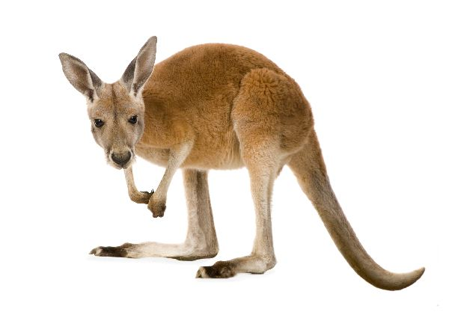
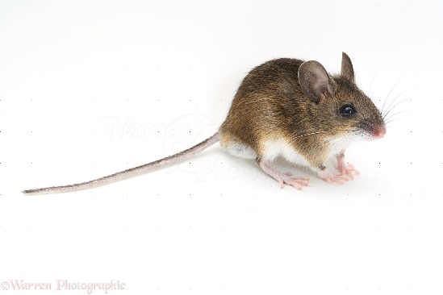
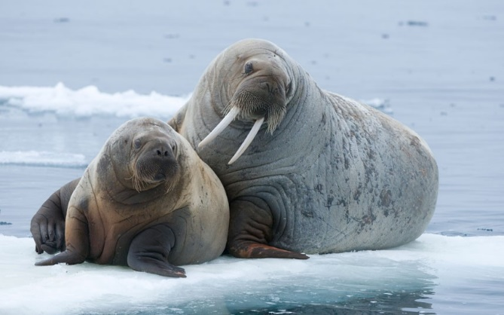
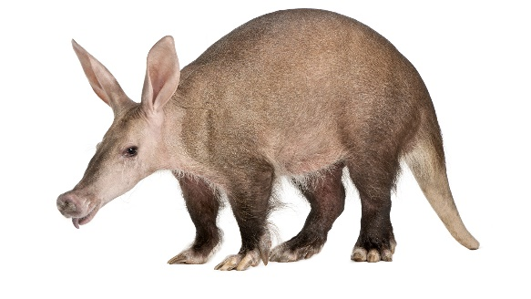
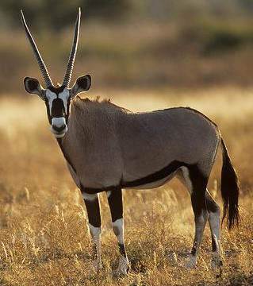
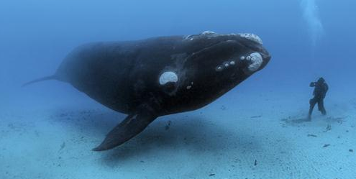
What is a mammal?
Endothermic vertebrate
Amniotic egg
Four chambered heart
Characteristics of Mammals
Mammary glands
Hair
_______ inner ear bones
Single _______ bone (mandible)
Differentiated teeth
Notes:
Diphyodont = two sets of teeth (deciduous and permanent)

Slide 3
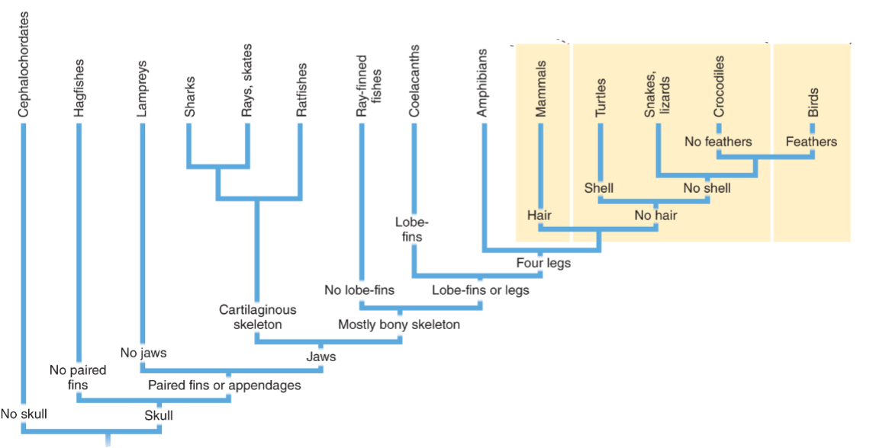
Phylogeny of Vertebrates

Slide 4
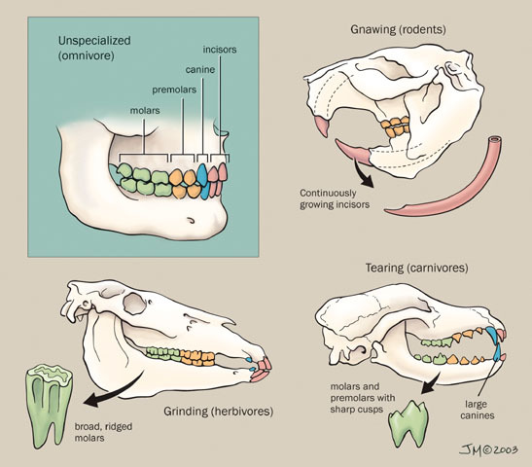
Mammal Dentition
Differentiation of teeth led to success in mammals
Size and arrangement of teeth associated with diet
Four distinct tooth types
Incisors: cutting
________: tearing
Premolars: grinding
Molars: crushing, grinding

Slide 5
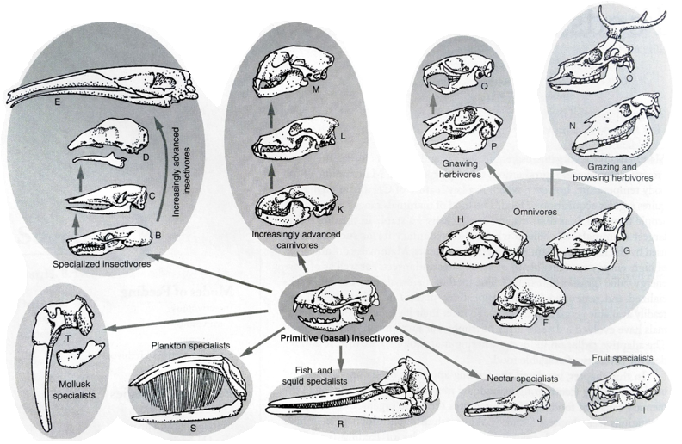
Diversification of Mammalian Dentition
Hedgehog
Mole
Armadillo
Anteater
Giant Anteater
Marmoset
Peccary
Bear
Fruit-eating bat
Nectar-eating bat
Raccoon
Coyote
Mountain lion
Horse
Deer
Jackrabbit
Wood rat
Porpoise
Right whale
Walrus

Slide 6
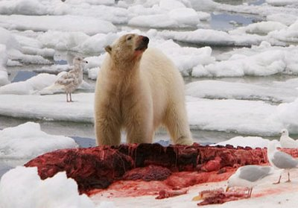
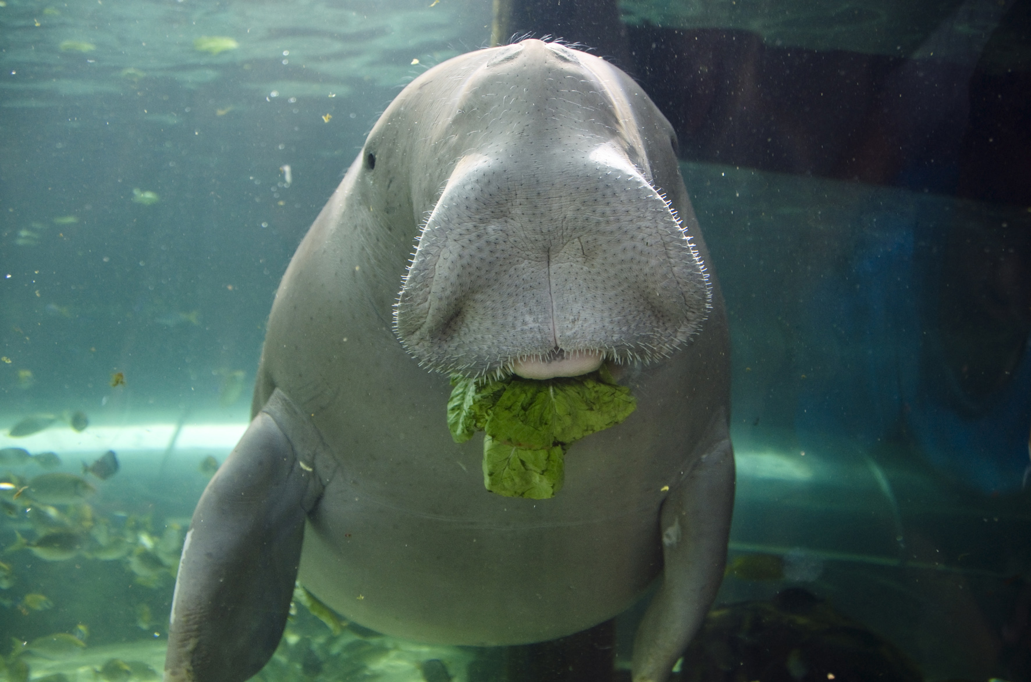
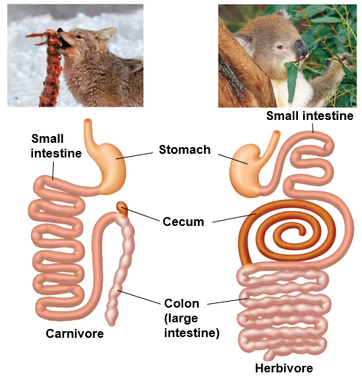
Digestive Tracts of Carnivores and Herbivores
Carnivores
Herbivores
Large, expandable stomachs
_____ digestive tract
Large cecum with symbiotic bacteria break down plant material
_____ digestive tract

Slide 7
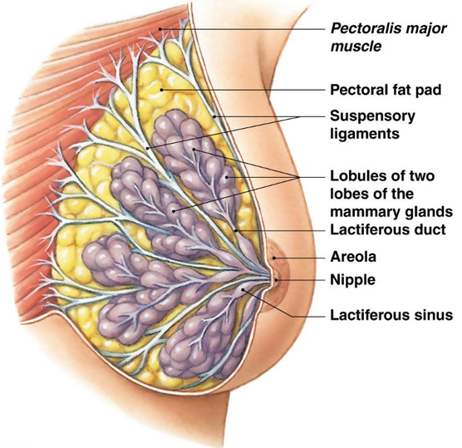
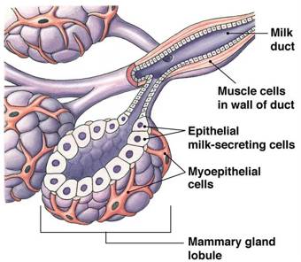
Lactation
Lactation: secretion of milk from mammary glands
Modified sweat glands
Milk: nutritional liquid comprised of fats, proteins, and lactose
Nutrition for newborn
Transmits passive _________
Supports growth of intestinal flora

Slide 8
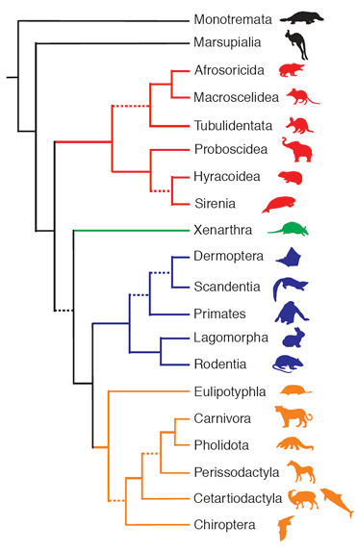
Major lineages of Mammals
Platypus, echidnas
Marsupials
Golden moles
Elephant shrews
Aardvarks
Elephants
Hyrax
Manatees
Armadillos, sloths, anteaters
Flying lemurs
Tree shrews
Apes, monkeys, humans
Rabbits and hares
Rodents
Hedgehogs, moles, true shrews
Canines, felines, bears, seals, weasels
Pangolins
Horses, tapirs, rhinos
Camels, pigs, whales, dolphins, antelope
Bats
Monotremes
Lay leathery eggs similar to reptiles
Marsupials
Nurture young in a marsupium (pouch)
Eutharians
Nurture young in a __________

Slide 9
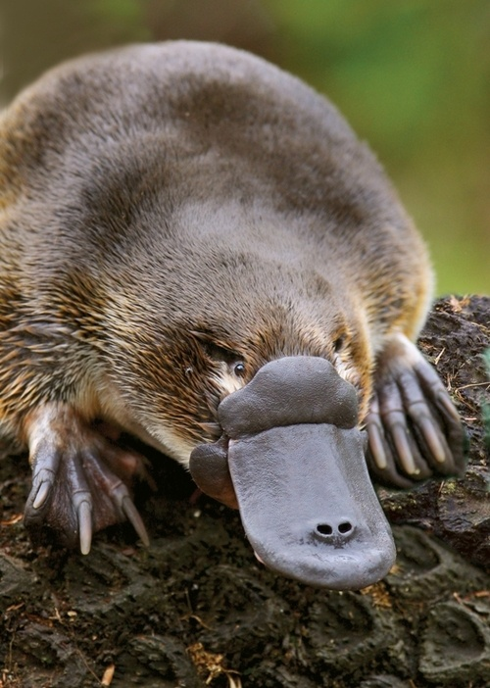
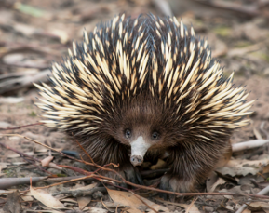
Monotremes
Single platypus species and four species of echidna
All found in either Australia or Papua New Guinea
Milk glands
Lack ________
Egg laying
Lack teeth as adults
Low metabolic rate
Cloaca
No marine monotremes
Notes:
Monotremes = “single opening” -Greek

Slide 10
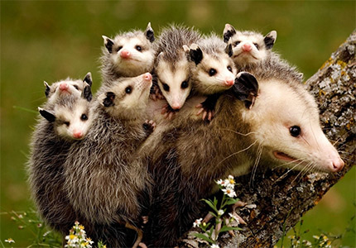
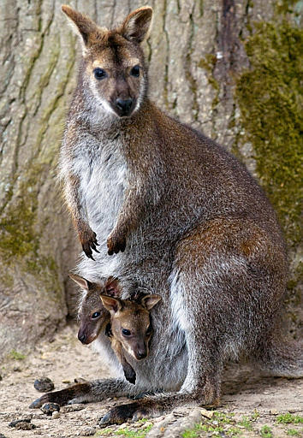
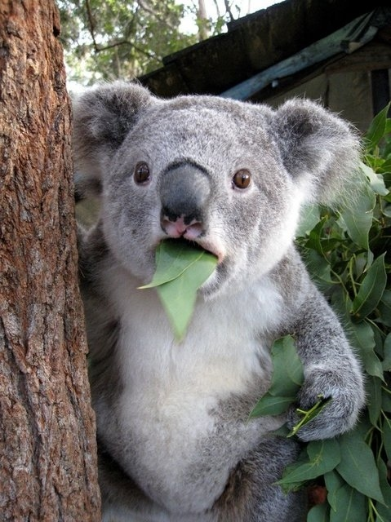
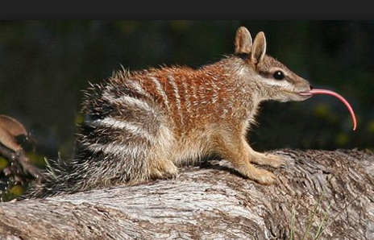
Marsupials
Limited to Australia and the Americas
____________ (pouch) often present
High metabolic rate
Small braincase (relative to body size)
No marine marsupials

Slide 11
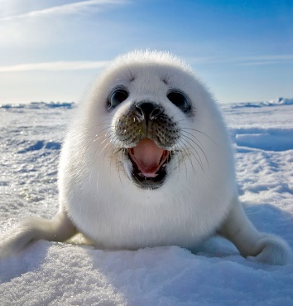
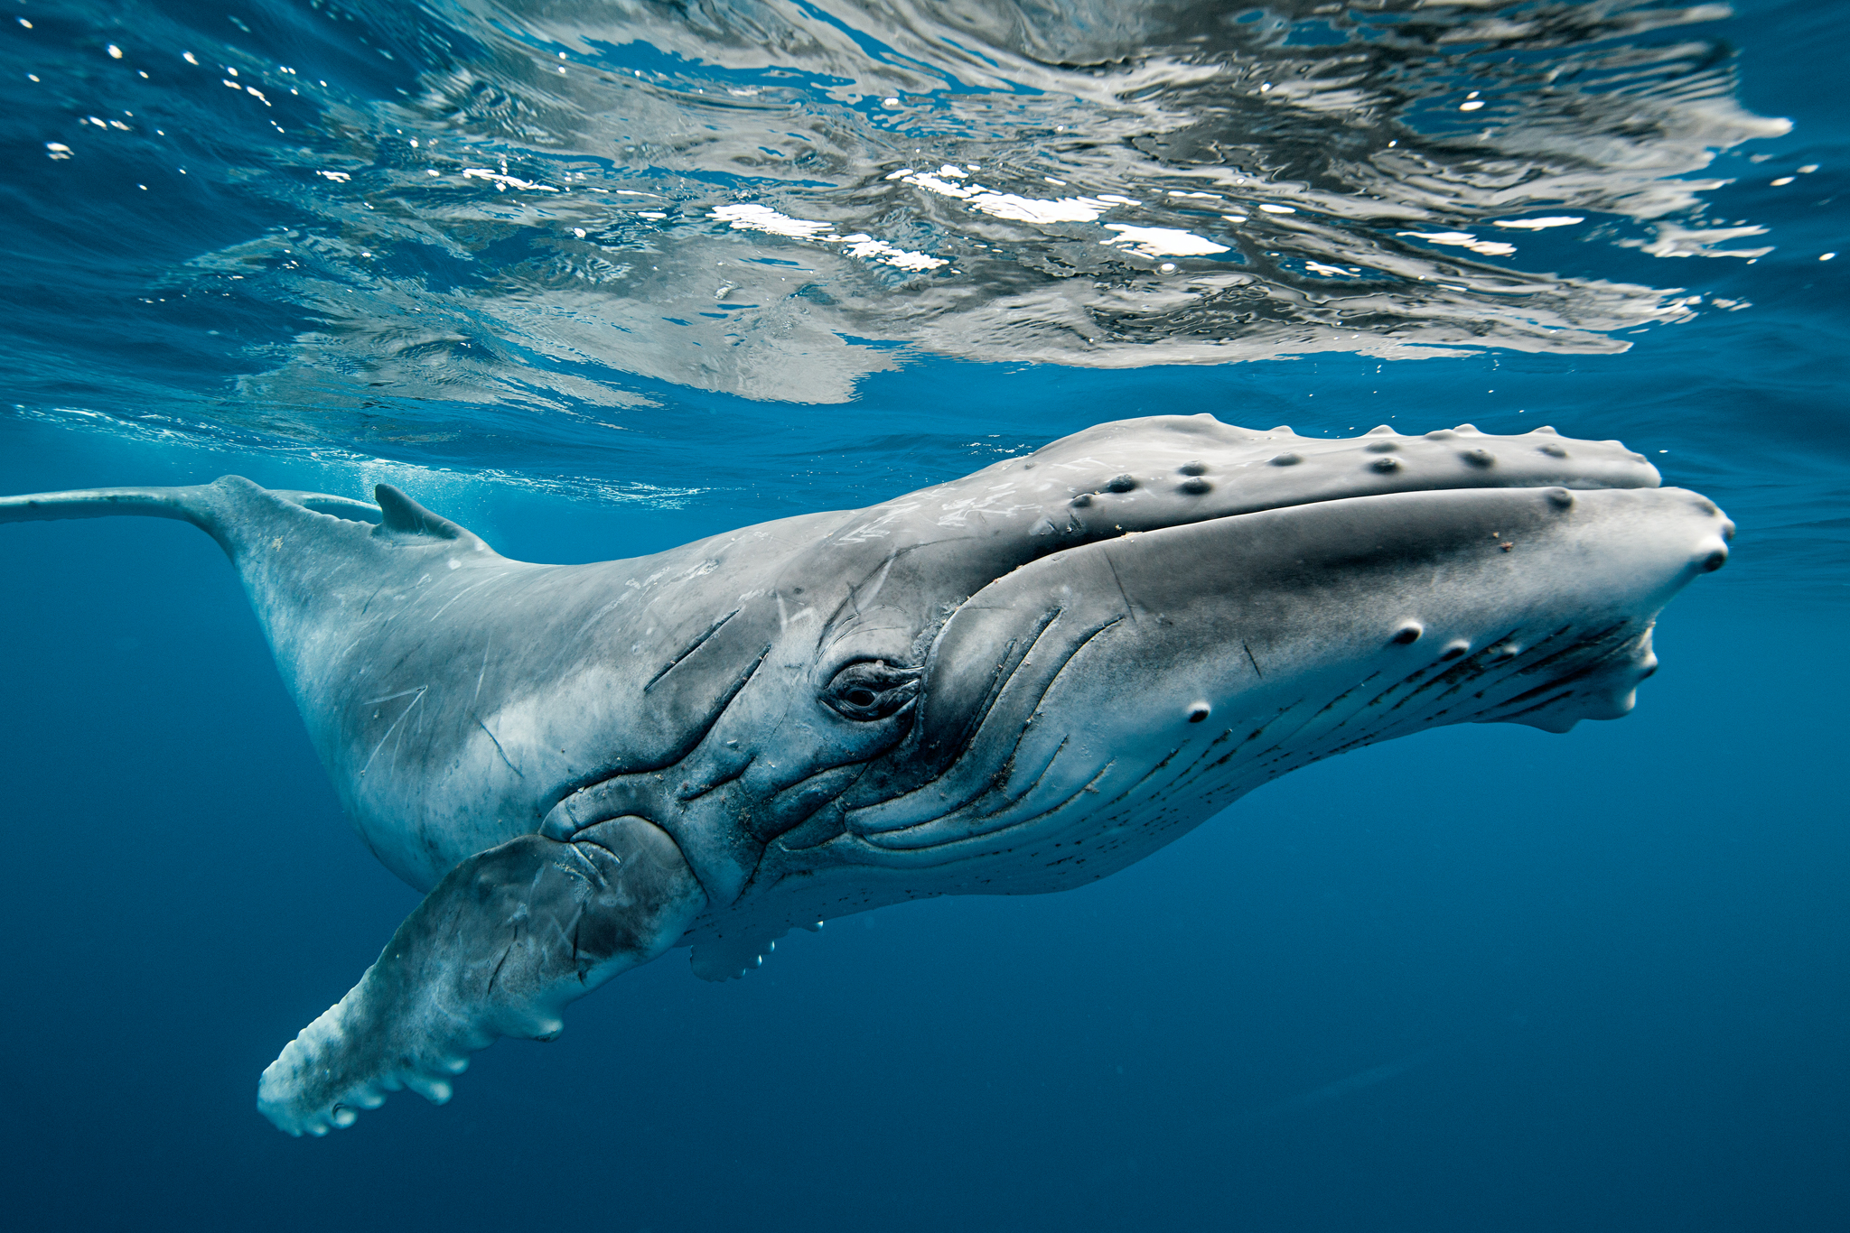
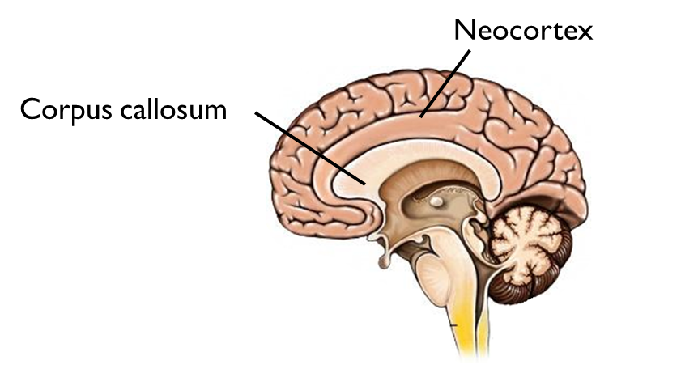
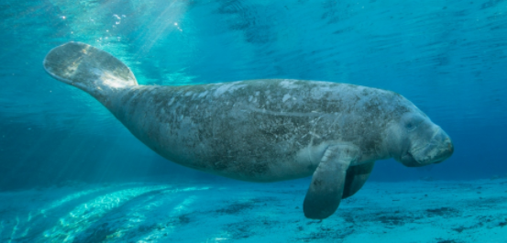
Eutherians
Worldwide distribution
Embryo nourished in placenta
Viviparous
Live birth
High metabolic rate
All marine mammals
___________
Complex neocortex: higher functions including sensory perception, language, spatial reasoning, motor commands
Corpus callosum: connects left and right hemispheres of brain

Slide 12
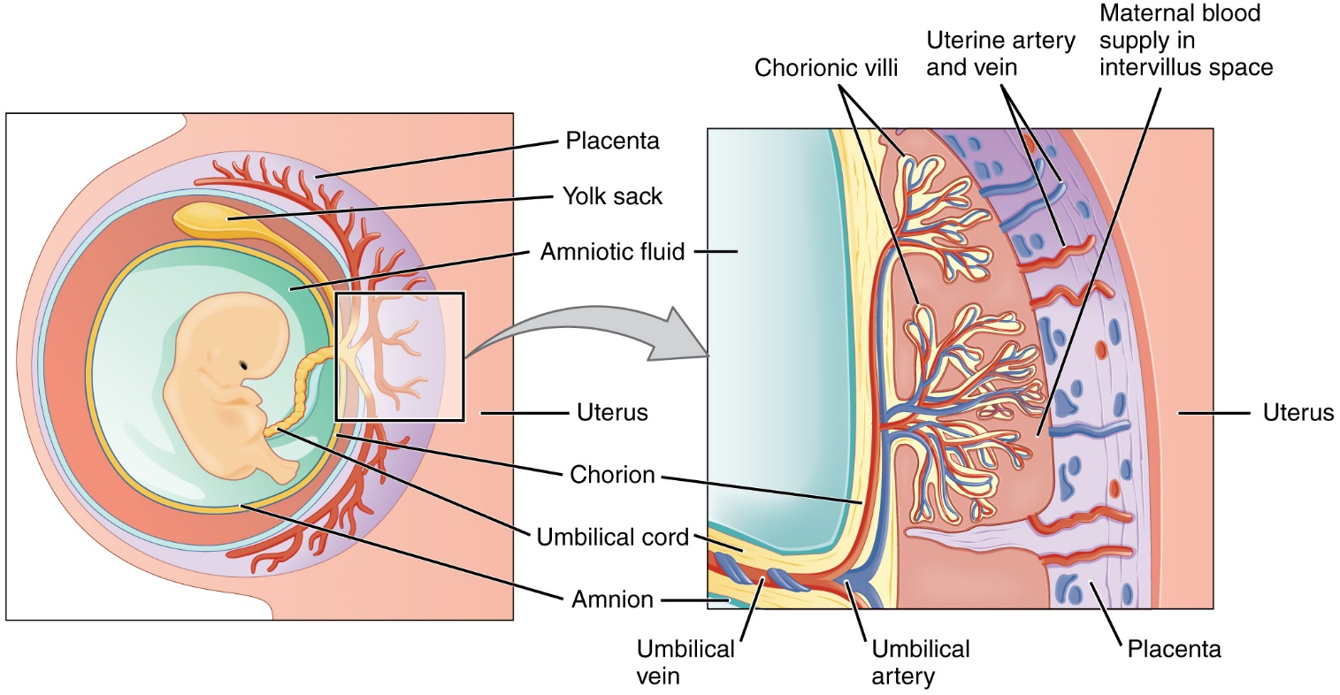
Placental Mammals
Placenta: organ that connects developing fetus to uterine wall and facilitated transfer of gases, nutrients and wastes.
Chorion: outermost membrane that develops chorionic villi, which facilitates exchange between mother and fetus
______________: vascularized cord connecting fetus to placenta
Notes:
Blood of fetus and mother do not mix

Slide 13
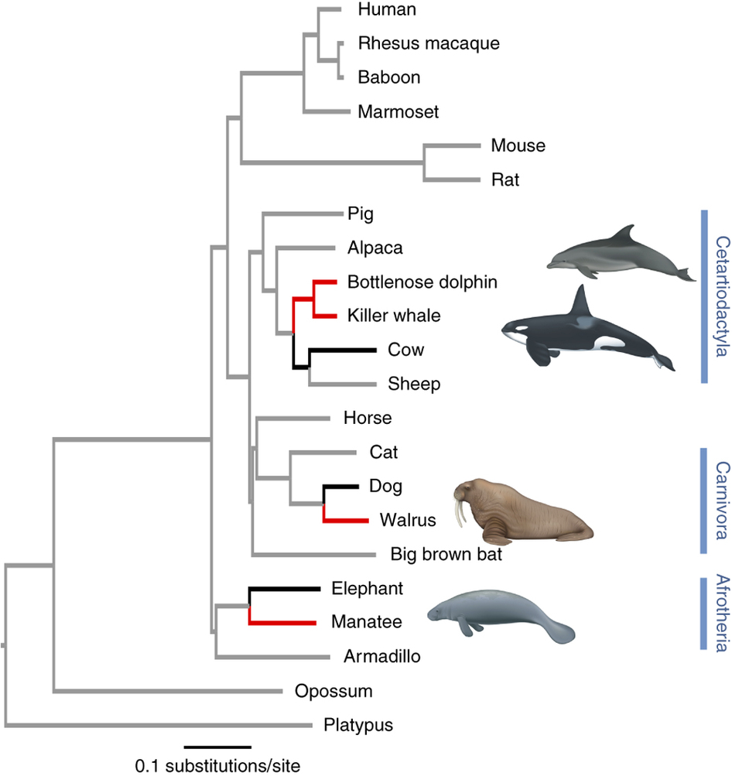
Return to Water
Three mammal clades returned to water
Whales
Carnivores (sea otter and pinnipeds)
Manatees and dugongs
Characteristics that support terrestrial origin
Lungs and a need to breathe air from the surface
Limb bones similar to land mammals
Vertical movement of spine
Vestigial pelvic bones in cetaceans

Slide 14
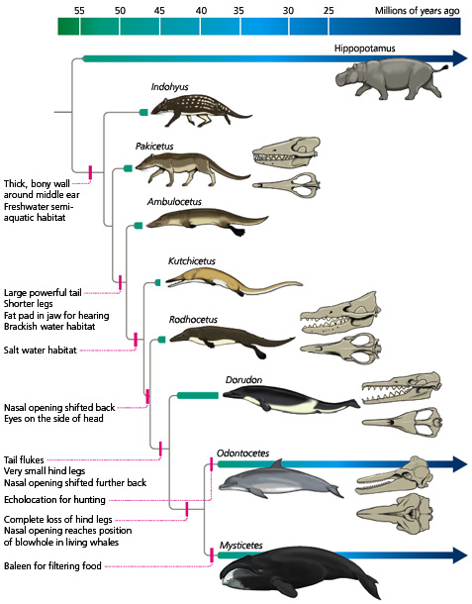
Whale Evolution
Whales evolved from terrestrial mammals around 50 million years ago
Key evolutionary steps in the evolution of whales:
Formation of a large, powerful tail
Reduction in ___________
Fore-limbs evolved into flippers
Nasal opening shifted to top of head
https://youtu.be/o92x6AvxCFg

Slide 15
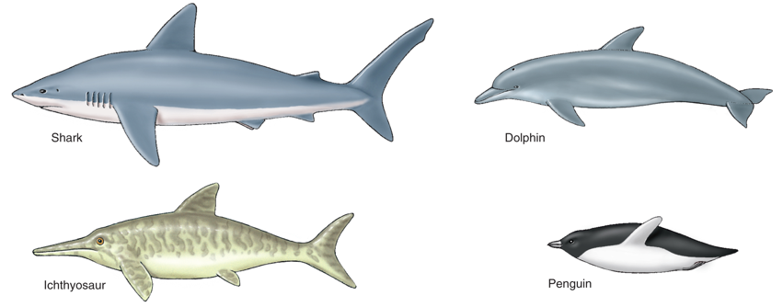
Convergent Evolution
The similar streamlined body of diverse groups of aquatic organisms is an example of convergent evolution.
Convergent evolution: similar morphological structures in _________ organisms due to similar selective pressures or lifestyles

Slide 16
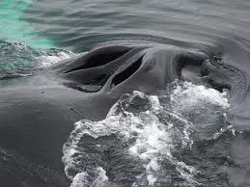
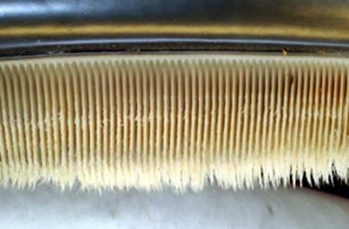
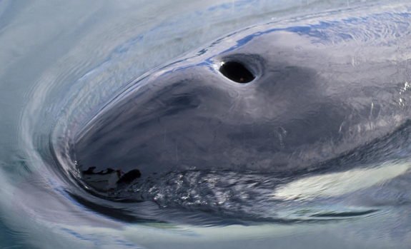
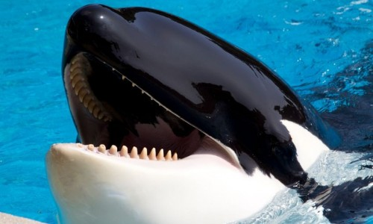
Cetacea
Mysticeti
Odontoceti
________ whales
Humpback whales, blue whales, right whales, minke whales
Krill, small schooling fish
15 species
_____ blow holes
Lack echolocation
_________ whales
Sperm whales, porpoises, dolphins, killer whales
Fish, squid, marine mammals
>70 species
_____ blow hole
Echolocation
Notes:
Hippos more closely related to cetaceans than other artiodactyla

Slide 17
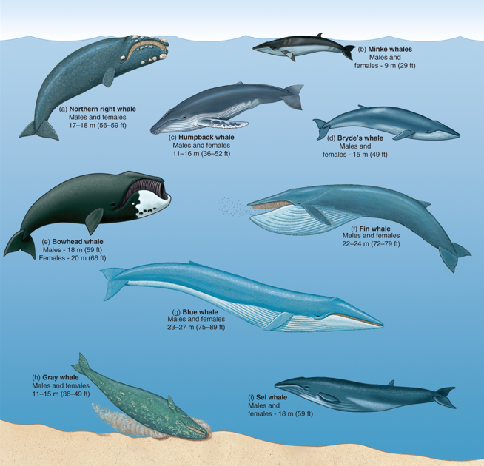
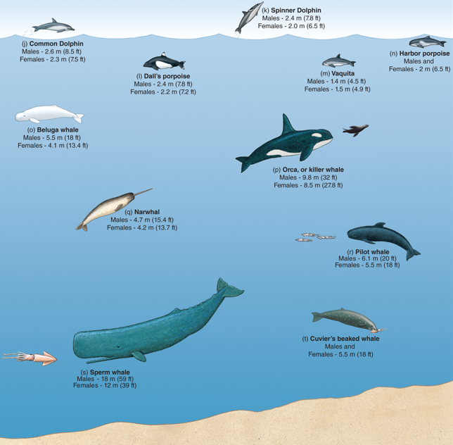
Mysticeti
Odontoceti

Slide 18
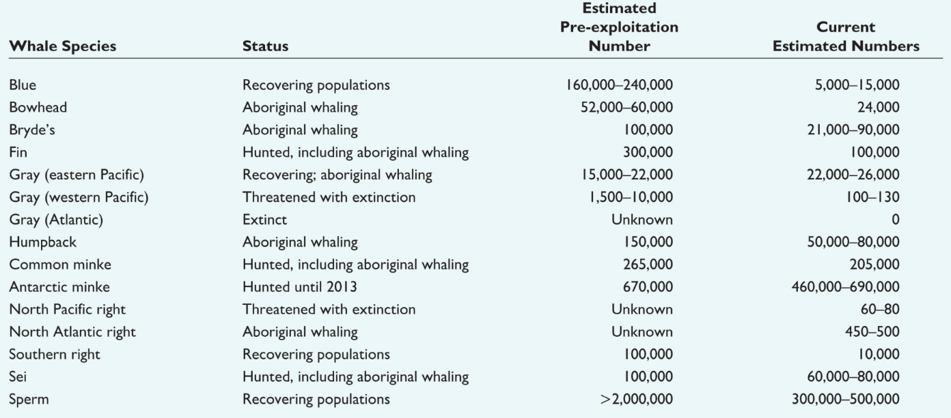
Status of Great Whales

Slide 19
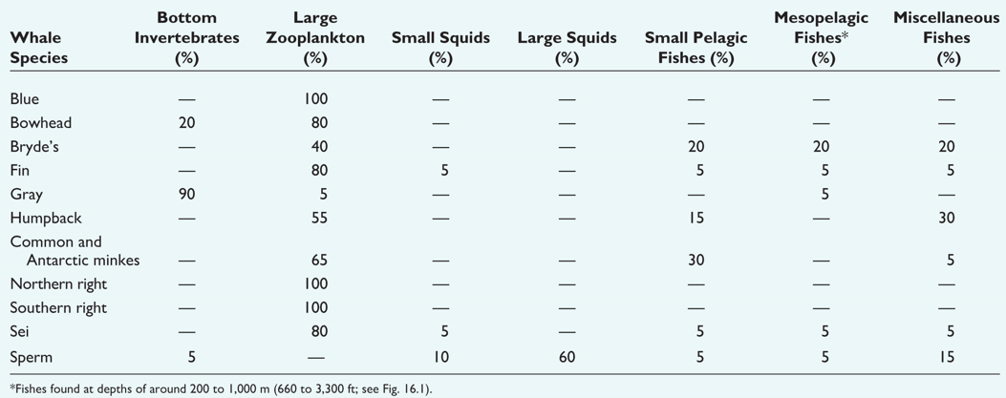
Feeding in Whales

Slide 20
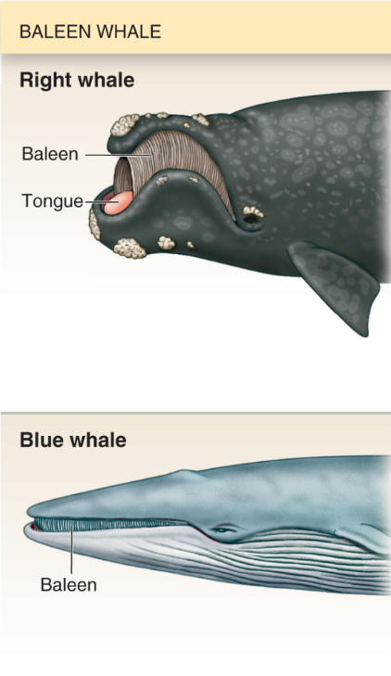
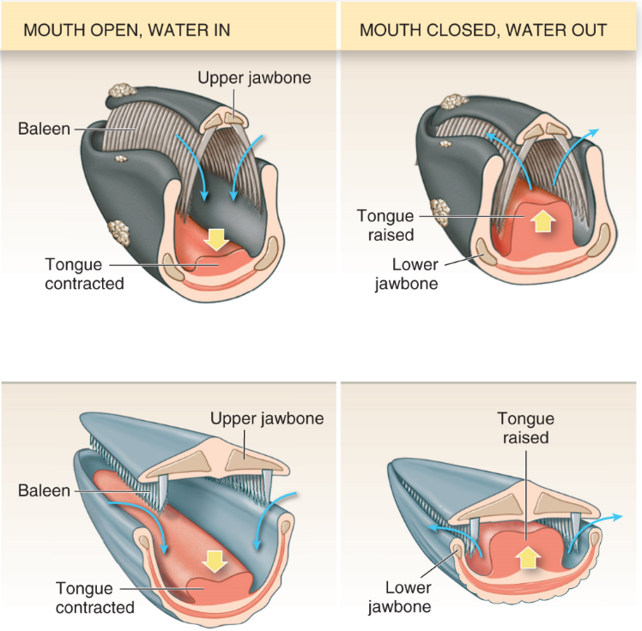
Feeding in Mysticeti
Whales filter-feed by taking a large mouthful of water and food and contracting their tongue to suck in water
Whales close their mouths a raise their tongues forcing water out of their mouth
Zooplankton trapped in their baleen is swallowed

Slide 21
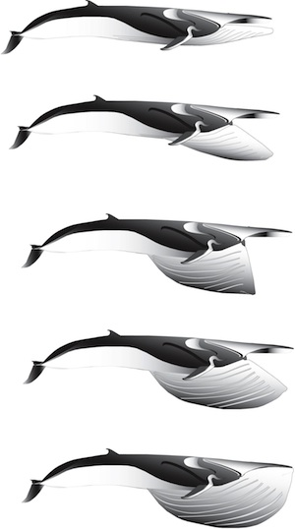
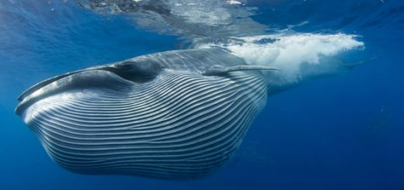
Feeding in Mysticeti
Some baleen whales, known as the ______, have longitudinal folds of skin known as ____________ from their mouth to their navel that allows their mouth to expand when feeding.
Rorquals will feed by gulping large quantities of water, then filtering out the zooplankton in the water

Slide 22
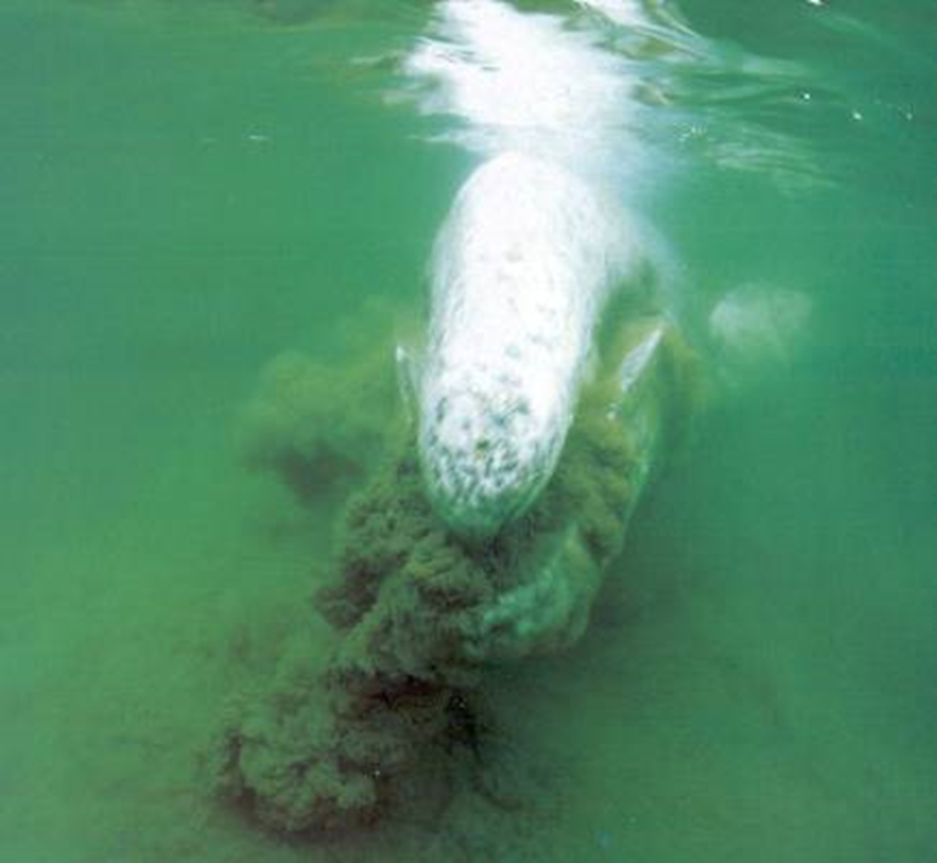
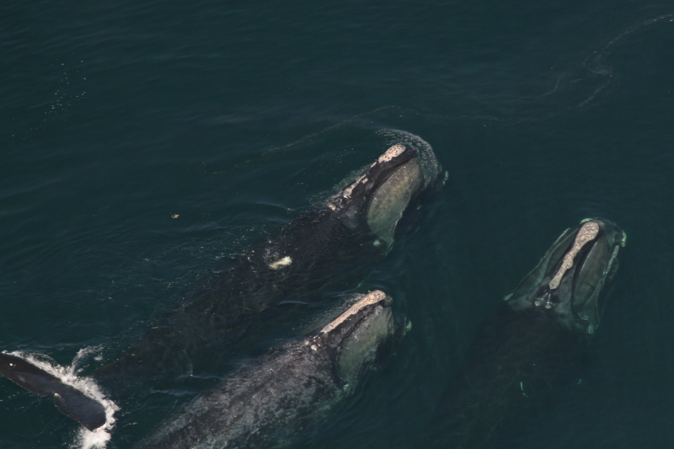
Feeding in Mysticeti
Grey Whales will feed on benthic invertebrates after stirring up the sandy bottom and filter feeding with baleen
Right and Bowhead whales have large baleen plates (up to 3m long) and feed by skimming the surface waters with the large mouths open

Slide 23
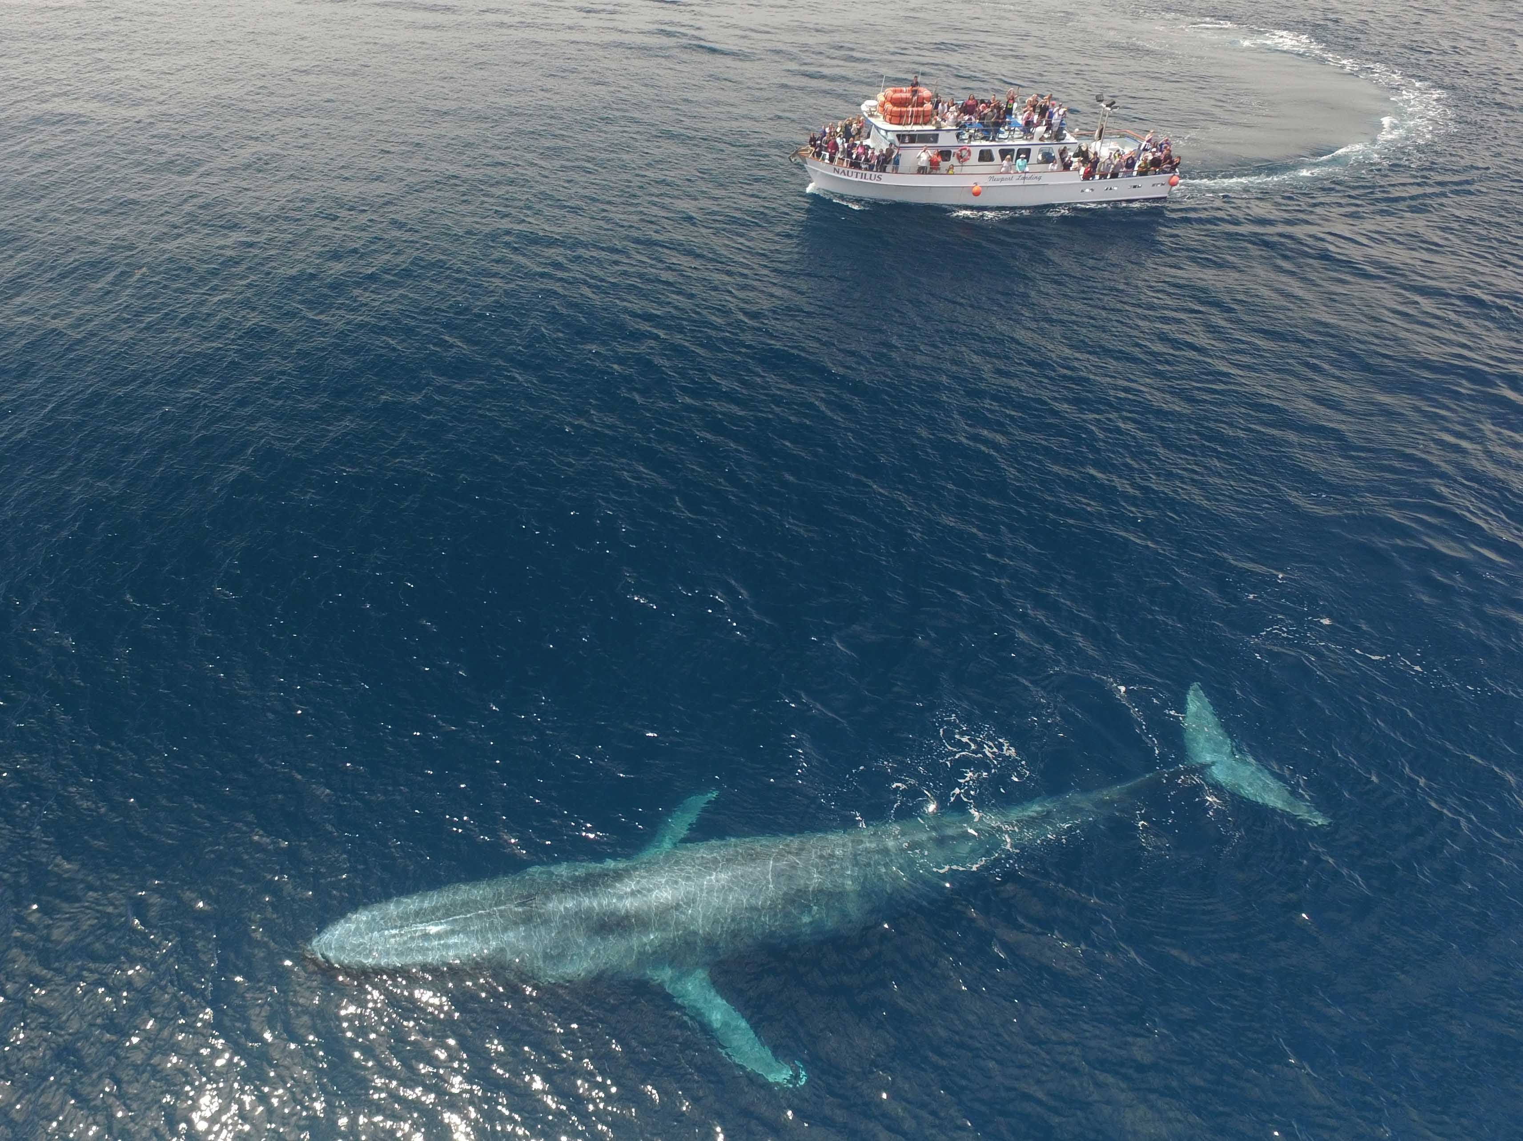
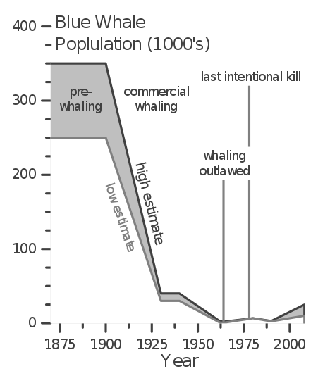
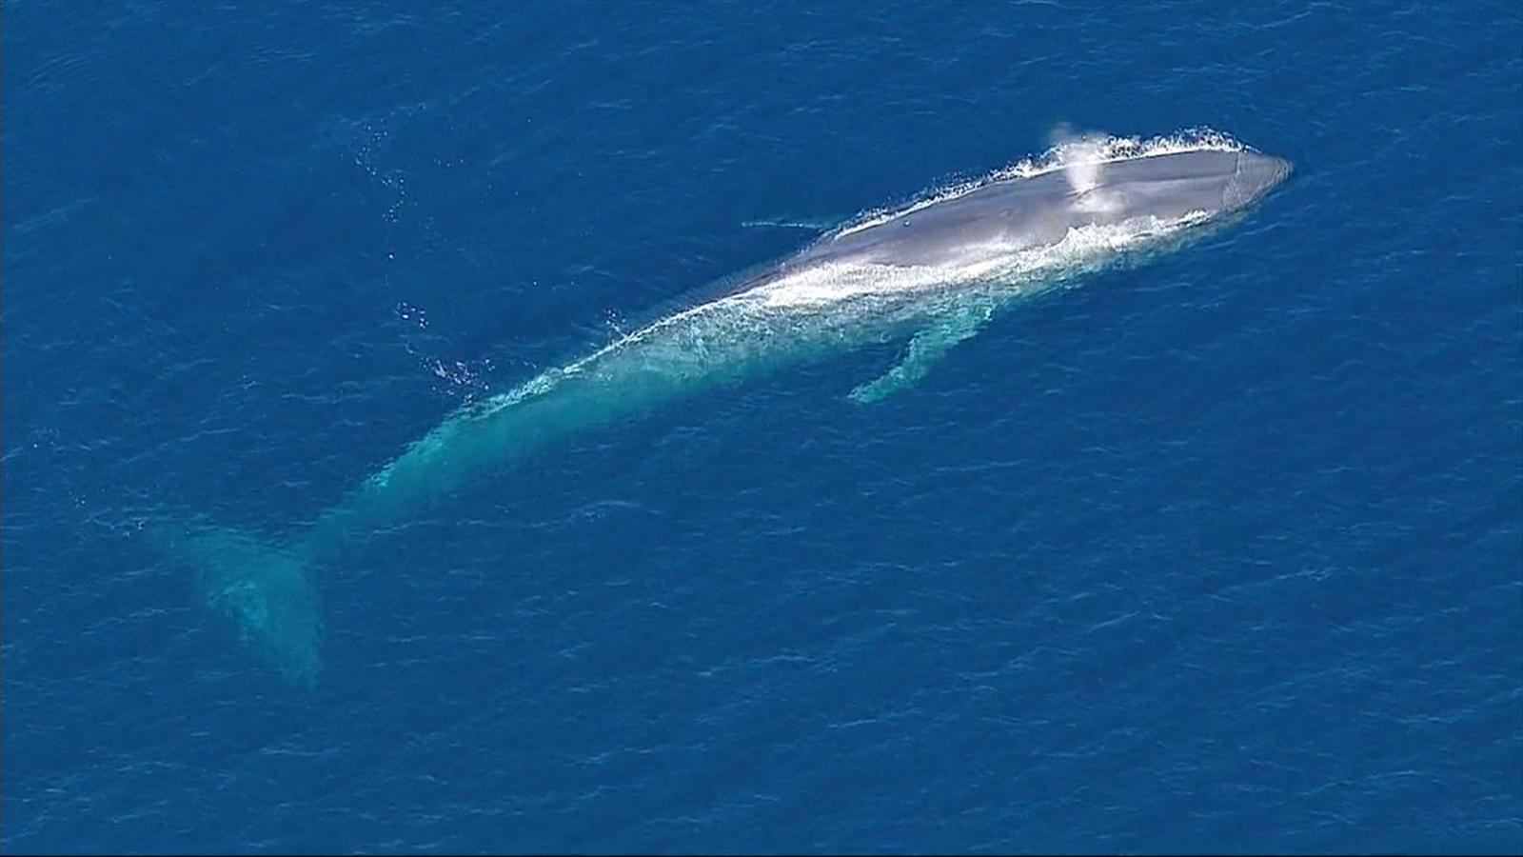
Mysticeti
Blue Whale
Largest animal to have _____
Up to 30m (98 ft)
Rorqual
Feeds on primarily krill
Can eat 40 million krill a day
Declines in populations due to whaling
Endangered
https://youtu.be/cbxSBDopVyw

Slide 24
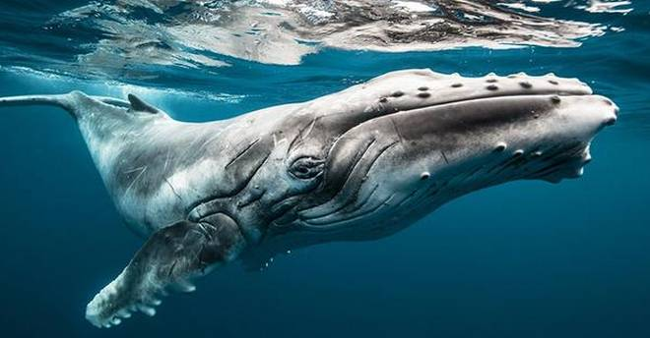
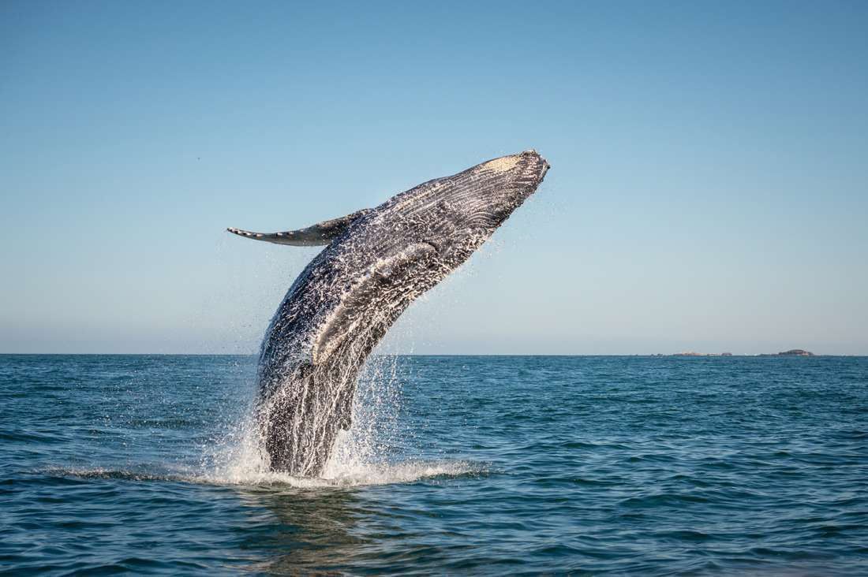
Mysticeti
Humpback Whale
Can grow to 52 ft long
_______________ and bumpy head
Found in all major oceans
Migrate to warm, tropical waters to breed, the to productive polar waters to feed
Feed primarily on krill and small fishes

Slide 25
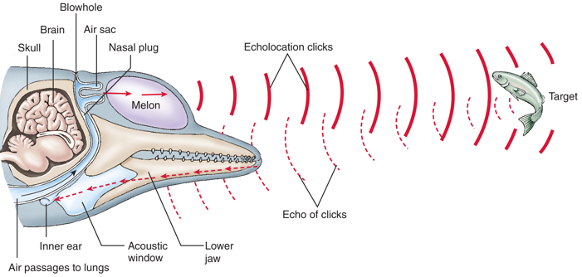
Feeding in Odontoceti
Bursts of sound waves or clicks are generated in the nasal passage and focuses by a lipid filled organ called the _______.
Low-frequency sound travel further than high-frequency sounds
Returning sound waves or echos are received by the lower jaw and transmitted to the inner ear
Sound information is sent from the inner ear to the brain for interpretation
Notes:
Toothed whales actively catch larger prey species like fish and squid

Slide 26
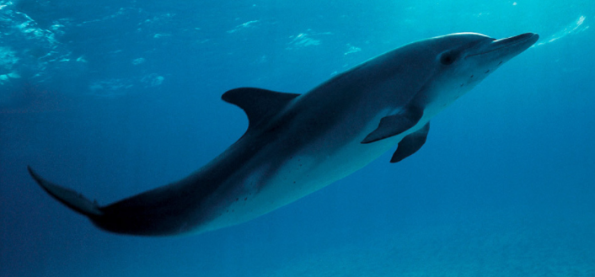
Odontoceti
Dolphin
Porpoise
40 species
Range from 4ft to 26ft long
Long snout
Flexible neck
Cone shaped teeth
______ dorsal fin
6 species
Range from 4 to 6ft in length
Short snout and bulbous head
Stiff, inflexible neck
Spade shaped teeth
Triangular dorsal fin

Slide 27
Odontoceti
Sperm Whales
Largest toothed whales
Name from spermaceti organ (melon) that contains waxy oil that whalers thought was sperm
Largest ____ of any animal on Earth
Clicks are some of the most powerful sounds in animal kingdom
Believed to stun prey
Teeth in lower jaw only
Feeds on primarily giant squid
Scars on head from fighting squid

Slide 28
Odontoceti
Orca (Killer Whale)
Worldwide distribution
Resident and transient populations
Largest dolphin species
Sexual dimorphism
Males have larger dorsal fin then females
Feed on primarily pinnipeds and fish
Coordinated feeding behaviors
Highly social
Family pods

Slide 29
Whale Behavior
Sleeping
Two modes of sleeping have been observed in whales
Rest vertically or horizontally in the water, occasionally surfacing to breathe
Logging: floating on the surface
Swimming slowly next to another whale
Whales rest ____________ at a time so that they remain alert and can still breathe

Slide 30
Whale Behavior
Migration
Many whales migrate toward the warmer tropical waters during the winter months to mate and give birth
Whales then migrate to temperate and polar oceans to feed during the summer months

Slide 31
Whale Behavior
Migration
Gray whales migrate further than any other mammal, traveling more than 10,000 miles a year
Feeds in Bering Sea where there is 24 hours of light and ample food during the summer
Breeds in Lagoons off the coast of Baja California
Pods of killer whales will attack calves as they migrate northward
video.nationalgeographic.com/video/whale_graymigration

Slide 32
Whale Behavior
Breaching: when the whale lifts most of its body out of the water
Hypotheses for breaching:
Remove external ___________
Signal nearby whales of food or danger
Exert dominance by expressing fitness
Play

Slide 33
Whale Behavior
https://youtu.be/Q8iDcLTD9wQ

Slide 34
Sirenia
Manatees and dugongs
Three manatee and one dugong species
All four species considered threatened
Only _____________ marine mammal
Indefinite molar replacement
Found in shallow bays, estuaries, and inland river systems
Long lungs and dense bones help regulate buoyancy
Steller’s sea cow extinct 27 years after discovery by Europeans
Notes:
Sea cow was hunted to extinction 27 years after being discovered by Europeans in 1741

Slide 35
Steller’s Sea Cow
Discovered by Georg Steller in 1741
Hunted to extinction 27 years later
Largest sirenian

Slide 36
Carnivora
Weasels, pinnepeds, cats, dogs, bears
Most are carnivores
Large brain to body mass ratio
Hunting
Camouflage fur
Ambush predators
Large canines
_________ pair
Shearing

Slide 37
Pinnipeds
Seals, Sea lions and Walrus
33 different species
Carnivorous
Worldwide distribution
Three families:
Otariidae (eared seals – sea lions)
Phocidae (earless seals – true seals)
Odobenidae (walrus)

Slide 38
Differences Between Seals and Sea lions

Slide 39
Earless Seals
Harbor seal, Elephant seal, Weddell seal, Leopard seal
More efficient swimmers than eared seals
Spend most of their lives at sea
Feed further away from shore
More clumsy on land
Most feed on fish, krill or squid
Common prey of white sharks and killer whales
Sexual dimorphism
Delayed implantation of embryo
____________: male breeds with several females
Harems

Slide 40
Eared Seals
Sea lions and Fur seals
Faster and more maneuverable than earless seals
Found near shore
Upwelling zones
Feed on fish, squid and krill
Common prey of white sharks and killer whales
Sexual dimorphism
Polygynous
Highly intelligent
Used in military training and human amusement

Slide 41
Walrus
Males can weigh up to 4,400 lbs.
Live in shallow waters above continental shelves
Feed primarily on _____________
Whiskers used to feel for molluscs
Males and females have tusks
Tusks used to make holes in sea ice and aid the walrus in climbing out of the water

Slide 42
Sea Otters
Larges member of the weasel family
Can weight up to 99 lbs
____________ of any mammal
1 million hairs per square inch
Carnivore
Eats primarily sea urchins, molluscs, and crustaceans
Endangered species
Hunting for their fur lead to their near extinction
For more than 150 years (1741 to 1911) sea otters were killed throughout their range

Slide 43
Polar Bear
One of the largest bear species
Males weigh up to 1,500 lbs.
Population estimated between 20,000 to 30,000
Feed almost exclusively on seals
Can swim for days covering over a hundred miles
Adaptations for survival in the Arctic:
__________ absorbs solar heat
Shorter legs, tails and ears reduce heat loss
Large feet distribute weight in snow
Thick layer of fat provides insulation

Slide 44
Deep Diving Mammals
Sea Otters: 4-5 minutes; 180 ft
Pinnipeds: 30 minutes; 490 – 820 ft
Elephant Seals: Adult female elephant seals make 20 minute dives to depth of 2,625 ft with less than 3.5 minutes between dives.
Sperm Whale: 1 hour; 7,380 ft
Weddell Seal: 1hour 30 minutes; 1,900 ft

Slide 46
The Diving Response
Apneustic breathing: rapid, deep breaths before a dive to increase oxygen in blood
Marine mammals exchange as much as 90% of the oxygen in the lungs with each breath
Humans exchange about 20% of the oxygen in the lungs with each breath
Decreased _____________
Decreased metabolic rate
Blood flow to non-vital organs is reduced

Slide 47
Adaptations for Deep Diving
Weddell seals can hold their breathe for more than an hour.
High concentrations of myoglobin in the muscle, which binds to oxygen molecules in blood
Anaerobic metabolism: generate cellular energy without the need for ________
Greater volume of red blood cells store more oxygen
Oxygen concentrations 4 times greater than humans
Buffering their blood to compensate for the decrease in pH with higher CO₂ concentrations

Slide 48
Summary of Marine Mammals

Slide 49
Check Your Understanding
True or False: Odontoceti have a single blow hole
True or False: The digestive tract of carnivores is longer than the digestive tract of herbivores
True or False: Whales migrate to the polar regions in the summer to feed and the tropics in the winter to breed

Slide 50
Check Your Understanding
Which of the following is false concerning true seals?
a. No external ears
b. Hair covering their front flippers
c. Internal testicles
d. Can move their hind limbs forward
e. All of the above are true concerning seals

Slide 51
Check Your Understanding
Which of the following are not one of the adaptations of deep diving mammals?
a. Greater volume of blood and red blood cells
b. Huge lungs
c. Apneustic breathing
d. High concentrations of myoglobin in the muscles
e. All of the above are true concerning deep diving mammals

Slide 52
Check Your Understanding
Describe the different feeding strategies of baleen whales (Mysteceti) and toothed whales (Odontoceti), including the process of producing sound waves in Odontoceti.

Slide 53
Whale Behavior
Bubble Netting
RING LEADER
Creates a ring of bubbles above the shoal that prevents the fish from escaping
HERDERS
Encircle the fish, keeping the shoal together
CALLER
Emits a loud call from below the fish driving them upward
All the whales gather below the fish and ascend to the surface together
https://youtu.be/Q8iDcLTD9wQ

