Slide 1
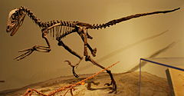
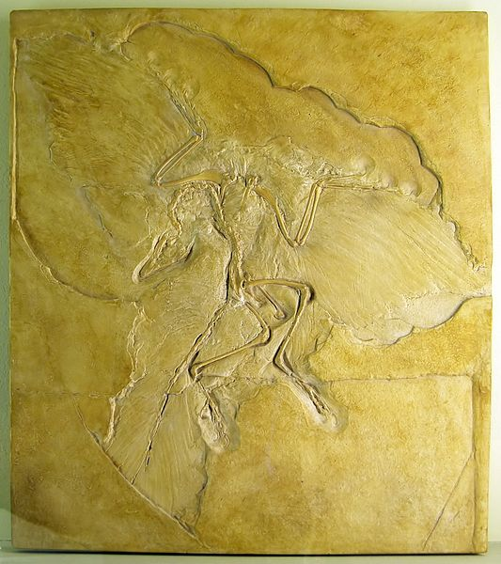
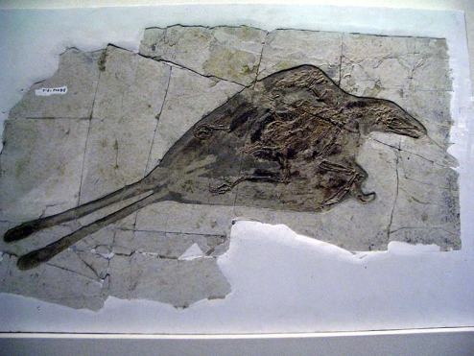
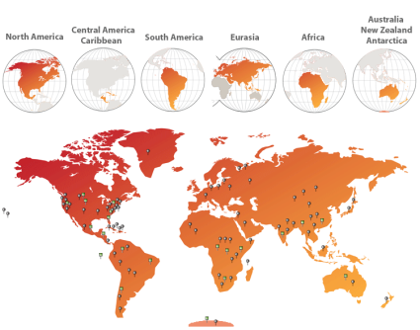
Aves
General Characteristics and structures – Modern birds are characterized by feathers, a beak with no teeth, the laying of hard-shelled eggs, a high metabolic rate, a four-chambered heart, and a lightweight but strong skeleton. All living species of birds have wings which are evolved forelimbs, and most bird species can fly.
Evolutionary History – The fossil record indicates that birds emerged within theropod dinosaurs during the Jurassic period, around 150 million years ago.
Biogeography – Birds live and breed in most terrestrial habitats and on all seven continents, reaching their southern extreme in the Snow Petrel's breeding colonies in Antarctica.
Mounted skeleton of a theropid dinosaur
Deinonychus antirrhopus
Archaeopteryx
Confuciusornis,
a Cretaceous bird from China

Slide 2
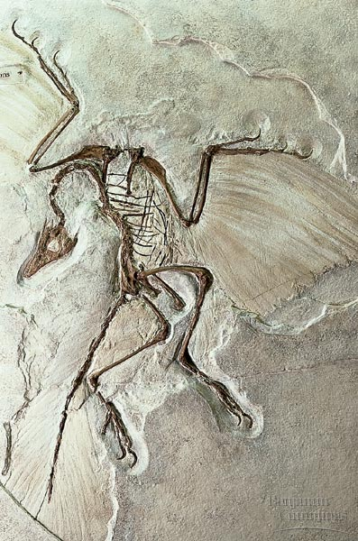
Evolutionary History Archaeopteryx
Archaeopteryx means “ancient wing”. It is one of the earliest and most primitive birds known. It is often considered a “transitional form”. Unlike modern-day birds, it had teeth, three claws on each wing, a flat sternum (breastbone), belly ribs (gastralia), and a long, bony tail. Like modern-day birds, it had wings, feathers, a lightly-built body with hollow bones, a wishbone (furcula) and reduced fingers.

Slide 3
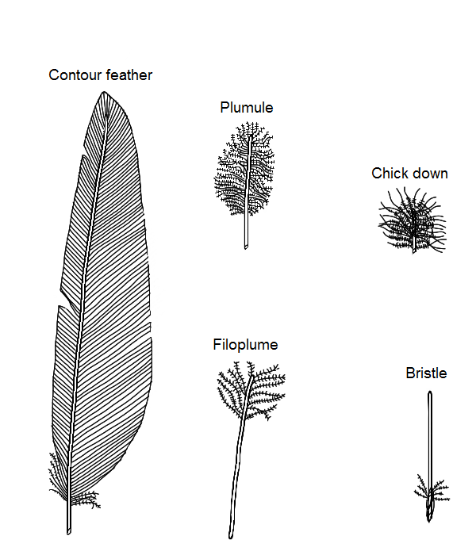
Birds – General Characteristics
Feathers - Feathers are made up of keratin (the same material as scales found in reptiles). Birds have six different types of feathers, each with a different function.
Contour Feathers – Body Covering
Flight Feathers – Flight
Down Feathers – Warmth
Filoplume – probably a sensory function
Plumule or Semiplume – provide form, insulation and aerodynamics
Bristles – Sensory and protective function
-

Slide 4
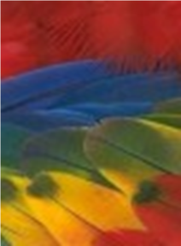
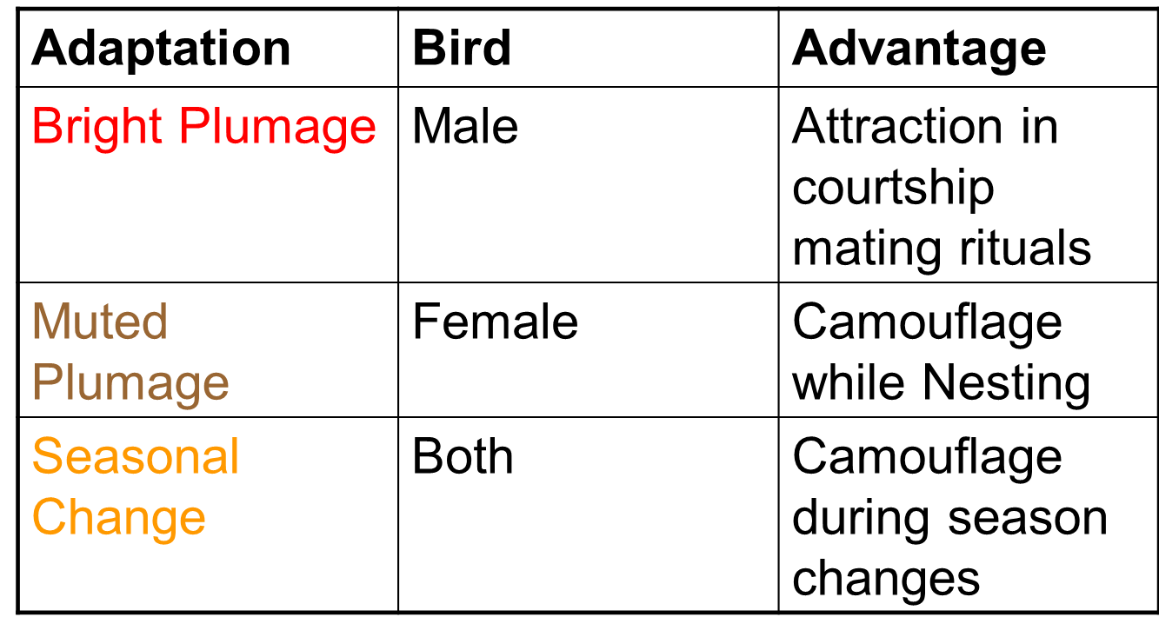
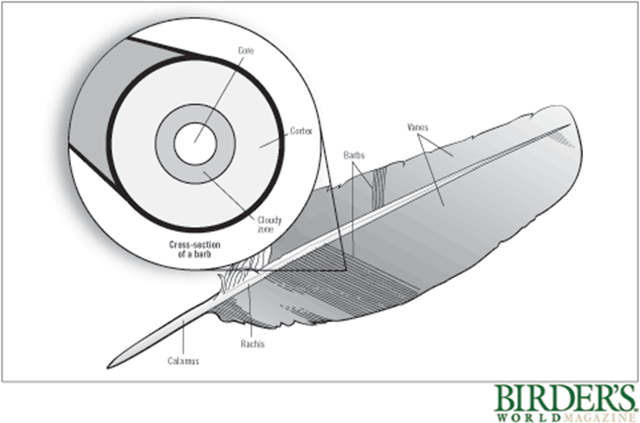
Birds – General Characteristics
Color in Birds
Pigments are responsible for some feather colors. Colors also occur in feathers in which the cortex is pigment-free. In these feathers, the layer between core and cortex - called either the cloudy zone or the spongy layer due to the appearance of a dissected feather to the naked eye - produces colors through convoluted air cavities that act as tiny light-scattering prisms. Not all feathers have a cloudy zone.

Slide 5
General Characteristics Color in Birds
Cardinals = The dogwood tree grows bright red autumn berries - a favorite food of the Northern Cardinal and a source of red carotenoids. When the cardinal metabolizes dogwood berries, the carotenoid pigments are sequestered in the liver and then transported to the bloodstream for eventual deposit in growing feather follicles where they crystallize.

Slide 6
General Characteristics Color in Birds
Flamingos = Carotenoids may be acquired indirectly at the end of a food chain. Brine shrimp feed on algae containing red and yellow carotenoid pigments. The pigments eventually cycle into the feathers of birds that eat the shrimp, such as flamingoes. Captive flamingoes and fade to white without carotenoid-rich dietary supplements, so zoos must feed pigment extracts to maintain the bright coloration of their pink birds.

Slide 7
General Characteristics Color in Birds
Western Scrub Jay =Unlike virtually every other feather color, no pigment turns feathers blue. To find the source of blue color, we have to drill down past the barbs and barbules to the "nanostructural" level of the cloudy zone. In the cloudy zone of blue feathers, the melanin and air cavities are so close that the distance between them is shorter than a wavelength of light, When scattering elements are this small, they interact with light through a process called constructive interference. The nanostructural array in blue feathers scatters light in an orderly way. The scattered light waves are in phase and reinforce each other and appear blue in the light.

Slide 8
General Characteristics Color in Birds
American Goldfinch = Yellow goldfinches, likewise, get their bright color exclusively from the seeds they eat. The inner core of a yellow feather is devoid of pigment, so only the light yellow color of the carotenoid is visible.

Slide 9
General Characteristics Color in Birds
Anna’s Hummingbird = Iridescent feathers are made up of complicated arrays of minute reflectors, often in the barbules, and sometimes comprise several ordered layers of melanin granules, air cavities, or both. The structures are sometimes twisted, so they work like the crystals of an infinitesimally small chandelier, absorbing and reflecting a range of wavelengths.

Slide 10
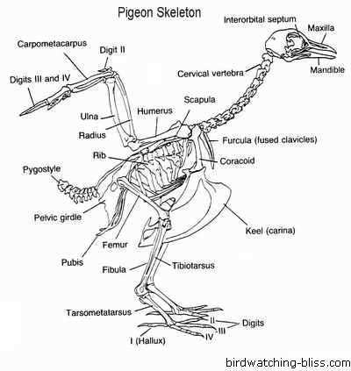
General Characteristics - Bones
Bones are fused in three regions of the avian skeleton:
1) the throax - a fusion of the two clavicles (collar bones) called the furcula
2) the pelvis - the three lowest lumbar vertebrae of the back and the six upper vertebrae in the tail are fused with the pelvis to form the synsacrum
3) the outer wing - the bones, equivalent to the mammalian hand and wrist are either fused, reduced or absent to increase flexibility in how their wing is held. This area is called the carponmetacarpus.

Slide 11
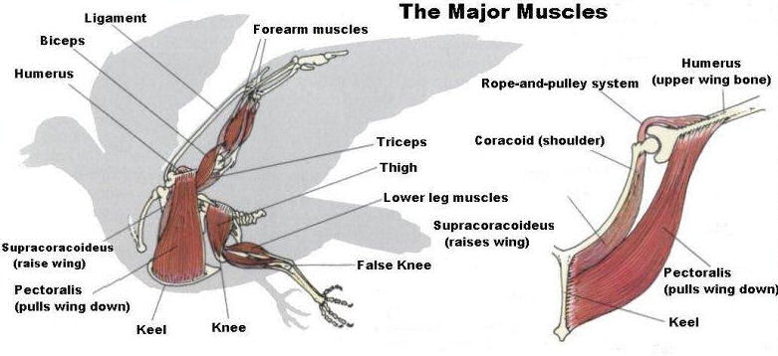
General Characteristics -Muscles
The muscle responsible for lifting the wing is the supracoracoideus. The muscle responsible for lowering the wing for its downstroke is the pectoralis. Birds that fly allocate an enormous percentage of their body resources to the flight muscles, which can account for 20 -25% of their total body mass.

Slide 12
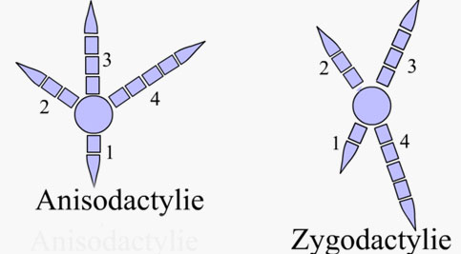
General Characteristics – Bipedalism and Feet
Although most tetrapods are quadrupeds, Birds are bipedal. Many people think that a bird’s knees bend backward. Birds actually walk on their toes, however, and the backwards-oriented joints that seem to be their knees are actually their ankles. Most birds have their toes oriented in a anisodactyl manner (with three toes in front, and one in the back). Other birds like owls and woodpeckers have a zygodactyl arrangement with two toes forward and two toes back.

Slide 13
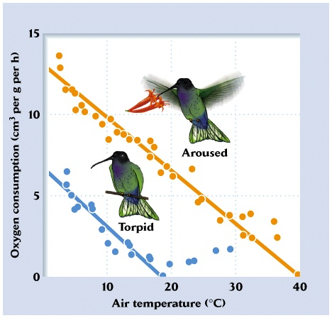
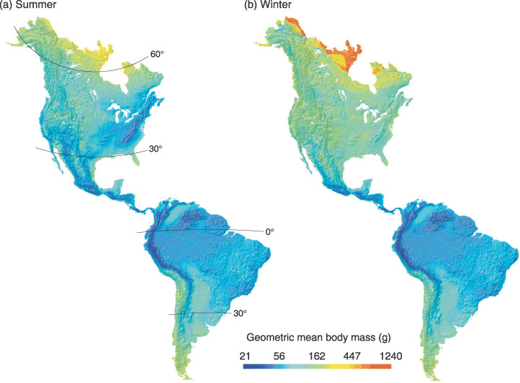
General Characteristics – Metabolism
Birds have unique metabolic rates and are endothermic. If you look at the average body temperature of vertebrates you’ll find that birds have the highest average body temperature of all. They’re significantly higher than mammals and are actually right on the cusp of protein denaturation. As with metabolic rates, birds tend to have higher body temperatures than mammals. In general, body temperatures of birds range from about 38 - 42 degrees Celsius (100 – 108 degrees Fahrenheit). Birds are actually larger in temperate zones than in the tropics to limit surface area to reduce heat loss.

Slide 14
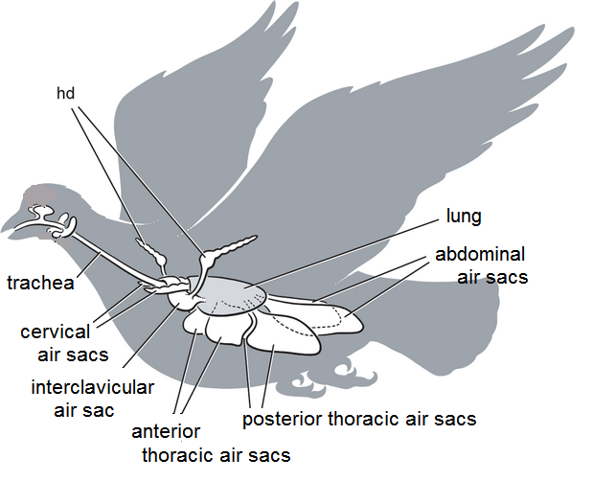
General Characteristics – Metabolism
The avian respiratory system delivers oxygen from the air to the tissues and also removes carbon dioxide. In addition, the respiratory system plays an important role in thermoregulation (maintaining normal body temperature). The avian respiratory system is different from that of other vertebrates, with birds having relatively small lungs plus nine air sacs that play an important role in respiration (but are not directly involved in the exchange of gases). The air sacs permit a unidirectional flow of air through the lungs. Unidirectional flow means that air moving through bird lungs is largely 'fresh' air & has a higher oxygen content.

Slide 15
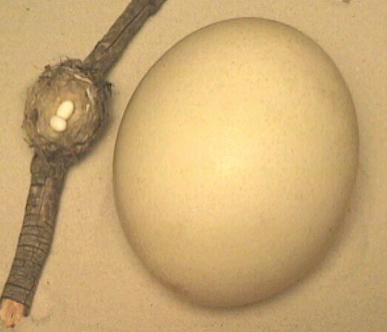
General Characteristics - Reproduction
Egg laying is unique in birds because birds are the only vertebrates whose eggs have a hard covering for protection. Birds are also the only vertebrates where all the members lays eggs. The largest egg is the Ostrich and the smallest egg is the hummingbirds.

Slide 16
Reproductive Behavior - Monogamy
Until recently, monogamy was considered the norm for birds. It has been shown that birds commonly engage in extra-pair copulations or “cheating”. Birds that raise young together are said to be Socially Monogamous. More than 90% of all species are thought to be socially monogamous.

Slide 17
Reproductive Behavior - Polygyny
Polygyny is when one male has multiple females. In red-winged black birds, males fight for territories and females choose males on their preception of the male’s fitness. Conditions that favor this reproductive system are colonial groups where there is enough resources for females to feed the young alone and the young are independent early in life.

Slide 18
Reproductive Behavior – Sage Grouse
Sage Grouse use an extreme form of polygyny called lekking. Lekking is where males collect in a group to perform courtship displays. The area they gather in is called an arena or booming ground. The benefits for the males is they are found in areas without resources so the arena allows them to show off their genetic qualities. Females are able to choose males quickly and the young females can learn from the more experienced females.

Slide 19
Reproductive Behavior – Northern Jacuna
Nortern Jacuna use a system called polyandry. Polyandry is where the female attracts more than one male. The sexual roles in this system are reversed. The females fight for territories, males, and resources. Polyandry evolutionary speaking is the same as polygyny where one parent does not have to worry about parental care and can concentrate on offspring number. It allows the females to reproduce quicker because the females do not have to care for the young. It is less common because females invest more into the egg than males do to their sperm.

Slide 20
Reproductive Behavior – Acorn Woodpecker
Acorn Woodpeckers will find that females will be paired with several males and males will be paired with several females. This is called polygyandry. Acorn Woodpeckers live in groups to protect their storage of acorns. Several females will lay their eggs in a single nest and each will compete to leave the most eggs. Females will even throw out other females eggs. Once the clutch is laid, all the adults will care for the young.

Slide 21
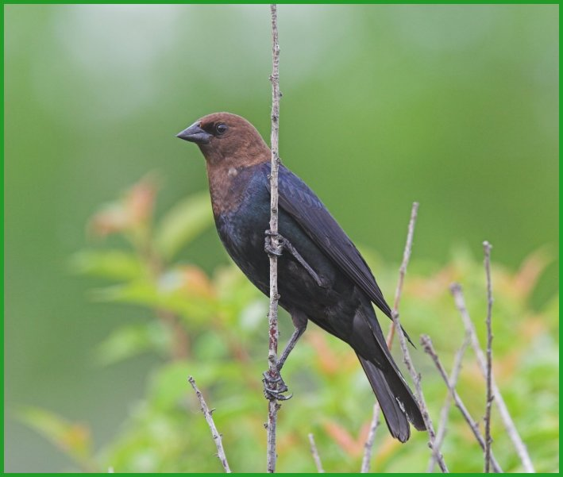
Reproductive Behavior – Brown-headed Cowbird
Brown-headed Cowbirds reproduce by a strategy called brood parasitism where females lay their eggs in another species next. The parasitized species then raises the cowbird’s young. Brown-headed cowbirds have successfully parasitized 140 of 220 species in whose nests its eggs have been observed. Although only 3% of cowbird eggs reach adulthood, it reduces production of young by the host species. It represents a major threat to a few very vulnerable species.

Slide 22
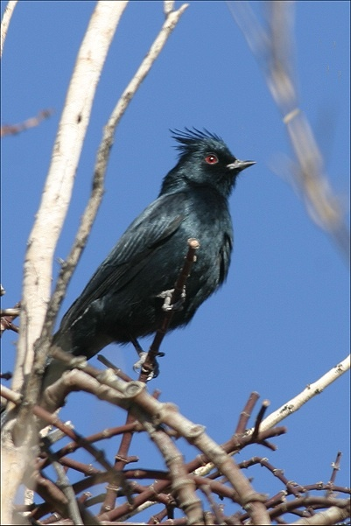
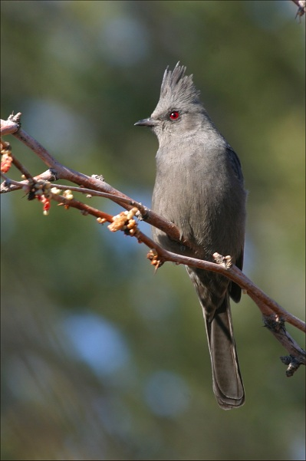
Reproductive Behavior – Phainopepla
Phainopeplas feed primarily on mistletoe berries. Phainopeplas are notable for their pattern of breeding twice each year, in two different habitats. The Phainopepla exhibits strikingly different behaviors in the two different habitats. In the desert, it is territorial, actively defending nesting and foraging sites, while in the woodlands it is colonial, with as many as four nesting pairs sharing one large tree.

Slide 23
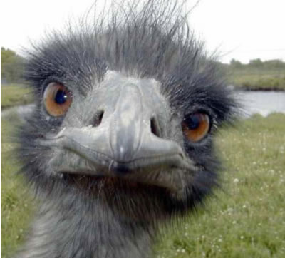
Feeding Behaviors
Ostriches are omnivores, and they eat whatever is available in their habitat and at different times of the year. They mostly eat plants, especially roots, leaves, and seeds, but they also munch on insects like locusts and small animals like lizards. When an ostrich eats, food is collected in the crop at the top of the throat until there is a large enough lump to slide down the neck.

Slide 24
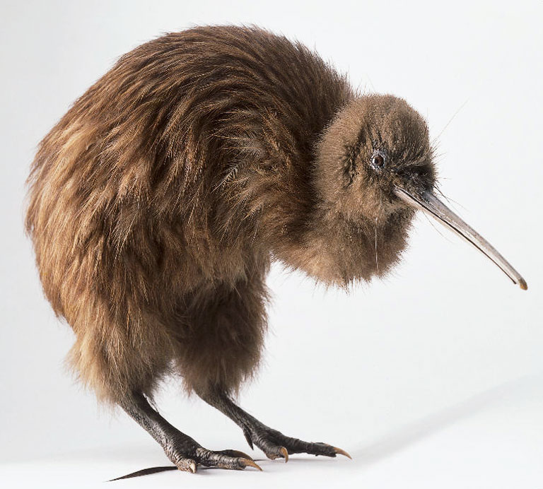
Feeding Behaviors
The Brown Kiwi have their nostrils at the tip of their long, slender beak, to help them smell food when they push their beak into the soil. Females have longer bills than males.

Slide 25
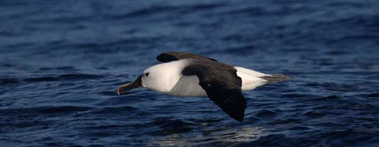
Feeding Behaviors
The Indian Yellow-nosed Albatross eat by surface seizing and/or shallow dives. They feed on a wide range of squid, fish and some crustaceans.

Slide 26
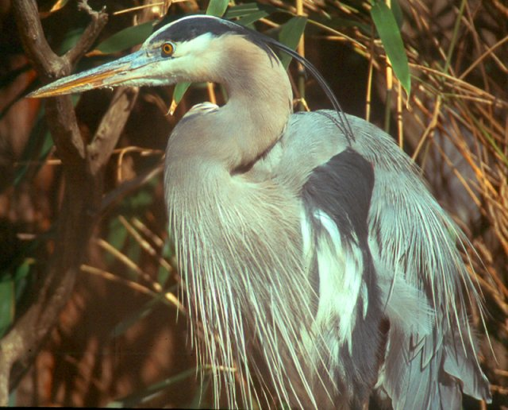
Feeding Behaviors
Great Blue Herons forage in marine coastal environments and in freshwater habitats. Its main food is small fish less than half the length of its bill, or under 65 mm long. On occasion, it also eats shellfish, insects, rodents, amphibians (mostly frogs), reptiles, and small birds. The Great Blue Heron has two principal fishing techniques. The first consists of standing motionless. When a potential meal comes close enough, the heron slowly folds its neck back and moves one leg in the direction of the prey. Suddenly, its entire body unbends, its head plunges into the water, it catches the prey in its bill.
Using the second technique, the heron slowly wades around in about 15 to 25 cm of water until it drives a fish out from a hiding place.

Slide 27
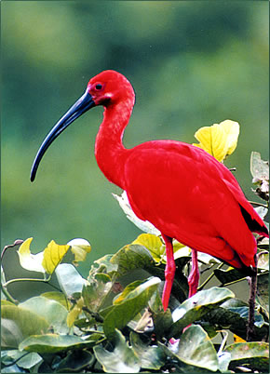
Feeding Behaviors
Scarlet Ibis has a long, thin bill perfect for probing in water or mud in its search for food. The ibis uses its bill to feel around for tasty items such as grasshoppers, beetles, worms, crustaceans, fish, and carrion. Sensitive feelers on the inside of their bill help the bird identify food before it even sees it. The bird's nostrils are at the base of the bill, so the ibis can breathe while sticking its bill in the water or mud

Slide 28
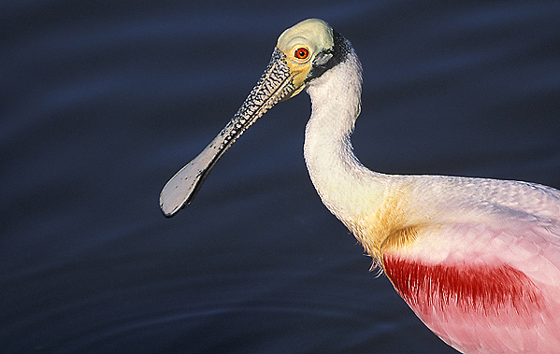
Feeding Behaviors
The Roseate Spoonbill feeds by wading through shallow water, head down, probing the bottom by sweeping its long, spoon-shaped bill back and forth in the water. Prey is detected by touch, and the bill snaps immediately shut around the small fish, crustaceans, and insects that make up the bulk of the diet. Roseate Spoonbills attain their pink coloration from the pigments attained from the crustaceans that they feed upon.

Slide 29
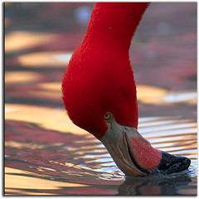
Feeding Behaviors
Caribbean, flamingos have shallow-keeled bills and feed on insects, aquatic invertebrates, and small fishes. Standing in shallow water, flamingos lower their necks and tilt their heads slightly upside-down, They sweep their head from side to side deeper into the mud to collect their food. They filter their food out of the water and mud with a spiny, piston-like tongue that aids in sucking food-filled water past the lamellae inside the curved bill. The fringed lamellae filter out food, and the water is passed back out of the bill

Slide 30
Feeding Behaviors
The edges of a duck's bill are fringed to strain plants, seeds, and small animals from mud and water

Slide 31
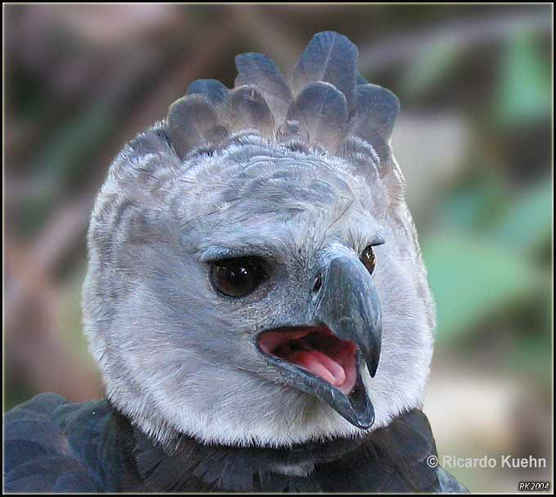
Feeding Behaviors
Harpy Eagles are an actively hunting carnivore. Its main prey items are tree-dwelling mammals such as monkeys, coatis, and sloths; it may also attack other bird species. The talons are extremely powerful and help assist with suppressing prey.

Slide 32
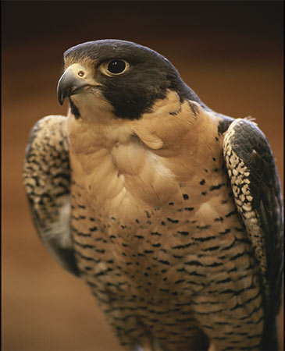
Feeding Behaviors
Peregrine Falcons feed almost exclusively on medium-sized birds, but will occasionally hunt small mammals. They strike their prey with a clenched foot, stunning or killing it, then turn to catch it in mid-air. They have been clocked at speeds of 220 mph.

Slide 33
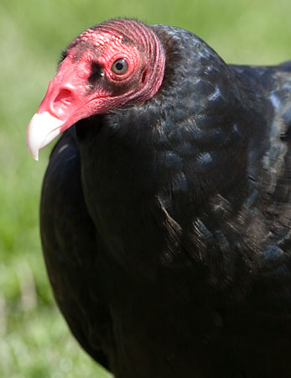
Feeding Behaviors
The Turkey Vulture is a scavenger and feeds almost exclusively on carrion. It finds its meals using its sense of smell, flying low enough to detect the gases produced by the beginnings of the process of decay in dead animals. .

Slide 34
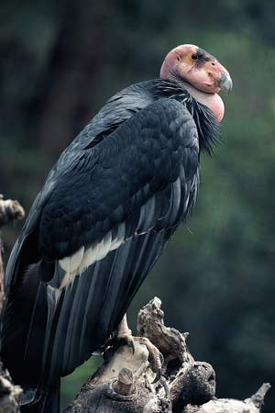
Feeding Behaviors
The California Condor has a diet consisting of medium and large-sized dead mammals like cattle, sheep, deer, and horses in any state of decay. Condors may travel several hundred miles in search of food.

Slide 35
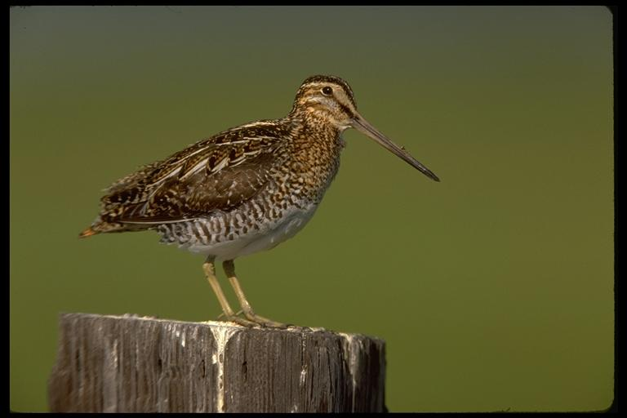
Feeding Behaviors
The Common Snipe forages in soft mud, probing or picking up food by sight. They mainly eat insects and earthworms, also plant material.

Slide 36
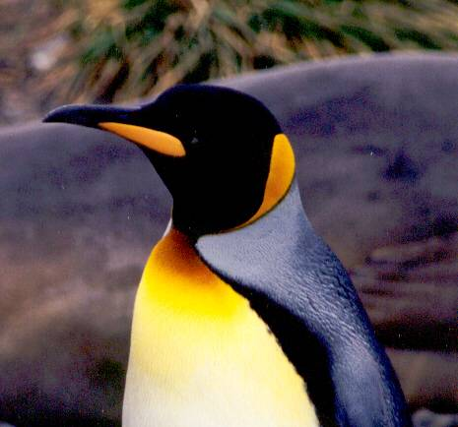
Feeding Behaviors
The King Penguin eats small fish, and squid and rely less than most Southern Ocean predators on krill and other crustaceans. Fish constitute 80-100% of the diet, except in the winter months of July and August, when they make up only 30.

Slide 37
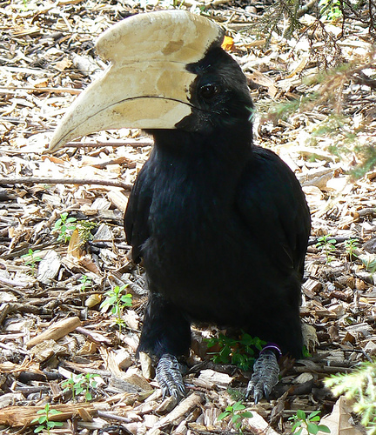
Feeding Behaviors
The Black Hornbills diet consists mostly of fruit but the also 20% of their diet is invertebrates and small animals. They have a very dextrous bill that they use to manipulate and eat poisonous prey such as scorpions and centipedes without causing any harm to themselves.

Slide 38
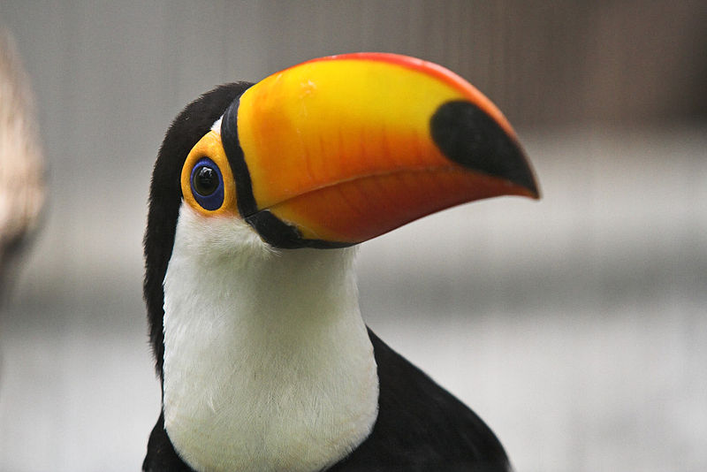
Feeding Behaviors
The Toco Toucan eats fruit using its bill to pluck them from trees, but also insects, and nestlings and eggs of birds. It also has been known to capture and eat small adult birds in captivity. The long bill is useful for reaching things that otherwise would be out-of-reach.

Slide 39
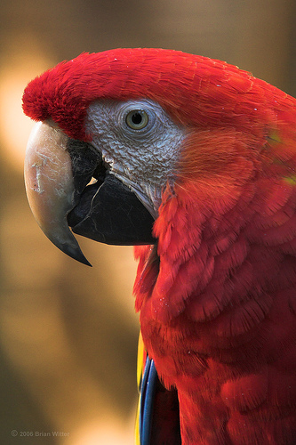
Feeding Behaviors
Scarlet macaws prefer undisturbed rainforest. The macaw’s strong bill is adapted not only to crush its food, but also as an additional limb for climbing. The bill is hinged against the skull for independent movement, thus increasing its strength and flexibility They eat fruits, nuts, flowers and nectar, and they often eat unripe fruit and nuts that other animals avoid. These macaws also eat clay from river banks.

Slide 40
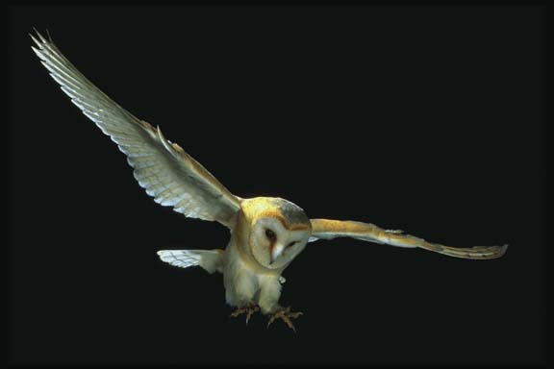
Feeding Behaviors
Owls are Birds of Prey, which means that they must kill other animals to survive. Their diet includes invertebrates (such as insects, spiders, earthworms, snails and crabs), fish, reptiles, amphibians, birds and small mammals. the Owl will fly towards it, keeping its head in line with it until the last moment. This is when the Owl pulls its head back, and thrusts its feet forward with the talons spread wide - two pointing backwards and two forwards. The force of the impact is usually enough to stun the prey, which is then dispatched with a snap of the beak.

Slide 41
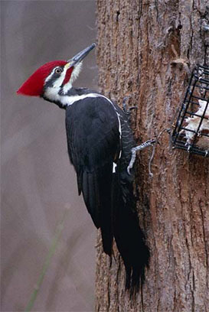
Feeding Behaviors
Pilated Woodpeckers have strong beaks which taper to the tip, forming a chisel for pecking holes in trees for food or nests. Most feed on insects which live under the bark.

Slide 42
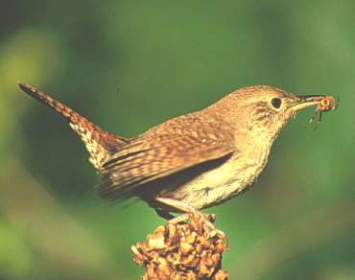
Feeding Behaviors
The Wren has a thin, slender, pointed beaks for eating insects. They are also used to pick insects off leaves, twigs, and bark.

Slide 43
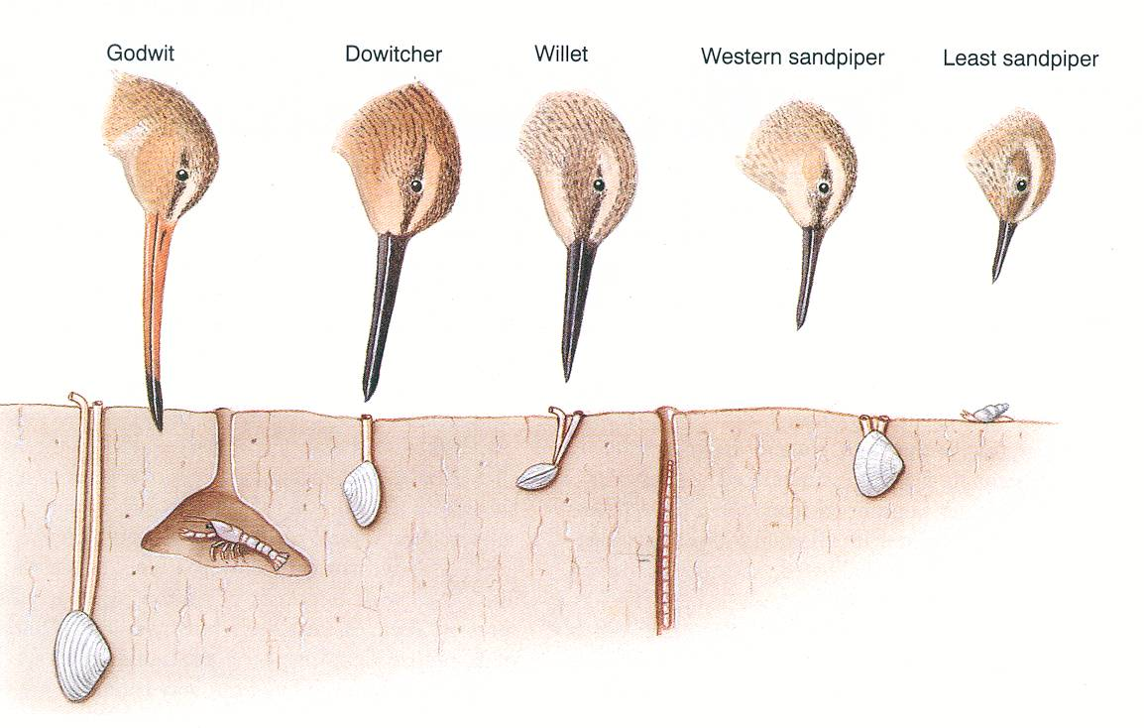
Resource Partitioning
Many wading birds feed on prey buried in the sand. To reduce competition, the different type beaks allow for each species to specialize in a particular food source reducing the energy needed to fight for food. This is called resource partitioning. Two birds at our local beaches have different shaped beaks which are used slightly different. The American Avocet’s beak turns upward to skim the surface of the sand and the Black-necked Stilt is straight to dig into the sand.

Slide 44
Ducks (Dabblers vs. Divers)
Ducks usually come in two types. Diving ducks, or "divers," are ducks that propel themselves underwater with large feet attached to short legs situated far back on the body. "Dabblers," in contrast, have smaller feet and their legs are situated farther forward. While a few dabblers may occasionally dive to feed or to escape predators, typically they skim food from the surface or feed in the shallows by tipping forward to submerge their heads and necks.

Slide 45
Loggerhead Shrikes
Loggerhead shrikes are often called birds of prey because they are predators on insects, lizards, birds, and small mammals. Unlike other birds of prey like hawks and owls, they do not have sharp talons to kill their prey. They have an unusual habit of spearing their food on cactus spines and barb wire fences. Their nickname because of this behavior is “Butcher Bird”.

Slide 46
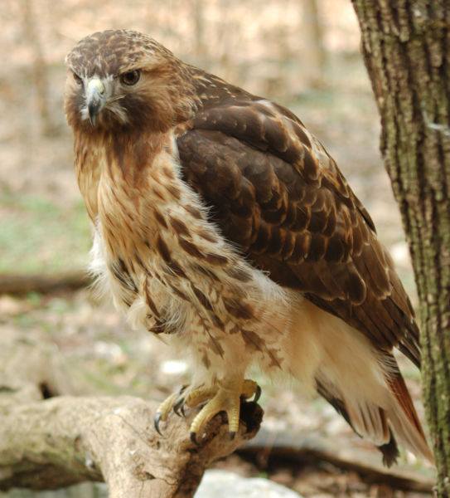
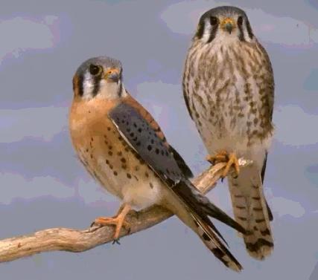
Hawks and Falcons
Red-tailed Hawks are the most common large hawk across the United States. They are an opportunistic hunter. Their diet is varied, but there is conclusive evidence now that 85 to 90 % is composed of small rodents, with rabbits, snakes and lizards included
Peregrine Falcons are known for their speed being clocked at 220 mph in a stoop or dive. They eat primarily birds.
American Kestrels are the only North American falcon to habitually hover with rapid wing beats, keeping its head motionless while scanning the ground for prey. They usually eat insects or small mammals.

Slide 47
Nocturnal Birds: Owls
Owl’s are nocturnal birds of prey. They are thought to have filled this niche due to competition from hawks during the day. They can see fine during the day, but have exceptional hearing for hunting at night. Their eyes are large and fixed in their sockets so they must turn their heads to look at things to the side. They can turn their heads 240 degrees because they have 14 cervical vertebrae (humans have seven). The twe major types of owls seen in our area are the Barn Owl and the Great Horned Owl. There is one species of diurnal owl called the Burrowing Owl. They nest in holes in the ground. The young will make a sound by clicking their beaks which resembles a rattlesnake to scare off predators.

Slide 48
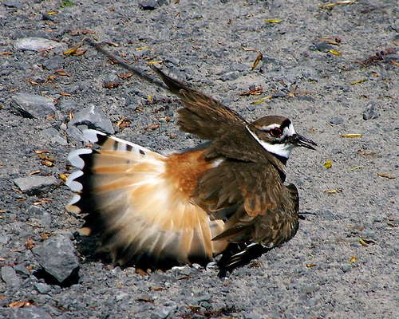
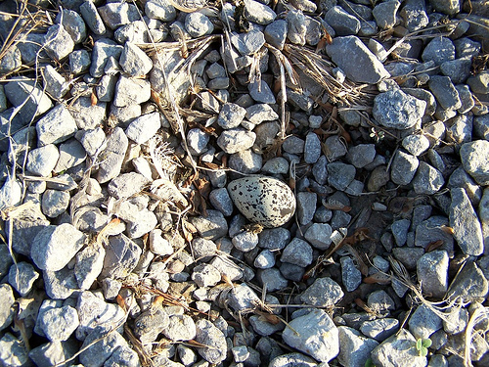
Killdeer
Killdeer nest on open ground, often on gravel. They may use a slight depression in the gravel to hold the eggs, but they don't line it at all, or line it only with a few stones. These birds will frequently use the "broken-wing act" to distract predators from their nests. This involves the bird walking away from its nesting area holding its wing in a position that simulates an injury and then flapping around on the ground emitting a distress call. The predators then think they have easy prey and are attracted to this seemingly injured bird and away from the nest. If the parent sees that a potential predator is not following them, they will move closer and get louder until they get the attention of the predator.

Slide 49
Introduced Species
Introduced species do occur and one of the more common ones seen here is the European Starling. They are thought to have been brought to Central Park because of the Shakespearean plays. They nest in tree cavities and have been affecting our local woodpecker populations. Another common introduced species is the house sparrow. Also an European transplant, they were once called the English Sparrow but the name has changed now that they are all over the world.

Slide 50
Bird Communication
Birds communicate by songs and calls or other noises, like tapping and drumming. Courtship flights and dances are other ways birds communicate.
Songs are specific patterns of notes repeated with few variations. Songs are used to attract mates and mark the territory necessary to raise young. Each species has its own specific song or songs. Some birds have over a dozen calls and songs (cardinal). Some birds are able to mimic the songs of other birds (catbird, mockingbird), When alerting others of danger, birds call. Calls are also made when feeding or migrating. When a flock of bushtits travel, they keep in touch by calling as they fly through their habitats.

Slide 51
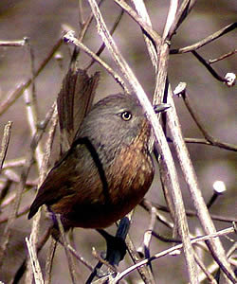
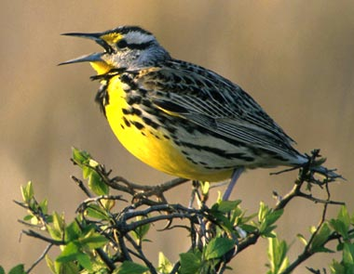
Bird Communication
Birds do not have vocal cords. To produce sounds, vibrations are sent across the syrinx (voice box) of a bird. The more muscles a bird has attached to the syrinx, the more sounds it can make. For instance, mockingbirds have many muscles and can produce a variety of sounds, while mourning doves' singular pair of muscles results in only the single "coo" sound. Wrentits are sometimes called “ping pong” birds because their call’s rhythm is like a dropped ping pong ball. Western Meadowlarks are separated from the eastern species because the young learn the song while still in the egg.

Slide 52
Bird Migration
Permanent residents, or just "residents," are non-migrating birds such as House Sparrows who remain in their home area all year round.
Summer residents are migratory birds such as Purple Martins who arrive in our Northern backyards in the spring, nest during the summer, and return south to wintering grounds in the fall.
Winter residents are migratory birds who have "come south" for the winter to our backyards. White-throated Sparrows, who are summer residents in much of Canada, are winter residents in much of the U.S.
Transients are migratory species who nest farther north than our neighborhoods, but who winter farther south; thus we see them only during migration, when they are "just passing through."

Slide 53
Bird Migration
The main advantage of migration is easy enough to guess. During northern winters there's little food, and cold temperatures make life hard. Farther south, there's more food and less cold.
Birds do not migrate because they figure out that they need to. It's been shown that, at least in some birds, changes in day length cause glands in the birds' bodies to produce hormones that produce profound changes inside the birds, changes that prepare them for the flight south. In the fall, as days grow shorter, fat accumulates under the skin. This fat contains energy needed for those coming days when the birds will be spending more energy flying than they'll be eating during their occasional rests. Weather changes sometimes trigger a migration's start, but by then the birds are already prepared. If The urge to migrate must be very powerful.

Slide 54
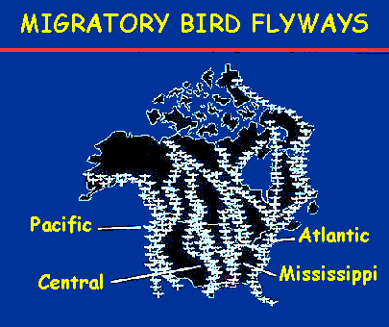
Bird Migration
When migrants start moving, they form broad, diffuse waves that merge into great "rivers" of birds, and the four main North American "rivers," or "flyways," are shown on the left. The bird species in these great bird-rivers in the sky pass specific spots on the map at more or less predictable times

Slide 55
Desert Adaptations: RoadRunners
Roadrunners are from the Cuckoo family and are found in our local deserts. To conserve energy, these birds go through a torpor (They lower their metabolism over night). To raise their body temperature back to normal requires a lot of energy. To enhance their energy savings, roadrunners have black skin underneath their feathers. In the mornings, they will pull back these feathers and allow the sun to warm their bodies and help raise their body temperature back to normal.

Slide 56
Desert Adaptations: Cactus Wren
Cactus Wren is a local species that get their name from making their nests in cactus. They can maneuver well around the spines and offers them protection from predators. They will make several nests in their territory. These nests are used as rest areas to get out of the heat. They will enter these areas to cool off in the hot summer heat.

Slide 57
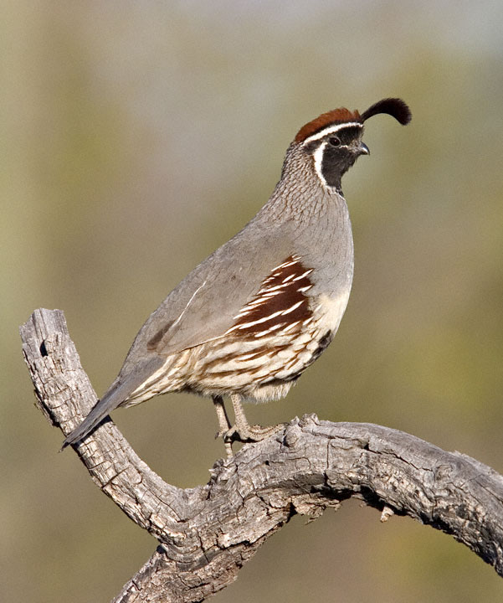
Desert Adaptations: Gambel’s Quail
Gambel’s Quail is the local species of quail found in our deserts. They have a body temperature of 104 degrees F. but can raise it 7 or 8 degrees when temperature is high to reduce water loss. The can lose up to 50% of their body weight in water. At 10% water loss, humans begin to go into crisis.

Slide 58
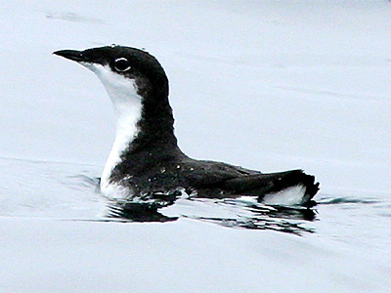
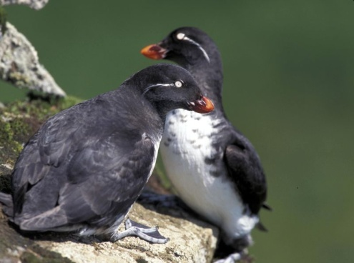
Penguins and Alcids
Penguins (found in the south hemisphere) and their northern hemisphere counterparts, the alcids, are all cold-loving, fish-gulping birds. Both usually breed in colonies. Penguins do not have the ability to fly while Alcids can. (Xanus Murrelet, Auklet, Emperor Penguin)

Slide 59
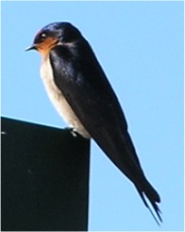
Hummingbirds and Swallows
Apodiformes, as this name ("footless") suggests, refer to the fact that their legs are small and have limited function aside from perching. Hummingbirds feed on nectar deep inside flowers. Swallows are a type of songbird which hunts insects in the air. Swallows make mud nest attached to cliffs and building structures.

Slide 60
American Robin
Location: Most of U.S woodlands and grasslands
Food: 40% inverts and 60% nuts and berries
Other: often seen as a symbol of spring

Slide 61
Brewer’s Blackbird
Location: Central and Western U.S. open areas and grasslands
Food: Mostly seeds and insects
Other: Live in large flocks near humans

Slide 62
Black Phoebe
Location: Western U.S. near water
Food: Flycatcher
Other: Pump their tails up and down incessantly when perched

Slide 63
California Gnatcatcher
Location: Coastal sage scrub in southern California
Food: Insects
Other: Endangered species

Slide 64
California Thrasher
Location: Dense brush of Coastal sage scrub in southern California
Food: Insects and small invertebrates
Other: Largest Thrasher

Slide 65
California Towhee
Location: Coastal sage scrub in southern California
Food: Seeds and insects
Other: Spends most of its time on the ground

Slide 66
Crow
Location: Most habitats throughout the United states
Diet: Omnivorous
Other: Bio indicator for West Niles Virus

Slide 67
House Finch
Location: Western U.S. – introduced in the east – Variety of habitats but often near humans
Food: Seeds
Other: Frequent visitor to bird feeders

Slide 68
Northern Oriole
Location: Western and Eastern U.S.
Food: Insects, Berries and Nectar
Other: Frequent visitor to hummingbird feeders

Slide 69
Plain Titmouse
Location: Dry slopes of California
Food: Seeds and Insects
Other: 40 attempts at insects every 15 minutes

Slide 70
Spotted Towhee
Location: Shrubby undergrowth in Western U.S.
Food: Omnivore
Other: Two footed backward scratching called “double scratching”

Slide 71
Western Bluebird
Location: Open woodlands of the western U.S.
Food: Insects
Other: Last year young often help at the nest

Slide 72
Western Kingbird
Location: Open areas with perches in the western U.S,
Food: Insects
Other: Spreading in the U.S. due to human activity (clearing forests and telephone poles)

Slide 73
Yellow-rumped Warbler
Location: In summer, open forest edges, In fall and winter they move to open woods and shrubby habitats Food: Insects and berries
Other: Most versatile feeder among all warblers

