Slide 1
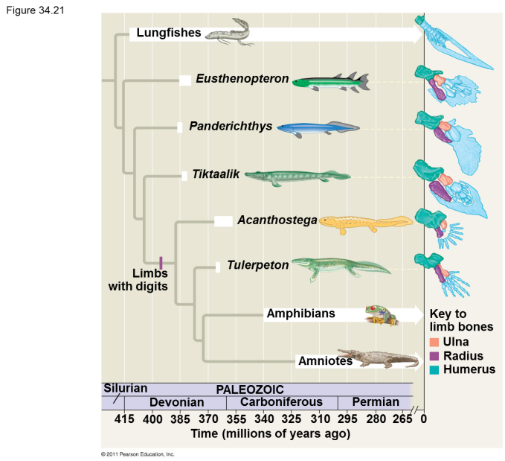
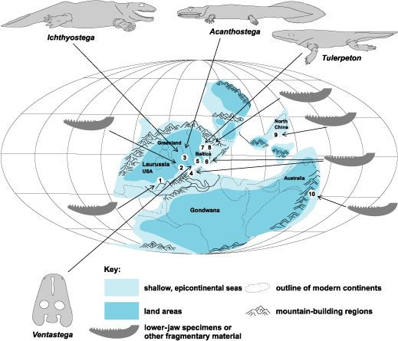
Tetrapods
General Characteristics and structures - Movement from water to land is perhaps the most dramatic event in animal evolution. Tetrapods evolved Important physical differences when they emerged to accommodate a new way of life: (1) oxygen content taken from the air, (2) body density, and (3) temperature regulation.
Evolutionary History – Tetrapods appear in the fossil record about 400 MYA during the Devonian Period evolving from a lobe-Finned fish (Class: Sarcopterygii) . The group of fish leading to the tetrapods were an extinct group of Lungfish called rhipidistians.
Biogeography – The first Tetrapods evolved in coastal and brackish marine environments, and in shallow and swampy freshwater habitats.

Slide 2
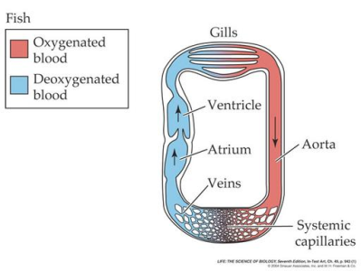
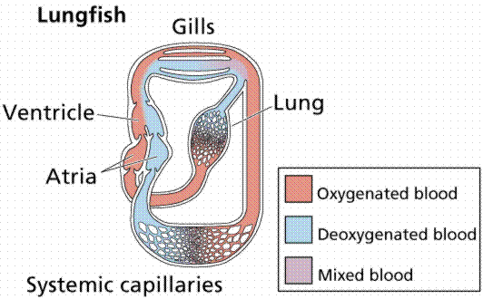
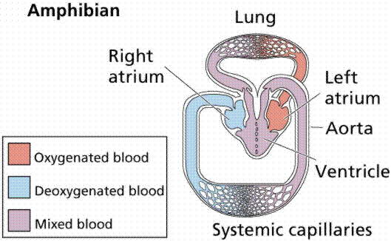
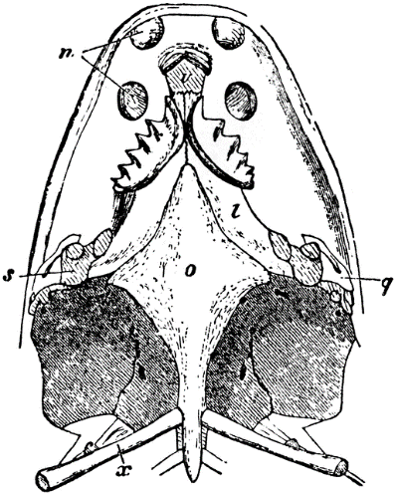
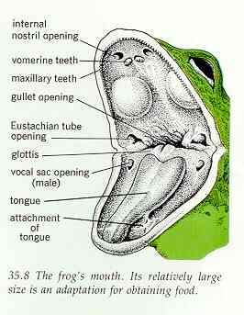
Tetrapods – General Characteristics
Greater Oxygen Acquisition
Lungs – To breath air, it required an increased vascularization of the air-filled cavity (a pouch from the posterior pharynx similar to the swim bladder), with a rich capillary network to form a lung.
Double circulatory system – Fish have a single circuit system where the heart pumps blood directly into the gills. The disadvantage of this system is the resistance in the gill capillaries drops the blood pressure to the body. The double circulation system allows for higher pressure with one circuit going to the lungs and another going to the body.
Nasal Openings – The nostrils in most bony fish differ from tetrapods. Bony fish have 4 external nares (2 on each side) which allows water to run across the olfactory tissue. Tetrapods have two external and two internal nares in the palate. This allows air to be drawn in through the nose.

Slide 3
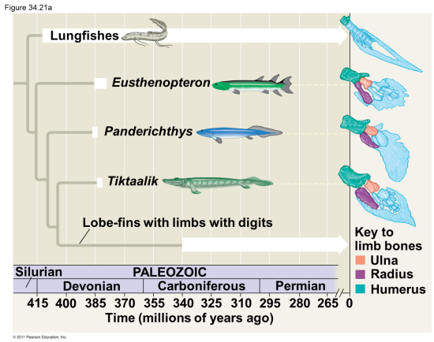
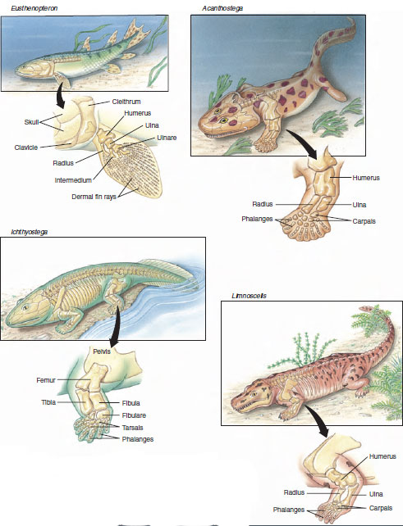
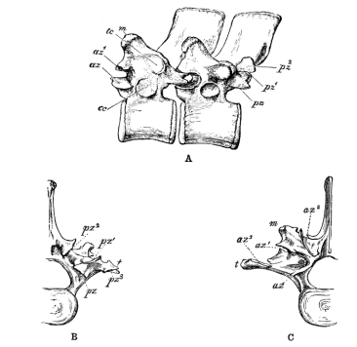
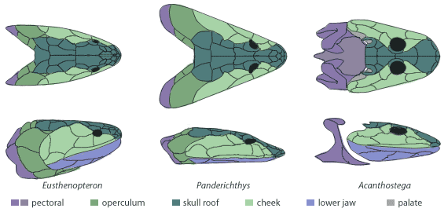
Tetrapods – General Characteristics
Body Density
Limbs – This characteristic evolved in an ancestral aquatic habitat. These animals would use the new limbs in the shallow water. Air however is 1000 times less buoyant then water requiring animals to counter the effects of gravity. Although very different than fins, they have homologous structures (bones – humerus, ulna and radius).
Girdles – In fish, the pectoral girdle is attached to the skull. Early tetrapods developed a stronger shoulder girdle, bulky limb bones and well developed muscles. The pelvic girdle is fused to the backbone to increase the force that can be generated by the hind legs.
Vertebrae and Ribs – Vertebrae have developed zygapophyses (bony projections that brace against adjoining vertebrae) which can help support the spine in the absence of buoyant water. The development of ribs can also protect the lungs.
Skull and Neck – The skull has been shortened and the snout elongated. The head becomes separated from the body by a neck (a cervical vertebrae) that allows the head to be lifted. A second vertebrae was then added to allow for a side to side movement.

Slide 4
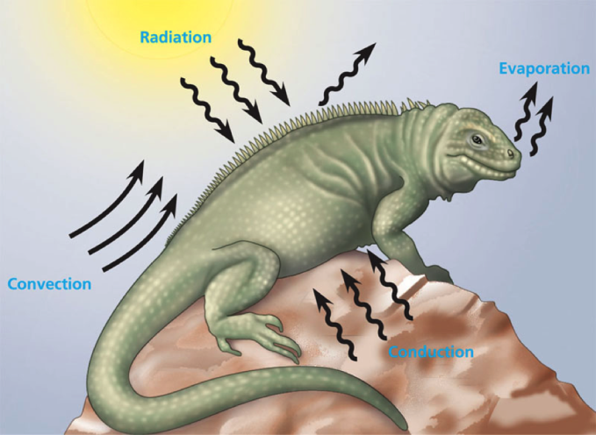
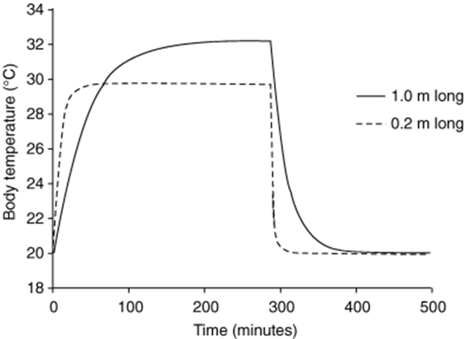
Tetrapods – General Characteristics
Temperature Regulation - Air fluctuates in temperature more readily than water, so terrestrial animals must develop behavioral and physiological strategies to cope with thermal extremes.
Advantages of Terrestrially living – The current hypothesis for the advantage tetrapods received by evolving a terrestrial life is it allows for an increase in metabolism and development due to higher body temperature.
Energy – An increase of 10 degrees Celsius (from 20 degrees (water temp) to 30 degrees (air temp) would allow for a doubling of their metabolic rates which would then allow for better digestion and tissue development.

Slide 5
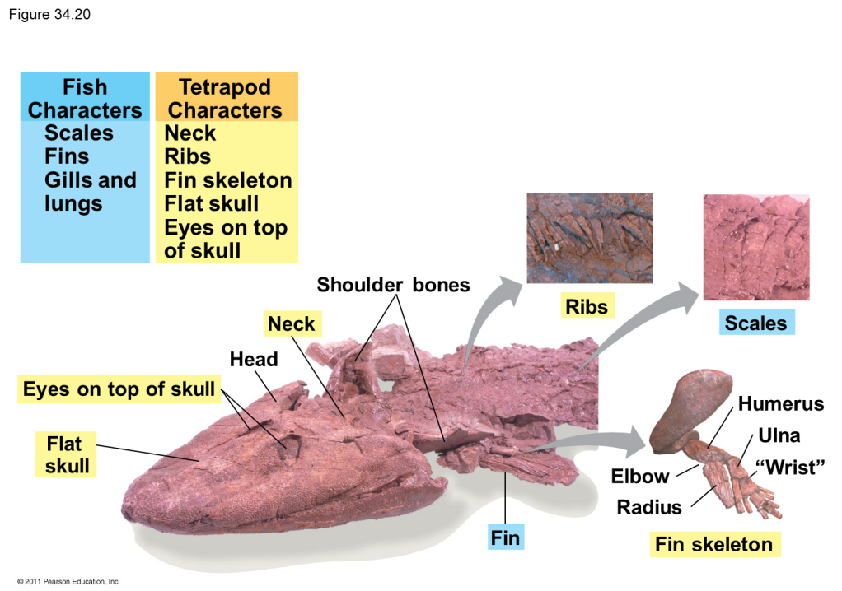
Tetrapods – Evolutionary History
“Fishapod” – Tiktaalik (375 mya)
A fish with tetrapod features, this animal probably could not walk on land but could lift itself out of the water.
Fish Characteristics
Scales
Fins
Gills and lungs
Tetrapod Characteristics
Neck
Ribs
Fin skeleton
Flat skull
Eyes on top of skull

Slide 6
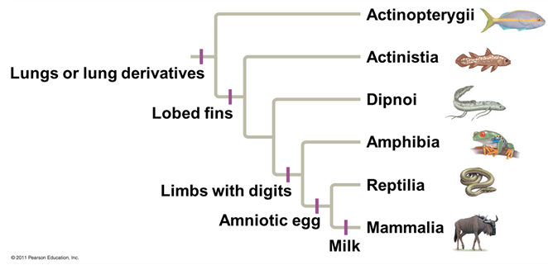
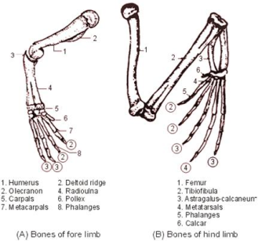
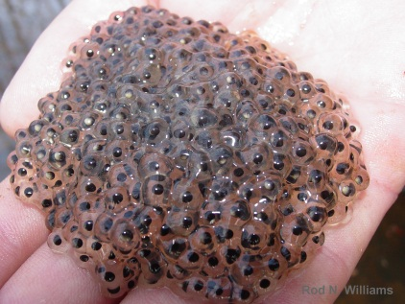
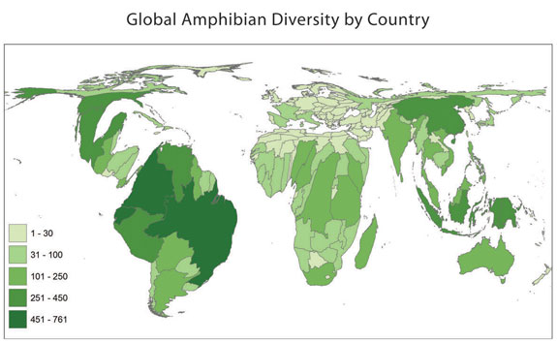
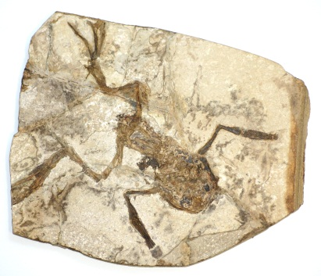
Amphibians
General Characteristics and structures - The word amphibian comes from an ancient Greek word meaning “both kinds of life” which refers to the ability to live on both land and water. The clade consists of ectothermic vertebrates with a mesolecithal (jelly-like) egg which requires water or moist terrestrial surfaces. They have four limbs with the forelimbs usually with four digits. The skin is smooth, moist and glandular which allows for cutaneous respiration and the release of toxins.
Evolutionary History – Amphibians appear in the fossil record about 365 MYA during the Devonian Period evolving from a lobe-Finned fish but modern amphibian fossils date from the early Jurassic.
Biogeography – Amphibians are found on every continent but Antarctica.

Slide 7
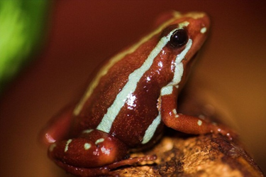
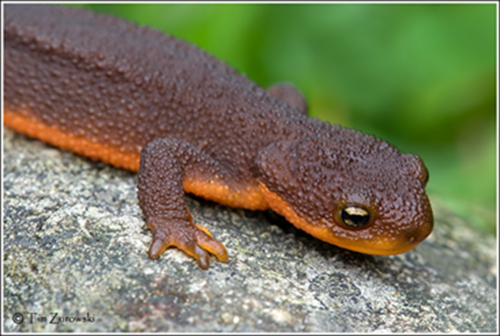
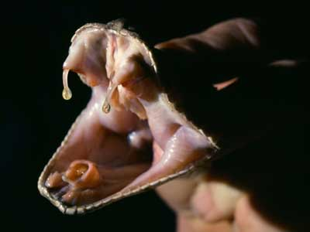
Class: Amphibia – General Characteristics
Poisonous vs. Venomous - Both venomous and poisonous animals produce a toxin that is injurious or even lethal to another organism. The real difference between the two terms involves how that toxin is delivered.
Poisonous – The Poisonous organisms do not deliver their toxins directly. The entire body, or large parts of it, may contain the poisonous substance. These organisms may be harmful when eaten or touched.
Venomous – The Venomous organisms deliver or inject venom into other organisms, using a specialized apparatus of some kind (usually fangs or a stinger). The venom is produced in a gland attached to this apparatus.

Slide 8
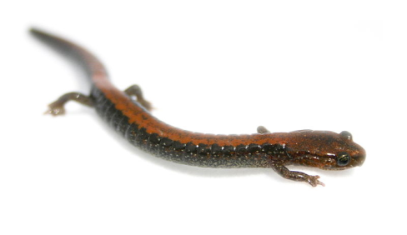
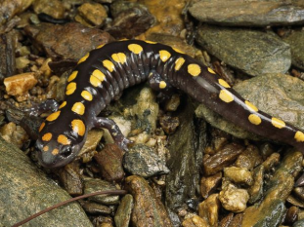
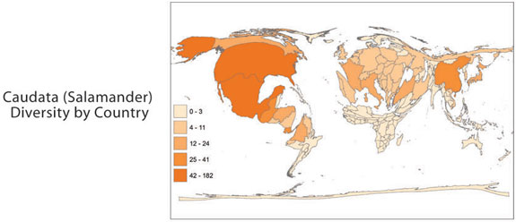
Order: Urodela
General Characteristics and structures - The word Urodela comes from a Greek word meaning “evident tail”. (Lumped with the extinct salamanders, they are sometime placed in a clade named Caudata which is Latin meaning “Tail”). The clade consists of salamanders and newts. Most have limbs set at right angles to the trunk with fore and hind limbs of equal size. They are carnivorous as both larvae and adults, preying on worms, small arthropods and mollusks.
Evolutionary History – Modern Salamanders appear in the fossil record during the early Jurassic.
Biogeography – There are approximately 553 species of salamanders and are found in the northern temperate regions of the world and in the tropical areas of Central and Northern South America.

Slide 9
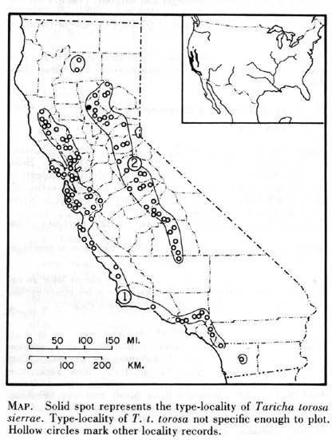
California Newt (Taricha torosa)
General Characteristics - A newt is an aquatic amphibian with skin that is usually rougher than a salamander. It is 5 to 8 inches long with an orange belly. Newts metamorphose through three distinct developmental life stages: aquatic larva, terrestrial juvenile (called an eft), and an adult. Adult newts have lizard-like bodies and may be either fully aquatic, living permanently in the water, or semi-aquatic, living terrestrially but returning to the water each year to breed
Unique Characteristics – California Newts are poisonous animals because they secrete toxins thorough their moist skin and usually cause harm when they are ingested. The toxins are called tarichatoxin a very strong neurotoxins (the same found in puffer fish). The toxins have been known to kill humans and other animals that attempt to eat them.
Biogeography –California newts exist primarily on the California coastal area and in the Sierra Nevada. (mountains)
Habitat - During the non-breeding season the newts are land dwelling, preferring rock crevices and logs. While breeding, the Sierra Nevada populations prefer slow moving pools in coastal streams.
Diet – Worms and invertebrates

Slide 10
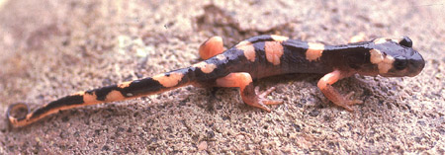
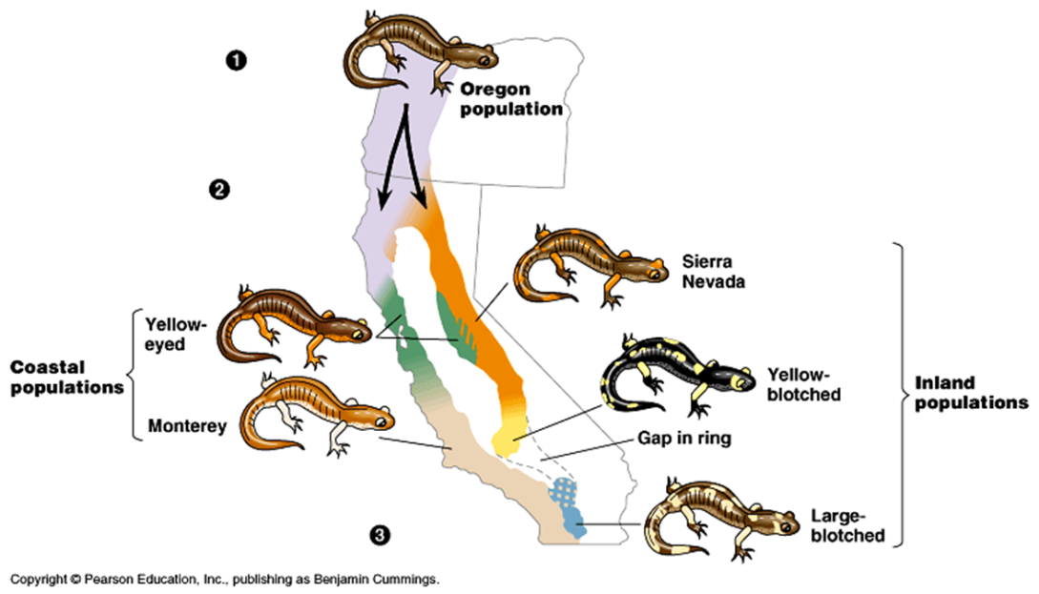
Ensantina (Ensatina eschscholtzii )
General Characteristics - A highly variable species that is up to six inches long. They have a large head and a constriction at the base of the tail. All specimens have yellow, greenish yellow, or orange on all four limbs from the base of the limb to the elbow. Ensatinas have four toes on the front feet, five on the rear.
Unique Characteristics – They are considered a “ring species”. A ring species is a connected series of neighboring populations, each of which can interbreed with closely sited related populations, but for which there exist at least two "end" populations in the series, which are too distantly related to interbreed. There is a gap within species where no breeding occurs.
Biogeography – This genus is a complex of lungless salamanders found in coniferous forests, oak woodlands and chaparral from British Columbia, through Washington, Oregon, across California (where all seven subspecies variations are located), all the way down to Baja California in Mexico.
Habitat - The Ensatina can usually be found under logs, brush, by or in streams and lakes, and in other moist places. They may exude a toxic milky secretion from the tail.
Diet – Worms, insects and invertebrates

Slide 11
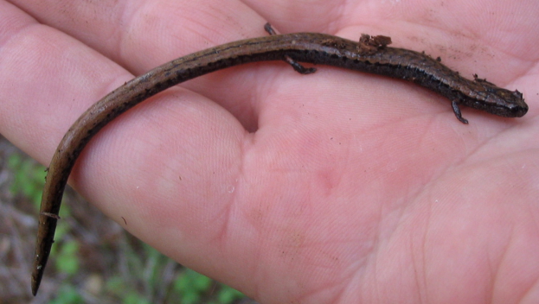
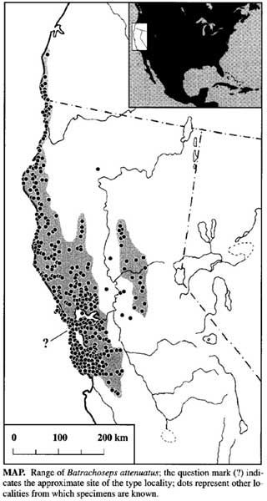
California Slender Salamander (Batrachoseps attenuatus)
General Characteristics – The body and head shapes are narrow. This organism has four toes on each foot, and the legs are very small. There are between eighteen and twenty-one costal grooves, conspicuous in appearance, lending a worm-like character to this species. They are a lungless salamander and breathe through their skin.
Unique Characteristics – Endemic means only in one area. This species is considered quasi-endemic due to their limited range.
Biogeography – This genus is found primarily in coastal mountain areas of Northern California, as well as in a limited part of the western foothills of the Sierra Nevada's, California, in patches of the northern Central Valley of California, and in extreme southwestern Oregon. They are also a local species here in southern California.
Habitat –They are found in several plant communities including California oak woodlands, redwood forests, Douglas fir forests, montane hardwood conifers, grasslands and riparian zones; occurrence ranges from valley floors to mid-elevation in coastal ranges. From approximately October to March, the California slender salamander seeks cover near streams and other moist environments. They are often found resting beneath leaf litter or other woodland detritus, or beneath rotting logs or rocks providing a wet environment.
Diet - Invertebrates

Slide 12
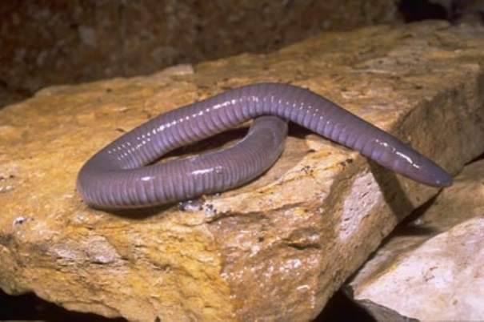
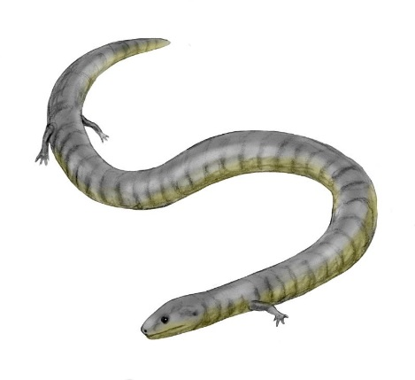
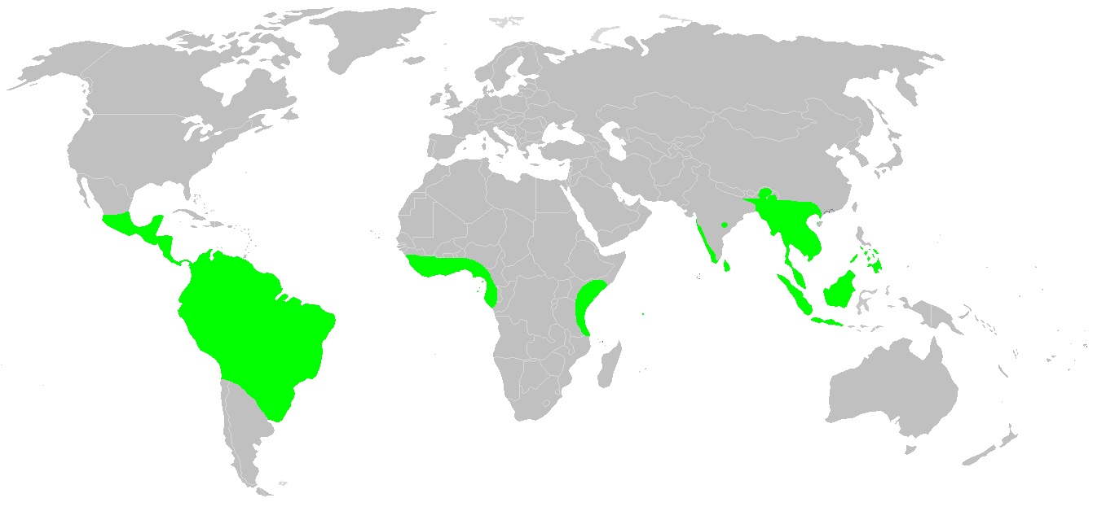
Order: Caecilians
General Characteristics and structures – Caecilians (meaning blind ones in Latin) are a group of limbless, serpentine amphibians. They are also known as Apodans. They mostly live hidden in the ground, making them the least familiar order of amphibians. Caecilians completely lack limbs, making the smaller species resemble worms, while the larger species resemble snakes. Adapting to their underground life, the eyes are small and covered by skin for protection, which has led to the misconception that they are blind. This is not strictly true, although their sight is limited to simple dark-light perception.
Evolutionary History –Vertebrae attributed to Caecilians have been found in the Cretaceous period.
Biogeography – Caecilians are mostly distributed in the tropics of South and Central America, Africa, and southern Asia..
Earliest known Caecilian

Slide 13
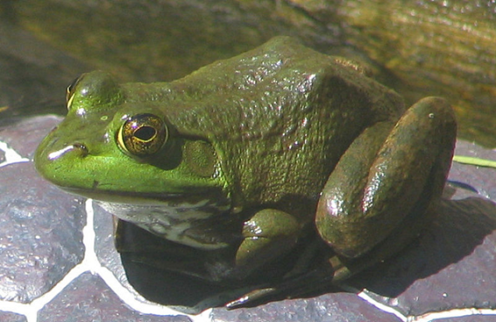
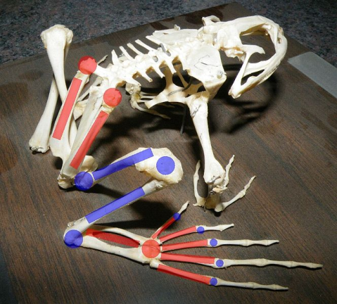
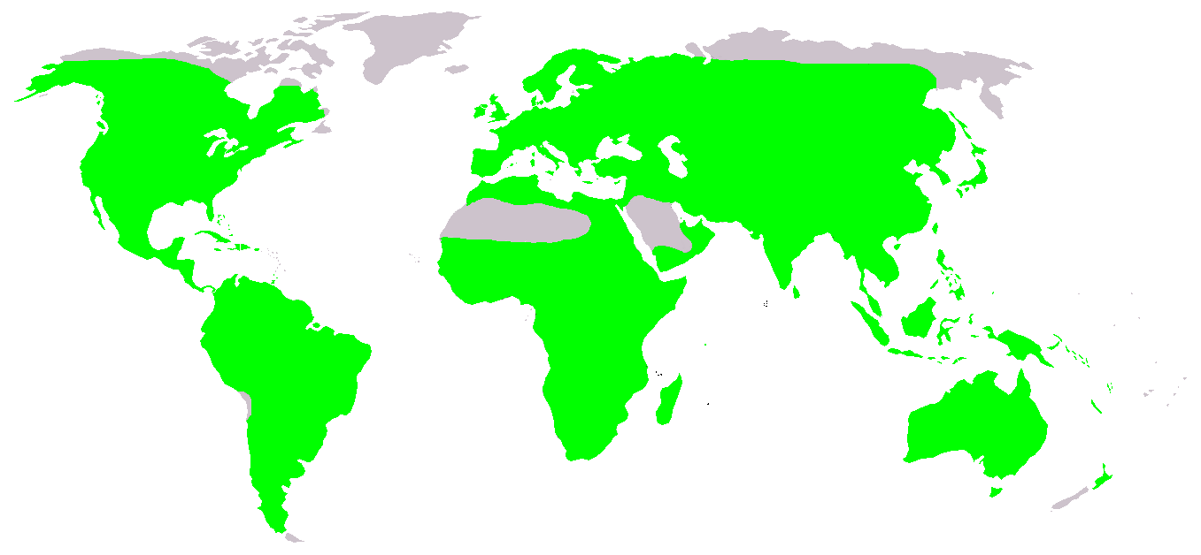
Order: Anura
General Characteristics and structures - The word Anura comes from a Greek word meaning “without a tail”. The clade consists of Frogs and Toads. The body plan of an adult frog is generally characterized by a stout body, protruding eyes, cleft tongue, limbs folded underneath and the absence of a tail. The skin of the frog is glandular, with secretions ranging from distasteful to toxic.
Evolutionary History – The oldest fossil "proto-frog" appeared in the early Triassic of Madagascar, but molecular clock dating suggests their origins may extend further back to the Permian, 265 million years ago.
Biogeography – Frogs are widely distributed, ranging from the tropics to subarctic regions, but the greatest concentration of species diversity is found in tropical rainforests.
A bullfrog skeleton, showing elongate limb bones and extra joints. Red marks indicate bones which have been substantially elongated in frogs and joints which have become mobile. Blue indicates joints and bones which have not been modified or only somewhat elongated.

Slide 14
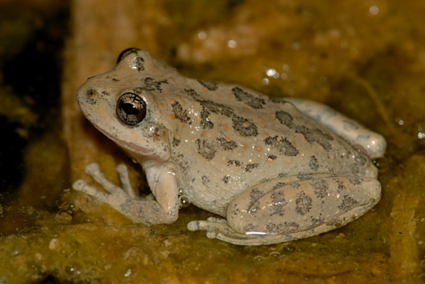
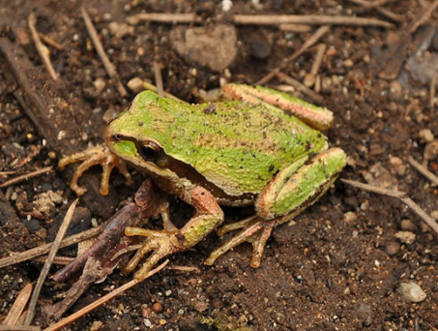
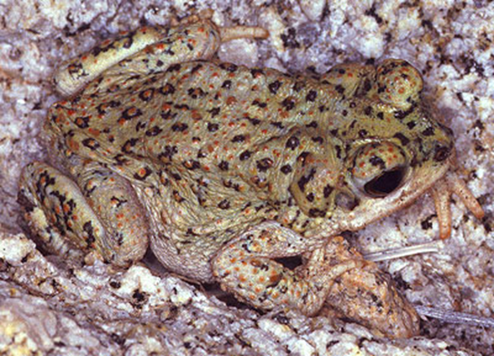
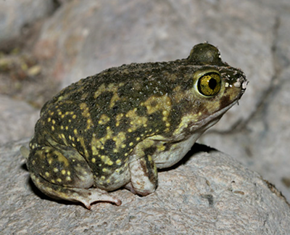
Order: Anura – General Characteristics
Frogs vs. Toads - The use of the common names "frog" and "toad" has no taxonomic justification. From a classification perspective, all members of the order Anura are frogs, but only members of the family Bufonidae are considered "true toads".
Frogs – The use of the term "frog" in common names usually refers to species that are aquatic or semi-aquatic and have smooth, moist skins.
Toads – The use of the term "toad" generally refers to species that are terrestrial with dry, warty skins.

Slide 15
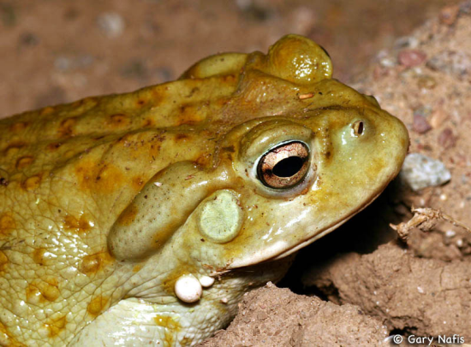
Order: Anura – General Characteristics
Defense –
Frogs - The skin of many frogs contains mild toxic substances called bufotoxins to make them unpalatable to potential predators.
Toads - Most toads and some frogs have large poison glands, the parotoid glands, located on the sides of their heads behind the eyes and other glands elsewhere on their bodies. These glands secrete mucus and a range of toxins that make frogs slippery to hold and distasteful or poisonous. If the noxious effect is immediate, the predator may cease its action and the frog may escape. If the effect develops more slowly, the predator may learn to avoid that species in future.
Poison dart frogs - Many poison dart frogs secrete alkaloid toxins through their skin. Alkaloids in the skin glands of poison frogs serve as a chemical defense against predation, and they are therefore able to be active alongside potential predators during the day. It is argued that dart frogs do not synthesize their poisons, but obtain the chemicals from arthropod prey items, such as ants, centipedes and mites. Poisonous frogs tend to advertise their toxicity with bright colors, an adaptive strategy known as aposematism.
Parotoid Gland

Slide 16
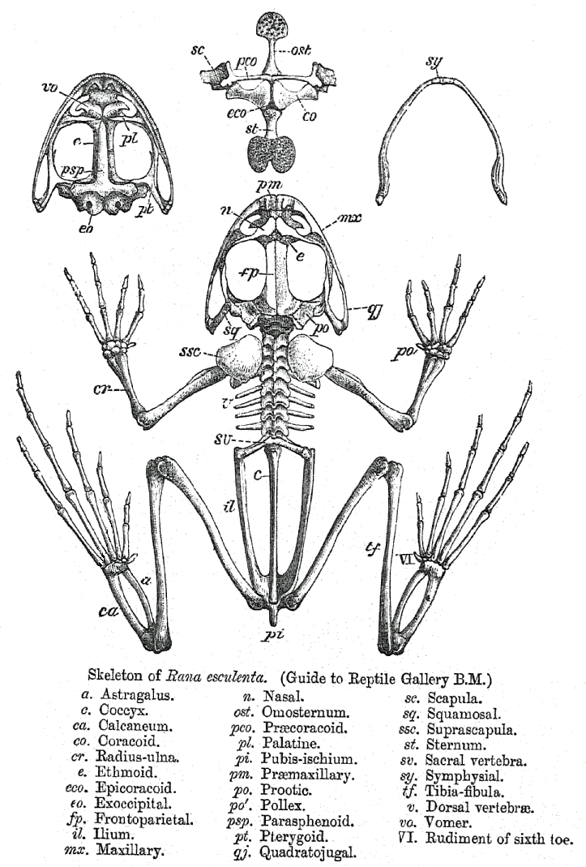
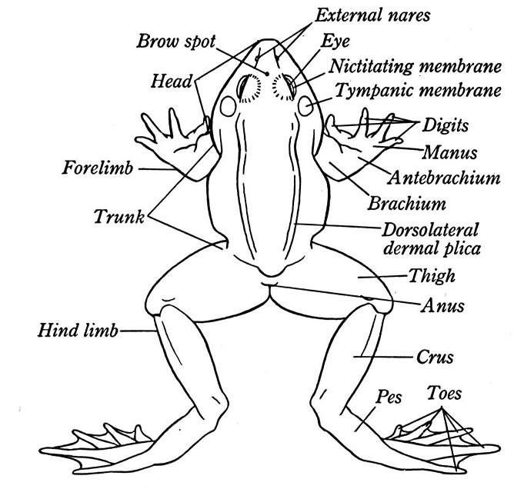
Order: Anura – General Characteristics
Features
External Features - The tongue is attached to the front of the mouth. The tympanic membrane is an area of tight skin that acts like an eardrum. The eyes have eyelids and a nictitating membrane (a transparent membrane).
Internal Features - The three functions of the skull of an amphibian are 1) protection of the nervous system, 2) feeding apparatus, and 3) a means for respiration. The skeletal system is not as flexible as the fish because it has become a rigid frame of transmitting force from the hind limbs to the body. The appendicular skeleton is now more modified. The pectoral girdle absorbs shock during landings. The pelvic girdle is modified for jumping. The sacral hump is made from the protusion of the pelvic girdle. Frogs lack ribs (except a few primitive ones).

Slide 17
Class: Amphibia (Internal)
System | Structure | Function
Muscular | Muscles | Contractions
Digestive | Stomach | Chemical Digestion
 | Intestine | Absorption of nutrients
 | Liver | Storage, conversion, removes toxins
 | Gall Bladder | Store Bile
 | Pancreas | Secretes enzymes
 | Spleen | Immune response
Excretory | Kidneys | Filtration
 | Urinary Bladder | Holds Urine
Circulatory | Atrium | Pumps blood into ventricle
 | Ventricle | Pumps blood into body

Slide 18
Class: Amphibia (Internal)
System | Structure | Function
Respiratory | Lungs | Gas Exchange
Nervous | Cerebrum | Higher Thought
 | Olfactory Lobe | For smell
 | Optic Lobe | For sight
 | Medulla Oblongata | Sends messages between brain and SC
 | Spinal Cord | Transports signals
Reproductive | Ovaries | Produce Eggs
 | Testis | Produce Sperm

Slide 19
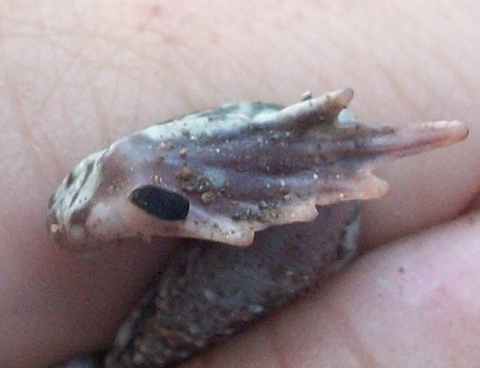
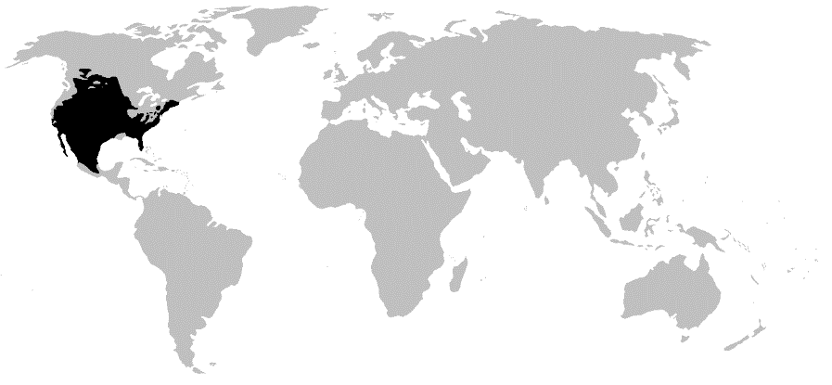
Western Spadefoot Toad (Spea hammondii)
General Characteristics – The American spadefoot toads have a typical shape similar to most fossorial (or burrowing) frogs. They are round, with short legs and protruding eyes.
Unique Characteristics – As suggested by their name, these frogs have hard, keratinous protrusions present on their feet, which help them to dig. Like most burrowing frogs, they will dig backwards into the ground.
Biogeography – They are native to southern Canada and the USA south to southern Mexico.
Habitat - Spadefoot toads are generally found underground in arid climates, generally beneath perennial ponds, creek beds, or other moisture-retaining areas. During years of sufficient rainfall, the toads surface to breed and lay eggs.
Diet – Worms, insects and invertebrates
Spade

Slide 20
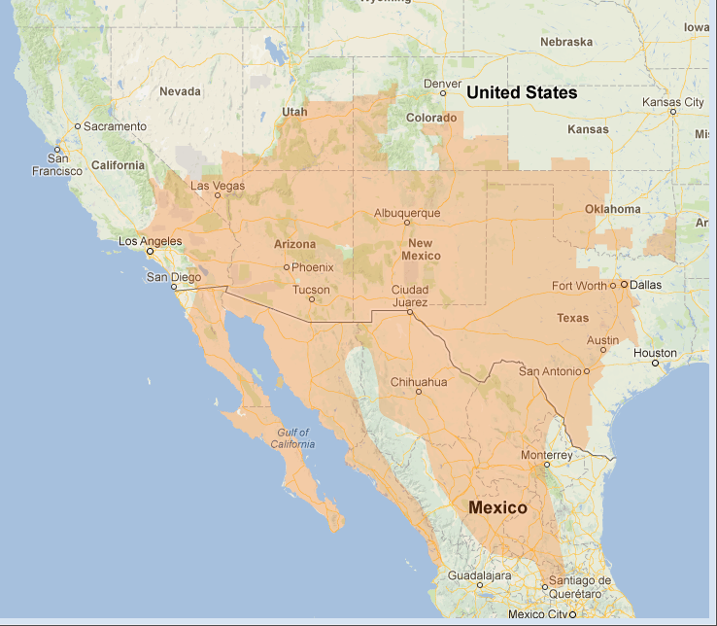
Red Spotted Toad (Bufo punctatus)
Red Spots
General Characteristics – The Red-spotted toad is a small toad species growing to 3.7 to 7.5 centimeters in length. It has a flattened head and body, and a light grey, olive or reddish brown dorsum with reddish or orange skin glands. Its snout is pointed.
Unique Characteristics – It is easiest to identify these by their round parotoid glands.
Biogeography – This toad is native to the southwestern United States and northwestern Mexico, especially Baja California
Habitat - It occurs primarily along rocky streams and riverbeds, often in arid or semi-arid regions. It is very localized on the coastal slope, but widespread in the deserts.
Diet – Insects

Slide 21
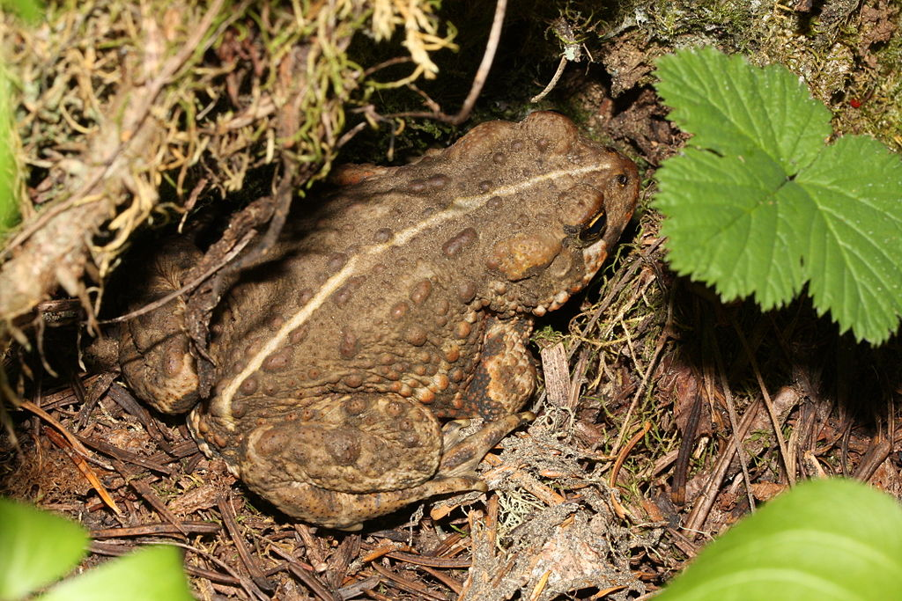
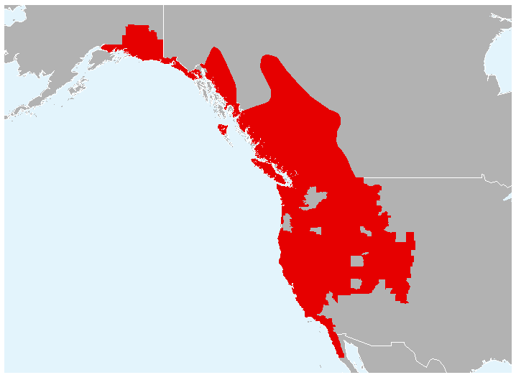
Western Toad (Anaxyrus boreas)
General Characteristics – It is a large toad with a white or cream dorsal stripe, and is dusky gray or greenish dorsally with skin glands concentrated within the dark blotches.
Unique Characteristics - Its parotoid glands are oval and widely separated
Biogeography – Western North America
Habitat – Wet habitats in mountains or riparian areas with ponds for breeding
Diet – Insects and invertebrates
Dorsal Stripe

Slide 22
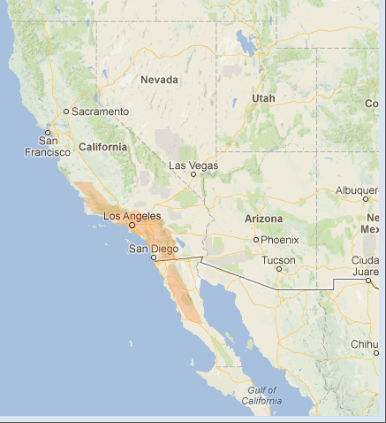
California Tree Frog (Pseudacris cadaverina)
General Characteristics – The California tree frog is a cryptically colored species of tree frog, often resembling granitic stones. It is grey or light brown on its dorsum with darker blotches, and has a whitish venter. It is yellow on the undersides of its legs, groin, and lower abdomen; males of the species have a dusky-yellow throat. The California tree frog has conspicuous toe webbing and pads, and its dorsal skin is roughened and warty
Unique Characteristics – This species usually lacks an eye stripe.
Biogeography – Found from desert to riparian areas to the mountain areas near streams and washes where there are rocks and shade.
Habitat - This species is most likely to occur along streams with abundant boulders and cobbles in their channels. Its distribution is spotty and localized.
No eye stripe

Slide 23
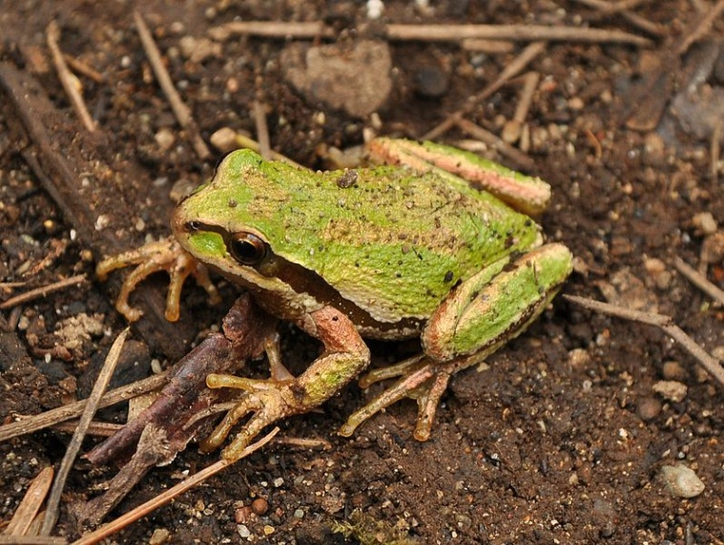
Pacific Tree Frog (Pseudacris regilla)
General Characteristics – The Pacific tree frog comes in shades of greens or browns and can change colors over periods of hours or weeks.
Unique Characteristics – This species usually has an eye stripe.
Biogeography – Pacific tree frogs are most common on the pacific coast of California, Oregon and Washington, but they are found anywhere from Baja California all the way up to British Columbia
Habitat – This species are found upland in ponds, streams, lakes and sometimes even further away from water: their habitat includes a wide variety of climate and vegetation from sea level to high altitudes. The Pacific tree frog makes its home in riparian habitat as well as woodlands, grassland, chaparral, pasture land, and even urban areas including back yard ponds.
Diet – Insects and Invertebrates
Eye Stripe

Slide 24
American Bullfrog (Rana catesbeiana)
General Characteristics – The American Bullfrog’s dorsal surface of the bullfrog has an olive-green basal color. The ventral surface is off-white blotched with yellow or gray. The eyes are prominent with brown irises and horizontal almond-shaped pupils. This species has prominent tympani (eardrums) and the dorsolateral folds of skin end close to them.
Unique Characteristics – It is considered to be an invasive species and there is concern that it may outcompete native species of amphibians and upset the ecological balance.
Biogeography – The bullfrog is native to the eastern half of the United States. Its natural range extends from the Atlantic Coast to as far west as Oklahoma and Kansas. It has been introduced into Massachusetts, Arizona, Utah, other parts of Colorado and Nebraska, Nevada, California, Oregon, Washington, and Hawaii.
Habitat – Bullfrogs are among the largest of all frog species and, as is the case for many types of frogs, live in permanent freshwater habitats. These include a variety of habitats, everything from ponds, rivers and lakes to reservoirs, ditches, irrigation canals and more. Importantly, this species is able to live in both deep and shallow water.
Diet – Small animals
Tympanic Membrane

Slide 25
Amniotes
General Characteristics and structures – The amniotes are a group of tetrapods (four-limbed animals with backbones or spinal columns) that have an egg equipped with an amnion, an adaptation to lay eggs on land. They include synapsids (mammals along with their extinct kin) and sauropsids (reptiles and birds), as well as their fossil ancestors. Amniote embryos, whether laid as eggs or carried by the female, are protected and aided by several extensive membranes. In eutherian mammals (such as humans), these membranes include the amniotic sac that surrounds the fetus. These embryonic membranes, and the lack of a larval stage, distinguish amniotes from tetrapod amphibians
Evolutionary History – The first amniotes had evolved from amphibians about 340 million years ago, in the Carboniferous geologic period.

Slide 26
Amniotes – General Characteristics
Amniotic Egg - The first amniotes (referred to as "basal amniotes"), resembled small lizards and had evolved from the amphibians about 340 million years ago, in the Carboniferous geologic period. Their eggs could survive out of the water, allowing amniotes to branch out into drier environments. The eggs could also "breathe" and cope with wastes, allowing the eggs and the amniotes themselves to evolve into larger forms.
The amniotic egg represents a critical divergence within the vertebrates, one enabled to reproduce on dry land—free of the need to return to water for reproduction as required of the amphibians. From this point the amniotes spread across the globe, eventually to become the dominant land vertebrates.

Slide 27
Amniotes – General Characteristics
Skull Development - It was traditionally assumed that the first reptiles retained an anapsid skull inherited from their amphibian ancestors. This type of skull has a skull roof with only holes for the nostrils, eyes and a pineal eye.
Very shortly after the reptiles appeared, a lineage called Synapsids split off, characterized by a temporal opening in the skull behind each eye to give room for the jaw muscle to move. These are the "mammal-like reptiles" that later gave rise to the true mammals.
Soon after, another group evolved a similar trait, this time with a double opening behind each eye, earning them the name Diapsids ("two arches"). The function of the holes in these groups was to lighten the skull and again give room for the jaw muscles, allowing for a more powerful bite.
The clade Sauropsida includes the Diapsids and the anapsid reptiles (turtles?) and are often classifed as the "true reptiles"
A
B
C
A = Anapsid, B = Synapsid, C = Diapsid

Slide 28
Reptiles
General Characteristics and structures – Traditionally, reptiles are members of a class called Reptilia comprising the amniotes that are neither birds nor mammals. (The amniotes are the vertebrates with eggs featuring an amnion, a double membrane that permits the embryo to breathe effectively on land.) Living reptiles, in that sense, can be distinguished from other tetrapods in that they are ectotherms and bear scutes or scales. The current taxonomy has divided reptiles into four separate classes.
Evolutionary History – Reptiles originated around 320-310 million years ago during the Carboniferous period, having evolved from advanced reptile-like amphibians that became increasingly adapted to life on dry land. Many groups are extinct, including dinosaurs, pterosaurs, and aquatic groups such as the ichthyosaurs.
Biogeography – Modern reptiles inhabit every continent with the exception of Antarctica

Slide 29
Reptiles – General Characteristics
Reptiles – The old class of Reptilia has been divided into new classes. These classes are:
Testudines (turtles, terrapins and tortoises): approximately 330 species
Sphenodontia (tuataras from New Zealand): 2 species
Squamata (lizards and snakes): over 9,400 species
Crocodilia (crocodiles, gavials, caimans, and alligators): 25 species

Slide 30
Class: Testudines
General Characteristics and structures – Turtles are reptiles characterized by a special bony or cartilaginous shell developed from their ribs. Like all other extant reptiles, turtles breathe air, are ectotherms and do not lay eggs underwater, although many species live in or around water. The largest turtles are aquatic.
Evolutionary History –The earliest known turtles date from 220 million years ago during the Triassic Period making turtles one of the oldest reptile groups and a more ancient group than lizards, snakes or crocodiles.
Biogeography – There are approximately 330 species of turtles and are found all around the world except for polar regions.
Odontochelys is the oldest known turtle genus

Slide 31
Testudines – General Characteristics
Turtle vs. Tortoise - The class Testudines includes turtles, tortoises and terrapins. For the most part, the difference between a turtle and a tortoise is more of a matter of semantics than a strict scientific separation. Both biologists and laypeople use the word "turtle" to mean all Testudines. In general, the reptiles referred to as turtles live in or near the water and have adapted to swim by holding their breath underwater. The reptiles referred to as tortoises typically live primarily in arid regions and are built for storing their own water supply and walking on sandy ground.
From a biological perspective, a tortoise is a kind of a turtle, but not all turtles are tortoises. Tortoises occupy their own taxonomic family, called Testudinidae. All types of land and aquatic turtles come in a wide range of sizes, colors and shapes. Sometimes, the name "terrapin" is used to refer to an animal that falls somewhere between a turtle and a tortoise. Terrapins live in swampy areas or begin life underwater and eventually move to dry land.

Slide 32
Testudines – General Characteristics
Turtle Skulls - They have been traditionally believed to be surviving reptilian anapsids, on the basis of their skull structure. The rationale for this classification has been disputed, with some arguing that turtles are diapsids that reverted to this primitive state in order to improve their armor. Later morphological phylogenetic studies with this in mind placed turtles firmly within the diapsids. All molecular studies have strongly upheld the placement of turtles within the diapsids.
A
B
C
A = Anapsid, B = Synapsid, C = Diapsid

Slide 33
Class Testudines – General Characteristics
Features
Shell – The upper shell of the turtle is called the carapace. The lower shell that encases the belly is called the plastron. The carapace and plastron are joined together on the turtle's sides by bony structures called bridges. The inner layer of a turtle's shell is made up of about 60 bones that include portions of the backbone and the ribs, meaning the turtle cannot crawl out of its shell. In most turtles, the outer layer of the shell is covered by horny scales called scutes that are part of its outer skin, or epidermis. Scutes are made up of the fibrous protein keratin that also makes up the scales of other reptiles. These scutes overlap the seams between the shell bones and add strength to the shell. Some turtles do not have horny scutes. For example, the leatherback sea turtle and the soft-shelled turtles have shells covered with leathery skin, instead.
Head - Turtles have rigid beaks, and use their jaws to cut and chew food. Instead of having teeth, the upper and lower jaws of the turtle are covered by horny ridges. Carnivorous turtles usually have knife-sharp ridges for slicing through their prey. Herbivorous turtles have serrated-edged ridges that help them cut through tough plants. They use their tongues to swallow food, but unlike most reptiles, they cannot stick out their tongues to catch food.
Neck Folding - There are two main lineages: main lineages in turtles: the Cryptodira: "hidden-neck" turtles that draw their necks straight within their shell and the Pleurodira: "side-neck" turtles that cannot draw their necks into their shell, but instead fold their head/neck under the front edge of the upper shell (sideways)

Slide 34
Green Sea Turtle (Chelonia mydas)
General Characteristics – Its appearance is that of a typical sea turtle. This species has a dorsoventrally flattened body, a beaked head at the end of a short neck, and paddle-like arms well-adapted for swimming. Adult green turtles grow 5 feet long.
Unique Characteristics – The green turtle's snout is very short and its beak is unhooked. The front appendages have only a single claw.
Biogeography – Its range extends throughout tropical and subtropical seas around the world, with two distinct populations in the Atlantic and Pacific Oceans.
Habitat - Green sea turtles move across three habitat types, depending on their life stage. Pregnant females lay their eggs on beaches. Mature turtles spend most of their time in shallow, coastal waters with lush seagrass beds. Young adults frequent inshore bays, lagoons and shoals with lush seagrass meadows. Entire generations often migrate between one pair of feeding and nesting areas. Turtles spend most of their first five years in convergence zones within the open ocean. These young turtles are rarely seen as they swim in deep, pelagic waters.
Diet – Sea grasses and algae.

Slide 35
Leatherback Sea Turtle (Dermochelys coriacea)
General Characteristics – Leatherback turtles have the most hydrodynamic body design of any sea turtle, with a large, teardrop-shaped body. A large pair of front flippers power the turtles through the water. Like other sea turtles, the leatherback has flattened forelimbs adapted for swimming in the open ocean. Claws are absent from both pairs of flippers.
Unique Characteristics – It can easily be differentiated from other modern sea turtles by Its lack of a bony carapace. Instead of scutes, it has thick, leathery skin with embedded minuscule osteoderms. Seven distinct ridges rise from the carapace.
Biogeography – This species has a cosmopolitan global range. Of all the extant sea turtle species, it has the widest distribution, reaching as far north as Alaska and Norway and as far south as the Cape of Good Hope in Africa and the southernmost tip of New Zealand. The leatherback is found in all tropical and subtropical oceans, and its range extends well into the Arctic Circle.
Habitat -Leatherback turtles can be found primarily in the open ocean. Leatherbacks prefer deeper water in the daytime, and shallower water at night. Its favored breeding beaches are mainland sites facing deep water and they seem to avoid those sites protected by coral reefs
Diet – They feed primarily on Sea Jellies.

Slide 36
Desert Tortoise (Gopherus agassizii)
General Characteristics – These tortoises may attain a length of 10 to 14 inches , with males being slightly larger than females. Male tortoises have a longer gular horn than females and their plastron (lower shell) is concave compared to female tortoises. Their shells are high-domed, and greenish-tan to dark brown in color. Desert tortoises can grow up to 4–6" in height and weigh 8–15 lbs. The front limbs have sharp, claw-like scales and are flattened for digging.
Unique Characteristics – Desert tortoises can live in desert areas with ground temperatures exceeding 140 °F because of their ability to dig underground burrows and escape the heat. At least 95% of their life is spent in burrows. There, it is also protected from freezing winter weather while dormant, from November through February or March.
Biogeography – They are native to the Mojave desert and Sonoran desert of the southwestern United States and northwestern Mexico and the Sinaloan thornscrub of northwestern Mexico.
Habitat – Desert tortoises inhabit semi-arid grasslands, gravelly desert washes, canyon bottoms and rocky hillsides below 3,530 ft.
Diet – The desert tortoise is an herbivore. Grasses form the bulk of its diet, but it also eats herbs, annual wildflowers, and new growth of cacti, as well as their fruit and flowers.

Slide 37
Western Pond Turtle (Clemmys marmorata)
General Characteristics – The dorsal color is usually dark brown or dull olive, with or without darker reticulations or streaking. The carapace is low and broad, usually widest behind the middle, and in adults is smooth, lacking a keel or serrations.
Unique Characteristics – The plastron is yellowish, sometimes with dark blotches in the centers of the scutes.
Biogeography – It is limited to the west coast of the United States of America and Mexico, ranging from western Washington state to northern Baja California.
Habitat – Western pond turtles occur in both permanent and intermittent waters, including marshes, streams, rivers, ponds, and lakes. They favor habitats with large numbers of emergent logs or boulders, where they aggregate to bask.
Diet – Western pond turtles are omnivorous and most of their animal diet includes insects, crayfish and other aquatic invertebrates. Fish, puss, tadpoles, and frogs are eaten occasionally, and carrion is eaten when available. Plant foods include filamentous algae, lily pads, tule and cattail roots.

Slide 38
Red-eared Slider (Trachemys scripta elegans)
General Characteristics – The carapace is oval and flattened, has a weak keel, and the rear marginal scutes are notched. The carapace usually consists of a dark green background with light and dark, highly variable markings. The plastron is yellow with dark, paired, irregular markings in the center of most scutes. The plastron is highly variable in pattern.
Unique Characteristics – It is the most popular pet turtle in the United States and also popular in the rest of the world.
Biogeography – It is native only to the southern United States and northern Mexico, but has become established in other places because of pet releases and has become an invasive species in many introduced areas, such as California, where it outcompetes the native western pond turtle.
Habitat – Pond sliders are aquatic, and although they prefer quiet waters, T. elegans is highly adaptable and can tolerate anything from brackish waters, to manmade canals, and city park ponds. The Red-eared Slider may wander far from water, and rapidly colonize any newly available habitat.
Diet - Red-eared sliders are omnivores and eat a variety of animal and plant materials in the wild including, but not limited to, fish, crayfish, carrion, tadpoles, snails, crickets, mealworms, wax worms, aquatic insects, and numerous aquatic plant species.

Slide 39
Spiny Softshell Turtle (Apalone spinifera)
General Characteristics –They have a round, flat, flexible shell. The neck is long with the nostrils open at the end of a proboscis like snout.
Unique Characteristics – They get their name from the spiny, cone-like projections on the leading edge of their carapaces, which are not scutes.
Biogeography – The spiny softshell has a wide range, extending throughout much of the United States, as well as north into the Canadian provinces of Ontario and Quebec, and south into the Mexican states of Tamaulipas, Nuevo León, Coahuila and Chihuahua
Habitat - Primarily a river turtle attracted to quiet water with a bottom of mud, sand or gravel. It will also enter ponds and canals.
Diet –They eat earthworms and other invertebrates. They are carnivores that need to be submerged to be able to swallow food.

Slide 40
Mata Mata (Chelus fimbriata)
General Characteristics – The mata mata is a large sedentary turtle that has a large triangular flattened head characterized with many tubercles and flaps of skin and a "horn" on its long and tubular snout. They are the only species in this lab that are side-neck turtles (Pleurodira).
Unique Characteristics – The appearance of the mata mata's shell resembles a piece of bark, and its head resembles fallen leaves.
Biogeography – This species is a freshwater turtle found in South America, primarily in the Amazon.
Habitat - The mata mata inhabits slow moving, blackwater streams, stagnant pools, marshes, and swamps. The mata mata is strictly an aquatic species but it prefers standing in shallow water where its snout can reach the surface to breathe.
Diet - The mata mata eats fish by thrusting out its head and opens its large mouth as wide as possible, creating a low-pressure vacuum that sucks the prey into its mouth, known as suction feeding. The mata mata snaps its mouth shut, the water is slowly expelled, and the fish is swallowed whole; the mata mata cannot chew due to the way its mouth is constructed.

Slide 41
Class: Spenodontia
General Characteristics and structures – Tuatara are greenish brown and gray, and measure up to 31 inches from head to tail-tip and weigh up to 3 lbs. They have a spiny crest along the back, especially pronounced in males. Their dentition, in which two rows of teeth in the upper jaw overlap one row on the lower jaw, is unique among living species. They are further unusual in having a pronounced photoreceptive eye dubbed the "third eye“ which has a lens, whose current function is a subject of ongoing research, but is thought to be involved in setting circadian and seasonal cycles. They are able to hear, although no external ear is present.
Evolutionary History – They appeared in the fossil record 220 million years ago during the late Triassic
Biogeography – They are found on the islands off New Zealand.

Slide 42
Class: Squamata
General Characteristics and structures – The Squamata, or the scaled reptiles, are the largest recent order of reptiles, comprising all lizards and snakes. Members of this class are distinguished by their skin, which bear horny scales or shields. They also possess movable quadrate bones, making it possible to move the upper jaw relative to the braincase.
Evolutionary History –Squamate fossils first appear in the middle Jurassic period, but a mitochondrial phylogeny suggests they evolved in the late Permian.
Biogeography – Members of Squamata can be found on all continents except for Antarctica and live in a wide variety of habitats.
Slavoia darevskii, a fossil squamate

Slide 43
Squamata – General Characteristics
Squamata – Traditionally the Squamata have been divided into two major subgroups, the lizards, subclass Sauria, and the snakes, subclass: Serpentes. The latter group is basically a series of limbless lizards, and it is certain that snakes are derived from some saurian ancestor. There are many different legless lizards, and it has been suggested that more than one line has evolved to produce those species currently grouped together as snakes.
Lizards – The majority of lizards have 4 limbs, a tail, external ears and moveable eyelids. They are mostly insectivorous, but a few feed on plants while others, feed on larger prey including birds and mammals.
Snakes - Snakes are basically specialized, limbless lizards which probably evolved from burrowing forms but have now returned from subterranean habitats to occupy terrestrial, arboreal, and aquatic situations. The following characteristics are typical of all serpents. There is no temporal arch so that the lower jaw and quadrate are very loosely attached to the skull. This gives the jaw even greater motility than is the case in lizards. The body is elongate with 100–200 or more vertebrae, and the internal organs are elongate and reduced. A spectacle covers the eye which means they have no moveable eyelids. They lack external ears.

Slide 44
Lizards – General Characteristics
Autotomy – Many species of lizards are capable of tail autotomy or self amputation which is the act whereby an animal severs one or more of its own appendages, usually as a self-defense mechanism designed to elude a predator's grasp. The animal can partially regenerate its tail over a period of weeks. The new section will contain cartilage rather than bone, and the skin may be distinctly discolored compared to the rest of the body. The technical term for this ability to drop the tail is caudal autotomy.
Autotomy in lizards is enabled by special zones of weakness at regular intervals in the vertebrae posterior to the vent. Essentially, the lizard contracts a muscle to fracture a vertebra rather than break the tail between two vertebrae. Sphincter muscles in the tail then contract around the caudal artery to minimize bleeding.

Slide 45
Family: Agamidae
General Characteristics – This Old World Lizard family can be described as lizards that usually have well-developed, strong legs. They cannot regenerate their tails. These lizards are often called dragons or dragon lizards. Bearded dragons will expand their scales around their neck when threatened. This species also displays a hand-waving gesture, thought to draw an attack from any predator that may be in the area, however this can also be used as a form of communication between the species.
Unique Characteristics – One of the key distinguishing features of the agamids is their teeth, which are borne on the outer rim of the mouth (acrodont), rather than on the inner side of the jaws. (shared with chameleons).
Biogeography – These lizards include more than 300 species in Africa, Asia, Australia, and a few in Southern Europe.

Slide 46
Family: Chameleonidae
General Characteristics – Many Chameleons have head or facial ornamentation. They have long tongues and lack ears. They may have a prehensile tail. Chameleons are didactyl: (on each foot the five toes are fused into a group of two and a group of three, giving the foot a tongs-like appearance). Their eyes are the most distinctive among the reptiles. The upper and lower eyelids are joined, with only a pinhole large enough for the pupil to see through. They can rotate and focus separately to observe two different objects simultaneously. Chameleons have very long tongues (sometimes longer than their own body length) which they are capable of rapidly extending out of the mouth.
Unique Characteristics – Some chameleon species are able to change their skin coloration. Different chameleon species are able to vary their coloration and pattern through combinations of pink, blue, red, orange, green, black, brown, light blue, yellow, turquoise and purple. Color change in chameleons has functions in social signaling, in reactions to temperature and other conditions, as well as in camouflage.
Biogeography – Uniquely adapted for climbing and visual hunting, they are found in warm habitats that vary from rain forest to desert conditions--in Africa, Madagascar, and southern Europe, and across south Asia as far as Sri Lanka. They have also been introduced to Hawaii, California, and Florida.

Slide 47
Family: Polychrotidae Green Anole
General Characteristics – A large majority of the Anoles sport a green coloration. As their name suggests, these lizards are emerald green in color, but can change to brown. Both males and females have a pink throat fan (a.k.a. dewlap), which is used as a means for inter- and intraspecific communication. Their toes are expanded at the tips to accommodate adhesive toe pads, which aid them in climbing smooth surfaces where claws cannot be used.
Unique Characteristics – Anole lizards are frequently and incorrectly called American chameleons or geckos, although they are not closely related to either of those groups. In fact, they are more closely related to iguanas. These misconceptions are likely due to their ability to alter their skin color and run up walls.
Biogeography – Anoles are small and common lizards that can be found throughout the southeastern United States, the Caribbean, and various other regions of the Western world. They are widespread due to the pet trade and eggs in imported plants

Slide 48
Family: Geckonidae
General Characteristics – Most gecko species can lose their tails in defense. Many species are well known for their specialized toe pads that enable them to climb smooth and vertical surfaces, and even cross indoor ceilings with ease. Unlike most lizards, geckos are usually nocturnal and are great climbers.
Unique Characteristics – All geckos lack eyelids and instead have a transparent membrane, which they lick to clean.
Biogeography – Geckos are lizards found in warm climates throughout the world.

Slide 49
Family: Corytophanidae
General Characteristics – They are all thin, long-tailed lizards, with long limbs, and relatively small size (9-20 cm snout-vent length). In Basiliscus, only the males have crests (and males grow faster than females after their first year of life). Together with the other seven families previously placed in Iguanidae, corytophanids have pleurodont teeth, which distinguishes them from other members of the Iguania (agamids and chamaeleons).
Unique Characteristics – The common name for lizards of the genus Basiliscus, Jesus Christ lizards, alludes to an escape behavior in which they run bipedally on the surface of water. This is made possible by the presence of enlarged, squarish, fringed scales on their toes, as well as highly muscularized legs.
Biogeography – Corytophanid lizards range from rainforests to dry scrub forests. Some species are highly arboreal, living in the forest canopy. By contrast, Basiliscus tends to forage on the forest floor, often near water.

Slide 50
Family: Scincidae
General Characteristics – Skinks look roughly like true lizards, but most species have no pronounced neck and their legs are relatively small.
Unique Characteristics – Most species of skinks have long, tapering tails they can shed if a predator grabs the tail. Such species generally can regenerate the lost part of a tail, though imperfectly
Biogeography – Skinks are cosmopolitan meaning they are found in a variety of habitats worldwide. They are strong burrowers and spend much of their time underground.

Slide 51
Western Skink (Eumeces skiltonianus)
General Characteristics – Skinks look roughly like true lizards, but most species have no pronounced neck and their legs are relatively small.
Unique Characteristics – Juvenile Western Skinks (Eumeces skiltonianus) have a bright blue tail which tends to attract predators to the tail so that the lizard can escape.
Biogeography – It is a common but secretive species whose range extends throughout the Western U.S. (Washington, Oregon, Nevada, Utah, and Wyoming and into western Montana and northern Arizona). It is widespread in northern California but restricted to the coast in central and southern California. Found in a variety of habitats, this lizard is most common in early successional stages or open areas of late successional stages.
Diet – They prey upon small invertebrates including spiders, a variety of insects and sow bugs.

Slide 52
Family: Iguanidae
General Characteristics – This group of relatively large, dry-adapted lizards is undergoing much systematic revision, and as defined here is equivalent to the previously identified subfamily Iguaninae . Under this strict classification, there are eight iguanid genera, and approximately 35 species currently recognized.
Unique Characteristics – The true iguanas are among the largest of the iguanians, ranging from the Desert Iguana to the much larger Green Iguana. Iguanids have pleurodont teeth (the teeth that are fused (ankylosed) by their sides to the inner surface of the jaw bones), which distinguishes them from other members previous included in this family (agamids and chamaeleons).
Biogeography – Iguanids may be terrestrial, rock-dwelling, or arboreal. Arboreal species leave the trees only rarely, often to lay eggs. Many iguanids are adapted for arid landscapes.

Slide 53
Chuckwalla (Sauromalus ater)
General Characteristics – Chuckwallas are a stocky wide-bodied lizard with a flattened midsection and prominent belly. Their tails are thick, tapering to a blunt tip. Loose folds of skin characterize the neck and sides of the body, which is covered in small, coarsely granular scales.
Unique Characteristics - Harmless to humans, these lizards are known to run from potential threats. When disturbed, a chuckwalla will wedge itself into a tight rock crevice and gulp air to inflate its lungs in order to distend their bodies making them difficult to remove from the rocks.
Biogeography – The genus Sauromalus has a wide distribution in biomes of the Sonoran and Mojave Desert. The common chuckwalla is the species with the greatest range, found from southern California east to southern Nevada and Utah, western Arizona and south to Baja California and northwestern Mexico
Habitat –Chuckwallas prefer lava flows and rocky areas. These areas are typically vegetated by creosote bush and other such drought-tolerant scrub.
Diet - Primarily herbivorous, chuckwallas feed on leaves, fruit and flowers of annuals and perennial plants; insects represent a supplementary prey

Slide 54
Desert Iguana (Dipsosaurus dorsalis)
General Characteristics – The desert iguana is a blunt, medium-sized lizard which grows to 16 inches including the tail. They are pale gray-tan to cream in color with a light brown reticulated pattern on their backs and sides. Down the center of the back is a row of slightly-enlarged, keeled dorsal scales that become slightly larger as you move down the back. The reticulated pattern gives way to brown spots near the back legs, turning into stripes along the tail. The tail is usually around 1½ times longer than the body from snout to vent. The belly is pale. During the breeding season, the sides become pinkish in both sexes.
Unique Characteristics – These lizards can withstand high temperatures and are out and about after other lizards have retreated into their burrows. They are capable of tolerating body temperatures of 42 °C (108 °F) which is higher than any known vertebrate. They burrow extensively, and will often climb into shrubs for shelter and defense. Their burrows are usually constructed in the mounds of sand that accumulate around the bases of bushes like the creosote.
Biogeography – The desert iguana is one of the most common lizards of the Sonoran and Mojave deserts of the southwestern United States and northwestern Mexico. They also occur on several Gulf of California islands.
Habitat – Their preferred habitat is largely contained within the range of the desert scrubland below 3,300 feet
Diet - Desert iguanas are primarily herbivorous, eating buds, fruits and leaves of many annual and perennial plants.[4] They are especially attracted to the yellow flowers of the creosote bush

Slide 55
Green Iguana (Iguana iguana)
General Characteristics – The Green Iguana or Common Iguana (Iguana iguana) is a large, arboreal herbivorous species of lizard.
Unique Characteristics – The Green Iguana's popularity in the pet trade and as a food source in Latin America make them widely introduced into other areas and are often called a “disposable pet” due to the fact many owners release them when they become to difficult to handle.
Biogeography – The native range of the Green Iguana extends from central and northern South America (from southern Mexico to central Brazil, Paraguay, and Bolivia and the Caribbean)
Habitat – Green Iguanas are diurnal, arboreal, and are often found near water
Diet - Green Iguanas are primarily herbivores, feeding on leaves, flowers, fruit, and growing shoots of upwards of 100 different species of plant.

Slide 56
Marine Iguana (Amblyrhynchus cristatus)
General Characteristics –This Iquana is often black but not always; the young have a lighter colored dorsal stripe, and some adult specimens are grey, and adult males vary in color with the season. Dark tones allow the lizards to rapidly absorb heat to minimize the period of lethargy after emerging from the water.
Unique Characteristics – The marine iguana is an iguana found only on the Galápagos Islands that has the ability, unique among modern lizards, to live and forage in the sea, making it a marine reptile. Marine iguanas have been found to change their size to adapt to varying food conditions. During an El Niño cycle in which food diminished for two years, some were found to decrease their length by as much as 20%. When food supply returned to normal, iguana size followed suit. It is speculated that the bones of the iguanas actually shorten as shrinkage of connective tissue could only account for a 10% change in length. Research suggests iguanas secrete a stress hormone that induces decreased skeletal size.
Biogeography – Galapagos Islands.
Habitat – It mainly lives on the rocky shore, but can also be spotted in marshes and mangrove beaches.
Diet -Its diet consists of seaweed and algae. As an ectothermic animal, the marine iguana can spend only a limited time in cold water diving for algae. Dives of more than 15 m may last up to half an hour. Afterwards it basks in the sun to warm up. Until it can do so it is unable to move effectively, making it vulnerable to predation.

Slide 57
Family: Phrynosomatidae
General Characteristics – These lizards are a diverse family of lizards, Many members of the group are adapted to life in hot, sandy deserts, although the spiny lizards prefer rocky deserts or even relatively moist forest edges, and the short-horned lizard lives in prairie or sagebrush environments.
Unique Characteristics – The group includes both egg-laying and viviparous species, with the latter being more common in species living at high elevations
Biogeography – Members of group are found throughout most of the continental United States, all of Mexico, and in northern Central America. They are found from Panama to the extreme south of Canada.

Slide 58
Zebra-tailed Lizard (Callisaurus sp.)
General Characteristics – These lizards are grey to sandy brown, usually with series of paired dark gray spots down their backs, becoming black bands on the tails. The underside of tail is white with black bands. Males have a pair of black blotches on their sides, extending to blue patches on their bellies. Females have no blue patches, and the black bars are either faint or completely absent.
Unique Characteristics – They are diurnal and alert. They rise early and are active in all but the hottest weather. During the hottest times of day, lizards may stand alternately on two legs, switching to the opposite two as needed in a kind of dance. When threatened they will run swiftly with their toes curled up and tails raised over their backs exposing the stripes.
Biogeography –The zebra-tailed lizard is common and widely distributed throughout the southwestern United States, ranging from the Mojave and Colorado deserts north into the southern Great Basin.
Habitat – They live in open desert with fairly hard-packed soil, scattered vegetation and scattered rocks, typically flats, washes and plains.
Diet - It feeds on a variety of prey from insects, such as moths, ants and bees, as well as spiders and other smaller lizards. Its diet occasionally includes vegetation, such as spring buds and flowers.

Slide 59
Western Fence Lizard (Sceloporus occidentalis)
General Characteristics – The Western Fence Lizard is a common lizard of California and the surrounding area. They are brown to black in color and have black stripes on their backs, but their most distinguishing characteristic is their bright blue bellies. The ventral sides of the limbs are yellow. These lizards also have blue patches on their throats. This bright coloration is faint or absent in both females and juveniles.
Unique Characteristics – Because the ventral abdomen of an adult is characteristically blue, it is also known as the blue-belly.
Biogeography – Although California is the heart of the range of this lizard, it is also found in eastern and southwestern Oregon (some populations are found even north of Seattle, WA), as well as in the Columbia River Gorge, southwestern Idaho, Nevada, western Utah, northwestern Baja California, and some of the islands off the coast of both California and Baja California.
Habitat – The western fence lizard occupies a variety of habitats. It is found in grassland, broken chaparral, sagebrush, woodland, coniferous forest, and farmland, and occupies elevations from sea level to 10,800 ft. They generally avoid the harsh desert.
Diet - Its diet consists of insects and various other arthropods.

Slide 60
Side-blotched Lizard (Uta sp.)
General Characteristics – Side-blotched lizards are lizards of the genus Uta. They are some of the most abundant and commonly observed lizards in the deserts of western North America. They commonly grow to six inches including the tail, with the males normally being the larger sex.
Unique Characteristics – Males often have bright throat colors. Orange-throated males establish large territories and accommodate multiple females. Yellow stripe-throated males (sneakers) stay on the fringes of orange-throated lizard territories and mate with their females while the orange-throat is absent, as the territory to defend is large. Blue-throated males defend a small territory large enough for one female. They can fend off the yellow stripe-throated males but they can not withstand attacks by orange-throated males.
Biogeography – They common to abundant throughout arid and semi-arid regions of the west, excluding most of northern California.
Habitat – They prefer open habitats including desert cactus scrub, coastal scrub, chaparral, grass, juniper, pinyon pine-juniper, Joshua tree and valley-foothill.
Diet – These lizards were found to consume diets largely based upon arthropod populations within the area, within a given season.
Side Blotch

Slide 61
Horned Lizard (Phrynosoma sp.)
General Characteristics – The horned lizard is popularly called a "horned toad", "horny toad", or "horned frog", but it is neither a toad nor a frog. The popular names come from the lizard's rounded body and blunt snout, which make it resemble a toad or frog.
Unique Characteristics – Horned lizards use a wide variety of means to avoid predation. Their coloration generally serves as camouflage. When threatened, their first defense is to remain still to avoid detection. If approached too closely, they generally run in short bursts and stop abruptly to confuse the predator's visual acuity. If this fails, they puff up their bodies to cause them to appear more horned and larger, so more difficult to swallow. At least four species are also able to squirt an aimed stream of blood from the corners of the eyes for a distance of up to five feet. They do this by restricting the blood flow leaving the head, thereby increasing blood pressure and rupturing tiny vessels around the eyelids. This not only confuses predators, but also the blood tastes foul to canine and feline predators. Horned lizards also do a behavior called “rain harvesting” in which they arch there body during and use scales to channel raindrops from their body towards there mouth.
Biogeography – Horned Lizards are found only in the western portions of the United States and Mexico. They range from Arkansas to the Pacific Coast, and from British Columbia south to Guatemala.
Habitat – These lizards are creatures of hot, dry, sandy environments.
Diet - . Horned lizards are myrmecophagous (ant eaters). They have specialized teeth for eating ants and an enlarged stomach that allows to better digest ant meals.

Slide 62
Family: Anguidae – The Southern Alligator Lizard (Elgaria multicarinata)
General Characteristics – Anguidae is a large and diverse family of lizards native to the northern hemisphere. The group includes the slowworms, glass lizards, and alligator lizards, among others. The Southern Alligator Lizard is a lizard native to the Pacific coast of North America.
Unique Characteristics – They have hard osteoderms beneath their scales, and many of the species have reduced or absent limbs, giving them a snake-like appearance, although others are fully limbed. The Southern Alligator Lizard has a long prehensile tail, up to twice the length of its body. Like many lizards, however, it can drop its tail if attacked, possibly giving it a chance to flee; the tail will regenerate, but will never be as long or richly colored as the original.
Biogeography – Anguids are carnivorous or insectivorous, and inhabit a wide range of different habitats. The group includes both egg-laying and viviparous species. Most species are terrestrial, although some climb trees. The Southern Alligator Lizard is common throughout Southern California and can be found in grasslands, chaparral, and forests as well as urban areas. In dry climates, it is likely to be found in moist areas or near streams.
Diet - In the wild they eat small arthropods and small animals (lizards, small mammals and occasionally young birds and eggs)

Slide 63
Family: Anniellidae California Legless Lizard (Anniella pulchra)
General Characteristics – A small slender lizard with no legs, a shovel-shaped snout, smooth shiny scales, and a blunt tail. Sometimes confused for a snake, (which has no eyelids) but on close observation the presence of eyelids is apparent when this lizard blinks.
Unique Characteristics – Does not bask in direct sunlight. Tolerance of low temperatures allows activity in cool conditions. Lives mostly underground, burrowing in loose sandy soil. Forages in loose soil, sand, and leaf litter during the day. Sometimes found on the surface at dusk and at night. Apparently active mostly during the morning and evening when they forage beneath the surface of loose soil or leaf litter which has been warmed by the sun.
Biogeography – They live in loose, sandy soils or leaf litter, typically in sand dunes along the coast. They are found from Contra Costa County in northern California, all the way south to Baja California, although occurrences are often scattered. They require moisture to aid in shedding their skin.
Diet - Eats primarily larval insects and other invertebrates, (beetles, termites, and spiders). Conceals itself beneath leaf litter or substrate then ambushes its prey.

Slide 64
Family: Crotaphytidae Blunt-nosed Leopard Lizard (Gambelia sila)
General Characteristics – The blunt-nosed leopard lizard (Gambelia sila) is a relatively large lizard. It has a long, regenerative tail, long, powerful hind limbs, and a short, blunt snout.
Unique Characteristics – The Blunt-nosed leopard lizard along with other small terrestrial vertebrates are declining due to the ecological changes of the San Joaquin Valley as it is hypothesized that the invasive plants are altering vegetative structure.
Biogeography – Gambelia sila is found primarily in Southern California in the San Joaqin Valley and adjacent foot hills Currently Gambelia sila can only be found in isolated sections of undeveloped land in San Joaqin Valley.
Diet - The diet of the Gambelia Sila mainly consists of an assortment of invertebrates and other lizards. The insects that it normally preys on are: grasshoppers, beetles, bees, wasps and ants. The blunt nose lizard is also know to eat other species of lizard, and sometimes eats its own offspring. It is a very agile predator, with the ability to leap 60 centimeters making it very easy to catch its prey

Slide 65
Family: Teiidae Western Whiptail Lizard (Aspidoscelis tigris)
General Characteristics – It is a small lizard (adults average 25 to 35 cm - about a foot - in length). They have an extremely long tail.
Unique Characteristics – In some of the Whiptail species, there are no males, and they reproduce through parthenogenesis. Those species without males are now known to originate through hybridization, or interspecific breeding. Occasionally, a mating between a female of one species and a male of another produces a parthenogen, a female that is able to produce viable eggs that are genetically identical to her own cells. The lizards that hatch from these eggs are thus also parthenogens that can again produce identical eggs, resulting in an asexual, clonal population.
Biogeography – It ranges throughout most of the southwestern United States. It lives in a wide variety of habitats, including deserts and semiarid shrubland, usually in areas with sparse vegetation; also woodland, open dry forest, and riparian growth. It lives in burrows.
Diet - are all terrestrial and diurnal, and are primarily carnivorous or insectivorous, although some will include a small amount of plant matter in their diet.

Slide 66
Family: Helodermatidae
General Characteristics – Members of the family are venomous. Venom glands are located in the lower jaw, unlike snakes' venom glands, which are located in the upper jaw. Also, unlike snakes, helodermatids lack the musculature to inject venom.
Unique Characteristics –The venom is typically used only in defense, rather than in subduing prey, and the lizard must chew on its victim to work the venom into the flesh
Biogeography – These lizards include only two species the Gila monster and the Mexican Beaded Lizard. The third lizard found to be venomous is the Komodo Dragon.

Slide 67
Snakes – General Characteristics
General Characteristics and Structures– Snakes are elongate, legless, carnivorous reptiles of the suborder Serpentes that can be distinguished from legless lizards by their lack of eyelids and external ears. Like all squamates, snakes are ectothermic, amniote vertebrates covered in overlapping scales. Many species of snakes have skulls with a more mobile quadrate bone than their lizard ancestors, enabling them to swallow prey much larger than their heads with their highly mobile jaws. To accommodate their narrow bodies, snakes' paired organs (such as kidneys) appear one in front of the other instead of side by side, and most have only one functional lung. Some species retain a pelvic girdle with a pair of vestigial claws on either side of the cloaca.
Evolutionary History - There is fossil evidence to suggest that snakes may have evolved from burrowing lizards during the Cretaceous Period.
Biogeography - There are over 2,900 species of snakes ranging as far northward as the Arctic Circle in Scandinavia and southward through Australia. Snakes can be found on every continent (with the exception of Antarctica) and in the sea.

Slide 68
Snakes – General Characteristics
Jacobson’s (Vomeronasal) Organ – It is an organ of chemoreception that is part of the olfactory system of amphibians, reptiles, and mammals, although it does not occur in all tetrapod groups. It is a patch of sensory cells within the main nasal chamber that detects heavy moisture-borne odor particles. Airborne odors, in contrast, are detected by the olfactory sensory cells located in the main nasal chambers.
Loreal Pits - Pit vipers have a distinct pit, a temperature-sensitive structure, on each side of the face between the eyes and nostrils, which helps them locate prey. To the right is a picture generated by a computer to demonstrate how a snake might thermally visualize a rat.

Slide 69
Family: Elapsidae
General Characteristics – Most Elapsids have long, slender bodies with smooth scales. This family includes cobras, adders, mambas and more.
Unique Characteristics – All elapids are characterized by hollow, fixed fangs through which they inject venom from glands located towards the rear of the upper jaws. Their venom is mainly neurotoxic, although many of them also possess several other types of toxins, including cardiotoxins and cytotoxins.
Biogeography - The Elapidae are a family of venomous snakes found in tropical and subtropical regions around the world terrestrially in Asia, Australia, Africa, North America, and South America, and aquatically in the Pacific and Indian Oceans.
Diet -Most are active hunters (as opposed to ambush predators).

Slide 70
King Cobra (Ophiophagus hannah)
General Characteristics – The king cobra is the world's longest venomous snake, with a length up to 18.8 feet. Although its venom is not extremely toxic, it injects a large amount of venom with every bite. A typical bite contains enough venom to kill 20 people. The skin of this snake is either olive-green, tan, or black, and it has faint, pale yellow cross bands down the length of the body. The belly is cream or pale yellow, and the scales are smooth.
Unique Characteristics – When confronted, it rears up the anterior portion (usually one-third) of its body when extending the neck (hood), showing the fangs and hissing loudly. It can be easily irritated by closely approaching objects or sudden movements. When raising its body, the king cobra can still move forward to strike with a long distance and people may misjudge the safe zone.
Biogeography – It is found from India through Southeast Asia to Indonesia and the Philippines
Habitat – Forests
Diet - This species preys chiefly on other snakes.

Slide 71
Taipan (Oxyuranus sp.)
General Characteristics – The Taipan is a genus of large, fast-moving and highly venomous Australasian snakes.
Unique Characteristics – Species of this genus possess highly neurotoxic venom with some other toxic constituents which have multiple effects on victims. The venom is known to paralyze victim's nervous system and clot the blood which then blocks blood vessels and uses up clotting factors. Members of this genus are considered to be among the most venomous land snakes. One bite contains enough venom to kill 100 people.
Biogeography – Australia
Habitat – Desert scrub to subtropical
Diet - Their diets consist primarily of small mammals, especially rats and bandicoots.

Slide 72
Sea Snake
General Characteristics – Though they evolved from terrestrial ancestors, most are extensively adapted to a fully aquatic life and are unable to move on land. All have paddle-like tails and many have laterally compressed bodies that give them an eel-like appearance. Unlike fish, they do not have gills and must surface regularly to breathe. They are among the most completely aquatic of all air-breathing vertebrates.
Unique Characteristics – Among this group are species with some of the most potent venoms of all snakes. Some have gentle dispositions and bite only when provoked, but others are much more aggressive.
Biogeography – It is found from India through Southeast Asia to Indonesia and the Philippines
Habitat – They are found in warm coastal waters from the Indian Ocean to the Pacific.
Diet - They feed on small fish.

Slide 73
Family: Boidae
General Characteristics – The Boidae are a family of nonvenomous snakes. Relatively primitive snakes, adults are medium to large in size, with females usually larger than the males. This includes the Anaconda from America and the Rock Python from Africa.
Unique Characteristics – Nearly all have a relatively rigid lower jaw with a coronoid element, as well as a vestigial pelvic girdle with hind limbs that are partially visible as a pair of spurs.
Biogeography – They are found in America, Africa, Europe, Asia and some Pacific Islands.
Diet - Larger specimens usually eat animals about the size of a house cat, but larger food items are not unknown: the diet of the common anaconda, is known to include subadult tapirs. Prey is swallowed whole, and may take several days or even weeks to fully digest. Despite their intimidating size and muscular power, they are generally not dangerous to humans. Contrary to popular belief, even the larger species do not crush their prey to death; in fact, prey is not even noticeably deformed before it is swallowed.

Slide 74
Rosy Boa (Lichanura trivirgata)
General Characteristics – Coloration in Rosy Boas is highly variable. The common name is derived from the rosy or salmon coloration that is common on the belly of Rosy Boas. Almost all Rosy Boas have at least some trace of three longitudinal stripes, one down the center of the back, and two on the lower sides
Unique Characteristics – Rosy Boas are extremely docile when encountered by humans. When disturbed they usually roll into a compact ball with the head in the center. The species is not prone to bite in defense, and when human bites have occurred they have usually been the result of a feeding response with a captive animal.
Biogeography – The Rosy Boa is found in the southwestern United States in the states of California and Arizona, and northwestern Mexico in the states of Baja California and Sonora. In California,
Habitat – Rosy Boas spend most of their lives concealed beneath rocks and in crevices to escape the elements and natural predators. Granite outcroppings are the most common geologic association inhabited by the Rosy Boa
Diet - These snakes forage mainly for small mammals.

Slide 75
Green Anaconda (Eunectes murinus)
General Characteristics – More typical mature specimens reportedly can range up to 5 m (16.4 ft), with the females, at around a mean length of 4.6 m (15.1 ft), being generally much larger in adulthood than the male, which averages around 3 m (9.8 ft).Weights are less well studied, though will reportedly range from 30 to 70 kg (66 to 154 lb) in an average-range adult.
Unique Characteristics – The green anaconda is the world's heaviest and one of the world's longest snakes
Biogeography – It is the largest snake native to South America
Habitat – Primarily aquatic
Diet - These snakes forage mainly on fish, birds, mammals and reptiles but large snakes will eat tapirs, deer, capybaras, and caimens

Slide 76
Family: Pythonidae
General Characteristics – The Pythonidae, commonly known simply as pythons, from the Greek word python, are a family of nonvenomous snakes found in Africa, Asia, and Australia. Among its members are some of the largest snakes in the world. It includes the Rock Python
Unique Characteristics – Pythons differ from Boas in that they lay eggs in stead of giving birth to live young. Furthermore Pythons have heat sensors which most of the Boas lack.
Biogeography – They are found in Asia, Africa and introduced to the U.S.
Diet - Larger specimens usually eat animals about the size of a house cat, but larger food items are known; some large Asian species have been known to take down adult deer, and the African rock python, Python sebae, has been known to eat antelope. All prey is swallowed whole, and may take several days or even weeks to fully digest.

Slide 77
Rock Python (Python sebae)
General Characteristics – It is one of the world's largest snakes, the typical African rock python adult measures 3 to 3.53 m (9 ft 10 in to 11 ft 7 in), with only unusually large specimens likely to exceed 4.8 m (15 ft 9 in). Weights are reportedly in the range of 44 to 55 kg (97 to 121 lb), per one study adults are expected to weigh only up to 32.2 kg (71 lb).
Unique Characteristics – Africa's largest snake species
Biogeography – It is the largest snake native to Africa
Habitat – It inhabits a wide range of habitats, including forest, savanna, grassland, semi-desert, and rocky areas but usually near water.
Diet - The African rock python feeds on a variety of large rodents, monkeys, warthog, antelopes, fruit bats, monitor lizards and even crocodiles in forest areas

Slide 78
Family: Colubridae
General Characteristics and Structures – Colubridae is the largest snake family, and includes about two-thirds of all current snake species. While most colubrids are nonvenomous (or have venom that is not known to be harmful to humans) and are mostly harmless, a few groups have caused human fatalities. Some of the colubrids are described as opisthoglyphous or rear-fanged snakes meaning they have elongated, grooved teeth located in the back of the upper jaw.
Evolutionary History - The earliest species of the family date back to the Oligocene epoch.
Biogeography - Colubrid species are found on every continent except Antarctica.

Slide 79
Ring-necked Snake (Diadophis punctatus)
General Characteristics – Ring-necked snakes are secretive, nocturnal snakes, so are rarely seen during the day time. They are slightly venomous, but their nonaggressive nature and small, rear-facing fangs pose little threat to humans who wish to handle them.
Unique Characteristics – They are best known for their unique defense posture of curling up their tails, exposing their bright red-orange posterior, ventral surface when threatened.
Biogeography – They are found throughout much of the United States, central Mexico, and southeastern Canada
Habitat – Ring-necked snakes occur in a wide variety of habitats. Preference seems to be determined by areas with abundant cover and denning locations. Northern and western species are found within open woodlands near rocky hillsides, or in wetter environments with abundant cover or woody debris. Southern species exist primarily within riparian and wet environments, especially in more arid habitats
Diet - The diet of the ring-necked snake consists primarily of smaller salamanders, worms, and slugs, but they also sometimes eat lizards, frogs, and some juvenile snakes of other species.

Slide 80
Coachwhip (Masticophis flagellum)
General Characteristics – Coachwhips are thin-bodied snakes with small heads and large eyes with round pupils. They vary greatly in color, but most reflect a proper camouflage for their natural habitat.
Unique Characteristics – They tend to be sensitive to potential threats, and often bolt at the first sign of one; they are extremely fast-moving snakes. They are curious snakes with good eyesight, and are sometimes seen raising their heads above the level of the grass or rocks to see what is around them.
Biogeography – These species is endemic to the United States and Mexico.
Habitat –Coachwhips are commonly found in open areas with sandy soil, open pine forests, old fields, and prairies. They thrive in sandhill scrub and coastal dunes.
Diet - Coachwhips are diurnal, and actively hunt and eat lizards, small birds, and rodents.

Slide 81
Western Shovel-nosed Snake (Chionactis occipitalis)
General Characteristics – Smooth, shiny scales, not keeled. The ground color is cream or yellowish and the body is circled with dark brown bands, usually with faint brownish crossbands between them which might show some red color. Some of the dark bands completely encircle the body, though many do not.
Unique Characteristics – The head is narrow with a large spade-like scale on the tip of a flat shovel-like snout, a countersunk lower jaw, and nasal valves.
Biogeography – This species' range includes the Mojave and Sonoran deserts from southwestern Nevada and southeastern California east to south-central Arizona, United States, and southward into northeastern Baja California (to near Bahia Santa Maria) and extreme northwestern Sonora, Mexico.
Habitat – The western shovel-nosed snake burrows in fine sand. It also utilizes the burrows of other animals. It probably requires the presence of fine sand or wind-blown sand. This snake has also been found under surface cover objects. They are often found under bushes or clumps of grass. Snakes often lie just under the surface of the sand where they can be heated by the warmth of the sun without exposing themselves
Diet - Shovel-nosed snakes eat primarily roaches and scorpions.

Slide 82
California King Snake (Lampropeltis getula)
General Characteristics – The majority of kingsnakes have quite vibrant patterns on their skins. Some species of kingsnake, such as the scarlet kingsnake, have coloration and patterning that can cause them to be confused with the venomous coral snakes. One of the mnemonic rhymes to help people distinguish between the coral snake and its nonvenomous look-alikes in the United States is "Red and black, friend of Jack; Red and yellow, kill a fellow.
Unique Characteristics – The "king" in their name refers to their propensity to hunt and consume other snakes, including venomous rattlesnakes that are commonly indigenous to their natural habitat.
Biogeography – The California kingsnake is found in many places on the West Coast, including the highest mountain ranges, as well as southern portions of Nevada,and/or Utah, Oregon, northwestern New Mexico, and in extreme southwestern Colorado, northwestern Mexico. In Arizona, they intergrade with the desert kingsnake and the Mexican black kingsnake.
Habitat – They are found in a wide variety of habitats.
Diet - California kingsnakes are opportunistic feeders, feeding on almost any vertebrate they can constrict, just as all Colubridae do. Common food items include rodents, other reptiles, birds, and amphibians. All kingsnakes are non-venomous, but are powerful constrictors and generally kill their prey through suffocation.

Slide 83
Gopher Snake (Pituophis catenifer)
General Characteristics – It is a species of nonvenomous snake endemic to North America. Dorsally they are yellowish or pale brown, with a series of large dark brown or black blotches, and smaller dark spots on the sides. Ventrally they are yellowish, either uniform or with brown markings.
Unique Characteristics – This snake is often mistaken for a diamondback rattlesnake but can be easily distinguished from a rattlesnake by the lack of black and white banding on its tail, and by the shape of its head which is narrower than a rattlesnake's. They have a round pupil instead of the slit seen in vipers.
Biogeography – The Pacific gopher snake ranges up and down the West Coast of the United States, its range ending in the southern coast of California. The Pacific gopher snake can also be found in southern British Columbia and Alberta, and in Mexico.
Habitat – Gopher snakes are rarely seen above 2000 feet and are most commonly seen adjacent to farms in semi-arid brushy areas.
Diet - The gopher snake eats rodents, rabbits, birds and their eggs and occasionally lizards, frogs and insects.

Slide 84
Family: Viperidae
General Characteristics and Structures –All viperidae have a pair of relatively long hollow fangs that are used to inject venom from glands located towards the rear of the upper jaws. Each of the two fangs is at the front of the mouth on a short maxillary bone that can rotate back and forth. When not in use, the fangs fold back against the roof of the mouth and are enclosed in a membranous sheath. The left and right fangs can be rotated together or independently. During a strike, the mouth can open nearly 180° and the maxilla rotates forward, erecting the fangs as late as possible so as the fangs do not become damaged. The jaws close on impact and powerful muscles that surround the venom glands contract to inject the venom as the fangs penetrate. This action is very fast; in defensive strikes, it will be more a stab than a bite. Viperids use this mechanism primarily for immobilization and digestion of prey. Secondarily, it is used for self-defense, though in cases with nonprey, such as humans, they may give a dry bite (not inject any venom). Despite popular belief, large rattlesnake are more dangerous and inject more venom that an small rattlesnake.
Evolutionary History - The earliest species of the family date back to the Miocene epoch.
Biogeography –They are found all over the world, except in Antarctica, Australia, New Zealand, Ireland, Madagascar, Hawaii, various other isolated islands, and north of the Arctic Circle.
Venom - Snake venom contains a variety of molecules that often fall into two categories: those that are hemotoxic (dissolve tissue) and those that are neurotoxins (block nervous functions).

Slide 85
Western Diamondback (Crotalus atrox)
General Characteristics – The color pattern generally consists of a dusty-looking gray-brown ground color, but it may also be pinkish-brown, brick red, yellowish, pinkish, or chalky white. This ground color is overlaid dorsally with a series of 24-25 dorsal body blotches that are dark gray-brown to brown in color. The tail has two to eight (usually four to six) black bands separated by ash white or pale gray interspaces.
Unique Characteristics – It is likely responsible for the majority of snakebite fatalities in northern Mexico and the second-greatest number in the USA after C. adamanteus
Biogeography – It is found in the south central United States from central Arkansas to southeastern California, south into Mexico as far as northern Sinaloa, Hidalgo and northern Veracruz.
Habitat – Its habitats range from flat coastal plains to steep rocky canyons and hillsides; it is associated with many different vegetation types, including desert, sandy creosote areas, mesquite grassland, desert scrub, and pine-oak forests.
Diet -By weight, 94.8% of their prey consisted of small mammals

Slide 86
Red Diamond Rattlesnake (Crotalus ruber)
General Characteristics – Crotalus ruber is very similar in pattern to C. atrox, but it is distinguished by its reddish color, to which the specific name, ruber.
Unique Characteristics – This species is of a mild disposition and has one of the least potent rattlesnake venoms
Biogeography – They are found in the United States in southwestern California and southward through the Baja California peninsula, although not in the desert east of the Sierra de Juárez in northeastern Baja California.
Habitat – C. ruber inhabits the cooler coastal zone, over the mountains, and into the desert beyond. It prefers dense the chaparral country of the foothills, cactus patches, and boulders covered with brush, from sea level to 1,500 m in altitude.
Diet - This species preys on rabbits, ground squirrels, birds, lizards, and other snakes

Slide 87
Speckled Rattlesnake (Crotalus mitchellii)
General Characteristics – A large rattlesnake with extremely variable coloration. Specimens from the majority if its range in Arizona are rusty tan or dull pinkish-brown. Northwestern Arizona specimens are often pink or peach. Some specimens from the east-central part of its range in Arizona are off-white, pale gray, or pale blue-gray. Some specimens from the far southwestern part of its range in Arizona are off-white, cream, and tan. Its coloration and markings often match the rocks on which the animal lives. Markings consist of speckling and blotches that are somewhat scattered anteriorly and become more unified and band-like near the tail. The tip of the tail is usually marked with dark gray or black rings.
Unique Characteristics – When encountered this snake often remains motionless, presumably to avoid detection.
Biogeography – This species is found in the southwestern United States and in northwestern Mexico.
Habitat – An inhabitant of communities ranging from Sonoran Desertscrub and Mohave Desertscrub to the lower reaches of Interior Chaparral and Great Basin Conifer Woodland. It is found mostly in rocky country
Diet - The Speckled Rattlesnake eats mice, rats, Chuckwalla lizards, smaller lizards, and birds.

Slide 88
Western Rattlesnake (Crotalus oreganus)
General Characteristics – The color pattern of the typical form, C. o. oreganus, has a dark-brown, dark-gray, olive-brown, or sometimes black or pale yellowish ground color overlaid dorsally with a series of large, dark blotches with uneven white edges. These blotches are also wider than the spaces that separate them.
Unique Characteristics – The Western Rattlesnake has a highly toxic venom that is much like mojave toxin in the way it attacks nerve endings. It also contains myotoxins and hemotoxins it can easily give a fatal bite.
Biogeography – It is found in North America from southwestern Canada, through much of the western half of the United States, and south into northern Mexico.
Habitat – This snake is considered a generalist, which means that it isn't too picky about its habitat. It can be found living in deserts, grassy plains, forests, rocky hillsides and areas along the coast.
Diet - C. oreganus eats birds, bird eggs, and small mammals, from mice up to and including rabbits. It also eats small reptiles and amphibians.

Slide 89
Sidewinder (Crotalus cerastes)
General Characteristics – The color pattern consists of a ground color that may be cream, buff, yellowish-brown, pink, or ash gray, overlaid with 28-47 dorsal blotches subrhombic or subelliptical in shape
Unique Characteristics – The common name sidewinder alludes to its unusual form of locomotion, which is thought to give it traction on windblown desert sand, but this peculiar locomotor specialization is used on any substrate over which the sidewinder can move rapidly. As its body progresses over loose sand, it forms a letter J-shaped impression, with the tip of the hook pointing in the direction of travel.
Biogeography – In the southwestern United States, this species is found in the desert region of eastern California, southern Nevada, southwestern Utah, and western Arizona. In northwestern Mexico, it is found in western Sonora and eastern Baja California.
Habitat – The Sidewinder can often be found buried in the sand of the desert or in animal burrows.
Diet - Like many other snakes the diet of the Sidewinder consists of small rodents such as the Kangaroo Rat and lizards.

Slide 90
Mohave Rattlesnake (Crotalus scutulatus)
General Characteristics – The color varies from shades of brown to pale green depending on the surroundings.
Unique Characteristics – It is perhaps best known for its potent neurotoxic venom. The Mojave rattlesnake can be highly irritable and unpredictable
Biogeography – This snake is found in the southwestern United States in southern California, southern Nevada, extreme southwestern Utah, most of Arizona, southern New Mexico, and most of Texas.
Habitat – Primarily a snake of high desert or lower mountain slopes, it is often found near scrub brush such as mesquite and creosote, but may also reside in lowland areas of sparse vegetation, among cacti, Joshua tree forests, or grassy plains. It tends to avoid densely vegetated and rocky areas, preferring open, arid habitats.
Diet - The diet of Mojave rattlesnakes primarily consists of small mammals, such as mice, rats and rabbits.

Slide 91
Class: Crocodilia
General Characteristics and structures – The order Crocodilia includes the true crocodiles (family Crocodylidae), the alligators and caimans (family Alligatoridae) and the gharials (family Gavialidae). Although the term 'crocodiles' is sometimes used to refer to all of these, a less ambiguous vernacular term for this group is 'crocodilians'. They are the closest living relatives to birds.
Evolutionary History – They are large reptiles that appeared 83.5 million years ago in the Late Cretaceous period
Biogeography – Crocodilians are generally found in the tropical regions, being unable to survive and reproduce successfully in cold climates.
From the left: Heads of the Indian gharial (Gavialis gangeticus), American alligator (Alligator mississippiensis), and an American crocodile (Crocodylus acutus)

Slide 92
Class: Crocodilia
Alligators tend to have wider, rounded, U-shaped snouts. The bottom teeth cannot be seen when there mouth is closed.
Crocodiles tend to have more a longer, more pointed, V-shaped snout. Also, the fourth tooth on the lower jaw of crocodiles sticks up and over the upper lip so that it can be seen when the crocodiles mouth is closed. The largest of the crocodiles is the Saltwater Crocodile found in and around northern Australia. Saltwater Crocodiles can be as large as 18 feet and weigh 3000 pounds.
Caimen all have wide, flat heads with rounded noses. Eyeline ridge is slightly more pronounced than in the closely related American alligator, Alligator mississippiensis. When their mouth is closed, only teeth from the upper jaw are visible.
Gavials have very narrow, long pointed snouts.

Slide 93
From Top Left
Gavial
Alligator
Crocodile
Caiman

