Slide 1
Lab 8: Chordates and Chondrichthyes

Slide 2
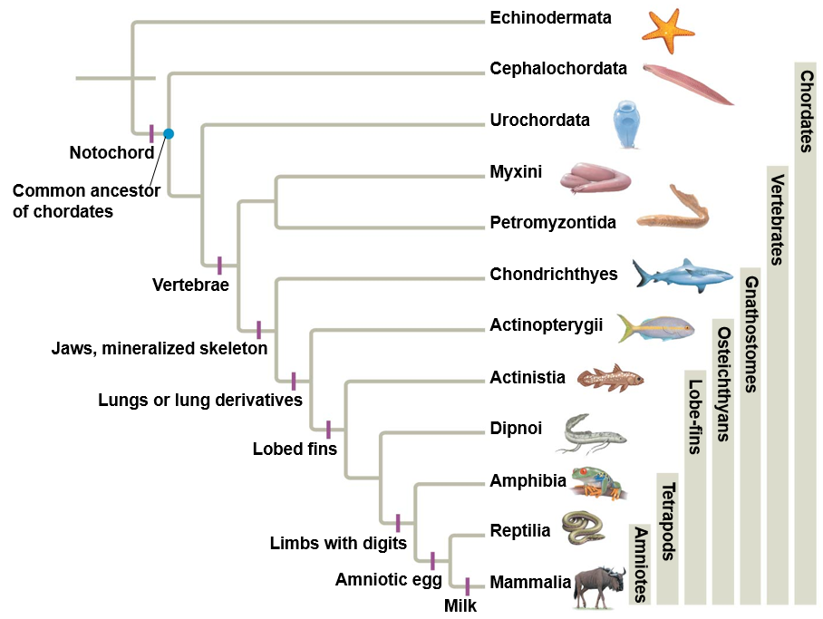
Phylum: Chordata
Bilateral Symmetry
Segmented
Coelomates
Invertebrates and vertebrates
Four distinct anatomical features
Notochord
Dorsal, hollow nerve cord
Pharyngeal gill slits
Muscular, post-anal tail
ANCESTRAL
DEUTEROSTOME

Slide 3
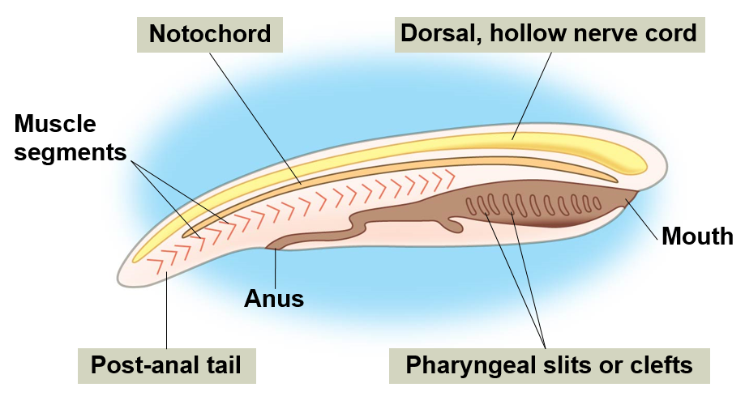
Chordata Characteristics
Notochord: longitudinal, flexible rod that provides structural support, becomes disks between vertebrae in humans and other vertebrates
Dorsal, Hollow Nerve Cord: develops into central nervous system
Pharyngeal Slits: develop into gills in some vertebrates and part of the ear and neck in tetrapods
Muscular, Post-anal Tail: used for locomotion in aquatic chordates, reduced during development in many species
Notes:
Notocord is between digestive tube and nerve cord

Slide 4
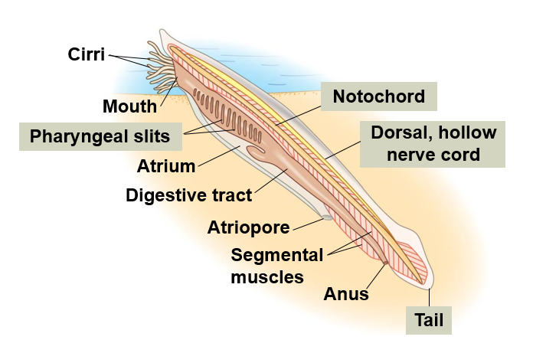
Phylum Chordata, Subphylum: Cephalochordata
Lancelets
Contains all four chordate characters as an adult

Slide 6
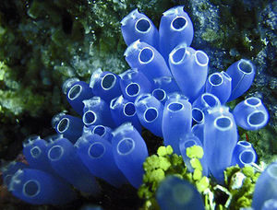
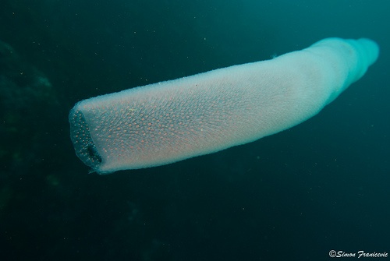
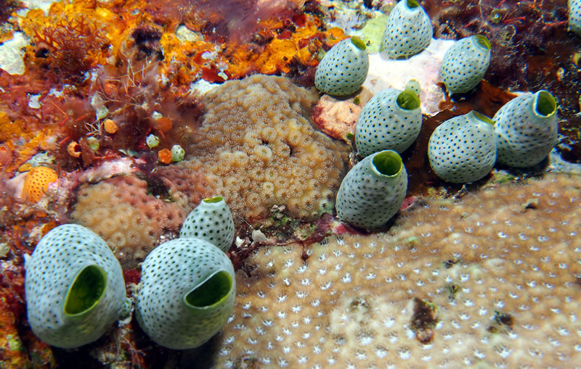
Phylum: Chordata, Subphylum: Urochordata
Tunicates or sea squirts
Sessile
Closest relative to vertebrates
Metamorphosis
Retains only pharynx with slits as an adult
Reabsorbed tail and notochord
Notes:
Some species shoot water through the excurrent siphon when attacked “sea squirt”

Slide 7
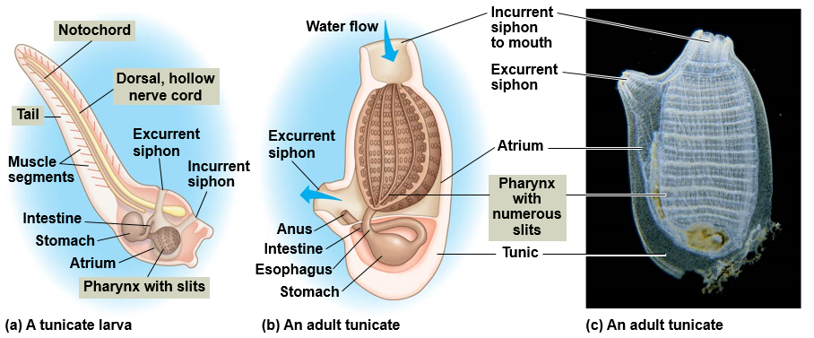
Phylum: Chordata, Subphylum: Urochordata
Notes:
Some species shoot water through the excurrent siphon when attacked “sea squirt”

Slide 8
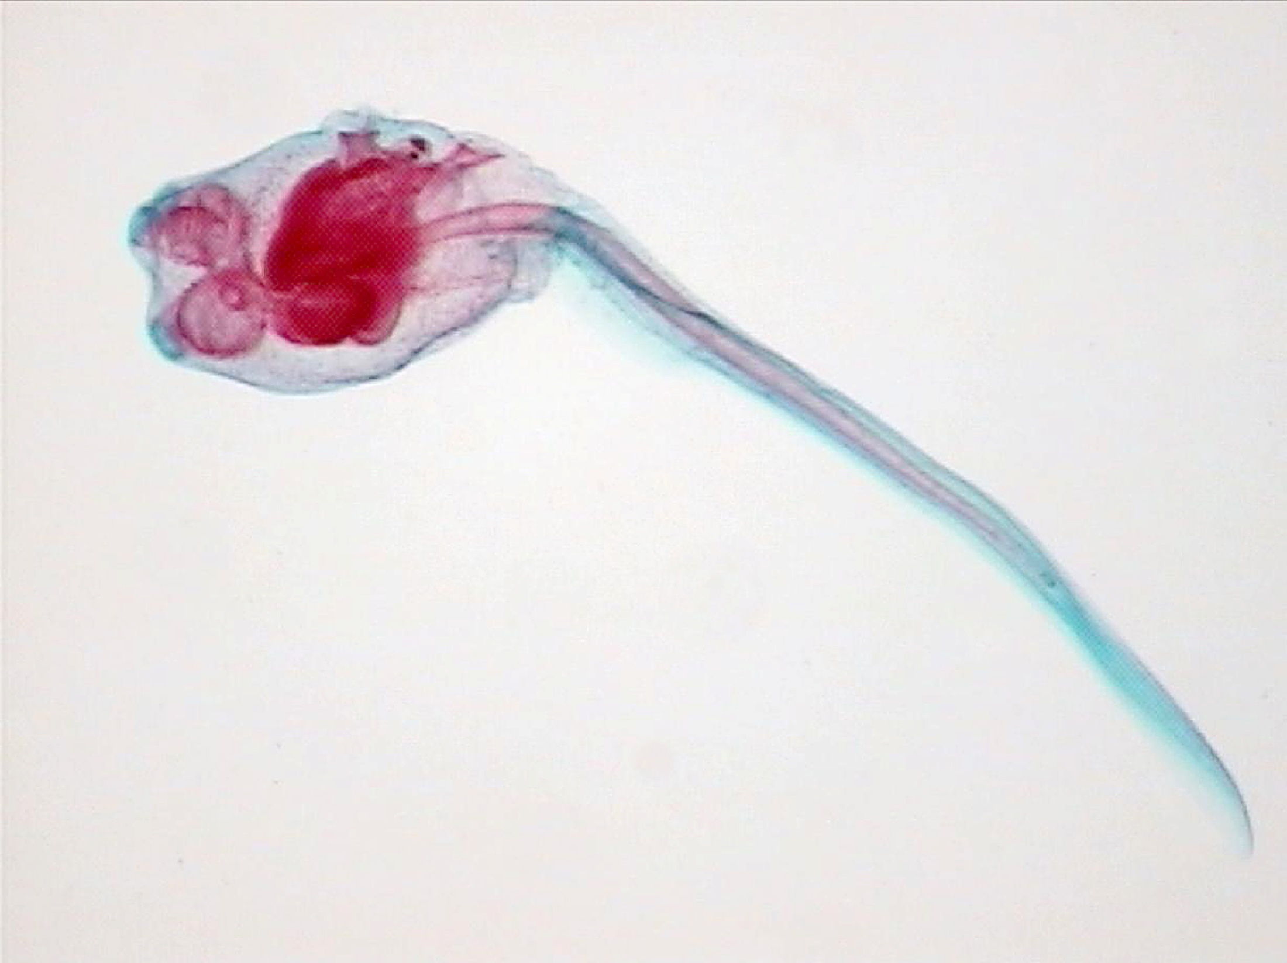
Incurrent siphon
Eyespot
Statocyst
Excurrent
siphon
Postanal tail
Adhesive
papillae
Pharynx with
Pharyngeal
gill slits
Notochord
Phylum Chordata
Subphylum Urochordata
Tunicate larva

Slide 9
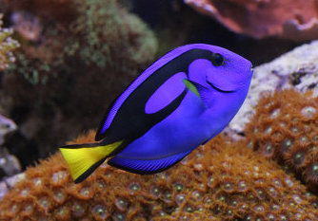
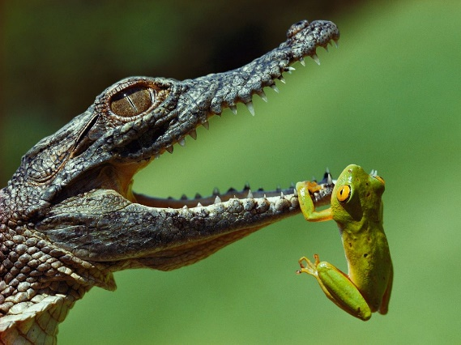
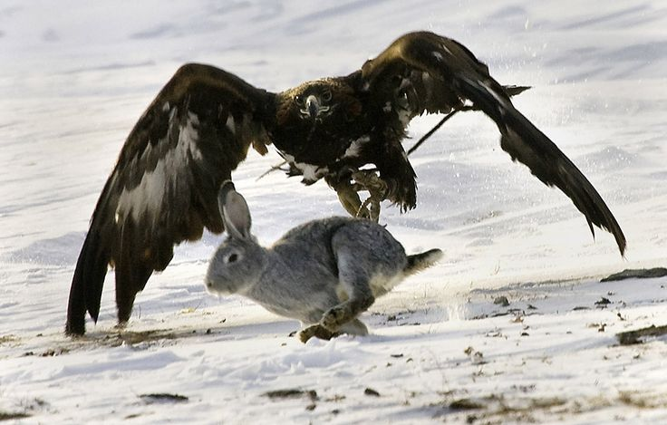
Phylum: Chordata, Subphylum: Vertebrata
Vertebrate column (backbone): flexible column stretching from the neck to the tail, made up of series of bones (vertebrae)
Closed circulatory system
Internal skeleton
Cartilage and/or bone
Bilateral symmetry
Well developed sensory organs and nervous system
Highly develop brain enclosed in skull
Respiratory system located near pharynx or throat
Gills or lungs
Notes:
Approximately 57,000 species of vertebrates
Tetrapods diverged 365 mya
Range from 8.4mm fish 100 billion times smaller than blue whale

Slide 10
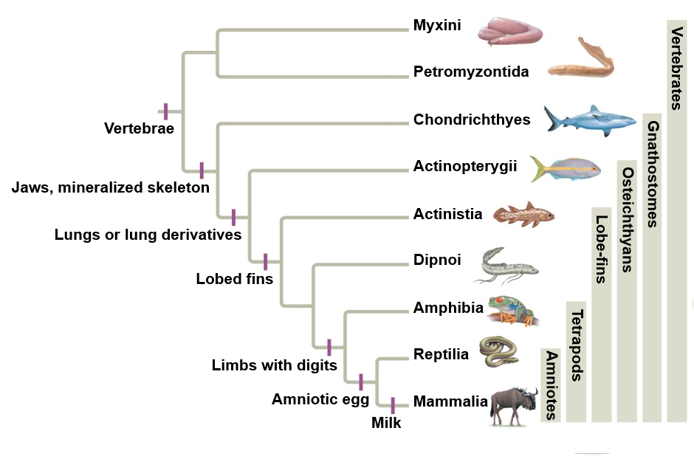
Vertebrate Phylogeny
Vertebrate Classes
Agnatha – Hagfish and lampreys
Chondrichthyes - Cartilaginous fishes
Osteichthyes - Bony fishes
Sarcopterygii – Lobe finned fishes
Actinopterygii – Ray finned fishes
Amphibia - Frogs, toads, salamanders
Reptilia - Turtles, snakes, lizards, crocodilians, birds
Mammalia - Mammals
Jaws, teeth
Milk, hair
Notes:
Key adaptations in Vertebrate evolution

Slide 11
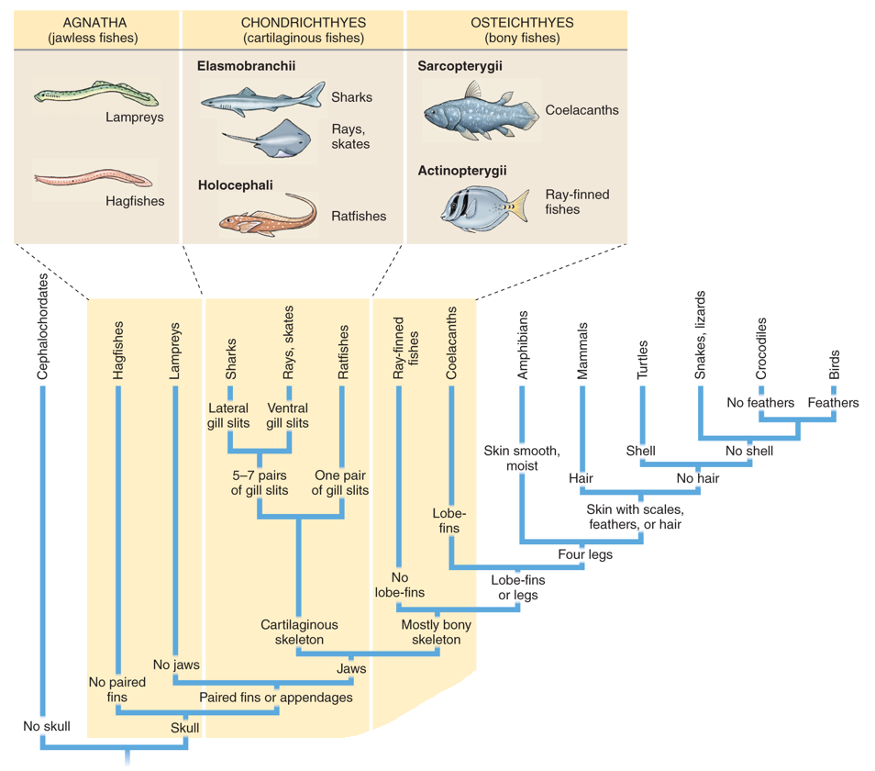
Major Groups of Fishes
Agnatha:
Jawless fishes
Chondrichthyes: Cartilaginous fishes
Osteichthyes:
Bony fishes

Slide 12
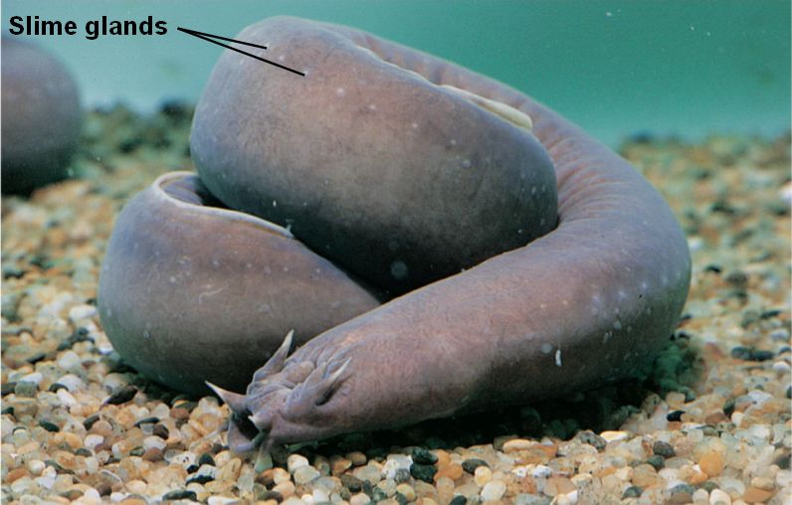
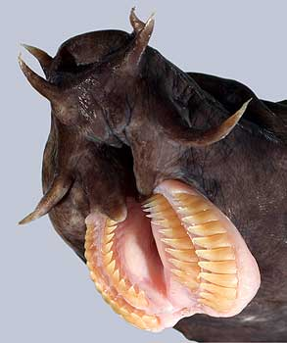
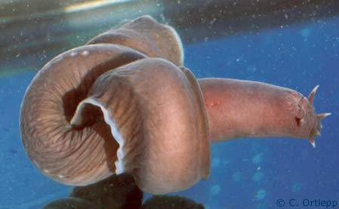
Agnatha
Hagfish
Jawless
Reduced vertebrae with cartilaginous braincase
Marine scavengers
Produce slime
Lack scales and paired appendages
Reduced brain, eyes, ears, and nasal opening
Tie themselves in a knot to release slime or provide leverage when feeding
Barbels

Slide 13
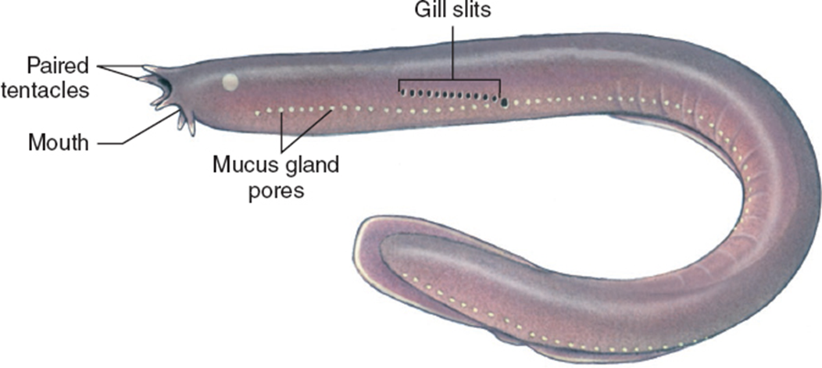
Hagfish Slime
https://youtu.be/Bta18FdkVcA
https://www.youtube.com/watch?v=pmaal7Hf0WA
https://www.youtube.com/watch?v=t5PGZRxhAyU

Slide 14
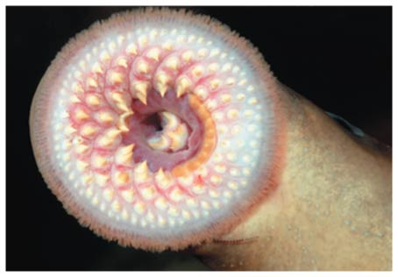
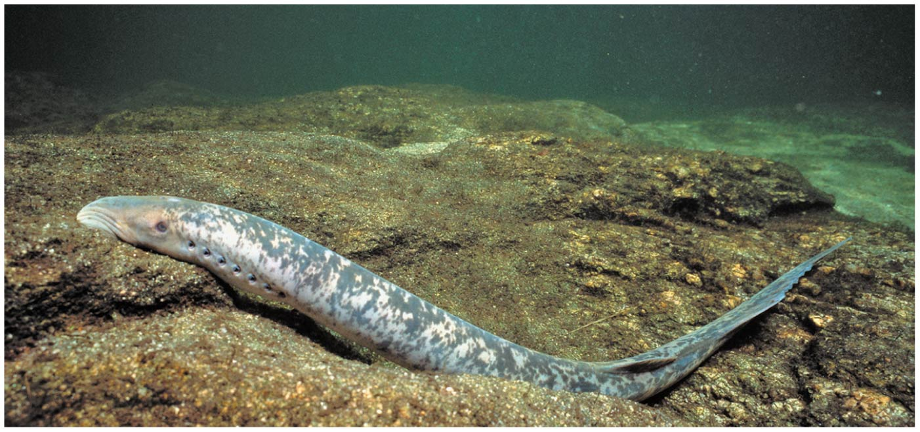
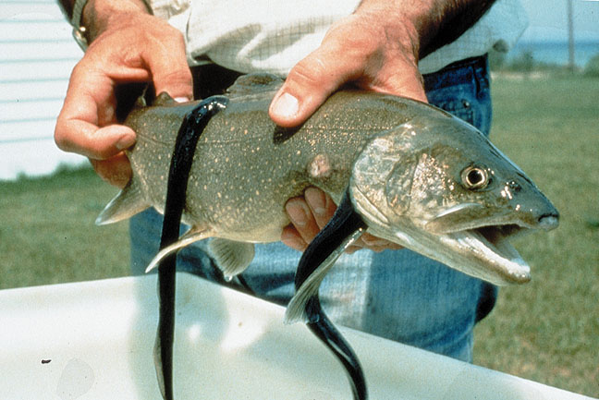
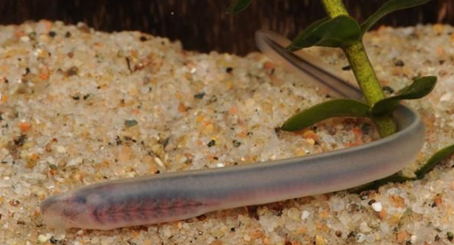
Agnatha
Lampreys
Jawless
Rudimentary vertebrae and cartilaginous skeleton
Marine and freshwater
Anadromous: migrates to fresh water to spawn
Ammocoetes larvae: filter feeders, buried in sediment
Most are parasitic
Lack scales and paired appendages

Slide 15
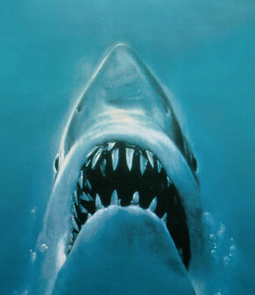
Evolution of Jaws
Jaws likely developed from gill arches used in filter feeding
Lead to the diversification of food types (carnivory and herbivory)
Allowed for active defense from predators
De-emphasis on armored plates
Development of paired appendages
Notes:
“Perhaps the greatest of all advances in vertebrate history was the development of jaws and the consequent revolution in the mode of life of early fishes” –Romer 1962

Slide 16
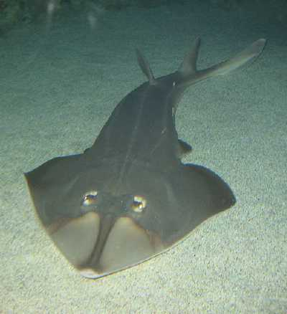
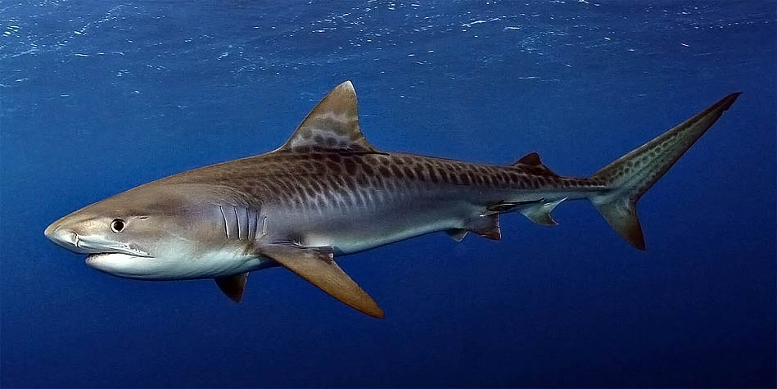
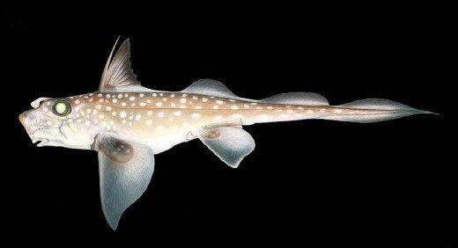
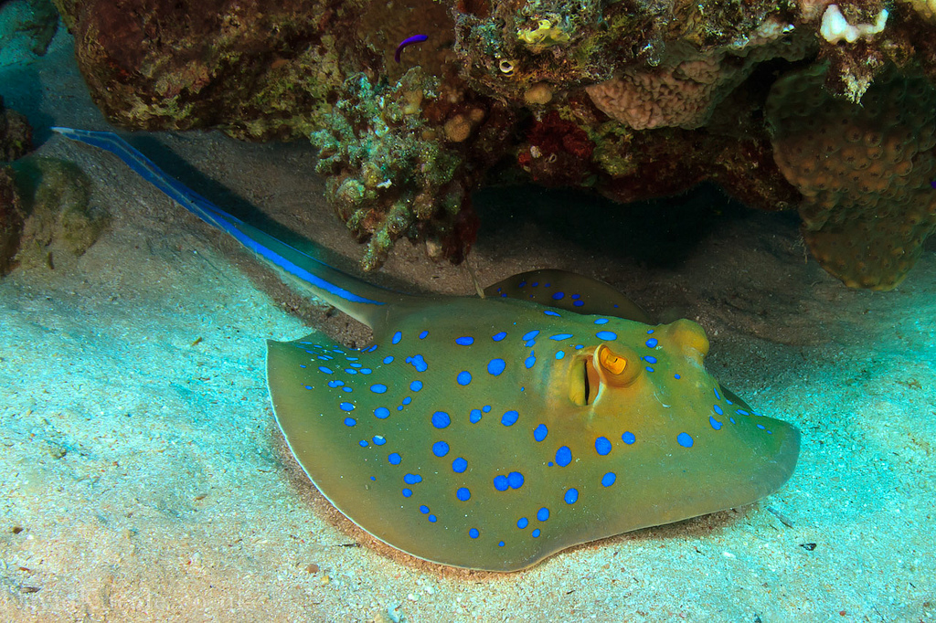
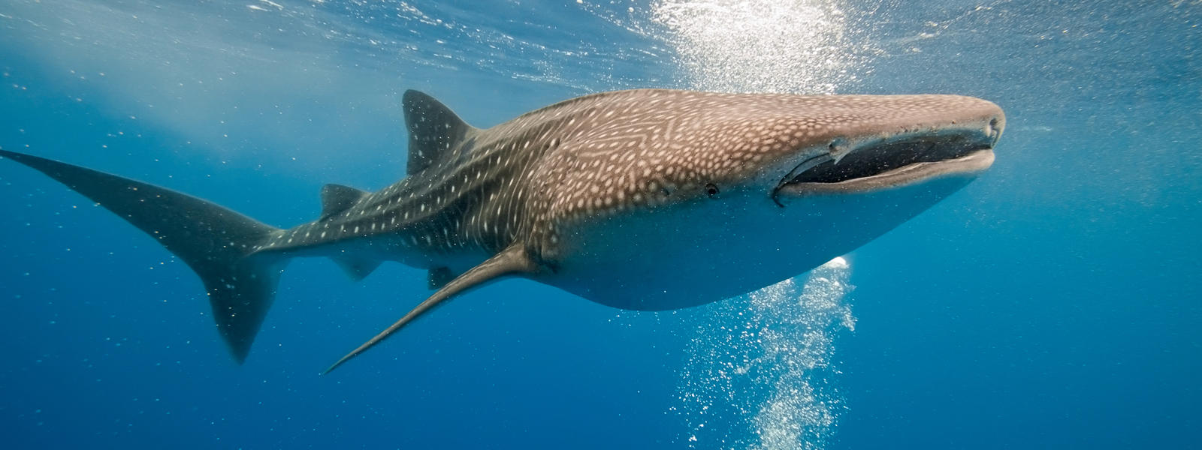
Class Chondrichthyes (kon-DRIK-thee-EEZ)
Cartilaginous skeleton
Placoid scales
Teeth derived from placoid scales are not fused with jaw
Replaceable (every few days)
Large, buoyant livers
Lack gas bladder or lungs
Spiral valve intestine
Highly developed sensory organs
Internal fertilization

Slide 17
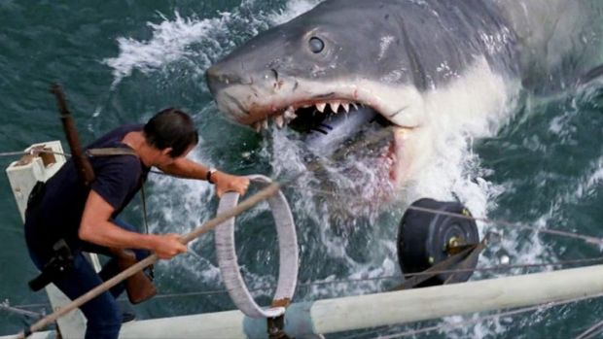
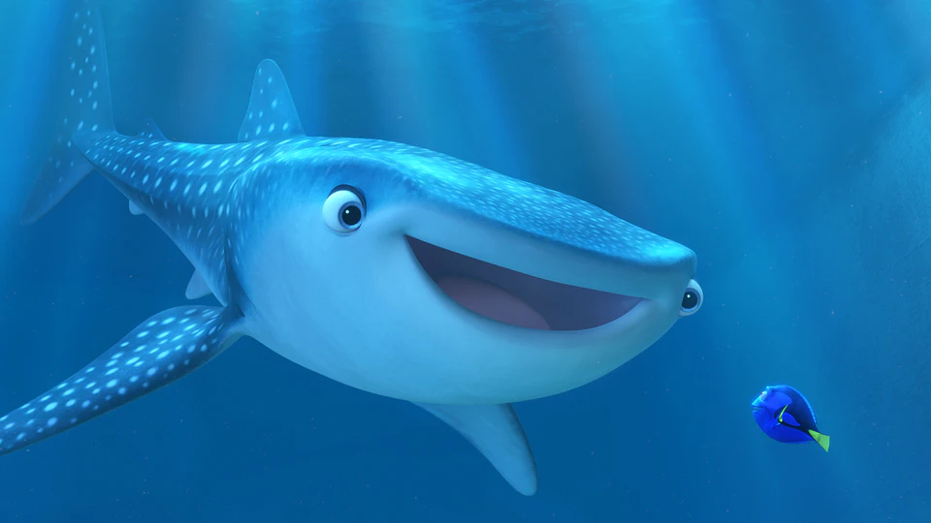
Sharks
https://youtu.be/wUb3YCPm4bY
https://youtu.be/xIxR1xz9n2A

Slide 18
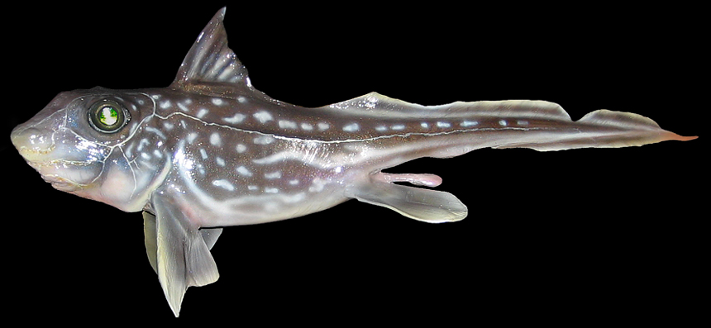
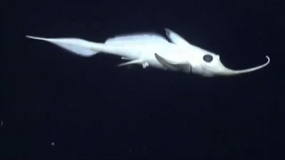
Class Chondrichthyes, Subclass Holocephali
Chimaera (ratfish)
Oviparous
One pair of gill slits
Upper jaw attached to braincase
Teeth modified as crushing plates
Diet of benthic invertebrates
Poisonous spine before first dorsal fin
Move by flapping pectoral fins
Lack scales

Slide 19
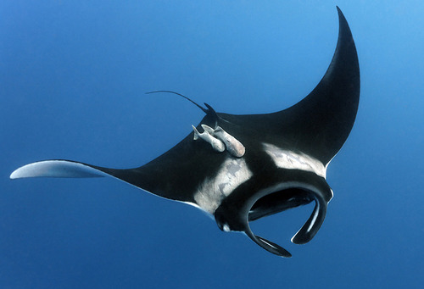
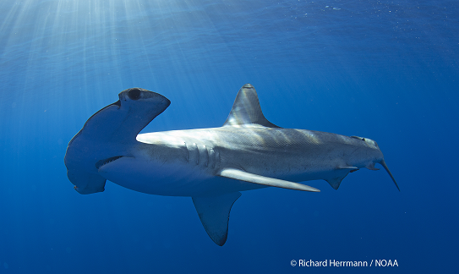
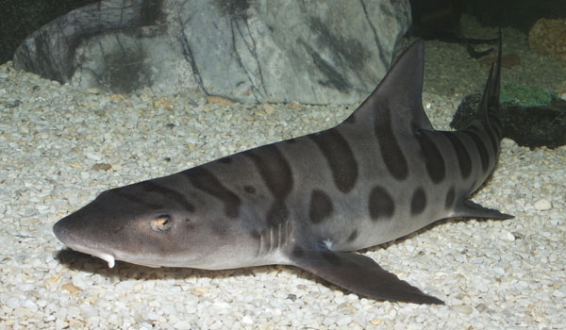
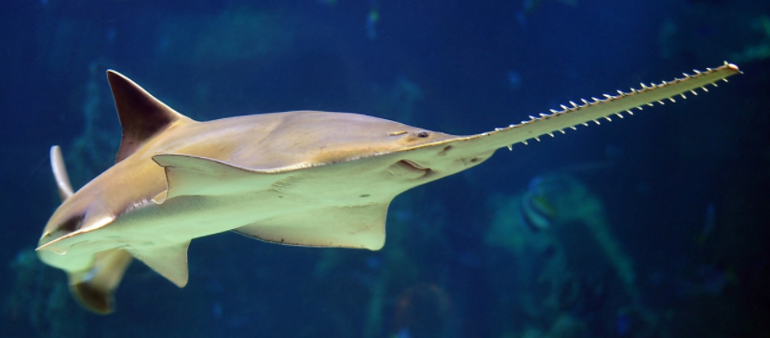
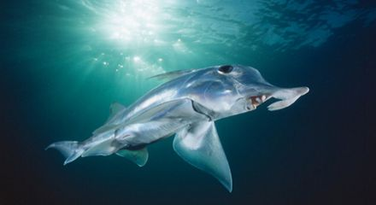
Class Chondrichthyes
Subclass Elasmobranchii
Sharks (8 orders, ~360 species)
Most are large (> 1m)
Most are active marine predators
Skates, Rays, Electric rays, Sawfish (4 orders, ~550 species)
Flattened bodies
Bottom dwelling predators
Subclass Holocephali
Chimaera (rat fish) (1 extant order, ~50 species)
Feed on benthic invertebrates in deep ocean

Slide 20
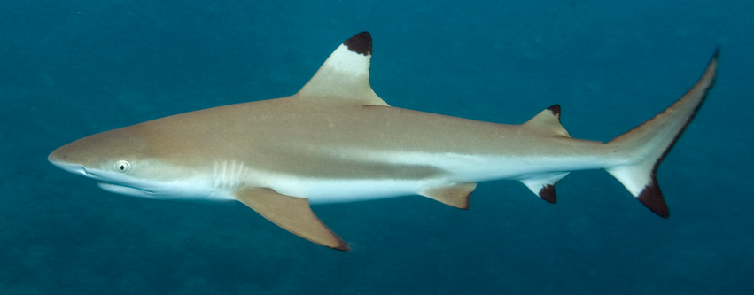
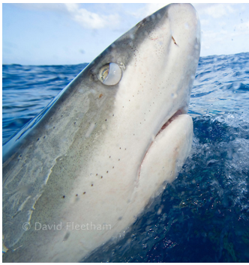
Class Chondrichthyes, Subclass Elasmobranchii
Sharks
Almost exclusively marine
Two dorsal fins, an anal fin, and 5 to 7 gill openings
Heterocercal caudal fin
Countershading
Dark on top, light on bottom
Nictitating membrane: translucent third eyelid that protects the eye when feeding
Elevated body temperature in some
Dorsal fins
Gill openings
Anal fin
Nictitating membrane

Slide 21
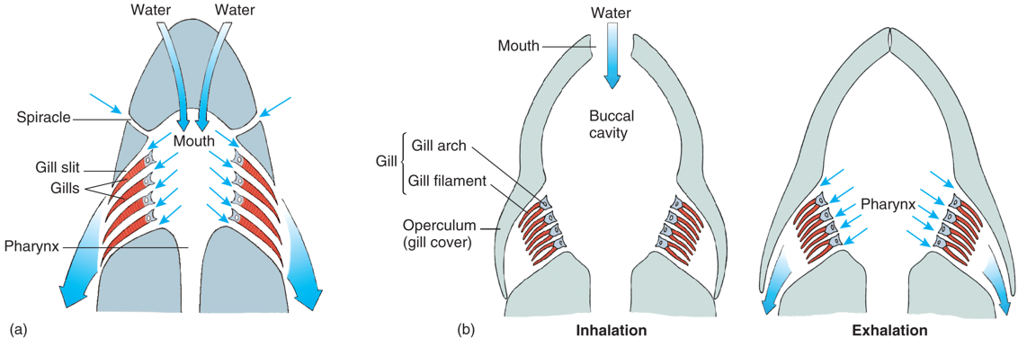
Respiration in Fishes
Most cartilaginous fish must swim continuously to force water through their mouth and over their gills
Skates and rays that live on the bottom can take in water through the spiracle while buried in the sandy bottom
Most bony fish draw water into the buccal (mouth) cavity while the opercula are closed, then the fish close their mouth and contract their pharynx, forcing water across their gills
Most bony fish do not need to constantly swim to perform gas exchange
Notes:
Many sharks are obligate ram ventilators

Slide 22
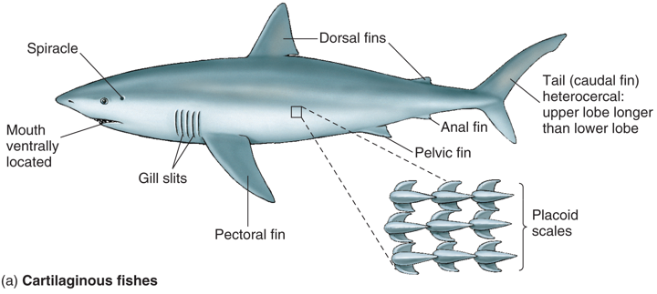
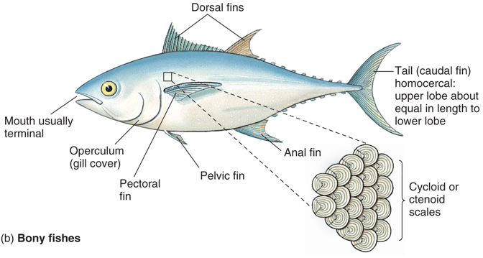
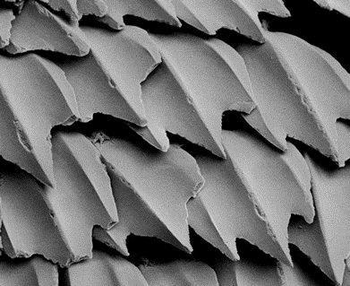
Differences Between Cartilaginous Fish and Bony Fish
Mouth ventrally located
5 to 7 gill slits
Placoid scales
Heterocercal caudal fin
Spiracle: respiratory opening
Large lipid-rich liver
Mouth at front of body (terminal)
Single gill cover (operculum)
Ctenoid or cycloid scales
Homocercal caudal fin
Swim bladder

Slide 23
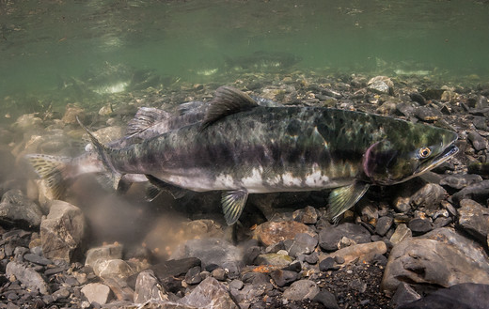
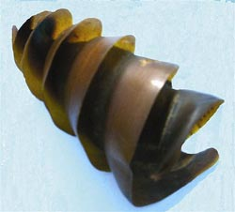
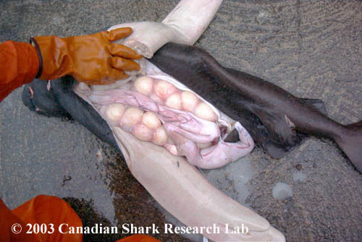
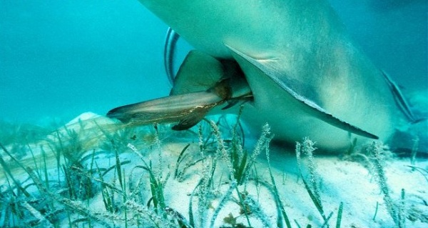
Modes of Reproduction
Ovuliparity: female lays unfertilized eggs, which are externally fertilized by the male
Most bony fish
Oviparity: the mother deposits internally fertilized eggs that develop and hatch outside of mother’s body
Some bony fish and some sharks
Ovoviviparous: mother retains fertilized eggs within the oviduct, but does not provide nourishment to the eggs
Few sharks
Viviparous: young develop within mother’s uterus and receive nourishment via the placenta, uterus or by eating other eggs, before being born (live birth)
Some sharks and fish

Slide 24
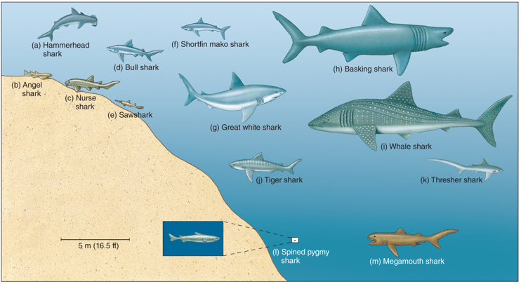
Distribution of Sharks in the Ocean
Sharks are found in nearly all habitats in the ocean and specialize in a variety of different prey types.
Pelagic: open ocean
Demersal: bottom dwelling

Slide 25
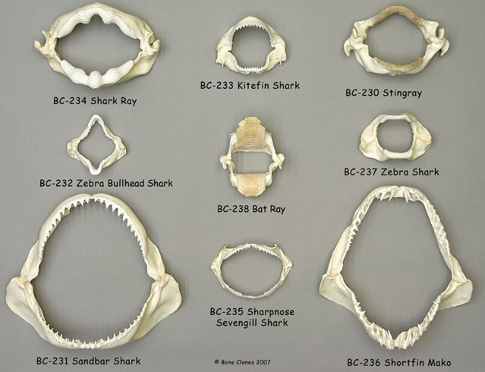
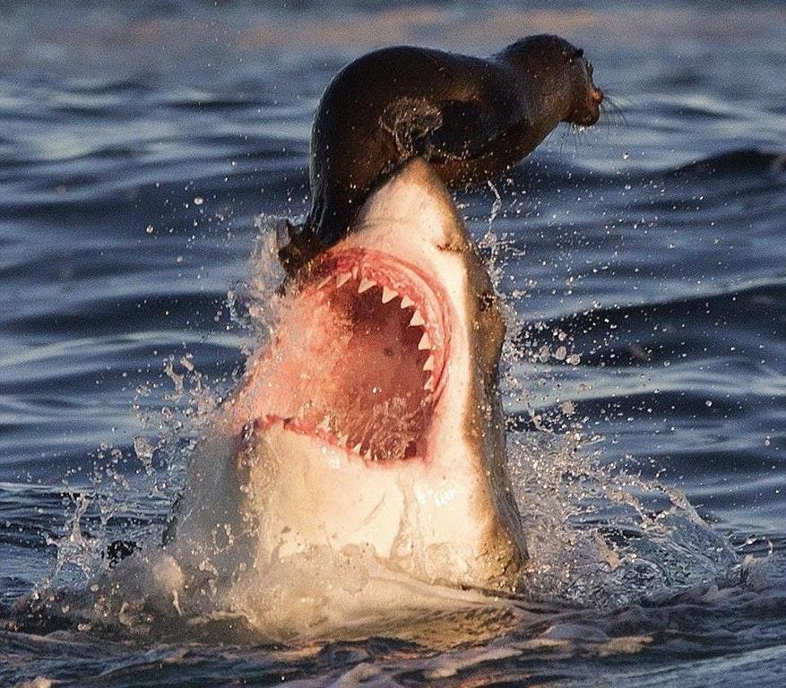
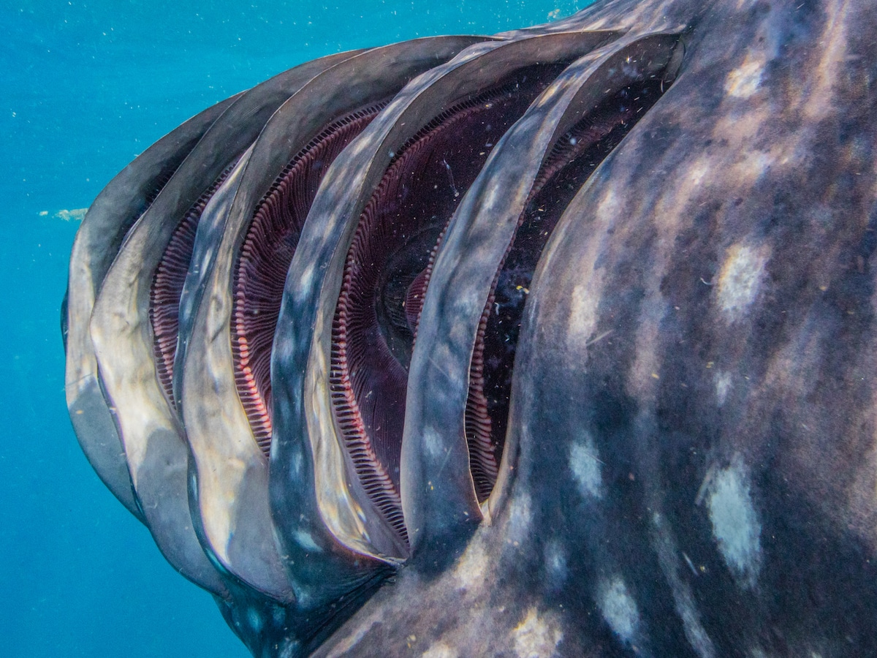
Shark Diet and Feeding

Slide 26
Chondrichthyes Reproduction
Claspers of male shark
Cloaca of female shark

Slide 27
Lateral Line
Lateral line: sensory organ along the side of the body used to detect vibrations and movements

Slide 28
Ampullae of Lorenzini
Ampullae of Lorenzini: small, jelly filled pores that contain electroreceptors, which can sense the electric fields produced by other fish
Ampullae of Lorenzini

Slide 29
Anatomy of a Shark
Ampullae of Lorenzini
Nostril

Slide 30
Anatomy of a Shark
Spiracle

Slide 31
Anatomy of a Shark
Spiral valve

Slide 32
Anatomy of a Shark
Stomach
Large, expansive stomach
Rugae
Small intestine
Duodenum
Digestive enzymes enter digestive tract
Ilium
Spiral valve increase surface area
Primary site of absorption
Cloaca
Single opening for waste removal and reproduction

Slide 33
Anatomy of a Shark
Liver
Rich in lipids
Aids in buoyancy
Produces bile
Emulsifies lipids
Gall bladder
Stores bile produced in liver
Pancreas
Secretes digestive enzymes

Slide 35
Heart
Liver
Stomach

Slide 36
Testis
Spleen
Liver

Slide 37
Ilium
Rectal gland
Cloaca
Pancreas
Pelvic fin

Slide 38
1. Stomach
Stomach
Gall bladder
2. Gall bladder

Slide 39
Pancreas
Duodenum
Rugae (folds) of stomach

Slide 40
Threats to Sharks
Shark finning: the removal of shark fins often while the shark is still alive
Driven primarily for demand of shark fin soup
Estimates of 80 million sharks killed every year
Late maturity and few young produced leads to drastic population declines
Populations increasing in United States due to protections
https://www.youtube.com/watch?v=mO7hvOtYnck
https://www.youtube.com/watch?v=mJG7RaLX-DM

Slide 41
Threats to Sharks
Commercial Fishing
Purse-seining: a large net encircles a school of fish then the bottom of the net is closed to create a bag-like net full of fish
Trawling: large cone-shaped nets are dragged behind boats at different depths. Bottom trawls can destroy benthic habitats
Gillnets: a long net hangs suspended in the water with holes that allow fish heads to pass through catching fish by their gills
Long-lining: a single fishing line stretching for up to 50 miles with thousands of baited hooks
Notes:
Chile has completely banned the practice of bottom trawling and other countries are placing restrictions on it.

Slide 42
Threats to Sharks
Bycatch: a fish or other species that is caught unintentionally
38.5 million tones of bycatch caught world-wide
Estimated to be nearly 40% of total catch every year
Most bycatch goes unreported
Injured or killed organisms often thrown back
Notes:
650,000 whales, dolphins, and seals were killed throughout the 1990s as a result of bycatch

Slide 43
Marine Food Webs
Food chain: the linear transfer of energy between organisms in an ecosystem from producers to consumers
Phytoplankton → Krill → Whale
Food web: the interconnection of all the food chains within a particular ecosystem

Slide 44
Marine Ecology
A decline in seal and sea lion populations has led to more sea otters being eaten by killer whales
A decline in sea otters has led to an increase in se urchins
An increase in sea urchins has led to an increase in sea urchin grazing intensity on the kelp
Increased grazing by sea urchins has led to a decline in healthy kelp forests

Slide 45
Marine Ecology
Hypothesize what would happen if sharks were removed from the food web to the right?

Slide 46
Biomagnification
Biomagnification: toxic substances become increasingly concentrated within living things as they move up each trophic level
Common with DDT, Mercury, and PCB’s
Notes:
Common in mercury, PCBs, and DDT
Polyclorinated biphenyl = PCB
Dichlorodiphenyltrichloroethane = DDT

Slide 47
Trophic Levels
Only about 10% of the biomass from one trophic level is converted to biomass in the next trophic level, which results in fewer top predators

