Slide 1
Arthropods
Lab 6

Slide 2
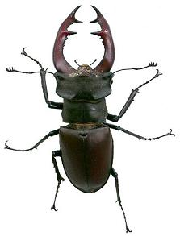
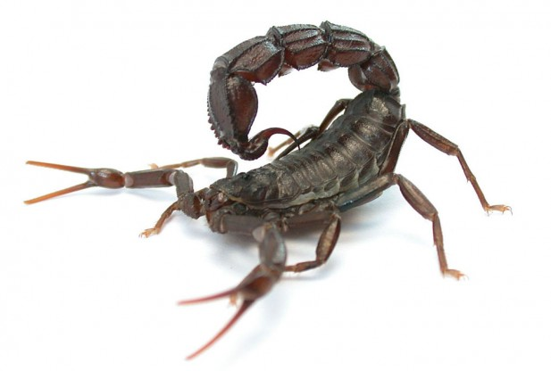
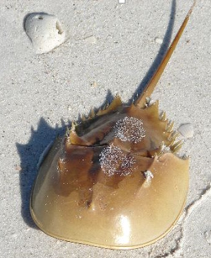
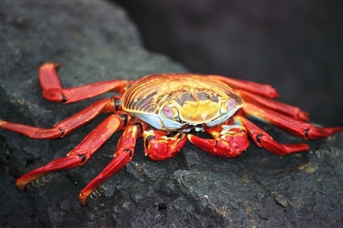
Phylum Arthropoda
Spiders, crustaceans, and insects
2/3 of all known species
More than 1 million described
Found in all habitats on earth
Hard exoskeleton, segmented body, jointed appendages
Must molt to grow
Segments carry paired appendages
Complex behavior patterns
Notes:
Nervous system similar to annelids
Estimates of about a billion billion arthropods on earth
Evolved from unspecialized lobopods
Specialization of segments key to evolutionary success.
Must shed exoskeleton to grow
Chitin: polysaccarhide
Protection
Muscle attachment

Slide 3
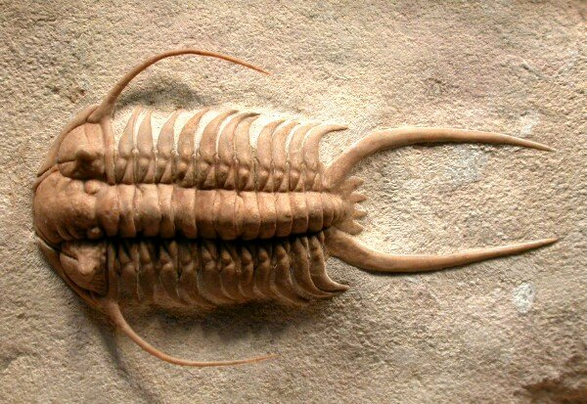
Phylum Arthropoda
Trilobites
All extinct (Permian era - 250 mya)
Segmented bodies without specialized appendages
Paired appendages

Slide 4
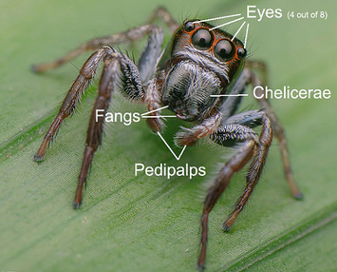
Phylum Arthropoda
Subphylum Chelicerata
Sea spiders, horseshoe crabs
Cephalothorax and Abdomen
Fusion of head and thorax
Six pairs of appendages
One pair of Chelicerae: specialized feeding appendages
Fangs or pinchers
One pair of Pedipalps: sensory organ, feeding, defense, reproduction
Four pairs of walking legs
No antennae
Most with simple eye (single lens)

Slide 5
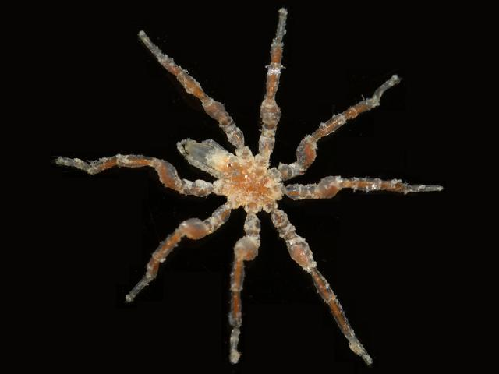
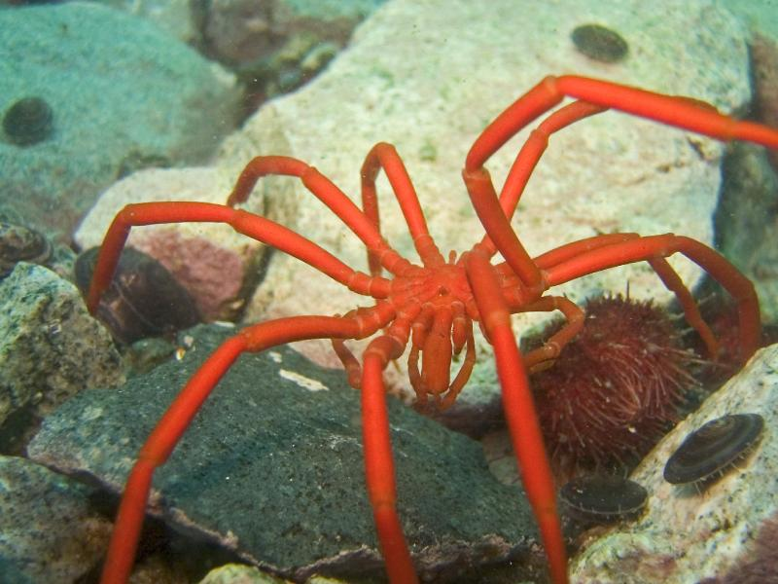
Phylum Arthropoda, Subphylum Chelicerata
Sea spiders
Approx: 1300 species
Not true spiders
Reduced body
No circulatory system
Predators or scavengers
Proboscis: elongated sucking mouthpart
Typically 8 walking legs
May have extra legs
Widespread marine distribution
Notes:
Not true spiders or arachnids

Slide 6
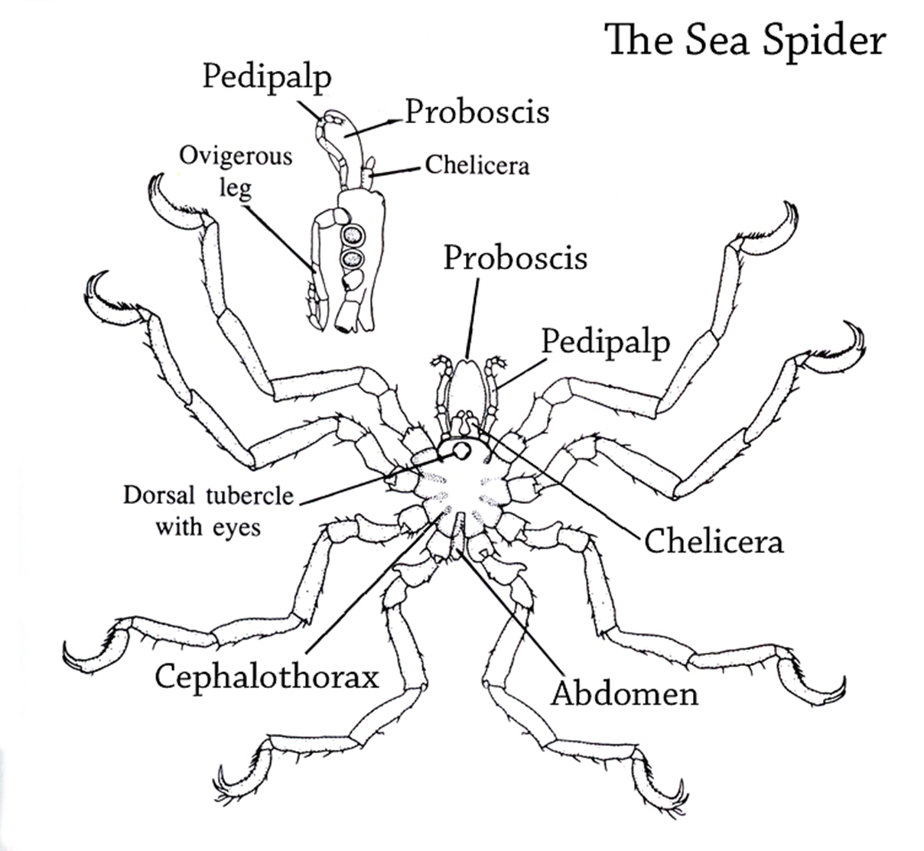

Slide 7
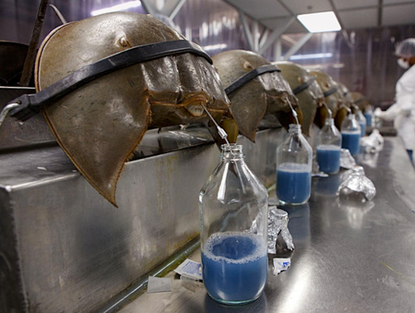
Phylum Arthropoda, Subphylum Chelicerata
Horseshoe carbs
Six pairs of appendages
One pair of chelicerae
Five pair of walking legs
Unchanged since the Triassic period
Shallow coastal waters
Blue hemolymph used to test for bacterial endotoxins
Hemocyanin
Notes:
Hemocyanin: oxygen transport protein with copper (blue color)
Amebocytes: mobile cells in the body of invertebrates move via pseudopodia. Active in defense against pathogens.
Blue blood cost $15,000 qt.

Slide 9
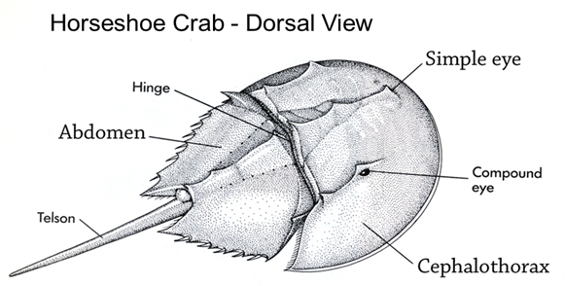
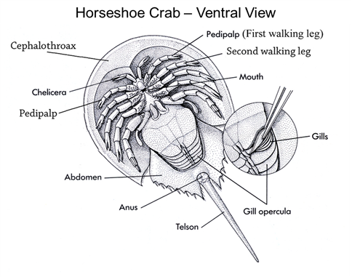
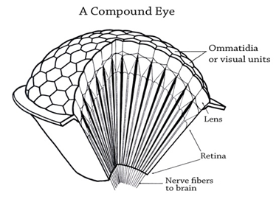

Slide 10
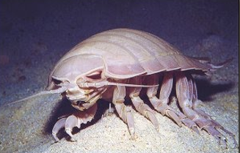
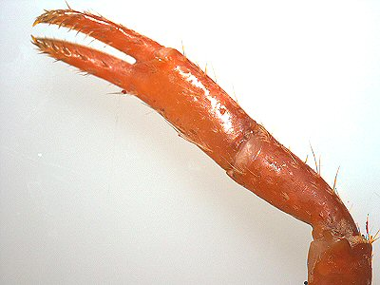
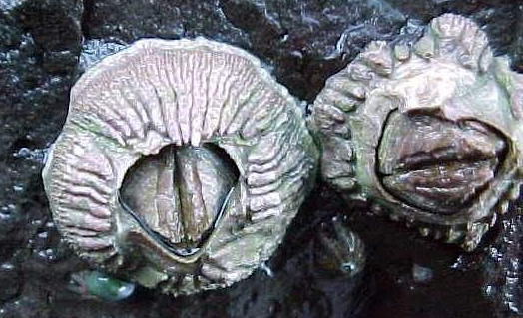
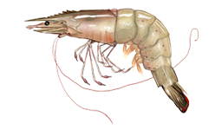
Phylum Arthropoda
Subphylum Crustacea
Copepods, lobster, barnacles, pill bugs, amphipods, isopods, copepods, krill
Contain two pair of antennae
Biramous appendages (two main branches)
Three mouth parts
1 pair of mandibles
2 pairs of maxillae
Body of two or three parts
Appendages on thorax and abdomen
Mostly marine

Slide 11
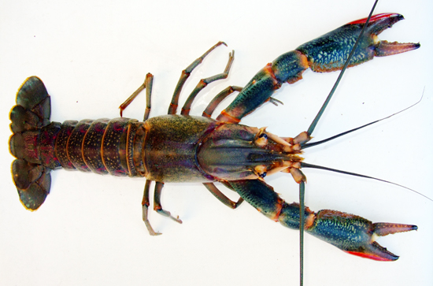
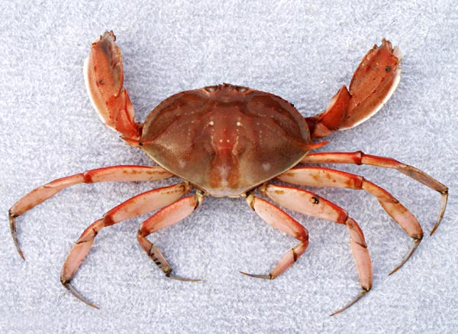
Phylum Arthropoda, Subphylum Crustacea
Class Malacostraca
(Crabs, lobster, krill, and shrimp)
Ten legs (Decapods)
Mostly marine
Calcium carbonate and chitin cuticle
Carapace
Cheliped (pinchers)

Slide 12
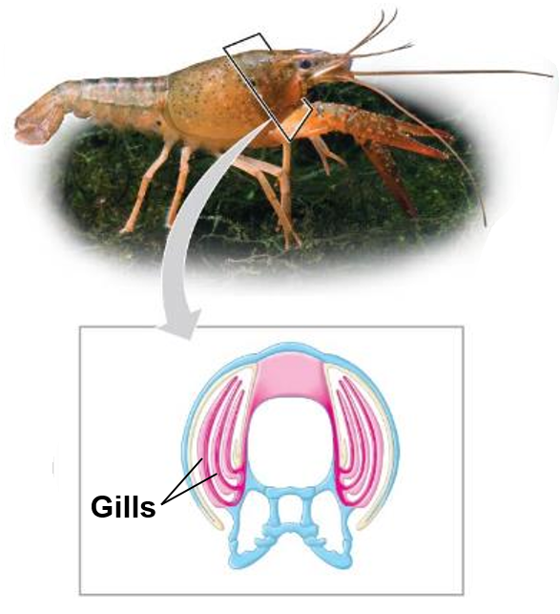
Respiration in Crustaceans
Gas exchange occurs across long, feather gills within the body cavity
Specialized appendages draw water across the gills

Slide 13
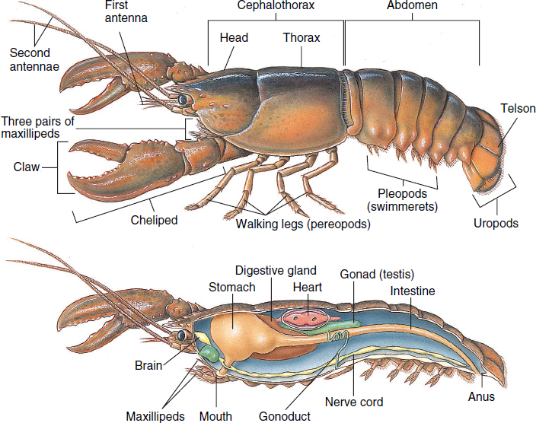
Crustacean Anatomy
Notes:
A lobsters brain is in it throat, nervous system in its abdomen, teeth in it stomach, kidneys in its head. It hears with its legs, tastes with its feet and tend to favor either the left or right claw.

Slide 14
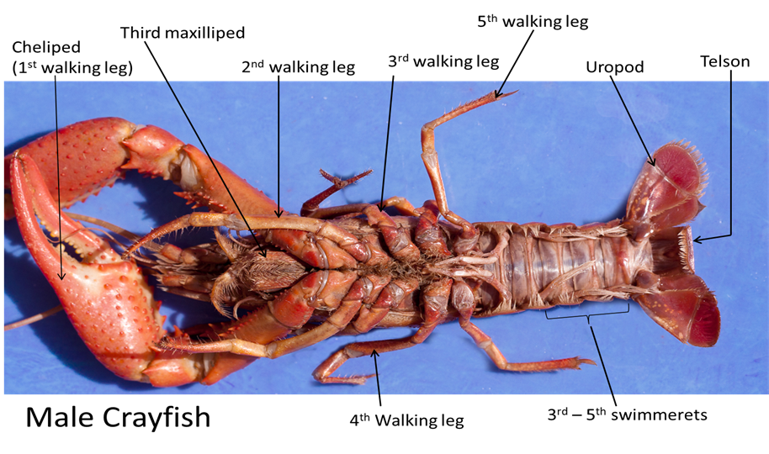
Crustacean Anatomy
Notes:
A lobsters brain is in it throat, nervous system in its abdomen, teeth in it stomach, kidneys in its head. It hears with its legs, tastes with its feet and tend to favor either the left or right claw.

Slide 15
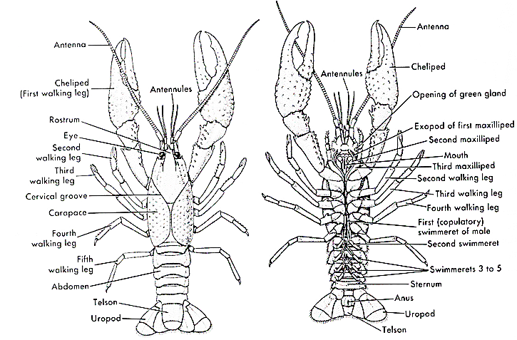
Crustacean Anatomy
Notes:
A lobsters brain is in it throat, nervous system in its abdomen, teeth in it stomach, kidneys in its head. It hears with its legs, tastes with its feet and tend to favor either the left or right claw.

Slide 16
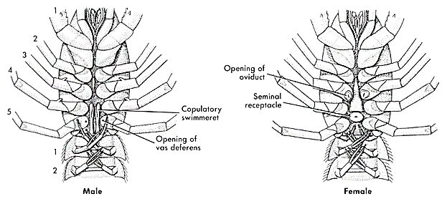
Crustacean Anatomy

Slide 17
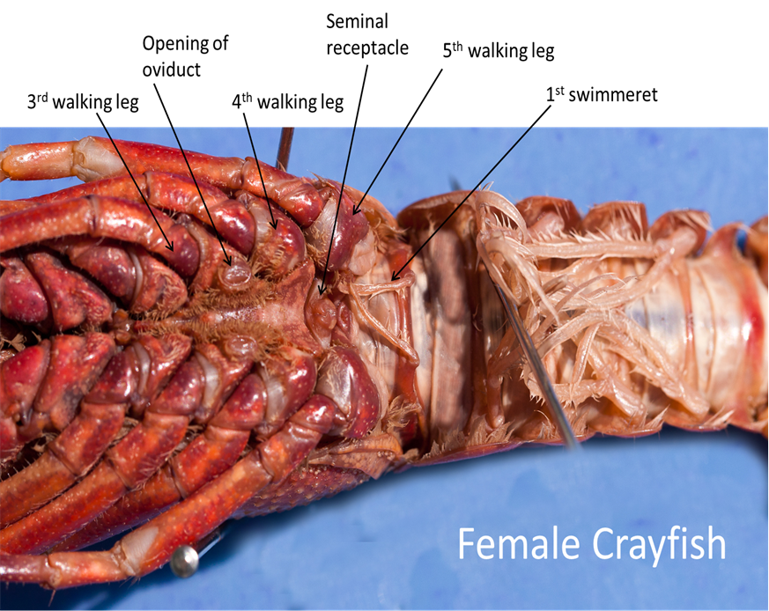
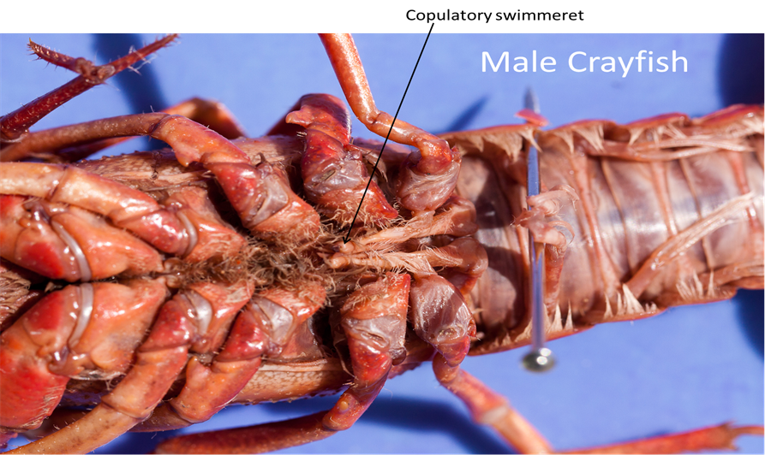
Crustacean Anatomy

Slide 18
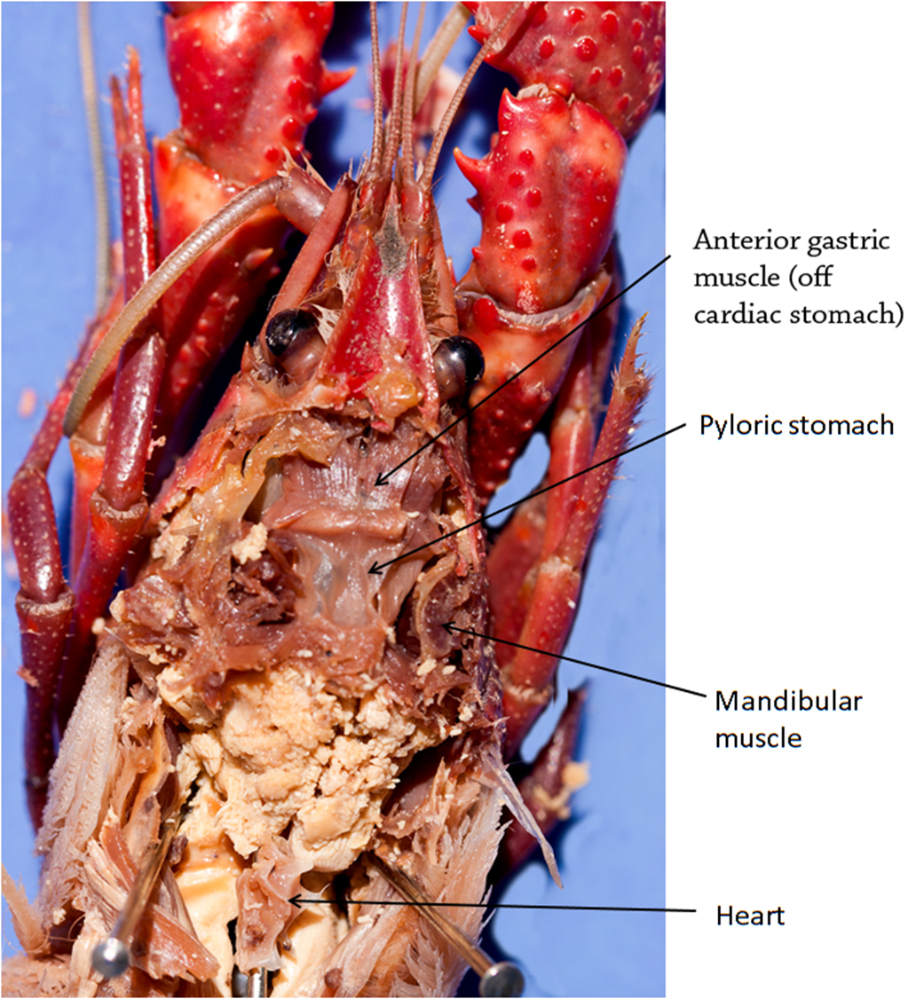
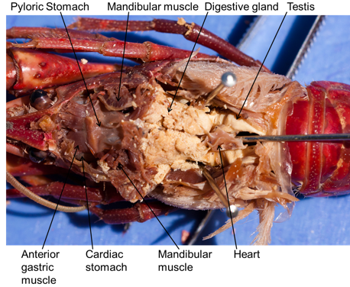
Crustacean Anatomy

Slide 19
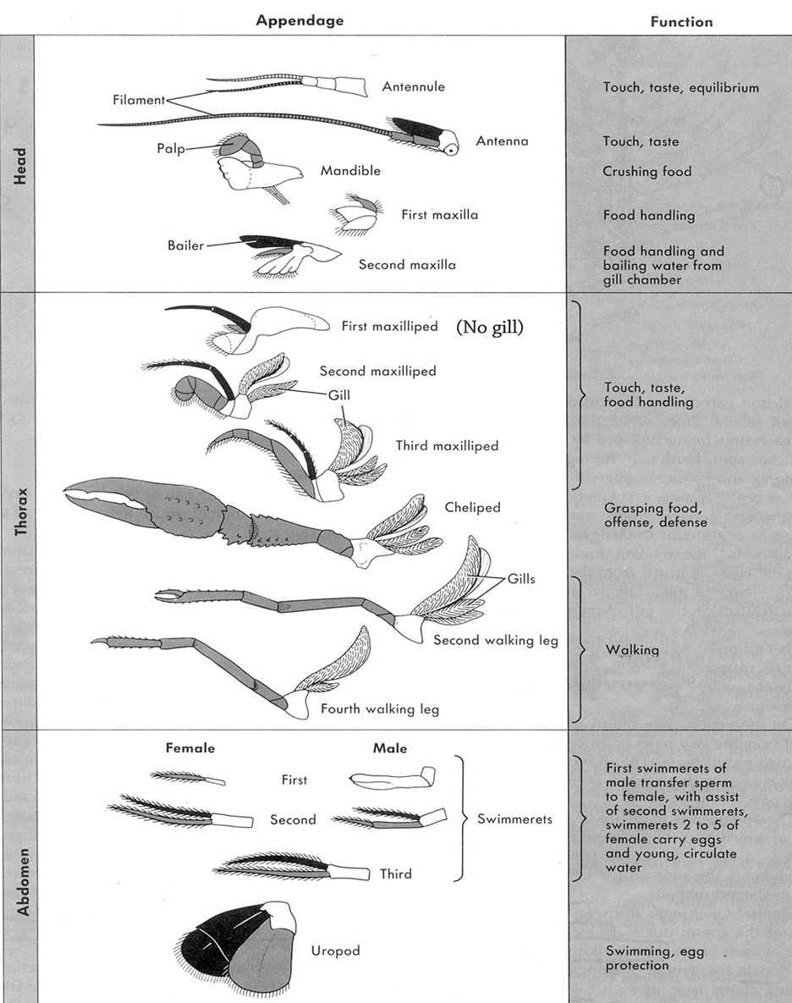
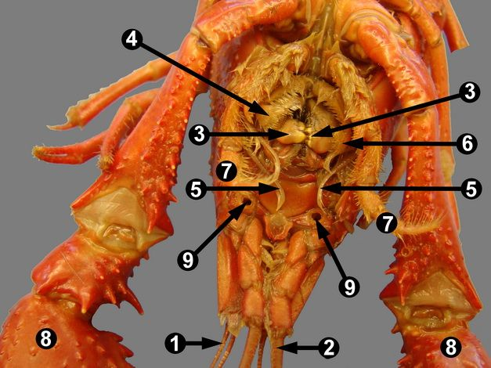

Slide 20
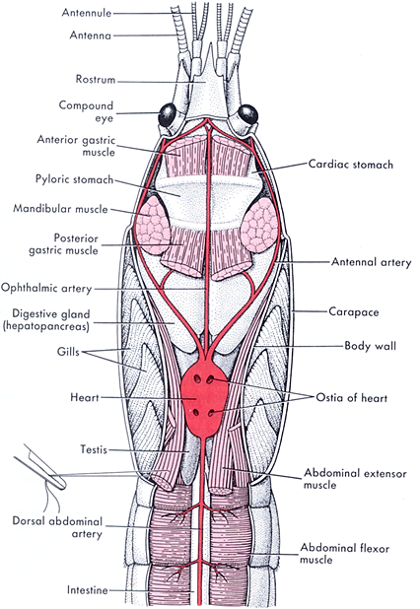
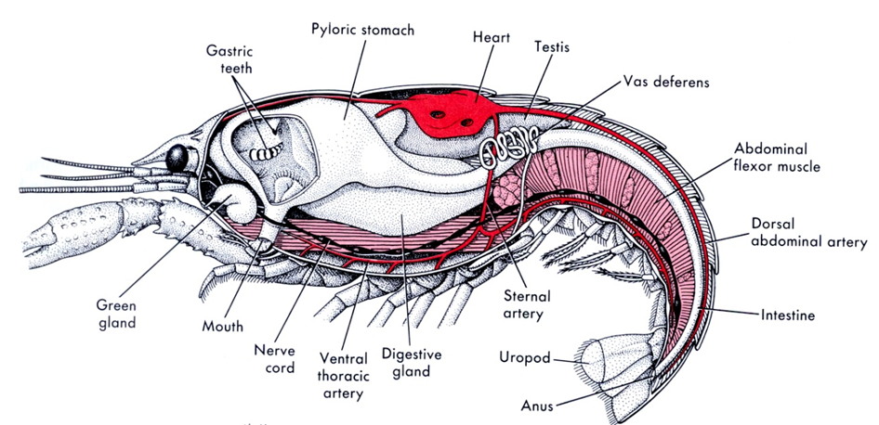

Slide 21
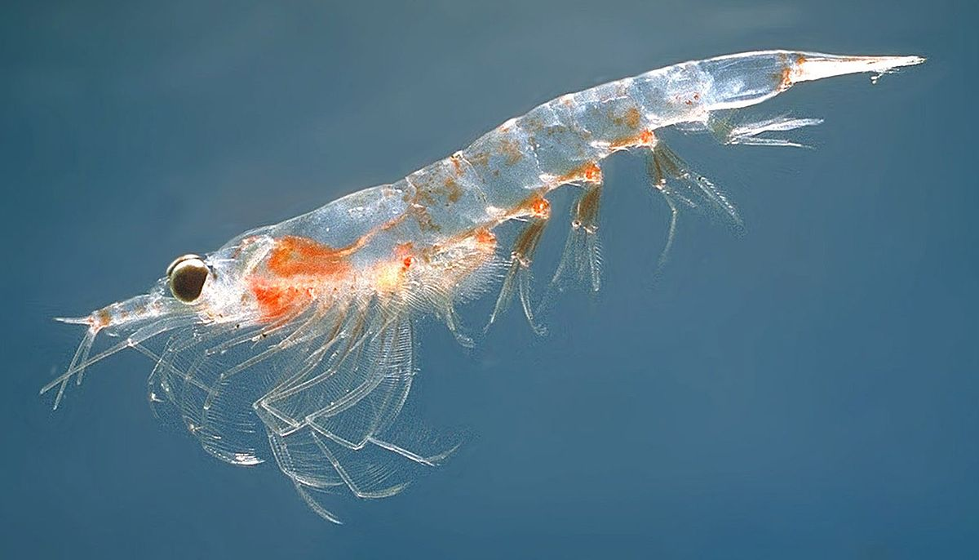
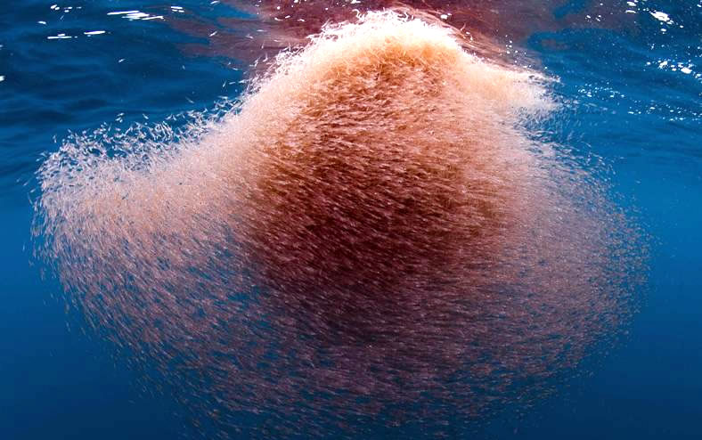
Phylum Arthropoda, Subphylum Crustacea
Krill
Approx. 85 species
Marine
Found in all the world’s oceans
Daily vertical migration
Surface at night and deeper depths during the day
Important food source for many marine species including whales, penguins, seals, squid, and fish

Slide 22
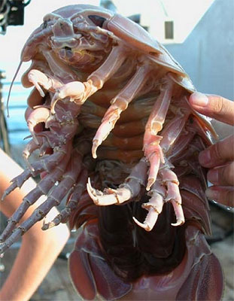
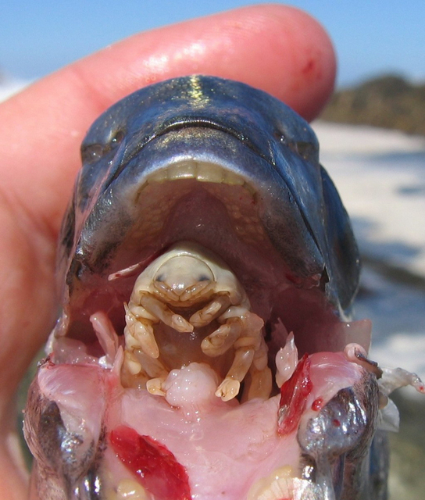
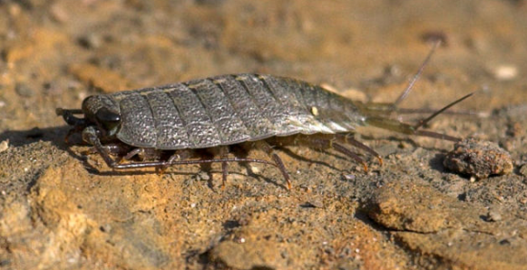
Phylum Arthropoda, Class Crustacea
Isopods
Approx.11,000 species
Dorsal/ventrally flattened
Marine, freshwater and terrestrial
Detritivores, herbivores, predators and parasites

Slide 23
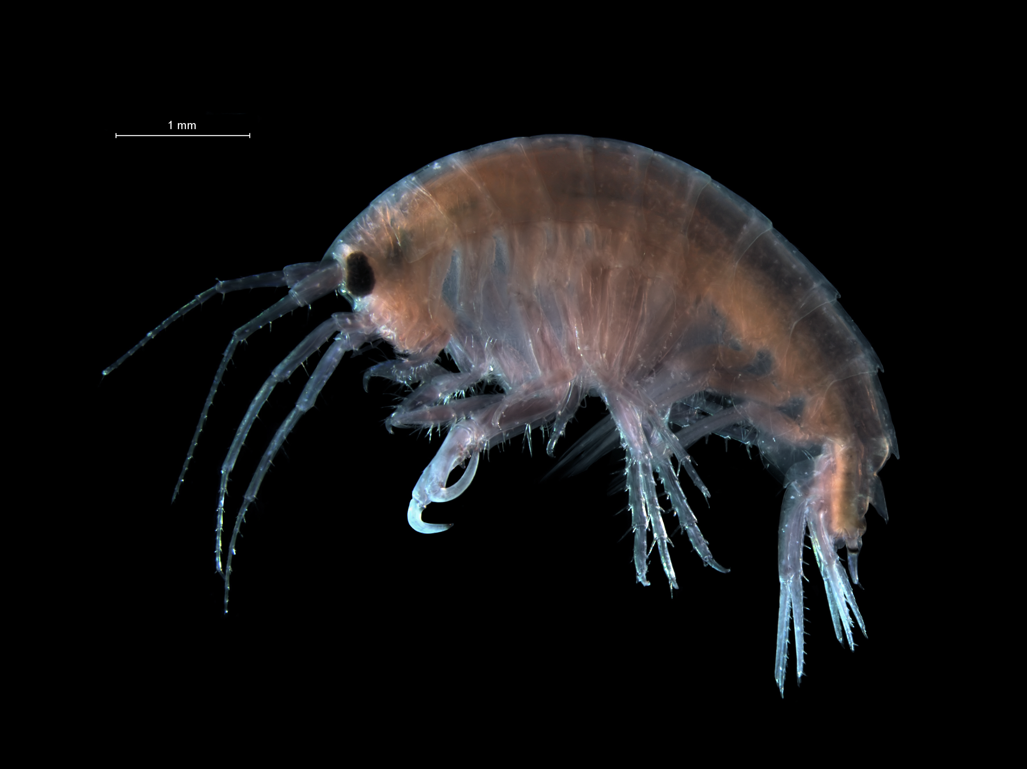
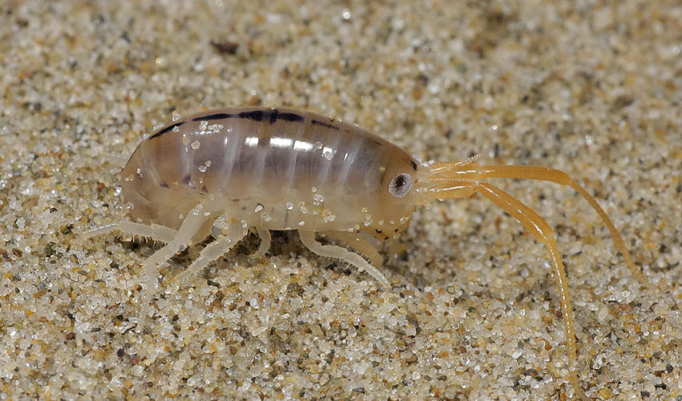
Phylum Arthropoda, Class Crustacea
Amphipods
Approx. 9,900 species
Marine, freshwater and terrestrial
Curved bodies that are laterally compressed
Detritivores or scavengers

Slide 24
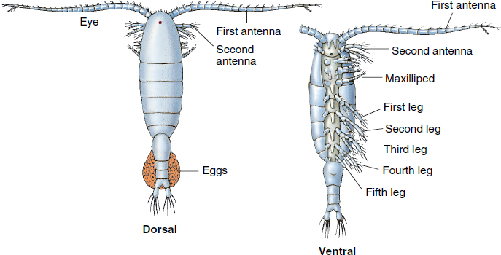
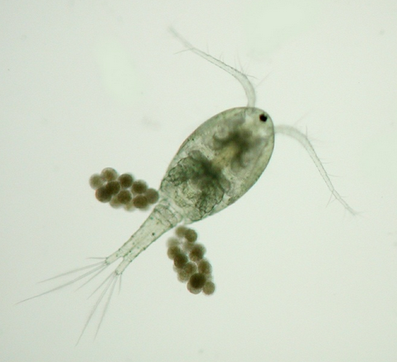
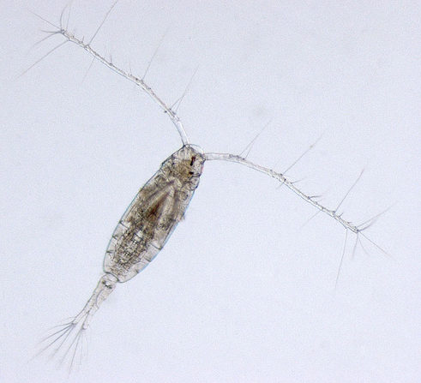
Phylum Arthropoda, Subphylum Crustacea
Class Copepoda
(Copepods)
Most planktonic
Marine, freshwater and wet terrestrial habitats
Small size
Tear-drop shaped body with large antennae
Food source for many fish species
Notes:
Planktonic: organisms that drift with current

Slide 25
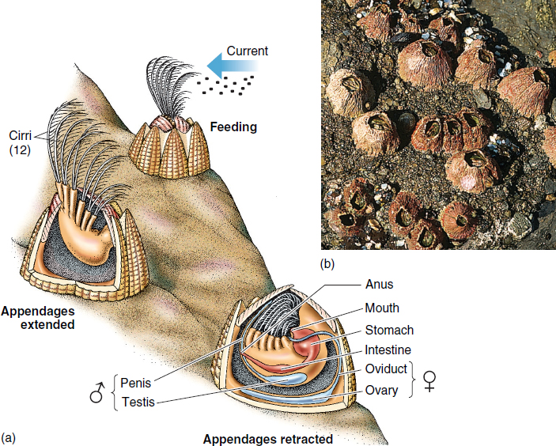
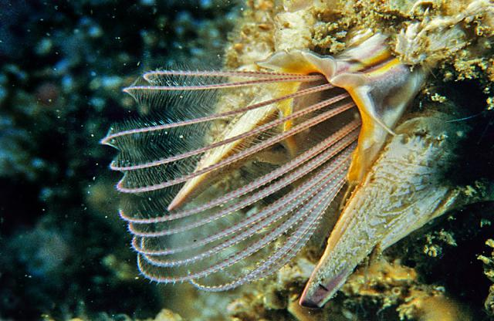
Phylum Arthropoda, Subphylum Crustacea
Class Cirripedia (Barnacle)
Marine only
Filter feeders
Cirri: modified feeding legs
Calcium carbonate cuticle

Slide 26
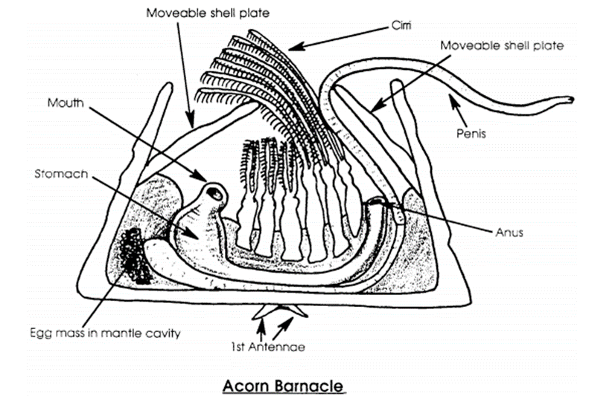
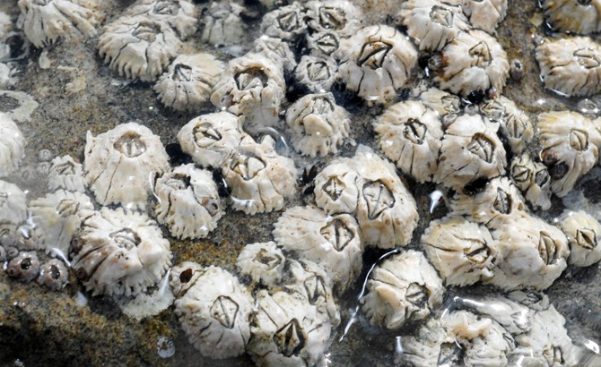
Barnacle Anatomy

