Slide 1
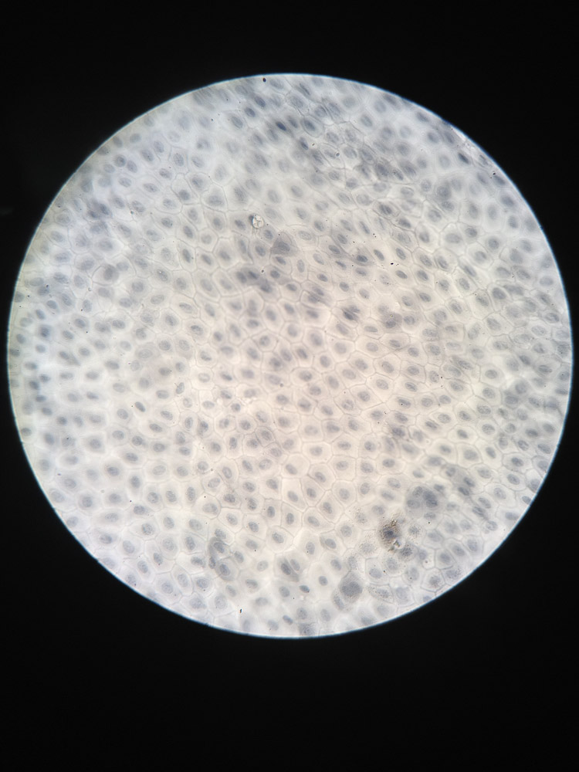
Notes:
Station 1 – Simple Squamous

Slide 2
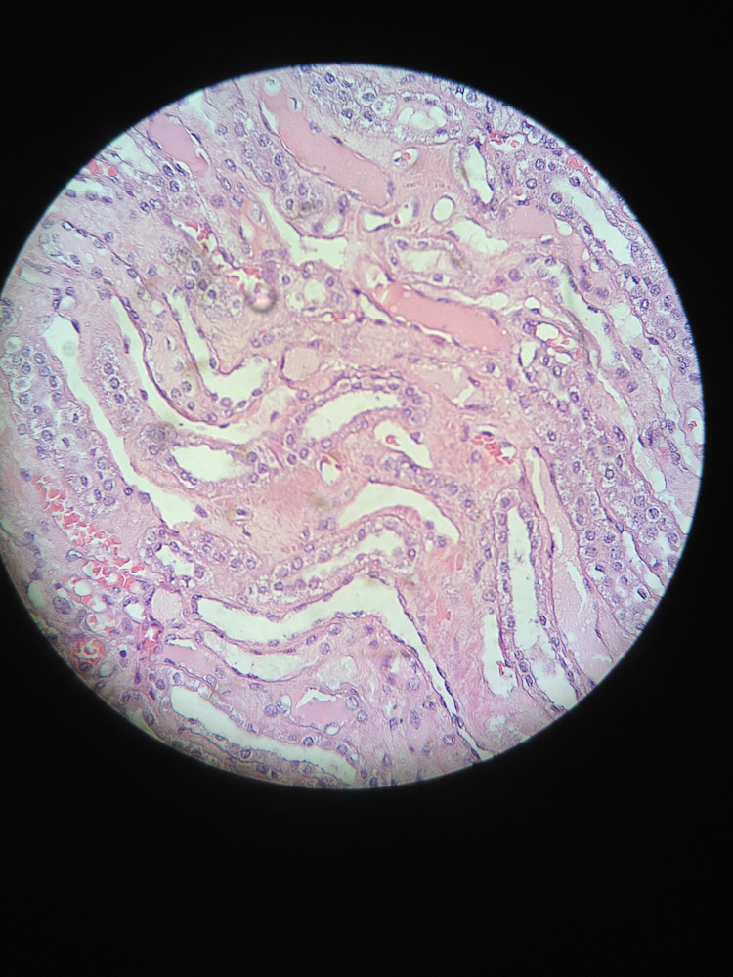
Notes:
Station 1-Simple Cubodial

Slide 3
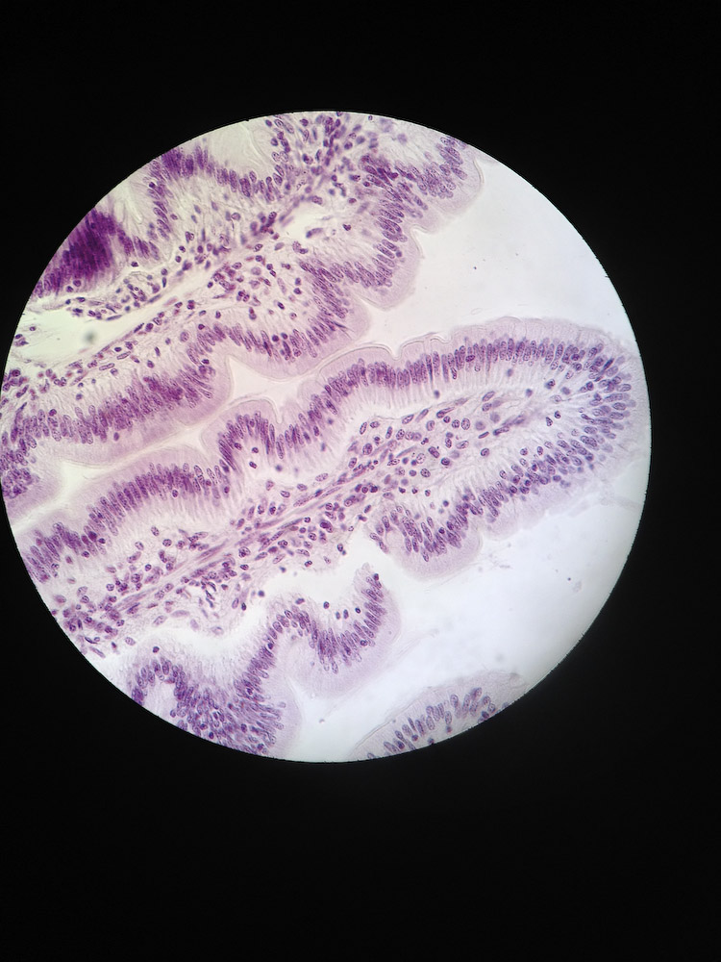
Notes:
Station 1-Simple Columnar

Slide 4
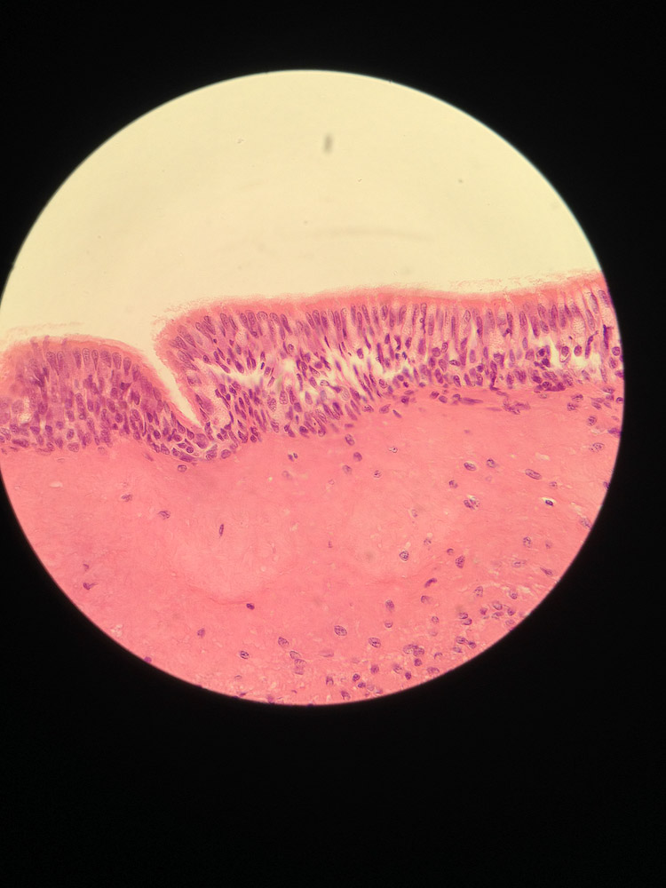
Notes:
Station 1- Stratified Columnar

Slide 5
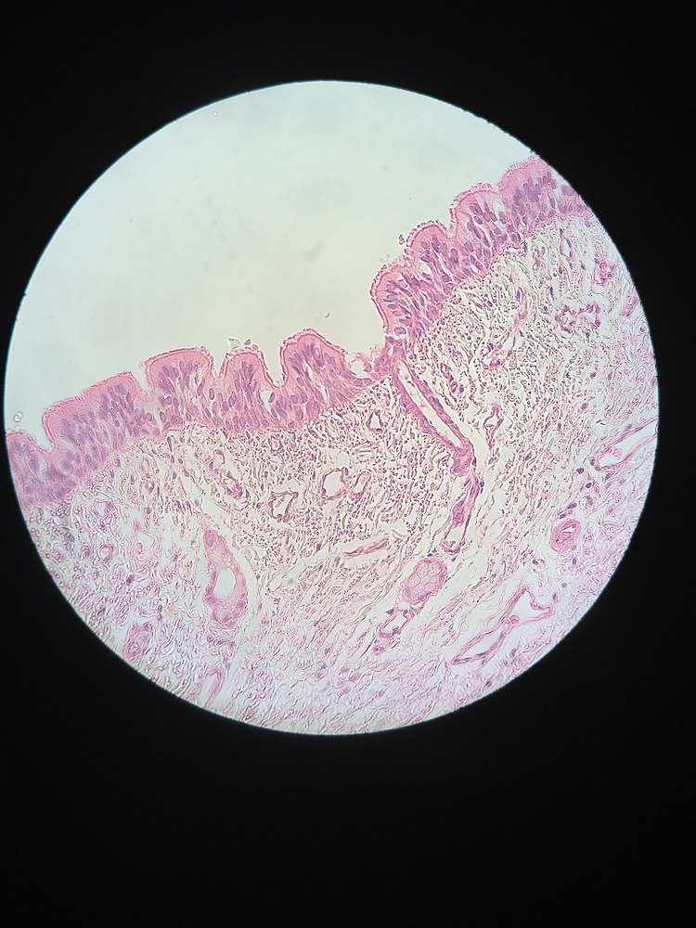
Notes:
Station 1- Pseudostratified Columnar

Slide 6
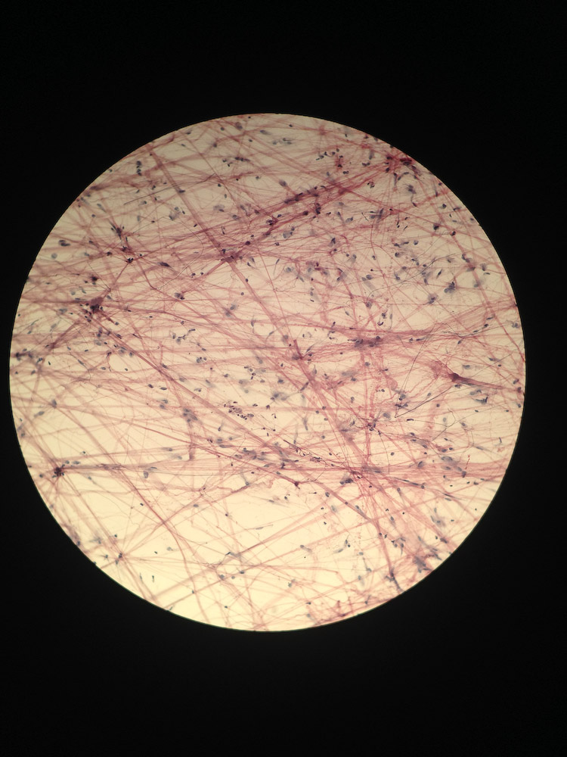
Notes:
Station 1- Loose Connective

Slide 7
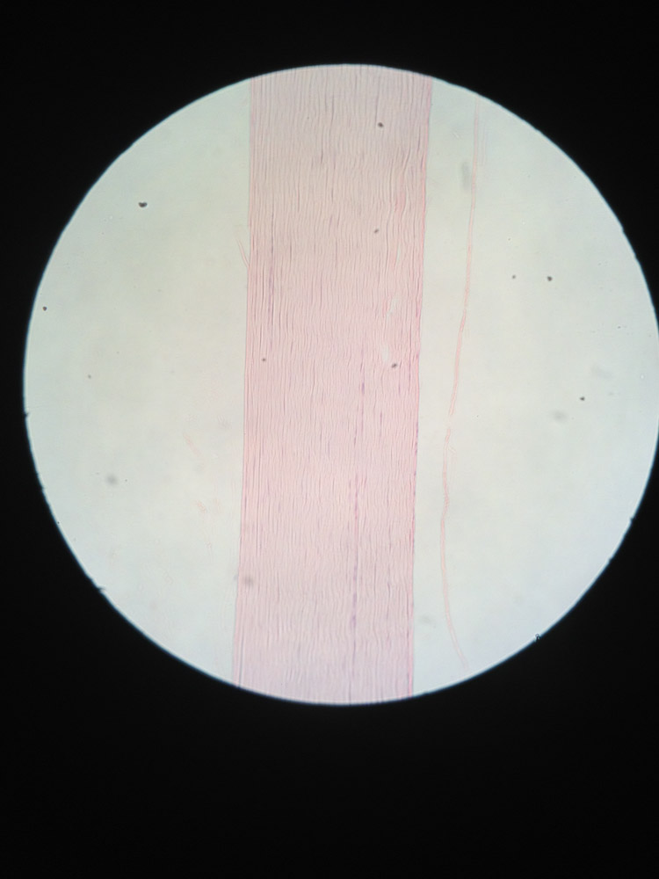
Notes:
Station 1- Fibrous Connective

Slide 8
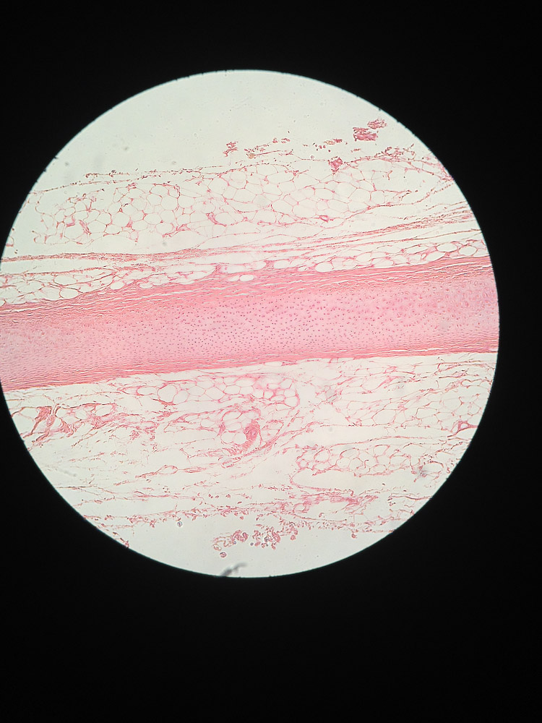
Notes:
Station 1- Cartilage

Slide 9
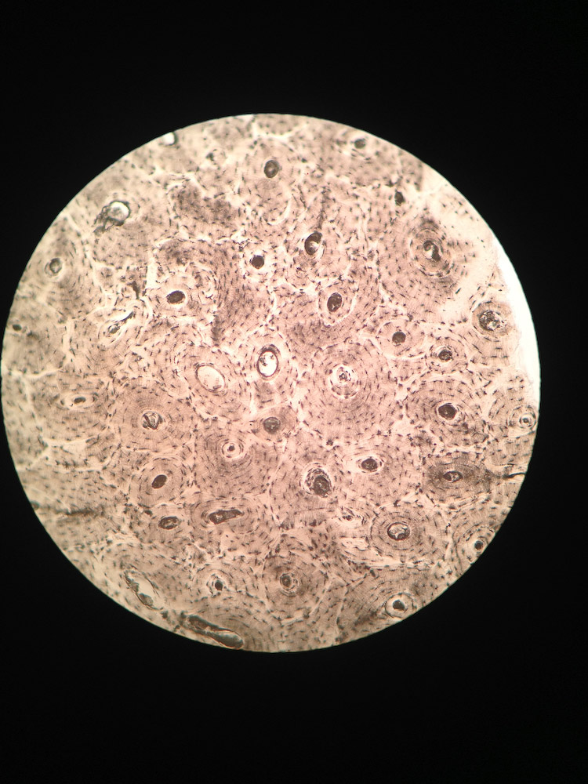
Notes:
Station 1- Bone

Slide 10
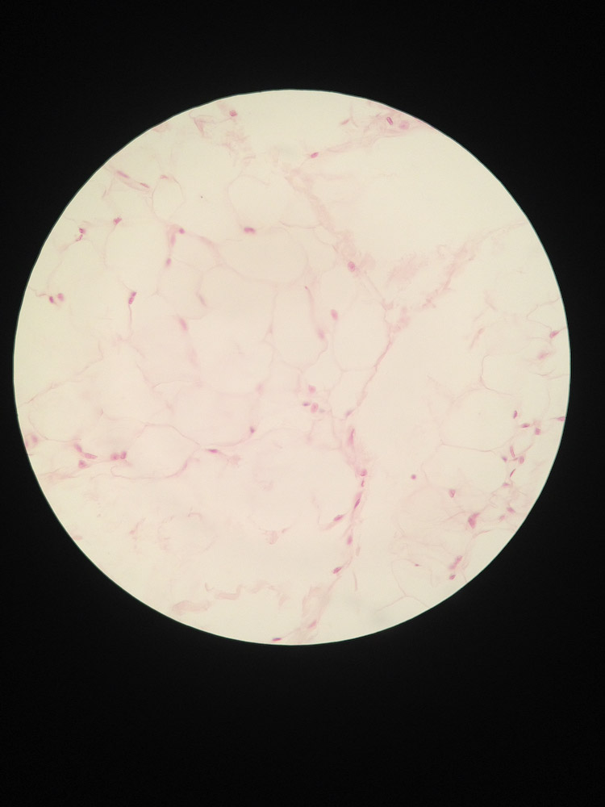
Notes:
Station 1- Adipose

Slide 11
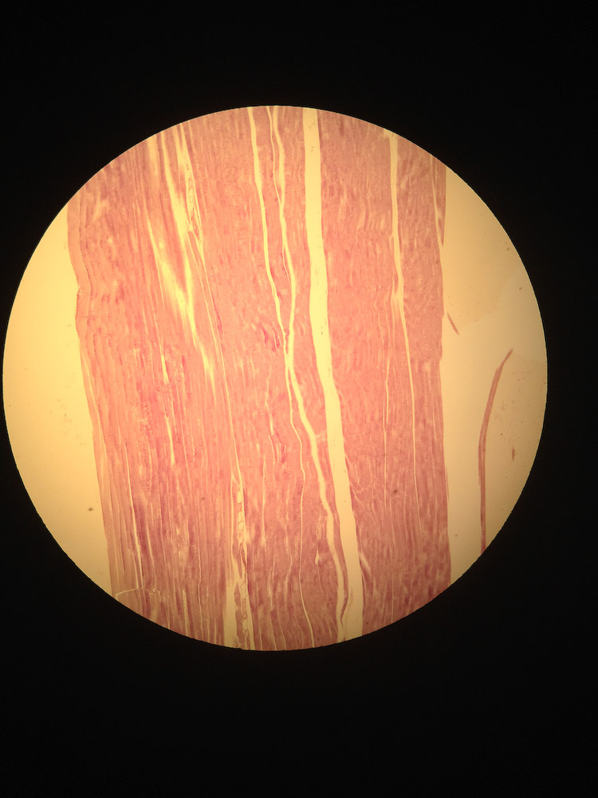
Notes:
Station 1- Skeletal Muscle

Slide 12
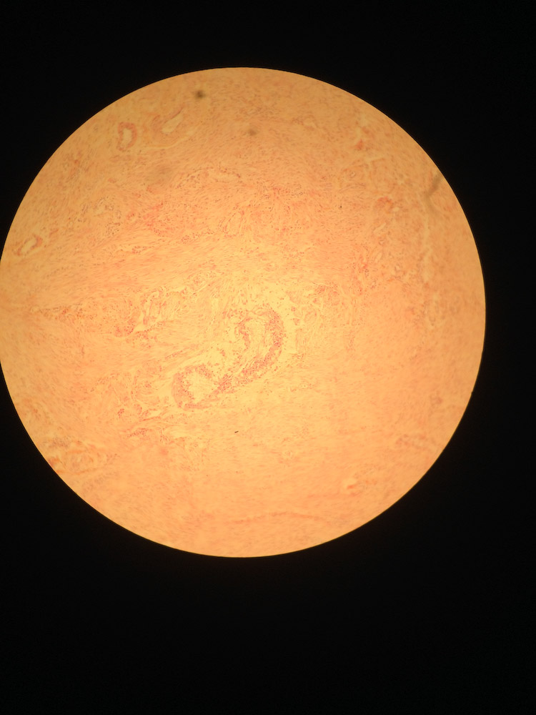
Notes:
Station 1- Smooth

Slide 13
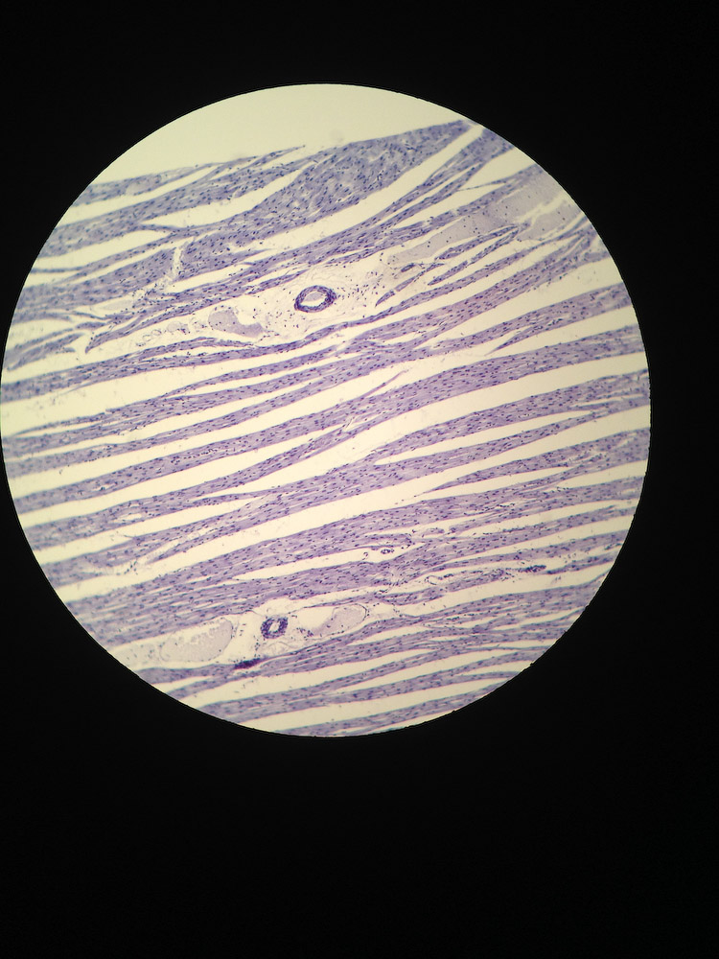
Notes:
Station 1- Cardic

Slide 14
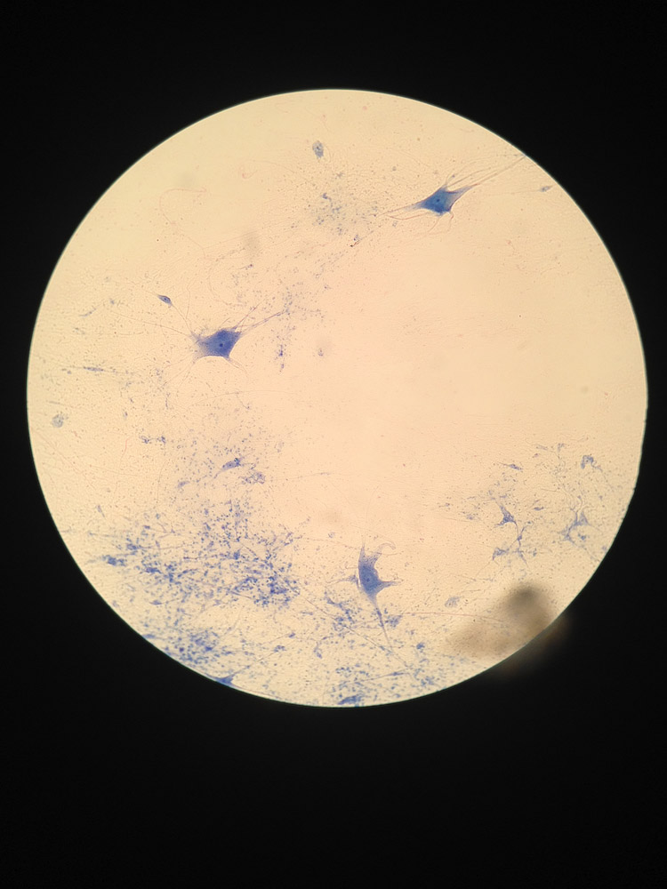
Notes:
Station 1-Neuron

Slide 15
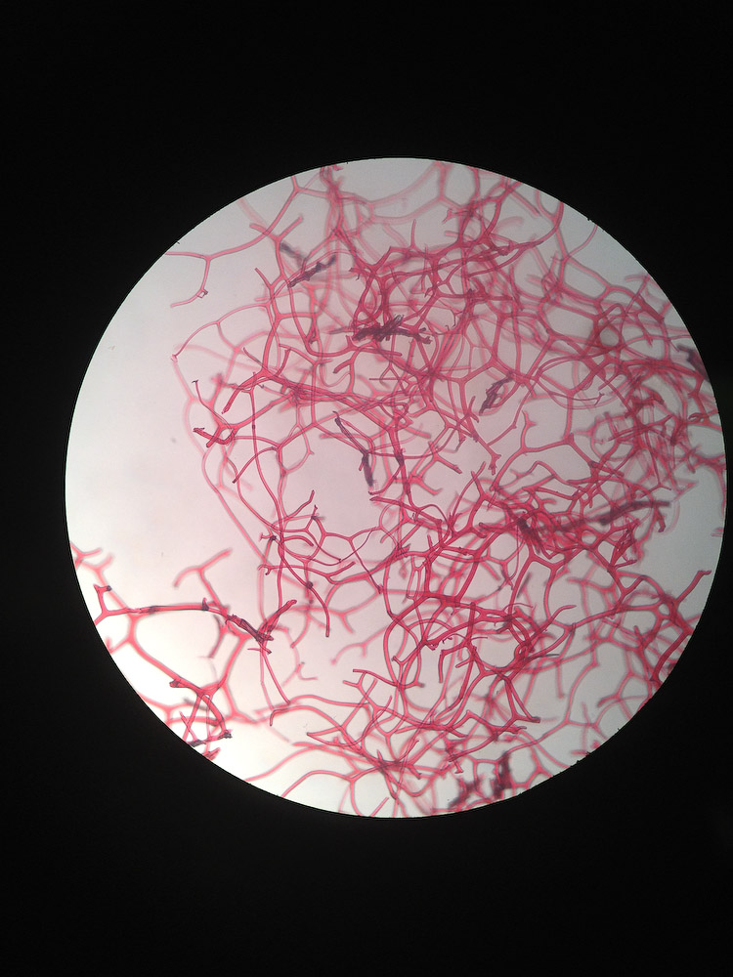
Notes:
Station 2- Spongin

Slide 16
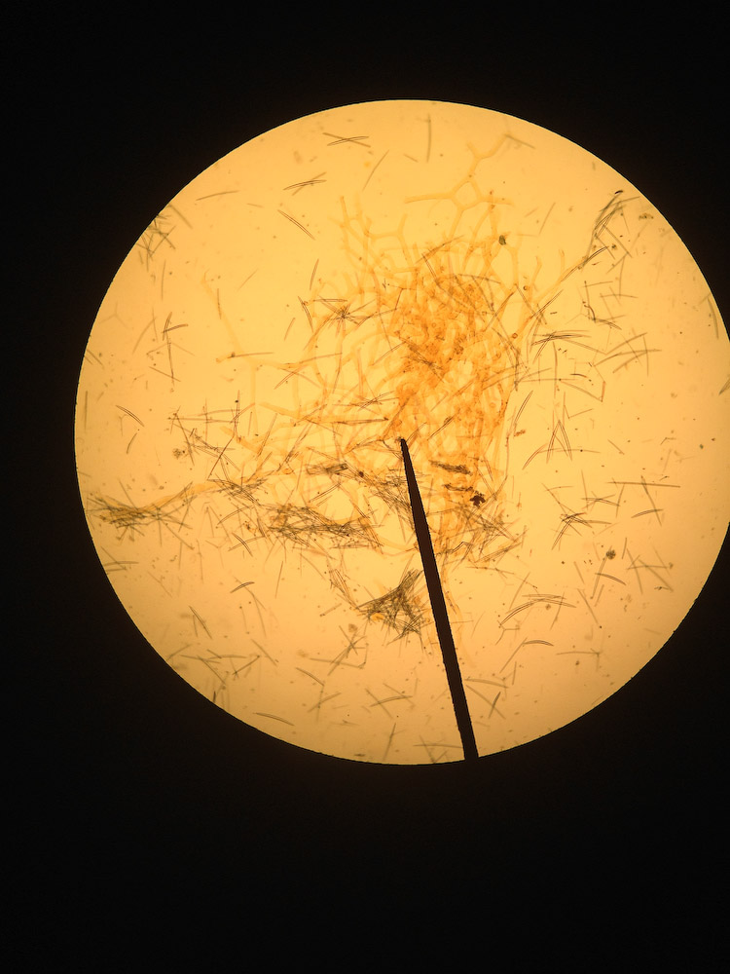
Notes:
Station 2- Spicules

Slide 17
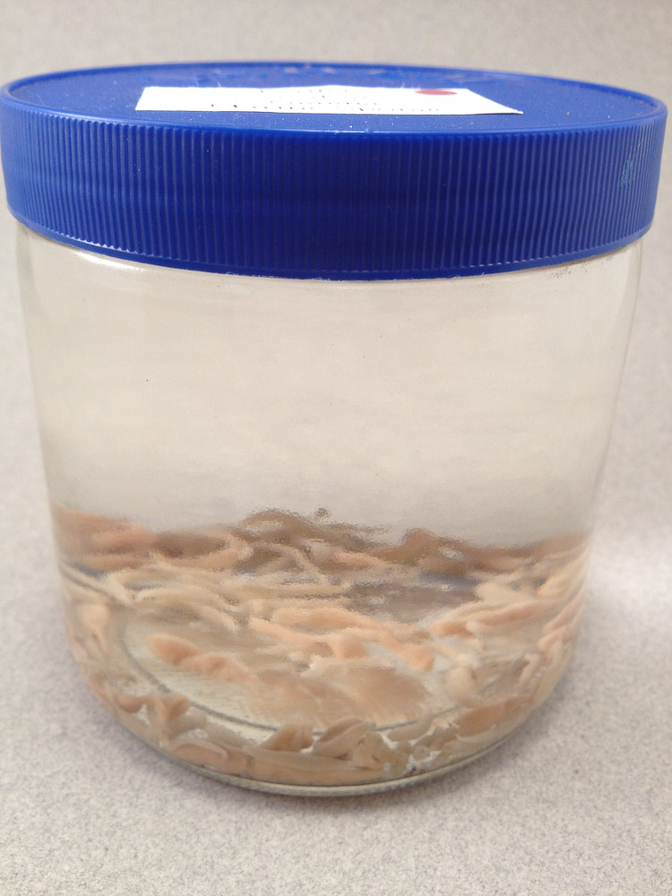
Notes:
Station 3&4 – Calcarea

Slide 18
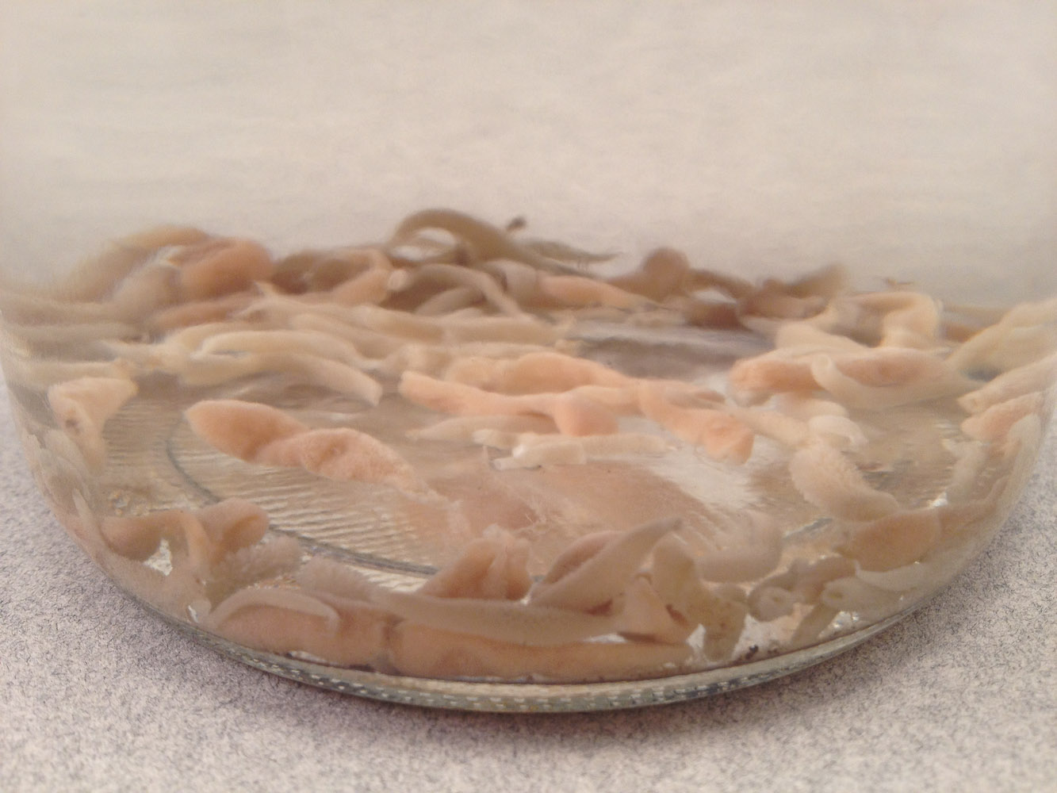
Notes:
Station 3&4 – Calcarea

Slide 19
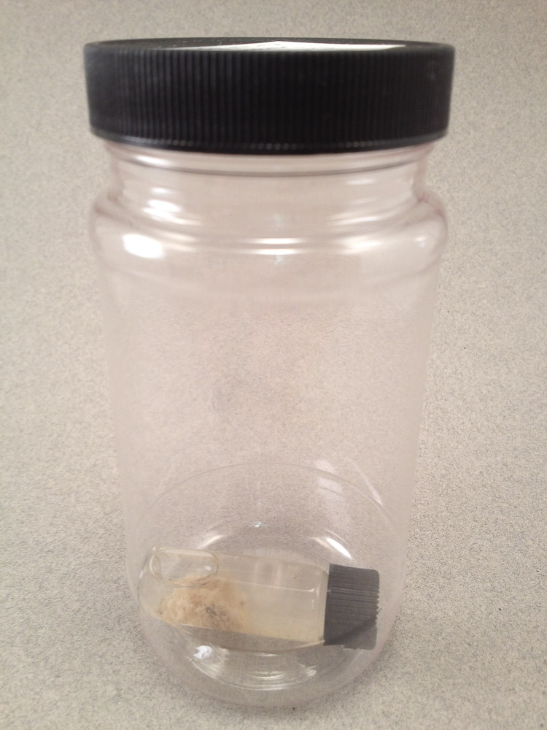
Notes:
Station 3&4 – Calcarea

Slide 20
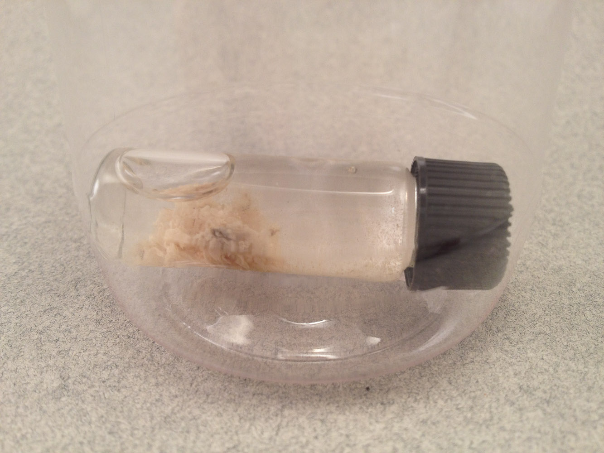
Notes:
Station 3&4 – Calcarea

Slide 21
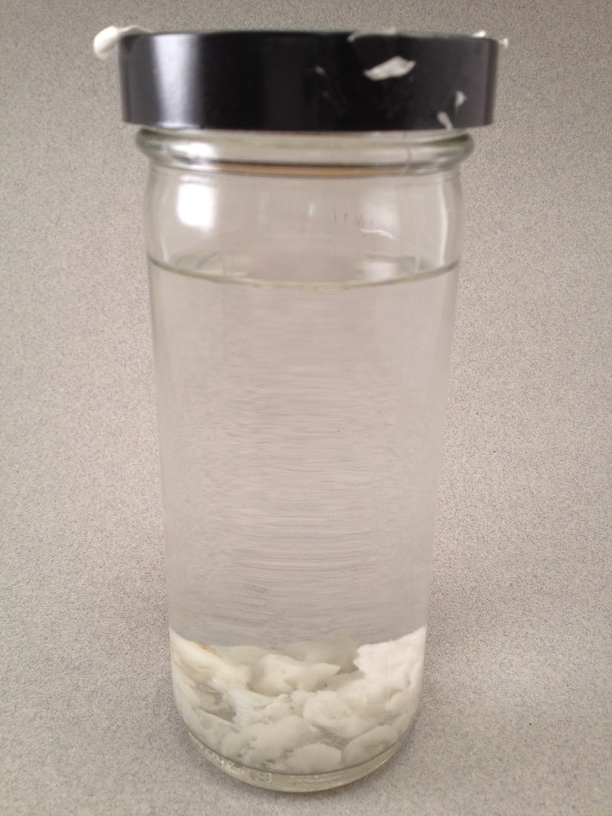
Notes:
Station 3&4 – Calcarea

Slide 22
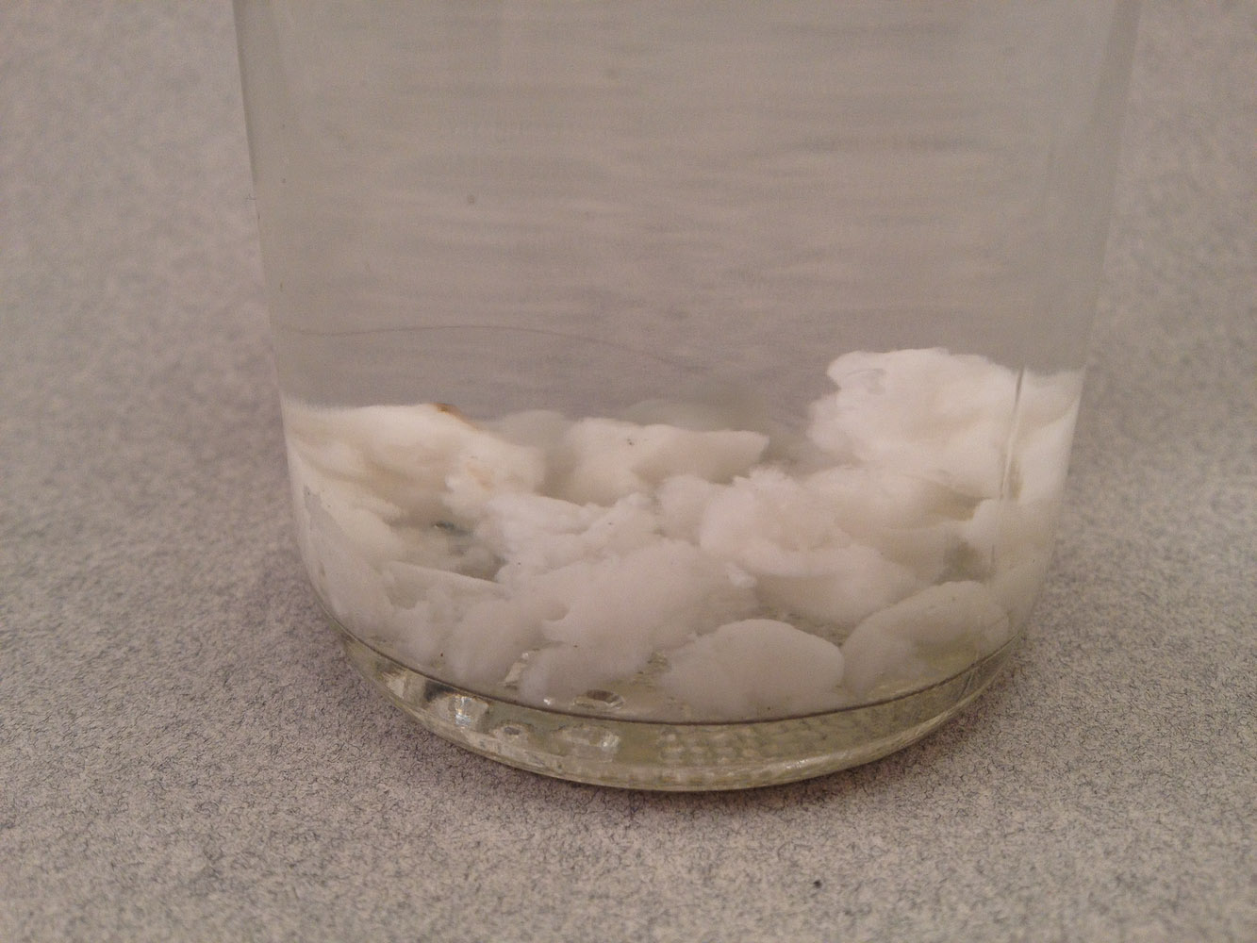
Notes:
Station 3&4 – Calcarea

Slide 23
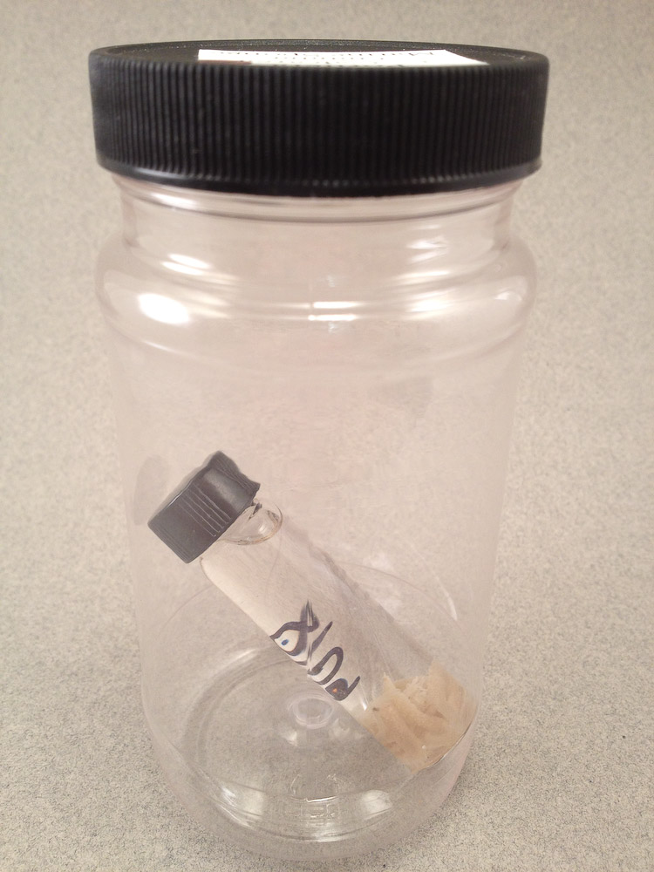
Notes:
Station 3&4 – Calcarea

Slide 24
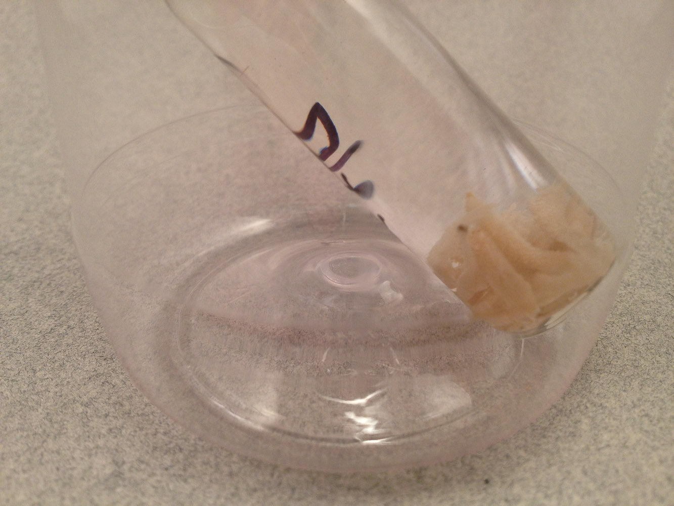
Notes:
Station 3&4 – Calcarea

Slide 25
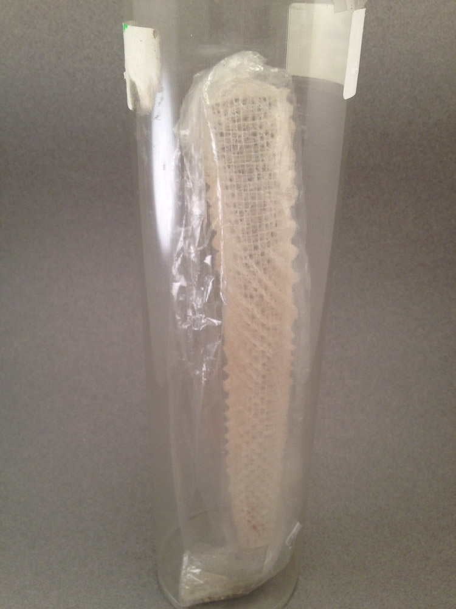
Notes:
Station 3&4 – Hexactinellidae

Slide 26
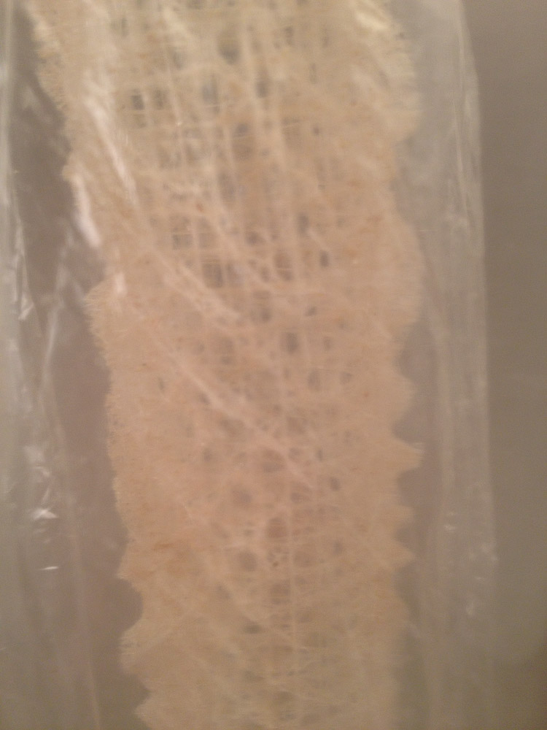
Notes:
Station 3&4 – Hexactinellidae

Slide 27
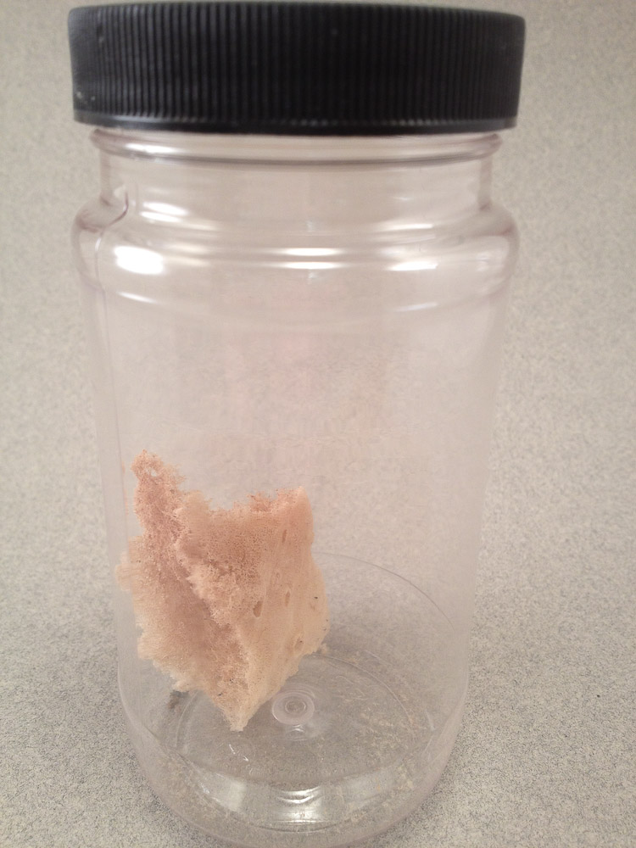
Notes:
Station 3&4 – Demospngiae

Slide 28
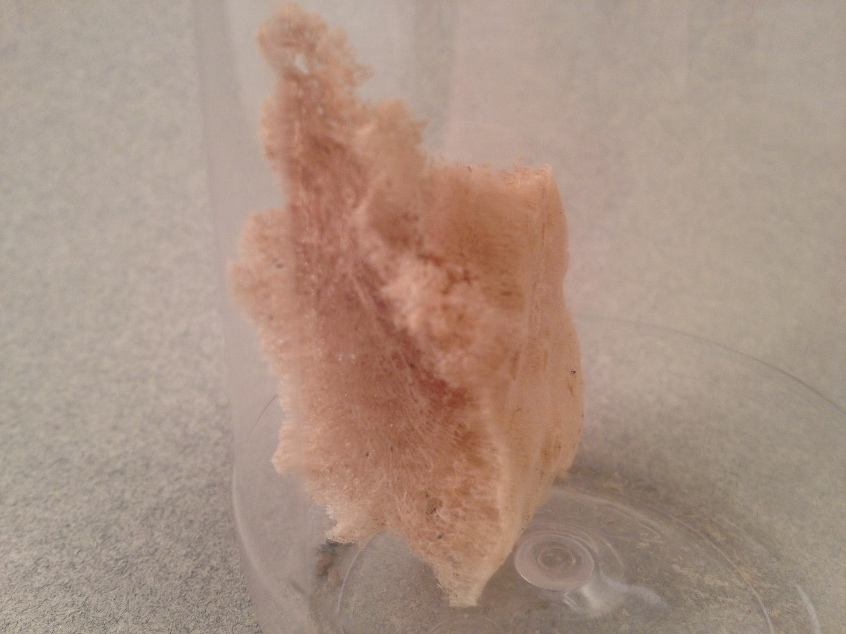
Notes:
Station 3&4 – Demospngiae

Slide 29
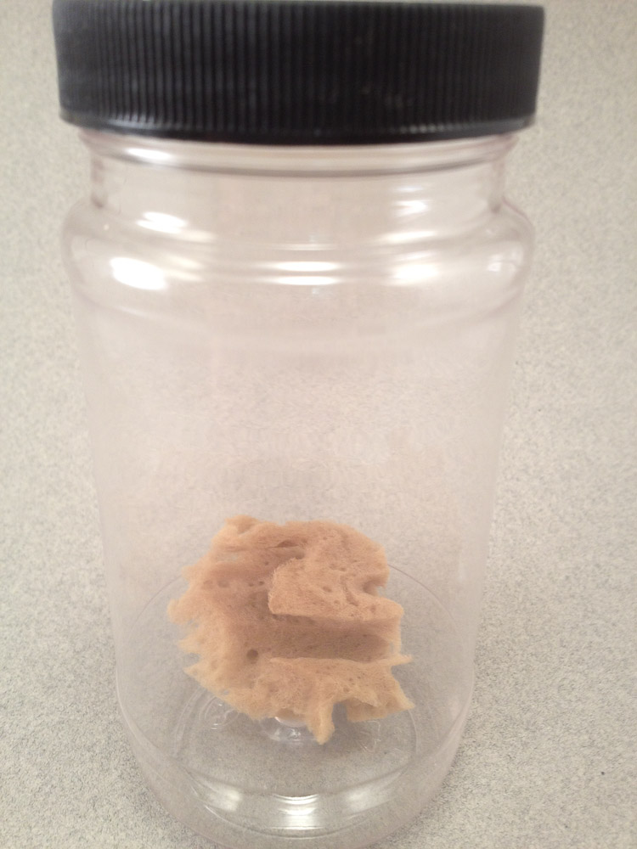
Notes:
Station 3&4 – Demospngiae

Slide 30
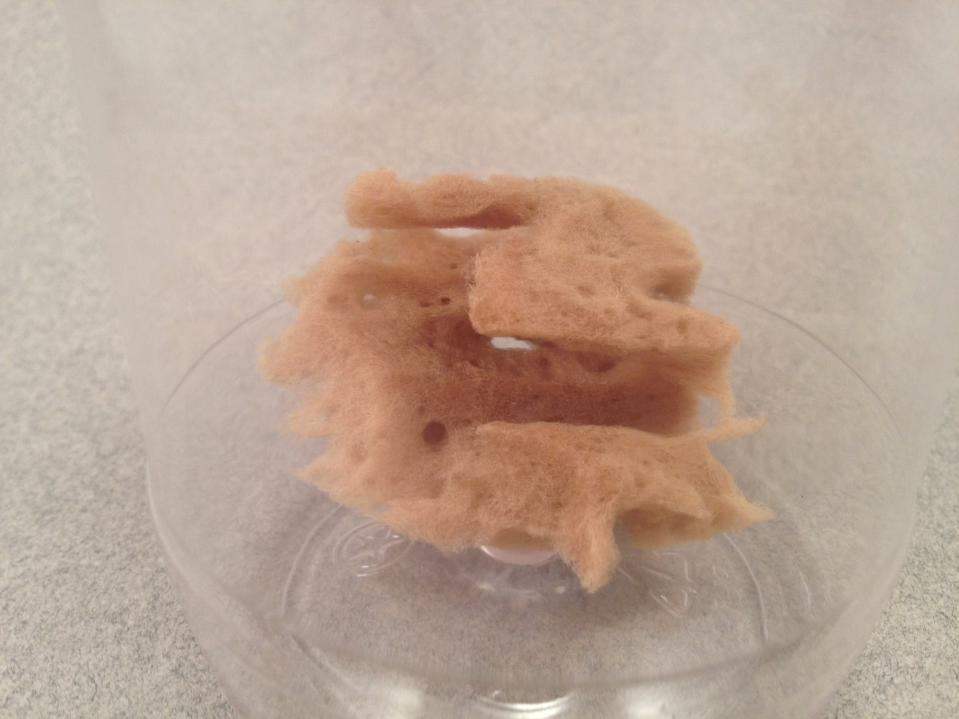
Notes:
Station 3&4 – Demospngiae

Slide 31
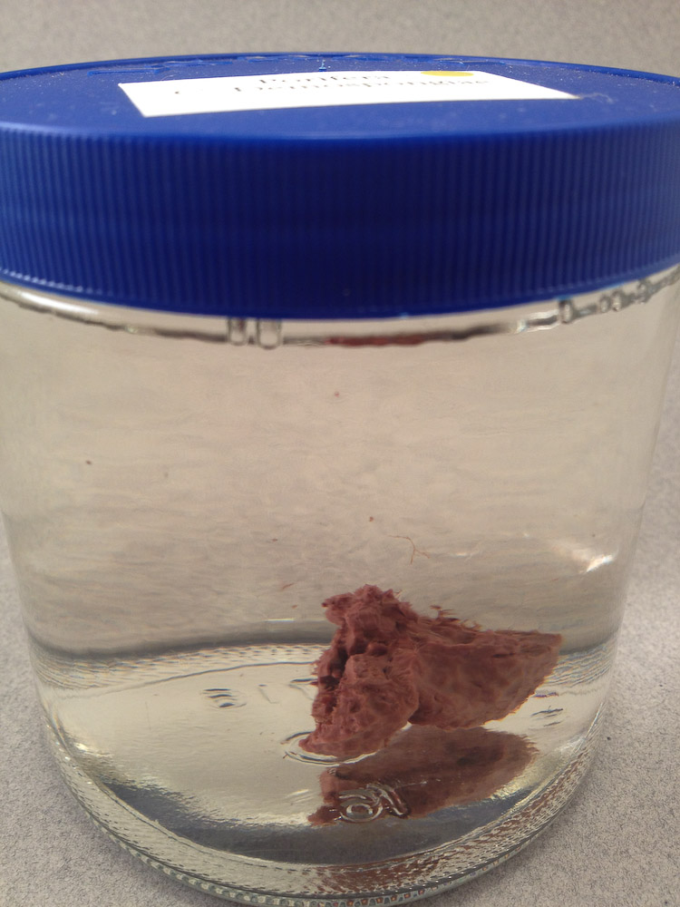
Notes:
Station 3&4 – Demospngiae

Slide 32
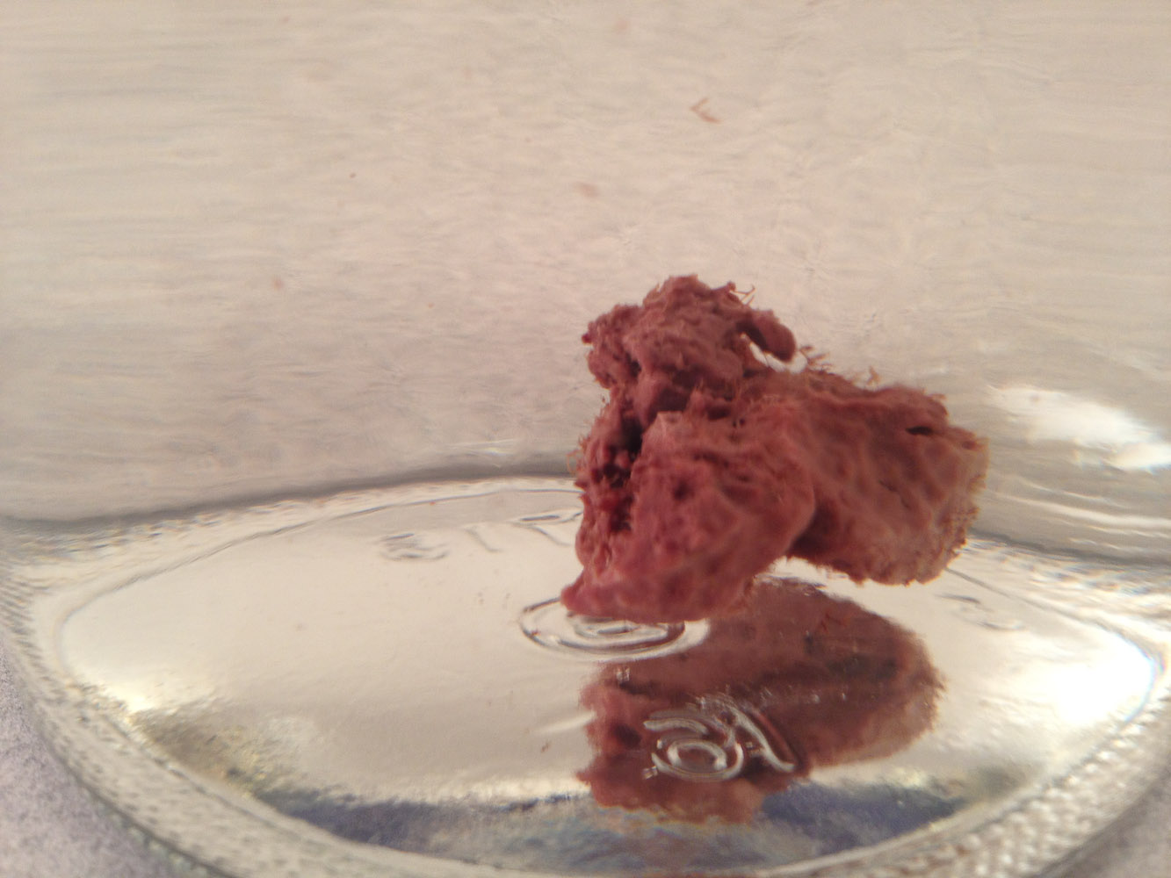
Notes:
Station 3&4 – Demospngiae

Slide 33
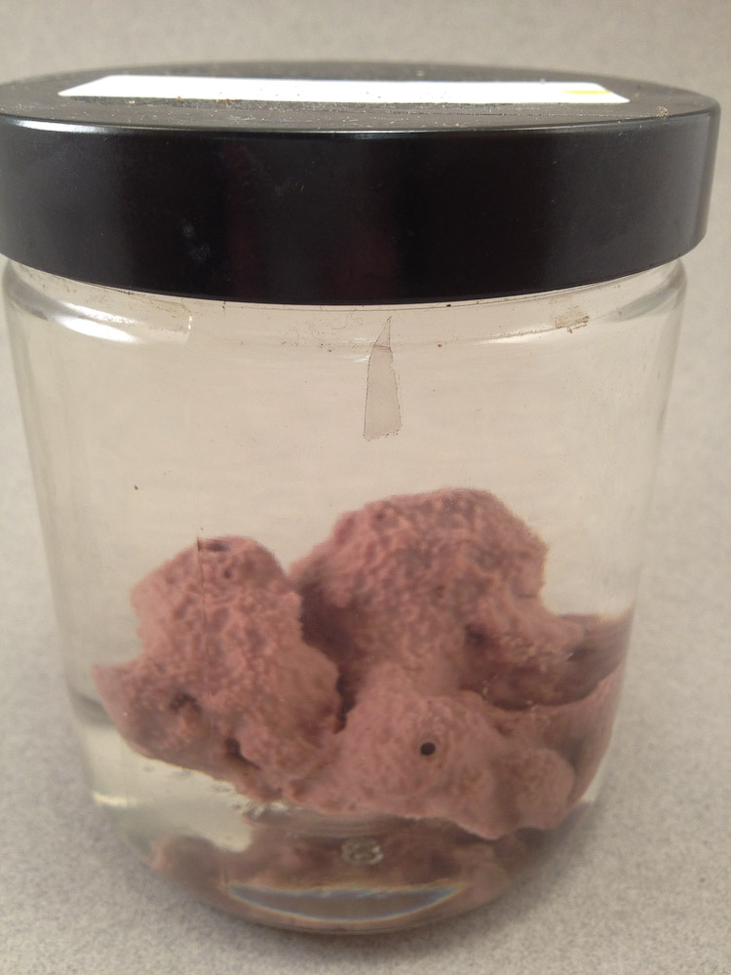
Notes:
Station 3&4 – Demospngiae

Slide 34
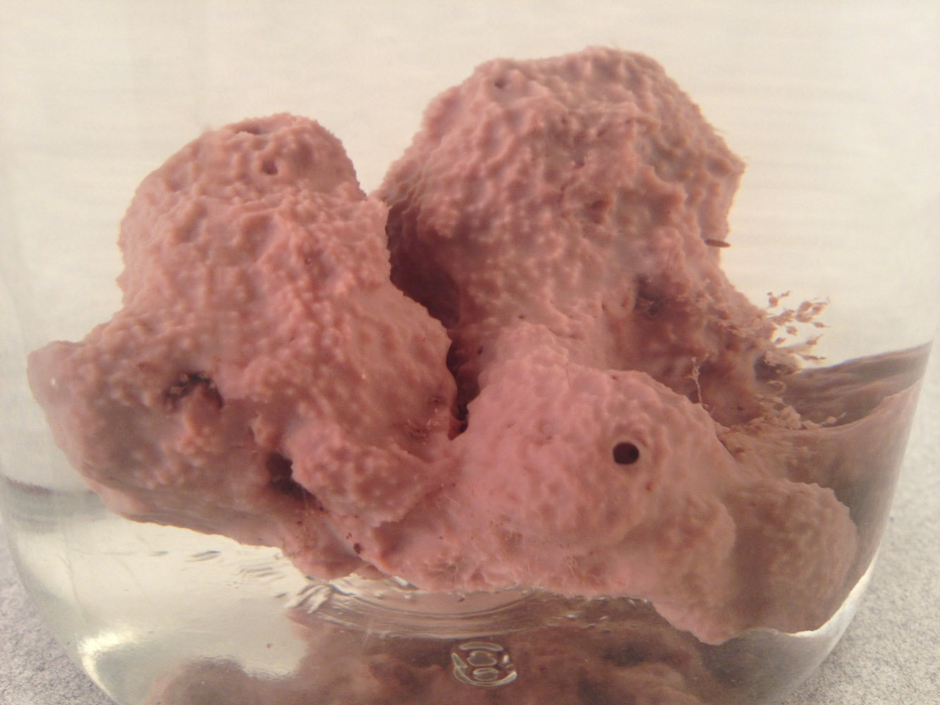
Notes:
Station 3&4 – Demospngiae

Slide 35
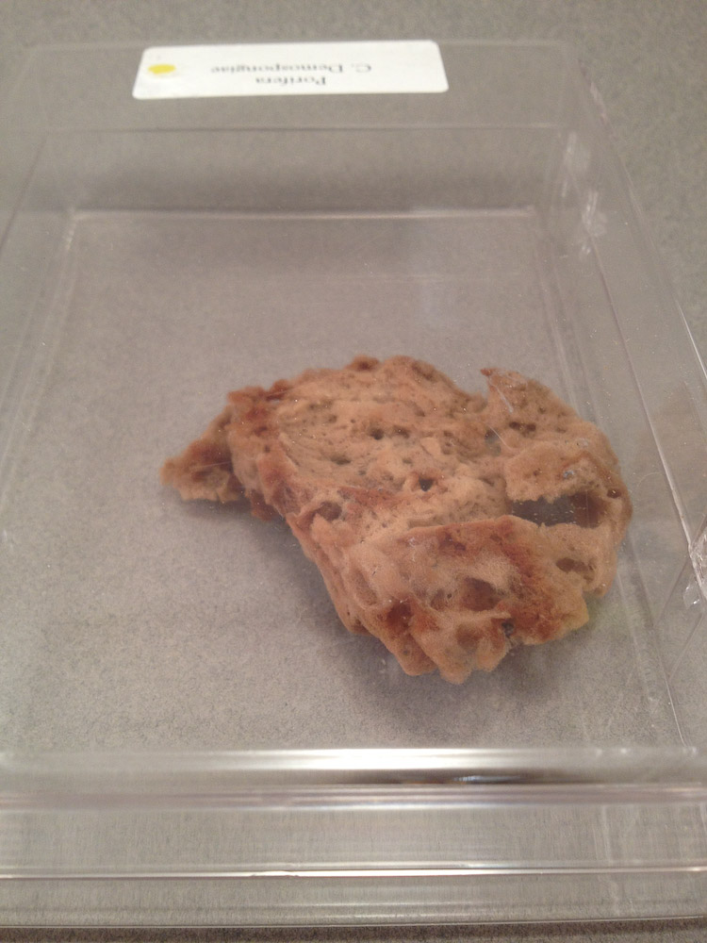
Notes:
Station 3&4 – Demospngiae

Slide 36
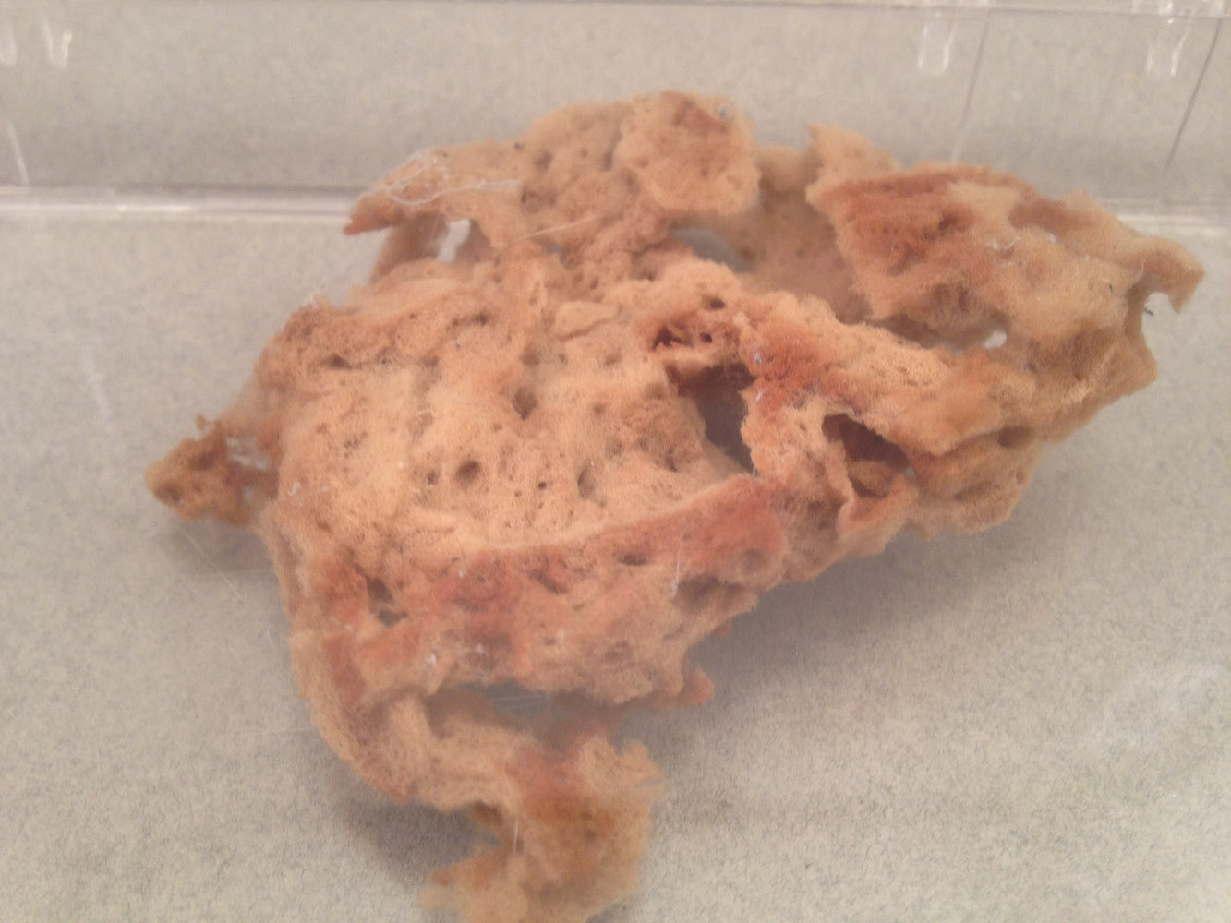
Notes:
Station 3&4 – Demospngiae

Slide 37
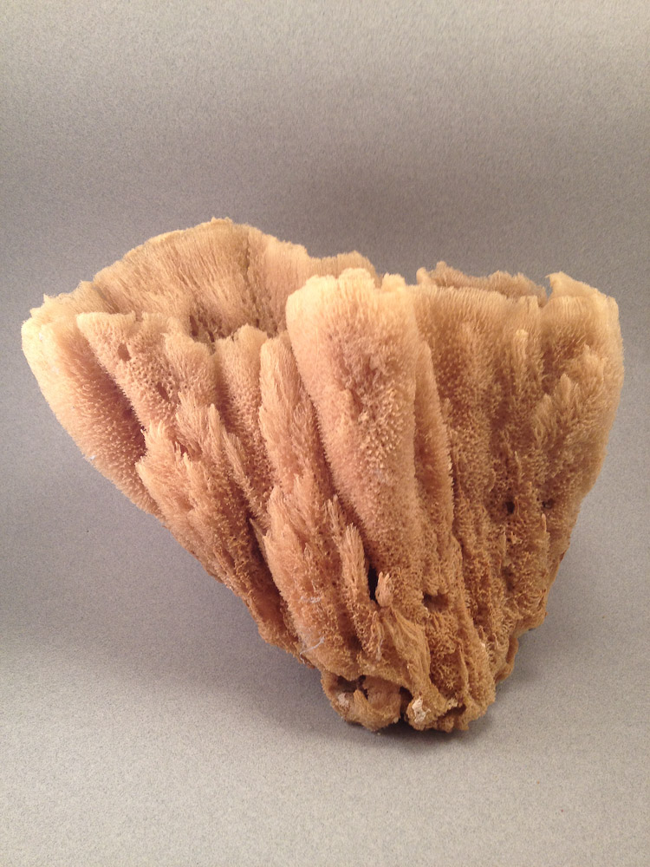
Notes:
Station 3&4 – Demospngiae

Slide 38
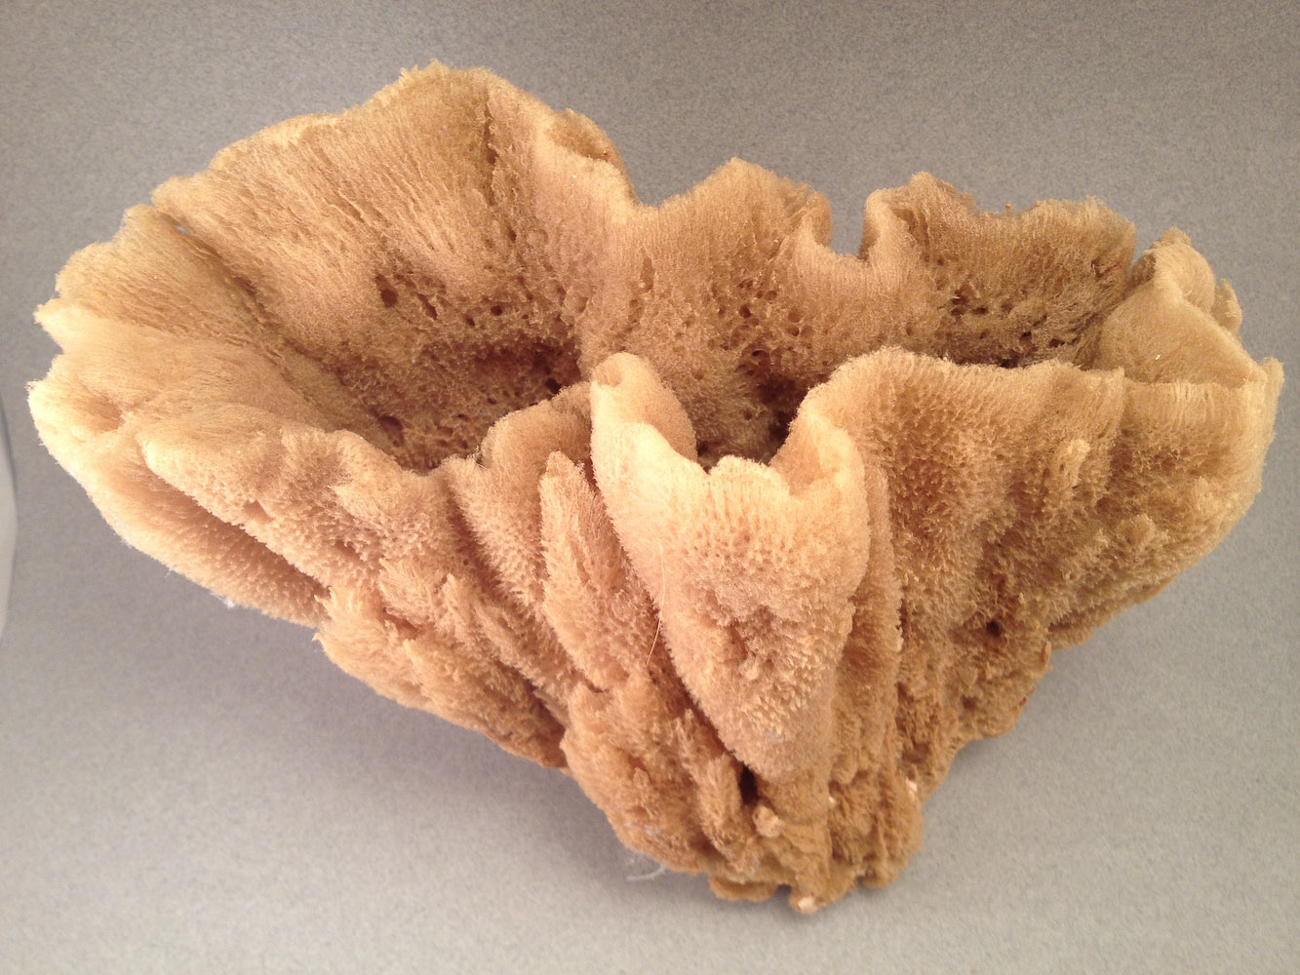
Notes:
Station 3&4 – Demospngiae

Slide 39
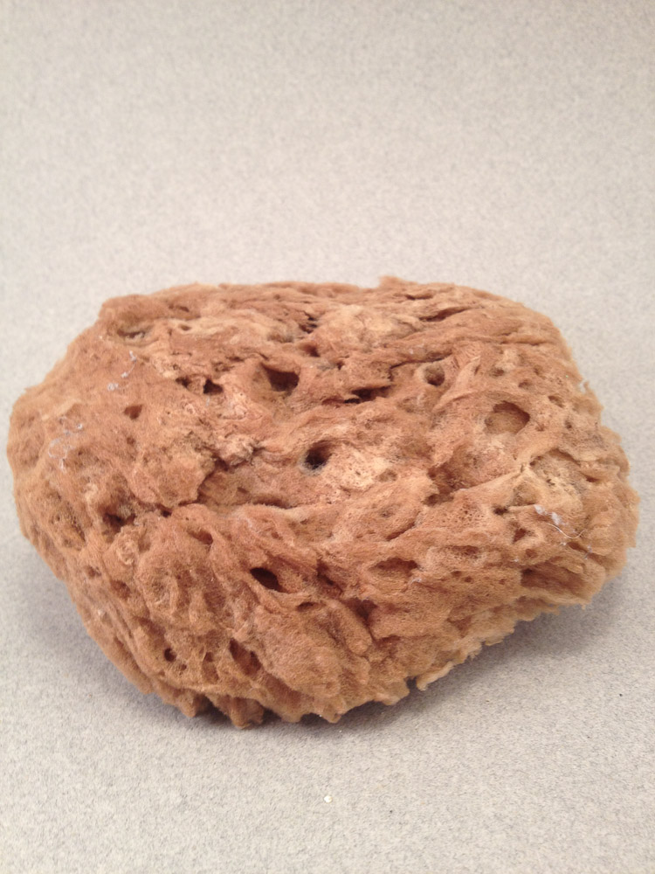
Notes:
Station 3&4 – Demospngiae

Slide 40
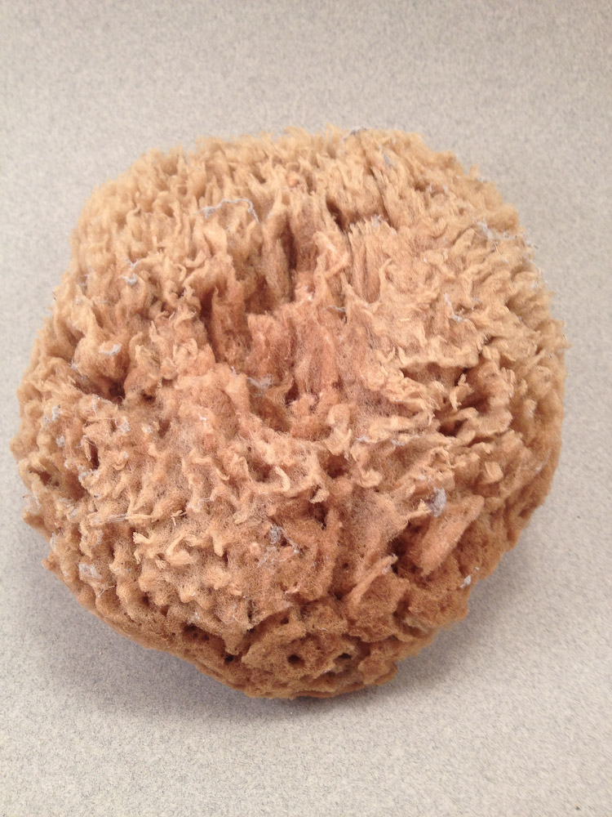
Notes:
Station 3&4 – Demospngiae

Slide 41
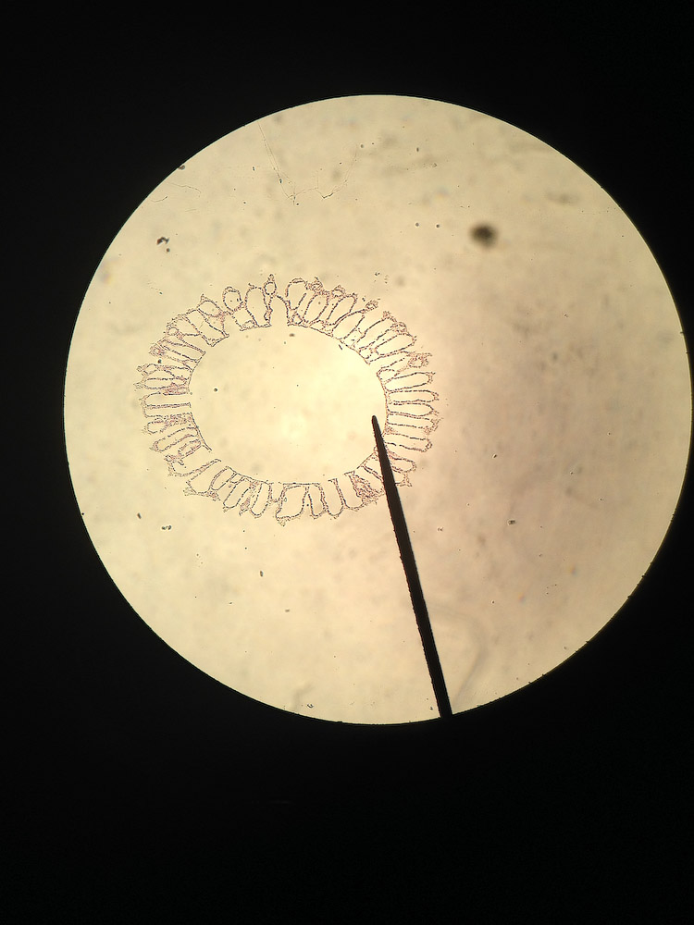
Notes:
Station 6 – Syconoid Body Plan

Slide 42
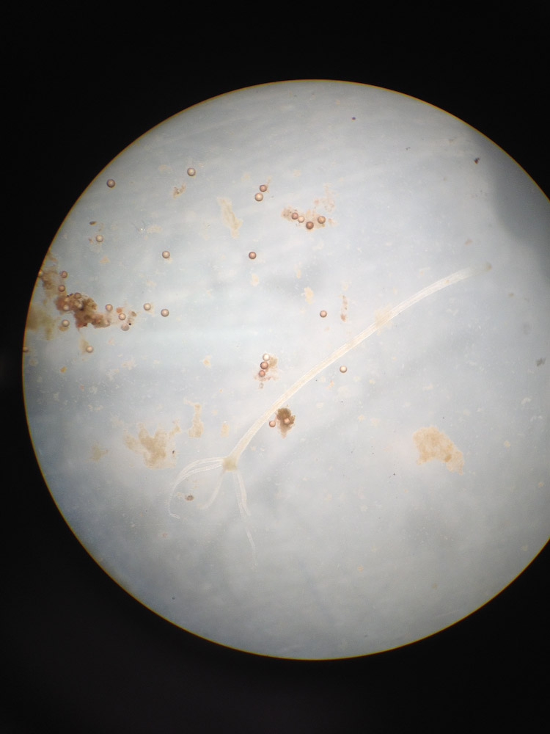
Notes:
Station 7 - Hydra

Slide 43
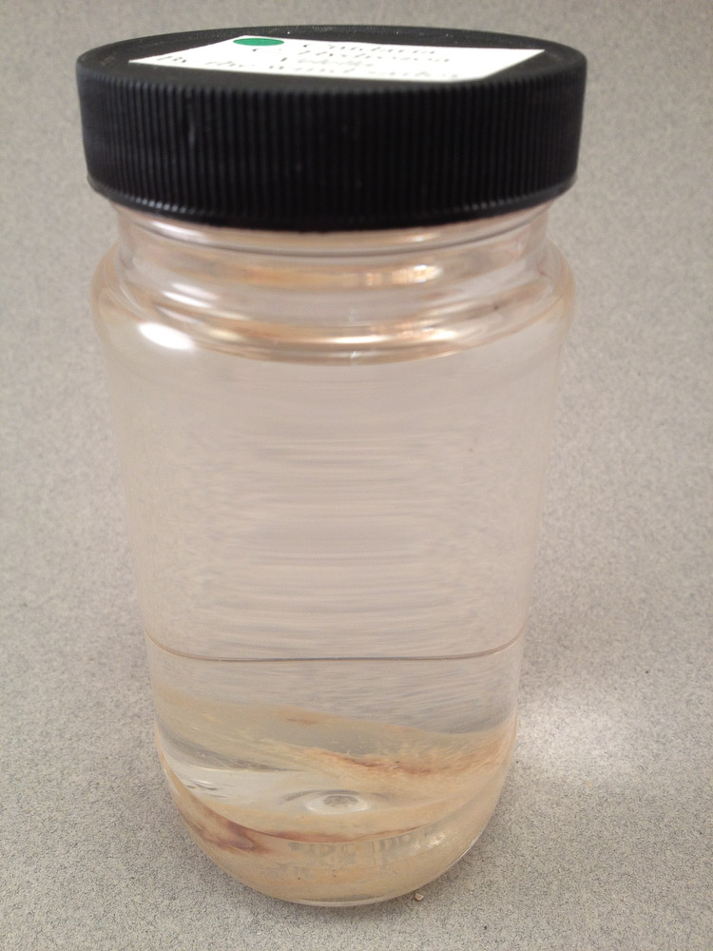
Notes:
Station#8 - Hydrozoa

Slide 44
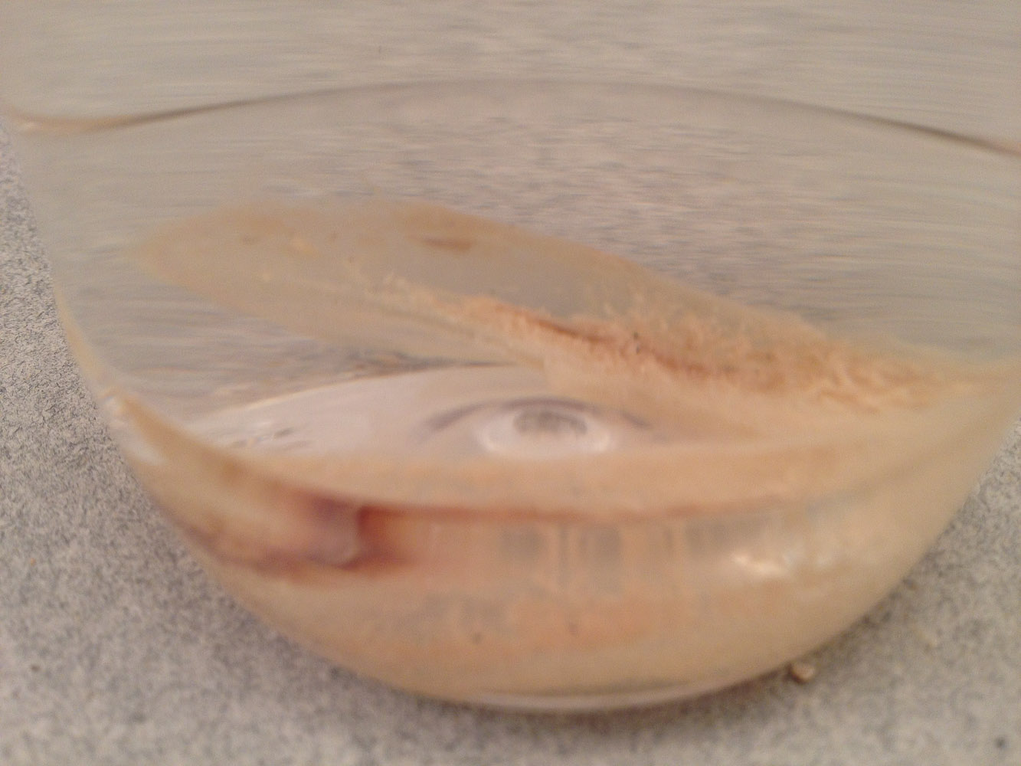
Notes:
Station#8 - Hydrozoa

Slide 45
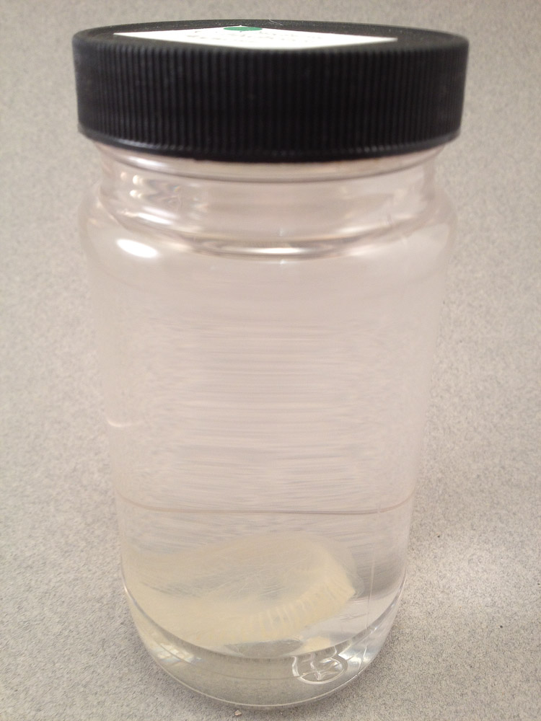
Notes:
Station#8 - Hydrozoa

Slide 46
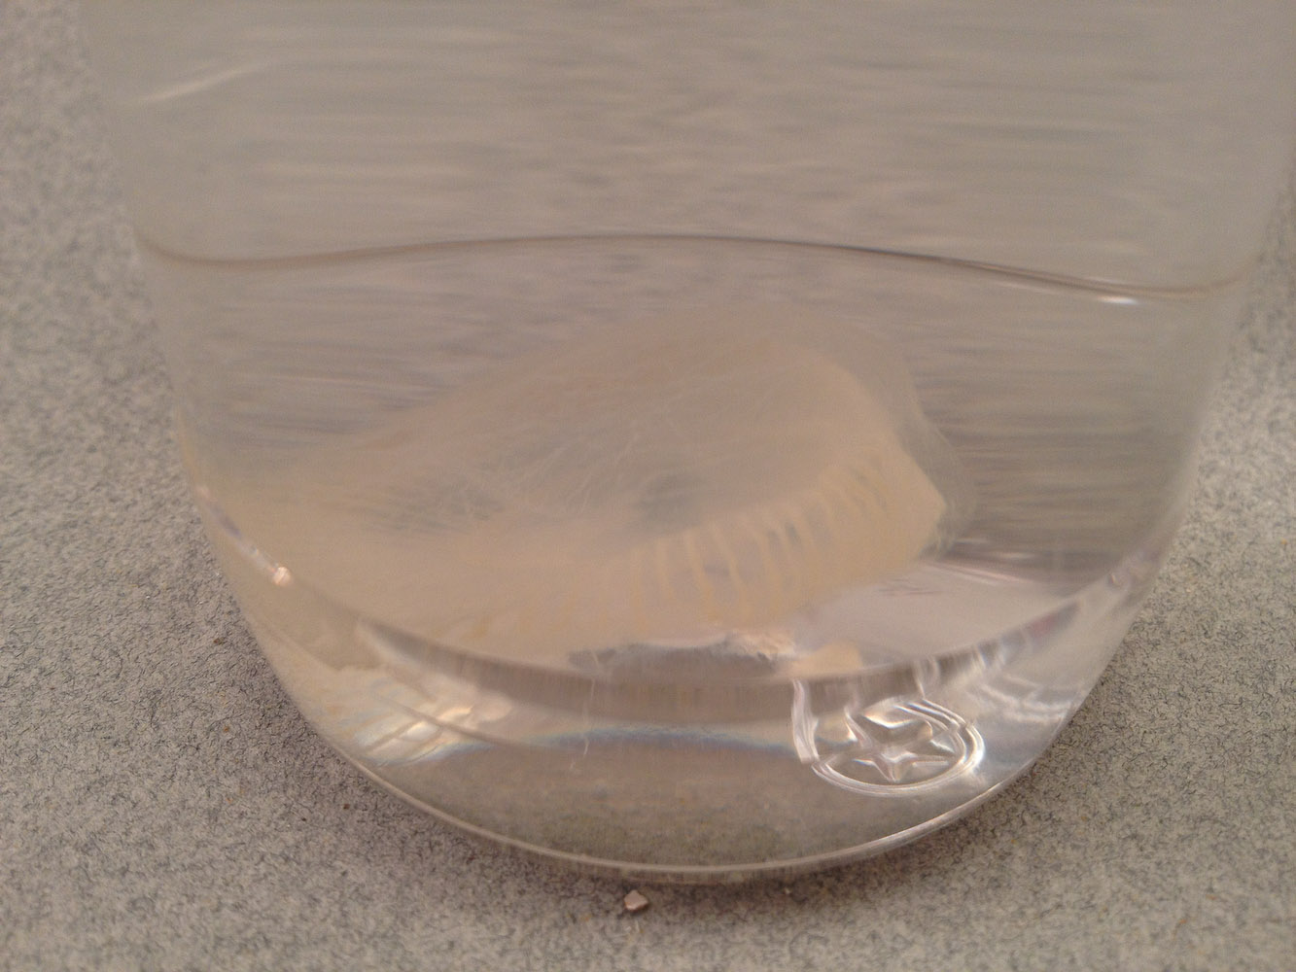
Notes:
Station#8 - Hydrozoa

Slide 47
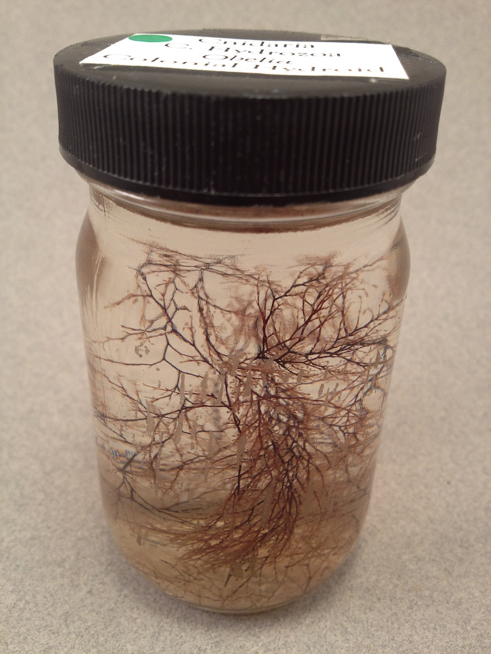
Notes:
Station#8 - Hydrozoa

Slide 48
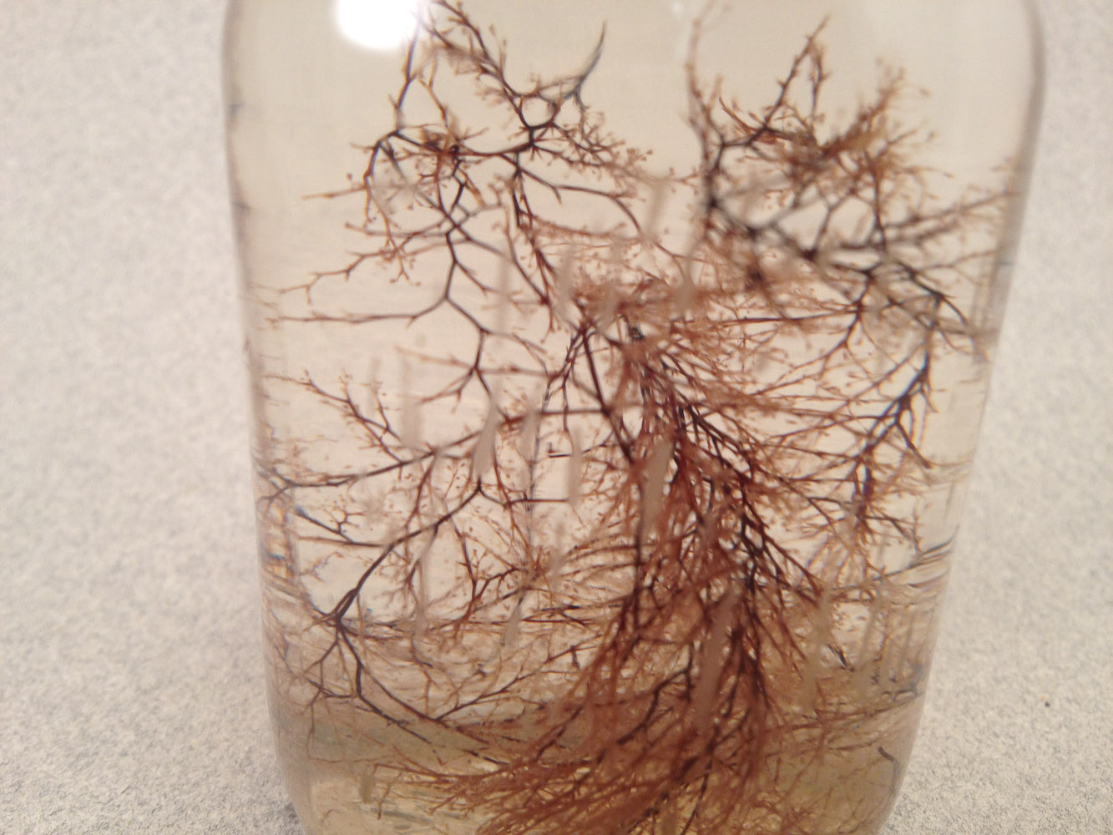
Notes:
Station#8 - Hydrozoa

Slide 49
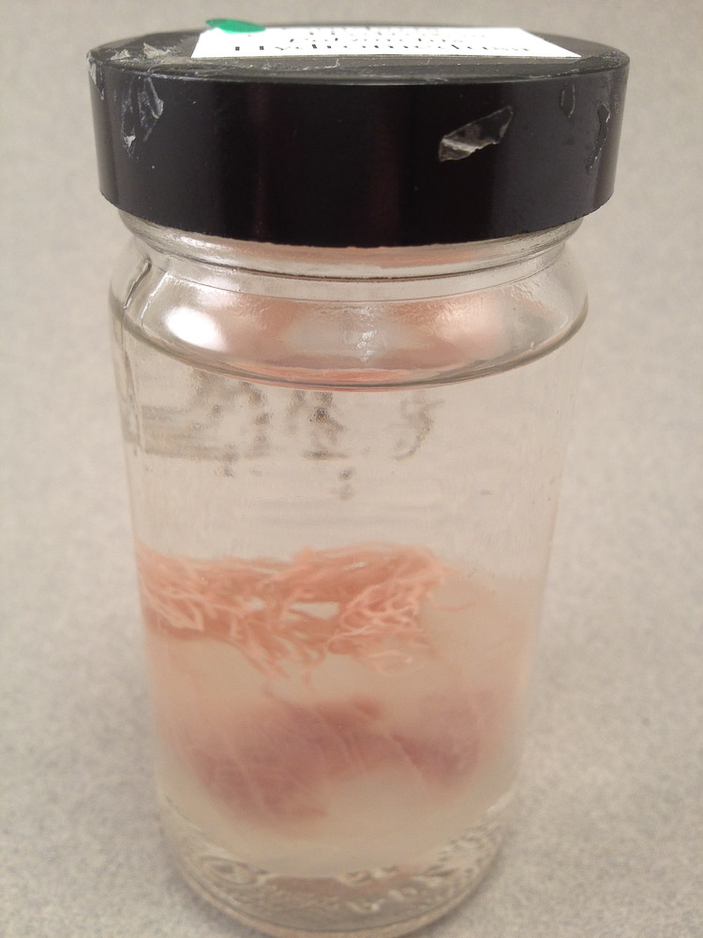
Notes:
Station#8 - Hydrozoa

Slide 50
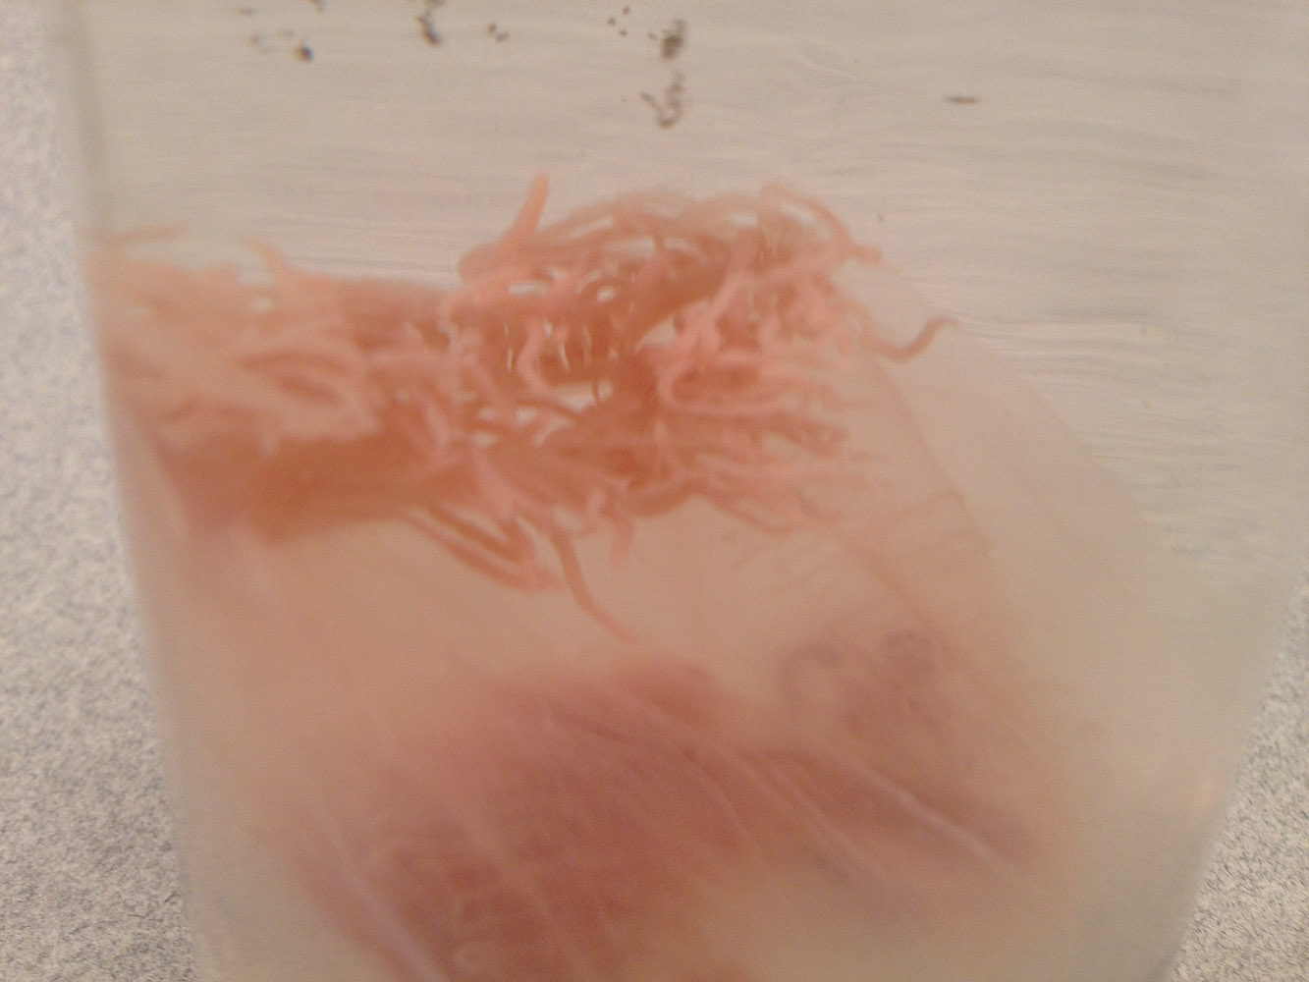
Notes:
Station#8 - Hydrozoa

Slide 51

Notes:
Station#8 - Hydrozoa

Slide 52

Notes:
Station#8 - Hydrozoa

Slide 53

Notes:
Station#8 - Hydrozoa

Slide 54

Notes:
Station#8 - Hydrozoa

Slide 55

Notes:
Station#8 - Hydrozoa

Slide 56

Notes:
Station#8 - Hydrozoa

Slide 57

Notes:
Station#8 - Hydrozoa

Slide 58

Notes:
Station#8 - Hydrozoa

Slide 59

Notes:
Station#8 - Hydrozoa

Slide 60

Notes:
Station#8 - Hydrozoa

Slide 61

Notes:
Station#8 - Hydrozoa

Slide 62

Notes:
Station#8 - Hydrozoa

Slide 63

Notes:
Station#8 - Hydrozoa

Slide 64

Notes:
Station#8 - Hydrozoa

Slide 65

Notes:
Station#8 - Scyphozoa

Slide 66

Notes:
Station#8 - Scyphozoa

Slide 67

Notes:
Station#8 - Scyphozoa

Slide 68

Notes:
Station#8 - Scyphozoa

Slide 69

Notes:
Station#8 - Scyphozoa

Slide 70

Notes:
Station#8 - Scyphozoa

Slide 71

Notes:
Station#8 - Scyphozoa

Slide 72

Notes:
Station#8 - Scyphozoa

Slide 73

Notes:
Station#8 - Anthozoa

Slide 74

Notes:
Station#8 - Anthozoa

Slide 75

Notes:
Station#8 - Anthozoa

Slide 76

Notes:
Station#8 - Anthozoa

Slide 77

Notes:
Station#8 - Anthozoa

Slide 78

Notes:
Station#8 - Anthozoa

Slide 79

Notes:
Station#8 - Anthozoa

Slide 80

Notes:
Station#8 - Anthozoa

Slide 81

Notes:
Station#8 - Anthozoa

Slide 82

Notes:
Station#8 - Anthozoa

Slide 83

Notes:
Station#8 - Anthozoa

Slide 84

Notes:
Station#8 - Anthozoa

Slide 85

Notes:
Station#8 - Anthozoa

Slide 86

Notes:
Station#8 - Anthozoa

Slide 87

Notes:
Station#8 - Anthozoa

Slide 88

Notes:
Station#8 - Anthozoa

Slide 89

Notes:
Station#8 - Anthozoa

Slide 90

Notes:
Station #10 Hydra Preserved Specimen

Slide 91

Notes:
Station #10 Hydra Budding

Slide 92

Notes:
Station #10 Hydra Budding

Slide 93

Notes:
Station #10 Hydra Ovary

Slide 94

Notes:
Station #10 Hydra Testes

Slide 95

Notes:
Station #10 Obelia

Slide 96

Notes:
Station #10 Hydra Medusa

Slide 97

Notes:
Station #13 Ctenophora

Slide 98

Notes:
Station #13 Ctenophora

Slide 99

Notes:
Station #13 Ctenophora

Slide 100

Notes:
Station #13 Ctenophora

Slide 101

Notes:
Station #15 Planaria

Slide 102

Notes:
Station #15

Slide 103

Notes:
Station #15 Trematoda

Slide 104

Notes:
Station #15 Trematoda

Slide 105

Notes:
Station #15 Trematoda

Slide 106

Notes:
Station #15 Trematoda

Slide 107

Notes:
Station #15 Trematoda

Slide 108

Notes:
Station #15 Cestoda

Slide 109

Notes:
Station #15 Cestoda

Slide 110

Notes:
Station #15 Cestoda

Slide 111

Notes:
Station #15 Cestoda

Slide 112

Notes:
Station #15 Cestoda

Slide 113

Notes:
Station #15 Cestoda

Slide 114

Notes:
Station #15 Cestoda

Slide 115

Notes:
Station #15 Cestoda

Slide 116

Notes:
Station #18 – Tubellaria Structures

Slide 117

Notes:
Station #18 – Tubellaria Anterior

Slide 118

Notes:
Station #18 – Tubellaria Pharyngeal Region

Slide 119

Notes:
Station #18 – Tubellaria Posterior

Slide 120

Notes:
Station #19 – Sheep Liver Fluke

Slide 121

Notes:
Station #19 – Sheep Liver Fluke

Slide 122

Notes:
Station #20 – Cestoda Scolex

Slide 123

Notes:
Station #20 – Cestoda Mature Proglottid

Slide 124

Notes:
Station #21 – Phylum Rotifera

Slide 125

Notes:
Station #24 - Nematoda

Slide 126

Notes:
Station #24 - Nematoda

Slide 127

Notes:
Station #24 – Nematoda Ascaris

Slide 128

Notes:
Station #24 – Phylum Nematoda (Toxocara canis)

Slide 129

Notes:
Station #24 – Phylum Nematoda (Toxocara canis)

Slide 130

Notes:
Station #24 - Ascaris

Slide 131

Notes:
Station #24 - Ascaris

Slide 132

Notes:
Station #24 - Ascaris

Slide 133

Notes:
Station #24 - Macracanthorhynchus

Slide 134

Notes:
Station #24 - Macracanthorhynchus

Slide 135

Notes:
Station #24 - Macracanthorhynchus

Slide 136

Notes:
Station #24 - Trichinella

Slide 137

Notes:
Station #24 - Trichinella

Slide 138

Notes:
Station #24 - Trichinella

Slide 139

Notes:
Station #24 - Enterobius

Slide 140

Notes:
Station #24 - Necator

Slide 141

Notes:
Station #24 - Turbatrix

Slide 142

Notes:
Station #24 - Turbatrix

Slide 143

Notes:
Station #26– Nematoda Cross section

Slide 144

Notes:
Station #28 – Lophophorates - Ectoprocts

Slide 145

Notes:
Station #28 – Lophophorates - Ectoprocts

Slide 146

Notes:
Station #28 – Lophophorates - Ectoprocts

Slide 147

Notes:
Station #28 – Lophophorates - Ectoprocts

Slide 148

Notes:
Station #28 – Lophophorates - Ectoprocts

Slide 149

Notes:
Station #28 – Lophophorates - Ectoprocts

Slide 150

Notes:
Station #28 – Lophophorates - Ectoprocts

Slide 151

Notes:
Station #28 – Lophophorates - Ectoprocts

Slide 152

Notes:
Station #28 – Lophophorates - Ectoprocts

Slide 153

Notes:
Station #28 – Lophophorates - Ectoprocts

Slide 154

Notes:
Station #28 – Lophophorates -Brachiopods

Slide 155

Notes:
Station #28 – Lophophorates -Brachiopods

Slide 156

Notes:
Station #28 – Lophophorates -Brachiopods

Slide 157

Notes:
Station #28 – Lophophorates -Brachiopods

Slide 158

Notes:
Station #28 – Lophophorates -Brachiopods

Slide 159

Notes:
Station #28 – Lophophorates -Brachiopods

Slide 160

Notes:
Station #29 – Radula

Slide 161

Notes:
Station #29 Phylum Mollusca Class Polyplacophora

Slide 162

Notes:
Station #29 Phylum Mollusca Class Polyplacophora

Slide 163

Notes:
Station #29 Phylum Mollusca Class Polyplacophora

Slide 164

Notes:
Station #29 Phylum Mollusca Class Polyplacophora

Slide 165

Notes:
Station #29 Phylum Mollusca Class Polyplacophora

Slide 166

Notes:
Station #29 Phylum Mollusca Class Polyplacophora

Slide 167

Notes:
Station #29 Phylum Mollusca Class Gastropoda

Slide 168

Notes:
Station #29 Phylum Mollusca Class Gastropoda

Slide 169

Notes:
Station #29 Phylum Mollusca Class Gastropoda

Slide 170

Notes:
Station #29 Phylum Mollusca Class Gastropoda

Slide 171

Notes:
Station #29 Phylum Mollusca Class Gastropoda

Slide 172

Notes:
Station #29 Phylum Mollusca Class Gastropoda

Slide 173

Notes:
Station #29 Phylum Mollusca Class Gastropoda

Slide 174

Notes:
Station #29 Phylum Mollusca Class Gastropoda

Slide 175

Notes:
Station #29 Phylum Mollusca Class Gastropoda

Slide 176

Notes:
Station #29 Phylum Mollusca Class Gastropoda

Slide 177

Notes:
Station #29 Phylum Mollusca Class Gastropoda

Slide 178

Notes:
Station #29 Phylum Mollusca Class Gastropoda

Slide 179

Notes:
Station #29 Phylum Mollusca Class Gastropoda

Slide 180

Notes:
Station #29 Phylum Mollusca Class Gastropoda

Slide 181

Notes:
Station #29 Phylum Mollusca Class Gastropoda

Slide 182

Notes:
Station #29 Phylum Mollusca Class Gastropoda

Slide 183

Notes:
Station #29 Phylum Mollusca Class Gastropoda

Slide 184

Notes:
Station #29 Phylum Mollusca Class Gastropoda

Slide 185

Notes:
Station #29 Phylum Mollusca Class Gastropoda

Slide 186

Notes:
Station #29 Phylum Mollusca Class Gastropoda

Slide 187

Notes:
Station #29 Phylum Mollusca Class Gastropoda

Slide 188

Notes:
Station #29 Phylum Mollusca Class Gastropoda

Slide 189

Notes:
Station #29 Phylum Mollusca Class Gastropoda

Slide 190

Notes:
Station #29 Phylum Mollusca Class Scaphopoda

Slide 191

Notes:
Station #29 Phylum Mollusca Class Bivalvia

Slide 192

Notes:
Station #29 Phylum Mollusca Class Bivalvia

Slide 193

Notes:
Station #29 Phylum Mollusca Class Bivalvia

Slide 194

Notes:
This is an Arthropoda and should not have been out today!

Slide 195

Notes:
Station #29 Phylum Mollusca Class Bivalvia

Slide 196

Notes:
Station #29 Phylum Mollusca Class Bivalvia

Slide 197

Notes:
Station #29 Phylum Mollusca Class Bivalvia

Slide 198

Notes:
Station #29 Phylum Mollusca Class Bivalvia

Slide 199

Notes:
Station #29 Phylum Mollusca Class Bivalvia

Slide 200

Notes:
Station #29 Phylum Mollusca Class Bivalvia

Slide 201

Notes:
Station #29 Phylum Mollusca Class Bivalvia

Slide 202

Notes:
Station #29 Phylum Mollusca Class Bivalvia

Slide 203

Notes:
Station #29 Phylum Mollusca Class Bivalvia

Slide 204

Notes:
Station #29 Phylum Mollusca Class Bivalvia

Slide 205


Slide 206

Notes:
Station #29 Phylum Mollusca Class Bivalvia

Slide 207

Notes:
Station #29 Phylum Mollusca Class Bivalvia

Slide 208

Notes:
Station #29 Phylum Mollusca Class Bivalvia

Slide 209

Notes:
Station #29 Phylum Mollusca Class Cephalopoda

Slide 210

Notes:
Station #29 Phylum Mollusca Class Cephalopoda

Slide 211

Notes:
Station #29 Phylum Mollusca Class Cephalopoda

Slide 212

Notes:
Station #29 Phylum Mollusca Class Cephalopoda

Slide 213

Notes:
Station #29 Phylum Mollusca Class Cephalopoda

Slide 214

Notes:
Station #29 Phylum Mollusca Class Cephalopoda

Slide 215

Notes:
Station #29 Phylum Mollusca Class Cephalopoda

Slide 216

Notes:
Station #34 Phylum Annelida Class Oligocheata

Slide 217

Notes:
Station #34 Phylum Annelida Class Oligocheata

Slide 218

Notes:
Station #34 Phylum Annelida Class Oligocheata

Slide 219

Notes:
Station #34 Phylum Annelida Class Oligocheata

Slide 220

Notes:
Station #34 Phylum Annelida Class Oligocheata

Slide 221

Notes:
Station #34 Phylum Annelida Class Oligocheata

Slide 222

Notes:
Station #34 Phylum Annelida Class Polychaeta

Slide 223

Notes:
Station #34 Phylum Annelida Class Polychaeta

Slide 224

Notes:
Station #34 Phylum Annelida Class Polychaeta

Slide 225

Notes:
Station #34 Phylum Annelida Class Polychaeta

Slide 226

Notes:
Station #34 Phylum Annelida Class Polychaeta

Slide 227

Notes:
Station #34 Phylum Annelida Class Polychaeta

Slide 228

Notes:
Station #34 Phylum Annelida Class Hirudinea

Slide 229

Notes:
Phylum Annelida Class Hirudinea

Slide 230

Notes:
Station #34 Phylum Annelida Class Hirudinea

Slide 231

Notes:
Station #34 Phylum Annelida Class Hirudinea

Slide 232

Notes:
Station #34 Phylum Annelida Class Hirudinea

Slide 233

Notes:
Station #34 Phylum Annelida Class Hirudinea

Slide 234

Notes:
Station #34 Phylum Annelida Class Hirudinea

Slide 235

Notes:
Station #38 Phylum Onychophora

Slide 236

Notes:
Station #38 Phylum Onychophora

Slide 237

Notes:
Station #38 Phylum Onychophora

Slide 238

Notes:
Station #38 Phylum Onychophora

Slide 239

Notes:
Station #38 Phylum Onychophora

Slide 240

Notes:
Station #38 Phylum Onychophora

Slide 241

Notes:
Earthworm Dissection Guides

Slide 242

Notes:
Earthworm DIssection

Slide 243

Notes:
Clam Dissection Guide

Slide 244

Notes:
Clam Dissection

