Slide 1
Molluscs and the Intertidal
Lab 5

Slide 2
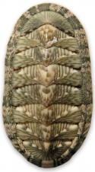
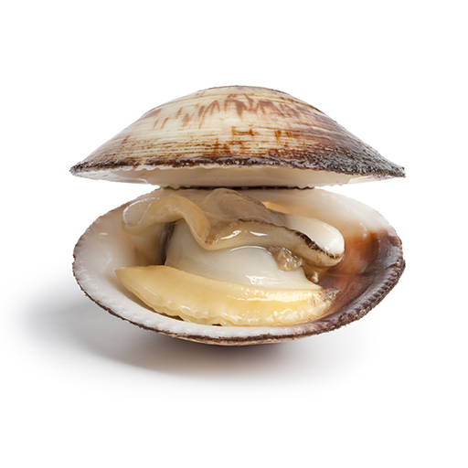
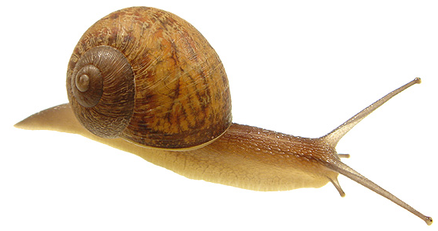
Phylum Mollusca
Over 100,000 species
Includes snails, clams, octopuses and chitons
Marine, freshwater and terrestrial
Soft bodied, unsegmented
Open circulatory system
Similar body plan
Muscular foot
Visceral mass
Mantle
Radula (except bivalves)
Exoskeleton
Shells of calcium carbonate

Slide 3
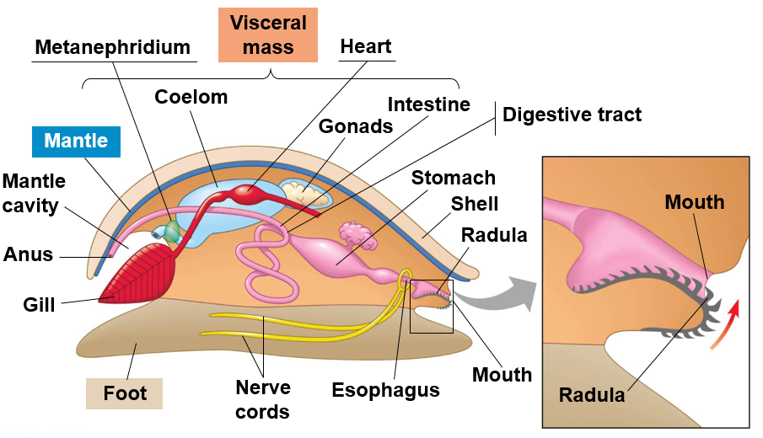
Mollusc Body Plan
Visceral mass: contains internal organs
Muscular foot: used for locomotion
Mantle: secretes calcium carbonate shell
Radula: specialized feeding structure
Notes:
Radula made up of hardest naturally produced material known to man! Look it up.

Slide 4
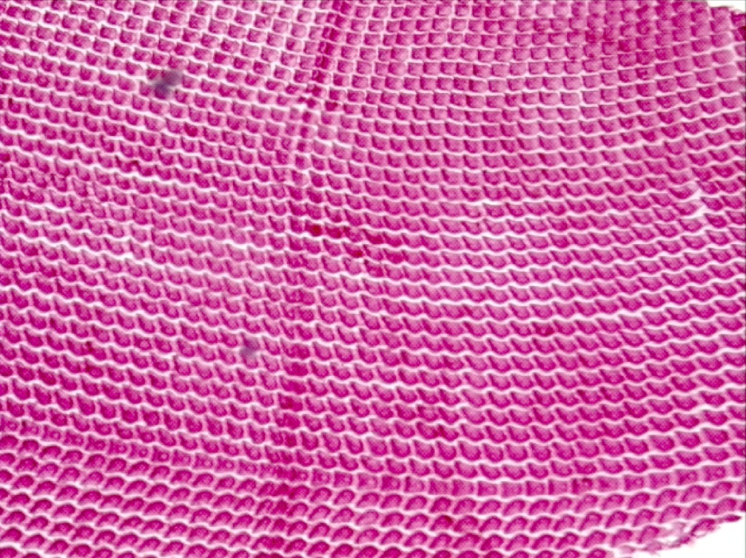
Mollusc Body Plan
Radula: feeding structure comprising tiny, tooth-like projections used to scrap or cut food

Slide 5
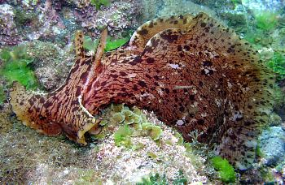
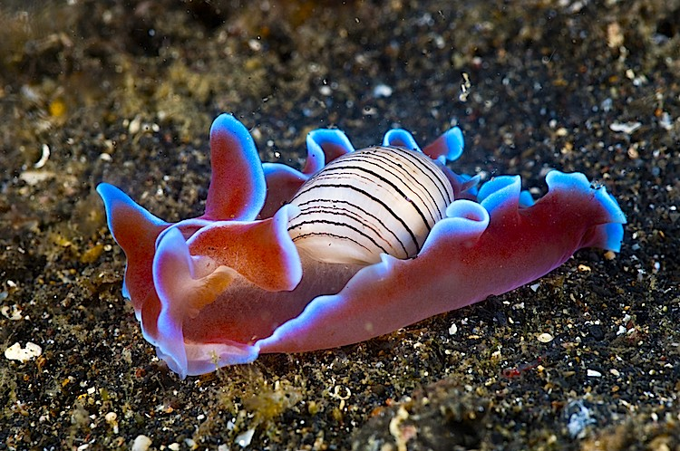
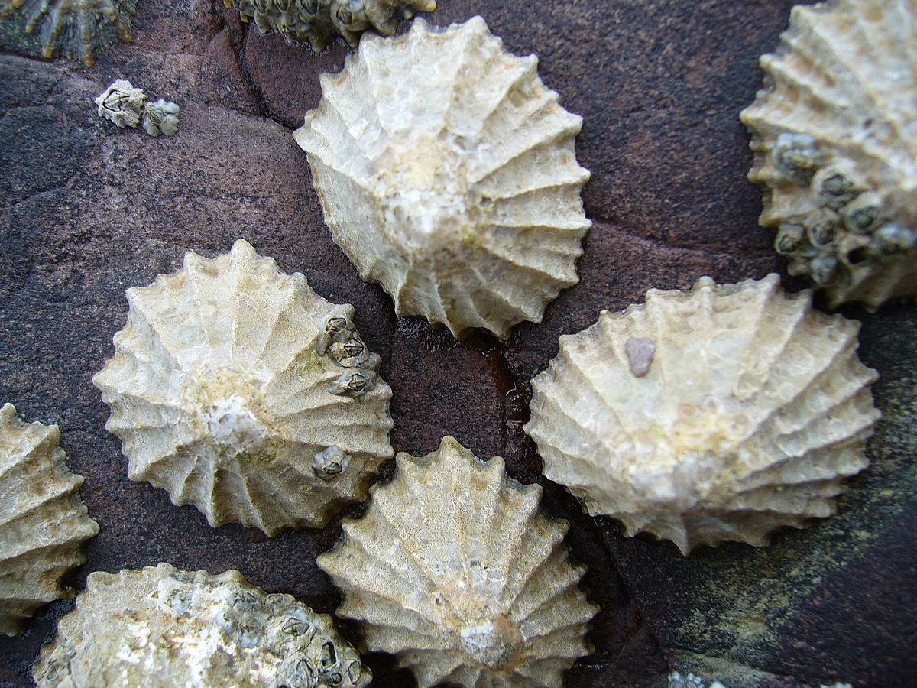
Phylum Mollusca, Class Gastropoda
Snails, slugs, limpets, nudibranchs
~ ¾ of all molluscs
Marine, Freshwater, and Terrestrial
Shell coiled
Reduced or absent in some
Asymmetrical due to torsion
Foot for locomotion
Radula present
Most herbivores (some carnivores)
Notes:
Gills absent in terrestrial species. Lining of mantle functions as a lung
Dextral= right
Sinistral = left

Slide 6
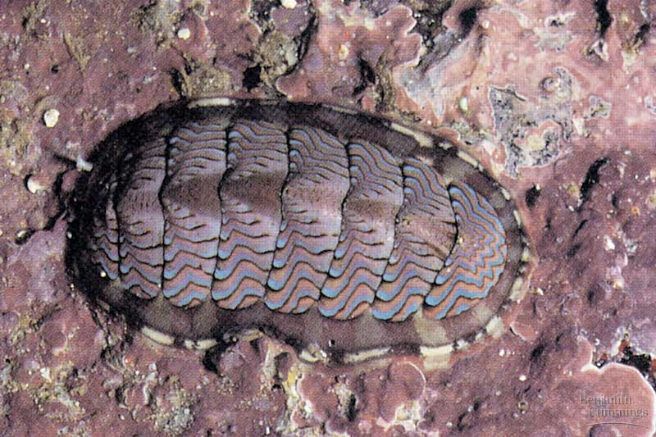
Phylum Mollusca, Class Polyplacophora
Chitons
Shell with eight overlapping plates
Unsegmented body
Marine
Foot used for locomotion
Head reduced
Radula used to scrap algae off rocks
Intertidal zone

Slide 7
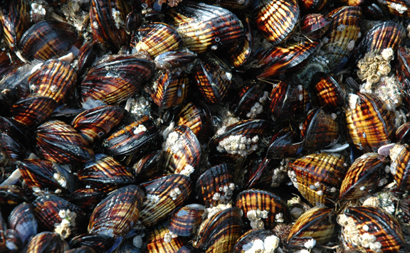
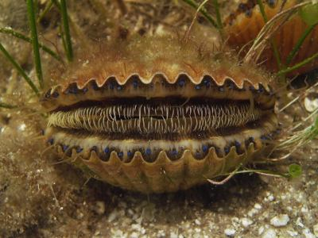
Phylum Mollusca, Class Bivalvia
Clams, oysters, mussels and scallops
Marine and Freshwater
Flattened shell with two valves
Head reduced
Filter feeders (siphons)
No radula

Slide 8
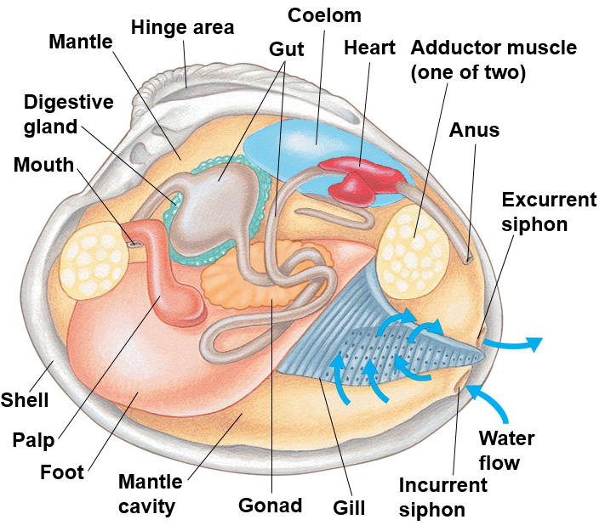
Bivalve Anatomy
Gas exchange and feeding occur across the gill surface
Water movement
Incurrent siphon → Gill surface → Excurrent siphon
Umbo
Notes:
Food particles enter

Slide 9
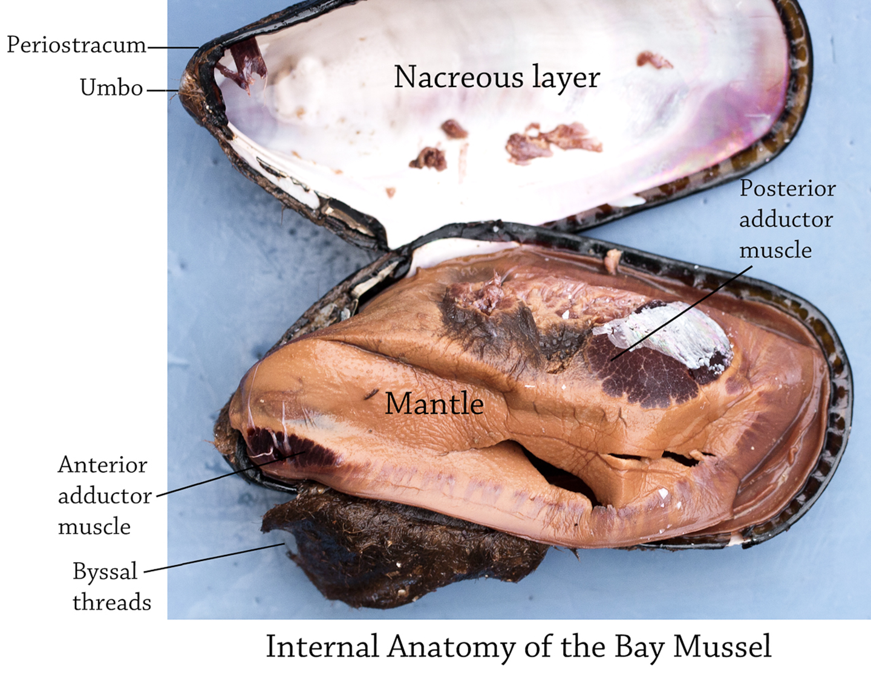

Slide 10
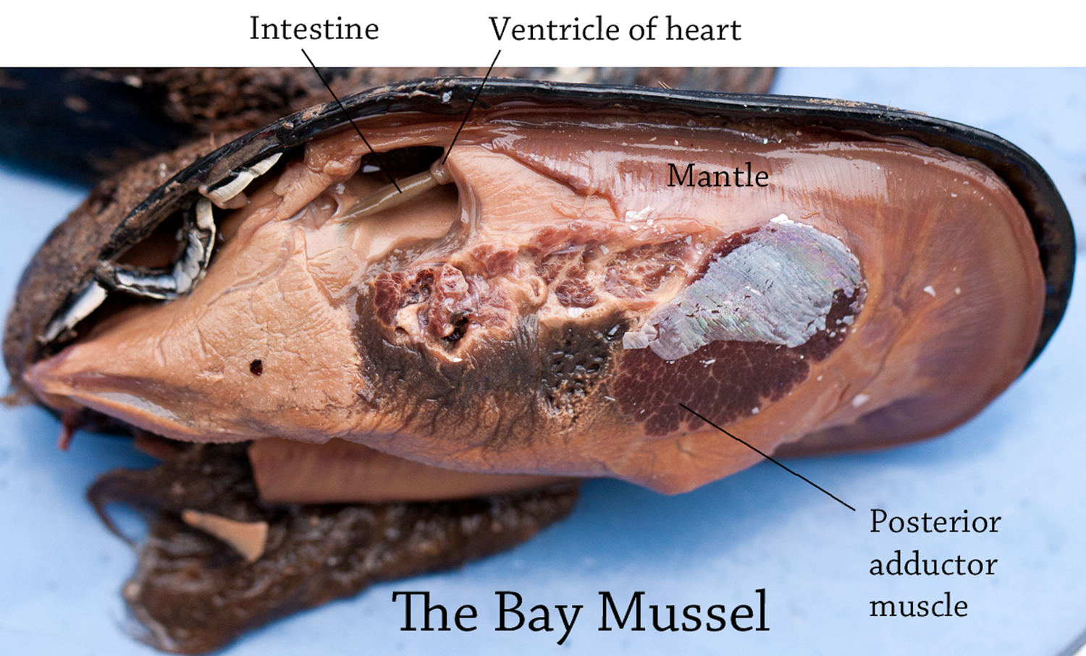

Slide 11
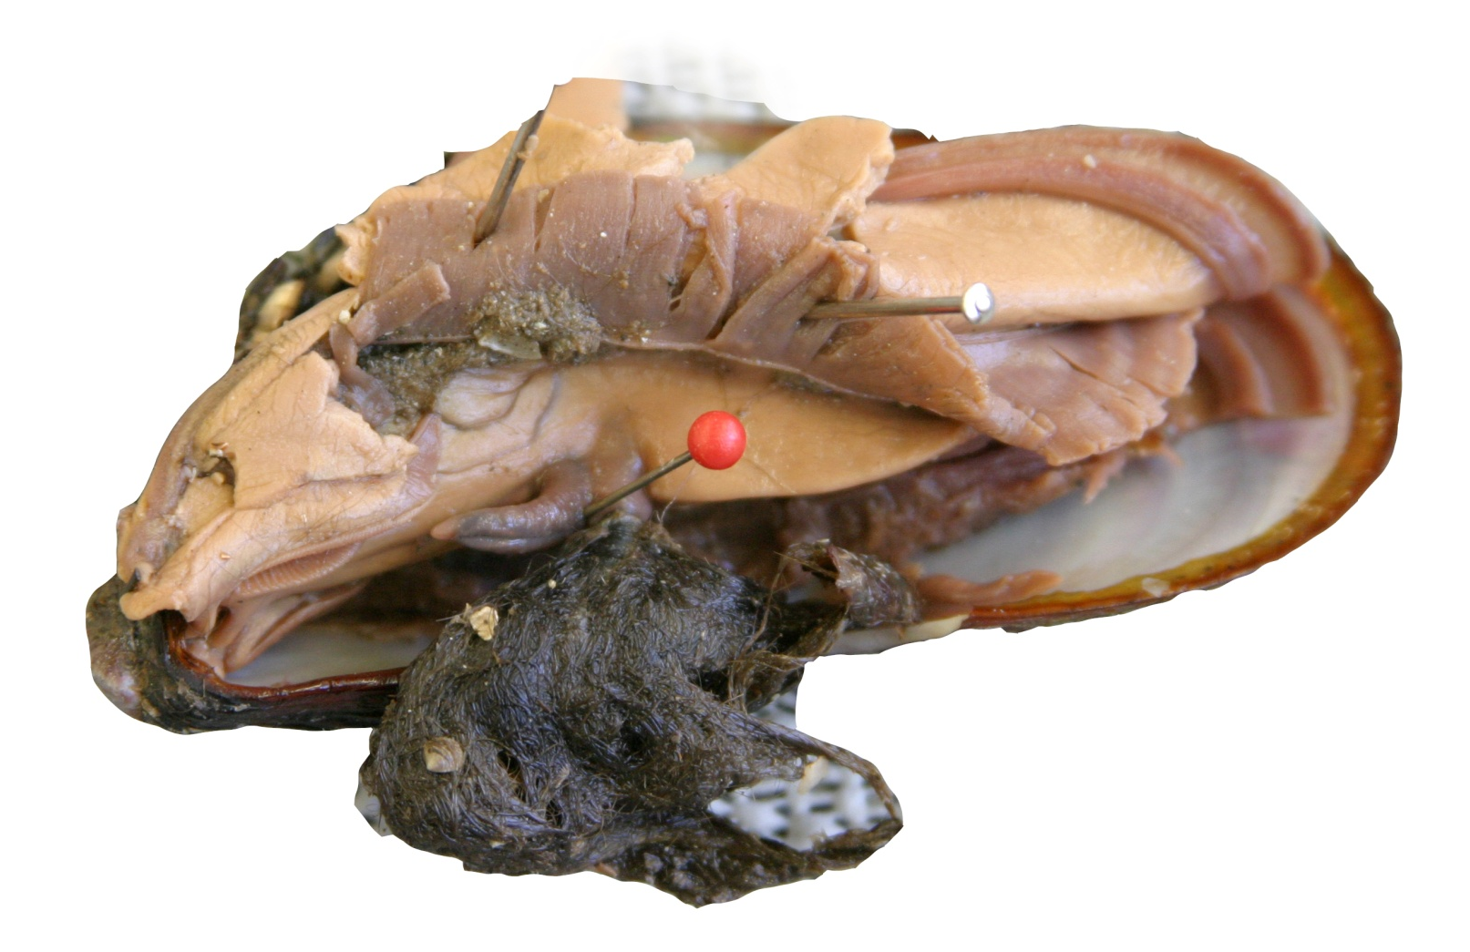
Byssal gland
Gills
Mantle
Muscular foot
Labial palp
Byssal threads

Slide 12
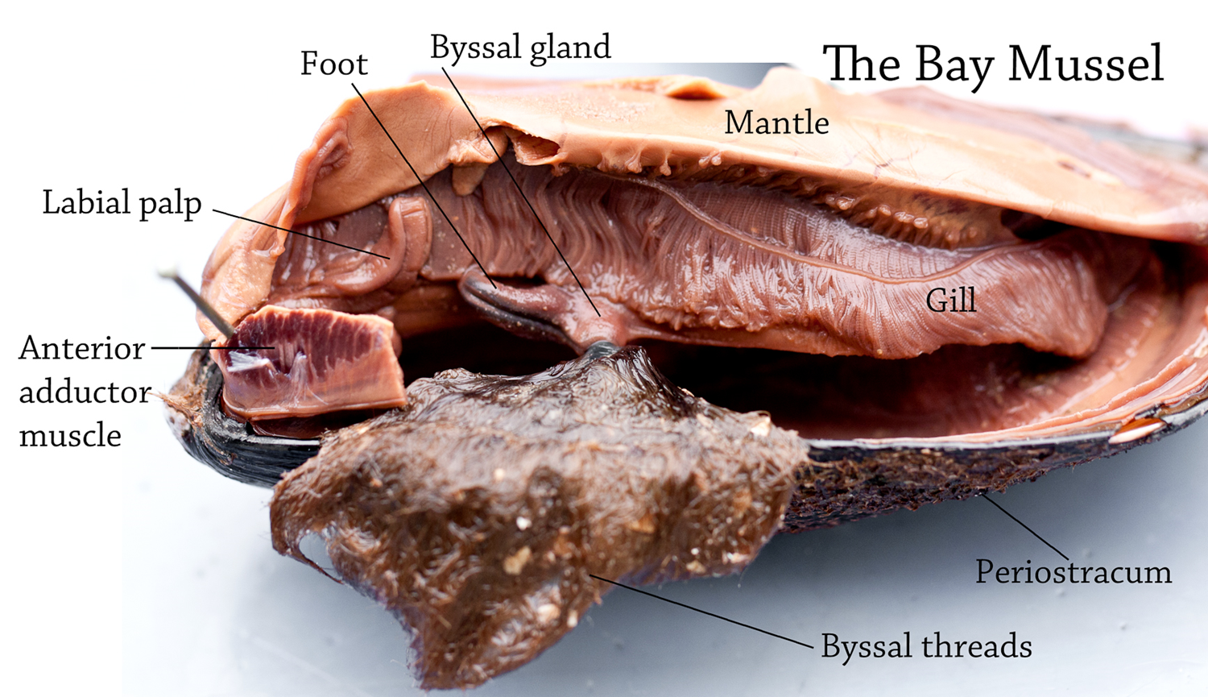

Slide 13
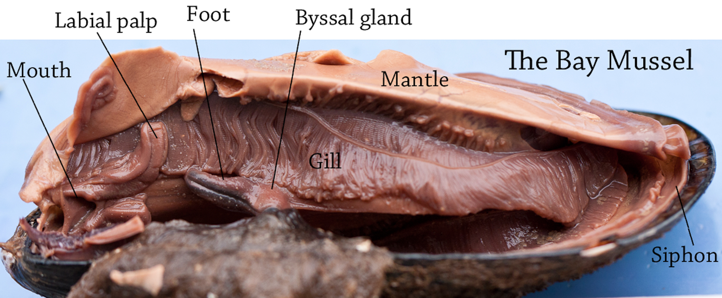

Slide 14
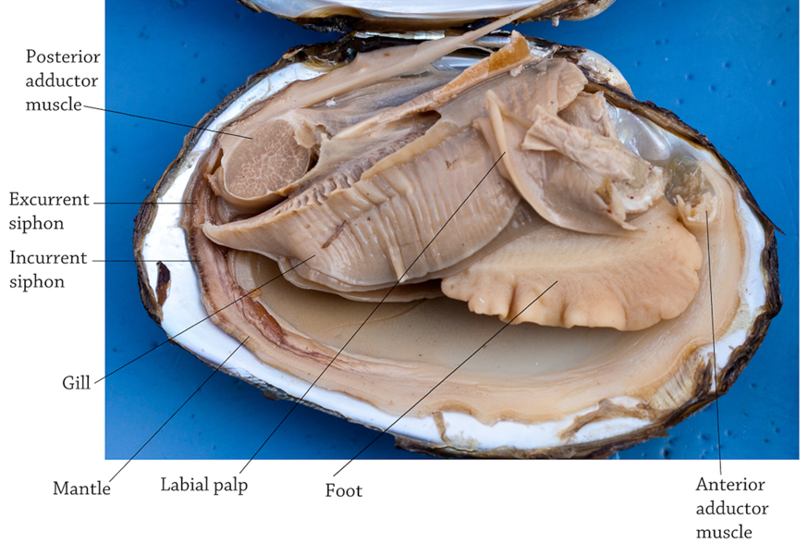

Slide 15
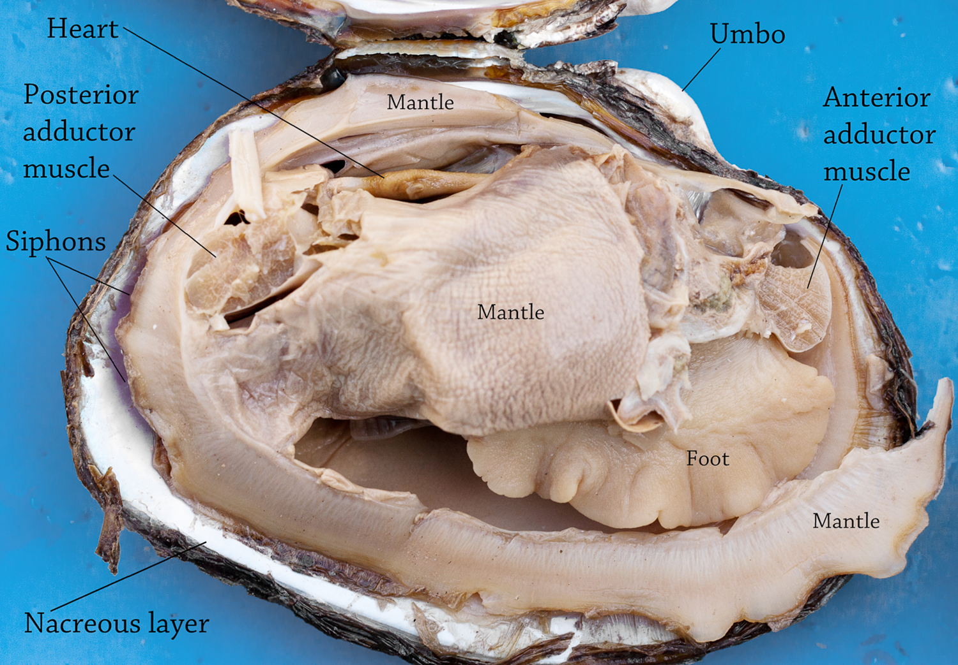

Slide 16
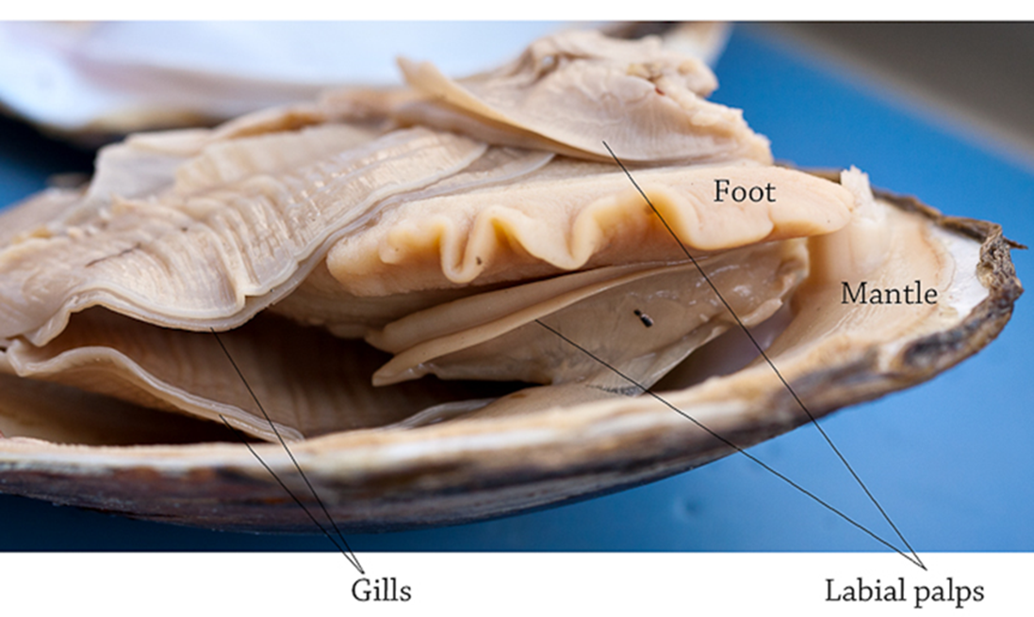

Slide 17
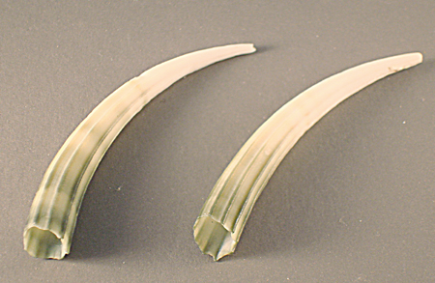
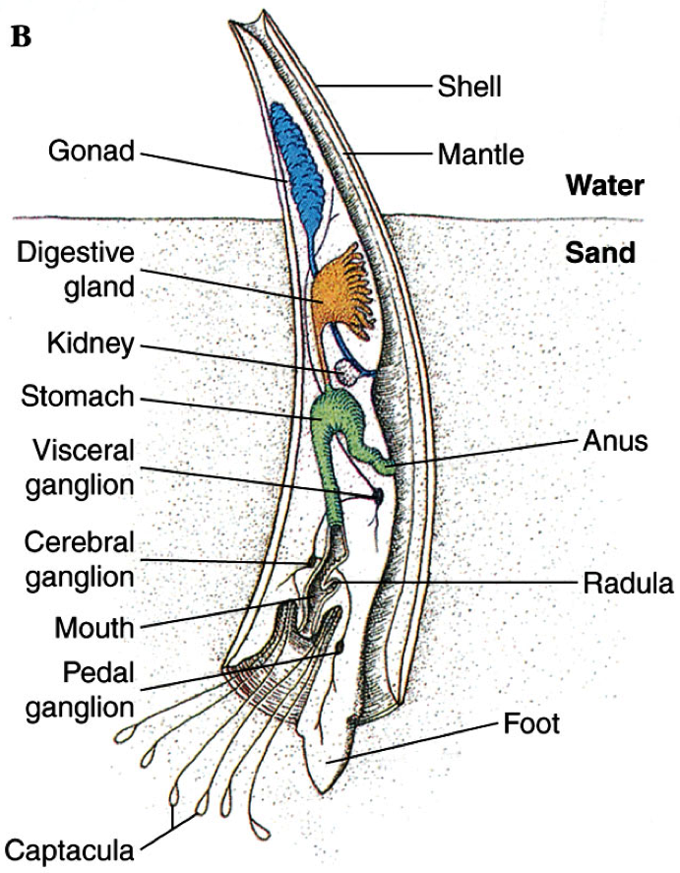
Phylum Mollusca, Class Scaphopoda
Tusk shells
Benthic
Burrow into sand using foot
Filter feeders
Sift through sediment and move food to gizzard using its radula

Slide 18
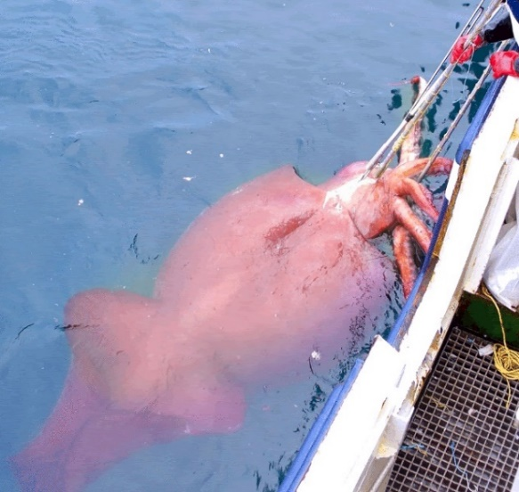
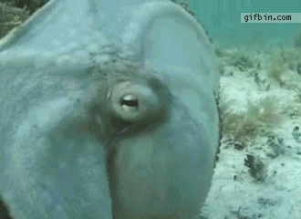
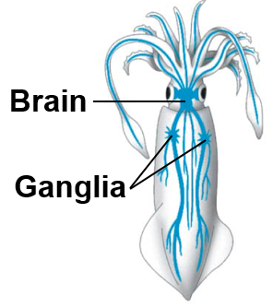
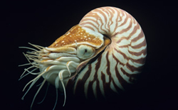
Phylum Mollusca, Class Cephalopoda
Octopuses, squid, nautilus
All Marine
Shell external, internal or absent
Mouth with radula and beak
Locomotion by siphon
Chromatophores
Closed circulatory system
Most developed invertebrate nervous system
Complex brain
Camera eye

Slide 19
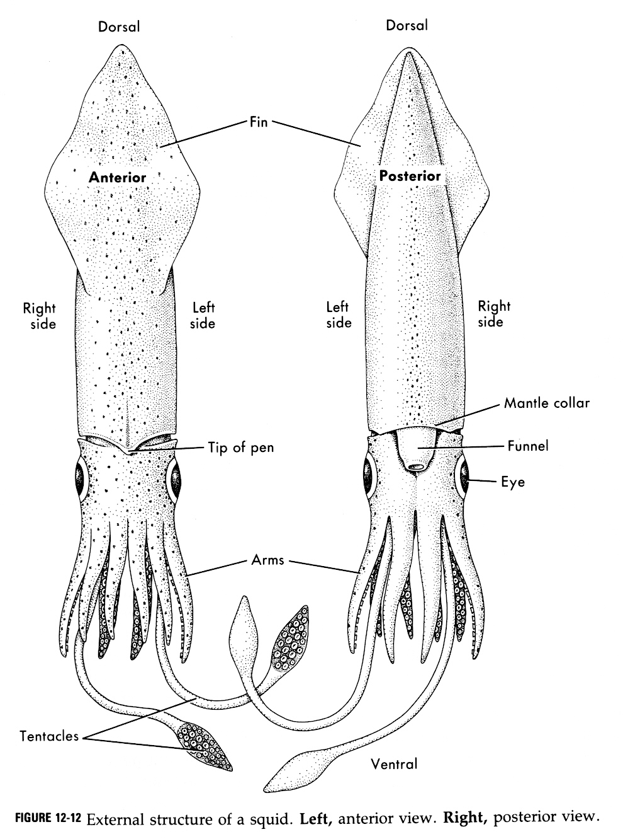
Dorsal
View
Ventral
View

Slide 20
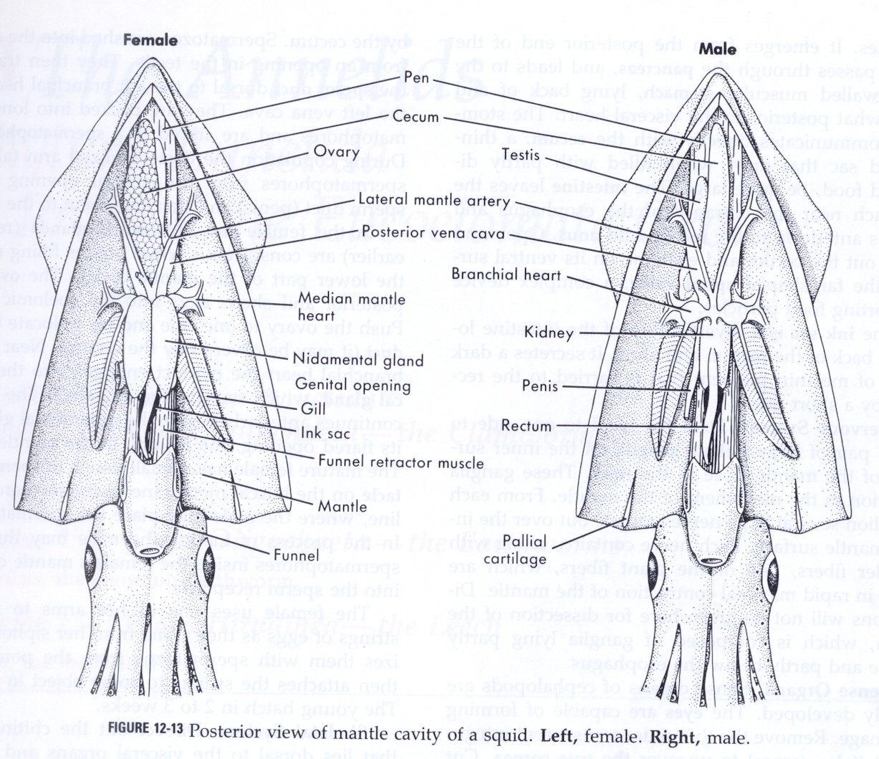

Slide 21
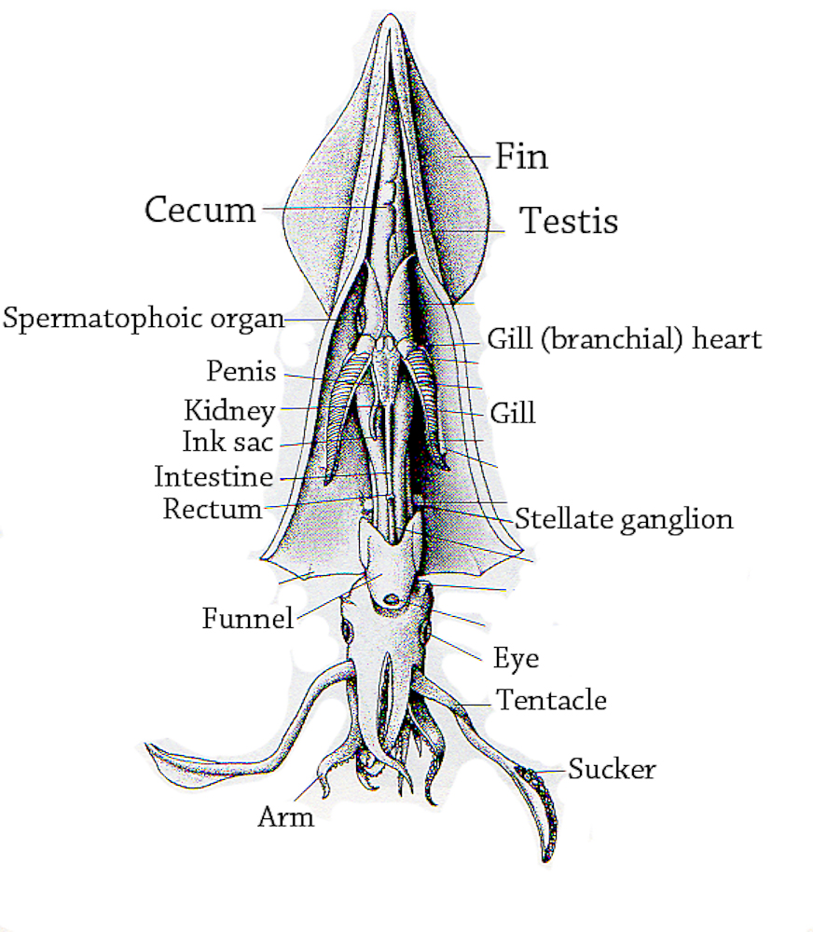

Slide 22
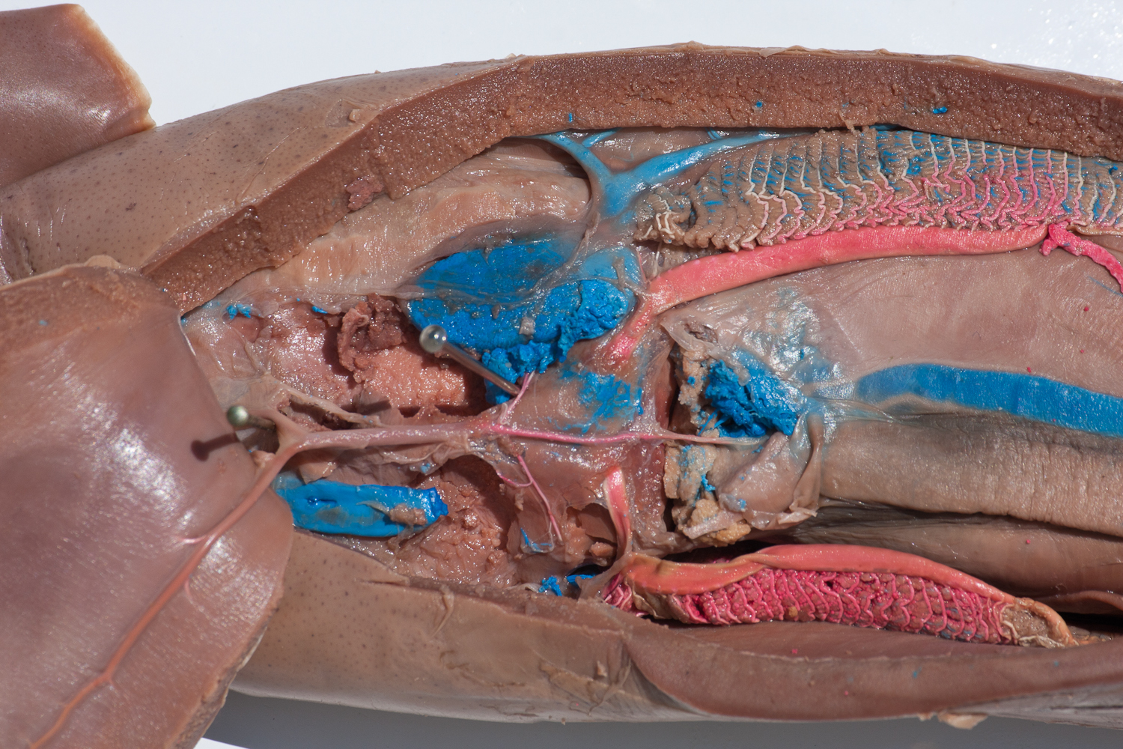
Lateral mantle artery
Caudal aorta
Systemic heart
Gill

Slide 23
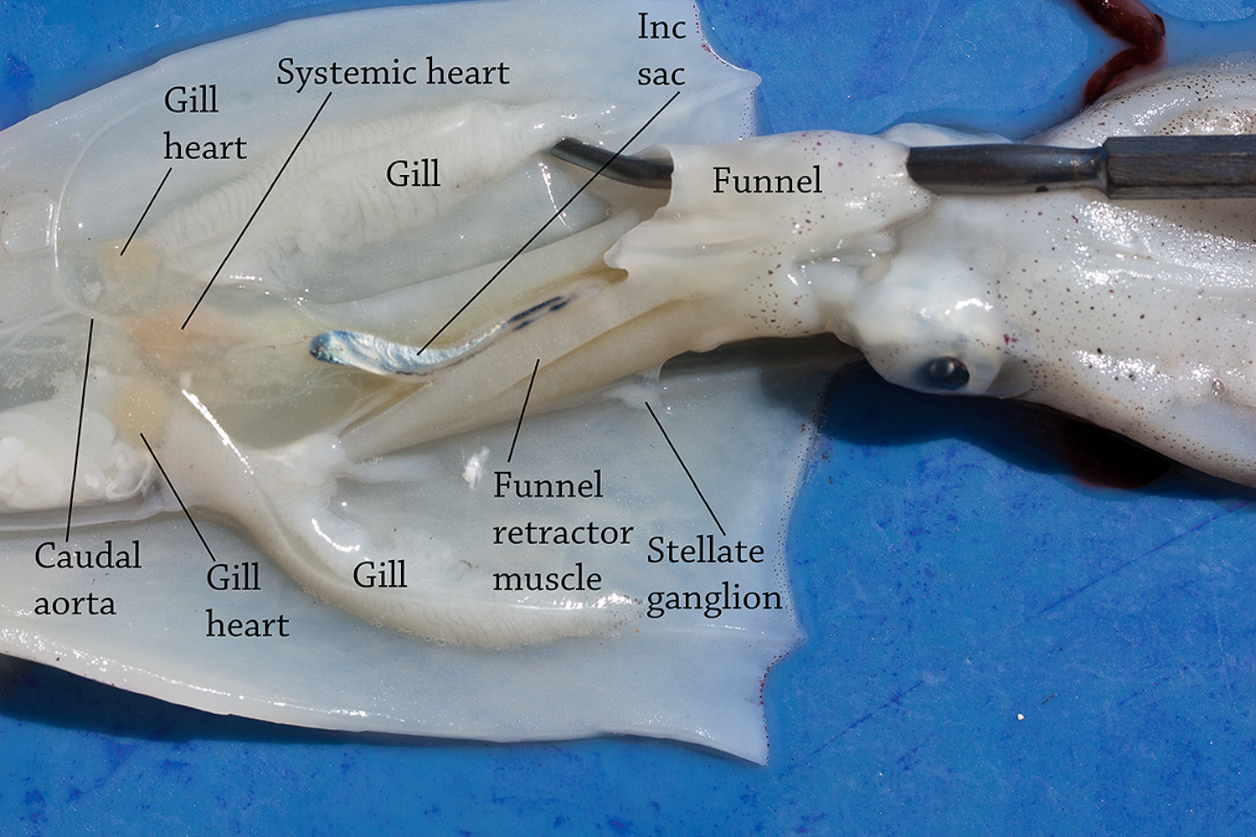

Slide 24
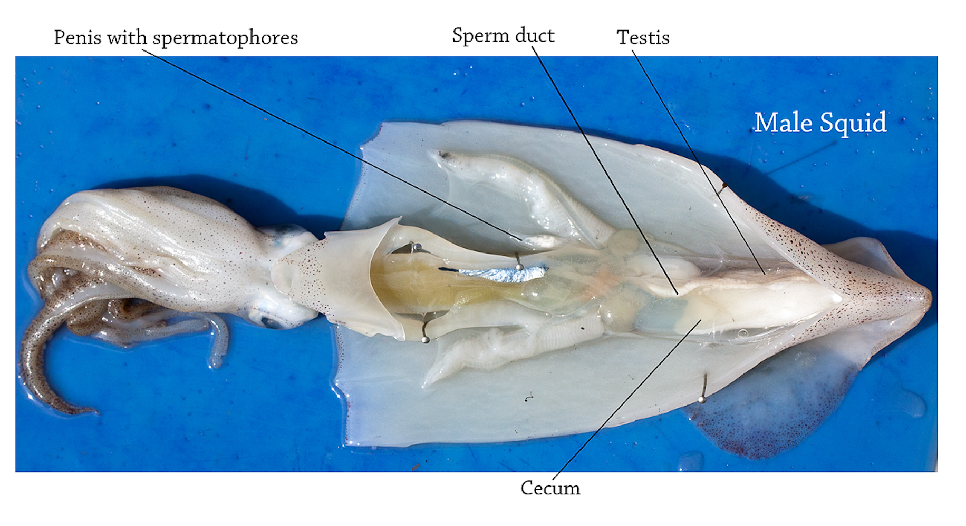

Slide 25
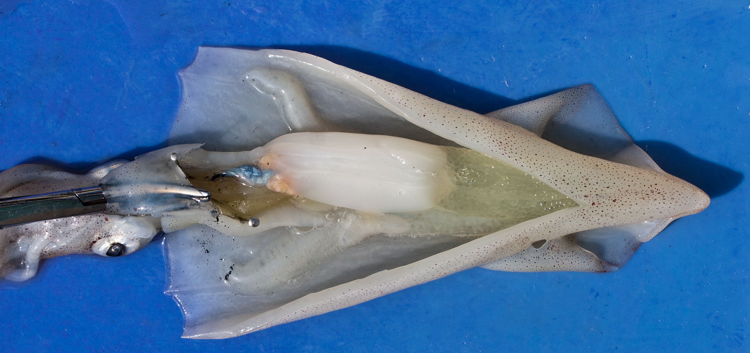
Nidamental gland
Ovary with eggs
Female Squid

Slide 26
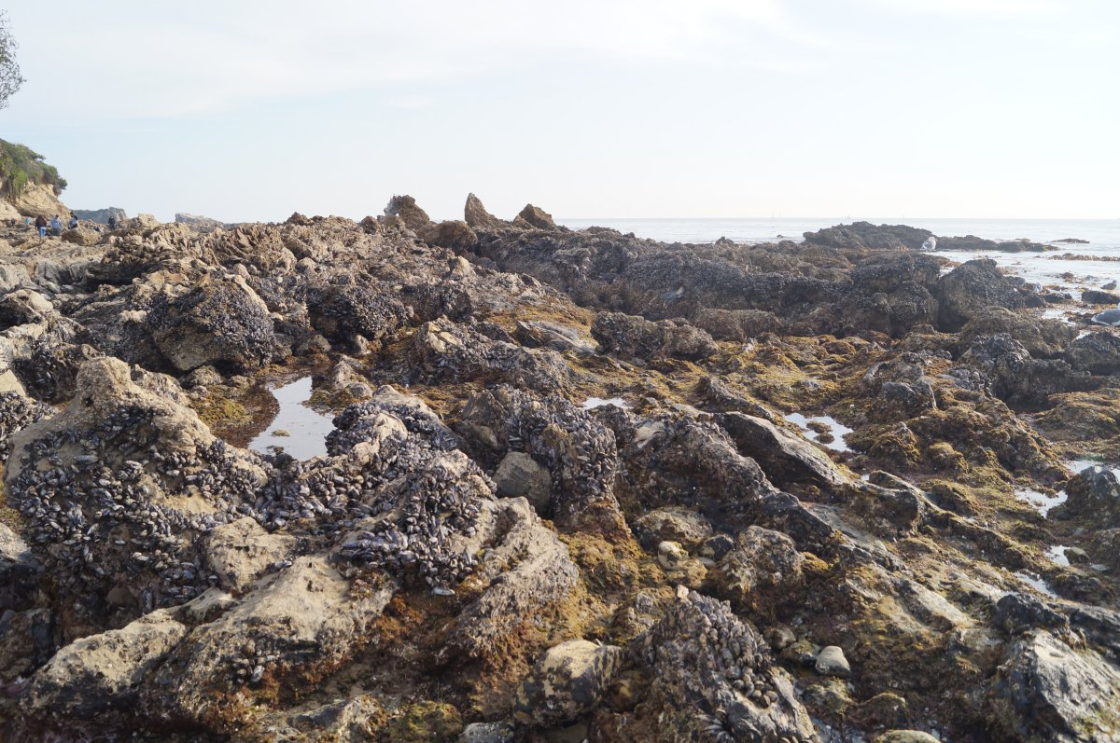
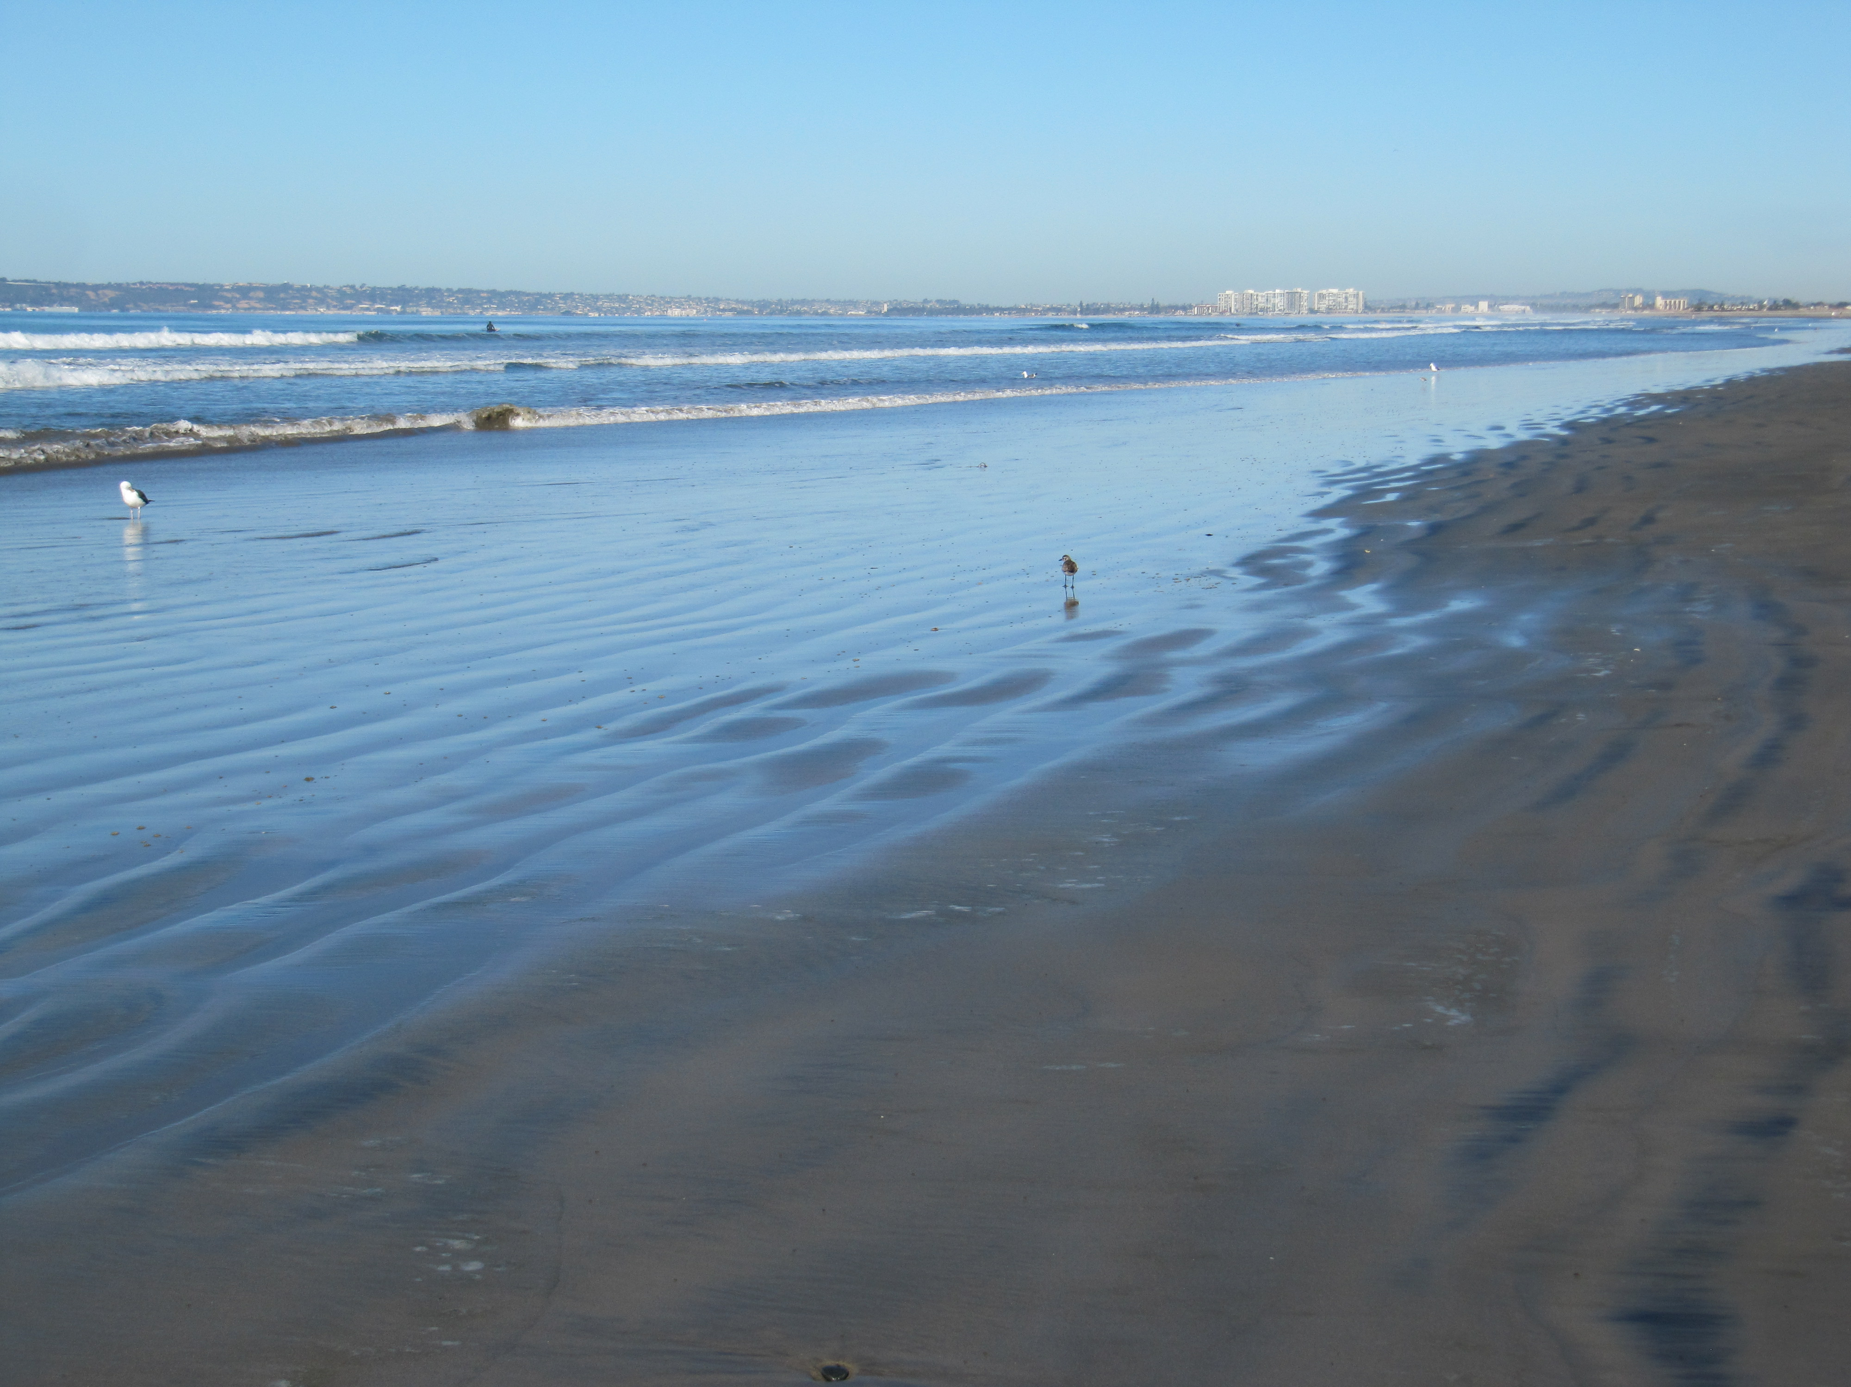
Intertidal Communities
The intertidal zone is the area between the mean low tide and mean high tide.
The intertidal zone is exposed during low tide.
Intertidal zone substrate can be rocky or soft bottom.
Rocky substrate can vary as to the type of rock and the slope angle.
Soft bottoms can vary from sand to silt or a mixture (mud).

Slide 27
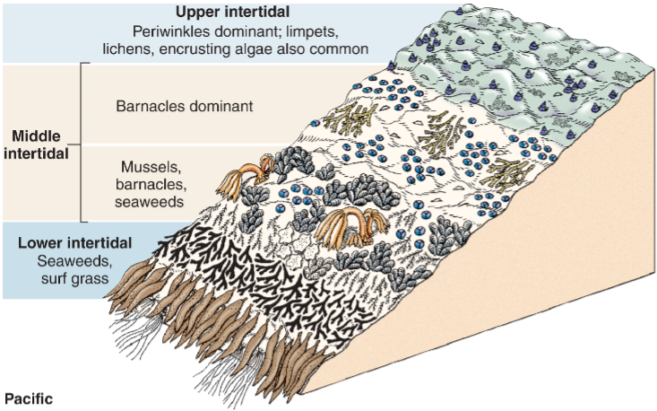
Zonation in the Intertidal
Intertidal organisms typically occupy distinct bands or vertical zones within the intertidal ecosystem
Zonation is due to varying degrees of exposure
Upper intertidal (most exposed)
Middle and lower intertidal (least exposed)

Slide 28
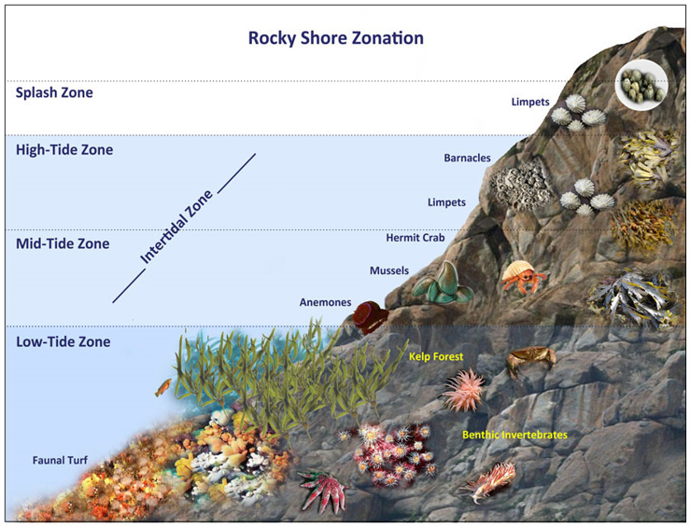
Intertidal Zonation
Splash zone: ~5ft above see level. Only inundated during highest high tides.
High-tide zone: ~2 to 5ft above sea level. Inundated during high tide and exposed to air during low tide.
Mid-tide zone: 0 – 2ft above sea level. Exposed to air only during low tide.
Low-tide zone: Below sea level. Only exposed to air during lowest low tides.

Slide 29
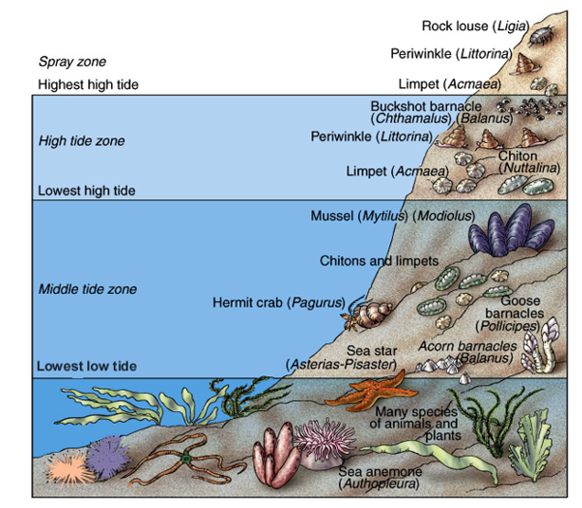
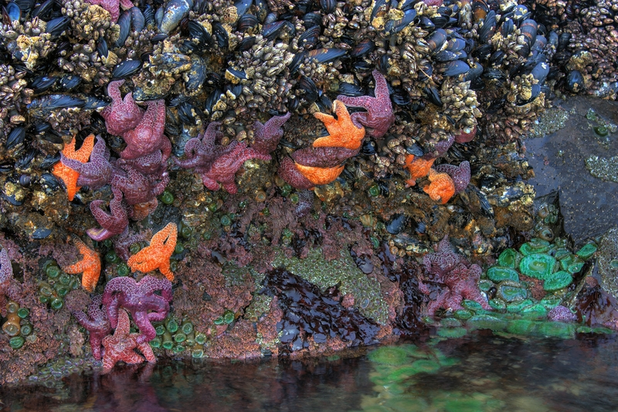
Marine Organisms and Tides
Intertidal organisms deal with periods of exposure during low tide, wave action, and changes in salinity and temperature.
Mostly shelled organisms
Many
soft-bodied organisms and algae

Slide 30
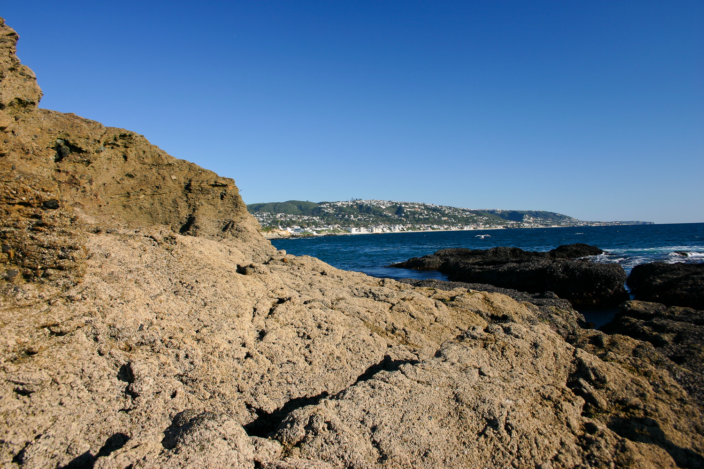
Splash Zone and Upper Intertidal
The Splash Zone, Upper Intertidal, and Middle Intertidal

Slide 31
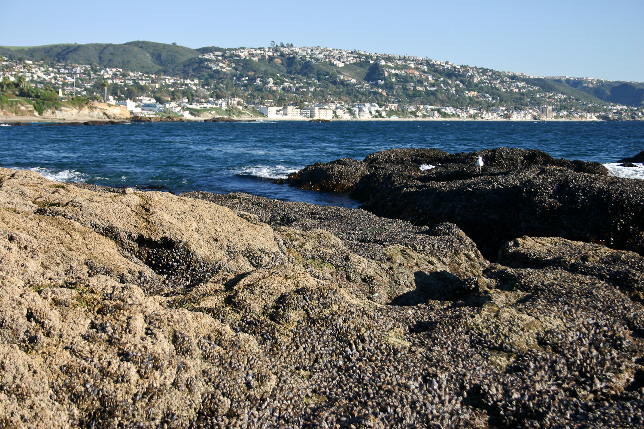
Upper and Middle Intertidal
The Upper and Middle Intertidal

Slide 32
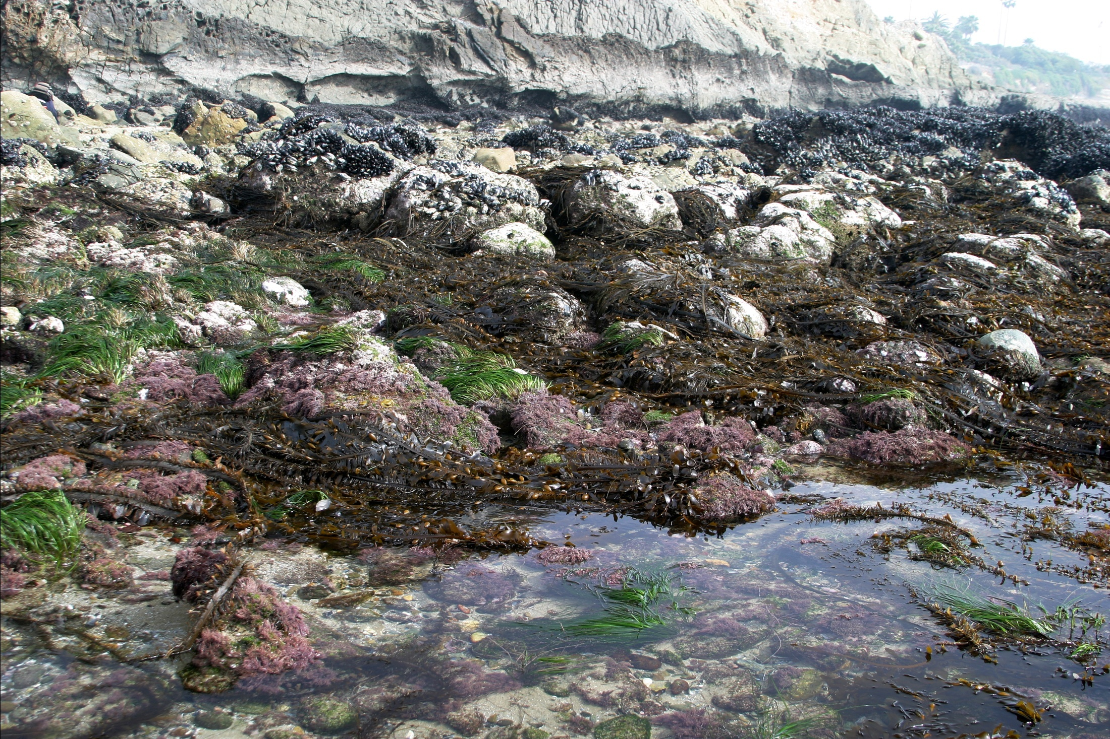
Middle and Lower Intertidal
Middle and Lower Intertidal

Slide 33
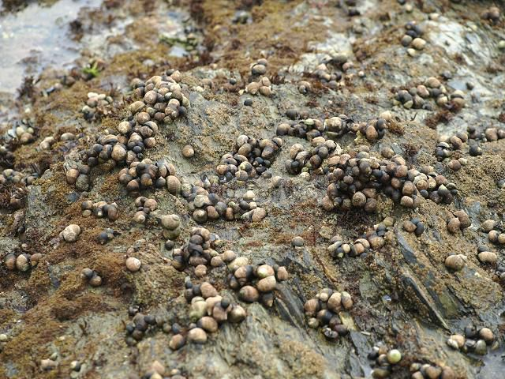
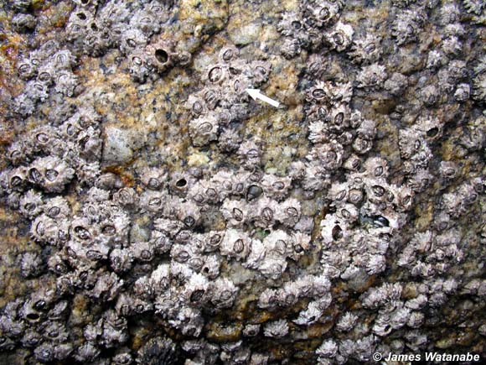
Intertidal Zonation
Splash zone: ~5ft above see level.
Only inundated during highest high tides.
Organisms sprayed with water during high tide but are rarely submerged
Organisms found in splash zone
Periwinkle snails
Small acorn barnacles
Periwinkle snails
Small acorn barnacles

Slide 34
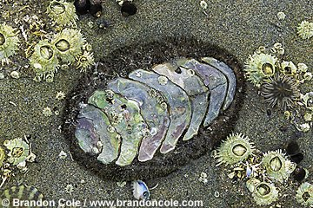
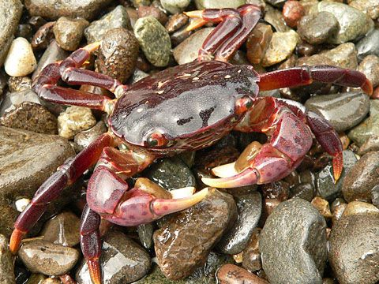
Intertidal Zonation
High-tide zone: ~2 to 5ft above sea level.
Inundated during high tide and exposed to air during low tide.
Organisms found in high-tide zone
Large acorn barnacle
Chiton
Limpets
Shore crabs
Rough chiton
Shore crab

Slide 35
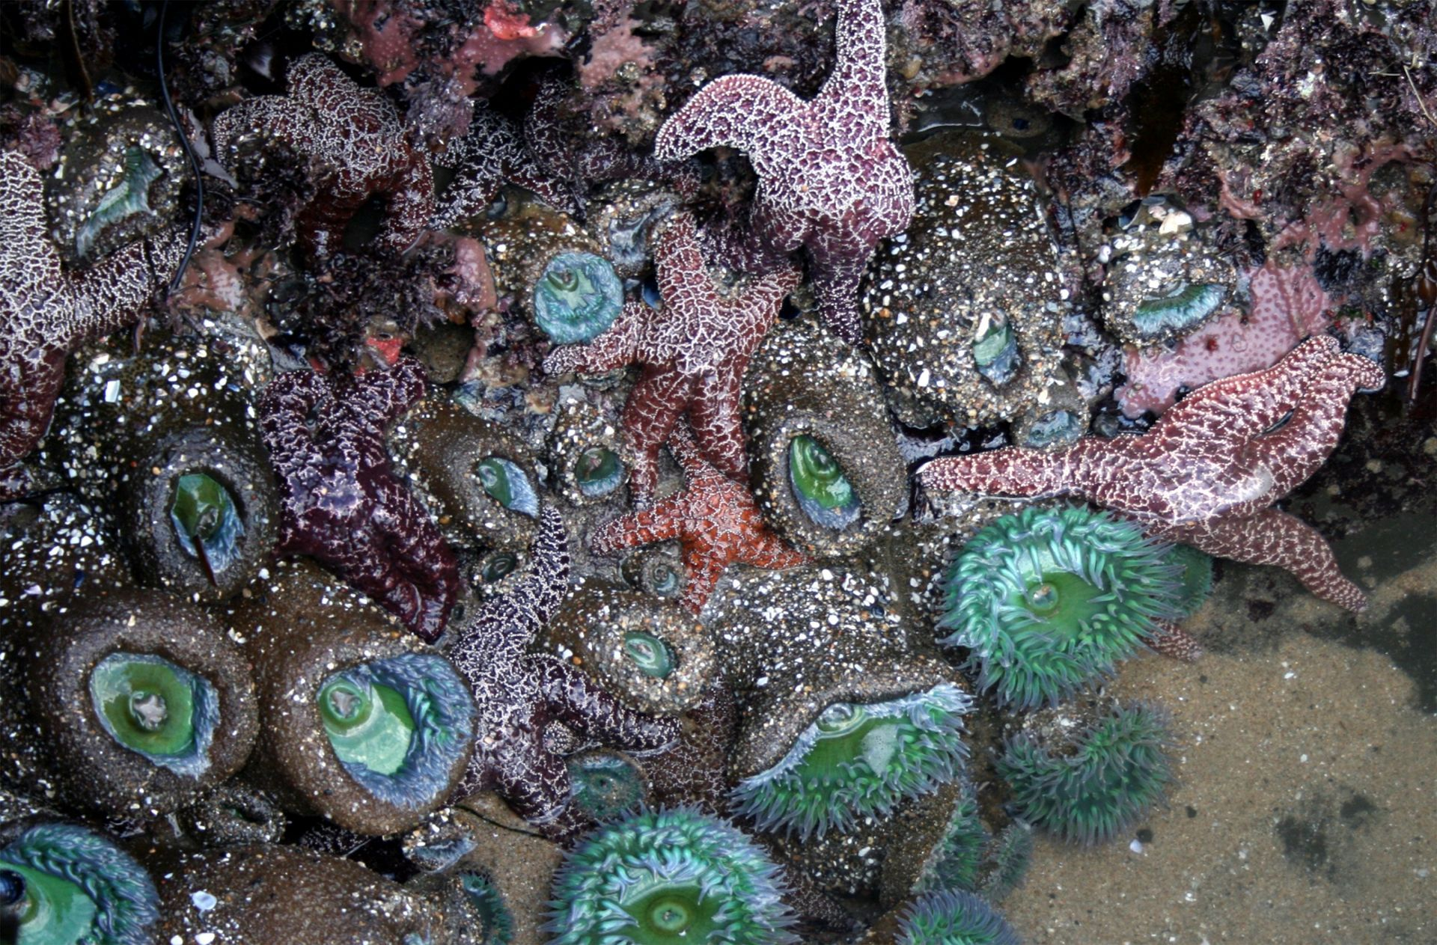
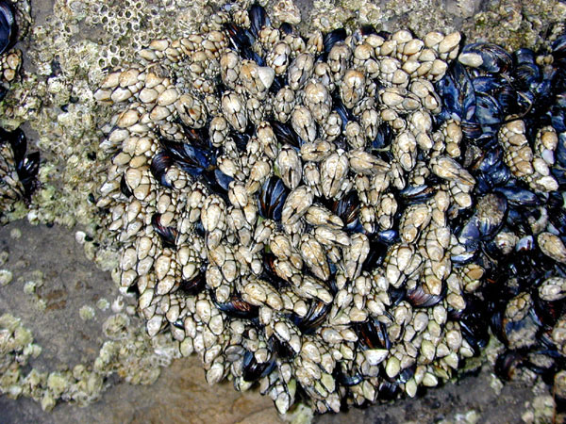
Intertidal Zonation
Mid-tide zone: 0 – 2ft above sea level.
Exposed to air only during low tide.
Organisms found in mid-tide zone
Sea star
California mussel
Gooseneck barnacles
Hermit crabs
Sea anemones
Sea stars and sea anemones
California mussels and gooseneck barnacles

Slide 36
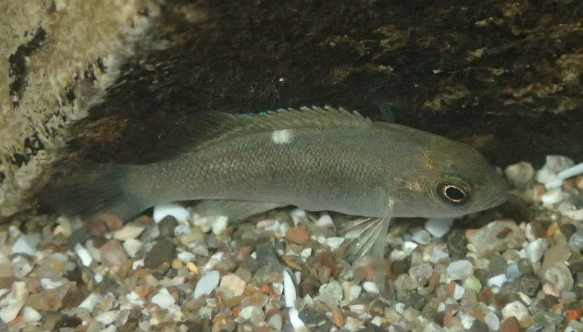
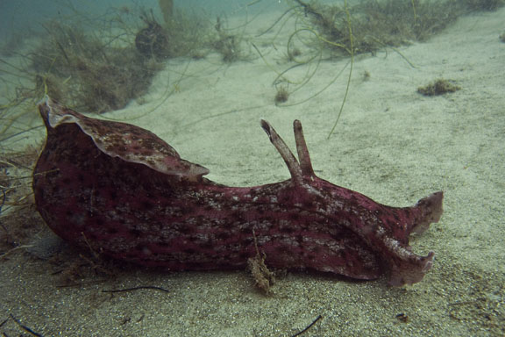
Intertidal Zonation
Low-tide zone: Below sea level.
Only exposed to air during lowest low tides.
Organisms found in low-tide zone
Brown algae
Opaleyes
California sea hare
Two spotted octopus
Sea urchins

Slide 37
Zonation in the Intertidal
Biological interactions (competition for space, predation, grazing) are often important factors in determining lower limit of rocky intertidal organisms, while physical factors (desiccation) often determine upper limit.

Slide 38
Zonation in the Intertidal
Competition is greatest in the lower intertidal because it is exposed to a lesser degree than the upper intertidal.
The lower intertidal has the greatest number of species because it is the least extreme of the zones

Slide 39
Intertidal Zone Organisms
Epifauna: organisms that live on the surface of the substrate
More common in rocky intertidal
Ex: mud snails on soft bottoms, barnacles on hard substrates
Infauna: organisms that live in the substrate
More common in sandy intertidal
Ex: clams burrowing in soft bottoms

Slide 40
Challenges of the Intertidal Zone
Desiccation: drying out during low tide.
Wave action and tides: impacts from waves and other objects. Wear from sandy water
Exposure: exposure to heat and UV from sun.
Temperature changes: drastic shifts in air and water temperature
Salinity changes: evaporation from pools changes salinity
Predation: intertidal predators including octopus, sea stars and fish
Limited space: intertidal organisms compete for space on the substrate
Oxygen availability: lack of oxygen in the water when exposed

Slide 41
Challenges of the Intertidal Zone
Desiccation: drying out during low tide
Bivalves close shells
Snails secrete slime
Operculum seals shell
Anemones close tentacles
Limpets and chitons trap moisture under shell
Motile organisms move to lower tide zones

Slide 42
Challenges of the Intertidal Zone
Wave shock: impacts from waves and other objects. Wear from sandy water.
Hard external skeleton
Shells or exoskeleton
Attachment to rocks
Byssal threads in mussels
Tube feet in echinoderms
Muscular foot in molluscs
Pelvic fins of cling fish
Modified pelvic fins to form sucking disc

Slide 43
Challenges of the Intertidal Zone
Exposure: exposure to heat and UV from sun.
Barnacles and muscles cluster together to reduce individual exposure
North side of rocks in northern hemisphere
Move out of most exposed area

Slide 44
Challenges of the Intertidal Zone
Temperature changes: drastic shifts in air and water temperature
Ectothermic
Can withstand a wide range of temperatures
Ridges in shell aid in evaporative cooling

Slide 45
Challenges of the Intertidal Zone
Salinity changes: evaporation from pools or rain can change salinity
Alter solute concentration in cells making them isotonic to sea water
Euryhaline: broad range of salt tolerances
Salt excretion

Slide 46
Challenges of the Intertidal Zone
Predation: intertidal predators including octopus, sea stars and fish
Enclose themselves in hard shell
Mussels and barnacles
Snails and hermit crabs
Hide in rock crevices
Firmly attach to rocks
Ink (sea hare)

Slide 47
Challenges of the Intertidal Zone
Limited space: intertidal organisms compete for space on the substrate
Efficient dispersal
Asexual reproduction (budding) in aggregate anemone
Strong attachment to the substrate
Mussels and barnacles

Slide 48
Challenges of the Intertidal Zone
Oxygen availability: lack of oxygen in the water when exposed or when there is a high density of organisms and a lack of photosynthetic algae
Breathe atmospheric air in oxygen poor water
Tide pool sculpin and juvenile opaleye

Slide 49
Rocky Intertidal Food Web
Secondary consumers
Primary consumers
Primary Producers

Slide 50
Rocky Intertidal Food Web
Predators act to control prey populations
Keystone species: a species whose absence in the community would bring about significant change in that community
Predator:
Pisaster ochraceous
Prey:
Mytilus californianus

Slide 51
Rocky Intertidal Food Web
Sea stars are especially important in controlling California mussel populations in the lower intertidal zone. The absence of sea stars can lead to the expansion of the mussel beds into the lower intertidal.

Slide 52
Sea Star Wasting Disease
Sea Star Wasting Disease (SSWD) is a disease that affects various echinoderm species causing them to decay and die
Some areas in southern California experienced a 99% decline in sea star populations
Sea water temperature may be correlated with the spread of the disease
Cause of the disease has yet to identified

