Slide 1
Cnidaria, Ctenophora, and Annelida
Lab 4

Slide 2
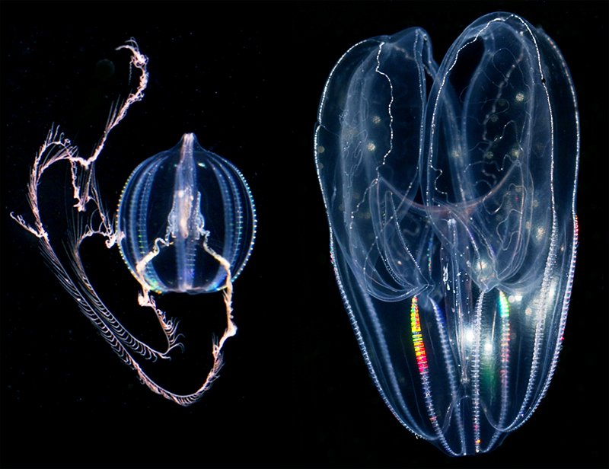
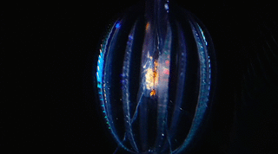
Phylum Ctenophora
Comb jellies
Approx: 100 species
Marine
Radial symmetry
Eight “combs” of cilia
Diploblastic
Colloblasts
Adhesive cells
Notes:
Largest animals to move via cilia
Like the cnidocytes of cnidarians, colloblasts are discharged from the tentacles and are used for prey capture. However, unlike cnidocytes, which are venomous cells, colloblasts stick to, rather than sting their prey.

Slide 3
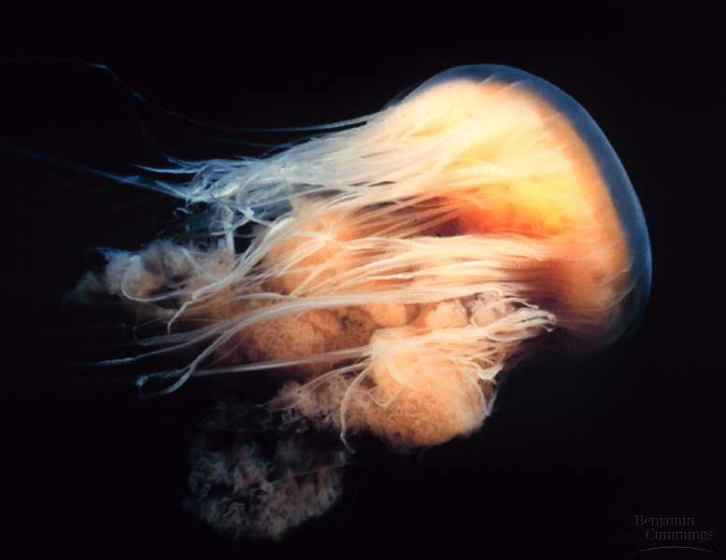
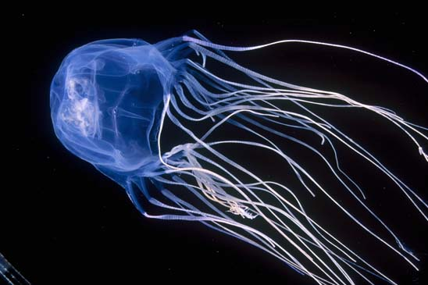
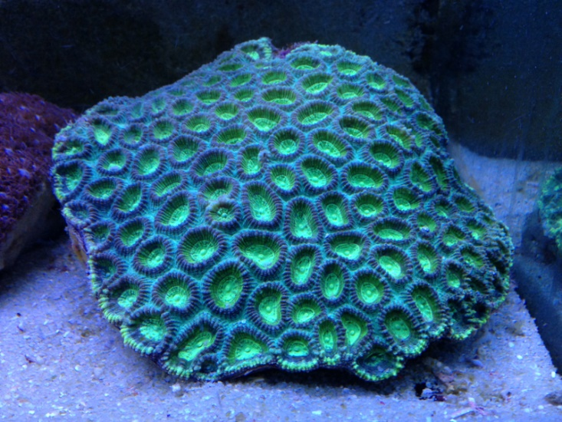
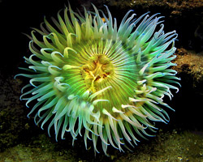
Phylum Cnidaria
Sea jellies, sea anemones, coral
Approx.: 10,000 species
Radial symmetry
Two life forms (some)
Polyp and Medusa
Two tissue layers
Diploblastic
Gastrovascular cavity

Slide 4
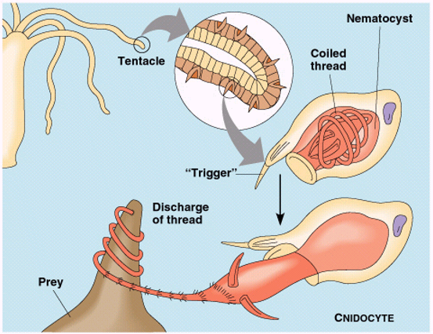
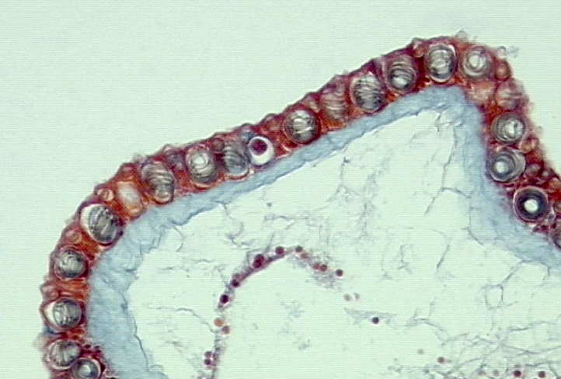
Cnidocytes and Nematocysts
Cnidocytes: specialized cells used in feeding and defense
Nematocysts (stinging organelle)
Cnidocytes with coiled nematocytes

Slide 5
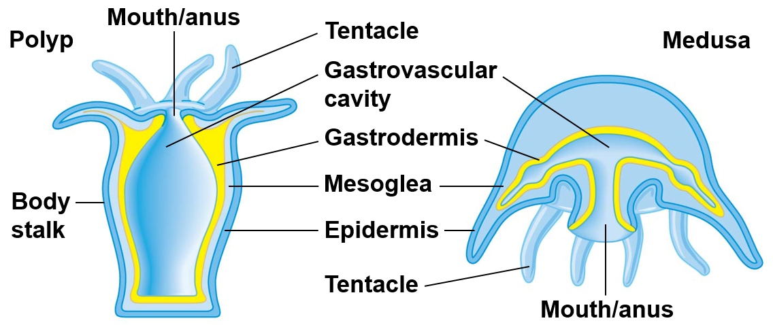
Cnidaria Body Forms
Gastrovascular cavity: central cavity where gas exchange and digestion occurs
Gastrodermis: cells lining gastrovascular cavity
Mesoglea: jelly-like tissue layer that forms hydrostatic skeleton
Polyp
(Sessile)
Medusa
(Free swimming)
Notes:
Sessile: stationary
Motile: free swimming or moving

Slide 6
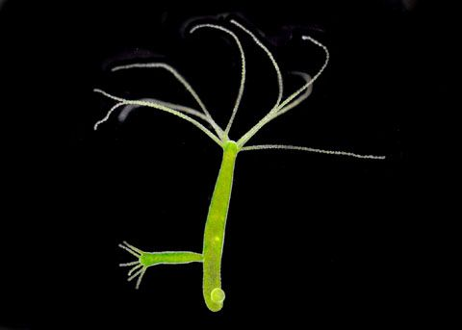
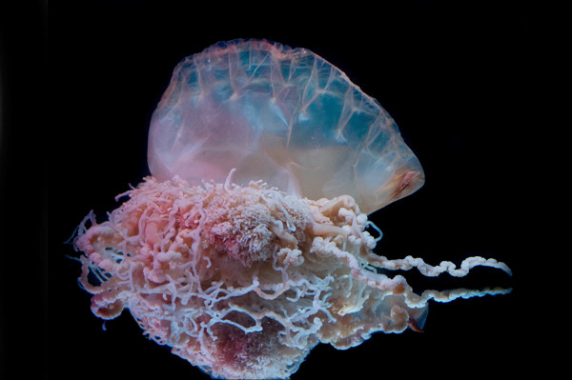
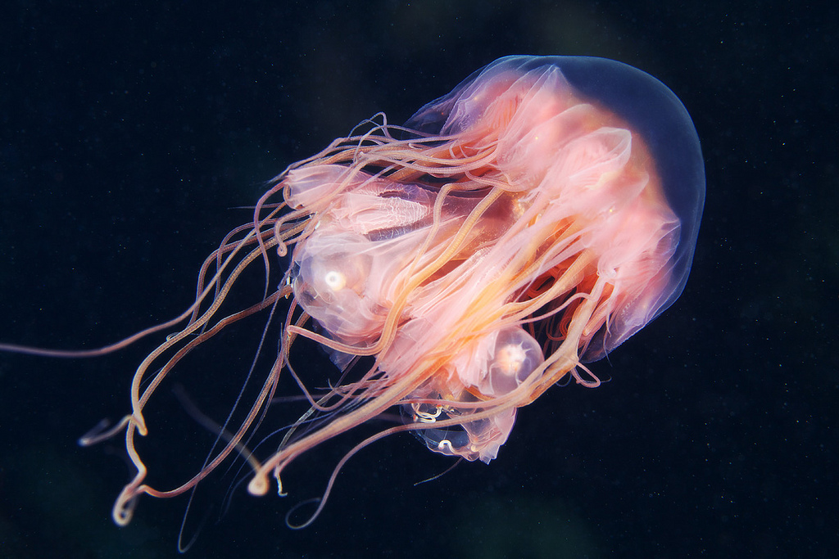
Cnidarian Classification
Class Hydrozoa
Most are marine
Most species contain both a polyp and medusa stage
Medusa usually small with velum
Polyp stage often colonial
Reproduction
Asexual: budding
Sexual: zygotes and larvae (planula)

Slide 7
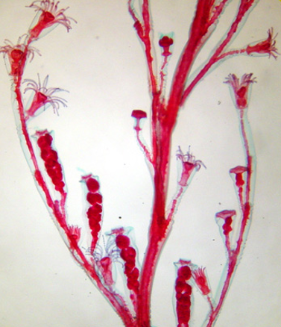
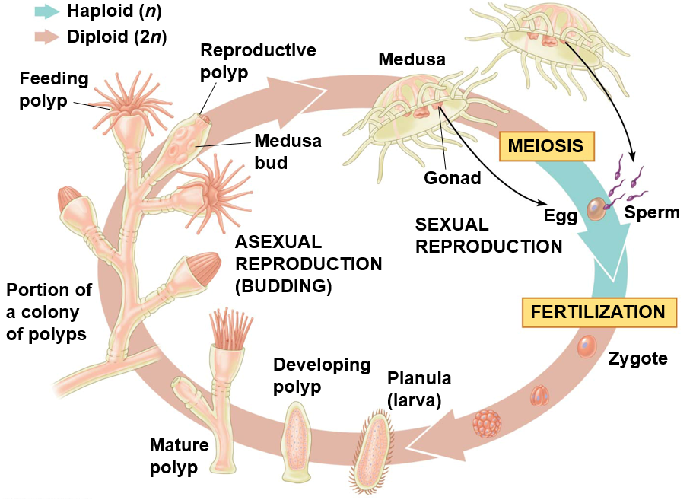
Cnidarian Life Cycle (Obelia)
Feeding
polyps
Reproductive
polyps
Medusa
buds
Obelia Colony

Slide 8
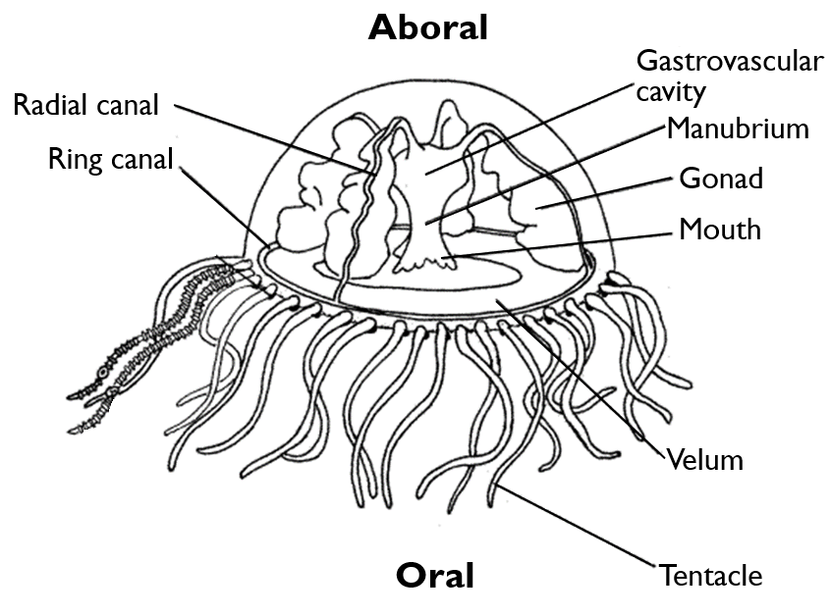
Hydrozoan Medusa Anatomy
Exumbrella
Velum: Shelf-like structure at base of subumbrella
Manubrium: tubular structure that contains the mouth
Radial canals: connect stomach (gastrovascular cavity) to ring canal
Subumbrella

Slide 9
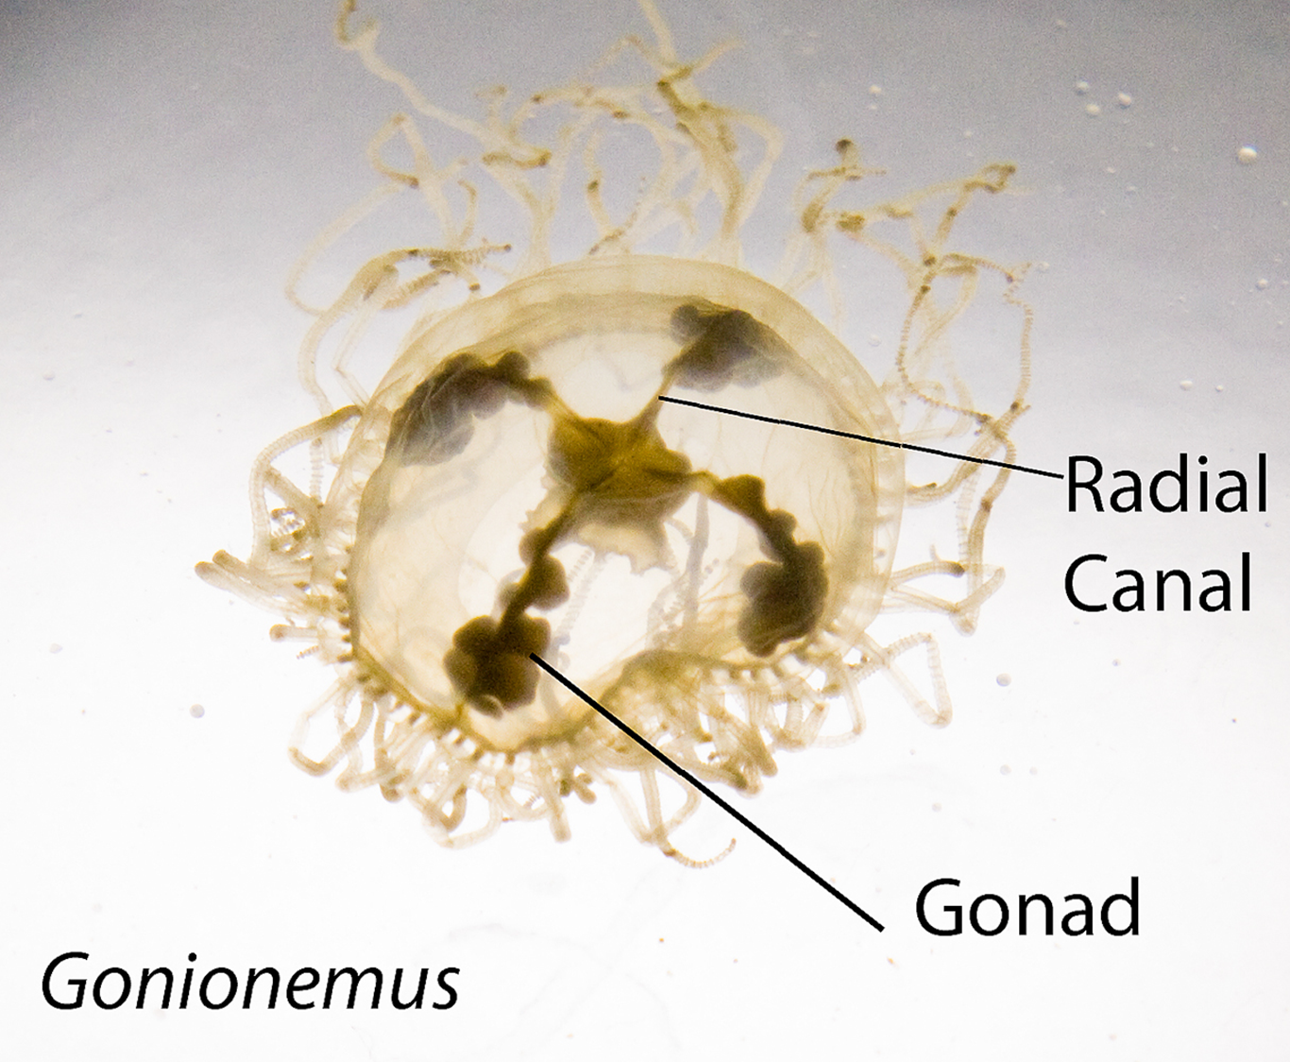

Slide 10
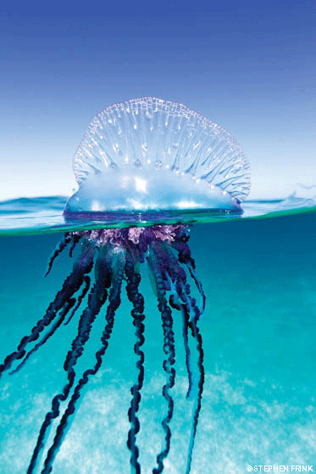
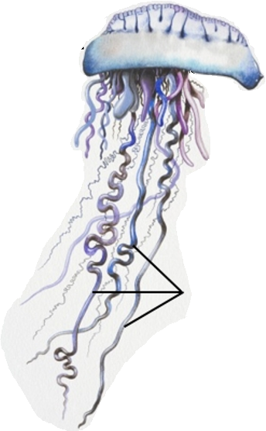
Portuguese Man of War (Physalia)
Siphonophores: colonies of specialized polyps
Crest (Sail)
Pneumatophore
(Float)
Feeding
polyps
Stinging polyps with cnidocytes

Slide 11
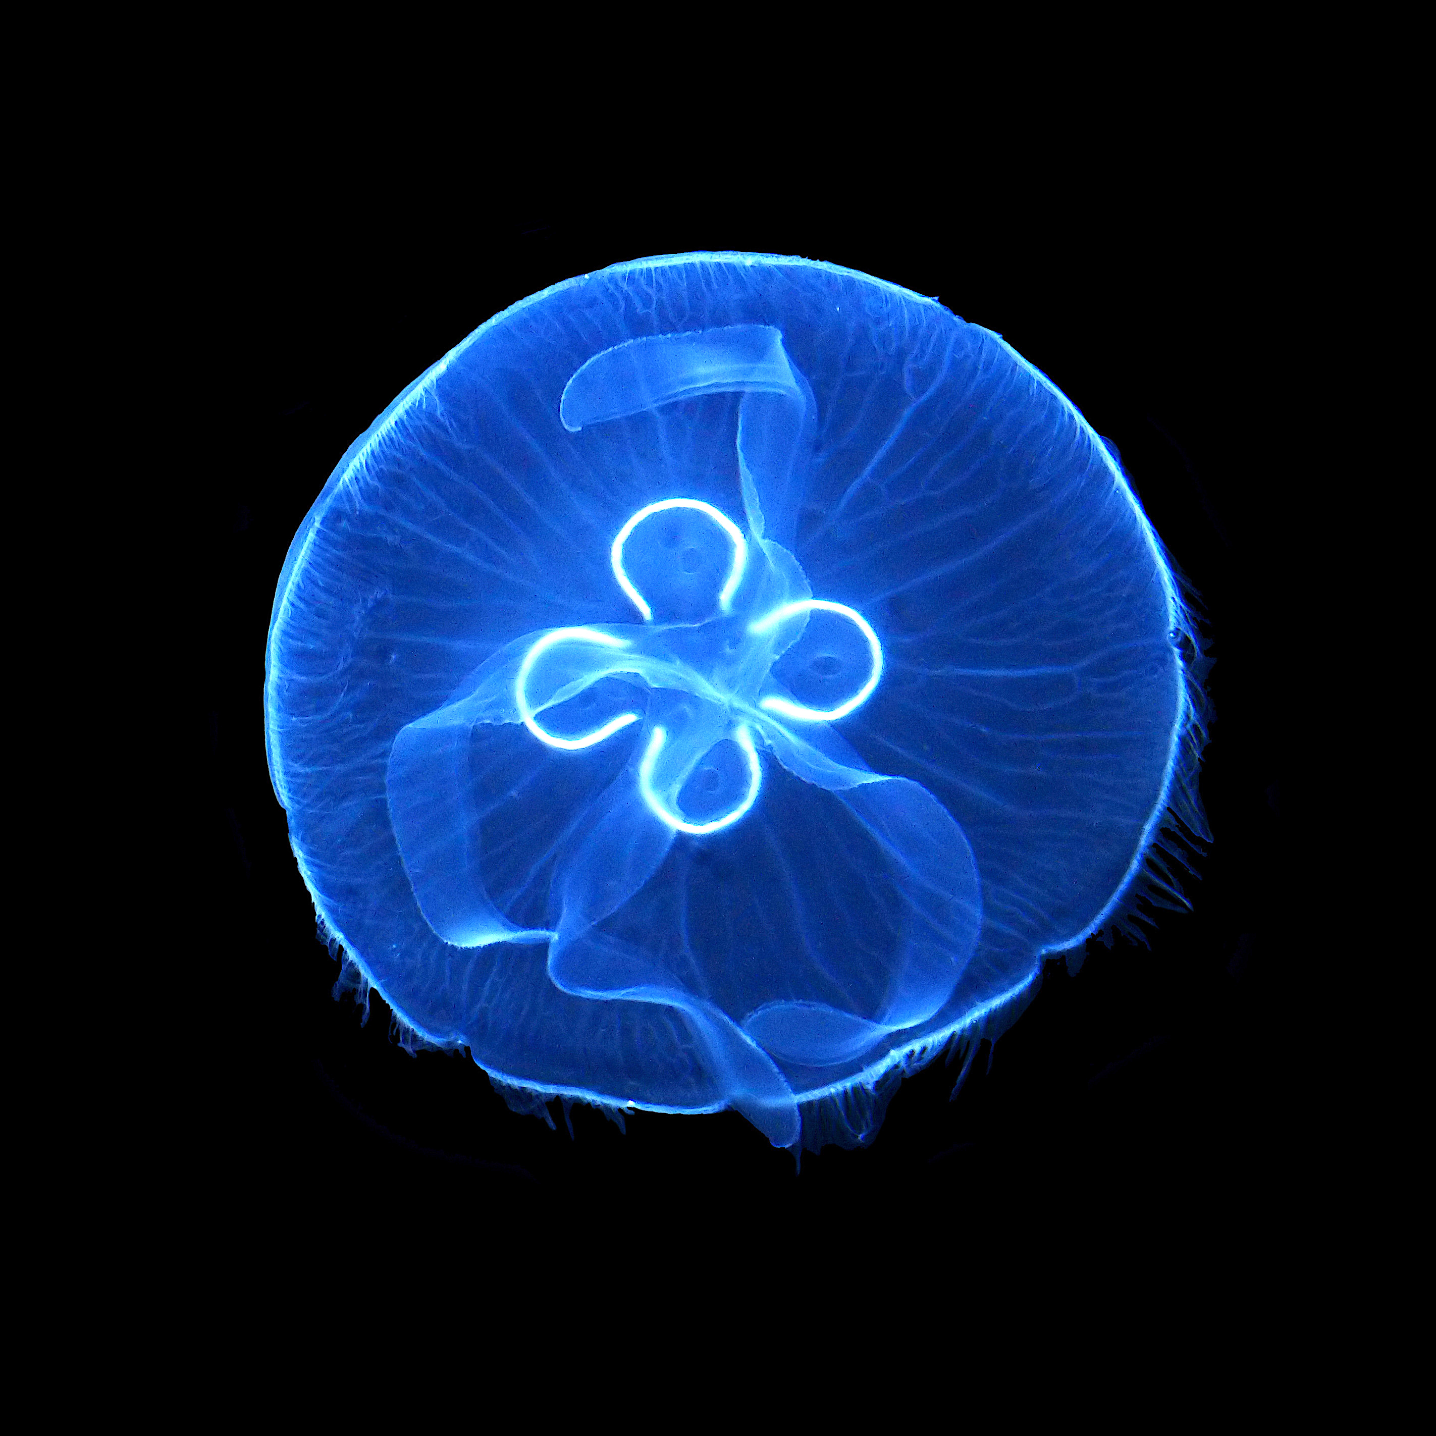
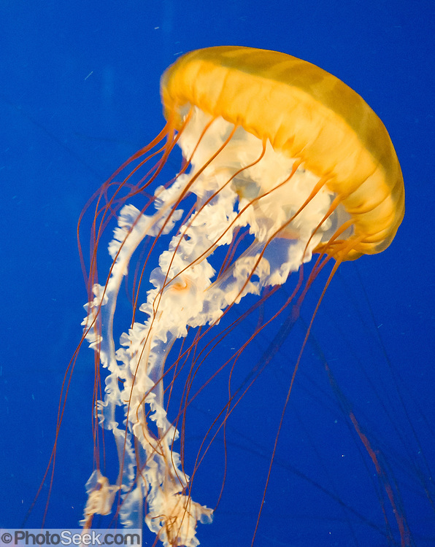
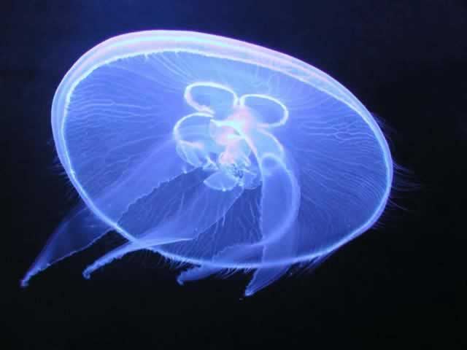
Cnidarian Classification
Class Scyphozoa
Sea jellies or “true” jellies
All are marine
Polyp stage reduced or absent
Medusa stage is free living

Slide 12
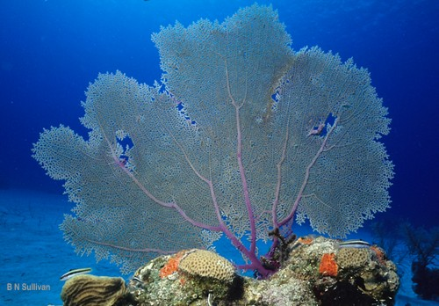
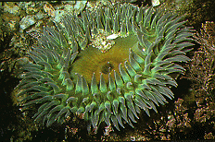
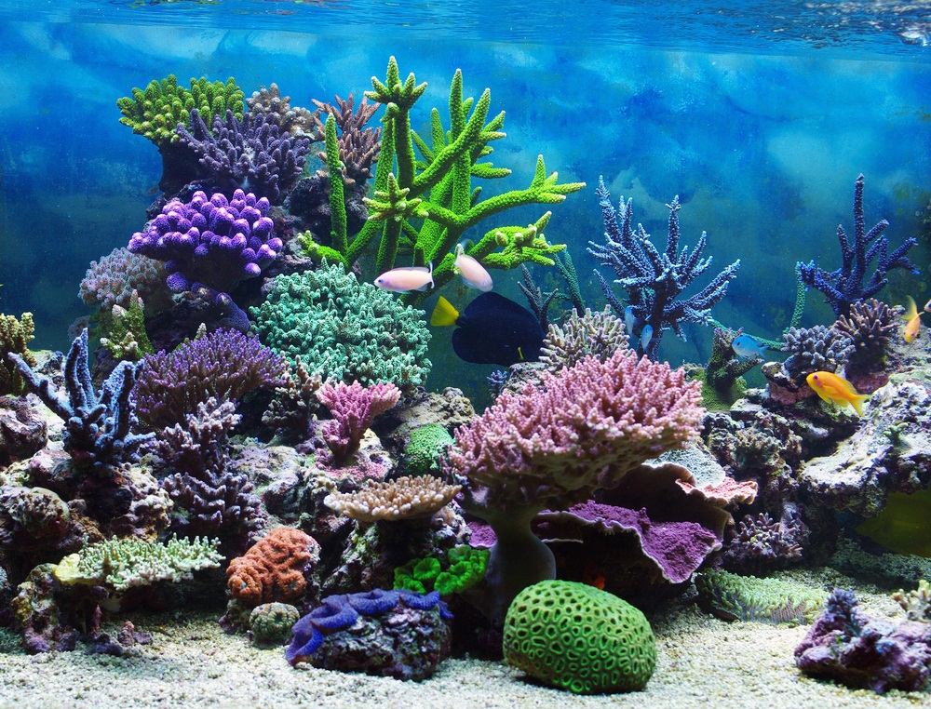
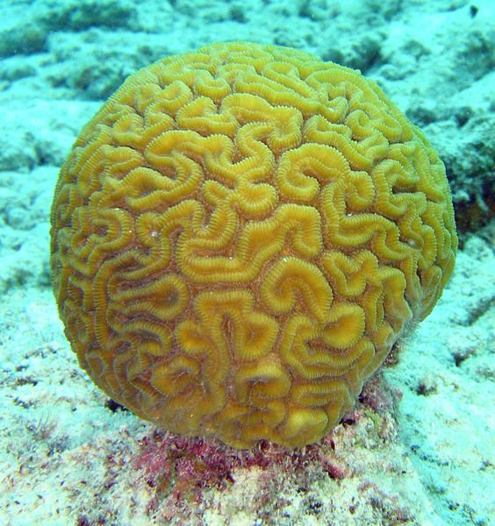
Cnidarian Classification
Class Anthozoa
Corals and anemones
All marine
Polyp stage dominant
No medusa stage
Calcium carbonate external skeleton
Symbiotic relationship with zooxanthellae

Slide 13
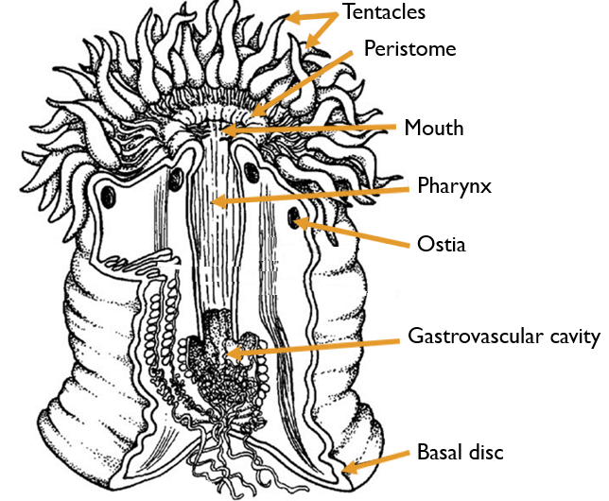
Anthozoan Anatomy
Peristome: the space between the tentacle and the mouth
Ostia: small openings where water enters
Basal disc: structure where the anemone attaches to the substrate

Slide 14
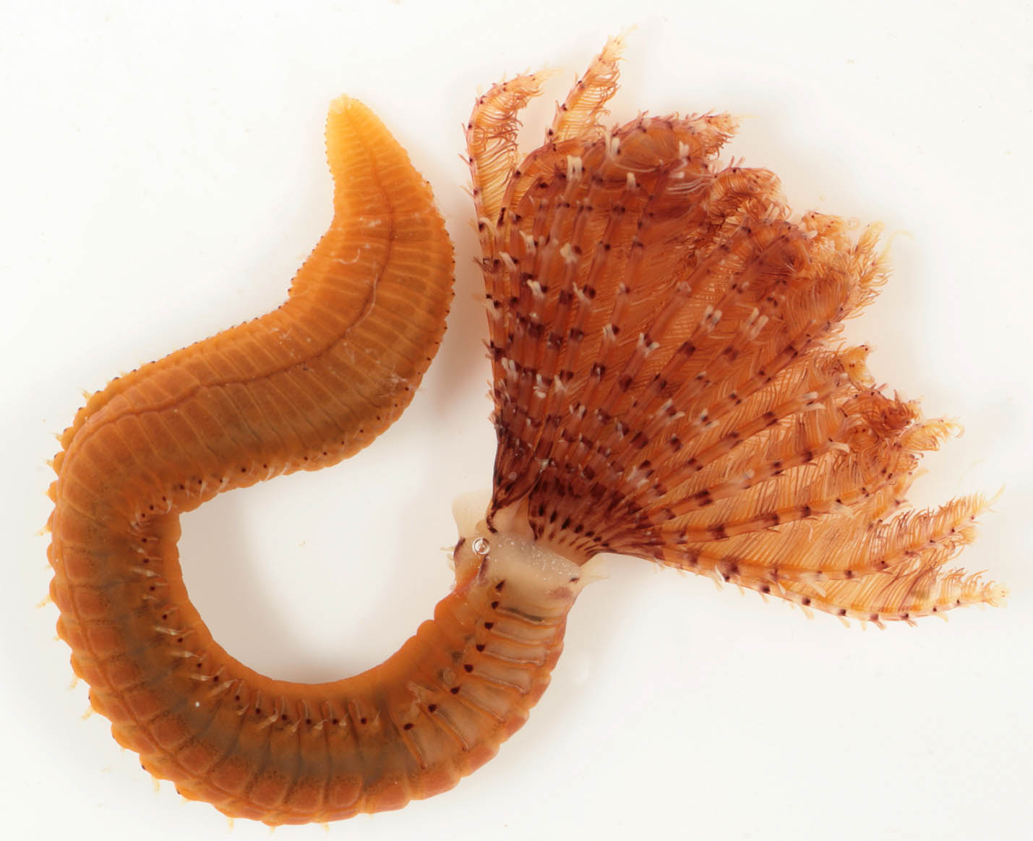
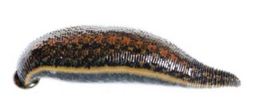
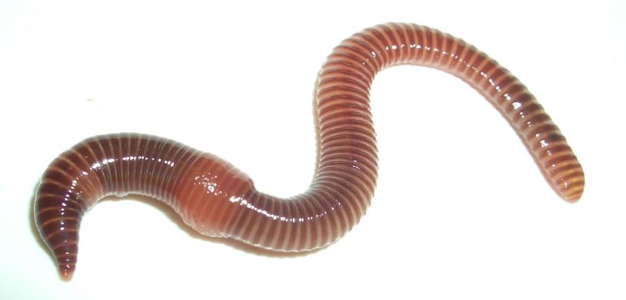
Phylum Annelida
Soft, segmented worms
~ 15,000 species
Marine, freshwater and terrestrial
Hydrostatic skeleton
Notes:
Annelid means “little rings” in reference to their segmented bodies

Slide 15
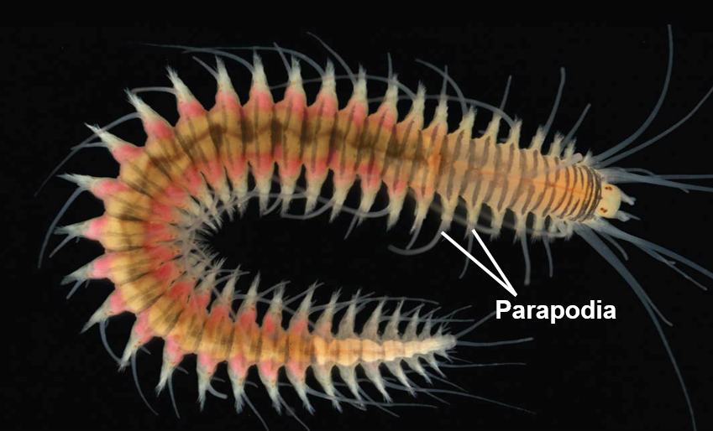
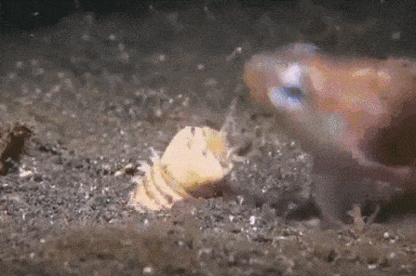
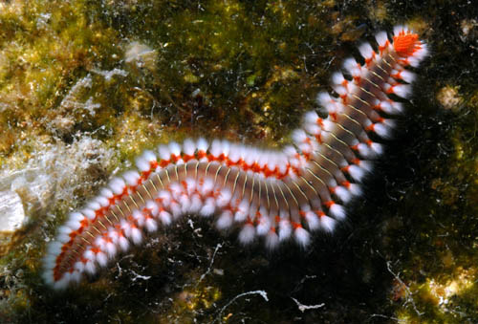
Phylum Annelida, Class Polychaete
Mostly mobile species
Mostly marine
Well developed head and jaws
Sensory organs
Predators and grazers
Parapodia
Setae
Setae
Notes:
Cheatae also setae

Slide 16
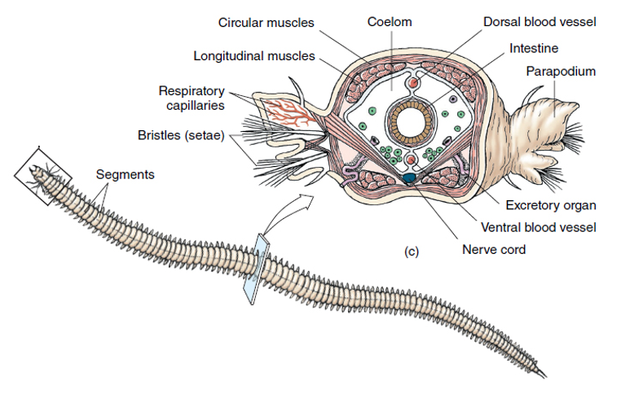
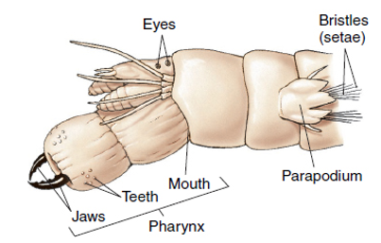
Phylum Annelida, Class Polychaete

Slide 17
Phylum Annelida, Class Polychaete
Parapodia: paired, unjointed outgrowths that bear chaeta, often used in locomotion
Parapodia on each body segment serve as gills, as well as a means of locomotion
Setae: stiff bristles made of chitin on the body
Segments
Bristles
(setae)
Eyes
Tentacles
Mouth
Parapodium
Teeth
Jaws
Pharynx

Slide 18
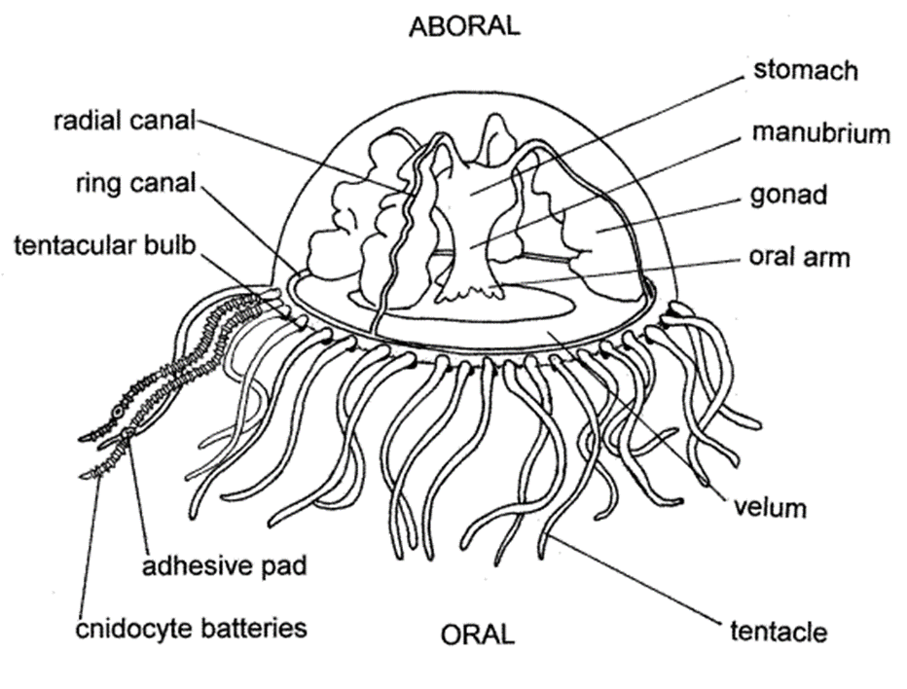
Gonionemus Medusa Anatomy
Aboral
Gastrovascular cavity
Radial canal
Manubrium
Ring canal
Gonad
Mouth
Velum
Oral
Tentacle

Slide 19
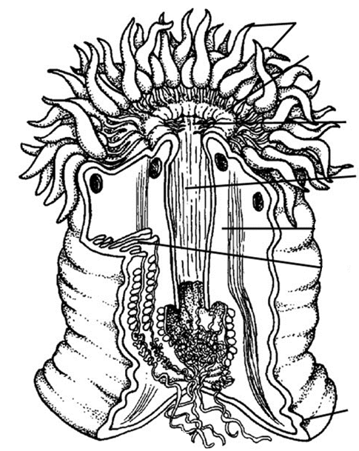
Tentacles
Peristome
Mouth
Pharynx
Ostia
Gastrovascular cavity
Basal disc

