Slide 1


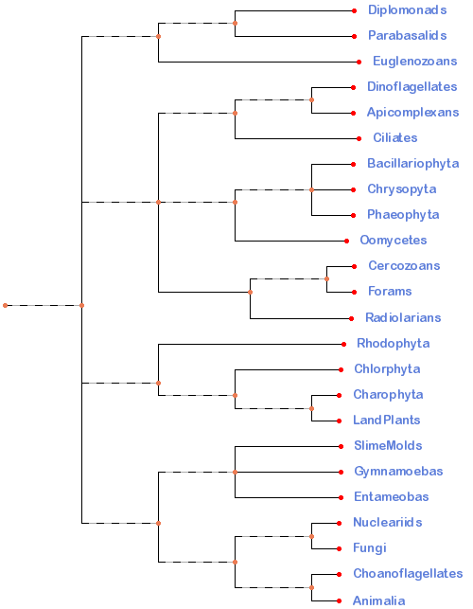
Protista Classification
Excavata
The kingdom Protista (in the five kingdom system) contains mostly unicellular eukaryotes. This taxonomic grouping is polyphyletic and based only on cellular structure and life styles not on any molecular evidence. Using molecular biology and detailed comparison of cell structure, scientists are now beginning to see evolutionary history in the protists. The ongoing changes in the protest phylogeny are rapidly changing with each new piece of evidence. The following classification suggests 4 “supergroups” within the original Protista kingdom and the taxonomy is still being worked out. This lab is looking at one current hypothesis shown on the right. Some of the organisms are grouped together because of very strong support and others are controversial. It is important to focus on the characteristics of each clade which explains why they are grouped together. This lab will only look at the groups that were once included in the Protista kingdom and the other groups (higher plants, fungi, and animals) will be examined in future labs.
Alveolates
SAR
Stramenopila
Rhizaria
Archaeplastida
Amoebozoans
Unikonta
Opisthokonts

Slide 2
Protista Classification
Excavata
Starting with the four “Supergroups”, we will divide the rest into different levels called clades. A Clade is defined as a group of biological taxa (as species) that includes all descendants of one common ancestor. Too simplify this process, we have included a cladogram we will be using throughout the course. We will divide or expand parts of the cladogram to emphasize evolutionary relationships. For the protists, we will divide the supergroups into smaller clades assigning them artificial numbers (clade1, clade2, clade3) to establish a grouping at a specific level.
Alveolates
SAR
Stramenopila
Rhizaria
Archaeplastida
Amoebozoans
Unikonta
Opisthokonts

Slide 3
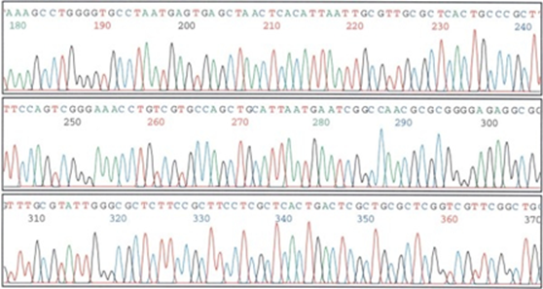
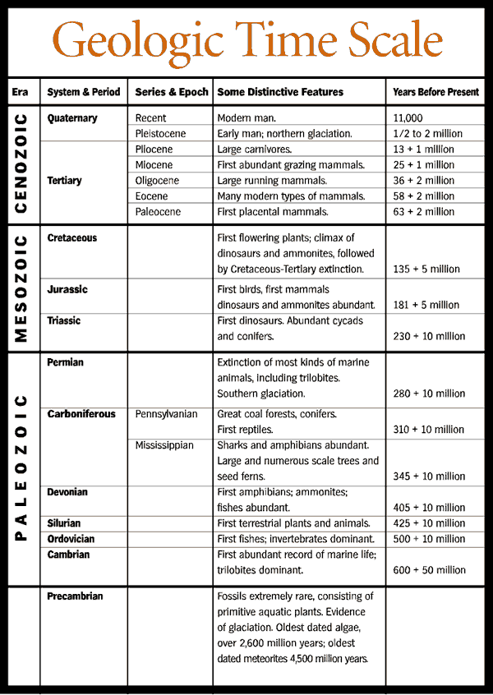
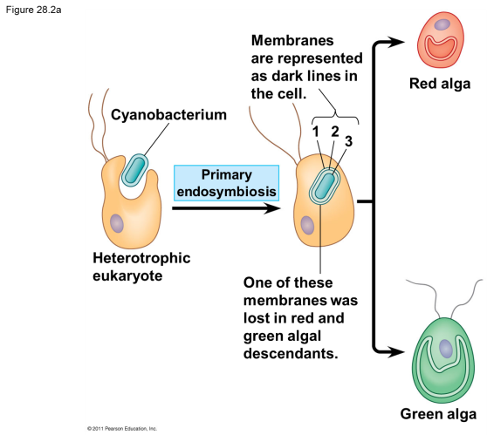
Supergroup: Archaeplastida
General Characteristics and structures – The members of this supergroup have similar DNA sequences and cell structure (The plastids are endosymbiotic cyanobacteria).
Natural History –Evidence suggests this supergroup evolved over a billion years ago with the incorporation of plastids from a cyanobacteria.
Biogeography – The Archaeplastida contain the red algae, green algae, and the higher plants.

Slide 4

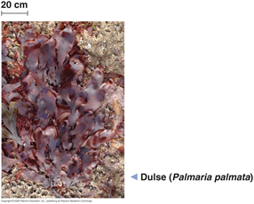
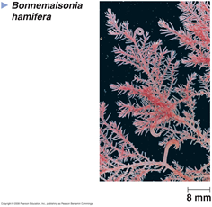
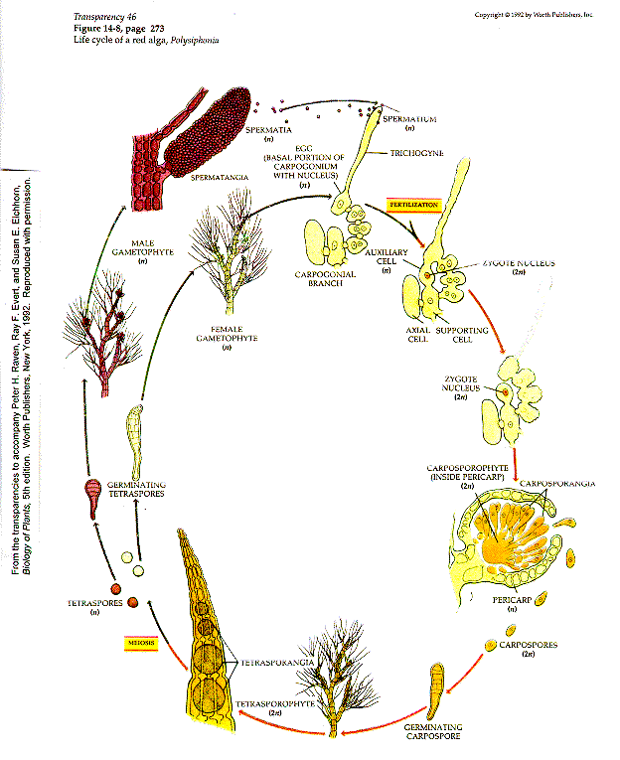
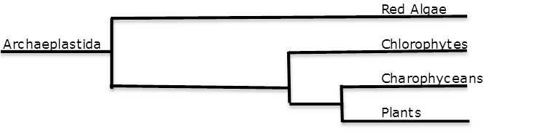
Supergroup: Archaeplastida
Clade₂: Red Algae
General Characteristics and structures – This clade includes 6000 known species that are reddish in color (pigment: phycoerythrin) which hides the green chlorophyll color. The red pigment allows them to absorb green and blue wavelengths of light that penetrate relatively far into the water. Their life cycle lacks a flagellated stage.
Biogeography – The red algae are the most abundant large algae in the warm coastal waters of tropical oceans.
Unique Characteristics – They are eaten as “nori”, the wrap around sushi. In the red algae life cycle, the structure most people identify as “algae” is either a structure that is haploid (n) or tetraploid (4n).

Slide 5
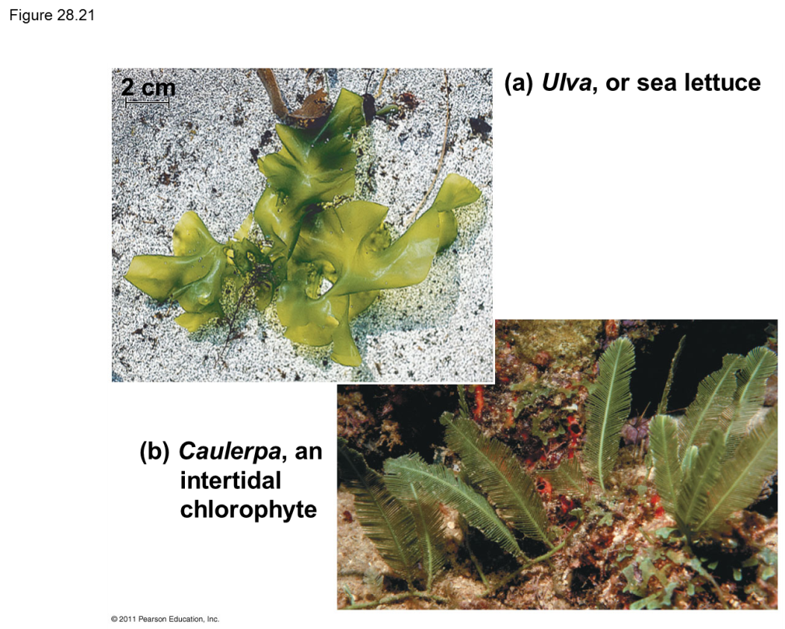
Supergroup: Archaeplastida
Clade₂: Chlorophytes
General Characteristics and structures – This clade includes species that are similar to higher plants in color (pigment: Chlorophyll A and B and carotenoids). They are so similar to plants that some want to include them in a kingdom with plants called Virdiplantae.
Biogeography – The Chlorophytes are found in marine, freshwater and terrestrial ecosystems and are even found in snow.
Unique Characteristics – They are one of two groups (along with the Charophytes) that are commonly called green algae.

Slide 6
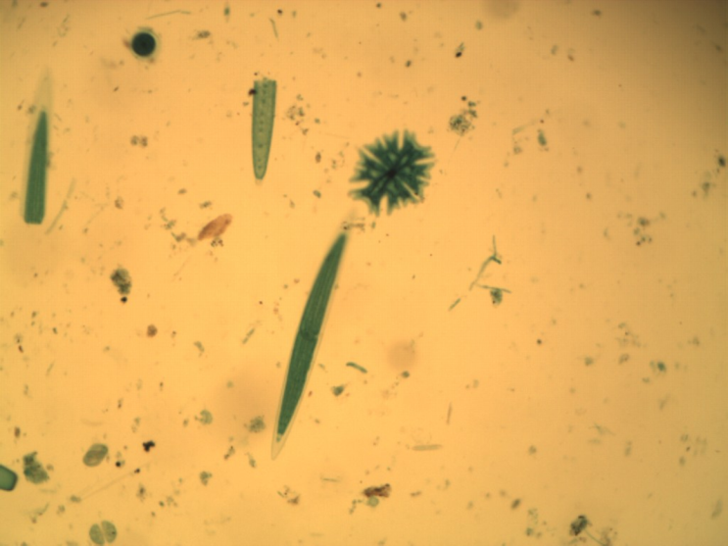
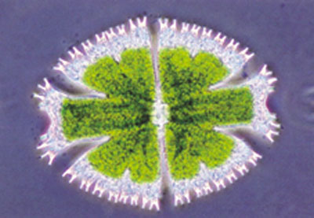
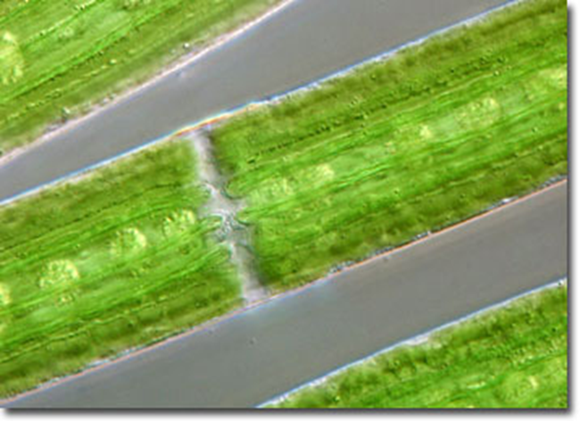
Supergroup: Archaeplastida
Clade₂: Chlorophytes
Ex. Desmids
General Characteristics - A group of chlorophytes, that are usually unicellular with an isthmus between its two halves.
Unique Characteristics – Within the isthmus, you will find the nucleus. In the two halves, you will find the chloroplasts.
Habitat - They are a very common alga found floating in fresh water.

Slide 7
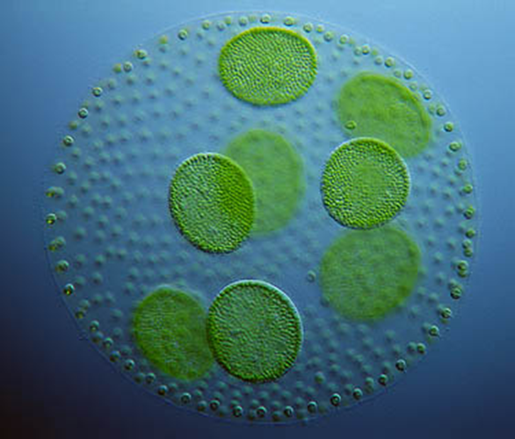
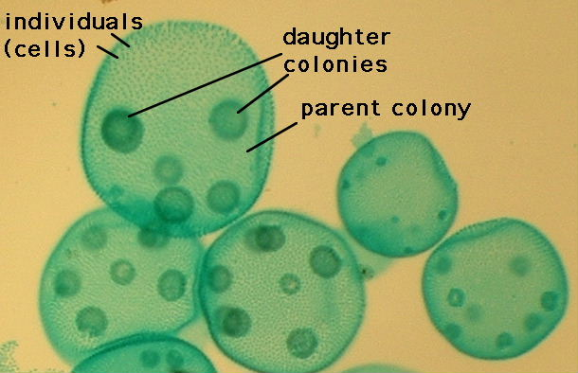
Supergroup: Archaeplastida
Clade₂: Chlorophytes
Ex. Volvox
General Characteristics - A group of chlorophytes that are a colonial species which consists of hundreds to thousands of vegetative cells arranged in a single, spherical layer held together by a gelatinous secretion and joined together by protoplasmic strands.
Unique Characteristics –. Reproduction may occur by binary fission where daughter colonies are formed.
Habitat -Volvox is a freshwater alga and is found in ponds and ditches, even in shallow puddles

Slide 8
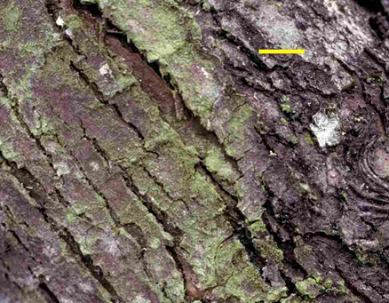
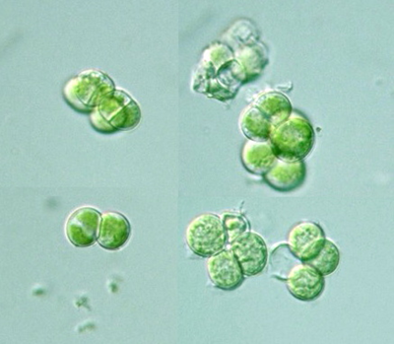
Supergroup: Archaeplastida
Clade₂: Chlorophytes
Ex. Protococcus
General Characteristics - A group of chlorophytes that are either unicellular are found in small colonies.
Unique Characteristics –. One of the terrestrial alga that is often confused with mosses.
Habitat -It is found as a thin, green covering on the moist, shaded side of trees, rocks, and soil.

Slide 9
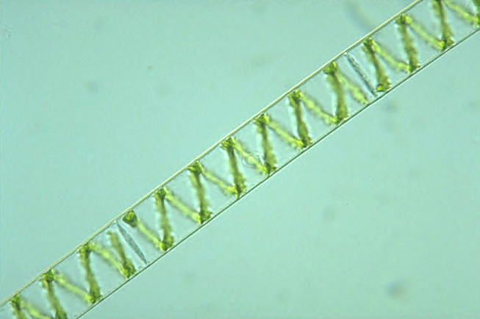
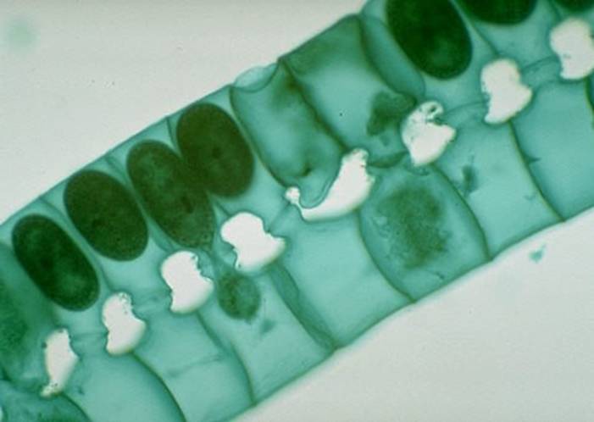
Supergroup: Archaeplastida
Clade₂: Chlorophytes
Ex. Spirogyra
General Characteristics - A group of chlorophytes that occur in multicellular filaments. The Chloroplasts are found in ribbon-like strands, which spiral through the cells. The nucleus is usually found near the center of the cell.
Unique Characteristics – Spirogyra can reproduce asexually or sexually. Asexually, they reproduce by fragmentation usually due to high winds. Sexually, they can reproduce through the process of conjugation. Two haploid filaments under certain conditions will form. The male and female gametes are identical in size and are called isogametes. The male gamete can be recognized because it travels across the conjugation tube to combine with the female gamete and form a diploid zygospore. New filaments are made when the zygospore goes through meiosis and produces new filaments.
Habitat -It is found in freshwater ponds.

Slide 10
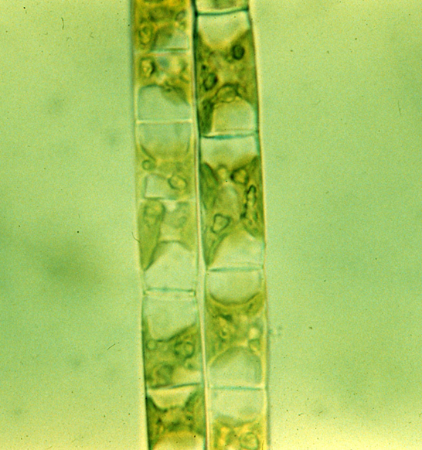
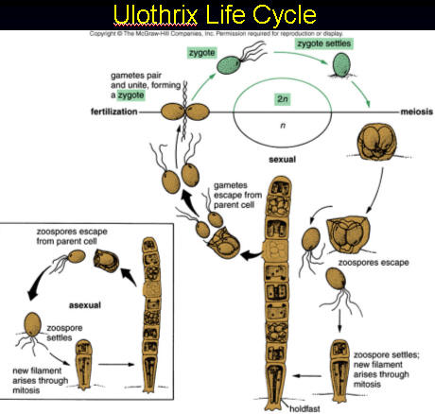
Supergroup: Archaeplastida
Clade₂: Chlorophytes
Ex. Ulothrix
General Characteristics - A group of chlorophytes that occur in multicellular filaments. They have a single bracelet-like chloroplast in each cell. The structure that most people identify as alga (the filaments) are haploid.
Unique Characteristics – Ulothrix is of interest because it has developed a holdfast, which is a clear example of specialization. The holdfast is often hard to find on prepared slides.
Habitat –Ulothrix is found in fresh water and marine environments and thrive in spring and winter in cool temperatures.

Slide 11
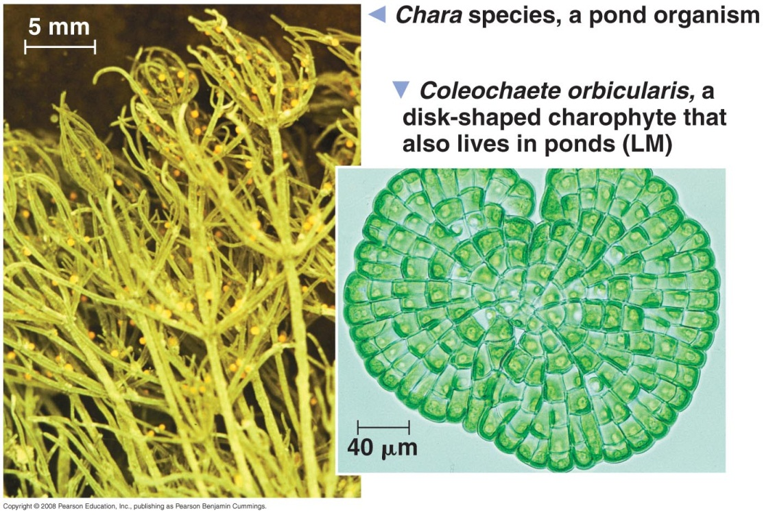
Supergroup: Archeplastida
Clade₂: Charophytes
General Characteristics and structures – This clade includes species that are similar to higher plants in color (pigment: Chlorophyll A and B and carotenoids). They are the closest relatives of land plants.
Biogeography – The Charophytes are found in ponds and lakes with the ancestors of higher plants living on the edge and were subject to occasional drying.
Unique Characteristics – They are one of two groups (along with the Chlorophytes) that are commonly called green algae. They have four distinctive traits that are shared with higher plants:
  Rings of cellulose-synthesizing proteins
  Peroxisome enzymes
  Structure of flagellated sperm
  Formation of a phragmoplast

Slide 12
Supergroup: Unikonta
General Characteristics and structures – The members of this supergroup either include a single flagella (in those species that have one) and the fusion of three genes or have lobed or tube-shaped pseudopodia.
Natural History –Evidence suggests this supergroup might have been the first group of eukaryotes to evolve from other eukaryotes.
Biogeography – The Unikonta include two distinct clades: 1) The Amoebozoans and 2) the Opisthokonts

Slide 13
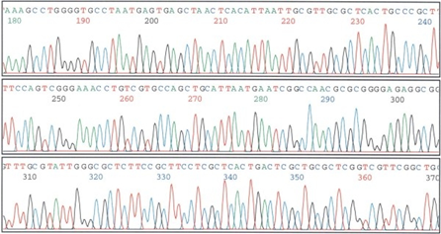
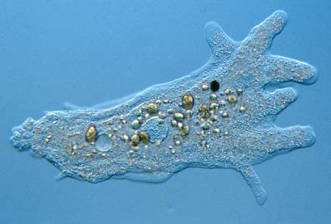
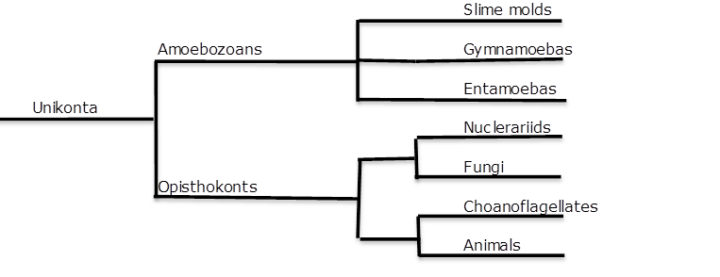
Supergroup: Unikonta
Clade₁: Amoebozoans
General Characteristics and structures – This clade is well supported by DNA evidence. These clades have lobe or tube-shaped pseudopodia.
Biogeography – The Amoebozoans include three different clades: 1) the Slime molds, 2) the Gymnamoebas, and 3) the Entamoebas.

Slide 14
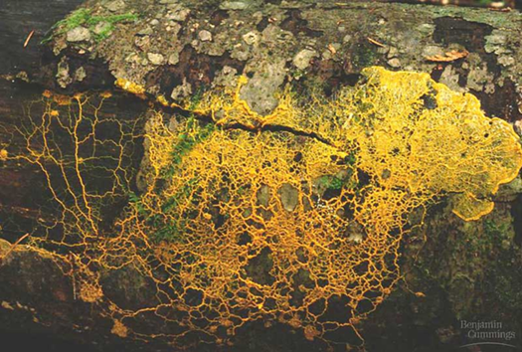
Supergroup: Unikonta
Clade₁: Amoebozoans Clade₂: Slime Molds
General Characteristics and structures – This clade includes species that were once thought to be fungi because they possess hyphae and their fruiting bodies. Molecular evidence suggests that they are Amoebozoans.
Biogeography – The Slime molds include more than 900 species and occur all over the world and feed on microorganisms that live in any type of dead plant material. They contribute to the decomposition of dead vegetation, and feed on bacteria, yeasts, and fungi. For this reason, these organisms are usually found in soil, lawns, and on the forest floor, commonly on decomposing logs.
Unique Characteristics – They are divided into two groups distinguished by their unique life cycles: the Plasmodial Slime Molds and the Cellular Slime Molds.

Slide 15
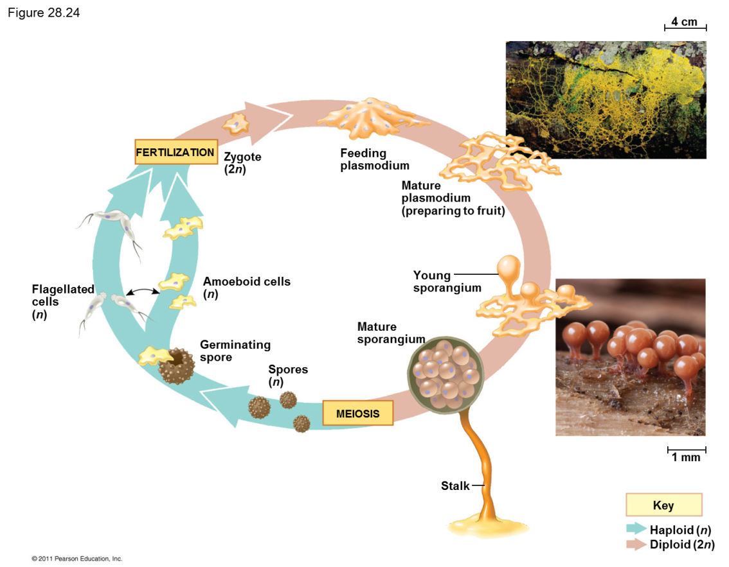
Supergroup: Unikonta
Clade₁: Amoebozoans
Clade₂: Slime Molds
Clade₃: Plasmodial Slime Molds
General Characteristics and structures – They are brightly colored (yellow or orange) and have hyphae that are multinucleated (Coenocytic)
Biogeography – These organisms are usually found in soil, lawns, and on the forest floor, commonly on decomposing logs.
Unique Characteristics - They form a plasmodium for feeding and reproduction.

Slide 16
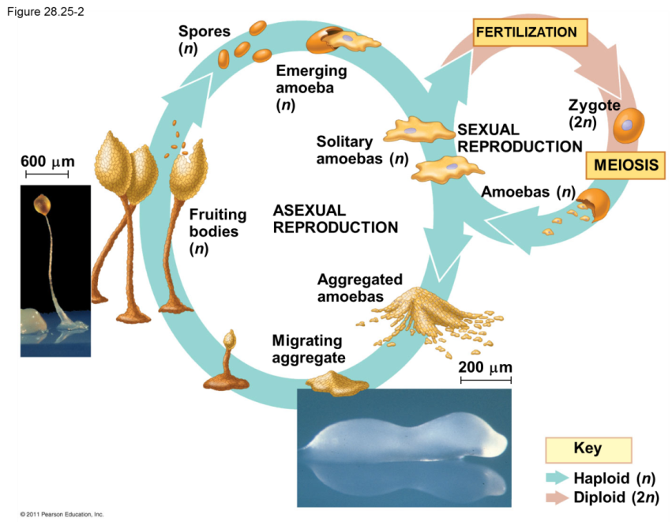
Supergroup: Unikonta
Clade₁: Amoebozoans
Clade₂: Slime Molds
Clade₃: Cellular Slime Molds
General Characteristics and structures – They are usually clear and have hyphae that are mono-nucleated (Septate).
Biogeography – These organisms are usually crawl through dung, soil, rotting mushrooms, decaying leaves and other organic material.
Unique Characteristics - They form a plasmodium during stress and reproduction.

Slide 17
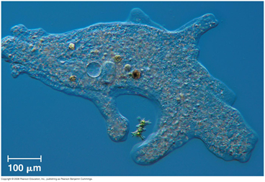
Supergroup: Unikonta
Clade₁: Amoebozoans Clade₂: Gymnamoebas
General Characteristics and structures – This clade includes species that have broad pseudopods and usually lack a test.
Biogeography – The Gymnamoebas are found in soil, fresh water, and marine environments.
Unique Characteristics – The majority of amoeba are free living heterotrophs but some feed on detritus (non-living organic material).

Slide 18
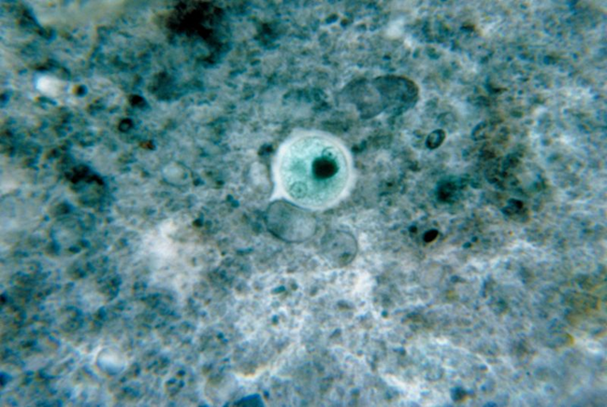
Supergroup: Unikonta
Clade₁: Amoebozoans Clade₂: Entamoebas
General Characteristics and structures – This clade includes amoeba species that are parasitic.
Biogeography – The Entamoebas infect all classes of vertebrate animals along with some invertebrates.
Unique Characteristics – There are six different species that infect humans. The only species that is known to be pathogenic is Entamoeba histolytica. Infection causes amebic dysentery and is spread from contaminated food and water. It is responsible for up to 100,000 deaths every year.

Slide 19
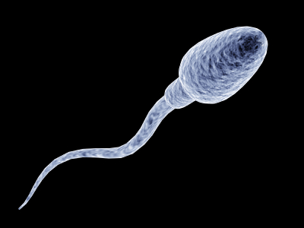
Supergroup: Unikonta
Clade₁: Opisthokonts
General Characteristics and structures – This clade is a very diverse group . One common characteristic of Opisthokonts is the flagellate cells, such as most animal sperm and chytrid spores, propel themselves with a single posterior flagellum.
Biogeography – The Opisthokonts include four different clades: 1) Nucleariids, 2) the Fungi, 3) the Choanoflagellates and the 4) the Animals.

Slide 20
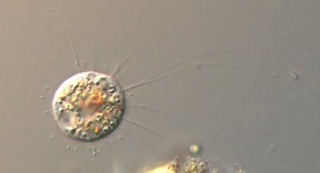
Supergroup: Unikonta
Clade₁: Opisthokonts Clade₂: Nucleariids
General Characteristics and structures – This clade lacks distinctive characters but it does include amoeboid species that contain a posterior flagella.
Biogeography – The Nucleariids are known from soil and freshwater.
Unique Characteristics – They form temporary pseudopods for feeding and locomotion.

Slide 21
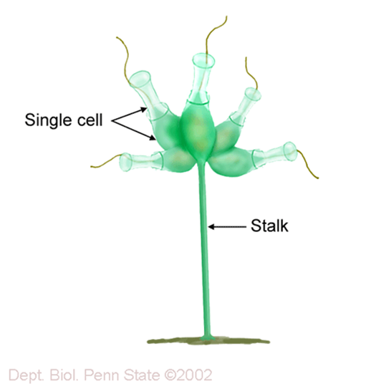
Supergroup: Unikonta
Clade₁: Opisthokonts
Clade₂: Choanoflagellates
General Characteristics and structures – This clade consists of organisms that are free-living unicellular and colonial flagellated eukaryotes. There make up is very similar to the collar cells (choanocytes) seen in sponges.
Biogeography – There are over 125 extant species of choanoflagellates distributed globally in marine, brackish and freshwater environments from the Arctic to the tropics, occupying both pelagic and benthic zones.
Unique Characteristics – DNA evidence has confirmed that this clade is the sister group to the animal kingdom.

Slide 22
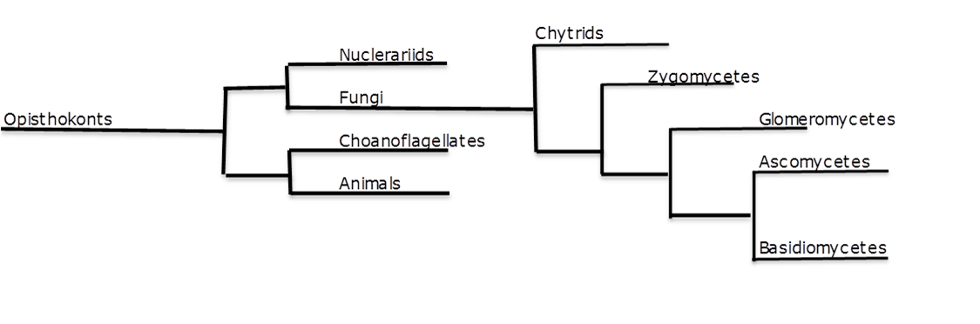
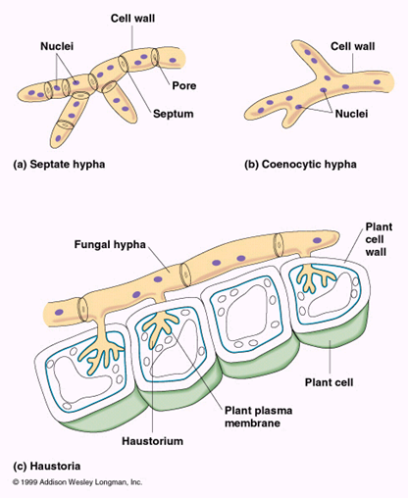
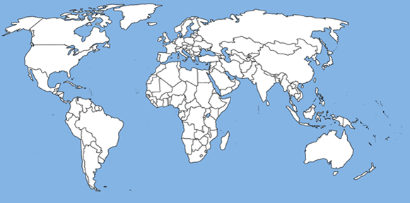

Fungi Classification
General Characteristics and structures – These organisms are all multicellular eukaryotes that are heterotrophs and acquire their nutrients by absorption. Foods are digested outside the organism by enzymes released by the fungi and then the nutrients are absorbed. Lacking chlorophyll, these organisms are entirely dependent upon organic matter. Most fungi derive their nutrients from dead organic compounds (saprobes or decomposers), but some draw their nourishment from living plant or animal material (parasites). They are made of tiny filaments called hyphae which have cell walls consisting of Chitin.
Natural History – Fungi belong to the Supergroup Unikonta because of DNA comparisons and posterior flagella. The first fungi organism appears in the fossil record about 460 million years ago during the Ordovician. It is believed that the first fungi was probably a flagellated ancestor that diverged from animals about 1 billion years ago according to molecular clock data. It is believed the microscope ancestors of terrestrial fungi did not fossilize well.
Biogeography – The distribution of fungi is worldwide; as a group, are found in almost every terrestrial and aquatic habitat. There are 100,000 described species and it is believe that there are as many as 1.5 million species of fungi.

Slide 23
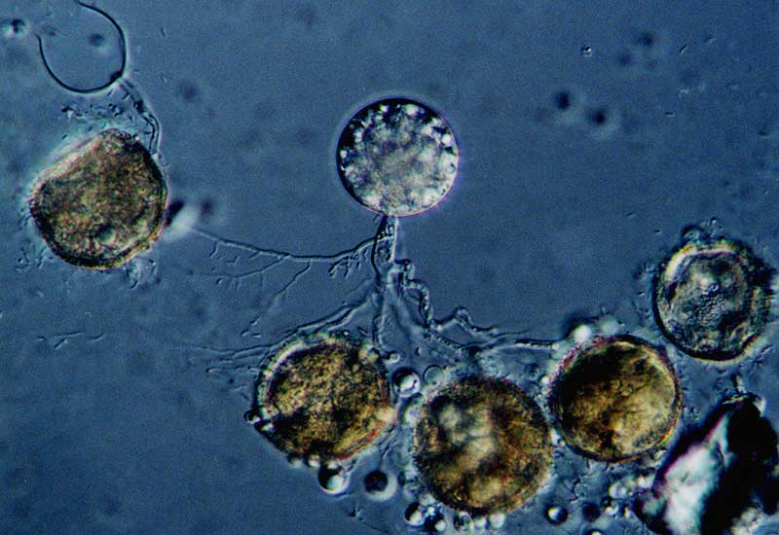
Kingdom: Fungi
Division: Chytridiomycota
General Characteristics and structures – Coenocytic hyphae (no cross walls) or may be unicellular
Biogeography – They are ubiquitous in lakes and soil.
Unique Characteristics – These fungi have both protista and fungi characteristics.
Uniflagellated cells
(Protist characteristic)
Cell Wall made of Chitin
Absorptive mode of eating
(Fungi characteristic)

Slide 24
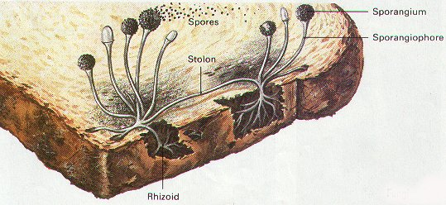
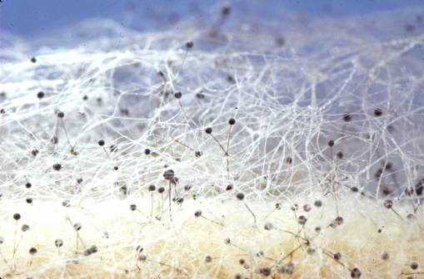
Kingdom: Fungi
Division: Zygomycota
Example:
Rhizopus nigercans
General Characteristics and structures – This group includes the molds that grow on food such as Black Bread Mold. They have Coenocytic hyphae (no cell walls).
Biogeography - They are typically fast growing molds found on bread, peaches, strawberries and sweet potatoes.
Unique Characteristics - Observe the petri dish and slant of the living culture Rhizopus growing on agar. The white hairs are the haploid hyphae that make up the mycelium. The hyphae that travel horizontally are called stolons and the hyphae that are vertical are called rhizoids.

Slide 25
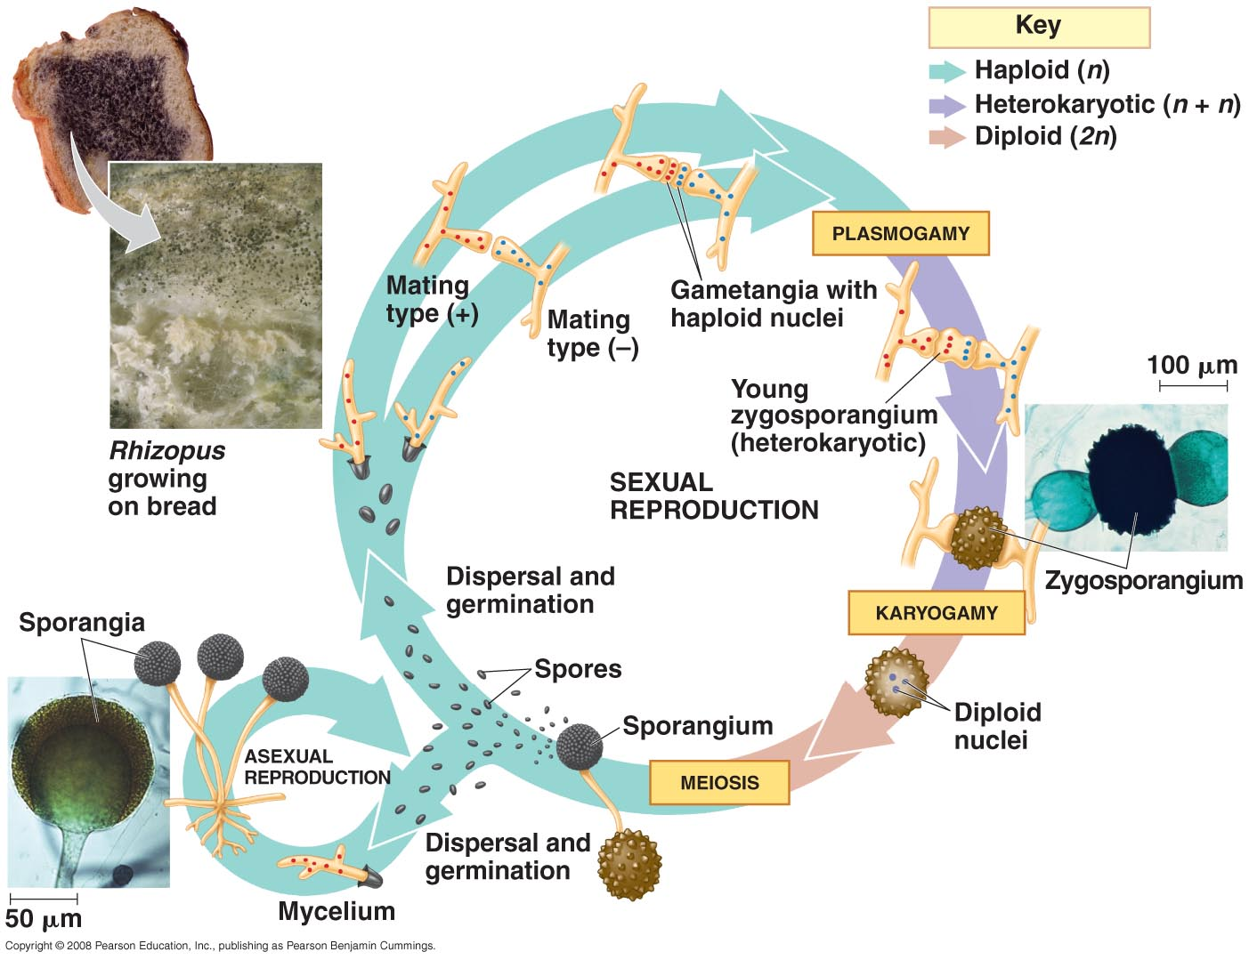

Slide 26
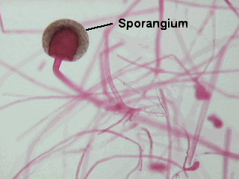
Kingdom: Fungi
Division: Zygomycota
Asexual Reproduction
The long hairs under the scope are the hyphae that make up the mycelium. The mycelium can form sporangium, containing the asexually produced spores. The special hyphae bearing the sporangia are called sporangiophores.

Slide 27
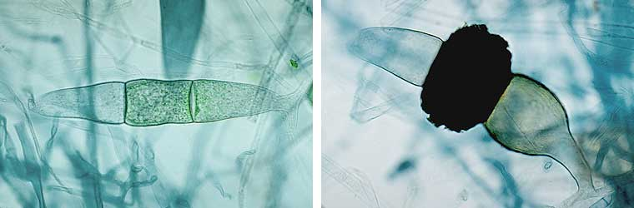
Kingdom: Fungi
Division: Zygomycota
Sexual Reproduction
Genetic recombination is by the process of conjugation which occurs when two strains grow close together. Each mycelium grows projections, called progametes. The cytoplasm of the two strains will fuse by a process called plasmogamy. At this point, the haploid nuclei pair off and the cell is said to be dikaryotic. The cell develops a rough, thick wall tha can protect the nucleus from harsh conditions. This structure is called a zygospore which than can go through karyogamy to form a diploid cell.

Slide 28
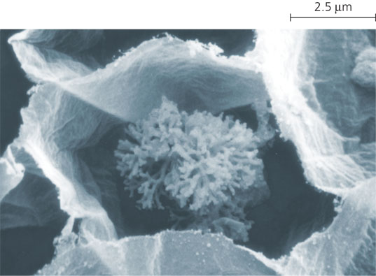
Kingdom: Fungi
Division: Glomeromycetes
General Characteristics and Structures - Coenocytic hyphae with mutualistic relationships with plant roots.
Biogeography - These fungi are called arbuscular mycorrhizae. The tips of the hyphae enter the plant roots and branch into tiny treelike structures called arbuscules.
Unique Characteristics - This division was formerly included in the zygomycetes but genetic evidence supports these should belong to a separate clade. Although there are only 160 species, they have a symbiotic association with 90% of all plant.

Slide 29
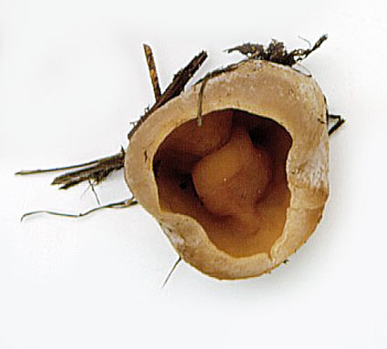
Kingdom: Fungi
Division: Ascomycota
General Characteristics and Structures – These fungi are called Sac Fungi and include yeast, truffles, Dutch Elm disease and some mold. These fungi include Septate hypae (cross walls) and reproduce with Asci.
Biogeography - They are found in marine, freshwater and terrestrial habitats.
Unique Characteristics - The mushroom is this division is called an ascocarp.
Example: Peziza

Slide 30
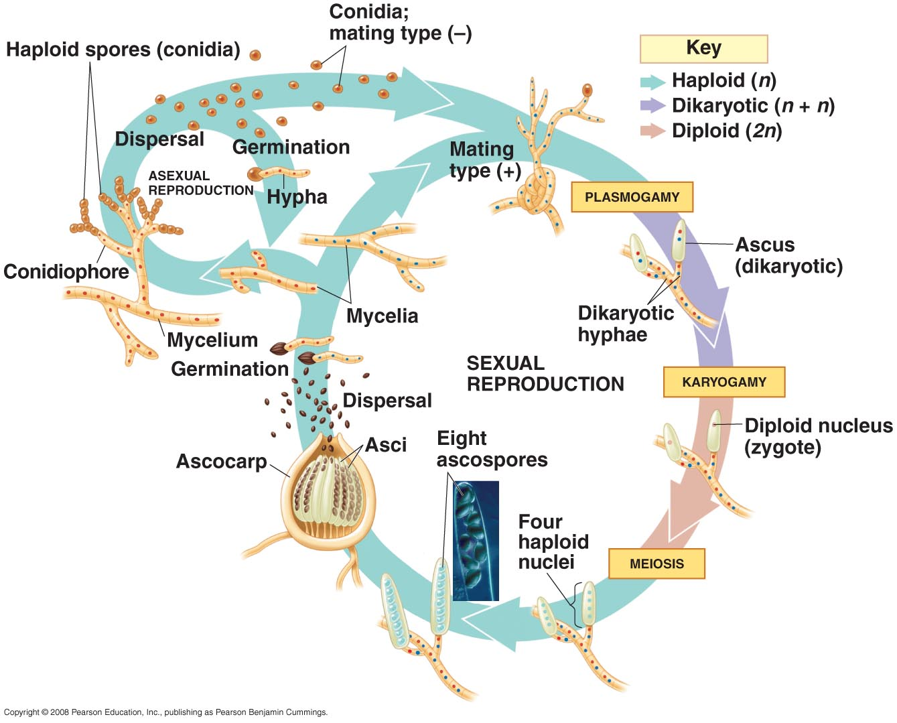

Slide 31
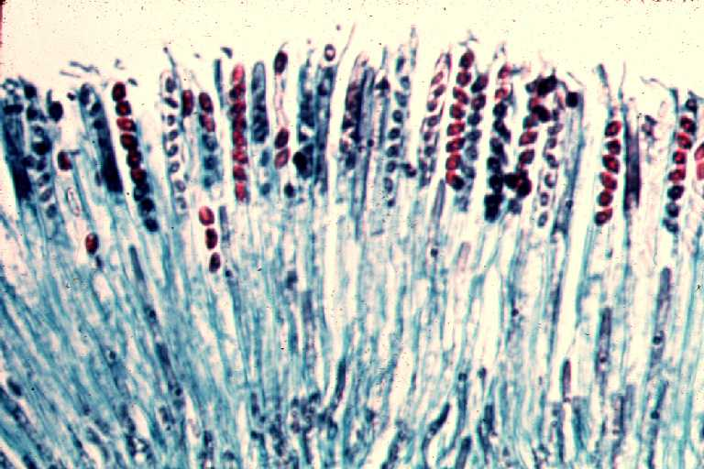
Kingdom: Fungi
Division: Ascomycota
Sexual Reproduction:
The fruiting structure called an ascocarp is the result of sexual reproduction. The tips of the hyphae produce elongated sacs called asci. Within the asci, karyogamy occurs which produces a diploid nucleus. This nucleus divides by meiosis to create 4 haploid nuclei. The nuclei divide again by mitosis to form 8 haploid nuclei called ascospores. All the asci together are called the hymenial layer. Examine a prepared slide of Peziza, which shows a longitudinal cross section through the ascocarp.

Slide 32
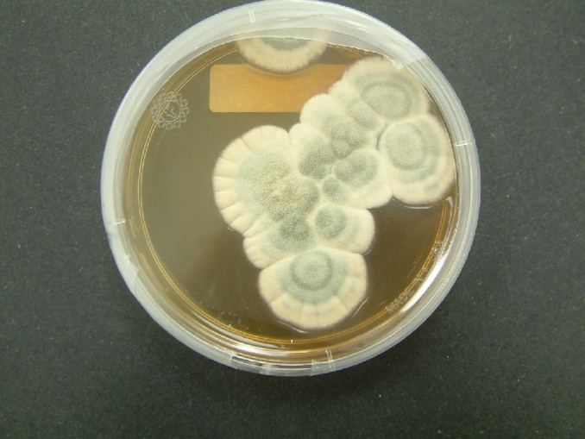
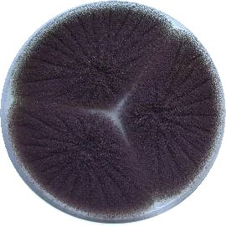
Kingdom: Fungi
Division: Ascomycetes
Two examples of imperfect fungi are Penicillum notatum, which is used make the antibiotic penicillin, and Aspergillus niger, which is used to flavor foods. Examine living cultures of Penicillum notatum and Aspergillus niger. Note the coloring and texture of each culture. They were once placed in the Division: Deuteromycota. These species are called imperfect fungi because they don’t have (or we haven’t found) a sexual stage. They are now considered to be in the division Ascomycetes because they reproduce asexually by means of conidia.

Slide 33
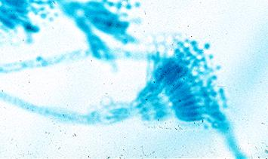
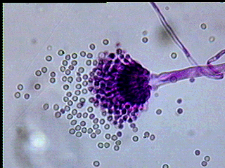
Kingdom: Fungi
Division: Ascomycetes
Ascomycetes reproduce asexually by conidia.. Looking at prepared slides of the spore-bearing condidophores which house conidia. Spores of Penicillum appear blue-green and resemble a “kitchen fork”. Spores of Aspergillus appear black and resemble an “afro” hair style.

Slide 34
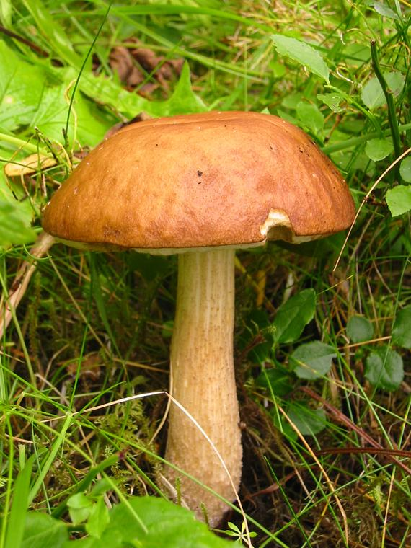
Kingdom: Fungi
Division: Basidiomycetes
General Characteristics and Structures – The common name of these fungi are Club fungi and they include mushrooms, toadstools, puffballs, smuts and rusts. They have Septate hyphae (cross walls) and Basidia
Biogeography – These fungi are terrestrial and are important decomposers of wood and other plant material.
Unique Characteristics – The mushroom of these fungi are called basidiocarps made up of dikaryotic hyphae. They basidiocarp have a cap, gills, stipe and annulus.

Slide 35


Slide 36

Kingdom: Fungi
Division: Basidiomycetes
Sexual Reproduction:
The fruiting structure called a basidiocarp is the result of fusion of haploid hyphae. The fusion of haploid hyphae produce dikaryotic hyphae which make up the basidiocarp. The tips of the hyphae produce club shaped basidia. Within the basidia, karyogamy occurs which produces a diploid nucleus. This nucleus divides by meiosis to create 4 haploid nuclei. The 4 haploid nuclei move into appendages at the end of the hyphae called basidiospores.

Slide 37

Kingdom: Fungi
Division: Basidiomycetes
Bird Nest Fungus
This fungus got its name because the fruiting bodies look like tiny egg filled nests. This group of fungi are saprobes found in cities growing in soil covered in wood chips or bark mulch. The “nests” are used as splash cups to allow spores to disperse when a rain drop hits the cup sending the spore up to one meter away.

Slide 38


Lichens
General Characteristics and structures - Lichens are actually a symbiotic relationship usually between a fungi and an algae. The fungal component is usually an ascomycota, but may be a basidiomycota. The fungus supplies moisture and shelter from high light intensity for the algae. The algae components are generally single-celled forms of green algae or cyanobacteria. The algae furnish food for the fungus. Lichens come in various colors and structures.

