Slide 1
The Cell, Plankton, and Microscopes
Lab 1

Slide 2
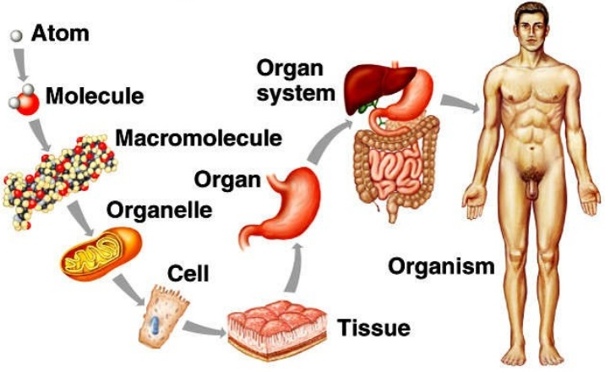
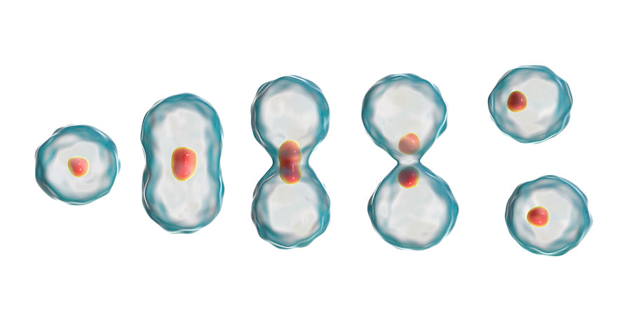
Cell Theory
All living organisms are composed of cells
Unicellular or multicellular
Cells come from existing cells
Notes:
Adult humans are comprised of at least 60 trillion cells, all of which came from one cell: the single fertilized egg.
Seven billion bacteria in your mouth right now.

Slide 3
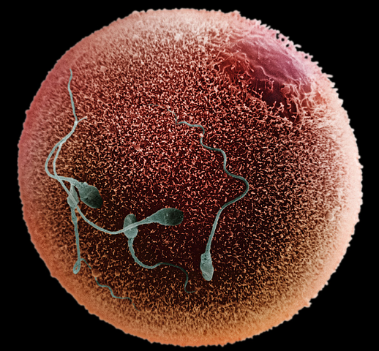
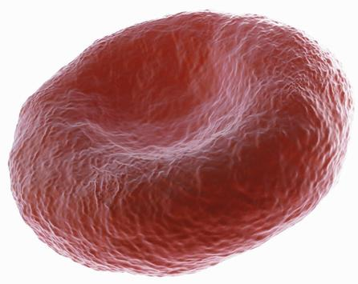
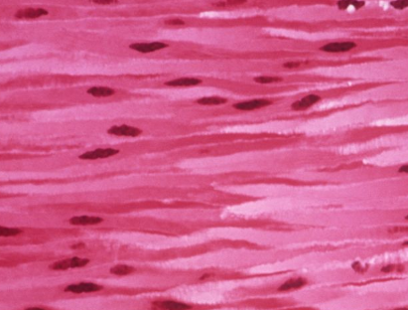
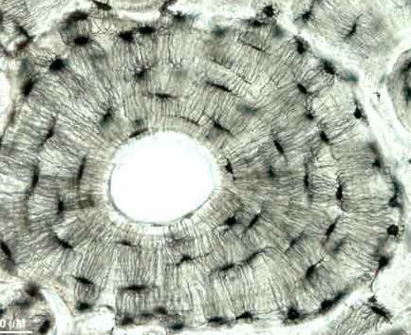
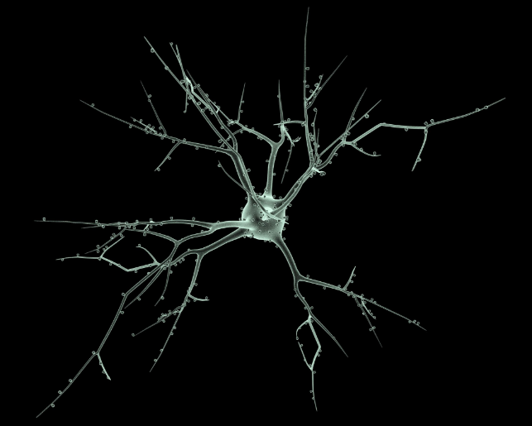
Cells are Specialized
Over 200 different cells in the human body
You are made of trillions of cells!!
Reproductive cells
Red blood cell
Cardiac muscle cells
Bone cells
Nerve cell

Slide 4
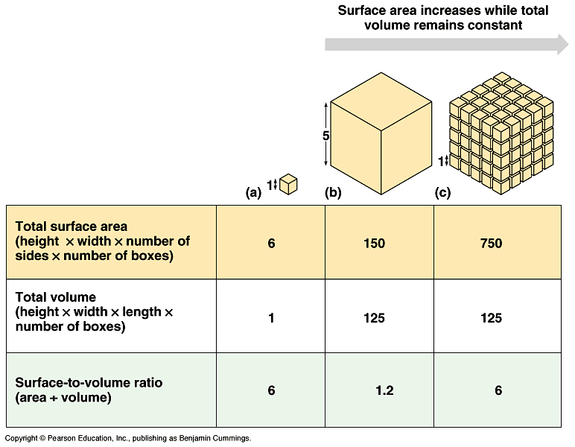
Why so small?
Surface area to volume ratio!
Greater surface area means greater efficiency
Transporting stuff into and out of the cell
Notes:
Volume increases faster than surface area
Large size means more volume to surface area and lower efficiency.

Slide 5
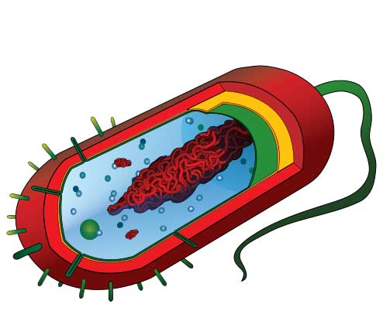
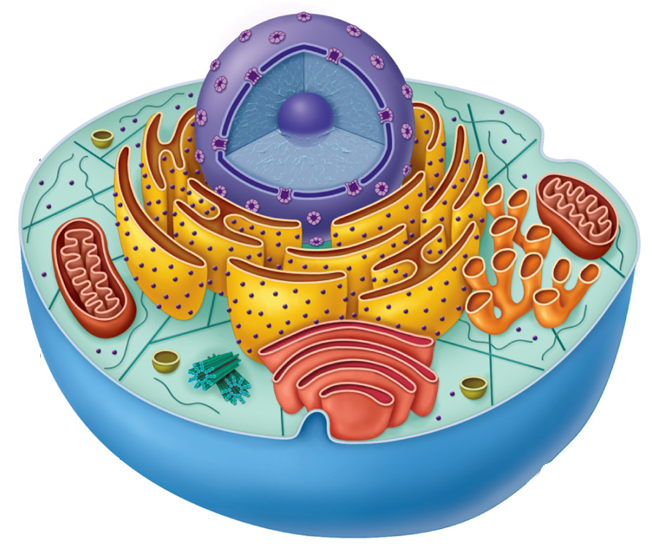
Two Main Groups of Cells
Prokaryotic
(Bacteria and Archaea)
Eukaryotic
(Protists, Plants, Animals and Fungi)
*Not to scale

Slide 6
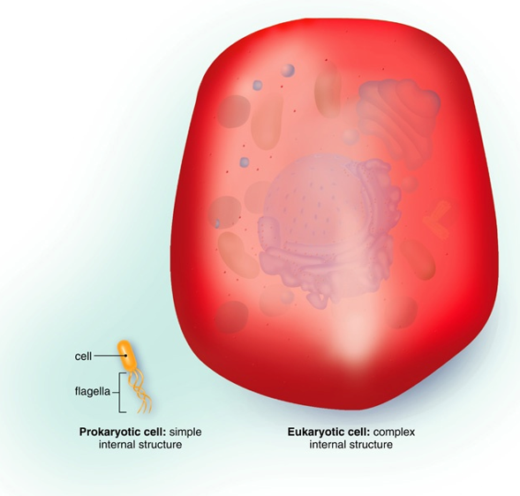
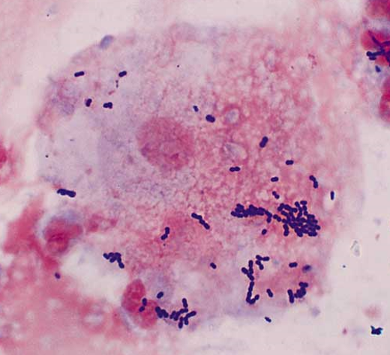
Prokaryotic and Eukaryotic Cells
Eukaryotic cell
Prokaryotic cell
Eukaryotic cell
Prokaryotic cell

Slide 7
Major Components of Eukaryotic Cells
Nucleus: membrane bound region that contains the cell’s DNA. The nucleolus is where protein making organelles (Ribosomes) are made
Organelles: highly organized structure in the cell that performs a specific cellular function
Plasma membrane: a complex, two-layered membrane that encloses the cytoplasm and regulate passage of ions and molecules into and out of the cell
Cytoplasm: protein rich, jelly-like fluid between the nucleus and the plasma membrane in which the organelles are immersed
Nucleolus
Nucleus
Cytoplasm
Organelles
Plasma membrane
Notes:
Nucleus: large membrane bound organelle containing DNA and RNA and responsible for growth and reproduction
Organelles: membrane bound compartment with specific function
Cytosol: fluid in which the organelles are immersed
Cytoplasm: everything inside the plasma membrane excluding the nucleus
Cytoskeleton: internal supports made of protein fibers
Plasma membrane: outer lining of cell that regulates passage of ion and molecules into and out of cell

Slide 8
Major Components of Eukaryotic Cells
Eukaryotic cells contain organelles which allow for larger cell size through compartmentalization.
Increased efficiency
Separation of chemical reactions
Notes:
Compartmentalization allows for larger size
Increased efficiency and separation of chemical reactions

Slide 9
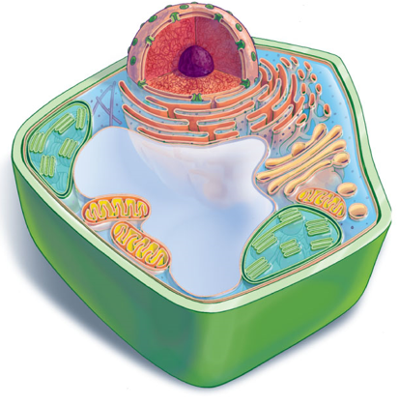
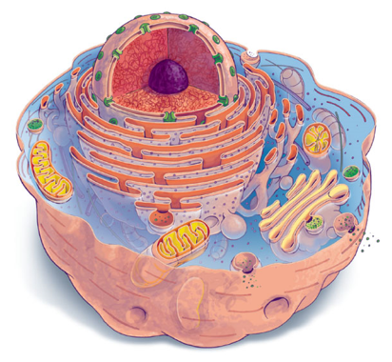
Plant and Animal Cells
Nucleus
Nucleolus
Endoplasmic reticulum
Mitochondria
Cytoplasm
Plasma membrane
Cell wall
Chloroplast
Central vacuole

Slide 10
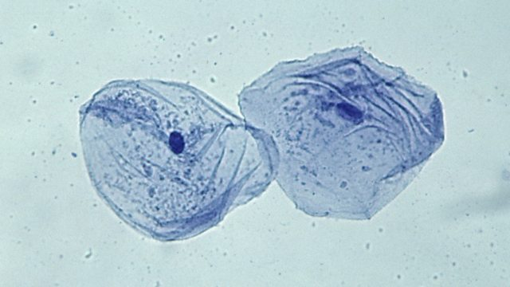
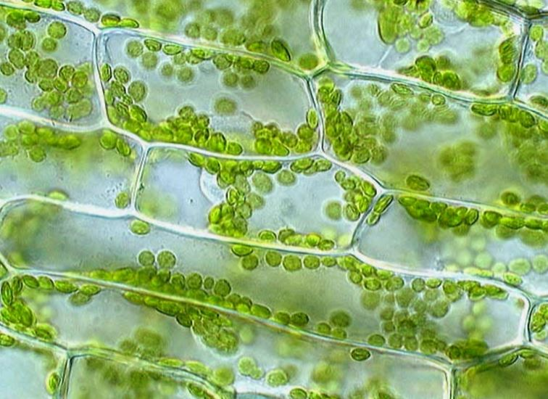
Plant and Animal Cells
Human cheek cell
Plant cell (Elodea)

Slide 11
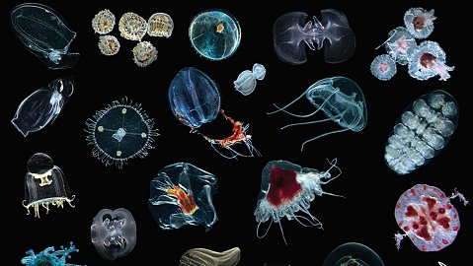
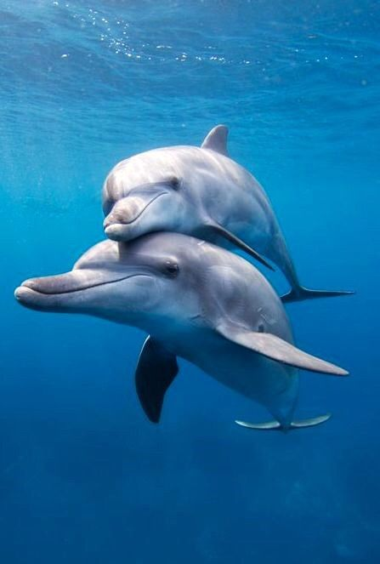
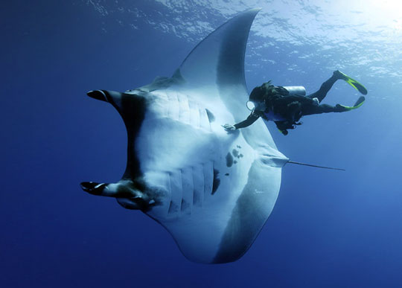
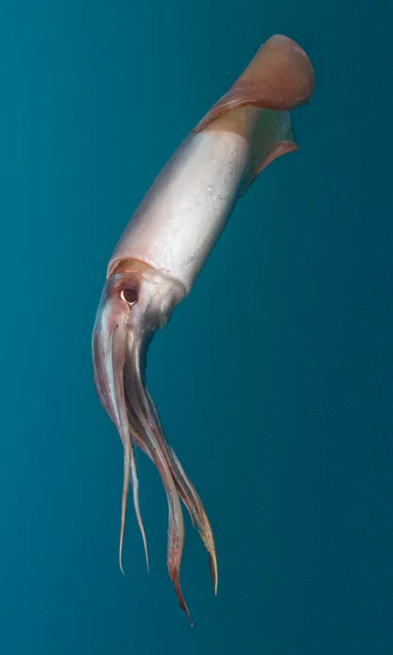
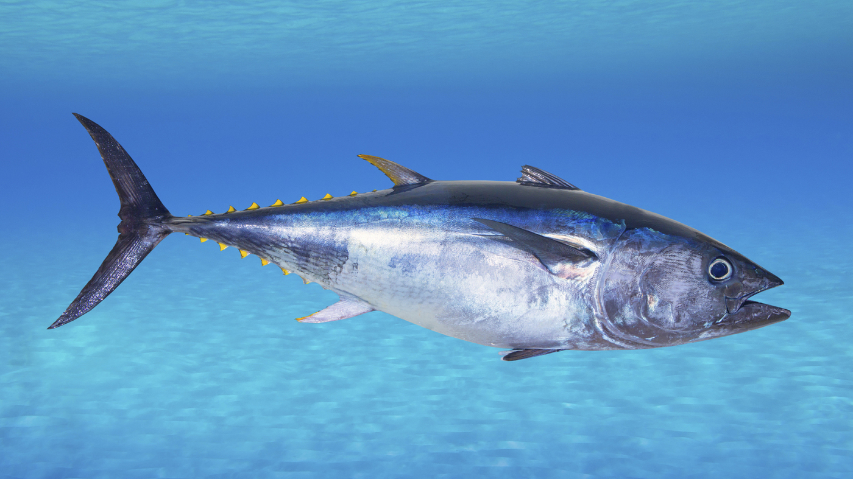
Plankton versus Nekton
Plankton: aquatic organisms that are unable to swim against the current
Phytoplankton: photosynthetic planktonic organisms
Zooplankton: heterotrophic planktonic organisms
Nekton: actively swimming organisms that can swim against the current
Notes:
Define photosynthetic (autotrophs) and heterotrophic on the board.

Slide 12
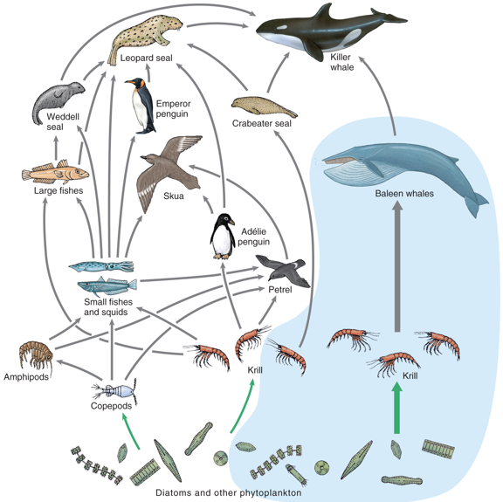
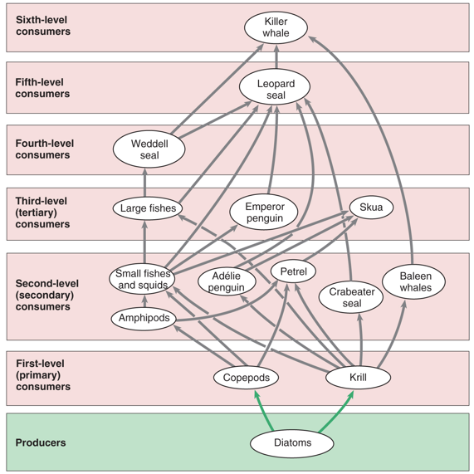
Trophic Levels

Slide 13
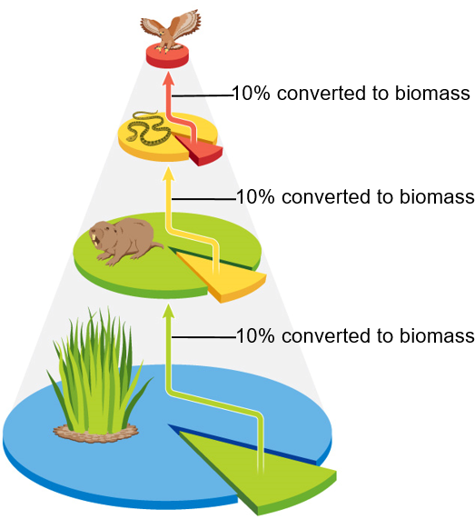
Trophic Levels
Tertiary consumers: carnivores that eat other carnivores
Secondary consumers: carnivores are animals that eat herbivores
Primary consumers: herbivores are animals that eat plants
Primary producers: autotrophs (algae) that convert solar energy to chemical energy
Only about 10% of the biomass from one trophic level is converted to biomass in the next trophic level
TERTIARY CONSUMERS
SECONDARY CONSUMERS
PRIMARY CONSUMERS
PRIMARY PRODUCERS

Slide 14
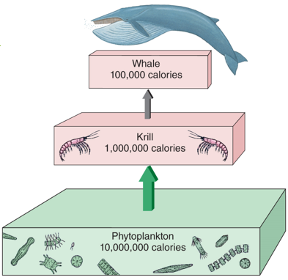
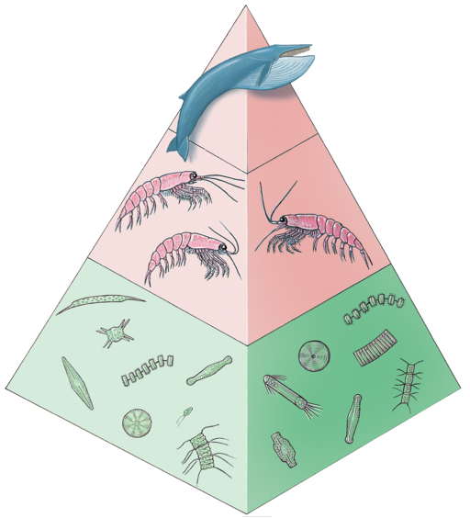
Trophic Levels
Only about 10% of the biomass from one trophic level is converted to biomass in the next trophic level, which results in fewer top predators

Slide 15
Marine Trophic Levels
Quaternary
Consumers
Top predators
Tuna, Sharks
Tertiary Consumers
Larger carnivores: Large fish, Sea birds
Secondary Consumers
Carnivores: Small fish, Crabs, whales
Primary Consumers
Herbivorous zooplankton: Copepods, Krill
Primary producers
Phytoplankton: Diatoms, Cyanobacteria
10% energy transferred
1,000 Calories
10% energy transferred
10,000 Calories
10% energy transferred
100,000 Calories
10% energy transferred
1,000,000 Calories
1-2% Efficiency

Slide 16
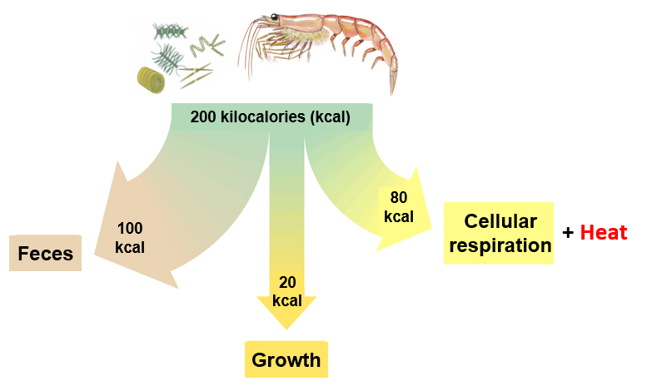
Energy Transfer Between Trophic Levels
Most energy consumed is lost as waste or is used in cellular respiration and is lost as heat.
Only about 10% of consumed energy goes toward growth (stored energy), which can then be passed on to the next trophic level
Less energy available at higher trophic levels

Slide 17
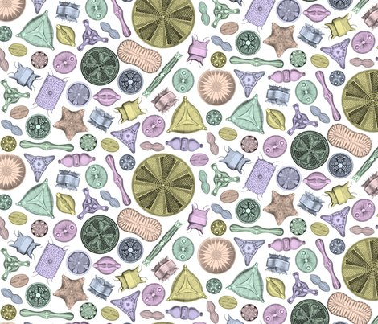
Phytoplankton
Diatoms
Planktonic
Unicellular, but often form chains
Cell walls made of silica (glass-like material) called frustule
Diatomaceous earth
Carotenoids (yellow and brown pigments)
Important primary producers

Slide 18
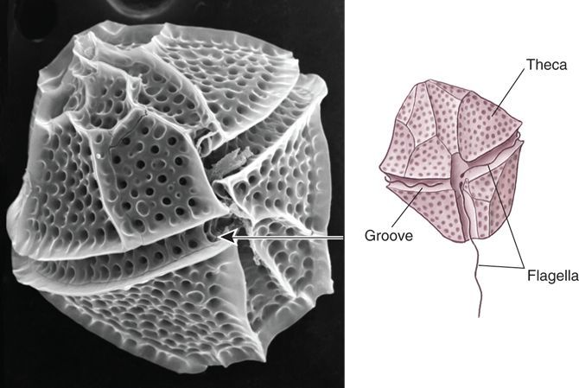
Phytoplankton (and Zooplankton)
Dinoflagellates
Planktonic
Unicellular
Many are mixotrophic
Mixotroph: organisms that perform photosynthesis but are also heterotrophic
Cell wall made of cellulose plates
Two flagella
Some are bioluminescent
Algal blooms (red tides)
Demonic acid

Slide 19
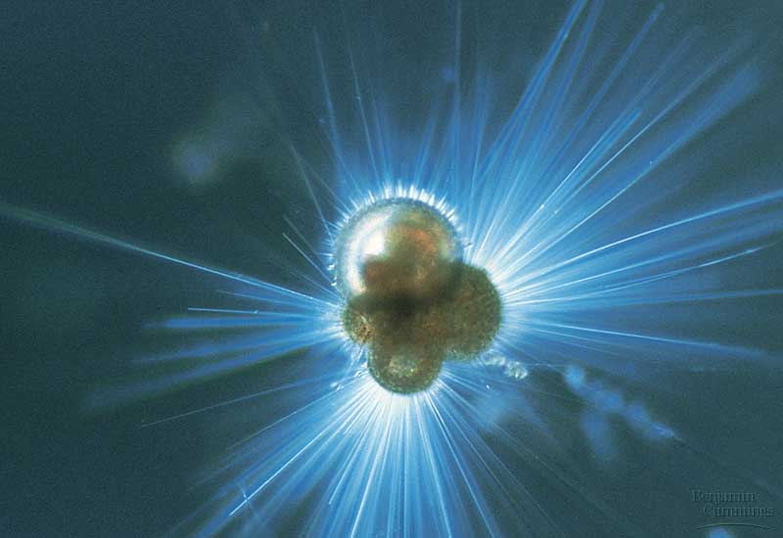
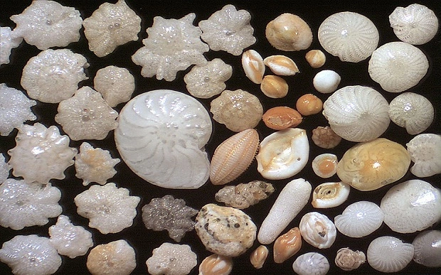
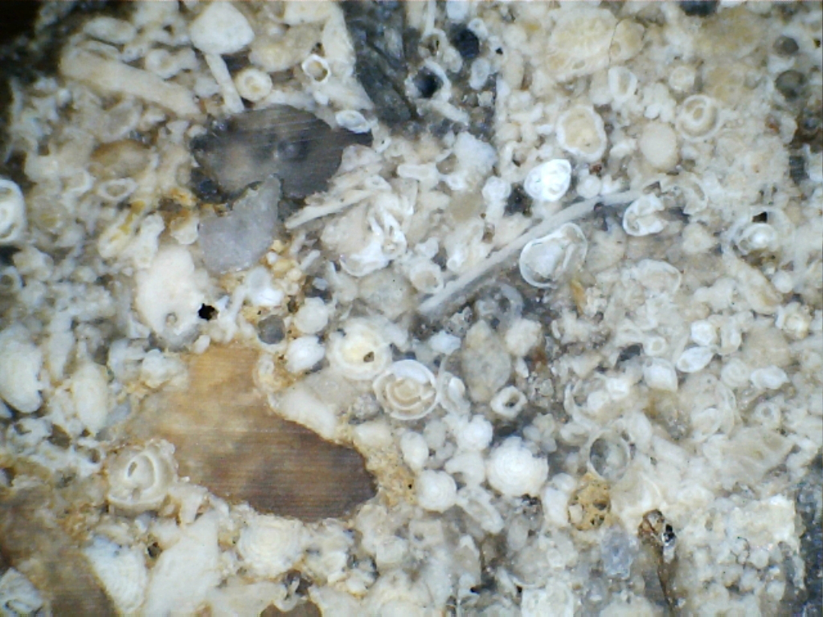
Zooplankton
Foraminiferans
Porous, calcium carbonate tests (shells)
Foramen (little hole), ferre (to bear)
Thin pseudopodia (false feet) capture food
Marine and freshwater
Most are benthic (live on the bottom)
Fossilized forams = limestone rock
Pyramids made of fossilized forams
Chemical markers in tests used to determine previous climates

Slide 20
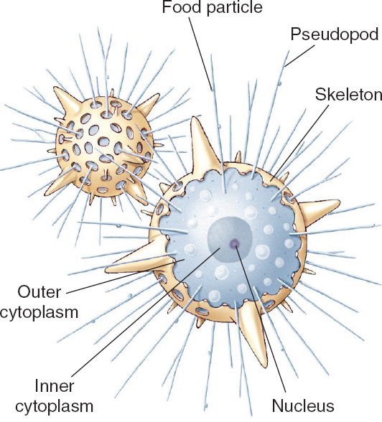
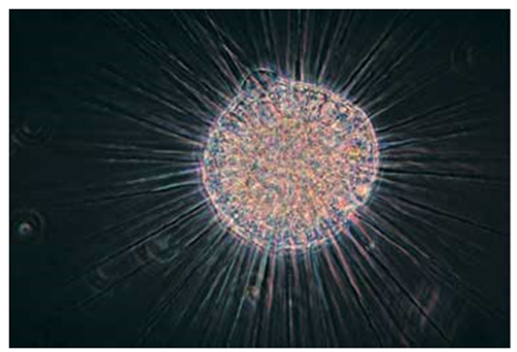
Zooplankton
Radiolarians
Porous, silica (glass) tests
Thin pseudopodia capture food
Planktonic
Radiolarian ooze: skeletal remains of radiolarians that settles on the bottom

Slide 21
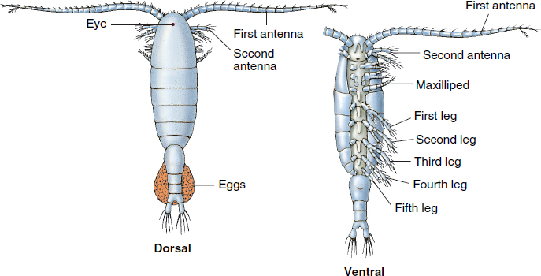
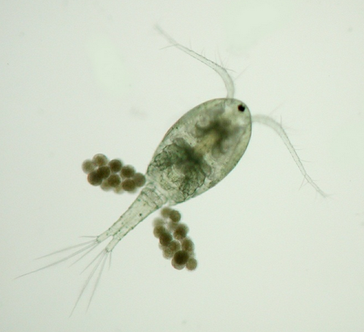
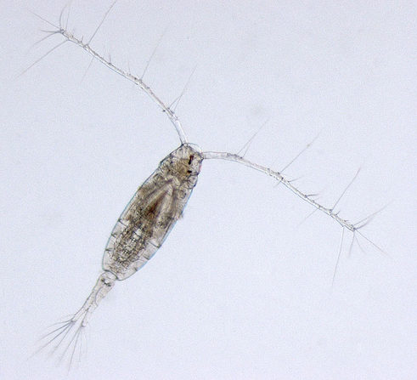
Zooplankton
Copepods
Most planktonic
Marine, freshwater and wet terrestrial habitats
Arthropods
Tear-drop shaped body with large antennae
Food source for many fish species
Notes:
Planktonic: organisms that drift with current

