Slide 1
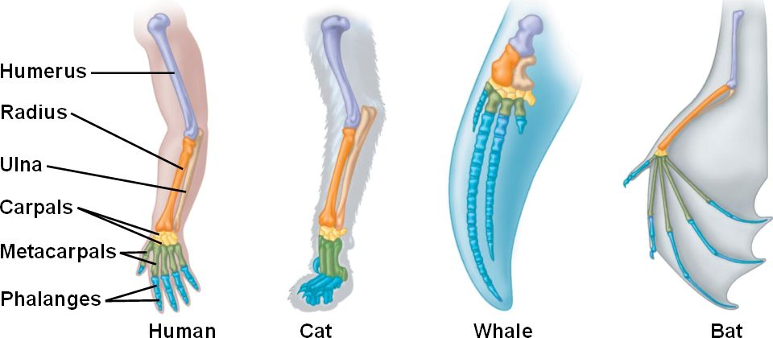
Homologous vs. Analogous
Homologous structures: Characteristics of different organisms that are similar because they were derived from a common ancestor with the characteristic

Slide 2
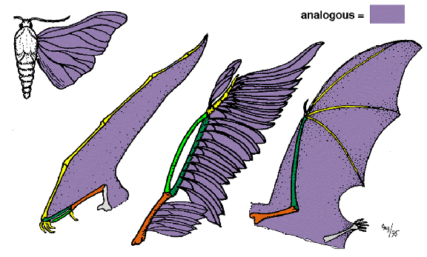
Homologous vs. Analogous
Analogous structures: structures from different species with similar function but different evolutionary origin
Convergent Evolution
Notes:
Similar selective pressures drive evolution of similar characteristics
Homoplasy: same as convergent evolution, however the term is used in cladistics = “to mold in the same way”-Greek

Slide 3
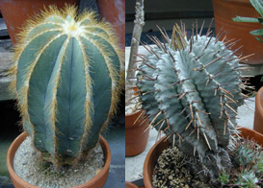
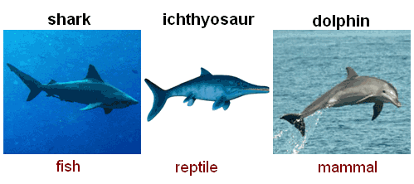
Convergent Evolution
Convergent evolution: the independent evolution of similar features in species of different lineages

Slide 4
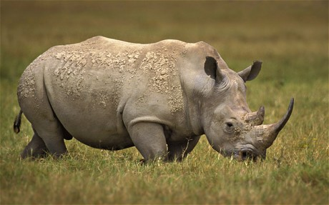
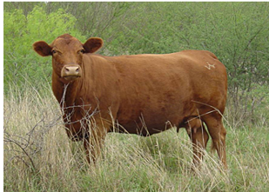
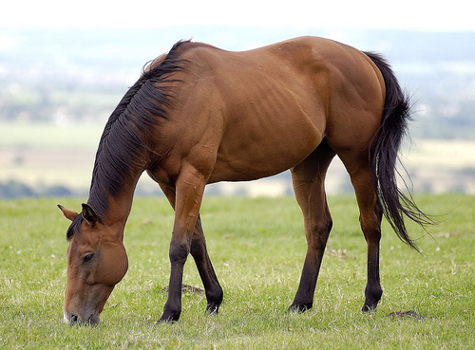
Which species are more closely related?

Slide 5
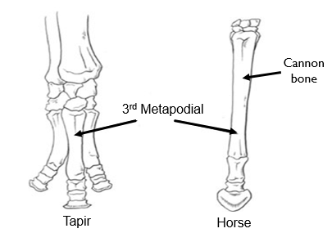
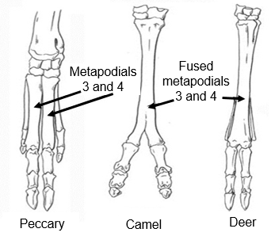
Ungulates (Hoofed Animals)
Perissodactyla
Odd-toed Ungulates
Artiodactyla
Even-toed Ungulates
Fused metapodials
3 and 4
Metapodials
3 and 4
3rd Metapodial
Tapir
Horse
Peccary
Camel
Deer
Notes:
Cannon bone = fused metapodials

Slide 6
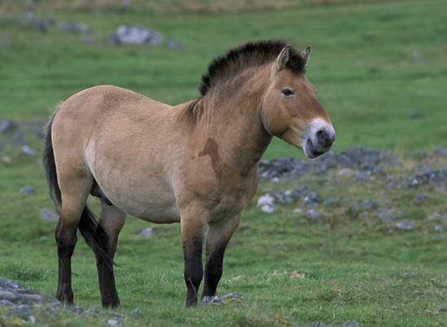
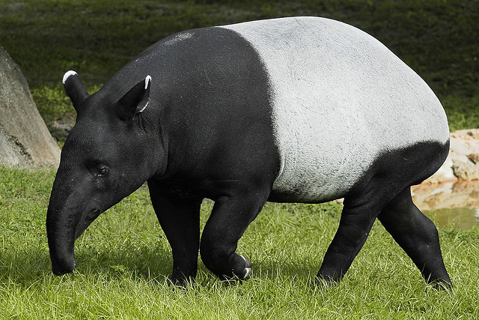
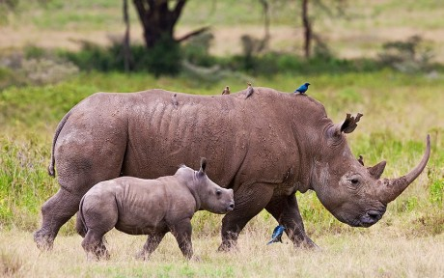
Perissodactyla
Odd-toed ungulates
Equidae (Zebra, Asses and Horse)
8 species
Tapiridae (Tapirs)
4 species
Rhinocerotidae (Rhinos)
5 species
Dominant ungulates from 50 mya to 25 mya
Upper incisors present (except rhinos)
Hind gut fermentation
Large cecum
Fibrous vegetation

Slide 7
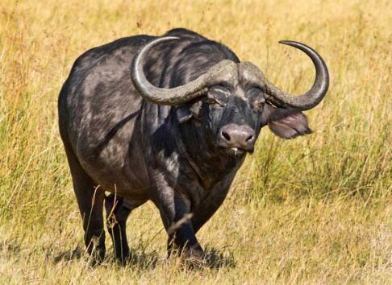
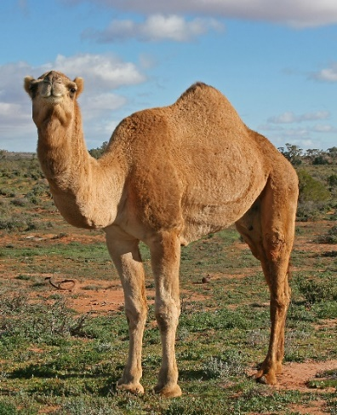
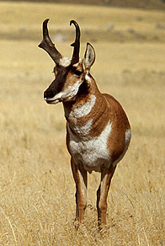
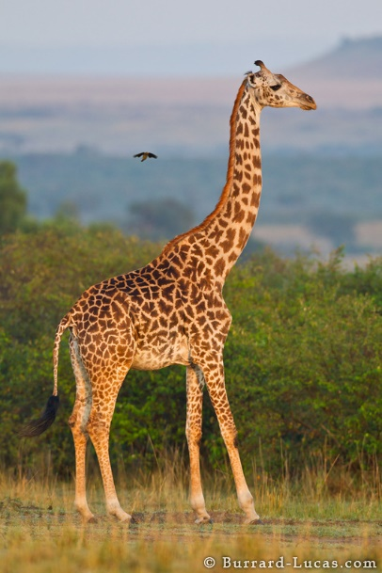
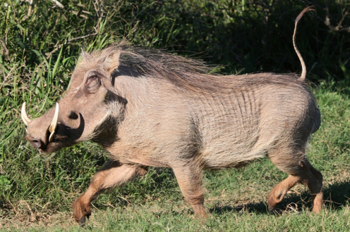
Artiodactyla
Even-toed ungulates
10 families, ~220 species
Pigs, hippos, camels, antelope, deer, giraffe, bovines
Upper incisors and canines reduced or absent
Ruminant fermentation (except pigs)

Slide 8
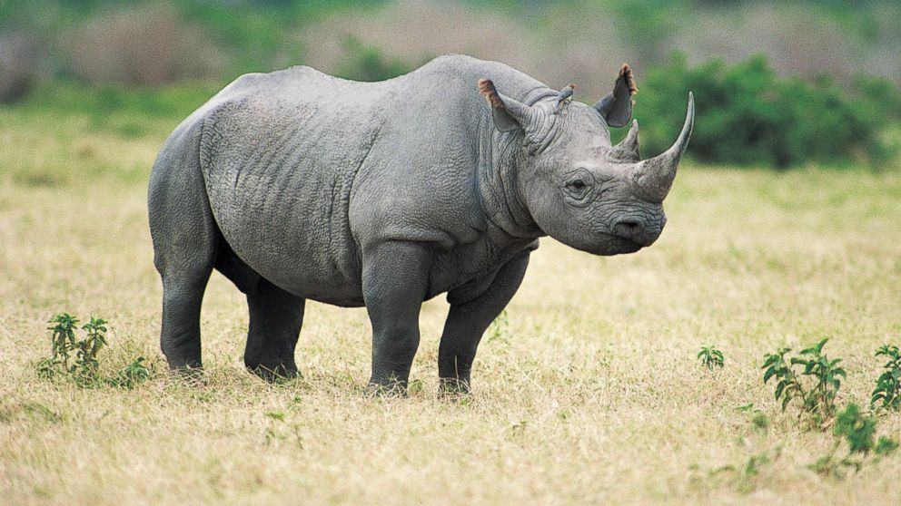
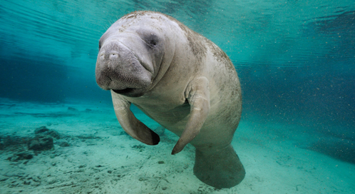
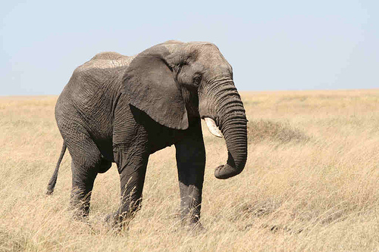
Which species are more closely related?
Notes:
Hyrax and elephant have scrotum hidden in body cavity
Like elephants hyrax have tusks that develop from incisor teeth, other mammals from canines
Flat nails instead of curved nails

Slide 9
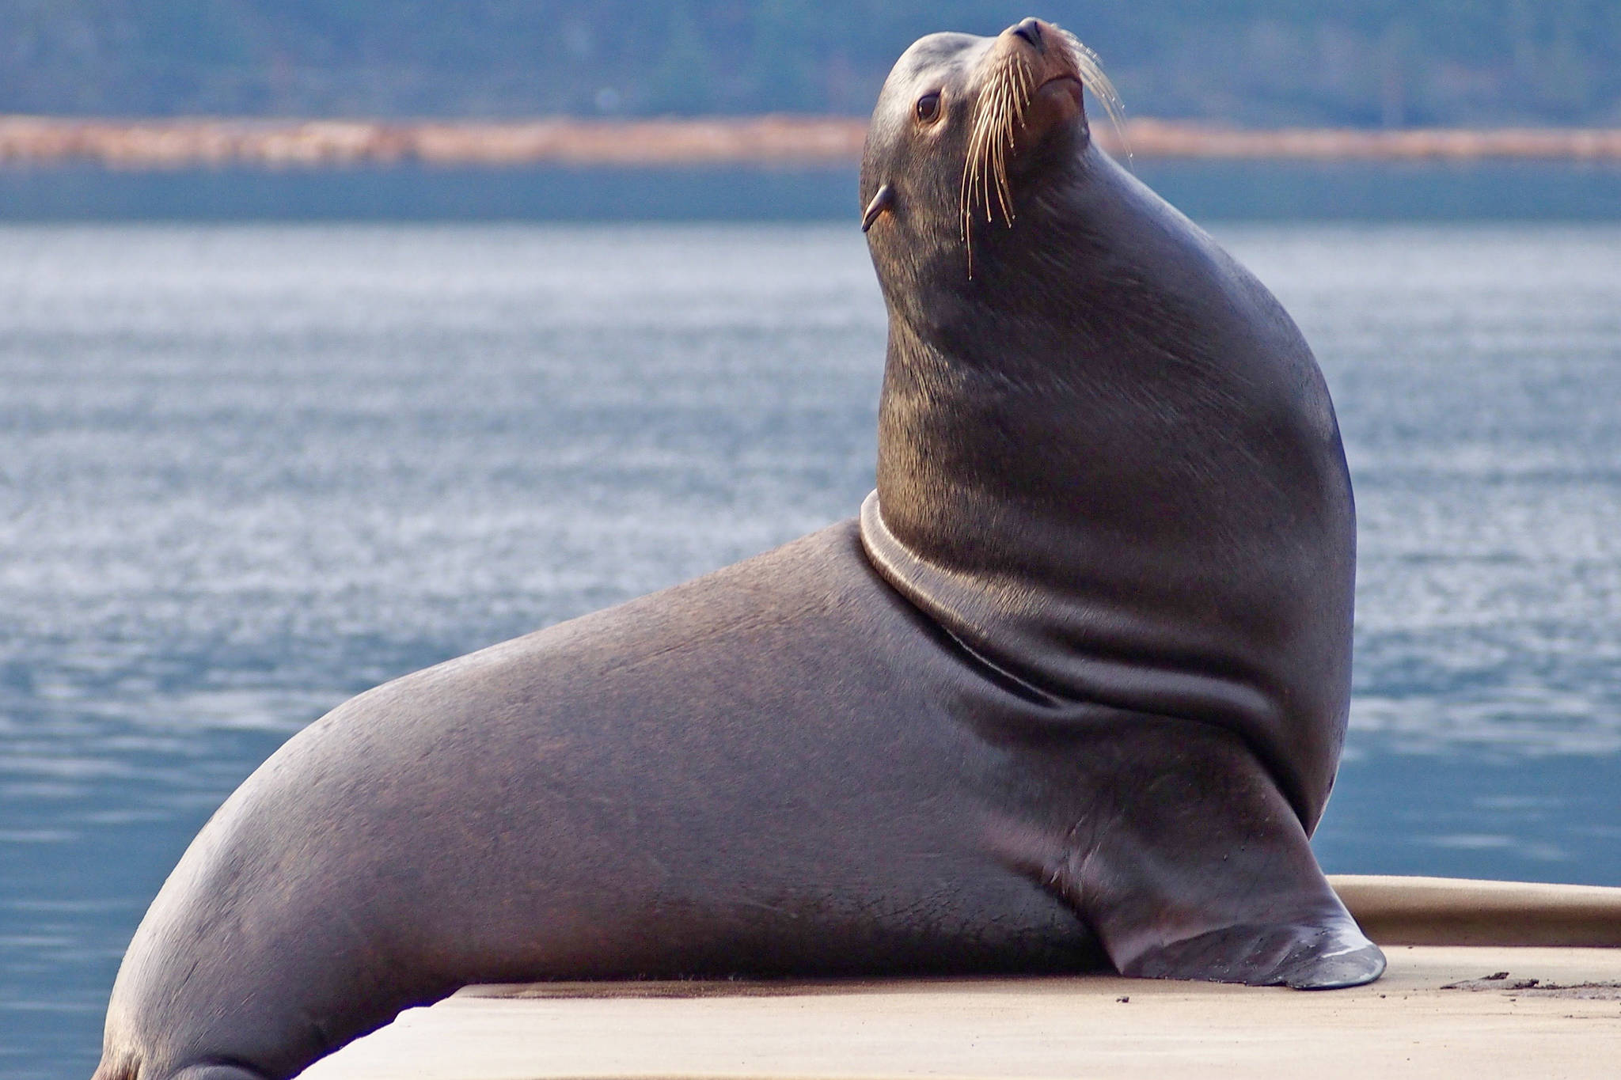
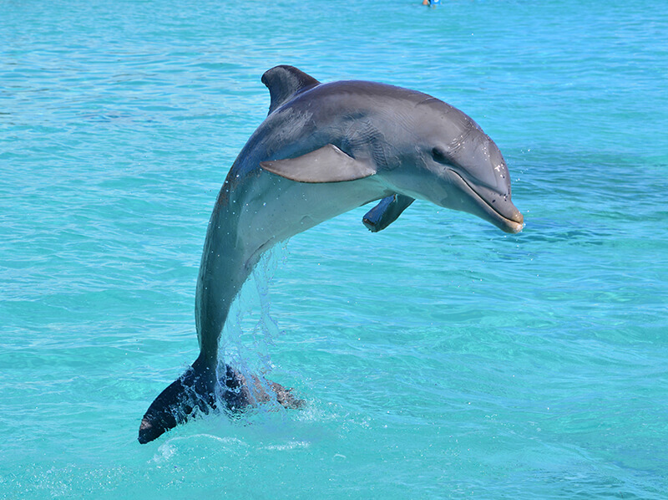
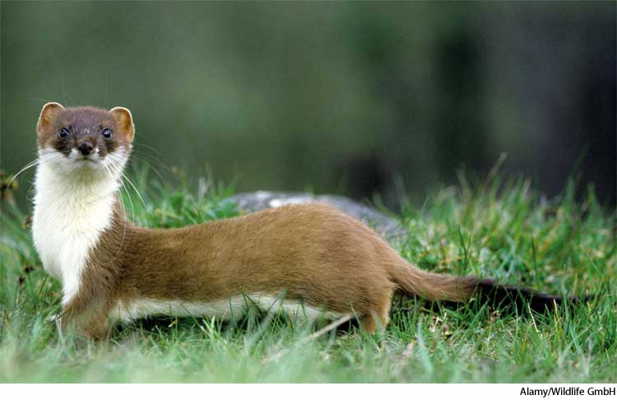
Which species are more closely related?

Slide 10
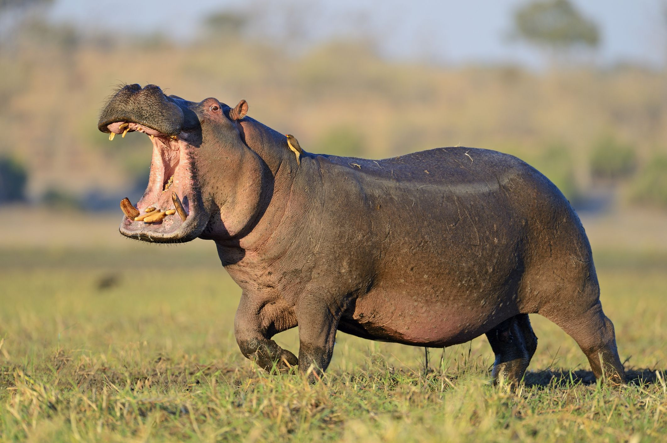
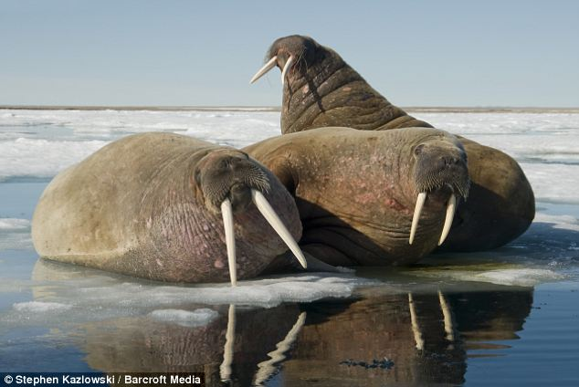
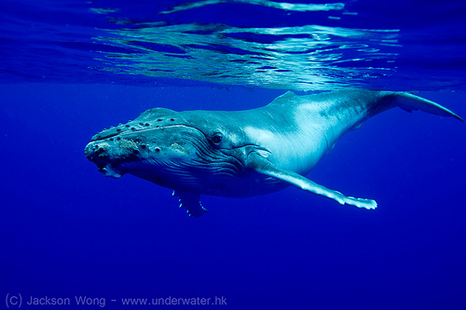
Which species are more closely related?
https://youtu.be/o92x6AvxCFg

Slide 11
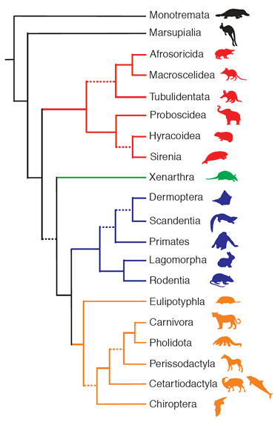
Major Lineages of Mammals
Platypus, echidnas
Marsupials
Golden moles
Elephant shrews
Aardvarks
Elephants
Hyrax
Manatees
Armadillos, sloths, anteaters
Flying lemurs
Tree shrews
Apes, monkeys, humans
Rabbits and hares
Rodents
Hedgehogs, moles, true shrews
Canines, felines, bears, seals, weasels
Pangolins
Horses, tapirs, rhinos
Camels, pigs, whales, dolphins, antelope
Bats
Monotremes
Marsupials
Eutharians (Placental mammals)

Slide 12
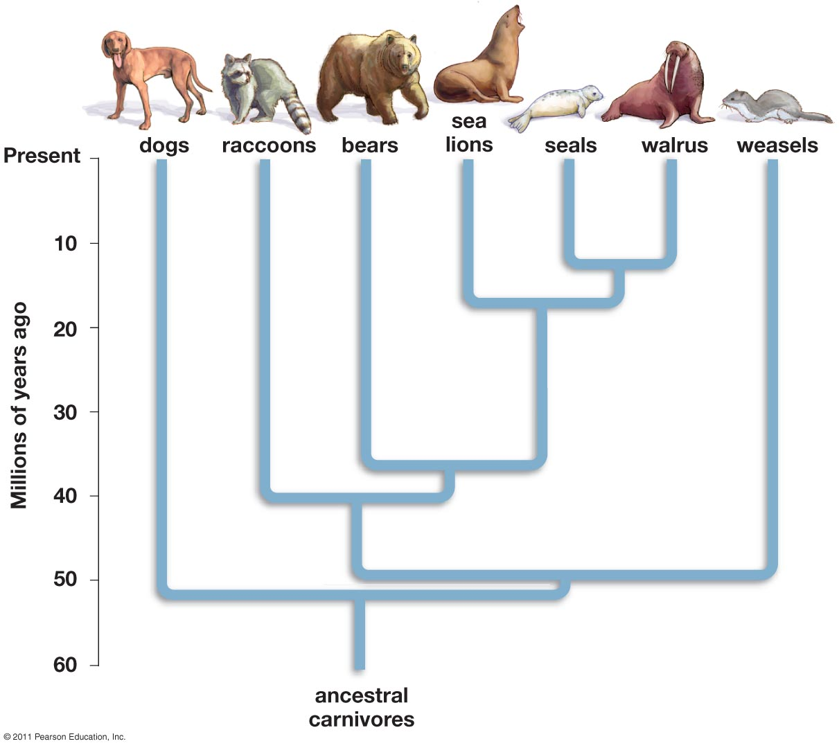

Slide 13
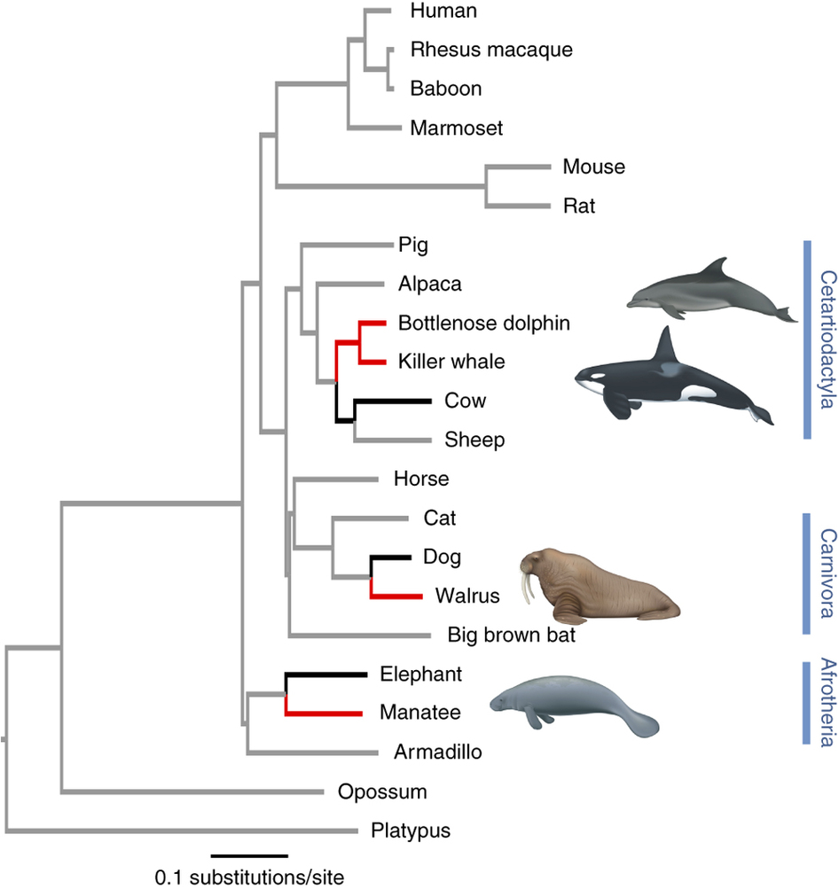
Return to Water
Three mammal clades returned to water
Cetartiodactyla
Carnivora
Afrotheria
Characteristics that support terrestrial origin
Lungs and a need to breathe air from the surface
Limb bones homologous with land mammals
Vertical movement of spine
Vestigial pelvic bones in cetaceans

Slide 14
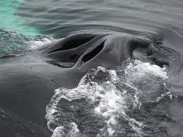
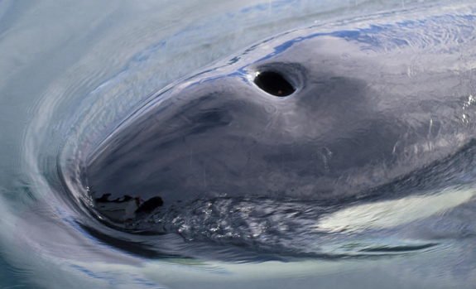
Cetacea
Mysticeti
Odontoceti
Baleen whales
Humpback whales, blue whales, right whales, minke whales
Krill, small schooling fish
15 species
Two blow holes
Lack echolocation
Toothed whales
Sperm whales, porpoises, dolphins, killer whales
Fish, squid, marine mammals
>70 species
One blow hole
Echolocation
Notes:
Hippos more closely related to cetaceans than other artiodactyla

Slide 15
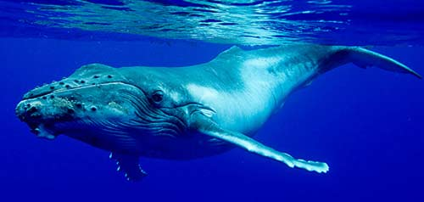
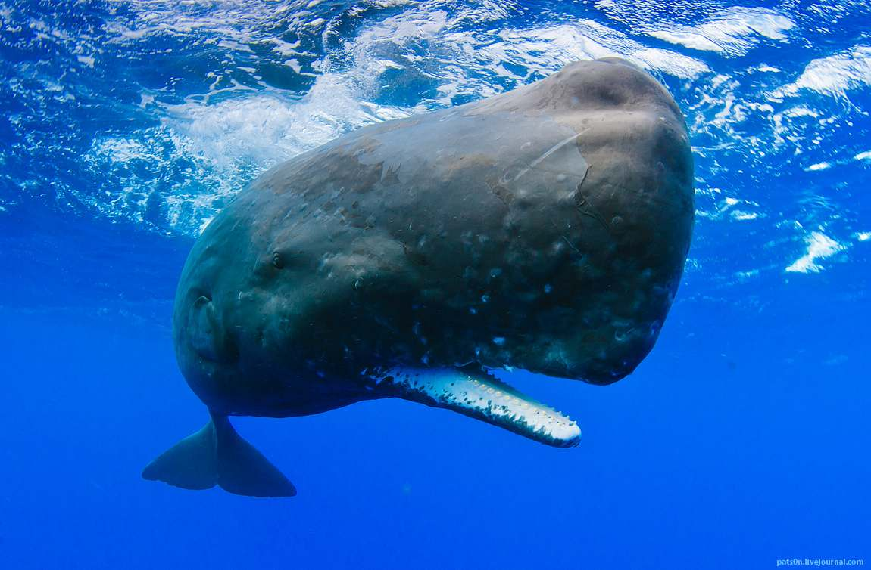
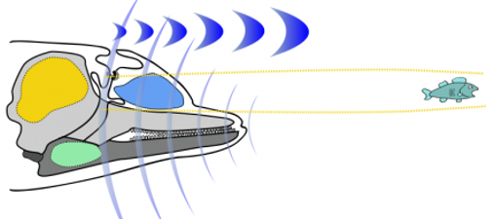
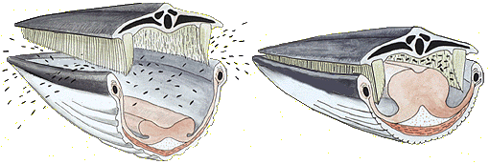
Cetacea
Mysticeti
Odontoceti
Baleen
Brain
Melon
Tongue
Fat-filled cavity

Slide 16
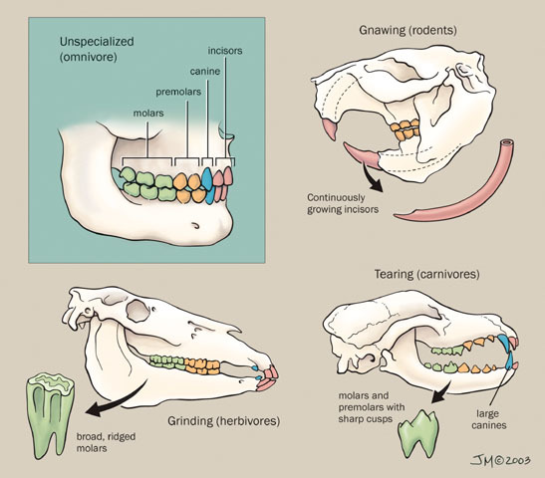
Mammal Dentition
Differentiation of teeth led to success in mammals
Size and arrangement of teeth associated with diet
Cusps
Four distinct tooth types
Incisors: cutting
Canines: tearing
Premolars: grinding
Molars: crushing, grinding

Slide 17
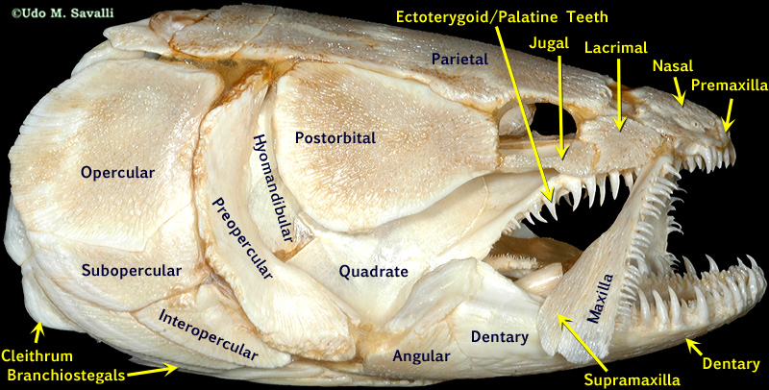
Skull of a Fish (Amia)

Slide 18
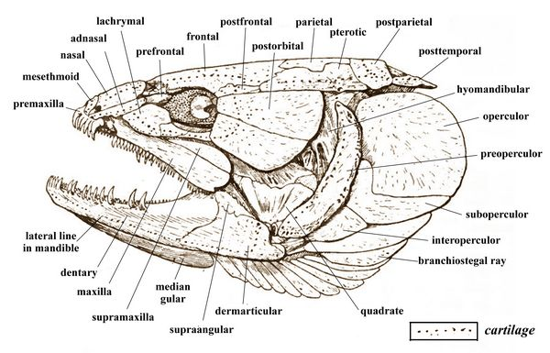

Slide 19
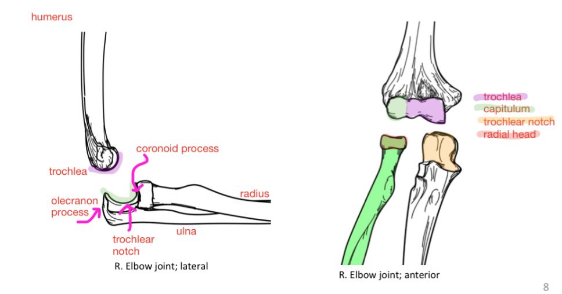
Human Forelimb Anatomy

