Slide 1
An Introduction to Evolution
“ There is grandeur in this view of life … from so simple a beginning endless forms most beautiful and wonderful have been, and are being, evolved”
- Charles Darwin
“ If I have seen further than others it is by standing on the shoulders of giants”
-Sir Isaac Newton
Chapter 8

Slide 2
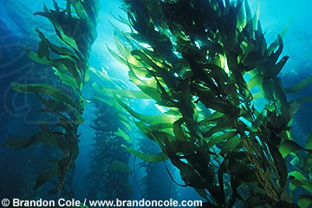
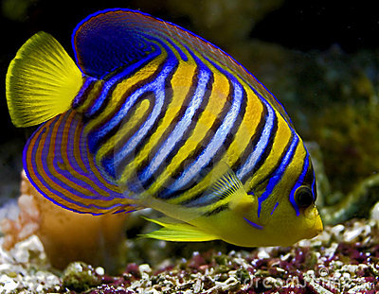
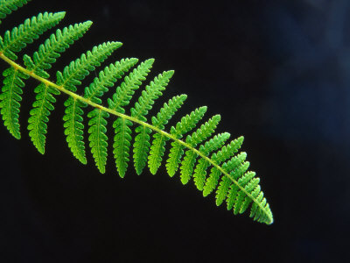
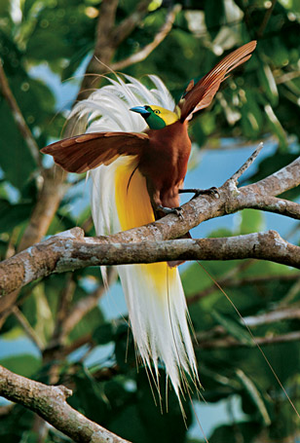
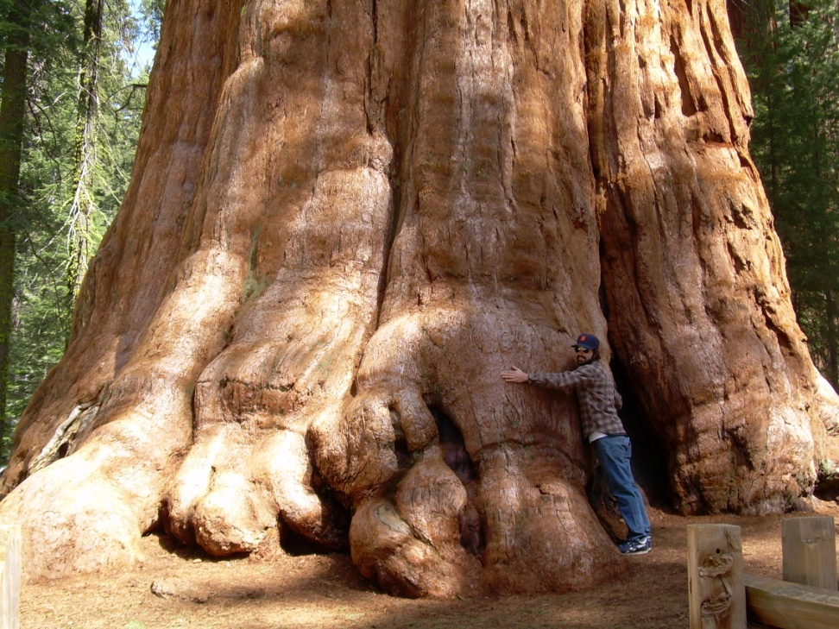
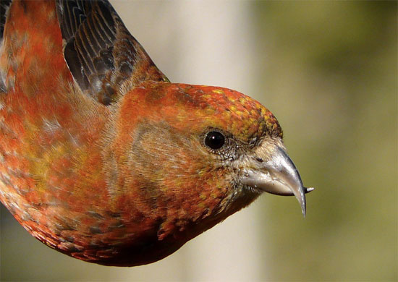
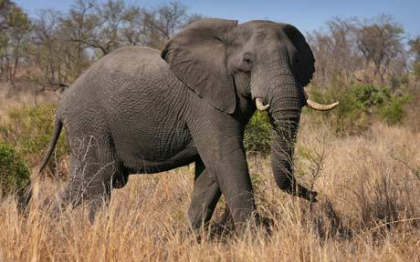
Explaining the Mysteries of Life

Slide 3
The Importance of Evolution
Evolution unites all living things
Common ancestor
All living things have evolved and are _________
Theory of evolution provides actual _______ for understanding the diversity of nature
Everything can be explained through the processes of evolution

Slide 4
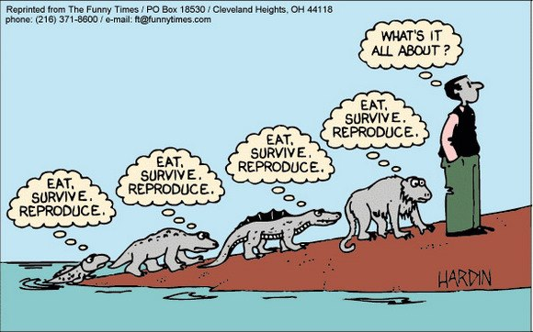
The Importance of Understanding Evolution
Understanding evolution you will give you a greater appreciation for…
-the way plants and animals survive
-why plants and animals look the way the do
-why species are found only in certain areas
-the natural world!!!

Slide 5
Introduction to Theory of Evolution
Common descent with modification: species of living things can undergo modification in successive generations, with these changes sometimes resulting in the formation of a new species
Species are untied by a __________________
___________________: the process through which traits that provide a reproductive advantage to an individual organism grow more common in populations of organisms over successive generations
Environmental conditions determines or selects organisms best suited for that specific environment

Slide 6
History of Evolutionary Thought

Slide 7
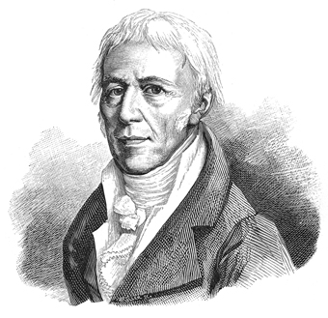
Precursors to Evolutionary Thought
Jean-Baptiste de Lamarck (1744 – 1829)
French naturalist
Proposed that organisms could _______ acquired traits
Changes that occurred during an organisms life could be passed on

Slide 8
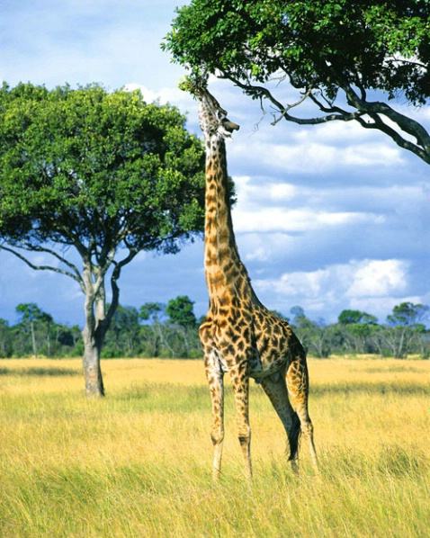
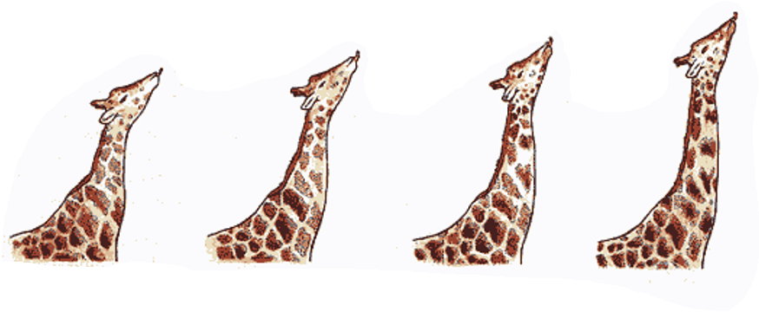
Lamarck and Darwin on Giraffes
Giraffes that stretch their necks to reach higher branches will elongate their necks.
Giraffes will pass on longer necks to offspring.
Traits acquired through ______
Stretching

Slide 9
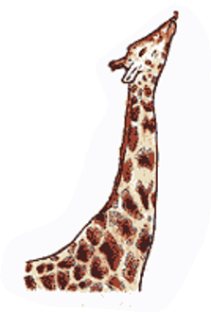
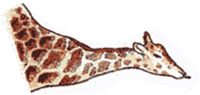
Lamarck and Darwin on Giraffes
Variation in neck length within a population of giraffes
Those with slightly longer necks will _________ better where trees are hard to reach
Shorter necked individuals will fail to reach branches and die
Longer necked individuals will pass on their trait for longer necks
RIP
Short neck
*No stretching, just death

Slide 10
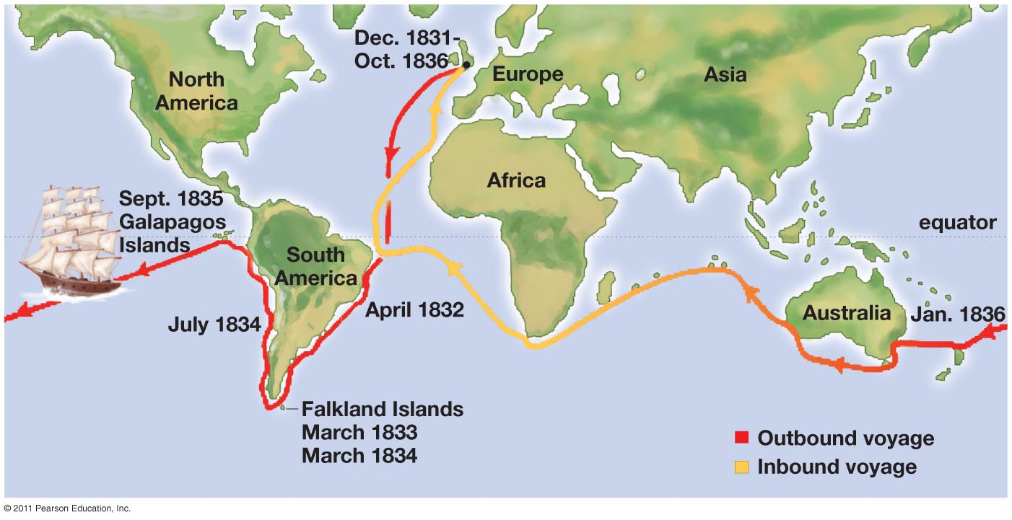
Charles Darwin’s Voyage
5 year trip around the world aboard H.M.S Beagle

Slide 11
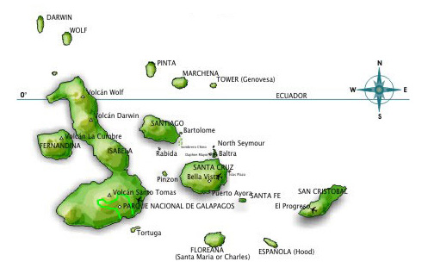
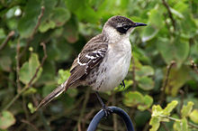
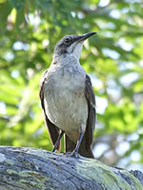
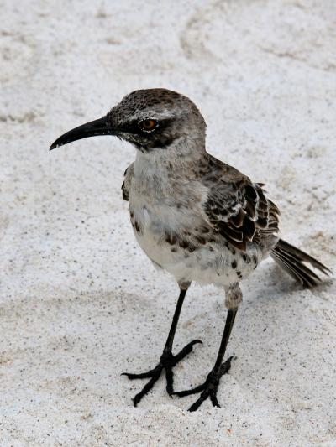
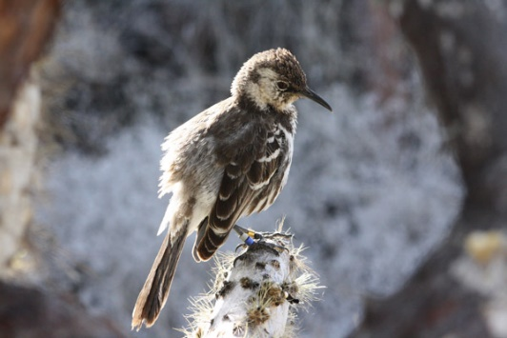

Slide 12
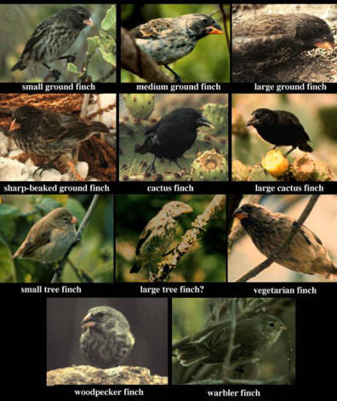
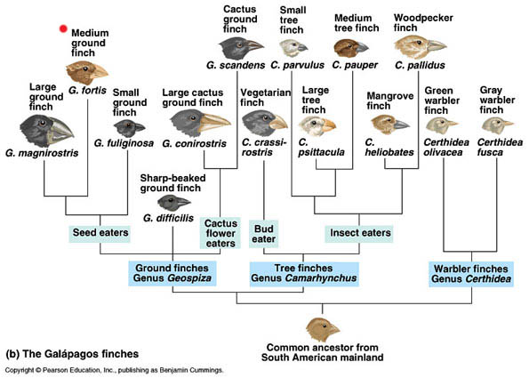
The Galapagos Finches

Slide 13
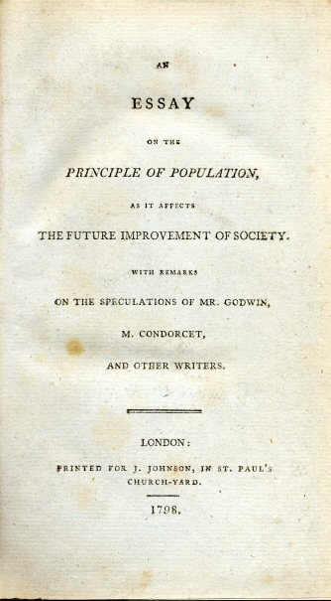
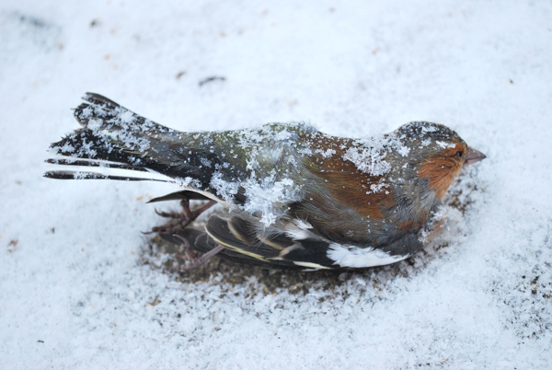
Crystallization of an Idea
Darwin read Thomas Malthus's An Essay on the Principle of Population 6th ed. (1826)
_______________ will be checked by limited resources, disease, famine
______________ of birds after a cold snap near Down House

Slide 14
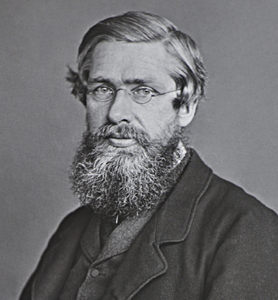
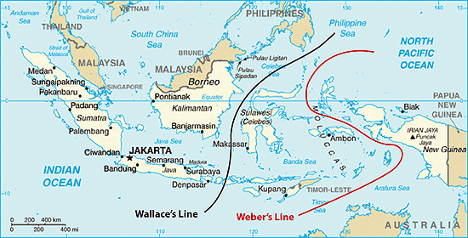
Alfred Russel Wallace
Collected specimens in Brazilian Amazon the throughout Malaysian Archipelago (Wallacea)
Father of _____________
Geographic barriers often separated closely related species
Wallace’s Line
Independently conceived idea of natural selection

Slide 15
Wallace on Natural Selection
“As animals usually breed much more quickly than does mankind, the destruction every year from these causes must be enormous in order to keep down the numbers of each species, since evidently they do not increase regularly from year to year, as otherwise the world would long ago have been crowded with those that breed most quickly. Vaguely thinking over the enormous and constant destruction which this implied, it occurred to me to ask the question, why do some die and some live? And the answer was clearly, on the whole the best fitted live… and considering the amount of individual variation that my experience as a collector had shown me to exist, then it followed that all the changes necessary for the adaptation of the species to the changing conditions would be brought about. In this way every part of an animal’s organization could be modified exactly as required, and in the very process of this modification the unmodified would die out, and thus the definite characters and the clear isolation of each new species would be explained.”

Slide 16
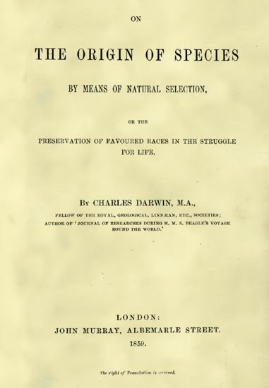
On the Origin of Species
Darwin publishes his theory
On The Origin of Species by Means of Natural Selection or the Preservation of Favoured Races in the Struggle For Life (1858)
Decent with modification
Natural selection

Slide 17
Darwin’s Four Postulates
Individual organisms in a population ______ in the traits they possess
Some of the trait differences are ___________
Only some individuals survive long enough to produce offspring and some produce ______________ than others
The subset of individuals that survive best and produce the most offspring _______ a random sample of the population

Slide 18
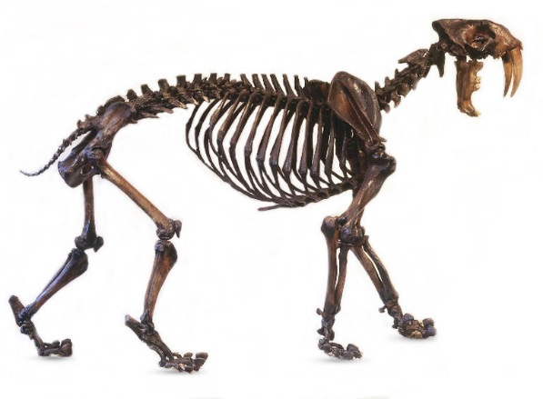
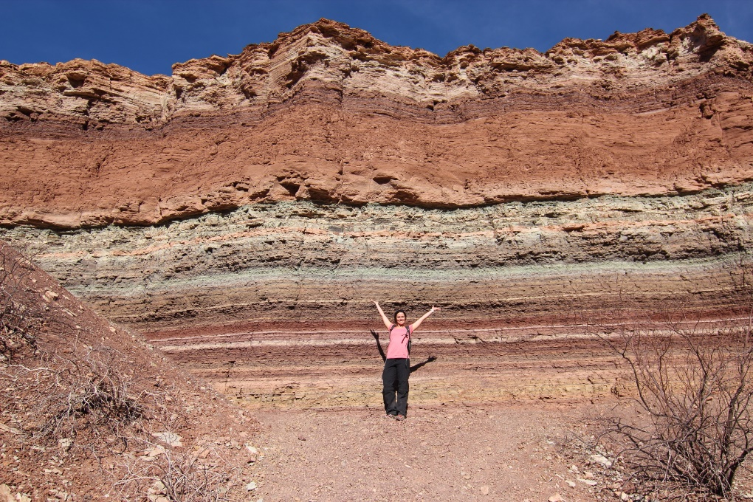
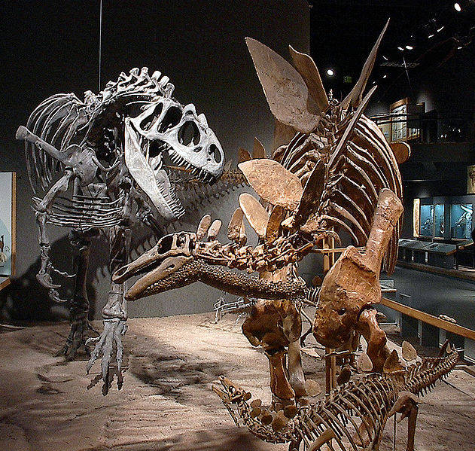
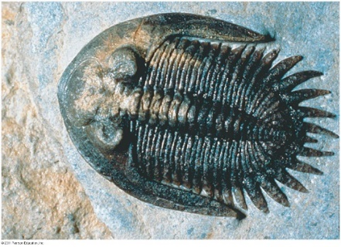
Evidence for Evolution
_________________
Evidence for extinction
Evidence for diversification

Slide 19
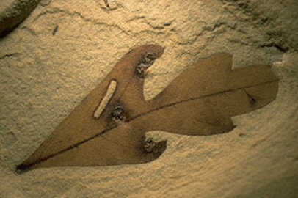
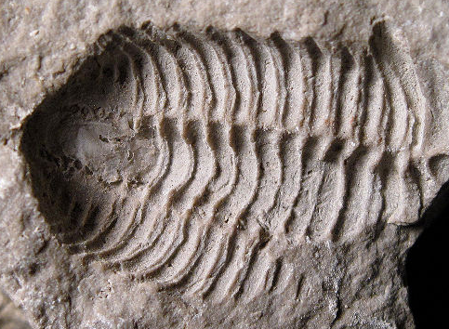
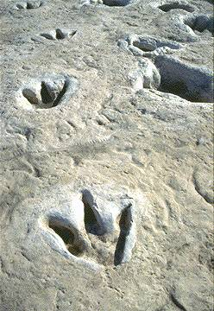
Evidence for Evolution
Fossil record
Organic material replaced by minerals
Petrified wood
Organic material: part of the organism was preserved
Casts: impressions made by an organism
_______ fossils: signs of life that were preserved
Footprints, burrows
Entire organisms

Slide 20
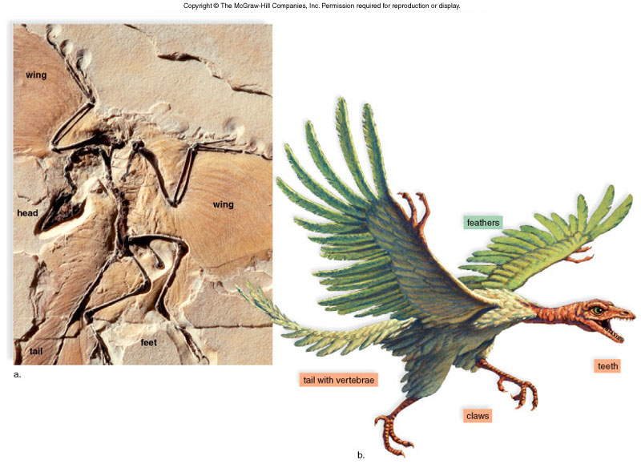
Evidence for Evolution
____________ forms: Intermediate states between ancestral form and its decedents
Archaeopteryx
Teeth of ________
_________ of bird
Tail with vertebrae like reptile
Claws of reptile

Slide 21
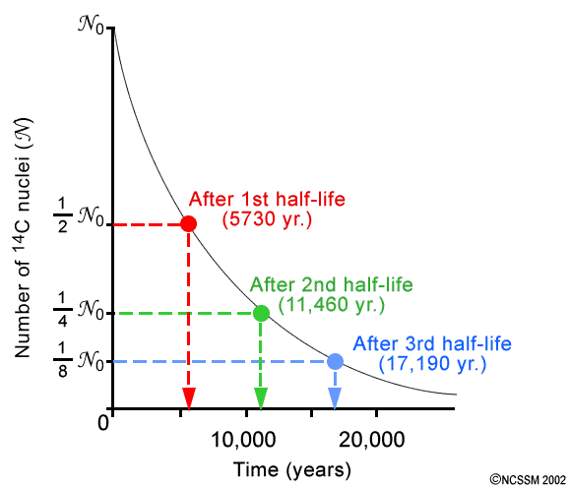
Radiometric Dating
Radiometric dating: a technique used to date the age of an object by measuring the ______________ of radioactive elements within the object
Carbon dating
C¹² and C¹⁴
Half life of C¹⁴ = 5730 years
Uranium dating
Uranium-238 to Lead-206
Half life = 4.5 billion years

Slide 22
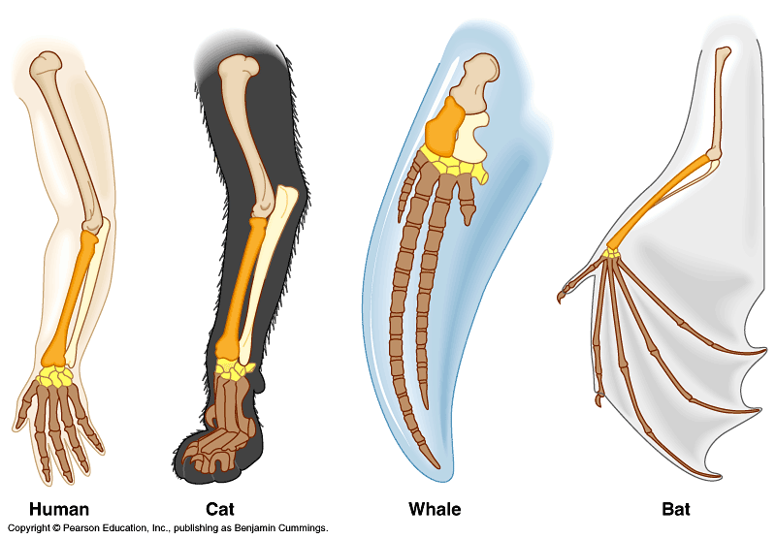
Evidence for Evolution
Morphology: study of physical forms of organisms
Homologous structures: ___________________ structures among different vertebrate groups
Due to a common ancestor

Slide 23
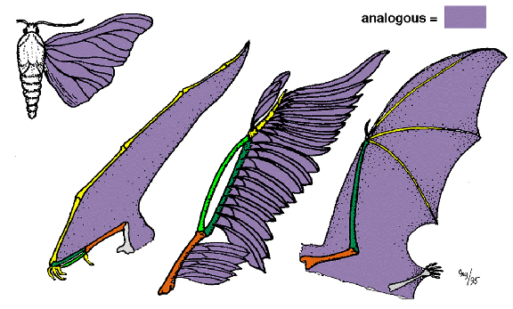
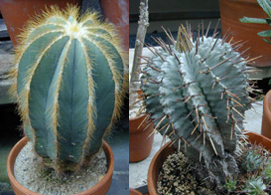
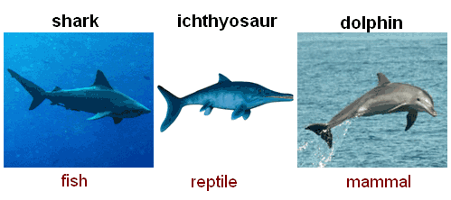
Evidence for Evolution
Analogous structures: structures from different species with similar function but ____________ evolutionary origin
____________________: the independent evolution of similar features in species of different lineages

Slide 24
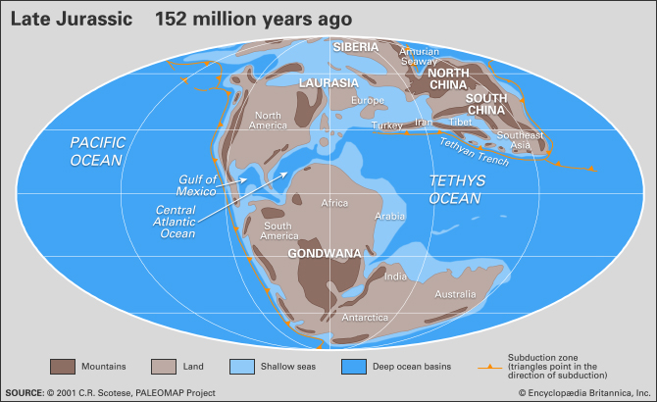
Evidence for Evolution
Biogeography: study of the distribution patterns of organisms around the world
Marsupials in South America and Australia

Slide 25
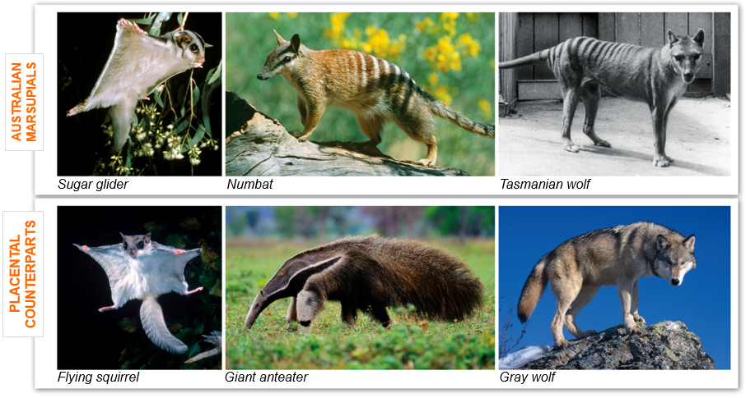
Evidence for Evolution
Convergent evolution of Australian marsupials and placental mammals occupying similar ecological niches

Slide 26
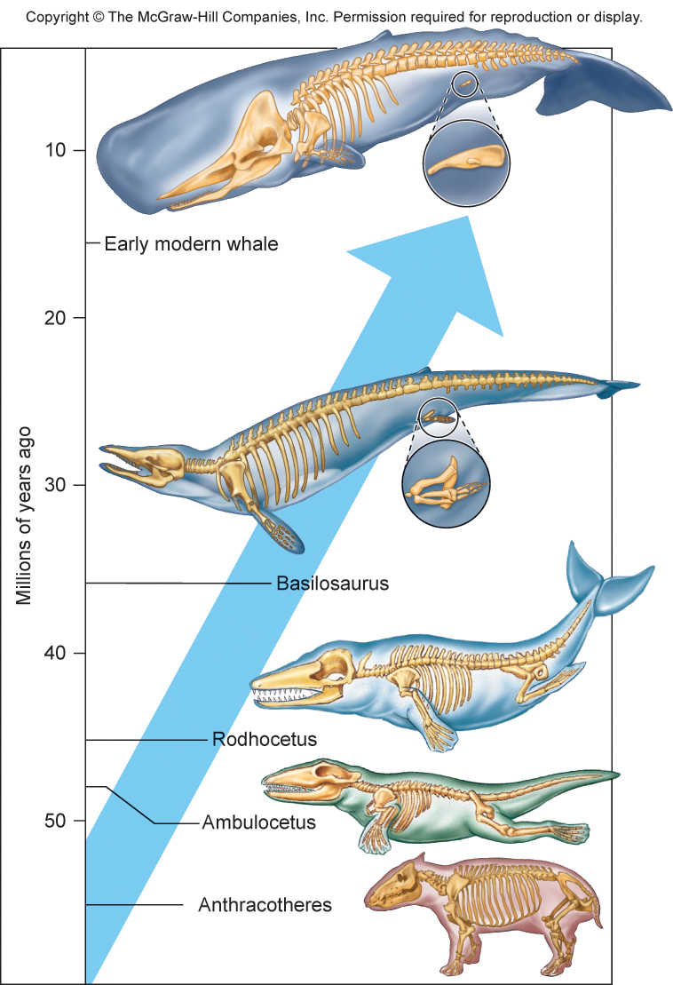
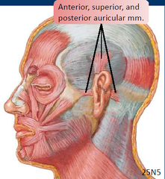
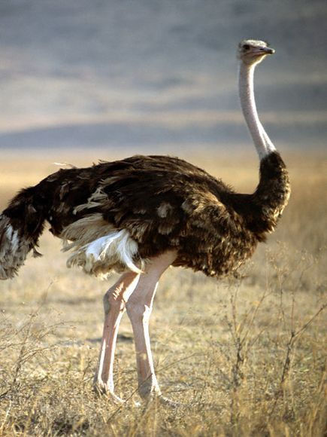
Evidence for Evolution
_______________: a structure in an organisms whose original structure has been lost during the course of evolution

Slide 27
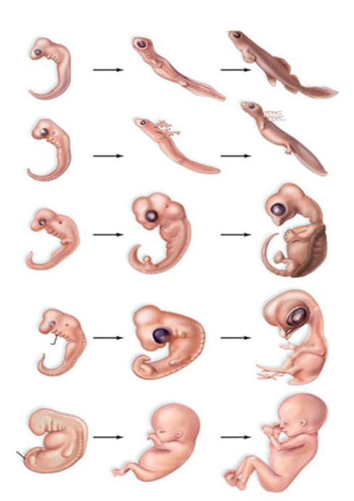
Evidence for Evolution
Embryology: study of development from fertilization to fetus stage
Similar structures during embryonic development among vertebrate groups
Pharyngeal gill slits
Post anal tail
Fish
Salamander
Tortoise
Bird
Pharyngeal pouches
Human
Post-anal tail

Slide 28
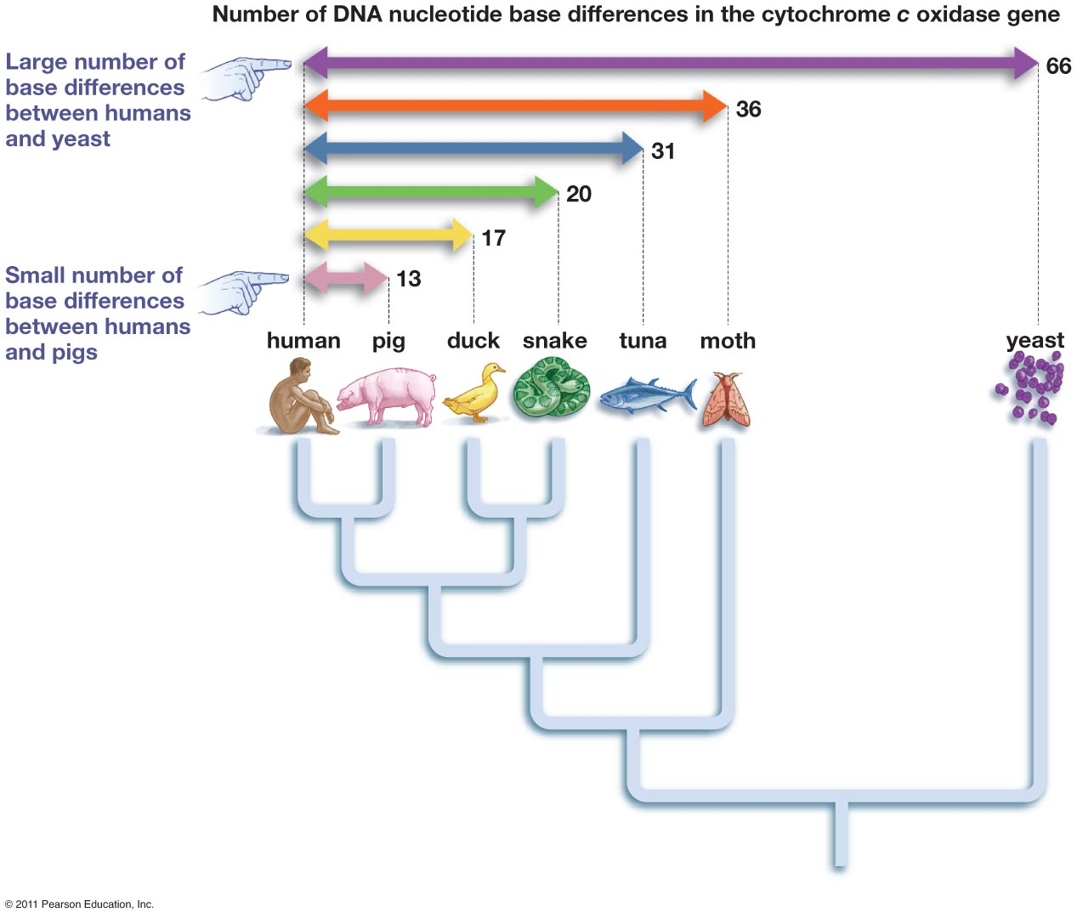
Evidence for Evolution
Similarities in DNA among close relatives
______________ used as a molecular clock
Longer organisms have been apart the more differences in their DNA

Slide 29
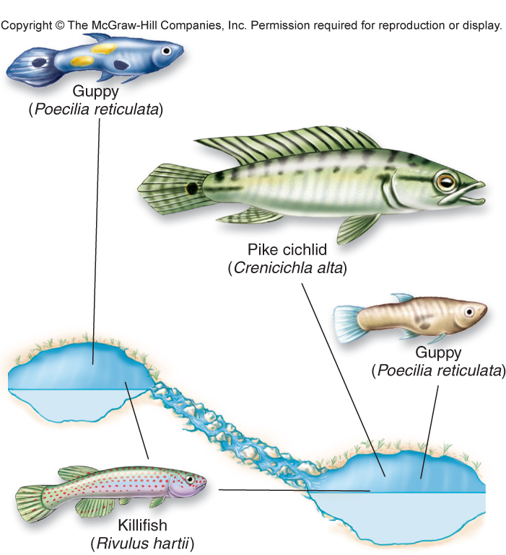
Evidence for Evolution
John Endler’s guppy experiments show evolution under different environmental conditions
Female guppies prefer ________ colored males
Brightly colored males are easier to spot by predator (pike)
No predator = no pressure = bright males
Predator present = drab coloration

Slide 30
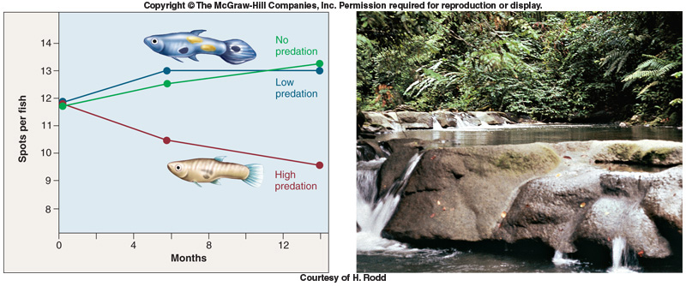
Evidence for Evolution

Slide 31
Check Your Understanding
True or False: Once something has evolved to a certain point it stops evolving
True or False: According to Darwin’s theory of natural selection the individuals within a population that survive longer and produce more viable offspring is completely random

Slide 32
Check Your Understanding
Similar characteristics among organisms of different groups due to a shared common ancestor are known as ______________________.
a. convergent evolution
b. analogous structures
c. homologous structures
d. vestigial traits
e. embryology

Slide 33
Check Your Understanding
Describe the difference between Lamarck’s theory of evolution through acquired traits and Darwin’s theory of evolution by means of natural selection using giraffes as an example

