Slide 1
Intertidal and Estuary Environments

Slide 2
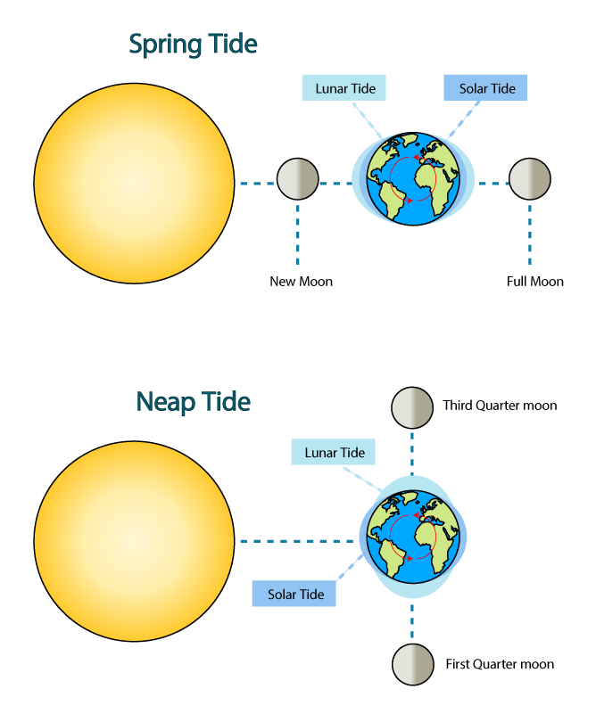
Tides
Created by the gravitational pull
Moon: large effect
Sun: small effect
Spring Tides
Direct alignment of sun, earth, and moon
Extreme tides (3x greater than neap tides)
Neap Tides
90 angle between sun, earth, and moon
Lower variation than spring tides
Spring Tide
Lunar Tide
Solar Tide
New Moon
Full Moon
Neap Tide
Third Quarter Moon
Lunar Tide
Solar Tide
First Quarter Moon

Slide 3
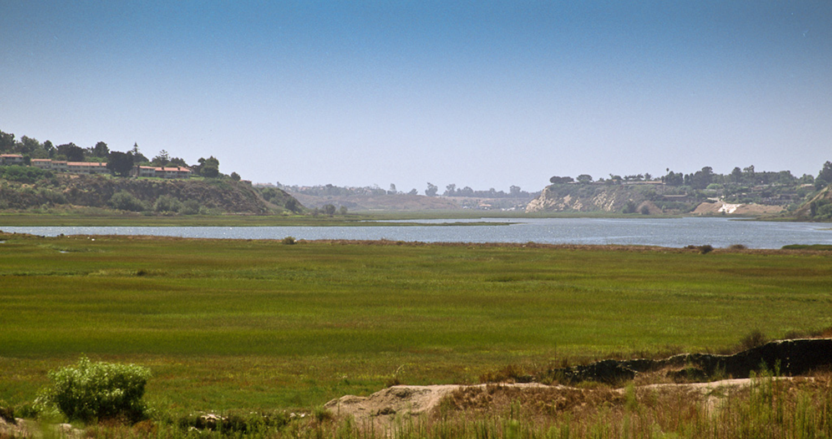
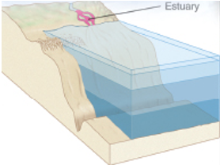
Estuaries
Estuary: a partially enclosed area where a freshwater river or stream meets the ocean resulting in brackish waters.
Estuary
Newport Back Bay

Slide 4
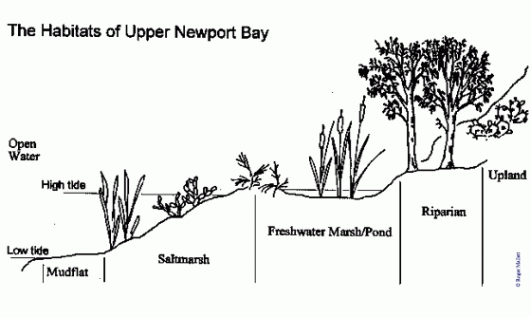
Estuaries
Estuary habitat types:
Open water: area covered with water during low tide
Mudflats: areas covered during high tide but exposed during low tide
Saltmarsh: area covered during high tide
Freshwater marshes and ponds: stagnant freshwater habitats
Riparian: terrestrial areas along freshwater habitats
Upland: terrestrial habitats not adjacent to fresh or salt water habitats
Habitats of Upper Newport Bay

Slide 5
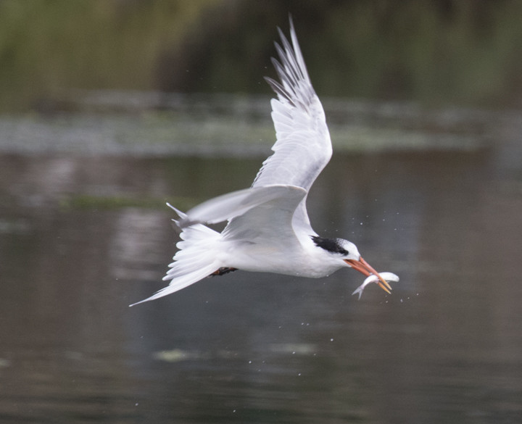
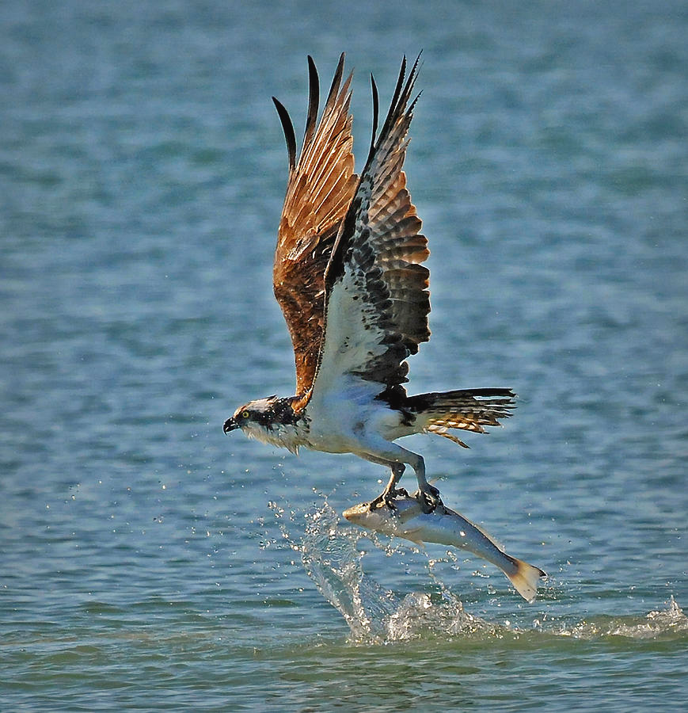
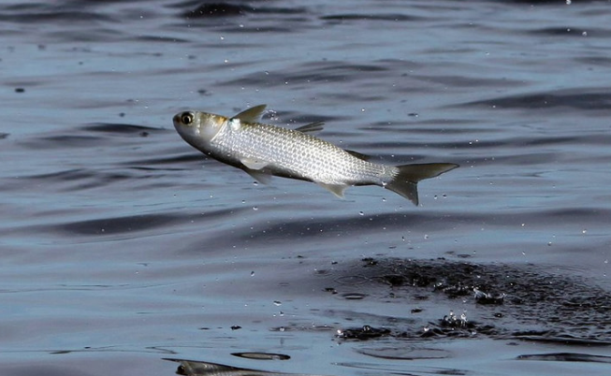
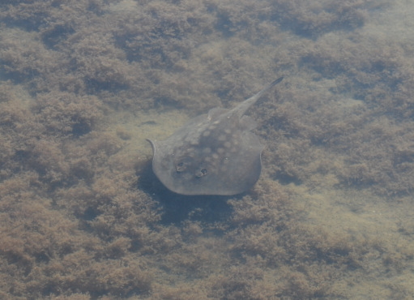
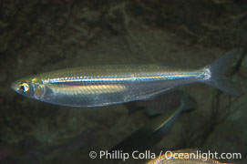
Estuary Habitats – Open Water
Marine organisms in the open water habitat
Osprey and terns forage for fish in the open water
Topsmelt and mullet are two fish species common in estuaries
Round rays and other cartilaginous fish will often use estuaries as nurseries
Anadromous and catadromous fish migrate through estuaries

Slide 6
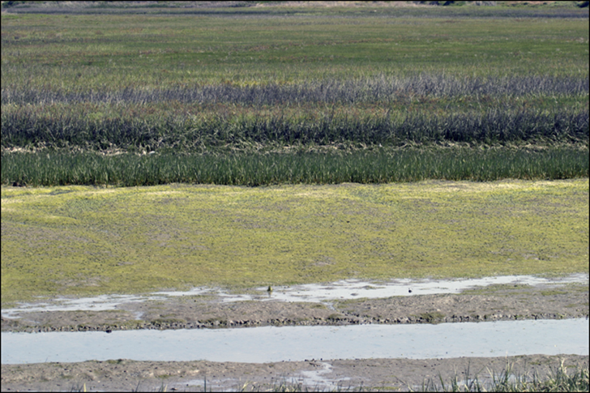
Estuary Habitats – Salt Marsh
Areas partially flooded during high tide
Saltmarsh plants bordering mudflats mark height of average high tide.
Temperate and subarctic regions worldwide
Dominated by halophytes (salt-tolerant plants)
Salt grass, cord grass and pickleweed
Salt marsh plants help stabilize soils by decreasing erosion caused by wave action

Slide 7
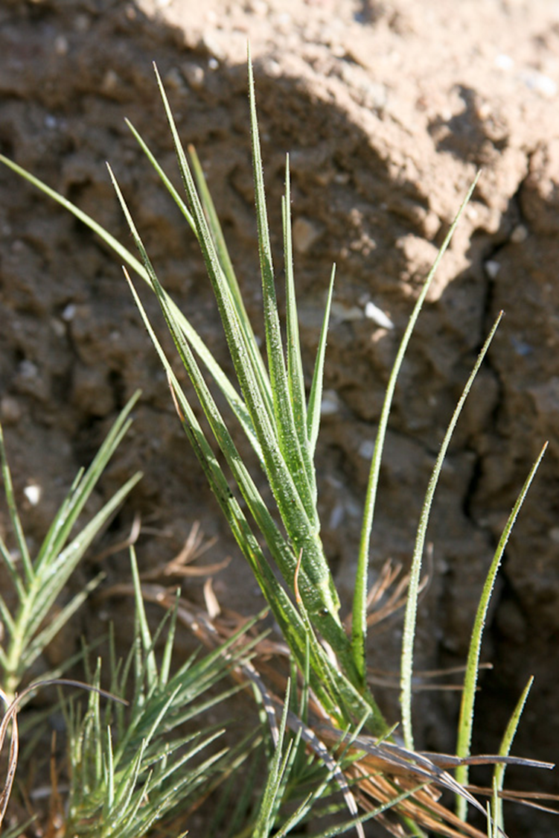
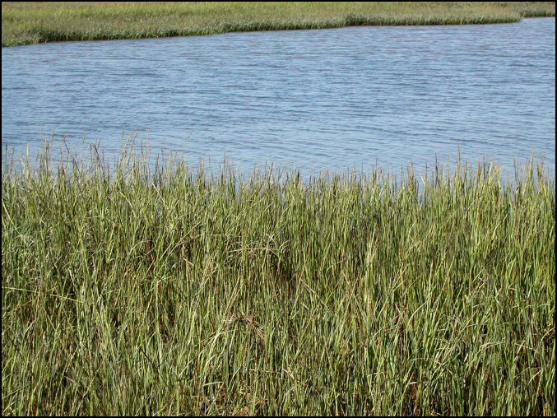
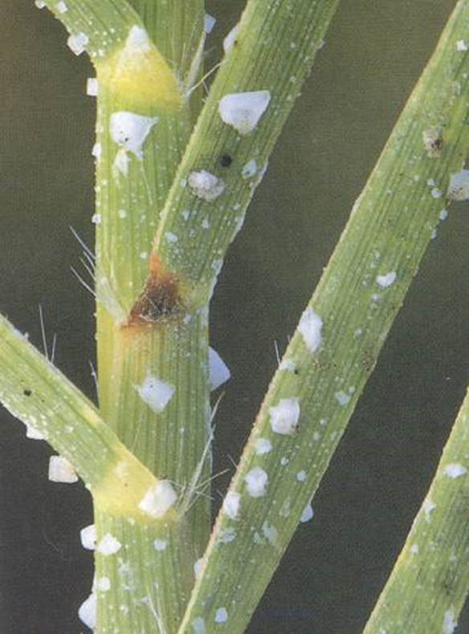
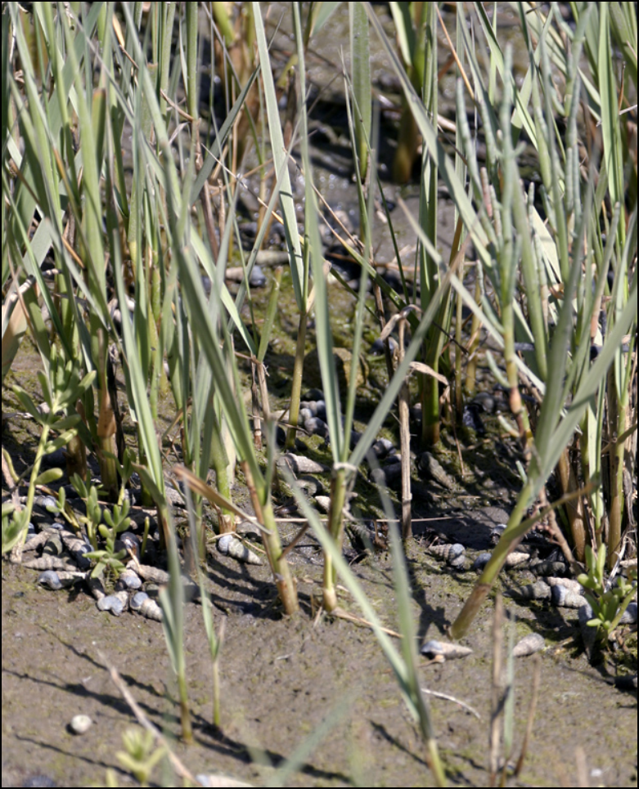
Estuary Habitats – Salt Marsh
Salt Grass
Typically found in middle zone of salt marsh
Halophytes: salt tolerant plant species
Excretes salt from pores crystallizes on the blade forming characteristic square salt shape.
Asexual reproduction through rhizomes (horizontal stems)
Used by nesting birds and as a food source for ducks and geese

Slide 8
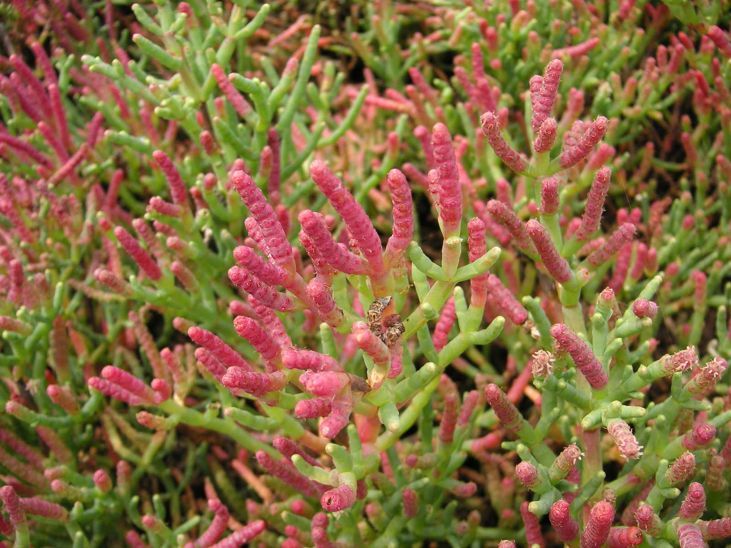
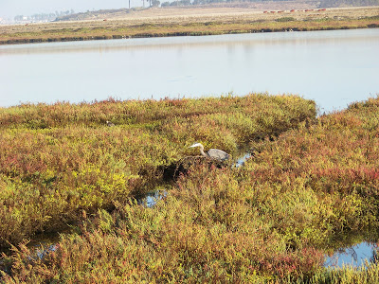
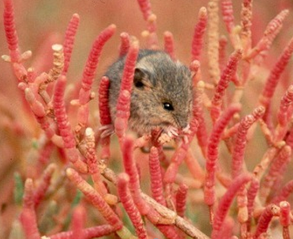
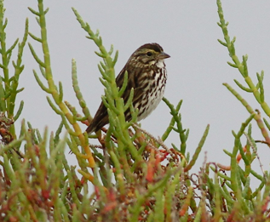
Estuary Habitats – Salt Marsh
Pickleweed
Typically found in low to middle zones of salt marsh
Succulent
Excess salt is transported to the tips of the plant where the salt containing cells break down and die, turning red in the process
Important habitat for protected species
Belding’s savanna sparrow and saltmarsh harvest mouse

Slide 9
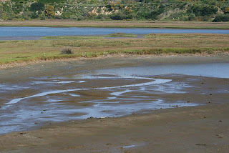
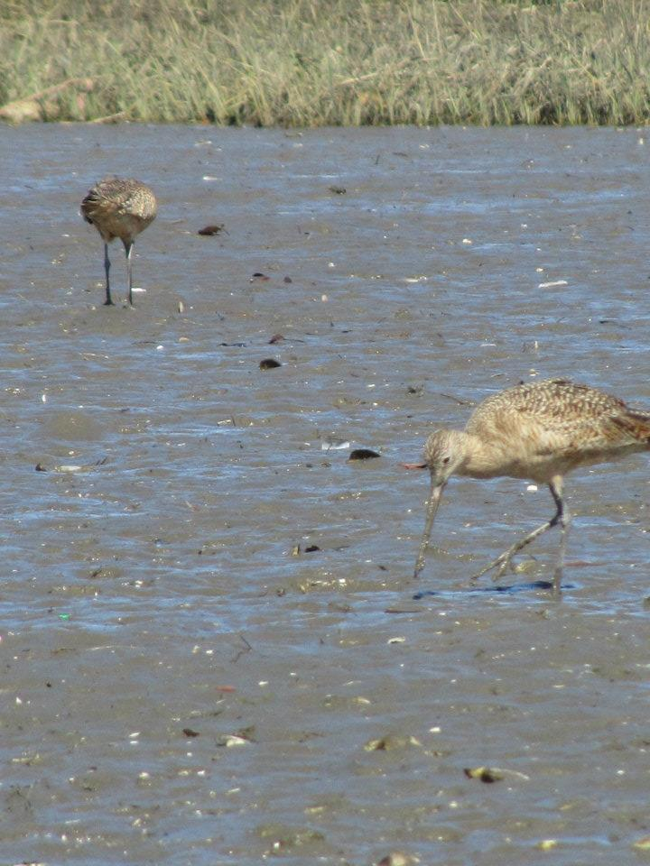
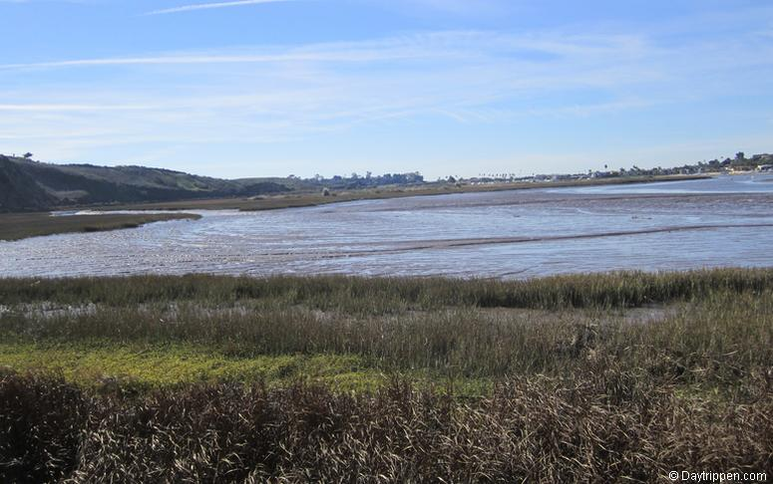
Estuary Habitats – Mudflats
Area exposed during low tide.
Mud formed by fine particles consisting of silt, clay and detritus deposited by freshwater and marine inputs.
Highest concentration of living organisms of all estuary habitats
Invertebrate infauna are dominant in mudflat habitat
Important food source for shorebirds during low tide and fishes during high tide
Notes:
One cubic foot can have as many as 40,000 inhabitants

Slide 10
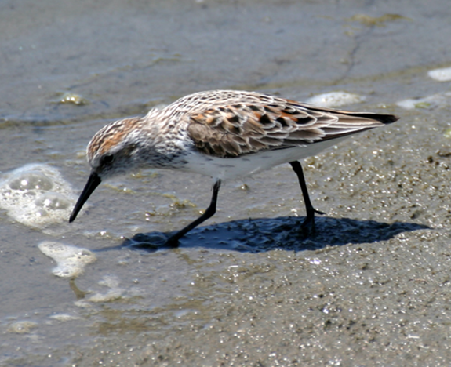
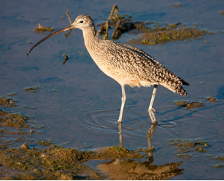
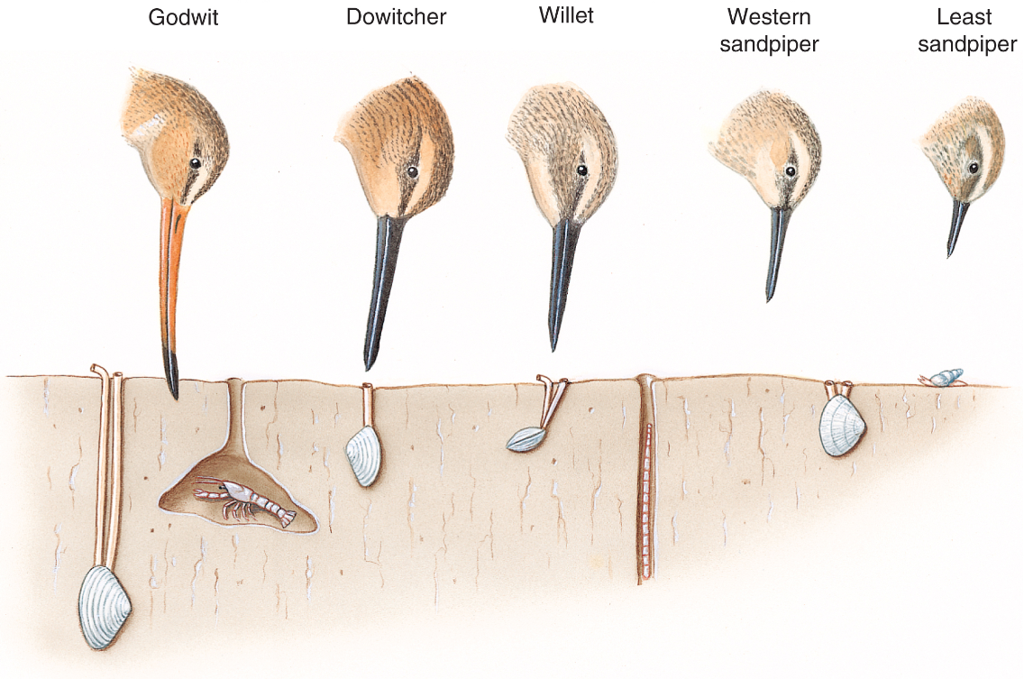
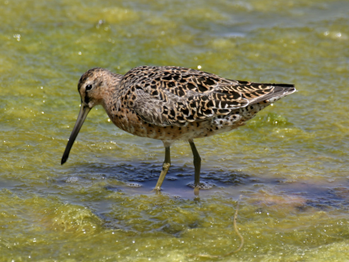
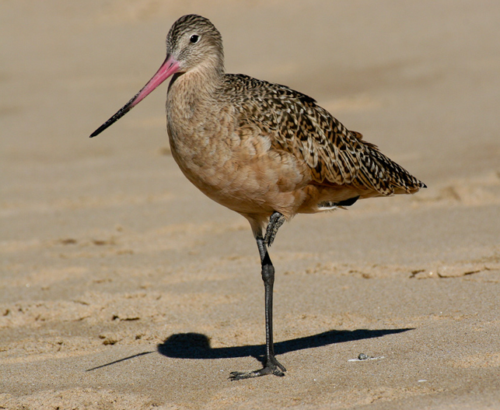
Estuary Habitats – Mudflats
Various bill lengths and shapes of shorebird species are an example of resource partitioning

Slide 11
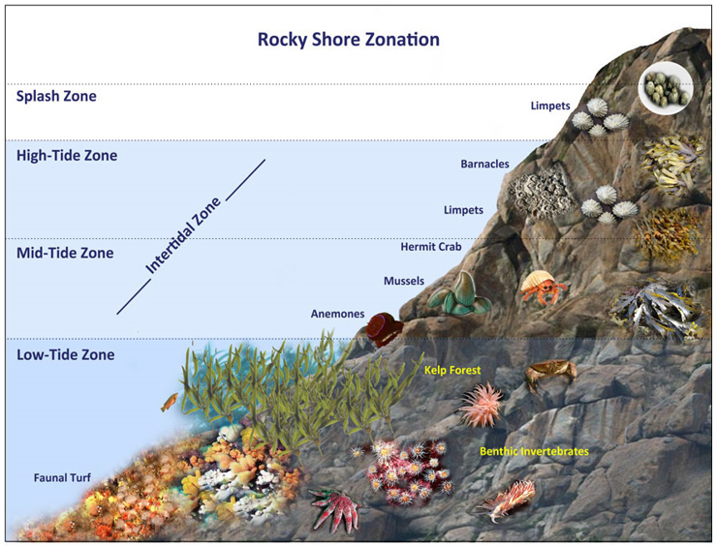
Intertidal Zonation
Splash zone: ~5ft above see level. Only inundated during highest high tides.
Small acorn barnacles, periwinkle snails
High-tide zone: ~2 to 5ft above sea level. Inundated during high tide and exposed to air during low tide.
Large acorn barnacle, chitons, limpets, Striped shore crab
Mid-tide zone: 0 – 2ft above sea level. Exposed to air only during low tide.
Seastar, California mussel, gooseneck barnacle, blueband hermit crabs, turban snails, sea anemones
Low-tide zone: Below sea level. Only exposed to air during lowest low tides.
Brown algae, opaleye, sand-castle worms, California sea hare, two spotted octopus, sea urchins

Slide 12
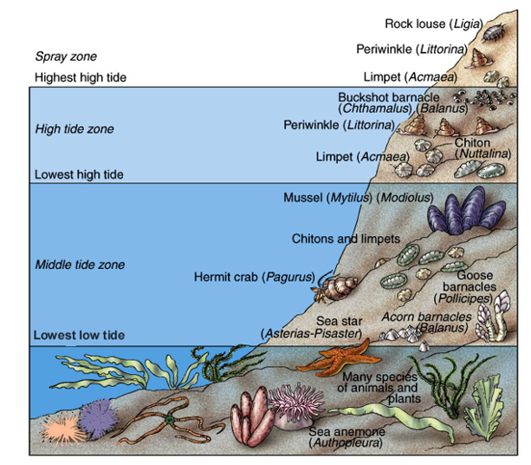
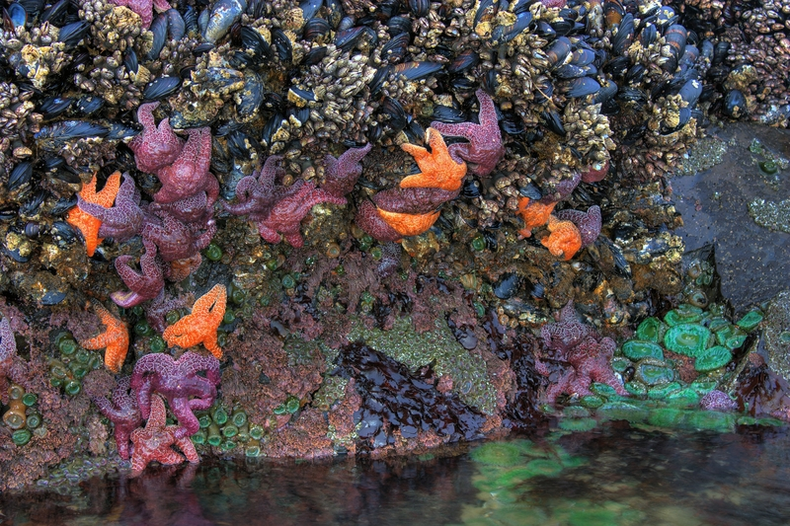
Marine Organisms and Tides
Intertidal organisms deal with periods of exposure during low tide, wave action, and changes in salinity and temperature.
Mostly shelled organisms
Many
soft-bodied organisms and algae

Slide 13
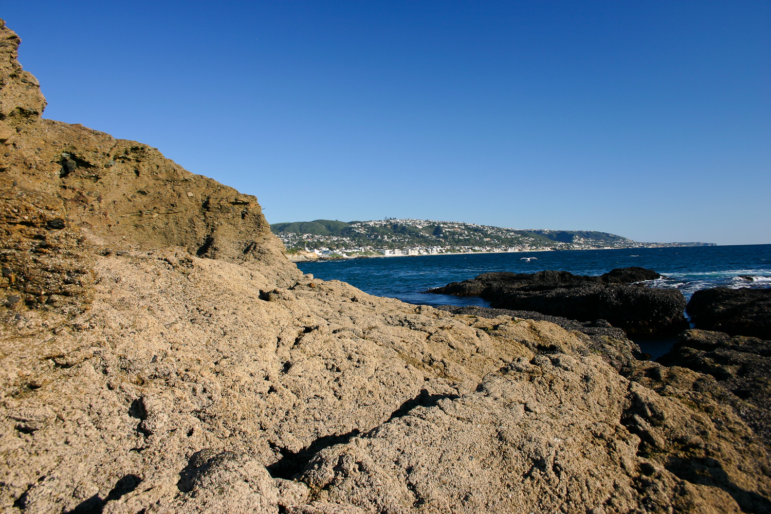
Splash Zone and Upper Intertidal
The Splash Zone, Upper Intertidal, and Middle Intertidal

Slide 14
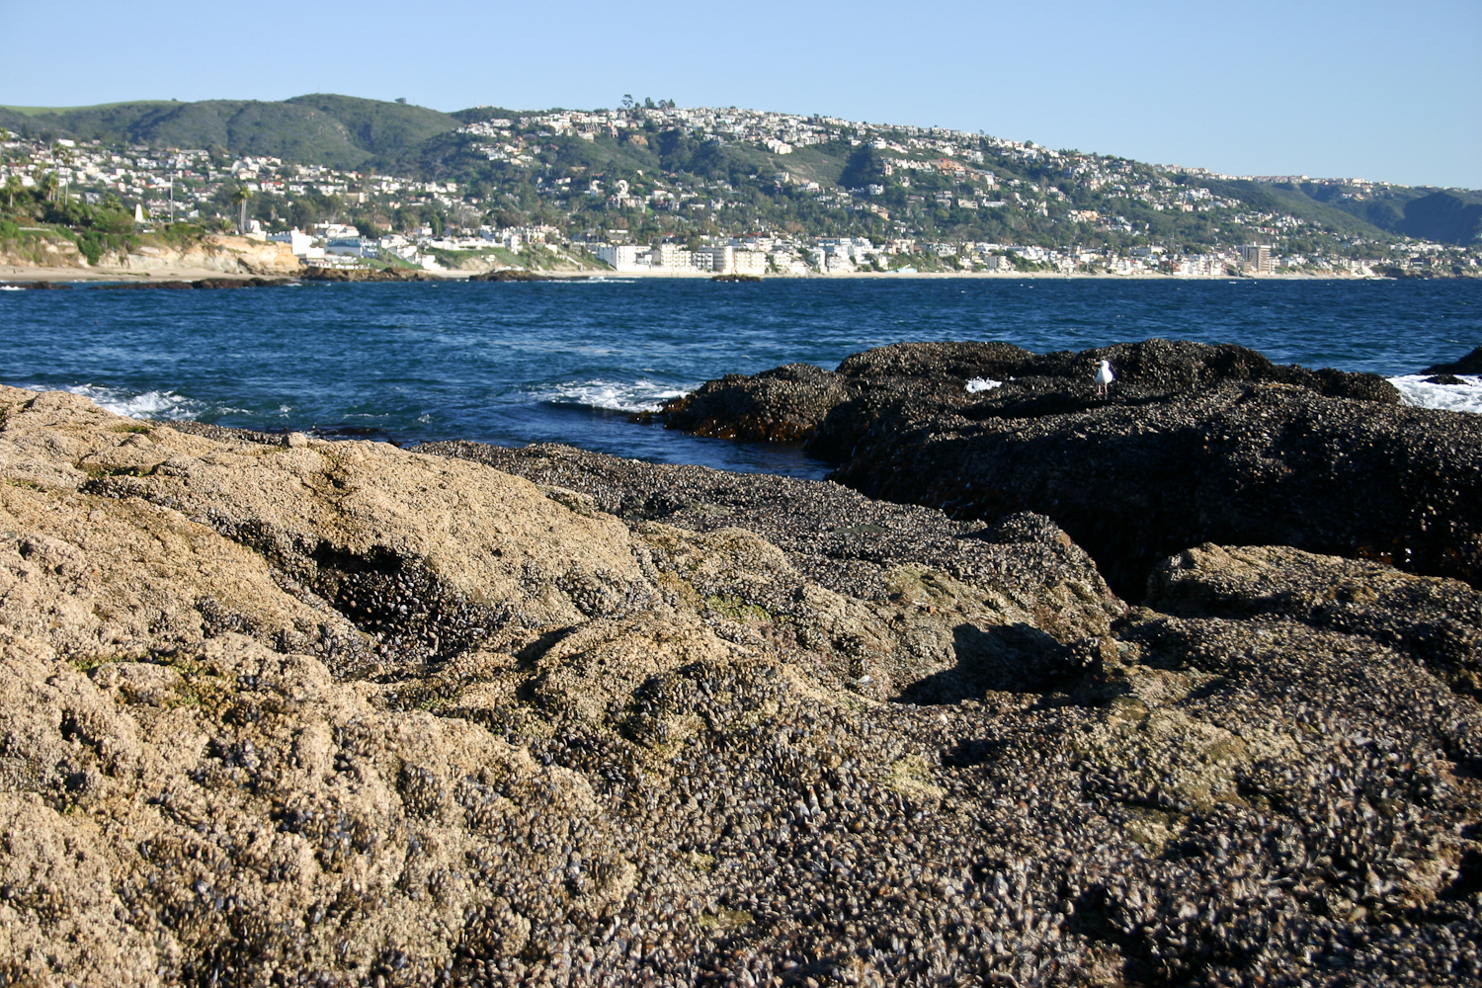
Upper and Middle Intertidal
The Upper and Middle Intertidal

Slide 15
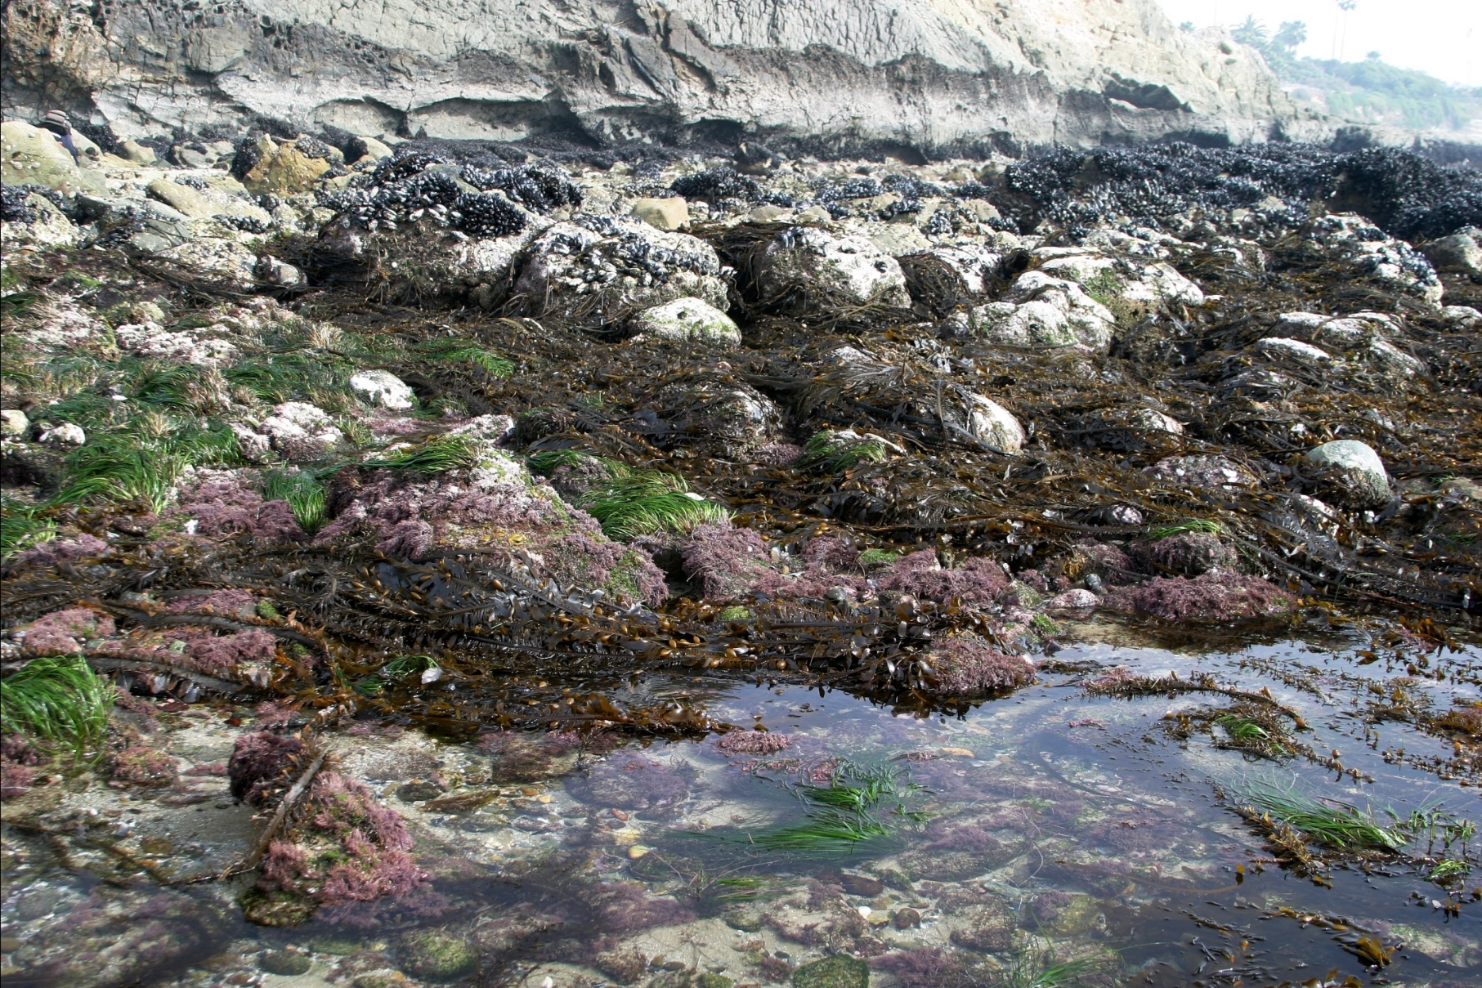
Middle and Lower Intertidal
Middle and Lower Intertidal

Slide 16
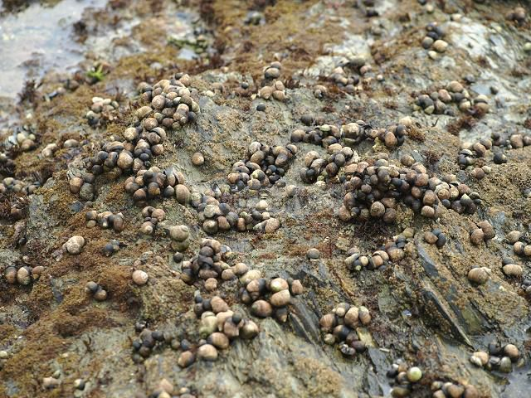
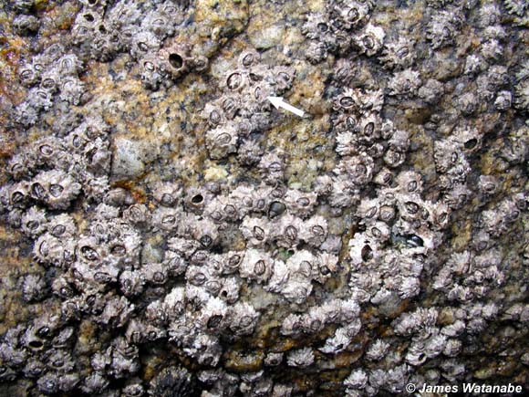
Intertidal Zonation
Splash zone: ~5ft above see level.
Only inundated during highest high tides.
Organisms sprayed with water during high tide but are rarely submerged
Organisms found in splash zone
Periwinkle snails
Small acorn barnacles
Periwinkle snails
Small acorn barnacles

Slide 17
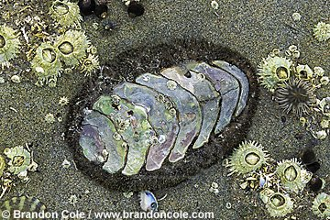
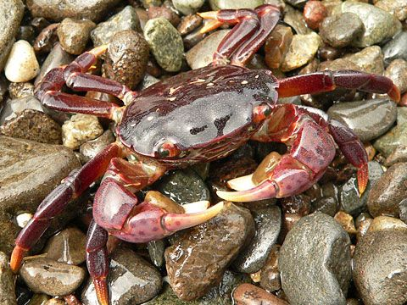
Intertidal Zonation
High-tide zone: ~2 to 5ft above sea level.
Inundated during high tide and exposed to air during low tide.
Organisms found in high-tide zone
Large acorn barnacle
Chiton
Limpets
Shore crabs
Rough chiton
Shore crab

Slide 18
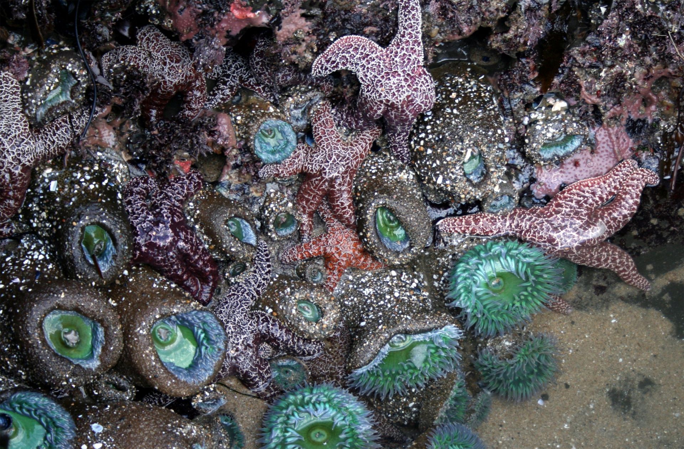
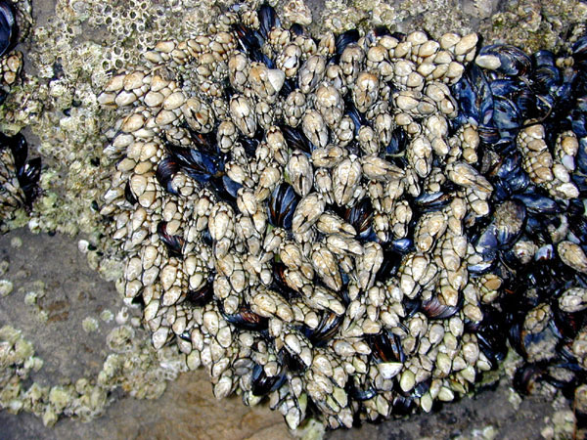
Intertidal Zonation
Mid-tide zone: 0 – 2ft above sea level.
Exposed to air only during low tide.
Organisms found in mid-tide zone
Sea star
California mussel
Gooseneck barnacles
Hermit crabs
Sea anemones
Sea stars and sea anemones
California mussels and gooseneck barnacles

Slide 19
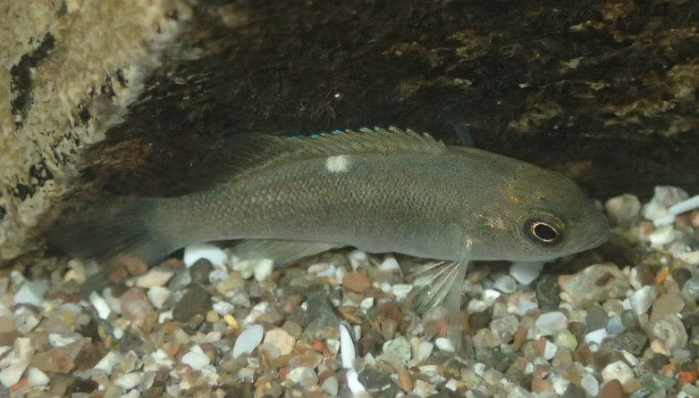
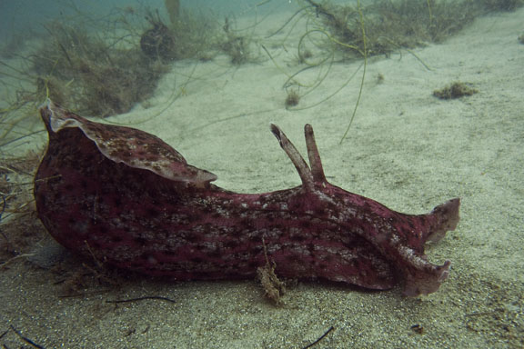
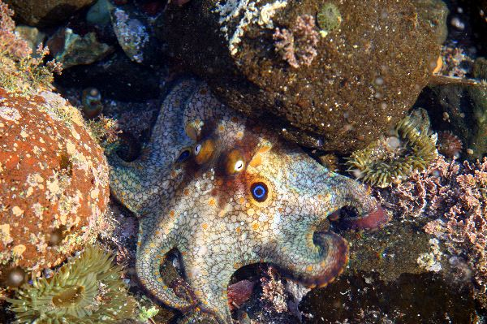
Intertidal Zonation
Low-tide zone: Below sea level.
Only exposed to air during lowest low tides.
Organisms found in low-tide zone
Brown algae
Opaleyes
California sea hare
Two spotted octopus
Sea urchins

Slide 20
Challenges of the Intertidal Zone
Desiccation: drying out during low tide.
Bivalves close shells, snails secrete slime, anemones close tentacles, limpets and chitons trap moisture under shell
Wave shock: impacts from waves and other objects. Wear from sandy water
Hard external skeleton (shells or exoskeleton), attachment to rocks (byssal threads in mussels, tube feet in echinoderms, muscular foot in molluscs)
Exposure: exposure to heat and UV from sun.
Barnacles and muscles cluster together to reduce individual exposure, north side of rocks, move out of most exposed area
Temperature changes: drastic shifts in air and water temperature
Breathe atmospheric air in oxygen poor water, ridges in shell aid in evaporative cooling, ectothermic
Salinity changes: evaporation from pools changes salinity
Alter solute concentration in cells, salt excretion
Predation: intertidal predators including octopus, seastars and fish
Hide in rock crevices, firmly attach to rocks, ink (sea hare)

Slide 21
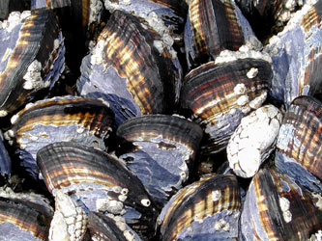
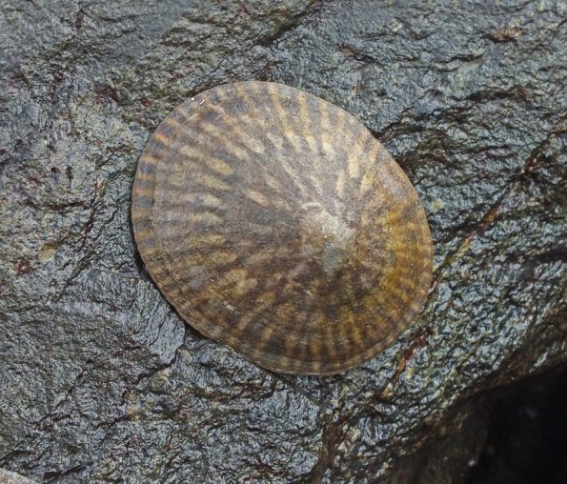
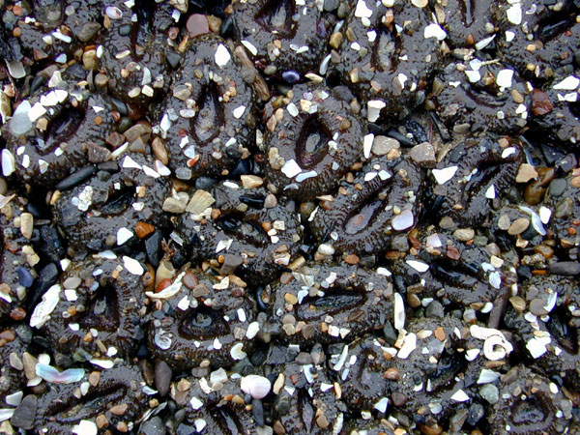
Challenges of the Intertidal Zone
Desiccation: drying out during low tide
Bivalves close shells
Snails secrete slime
Operculum seals shell
Anemones close tentacles
Limpets and chitons trap moisture under shell
Motile organisms move to lower tide zones

Slide 22
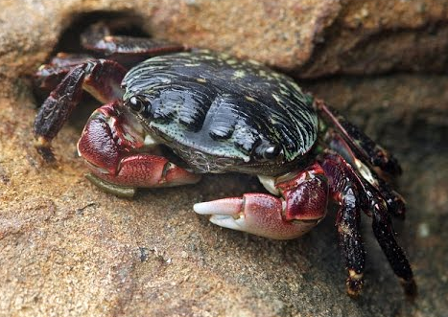
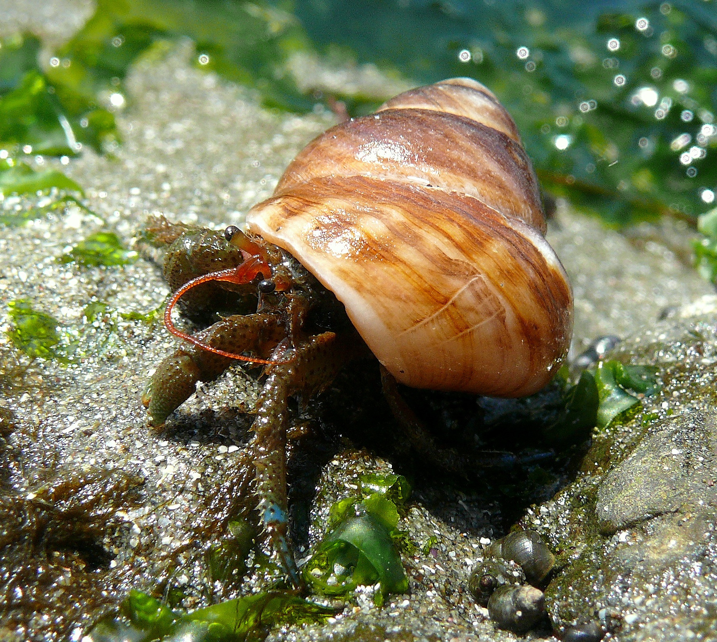
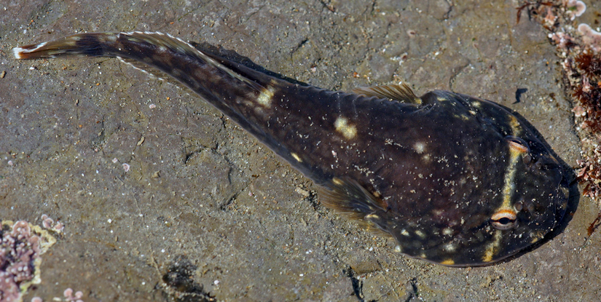
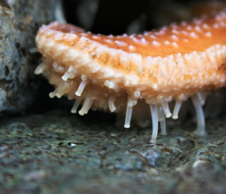
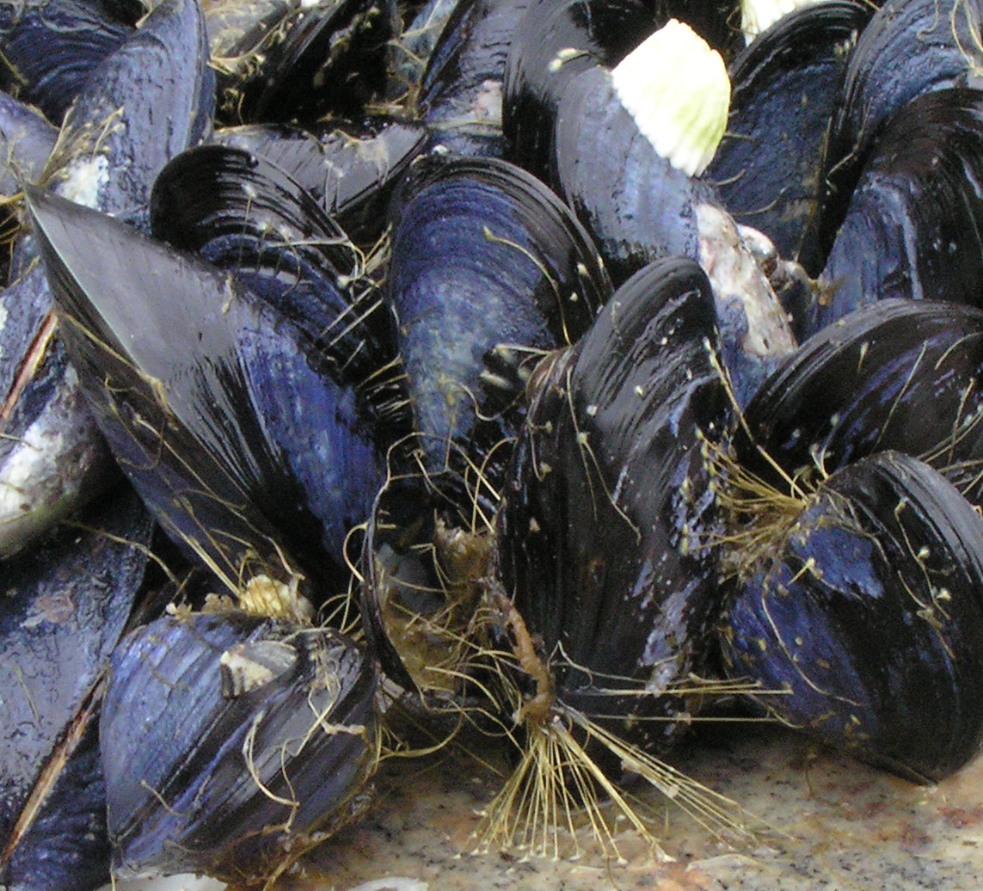
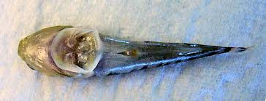
Challenges of the Intertidal Zone
Wave shock: impacts from waves and other objects. Wear from sandy water.
Hard external skeleton
Shells or exoskeleton
Attachment to rocks
Byssal threads in mussels
Tube feet in echinoderms
Muscular foot in molluscs
Pelvic fins of cling fish
Modified pelvic fins to form sucking disc

Slide 23
Challenges of the Intertidal Zone
Exposure: exposure to heat and UV from sun.
Barnacles and muscles cluster together to reduce individual exposure
North side of rocks in northern hemisphere
Move out of most exposed area

Slide 24
Challenges of the Intertidal Zone
Temperature changes: drastic shifts in air and water temperature
Ectothermic
Can withstand a wide range of temperatures
Ridges in shell aid in evaporative cooling

Slide 25
Challenges of the Intertidal Zone
Salinity changes: evaporation from pools or rain can change salinity
Alter solute concentration in cells making them isotonic to sea water
Euryhaline: broad range of salt tolerances
Salt excretion

Slide 26
Challenges of the Intertidal Zone
Predation: intertidal predators including octopus, sea stars and fish
Enclose themselves in hard shell
Mussels and barnacles
Snails and hermit crabs
Hide in rock crevices
Firmly attach to rocks
Ink (sea hare)

Slide 27
Challenges of the Intertidal Zone
Limited space: intertidal organisms compete for space on the substrate
Efficient dispersal
Asexual reproduction (budding) in aggregate anemone
Strong attachment to the substrate
Mussels and barnacles

Slide 28
Challenges of the Intertidal Zone
Oxygen availability: lack of oxygen in the water when exposed or when there is a high density of organisms and a lack of photosynthetic algae
Breathe atmospheric air in oxygen poor water
Tide pool sculpin and juvenile opaleye

Slide 29
Rocky Intertidal Food Web
Secondary consumers
Primary consumers
Primary Producers

Slide 30
Rocky Intertidal Food Web
Predators act to control prey populations
Keystone species: a species whose absence in the community would bring about significant change in that community
Predator:
Pisaster ochraceous
Prey:
Mytilus californianus

Slide 31
Rocky Intertidal Food Web
Sea stars are especially important in controlling California mussel populations in the lower intertidal zone. The absence of sea stars can lead to the expansion of the mussel beds into the lower intertidal.

Slide 32
Sea Star Wasting Disease
Sea Star Wasting Disease (SSWD) is a disease that affects various echinoderm species causing them to decay and die
Some areas in southern California experienced a 99% decline in sea star populations
Sea water temperature may be correlated with the spread of the disease
Cause of the disease has yet to identified

